Slide 1
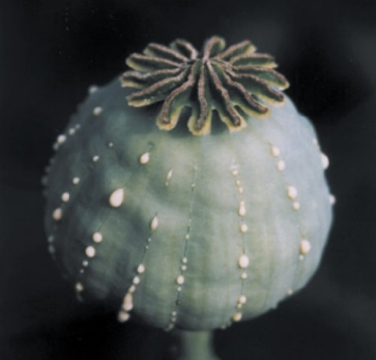
Secondary metabolites
Katerina Dadakova, Department of Biochemistry
1
Figures adopted from Buchanan et al., Biochemistry & molecular biology of plants

Slide 2
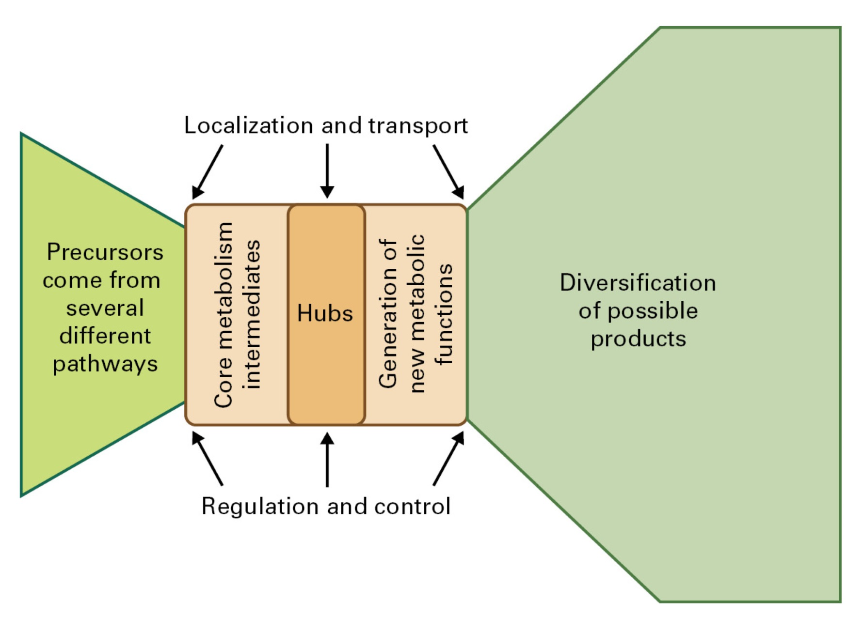
Secondary metabolites
Diversity of plant natural products

Slide 3
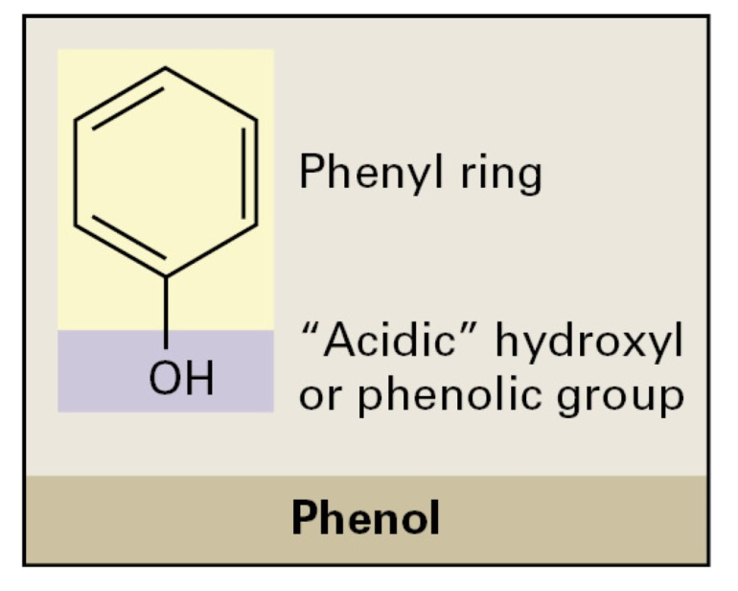
Secondary metabolites
Phenolic compounds
Major subclasses of phenolic compounds:
flavonoids
  flavones
  flavonols
  flavanones
  anthocyanidins
  isoflavones
  chalcones
stilbenes
coumarins and furanocoumarins
lignins and lignans
naphta- and anthraquinones
diarylheptanoids

Slide 4
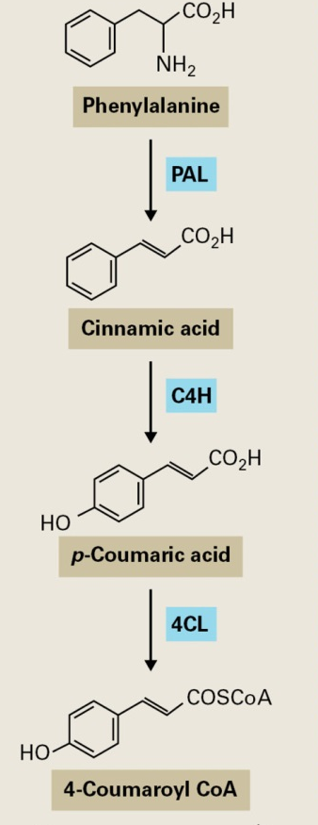
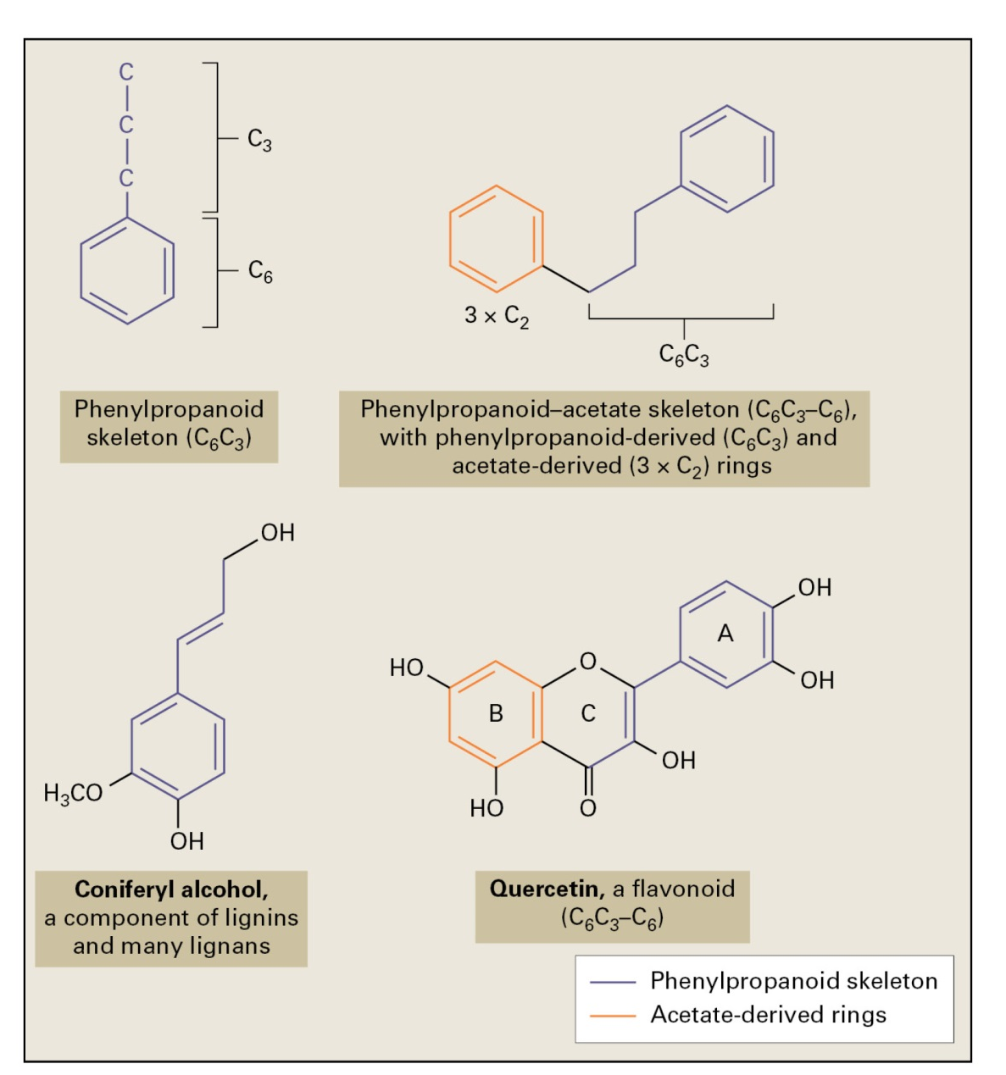
Secondary metabolites
Phenolic compounds

Slide 5
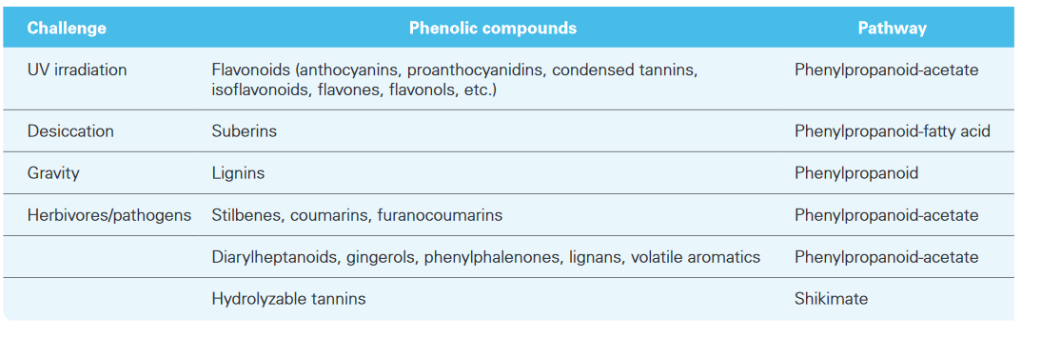
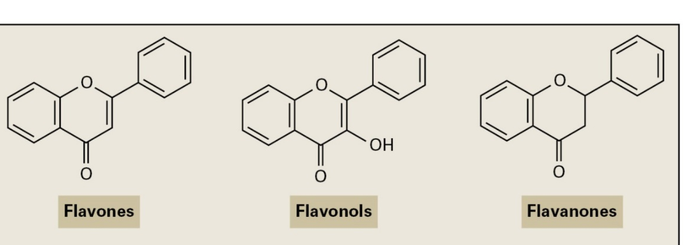

Secondary metabolites
Phenolic compounds
Flavonoids

Slide 6
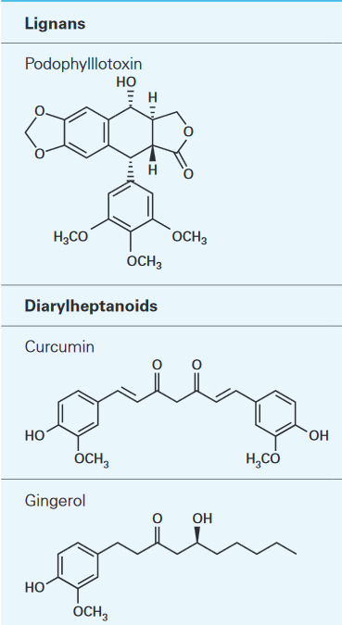
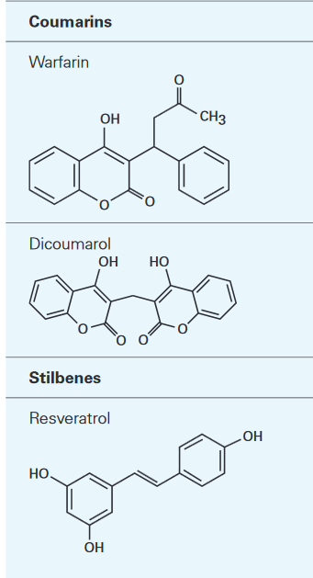
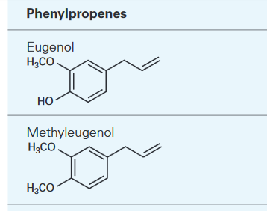
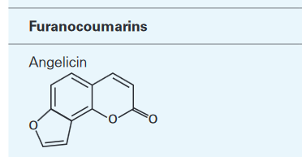
Secondary metabolites
Phenolic compounds

Slide 7
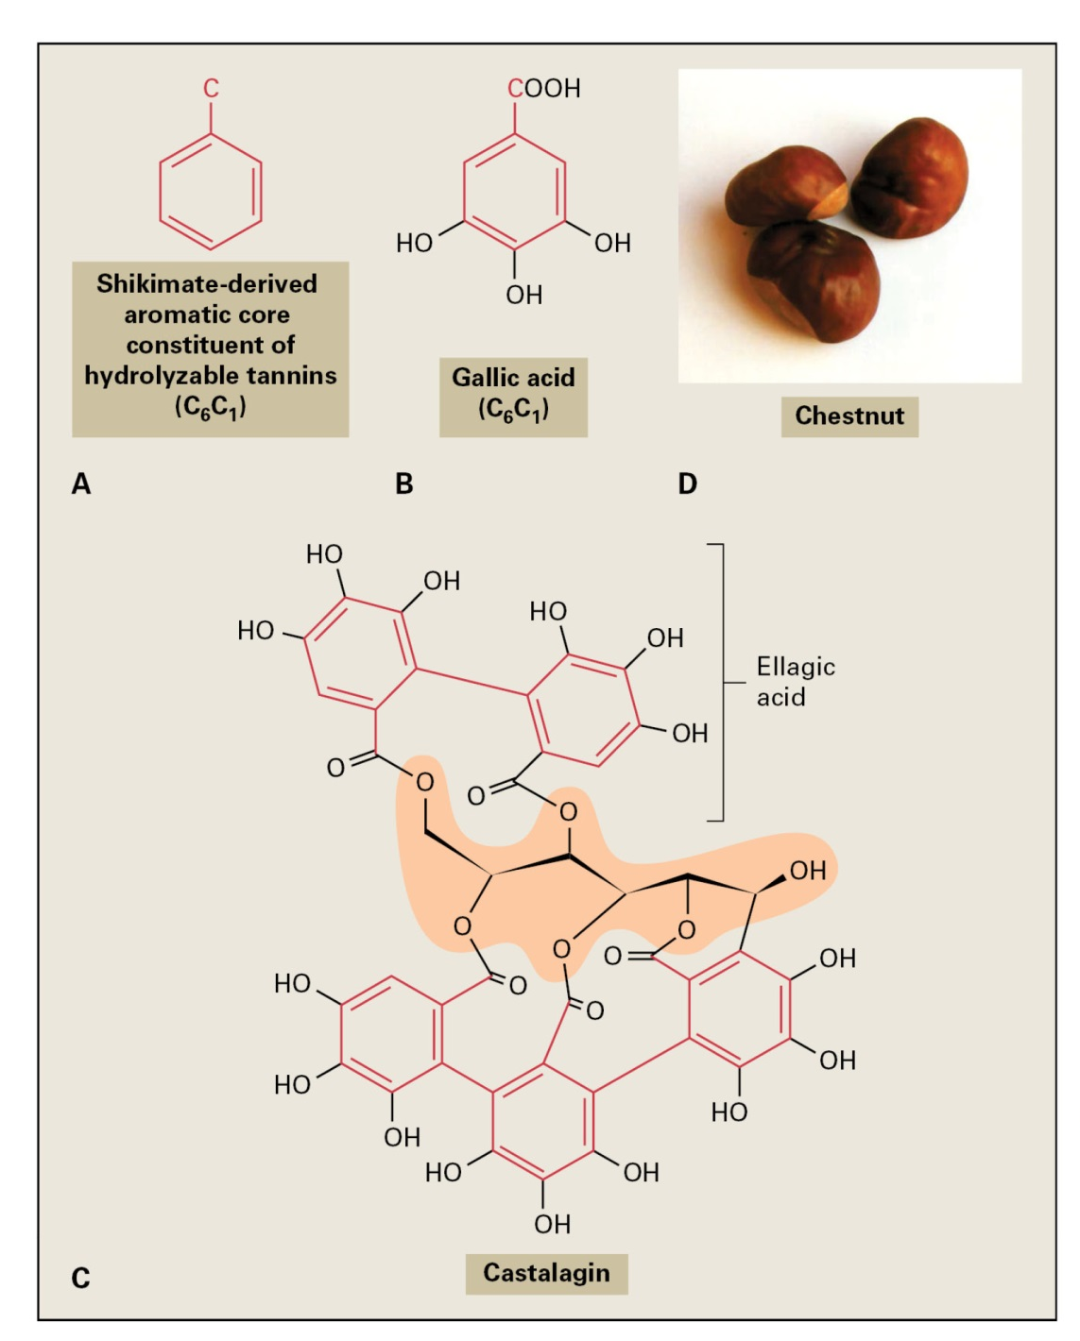
Secondary metabolites
Phenolic compounds

Slide 8
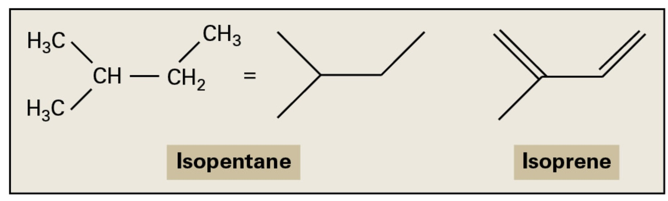
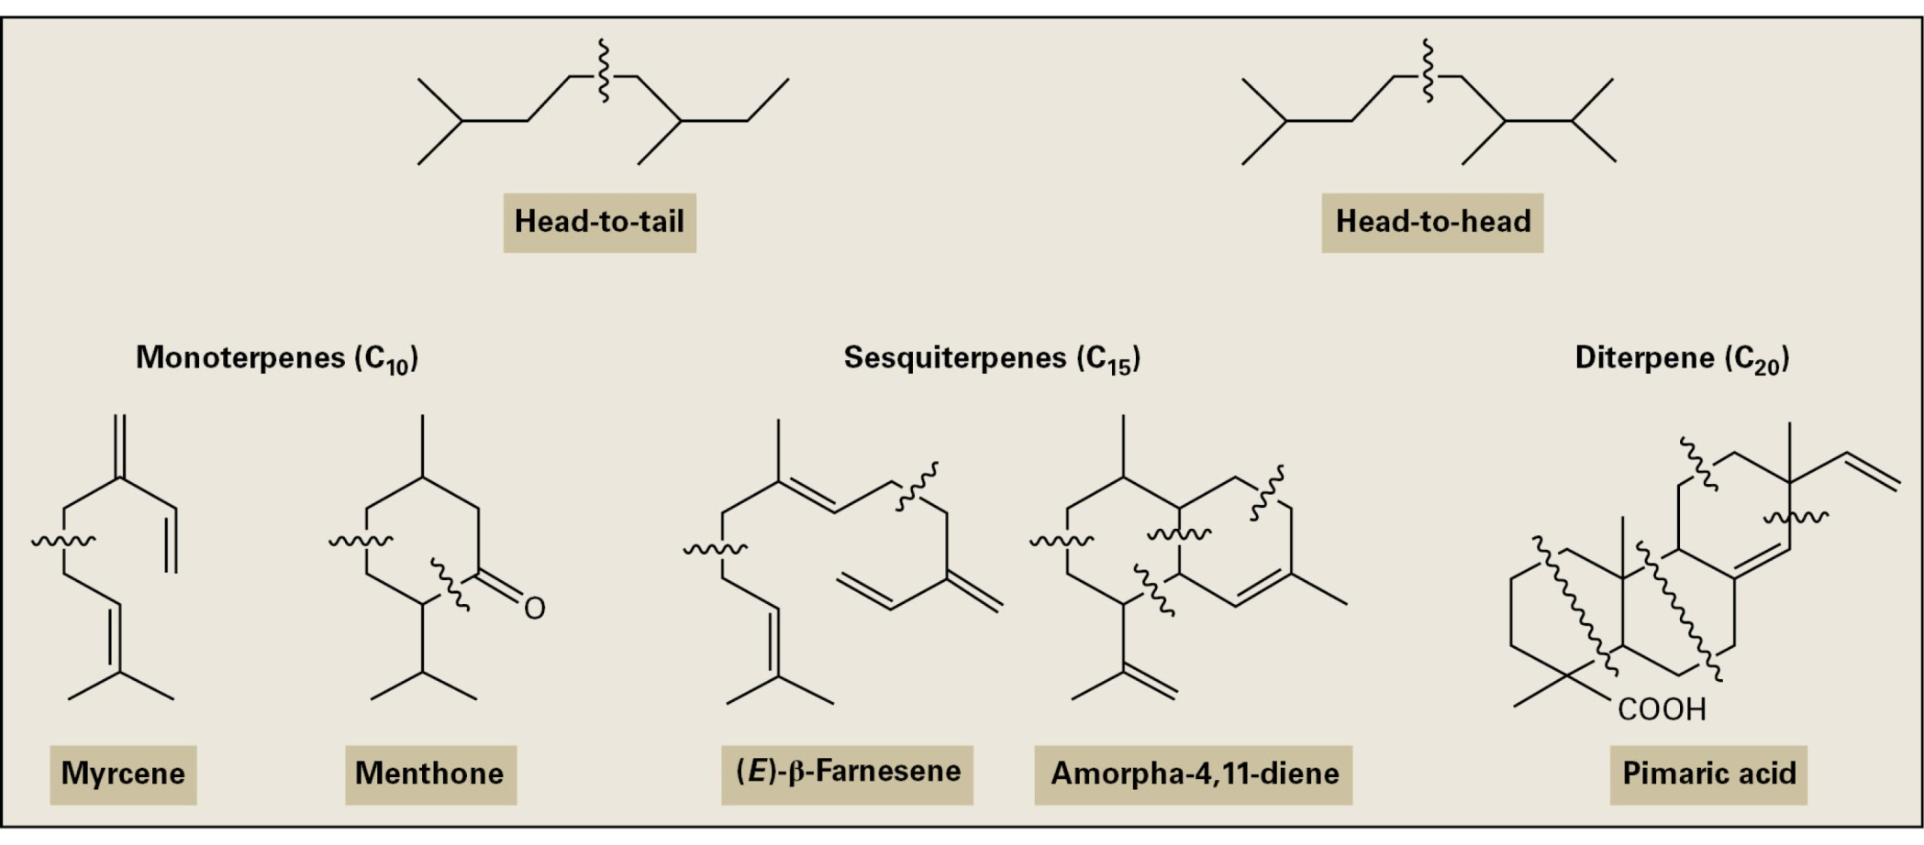
Secondary metabolites
Terpenoids

Slide 9
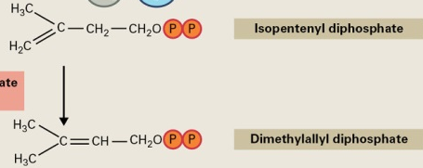
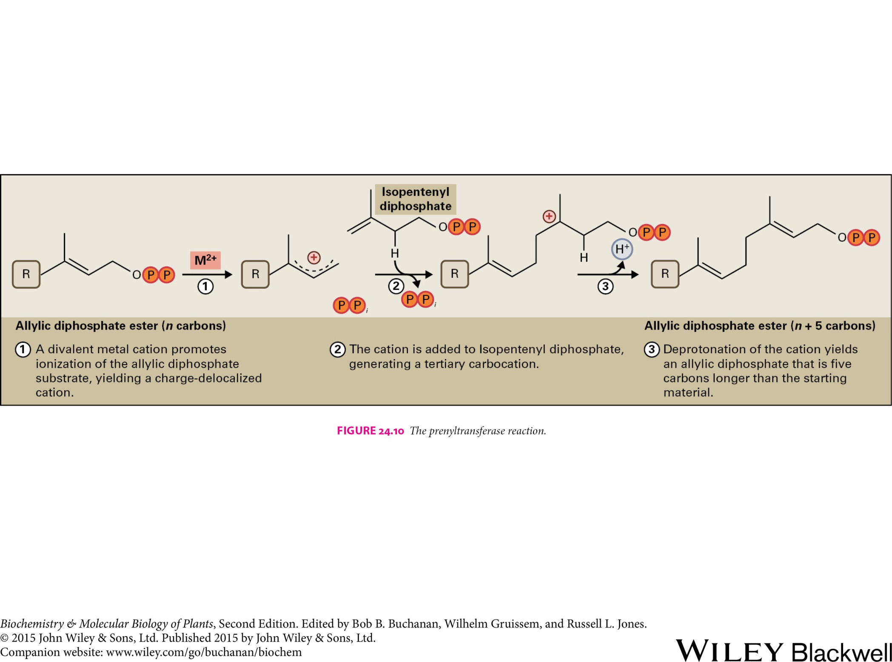
Secondary metabolites
Terpenoids
Terpenoid biosynthesis:
Biosynthesis of the basic five-carbon unit
Repetitive additions of C₅ units
Formation of parent carbon skeletons
Modification of terpenoid skeletons
The prenyltransferase reaction

Slide 10
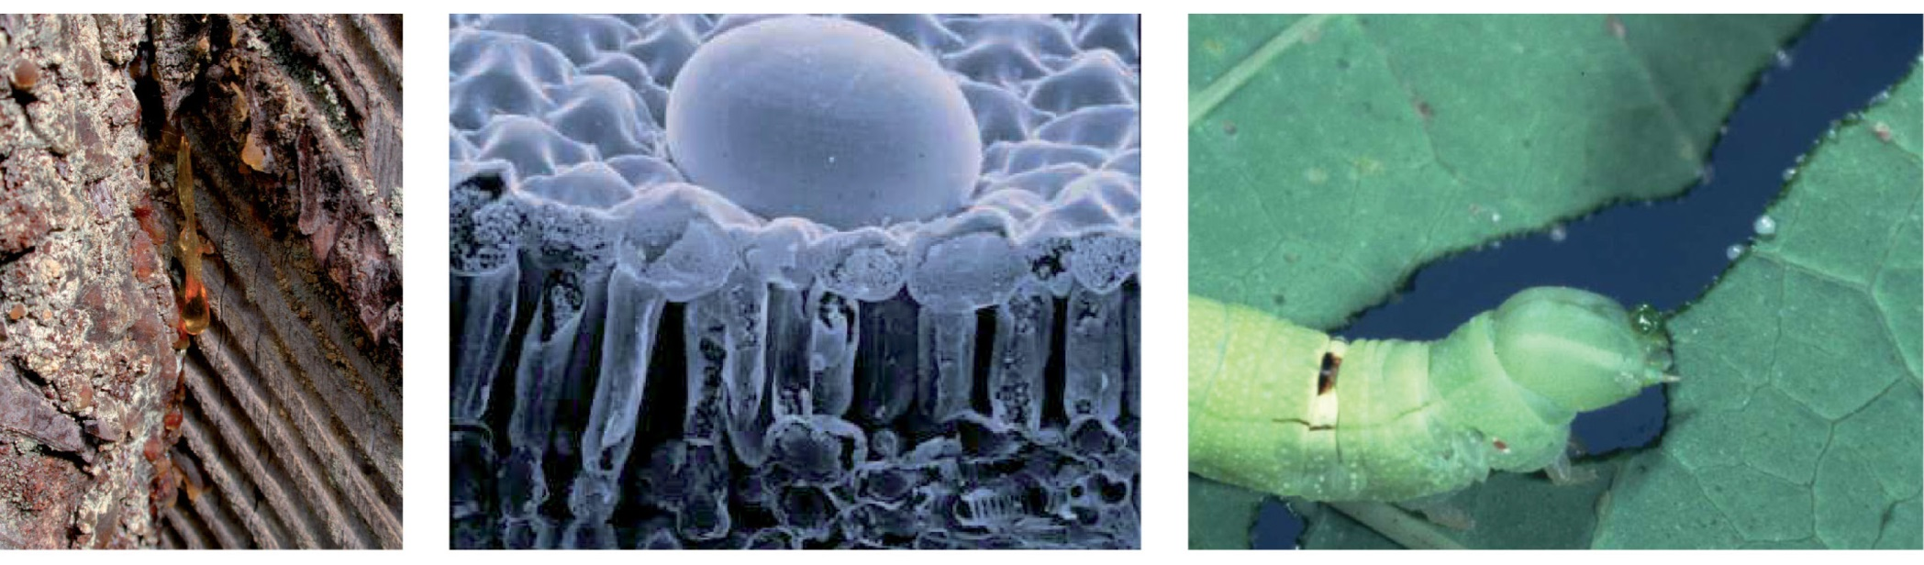
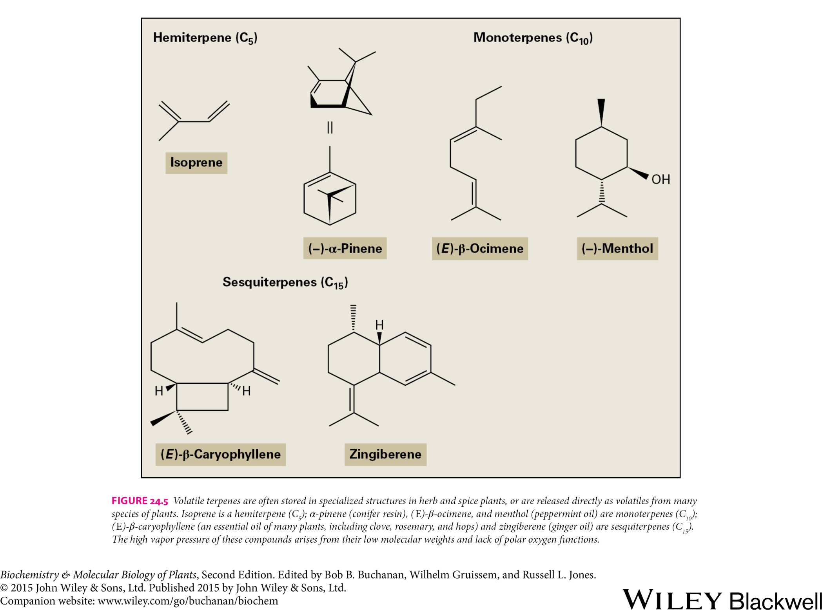
Secondary metabolites
Terpenoids
Resin Oil stored in a glandular hair Plant latex

Slide 11
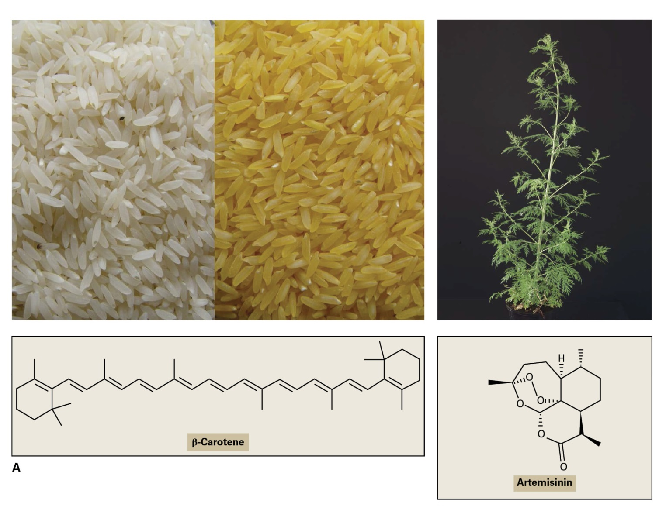
Secondary metabolites
Terpenoids

Slide 12
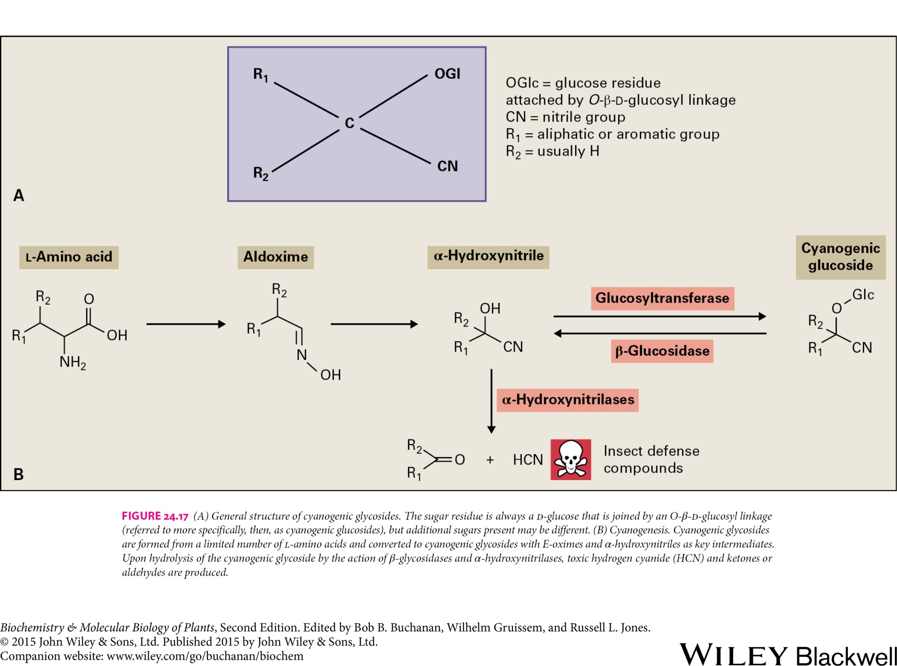
Secondary metabolites
Cyanogenic glycosides

Slide 13
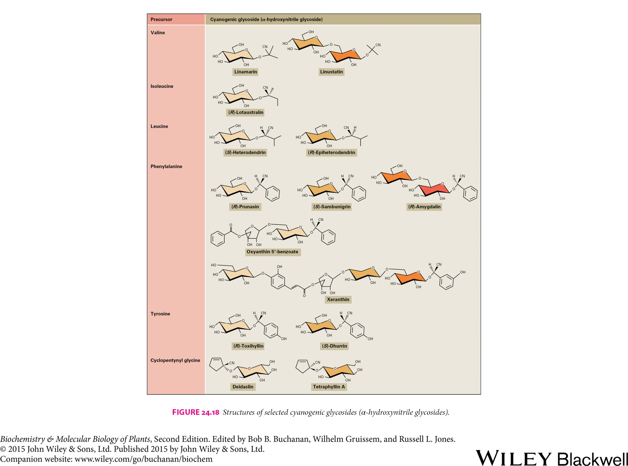
Secondary metabolites
Cyanogenic glycosides
Cassava (Manihot esculentum)
Almond (Prunus amygdalus)
Sorghum (Sorghum bicolor)
Barley (Hordeum vulgare)

Slide 14
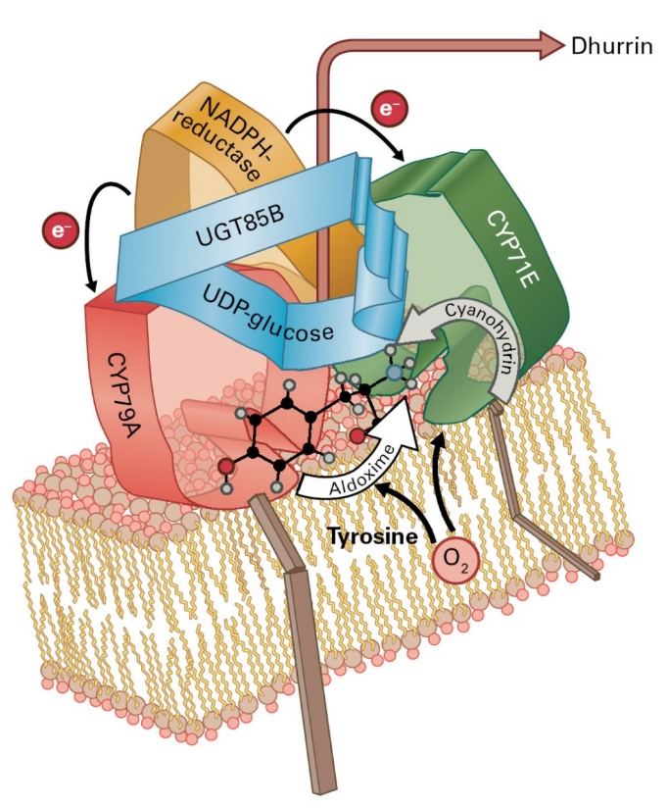
Secondary metabolites
Cyanogenic glycosides

Slide 15
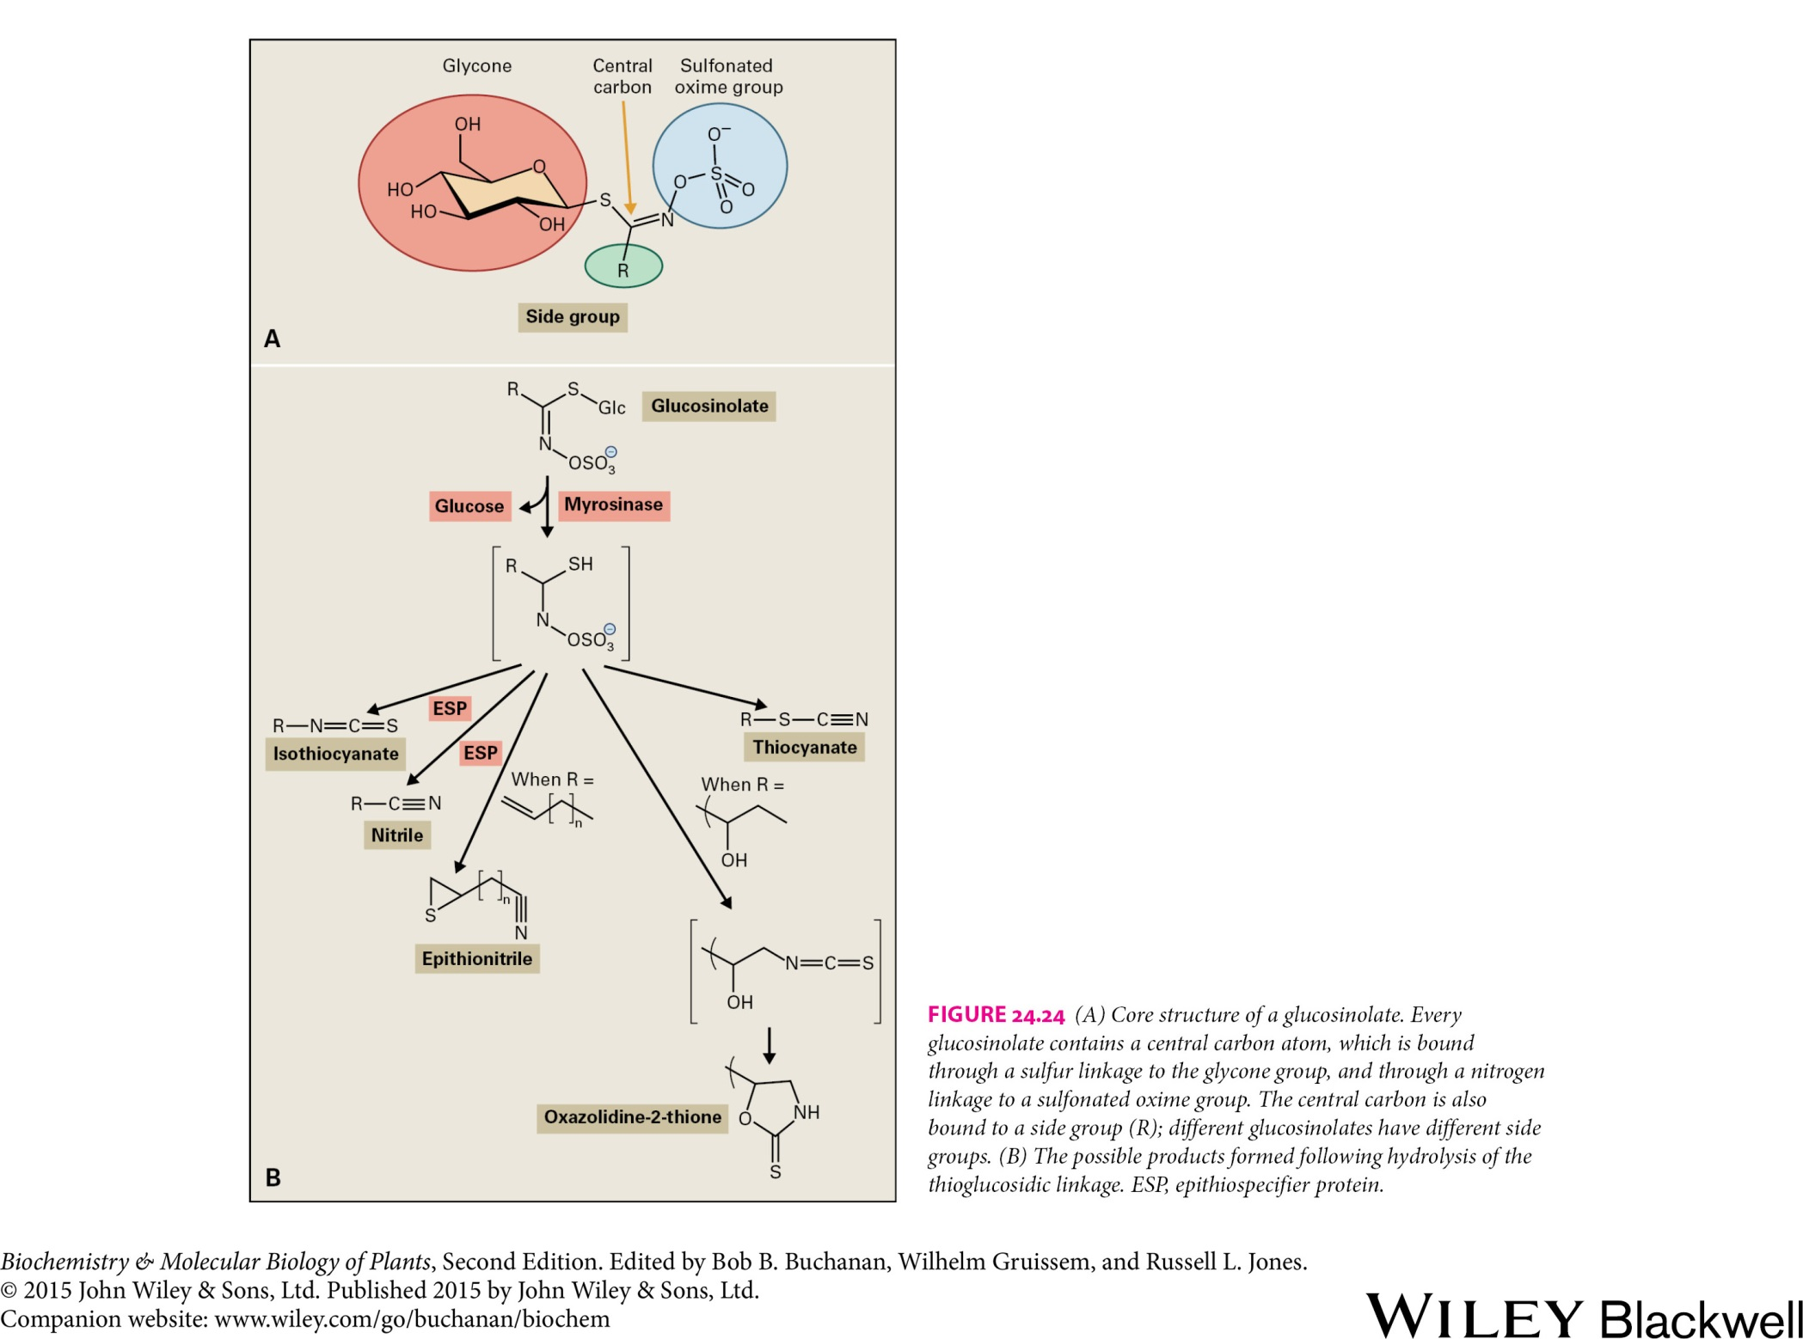
Secondary metabolites
Glucosinolates

Slide 16
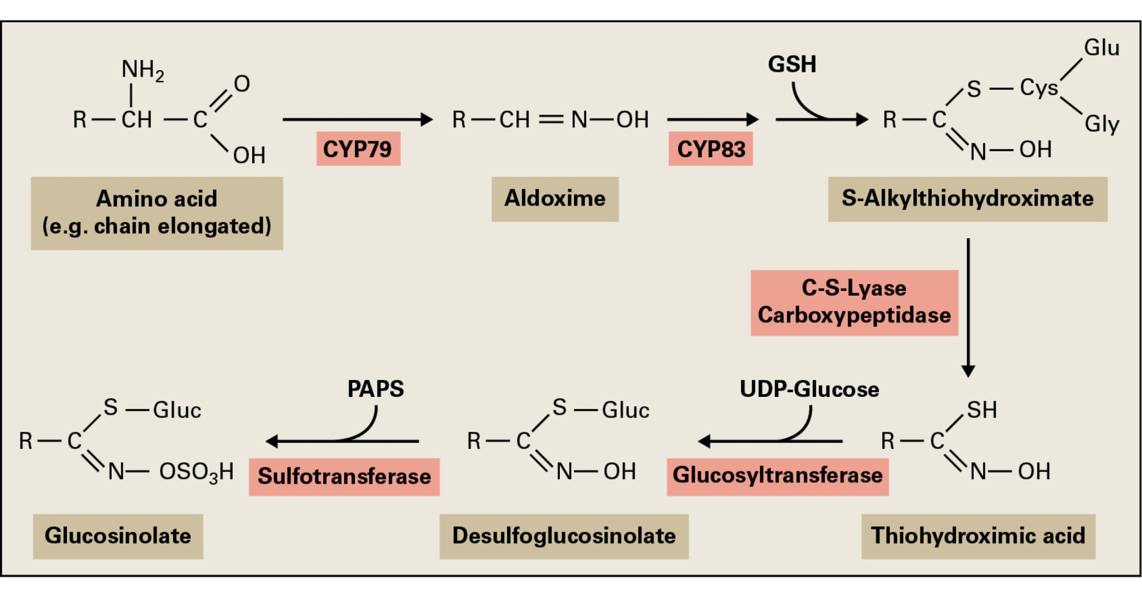
Secondary metabolites
Glucosinolates

Slide 17
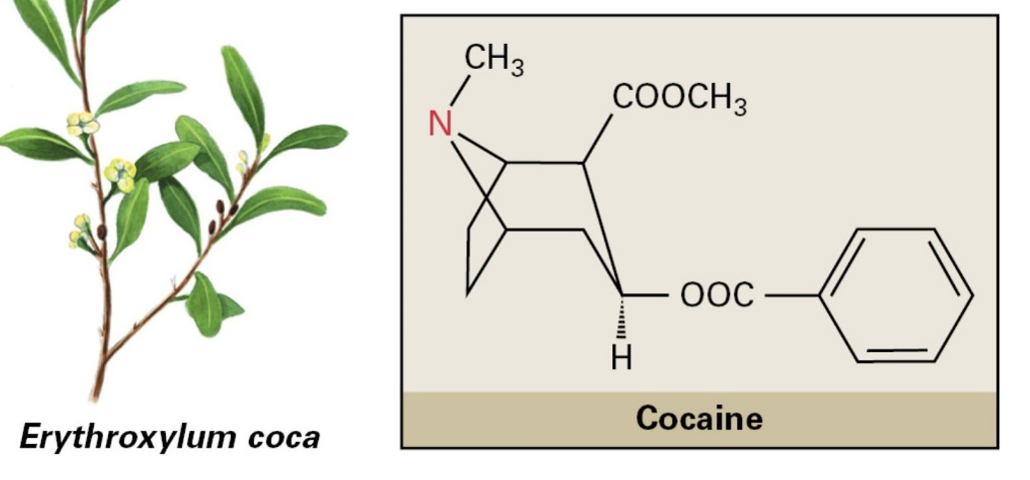
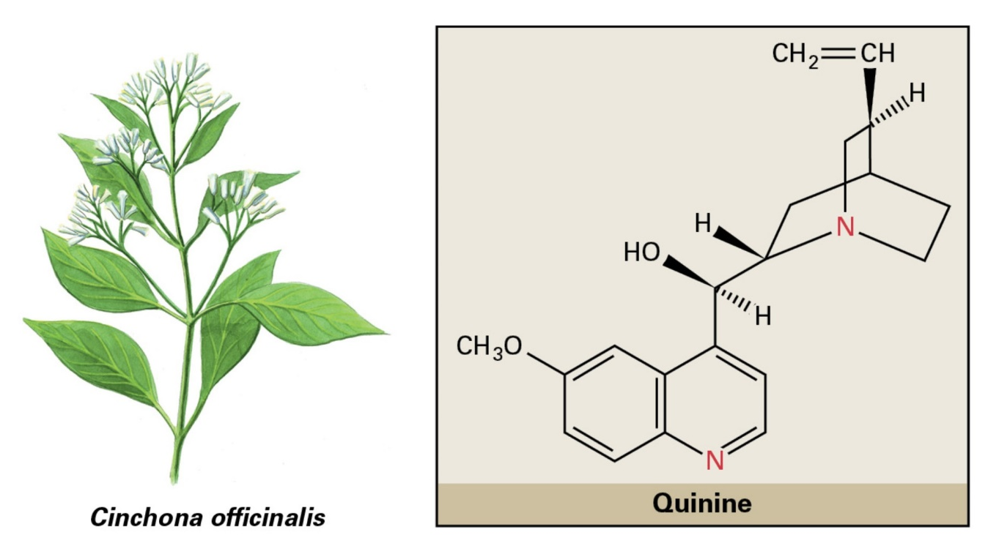
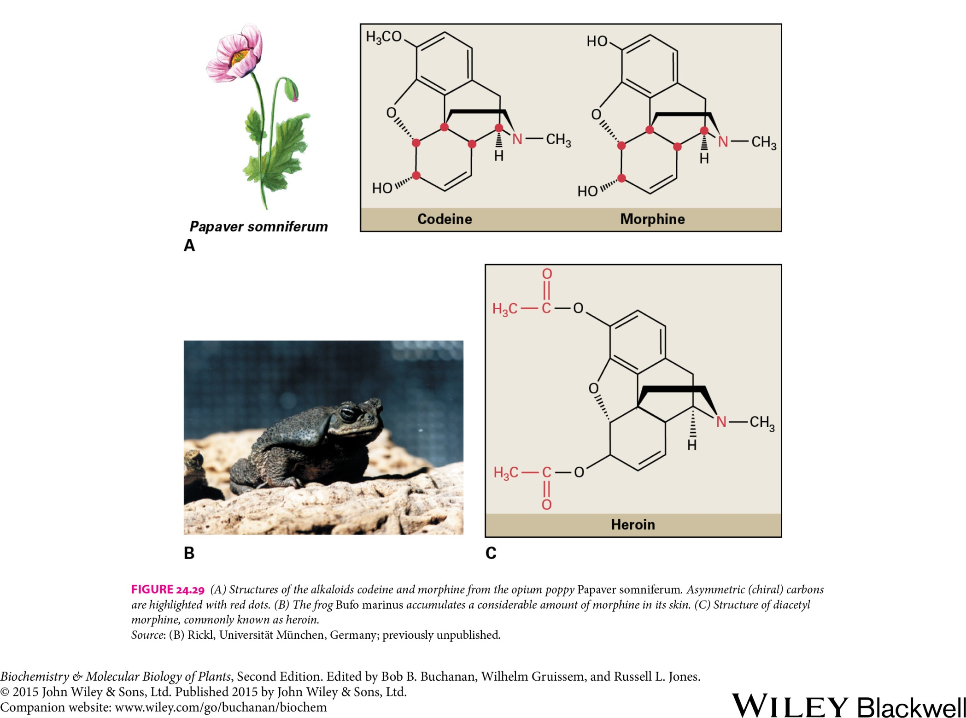
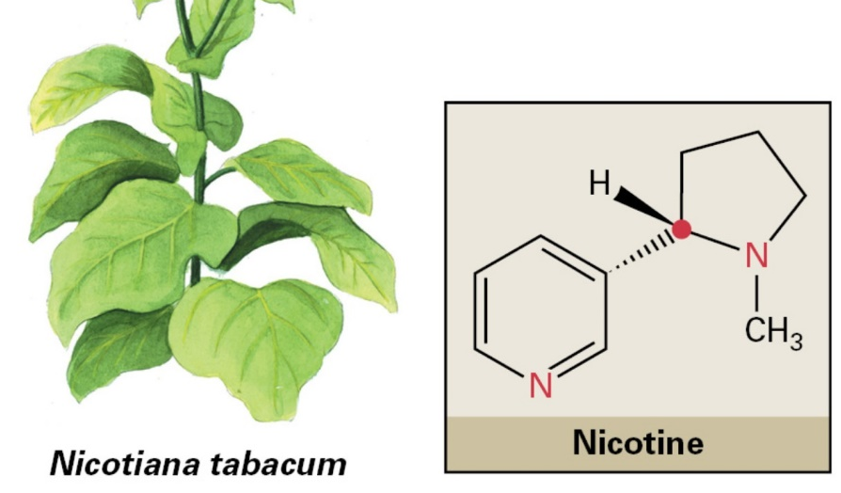
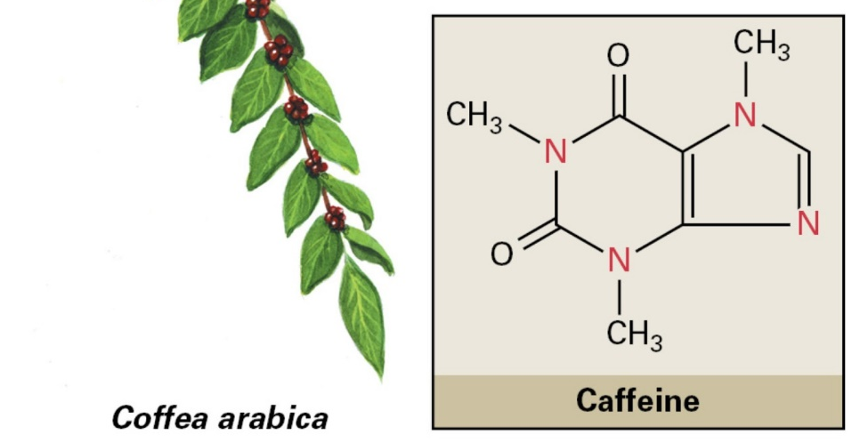
Secondary metabolites
Alkaloids

Slide 18
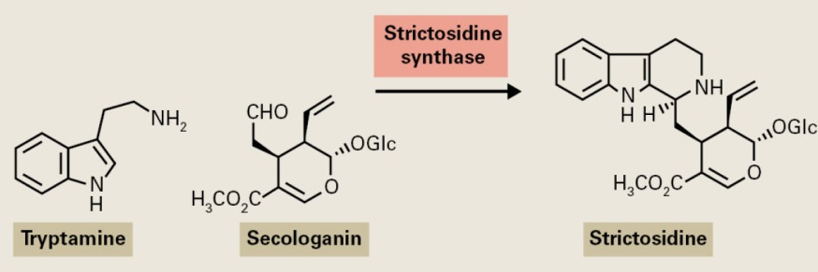
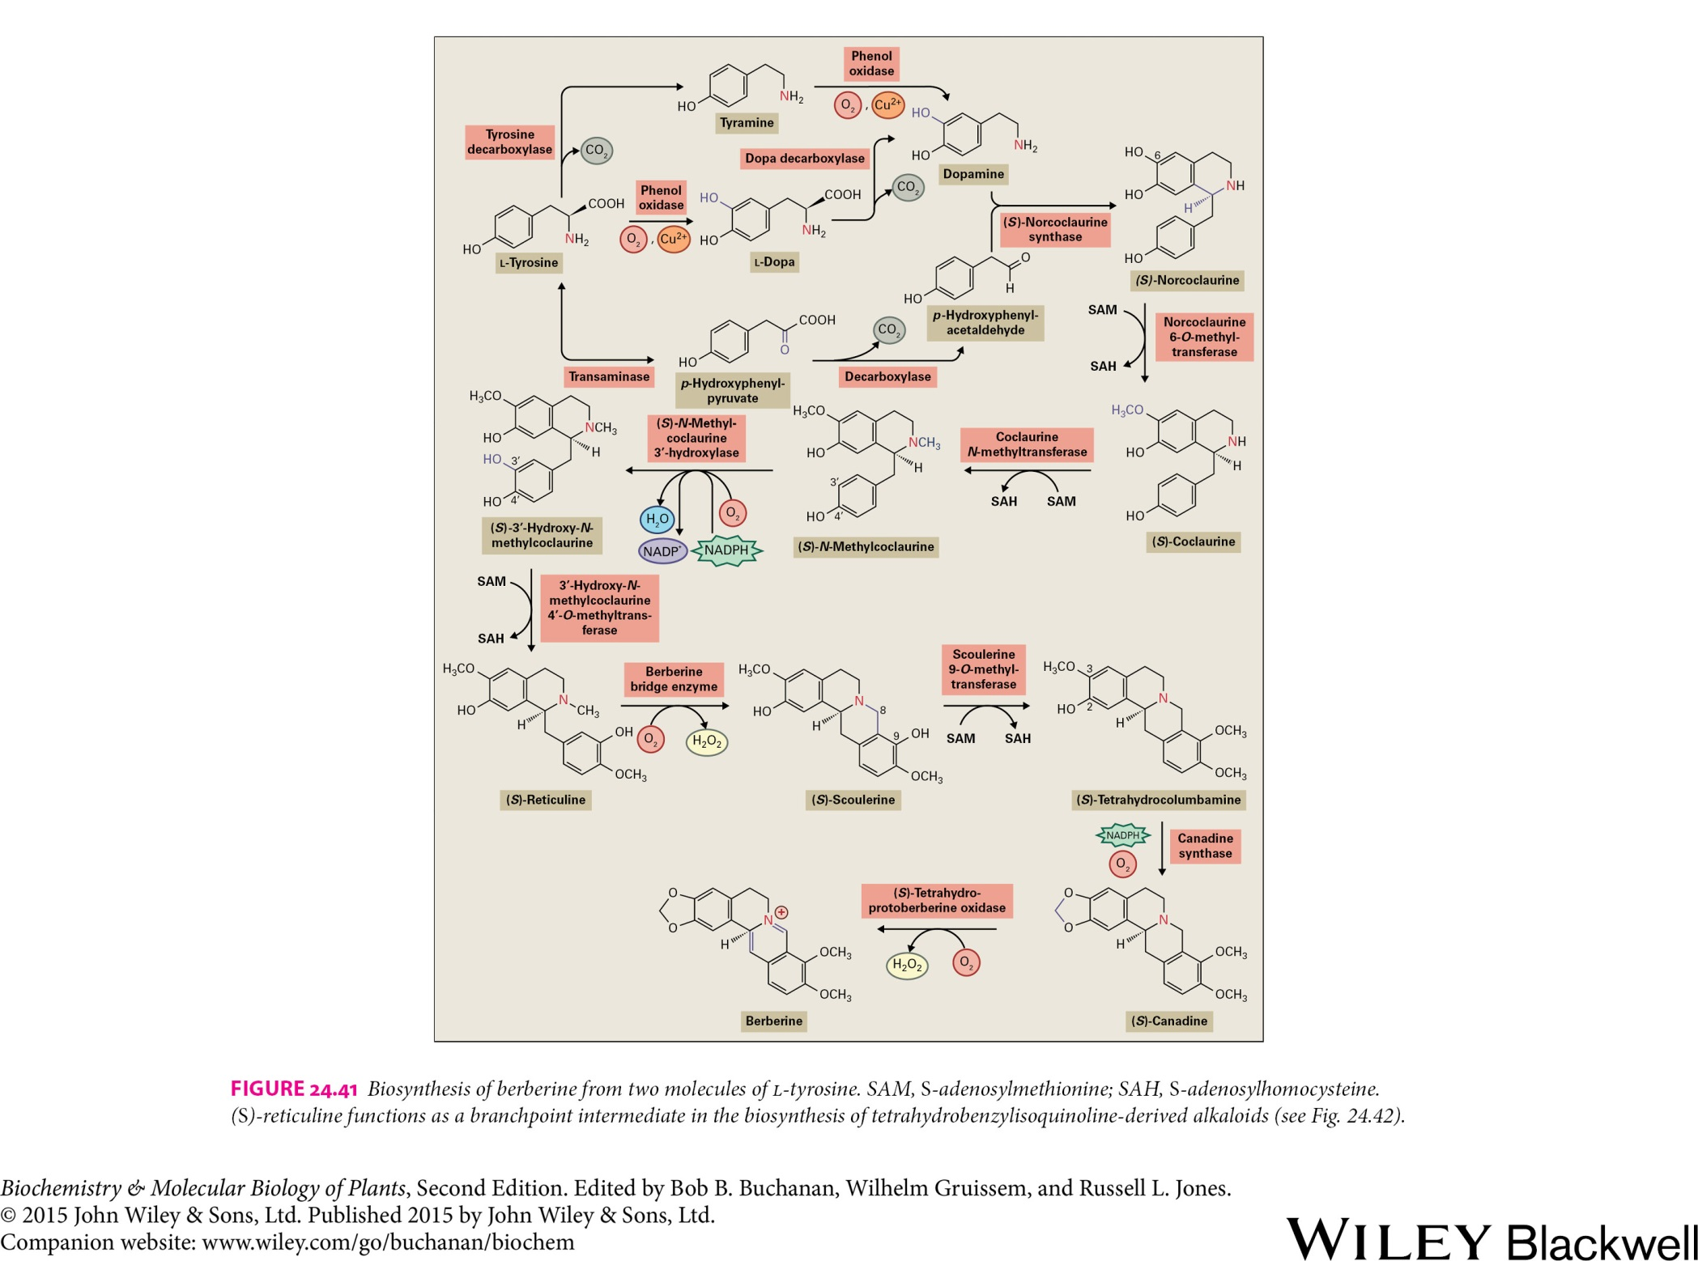
Secondary metabolites
Alkaloids

Slide 19
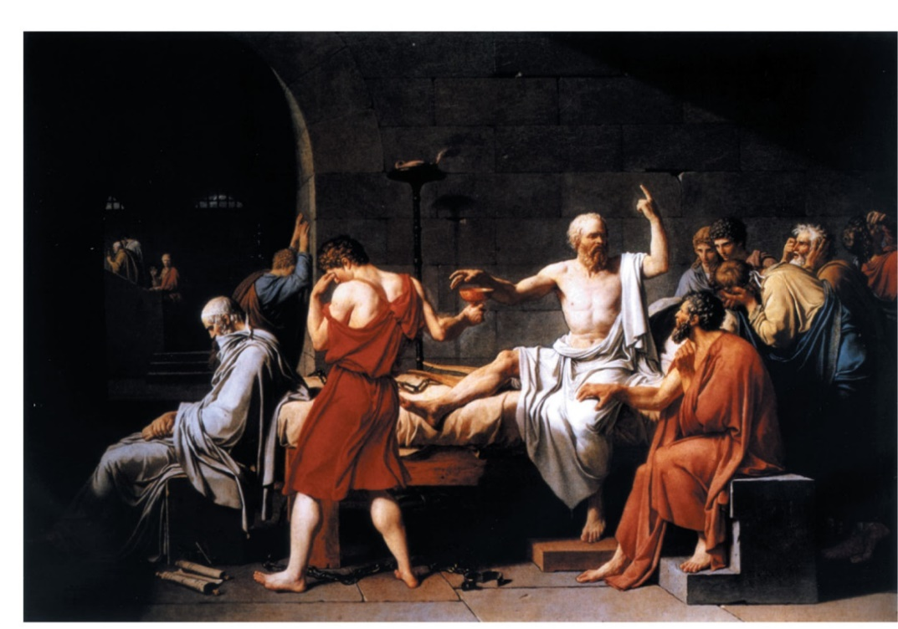
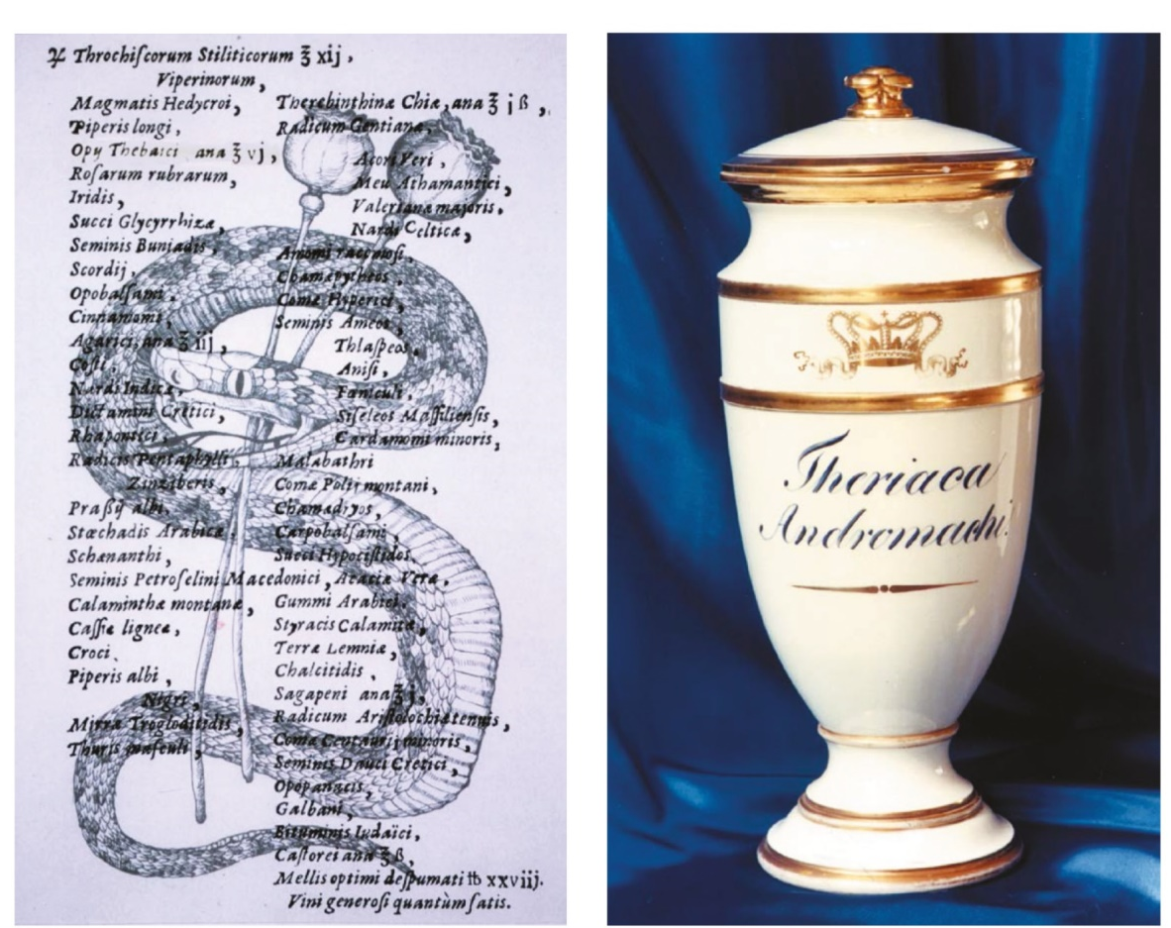
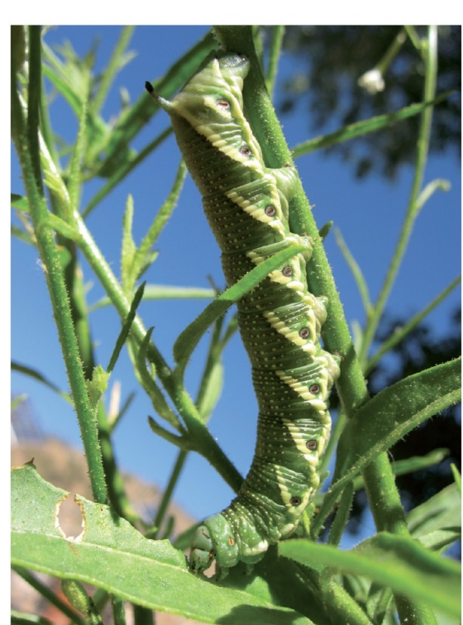
Secondary metabolites
Alkaloids

Slide 20
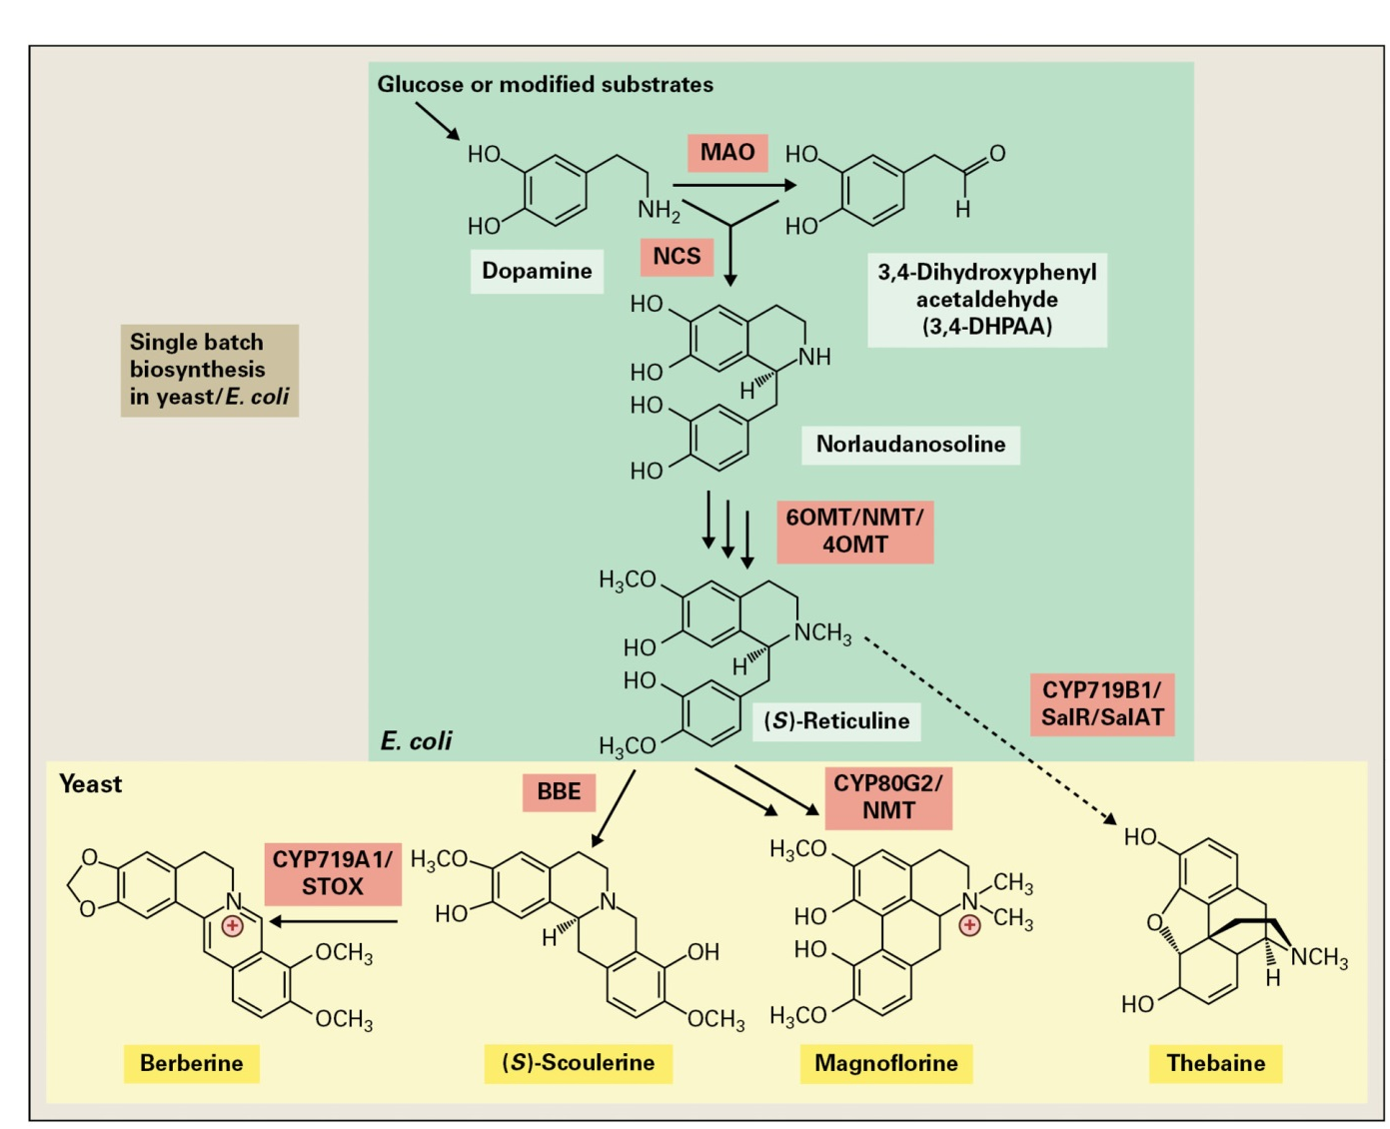
Secondary metabolites
Alkaloids
Bacteria and yeast have been engineered with a combination of plant and animal genes to produce isoquinoline alkaloids. Single batch means a co-culture of yeast and bacterium.

