Slide 1
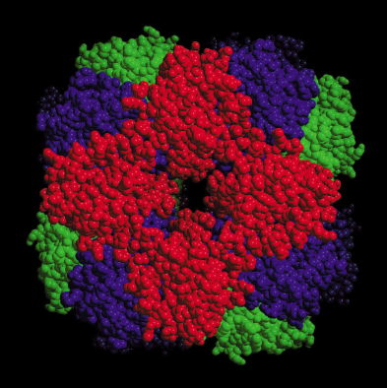
Photosynthesis
Katerina Dadakova, Department of Biochemistry
Figures adopted from Buchanan et al., Biochemistry & molecular biology of plants

Slide 2
Photosynthesis
Using light energy to synthesize organic compounds from inorganic precursors
hν
CO₂ + 2H₂O (CH₂O) + O₂ + H₂O
Oxygenic photosynthesis
The free energy change is ΔG = +2840 kJ per mol of glucose formed

Slide 3
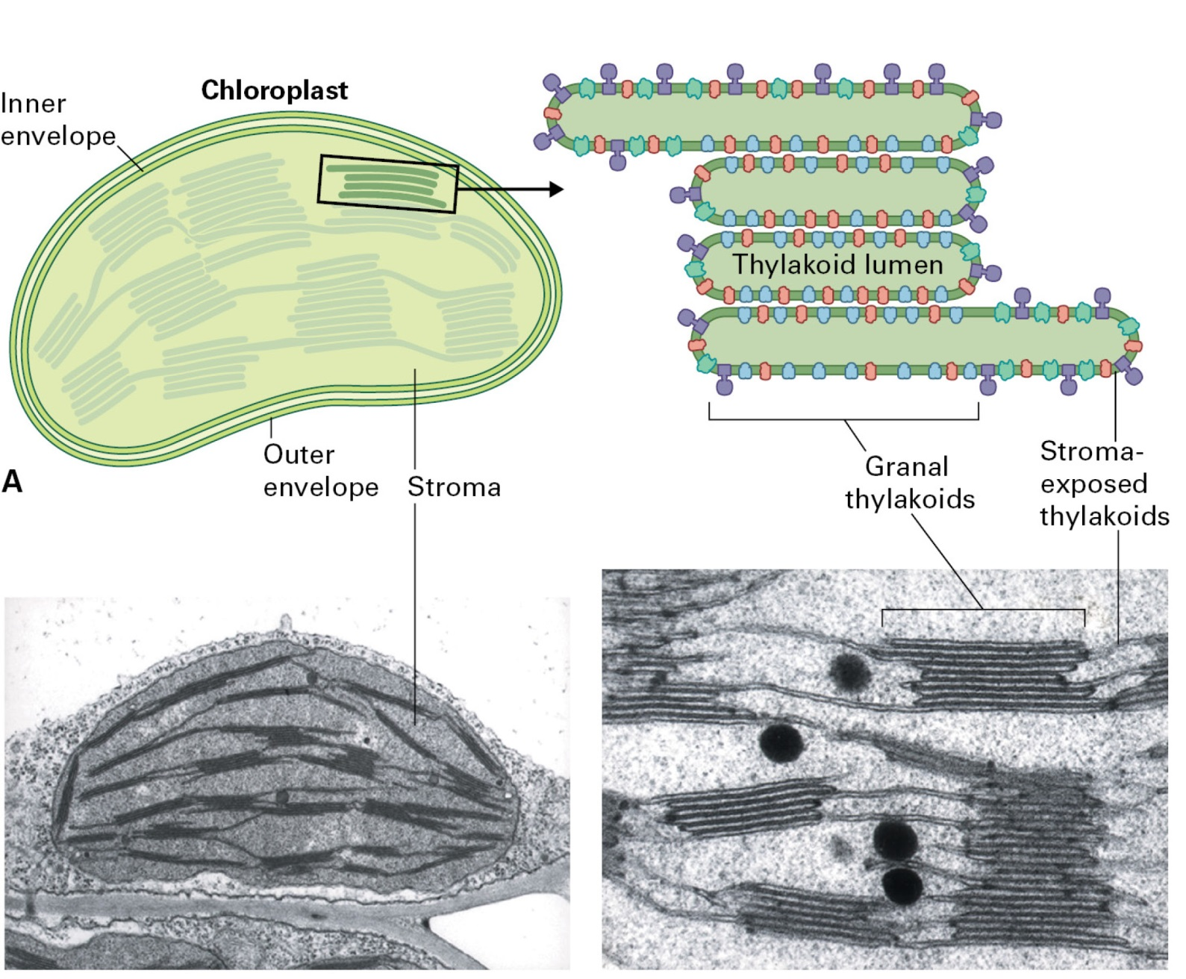
Photosynthesis
Plant chloroplast

Slide 4
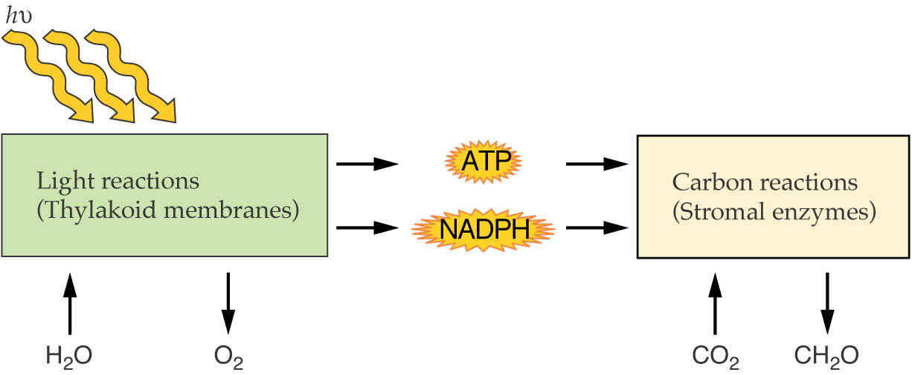
Photosynthesis
Two phases of photosynthesis
Water oxidation and CO₂ reduction are not obligately linked.

Slide 5
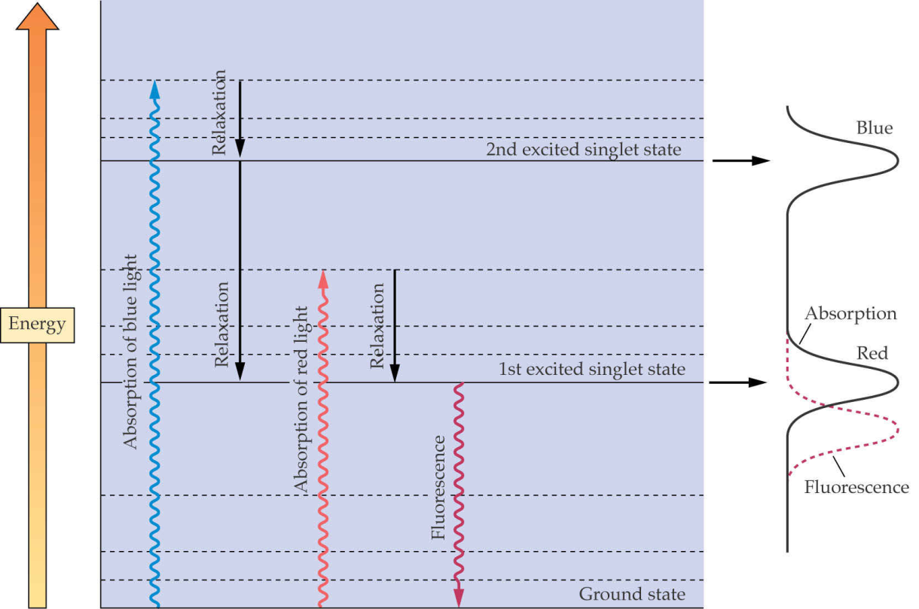
Photosynthesis
Light absorption
The energy of a photon is inversely proportional to its wavelength
E = hc/λ
Energy levels in the molecule of the light-absorbing pigment chlorophyll

Slide 6
Photosynthesis
Light absorption
Mechanisms of energy release:
relaxation
fluorescence
energy transfer
charge separation (photochemistry)
pigment + acceptor ^{hν} pigment* + acceptor pigment⁺ + acceptor ⁻
Φ = number of products formed photochemically / number of quanta absorbed

Slide 7
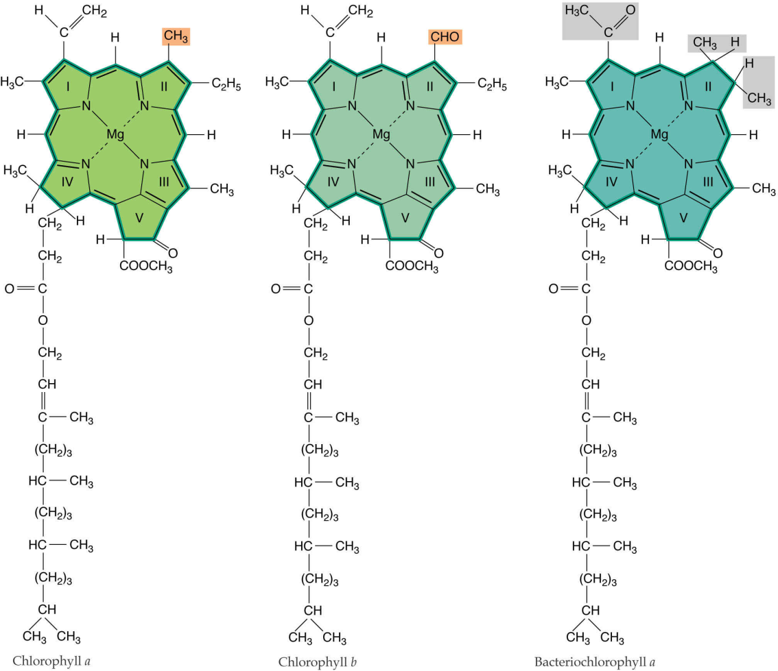
Photosynthesis
Light absorption
Chlorophyll a
Chlorophyll b
Bacteriochlorophyll

Slide 8
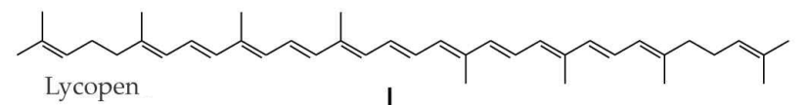
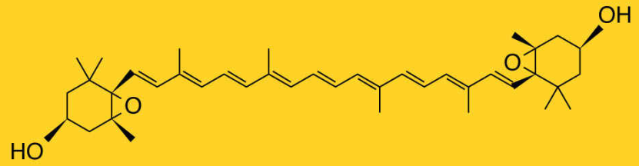
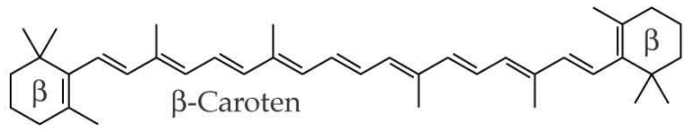
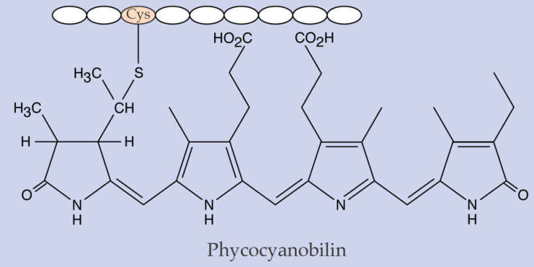
Photosynthesis
Light absorption
Carotenoids
Violaxanthin
Phycobilins

Slide 9
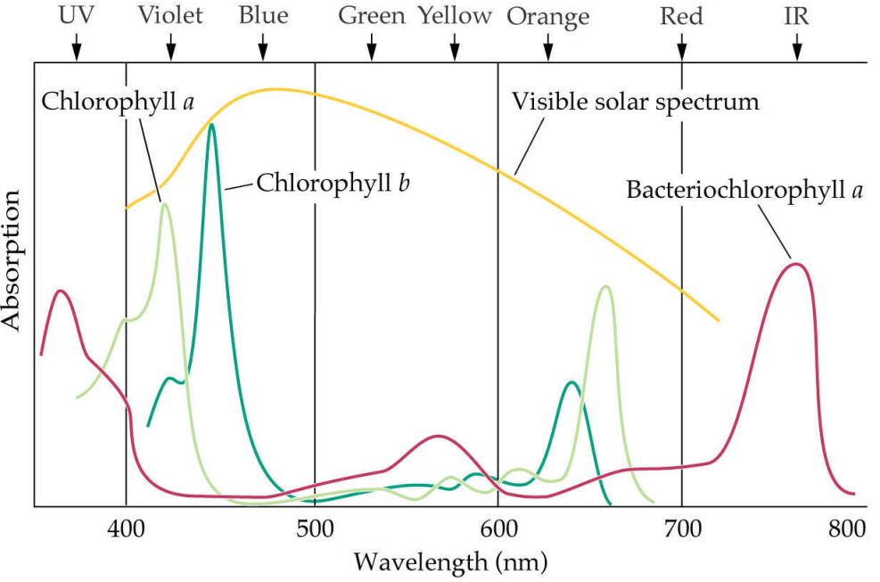
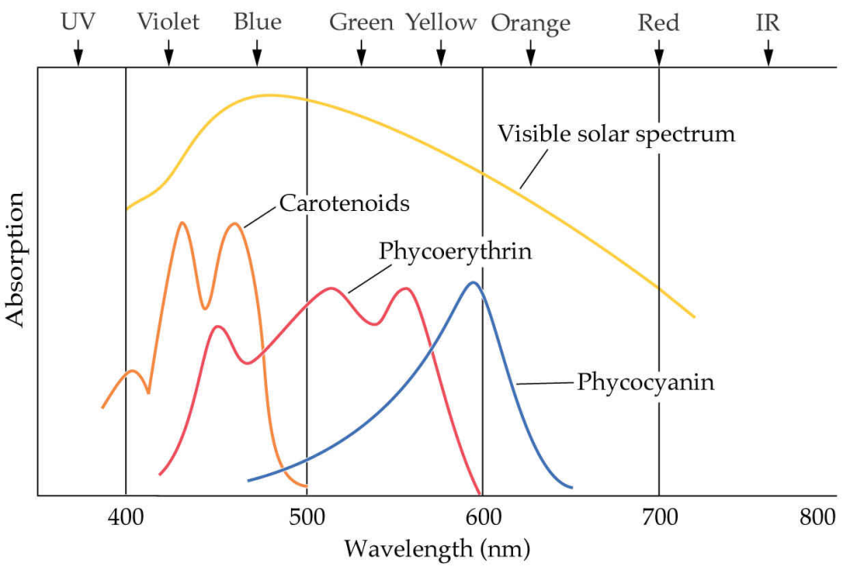
Photosynthesis
Light absorption
Chlorophylls
Other pigments

Slide 10
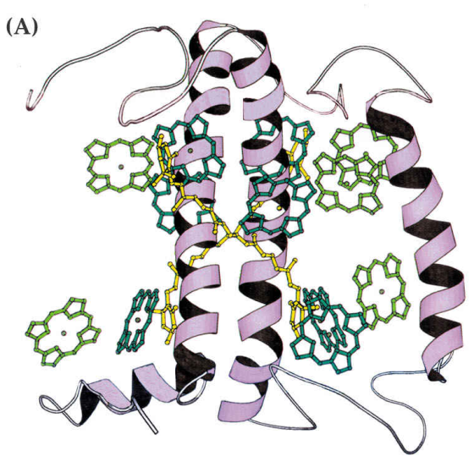
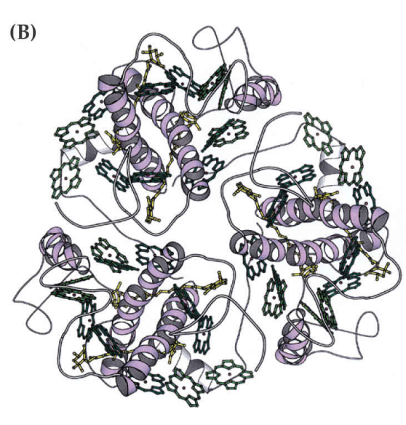
Photosynthesis
Light harvesting
LHC-II structure
Monomer
Trimer

Slide 11
Photosynthesis
The reaction center complex
Reaction centers are integral membrane protein complexes involved in conversion of light energy into chemical products
Plants contain two different reaction center complexes: Photosystem I and Photosystem II
Reaction centers contain both chlorophyll and electron acceptor molecules
Carrier | PSI | PSII
Chl | P700 | P680
A₀ | Chlorophyll a | Pheophytin a
A₁ | Phylloquinone | Plastoquinone (Q_{A})
A₂ | Fe-S center | Plastoquinone (Q_{B})
hν
Chl A_{O}A₁A₂ Chl*A_{O}A₁A₂ Chl⁺A_{O}⁻A₁A₂ Chl⁺A_{O}A₁⁻A₂ Chl⁺A_{O}A₁A₂⁻

Slide 12
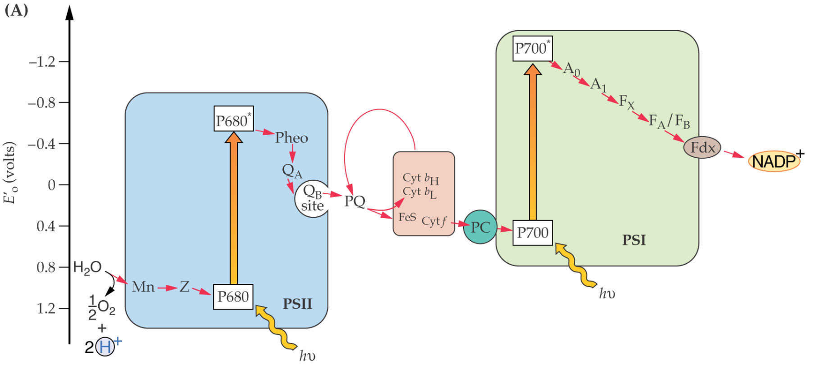
Photosynthesis
Electron transport pathways
The chloroplast noncyclic electron transport chain produces O₂, NADPH, and ATP and involves the cooperation of PSI and PSII
Strong reductant
Reductant
Oxidant
Strong oxidant

Slide 13
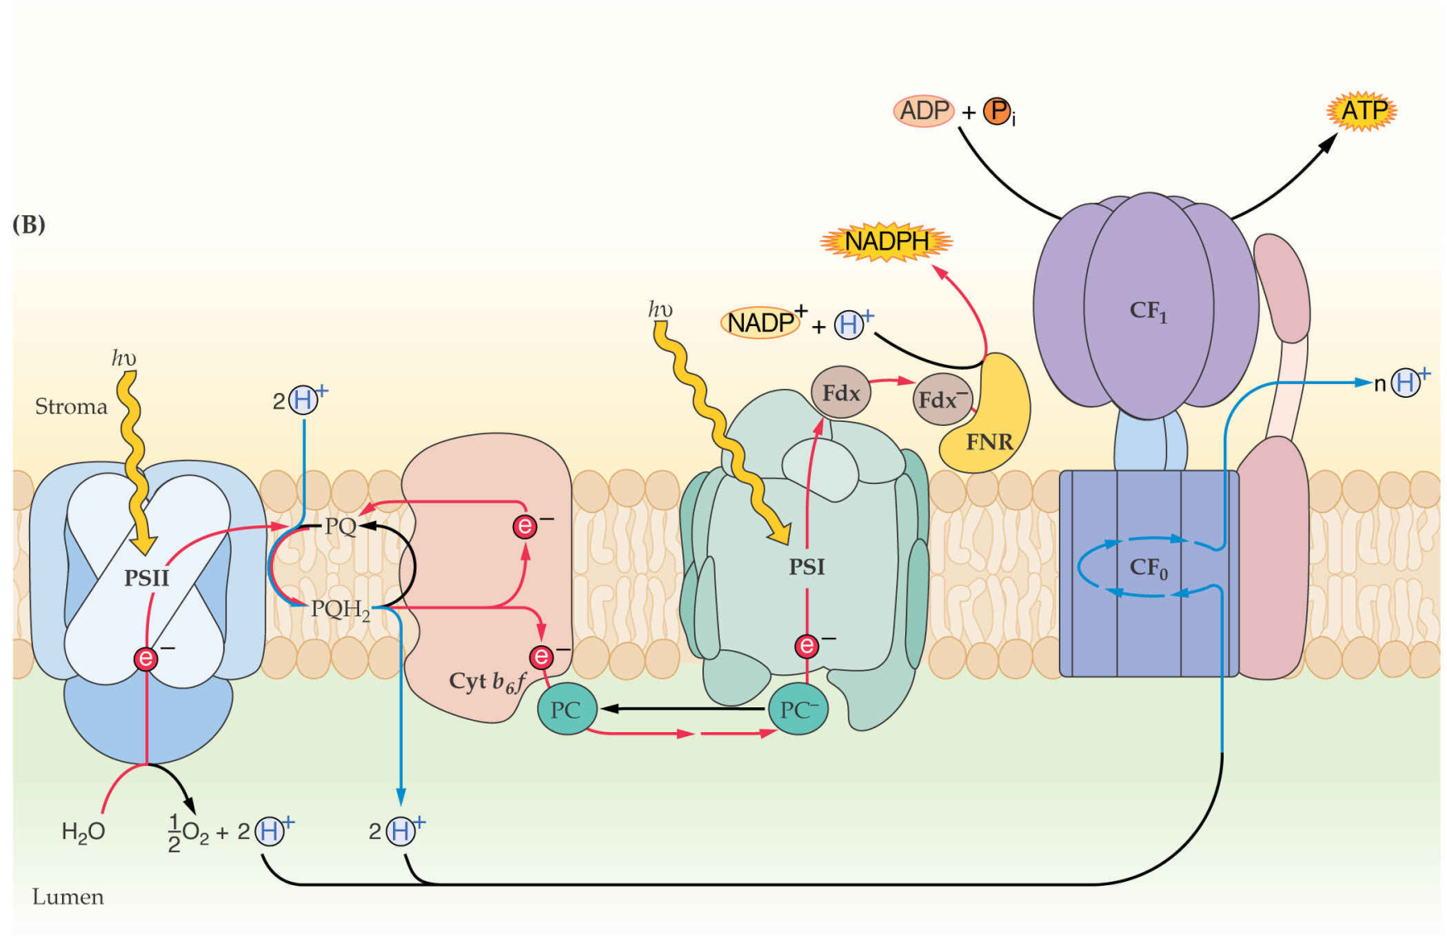
Photosynthesis
Electron transport pathways

Slide 14
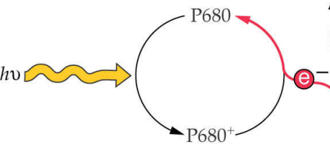
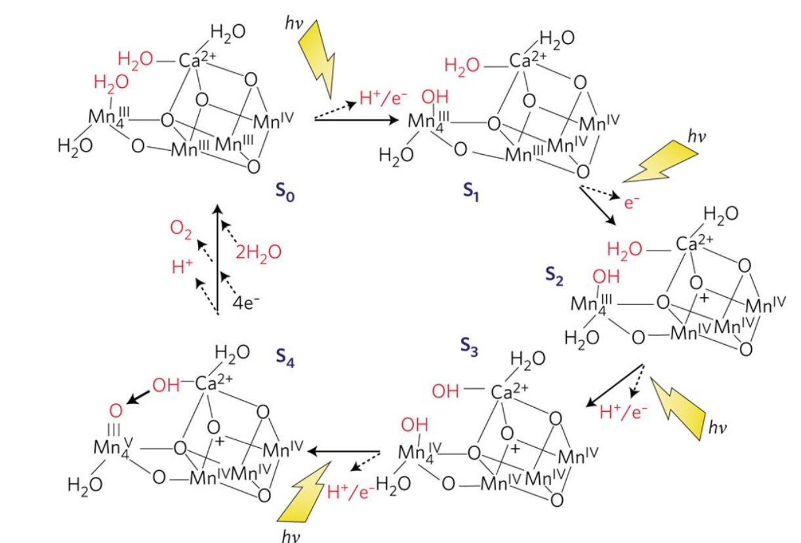
Photosynthesis
Oxidation of water
Barber, Nature Plants 3 (2017)
2H₂O O₂ + 4H⁺ + 4e⁻

Slide 15
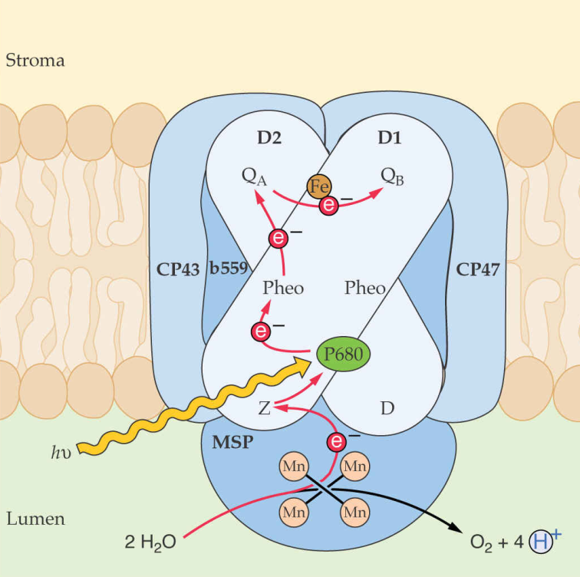
Photosynthesis
PSII
P680 Q_{A} Q_{B}
P680⁺ Q_{A}⁻ Q_{B}
P680 Q_{A} Q_{B}⁻
P680 ⁺ Q_{A} ⁻ Q_{B}⁻
Q_{B}²⁻ + 2H ⁺ Q_{B}H₂
QH₂ + 2PC_{ox} + 2H⁺_{stroma} Q + 2PC_{red} + 4H⁺_{lumen}

Slide 16
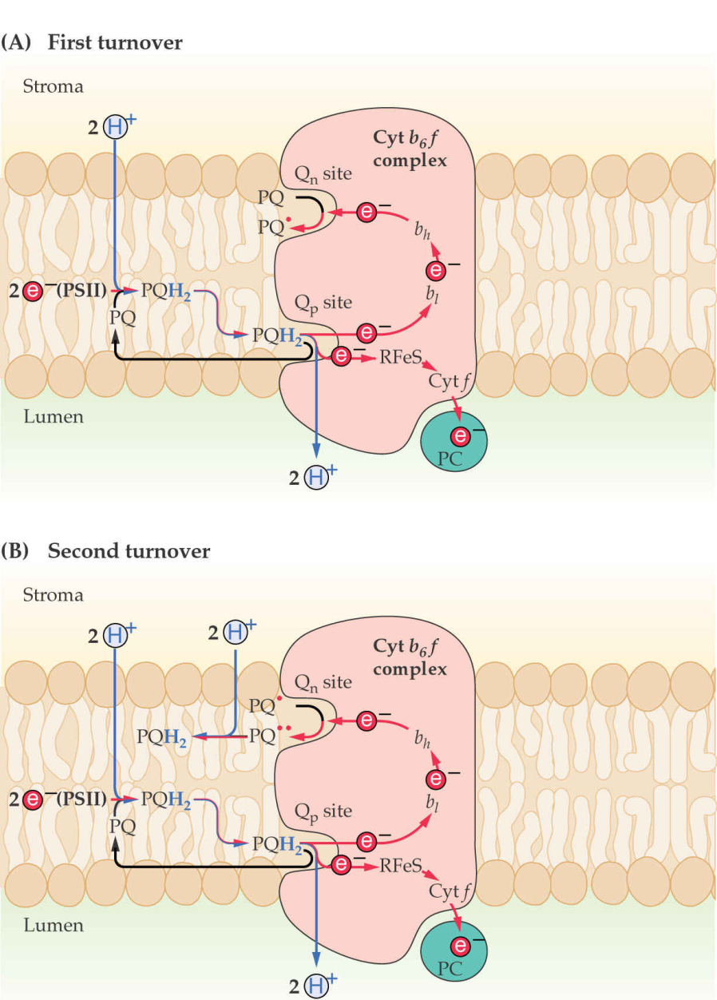
Photosynthesis
Cytochrome b₆f

Slide 17
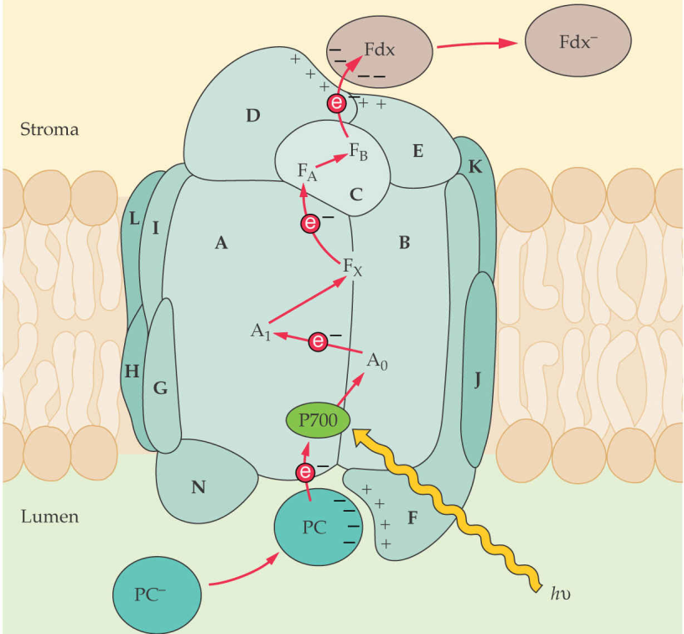
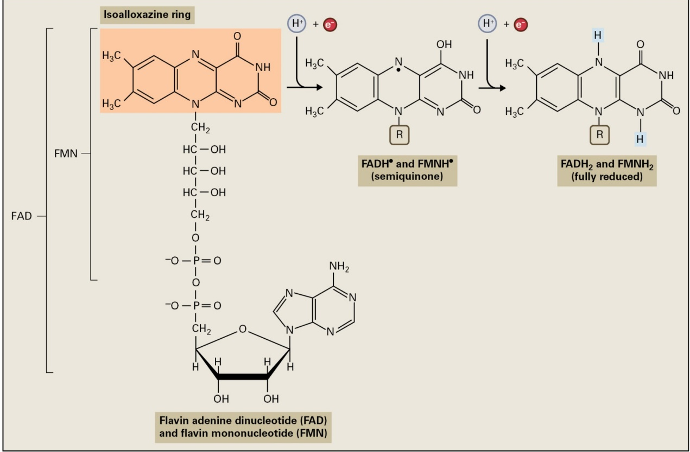
Photosynthesis
PSI
Structure and redox chemistry of flavin coenzymes

Slide 18
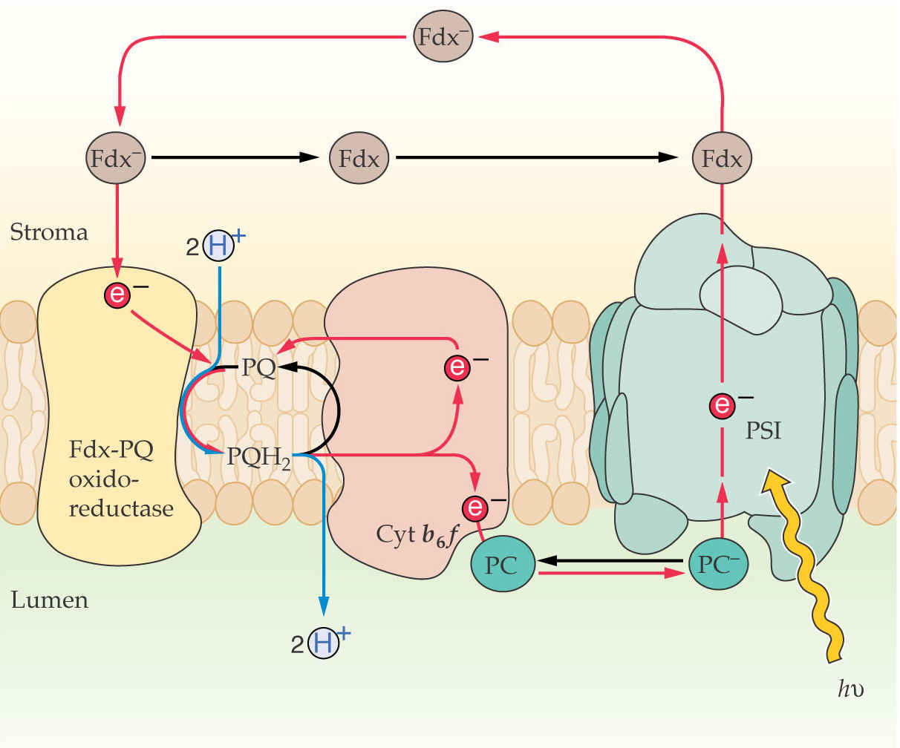
Photosynthesis
Cyclic electron transport chain

Slide 19
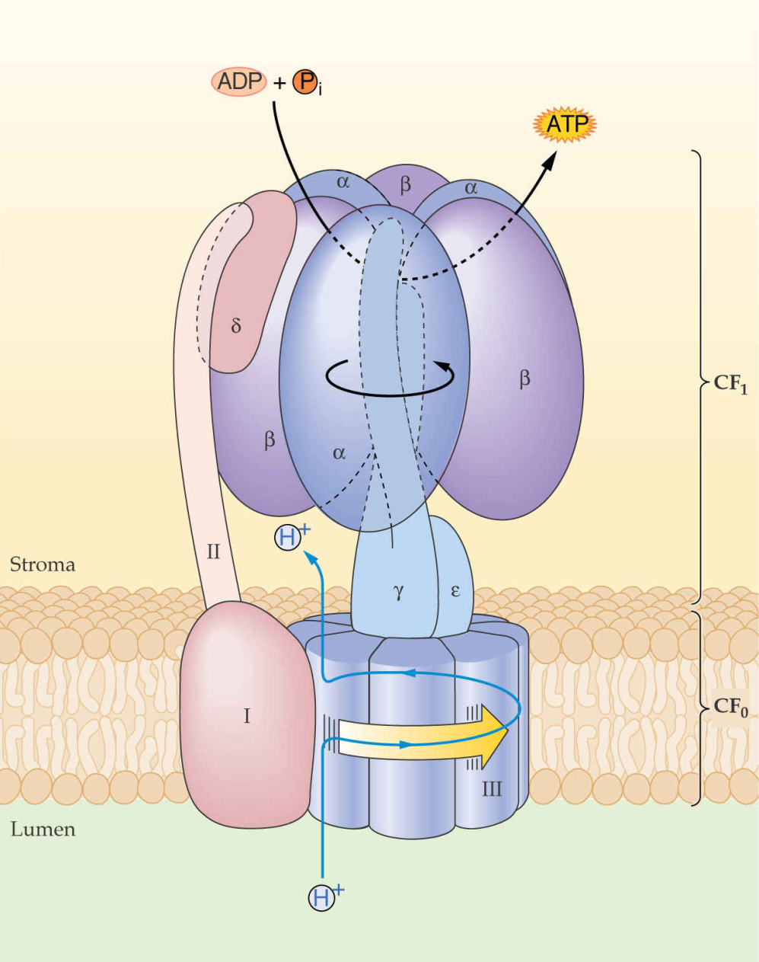
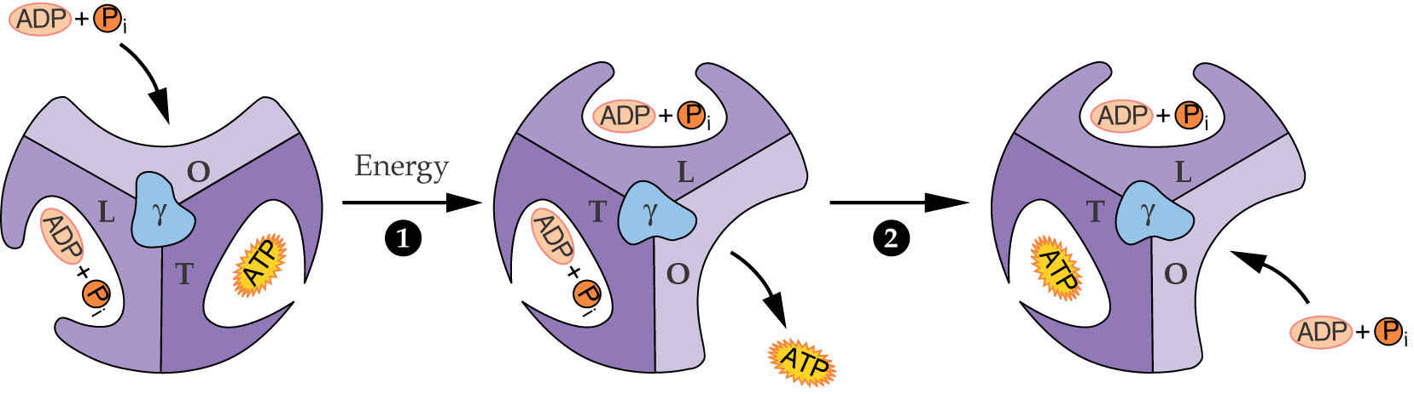
Photosynthesis
ATP synthesis in chloroplasts
Chloroplasts synthesize ATP by a chemiosmotic mechanism driven by a proton gradient

Slide 20
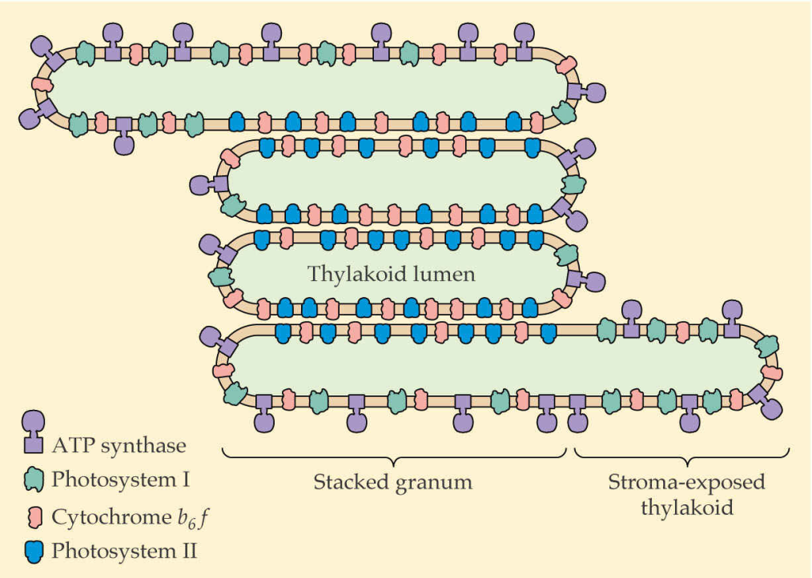
Photosynthesis
Organization of the thylakoid membrane
Component (%) | Granal thylakoids | Stromatal thylakoids
PSII | 85 | 15
PSI | 10 | 90
Cytochrome b₆f complex | 50 | 50
LHC-II | 90 | 10
ATP synthase | 0 | 100
Plastocyanin | 40 | 60

Slide 21
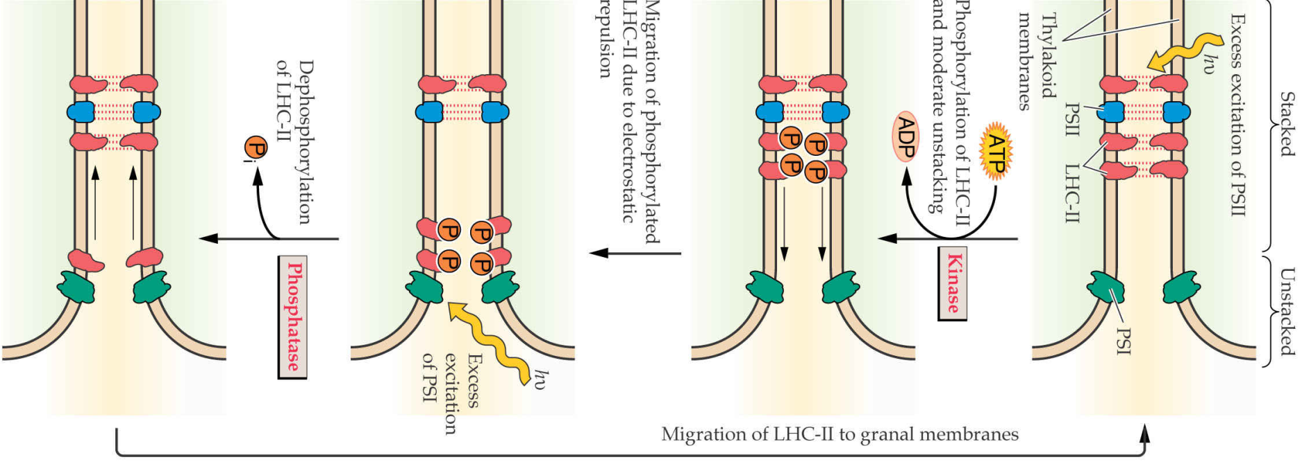
Photosynthesis
Energy distribution between PSI and PSII
Balanced excitation of both photosystems is required for maximum electron transfer efficiency

Slide 22

Photosynthesis
Carbon reactions in C₃ plants
C₃ plants produce a three-carbon compound as the first stable product.
In these plants, photosynthetic carbon fixation is catalyzed by a single enzyme, Rubisco.
Rubisco, probably the most prevalent
protein on Earth, constitutes up to half
the protein of the chloroplast stroma

Slide 23
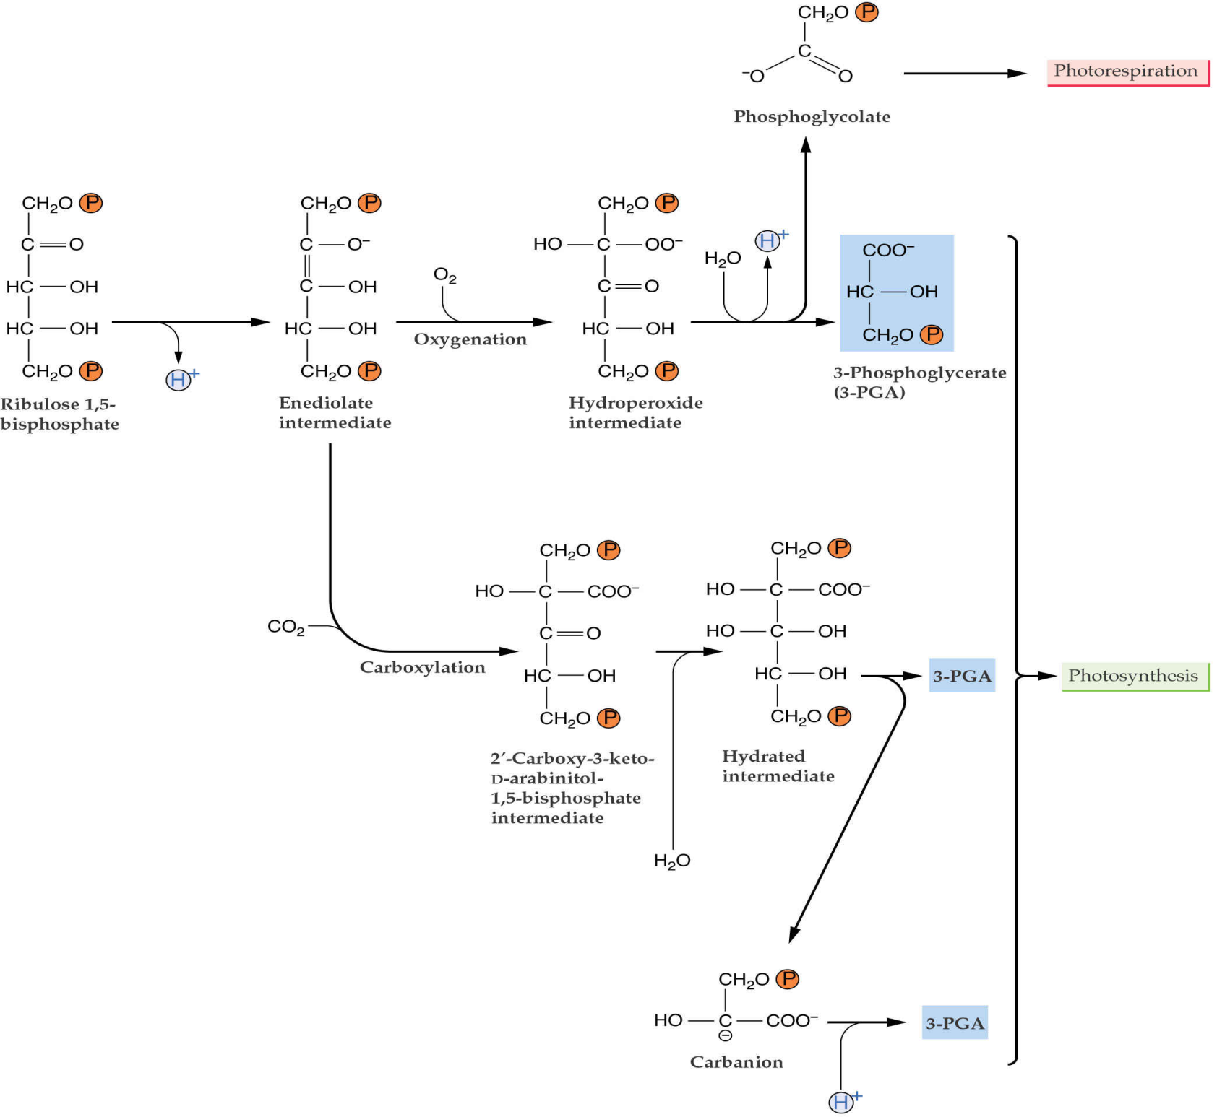
Photosynthesis

Slide 24
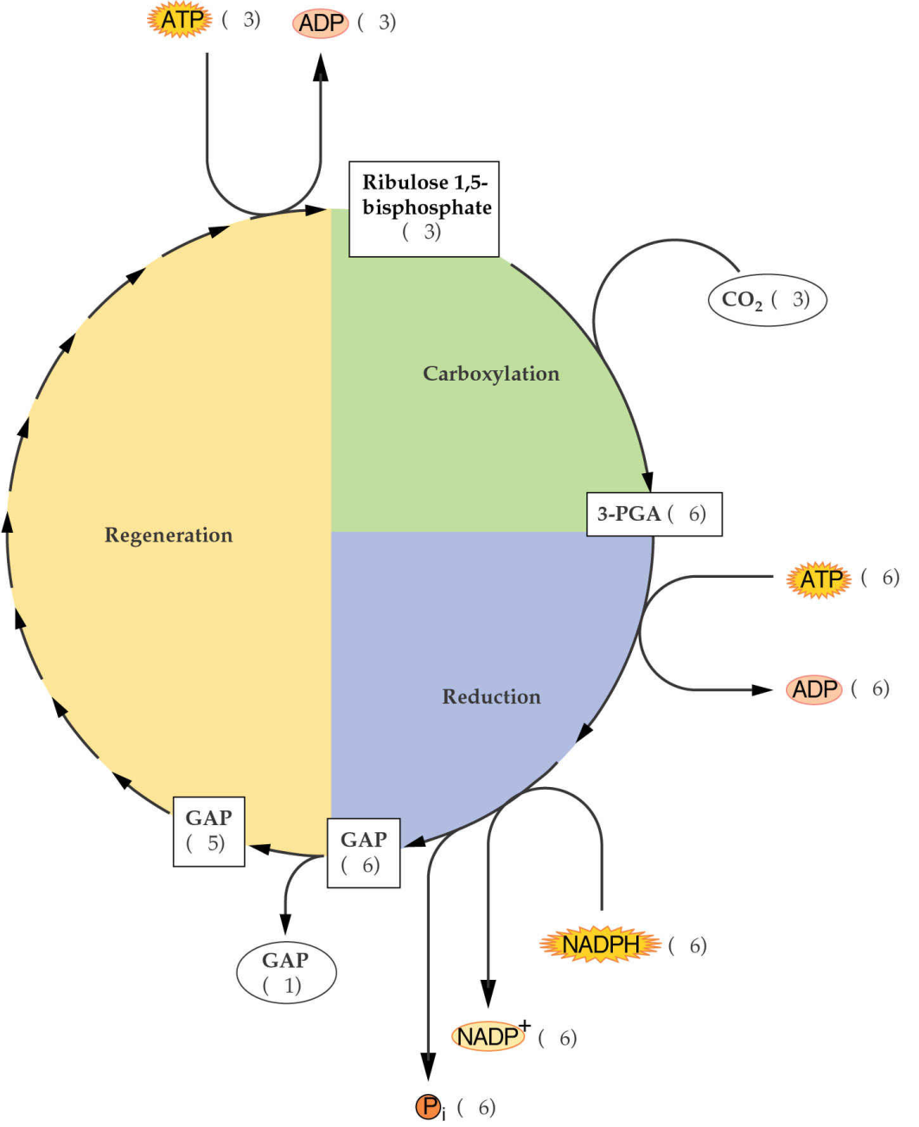
Photosynthesis
Carbon reactions (Calvin cycle)
Fixation of one molecule of CO₂ requires two molecules of NADPH and three of ATP.

Slide 25
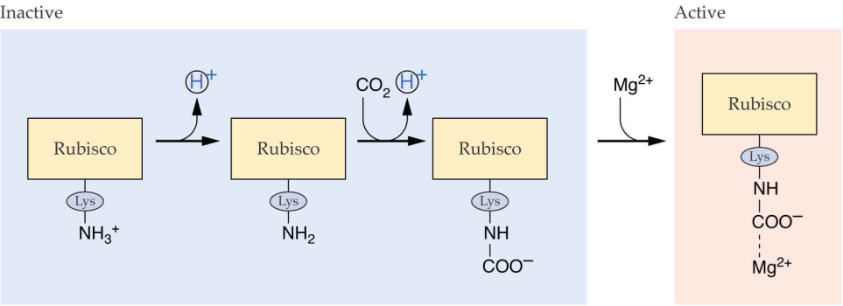
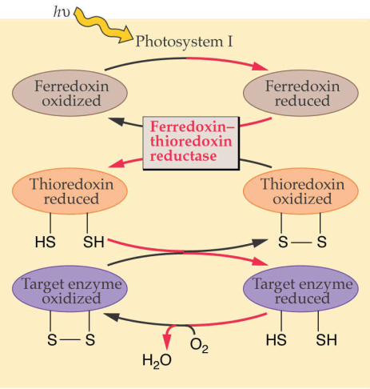
Photosynthesis
The Calvin cycle regulation
Activation of Rubisco by carbamylation
The ferredoxin-thioredoxin system

Slide 26
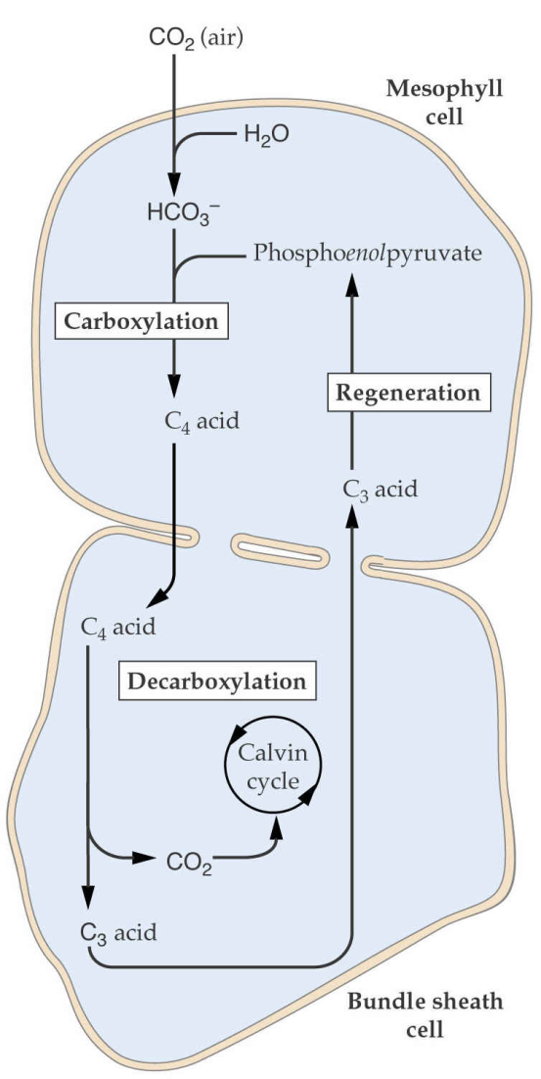
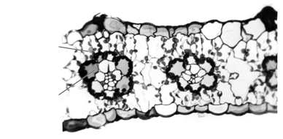
Photosynthesis
C₄ fixation mechanism
C₄ plants contain two distinct CO₂-fixing enzymes
They have specialized foliar anatomy:
Mesophyll cell
Bundle sheat cell
They form four-carbon organic acids as the first
products of CO₂ fixation

Slide 27
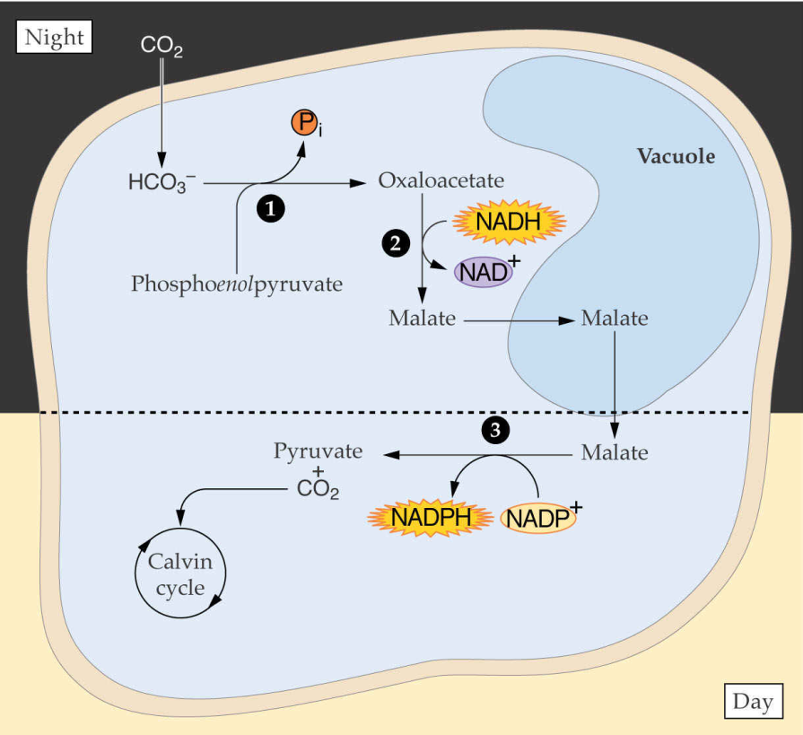
Photosynthesis
CAM fixation mechanism

