Slide 1
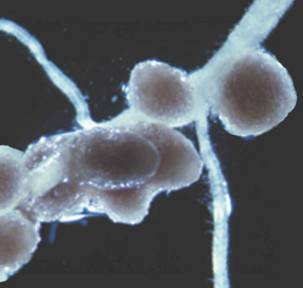
Nutrients
Katerina Dadakova, Department of Biochemistry
Figures adopted from Buchanan et al., Biochemistry & molecular biology of plants

Slide 2
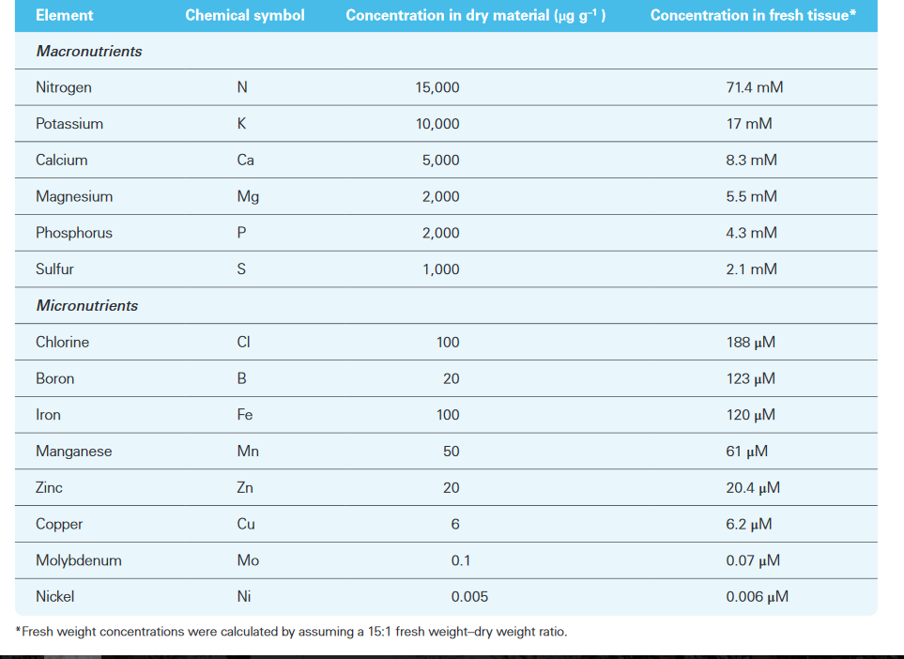
Nutrients
Essential mineral nutrients

Slide 3
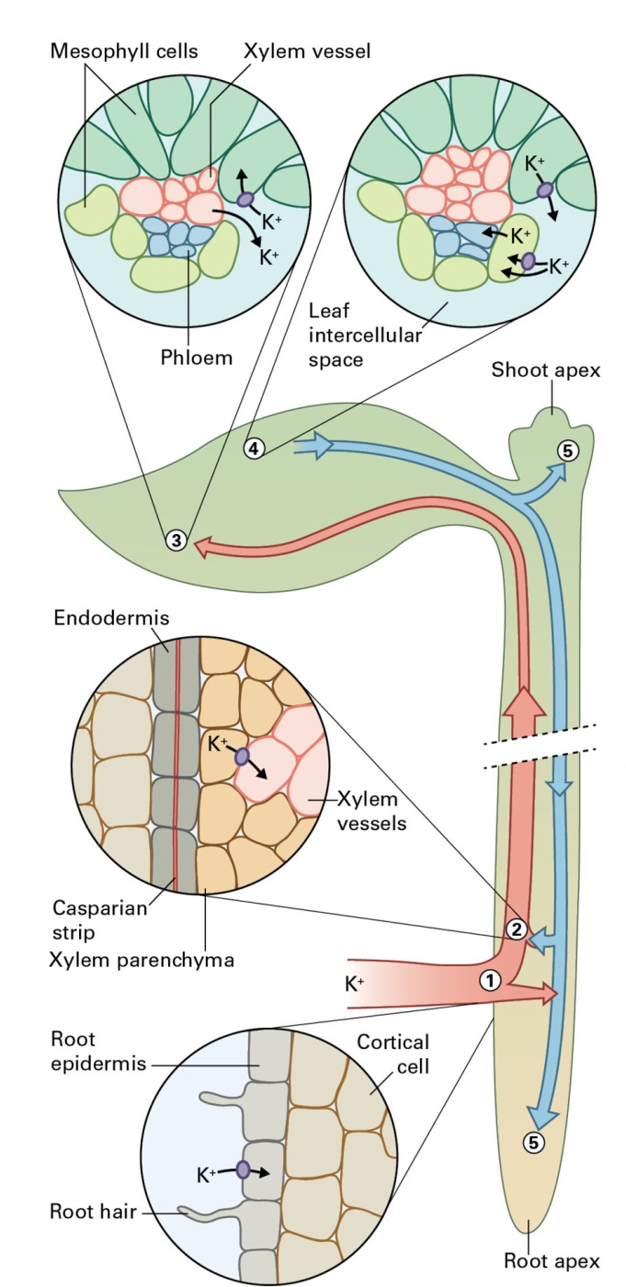
Nutrients
Potassium
K⁺ is the most abundant cellular cation
K⁺ functions:
osmoticum
charge balance
enzyme activation

Slide 4
Nutrients
Nitrogen
Compound | Oxidation state of N | Name
N₂ | 0 | Dinitrogen (nitrogen gas)
HN₃ | -3 | Ammonia
NH₄⁺ | -3 | Ammonium ion
N₂O | +1 | Nitrous oxide
NO | +2 | Nitric oxide
NO₂⁻ | +3 | Nitrite
NO₂ | +4 | Nitrogen dioxide
NO₃⁻ | +5 | Nitrate
nitrogen fixation glutamine synthetase
N₂ NH₄⁺ Glutamine Organic nitrogen compounds
Glutamate

Slide 5
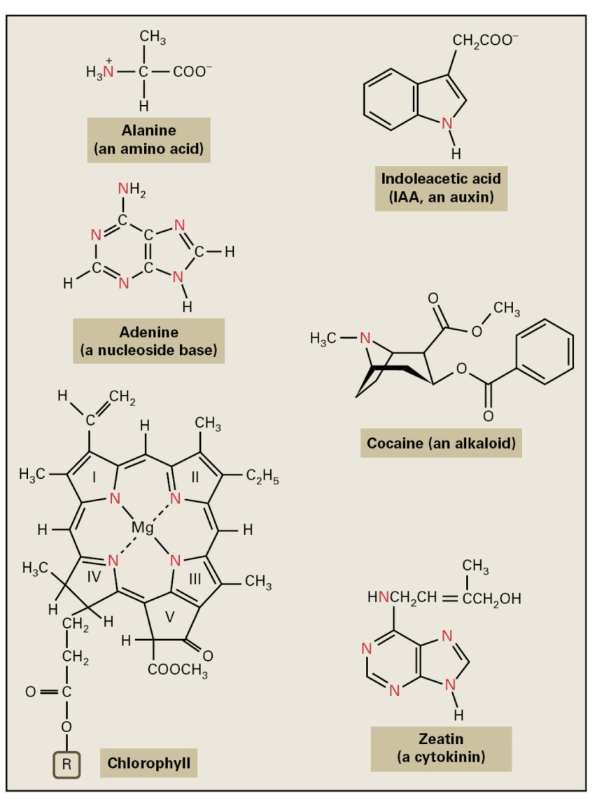
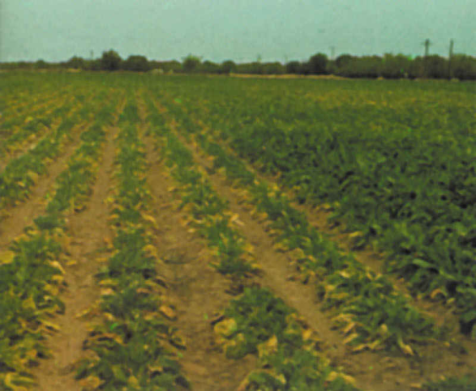
Nutrients
Nitrogen deficiency phenotype
Selected organic nitrogen compounds

Slide 6
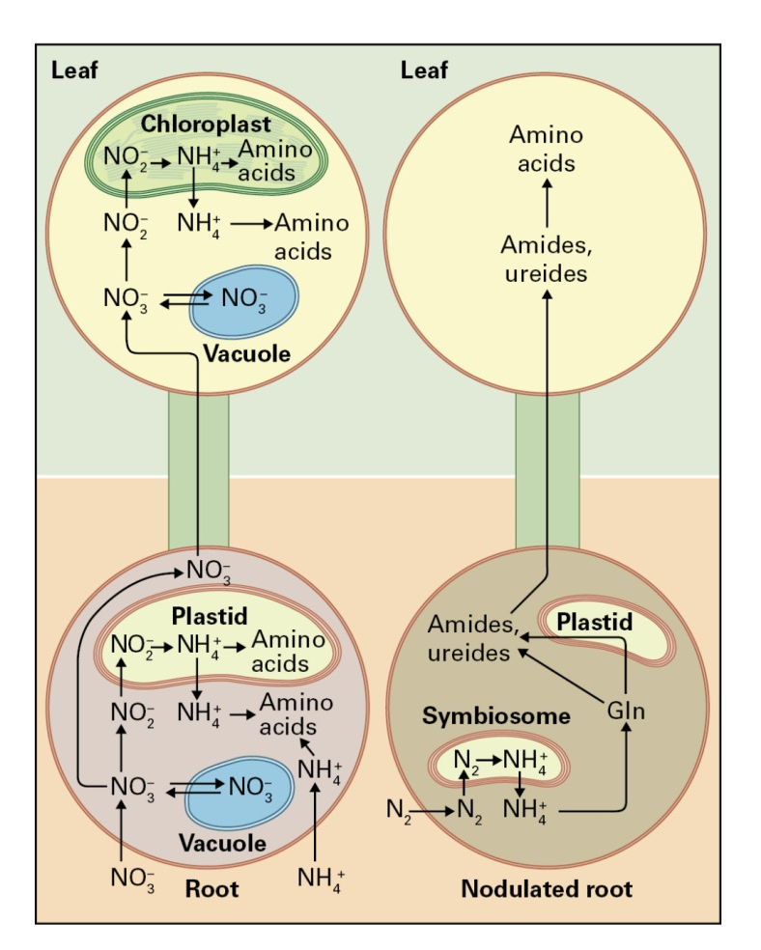
Nutrients
Plants may acquire N as:
ammonium ion
nitrate
dinitrogen, only in the case of plant species capable of endosymbiosis with nitrogen-fixing bacteria
Obtaining nitrogen through symbiosis consumes 12 to 17 g of carbohydrate per gram of N fixed

Slide 7
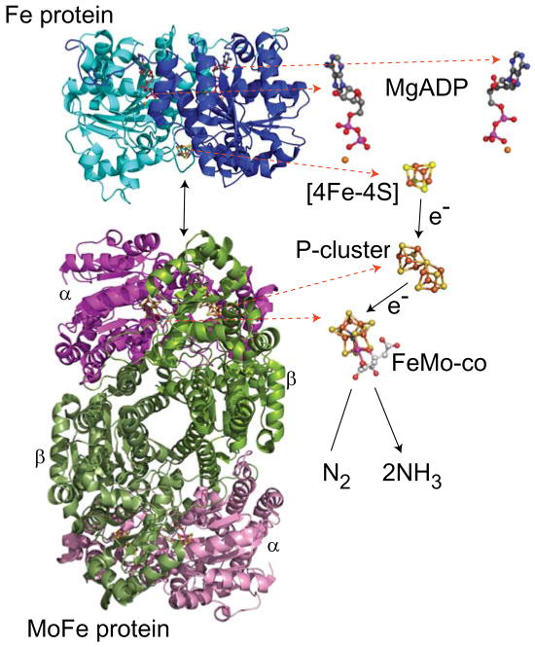
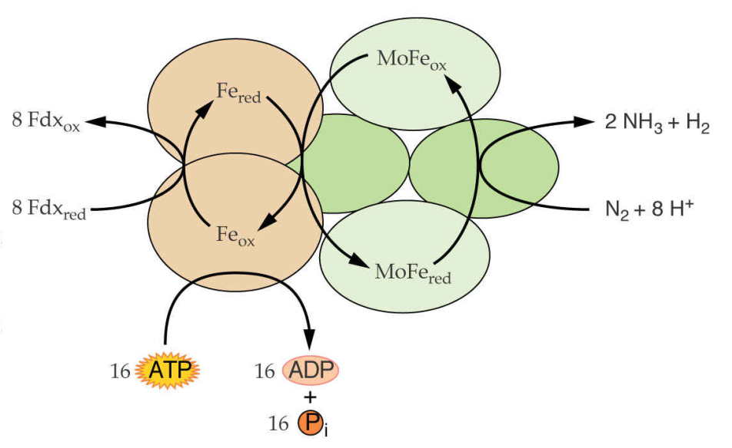
Nutrients
Nitrogen fixation
Nitrogenase complex
Dinitrogenase reductase
Fe protein
Dinitrogenase
MoFe protein
N₂ + 16ATP + 8e⁻ + 8H⁺
2NH₃ + H₂ + 16ADP + 16P_{i}

Slide 8
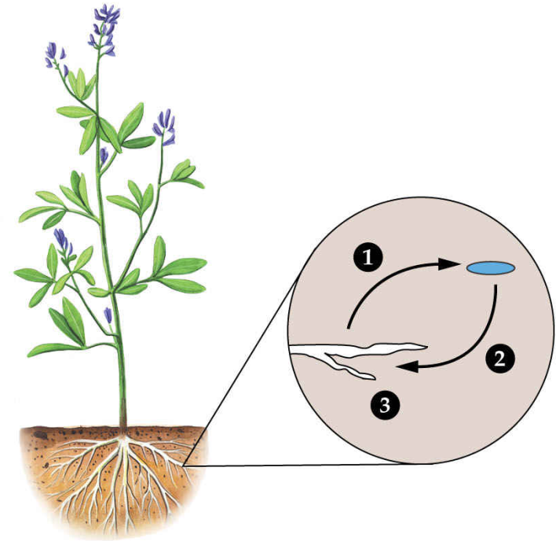
Nutrients
Legume-rhizobial symbiosis
The plant creates root nodules to ensure:
microaerobic environment
organic acids to feed the bacteria
carbon skeletons to transport fixed nitrogen
Bacterial symbionts fix nitrogen and release the resulting ammonia
Plant signals
Nod factors
Nodulin proteins

Slide 9
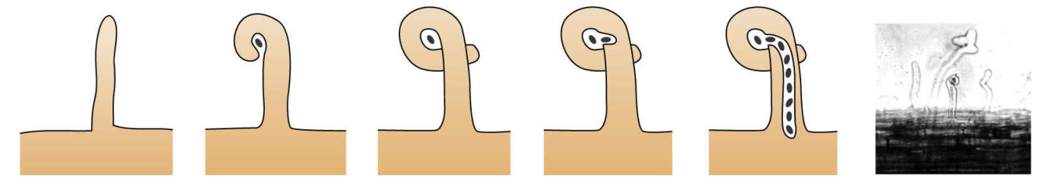
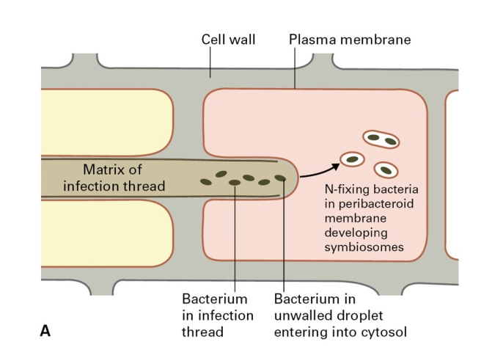
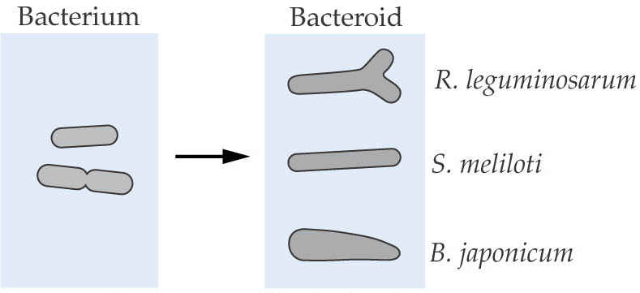
Nutrients
Nodule morphogenensis
In symbiosomes, bacteria differentiate into bacteroids

Slide 10
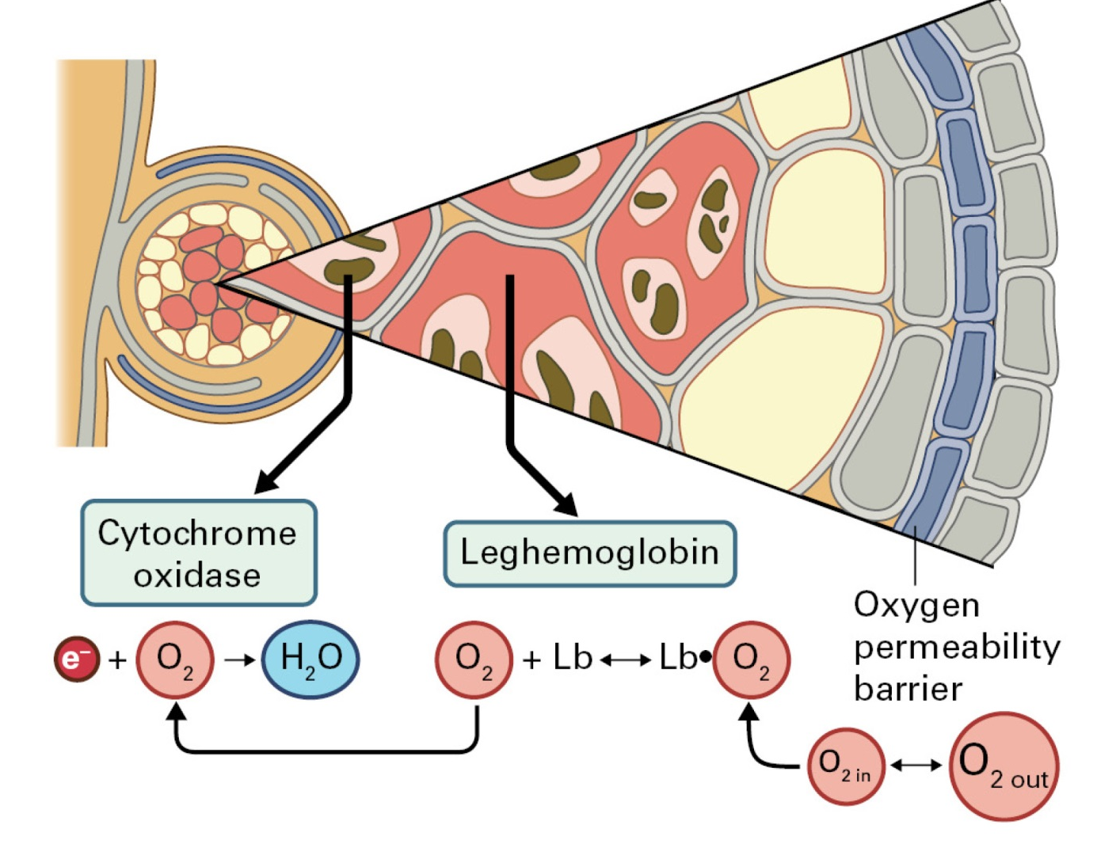
Nutrients
Microaerobic nodule environment is created
Carbon is provided to the bacteroids as dicarboxylic acids
oxidation of DCA provides ATP
DCA carbon backbones are used for nitrogen transport

Slide 11
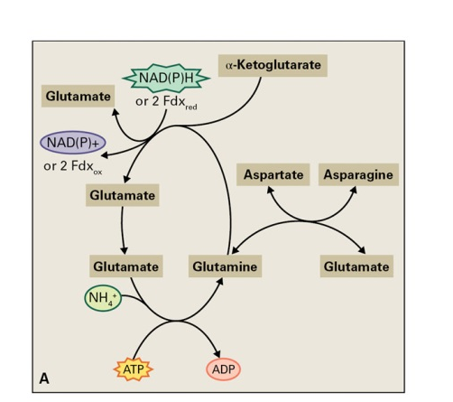
Nutrients
Ammonia assimilation
GS-GOGAT cycle

Slide 12
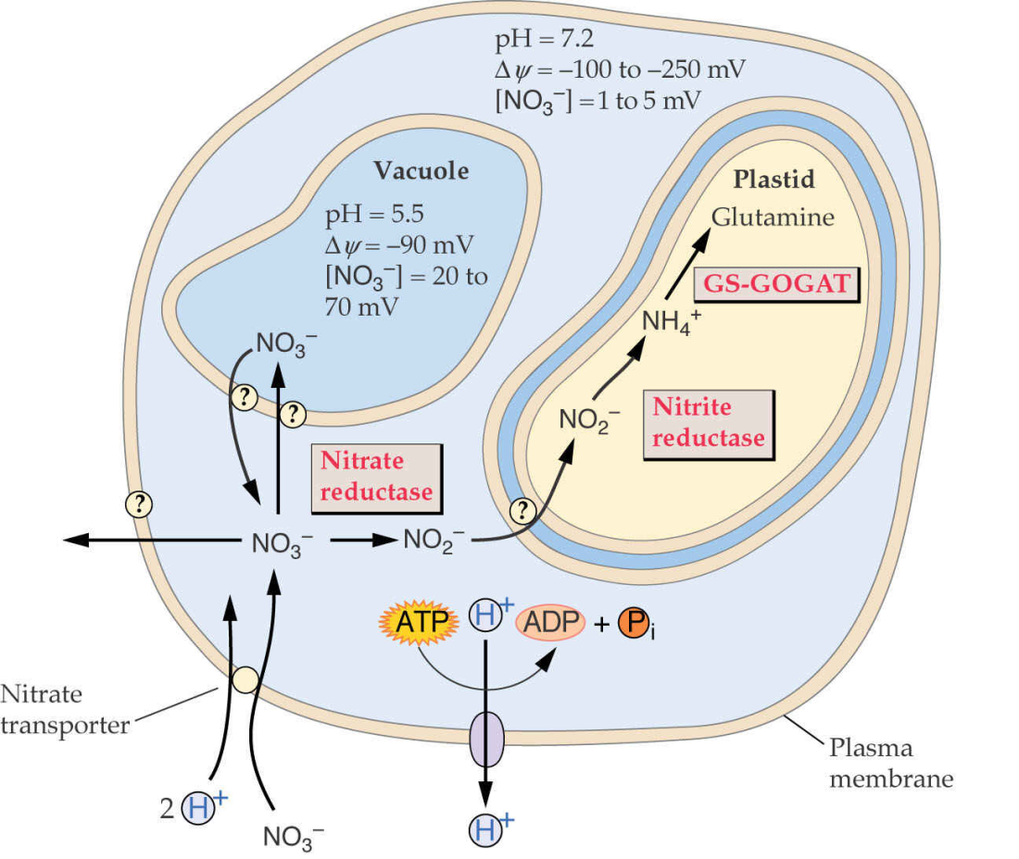
Nutrients
Nitrate assimilation

Slide 13
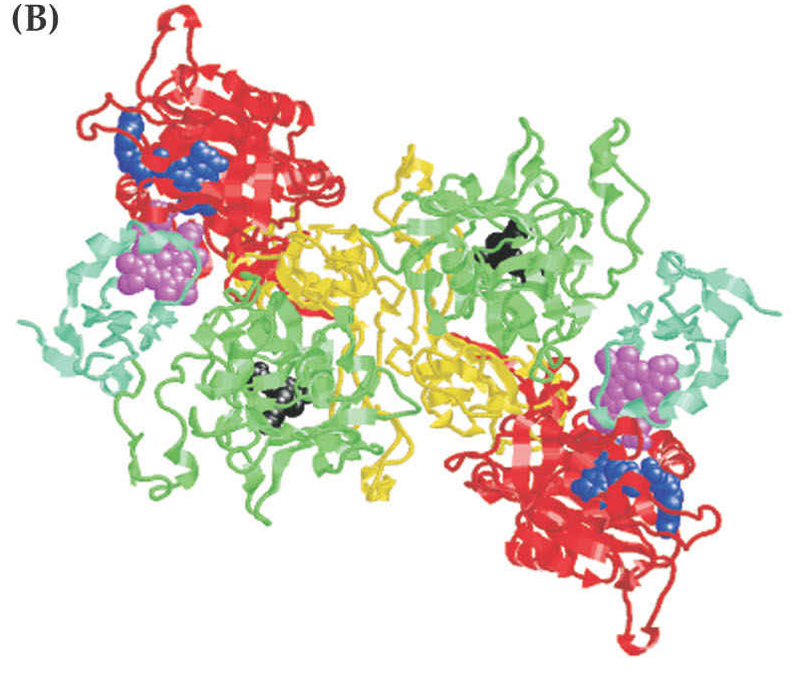
Nutrients
Nitrate reductase
NR reaction
NR homodimer
NO₃⁻ + NAD(P)H + H⁺
NO₂⁻ + NAD(P)⁺ + H₂O
NAD(P)H NAD(P)⁺ NO₃⁻ NO₂⁻
FAD
Heme
-Fe
MoCo
Hinge II Hinge I

Slide 14
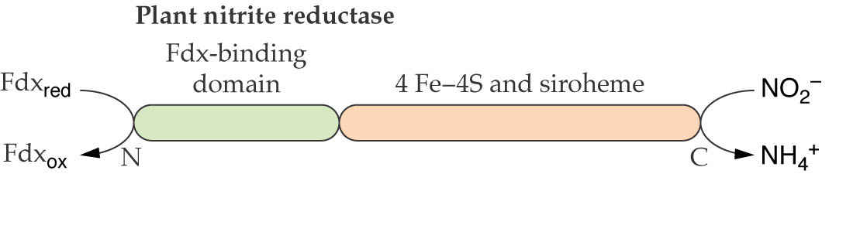
Nutrients
Nitrite reductase
NiR reaction
NO₂⁻ + 6 Fdx_{red} + 8 H⁺ NH₄⁺ + 6 Fdx_{ox} + 2 H₂O

Slide 15
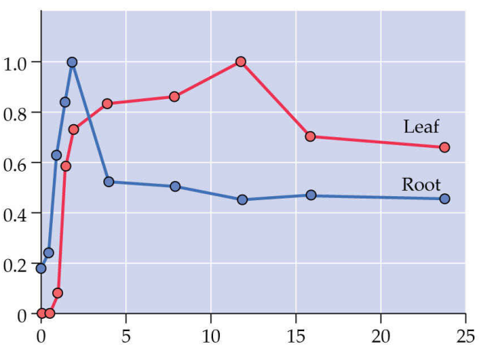
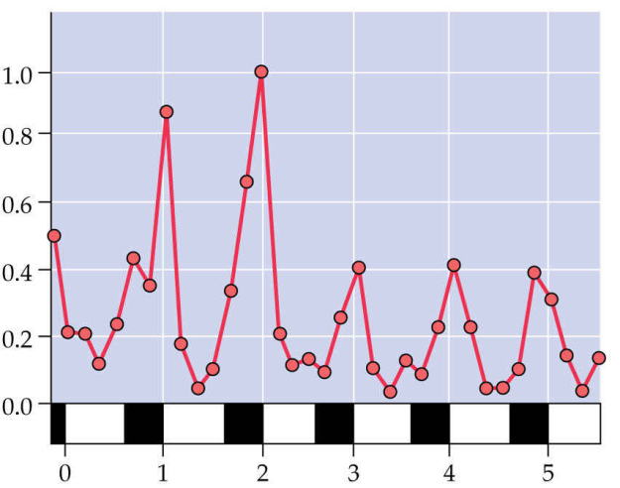
Nutrients
Regulation of nitrate assimilation
Relative NR mRNA abundance
Relative NR mRNA abundance
hours of nitrate exposure
days
nitrogen assimilation into amino acids
nitrate
light
CO₂

Slide 16
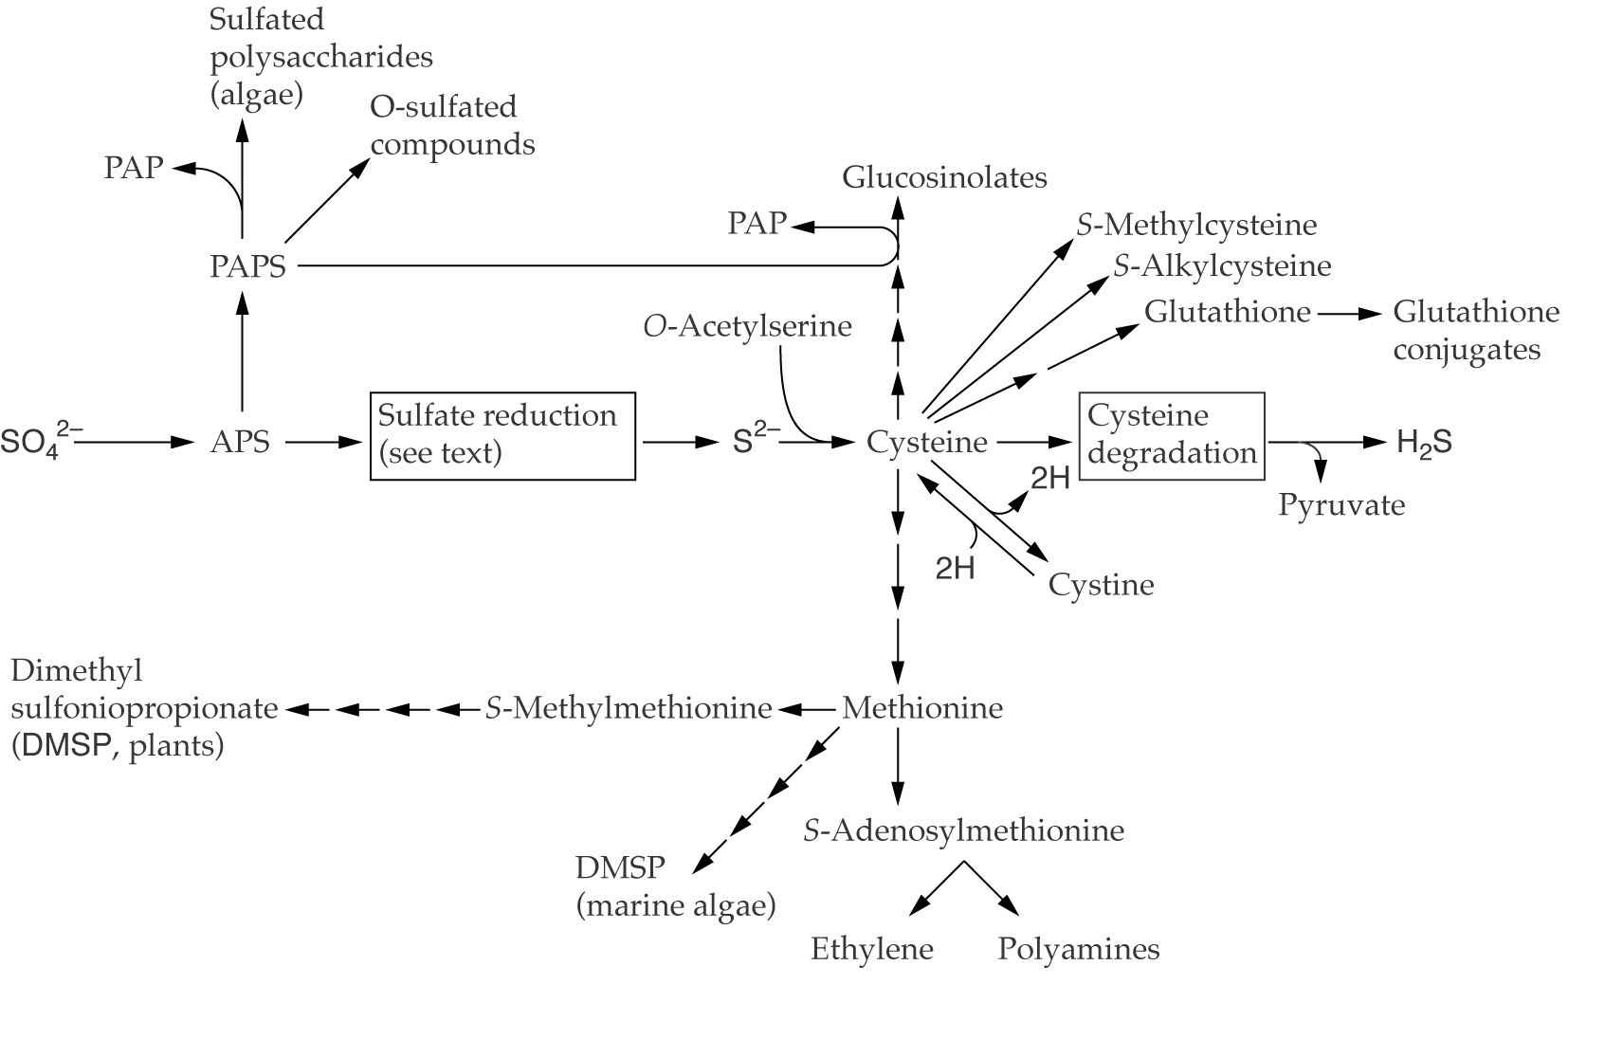
Nutrients
Sulfur
APS – 5-adenylylsulfate
PAPS – 3´phosphoadenosine-5´-phosphosulfate,

Slide 17
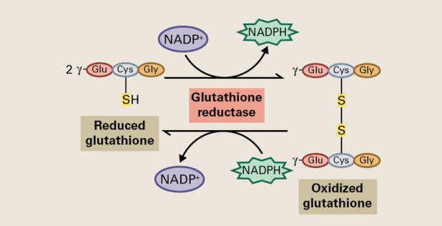
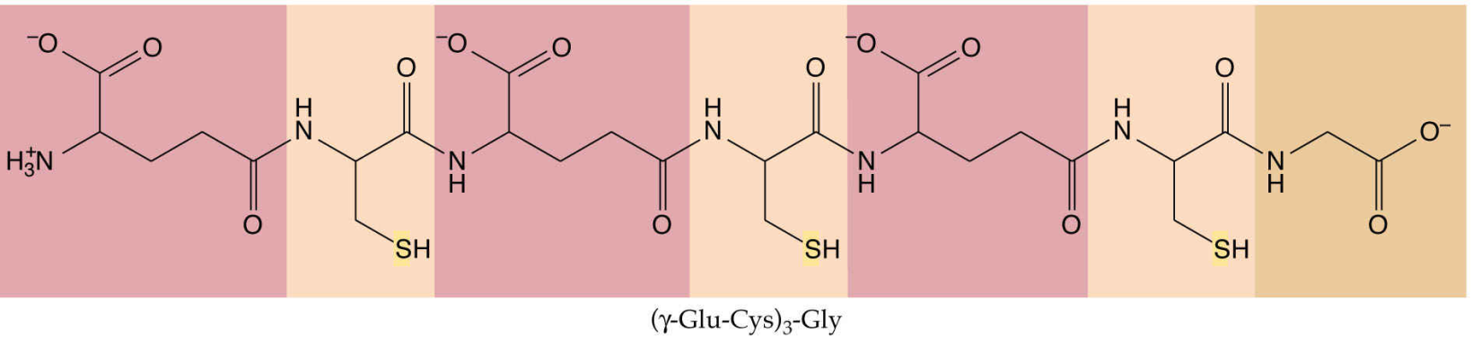
Nutrients
Phytochelatin molecule

Slide 18
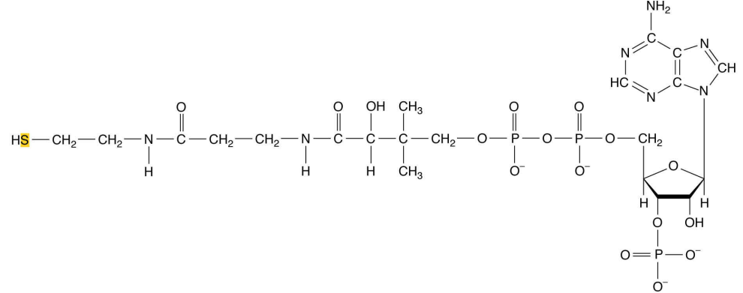
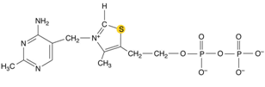
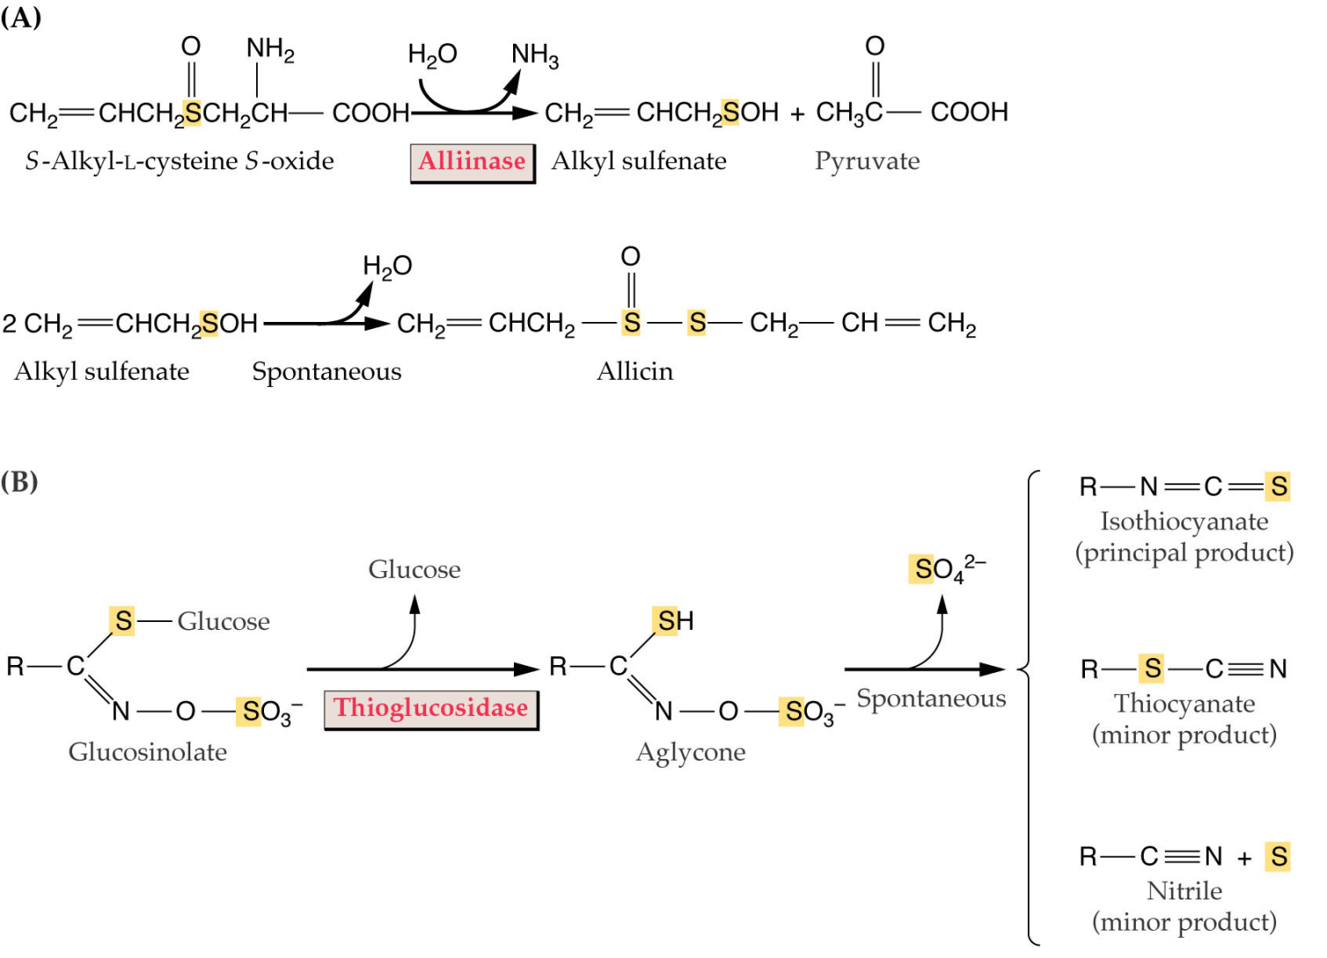
Nutrients
Thiamine pyrophosphate
Coenzyme A

Slide 19
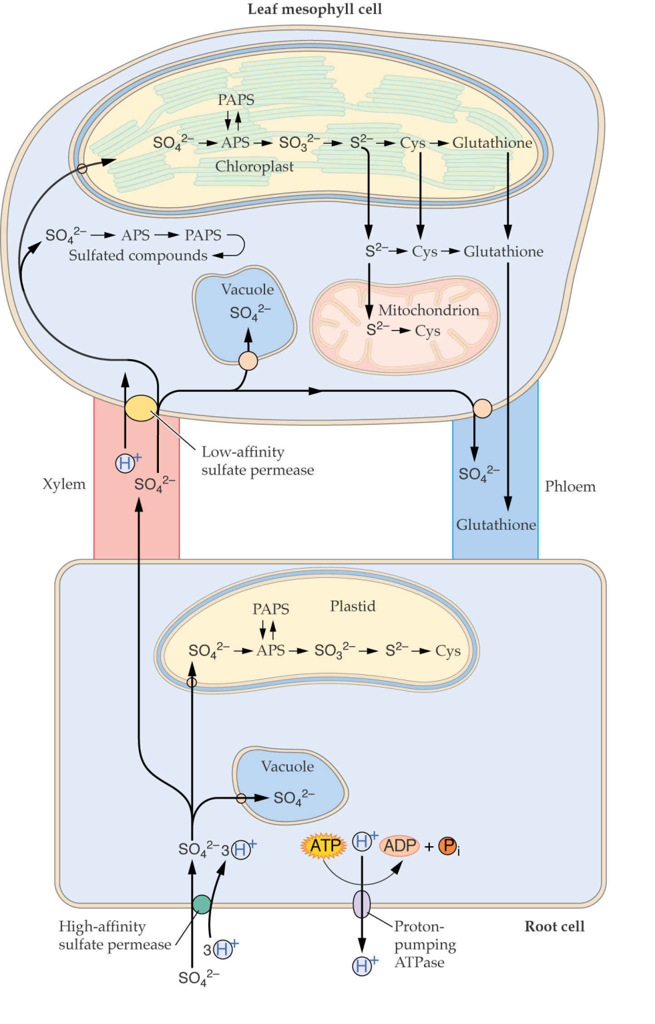
Nutrients

Slide 20
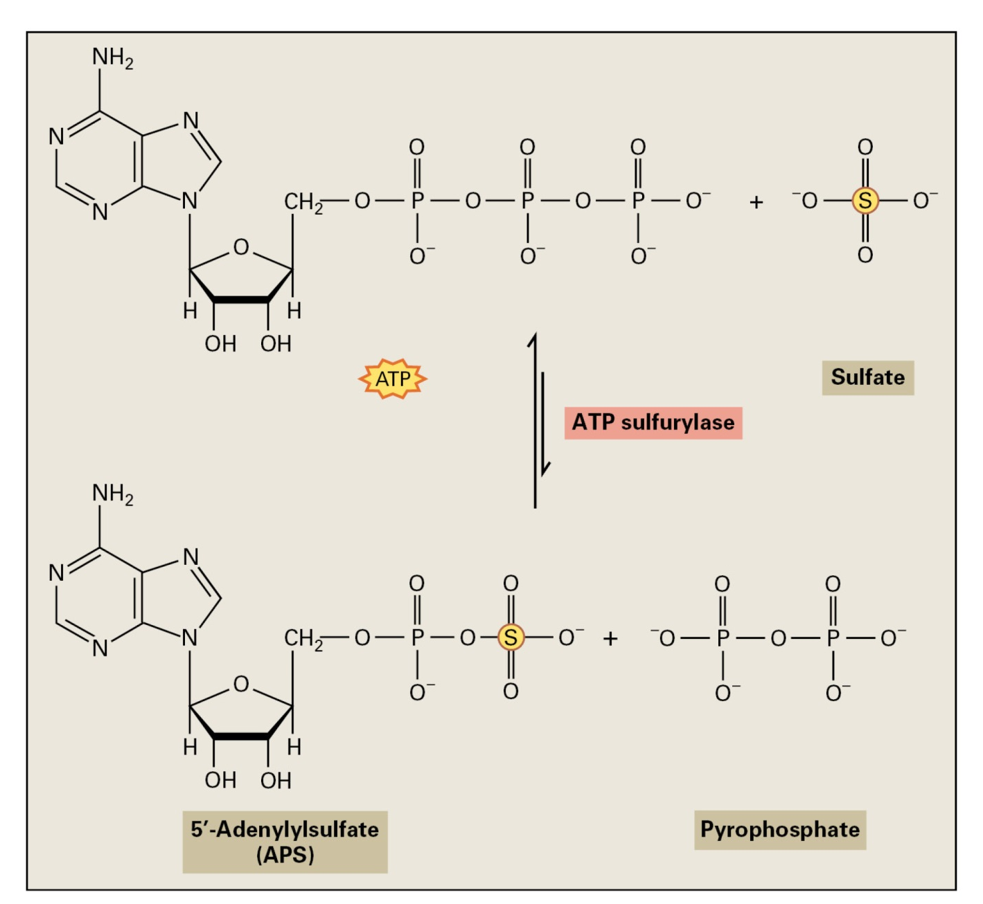
Nutrients
Sulfate activation

Slide 21
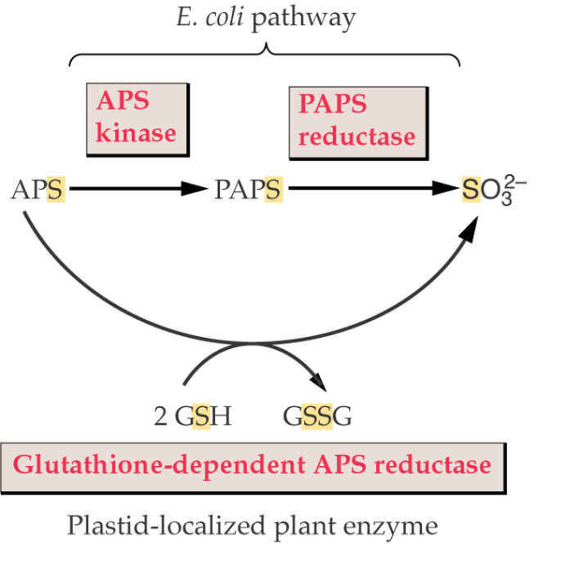
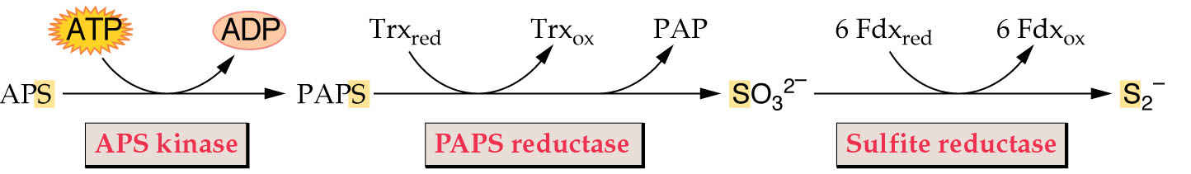
Nutrients
Sulfate reduction to sulfide

Slide 22
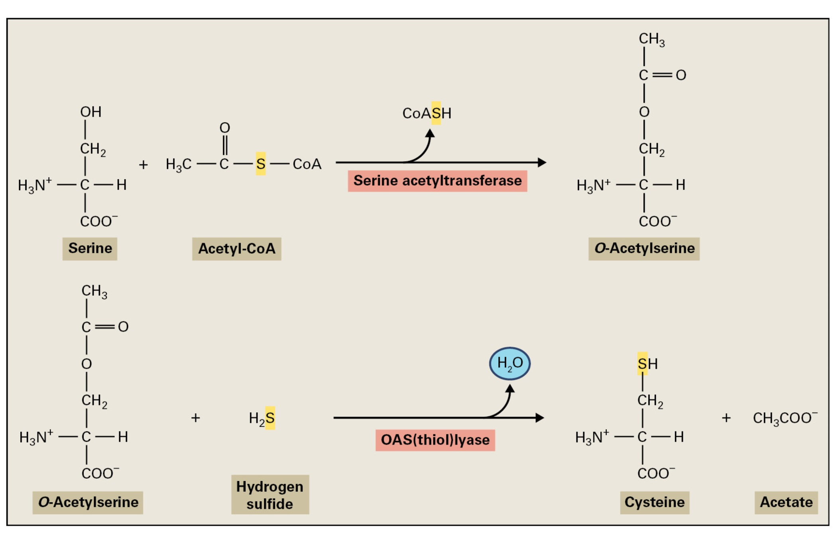
Nutrients
Cysteine synthesis

Slide 23
Nutrients
Regulation of sulfate assimilation
Sulfur assimilation is not strongly regulated by light
the enzymes are also active in etiolated plants and do not demonstrate diurnal oscillations
Sulfur assimilation is regulated by developmental stage
all the enzymes are highly active in young leaves and root tips
Sulfur assimilation is regulated in response to the availability of sulfur
sulfur starvation results in the up-regulation of sulfate transport and APS reductase
The content of reduced sulfur and nitrogen is strictly coordinated
Sulfite and sulfide are not allowed to accumulate

Slide 24
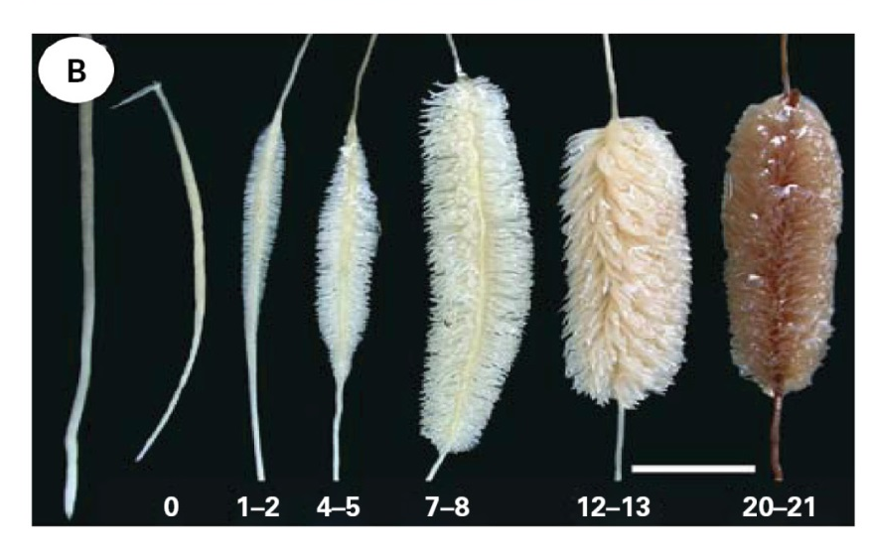
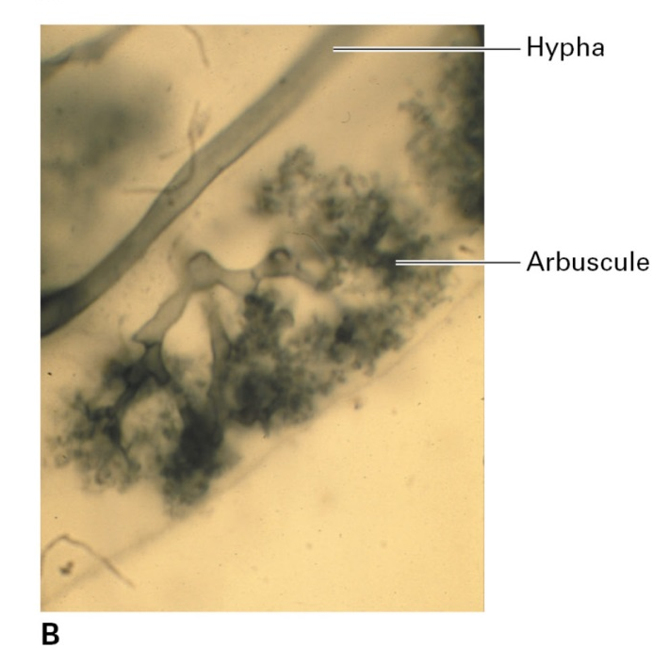
Nutrients
Phosphorus
Root modifications in low Pi concentration, days
Phosphate functions:
component of nucleic acids and phospholipids
energy conversion (ATP)
regulation
Endomycorrhizae

