Slide 1
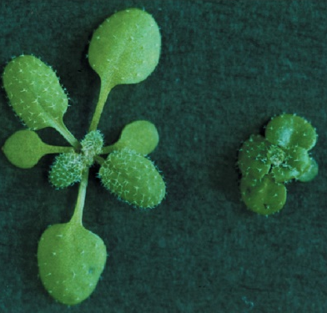
Hormones and Signal Transduction
Katerina Dadakova, Department of Biochemistry
1
Figures adopted from Buchanan et al., Biochemistry & molecular biology of plants

Slide 2
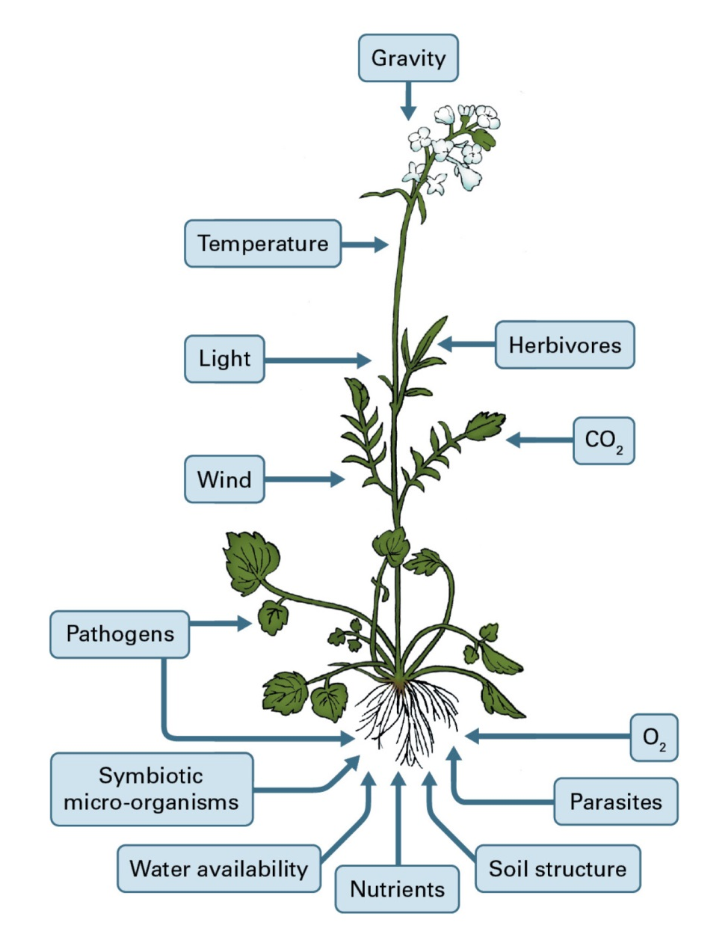
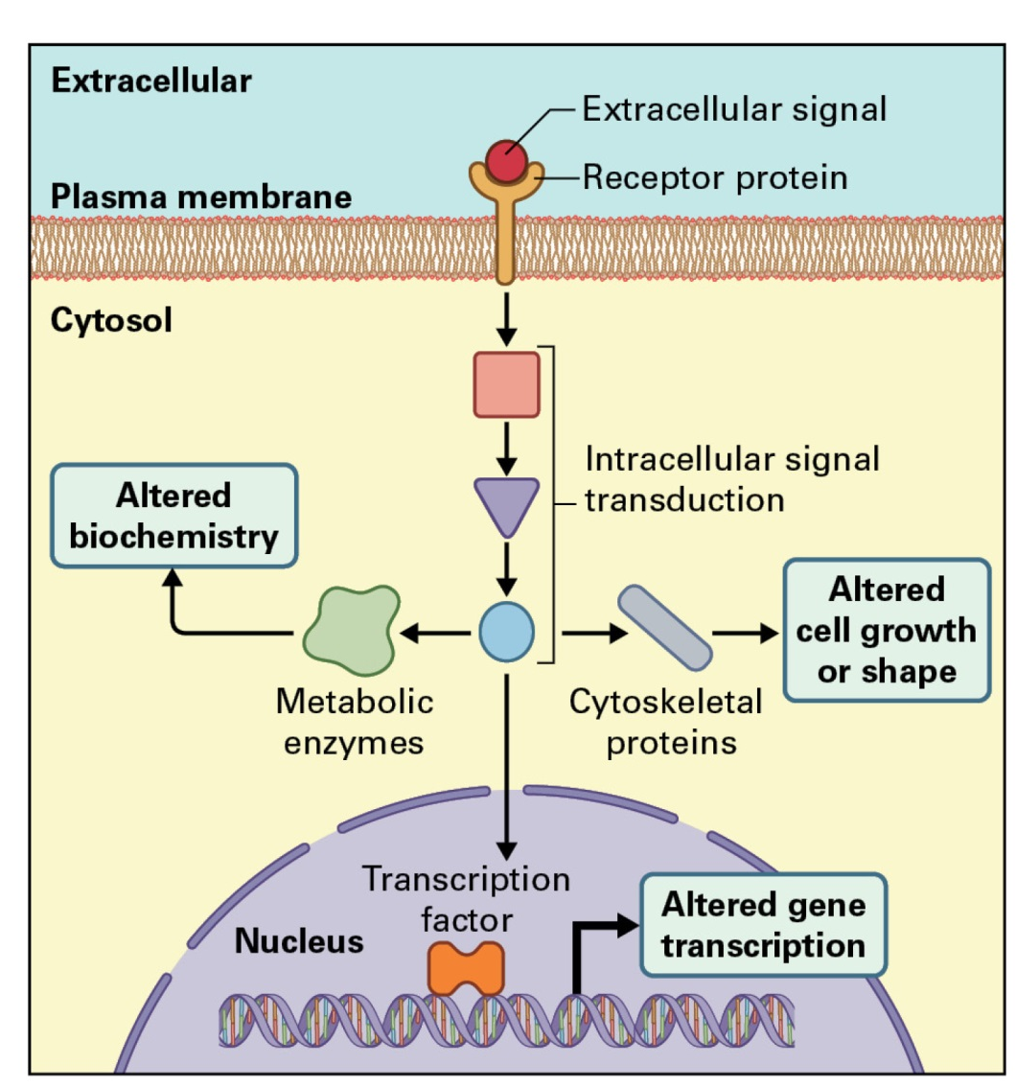
Hormones and Signal Transduction
Signal transduction

Slide 3
Hormones and Signal Transduction
Signal perception
Symplast
RNA
transcription factors
Apoplast
Plasma mebrane receptors
Intracellular receptors
ethylene
auxin
gibberellin
light
G-protein-coupled receptors
Ion channels
Receptor
kinases
brassinosteroids

Slide 4
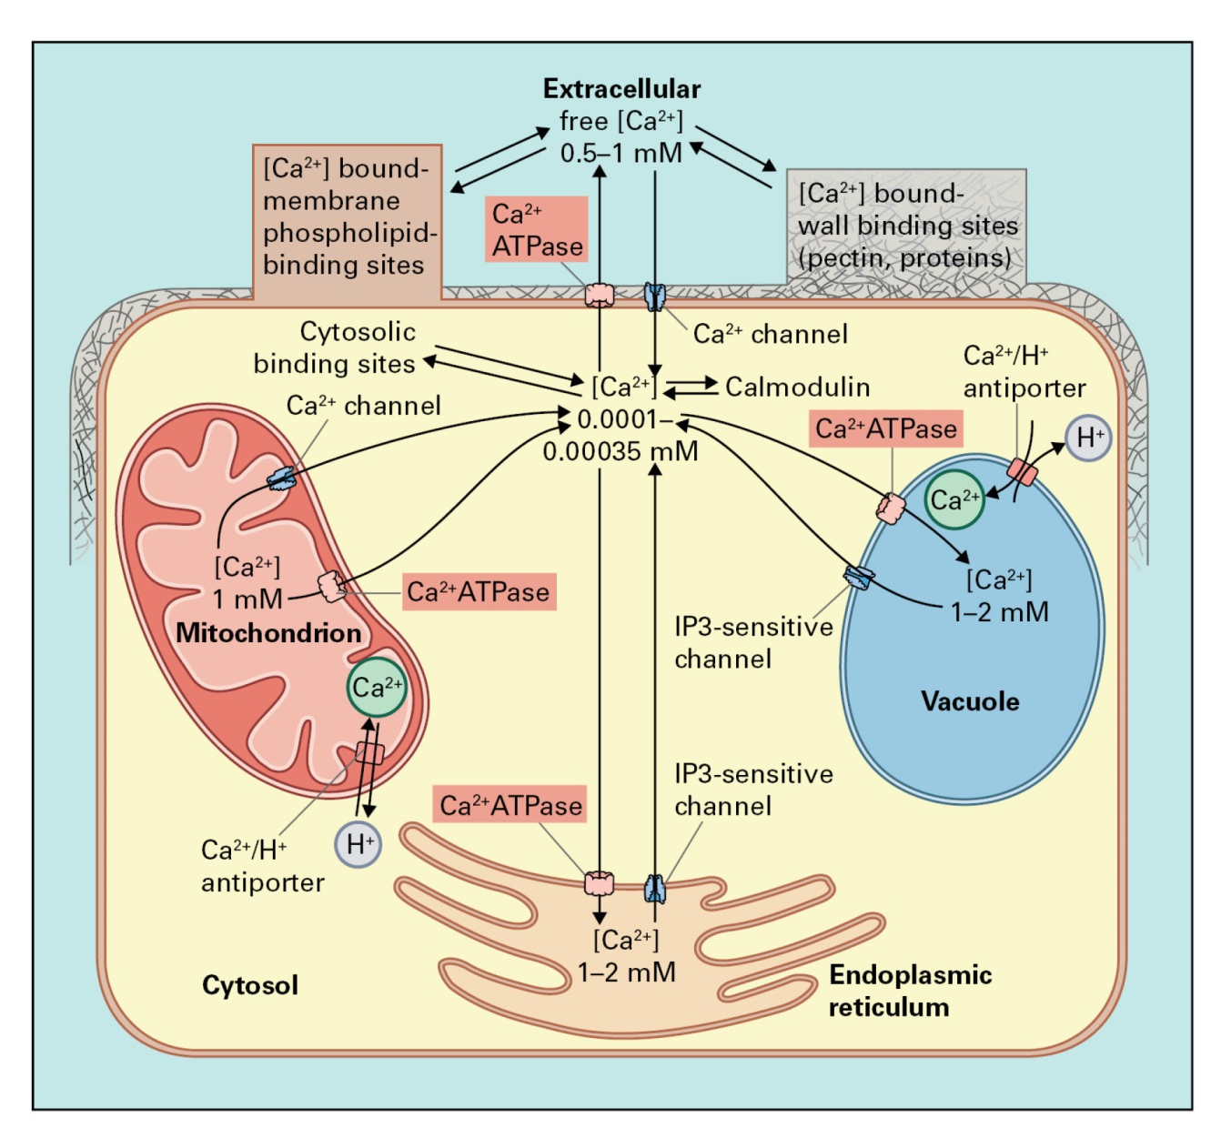
Hormones and Signal Transduction
Second messengers

Slide 5
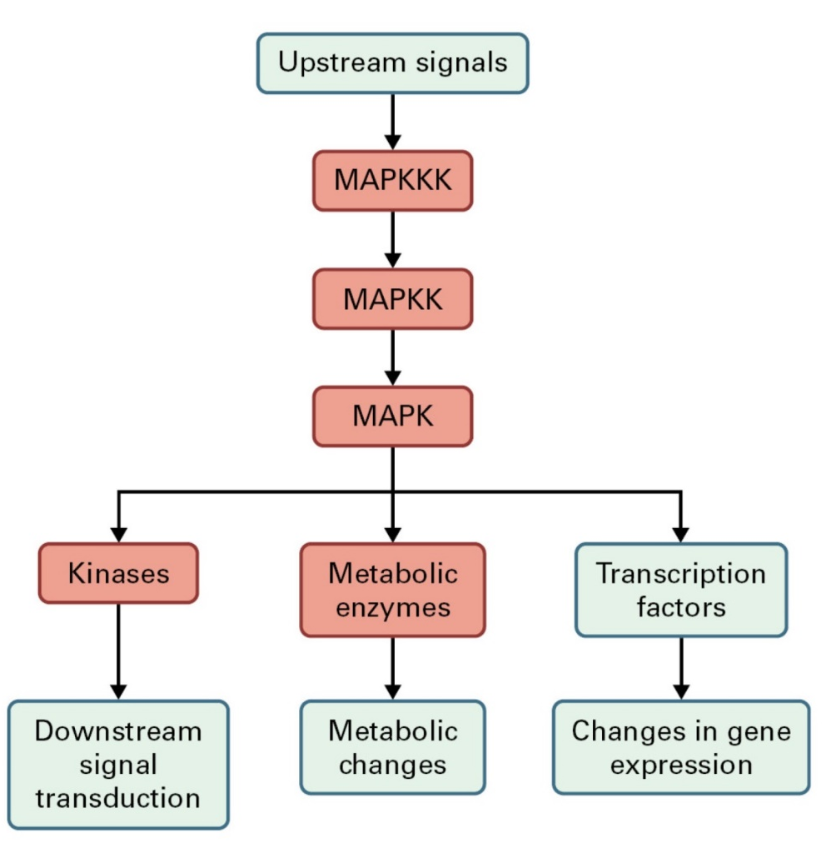
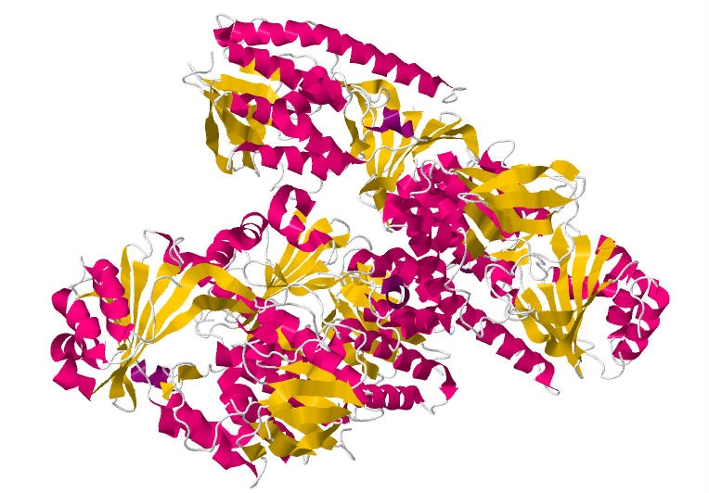
Hormones and Signal Transduction
MAPK cascades and Phytohormones
Monooxygenase
By Jmol Development Team/Briana Miller - Jmol, GPL, https://commons.wikimedia.org/w/index.php?curid=15026248

Slide 6
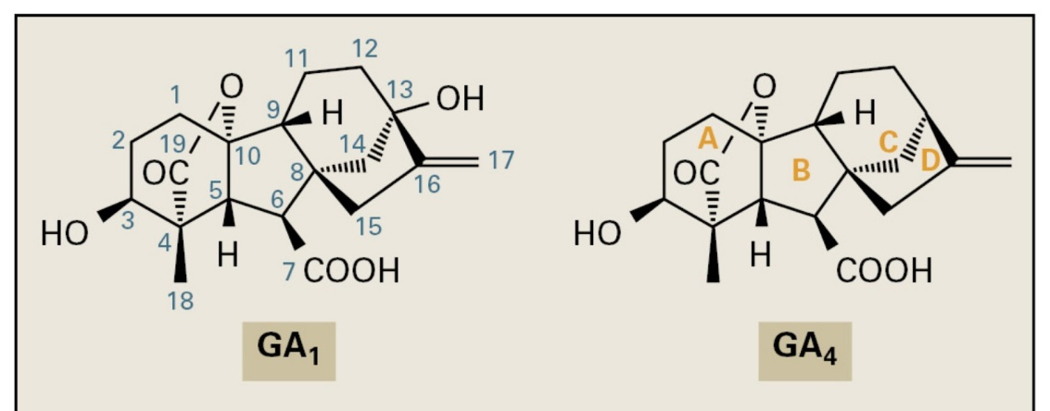
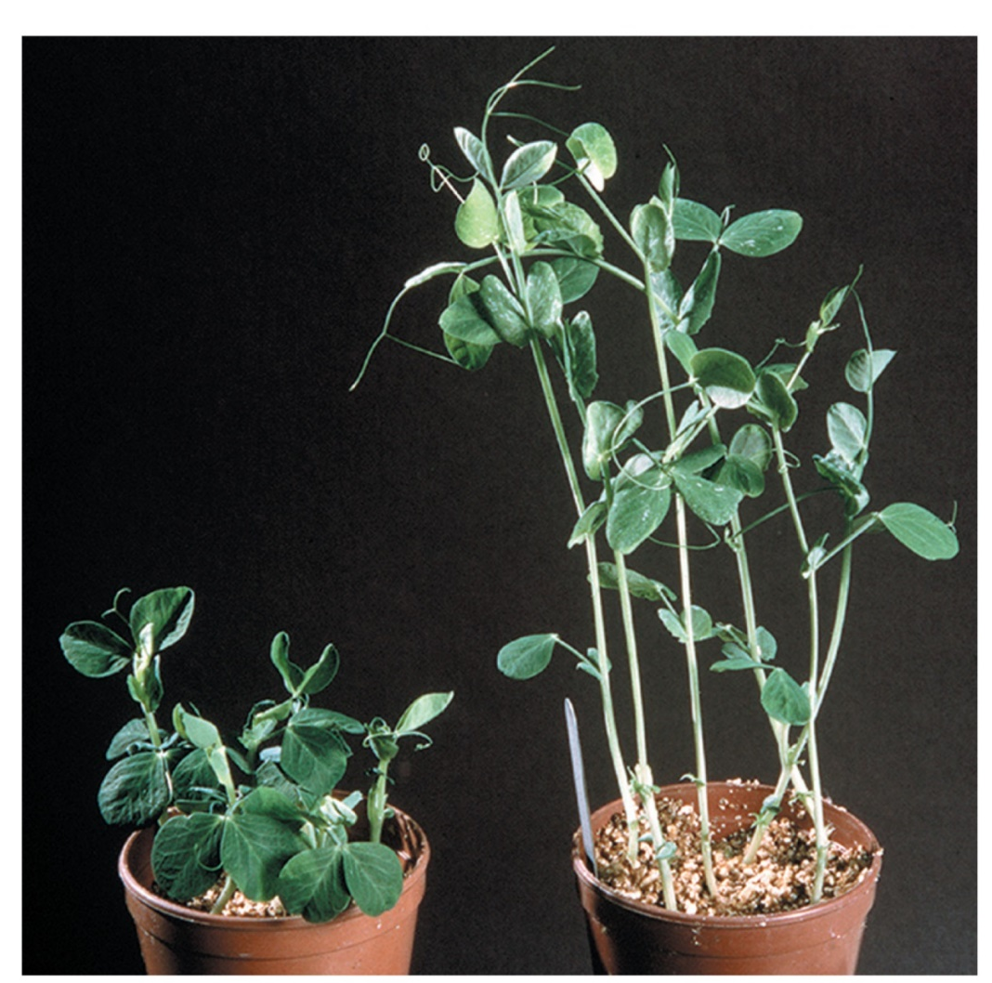
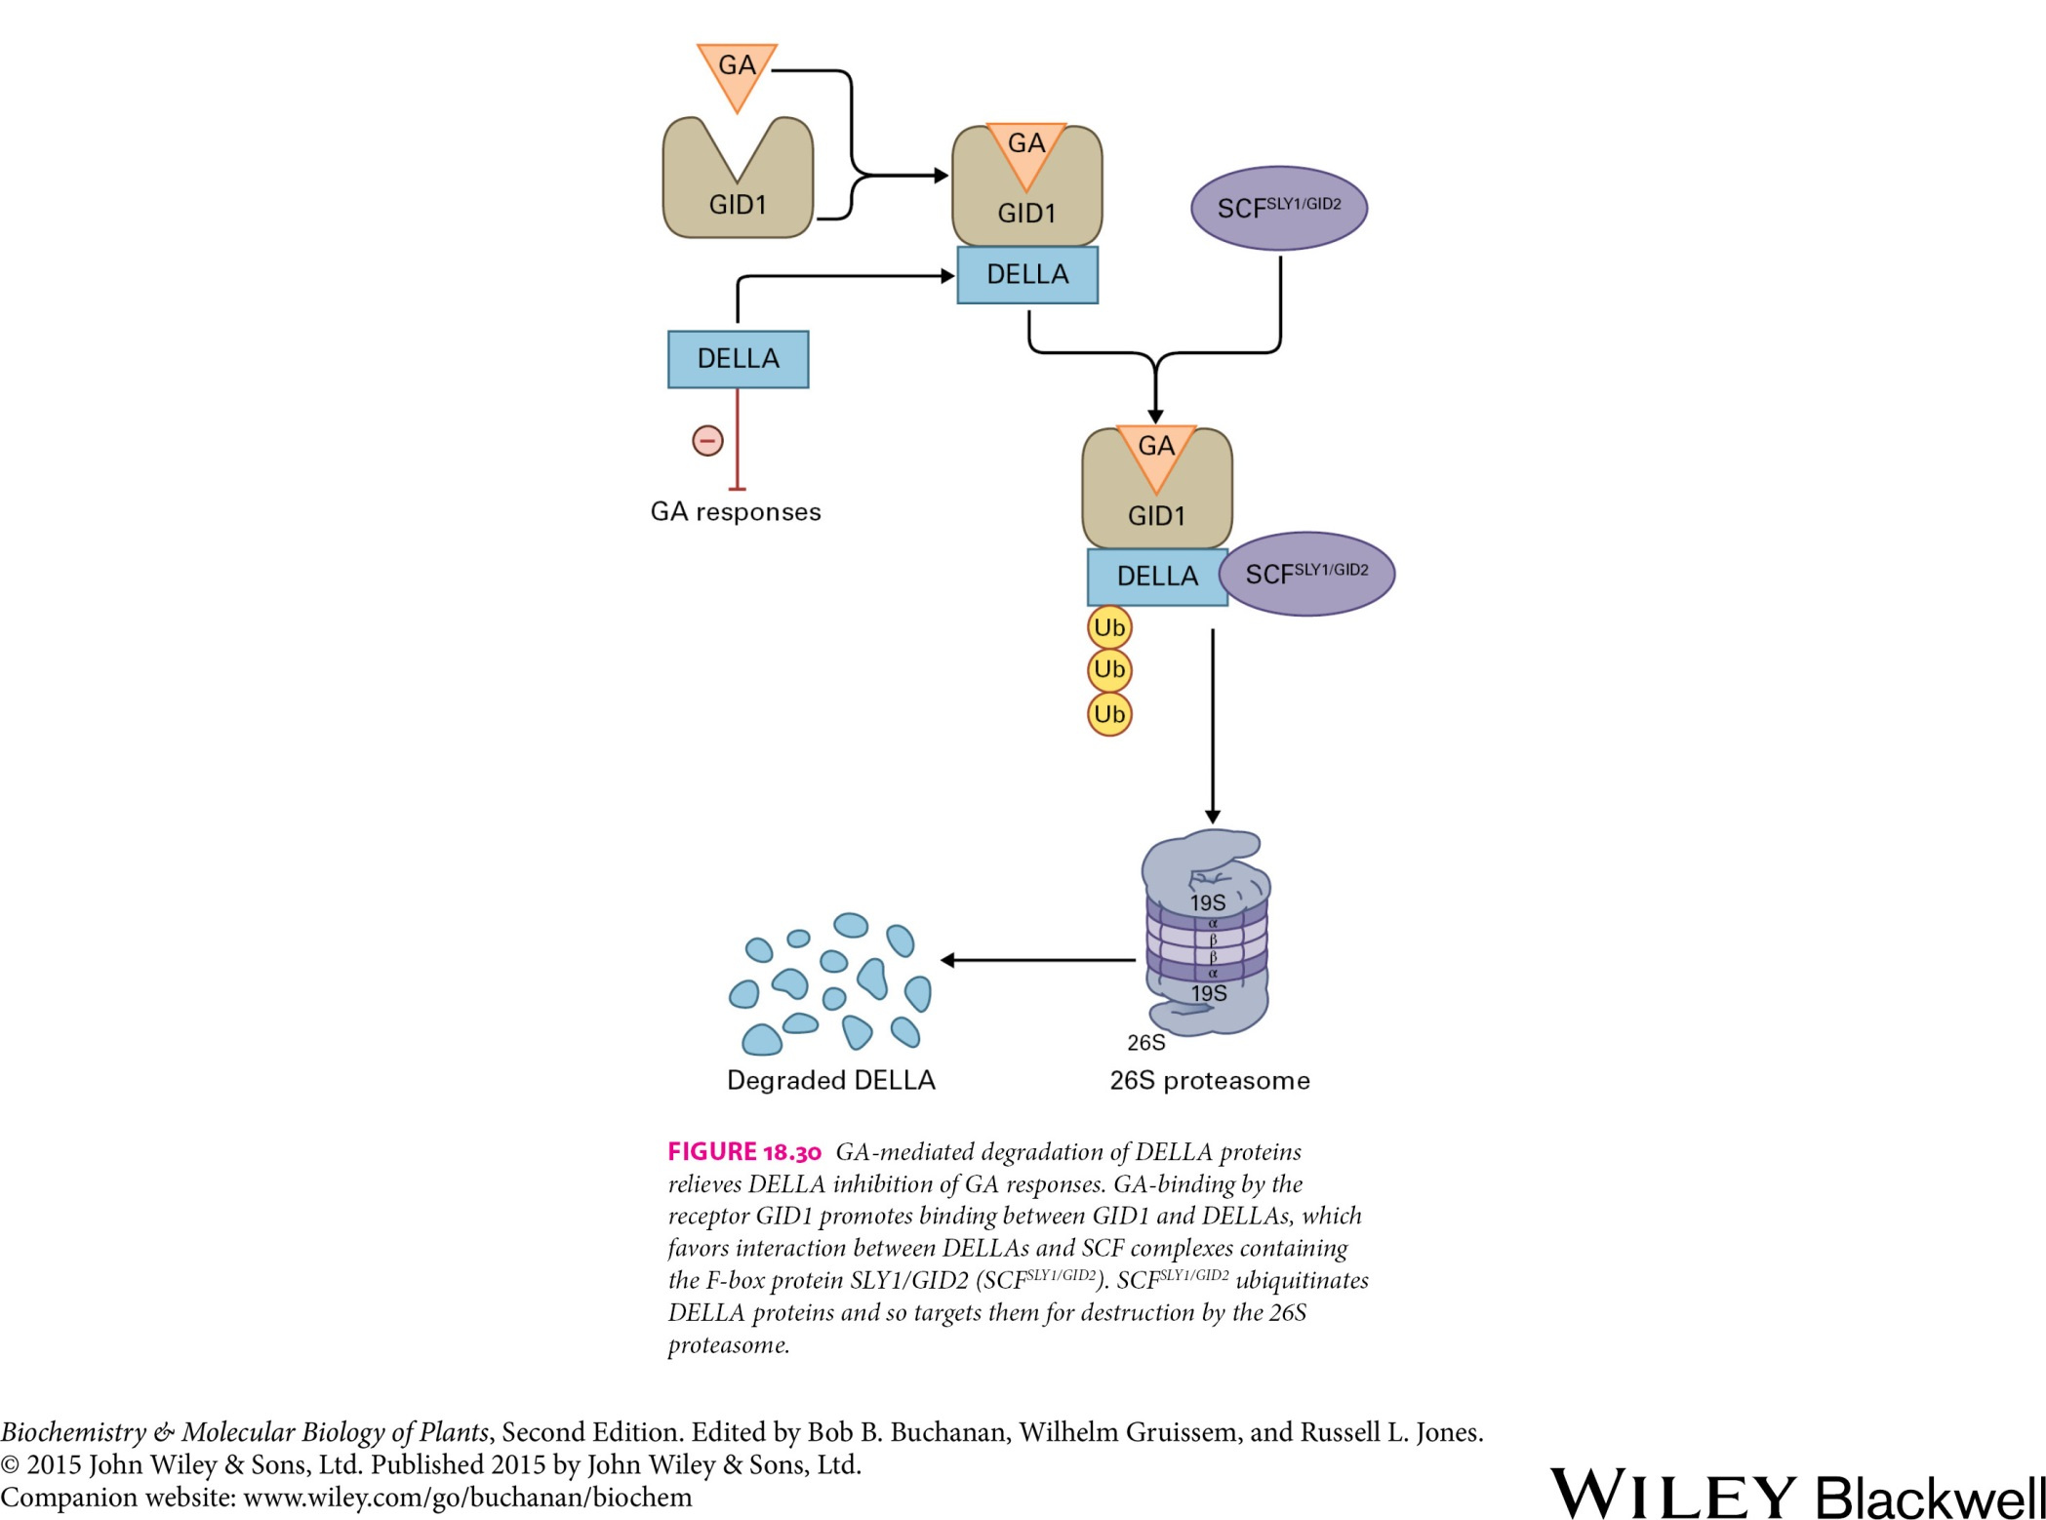
Hormones and Signal Transduction
Gibberellins
Effect of GA₃ on stem elongation.
left: control plant
right: plant 7 days after treatment with GA₃

Slide 7
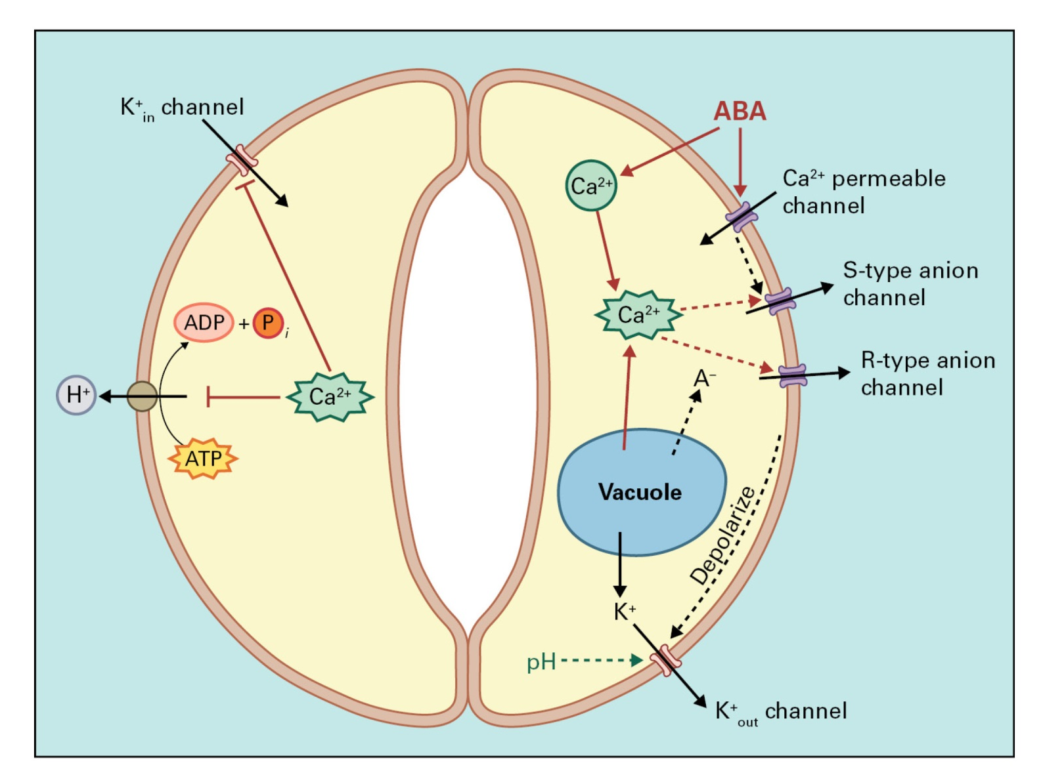
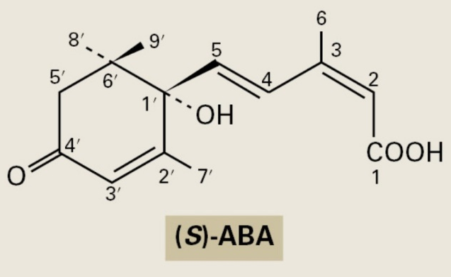
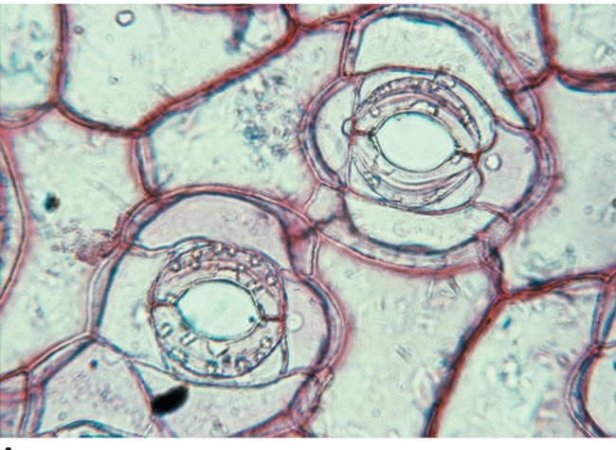

Hormones and Signal Transduction
Abscisic acid

Slide 8
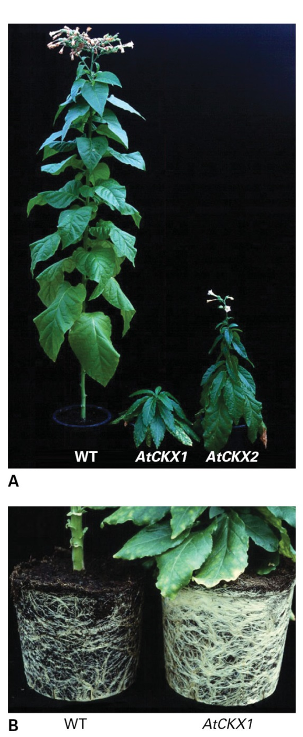
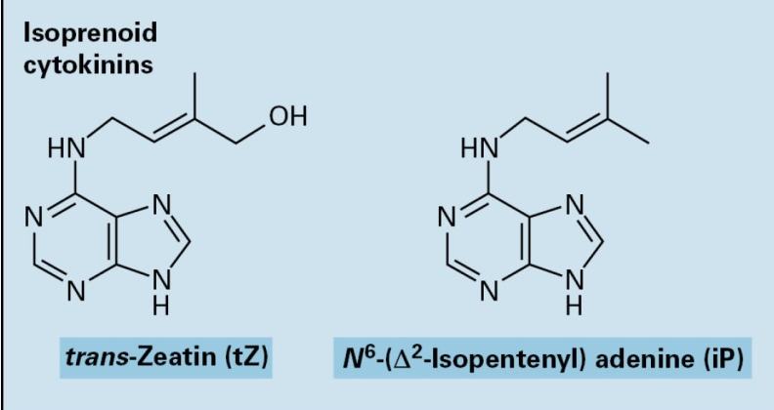
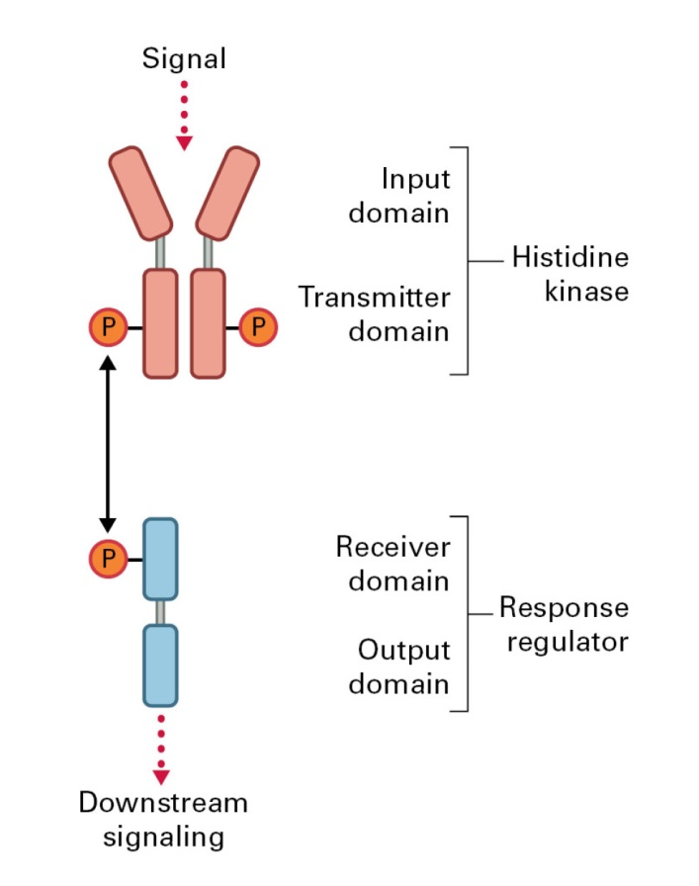
Hormones and Signal Transduction
Cytokinins
The two-component system
Transgenic plants AtCKX have lower CK content compared to wild-type.

Slide 9
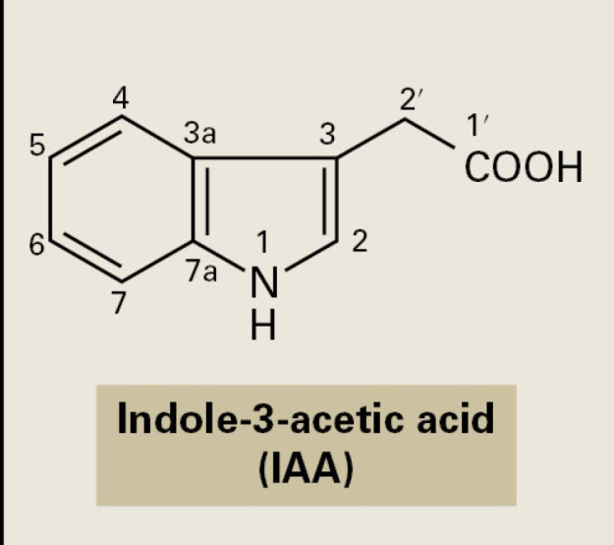
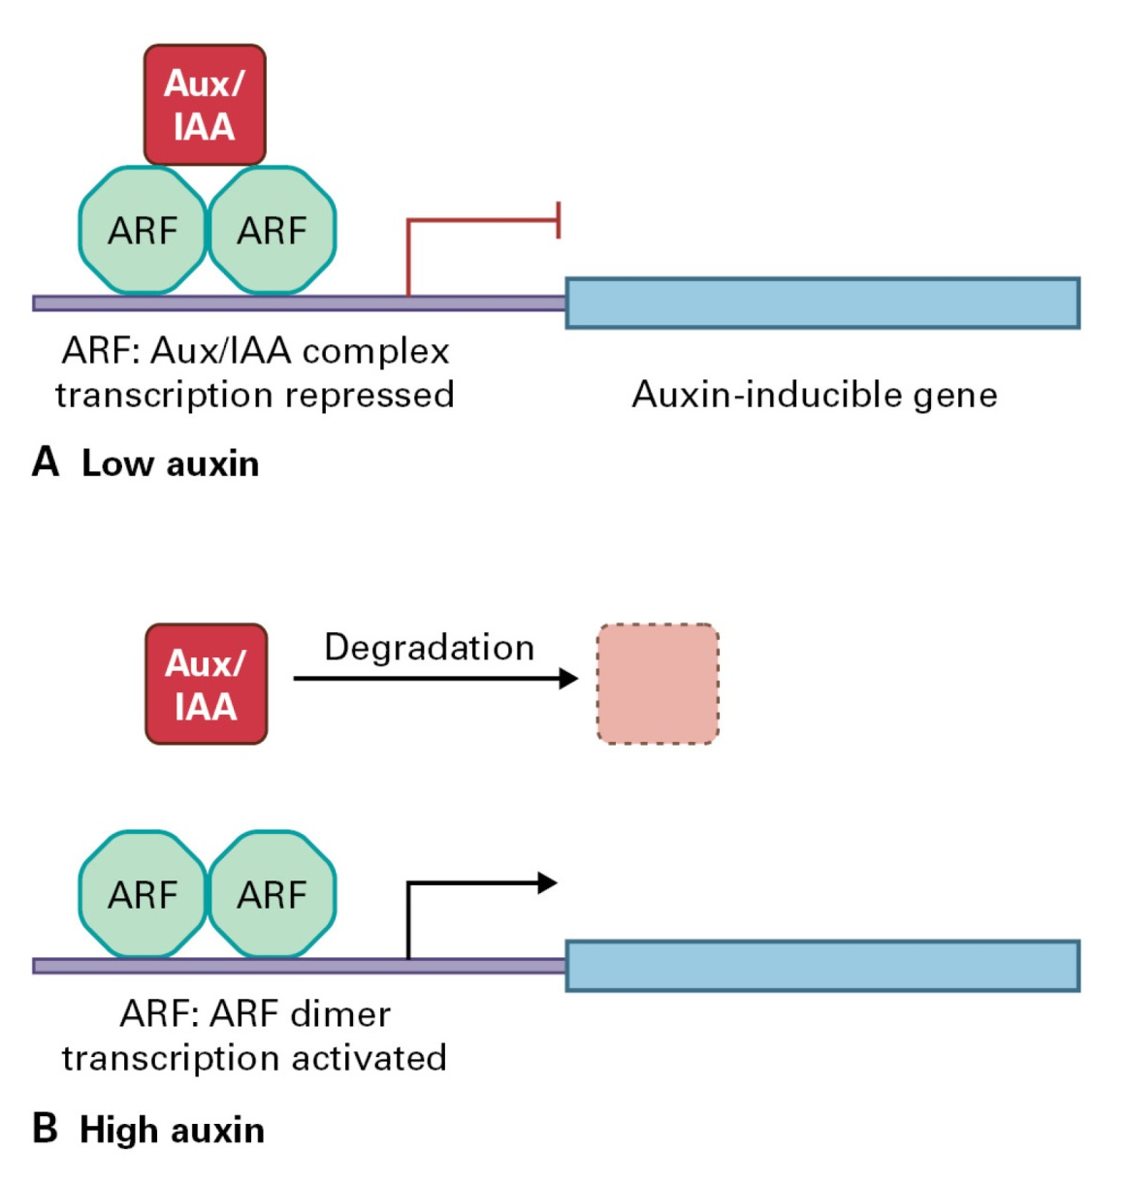
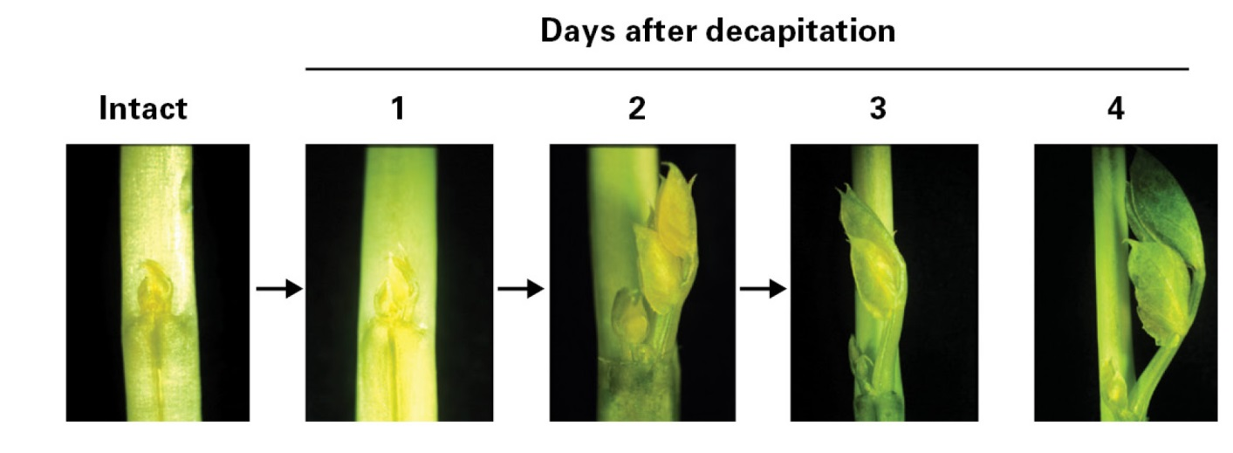
Hormones and Signal Transduction
Auxin

Slide 10
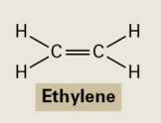
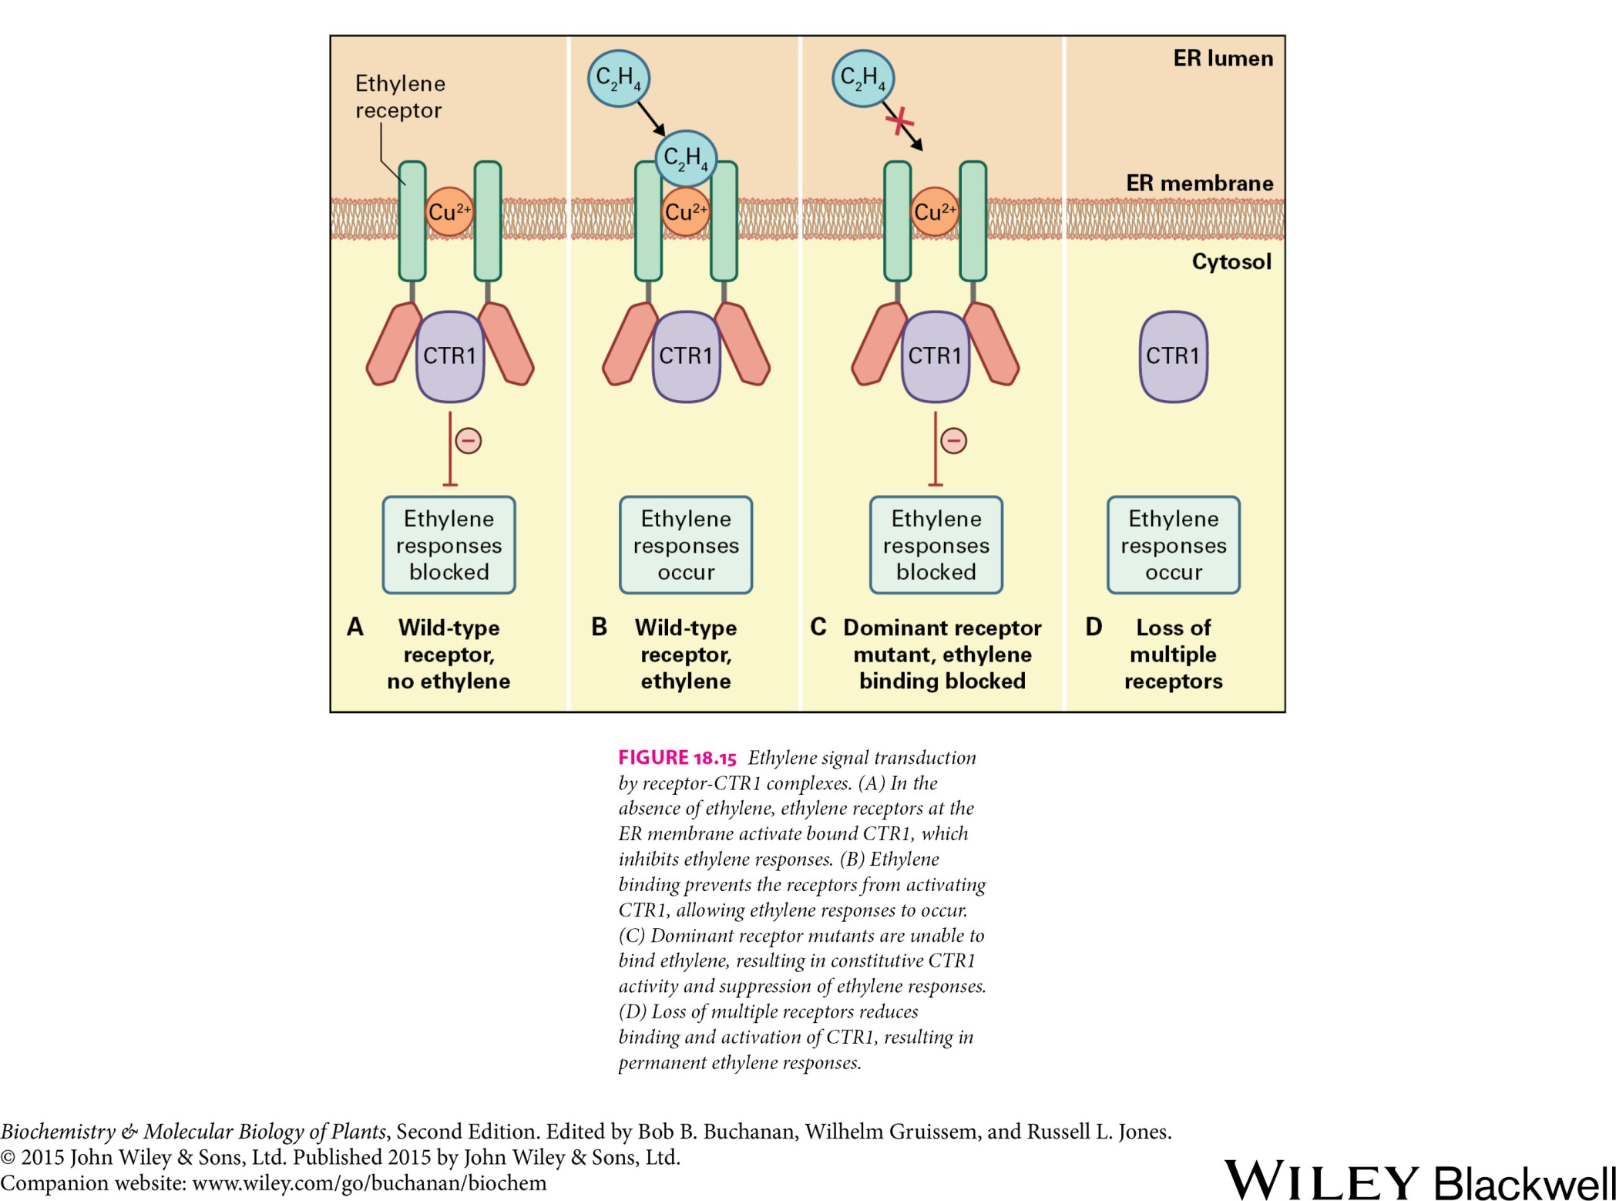
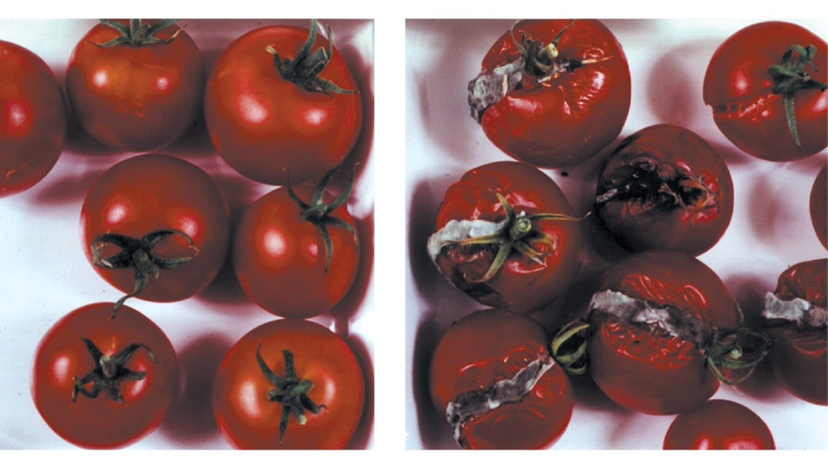
Hormones and Signal Transduction
Ethylene
Left: Fruits, which generate about 5 % of normal amount of ethylene. Right: Fruits, which produce normal amounts of ethylene.

Slide 11
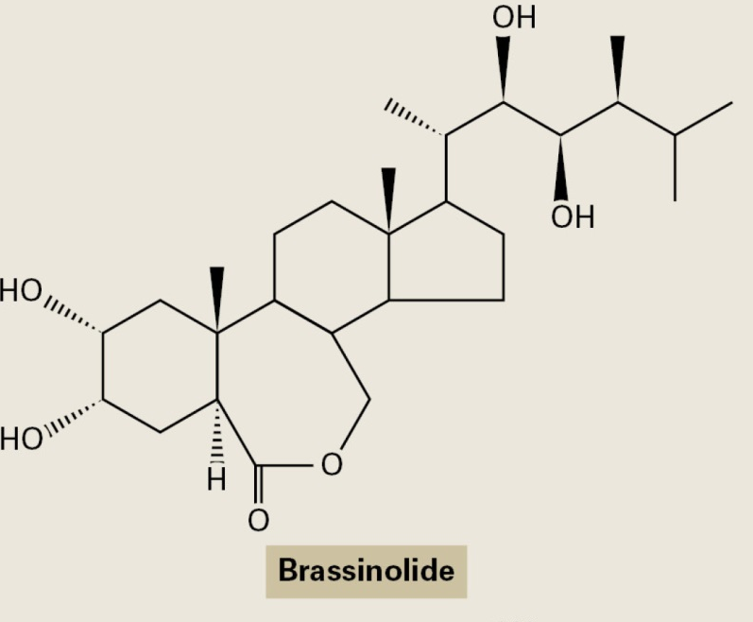

Hormones and Signal Transduction
Brassinosteroids
Wild-type and BL-defficient Arabidopsis plant

Slide 12
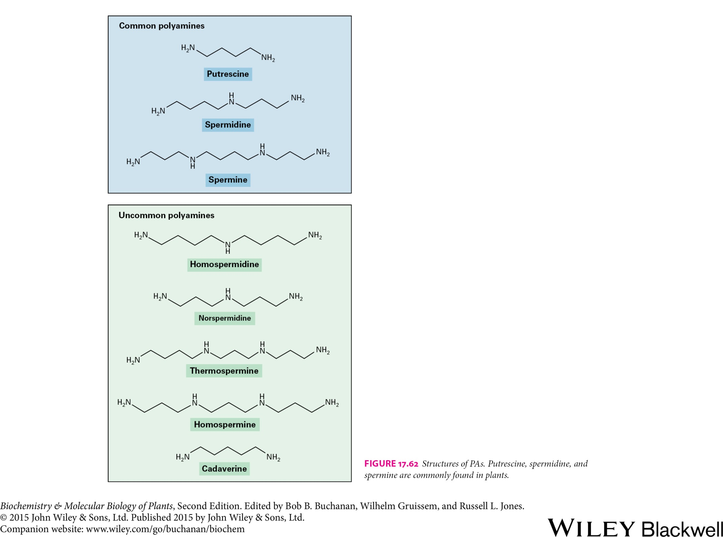
Hormones and Signal Transduction
Polyamines

Slide 13
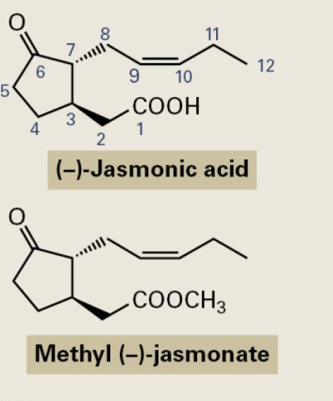
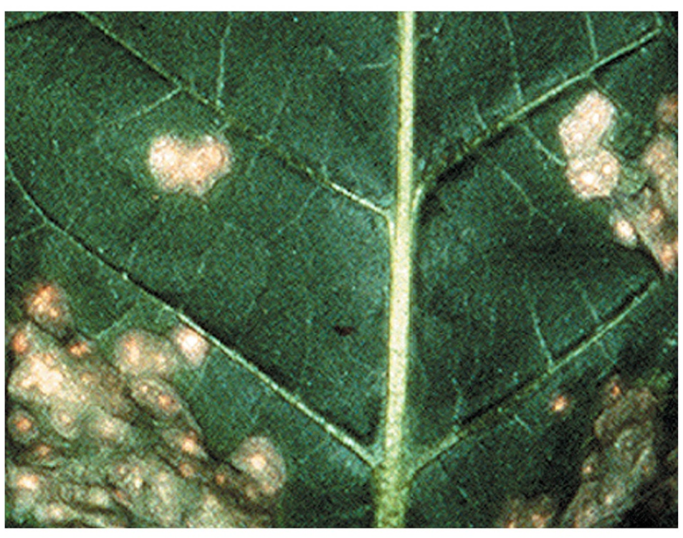
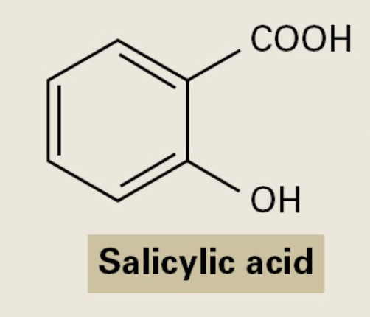
Hormones and Signal Transduction
Jasmonic acid and Salicylic acid
Necrotic lesions on the leaf of tobacco

Slide 14
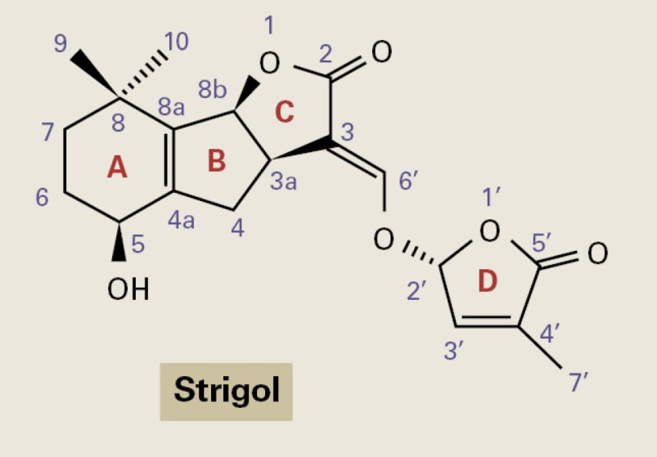
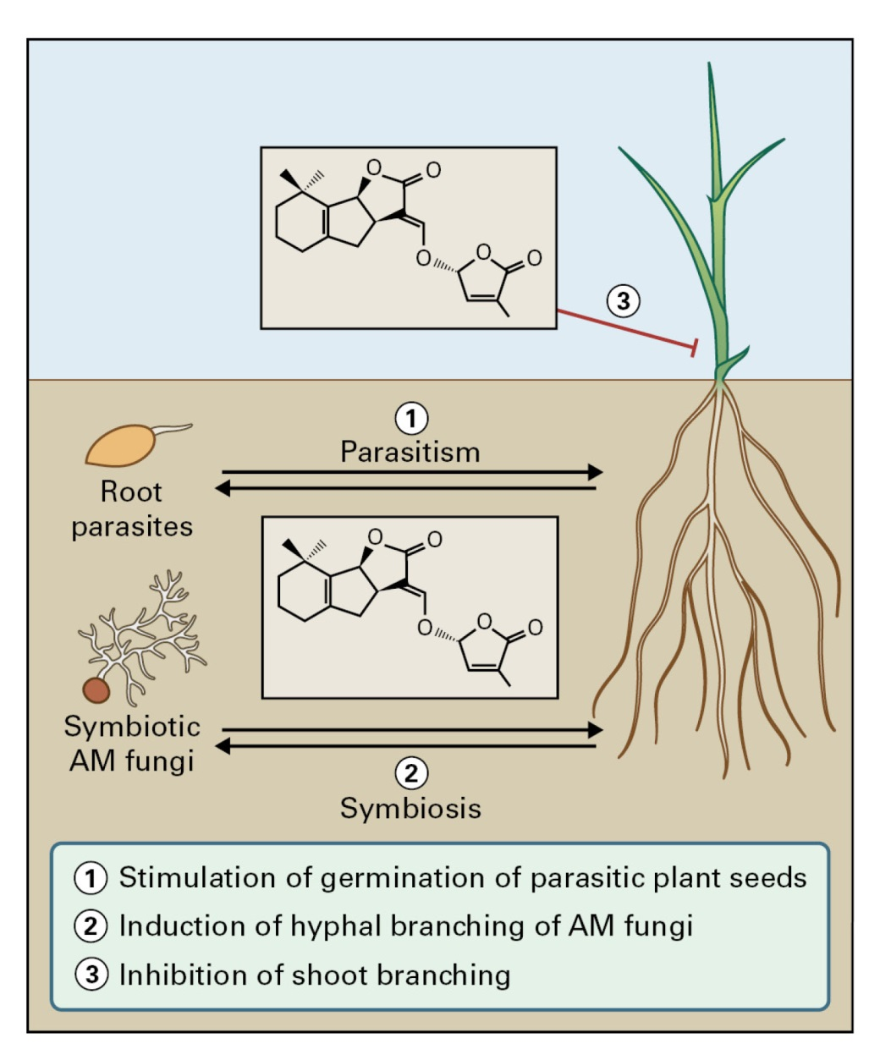
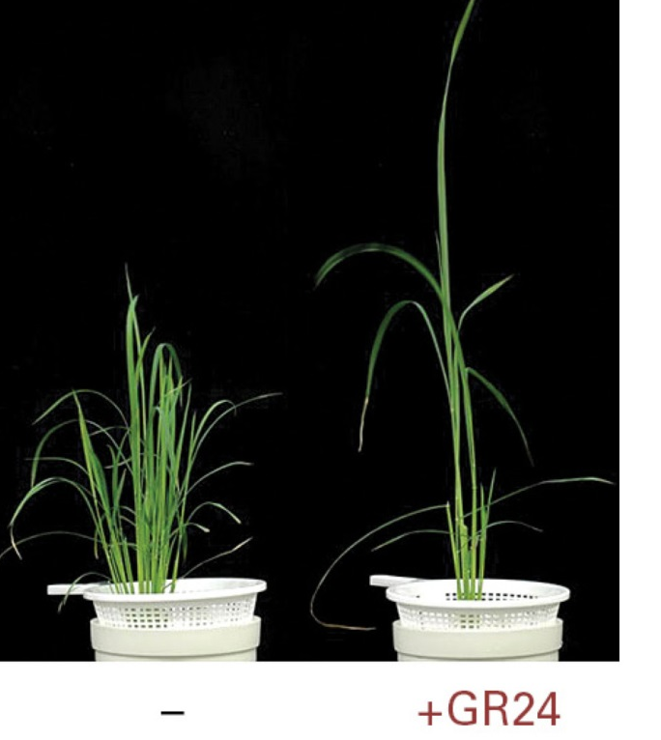
Hormones and Signal Transduction
Strigolactones

Slide 15
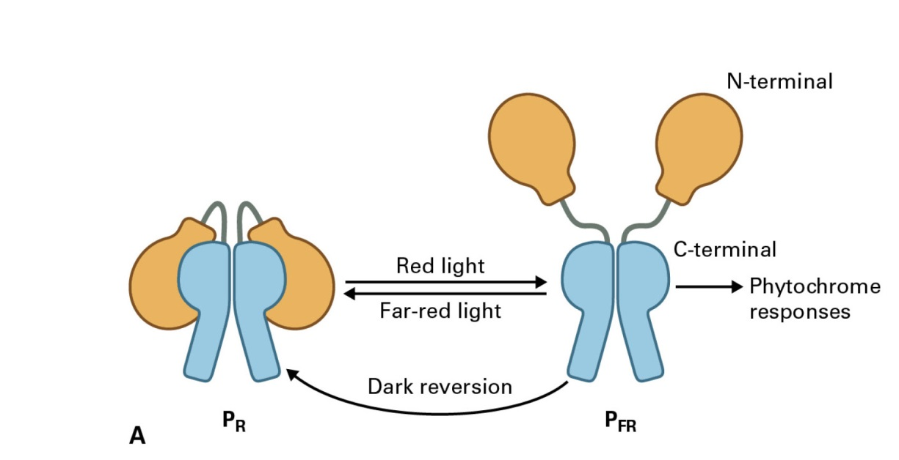
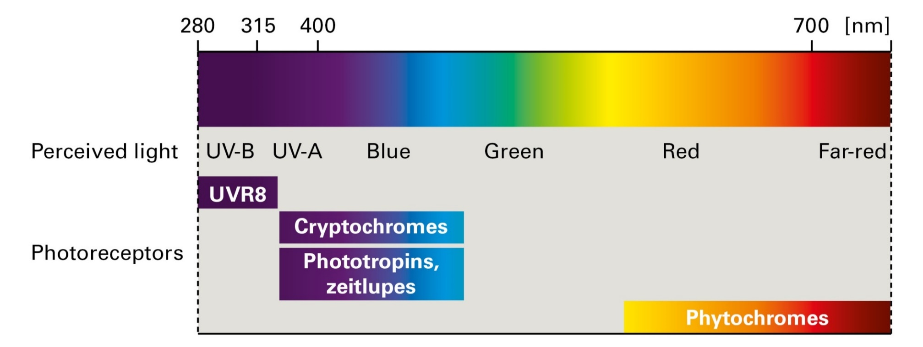
Hormones and Signal Transduction
Plant photoreceptors
Phytochromes

