Slide 1


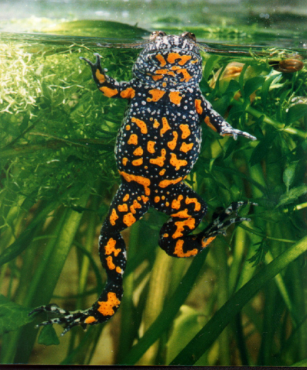
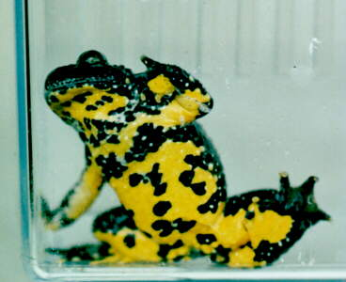
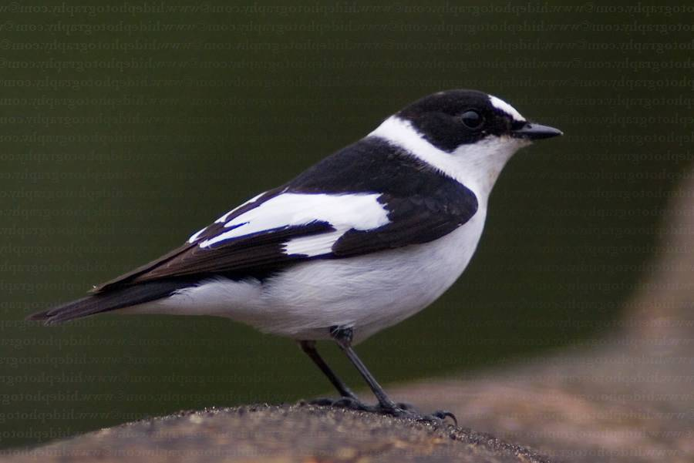
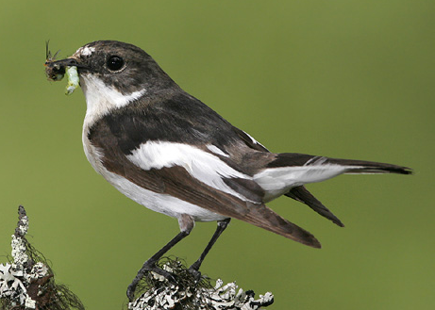
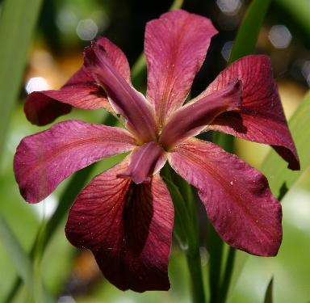
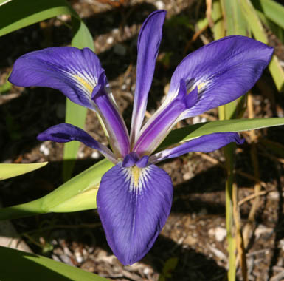
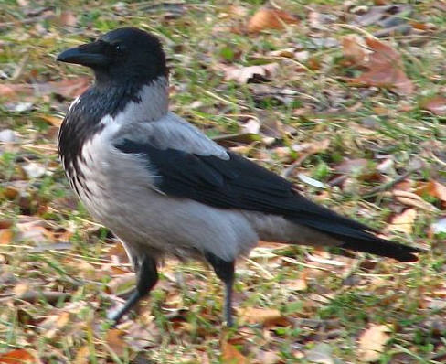
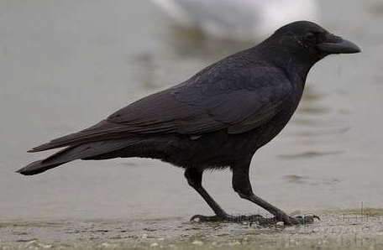

MODULARIZACE VÝUKY EVOLUČNÍ A EKOLOGICKÉ BIOLOGIE
CZ.1.07/2.2.00/15.0204
HYBRIDIZATION AND
HYBRID ZONES
tok genů: Fst, Dxy
test Patterson´s D = ABBA/BABA
ghost introgression: Zhang19 (mám PDF)

Slide 2
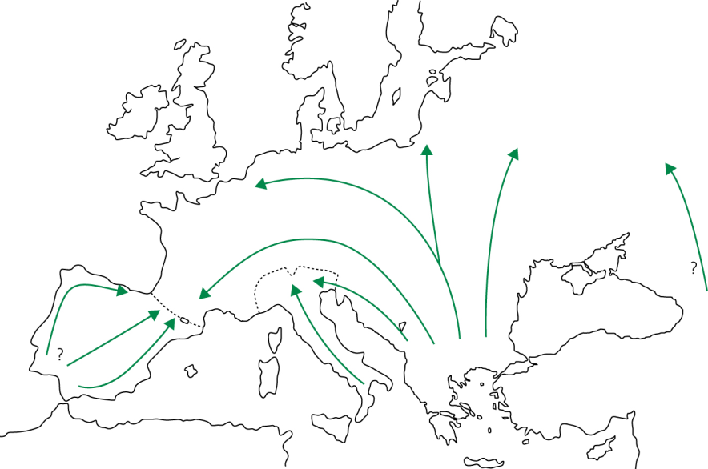
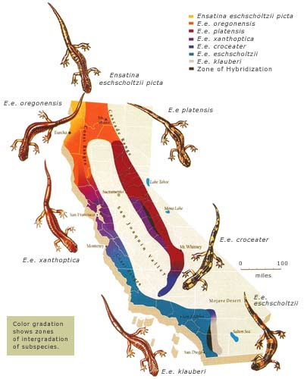
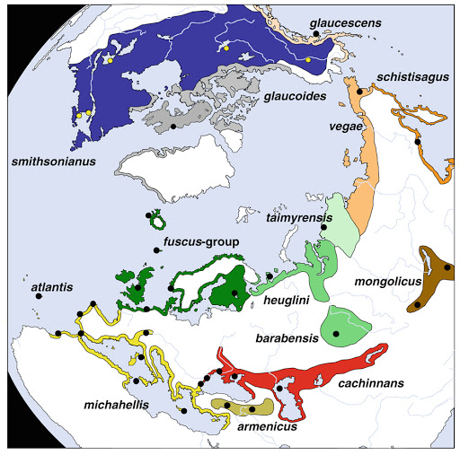
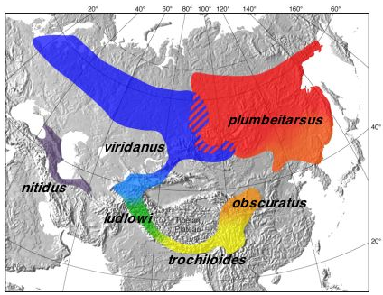
Secondary contact
Chorthippus
parallelus
ring species:
postglacial expansion
greenish warbler (Philloscopus trochiloides)
Ensatina eschscholtzii - klauberi
Larus argenteus/L. fuscus

Slide 3
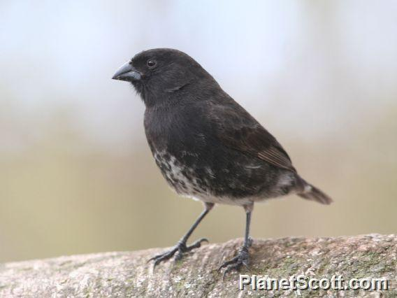
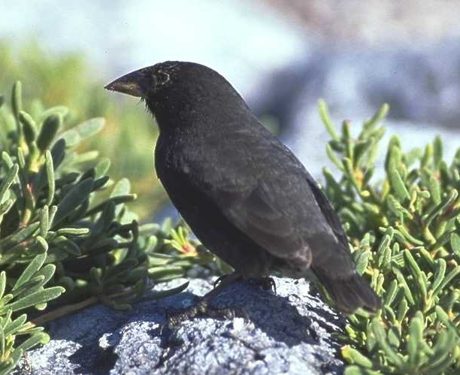
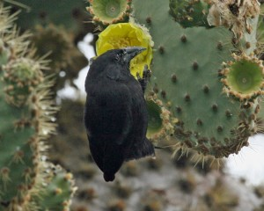
Hybridization:
25% species of vascular plants
10% species of animals
probably underestimation (only conspicuous species: ducks,
birds of paradise, butterflies)
often result of environmental disturbance:
eg. „Darwin’s finches“ Geospiza fuliginosa, G. fortis and
G. scandens after El Niño event
Geospiza fuliginosa
G. fortis
G. scandens

Slide 4
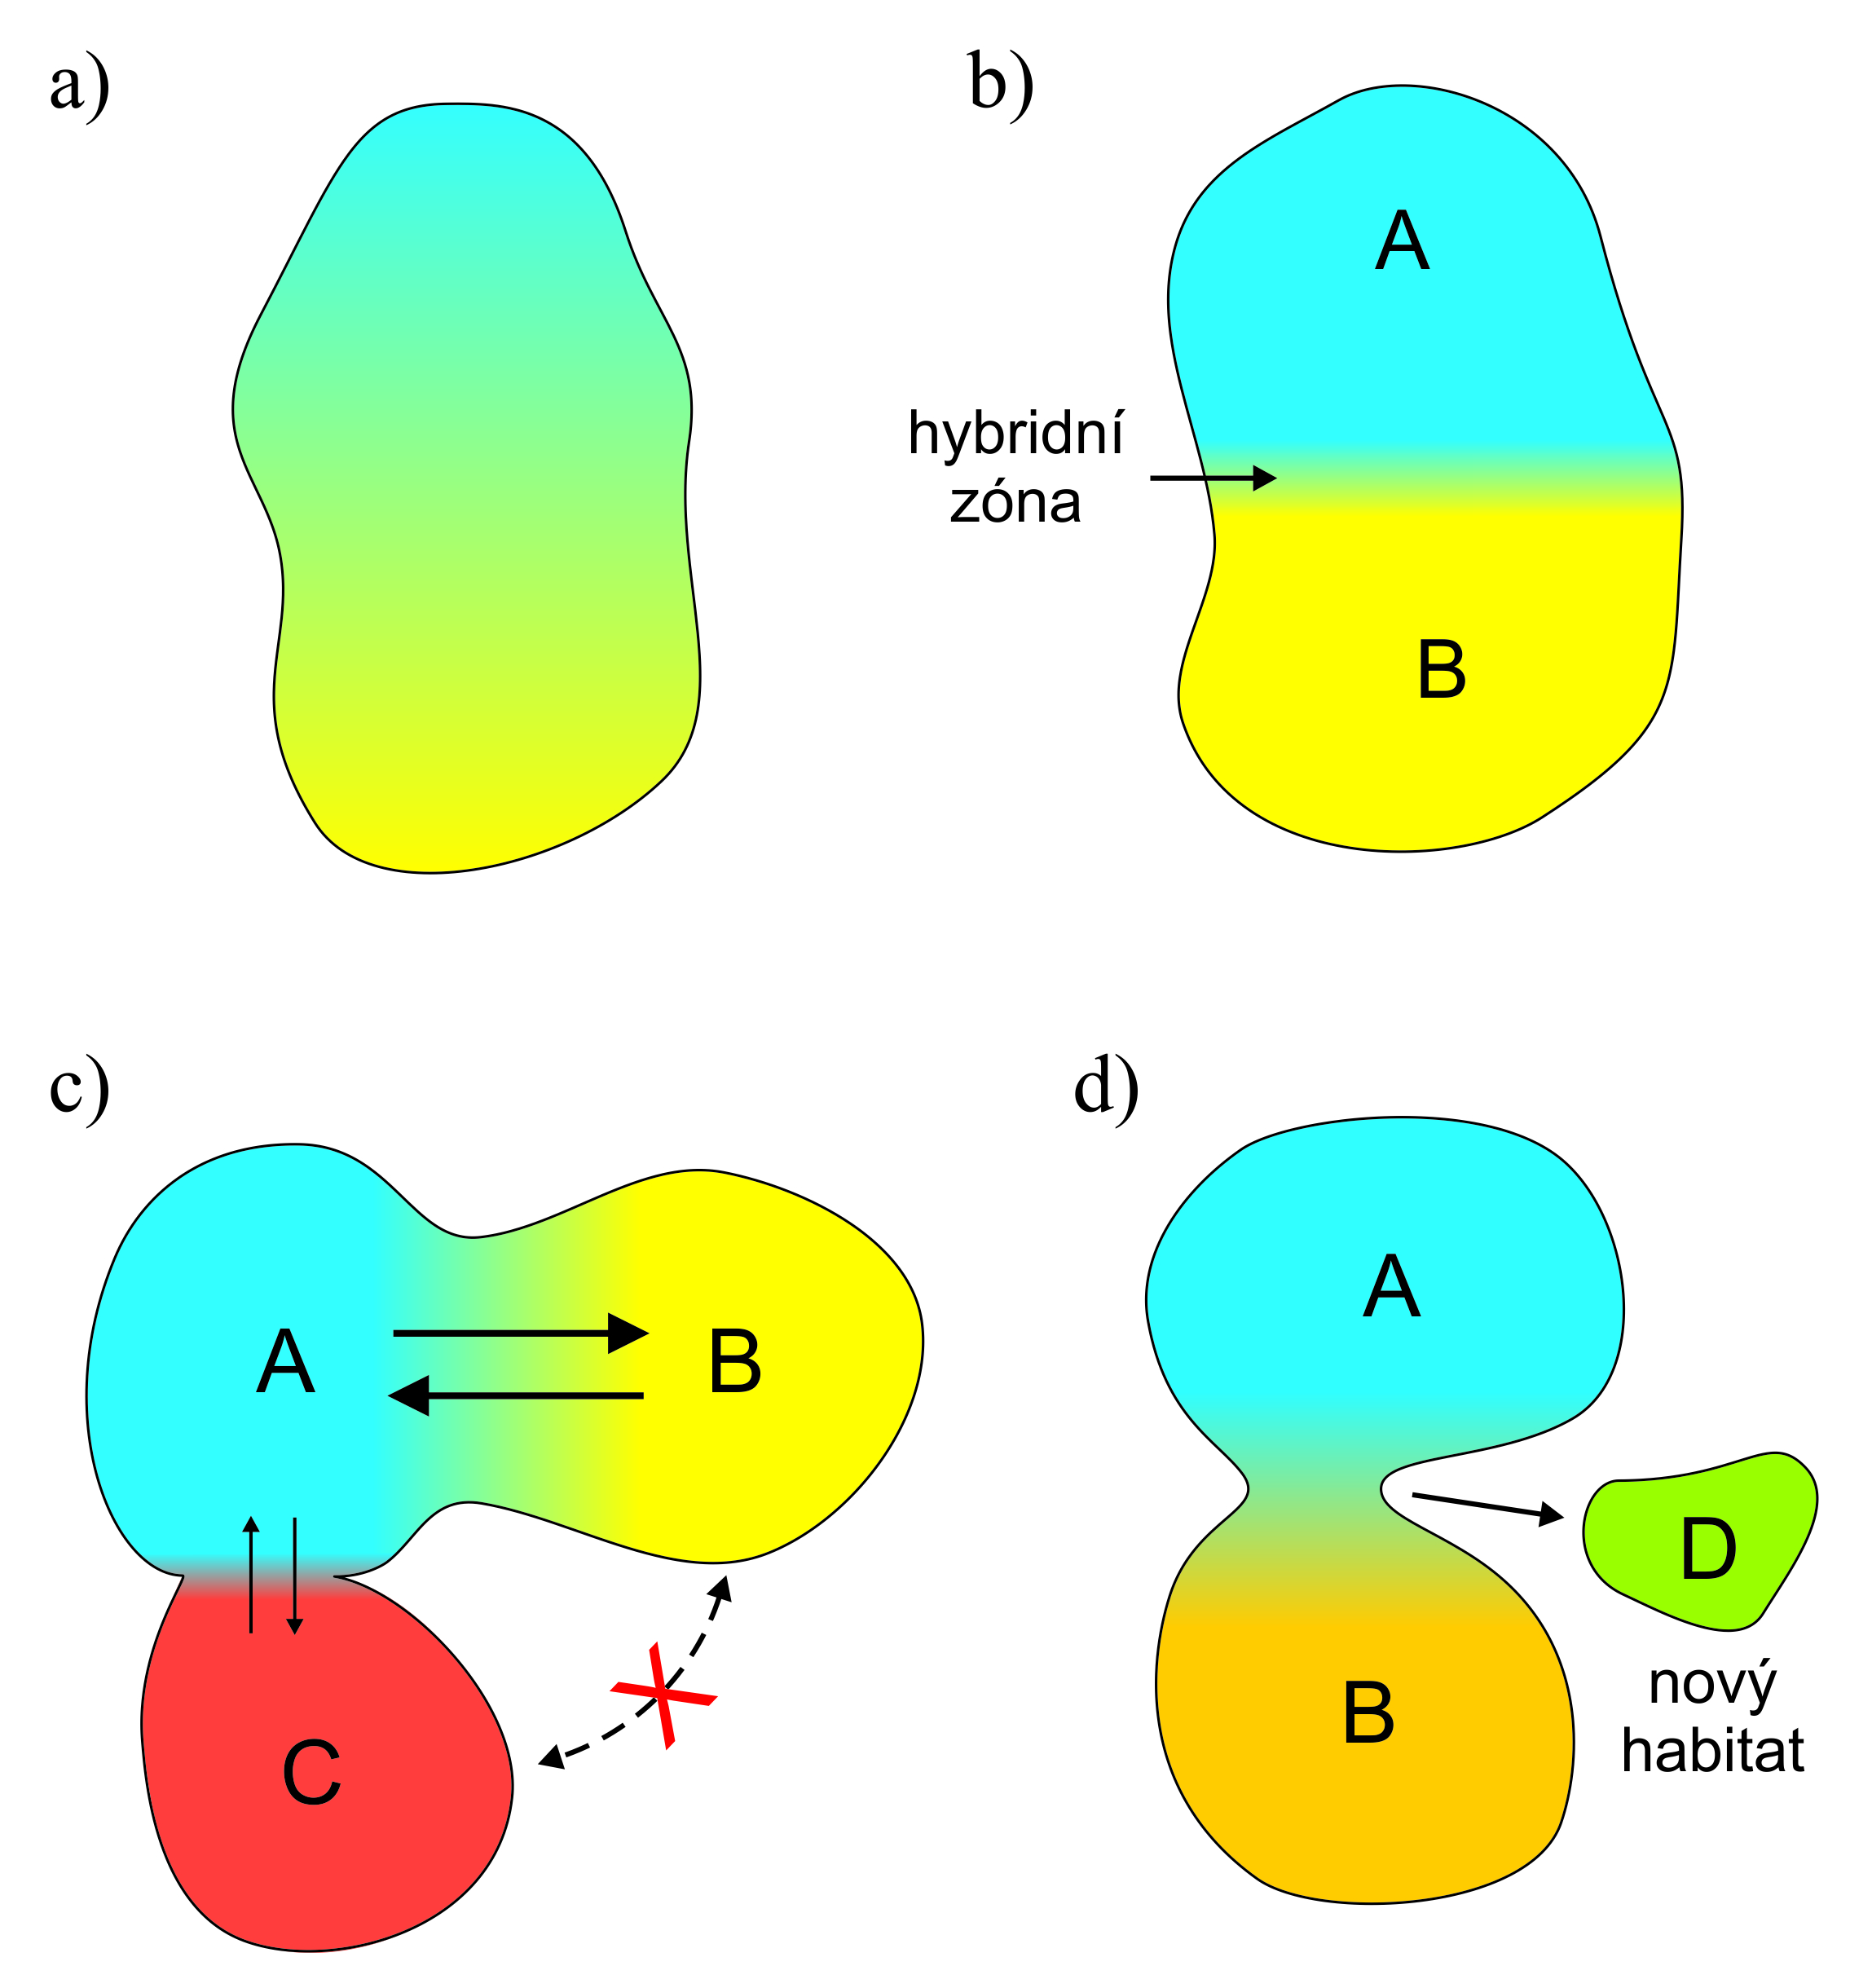
Possible outcomes of hybridization
hybrid zone
hybrid swarm
hybrid taxon
new
habitat

Slide 5
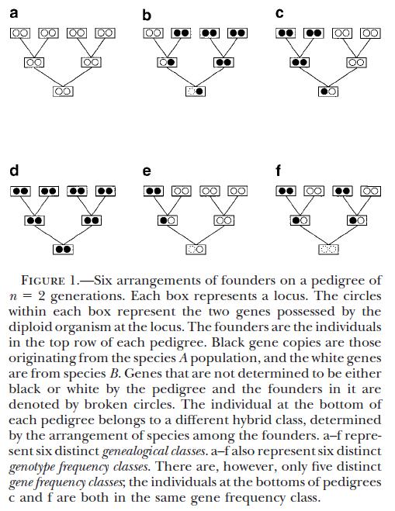
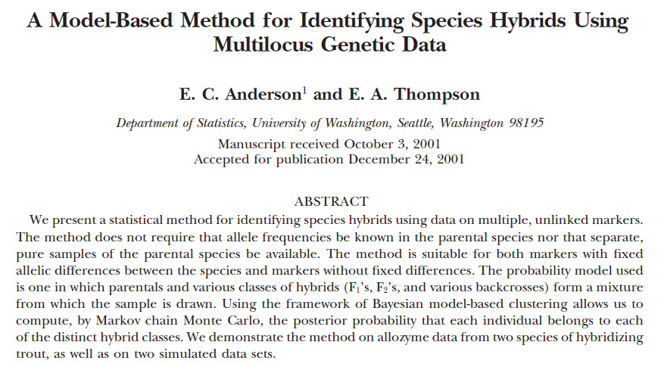
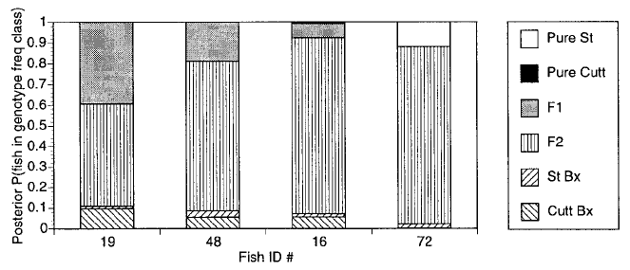
Program NewHybrids:

Slide 6
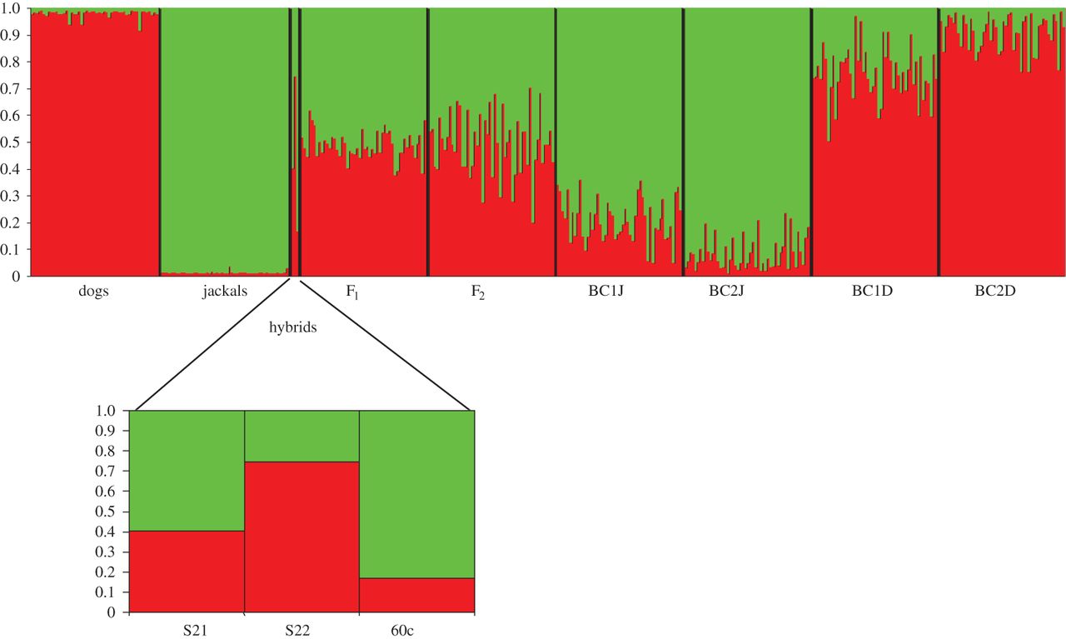
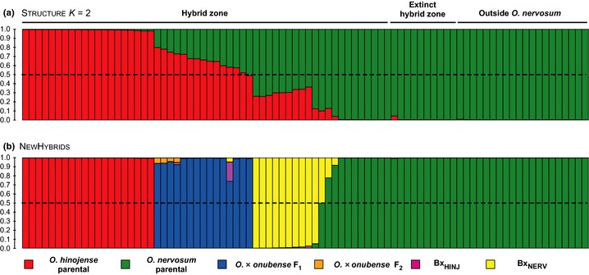
STRUCTURE
ADMIXTURE

Slide 7
Hybrid zone (Barton a Hewitt 1985)
= area, where genetically different populations meet, mate and give rise
at least some hybrid offspring
Hybrid zones may be classified as:
primary
secondary
tension, mosaic, staggered, „mottled“ ...
extrinsic selection (external environment)
intrinsic selection (prezygotic or postzygotic barriers)

Slide 8
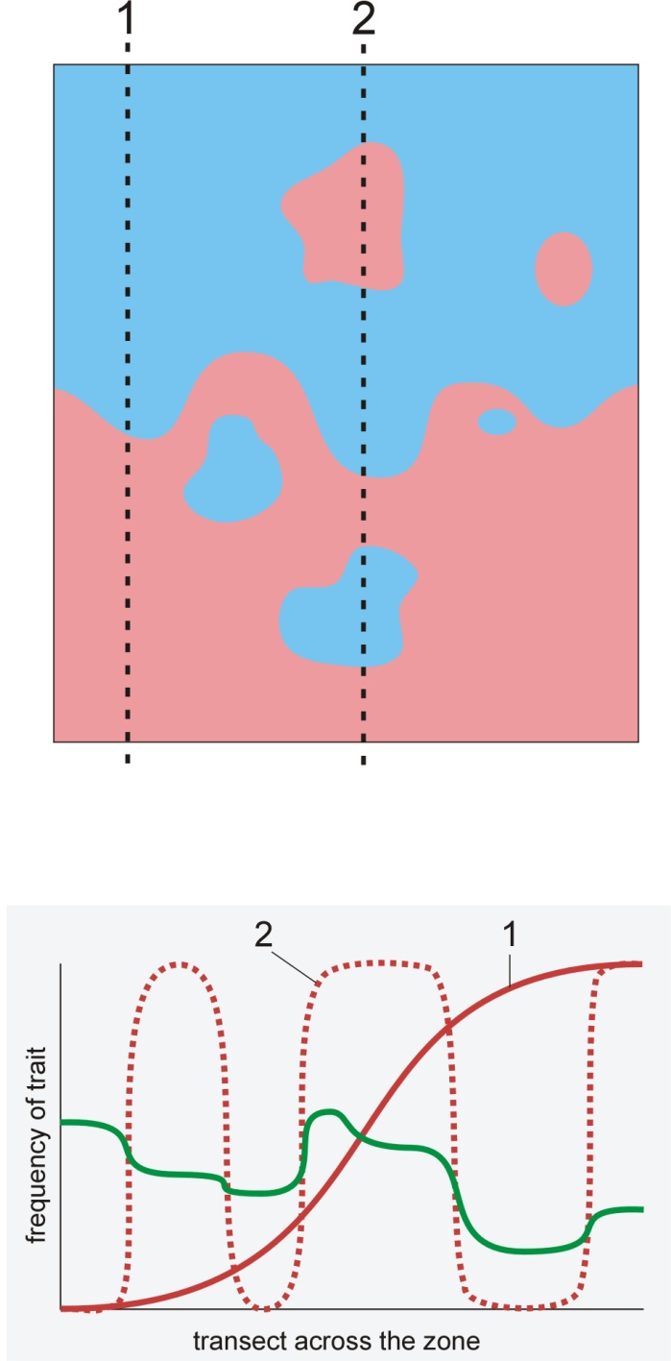
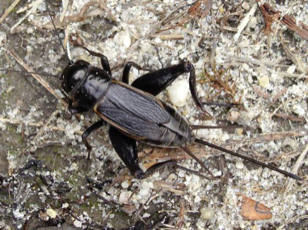
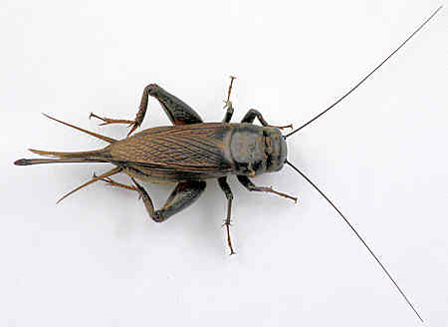


Mosaic hybrid zone:
influence of environment
in fact a set of several hybrid zones
eg.: Gryllus firmus x G. pennsylvanicus (NE USA)
sandy x clayish soils
Iris fulva x I. brevicaulis:
I. fulva is limited to more forested sites

Slide 9
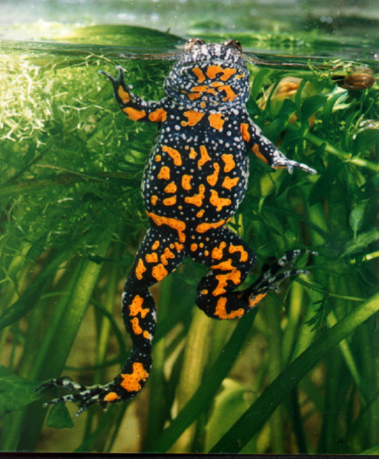
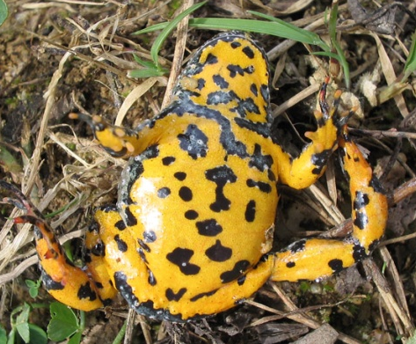
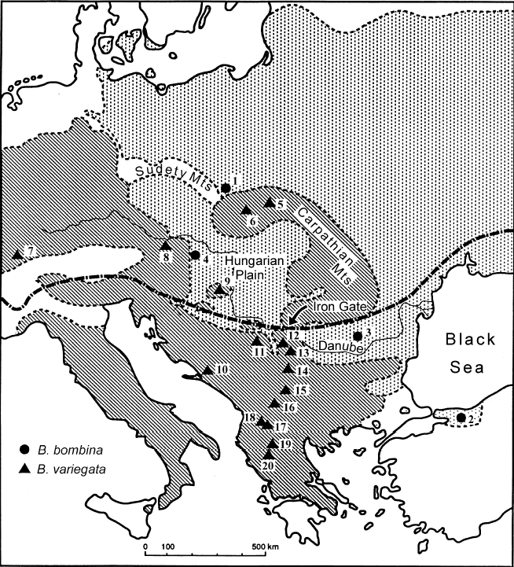
Bombina:
mosaic HZ in Croatia, not in Poland
fire-bellied toad
B. bombina:
lowlands
mostly in water
larger water surfaces
thiner skin
territorial
530 Hz
longer development
yellow-bellied toad
B. variegata:
hills, highlands
terrestrial
mating in puddles
thick skin
nonterritorial
580 Hz
shorter development

Slide 10

Most hybrid zones are
tension zones.
Nick Barton
... i.e., they are maintained by balance between dispersal and selection (Barton & Hewitt, 1985)

Slide 11


Tension zone is when…

Slide 12
Tension zone is when…
dispersal
⇒ zone widening

Slide 13
Tension zone is when…
×
♂
♀
selection
against
hybrids!
⇒ zone narrowing
Tension zone is maintained by dynamic equilibrium
between dispersal and selection

Slide 14
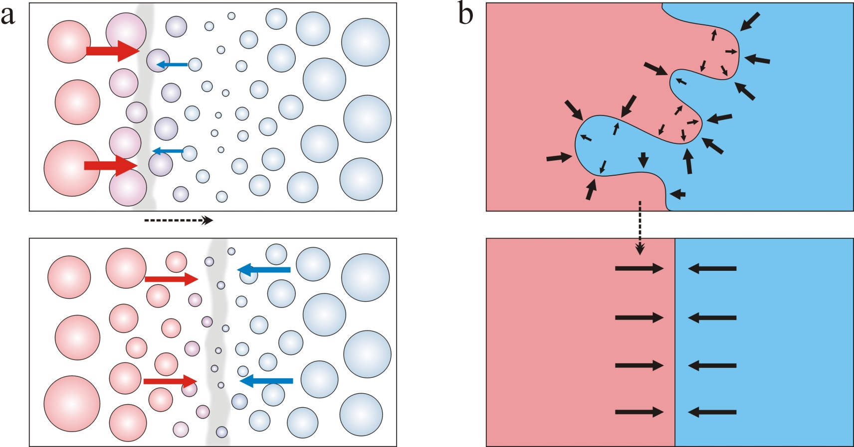
tension zone moves along the gradient of population density
Tension zone is independent of external conditions (intrinsic selection)
⇒ its movement ends at a geographical barrier or in the area
of the lowest population density („population/density trough“)

Slide 15
„population trough“

Slide 16
tension zone moves along population gradient

Slide 18
Theory of cline:
secondary contact:
coincident and concordant clines
Cline = gradient of trait(s) (eg. allele frequency or mean
of quantitative trait) across spatially continuous habitat
Notes:
According to theory, secondary contact will produce a set of parallel coincident and concordant clines CLICK → it means that these clines have the same position and the same shape or at least the width. CLICK →

Slide 19
clines
coincidence = same positions of zone centres
concordance = same cline shapes
(in practice usually same widths)

Slide 20
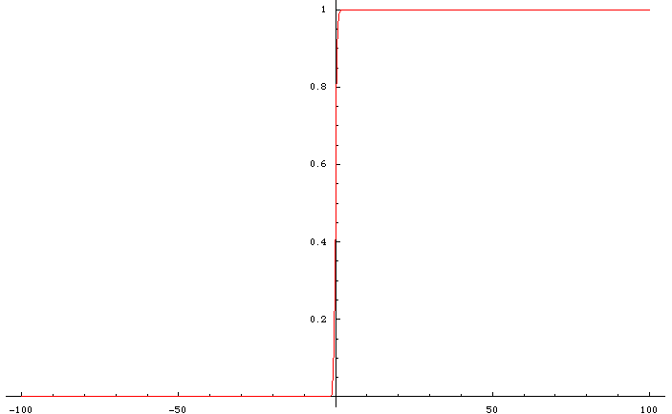
secondary contact
cline
Geographic scale
Notes:
20

Slide 21
Theory of cline:
neutral vs. selected loci
neutral locus
selection against hybrids
Notes:
But as the time is passing, clines for neutral loci get wider in comparison with loci under selection CLICK → so concordance diminishes; conversely, selection against hybrids tends to maintain the clines at the same place. CLICK →

Slide 22
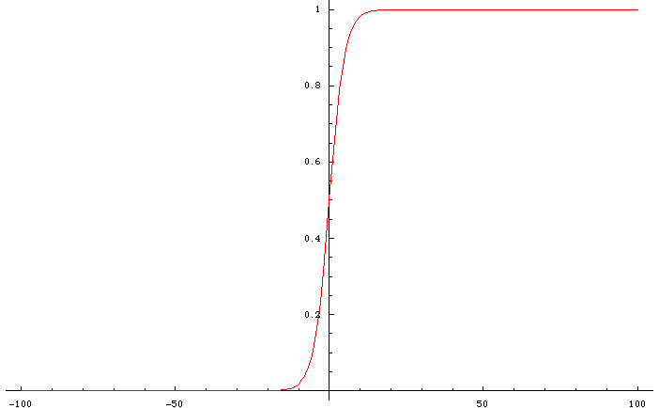
diffusion of neutral marker
Geographic scale
Notes:
22

Slide 23
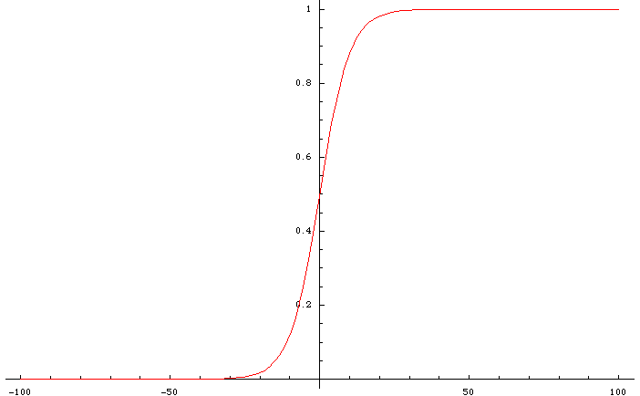
diffusion of neutral marker
Geographic scale
Notes:
23

Slide 24
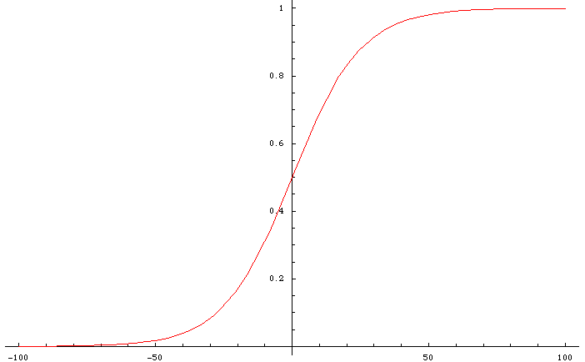
diffusion of neutral marker
Geographic scale
Notes:
24

Slide 25
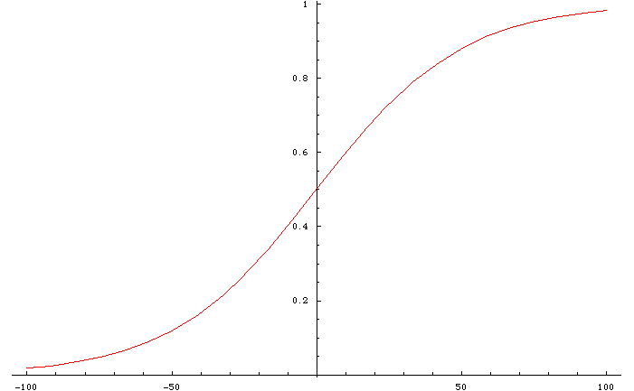
diffusion of neutral marker
Geographic scale
Notes:
25

Slide 26
neutral vs. selected loci
with time, concordance is disappearing ...
locus 1
locus 2
... but (in tension zone) selection pushes clines for individual loci to each other
⇒ maintains coincidence
Notes:
But as the time is passing, clines for neutral loci get wider in comparison with loci under selection CLICK → so concordance diminishes; conversely, selection against hybrids tends to maintain the clines at the same place. CLICK →

Slide 27
sometimes ...
locus 1
locus 2
... but clines still parallel
Notes:
Sometimes we can see one or more clines which are not coincident so we have to find some explanation for the pattern CLICK → but still it holds that the clines are parallel
CLICK →

Slide 28
cline models (diffusion approximation etc.), linkage disequilibrium,
evolutionary parameters
??
problem, how to analyse
Notes:
So even in this case we can use cline models – either based on diffusion approximation – or any other model, and to estimate cline parameters. CLICK → But what to do when the clines are not parallel? CLICK → Clearly, in this case one of the basic assumptions of cline theory is violated and it is not obvious what should we do in such a case CLICK →

Slide 29
Hybrid zone study
Sampling along linear or 2D transect, geographic coordinates
of localities
Genetic (morphological, behavioural etc.) analysis
… problem of sample independence (F_{ST}, F_{IS} … effective No. alleles)
Geographic clines
Estimation of dispersal, selection, and other parametres
Alternative approaches:
monotonic clines
2D analysis
genomic clines
concordance analysis

Slide 30
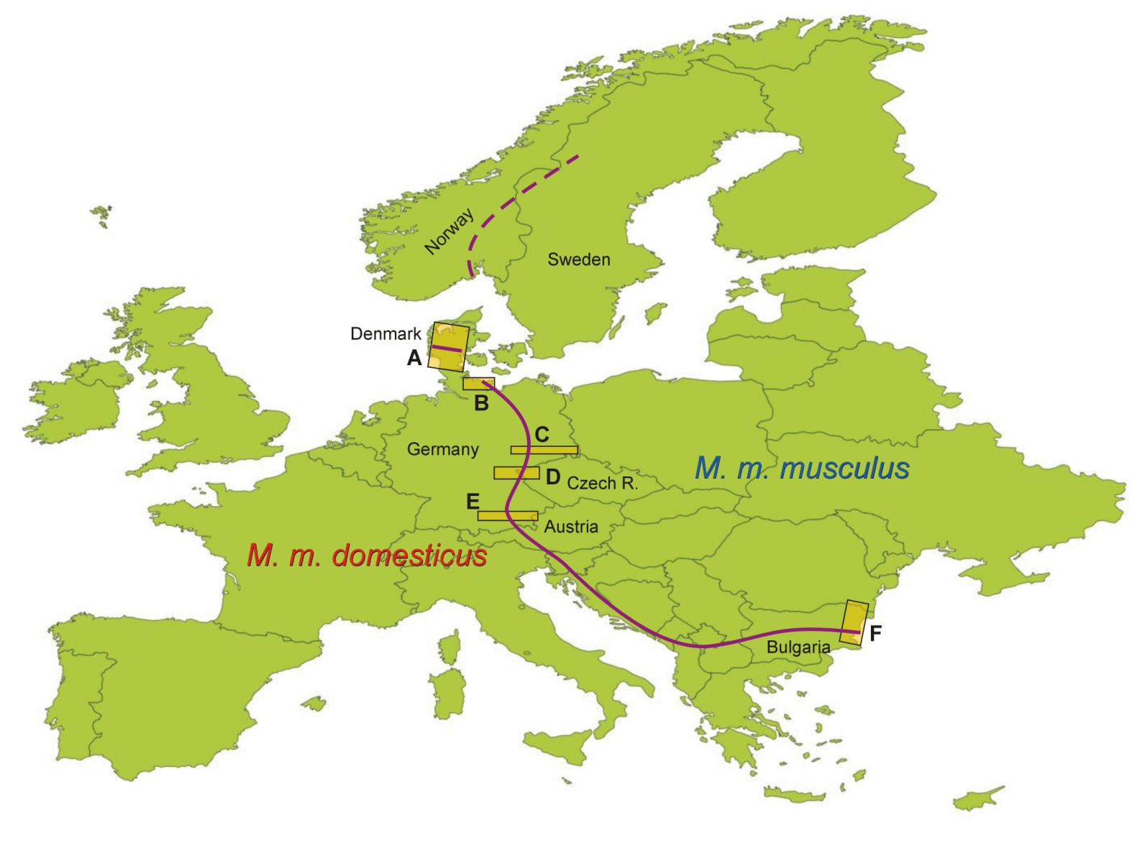
Case study: house mouse hybrid zone

Slide 31
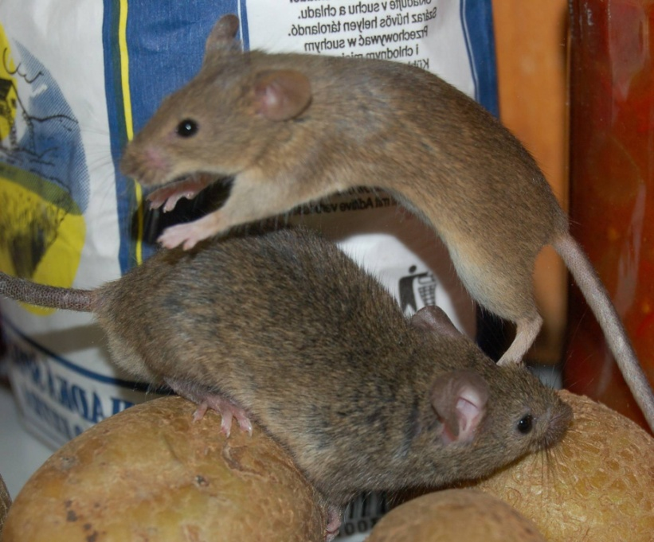
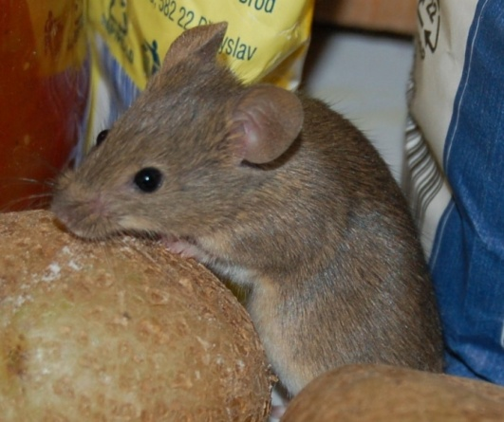
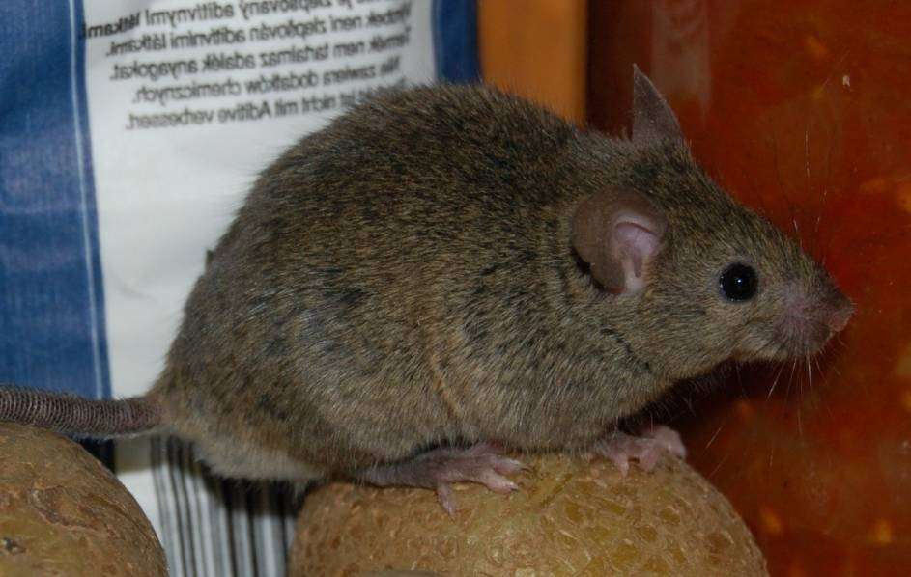
musculus
domesticus

Slide 32
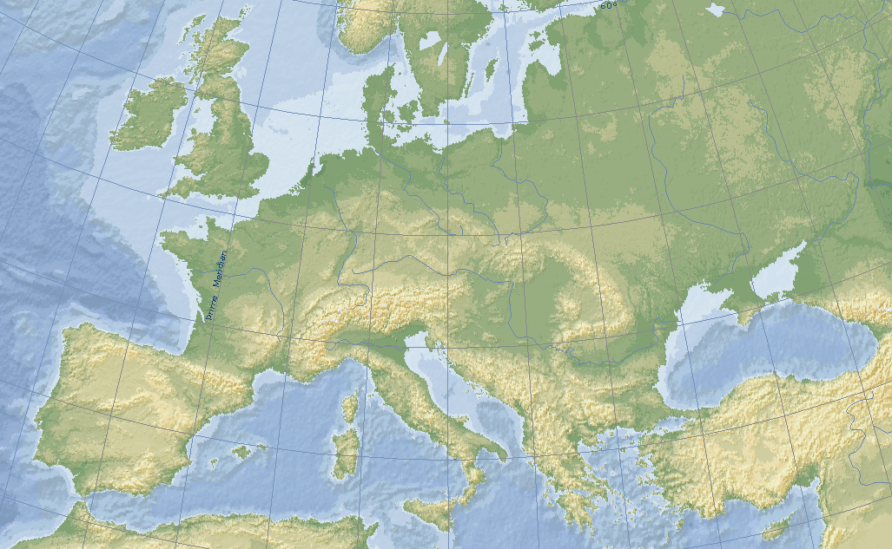
Mouse colonization of Europe
Neolithic
Cucchi et al. (2005)

Slide 33
Mouse colonization of Europe
Bronze and Iron Age
Cucchi et al. (2005)

Slide 34
Mouse colonization of Europe
Late Neolitnic
mid 4th millenium BC
Cucchi et al. (2011)

Slide 35
Mouse colonization of Europe
Vikings
Prager et al. (1993); Searle et al. (2009)

Slide 36
Hybrid zone in Europe
musculus
time of origin unknown…
domesticus

Slide 37
Hybrid zone in Europe
… than NW part
… but SE part older …
Co tuto zónu ovlivňuje?

Slide 38
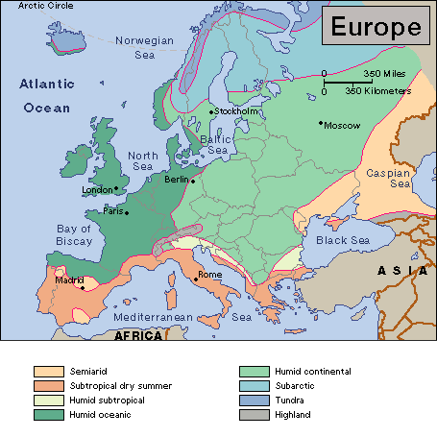
continental climate
oceanic climate

Slide 39
continental climate
oceanic climate
climatic factors don’t determine

Slide 40
Hybrid zone in Europe
Most hybrid zones are „tension zones“
Nick Barton
also the mouse hybrid zone?

Slide 41
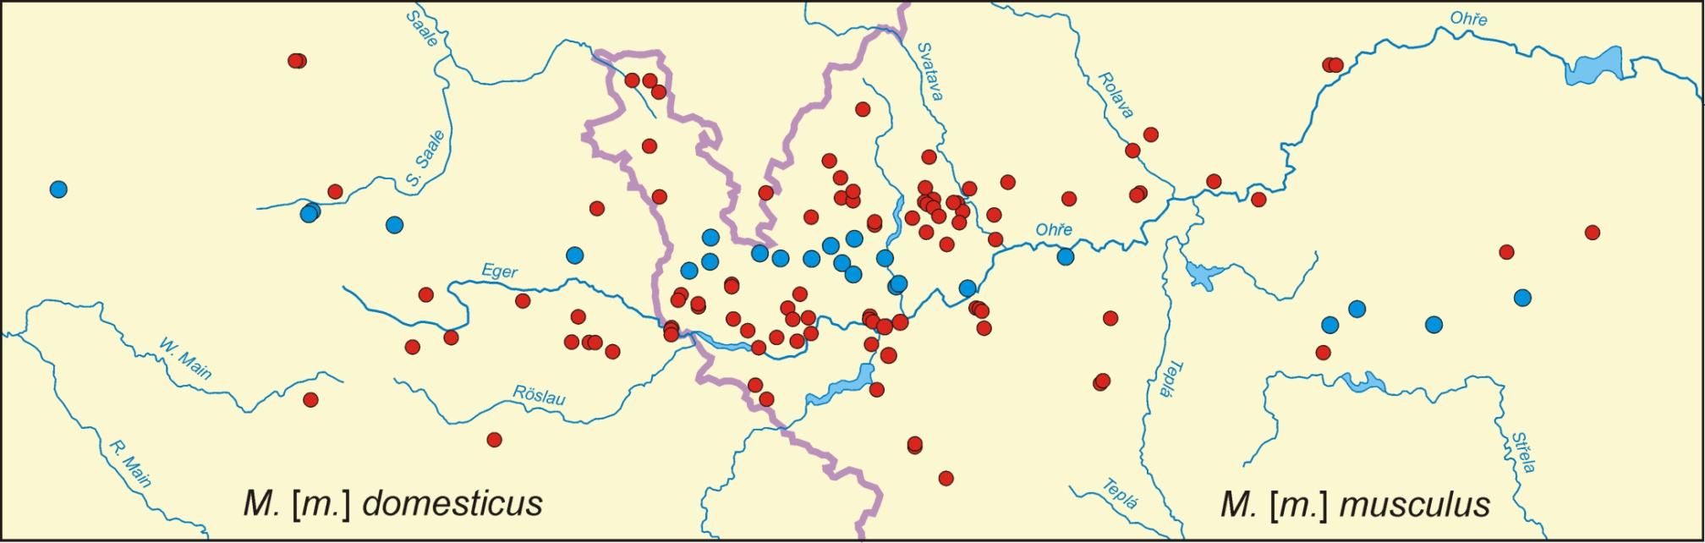
hybrid zone course may be complex....
... moreover, usually we don’t know a priori, or we extrapolate from global direction

Slide 42
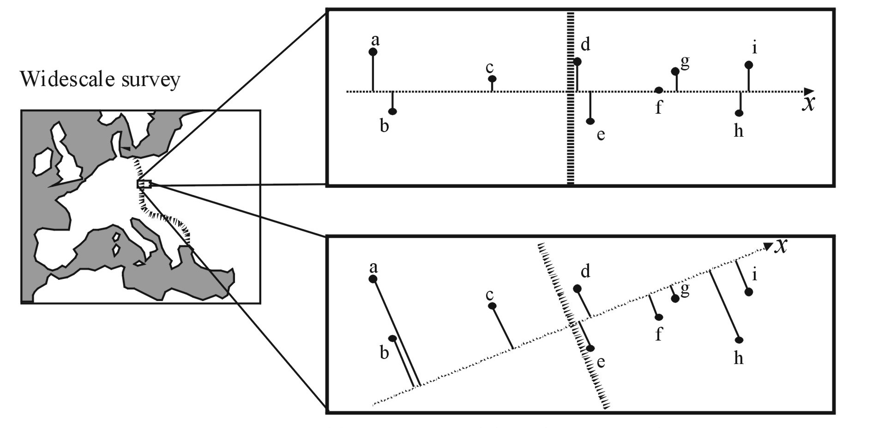
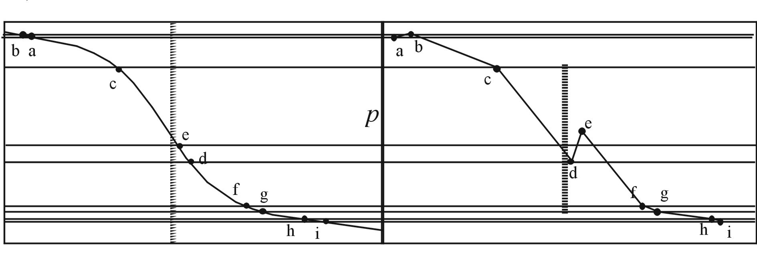
Real local cline
Cline interpolated
from widescale survey

Slide 43
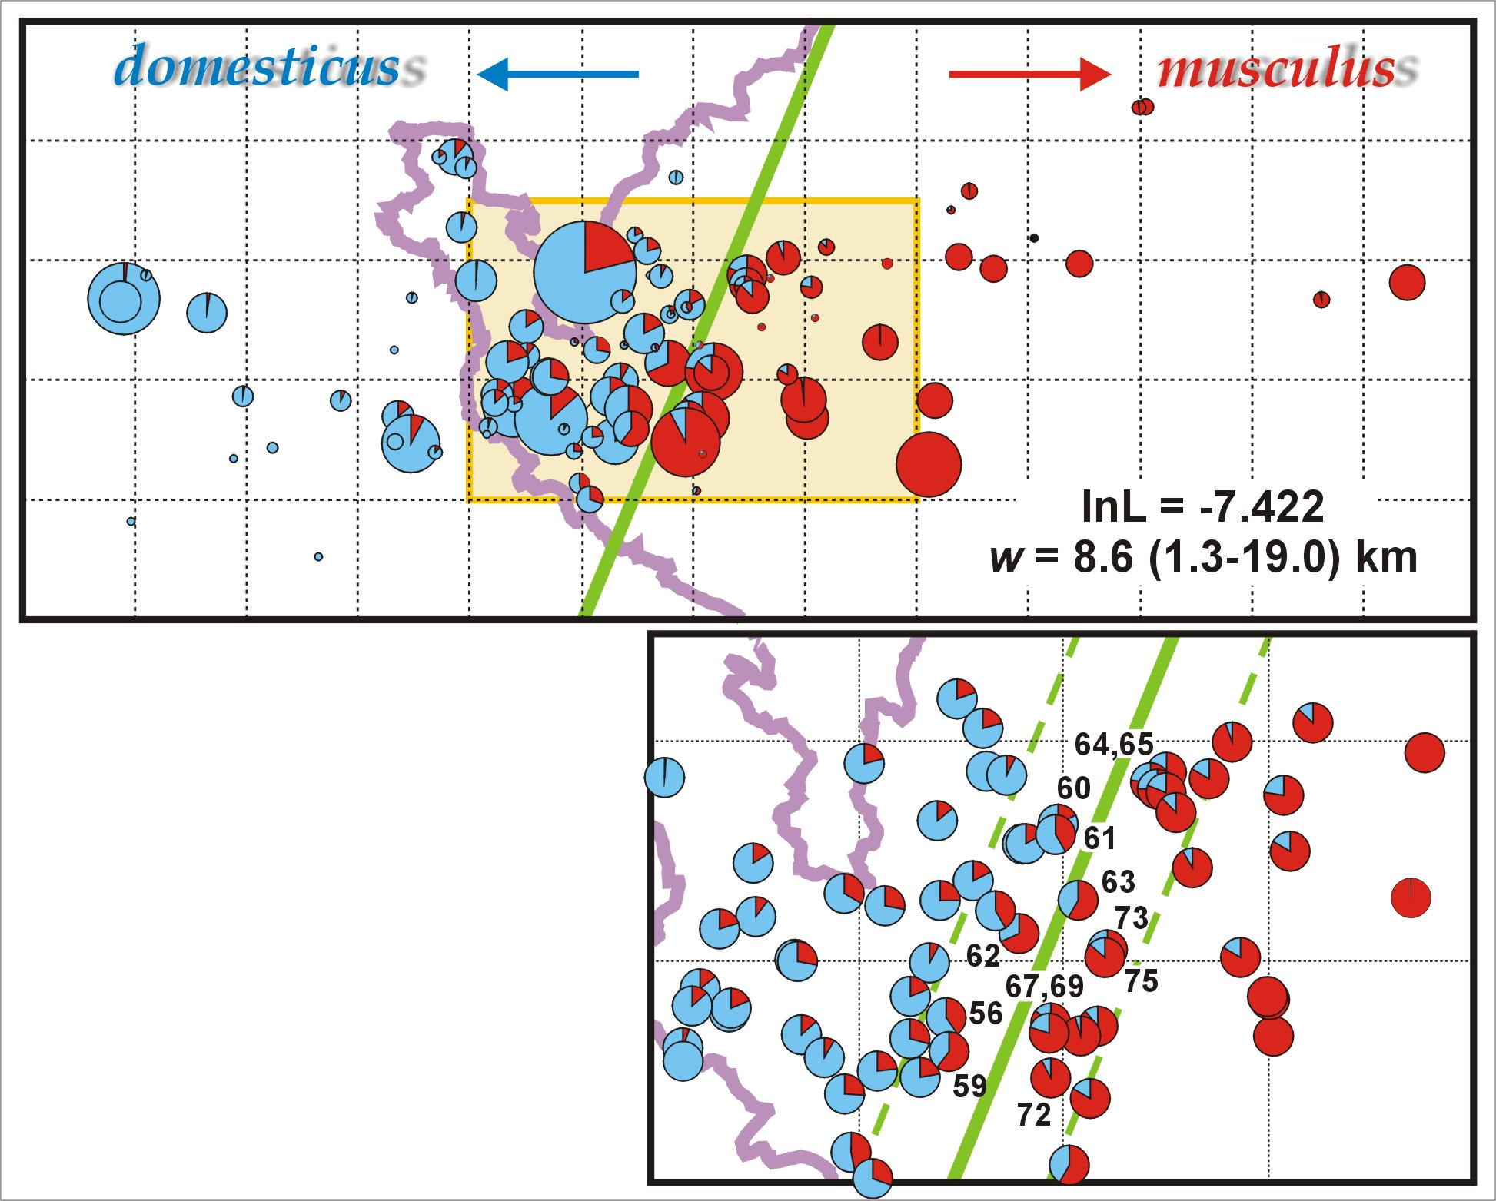
2D → 1D clines

Slide 44
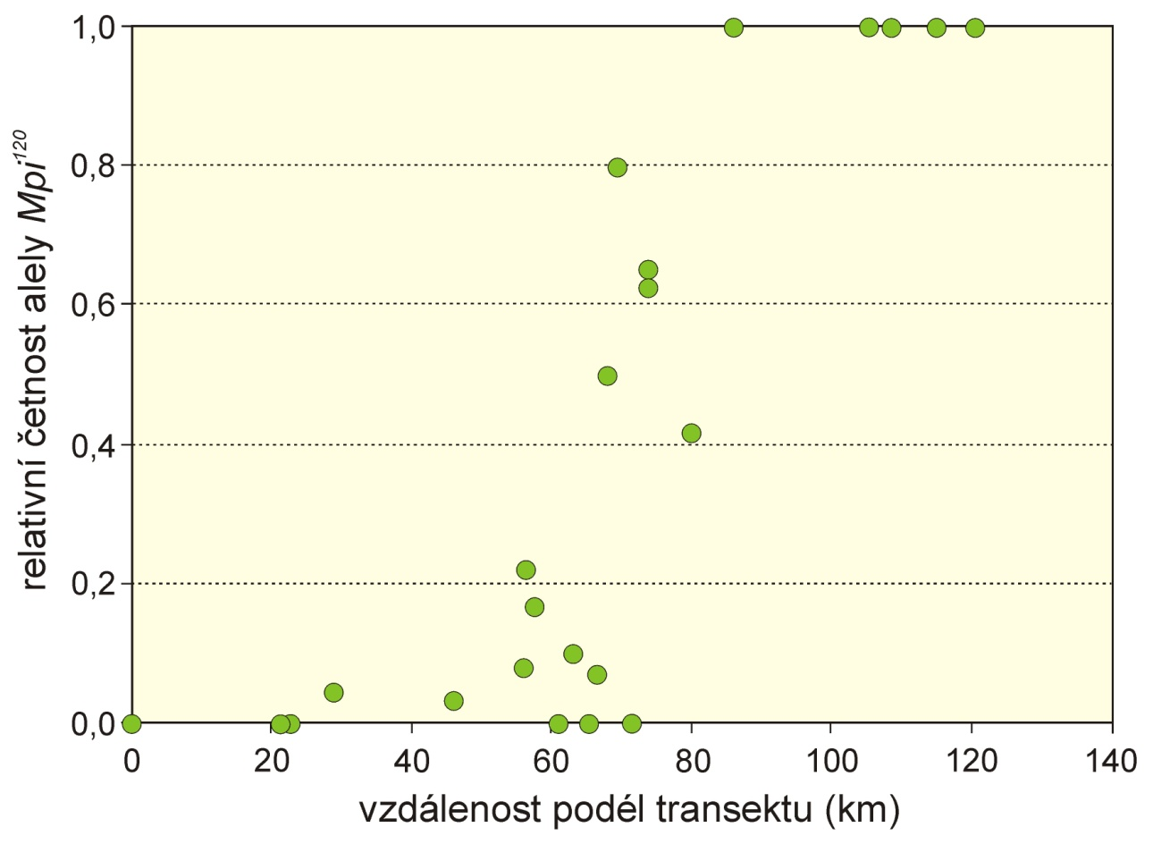
Example: Mpi
šířka (w) = 1/max. slope
střed (c)
fitting: eg. logistic regression × models based on cline theory
sigmoid model: hyperbolic tangent function:

Slide 45
Multiple genes:
1.0
0.8
0.6
Frequency
Δp
0.4
0.2
0.0
c
Distance along transect
„stepped“ model (symetrical, asymmetrical)
linkage disequilibrium resulting from influx of parental allele combinations ⇒
synergistic effect: strenghtening of selection in zone centre ⇒ central step
× introgression tails reflect selection at individual loci

Slide 46
We can estimate some other key evolutionary parametres
from LD and cline parametres:
dispersal:
effective selection:
selection on marker loci:
selection on selected loci:
fitness of hybrids:
number of loci under selection:

Slide 47
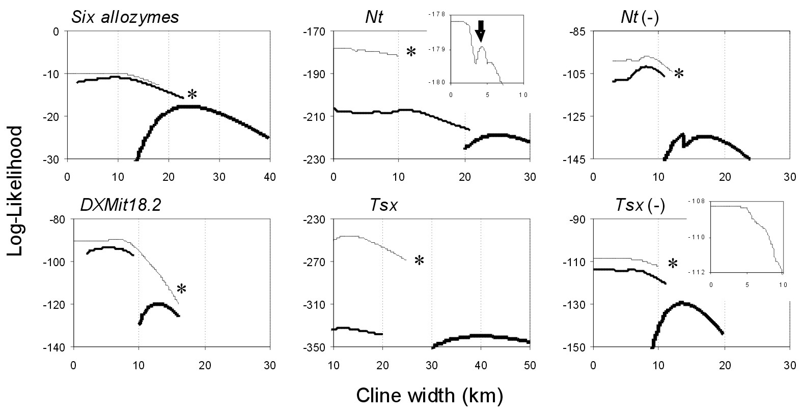
model comparison: LRT (they are nested); d.f. = difference in number
of parametres
likelihood profiles:

Slide 48
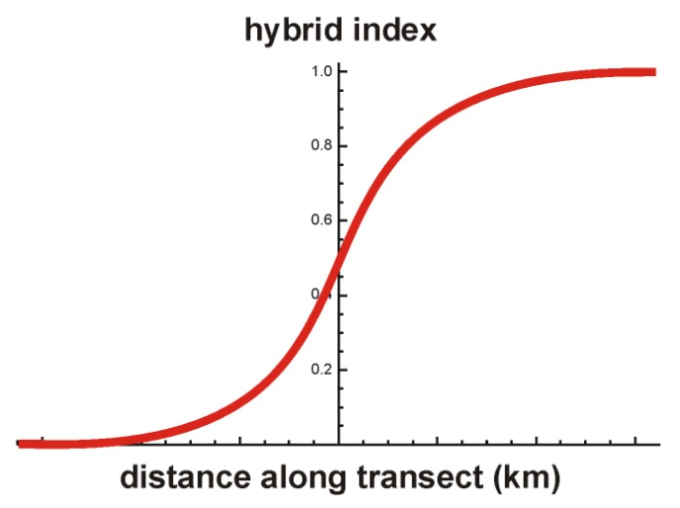
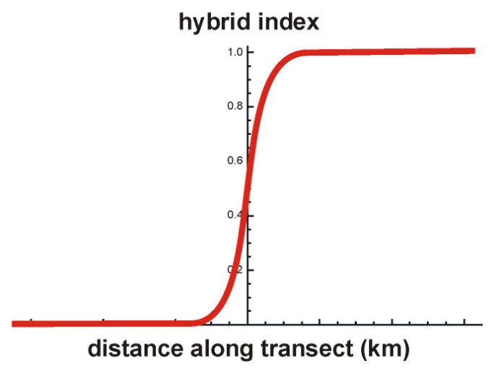
hybrid zone
selected areas
cline width
position on chromosome
centromere
molecular markers

Slide 49
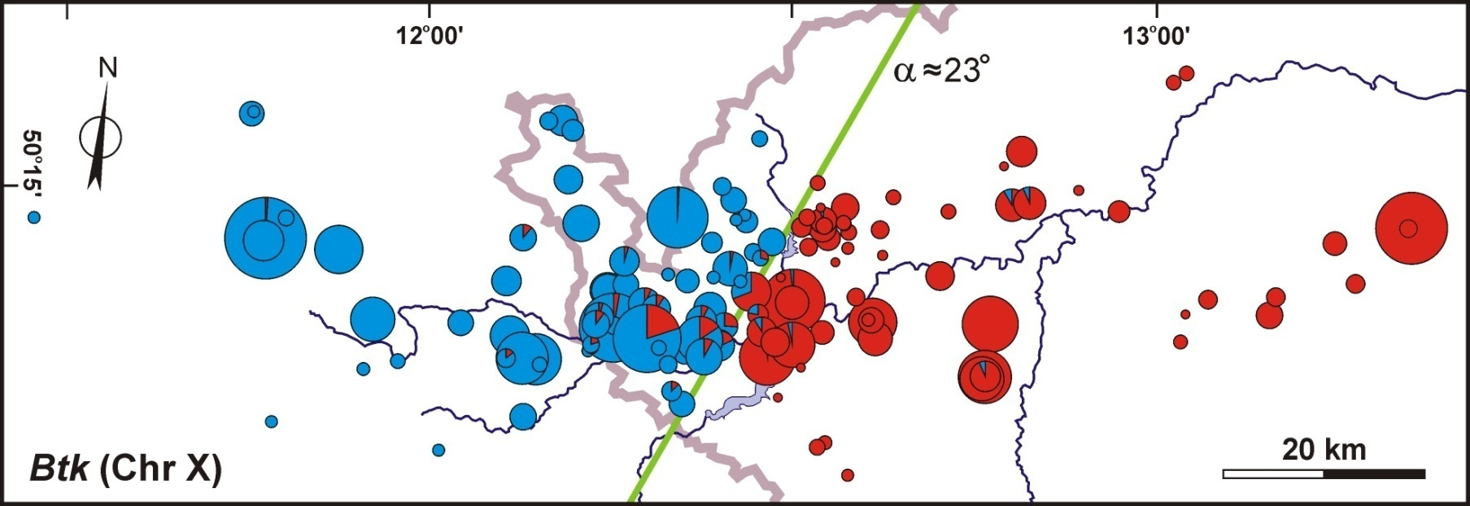
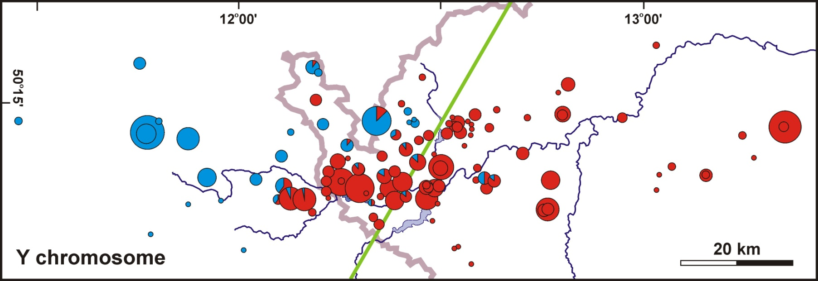
Problems – Y chromosome
>20 km

Slide 50
Monotonic clines – consensus orientation
Y
Notes:
Monotonic clines for all the markers along the consensus direction CLICK → all the autosomal and the X clines are pretty coincident CLICK → the Y, when the cline estimated for the consensus orientation, is wider and shifted to the west CLICK →

Slide 51
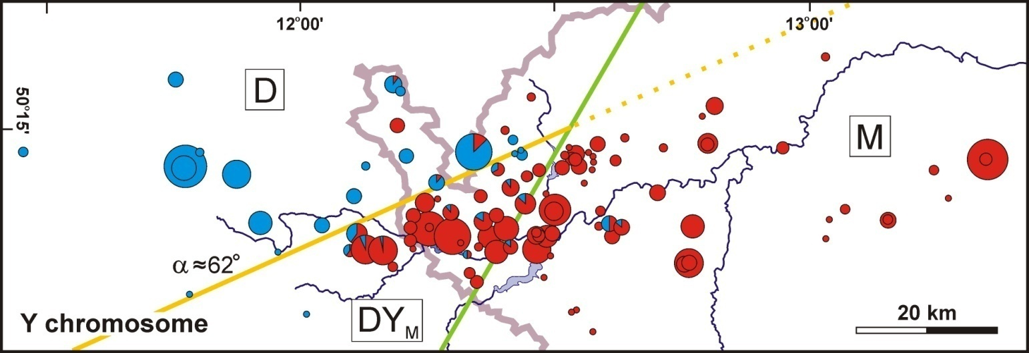
Notes:
Interestingly, trapping sex ratio was female biased in both areas without the Y introgression (so that the proportion of males was significantly different from parity) while in the D area with the musculus Y introgression the sex ratio was close to parity and significantly different from the former two. CLICK →

Slide 52
Y_{cons}
Y_{Y}
Btk_{cons}
Notes:
Here is the Y cline estimated along its own direction CLICK → you can notice that the change is very abrupt and similar to the change of the X chromosome along the consensus. CLICK → for comparison, we included also the Y monotonic cline for the consensus direction we saw on the previous slide. CLICK →

Slide 53

D=44%**
DY_{M}=51%
M=45%***
salient/invagination ≈ 330 km²
Notes:
Interestingly, trapping sex ratio was female biased in both areas without the Y introgression (so that the proportion of males was significantly different from parity) while in the D area with the musculus Y introgression the sex ratio was close to parity and significantly different from the former two. CLICK →

Slide 54
1. musculus Y more successful than domesticus Y on its own genetic background
2. higer proportion of males relative to other areas
Weird behaviour of the Y in the hybrid zone – summary:
Either coincidence, or ...

Slide 55


… or genetic conflict between X and Y
and probably some autosomal genes as well
Y
X

Slide 56

segregation law
Aa
A
a
Gregor Mendel
50%
50%

Slide 57
Intragenomic conflict results in higher proportion of
a genomic element in the next generation
?!
Aa
A
a
Gregor Mendel
„drive“
95%
5%
vychýlení segregačího (transmisního) poměru
= segregation distortion (SD)
= transmission ratio distortion (TRD)

Slide 58

X chromosome

Slide 59

Chr. X - 2D analysis
Geneland

Slide 60
‘Genomic clines’
Z. Gompert & A. Buerkle

Slide 61



Slide 62

Concordance
analysis:
S.J.E. Baird

Slide 63
very steep cline
strong introgression in both directions
S.J.E. Baird

Slide 64
Concordance
analysis:
introgression to the left
S.J.E. Baird

Slide 65
Concordance
analysis:
introgression to the right
S.J.E. Baird

Slide 66

Proximal marker on the X
blocks around proximal marker
centre of the Y introgression
musculus
domesticus
consensus
barrier
non-introgressed localities
Recombination reduces size of introgressed
block far of the zone centre

Slide 67

Using cline model for analysis of reinforcement
– odour preference in the mouse hybrid zone
reinforcement

Slide 68

Using cline model for analysis of gene expression
in the mouse hybrid zone – asymmetric model

Slide 69

Blocks of Neanderthal DNA found in modern humans can act like a biological clock, because they are fragmented more and more with each generation since interbreeding happened. The blocks of Neanderthal DNA in the Siberian man were on average three times longer than those seen in people alive today. Working backwards, the scientists calculate that Neanderthals contributed to the man’s genetic ancestry somewhere between 7,000 and 13,000 years before he lived.
The findings, published in the journal Nature, suggest that humans and Neanderthals had reproductive sex around 50,000 to 60,000 years ago…
The Guardian Wednesday 22 October 2014
Notes:
Even worse – for these calculation I have assumed a generation time of one year. For longer lived organisms the situation is even worse….

Slide 70
P
X
F1
F2
F3
....

Slide 71
Hybridization makes a cascade of blocks
advancing introgression into ‘blue’ genome

Slide 72


haplotype A
R. A. Fisher
haplotype B
Recombination brings together
DNA of different origin and makes
junctions (breakpoints)
they divide genome into blocks
(chunks, tracts, segments)
recombinant
4 markers
3 junctions
N SNP
N markers

Slide 73

chromosome 12 of Neanderthal
Romania, ∼40 kya, mating before
200–100 years
Siberia, ∼45 kya,
mating before 8000–5000
contemporary China,
54–49 kya

Slide 74
Chromosome 17
MHC!
>600 000 SNPs

Slide 75

Chromozom X

Slide 76




Why hybrid zones? Reproductive barriers and speciation!
Dobzhansky-Muller model
W. Bateson
T. Dobzhansky
H. Muller

Slide 77





„Arms races“ and secondary contact

Slide 78




genetic conflict: “classical” scenario
subpop. 1
incompatible!
arms race
in ancestral
population
continuing
arms race
secondary contact
subpop. 2
MAD = mutually
assured destruction
Notes:
Interlaced fingers, braid, fingerloop braiding, twist together

Slide 79



Never bring a knife
to a gunfight!
genetic conflict: alternative scenario
subpop. 1
arms race
in ancestral
population
continuing
arms race
secondary contact
the winner thrives on “naive” genetic background
subpop. 2
“antispeciation
genes”
Notes:
Interlaced fingers, braid, fingerloop braiding, twist together

Slide 80


Why we don’t see this more often?
incompatibility loci
neutral loci
hitchhikers
arms victors
Ticking time-bomb...
Notes:
Interlaced fingers, braid, fingerloop braiding, twist together

Slide 81
Cytonuclear disequilibria
= non/random associations of nuclear and cytoplasmic
(mitochondrial) alleles
3 × 2 table
 | nuclear genotype:
mtDNA: | AA | Aa | aa | total
M | u₁ | v₁ | w₁ | x
m | u₂ | v₂ | w₂ | y
total | u | v | w | 1

Slide 82
No hybridization
Random mating, hybrid swarm
 | nuclear genotype:
mtDNA: | AA | Aa | aa
M | +++ | 0 | 0
m | 0 | 0 | +++
 | nuclear genotype:
mtDNA: | AA | Aa | aa
M | obs=exp | obs=exp | obs=exp
m | obs=exp | obs=exp | obs=exp
Hybridization without apparent
introgression, crossing independent of sex
Hybridization without apparent
introgression, crossing depends on sex
 | nuclear genotype:
mtDNA: | AA | Aa | aa
M | ++ | obs=exp | 0
m | 0 | obs=exp | ++
 | nuclear genotype:
mtDNA: | AA | Aa | aa
M | ++ | ++ | 0
m | 0 | -- | ++

Slide 83
Hybrids mate more often with
less discriminating species
Symmetrical introgression
 | nuclear genotype:
mtDNA: | AA | Aa | aa
M | obs=exp | ++ | --
m | obs=exp | -- | ++
 | nuclear genotype:
mtDNA: | AA | Aa | aa
M | ++ | obs=exp | --
m | -- | obs=exp | ++
Potential introgression,
crossing dependent on sex
 | nuclear genotype:
mtDNA: | AA | Aa | aa
M | ++ | ++ | --
m | 0 | 0 | ++

Slide 84



Programs for hybrid zone analysis:
Analyse: Stuart J.E. Baird, Nick H. Barton (Mac)
ClineFit: Adam Porter (PC)
CFit: Thomas Lenormand (PC)
(Geneland)
S.J.E. Baird
N.H. Barton
A. Porter
T. Lenormand

