Slide 1
Radiomedicinské methody
SPECT – single photon emission computer tomography
PET – positron emission tomography
Radiotherapy

Slide 2
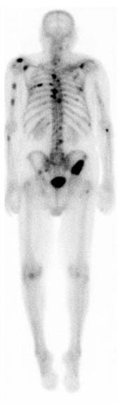
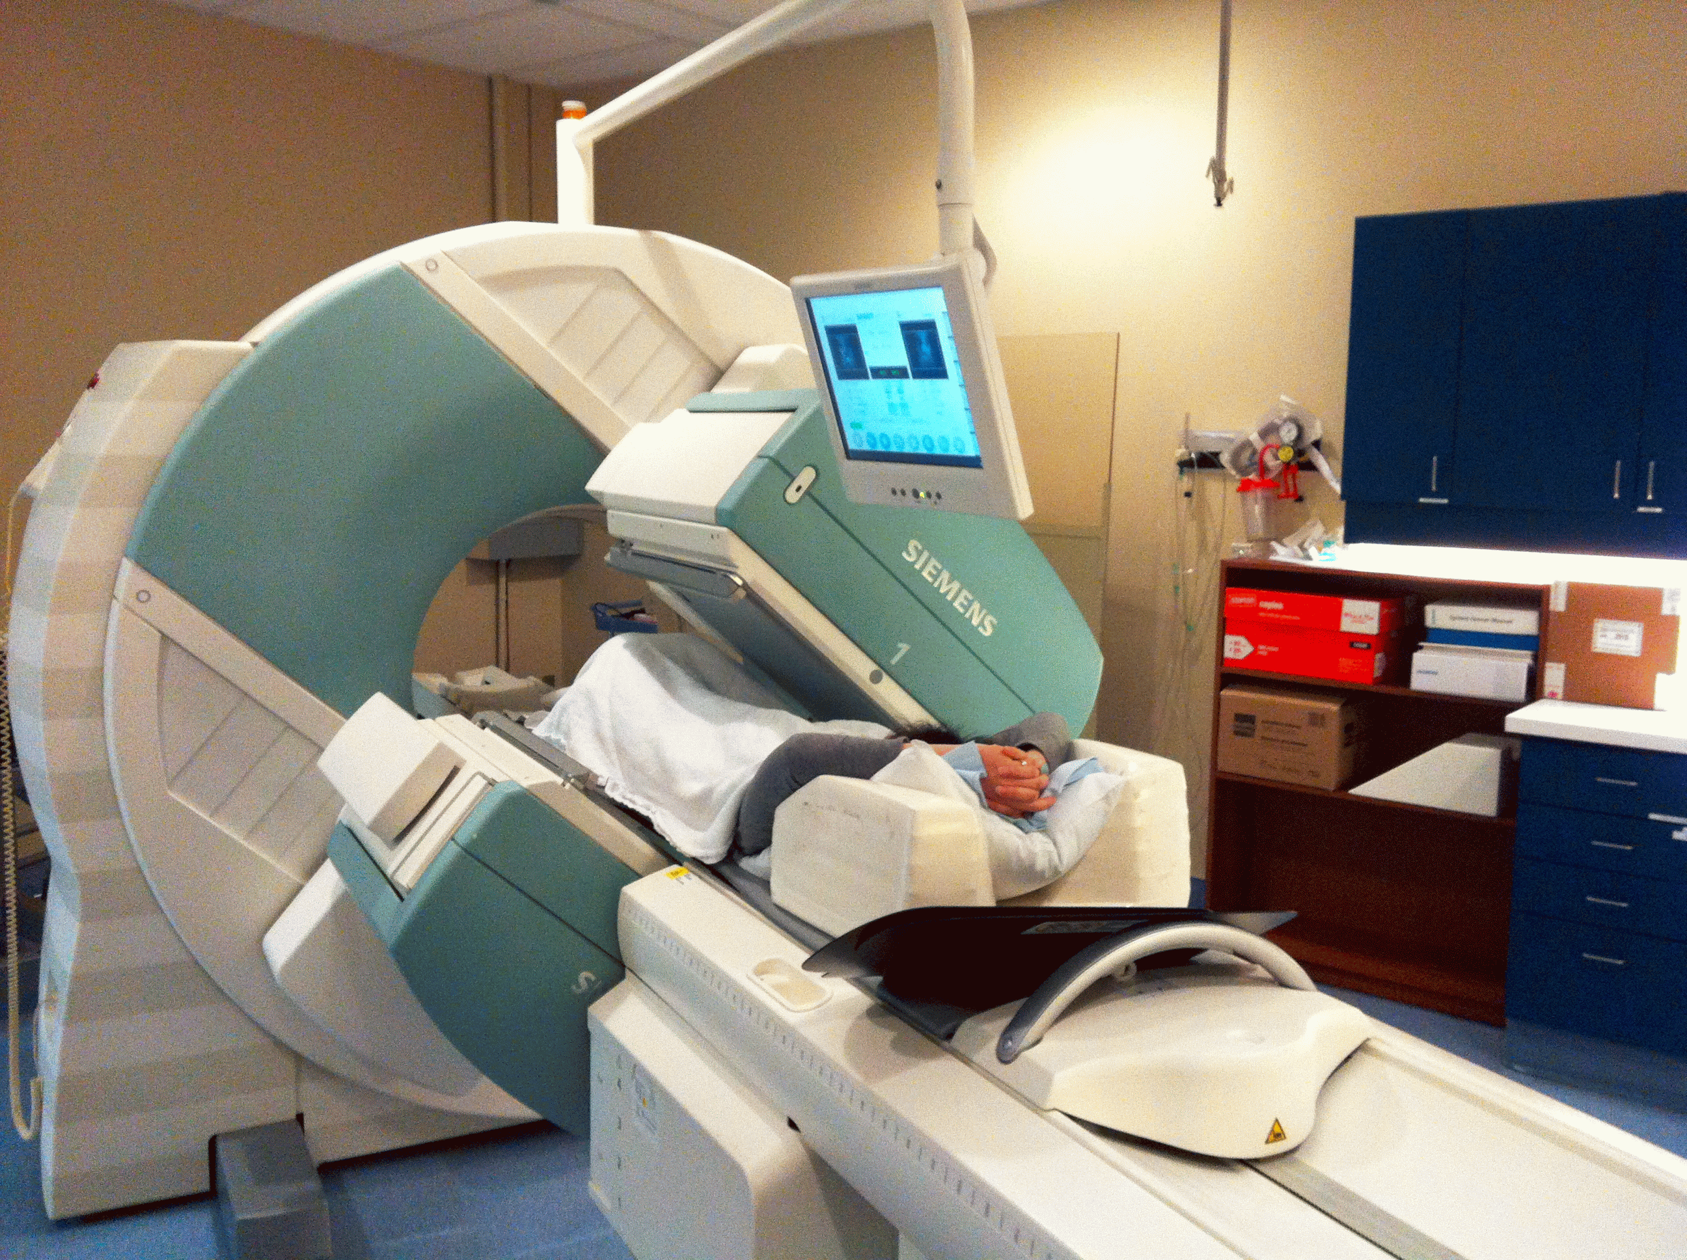
Radiodiagnostické metody
Jednofotonová emisní tomografie (SPECT)
γ-emitující radioisotopy
rozlišení ~1 cm³

Slide 3
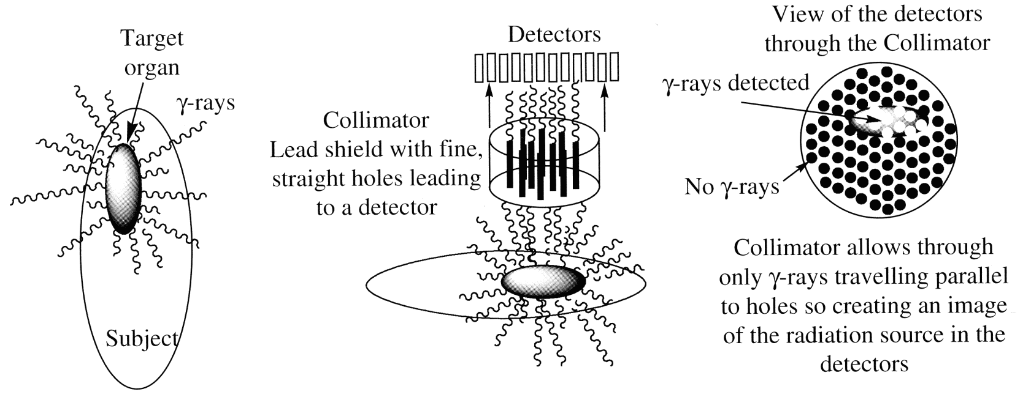
SPECT

Slide 4
Izotopy pro SPECT
Izotop | Přeměna | Poločas | Zdroj
^{99m}Tc | γ | 6 h | generátor, ⁹⁹Mo(β–)^{99m}Tc, 66 h
¹¹¹In | γ | 68 h | cyklotron, ¹¹¹Cd(p,n)¹¹¹In
¹³¹I | γ, β– | 8 d | reaktor
¹⁵³Sm | γ, β– | 46 h | reaktor
¹⁶⁶Ho | γ, β– | 26 h | reaktor
¹⁷⁷Lu | γ, β– | 6.7 d | reaktor

Slide 5
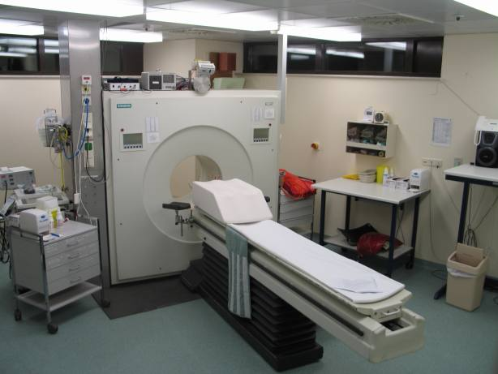
PET

Slide 6
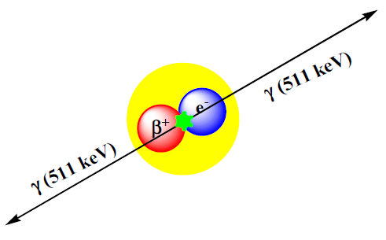
PET
radioisotopes emitting positrons (β+-particles)
annihilation with electrons
two co-linear photons with an energy of 511 keV
detection of both photons at the same time
resolution about 1 mm3
low energy → better resolution

Slide 7
Izotopy pro PET
Izotop | Přeměna | Poločas | Zdroj
¹⁹F | β⁺ | 110 min | cyklotron, ¹⁸O(p,n)¹⁸F
¹¹C | β⁺ | 20 min | cyklotron, ¹⁴N(p,α)¹¹C
⁶¹Cu | β⁺ | 3.3 h | cyklotron, ⁶¹Ni(p,n)⁶¹Cu
⁶⁴Cu | β⁺ | 13 h | cyklotron, ⁶⁴Ni(p,n)⁶⁴Cu
⁶⁶Ga | β⁺ | 9.5 h | cyklotron, ⁶³Cu(α,nγ)⁶⁶Ga
⁶⁸Ga | β⁺ | 68 min | generátor, ⁶⁸Ge(β–)⁶⁸Ga, 288 d
⁸⁶Y | β⁺ | 15 h | cyklotron, ⁸⁶Sr(p,n)⁸⁶Y
¹¹⁰In | β⁺ | 69 min | generátor, ¹¹⁰Sn(β–)¹¹⁰In, 4.11 d

Slide 8
Každá minuta se počítá
Příprava izotopu
Izolace izotopu
Příprava radiofarmaka
Separace radiofarmaka
Analýza radiofarmaka
Doprava k pacientovi
Aplikace pacientovi
Dosažení žádané biodistribuce
Snímkování

Slide 9
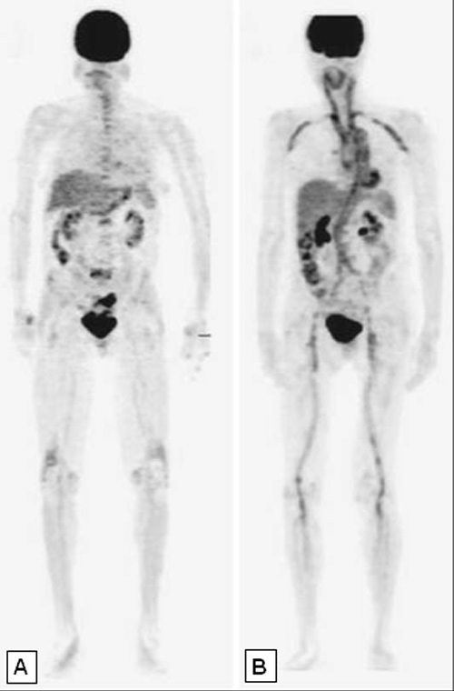
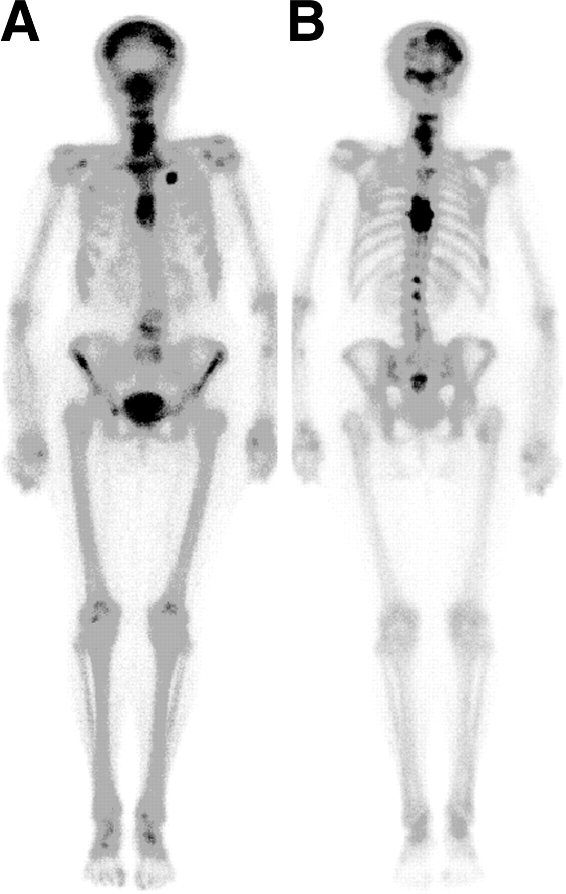
PET vs. SPECT
[18F]-FDG-PET
99mTc-MDP-SPECT

Slide 10
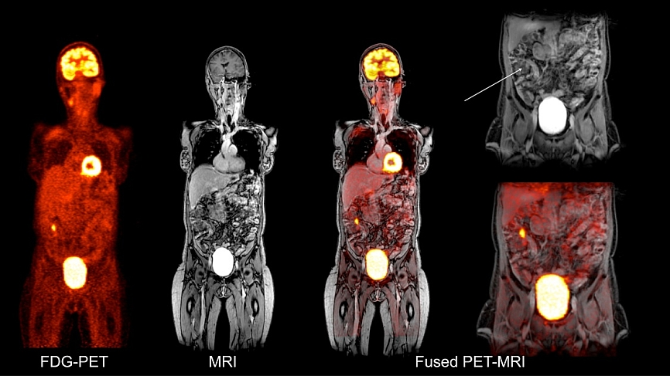
Fused images
localization in tissues – combined techniques with CT or MRI
fused images – PET/CT, PET/MRI, SPECT/CT, SPECT/MRI
multimodal contrast agents

Slide 11
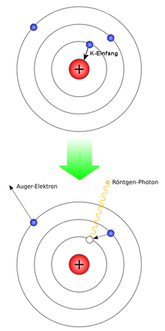
Radiotherapy
Leksell gamma knife
  focuses the radiation from external sources into tumour
internal sources of radiation
  short and defined radius of particles in tissue
  α-emitters
  β−-emitters
  γ-emitters with low energy
  emission of Auger electrons (EC isotopes)
  selective deposition in tumors – half-lives in hours

Slide 12
Radiotherapy
Isotope | Decay | Half-life | Source | Mean range in tissue
⁶⁴Cu | β– | 12.8 h | cyclotron, ⁶⁴Ni(p,n)⁶⁴Cu | 0.2 mm
⁶⁷Cu | β– | 62 h | cyclotron, ⁶⁷Zn(n,p)⁶⁷Cu
⁶⁷Ga | Auger | 3.26 d | cyclotron
⁸⁹Sr | β– | 50.5 d | reactor
⁹⁰Y | β– | 64 h | generator, ⁹⁰Sr(β–)⁹⁰Y | 3.9 mm
¹¹¹Ag | β– | 179 h | cyclotron | 1.1 mm
¹⁴⁹Pm | β– | 2.2 d | reactor
¹⁵³Sm | β– | 1.9 d | reactor
¹⁶¹Tb | β– | 166 h | reactor | 0.3 mm
¹⁶⁶Ho | β– | 1.1 d | reactor
¹⁷⁷Lu | β– | 6.7 d | reactor
¹⁸⁶Re | β– | 90 h | reactor | 1.1 mm
¹⁸⁸Re | β– | 17 h | generator, ¹⁸⁸W(β–)¹⁸⁸Re | 3.3 mm
²¹²Pb | β–/α | 10.6 h/1.01h | reactor | 0.1 mm

Slide 13
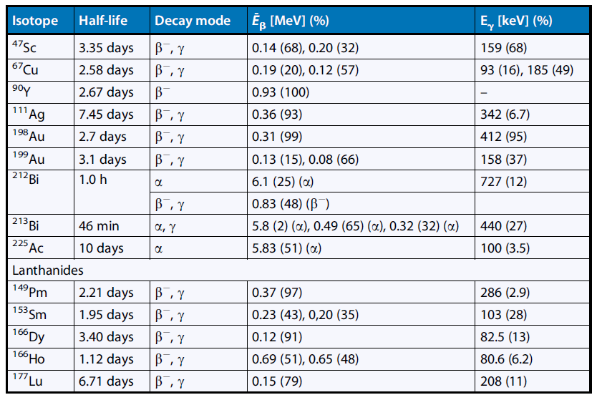
Radiotherapy

Slide 14
Common criteria for radiopharmaceuticals
Selected molecule must be amenable to radiolabelling. Reaction must provide sufficient radiochemical yield, specific activity and must proceed in appropriate time, that means maximally 4, ideally less than 3 half-lives of radioisotope – also depends on half-life itself. Reaction must proceed under reasonable conditions because of automation of procedure in the case of clinical production. Procedure including yield must be reliable and reproducible.
Biodistribution of a radiopharmaceutical must be related to the physiological response to enable measuring functionality of biochemical process under investigation.
High affinity to the target leading to high contrast of a PET image. Interaction between radiopharmaceutical and biomolecules in target tissue must be the major mechanism. Also high specificity for target molecule is essential because interaction with similar targets leads to interference with desired radioactive signal detected by a PET camera.
The lipophilicity (defined as usual partition coefficient between n-octanol and water – log P) that determines ability to cross cell membranes.
Optimal passage of lipid bilayers requires log P ~ 1.5 – 2. Higher log P values result in nonspecific binding caused by hydrophobic interactions with lipids and proteins.
Certain properties as passage across the cell membrane or other barriers like blood brain barrier (BBB). Besides mentioned lipophilicity, also active transport of compounds must be taken in account, e.g. dopamine, serotonin and amino acids.

Slide 15
Common criteria for radiopharmaceuticals
In general, a low affinity to P-glycoprotein (P-gp) is a desirable property for most radiopharmaceuticals. P-gp is an ATP-dependent efflux pump naturally expressed in BBB. It can be over-expressed in tumours. P-gp transports compounds that have high affinity for the pump out of the cell and then radiotracers that have high affinity for P-gp show little accumulation in tissues like brain and tumour.
Metabolism of a radiopharmaceutical is a very important point. Rapid metabolism is generally undesirable. Metabolites can then bind to other molecules or take part in other metabolic processes and result in non-specific accumulation of radioactivity. It is preferable to have the radioisotope in the part of molecule which reaches the target at first and after that is further metabolised. In some cases, metabolism of radiotracer is the mechanism underlying the accumulation of radioactivity in tissue.
Clearance of non-specifically bound radioactivity by the time of measurement PET must be discriminated. This is relevant mainly for labelled macromolecules that slowly diffuse into cells and only small portion is bound to the target of interest. The unbound radiolabelled molecules must leave the cells again and be cleared from the circulation.
Mutagenicity and toxicity, despite the radiophramaceutical is prepared under non-carrier added (NCA) conditions and small mass is administrated to the patient, must be tested. This differs in different countries according to the law. Usually toxicity tests on rodent species and Ames test for mutagenicity are performed at dosages much higher than those applied in PET studies.

Slide 16
Preparation and administration
RCY – RadioChemical Yield
CA – Carrier Added
NCA – Non-Carrier Added

Slide 17
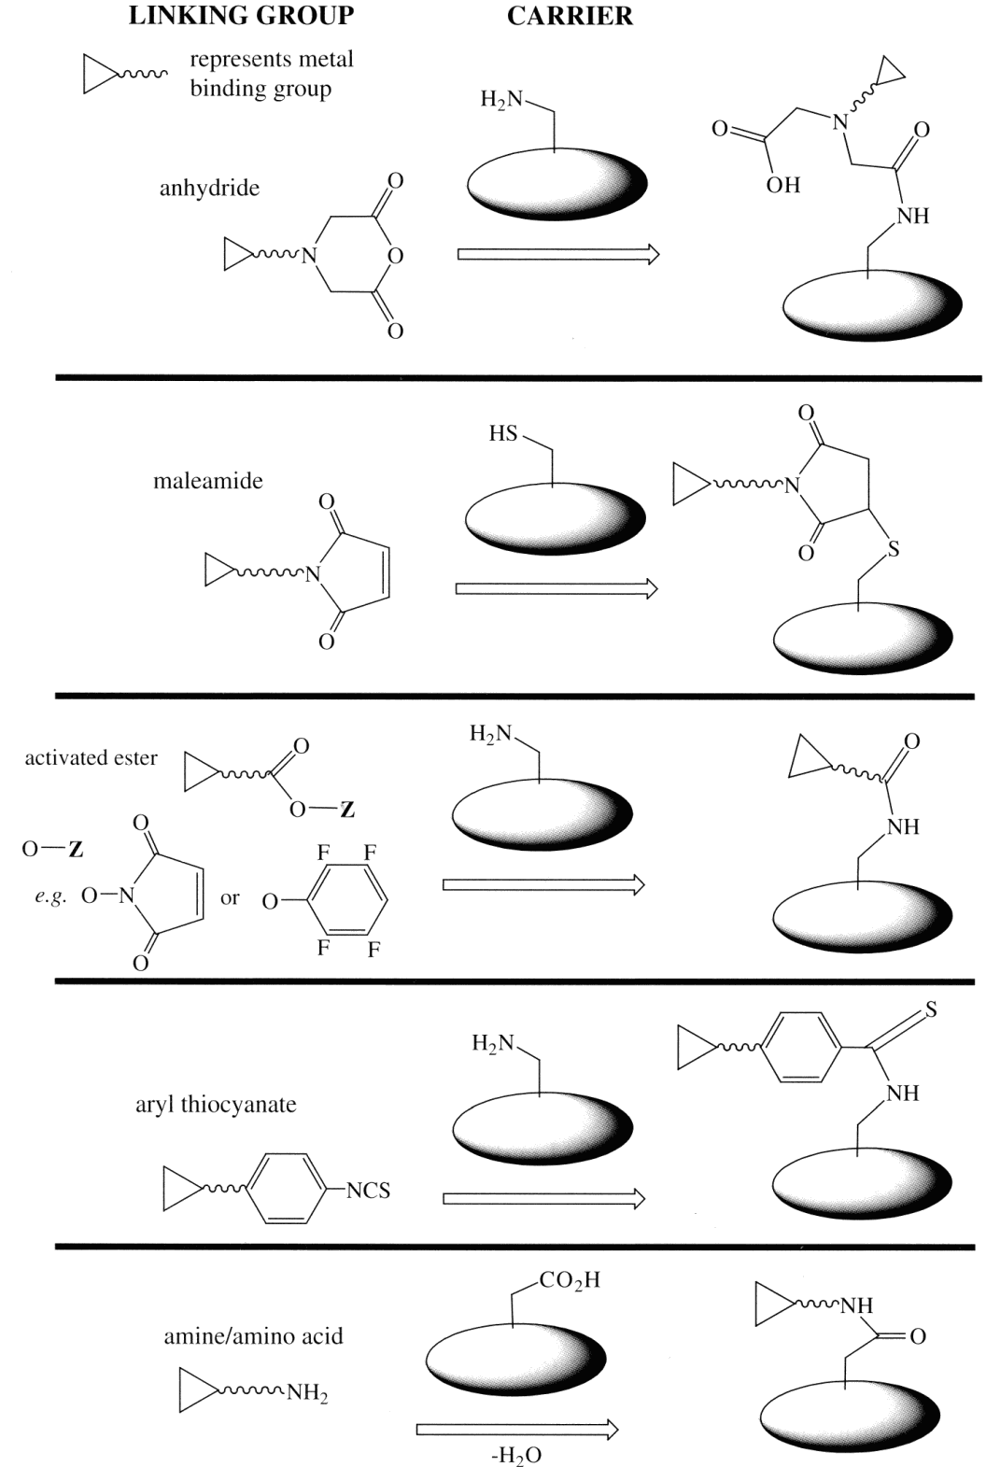
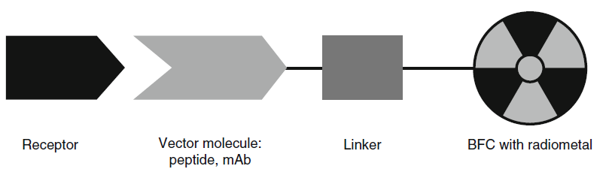
Targeting
vector – selectivity for imaged tissue: peptide, oligosacharide, etc.
chemically sensitive – labelling at mild conditions

Slide 18
Targeting
include a biologically active molecule covalently linked to the complex
e.g.
Progesterone receptor analogues
(prostate cancer)
Cocaine analogues
(CNS diseases)
Notes:
18

Slide 19
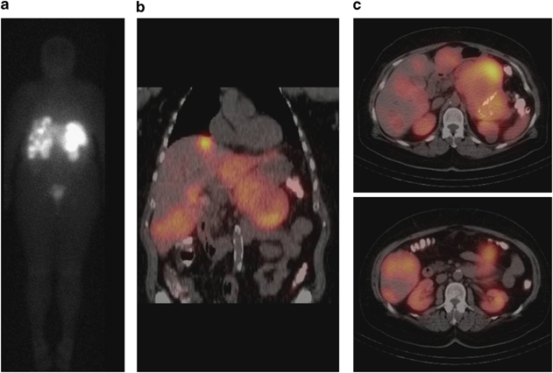
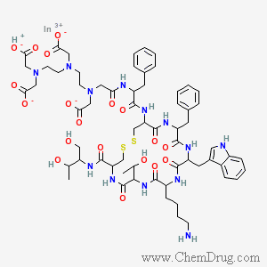
Targeting
Octreoscan – 111In –DTPA-Octreotide
Octreoscan imaging for neuroendocrine tumors.
a) Coronal octreoscan image demonstrating radiotracer uptake in multiple liver metastases and a large pancreatic primary neuroendocrine carcinoma.
(b) Coronal octreoscan fusion images with single photon emission tomography (SPECT) providing increased anatomic detail.
(c) Axial octreoscan fusion images with SPECT.

Slide 20
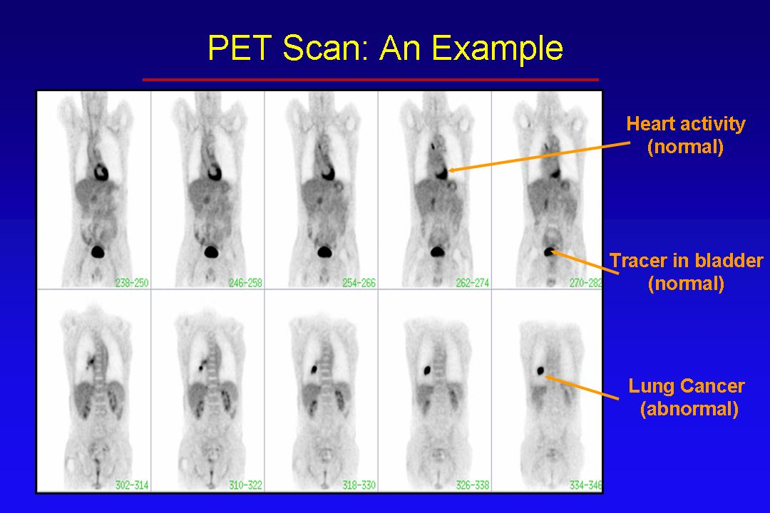

Slide 21
Technetium 99mTc
predicted by Mendeleev
first isolated 1938
20 isotopes (7 relatively stable)
used extensively (>90% of all diagnostic nuclear medicine)
t_{1/2} = 6 h
γ-ray emission energy of 141 keV
versatile coordination chemistry
multiple oxidation states
easily generated from 99Mo (t_{1/2} = 66 h)
Rhenium
186Re, t_{1/2} = 90 h, available from reactor
188Re, t_{1/2} = 17 h, available from 188W(β–)188Re generator
chemical properties similar to Terchnetium: diagnostic/therapeutic isotop-pair
Notes:
21

Slide 22
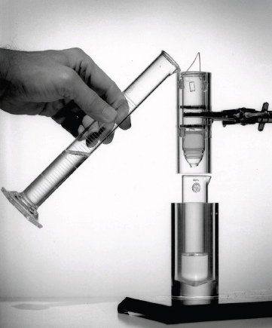
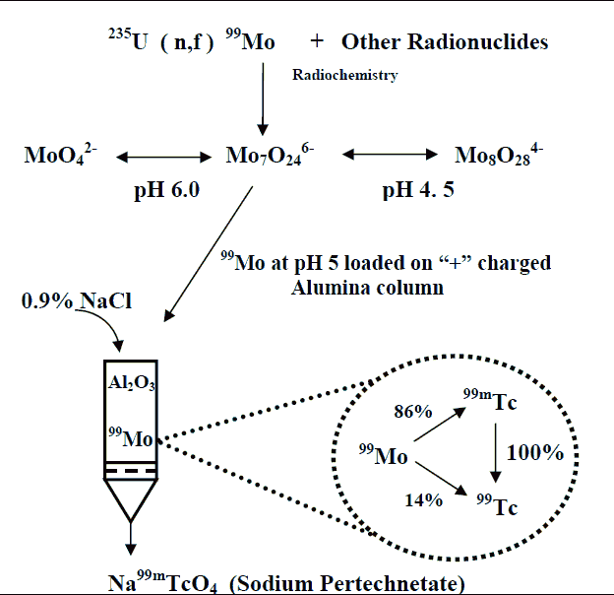
Technetium 99mTc
99Mo/99mTc Generator
patented in 1958
fission-produced 99Mo is processed and purified to anionic molybdate
loading on the positively charged alumina (Al₂O₃) column

Slide 23
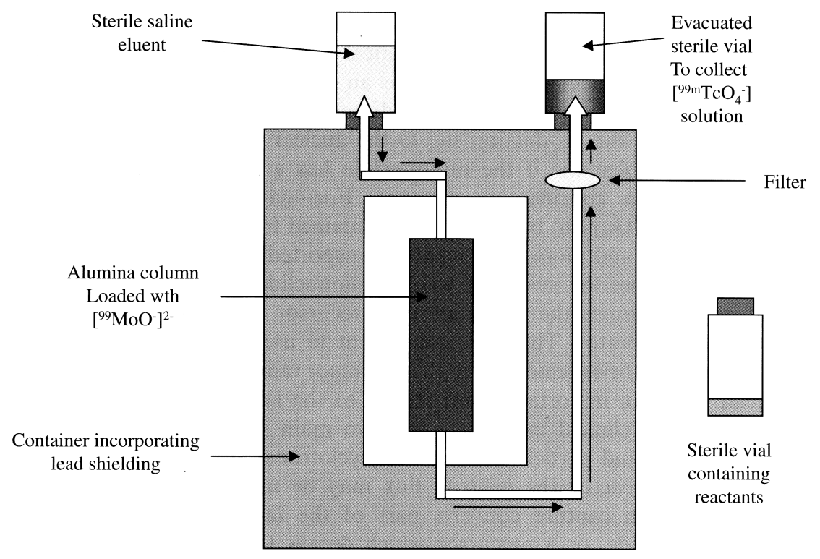
Technetium 99mTc
Radionuklidový generátor

Slide 24
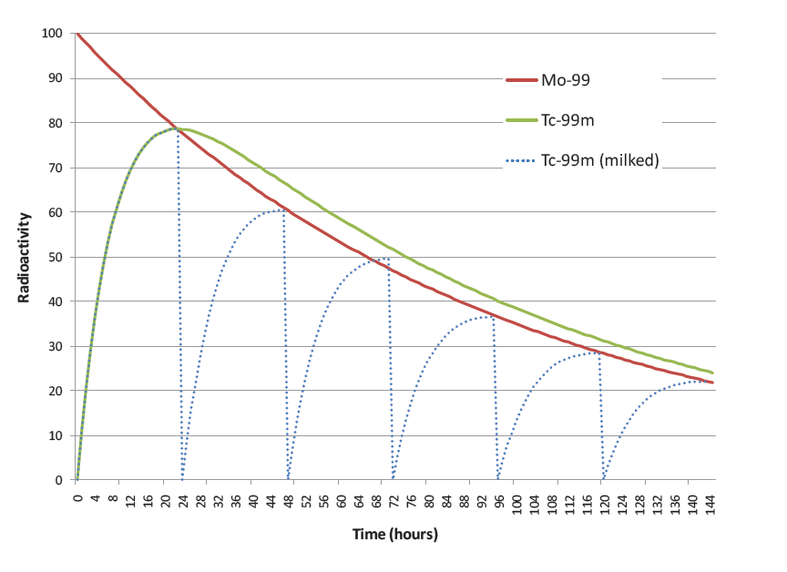
Technetium 99mTc
Počty elucí z generátoru 99mTc

Slide 25
Technetium 99mTc
Chemistry
TcO₄– most stable oxidation state, produced in generator, can not be complexed
insoluble TcO₂
reduction with ascorbic acid, FeCl₂, NaBH₄, Na₂S₂O₄, SnCl₂
– oxidation states IV, V – oxocation technecyl
(disproportionation V → IV + VII)
– oxidation states I, II, III (oxidation → IV)
stabilization of oxidation states with ligands
Technetium kit
reducing agent
coordinating ligand
antioxidants
buffers
lyophilized and sealed under inert atmosphere
Notes:
25

Slide 26
Technetium 99mTc
Pharmacology
bio-distribution and targeting depends much on size and charge:
  neutral – brain
  cationic – hart
  anionic – bones and kidney
so called technetium essential or first generation agent
targeting of other organs requires designer ligands:
  must traverse the blood brain barrier
  moderately lipophilic
  neutral charge
Notes:
26

Slide 27
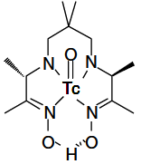
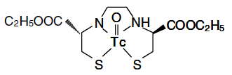
Neutral complexes
– brain imaging
– oxidation states IV, V
Technetium 99mTc

Slide 28
Technetium 99mTc
Cationic complexes
hart imaging
uptake via Na-K ATPase pump as K+ mimics
Cardiolite
Notes:
28

Slide 29
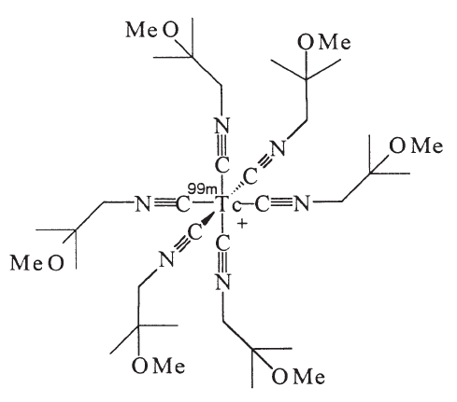
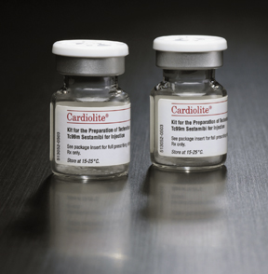
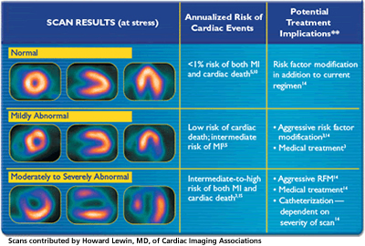
Technetium 99mTc
Cardiolite
Each 5 mL vial contains a sterile, non-pyrogenic, lyophilized mixture of:
Tetrakis (2-methoxy isobutyl isonitrile) Copper (I) tetrafluoroborate – 1.0 mg
Sodium Citrate Dihydrate – 2.6 mg
L-Cysteine Hydrochloride Monohydrate – 1.0 mg
Mannitol – 20 mg
Stannous Chloride, Dihydrate, minimum (SnCl₂•2H₂O) – 0.025 mg
Prior to lyophilization the pH is 5.3 to 5.9. The contents of the vial are lyophilized and stored under nitrogen.
This drug is administered by intravenous injection for diagnostic use after reconstitution with sterile, non-pyrogenic, oxidant-free Sodium Pertechnetate 99mTc Injection. The pH of the reconstituted product is 5.5 (5.0 - 6.0). No bacteriostatic preservative is present.
The precise structure of the technetium complex is 99mTc[MIBI]6+ where MIBI is 2-methoxy isobutyl isonitrile.
Over 40 million people have received cardiac scans using Cardiolite.
Notes:
Cardiolite has now been commercialized and is used to determine heart function and myocardial perfusion
201Tl is also used for heart imaging, but cardiolite is preferred
29

Slide 30
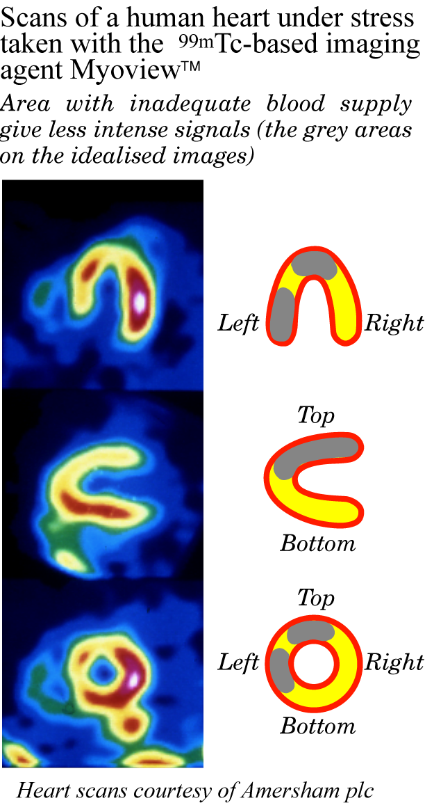
Technetium 99mTc
Imaging agents in action
Myoview = tetrofosmin
Notes:
30

Slide 31
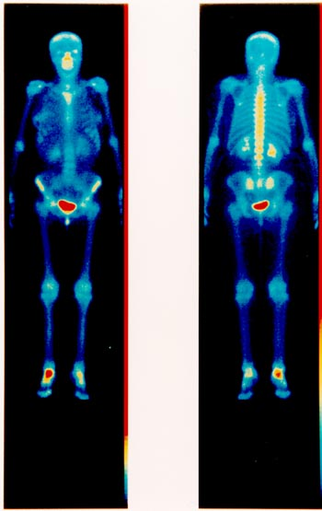
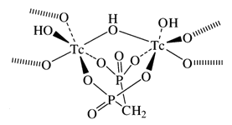
Technetium 99mTc
Bone imaging
hydroxyapatite principal mineral component of bones Ca₁₀(PO₄)₆(OH)₂
phosphate (PO₄3-) and pyrophosphate (P₂O₇2-) bone seeking anions
diphosphonates give improved performance
absorption via calcium coordination to phosphonate
stressed bone has higher calcium concentration
main use to detect cancer metastasis into bone
arthritic right ankle
Notes:
31

Slide 32
Carbon ¹¹C
half-life 20.40 min
decay mode: 99.8 % β+, 0.2 % EC
max β+ energy: 0.96 MeV
range in tissue: 0.96 mm
decay product: 11B
Production
cyclotron-generated: mainly produced by the proton bombardment of 14N
14N(p,α)11C nuclear reaction
target gas:
2% O₂ in N₂ → 11CO₂
5% H₂ in N₂ → 11CH₄

Slide 33
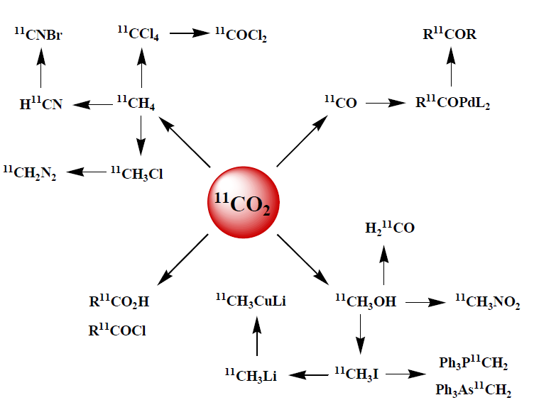
Carbon ¹¹C

Slide 34
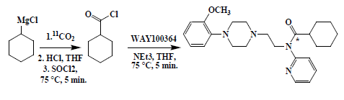

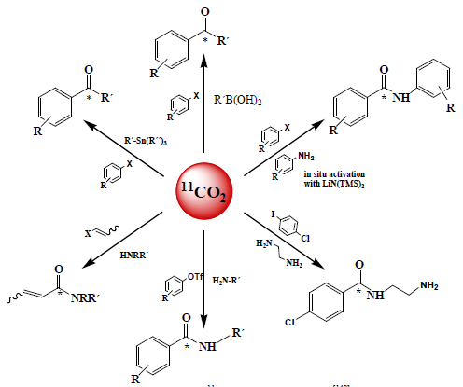
Carbon ¹¹C
Palladium mediated reactions

Slide 35
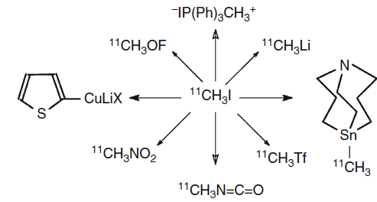
Carbon ¹¹C
11CH₃I
methylation of N –, O –, S – compounds

Slide 36
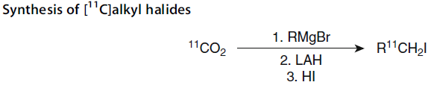
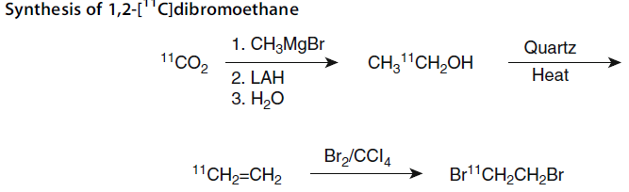
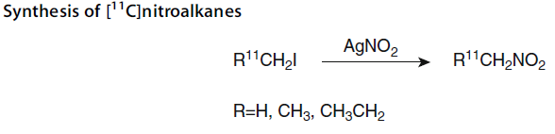
Carbon ¹¹C

Slide 37
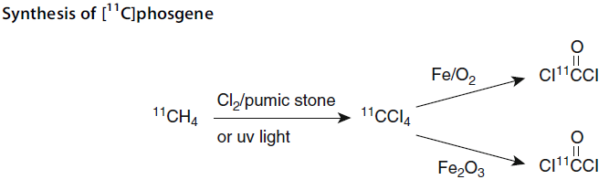
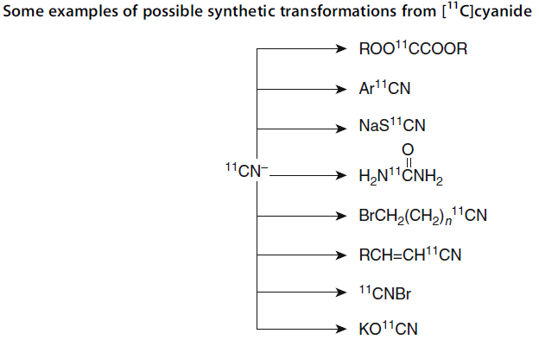
Carbon ¹¹C

Slide 38
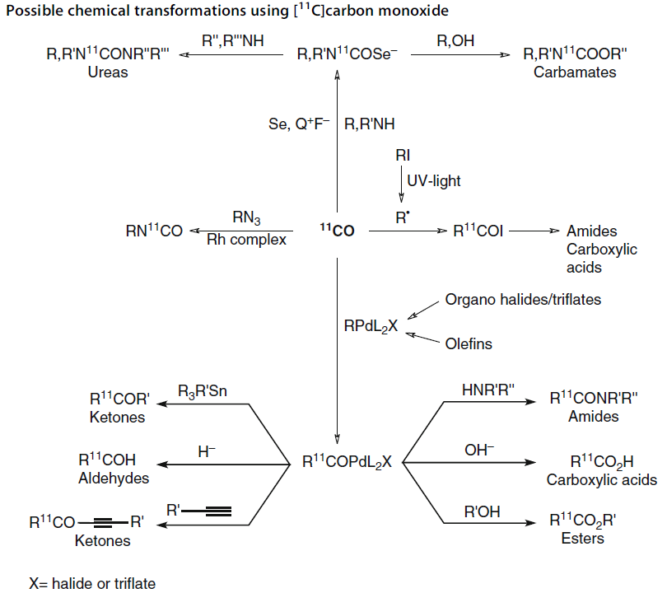
Carbon ¹¹C

Slide 39
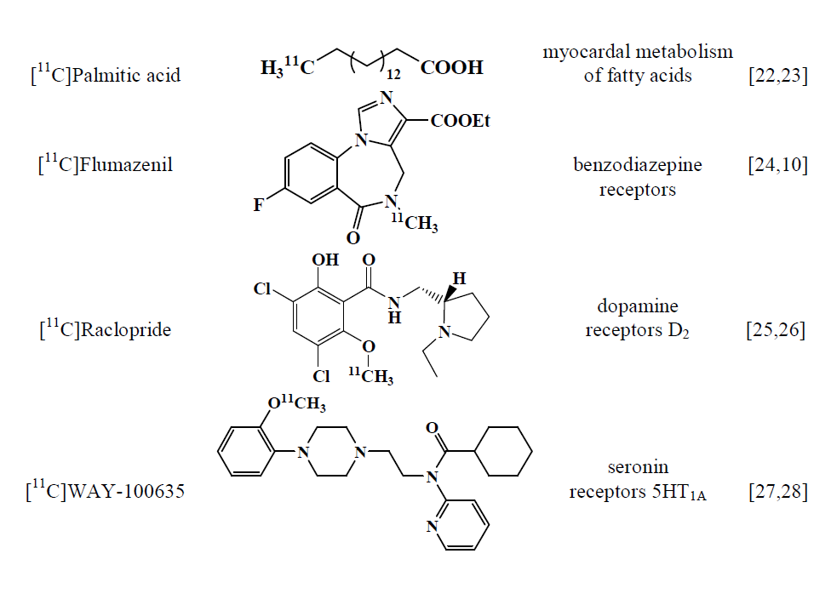
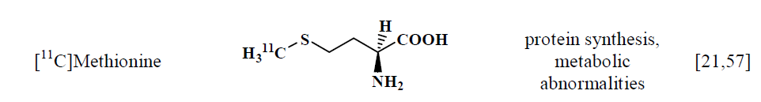
Carbon ¹¹C

Slide 40
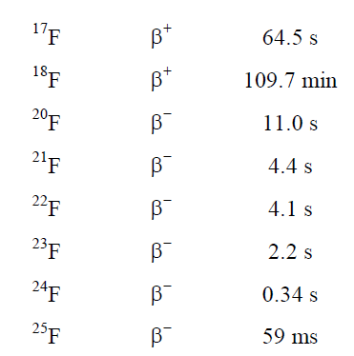
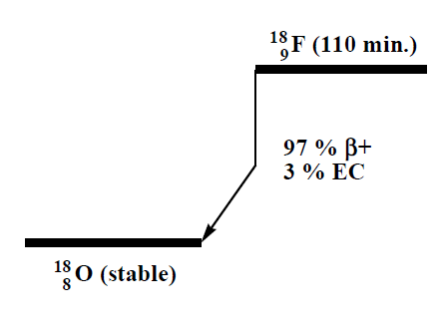
Fluorine ¹⁸ F
half-life 109.7 min
decay mode: 96.9 % β+, 3.1 % EC
max β+ energy: 0.63 MeV
range in tissue: 0.54 mm
decay product: 18O

Slide 41
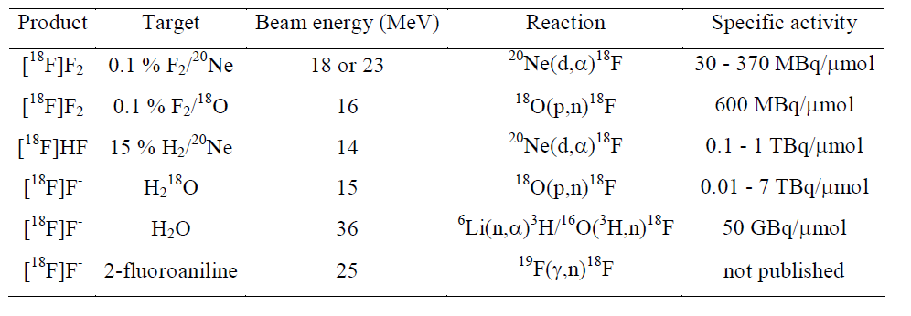
Fluorine ¹⁸ F
Production

Slide 42
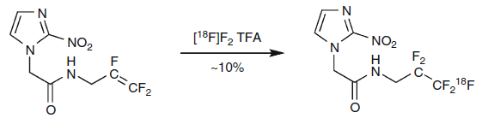
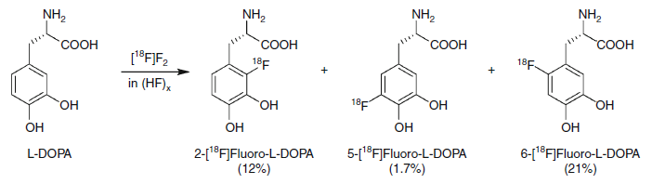
Fluorine ¹⁸ F
Electrophilic 18F-Fluorination
reaction of highly polarized fluorine with an electron rich reactant, e.g., an aromatic system, an alkene, or a carbanion
starting with [18F]F₂ – 50% RCY (molecule compsition 18F–19F)
other fluorination agents [18F]XeF₂, [18F]AcOF

Slide 43
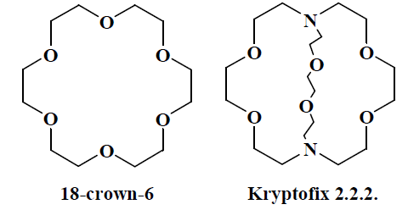
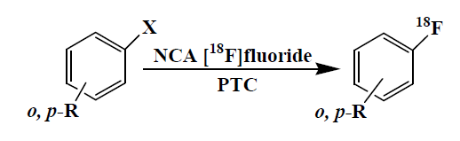
Fluorine ¹⁸ F
Nucleophilic 18F-Fluorination
[18F]fluoride
protonation at low pH
formation of ion pairs with cations – decrease of reactivity
phase transfer catalysis or use of crownethers and cryptands
Nucleophilic Aliphatic Fluorination
R–X + F– R–F + X–
Nucleophilic Aromatic Fluorination

Slide 44
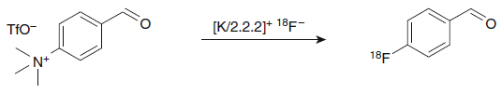
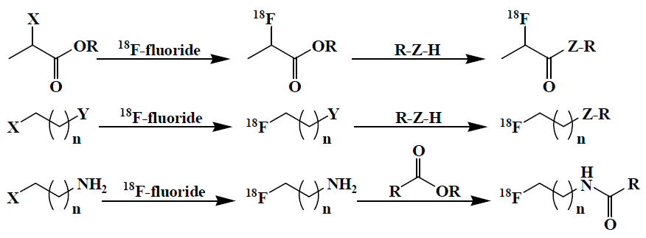
Fluorine ¹⁸ F
Prosthetic groups (PG)
labelled compound containing reactive moiety
fluoromethylation with [18F]FCH₂I or [18F]FCH₂Br
fluoroethylation with [18F]FCH₂CH₂X
other precursors

Slide 45
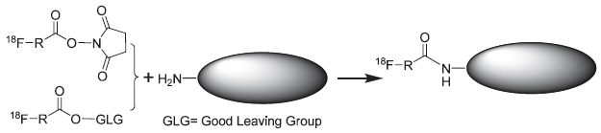


Fluorine ¹⁸ F
Prosthetic groups for biomolecules
enable labelling of peptides and proteins
Amine reactive PGs
Carboxylic acid reactive PGs
Thiol reactive PGs

Slide 46
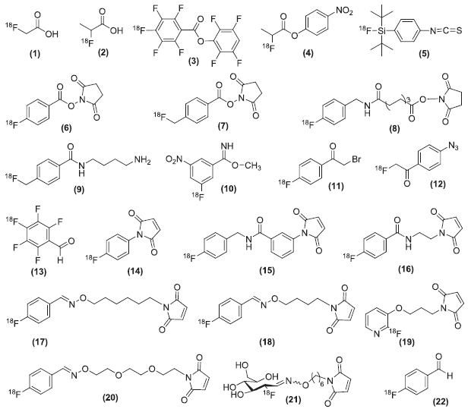
Fluorine ¹⁸ F
Prosthetic groups (PG)

Slide 47



Fluorine ¹⁸ F
18F-FDG: [18F]fluoro-2-deoxy-D-glucose – vyrábí se cyklotronicky v MOÚ
1968, J. Pacák and M. Černý, Department of Organic Chemistry, UK
the most common PET tracer
distribution similar to glucose
can not be metabolized
accumulation in metabolically-active tissues
Whole-body PET scan using 18F-FDG to show liver metastases of a colorectal tumor

Slide 48

Fluorine ¹⁸ F

Slide 49


Iodine isotopes

Slide 50

Metalic nuclides (non-Tc, non-Re)

Slide 51



Complex stability
Thermodynamic stability
proton vs. metal competition
ligand basicity
stability constants

Slide 52
Complex kinetics
Formation kinetic
chemistry – high concentrations; NMR, UV-VIS
radiochemistry – low concentrations
Kinetic inertness
in vitro experiments
  transmetallation (Zn(II))
  decomplexation in acidic solutions
  incubation in plood plasma

Slide 53

Open-chain ligands
high thermodynamic stability
kinetically labile
fast complexation
applied in large excess

Slide 54

Macrocyclic ligands
high thermodynamic stability
kinetically inert
slow complexation
variation of pendant arms
– carboxylates, alcohol, amine, phosphorus derivatives
– changes in stability, inertness, complexation rate, charge, lipophylicity

Slide 55

Bifunctional chelators
Thiourea bond

Slide 56

Gallium ⁶⁸Ga
half-life 67.6 min
decay mode: 89 % β+, 11 % EC
max β+ energy: 1.90 MeV
range in tissue: 2.12 mm
decay product: 68Zn
Generator produced
source 68Ge (T_{1/2} = 271 d)
adsorbed on TiO₂ or SnO₂
elution with HCl or citric acid
Chemistry
trivalent
hexacoordination
hard metal ion
precipitation of hydroxide at wide pH range
formation of tetrahydroxido complex at high pH

Slide 57











Ligands for ⁶⁸Ga complexation
Aminocarboxylates
Hydroxybenzyl and hydroxypyridyl derivatives
Thiol and amino-thiol chelates
Gallium ⁶⁸Ga
R =

Slide 58
Copper isotopes
Isotope | Decay | Half-life | Source
⁶⁰Cu | β⁺ | 24 min | cyclotron, ⁶⁰Ni(p,n)⁶⁰Cu
⁶¹Cu | β⁺ | 3.3 h | cyclotron, ⁶¹Ni(p,n)⁶¹Cu
⁶²Cu | β⁺ | 9.74 min | generator, ⁶²Zn(β–)⁶²Cu, 9.3 h
⁶⁴Cu | β⁺ (61%), β– (39%) | 12.8 h | cyclotron, ⁶⁴Ni(p,n)⁶⁴Cu
⁶⁷Cu | β– | 62 h | cyclotron, ⁶⁷Zn(n,p)⁶⁷Cu
isotopes 60, 61, 62 and 64 – PET
isotopes 64 and 67 – SPECT and therapy
difficult production and isolation
Chemistry
divalent
hexacoordination
Jahn-Teller effect

Slide 59






Ligands for copper complexation
Open-chain ligands
Copper isotopes

Slide 60






Ligands for copper complexation
Macrocyclic ligands
Copper isotopes

Slide 61
Sc, Y, In and Lanthanoides
 | Decay | Half-life | Source
Diagnotic isotopes
⁴⁴Sc | β⁺ | 3.93 h | generator, ⁴⁴Ti(EC)⁴⁴Sc, 59 y or cyclotron, ⁴⁴Ca(p,n)⁴⁴Sc
⁸⁶Y | β⁺ | 14.7 h | cyclotron, ⁸⁶Sr(p,n)⁸⁶Y
¹¹⁰In | β⁺ | 69.0 min | generator, ¹¹⁰Sn(β–)¹¹⁰In, 4.11 d
¹¹¹In | γ | 68 h | cyclotron, ¹¹¹Cd(p,n)⁶⁴In
¹³⁴La | β⁺ | 6.70 min | generator, ¹³⁴Ce(β–)¹³⁴La, 3.0 d
¹⁴⁰Pr | β⁺ | 3.39 min | generator, ¹⁴⁰Nd(β–)¹⁴⁰Pr, 3.3 d
Therapeutic isotopes
⁹⁰Y | β– | 64 h | generator, ⁹⁰Sr(β–)⁹⁰Y, 28.8 y
¹⁴⁹Pm | β– | 2.2 d | reactor
¹⁵³Sm | β– | 1.9 d | reactor
¹⁶¹Tb | β– | 166 h | reactor
¹⁶⁶Ho | β– | 1.1 d | reactor
¹⁷⁷Lu | β– | 6.7 d | reactor

Slide 62




Sc, Y, In and Lanthanoides
Chemistry
octa- or nona-coordination
octadentate ligands
hard metal ions

Slide 63

Radiochemical research
Bisphosphonate-containing dota-amides
ligand synthesis and characterization
chemical complexation study
labelling (complexation of radionuclide)
– pH, temperature, ligand concentration
affinity and stability study
Affinity
Labeling

Slide 64




Radiochemical research
Biodistribution of 177Lu-complexes in Lewis rat 24 h after injection

Slide 65


Radiochemical research
In vivo SPECT/CT visualization of 177Lu-complex
1 h p.i.
24 h p.i.

Slide 66
Radiochemical research
64Cu complex

Slide 67

Radiochemical research
PET/CT imaging of bone metastases with 68Ga-complex
(a) = coronal PET, (b) = sagittal PET/CT. For comparison (c) shows 18F-fluoride PET.
University of Mainz, Zentral Klinik Bad Berka

Slide 68

Radiochemical research
68Ga-complex

Slide 69

Děkuji za pozornost!

