Slide 1
Bioelectrochemistry
ELECTROCHEMICAL ANALYSIS OF NUCLEIC ACIDS, PROTEINS AND POLYSACCHARIDES IN BIOMEDICINE
Iveta Třísková
Notes:
Tuto šablonu lze použít jako počáteční soubor pro prezentaci výukových materiálů při práci ve skupině.
Oddíly
Po kliknutí na snímek pravým tlačítkem myši lze přidat oddíly. Oddíly mohou pomoci uspořádat snímky nebo usnadnit spolupráci mezi více autory.
Poznámky
Oddíl Poznámky použijte k zadání poznámek k doručení nebo dalších podrobností pro posluchače. Tyto poznámky lze zobrazit během prezentace.
Vezměte v úvahu velikost písma (důležité pro usnadnění, viditelnost, pořízení videozáznamu a online provoz).
Sladěné barvy
Věnujte zvláštní pozornost obrázkům, grafům a textovým polím.
Zvažte, zda účastníci budou tisknout černobíle nebo ve stupních šedé. Provedením zkušebního tisku ověřte, zda barvy fungují správně při vytištění černobíle i ve stupních šedé.
Obrázky, tabulky a grafy
Vsaďte na jednoduchost: pokud je to možné, použijte konzistentní a nerušivé styly a barvy.
Označte popisky všechny grafy a tabulky.

Slide 2
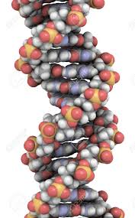
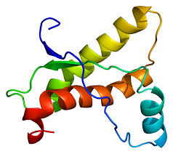
Outline
Introduction to electrochemical methods
Electrochemistry of nucleic acids and their components
Electrochemistry of proteins
Electrochemistry of polysaccharides
Biosensors
Nanoelectrochemistry

Slide 3
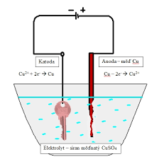
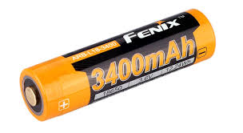
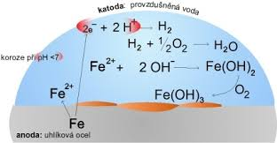
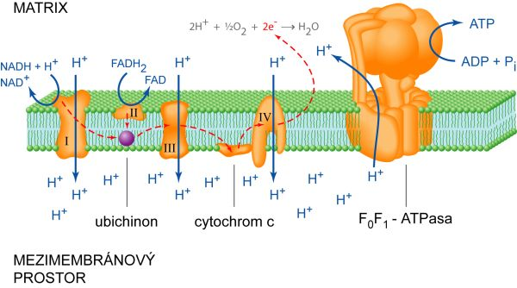
Electron transfer
Electrolysis
Redox reactions
Battery
Electron transfer system

Slide 4
Introduction to electrochemical methods

Slide 5
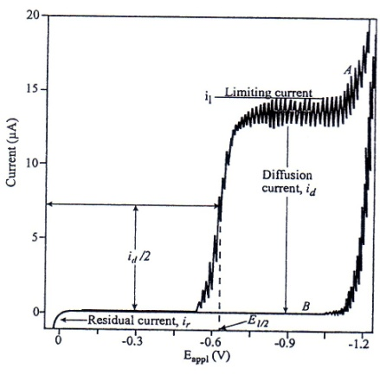
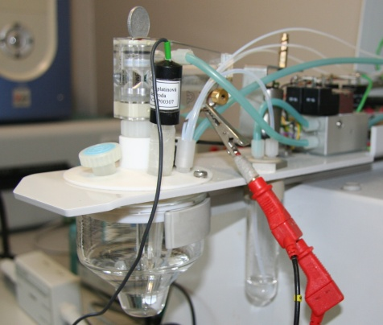
Polarography
1922 – Jaroslav Heyrovský
Electrolysis of the electroactive compound in the supporting electrolyte
The potential is insert between working (Hg) and reference electrode (Ag/AgCl/3M KCl)
Polarographic wave
Electrode polarization

Slide 6
Polarographic (voltammetric) currents
Charging current
Important for electrode double layer charging
Non-faradayic character
Migration current
Associated with transport of electroactive compound to the electrode surface
Eliminated with addition of big amount of supporting electrolyte
Diffusion current
For reactions when the rate determinig step rds is diffusion
1934 – Dionýz Ilkovič
Illkovič equation

Slide 7
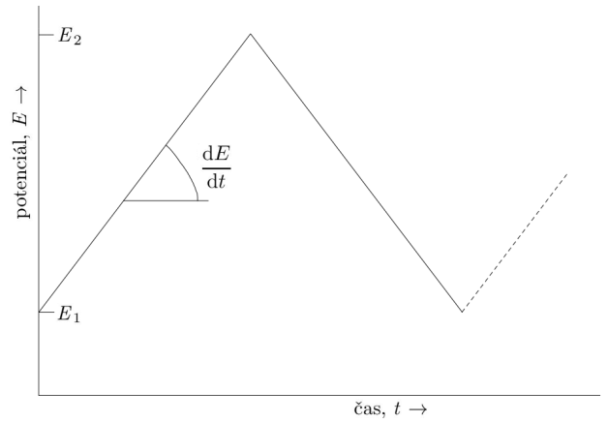
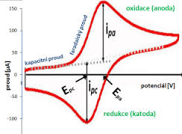
Cyclic voltammetry and Linear sweep voltammetry
Electrolysis of electroactive compounds in the supporting electrolyte
Three electrode set
dE/dt (scan rate)
Voltammetric signals have a peak shape
The study of redox reactions – mechanism of electrode reaction and its reversibility

Slide 8
Cyclic voltammetry
Reversible processes: Randles – Ševčík equation
where I_{p} is peak current (A); n number of electrones; A effective area of electrode (cm²); D is diffusion coefficient (cm²/s); c_{ox} is concentration (mol/cm³) a v is scan rate (V/s).
Irreversible processes: Delahay equation
where α is charge transfer coefficient; n_{a} is number of electrones in rate determining step (rds)

Slide 9
Elimination voltammetric procedure
Elimination voltammetric procedure (EVP) – developed parralel with elimination polarography (EP), but compared to EP, EVP is easier, faster and it is possible to apply it at solid electrodes
EVP – mathematic procedure eliminating/conserving some of partial voltammetric currents (diffusion, charging, kinetic) from measured LSV or CV curves
Elimination function as linear combination of total currents measured at different scan rates

Slide 10
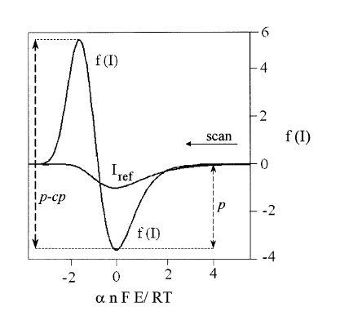
The two basic conditions of EVP
1st condition
I = I_{d} + I_{k} + I_{c} + ...…
2nd condition
I_{d} …diffusion current
I_{k} …kinetic current
I_{c} …charging current
EVP E4
I_{k} + I_{c} = 0
I_{d} ≠ 0
f (I) = - 11,657 I_{1/2} + 17,485 I - 5,8284 I₂

Slide 11
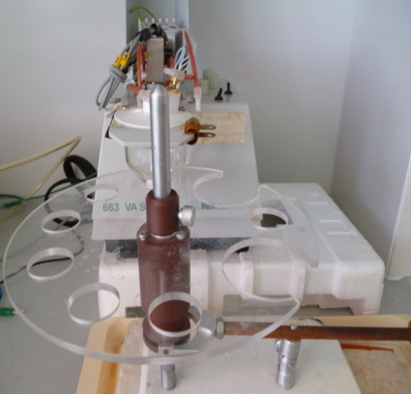
Adsorptive transfer stripping voltammetry (AdTSV)
PA buffer
pH 1.8, 5.8 or 12.8 t_{a} = 120 s
DNA or RNA
adsorption
Rinsing in MILI Q water
Voltammetric analysis in PA buffer; pH 5.8

Slide 12
Differential pulse voltammetry
ΔI = I₂ – I₁
Potential, V
I₂
I₁
I₂-I_{1,} A
doba kapky
time, t
Potential, V

Slide 13
Square-wave voltammetry
Ramaley and Krause
ΔI = I_{f} - I_{b}
Forward sample
Potential E
ΔE_{p}
E_{i}
ΔE_{s}
t_{p}
0
Backward sample
I_{total}
Time
I_{forward}
I_{backward}

Slide 14
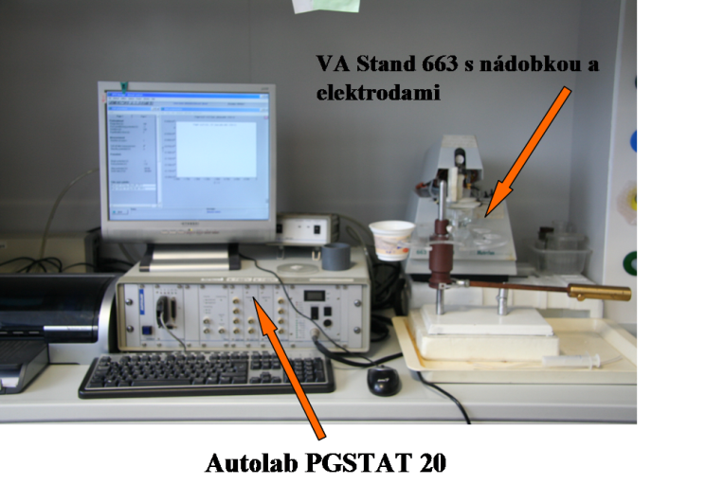
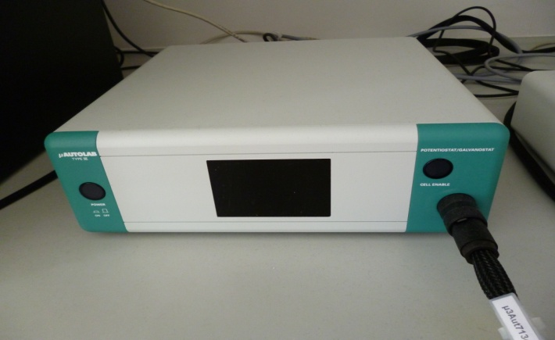
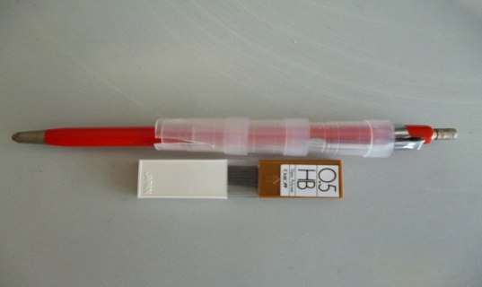
Equipments
Electrochemical analyzers:
AUTOLAB PGSTAT 20 (Eco Chemie, Utrecht, The Netherland)
μAUTOLAB TYPE III (Metrohm, Switzerland)
GPES Manager 4.9
Hanging Mercury Drop Electrode (HMDE)
Polymer pencil graphite electrode(pPeGE)

Slide 15
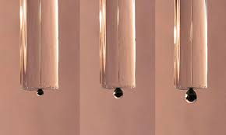
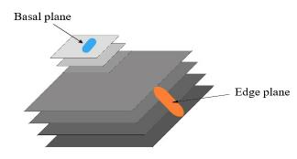


Electrodes
Hanging Mercury Drop Electrode (HMDE)
Graphite electrodes
Polymer pencil graphite electrode
Pyrolytic graphite electrodes
Basal plane pyrolytic graphite electrodes
Edge plane pyrolytic graphite electrodes
Inner structure of EPPG a BPPG electrodes

Slide 16
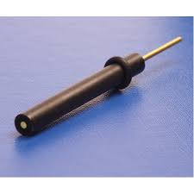
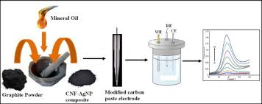
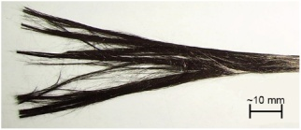
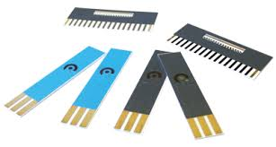
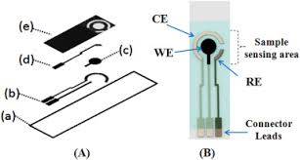
Graphite electrodes
Glassy carbon electrodes
Carbon paste electrodes
Carbon fibre electrodes
Boron dopped diamond electrodes
Screen printed electrodes

Slide 17
Nucleic acids

Slide 18
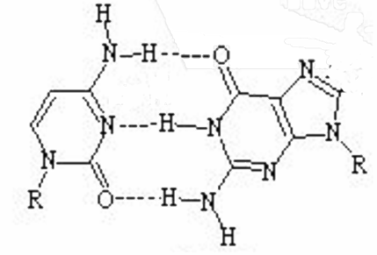
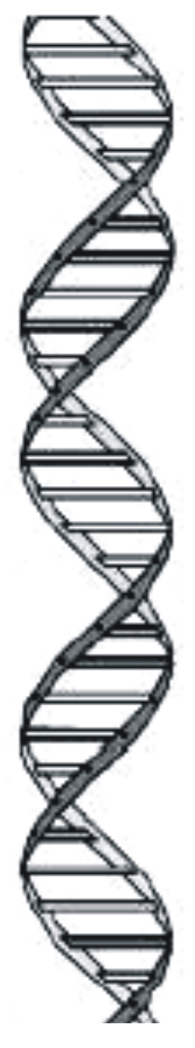
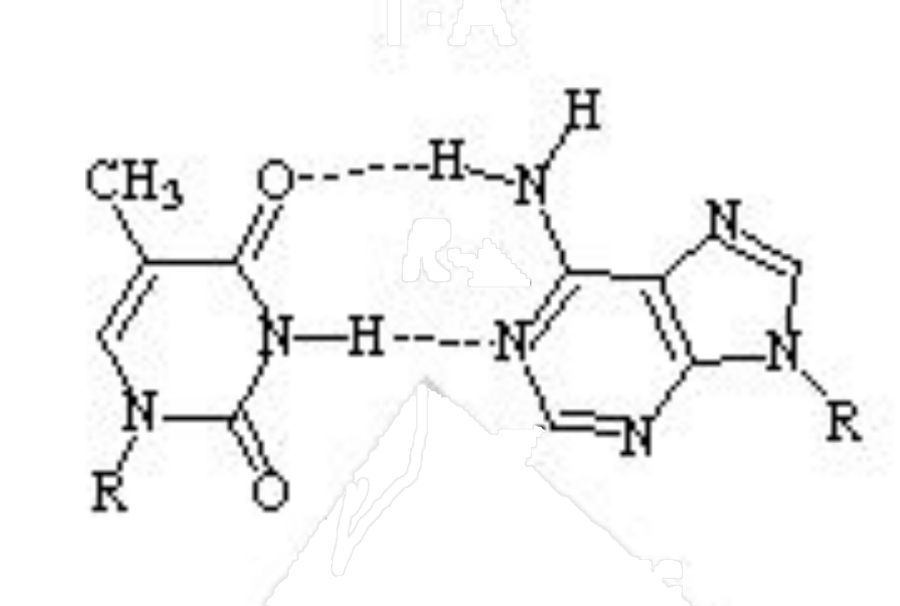
Nucleic acids and their components
A
pyrimidine bases
purine bases
D
DNA double helix
5’
3’
thymine (T)
cytosine (C)
adenine (A)
guanine (G)
major groove
B
C
T•A
2-deoxyribose
minor groove
base pairs
minor groove
nucleotide
Base pairs
major groove
phosphate
sugar-phosphate backbone
C•G

Slide 19
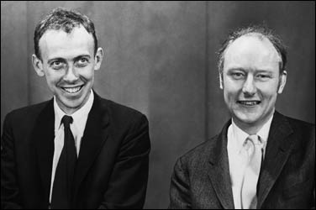
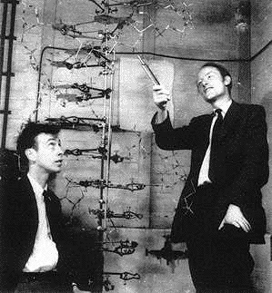
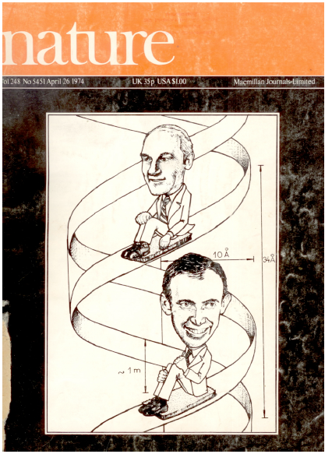
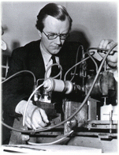
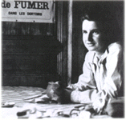
1953: James Watson, Francis Crick, Rosalind Franklin, Maurice Wilkins: DNA double helix
1962: Nobel prize (JW, FC, MW)
Explanation of the basic principles of preservation, transmission and expression of genetic information

Slide 20
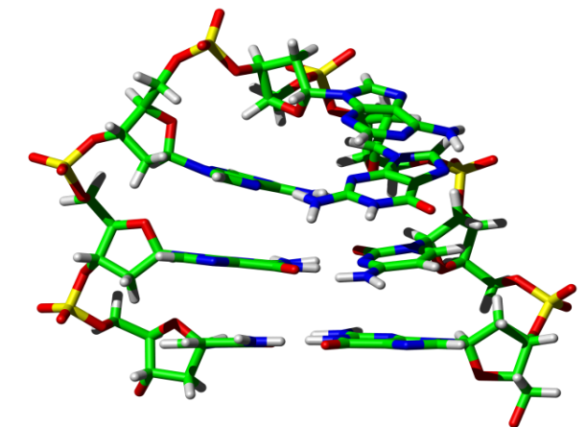
Hairpins
LOOP
A
G
A
T_{m} of DNA heptamer = 76 °C (0.1 M NaCl)
C
G
STEM
G C
5' 3'
The shortest and thermodynamically the most stable hairpin - DNA heptamer d(GCGAAGC) – replication origins of phage ФX 174 and herpes simplex virus, promotor regions of heat – shock genes of bacteria E. coli and rRNA genes
20

Slide 21
Hairpins
Hairpins are linked with triplet repeats expansion associated with many neurodegenerative diseases (fragile chromosome syndrom, Huntington disease, Friedriech’s ataxia)
Analysis of hairpins:
d(GCGAAGC):
UV, T_{m} (Hirao 1989, Yoshizawa 1994, 1997), NMR (Hirao 1994, Yoshizawa 1997, Padrta 2002, Sychrovský 2002), Ramanova spektroskopie (Chraibi 2000), electrophoresis (Hirao 1989, Yoshizawa 1994, 1997), CD (Hirao 1989), X – ray analysis (Sunami 2004), molecular dynamics (Nakamura 1999, Padrta 2002), electrochemistry (Trnková 2004)
21

Slide 22
G - quadruplexes
Stabilized by G-quartets (four molecules of guanine bound by Hoogsteen hydrogen bonds)
Especially formed in presence of Na⁺ a K⁺ ions
Structural polymorphism
Four - stranded tetraplex
Double - stranded intra-molecular tetraplex
Single - stranded intra-molecular tetraplex
22

Slide 23
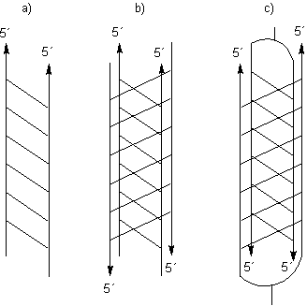
I - motifs
Hemiprotonized C – C⁺ pair as the basic structural unit
Formed at acidic or neutral pH
Diabetes mellitus and triplet repeats expansion linked with many neurodegenerative diseases
Structural polymorphism
Double-stranded structure
Four-stranded structure
Four-stranded structure with labeled ends
23

Slide 24

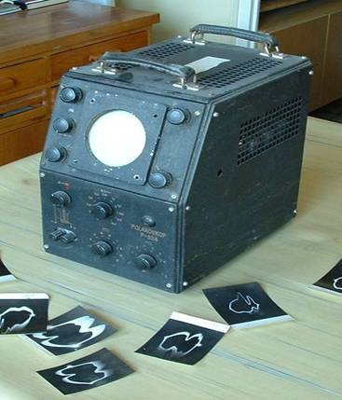
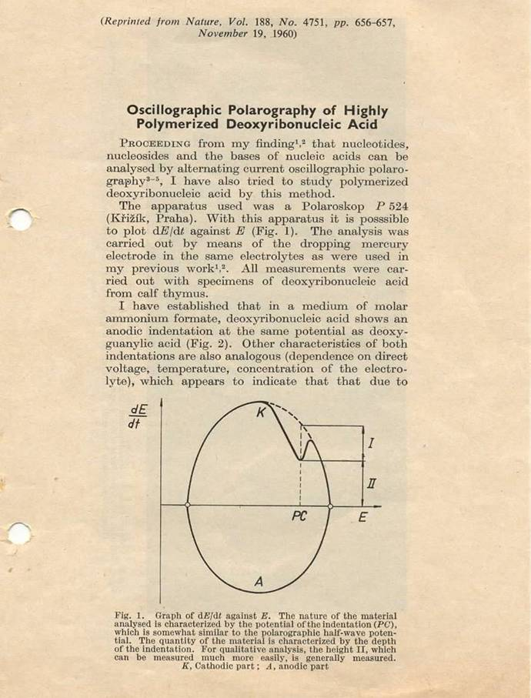
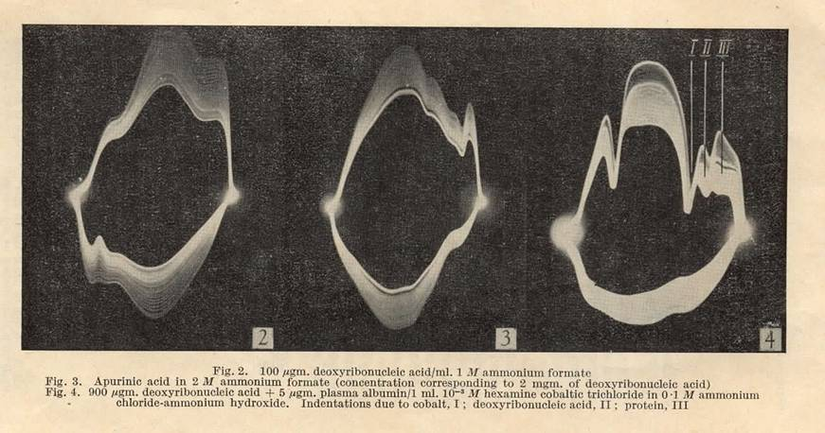
More than 55 years ago, Emil Paleček: DNA polarography (1960)
Oscillopolarography

Slide 25
Nucleic acids are electroactive
Mercury electrode: redox processes of A,C a G bases
Carbon electrodes: oxidation of purine and pyrimidine bases
Copper electrode: oxidation of sugar moieties in NA
Singhal, P.; Kuhr, W. G.: Anal. Chem. 1997, 69, 3552-3557; Anal. Chem. 1997, 69, 4828-4832.

Slide 26
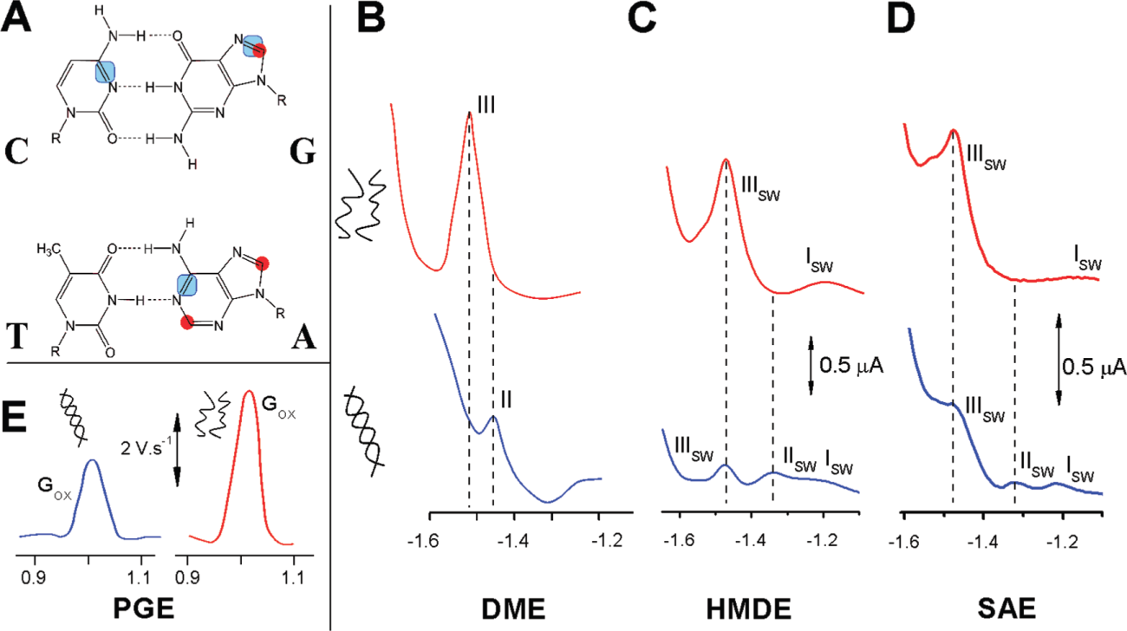
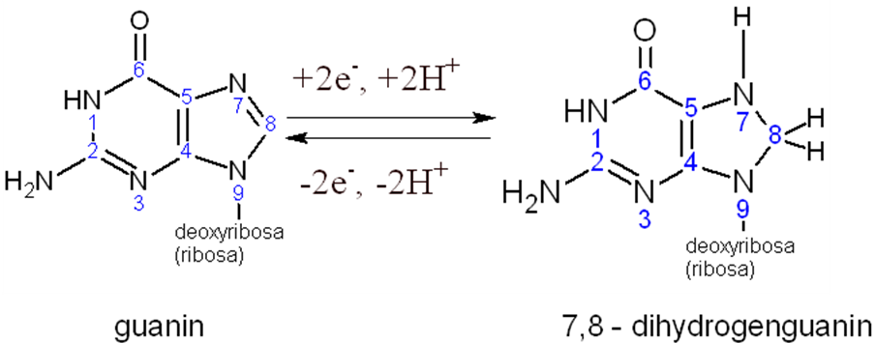
Electrochemistry of NA and ODN
Paleček, E., Bartošík, M.: Electrochemistry of Nucleic Acids. Chem. Rew., 2012
DNA
d(GCGAAGC)

Slide 27
DNA vs. RNA
DNA
RNA
oxidace
redukce

Slide 28
DNA heptamers with different sequence in molecule center
LSV
AAA CCC GAA GGG
EVP
EVP

Slide 29
The pH effect for d(GCGAAGC)
4,2
5,12
5,5
5,6
5,99
6,1

Slide 30
The concentration effect for (GCGAGC)
45 nmol·l⁻¹
90 nmol·l⁻¹
135 nmol·l⁻¹
180 nmol·l⁻¹
225 nmol·l⁻¹
315 nmol·l⁻¹
405 nmol·l⁻¹
495 nmol·l⁻¹
675 nmol·l⁻¹
855 nmol·l⁻¹
EVP
EVP

Slide 31
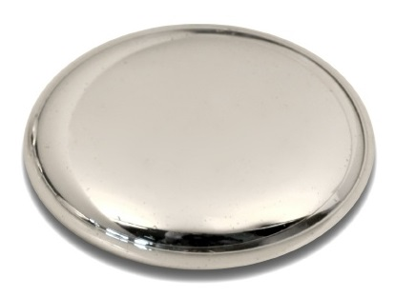





ADSORPTION
ELIMINATION
I_{p}
E1
E6
E5
c
d(GCAAAGC)
d(GCCCCGC)
d(GCGAAGC)
d(GCGGGGC)

Slide 32
Electrochemistry of purine and purine derivatives
The typical electroactive compounds
1962 - Smith a Elving – the first study of electrochemical reduction of purine and adenine by using polarography and coulometry on mercury dropped electrode (DME).
The two-step 2e⁻ reduction

Slide 33
Electrochemical reduction of adenine
Smith and Elving (1962)
6 e⁻ reduction process is accompanied by deamination process (e.g. coulometry)
Polarographic reduction is finished in point III (formation of 1,2,3,6-tetrahydro-6-aminopurine)
Problem of adenine reduction at pH > 6

Slide 34
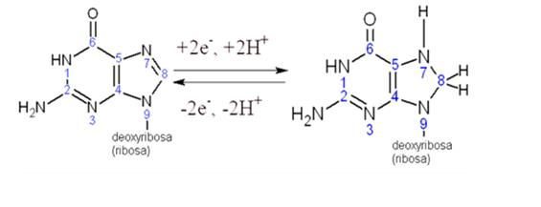
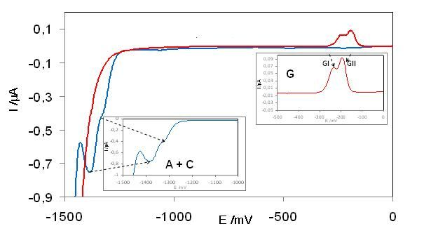
Electrochemical reduction of guanine
guanine
7, 8 - dihydrogenguanine
Anodic part
Cathodic part
d(GCGAAGC)

Slide 35
Electrohemical reduction of cytosine
Elving (1972)
Reduction is initialized by fast protonation of cytosine(I) in N-3 position to electroactive form(II). The two-electron reduction of N-3=C-4 follows and karbanion (III) is formed.
The reduction in polarography and volatmmetry is finished by 4-amino-
3,4-dihydrogenpyrimidine-2-on (IV) formation
The other intermediates is possible to obtain by using electrolysis or coulometry

Slide 36
Electrochemical oxidation of adenine
Dryhurst, Compton
6e⁻ and 6 H⁺ electrode process

Slide 37
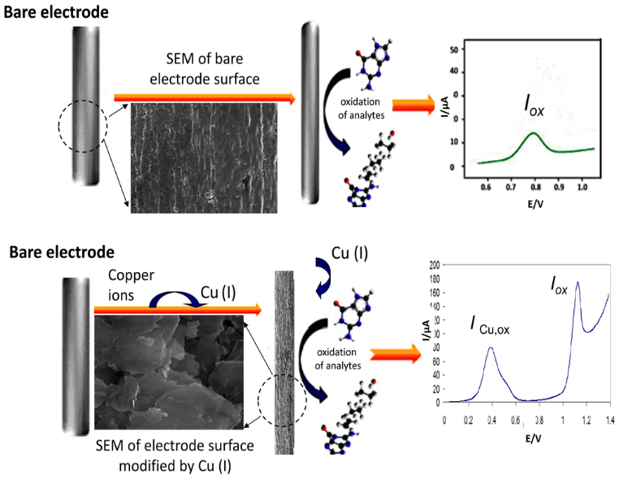
(V.Sharma, F. Jelen and L. Trnkova: Sensors, 2015, 15(1), 1564-1600)

Slide 38
The complex formation and its oxidation can be described by the following scheme:
1. Cu(II) + e⁻ → Cu(I) (at a deposition potential of 0.15 V)
2. Cu(I) + purine → [Cu(I)-purine] (in the reaction layer on PeGE surface)
3. [Cu(I)-purine] → [Cu(I)-purine]_{ads} (adsorption of the complex)
4. [Cu(I)-purine]_{ads} – e⁻ → [Cu(II)-purine]_{ads} (oxidative stripping, peak Ox_{Com})
5. [Cu(II)-purine]_{ads} – e⁻ → purine_{ox} + Cu(II) (oxidative stripping, peak Ox)

Slide 39
Electrochemical oxidation of guanine
Dryhurst
4e⁻ and 4 H⁺ electrode process

Slide 40
Before 1990…
Year
1962-1966 | ssDNA and dsDNA resolution
1967 | DNA damage detection
1967 | Interaction of DNA with low molecular weigth ligands
1978 | Application of solid electrodes
1981-1983 | DNA labeling with electroactive substance
1986 | DNA-modified electrodes

Slide 41
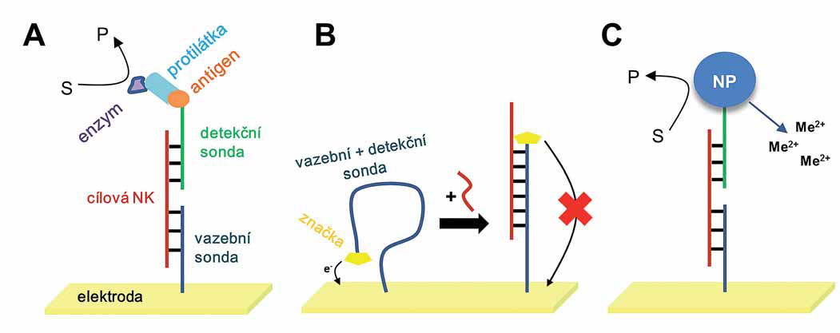
…after 1990
The big expansion in electrochemistry of NAs due to the considerable progress in genomics (Human Genome Project)
The synthesis of DNA probes – electrochemical detection of hybridization
Later, approaches targeted to improvement of sensitivity and reproducibility of analysis:
  ELISA analogy (A)
  Molecular beacon (B)
  Nanotechnology (C) – inorganic NPs, carbon nanotubes, grafen
Detection of oncogenes, tumor suppressor genes, mononucleotide polymorphism, repetitive sequence, viral and bacterial NAs, genetically modified organisms
Bartošík M., Paleček E., Vojtěšek B.: Klin Onkol, 2014, 27 (Suppl 1), S53-S60

Slide 42
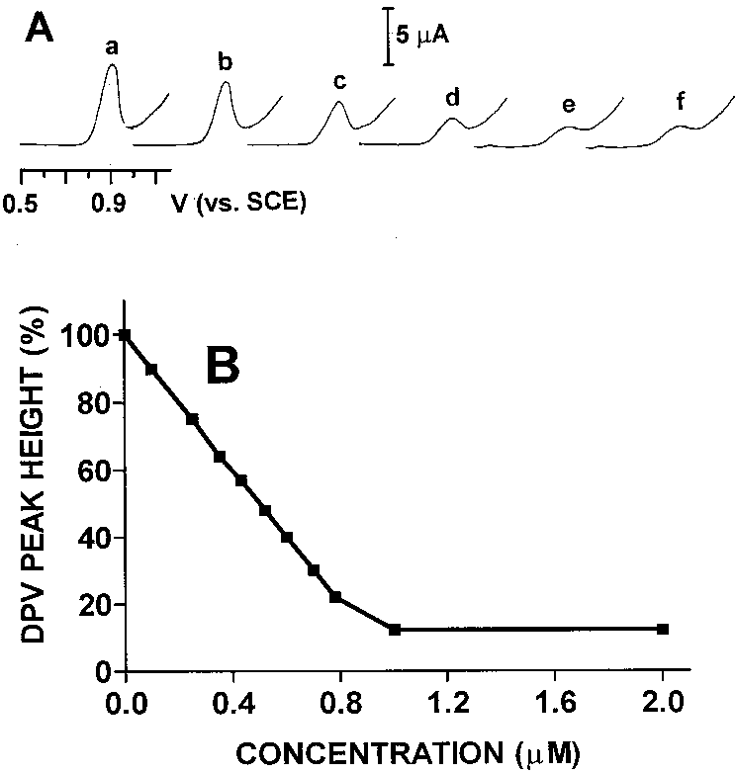
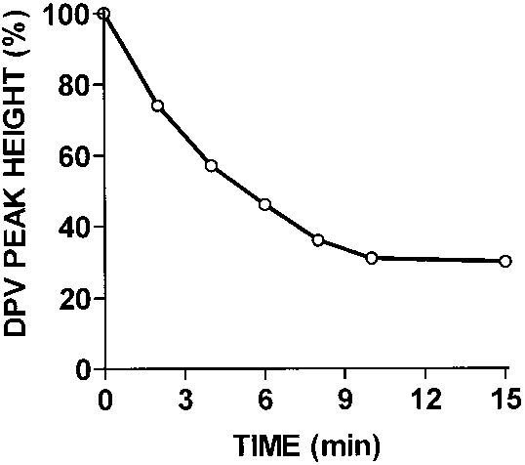
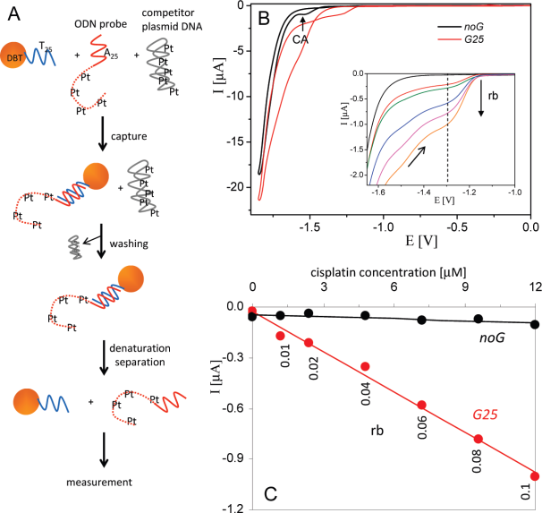
Electrochemistry of NA in oncology
Interaction of DNA with antitumor drugs
2000 – Brabec – electrochemical biosensor based on carbon electrodes – the monitoring of guanine oxidation signal decrease due to platinum derivatives establishing
Antitumor drugs yield electrochemical signal too
Brabec V.: Electrochim Acta, 2000, 45, 2929-2932
Monitoring of selective cisplatination of probe oligonucleotides in the presence of competitor plasmid DNA using magnetoseparation
and AdTS CV. (A) Separation of the cisplatinated ODN probes using magnetic beads. The recovered ODNs were analyzed by AdTS CV. (B) Sections of AdTS CVs obtained for the ODNs noG (black) or G25 (red) treated with cisplatin (rb ) 0.1) in the mixture with plasmid DNA. (C)
Dependence of the current value measured at the anodic part of the AdTS CV at -1.3 V on the
concentration of cisplatin used for modification of the ODN probes in the presence of plasmid DNA: noG (black); G25 (red).
Horakova P., Tesnohlidkova L., Havran L. et al.: Anal Chem, 2010, 82, 2969-2976

Slide 43
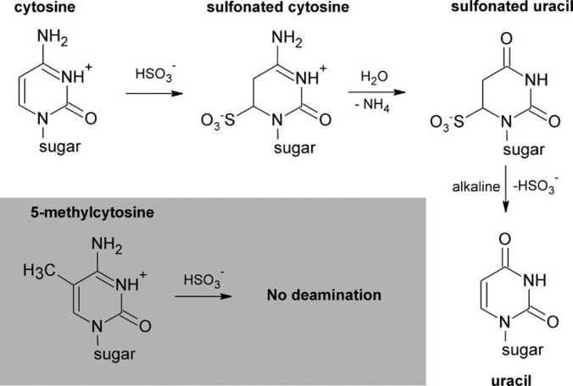
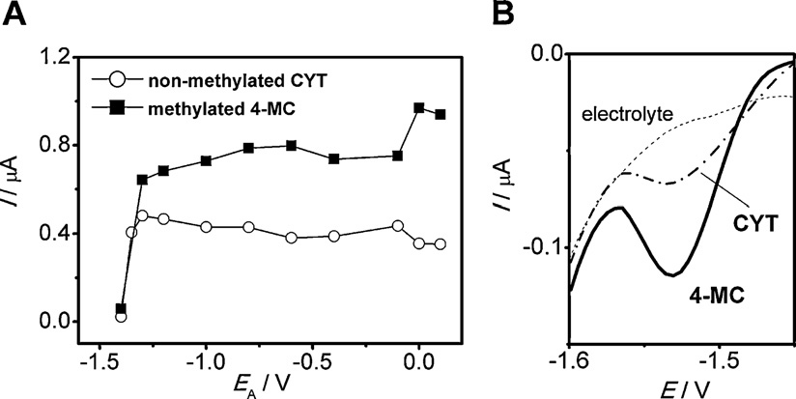
DNA methylation
Epigenetic modification playing important role in gene expression
Changed methylation patterns of DNA associated with carcinogenesis
Cytosine methylation – 1) reaction with NaHSO₃(cytosine is deaminated to uracil, methylcytosine is not changed), after that amplification of DNA and m-DNA by PCR (uracil is amplificated as thymin and methylcytosine as cytosine) and finally electrochemical detection by using suitable redox labels
2) After reaction with NaHSO₃ electrochemical reduction of DNA at Hg and solid amalgam electrodes (uracil is unreducible at Hg electrode, but methylcytosine is reducible at Hg electrode→after reaction with NaHSO₃ m - DNA yields higher signal than DNA)
Bartošík M., Fojta M., Paleček E.: Electrochim Acta, 2012, 78, 75-81
Bartošík M., Fojta M., Paleček E.: Electrochim Acta, 2012, 78, 75-81

Slide 44
DNA methylation
Guanine methylation – at first electrochemical reduction at Hg electrode, later boron – doped diamond electrodes and carbon electrodes

Slide 45
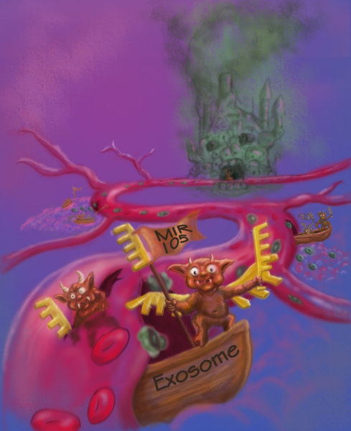
miRNA
Why to study miRNA?
Gene expression regulation
Regulation of processes during tumor grow
Present in all human tissues and fluids – easily accessible
Other miRNA between healthy and diseased individuals
Oncomarker?
miRNA as a drug
Cancer, cardiovascular diseases, neurodegenerative diseases
Electrochemical detection of miRNA
DNA probes and enzymatic or NPs labels for signal amplification
The method using miRNA labeling by using electroactive complex on the base of hexavalent osmium

Slide 46
Proteins

Slide 47
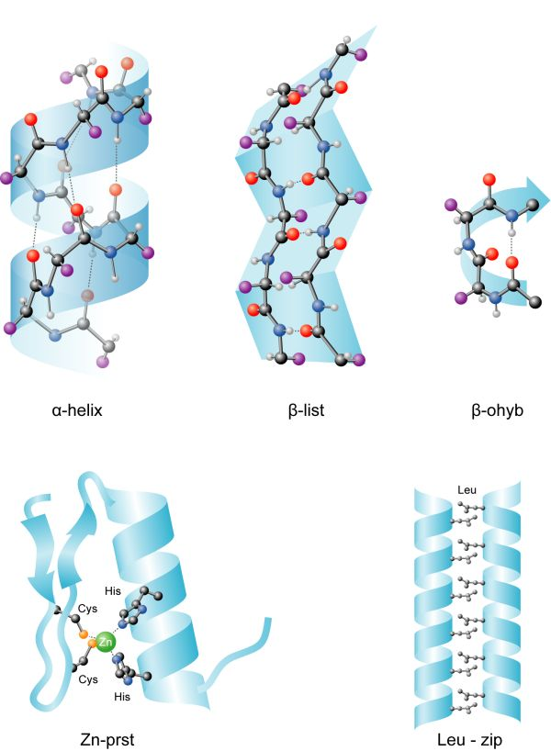
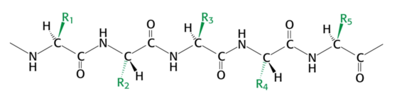
Primary structure
The order of AA in polypeptide chain
Secondary structure
The geometrical arrangement of polypeptide chain

Slide 48


α-helix
Tertiary structure
The spatial arrangement of polypeptide chain
β – folded sheet
Quaternary structure
Subunits in protein agglomerates forming one functional protein

Slide 49

Proteins are electroactive
The first biomacromolecules investigated by using electrochemical methods
Herles and Vančura – polarographic study of human body fluids (blood serum and urine). „Presodium wave“ – cathodic wave occuring at potentials more positive (300 mV) than cathodic reduction of sodium ions. Preliminarily this wave was assigned to proteins
Heyrovský and Babička – albumin in presence of ammonium ions produces in dc polarography so called „presodium wave“ (H peak), caused by catalytic hydrogen evolution reaction
„Presodium wave“ not suitable for analytical purposes
Polarographic catalytic waves of human serum. (2) the “presodium” catalytic wave in 0.1 M ammonia/ammonium chloride

Slide 50
Brdička‘s catalytic reaction (BCR)
1933 – Brdička‘s catalytic reaction – polarographic double – wave of proteins containing Cys residues in buffered solutions of cobalt (Brdička solution – ammonium buffer NH₄OH + NH₄Cl and cobalt complex [Co(NH₃)₆]Cl₃)
Originally designed for detection sulphur rich substances, such as organic compounds
(2- mercaptopropionic acid, 2-diethylaminoethanethiol hydrochloridum), amino acids
(cysteine, cystine) and proteins (albumin)
Application of Brdička‘s catalytic reaction in clinical medicine and pharmacology (cancer diagnostic)
Mechanism of electrode process of Brdička catalytic reaction is not known in details, but it is propossed that complex of Co(II) with –NH₂ and –SH moieties plays a key role
Polarographic catalytic waves of human serum. (4) the catalytic double-wave in Brdička solution

Slide 51
What is catalytic hydrogen evolution reaction (CHER)?
Electrochemical phenomenon caused by a catalyst, in which presence the hydrogen evaluates at the cathode polarized to more positive potentials than in the catalyst absence
The hydrogen evolution is produced by cathodic catalytic current. The current intensity is depend on the catalyst concentration and the kinetic catalyst efficiency
2PH_{(surf)} + 2e⁻ → 2P⁻_{(surf)} + H₂(g)
P⁻_{(surf)} + BH(aq)↔ PH_{(surf)} + B⁻(aq)
PH a P⁻: protonized/deprotonized form of AA residues in protein molecule
BH is acid component of buffer; B⁻ is its conjugated basis
The reaction shows, that catalyst is protein immobilized on the electrode surface
Basic AA - Cys, Lys, Arg a His residues of protein molecule – catalyze the hydrogen evolution on the Hg electrode

Slide 52
H peak
In recent years – The „presodium wave“ (J. Heyrovsky) in combination with CPSA (chronopotentiometric stripping analysis) at stationary and chemically modified Hg electrodes (amalgam electrode included) – suitable tool for proteins analysis
Catalytic signal - H peak (discovered due to catalytic hydrogen evolution reaction – CHER; named according J. Heyrovsky) – is sensitive to structural and conformational changes of proteins
H peak (by proteins) used to monitoring of denaturation, agreggation, interaction with low molecular weight ligands or DNA, structural changes as the result of mutation and redox state
CPSA – chronopotentiometric stripping analysis

Slide 53

Electrochemical oxidation of proteins
Free aminoacids (Cys, His, Met, Tyr a Trp) are oxidized at carbon electrodes
Proteins are oxidized at carbon electrodes (CPSA method)
Tyr a Trp residues in proteins yield oxidation signals at carbon electrodes → the study of DNA-protein interaction, the resolution of fosforylated and unfosforylated forms, membrane Na-K pump, determination of insuline and α-synuklein (important protein in the Parkinson‘s disease)
Tryptophane
Tyrosine
Tyr
Trp
Bartošík M., Paleček E., Vojtěšek B.: Klin Onkol, 2014, 27 (Suppl 1), S53-S60

Slide 54
Proteins are electroactive
External protein labeling (sensitive detection of specific proteins in the mixture of other molecules)
  Immunoassays (ELISA)
Nanotechnology – nanoparticles, nanotubes
Aptamers
Bartošík M., Paleček E., Vojtěšek B.: Klin Onkol, 2014, 27 (Suppl 1), S53-S60
Bartošík M., Paleček E., Vojtěšek B.: Klin Onkol, 2014, 27 (Suppl 1), S53-S60

Slide 55
Polysaccharides

Slide 56

Polysaccharides
Naturally occuring polysaccharides (PSs) and oligosaccharides (OLSs) are free or fixed on proteins or lipides
Structural flexibility – ideal indetificators of intermolecular or intercells interactions
Most mammalian proteins occur in the form of glycoproteins
Protein glykosylation in the human health and diaseases (cancer)

Slide 57

Are polysaccharides electroactive?
Since 2009 PSs and OLSs considered as electrochemical inactive compounds
In 2009 – some sulphated PSs catalyze hydrogen evolution reaction and give CPS signals at Hg electrodes
PSs and OLSs are easy modifiable with Os(VI)L complexes (with nitrogen ligands); electroactive aducts
Lectine biosensors for glycane detection(sugar residues of glycoproteins and glycolipides); electrochemical impedance spectroscopy (EIS) biosensors
  Easy and quick detection of oncomarkers and other proteins important in biomedicine
Bartošík M., Paleček E., Vojtěšek B.: Klin Onkol, 2014, 27 (Suppl 1), S53-S60

Slide 58
Biosensors

Slide 59
What is biosensor?
Analytical instrument containing senstivite bioreceptor, which is the part of physicochemical tranducer or it is in the close proximity with physicochemical transducer
Analyte
Electronic signal
Bioreceptor
Transducer
Biosensor
Bioreceptors
  Biocatalytic (enzyme, organela, cell, tissue, organ, organism) – analyte is conversed during chemical reaction
  Bioaffinity (lectine, antibody, NA, receptor) – analyte is specifically bound in bioaffinity complex
Physicochemical transducers – electrochemical, optical, piezoelectric and acoustic, calorimetric

Slide 60
From the history
The beginning of the 20th century – the conception of redox potentials and the fisrt pH measurement
1922 – Jaroslav Heyrovský – discovery of polarography
1935 – Müller and Bamberger – measurement of O₂ concentration in biological fluids at Hg electrode
1938 – Petering and Daniels – measurement of O₂ consumption with living oragnisms at Hg electrode
40s of 20th century – cathodic reduction of O₂ at noble metals (Au, Pt) – bare electrodes lost their lifetime in the biological material
1956 – Leland C. Clark Jr. – the first membrane electrode permeable for gases → the birth of biosensors
1962 – Clark and Lyons – enzyme electrode (experiment with glukose oxidase immobilized on the oxygen electrode surface by the dialysis membrane)
60s of the 20th century – ion-selective electrodes (ISE)
70s of the 20th century – progress in the field of enzyme electrodes
1975 – the first commercial biosensor for glukose (Yellow Springs Instrument Company)
The end of 70s – the beginning of the immunosensors research
Biosensors emerge from the scientific laboratories into the real world!

Slide 61



Discovery of biosensor
Clark (1962) – amperometric sensor for glucose with glucose oxidase and oxygen electrode
Glucose + O₂ → Gluconic acid + H₂O₂
GOD
Oxygen electrode (1956)
Working electrode: Pt cathode
O₂ + H₂O + 2e⁻ → H₂O₂ + 2OH⁻
H₂O₂ + 2e⁻ → 2OH⁻
Reference electrode: Ag/AgCl electrode
The electrodes are separated from the measured solution with semipermeable membrane enabling passage of gasis

Slide 62
Requirements for biosensors
Sensitivity
Calibration
Linearity
Limit of detection
Noise
Background signal
Hysteresis
Long time stability
Selectivity
Response rate
Response time
Convection rate
Temperature dependence
Lifetime of the biosensor
Biocompatibility

Slide 63


Measurement conditions
Direct contact with a sample – biosensor in the monitored medium (river, tissue, bloodstream)
Closed vessel– biosensor in the vessel equipped with the water coat (due to tempering) and magnetic stirrer
Flow system – biosensor in the flowing cell

Slide 64




Types of biosensors
Optical biosensors
Piezoelectric biosensors
Calorimetric biosensors
Electrochemical biosensors
Enzyme biosensors

Slide 65

Electrochemical biosensors
1) Amperometric and voltammetric biosensors

Slide 66

Electrochemical biosensors
2) Potentiometric biosensors
  ISE with enzyme surface
enzyme
Nicolsky – Eisenman equation

Slide 67

Electrochemical biosensors
3) Conductometric/impedimetric biosensors

Slide 68
Nanoelectrochemistry

Slide 69


Elektrochemické metody využívající modifikace povrhu elektrod nanočásticemi
Voltametrické metody (klasické elektrody i mikroelektrody)
Potenciometrie – příprava ISE, senzorického pole a elektronického jazyka
Imobilizace na povrchu elektrod se provádí buď fyzikální adsorpcí nebo pomocí chemického navázání, kdy modifikované nanočástice reagují s povrchem elektrody, na jejímž povrchu je navázaná vhodná látka
Schéma imobilizace nanočástic zlata na povrch modifikované zlaté elektrody
Stanovení dusičnanů, měďnatých iontů, pesticidů a herbicidů ve vodách
Biosenzory ve farmacii a lékařství
Farmacie – stanovení léčiv
Lékařství – analýza biologických vzorků (hemoglobin, cytochrom c, glukosa, peroxid vodíku)
DNA diagnostika

Slide 70

Gold nanoparticles
Attractive electronic, optical, thermal and catalytic properties
Potential applications in the fields of physics, chemistry, biology, medicine and material science and their interdisciplinary fields
The unique physical and chemical properties of nanostructured materials provide excellent prospects for interfacting biological recognition events with electronic signal transduction and for designing a new generation of biosensors.
Especially AuNPs represent excellent biocompatibility and display unique structural, electronic, magnetic, optical and catalytic properties – attractive material for biosensor, chemisensor and electrocatalyst
The use of AuNPs for amperometric or voltammetric electrochemical nanobiosensors
AuNPs quantitative analysis following its production and application

Slide 71

Gold nanoparticles-based electrochemical sensor and bioelectrochemical sensor
Direct electrochemistry of redox-protein on AuNPs
Very important subject in bioelectrochemistry – construction of biochemical sensors
Direct electrochemistry of proteins (very important is establishment of satisfactory electrical communication between the active site of the enzyme and the electrode surface)
Modification of electrode surfaces with the AuNPs will provide a microenvironment similar to that redox-proteins in native systems and gives the protein molecules more freedom in orientation, thereby reducing the insulating effect of the protein shell through the conducting tunnels of AuNPs
1996 – Natan and co-workers - electrochemistry of horse heart cytochrome c at SnO₂ electrodes modified with 12 nm AuNPS
Possible ways of coupling an enzymatic and an electrochemical reactions:
mediated electron exchange and
direct, mediatorless, electron
transfer.

Slide 72
Gold nanoparticles-based electrochemical sensor and bioelectrochemical sensor
Direct electrochemistry of redox-protein on AuNPs
The nanoparticle/protein conjugates can be assembled on the electrode via self-assembly technology – the AuNPs could be immobilized on the self-assembled monolayer and complete DET
    DET of hemoglobin on the citrated-capped AuNPs assembled on a cysteamine modified gold substrate
    Investigation of electrocatalytic activity of NPs/hemoglobin electrode towards H₂O₂ reduction
    DET of glucose oxidase and HRP on AuNPs immobilized cysteinamine modified gold electrode
The AuNPs modifed carbon paste electrodes have provided a good microenvironment for completing the DET of different redox-proteins
    DET between immoblized myoglobin and colloidal gold modified carbon paste electrode
    Xanthin oxidase biosensor, based on a carbon paste electrode modified with electrodeposited AuNPs for the amperometric determination of hypoxanthine
The polymer-nanoparticles composites possess the interesting electrical, optical and magnetic properties superior to those of the parent polymer and nanoparticles
The nanocomposite composed of AuNPs and biopolymer such as chitosan as excellent matrix for completing the DET of some redox protein
    Biocomposite made of chitosan hydrogel, GOD and AuNPs for glucose biosensor

Slide 73

Gold nanoparticles in DNA immobilization
AuNPS can strongly adsorb DNA
DNA can also be immobilized onto AuNPs through special functional groups such as thiols and others, which can interact strongly with AuNPs
DNA oligonucleotides that contain several adenosyl phosphothiolate residues at their ends have been used to interact with the metal surface of NPs
Schematic of the methods used for conjugating oligonucleotides to gold nanoparticles. a) Thiol-modified and b) disulfidemodified oligonucleotides spontaneously bind to gold nanoparticle surfaces. Asymmetric disulfide modification adds an additional mercaptoalcohol ligand to the Au surface, but the density of oligonucleotides formed on the nanoparticle surface is the same as for thiol-terminal oligonucleotides. c) Di and d) trisulfide modified conjugates. e) Oligothiol – nanoparticle conjugates. Although four thiol connections are shown, any number are possible via sequential addition of a commercial dithiane phosphoramidite during solid-phase oligonucleotide synthesis. f) Oligonucleotide conjugates from NanoprobesQ phosphine-modified nanoparticles. Adapted from Nanotechnology, 2003, 14, R63.

Slide 74

Gold nanoparticles in DNA immobilization
Monomaleimido gold clusters have been coupled with thiolated DNA oligomers to synthesize probes for homogenous nucleic acid analyses and ensure a 1:1 DNA/AuNP connection with interest for sensitivity improvements
Schematics of A) Formation of particle-linked DNA network structure due to the interconnection between magnetic beads in the case where AuNPs modified with more than one DNA strands are used; B) The previous network is not created by using the 1:1 Au-DNA connection; C) The reaction of maleimido-Au67 with thiol-oligonulceotide that make possible the 1:1 Au-DNA connection. Adaped from Langmuir , 2005, 21, 9625

Slide 75

Gold nanoparticles-based electrochemical sensor and bioelectrochemical sensor
Gold nanoparticles for genosensors
The development of electrical DNA hybridization biosensors has attracted considerable research efforts
The AuNPs modified electrochemical sensing interfaces offer elegant ways for interacting DNA recognition events with electrochemical signal transduction, and for amplyfying the resulting electrical response
AuNPs –based electrochemical device will provide new opportunity for gene diagnostics
Merkoci and co-workers reviewed recent important achievements on the electrochemical sensing of DNA using AuNPs
Schematic procedure of the different strategies used for the integration of AuNPs into DNA sensing systems: (A) previous dissolving of AuNPs by using HBr/Br2 mixture followed by Au(III) ions detection, (B) direct detection of AuNPs anchored onto the surface of the genosensor, (C) conductometric detection, (D) enhancement with silver or gold followed by detection, (E) AuNPs as carriers of other AuNPs, (F) AuNPs as carriers of other electroactive labels. Reprinted with permission from Ref. [85], A. Merkoc¸i, 19 (2007) 743. Copyright Wiley-VCH (2007).

Slide 76
Gold nanoparticles-based electrochemical sensor and bioelectrochemical sensor
Gold nanoparticles for genosensors
The use of colloidal gold tags for electronic detection of DNA hybridization – capturing the AuNPs to the hybridized target, followed by highly sensitive anodic stripping electrochemical measurement of the metal tracer
Due to the toxicity of HBr/Br₂ solution the novel AuNPs –based protocol was reported – a novel AuNPs – based protocol for detection of DNA hybridization based on magnetically trigged direct electrochemical detection of gold quantum dot tracers
Enhancement by precipitation of silver or gold onto the AuNPs for amplifying signals and lowering detection limits
Analyzing sequence-specific DNA using AuNPs marked DNA probes and subsequent signal amplification step by silver enhancement (electrostatic adsorption of target ODNs onto the sensing surface of the GCE and its hybridization to the AuNPs-labeled ODNs DNA probe)
Another signal amplification strategy is to attach electroactive ferrocenylhexanethiol molecules or electrogenerated chemiluminiscence indicator to the AuNPs labels
    The AuNPs/streptavidin conjugates covered with 6-ferrocenylhexanethiol were attached onto a biotinylated DNA detection probe of a sandwich DNA complex
DNA ultrasensitive electrochemical detection by using AuNPs will play an important role on the development of specific and sensitive assays for clinical diagnosis, detection of pathogenic microorganisms

Slide 77

Gold nanoparticles-based electrochemical sensor and bioelectrochemical sensor
Gold nanoparticles for immunosensors
Immunosensors are important analytical tools based on the detection of the binding event between antibody and antigen
Electrochemical immunosensors are attractive tools and have received considerable attention becuase they are easy, economy, robust and achieve excellent detection limits with small analyte volumes
Several strategies have been proposed to develop electrochemical immunosensors with high sensitivity using AuNPs
DNA –free ultrasensitive electrochemical immunosensors have received considerable interests because of their simplify, rapidness and high sensitivity
(a) Schematic representation of the preparation of an immunosensing layer. (b) Schemiatic view of electrochemical detection of mouse IgG or prostate specific antigen. Reprinted with permission from Ref. [139], H. Yang, J. Am. Chem. Soc. 128 (2006) 16022

Slide 78

Gold nanoparticles as enhancing platform for electrocatalysis and electrochemical sensor
AuNPs have been studied extensively for the design and fabrication of electrocatalysts and using as an enhancing component of catalytic activity or selectivity
Scheme illustrating (a) the formation of Ru-AuNPs in aqueous medium due to electrostatic interactions between Ru(bpy)₃²⁺ and citrate-capped AuNPs and (b) the immobilization of Ru-AuNPs on a sulfhydryl-derivated ITO electrode surface.

Slide 79

Platinum nanoparticles
Platinum nanoparticles have been an intensive research subject for the design of electrodes
Platinum films modified microelectrodes were shown to be excellent amperometric sensor for H₂O₂ in a wide range of concentration
Pt nanoparticles and single walled carbon nanotubes were combined to modify a glassy carbon electrode to improve their electroactivity for H₂O₂ (glucose sensor)
Pt nanoparticles were used in combination with multi-walled carbon nanotubes (MWCNTs) for fabricating sensitivity-enhanced electrochemical DNA biosensor

Slide 80

Carbon nanotubes (CNTs)
CNTs are built from sp² carbon units – a seamless structure with hexagonal honeycomb lattices
Carbon nanotubes with one hundered time the tensile strength of steel, thermal conductivity, electrical conductivity similar to copper, but with the ability to carry much higher currents, they seem to be very interesting material
Since their discovery in 1991, CNTs have generated great interest for applications based on their field emission and electronic transport properties, their hiugh mechanical strength and chemical properties
CNTs appliccation in the field of emission devices, nanoscale transistors, tips for scanning microscopy or components for composite materials
Two groups of CNTs: A) multi-wall carbon nanotubes (MWCNTs) – concentric and closed graphite tubules with multiple layers of graphite sheet
B) single-wall carbon nanotubes (SWCNTs) – single graphite sheet rolled seamlessly, defining a cylinder of 1-2 nm diameter
Schematic representation of Single Walled Carbon Nanotube (SWCNT) and Multi Walled Carbon Nanotube (MWCNT)

Slide 81
Carbon nanotubes
CNTs exhibits strong electrocatalytic activity for a wide range of compounds, such as neurotransmitters NADH, hydrogen peroxide, ascorbic, cytochrome c, hydrazines, hydrogen suphide, amino acids, glucose and DNA
Various types of CNT modified electrodes were prepared including physical adsorption of CNT onto electrode surface, like glassy carbon and composite paste electrodes
CNT was incorporated into an epoxy polymer, forming an epoxy composite hybrid material as a new electrode with improved electrochemical sensing properties (CNTEC – carbon-nanotube epoxy composite)
SWCNT-glassy carbon modified electrode for the highly sensitive and selective detection of dopac in the presence of 5-hydroxytryptamin
SWCNT film modified glassy carbon electrodes towards the reduction/oxidation of cytochrome c
MWCNT biosensor was obtained by means of GOx immobilization through physical entrapment inside and epoxy resin matrix and its performance was examined for glucose determination
MWCNTEC modified with bacterial cells for application as a microbial sensor
CNTPE (carbon nanotubes paste electrode) for determination of dopamine, ascorbic acid, dopac, uric acid and hydrogen peroxide

