Slide 1
NUCLEIC ACIDS
Basic terms and notions
Presentation by
Eva Fadrná
adapted by Radovan Fiala

Slide 2
Literature
Books
Saenger, W., Principles of Nucleic Acid Structure, Springer 1984.
Bloomfield, V. A., Crothers, D. M., Tinoco, I., Nucleic Acids, Structures, Properties, and Functions, Univ. Sci. Books, 2000.
Wuthrich, K., NMR of Proteins and Nucleic Acids, Wiley, 1986.
Review articles
Bowater, R. P., Waller, Z. AE., In: eLS. John Wiley & Sons, Chichester, 2014.
Wijmenga, S. S., van Buuren, B. N. M., Progr. NMR Spect. 32, (1998), 287-387.
Furtig, B. et al., ChemBioChem 4 (2003), 936-962.

Slide 3
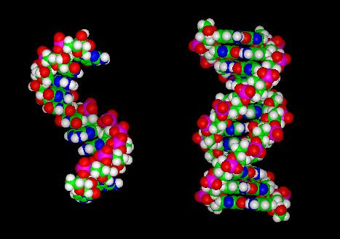
RNA vs DNA
Single strand A-RNA
B-DNA duplex

Slide 4
Length of NA
Total length of DNA in a human cell 1 m (1000 km)‏
DNA in typical human chromozome 1 cm (10 km)‏
DNA from bacterial chromozome 1 mm
Diameter of typical human cell 0.01 mm
Diameter of folded DNA 0.1 μm (0.1 m)‏
Diameter of DNA fiber 1 nm (1 mm)‏
Diameter of atom 1 Å
(multiplied by 10⁶)‏
⇒ 1 chromozome would be 10km long with fiber diameter of 1 mm and it would fold into 10 cm diameter ⇒ extraordinary DNA flexibility

Slide 5
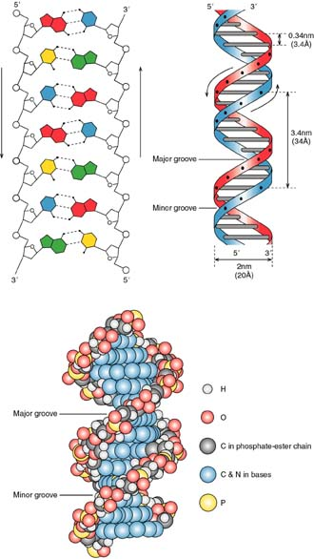
Nukleotide chain
NH₂
N
N
H –
H
|
N9
N
– H
O5’
C5’
– H
H –
O4’
C4’
C1’
– H
NH₂
H –
C3’
C2’
– H
N
O3’
O2’
– H
N
H –
H
|
N9
N
– H
O
P
O5’
C5’
– H
H –
O4’
O
C4’
C1’
– H
NH₂
H –
C3’
C2’
– H
N
O3’
O2’
– H
N
H –
H
|
N9
N
– H
O
P
O5’
C5’
– H
H –
O4’
O
C4’
C1’
– H
NH₂
H –
C3’
C2’
– H
nucleotide
N
N
O3’
O2’
– H
H –
H
|
N9
N
– H
O
P
O5’
C5’
– H
H –
O4’
O
C4’
C1’
– H
H –
C3’
C2’
– H
O3’
O2’
– H

Slide 6
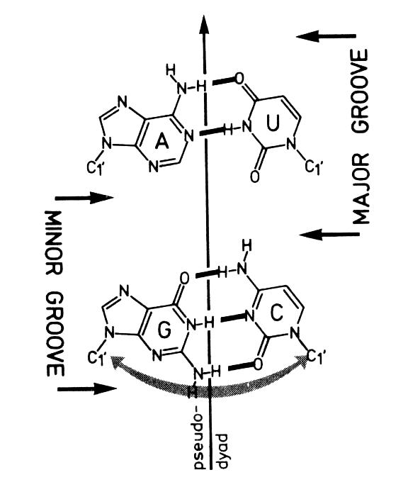
Grooves
major vs. minor
Notes:
minor groove: O2 v pyrimidinech, N3 v purinech

Slide 7
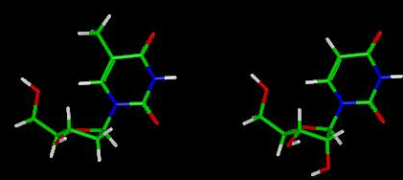
RNA vs DNA
deoxythymidine
uridine

Slide 8
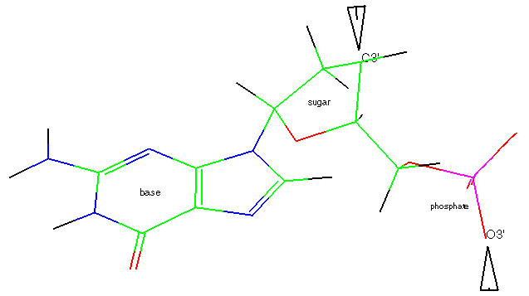
Nukleotide/nukleoside
base
+
sugar (ribose/deoxyribose)‏
nukleoside
+
phosphate
nukleotide

Slide 9
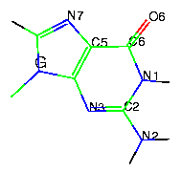
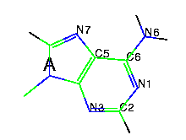
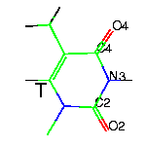
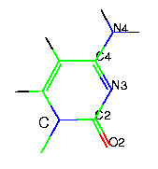
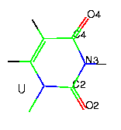
Bases
DNA
RNA
Guanin (Gua)‏
Adenin (Ade)‏
PURINES
Thymin (Thy)‏
Cytosin (Cyt)‏
Uracil (Ura)‏
sugar
PYRIMIDINES

Slide 10
Base numbering
PURINES
PYRIMIDINES
7
6
4
N
5
1
5
3
N
N
8
6
2
2
N
9
N
4
1
N
3
H

Slide 11
Base tautomerism
fysiolog. conditions
enol ↔ keto
C = C – O – H
→
CH – C = O
←
enamin ↔ imin
H
C = C – N
→
CH – C = N – H
←
H
Notes:
lisi se polohou H a dvojne vazby

Slide 12
Base tautomerism
enol ↔ keto
enamin ↔ imin
H
→
→
C = C – O – H
←
CH – C = O
C = C – N
←
CH – C = N – H
H
4 tautomers
O
OH
OH
O
HN
→
N
→
N
→
HN
←
←
←
N
N
HO
N
HO
N
O
O
H
H
Notes:
lisi se polohou H a dvojne vazby

Slide 13
Sugar - pentoses
5’
5’
HO
CH₂
semiacetal
hydroxyl group
HO
CH₂
OH
OH
O
O
4’
1’
4’
1’
DNA
RNA
3’
2’
3’
2’
OH
OH
OH
ß – D - ribose
2 – deoxy – ß – D - ribose
semiacetal
hydroxyl group
+
base
N-glycosidic bond
nukleoside
C1´ - N1
pyrimidines
C1´ - N9
purines

Slide 14
Nukleosides
purines
pyrimidines
C1´ - N9
NH₂
C1´ - N1
O
N
N
HN
N9
N
O
N1
HO
HO
O
O
C1’
C1’
N-glykosidic bond
OH
OH
OH
HO

Slide 15
Nukleosides
Ribonukleosides
uridine = U
cytidine = C
adenosine = A
guanosine = G
base
HO
O
Deoxyribonukleosides
deoxythymidine = dT
deoxycytidine = dC
deoxyadenosine = dA
deoxyguanosine = dG
HO
(OH)‏

Slide 16
Phosphate group
NH₂
NH₂
N
N
N
N
-
OH
N9
O
N9
N
N
O = P – OH
O = P – O
HO
O
-
O
OH
O
C1’
C1’
+
adenosine
OH
OH
OH
OH
acid
+
alcohol
ester
orthophosphoric
acid
H₃PO₄
adenosine
adenosine(mono)phosphate (AMP)‏
Notes:
Zmatek v názvosloví: fosfát – ester i sůl

Slide 17
Nukleotides
OH
base
O = P – O
O
OH
HO
(OH)‏
Ribonucleotides
uridyl acid = uridine – 5´monophosphate = UMP, pU
cytidyl acid = cytidin -“- = CMP, pC
adenyl acid = adenosin -“- = AMP, pA
guanyl acid = guanosin -“- = GMP, pG
Deoxyribonucleotides
deoxytymidyl acid = 2´deoxythymidine-5´-monophosphate = dTMP, pdT
deoxycytidyl acid = -“- cytidin -“- = dCMP, pdC
deoxyadenyl acid = -“- adenosin -“- = dAMP, pdA
deoxyguanyl acid = -“- guanosin -“- = dGMP, pdG

Slide 18
Phosphate group
NH₂
NH₂
N
N
N
N
N9
N
N9
N
HO
HO
5’
O
O
NH₂
C1’
NH₂
C1’
N
N
N
OH
OH
N
O
OH
N9
N
OH
O = P – O
N9
N
-
O
O = P – O
O
C1’
-
O
O
3’
C1’
OH
OH
nukleoside-nukleotide
OH
OH
alcohol
+
acid
diester
ApA
(ester)‏
Notes:
Zmatek v názvosloví: fosfát – ester i sůl

Slide 19
Nucleotide chain
NH₂
N
N
H –
H
|
N9
N
– H
O5’
C5’
– H
H –
O4’
C4’
C1’
– H
NH₂
H –
C3’
C2’
– H
N
O3’
O2’
– H
N
H –
H
|
N9
N
– H
O
P
O5’
C5’
– H
H –
O4’
5’
O
C4’
C1’
– H
NH₂
H –
C3’
C2’
– H
N
O3’
O2’
– H
N
H –
H
|
N9
N
– H
O
P
O5’
C5’
– H
H –
O4’
O
C4’
C1’
– H
NH₂
H –
C3’
C2’
– H
N
O3’
O2’
– H
N
H –
H
|
N9
N
– H
nucleotide
O
P
O5’
C5’
– H
H –
O4’
O
C4’
C1’
– H
H –
C3’
C2’
– H
3’
O3’
O2’
– H

Slide 20
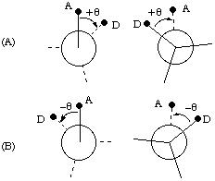
Torsion angle
⊕
A
D


B
C
<0º, 360º>
<-180º, 180º>

Slide 21
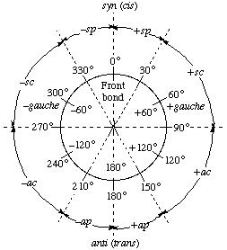
Torsion angle
synperiplanar (sp)‏
-gauche (-g)‏
+gauche (+g)‏
synclinal (sc)‏
anticlinal (ac)‏
antiperiplanar (ap)‏
trans (t)‏

Slide 22
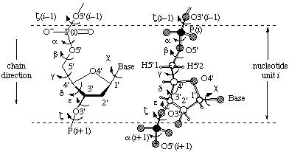
Torsion angles in NA
Sugar-phosphate backbone

Slide 23
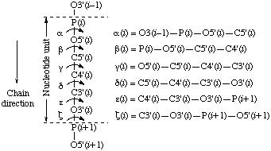
Torsion angles cont.
α
β
γ
δ
ε
ζ
χ

Slide 24
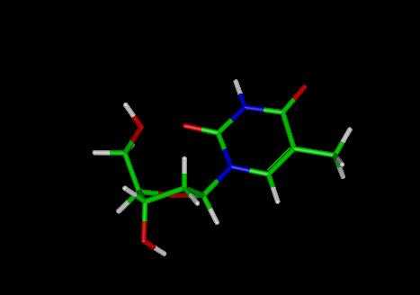
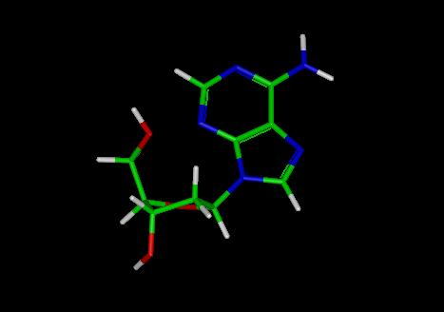
Torsion angle χ
SYN:
Pyrimidines: O2 above the sugar ring
Purines: 6-member purine ring above the sugar ring

Slide 25
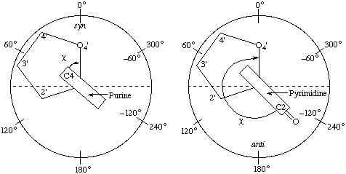
Torsion angle χ
Orientation around the C1’ – N glycosidic bond
O4’ – C1’ – N1 – C2 pyrimidines
O4’ – C1’ – N9 – C4 purines
SYN
χ
ANTI
<0º, 90º>
χ
<270º, 360º>
<90º, 270º>
Notes:
Obrazek je obracene oproti kruhu s popisem uhlu!!!

Slide 26
Torion χ – border intervals
high-syn (corresponds to +ac) … 90º + intrudes into anti
high-anti (corresponds -sc) … 270º + intrudes into syn
SYN
χ
∈
ANTI
<0º, 90º>
χ
∈
<270º, 360º>
<90º, 270º>

Slide 27
Torsion angles in DNA
Angle B-DNA A-DNA
α -40.7 -74.8
β -135.6 -179.1
-37.4 58.9
δ 139.5 78.2
ε -133.2 -155.0
ζ -156.9 -67.1
χ -101.9 -158.9

Slide 28
Sugar conformation
C5’
δ
endocyclic
δ … C5’ – C4’ – C3’ – O3’
exocyclic
O3’
δ, ν3 relation

Slide 29
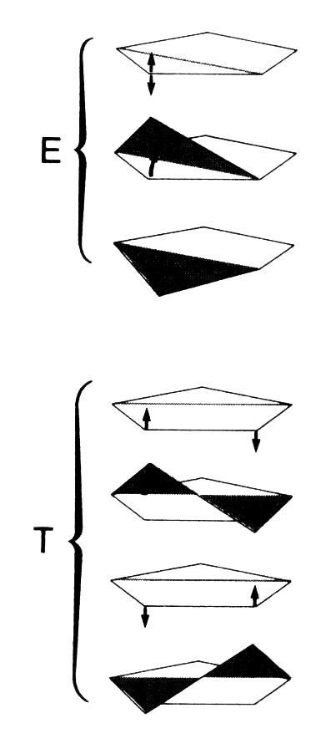
„Puckering“ of the sugar ring
Envelope 4 atoms in a plane,
the 5th above or below
Twist 3 atoms in a plane, the 4th and the 5th on the oposite sides of the plane

Slide 30
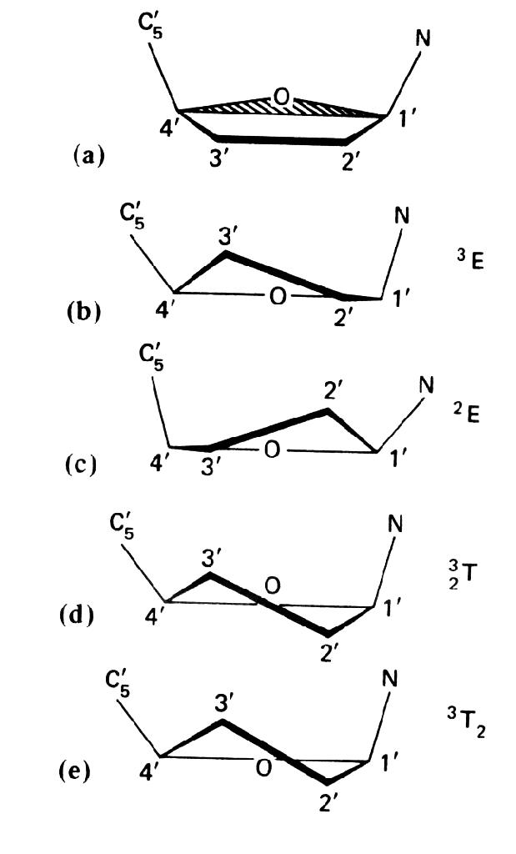
Definition of the puckering modes
The sugar ring is not planar
With respect to C5’
- endo
- exo
C1’ – O4’ – C4’ plane
Envelope C3’-endo ³E (prevalent in RNA)‏
Envelope C2’-endo ²E (prevalent in DNA)‏
symmetric Twist C2’-exo-C3’-endo ³₂T
Non-symmetric Twist C3’-endo-C2’-exo ³T₂

Slide 31
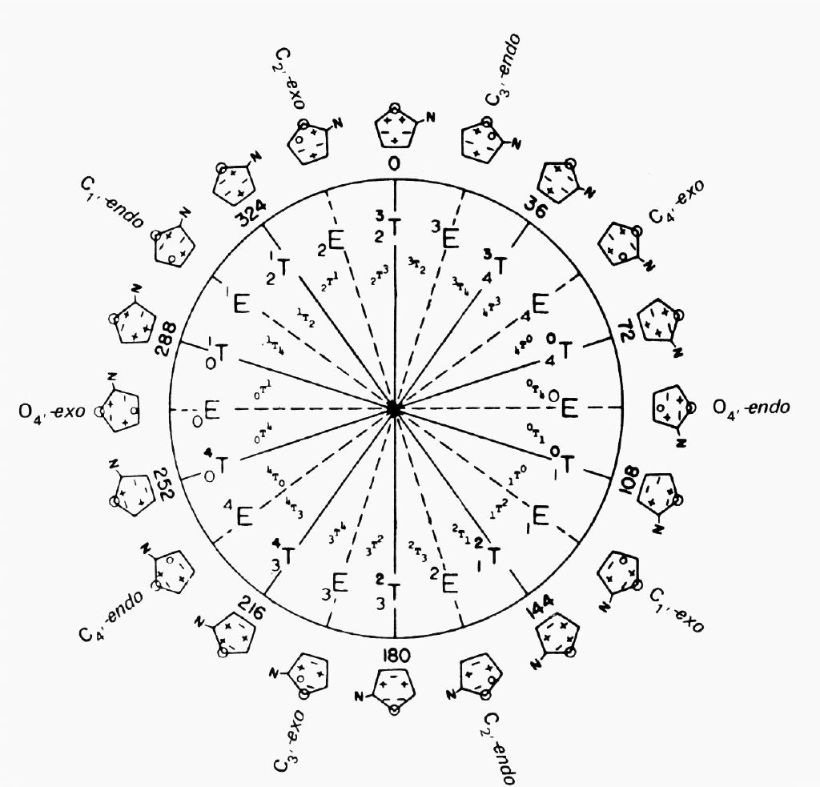
Pseudorotation cycle
Theoretically – infinite number of conformations, can be characterized by
maximum torsion angle (degree of pucker) and pseudorotation phase angle
Torsion angles are not independent (ring closed)‏
Pseudorotation phase angle P
P = 0º :
symmetric Twist C2’-exo-C3’-endo ³₂T
P = 180º :
asymmetric Twist C2’-endo-C3’-exo ²₃T

Slide 32
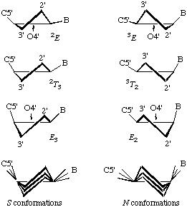
ν_{max} amplitude
Maximum out-of-plane pucker
ν_{max} = ν₂ / cos(P)‏

Slide 33
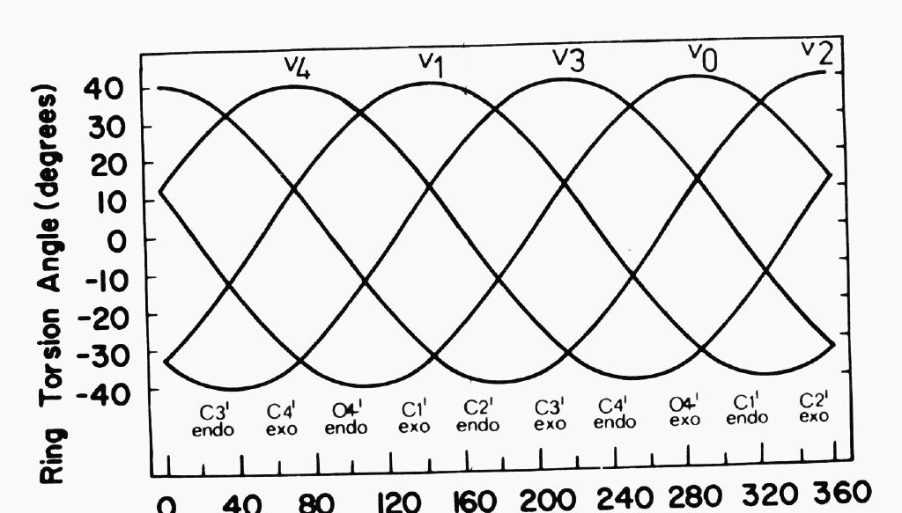
P, ν_{j} relation
P value defines unambiguously all endocyclic torsion angles ν₀ to ν₄
ν₂ = ν_{max} ⋅ cos(P + (j - 2) ⋅ 144°)‏
j = 0 .. 4
ν₀ + ν₁ + ν₂ + ν₃ + ν₄ = 0
Sum of all 5 ν = 0

Slide 34
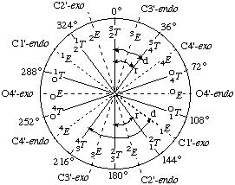
P in nucleic acids
NORTH
SOUTH
0º ≤ P ≤ 36º north (prevalent in RNA)‏
144º ≤ P ≤ 190º south (prevalent in DNA)‏

Slide 35
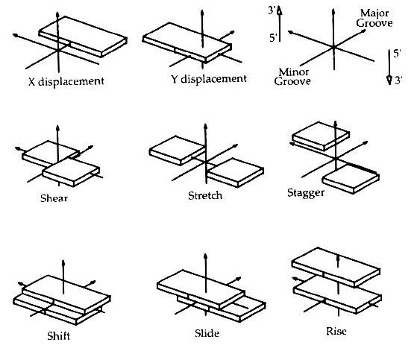
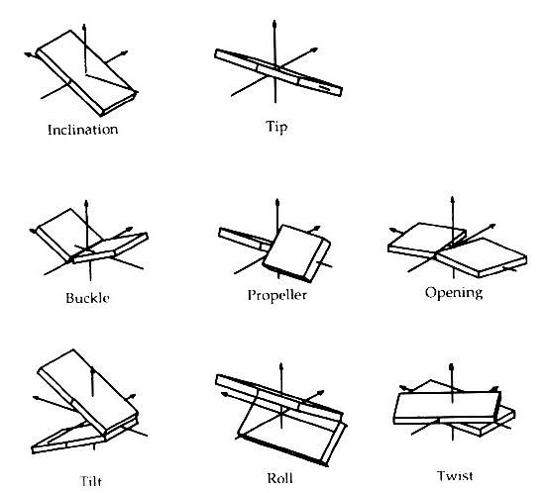
Helical parameters
axis-base, axis-base pair
intra-base pair
inter-base or inter-base pair
Distance/shift
Angle
Notes:
3 translations, 3 rotations, + X and Y displacement, axis inclination, axis tip.
Všechny tyto parametry – tzv. globální – uvažují existenci helikální osy.
Ale! pro vellmi deformované struktury to nefunguje – musí existovat lokální axis systém, založený na vztahu k předchozímu páru bazí.

Slide 36
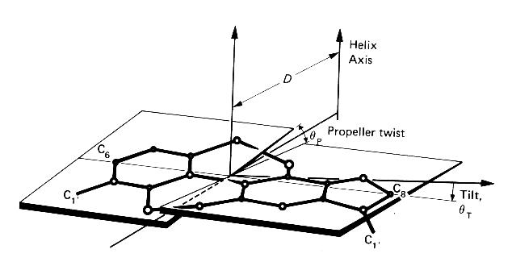
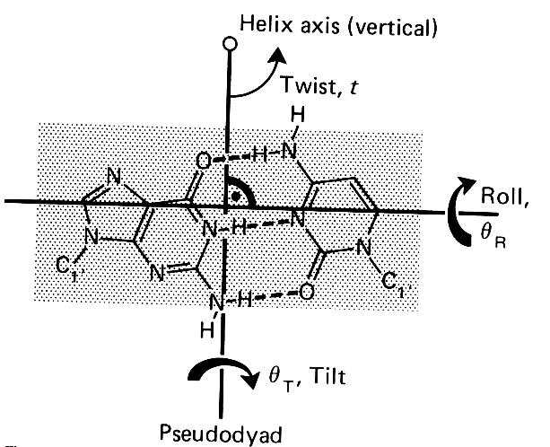
Helical…
D … displacement from helical axis
t …twist = 360º / n
θ_{R} … roll
θ_{T} … tilt
Notes:
Pár bazí není centrován kolem osy helixu, ale posunut poněkud vedle. Posunutí …θ displacement D.
Není kolmý k helikální ose … Tilt, Roll.
Báze nejsou koplanární … propeller twist.
Twist t = 360/n … rotace mezi nukleotidem a jeho nejblizsim sousedem

Slide 37
Helical parameters
for A and B DNA
Global B-DNA A-DNA
X disp. 0.0 -5.28
Y disp. 0.0 0.0
Inclin 1.46 20.73
Tip 0.0 0.0
Shear 0.0 0.0
Stretch 0.0 0.01
Stagger -0.08 -0.04
Buckle 0.0 0.0
Propeller -13.3 -7.5
Openning 0.0 -0.02
Shift 0.0 0.0
Slide 0.0 0.0
Rise 3.38 2.56
Tilt 0.0 0.0
Roll 0.0 0.0
Twist 36.00 32.70
Bases per turn 360/36=10 360/32.7=11
Shifts in Å, angles in degrees

Slide 38
Base pairing
Watson-Crick pairs

Slide 39
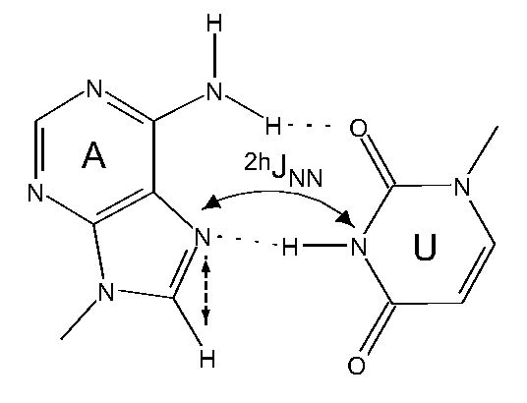
Base pairing
Hoogsteen and reverse Hoogsteen pairs

Slide 40
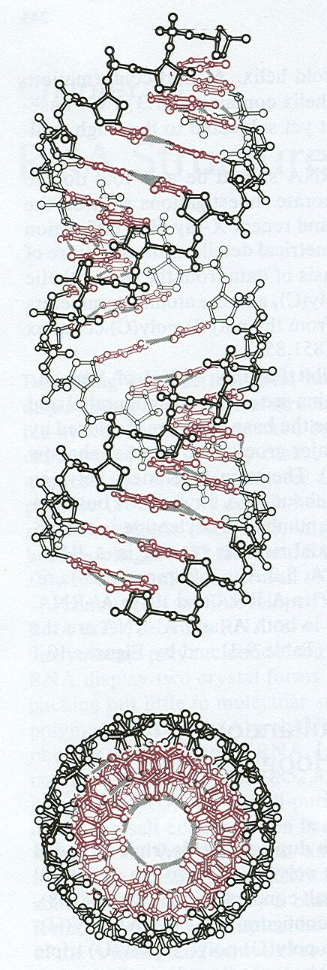
A and B double helix
A-RNA
Ball and stick models
B-DNA

Slide 41
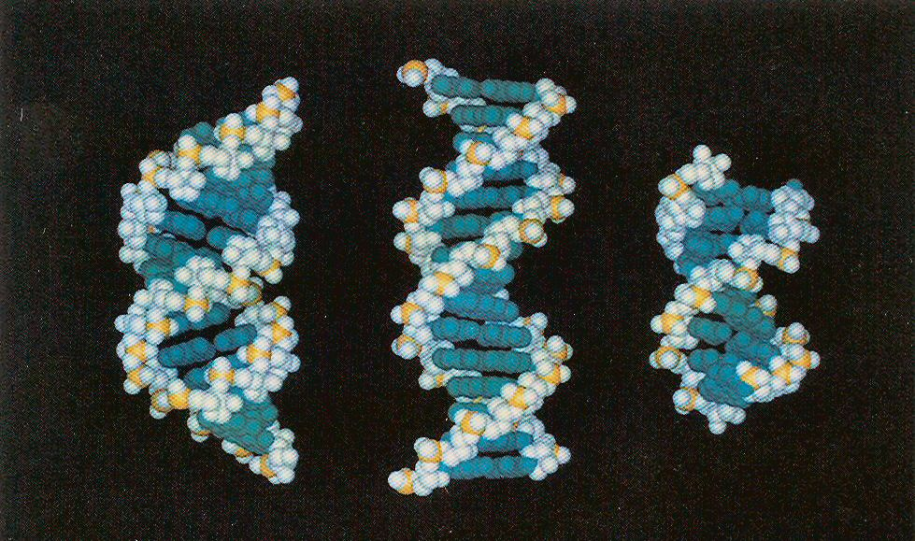
A and B helices
A-RNA with bulge
A-DNA
B-DNA

Slide 42
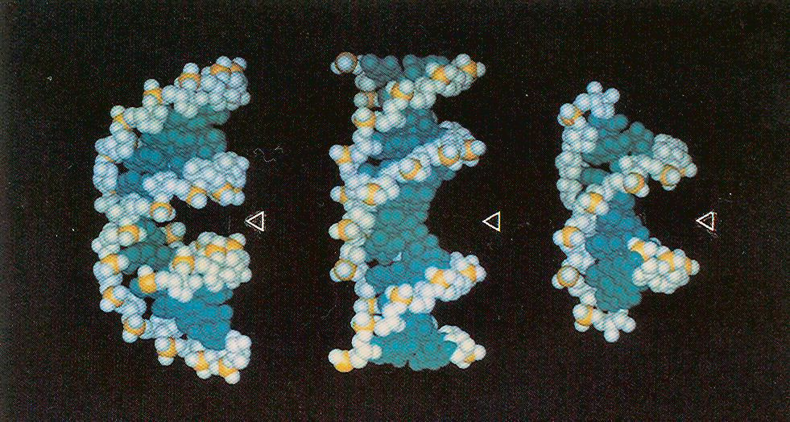
A and B helices
A-DNA
B-DNA
A-RNA with bulge
View tilted by 32° to show grooves

Slide 43
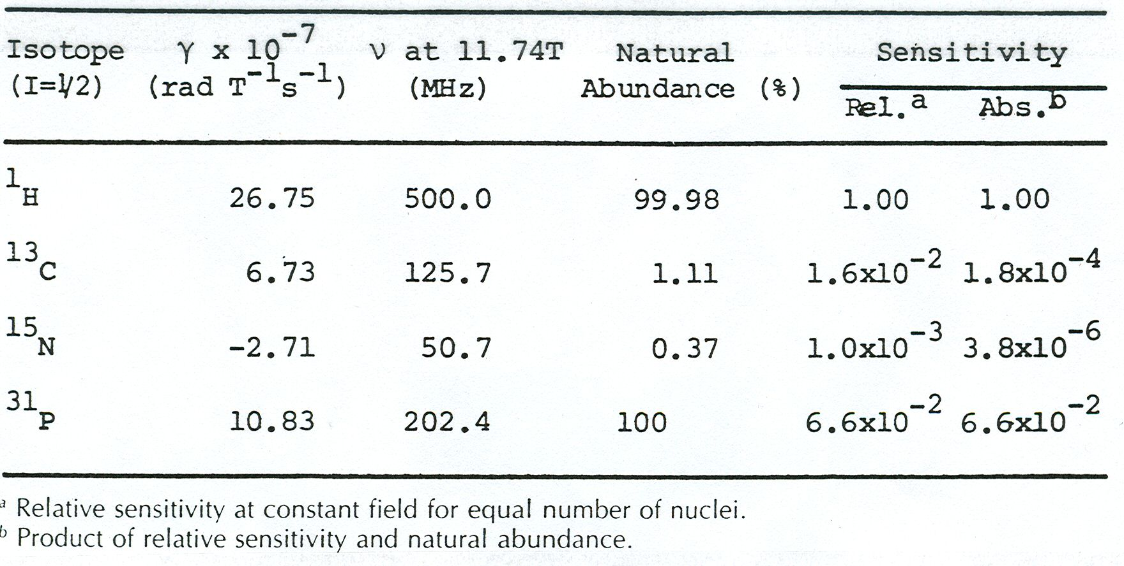
Nuclear properties of selected isotopes

Slide 44
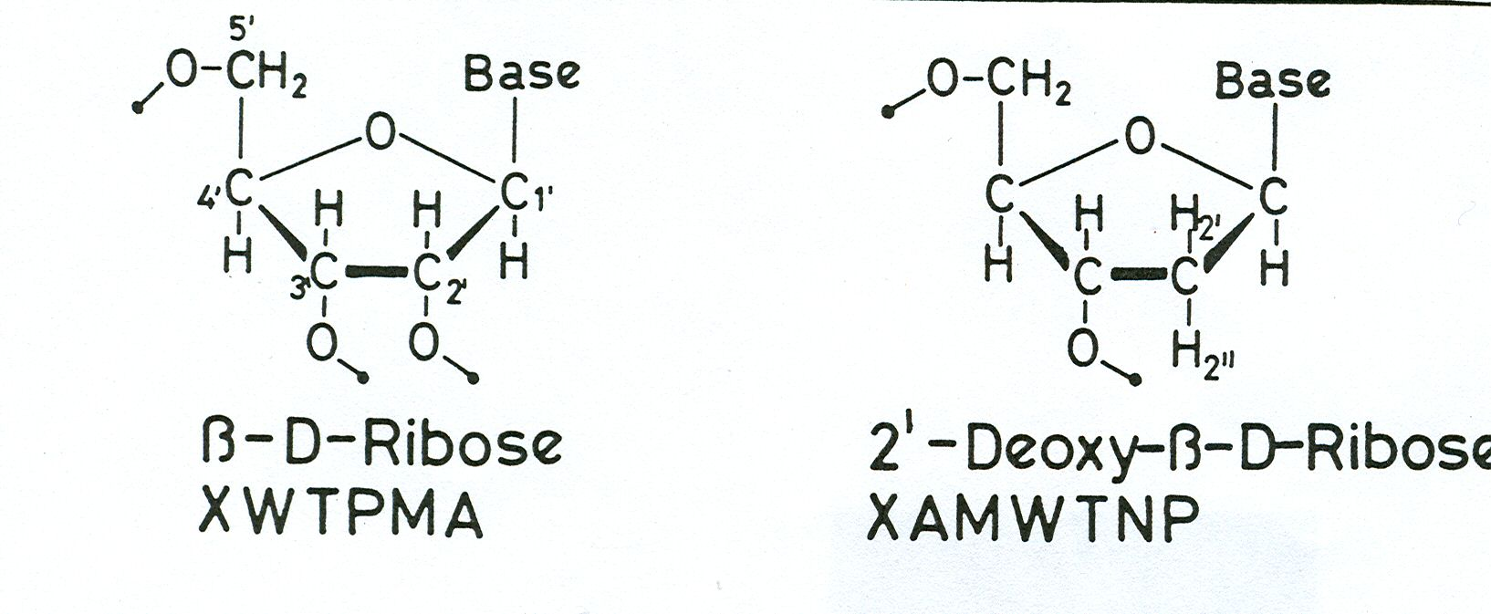
Spin systems in ribose and deoxyribose

Slide 45
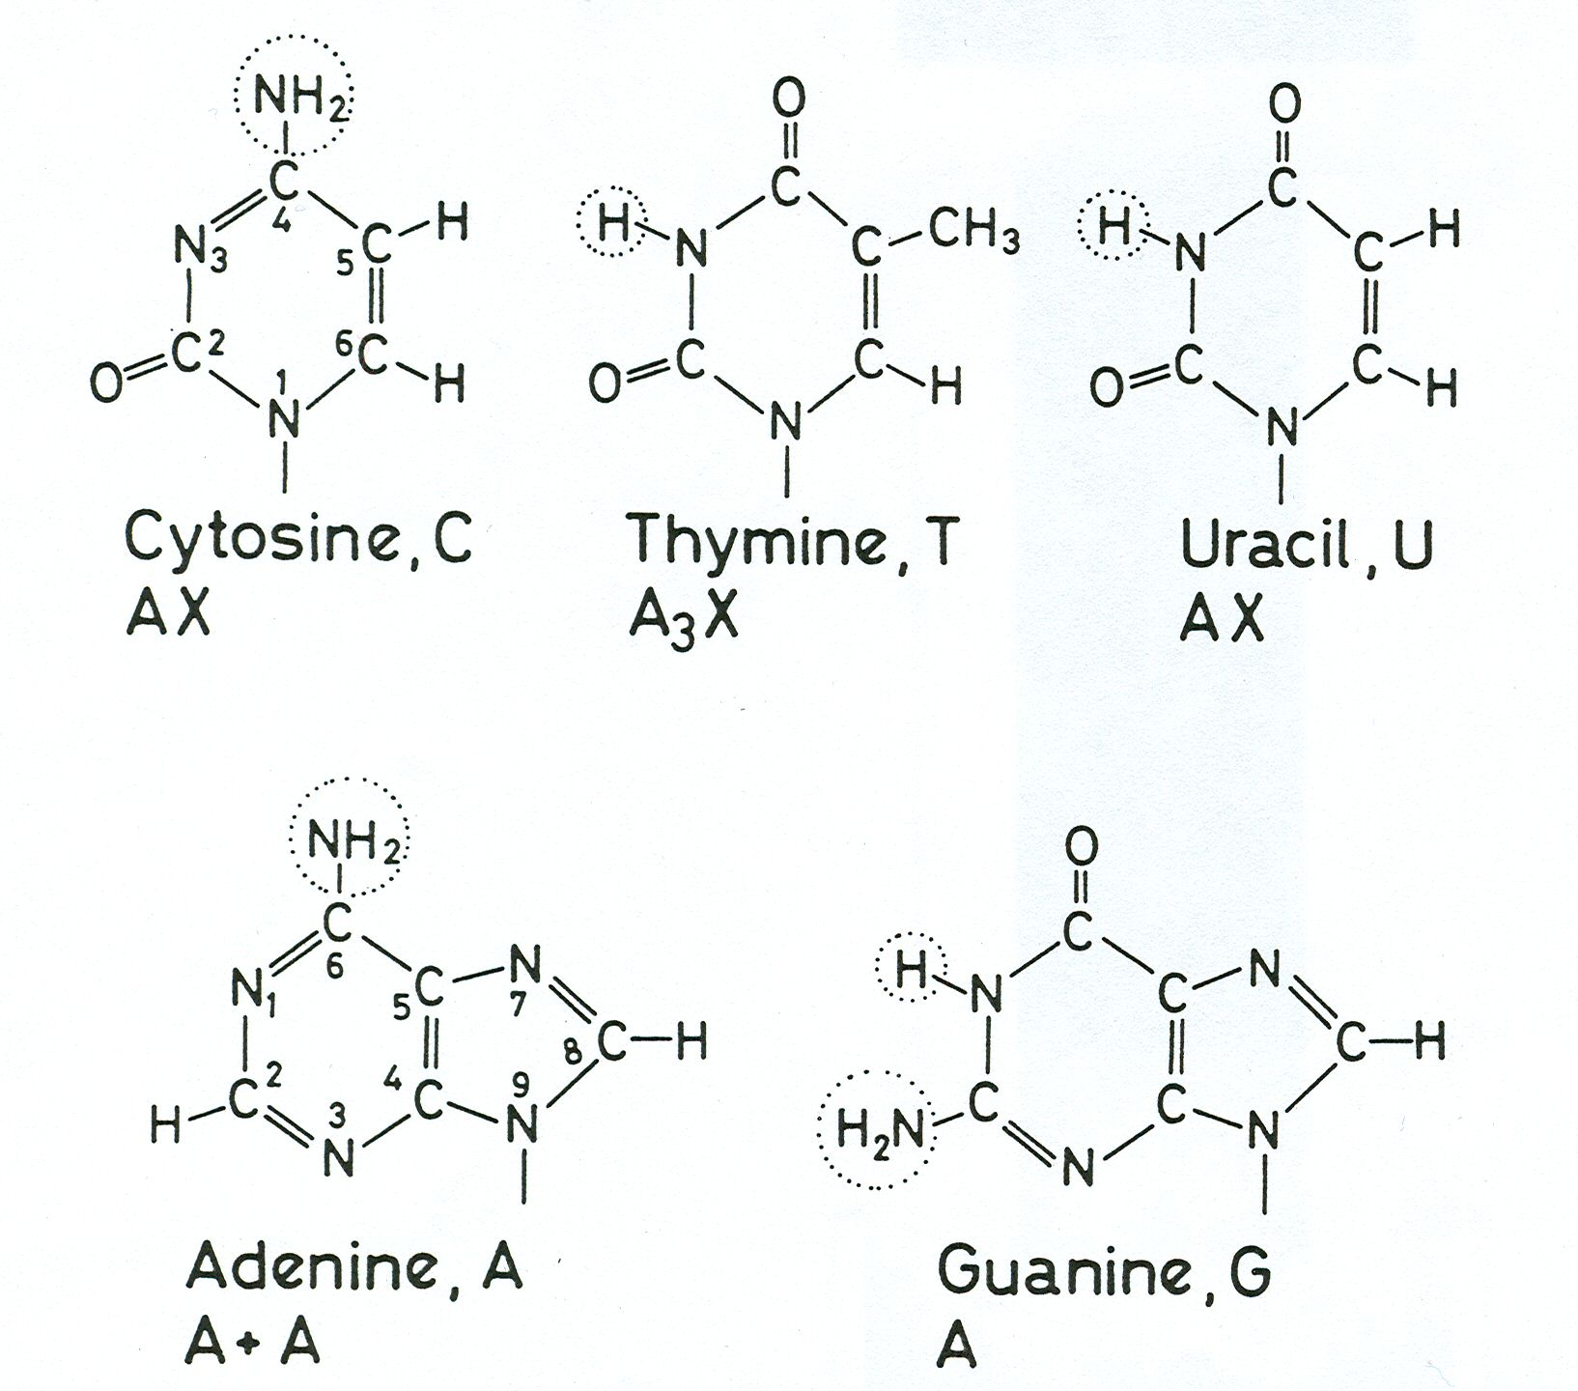
Spin systems in nucleic acid bases

Slide 46
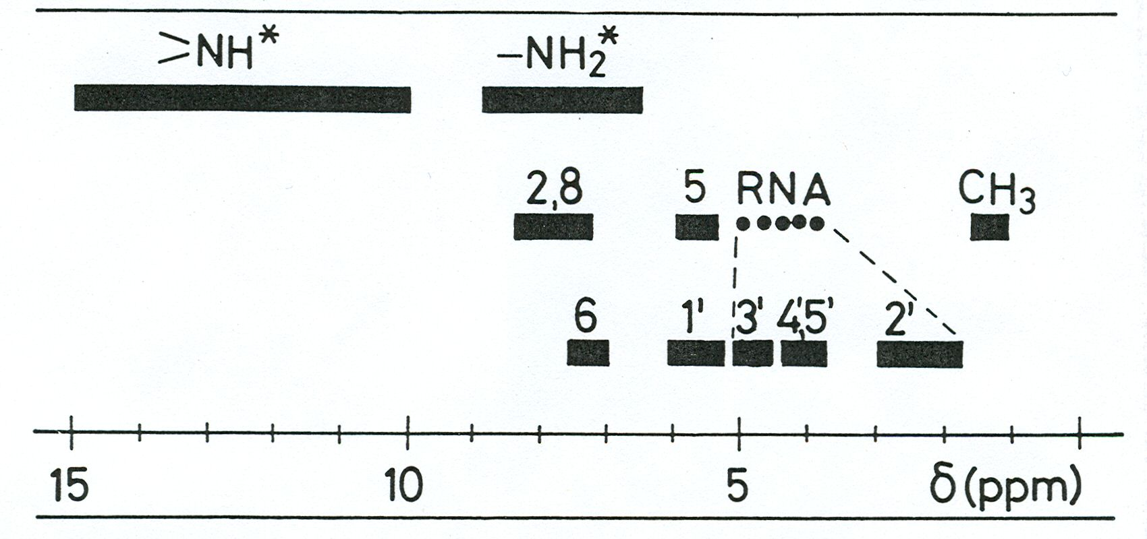
¹H chemical shift ranges in DNA and RNA

Slide 47
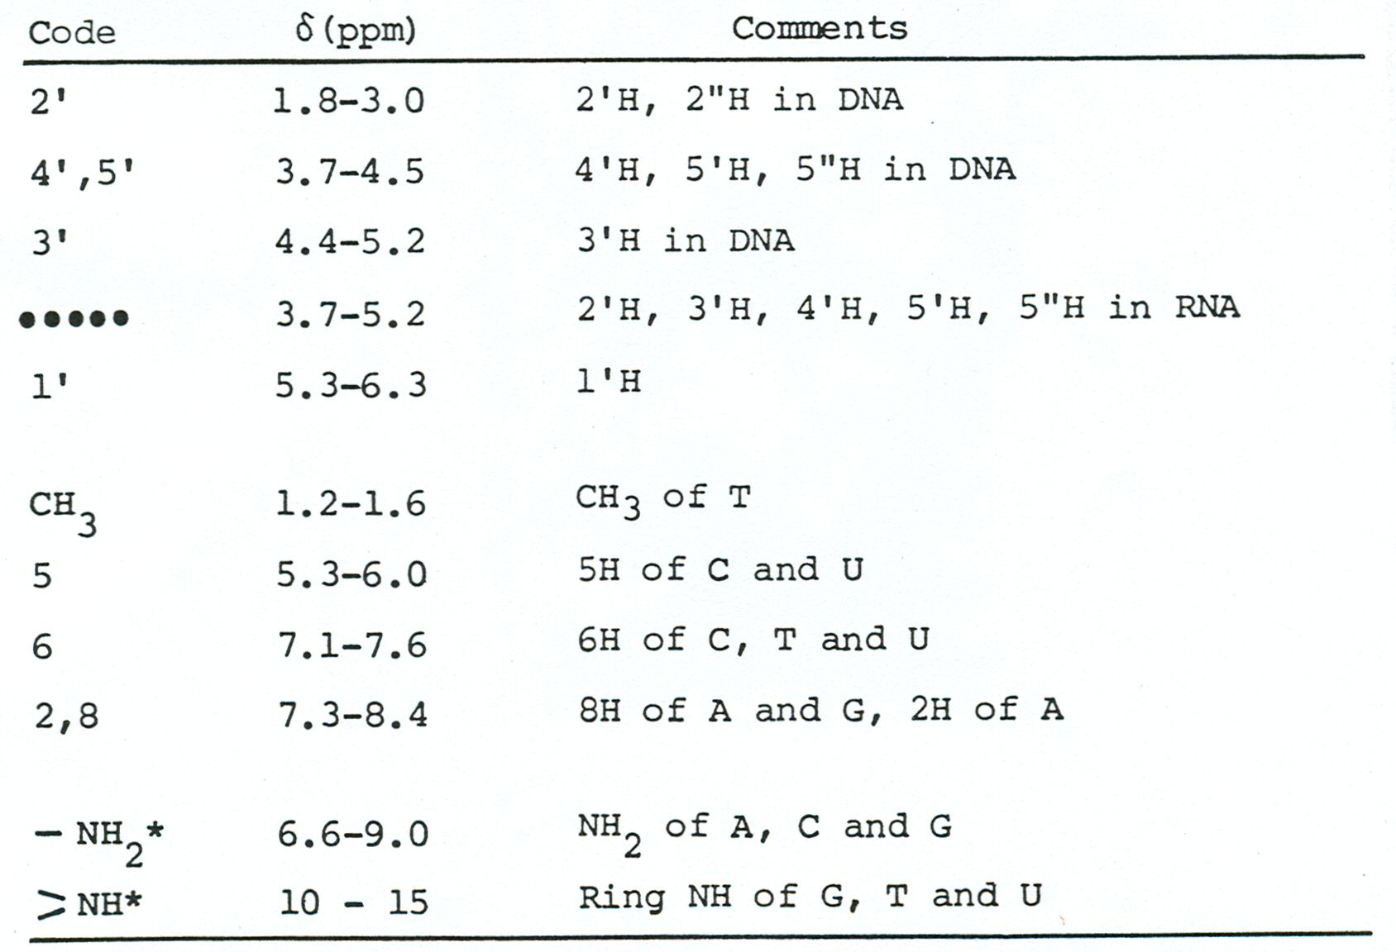
¹H chemical shift ranges in DNA and RNA

Slide 48
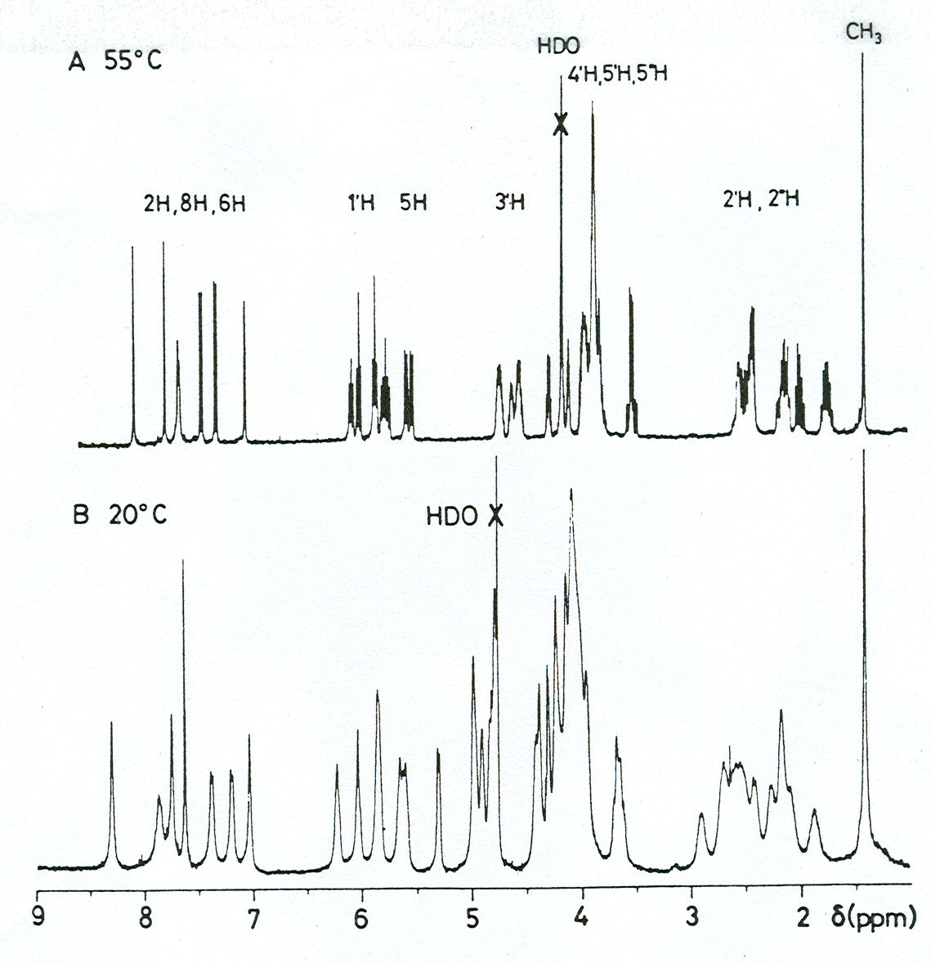
¹H NMR spectra of d(GCATGC)
Single strand
Duplex

Slide 49
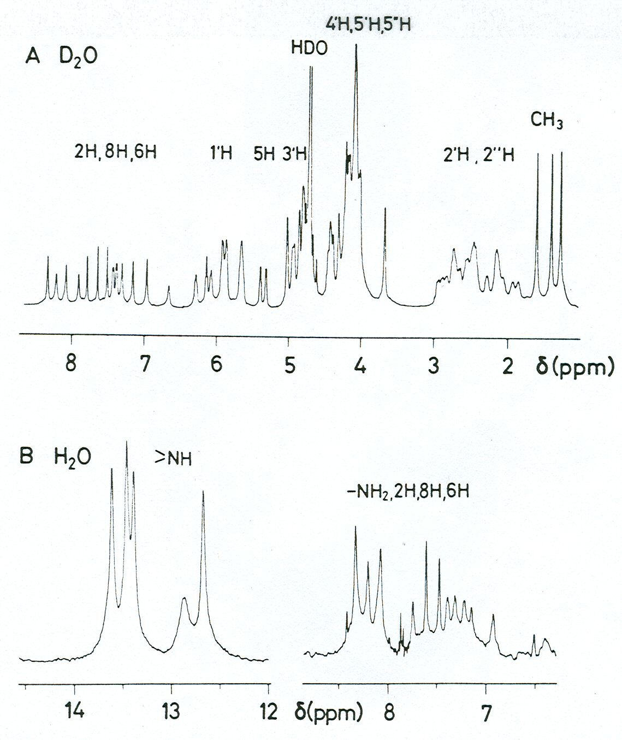
¹H NMR spectra in D₂O and H₂O
d(GCATTAATGC)₂

Slide 50
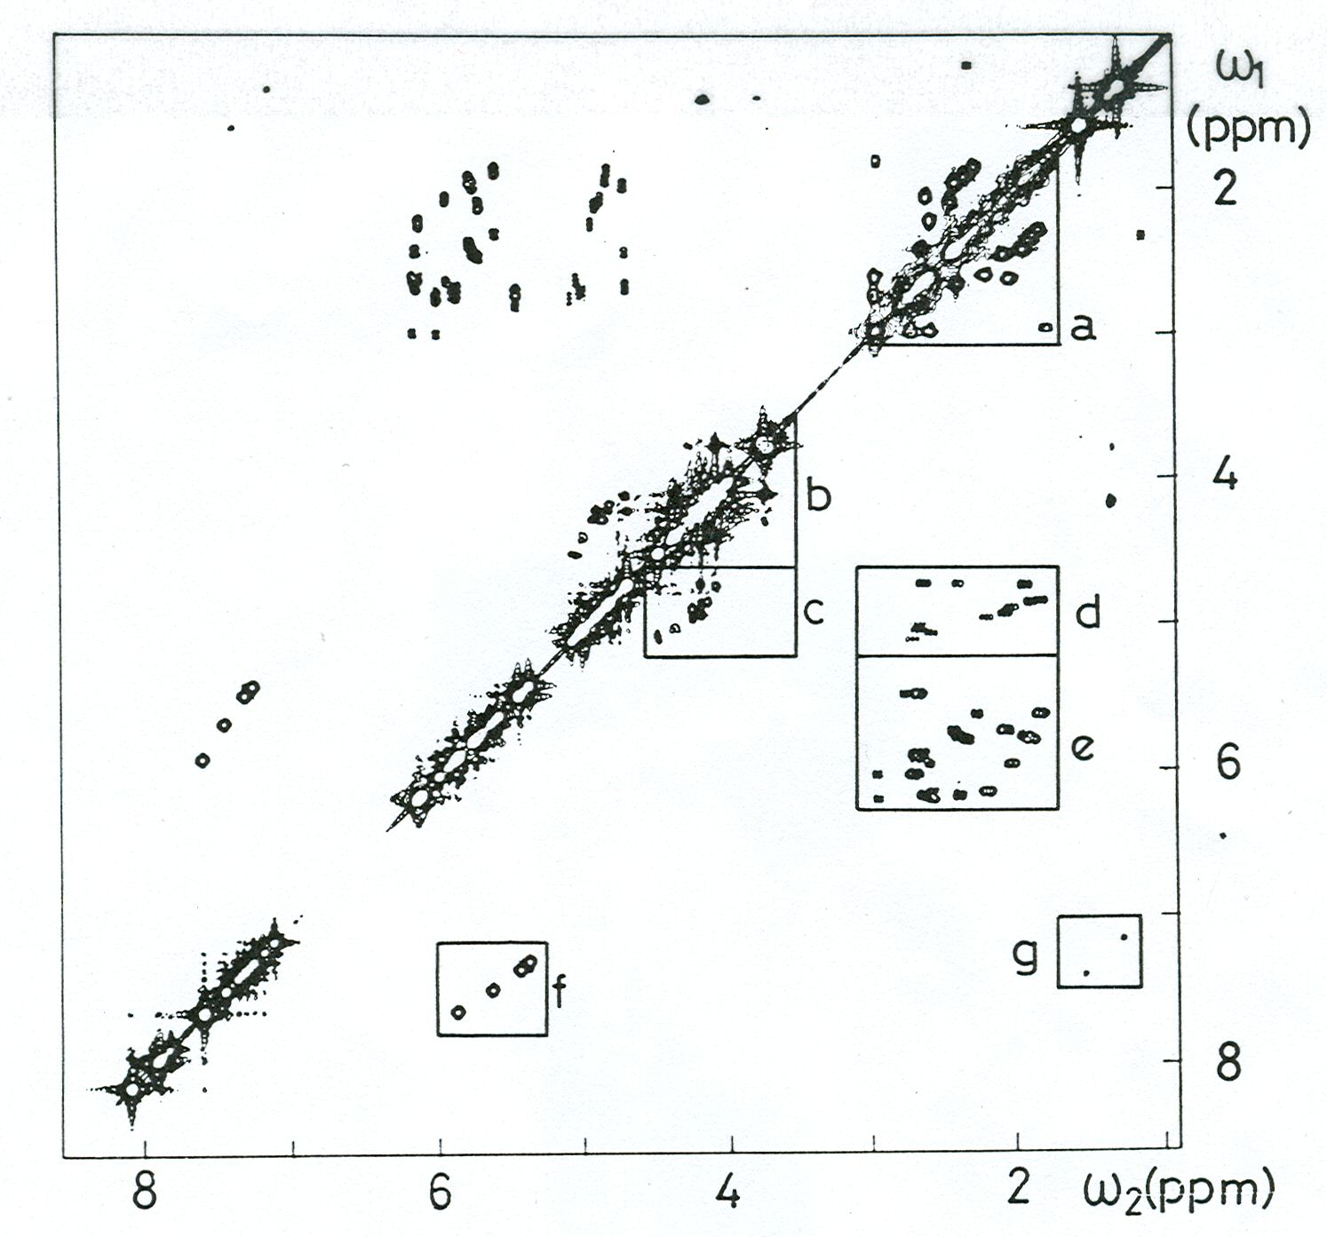
¹H COSY spectrum of DNA
a H2’-H2’’
b H4’-H5’,5’’
H5’-H5’’
c H3’-H4’
d H2’,2’’-H3’
e H1’-H2’,2’’
f H5-H6 (Cyt)‏
g CH₃-H6 (Thy)‏
d(CGCGAATTCGCG)₂

Slide 51
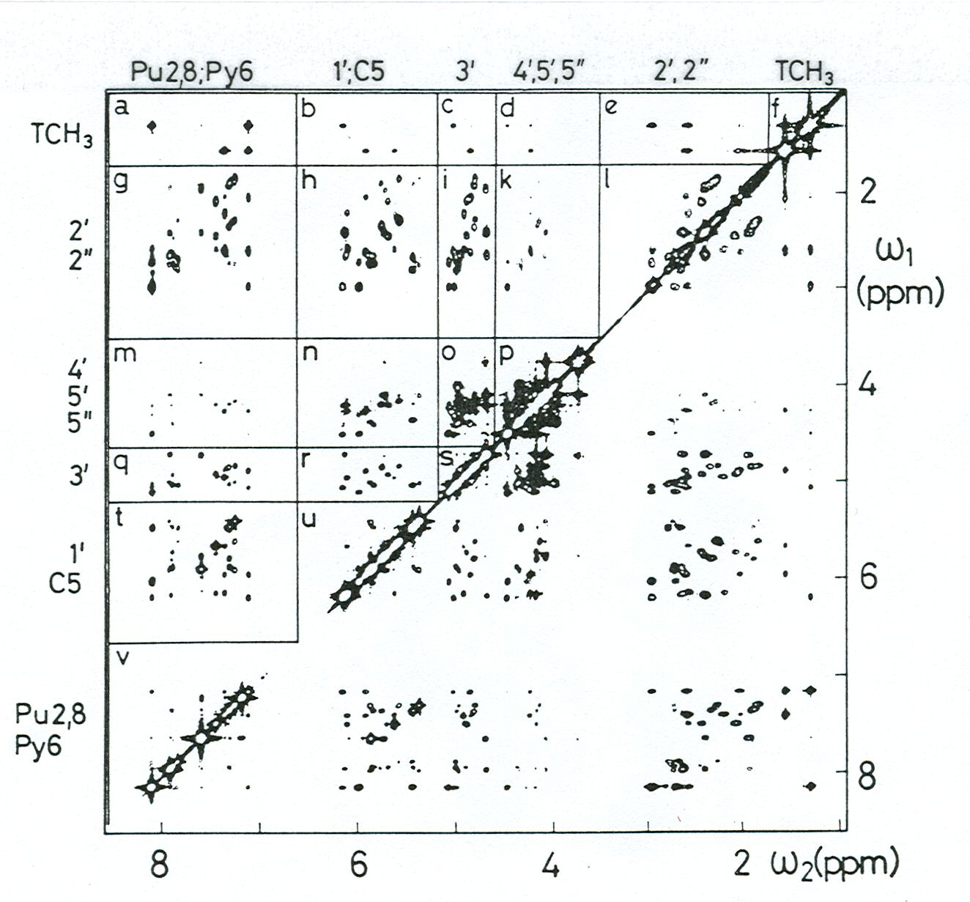
¹H NOESY spectrum of DNA
d(CGCGAATTCGCG)₂

Slide 52
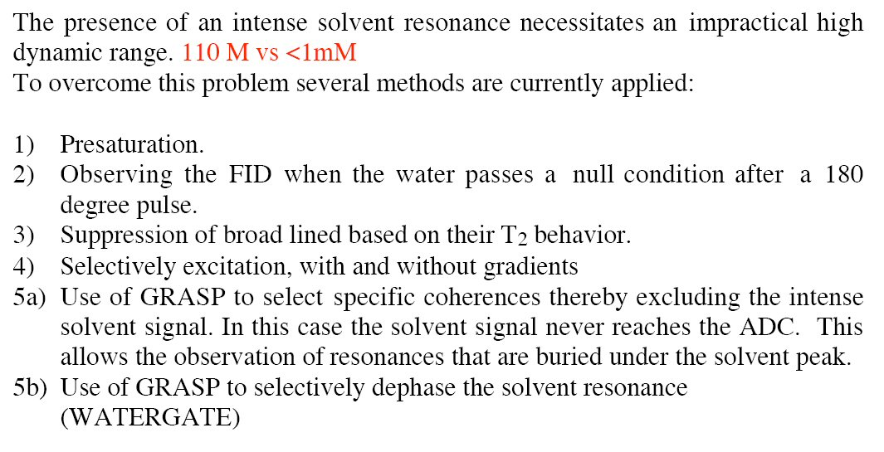
Water Suppression

Slide 55
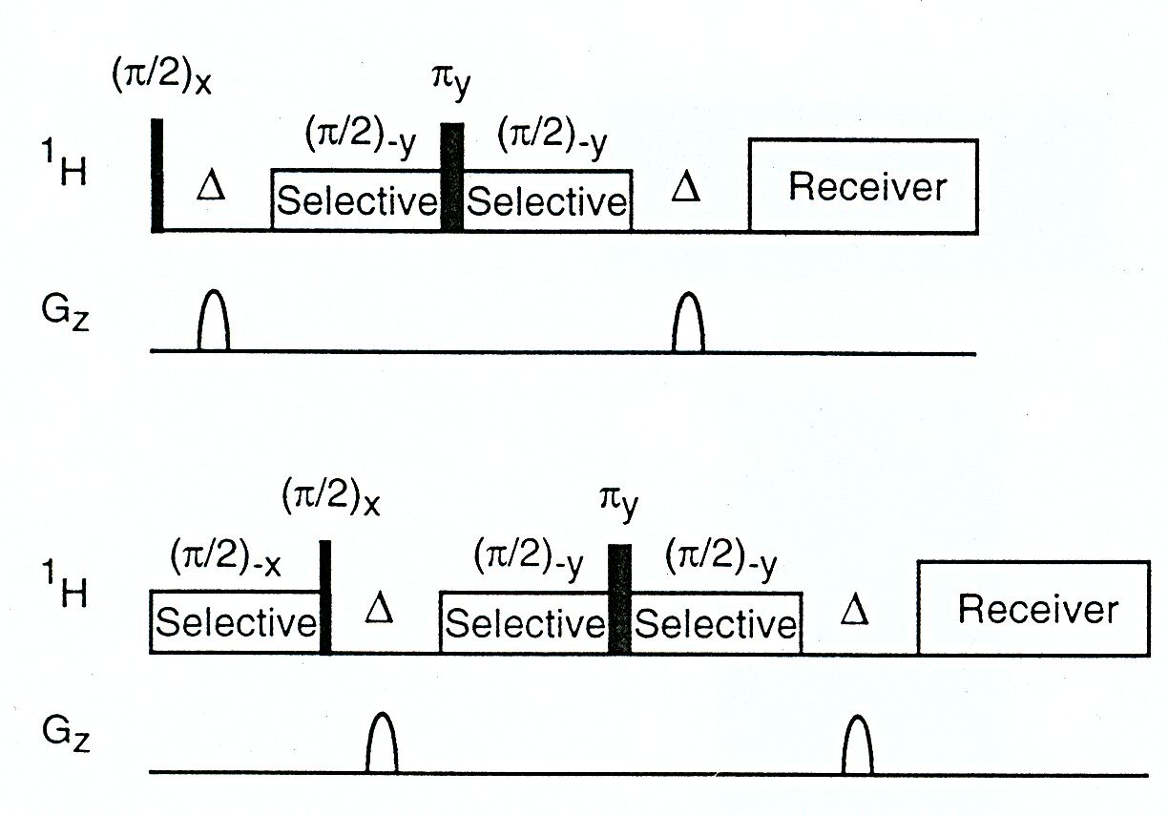
WATERGATE

Slide 56
Structure Determination Procedure

Slide 57
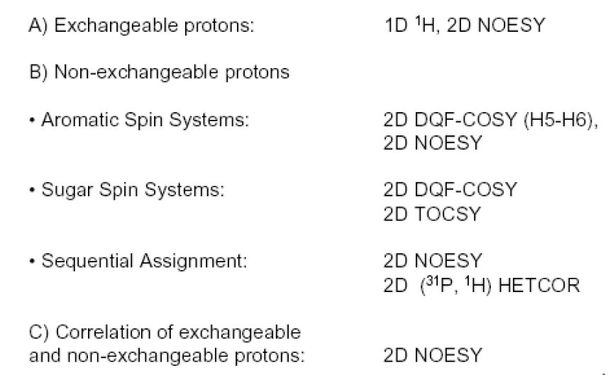
Resonance Assignment

Slide 58
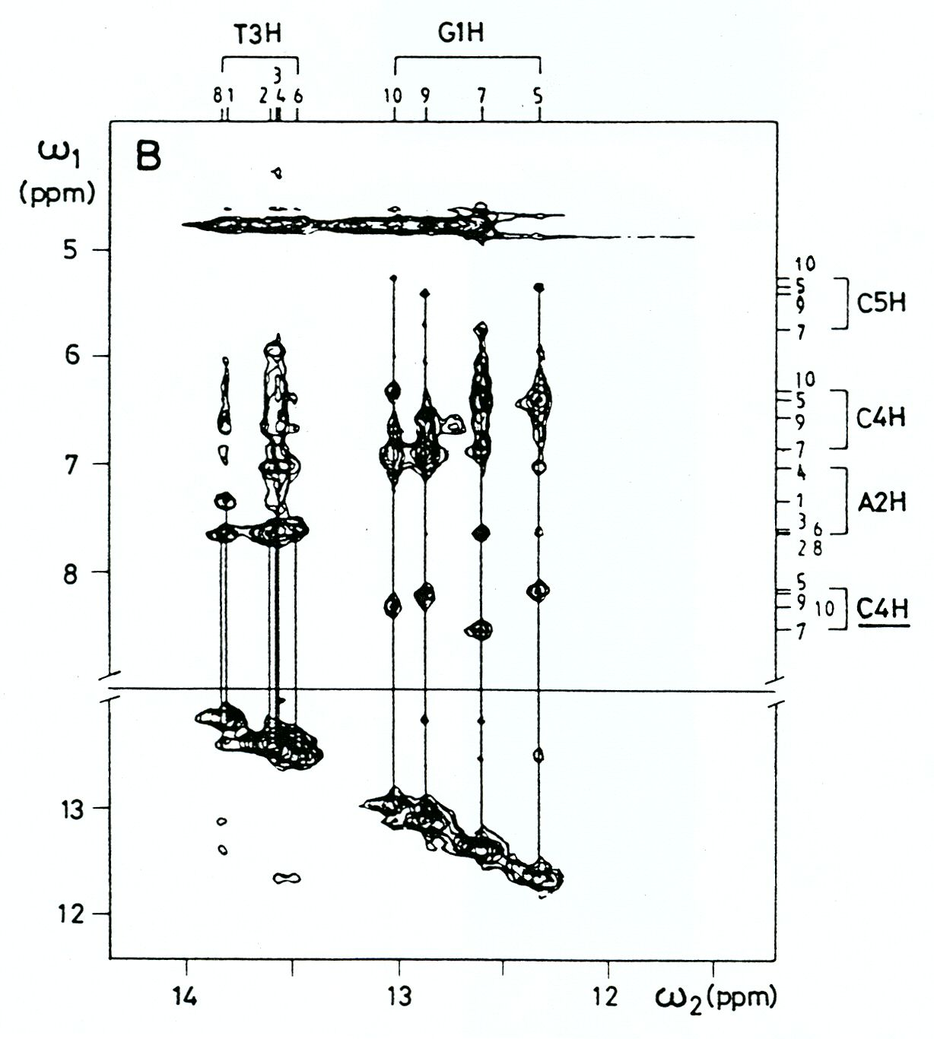
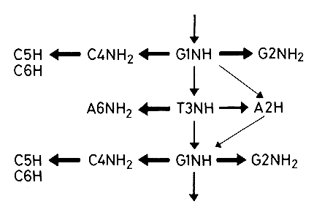
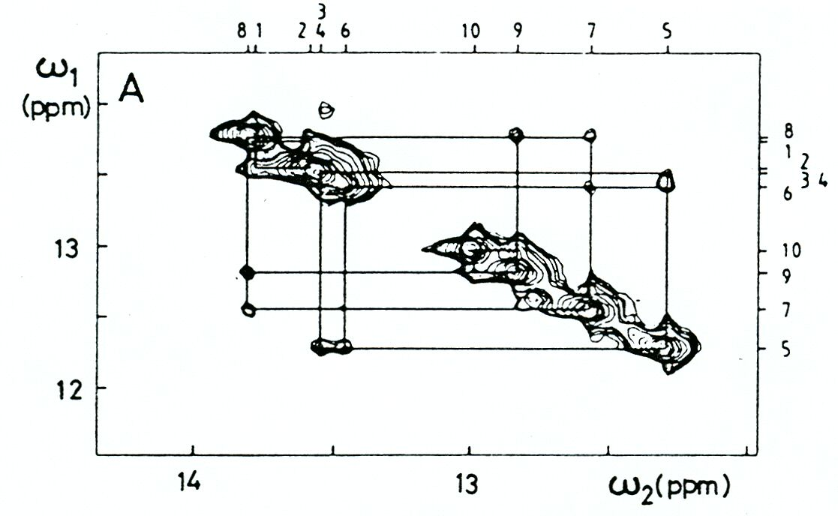
Sequential connectivities with exchangeable protons
d(GGAATTGTGAGCGG)‏
d(CCTTAACACTCGCC)‏
imino-imino
imino-amino

Slide 59
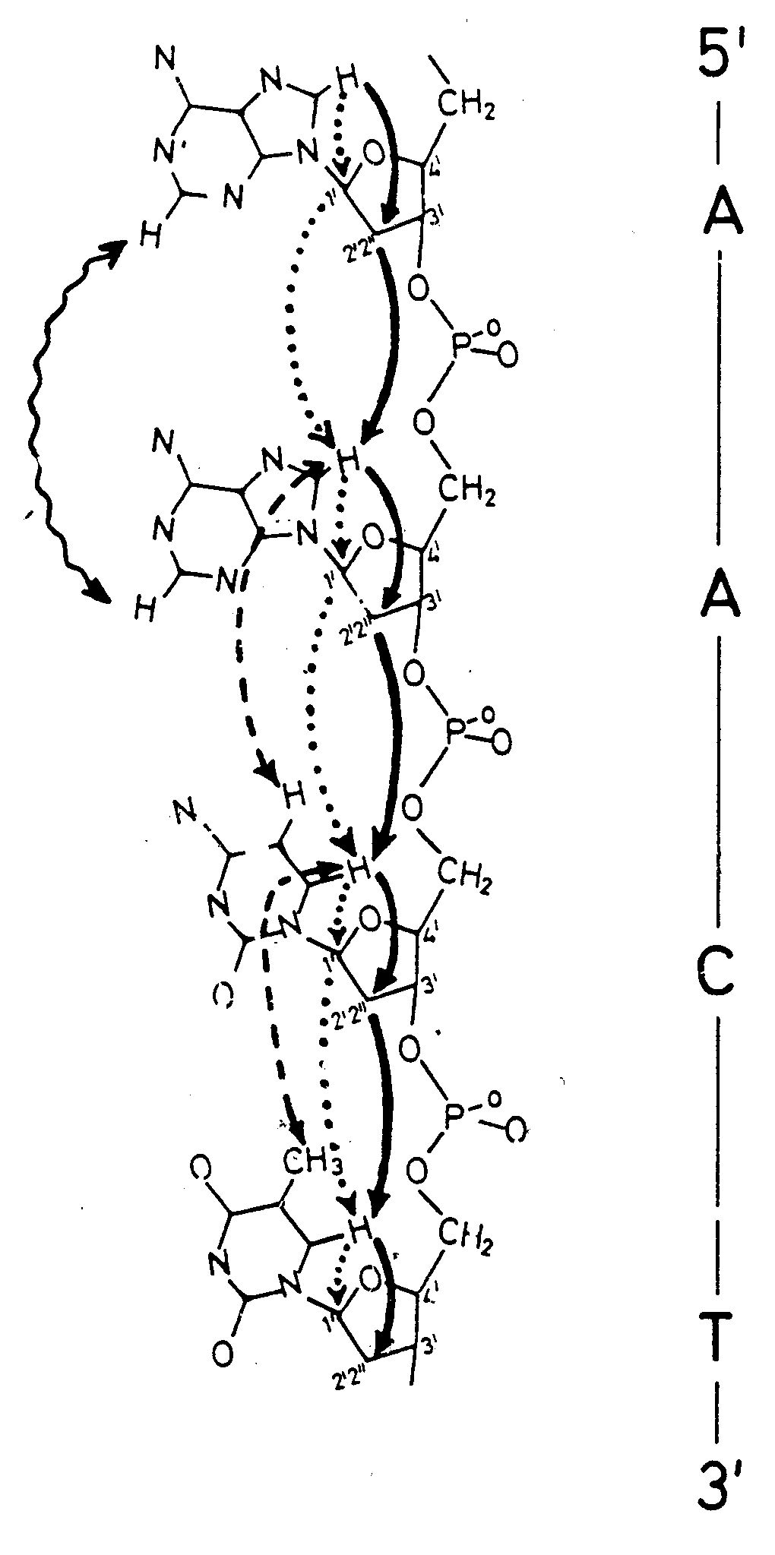
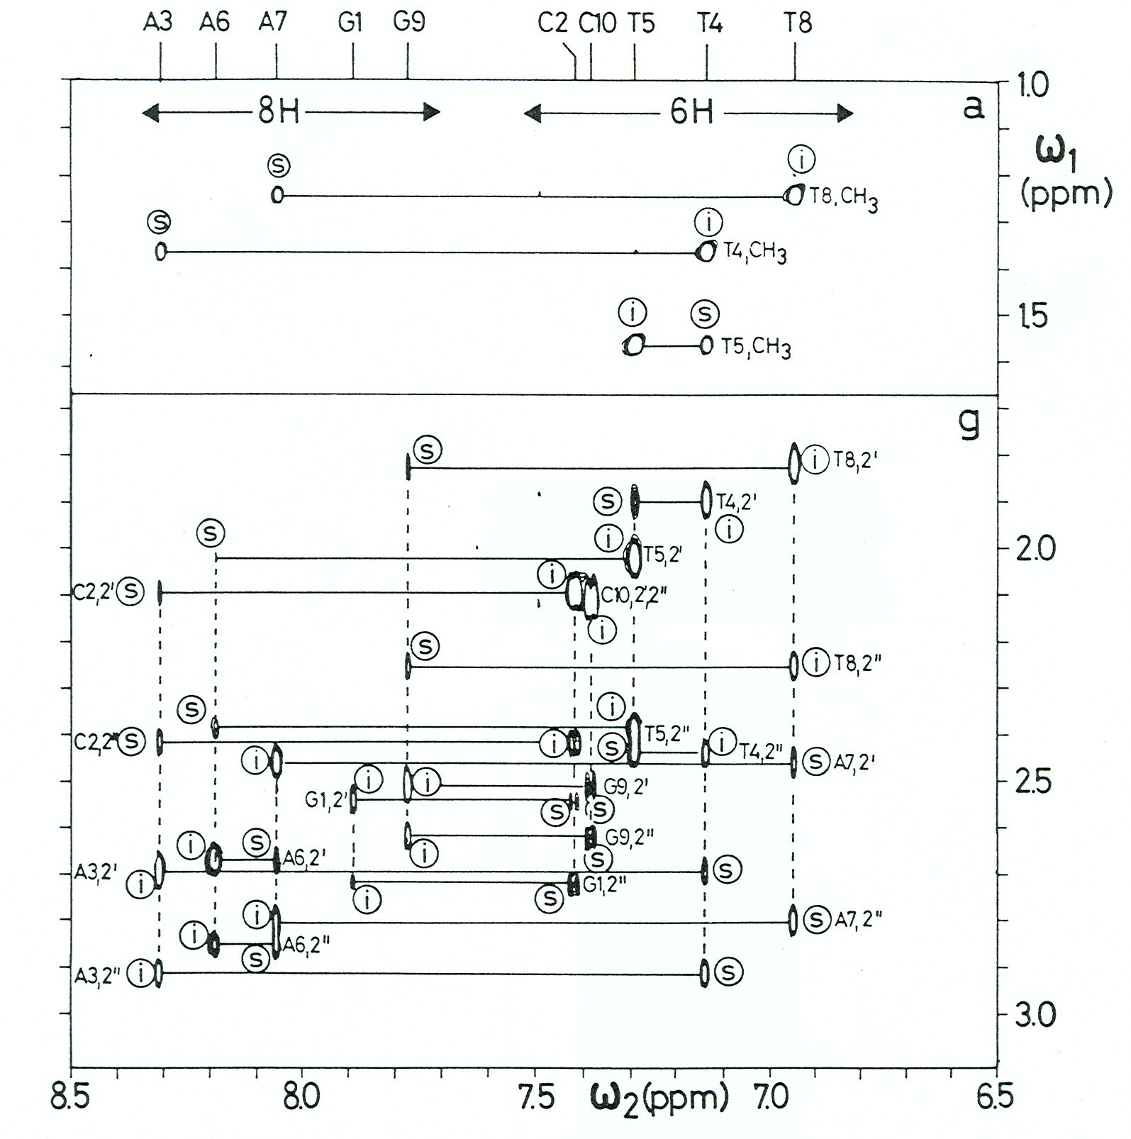
Sequential resonance assignments
d(GCATTAATGC)₂

Slide 60
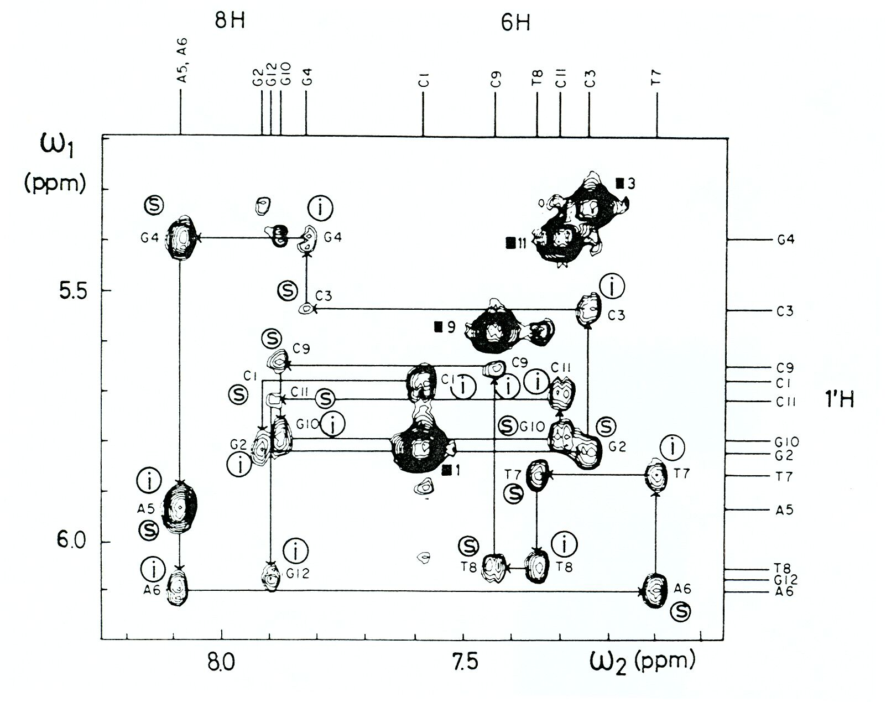
Connectivities between H1’ and H6/8
d(CGCGAATTCGCG)₂
i intra-residue
s sequential

Slide 64
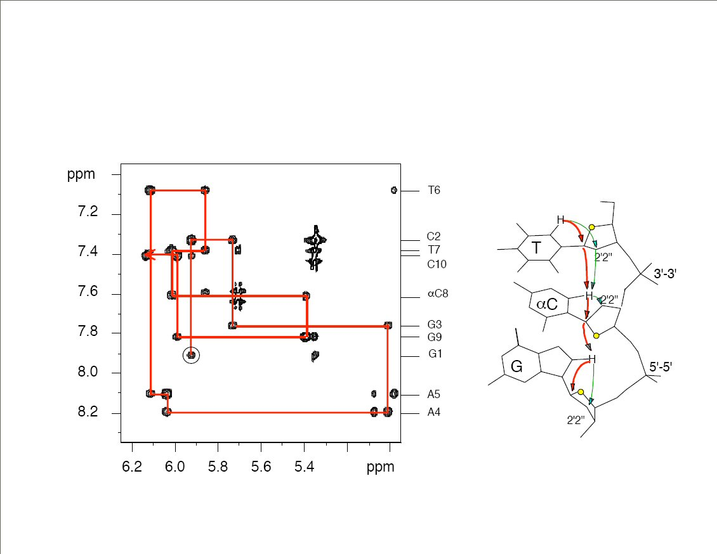

Slide 66
Assignment of Sugar-Phosphate Backbone
HP-COSY
HP-TOCSY

Slide 70
J-couplings from COSY spectra

Slide 71
P determination from J-couplings
2’’3’
3’4’
1’2’’
2’3’
1’2’

Slide 72
Equilibrium of N and S conformations
3’-endo
2’-endo

