Slide 1
Heteronuclear NMR of Nucleic Acids
In most cases, requires samples isotopicaly enriched
by ¹³C and ¹⁵N (except for HSQC, HMQC)
Assignment uses NOE or through-bond experiments
Traditional constraints (NOEs, J-couplings)
Novel constraints (RDCs, residual CSA)
Studies of intramolecular dynamics

Slide 2
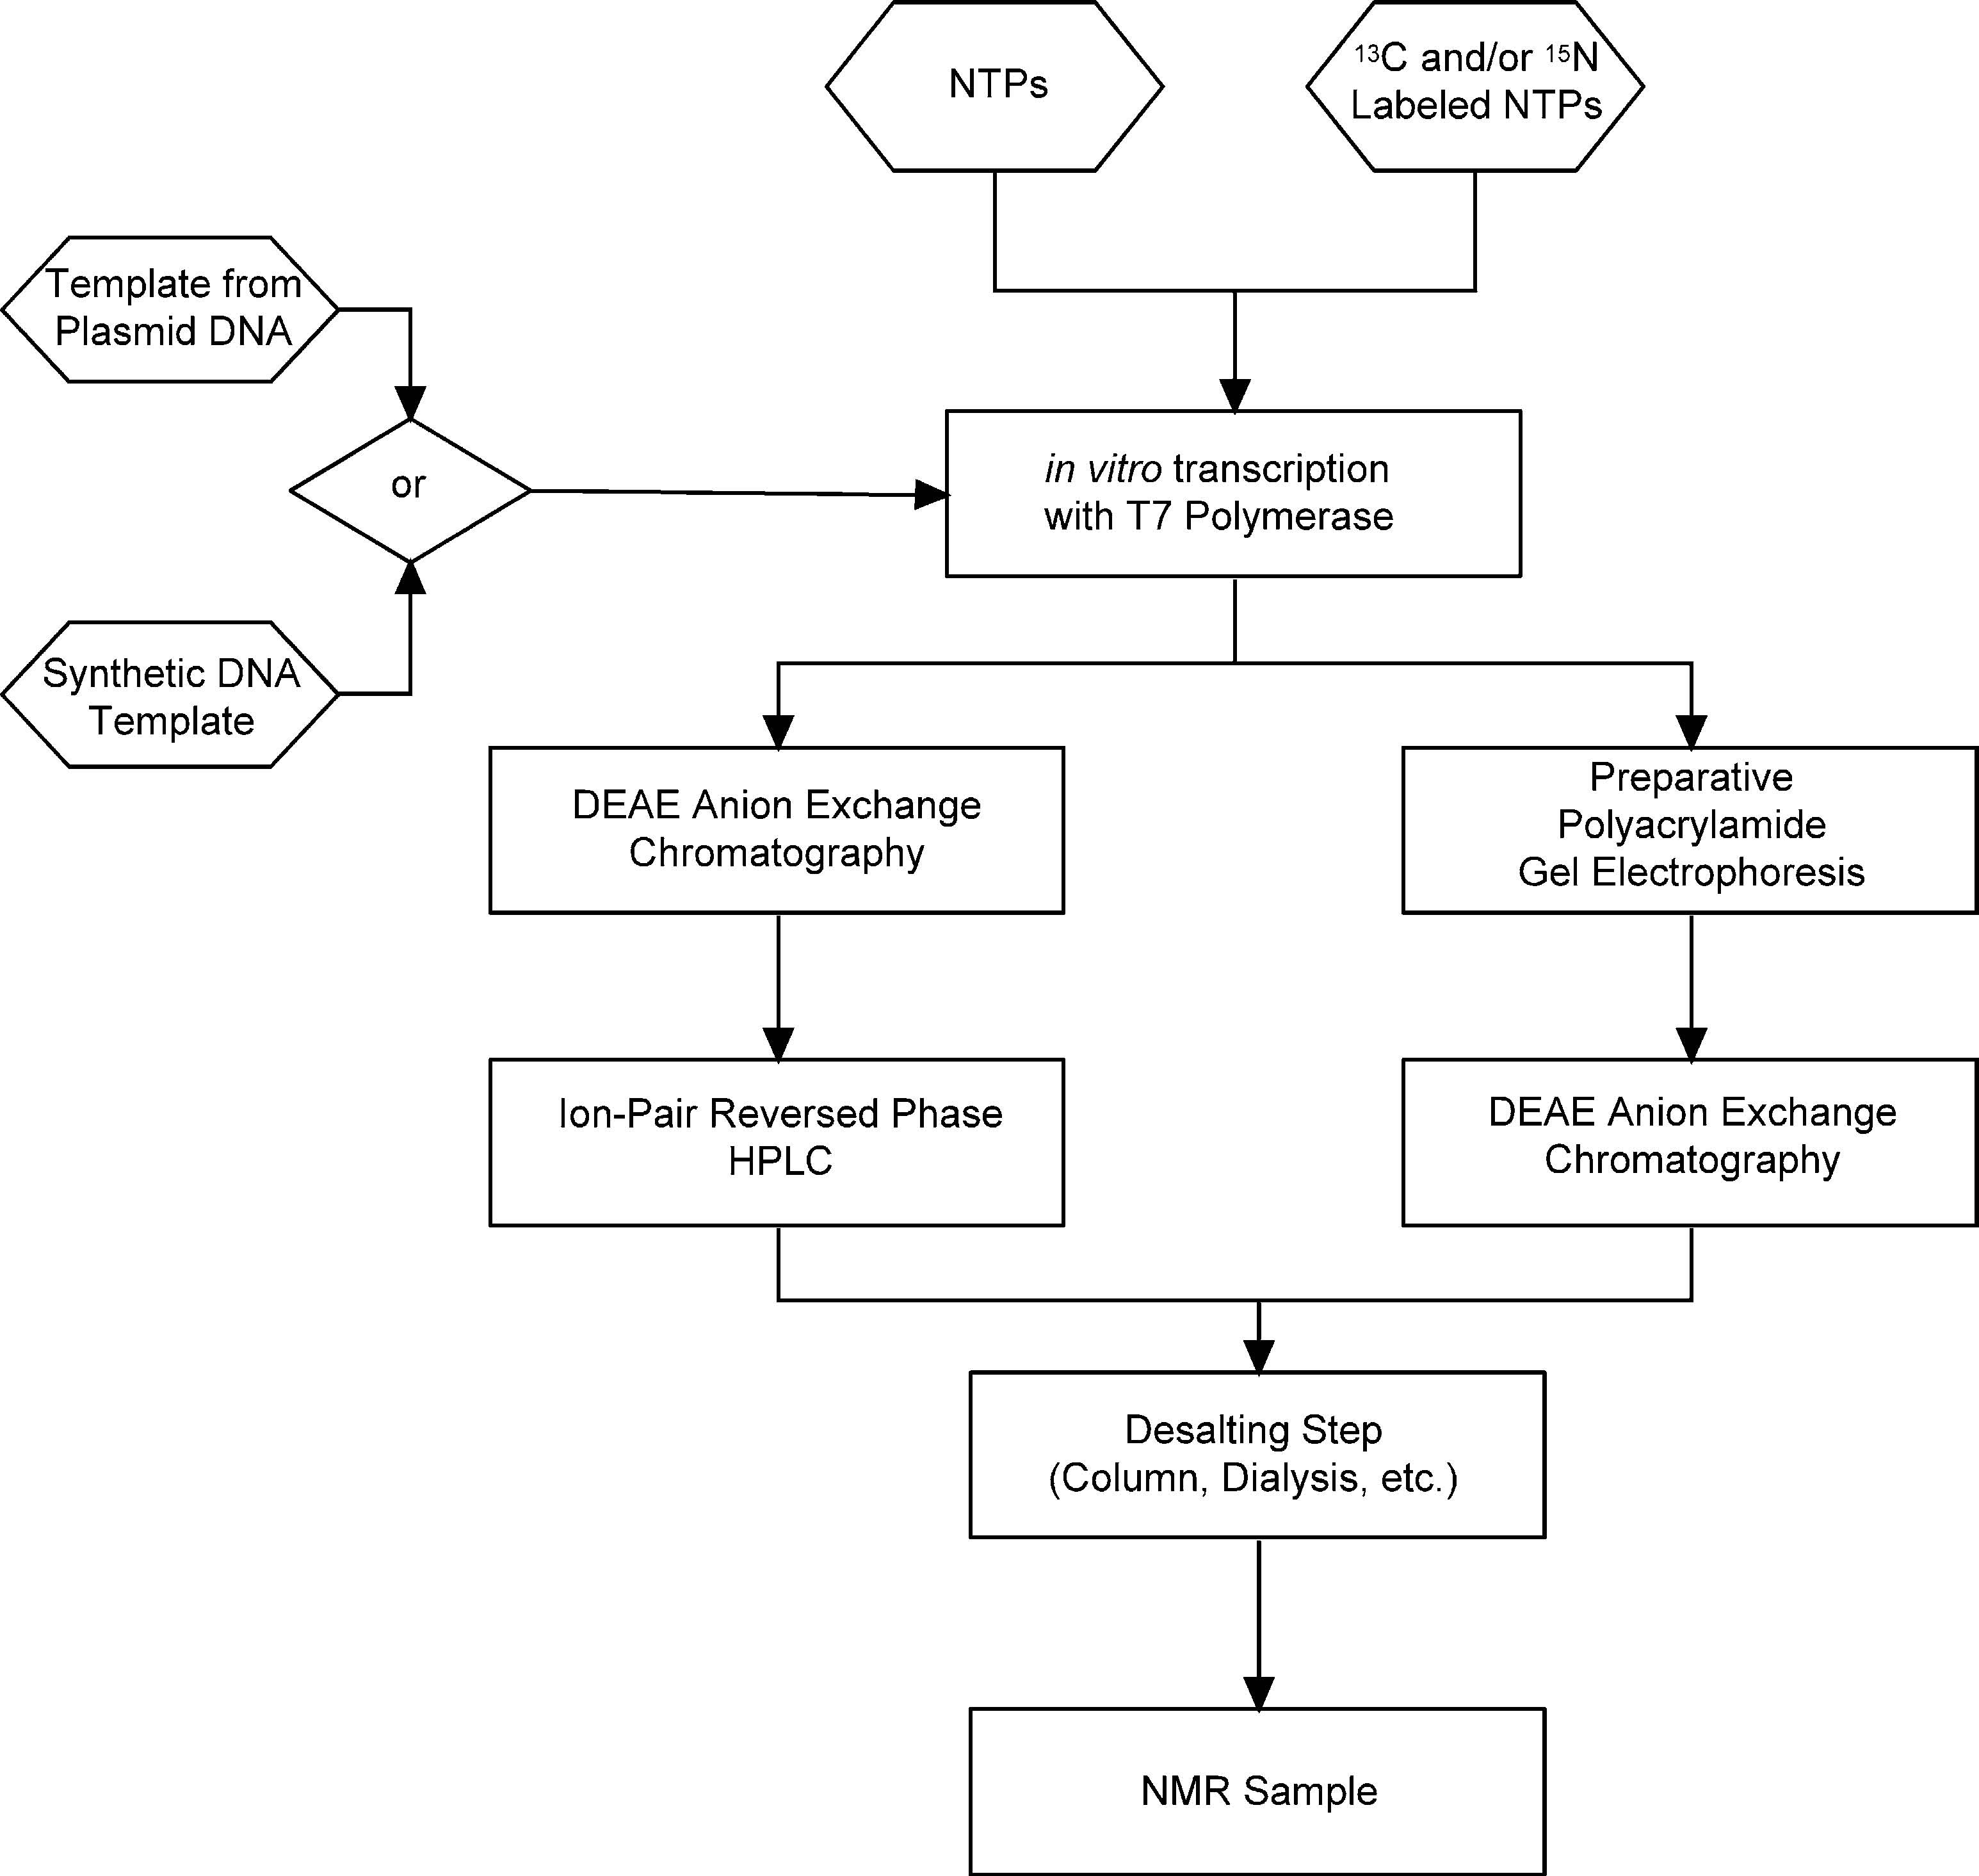
RNA preparation
Labeled NTPs
Available commercially
Can be grown in cells
E. Coli
¹³C-glucose, ¹⁵N-ammonium
M. Methylotropus
¹³C-methanol, ¹⁵N-ammonia

Slide 3
Assignment procedure for labeled NA
NOE based (I)

Slide 4
Assignment procedure for labeled NA
NOE based (II)

Slide 5
Assignment procedure for labeled NA
Through bond correlations (I)

Slide 6
Assignment procedure for labeled NA
Through bond correlations (II)

Slide 7
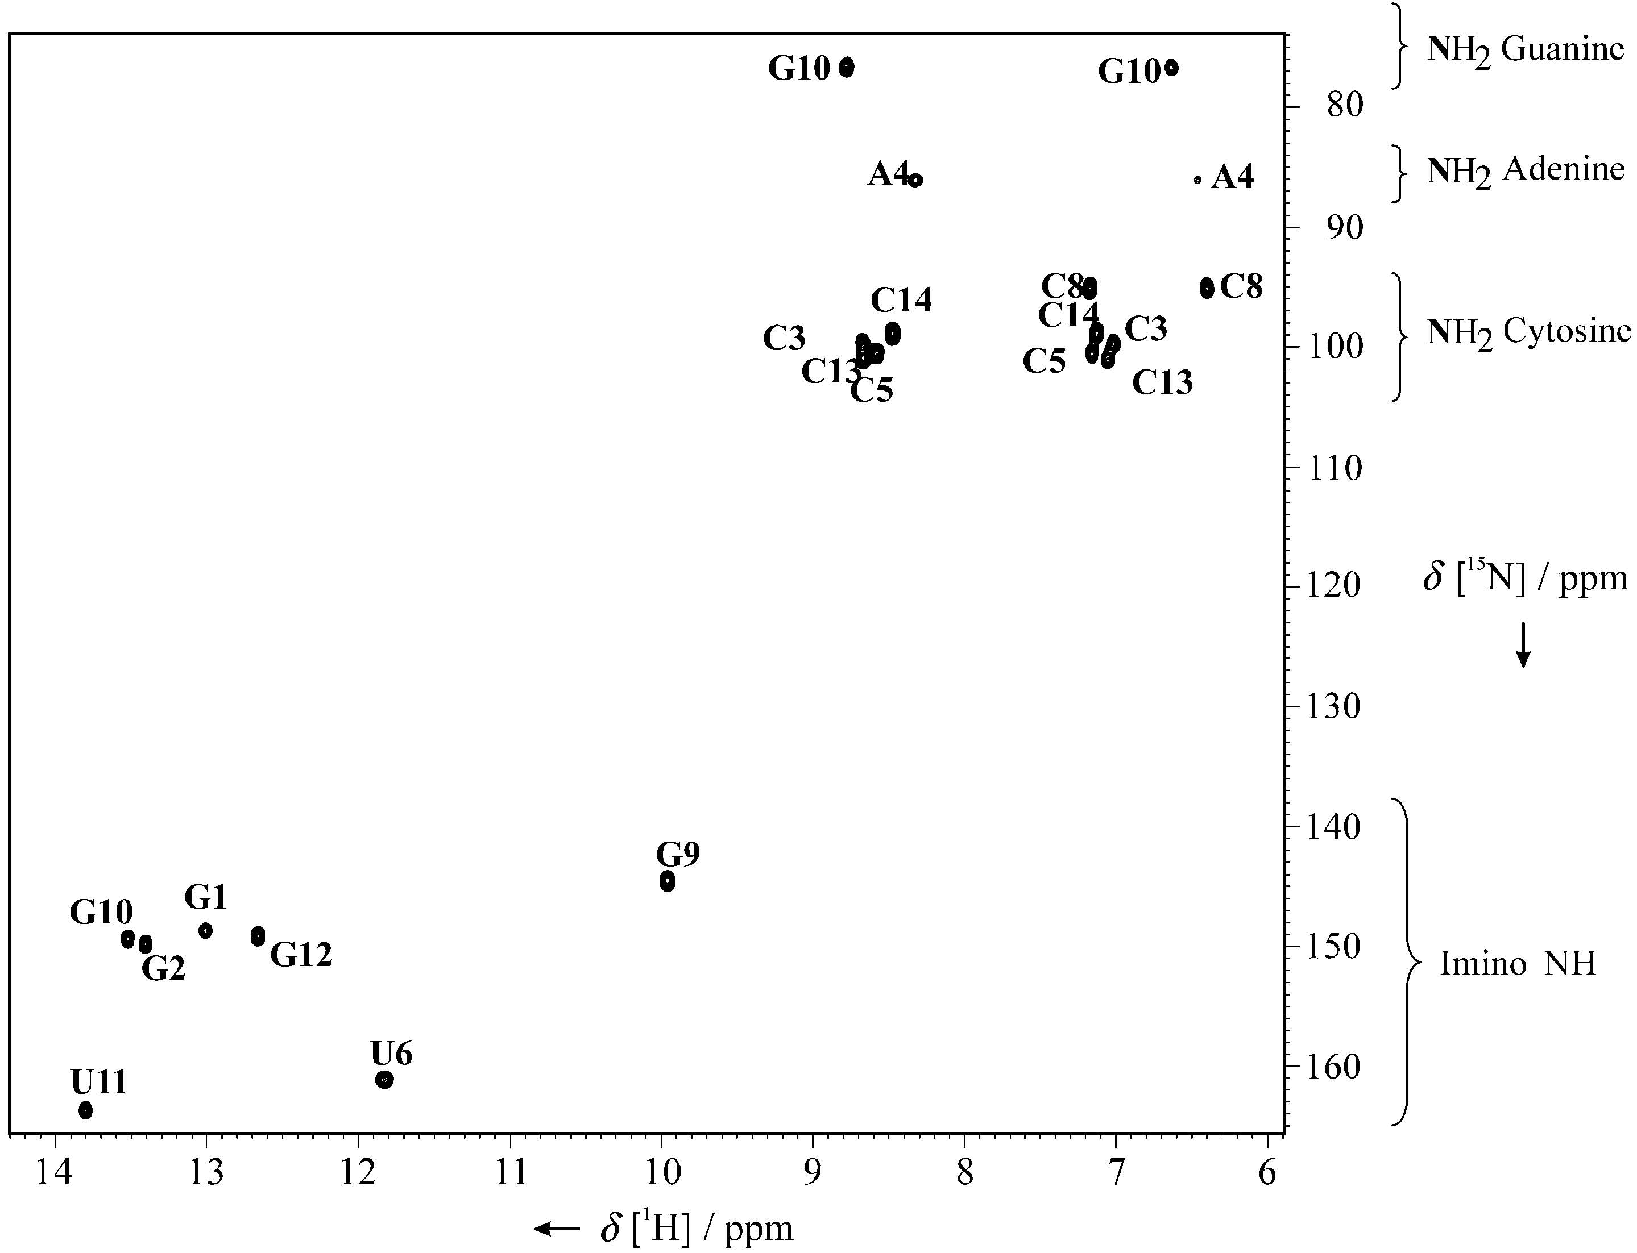
Correlation of exchangeable protons with ¹⁵N
U
C
U
G
C
G
5
10
A
U
C
G
G
C
1
G
C
Gradient sensitivity-enhanced HSQC
Kay, Keifer, Saarinen, JACS 1992.

Slide 8
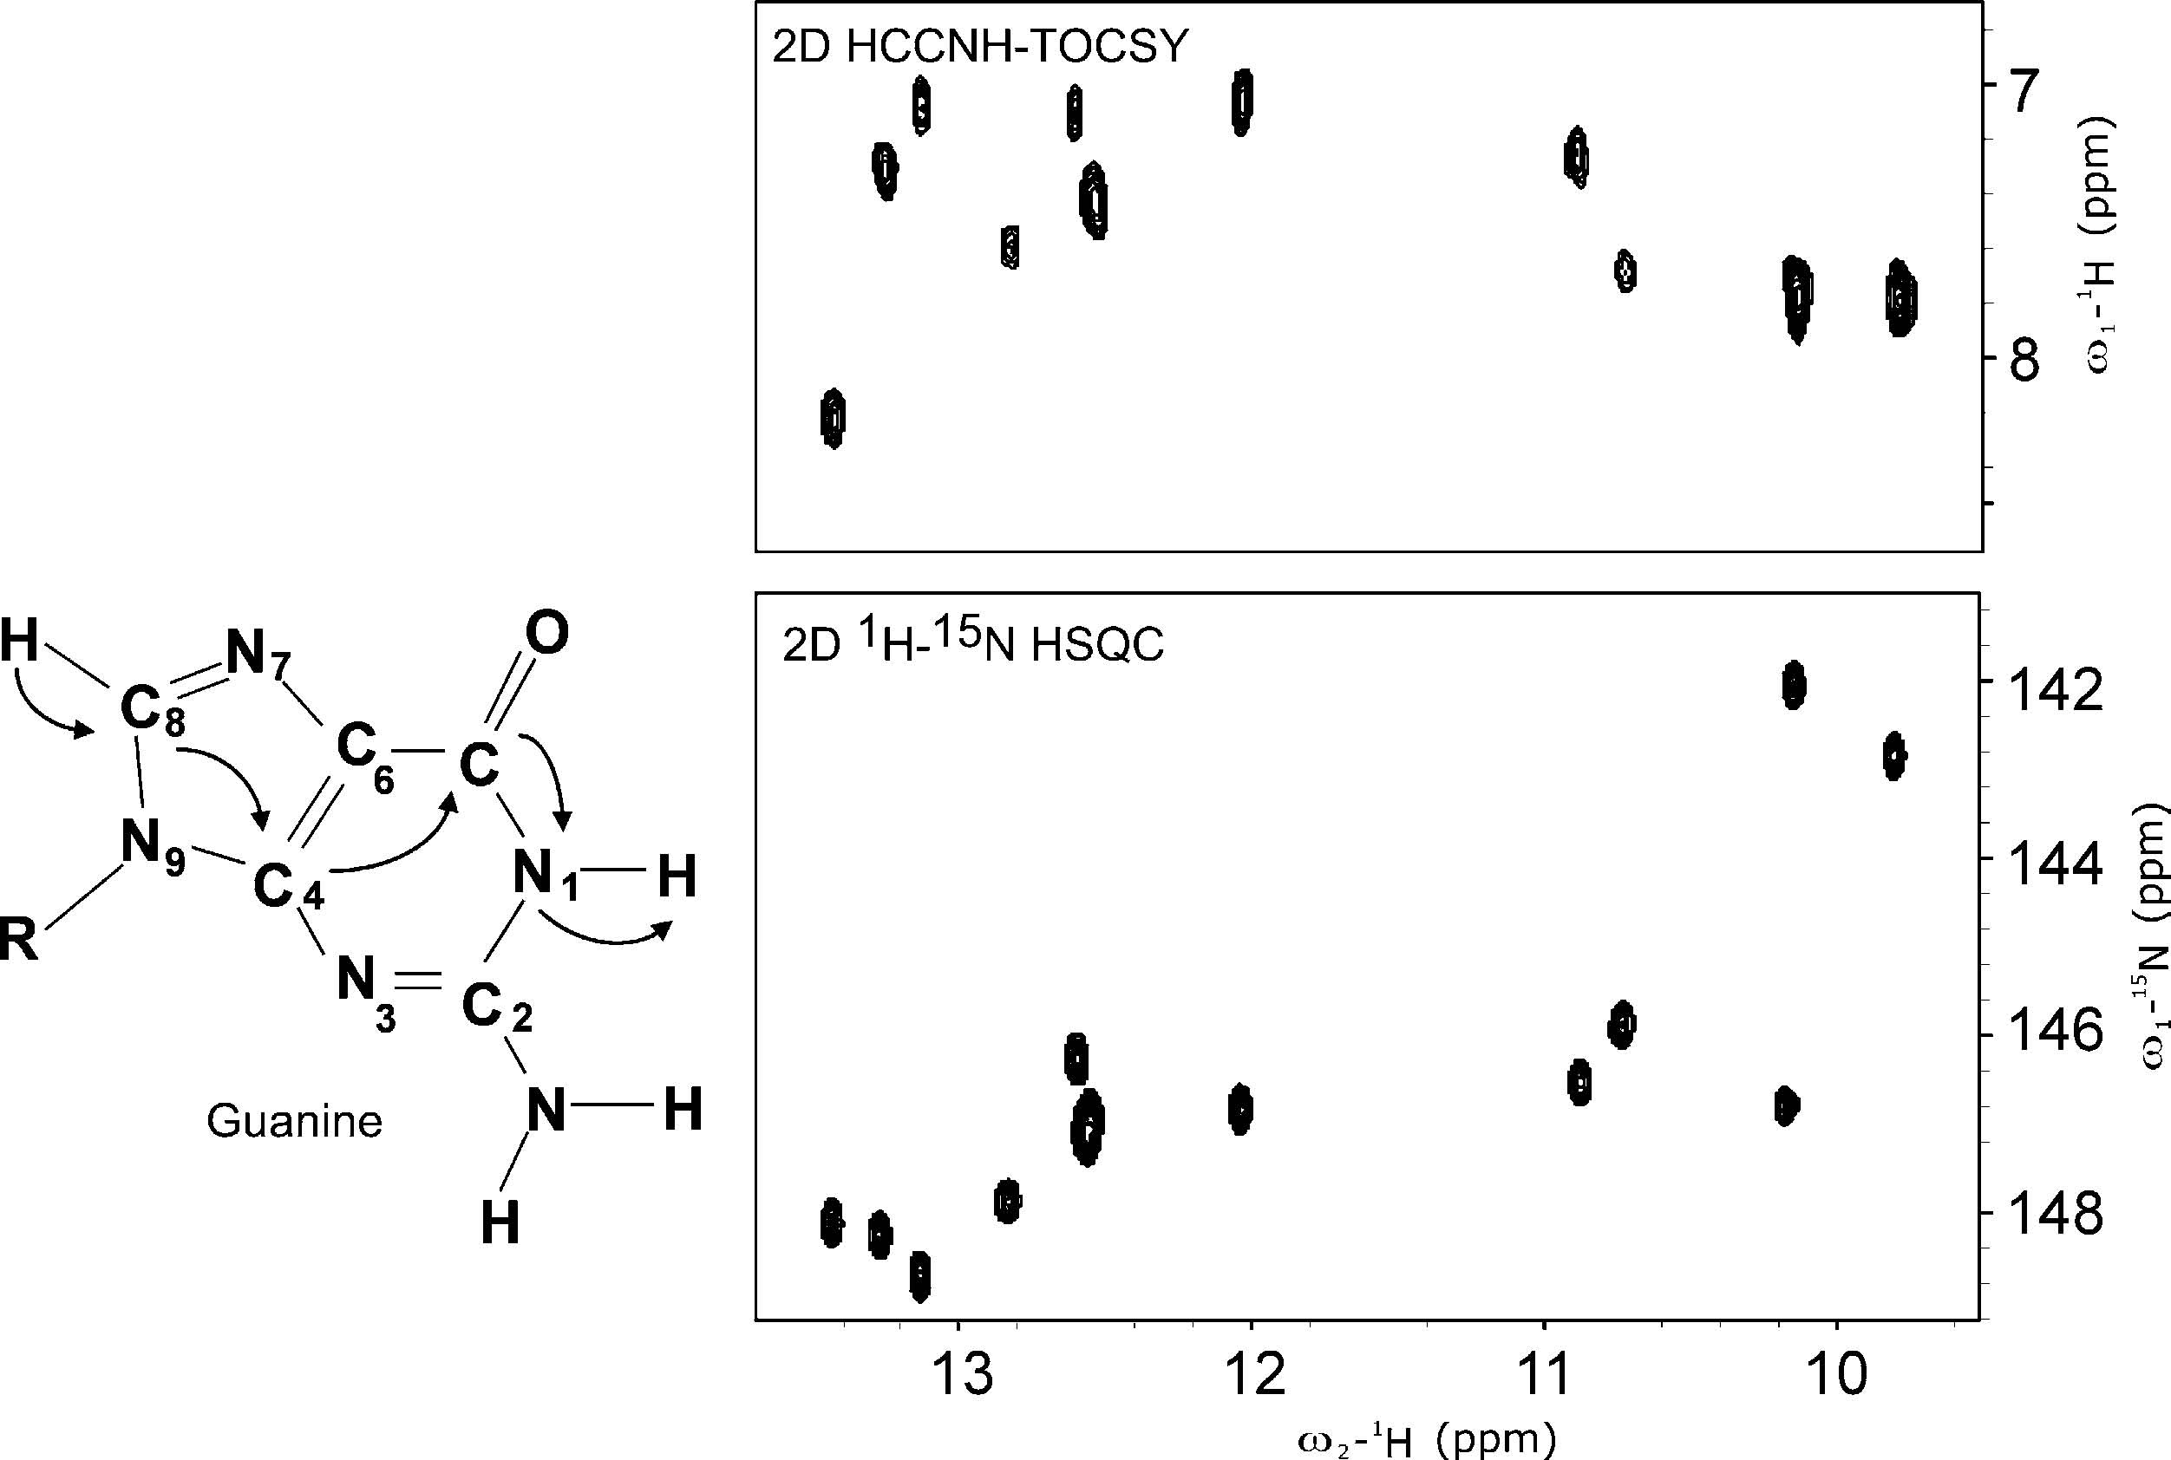
Correlation of exchangeable and non-exchangeable protons
HCCNH-TOCSY, Fiala et al. JACS 1996, Sklenar et al. J. Biomol. NMR 1996.

Slide 9
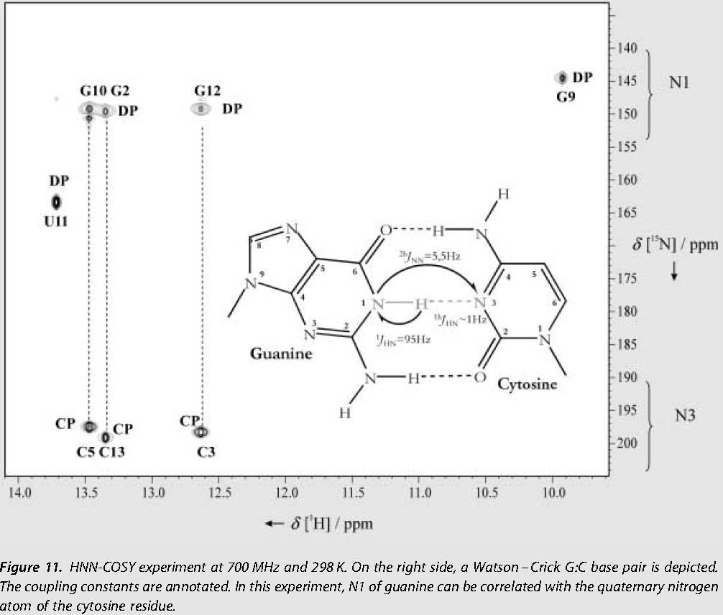
Correlation across the hydrogen bond
HNN-COSY experiment
Dingley and Grzesiek, JACS 1998

Slide 10
Identification of hydrogen and carbon atoms in bases and sugars
sugar
base
Constant-time ¹H-¹³C HSQC experiment

Slide 11
Assignment of non-exchangeable protons:
HCCH-type experiments

Slide 12
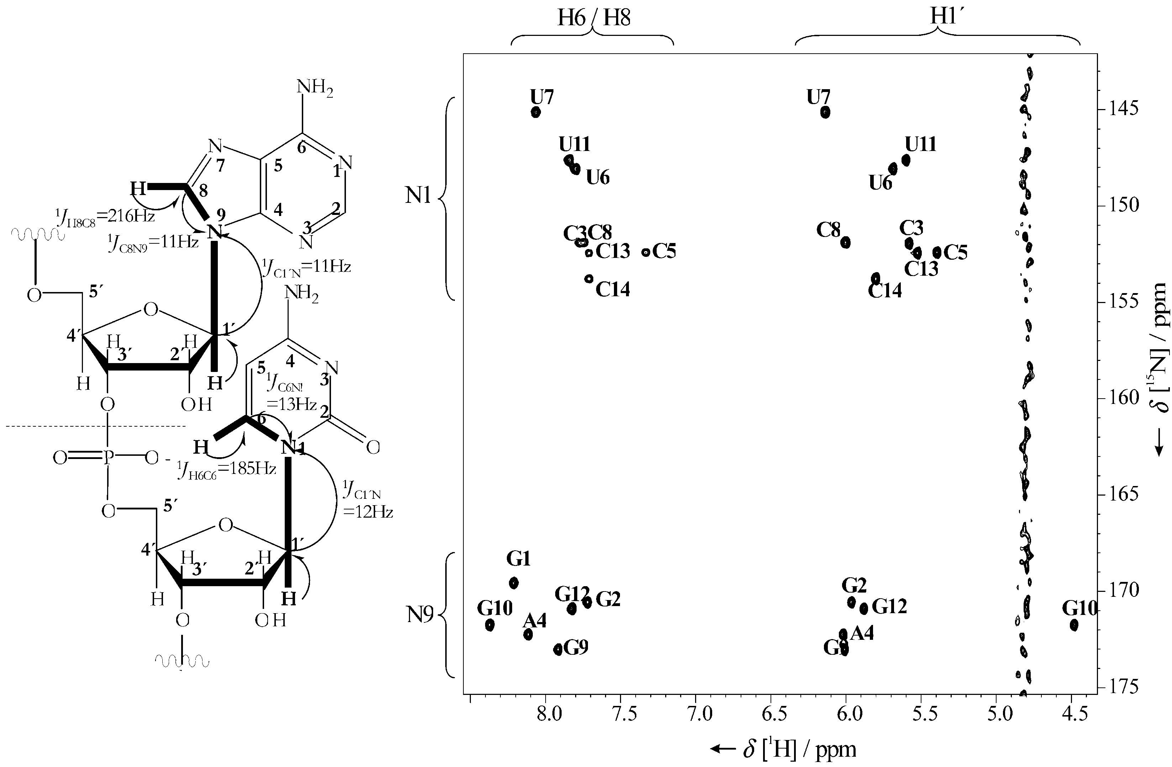
Sugar to base correlation – the HCN experiment
Sklenar et al., J. Biomol. NMR 1993, 1994, Fiala et al., J. Biomol. NMR 1998, 2000.

Slide 13
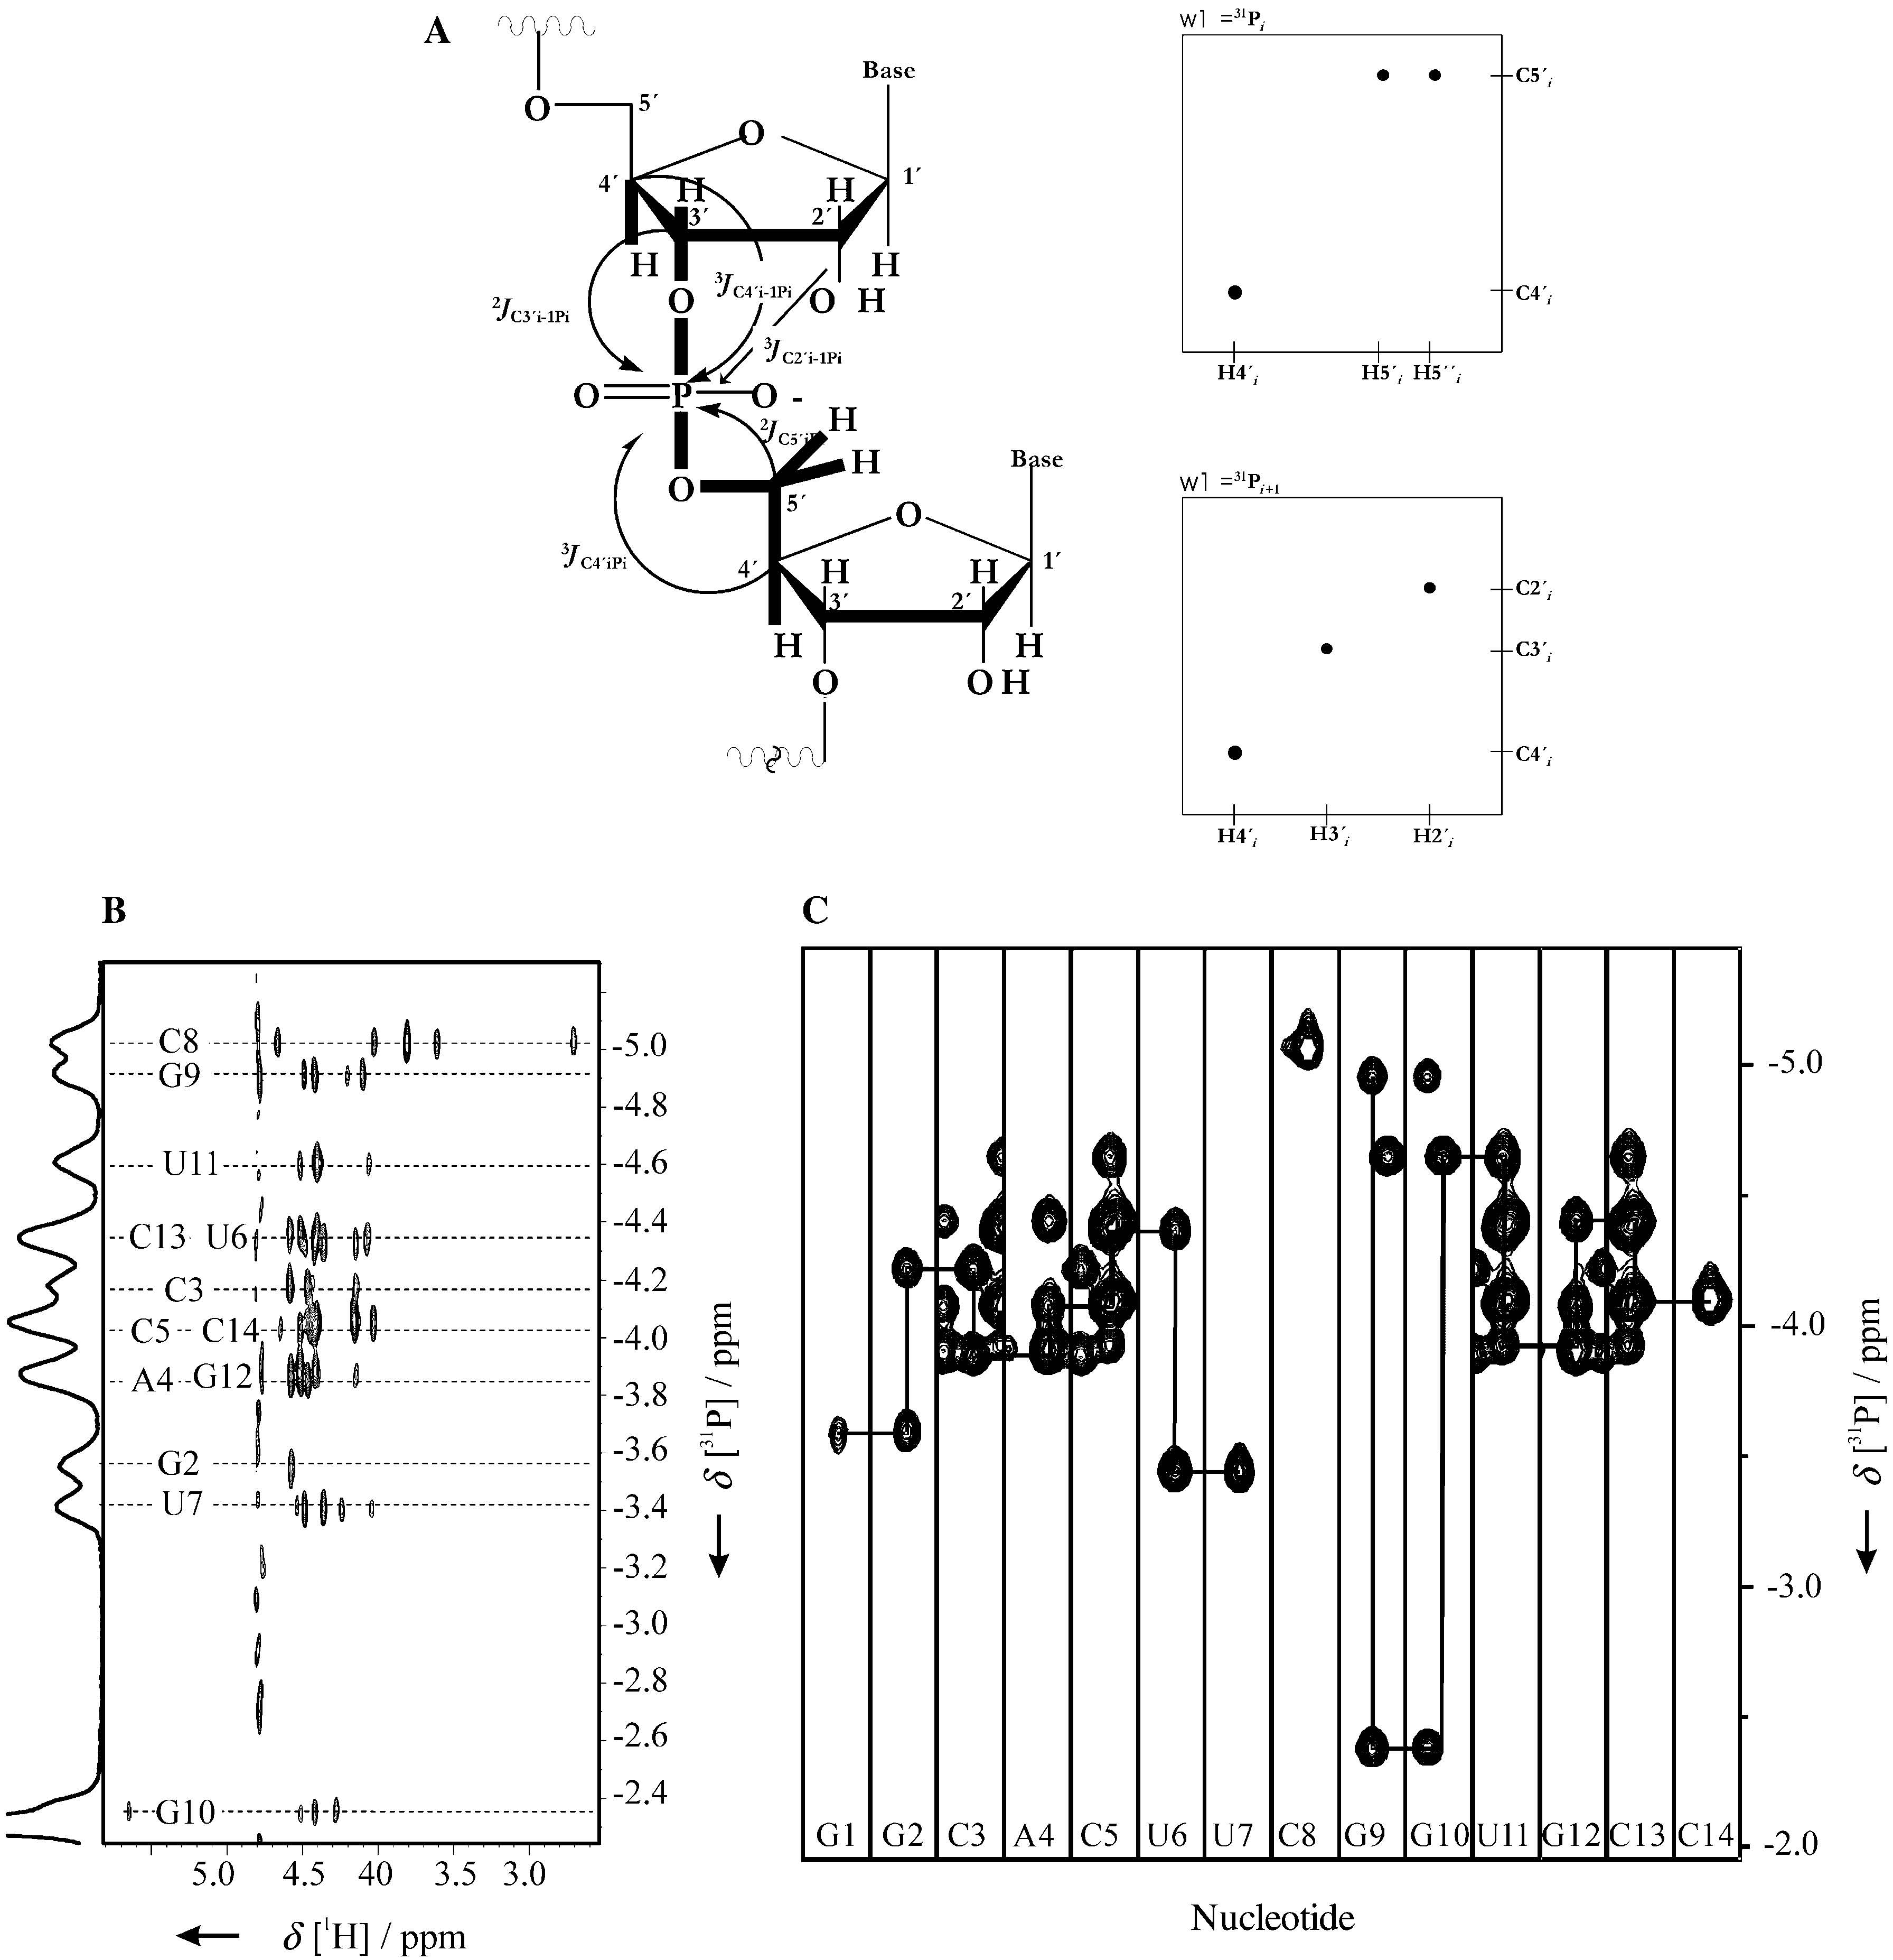
Sugar to phosphate correlation – the HCP experiment

Slide 14
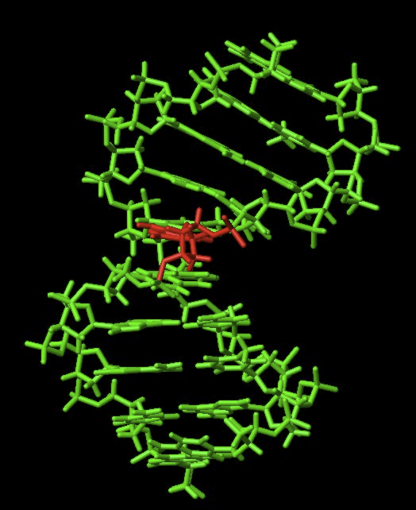
Dipolar couplings
Dipolar couplings add to J couplings
They show up as a field or alignment media dependence of the coupling
If the overall orientation of the molecule is known the orientation of the vectors can be determined

