Slide 1
Lasers - absorption methods
Vítězslav Otruba

Slide 2
Lasers in AAS
Advantages against classical measuring radiation sources:
Narrow spectral line (linear calibration)
Continuous tuning of wavelength possible (scanning)
High intensity (low noise, fast processes - spark, furnace)
Low divergence (spatial profiles, mini atomizers)
Short pulse time (time resolution)
Any wavelength (AAS of excited and ionized atoms)

Slide 3
AAS with low radiation intensity
Low intensity = not changed significantly occupation of energy levels
Atomic absorption profiles (Δλ≈ 0,1 – 0,001 pm)
Isotopic shifts (≈0,2 pm pro ΔM=1)
Splitting by nuclear spin
Doppler broadening (temperature)
Collision damping
Stark broadening (electron density)
Calibration graphs (linearity of up to 6 concentration orders)

Slide 4
Absorption spectroscopy
Lambert's law:
Lambert-Beer law :
General equation for light absorption
N_{n} depends on the concentration of atoms (molecules) in a given state n.

Slide 5
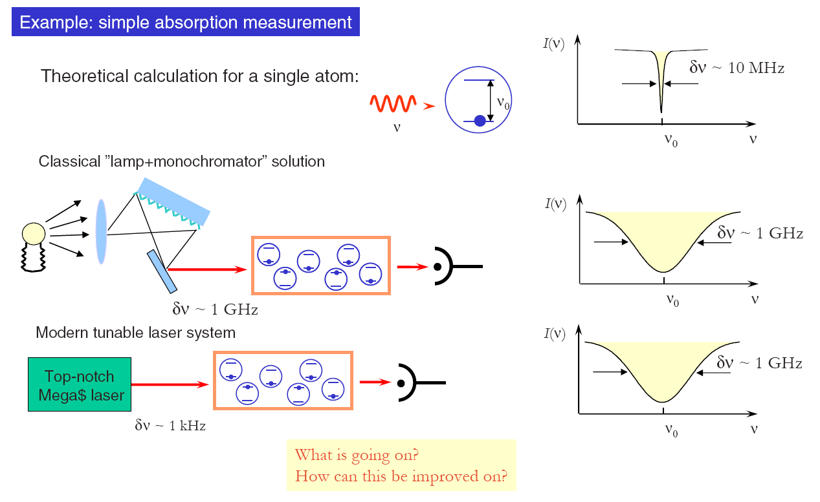
Absorption

Slide 6
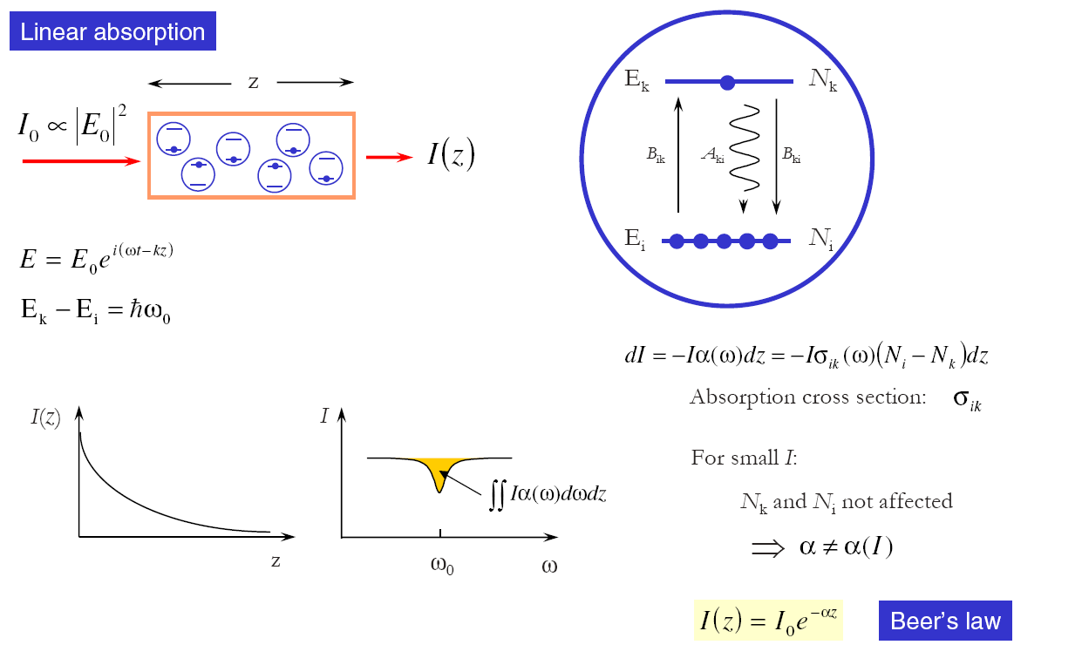
Linear absorption

Slide 7
Fine structure Hg I 404,7 nm
Around 2/3 of the stable atomic nuclei has a resulting nuclear spin, causing a fine line structure.
¹⁹⁹Hg and ²⁰¹Hg have unpaired neutrons and show spin splitting. Resulting profile is then results of combination with the natural linewidth and Doppler broadening. Isotopes ¹⁹⁸Hg; ²⁰⁰Hg; ²⁰²Hg and ²⁰⁴Hg are not splitted.

Slide 8
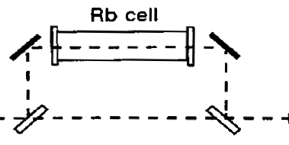
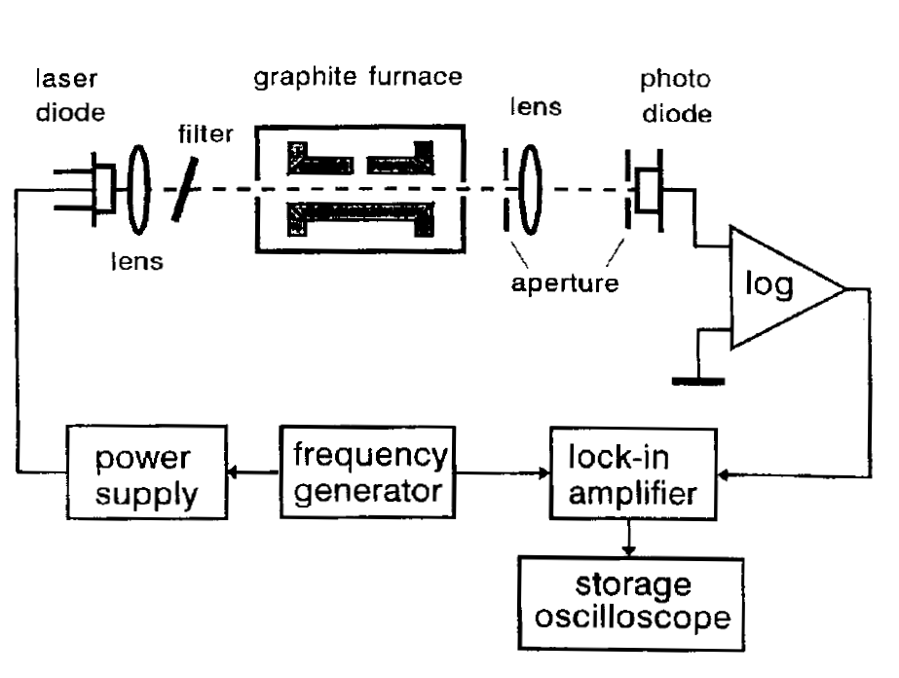
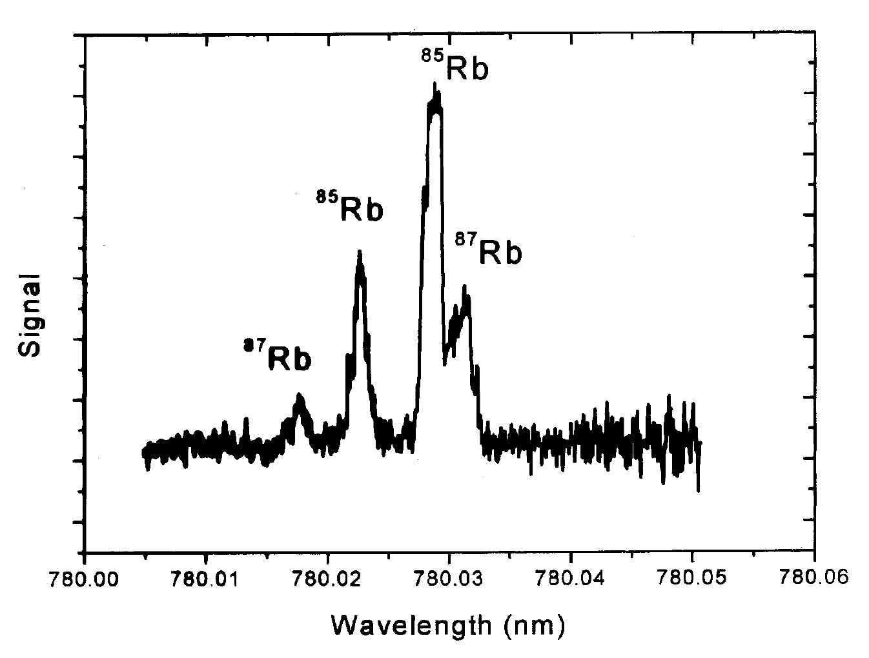
AAS with graphite furnace
Example of AAS spectrometer with laser diode and electrothermal atomizer (graphite furnace)

Slide 9
AAS in a laser spark
Spectral profile of the uranium absorption line. Distance to sample surface 5 mm, argon atmosphere 540 Pa.

Slide 10
Molecular absorption spectroscopy
Identification of the composition of the sample is performed by monitoring the loss of light after passing through the sample
Laser excels extraordinary monochromaticity emitted radiation, wavelength selection is thus ensured directly by the radiation source
Laser radiation is extremely intense, so the signal to noise ratio is very high. Extremely low detection limits can be achieved when using a multireflective cuvette.
Measurement speed using a laser is higher than with conventional spectrometers. There is no parasitic infrared radiation from the heat source
The radiation source can be moved away from the measuring cuvette (using fiber optic)
Considerable attention is paid to laser spectroscopy in the IR region. Laser (diode) IR spectrometer (semiconductor tunable laser) allows very precise identification of spectral lines in IR (structural analysis)

Slide 11
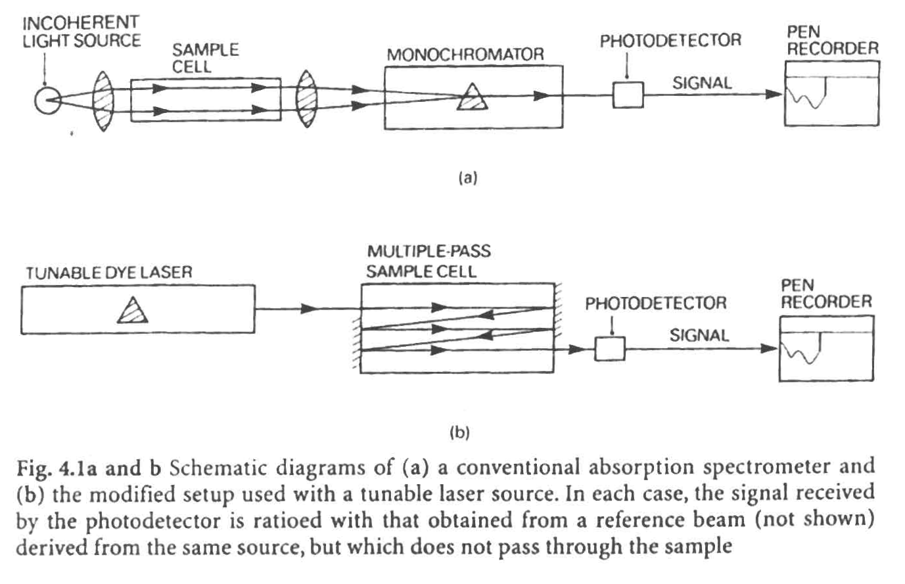
Absorption spectrometer with laser
A – classical absorption spectrometer; B – spectrometer with laser source

Slide 12
Methods of low absorbance measurement
intense source of monochromatic light, absorption is measured differentially
multiple passage of absorbed light through the sample, increasing the absorption length
absorption of radiation and measurement of fluorescence from excited states
optoacoustic detection methods
absorption of radiation and measurement of Raman emission spectra

Slide 13
Absorption spectroscopy in resonator cavity
Between the resonator mirror and the active laser medium is a space usable for spectroscopic purposes, in which a sample cuvette is inserted
This is a special detection method that excels in extraordinary sensitivity
Laser radiation passes through the cuvette located inside the resonator repeatedly
The laser output parameters are strongly influenced by internal absorption
Due to its sensitivity, the absorption method inside the resonator is best used to detect low concentrations of substances, especially gases
Spectroscopy inside the resonator is particularly suitable for qualitative analysis

Slide 14
Absorption spectroscopy in resonator cavity
Active medium
Absorption cuvette
Pumping
Absorption environment: gas, flame,
plasma, solution…
Ф
100
External cuvette
Internal cuvette
10
Absorption enhancement ≈ 5000x
1
10⁻⁹
10⁻⁷
10⁻⁵
g.cm⁻² I

Slide 15
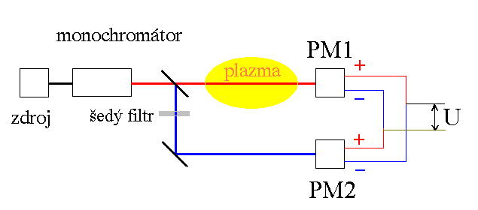
Differential measurement
monochromator
source
gray filter
Before the actual measurement it is necessary to set the gain of both photomultipliers so that the resulting voltage is zero. In the presence of plasma we then record the differential voltage in the order of magnitude μV – mV.

Slide 16
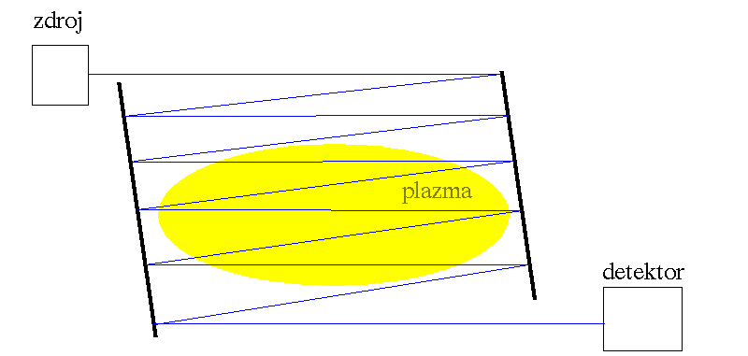
Multiple pass of light
source
detector
basic disadvantages - we lose spatial resolution
- the light beam is diverging

Slide 17
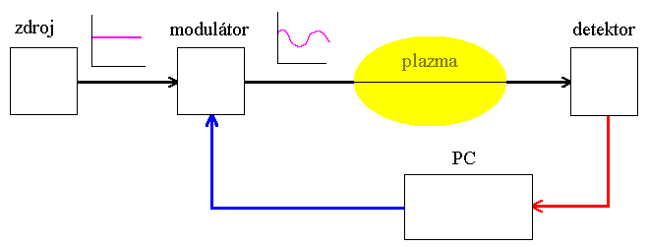
Application of Fourier transform
source
modulator
detector
The signal from the detector is modulated by the discharge. Fourier transform in a PC separates a signal with a different frequency than the modulation frequency; the result is noise reduction. It is also possible to realize direct modulation of the source (e.g. by lamp voltage). In absorption spectroscopy, it is suitable to use Fourier transform especially in the differential arrangement of detectors when the signal is small.

Slide 18
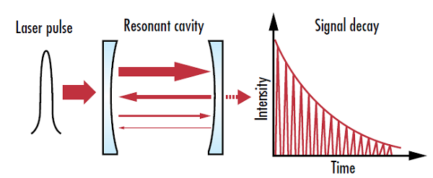
Cavity Ring Down Spectroscopy

Slide 19
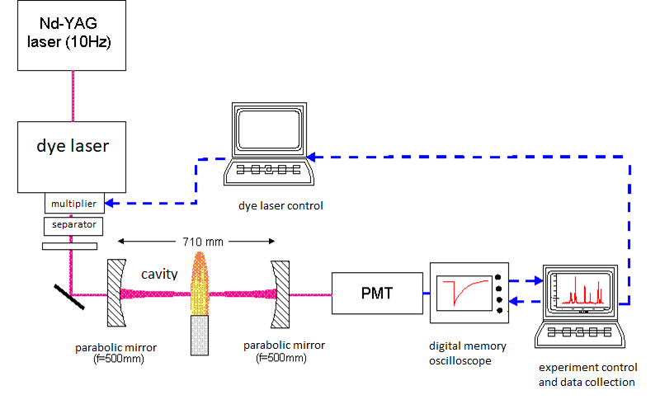
Cavity Ring Down Spectroscopy

Slide 20
Cavity Ring Down Spectroscopy
Using memory oscilloscope and PC, a large number of pulses can be averaged and reducing noise.
The concentration of absorbing particles can be determined from the exponential decrease in light intensity.
The detection limit is of the order of A=10⁻⁶.
Parabolic mirrors allow spatial localization of the detected area, so concentration profiles can be measured.
Currently, this method is only used in the visible and near UV range.

Slide 21
IR high resolution laser absorption spectrometry
FP = Fabry Perot standard for wave number calibration (Δν=c/(2dn))
L = semiconductor laser PbSnTe; PbCdS; Pb_{1-x}Sn_{x}Se;
λ≈2 – 30 μm; R≈10⁷;
UV – VIS: dye lasers, R≈5.10⁷

Slide 22
Double resonance methods
3
3
ω_{2,3} = rf, mw
ω_{2,3}
2 (virtual level)
2
ω_{3,4}
ω_{1,2} = optical
ω_{1,2}
4
1
1
ω_{1,2} = constant frequency laser, strong population level 2
ω_{2,3} = tuned radio frequency, microwave or optical radiation
ω_{3,4} = fluorescence radiation indicating resonance

Slide 23
Optical-microwave double resonance
Indication: Absorption of auxiliary beam Pω_{1,2}
At resonance 2 → 3, depopulation of level 2 occurs and its occupancy decreases, thereby increasing absorption 1 → 2
∼
detector
mw
detec-
tor
cuvette
laser active medium
Pω_{1,2}
3
ω_{2,3}
2
A(Pω_{1,2})
ω_{1,2}
Pω_{1,2}
1
f≈ω_{2,3}
f

Slide 24
Tuning of absorption levels
Zeeman effect can be used for molecules with permanent magnetic dipole moment. The magnetic field causes splitting of degenerate levels:
ΔE = -μ_{B}gm, where g=Landé factor; μ_{B}=Bohr magneton; B= magnetic induction; m = magnetic quantum number.
Sensitivity is particularly high for radicals with unpaired electrons.
Stark effect causes the splitting of the molecules in a permanent electric dipole moment. Necessary intensities of homogeneous el. fields are of order 1000V/mm.
Especially in the IR region, lasers HF, DF, CO, CO₂, N₂O, H₂O, D₂O, HCN

Slide 25
Tuning of absorption levels– Zeeman
S
→
B
detec-
tor
cuvette
lasers active medium
J
+3/2
E
+1/2
-1/2
ΔM=1
ΔM=1
+1/2
-3/2
ΔM=0
ΔM=-1
-1/2
B

Slide 26
Nonlinear spectroscopic methods
Methods based on simultaneous absorption of multiple photons by the same sample particle
The absorption coefficient value changes when more photons are absorbed by the particles at the same time
Interaction of the sample with a large amount of photons increases the occupancy of the upper energy level and reduces the absorption of the sample due to saturation of the absorption transition
If non-linear effects occur, Lambert-Beer's law cannot be used for absorption

Slide 27
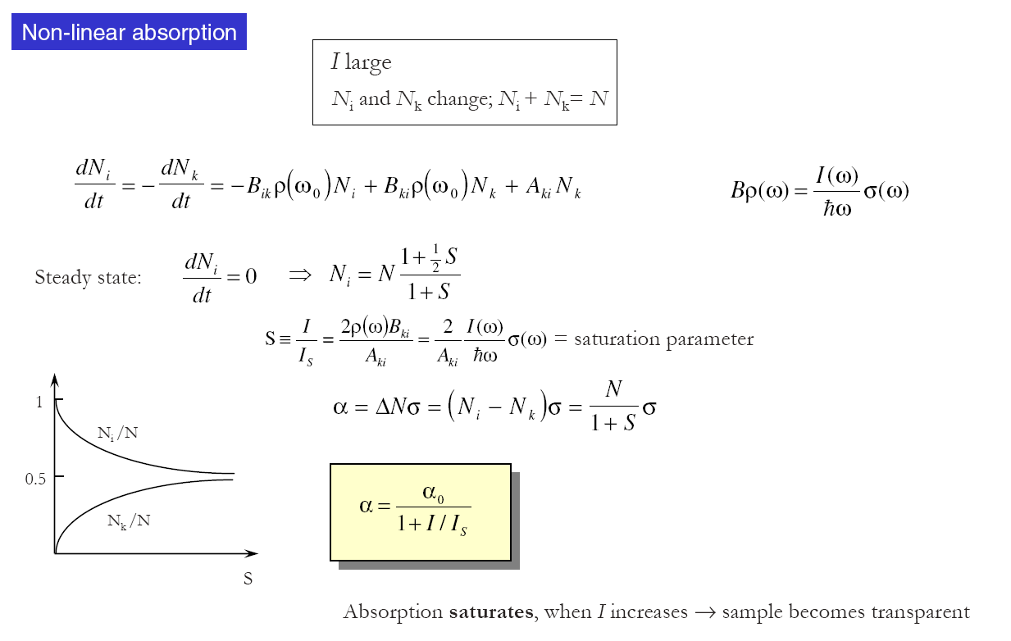
Non-linear absorption

Slide 28
Saturation spectrometry
Optically thick absorption - absorption coefficient regulation
Spectroscopy without Doppler Broadening e.g.:
  Lamb-dip spectrometry
  Two-photon Doppler-free spectrometry
Laser frequency stabilization
Multiphoton methods

Slide 29
Saturation Doppler-free Spectroscopy (Lamb-Dip Spectroscopy)
The saturation sub Doppler spectroscopy method finds its main application in determining the exact values of absorption lines and in stabilizing of lasers
The principle of saturation sub Doppler spectroscopy is based on the Doppler effect
Saturation sub Doppler spectroscopy is a method used for the study of gaseous substances
Gas particles that move chaotically appear in radiation interaction with frequency shift according to the speed of movement relative to the viewing direction
The particles interact with the frequency shift radiation given by the instantaneous velocity component

Slide 30
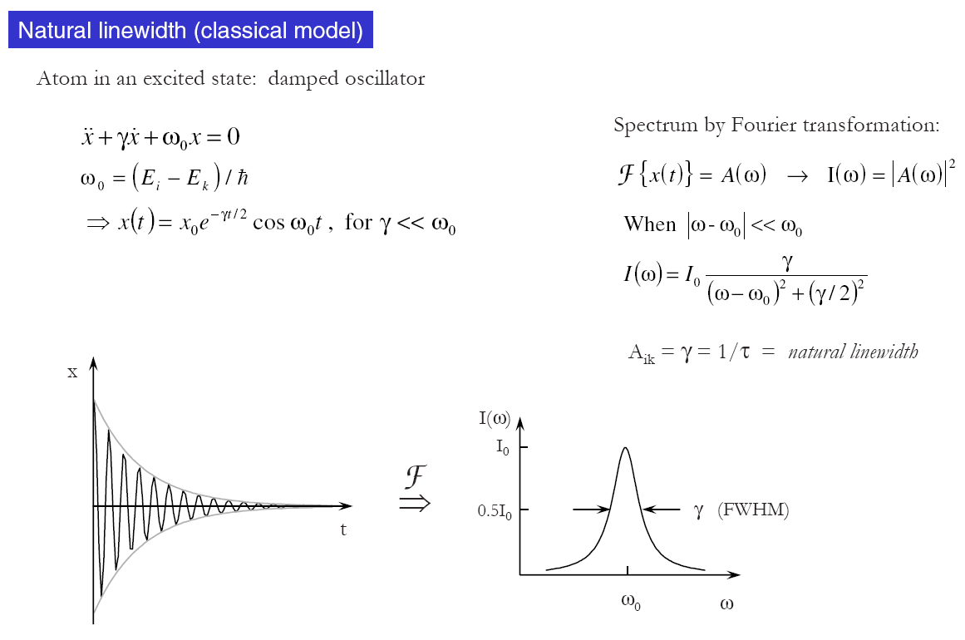
Natural linewidth

Slide 31
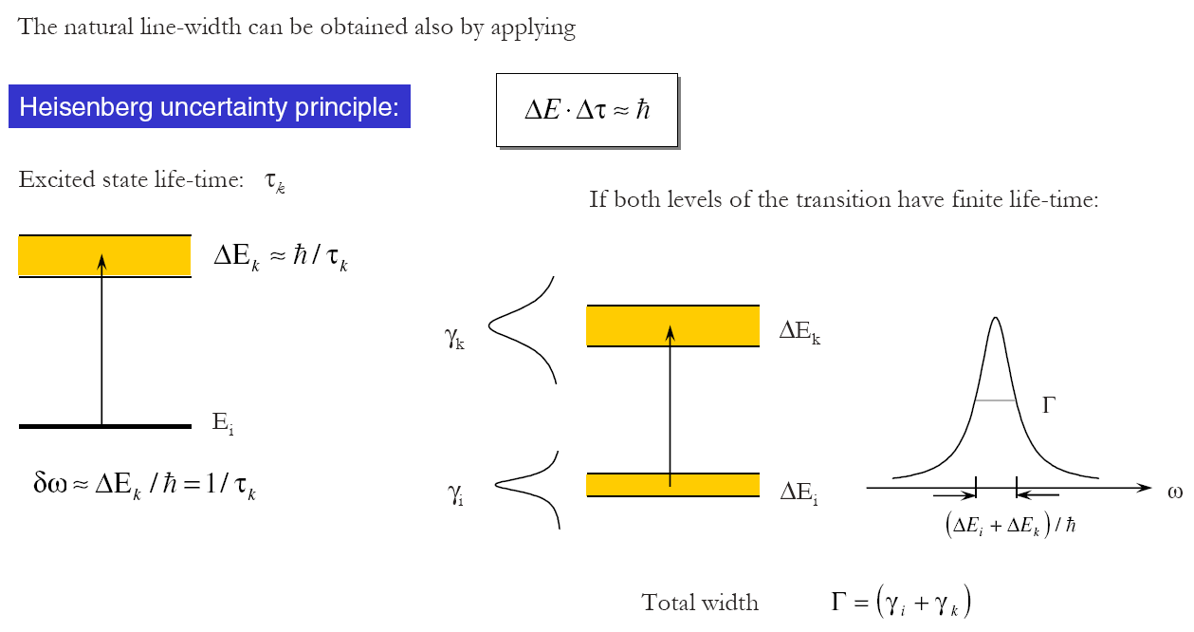
Heisenberg uncertainty principle

Slide 32
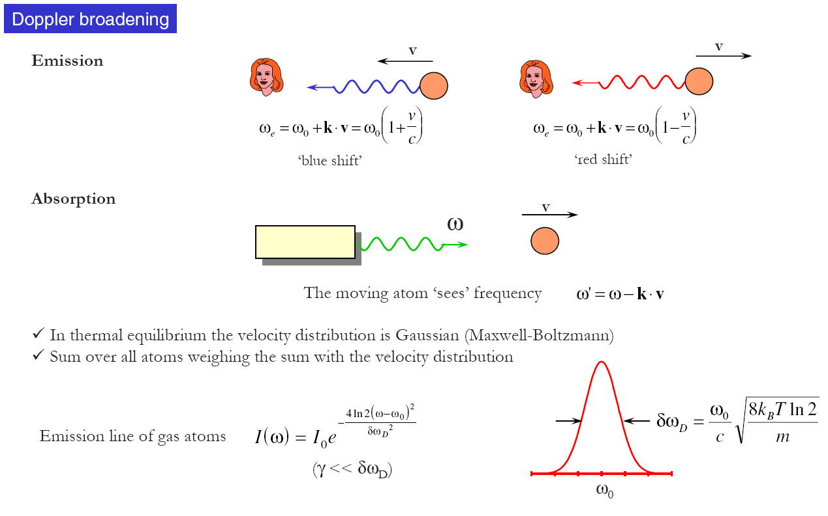
Doppler broadening

Slide 33
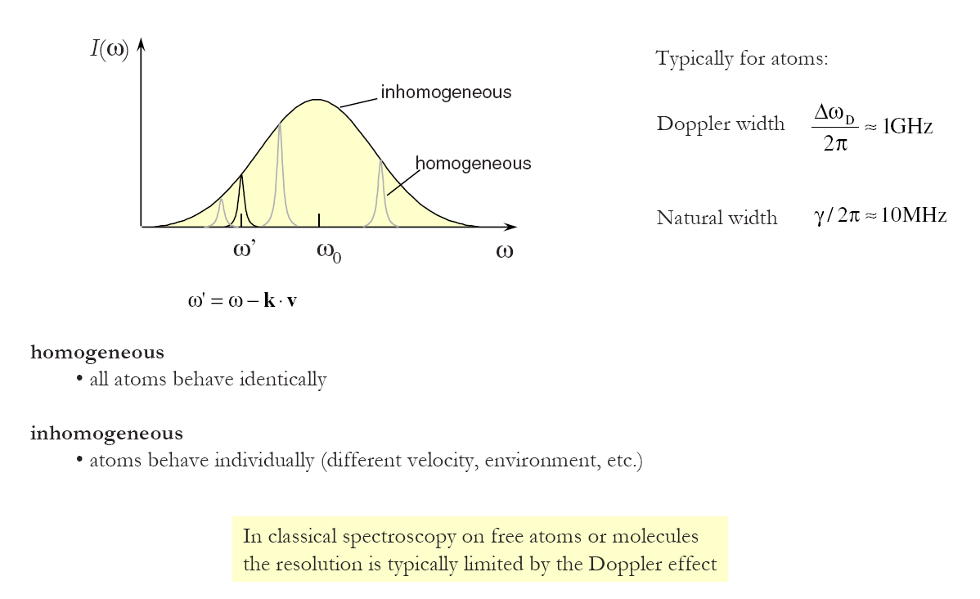
Homogeneous and inhomogeneous broadening

Slide 34
Movement of particles in gas
Gas particles that move chaotically appear in interaction with radiation by frequency shift according to the speed of movement relative to the viewing direction
hν
v₀-v_{D} v₀ v₀+v_{D}

Slide 35
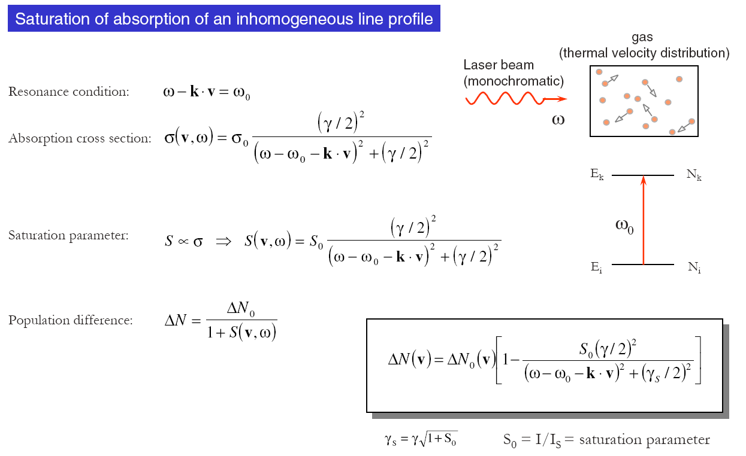
Absorption saturation on inhomogeneously broadened line

Slide 36
Both the saturation and probe beams are parallel
λ₀; λ₀ ± λ_{D}
λ_{s}
λ_{m}
D
D
Doppler
Lorentz
λ₀
λ_{s}=λ_{m}=λ₀+λ_{D}

Slide 37
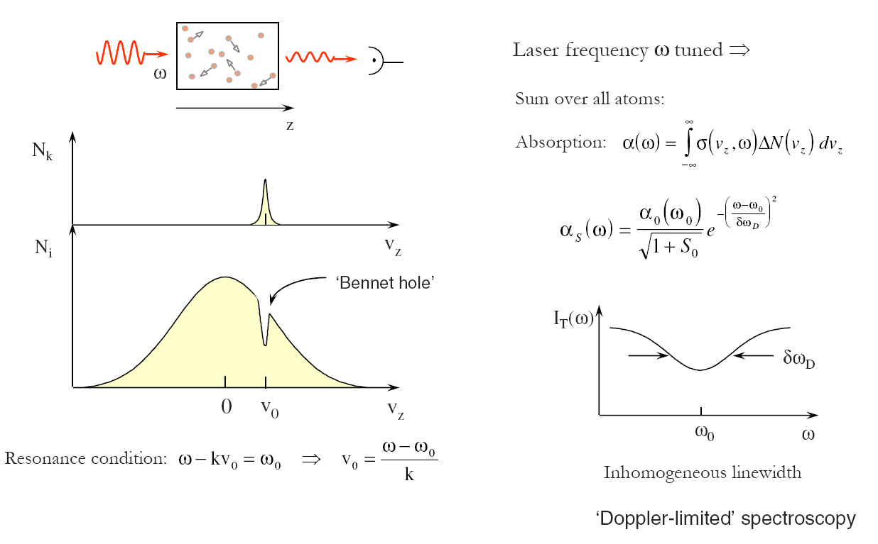
Bennet (Lamb) hole

Slide 38
Saturation and probing beam in opposite
λ₀; λ₀ ± λ_{D}
λ_{s}
D
D
λ_{m}
Doppler
Lorentz
λ_{m} ≈ λ₀-λ_{D}
λ₀
λ_{s}

Slide 39
Final solution
λ₀; λ₀ ± λ_{D}
λ_{s}
D
D
Doppler
Lorentz
λ_{s}=λ_{m}=λ₀

Slide 40
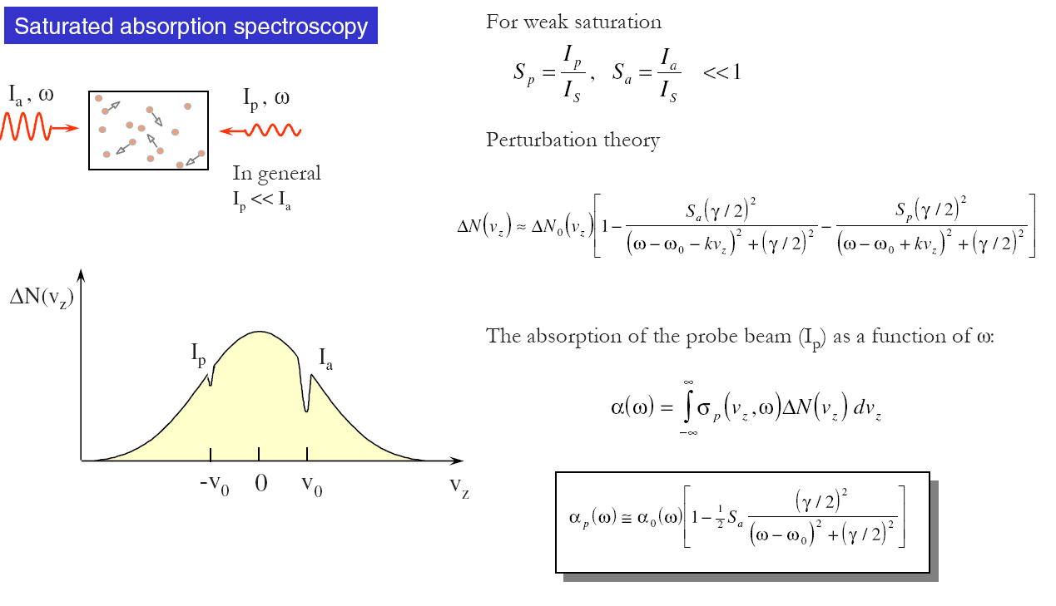
Saturated absorption spectroscopy

Slide 41
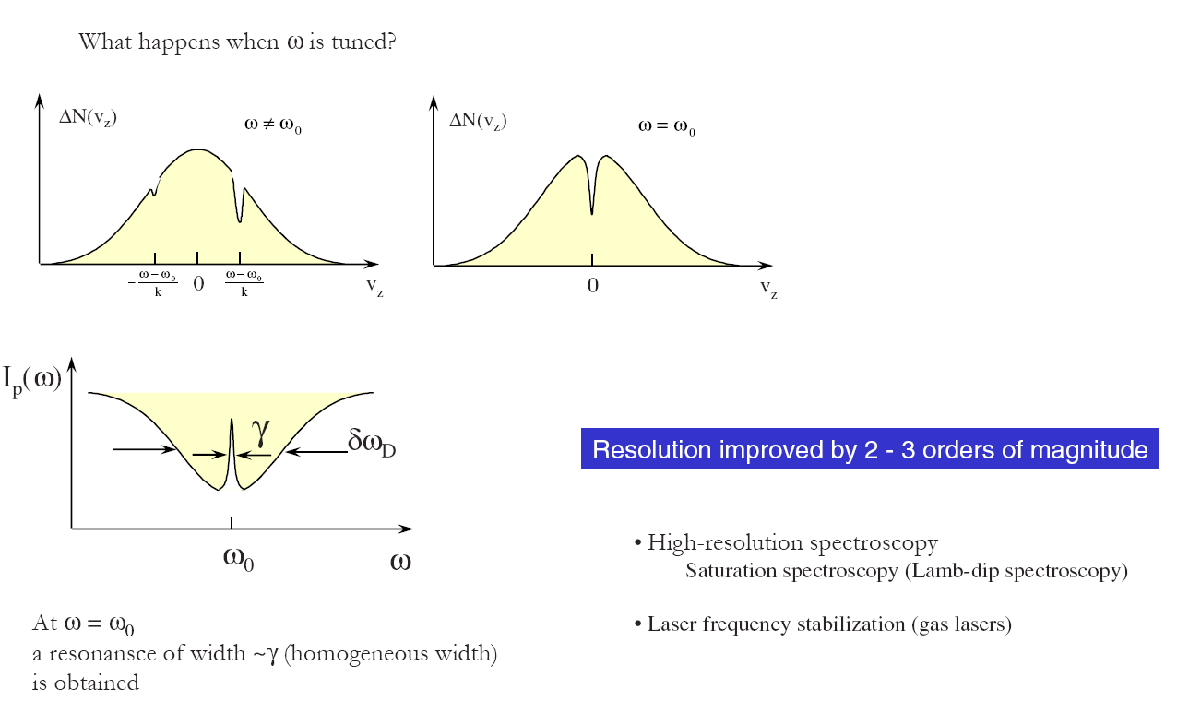
Doppler-free spectroscopy

Slide 42
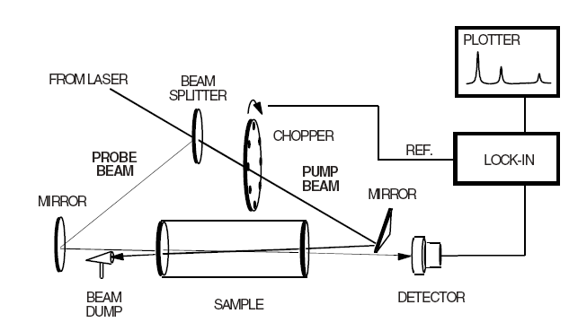
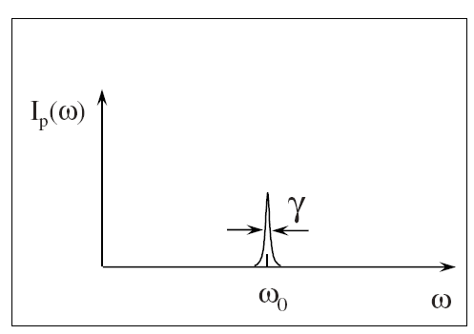
Experimental arrangement
Experiment results:
  Na(g),p=40μPa,
  t=110°C, λ=589 nm
  Δλ_{DOP} ≅1,7 pm
  (1500 MHz)
  Δλ_{LAS} ≅0,008 pm
  (7 MHz)
  Δλ_{EXP}≅0,068 pm
  (40 MHz)
  Δλ_{NAT} ≅0,01 pm (≈τ=16 ns)

Slide 43
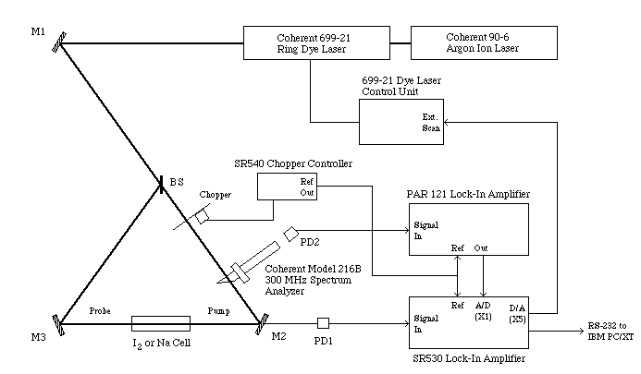
Apparatus for Doppler-free saturated absorption spectroscopy of I₂ and Na

Slide 44
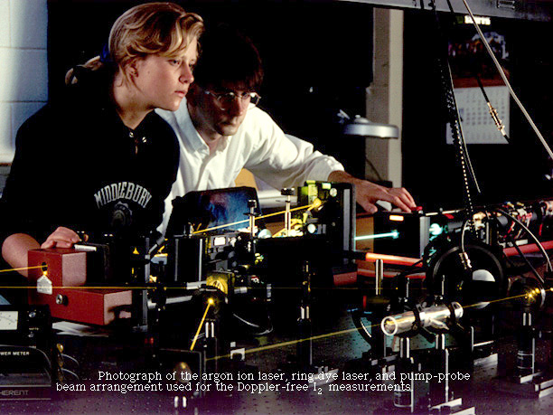
Doppler-Free Saturated Absorption Spectroscopy of Iodine and Sodium Using a Tunable Ring Dye Laser

Slide 45
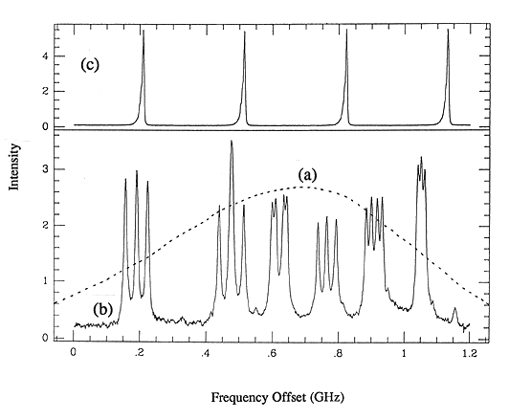
Absorption spectrum of iodine
Ordinary, Doppler broadened, (dashed line) and (b) Doppler-free (solid line)
absorption spectra of the 5682 Å, P(117), 21-1, X --> B transition of ¹²⁷I₂.
(c) 300 MHz interferometer transmission peaks for frequency calibration of laser scan.

Slide 46
Laser stabilization
L – laser active medium, Z – mirrors, K = cuvette,
E – etalon, PP = piezoelectric interface, LO – tuning circuit,
D – detector, R – feedback control.
Example: He-Ne laser 3390 nm, methane cuvette, stabilization ±0,5 Hz.

Slide 47
Doppler-free spectroscopy - summary
If the frequency of the intense laser beam is tuned off the centre of the absorption line profile, a dip is formed in the absorption line indicating a decrease in the absorption coefficient (non-linear effect)
In the experiment the laser beam is divided into two beams, intensive - saturation and weaker - test beams
Both beams pass through the cuvette against each other - the effects of the two beams, when aligned from the center of the absorption line, are positioned symmetrically with respect to the center of the line
When tuning the laser to the center of the line, the test beam is less absorbed due to the decrease in absorption in the dip and the laser beam intensity is significantly increased
A narrow resonance peak is obtained which represents the absorption line of the sample without Doppler broadening
Doppler-free spectroscopy allows experimentally removing the line broadening by selecting particles of zero velocity from the sample

Slide 48
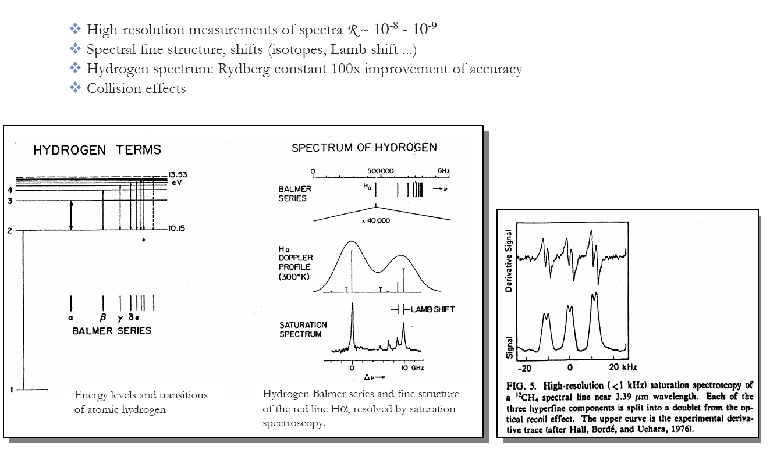
Experimental results

Slide 49

Two-photon Doppler-free spectroscopy
τ_{v} ≈10⁻¹² s
ω_{L} =½ E₀₁
VIS: Δλ≈1 GHz
Ф_{L}<dyn. Stark efect
Δλ_{L} ≈ 1 MHz ⇒
necessary stabilization by combination of Zeeman and Stark tuning
1
ω_{L}
Δω=ω_{L}(v/c)
Δω=-ω_{L}(v/c)
V
ω_{L}
0
Δω=0
Δω = Doppler shift

Slide 50
Experimental arrangement
Laser
Detector
absorption
Cuvette
A
FL
Detector
fluorescence
Detection of fluorescence in UV-VIS and near IR - transitions from excited levels
Detection of absorption of one of the exciting beams mainly in the IR region, e.g. UV-VIS

Slide 51
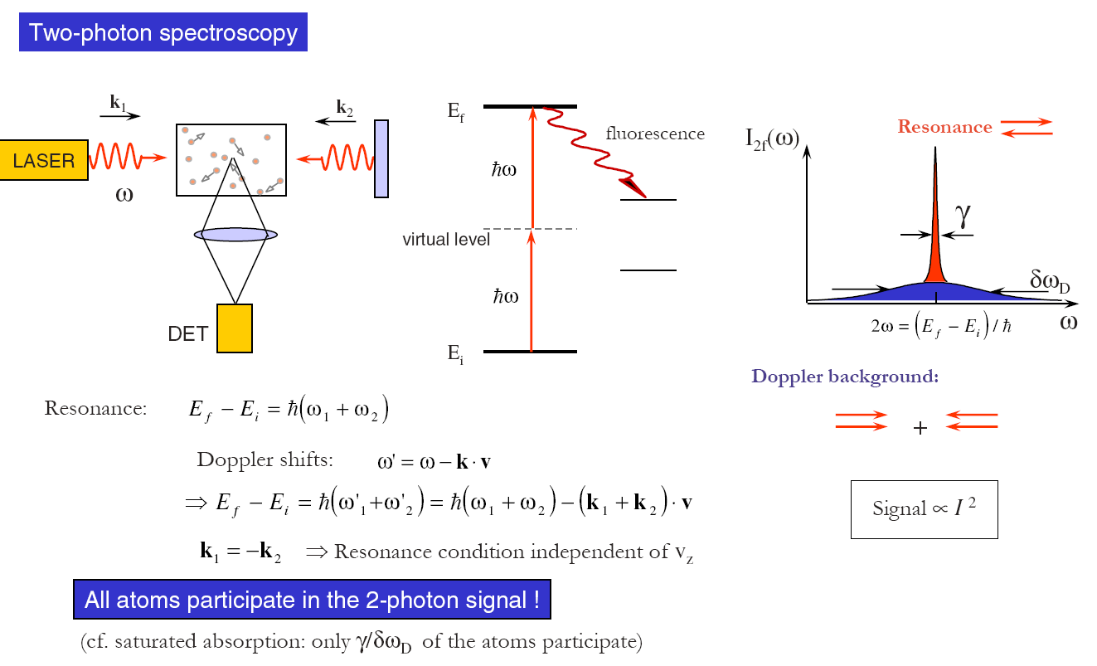
Two-photon spectrometry

Slide 52
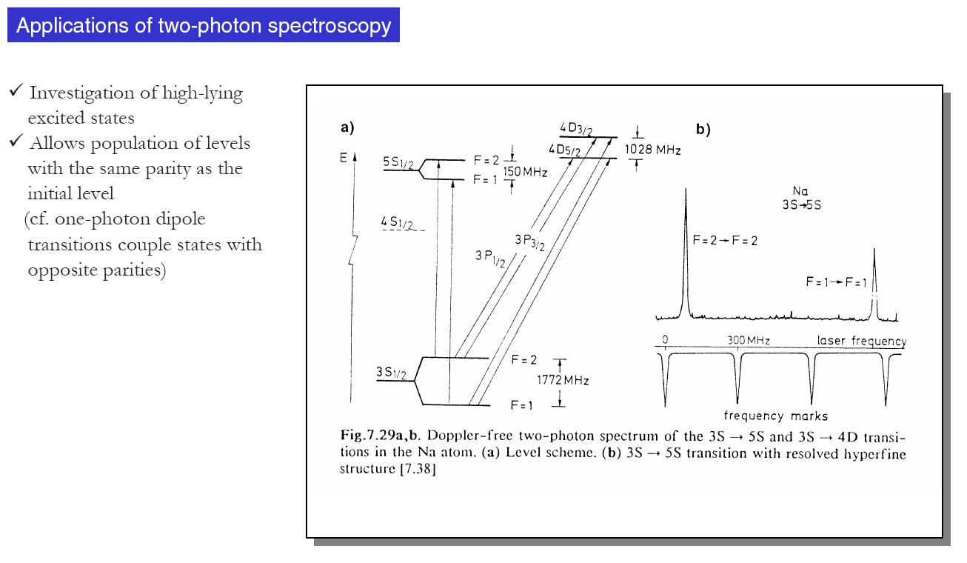
Application

