Slide 1
LIDAR (light detection and ranging)
Vítězslav Otruba

Slide 2
Lidar remote detection
Analytically important method used for sensitive analysis of air by laser radiation in open atmosphere
Due to its low divergence, the laser beam is very convenient for measuring absorption in the open atmosphere as a long optical path cell
Several experimental configurations can be used for open atmosphere measurements

Slide 3
Utilization of radiation reflection from installed reflector
The beam is directed into the atmosphere, the radiation returns after reflection from the reflector
The reflector is installed several hundred meters to several kilometers from the radiation source
For detection, wavelengths are chosen where they do not absorb basic atmospheric components
Most often, measurements are made in the 9 - 13 µm infrared spectral range
There are also measured in the UV / VIS part of the spectrum
In particular, vibrational levels of molecular pollutants are detected in the infrared region
In the UV region, electronic absorption transitions of atoms and molecules are used
There is no need for special detection techniques to detect radiation
Low-intensity semiconductor diodes can also be used as a laser
The sensitivity of the measurement is in the order of ppb depending on the absorption coefficient
The method is very simple and experimentally undemanding
The received signal provides information about the whole optical path
The spatial distribution of pollutant concentrations cannot be determined by this method

Slide 4
Utilization of backscatter on topographic barriers
Scattering on the topographic barrier is multidirectional
Only part of the radiation is returned and used for detection
The demands on receiving optics and electronics are high
Powerful pulse lasers are used for measurement
Here again, the received signal brings information about the whole optical path
The result of the measurement is the mean concentration of the monitored substance on the laser beam path
The method does not allow the determination of concentration clusters in excess of the mean concentration
Again, the spatial distribution of pollutant concentrations cannot be determined by this method

Slide 5
Utilization of backscatter on aerosol and atmospheric gas particles
Method allowing to return the laser beam back from the atmosphere without solid reflectors
Radiation scattering on aerosol and atmospheric gas particles is omnidirectional
Part of the radiation is reflected back and simulates a reflector spread over the entire path
Scattering on aerosol particles is called Mie's, on molecules of air Rayleigh's
After sending a nanosecond pulse into the atmosphere, part of the radiation gradually returns
The time delay of the received radiation is given by the time of light passing through to the point of scattering
At the concentration clusters, the resonance (specific) wavelength shows a decrease in intensity compared to the reference wavelength
The method for monitoring the concentration profile of a pollutant on a laser beam path is called DIAL - Diferential Absorption Lidar
The laser used in the DIAL method must be capable of fast tuning between the resonant and reference wavelengths
The LIDAR remote detection method can be used to determine nitrogen oxides and sulfur oxides
In addition to absorption, laser-induced fluorescence can also be used for remote detection
Laser-induced fluorescence method can be used for detection of stratospheric particles, monitoring of chlorophyll (data on damage to green matter), testing of clouds (amount of petroleum substances, state of plankton)
Only the high price of the lidar prevents the expansion of these exceptional devices

Slide 6
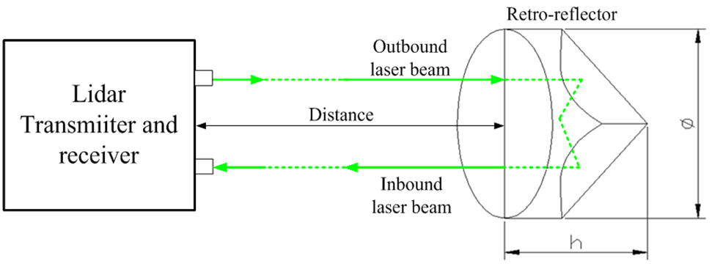
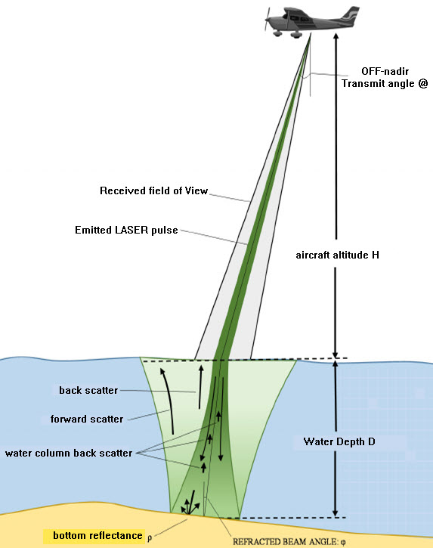
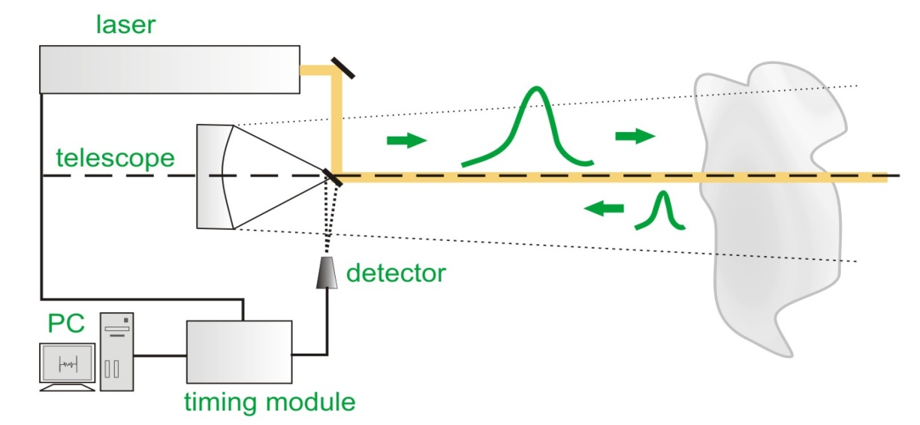
LIDAR - distance measurement

Slide 7
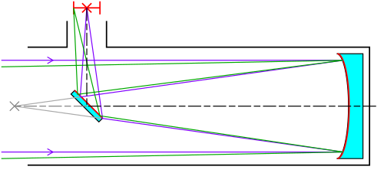
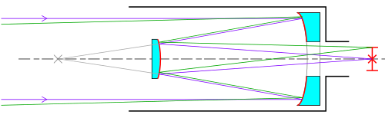
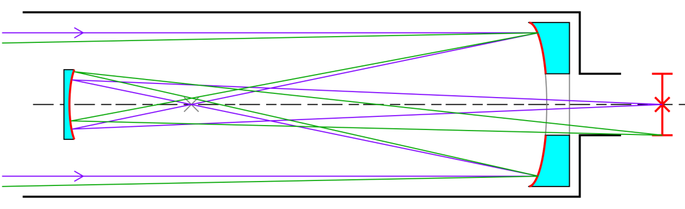
Telescopes
a)
A telescope is an afocal optical system composed of at least two optical systems (lens and ocular). Angular magnification is given by the ratio of the focal length of the lens and the ocular.
a - Newtonian telescope, image inverted
b - Cassegrain telescope, inverted image
c - Gregory's telescope, direct image
b)
c)

Slide 8
Reflectors
The corner reflector is a three- or hexagonal pyramid whose opposite reflecting walls are perpendicular to each other. The beam that enters the pyramid base into the inner, mirror part will come back after the double reflection from the pyramid walls.
The "cat's eye" is the optical system that uses
concave mirrors. R1, R2 are the radii of curvature of the mirrors

Slide 9

Lidar equation
P_{p}(R) - the power of the signal received by the detector after reflection from an object at a distance R. The received power is proportional to the transmitted power P_{v}. If τ is the length of the laser pulse, it is possible to observe from the smallest path length c τ / 2 in the object (eg aerosol, cloud) at a distance R from the LIDAR. The retroreflection coefficient is β(R). Ap represents the area of the receiving optics together with the losses. R-2 is the decrease in radiation intensity with the square of the distance. The last member in square brackets is the losses of absorption and scattering of radiation after passing through the atmosphere over a distance R.

Slide 10
Laser sources of LIDAR distance meters
For measurement accuracy it is important short and well-defined leading edge of the laser pulse, at most 1 ns, for more accurate measurement of picoseconds.
Classic applications :
GaAs laser, distance up to 1 km, Δl≈10 cm
Nd:YAG laser, distance up to 10 km, Δl≈1 m
Ruby 1 ns/109 W, distance up to 1000 km, Pp ≈ 100 fotons, Δl≈ 0,1 m (distance of satellites, movement of continents, gravitational anomalies), distance of the Moon from Earth Δl≈(1-10) m

Slide 11
Study of distances and dimensions of aerosol clouds (industrial exhalation and meteorology)
A single pulse time-variance analysis is used which is gradually scattered by the clouds of particles and returns with a different delay. Denser centers result in higher scattering and thus higher signal strength.
Short wavelength lasers for face clouds
IR lasers for concentration profiles inside clouds

Slide 12
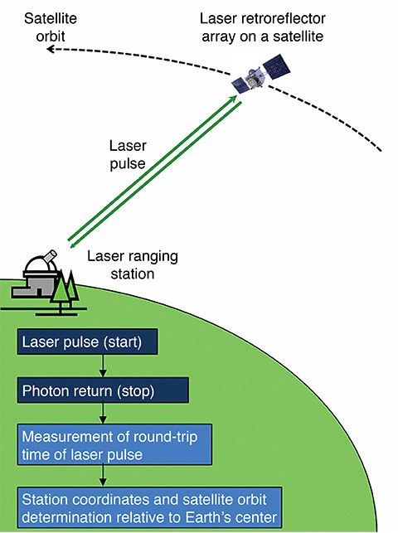
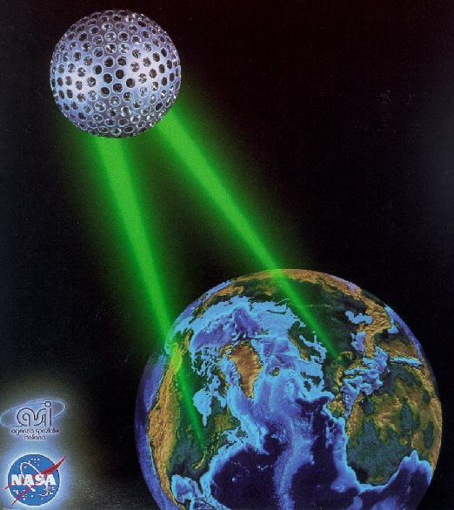
LAGEOS (LAser GEOdynamics Satellite).
Originally used ruby laser (length of transmitted pulse nanoseconds 10⁻⁹ sec) was replaced by Nd: YAG laser with pulse length three orders shorter (tens of picoseconds) 10⁻¹² sec) and newly for very accurate measurements - a titanium sapphire laser system with a pulse duration in the femtosecond range(10⁻¹⁵ sec).

Slide 13
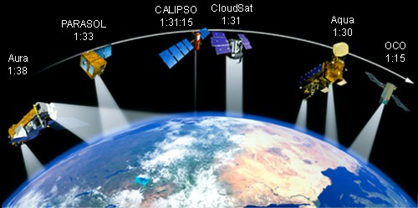
A-Train
A-Train, a sequence of five satellites now carrying instruments monitoring a certain part of the atmosphere. Aqua, CloudSat, CALIPSO, PARASOL and Aura satellites fly over the globe. In the future, the sixth OCO satellite is expected. The satellites fly almost on the same polar orbit, the last one is 8 minutes behind the first one

Slide 14
A-Train
A-train is the formation of five astronomical satellites on the polar orbit that comprehensively observe the atmosphere. Four of the satellites are NASA, one is the product of the French space agency CNES. These are the satellites Aqua, CloudSat, CALIPSO, PARASOL and Aura. The first satellite was launched in 2002, the other two in 2004 and the last two in 2006. In 2008, OCO will be added. The satellites are able to detect the altitude profile of clouds, water, carbon dioxide, ozone, aerosols and other atmospheric components. Some are equipped with lidar (laser equivalent of radar), other instruments, of course, include radar, grid spectrometer and various analyzers. As the satellites fly over the same spot, it is possible to see the dynamics of events in the atmosphere.

Slide 15
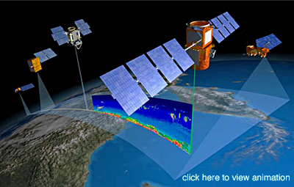
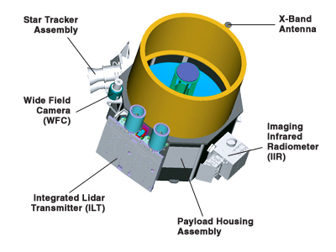
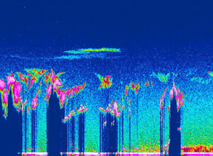
CALIPSO (Cloud-Aerosol Lidar and Infrared Pathfinder Satellite Observations)
On board the satellite is a LIDAR to measure the height profile of aerosols in the atmosphere, detect hardly visible tropospheric
cloud and polar stratospheric clouds

Slide 16
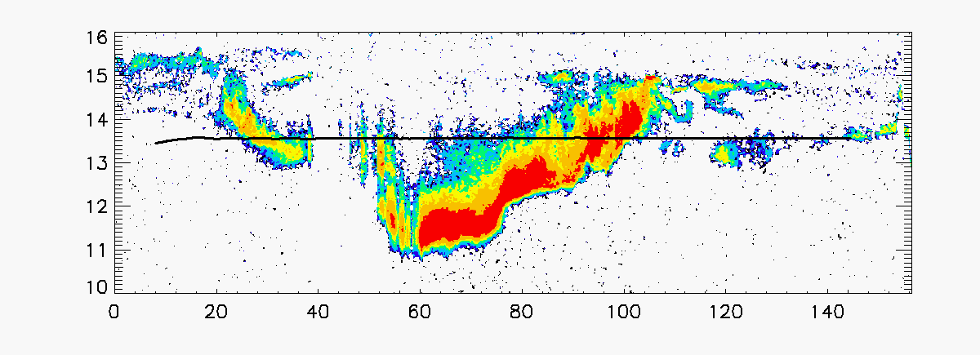
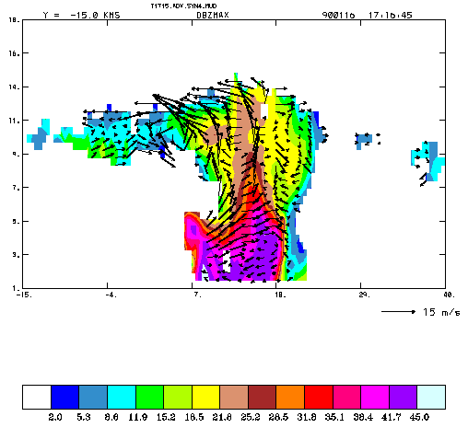
Cloud and Rain
Characteristics in the Australian Monsoon
Height and horizontal distance in km
Measurement of velocity in clouds by Doppler effect (m/s)

Slide 17
Analytical LIDAR
It is used for remote detection of ions, atoms of molecules and aerosols while monitoring of air pollution by remote sensing of pollutants and impurities.
LIDAR uses spectroscopic principles, does not require sampling and measurement is non-destructive.
Due to the high cost of the device, it is used only in cases where it is not possible to use any other analytical method, e.g. long distance measurements.
Analytical LIDAR is one of the so-called active techniques, because the response of analytes is caused by active intervention - sending a laser beam into the atmosphere.

Slide 18
Raman LIDAR 1
Radiation scattered by non-absorbing gas (atmosphere) contains components of Raman and Rayleigh scattering, which must be separated by a spectrometer.
Rayleigh scattering results in a relatively intensive thick line, with more Raman lines on both sides.
N2

Slide 19
Raman LIDAR 2
Raman scattering is related to the rotational and vibrational levels of molecules that can be identified from the Raman spectrum
The laser beam interacts with all molecules in the atmosphere, providing information about all the compounds in the beam path
Since the time of photon-molecule interaction is very short and the scattering occurs in a time interval of 10⁻¹⁰ to 10⁻¹² s, it is possible to determine compounds present in the atmosphere and their intensities and concentrations at the moment of receiving the signal from the position of the Raman lines. From the signal delay, the distance of the scattering compounds from the source can be determined.

Slide 20
Diagram of Raman LIDAR
The received radiation is focused into the entrance slit of the spectrometer, on the output is a multichannel detector. Signal processing and the detector are subject to extreme demands due to the processing of weak, short-term and exponentially decreasing signals.
It allows simultaneous selective determination of all molecules and allows their spatial resolution. Unfortunately, low signal strength limits the use of Raman LIDAR .
L - laser, E - beam expander (collimator), T - telescope, S - spectrometer,
MA - multichannel analyzer

Slide 21
Raman Lidar - nitrogen spectrum

Slide 22
Raman LIDAR - Spectrum of burning oil

Slide 23
Raman LIDAR - Properties
Intense Raman scattering has readily polarizable molecules (O2, N2). Molecules with a permanent dipole moment, which is the majority of pollutants, have a lower intensity.
The effective cross section of non-resonance Raman scattering is only 10⁻²⁹ cm².sr⁻¹, for resonance Raman scattering it is about 1000 times larger.
The intensity of the Raman scattering increases with the fourth power of the frequency of the excitation light with increasing frequency but decreases the reachable distance in the atmosphere.
Limits of detection SO2 are approx. 10 ppm/1 km, Δl≈10m/1km, laser Nd:YAG 2. harmonic

Slide 24
Fluorescence LIDAR
Resonance techniques have considerably greater sensitivity and range but mostly require tunable lasers. The size of the cross-section is of the order 10⁻²⁴ cm².sr⁻¹
Example: SO2 it is possible to determine at a wavelength of 300.1 nm from 1ppb/100m.
A - fluorescence to baseline
B - immediate fluorescence to a lower level
C - cascade fluorescence with radiant relaxation at upper levels

Slide 25
Fluorescence LIDAR
The greatest fluorescence appears for sodium, which can be observed in the atmosphere at a distance of 10 km and up to 100 km. It is used to determine the distribution of sodium in the stratosphere. The lifetime of the excited state (cca 10⁻⁹ s) should be taken into account when measuring the Na distribution
The diagram below shows the sodium distribution of the swarm Geminid over the Pacific (December 14, 1971 at 0 am - solid line, dashed at 3 am Pacific Standard Time)

Slide 26
Differential absorption measurement
Continuous lasers are used, resulting in a mean value along the beam path. The receiving device alternately receives radiation of both wavelengths. The logarithm of the proportion of their power corresponds to the mean concentration, the detection limits range in ppt units. Absorption paths can be up to tens of kilometers.
If a diffuse reflection from topographic targets is used instead of a corner reflector, the range is a considerably shorter - units of km.
L– laser emitting radiation at wavelengths
λ0, λr; T - Newtonian telescope; KO - corner
reflector; Abs - absorbing area; F - filter;
D - detector; Pλ0 / P λr - ratio analyzer
(ratio meter); ZAP - recorder

Slide 27
Absorption spectrum of the atmosphere
For the measurement, it is necessary to select the spectral region in which there is low signal attenuation.
The spectrum in the upper figure is the absorption of air on a pathway of 1828 m at sea level.

Slide 28
DASE LIDAR (differential absorption of scatettered energy lidar; DIAL- differential absorption lidar)
This variant of the previous methods allows absorption measurements to be used to spatially differentiate analyte concentrations. It uses radiation scattering on aerosols, whose particles play a role of localized scattering centers in the measured area. The method uses two beams of different wavelengths that are absorbed differently by the analyte. With an even distribution of the aerosol, the intensity of the returning radiation from different distant locations models the analyte concentration profile along the beam path. Power pulse lasers and sensitive and fast detectors must be used for this method.

Slide 29
Scheme of differential absorption LIDAR
L - pulsed laser emitting radiation at wavelengths λ0, λr; T - telescope; F - filter; TR - transient recorder; MP - computer; P - memory; OSC - oscilloscope; DIS - display; D - detector; A / D - analog to digital converter

Slide 30
Laser Remote Detector (VÚ 070 Brno)
Principle: detection of differential infrared absorption in the 10 μm band of the detected substance. The device contains two grid-tunable TEA CO2 lasers, the Cassegrain-type receiving telescope.
Application: The device is designed to detect chemical warfare agents in the rear of combat units. Reprogramming is possible for use in environmental measurements.
Technical data: reach distance 2000m; detection time for one measurement 45 s; detection limit (CxL) 70 mg.m⁻³.m; analyzed space 120° horizontally, 15° vertically, automatic measurement.
Measured gases: warfare agents GB, GD, GA and VX, phosgene; industrial exhalation - about 100 substances having a strong absorption in the emission band of the CO2 laser, e.g. ammonia, dichloroethane, freons, ozone, hydrazine, sulfur hexafluoride, tetrachlorethylene, trichloethylene, petroleum products etc.

Slide 31
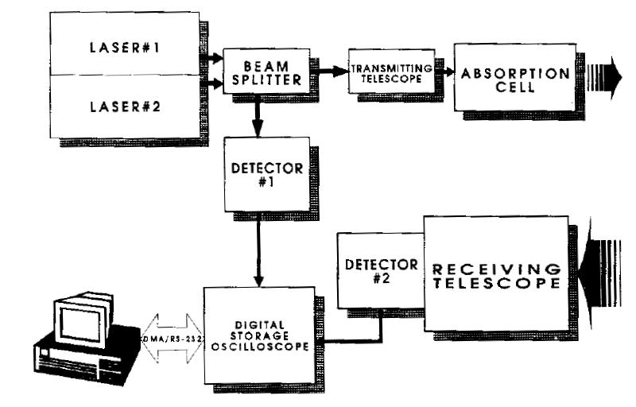
Laser Remote Detector (VÚ 070 Brno) - diagram

Slide 32
Lidar measurements of CHMI
(Czech Hydrometeorological Institute
The CHMI determines ozone (wavelengths 282.4 and 286.9 nm) and NO2 (wavelengths 398.3 and 397.0 nm), using the LIDAR 510M with the DIAL method, (pulse frequency 20 Hz, pulse length 35 ns, maximum range 2500 m, detection limit for O3: 2 ng/l, for NO2: 20 ng/l)
The device can measure in any direction and determine the concentration of the measured substance on different beams. It is possible to obtain two-dimensional horizontal and vertical maps of air pollution.

Slide 33
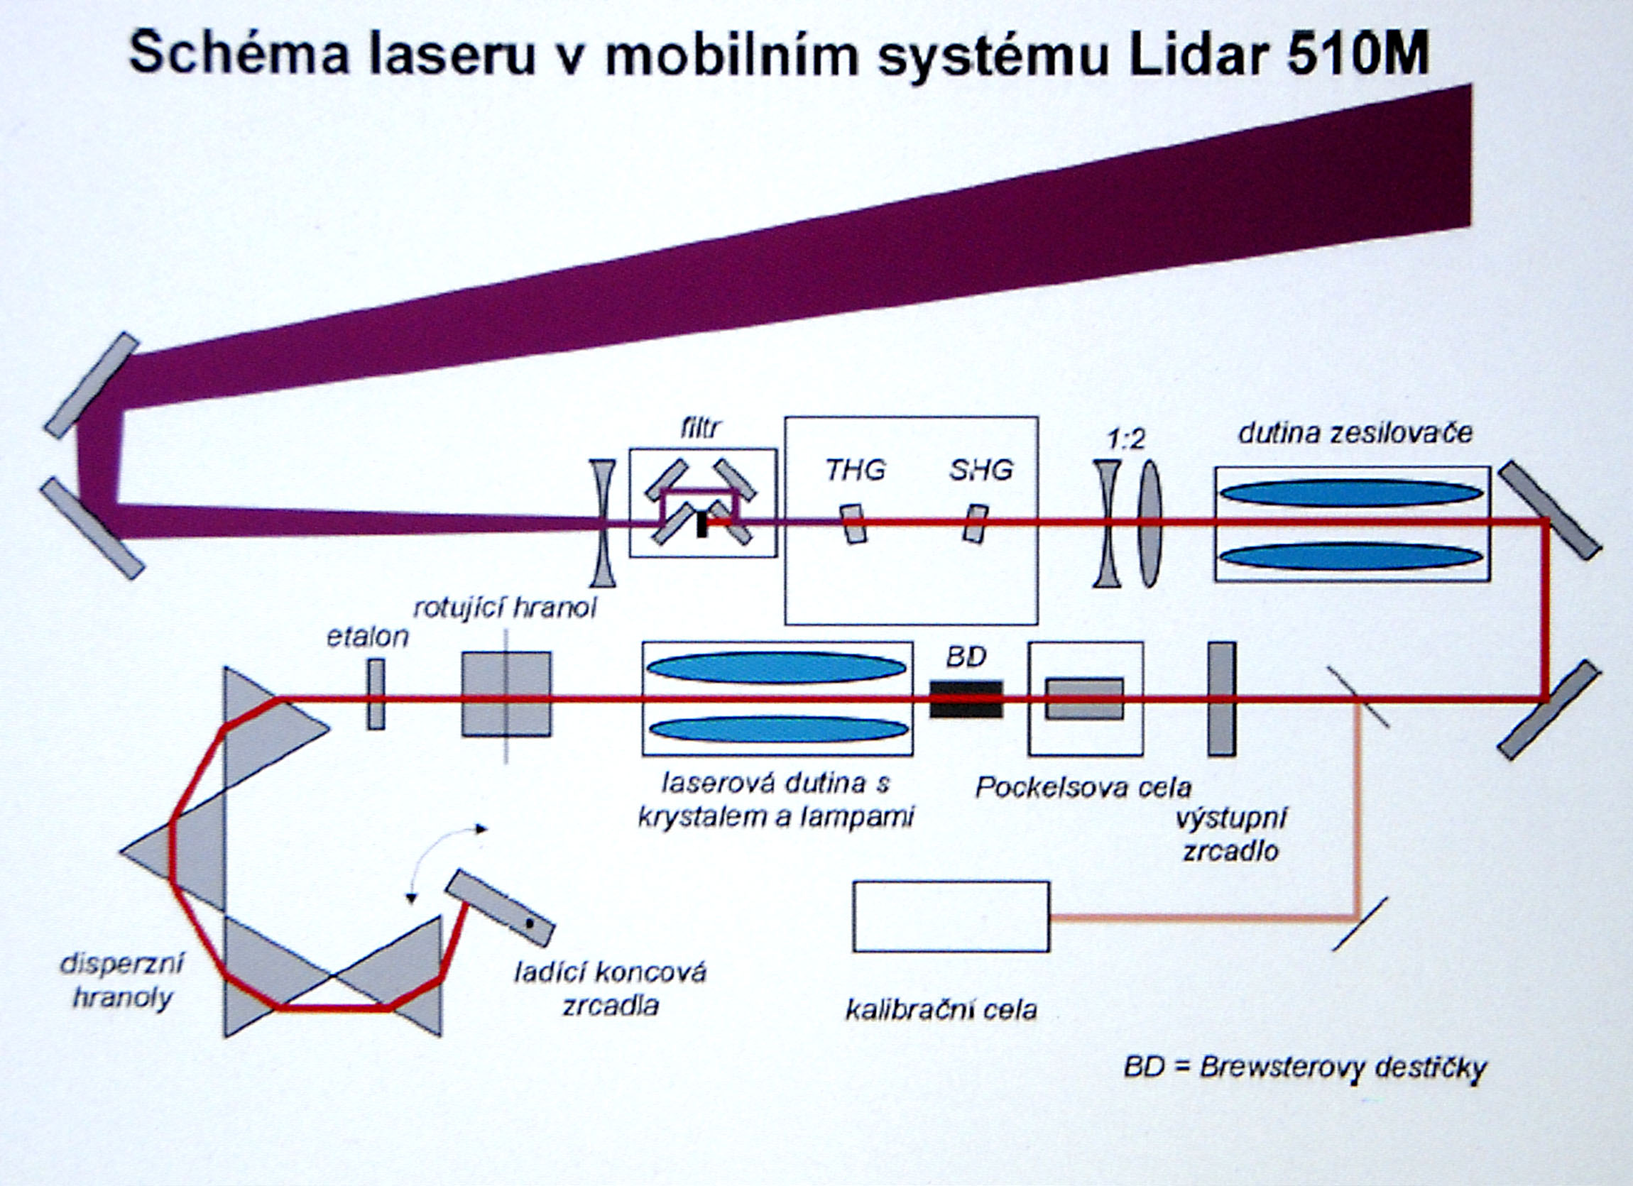
Diagram LIDAR 510M
Laser scheme in LIDAR 510M mobile device
amplifier cavity
rotating prism
laser cavity
output mirror
dispersion prisms
tuning end mirrors
calibration cell

Slide 34
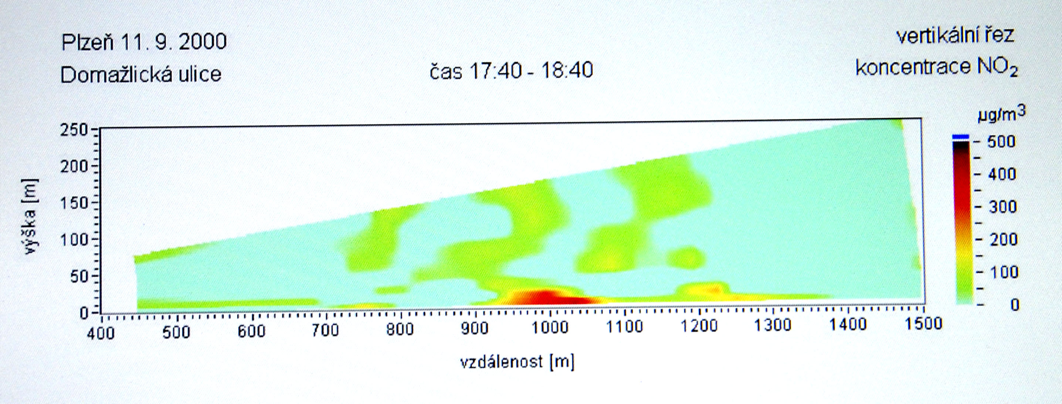
Results of lidar measurements NO2

Slide 35
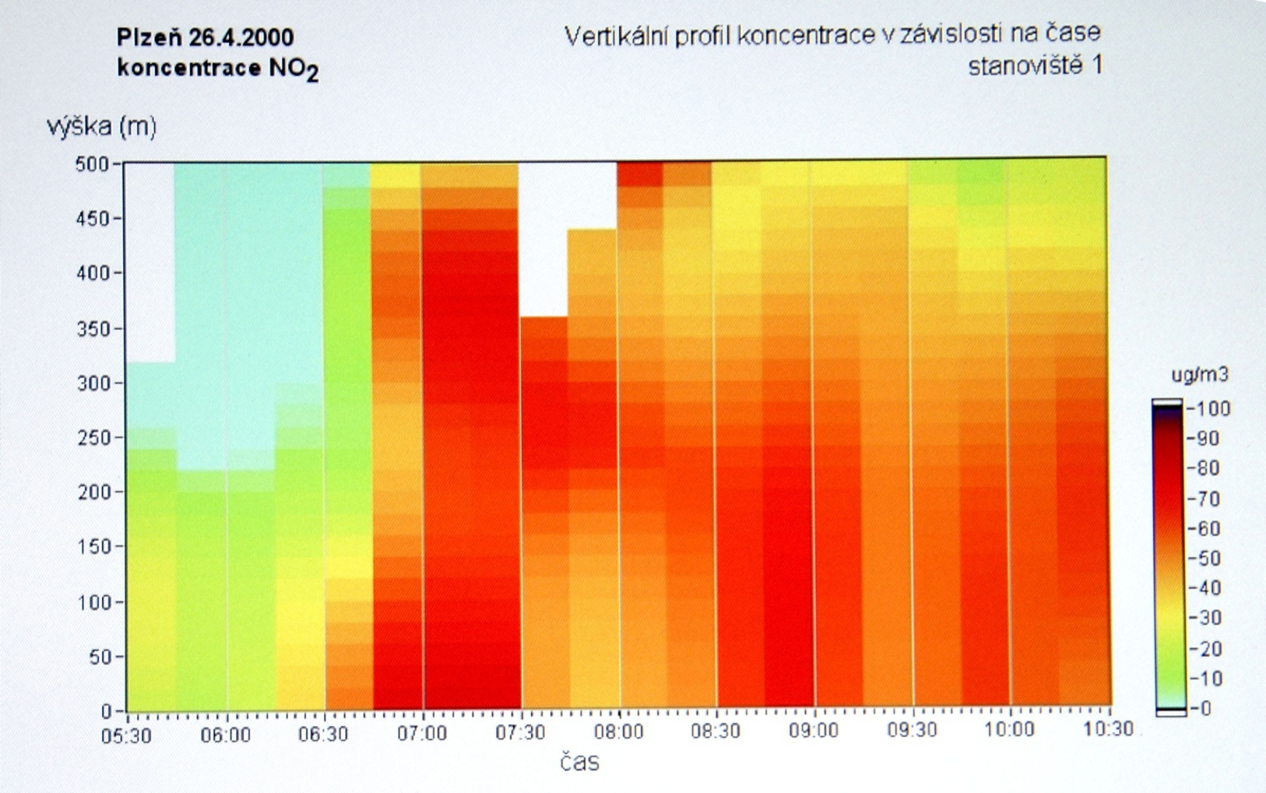
Results of lidar measurements NO2

Slide 36
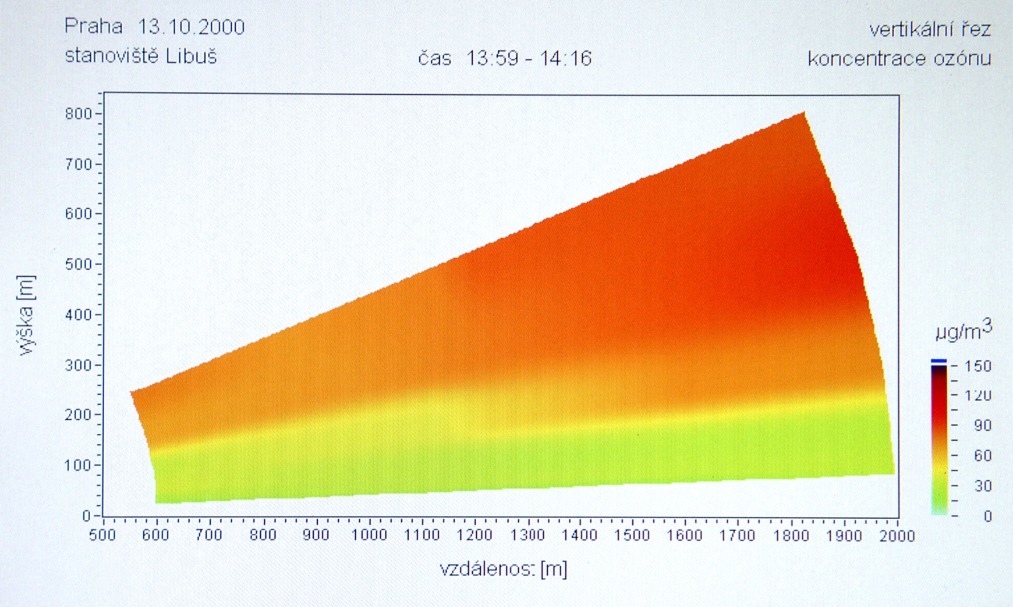
Results of lidar measurements O3

Slide 37
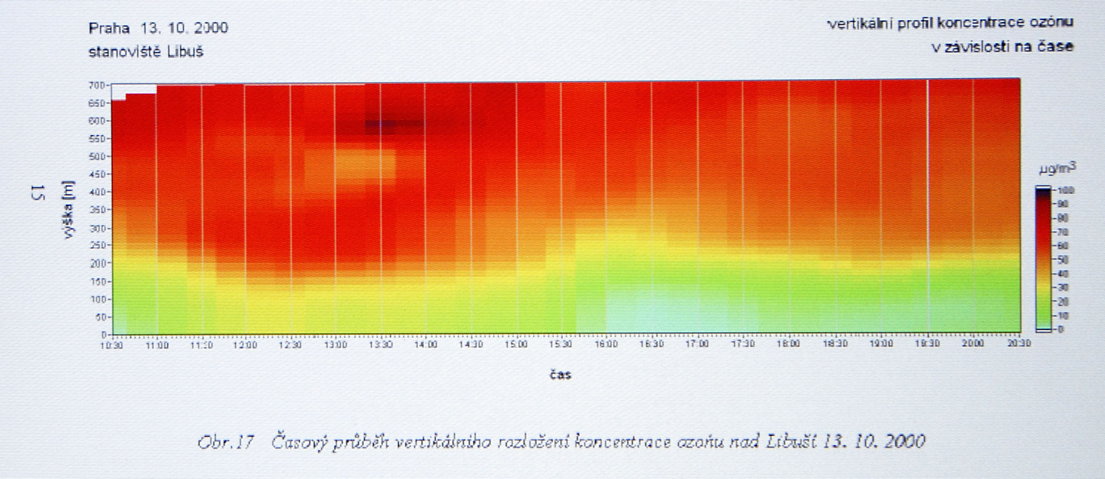
Results of lidar measurements O3

Slide 38
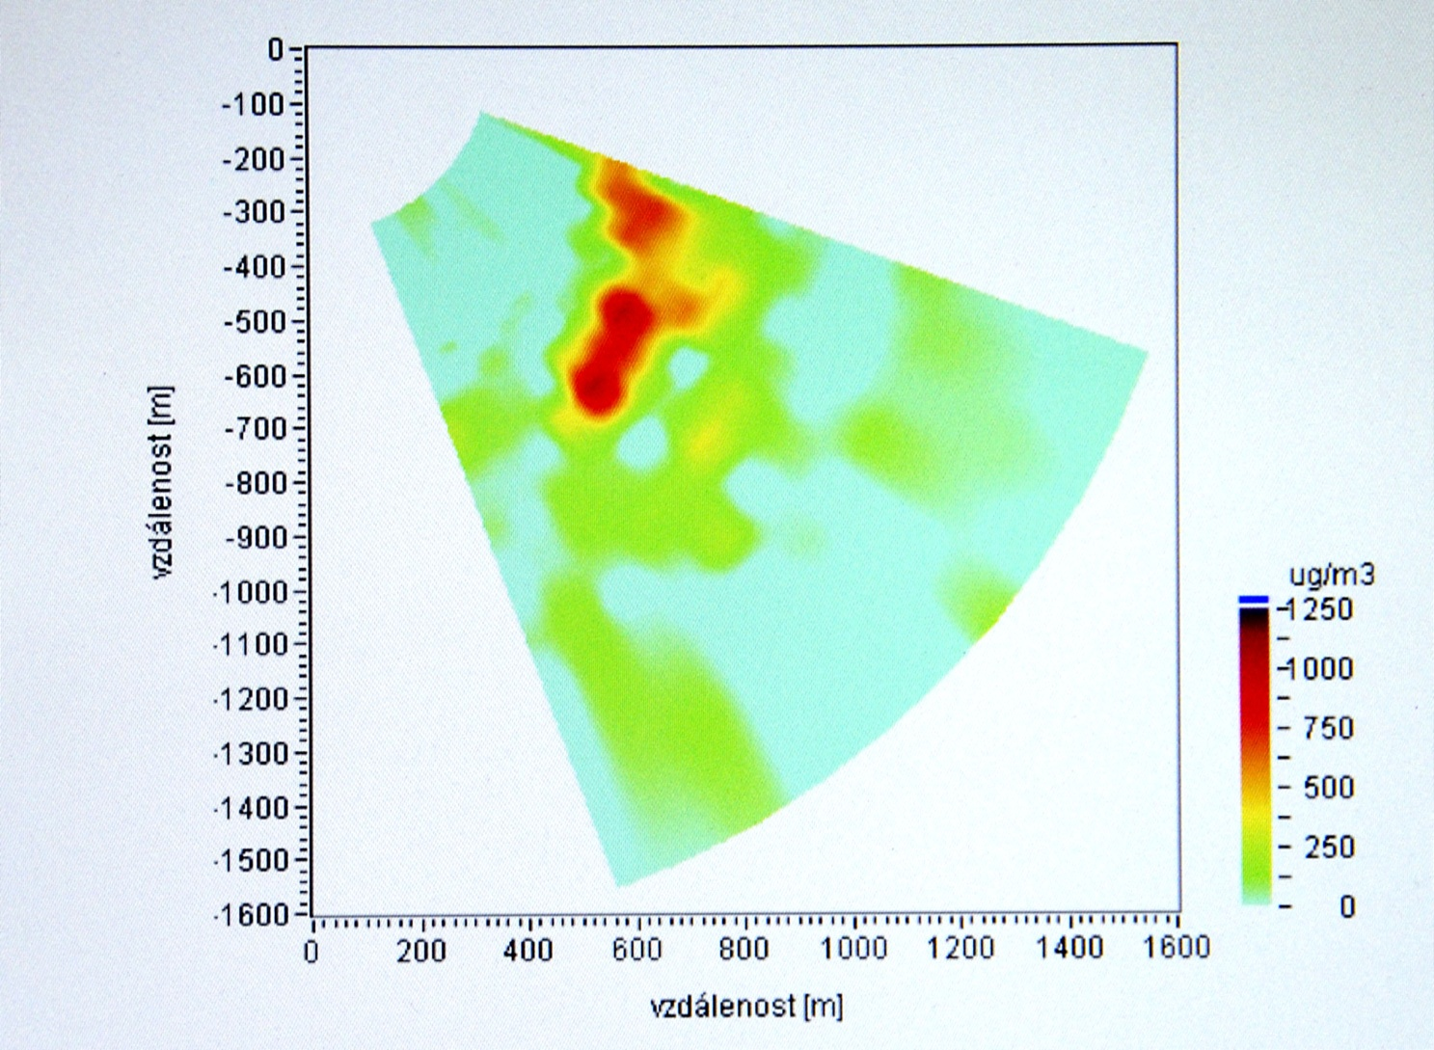
Horizontal section of concentration SO2 over the Esso refinery in Antwerp

Slide 39
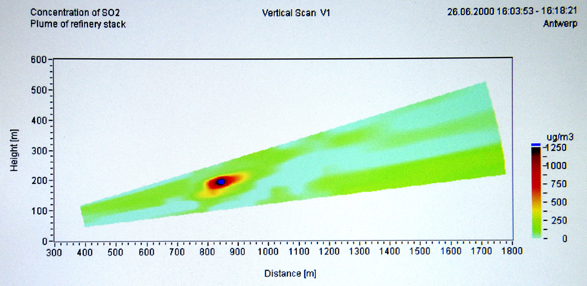
Cut of the smoke plume(SO2) – Esso refinery in Antwerp

Slide 40
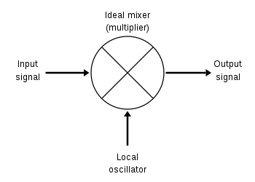
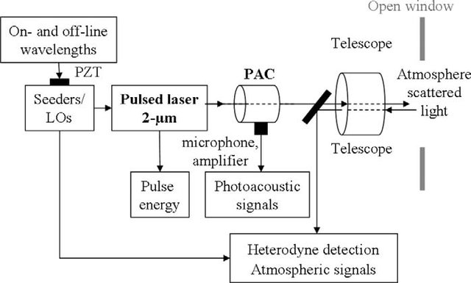
Heterodyne detection - absorption of solar radiation in the atmosphere
Laser heterodyne radiometer (LHR), as a radio receiver (using the Sun or interstellar medium as light source and a laser as local oscillator)
The combination of DIAL and heterodyne detection for extreme resolution spectra is called heterodyne DIAL (HDIAL).
Sketch of the 2 lm heterodyne differential absorption LIDAR (HDIAL) experimental setup. The role of the photo-acoustic cell (PAC) for the a posteriori corrective method is emphasized. LO: Local oscillator, PZT: piezoelectric element.

