Slide 1
Macromolecular crystallography
Lecture 1
Pavel Plevka

Slide 2
Lecture 1 – Introduction to X-ray crystallography, basic diffraction
Lecture 2 – Solution of phase problem, model building, and structure validation

Slide 3
Development of crystallography
Waves, radiation, and diffraction

Slide 4
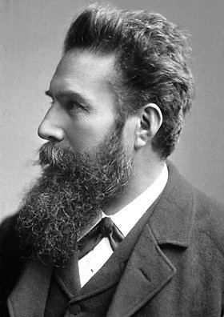
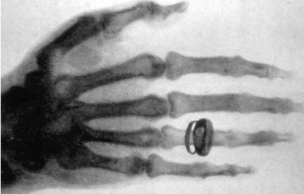
WILHELM CONRAD RÖNTGEN (1845-1923)
1901 Nobel Laureate in Physics
discovery of the remarkable rays subsequently named after him.

Slide 5
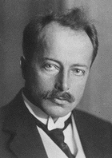
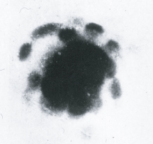
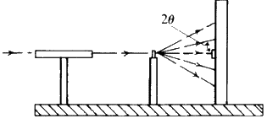
MAX VON LAUE
(1879-1960)
1914 Nobel Laureate in Physics
for his discovery of the diffraction of X-rays by crystals
Friedrich and Knipping

Slide 6
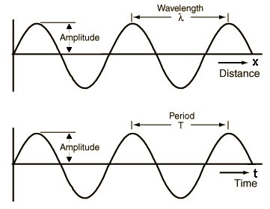
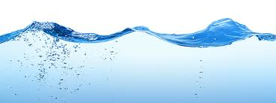
Waves

Slide 7
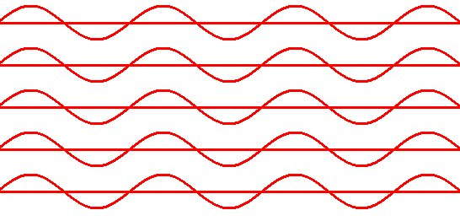
Coherent beam

Slide 8
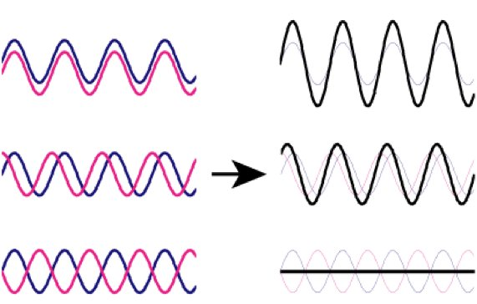
Addition of waves

Slide 9
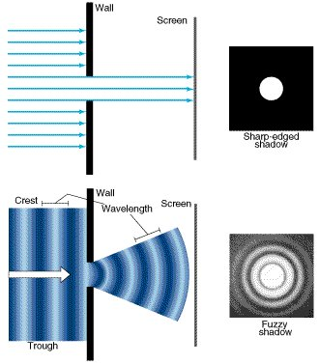
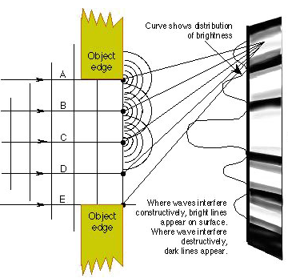
Particles & waves

Slide 10
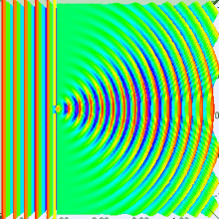
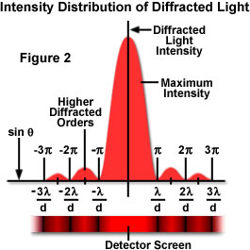
Diffraction of light

Slide 11
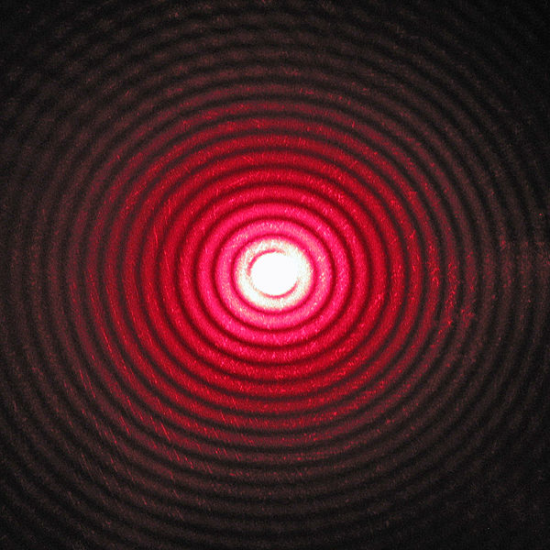
Diffraction of light

Slide 12
MAX VON LAUE
(1879-1960)
1914 Nobel Laureate in Physics
for his discovery of the diffraction of X-rays by crystals

Slide 13
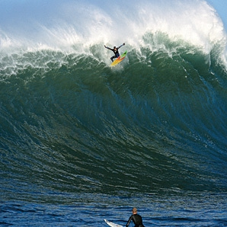
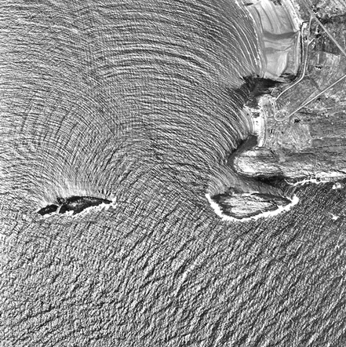
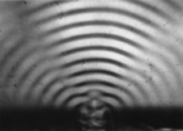
Wavelength and diffraction

Slide 14
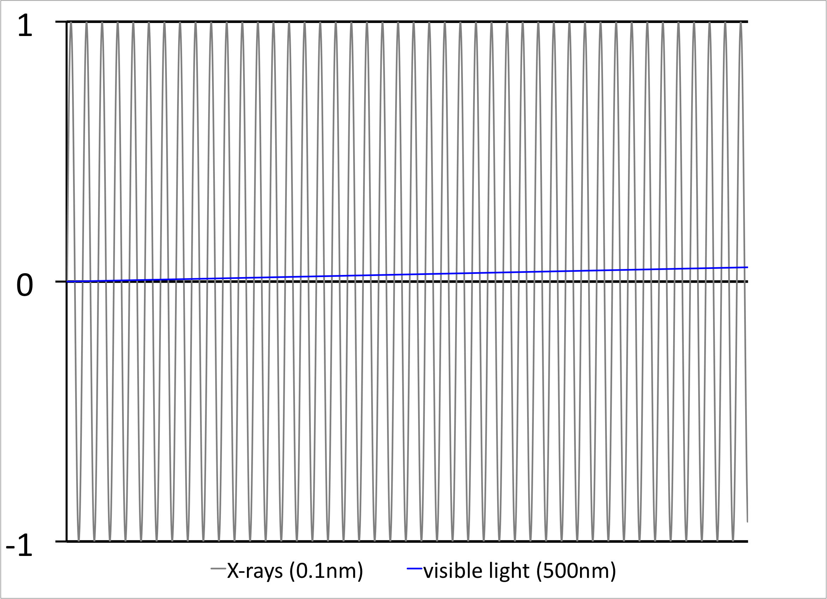
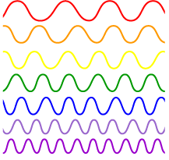
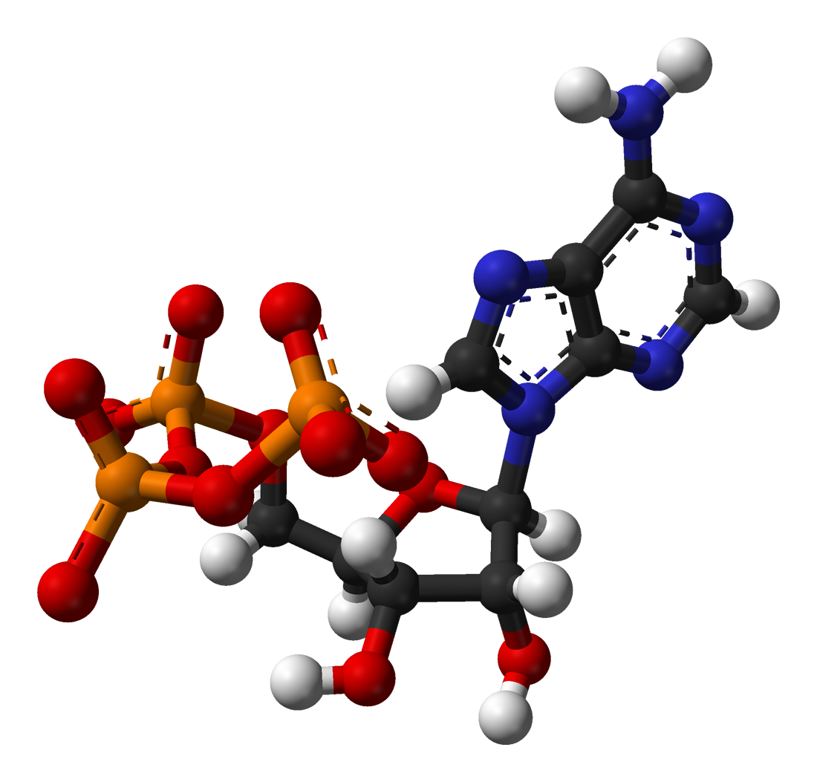
Wavelength comparison of X-rays and visible light
38λ

Slide 15
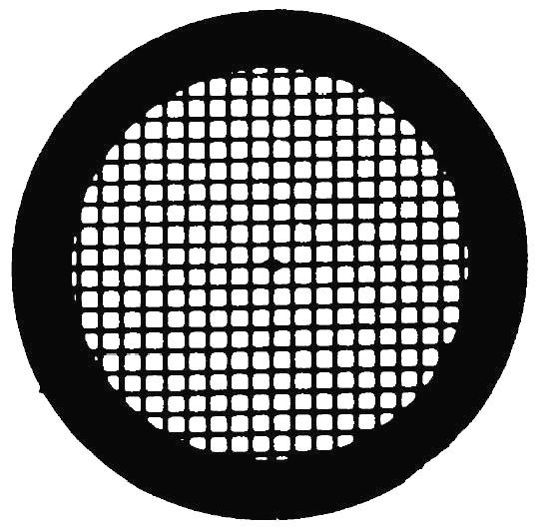
70μm

Slide 16
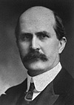
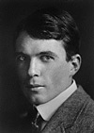
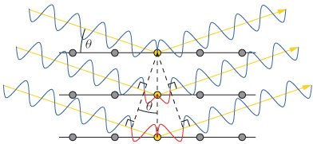
SIR WILLIAM HENRY BRAGG (1862-1942)
SIR WILLIAM LAWRENCE BRAGG (1890-1971)
1915 Nobel Laureates in Physics
for the analysis of crystal structure by means of X-rays
nλ = 2d sinθ

Slide 17
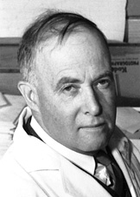
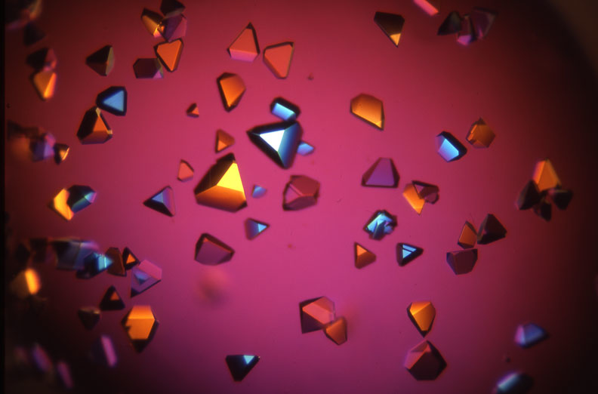
James Batcheller Sumner
(1879-1960)
1946 Nobel Laureate in Chemistry
for his discovery that enzymes can be crystallized

Slide 18
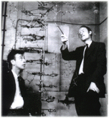
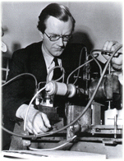
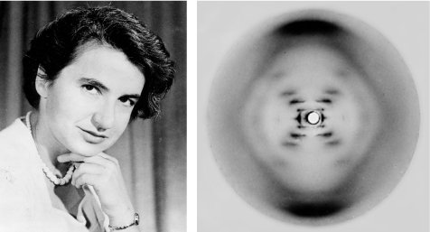
FRANCIS HARRY COMPTON CRICK (1916~2004)
JAMES DEWEY WATSON (1928~)
MAURICE HUGH FREDERICK WILKINS (1916~2004)
1962 Nobel Laureates in Physiology and Medicine
for their discoveries concerning the molecular structure of nuclear acids and its significance for information transfer in living material.
James Watson
and Francis Crick
Maurice Wilkins
Rosalind Franklin

Slide 19
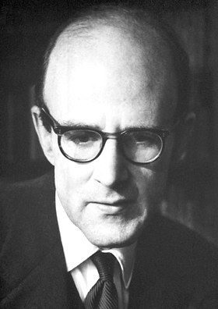
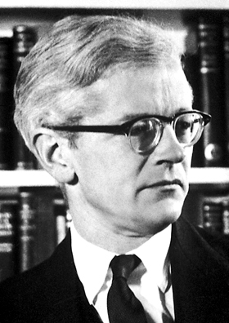
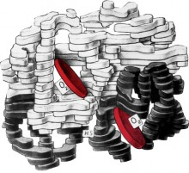
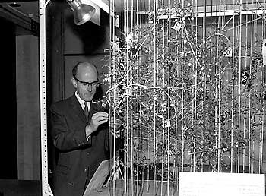
Max Ferdinand Perutz (1914 – 2002)
John Cowdery Kendrew (1917 – 1997)
1962 Nobel Laureates in Physics
for their studies of the structures of globular proteins

Slide 20
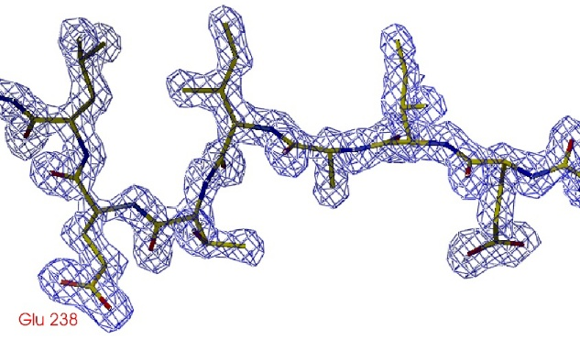
Information from X-ray diffraction experiment
y
z
x
[0;0;0]

Slide 21
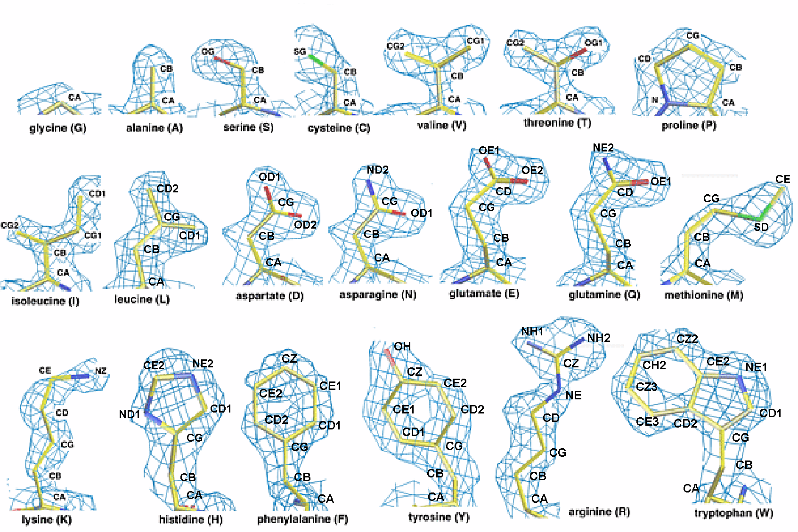
Representative electron density for amino acid side chains
Electron density maps calculated at 1.5 Angstrom resolution.

Slide 22
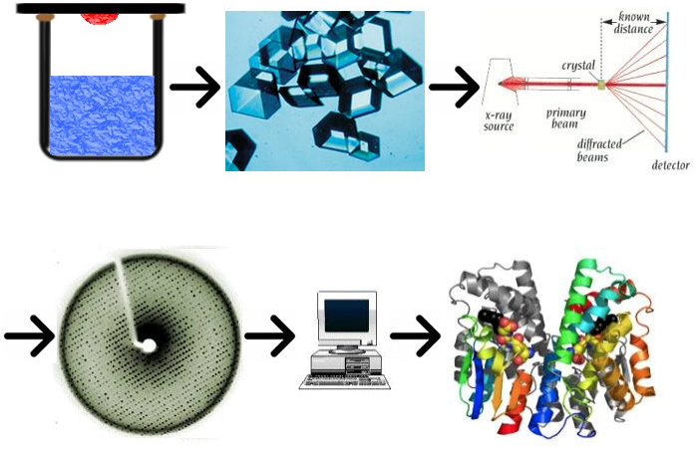

Slide 23
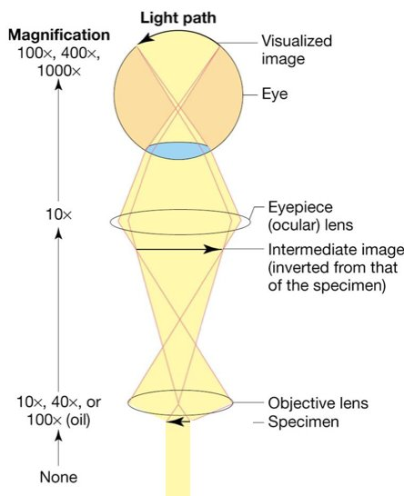
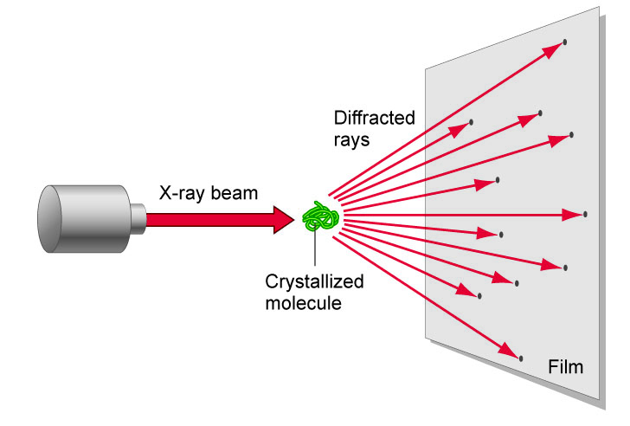
Comparison of microscope and diffraction

Slide 24
Waves and Radiation

Slide 25
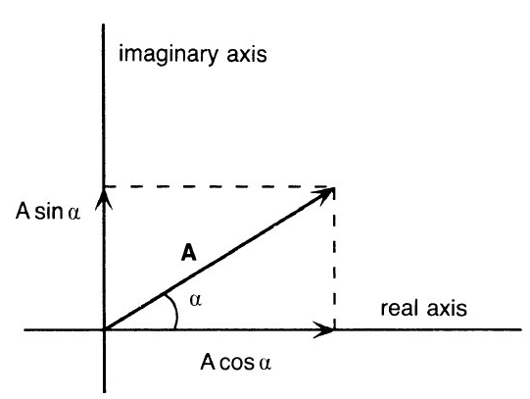
Wave as a vector
Imaginary axis
A
A- wave amplitude
α- wave phase
A
F
α
Real axis
F=Acosα+iAsinα
F=Aexp(iα)

Slide 26
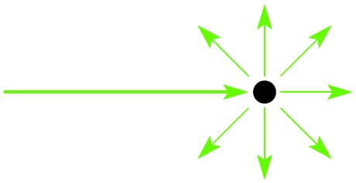
X-rays scatter from electrons in all directions
Primary beam
Secondary beams

Slide 27
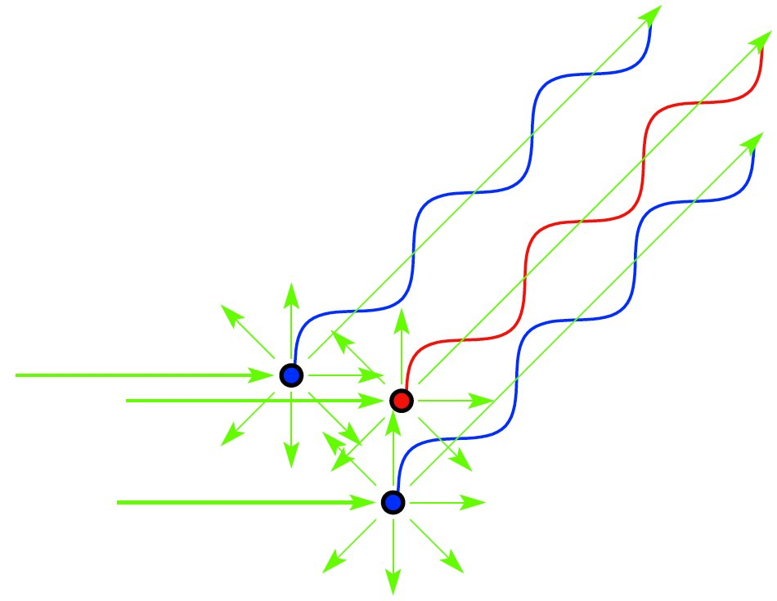
X-ray scattering from several electrons
Primary beam
When do electrons scatter “in phase” – waves add constructively?
Notes:
Molecule is composed of many electrons
Each electron will scatter secondary radiation uppon exposure to x-rays
The scattered secondary beams will interact and cause interference
The scattering from a molecule is dependent on number of and distances between electrons
In other words, scattering from molecule is dependent on its structure
If we would know the amplitudes and phases of scattered molecule, we could calculate the structure of molecule...

Slide 28
Scattering from a single molecule is not detectable
If molecules are all oriented in the same way, the scattering from individual molecules will add in certain directions
      Which directions?

Slide 29
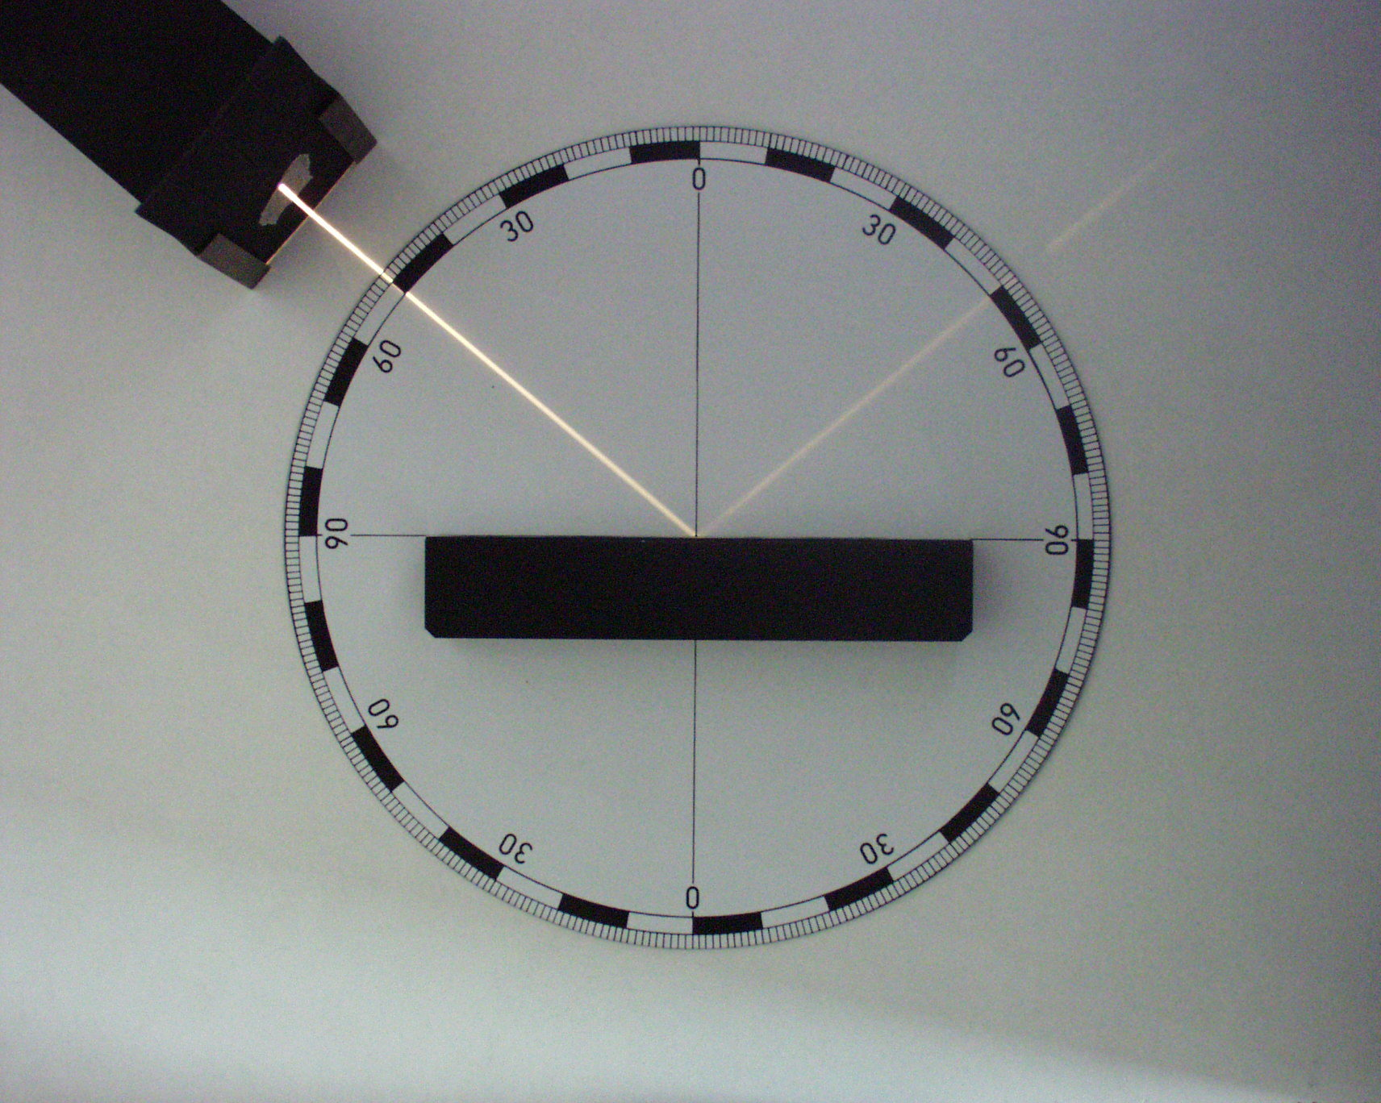
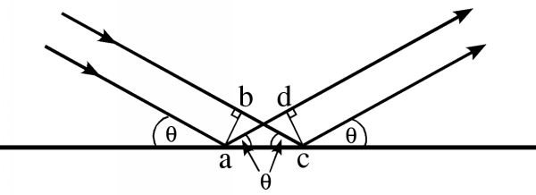
There is no path and PHASE DIFFERENCE when rays reflect from a plane

Slide 30
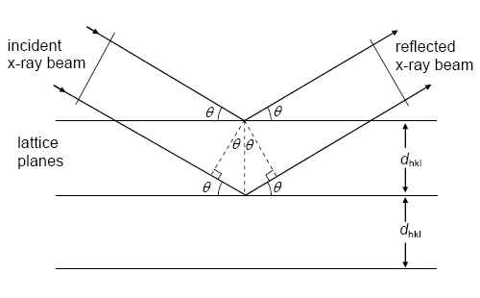
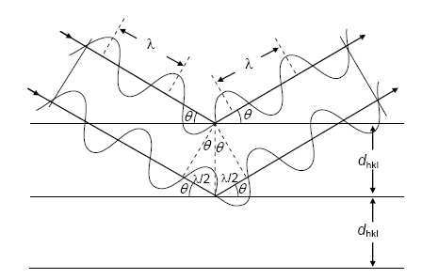
There is NO PHASE DIFFERENCE if the path differences are equal to whole number multiplies of wavelength (λ)
Bragg’s law:
nλ = 2d sinθ
w
sinθ = w/d
2w = nλ

Slide 31
There is NO PHASE DIFFERENCE if the path differences are equal to prime number multiplies of wavelength (λ)
Bragg’s law:
nλ = 2d sinθ
w
sinθ = w/d
2w = nλ

Slide 32
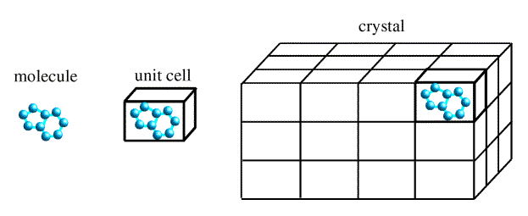

Slide 33
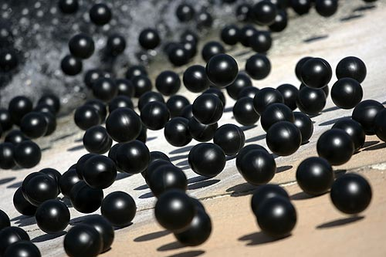
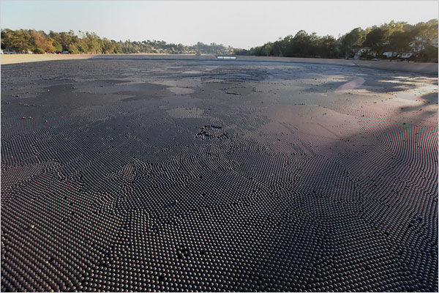
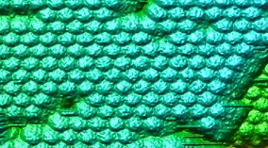

Slide 34
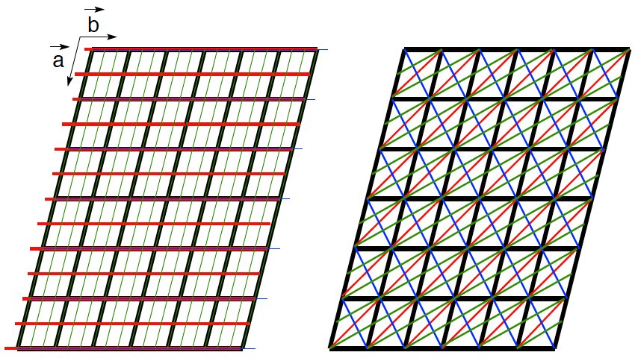

(h, k, l)

Slide 35


Diffraction pattern from a protein crystal

Slide 36
(h, k, l)

Slide 37


nλ = 2d sinθ

Slide 38






Real space cat
Fourier amplitudes and phases
Fourier transform
Circular rainbow scale of phases
Linear intensity scale of amplitude size
Observed amplitudes

Slide 39
Electron density equation + PHASE PROBLEM

Slide 40
Summary:
1. X-rays have suitable wavelength for study of molecular structures
2. Crystals allow measurement of useful diffraction data because they diffract strongly in certain directions
3. Our goal is to obtain three-dimensional distribution of electron density, because it shows the shape of a molecule
4. Diffraction experiments provide only amplitudes of structure factors => Phase problem

Slide 41


Human cardiovirus Saffold virus 3 (2.5Å resolution)

Slide 42
1. Rentgenové paprsky se používají ke studiu makromolekulárních struktur protože:
A.) Mají vlnovou délku podobnou meziatomovým vzdálenostem.
B.) Jako jediné elektromagnetické záření interagují s biologickým materiálem.
C.) Byly objeveny v době intenzivního zájmu o strukturu makromolekul a z historických důvodů se používají dodnes.
2. To, že makromolekuly tvoří krystaly znamená že:
A.) Mají enzymatickou aktivitu
B.) Jsou součástí kostry buňky (cytoskeletu)
C.) Mají stabilní strukturu.
3. Mapa elektronové hustoty, která je výsledkem rentgenové analýzy krystalů:
A.) Ukazuje tvar molekul, které tvoří krystal
B.) Má vždy bílou barvu
C.) Ukazuje tvar molekuly po denaturaci

Slide 43
Macromolecular crystallography
Lecture 2
Pavel Plevka

Slide 44
Phase problem and its solution
Building macromolecular structures based on X-ray diffraction data
Validation of macromolecular structures

Slide 45
Bragg’s law
nλ = 2d sinθ

Slide 46

Bragg’s law

Slide 47

Adition of waves
F=Acosα+iAsinα

Slide 48
Electron density equation
& PHASE PROBLEM

Slide 49

Real space cat
Fourier amplitudes and phases
Fourier transform
Fourier cat
Circular rainbow scale of phases
Linear intensity scale of amplitude size
Observed amplitudes

Slide 50

Solving the phase problem by:
Molecular replacement
1. source of initial phases is a model
2. the model is oriented and positioned to obtain the best agreement with the x-ray data
3. phases are calculated from the model
4. The calculated phases are combined with the experimental data
Molecular Replacement was invented by
Michael Rossmann

Slide 51


Unknown structure,
unknown orientation
Observed amplitudes Phases unknown!
Diffraction experiment
Cat
Fourier cat
Known structure
Calculated amplitudes and phases
Fourier transform
Manx cat
FT of Manx cat
Wrong orientation!

Slide 52

Known structure
Observed amplitudes Phases unknown!
Manx cat
Fourier cat
Fourier transform,
try different orientations
Calculated amplitudes and phases
FT of Manx cat
Wrong orientation!

Slide 53


Observed amplitudes (tailed cat), calculated phases (Manx cat)
Inverted Fourier transform
Even the tail becomes visible!

Slide 54




Model Bias
Duck
Fourier transform of duck
Fourier transform
Duck amplitudes + cat phases
Looks like a cat!!
Inverted Fourier transform

Slide 55
Solving the phase problem by:
Multiple/Single Isomorphous Replacement (MIR/SIR)
source of phases – intensity differences between data from native and derivative (heavy atom containing) crystals
Positions of heavy atoms identified from isomorphous difference Patterson maps

Slide 56
Solving the phase problem 3
Multiple/Single-wavelength anomalous diffraction (MAD/SAD)
source of phases – intensity differences between structure factors due to the presence of atom that specifically interacts with X-rays of a given wavelength
Positions of heavy atoms identified from anomalous difference Patterson maps

Slide 57

Model building & resolution
Notes:
Fitting of protein sequence in the electron density
Easy in molecular replacement
More difficult if no initial model is available
Unambiquous if resolution is high enough (better than 3.0 Å)
Can be automated, if resolution is close to 2Å or better

Slide 58

Model building & refinement

Slide 59


Model building & refinement

Slide 60
Validation
Assesment of model quality:
Is the model in agreement with experimwntal data?
How the geometry of amino acids look like?
Are atoms far / close enough from each other?
Are residues “happy” in their environment?
Are the hydrogen donors/acceptors satisfied?

Slide 61




R-factor, R_{free}factor
R-factor
R_{free} factor

Slide 62


Ramachandran plot
ω
Ψ
Ψ
φ
φ

Slide 63



Geometry and stereochemistry
Bond lengths
Dihedral angles

Slide 64

Real-space fit

Slide 65


Data deposition
Protein Data Bank (PDB)
Some structures are wrong!

Slide 66
Summary
1. X-rays have suitable wavelength for study of molecular structures
2. Crystals allow measurement of useful diffraction data because they diffract strongly in certain directions
3. Our goal is to obtain three dimensional distribution of electron density, because it shows the shape of a molecule
4. Diffraction experiments provide only amplitudes of structure factors => Phase problem
5. Solution of the phase problem:
Molecular replacement
Isomorphous replacement
Anomalous diffraction
6. Model building, refinement, validation, deposition

Slide 67





1. Virus purification
2. Crystallization
3. Diffraction data
4. Solve structure

Slide 68


Structural studies of human picornaviruses
Rhinoviruses
– 40% of common cold cases
– economic losses $16bn/year in USA
Enteroviruses (EV71)
– hand-foot-and-mouth-disease
– encephalitis
McMinn et al. Clin Infect Dis 2001. Image by Heng Soy, KI Media 2012.
Notes:
I would like to start my presentation by defining biological significance of my project.
My research is focused on structural studies of picornaviruses that include some of the most common human pathogens. For example, rhinoviruses are responsible for about 40$ of common cold cases. The economic damage caused by rhinoviruses was estimated to be 16bn dollars per year in the united states alone. Similar expenses are expected for European union.
Enterovirus 71 induces yearly outbreaks of hand-foot-and-mouth disease mostly in south-east Asia. About 5% of the infected children develop encephalitis that can be fatal or result in permanent brain damage. This magnetic resonance image shows inflammation in left section of cerebellum caused by EV71 infection. The three years old patient lost ability to speak.
Currently no antiviral drugs are available against rhinoviruses or enteroviruses. More basic research is needed to improve our understanding of picornavirus biology to allow identification of new targets for antiviral drugs. My research will address these requirements by -> next slide

Slide 69

Picornavirus replication cycle
Notes:
… aspiring to answer basic biological questions about picornavirus life cycle. It is well established that picornaviruses enter cells by receptor mediated endocytosis. However, it is not known how is the picornavirus ssRNA genome delivered from virions across the membrane of the endosome into cell cytoplasm. That is our first research question.
When in the cytoplasm the genome is translated into a polyprotein that is then cleaved into functional subunits. The viral proteins induce formation of so called virus-replication factories that contain lipid vesicles derived from intra-cellular membranes, viral and cellular proteins, ribosomes and viral RNAs. We will use modern cryo-electron tomography approaches to characterize the factories on molecular level.
In addition we will structurally characterize picornavirus genome replication and recombination – processes that happen in the vicinity of the replication factories.
Finally, we will determine picornavirus virion assembly mechanism.

Slide 70
Human cardiovirus Saffold virus 3 (2.5Å resolution)

Slide 71


Human Parechovirus 1 @ 3.1Å

Slide 72
1.) Jakou část strukturního faktoru můžeme změřit v difrakčním experimentu:
a) amplitudu (ve formě intensity)
b) fázi
2.) Nejčastější metoda pro získání fází je:
a) molekulární nahrazení (molecular replacement)
b) isomorfní nahrazení
c) anomální diffrakce
3.) Ramachandran plot ukazuje:
a.) distribuci úhlů v hlavním řetězci proteinu
b.) vzdálenosti mezi atomy
c.) konformace postranních řetězců aminokyselin

Slide 73

Honeybee viruses
Notes:
… aspiring to answer basic biological questions about picornavirus life cycle. It is well established that picornaviruses enter cells by receptor mediated endocytosis. However, it is not known how is the picornavirus ssRNA genome delivered from virions across the membrane of the endosome into cell cytoplasm. That is our first research question.
When in the cytoplasm the genome is translated into a polyprotein that is then cleaved into functional subunits. The viral proteins induce formation of so called virus-replication factories that contain lipid vesicles derived from intra-cellular membranes, viral and cellular proteins, ribosomes and viral RNAs. We will use modern cryo-electron tomography approaches to characterize the factories on molecular level.
In addition we will structurally characterize picornavirus genome replication and recombination – processes that happen in the vicinity of the replication factories.
Finally, we will determine picornavirus virion assembly mechanism.

Slide 74




Leishmania RNA virus 1
metastasis to nasopharyngeal tissues
Free Dictionary
Ives et al. Science, 2011
Olivier. Nature, 2011
cutaneous leishmaniasis

Slide 75







1. Virus purification
2. Grid preparation
3. cryo-EM
4. Reconstruction

Slide 76

Johann Deisenhofer (1943)
Robert Huber (1937)
Hartmut Michel (1948)
1988 Nobel Laureates in Chemistry
for the determination of the structure of a photosynthetic reaction centre

Slide 77

Venkatraman Ramakrishnan (1952)
Thomas A. Steitz (1940)
Ada E. Yonath (1939)
2009 Nobel Laureates in Chemistry
for studies of the structure and function of the ribosome

Slide 78
X-ray crystallography
First method to determine structure of molecules with atomic resolution
As of September 17, 2013 there were more than 70,000 structures determined by protein crystallography in Protein Data Bank
Macromolecular structures are crucial for our understanding of life at the molecular level
28 Nobel prizes

Slide 79

14 Bravais Lattices

Slide 80
Description of lectromagnetic waves
λ
λ
E = A cos 2πz/λ
E = A cos (α+2πz/λ)
E- electric field strength
A- amplitude
λ - wavelenght
z - position along beam path
α - phase

Slide 81
Diffraction pattern from a protein crystal
nλ = 2d sinθ

Slide 82

Phase problem
α
α
α

Slide 83
Phase problem
α
α
α

Slide 84
Building macromolecular structures

Slide 85
Building macromolecular structures

Slide 86

Building macromolecular structures

Slide 87
Phase problem

Slide 88
Electron density equation

Slide 89
Wave as a vector
Imaginary axis
A
A
F
α
Real axis
F=Acosα+iAsinα
F=Aexp(iα)
A - wave amplitude
α - wave phase

Slide 90


Patterson function, Patterson space

