Slide 1
Heterogeneous catalysis (C9981)
Kinetics
Mechanisms of catalytic reactions
Diffusional limitations on heterogeneous catalysts

Slide 2
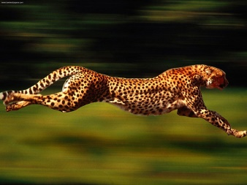
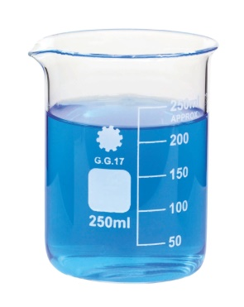
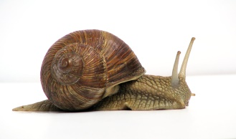
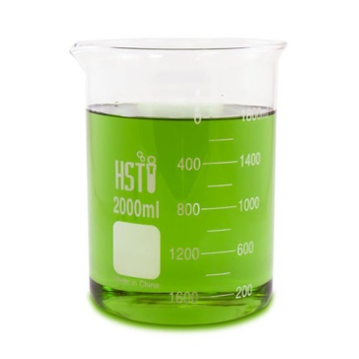
Definition
Catalyst is…
  A substance that speeds up a chemical reaction
  Without being consumed or changed
+ CATA
+ CATA
We get our products
  In shorter time; at lower rxn temperature; at lower pressure
  cheaper; economical; ecological

Slide 3
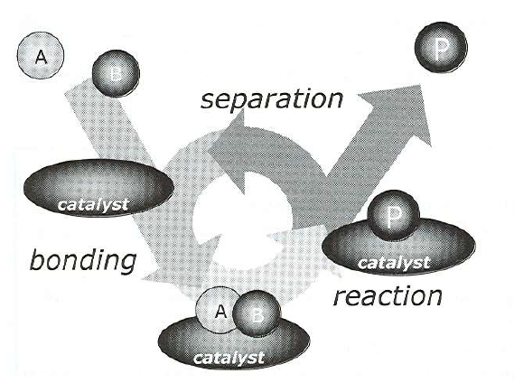
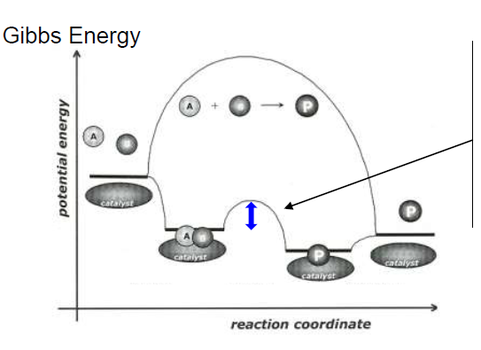
Catalytic cycle
A + B → P
E_{a} >> E_{a}(cata); k = A∙e^{–Ea/RT}
ΔG = ΔG(cata); ΔG = –RT∙lnK

Slide 4
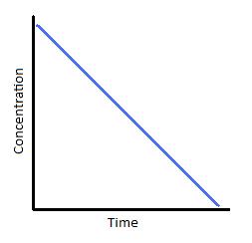
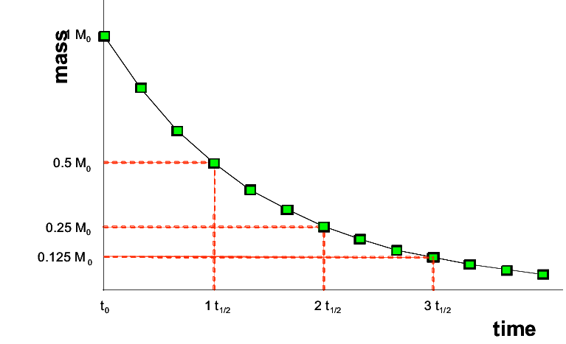
Kinetics
We know kinetics☺ (#ChemKin)
Rxns of zero order, first order, and second order
But in catalysis also 0.39 order… (many steps, all contribute!)

Slide 5
Kinetics
An important consideration: type of the reactor
  Batch
  Continuous (plug flow (fixed bed) reactor (PFR) or continuous stirred tank reactor (CSTR))
    Steady-state approximation (complicated math behind!)
    It is not possible to follow changes of concentrations in time

Slide 6
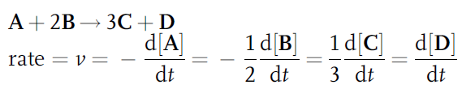

Kinetics
Important terms
  Rate
  Arrhenius equation

Slide 7


Kinetics
Important terms
  Reaction order
  For elementary reactions α, β = whole numbers (integers)
  For non-elementary reactions (i.e. catalytic reactions) α, β = non-integers

Slide 8
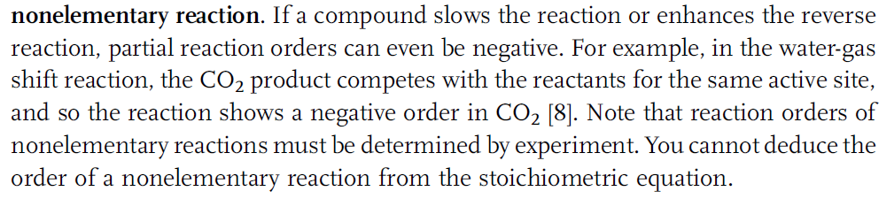

Kinetics
Important terms
  Reaction order
    Can be negative!

Slide 9

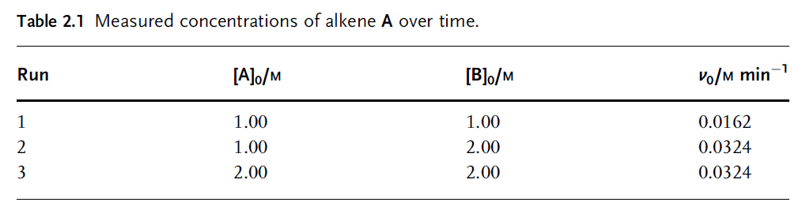

Kinetics
Important terms
  Reaction order
    Example: Determination of reaction order

Slide 10
Kinetics
Back to Arrhenius equation
k – is the reaction rate constant
k – is not a constant in fact
  It depends on temperature and pressure
  Its units differ according to the reaction order

Slide 11
Kinetics
Important terms
  Reaction pseudo-order
    Application of one (or more) of the reactants in a big excess so that its concentration in time t virtually equals concentration in time 0
    Simplification of reaction rate equation

Slide 12
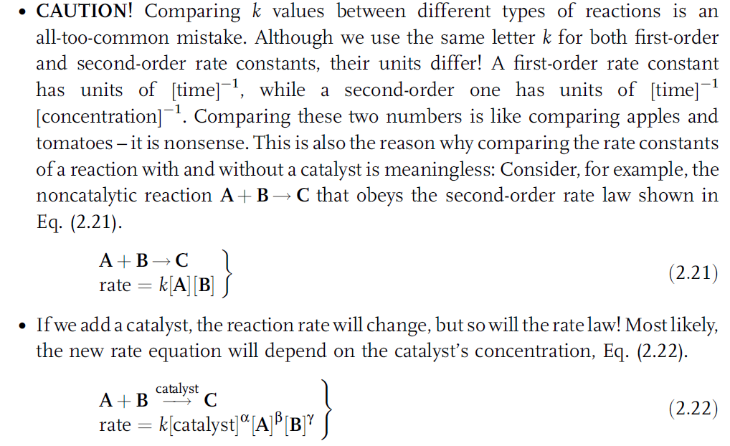
Kinetics

Slide 13
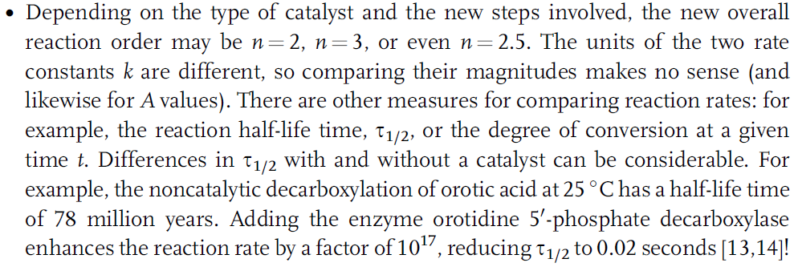
Kinetics

Slide 14
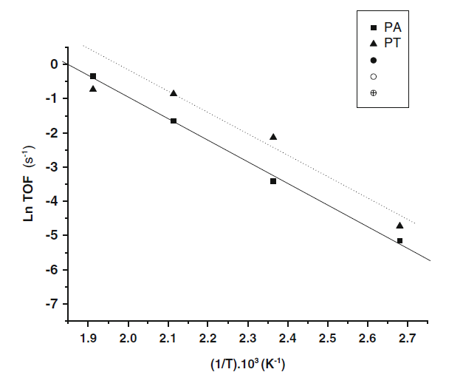
Kinetics
E_{a} (apparent) and A can be estimated by plotting ln k vs. 1/T = Arrhenius plot

Slide 15
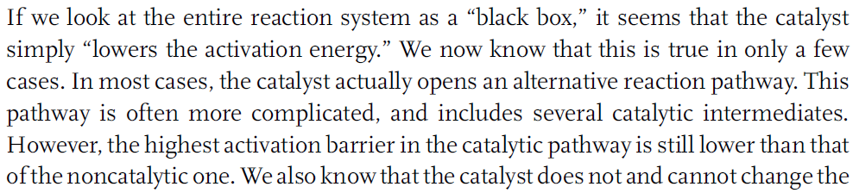
Kinetics
Summary

Slide 16
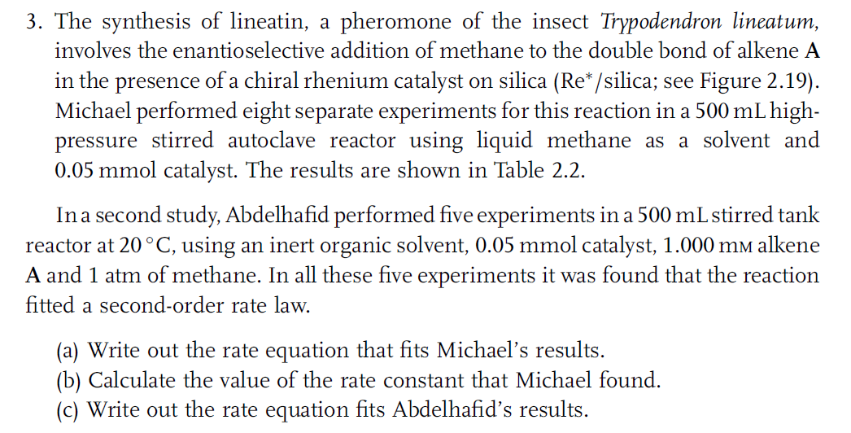
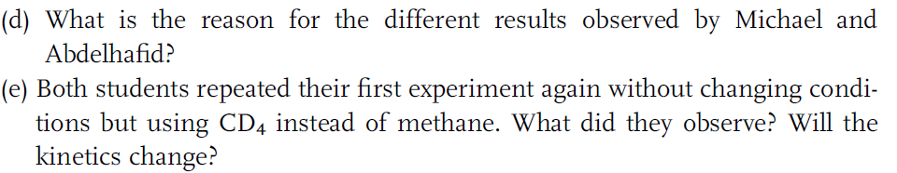
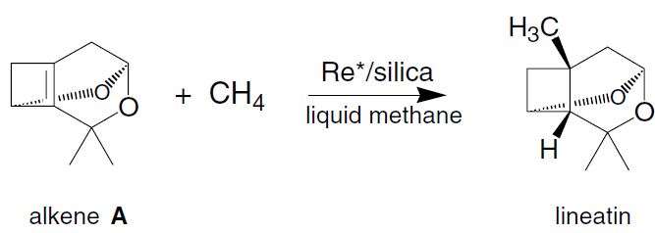
Homework 1

Slide 17
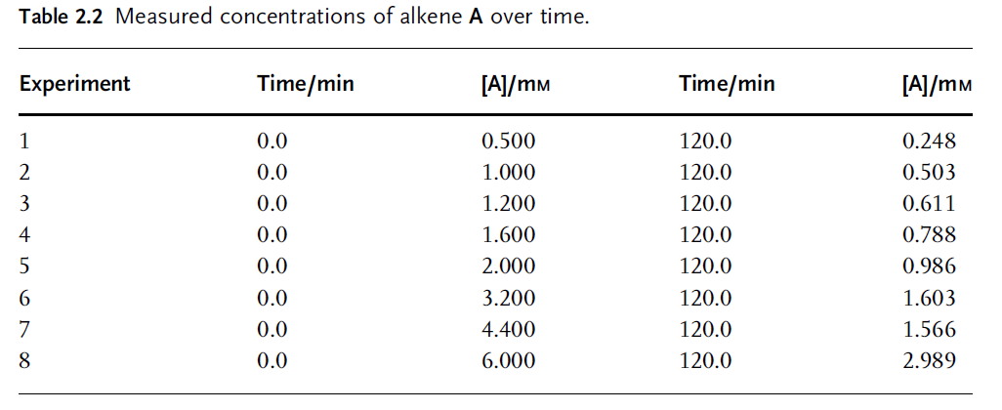
Homework 1

Slide 18
Mechanisms of catalytic reactions
Langmuir (monomolecular)
  A(adsorbed) → P(adsorbed)
Langmuir-Hinshelwood (bimolecular)
  A(adsorbed) + B(adsorbed) → P(adsorbed)
Eley-Rideal (bimolecular)
  A(adsorbed) + B(gas phase) → P(adsorbed)
Mars-van Krevelen (special case)

Slide 19
Mechanisms of catalytic reactions
Langmuir (monomolecular)
  A(adsorbed) → P(adsorbed)
Langmuir-Hinshelwood (bimolecular)
  A(adsorbed) + B(adsorbed) → P(adsorbed)
Eley-Rideal (bimolecular)
  A(adsorbed) + B(gas phase) → P(adsorbed)
Mars-van Krevelen (special case)

Slide 20
Langmuir
Hypotheses identical as for Langmuir adsorption isotherm
  Monolayer
  One molecule per active site
  The enthalpy of adsorption independent on surface coverage Θ
    All sites identical
    No interactions between molecules of adsorbate
  Adsorption and desorption in equilibrium

Slide 21
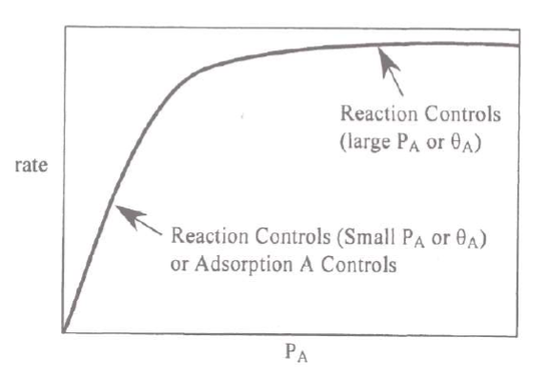
Langmuir
Note:
k can be k_{A→P}
Or
k_{A-adsorption}
Reaction rate ≈ k∙[A]
First order reaction

Slide 22
Langmuir
Surface is fully covered with A
No change with increasing [A]
Reaction rate ≈ k
Zero order reaction
Note:
k can be k_{A→P}
Or
k_{P-desorption}

Slide 23
Mechanisms of catalytic reactions
Langmuir (monomolecular)
  A(adsorbed) → P(adsorbed)
Langmuir-Hinshelwood (bimolecular)
  A(adsorbed) + B(adsorbed) → P(adsorbed)
Eley-Rideal (bimolecular)
  A(adsorbed) + B(gas phase) → P(adsorbed)
Mars-van Krevelen (special case)

Slide 24
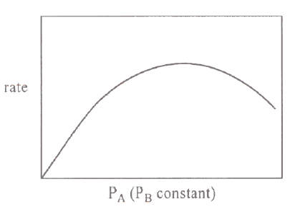
Langmuir-Hinshelwood
Competition between A and B adsorbates for adsorption sites

Slide 25
Mechanisms of catalytic reactions
Langmuir (monomolecular)
  A(adsorbed) → P(adsorbed)
Langmuir-Hinshelwood (bimolecular)
  A(adsorbed) + B(adsorbed) → P(adsorbed)
Eley-Rideal (bimolecular)
  A(adsorbed) + B(gas phase) → P(adsorbed)
Mars-van Krevelen (special case)

Slide 26
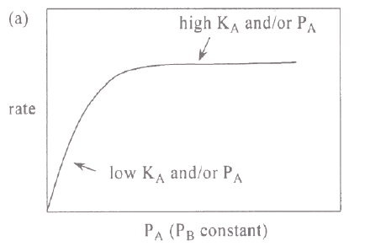
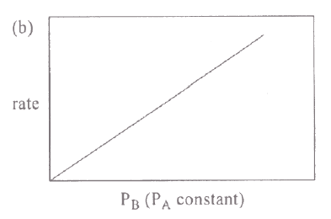
Eley-Rideal

Slide 27
Mechanisms of catalytic reactions
Langmuir (monomolecular)
  A(adsorbed) → P(adsorbed)
Langmuir-Hinshelwood (bimolecular)
  A(adsorbed) + B(adsorbed) → P(adsorbed)
Eley-Rideal (bimolecular)
  A(adsorbed) + B(gas phase) → P(adsorbed)
Mars-van Krevelen (special case)

Slide 28
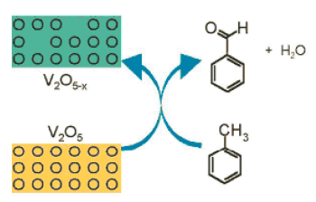
Mars-van Krevelen
Example: oxidation of toluene over V₂O₅
  Oxygen comes from crystal lattice (confirmed by isotope studies)
    Creation of oxygen vacancies
    Regeneration of catalyst with O₂ in the feed
Note:
Catalyst should not change during catalysis!
Compare with Langmuir-Hinshelwood and Eley-Rideal
O₂

Slide 29
Mars-van Krevelen
Possible only with metal oxides, sulphides, etc., where metal can achieve variable oxidation states and coordinations
Catalyst works as a „bank“
  It can borrow you oxygen if needed
  It can save oxygen for worse times…
Selectivity might be very high
  Specific oxidation species within the crystal lattice
Diffusion in solids needs to be considered
  Vacancies play an important role

Slide 30
Mars-van Krevelen
Possible only with metal oxides, sulphides, etc., where metal can achieve variable oxidation states and coordinations:
  Oxidation of propylene to acrolein over MoO_{3-x}
  Reduction of benzoic acid to benzaldehyde over MoO_{3-x}
  Hydrodesulfurization of DBT do DB over NiMoS_{2-x}
  Oxidation and reduction of gases in car exhausts over CeO₂-Ce₂O₃

Slide 32
Thermodynamics + steps of cat reaction
A + B → P
1: Adsorption of reactants on catalyst surface
2: Reaction on active site
1
2
1
3
3: Desorption of products from catalyst surface

Slide 33
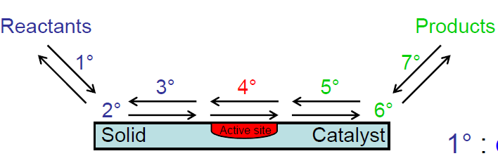
Steps of catalytic rxns
A + B → P
1: Diffusion medium→catalyst
2: Adsorption of reactants
(3: Diffusion on cat. surface)
4: Reaction on active site
(5: Diffusion on cat. surface)
6: Desorption of products
7: Diffusion catalyst→medium
2
4
1
6

Slide 34
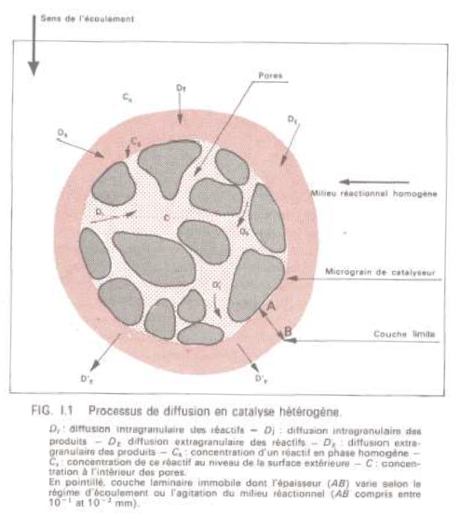
Steps of catalytic rxns
1a: Diffusion of the reactant in the fluid film surrounding the catalysts grain (External diffusion; macroporosity)
1b: Diffusion of the reactant in porous network until reaching surface (Internal diffusion; micro- and mesopores)
2: Adsorption of reactants
(3: Diffusion on cat. surface)
4: Reaction on active site
(5: Diffusion on cat. surface)
6: Desorption of products
7a: Diffusion of the product in the porous network until reaching the aperture of the pore (Internal diffusion)
7a: Diffusion of the product in the fluid film (External diffusion)

Slide 35
Rate determining step
Total: Up to 9 steps; 6 of them diffusion!
All of them more or less contribute to the final reaction rate (k_{apparent} and E_{apparent})
Slowest step???

Slide 36
Rate determining step
6 steps based on diffusion
  Fick laws
  Low dependance on temperature
  E_{a} = 4–8 kJ mol^{–1}
3 steps based on chemistry
  High dependance on temperature
  E_{a} = 20–200 kJ mol^{–1}
k = A∙e^{–Ea/RT}
Slowest step of the catalytic reaction???
Depends on the temperature!!!

Slide 37
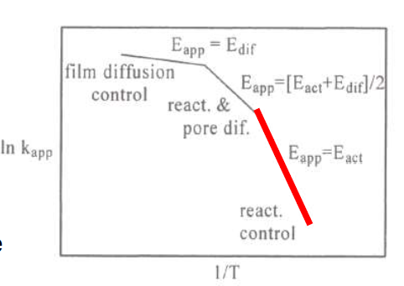
Rate determining step
Low temperature
  Chemical steps are limiting
  E_{app} = E_{a} of the reaction step

Slide 38
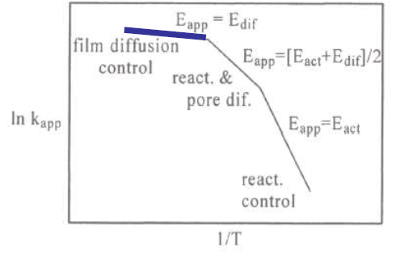
Rate determining step
High temperature
  The chemical reaction is fast
  There is no time for internal diffusion to take place, only external surface employed in catalysis
  Diffusional steps
  are limiting
  E_{app} = E_{a} of the diffusion
  in the fluid film
  (external diffusion)

Slide 39
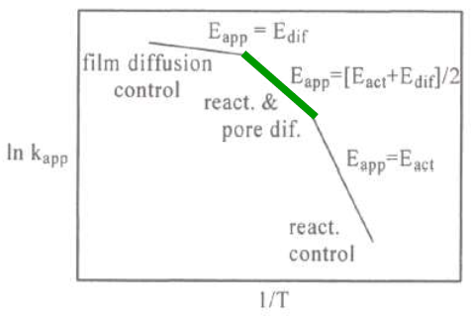
Rate determining step
Intermediate temperature
  Contribution of both chemistry and diffusion (diffusion in the pores, internal diffusion)
  E_{app} = average of E_{a} of the reaction step and E_{a} of internal diffusion

Slide 40
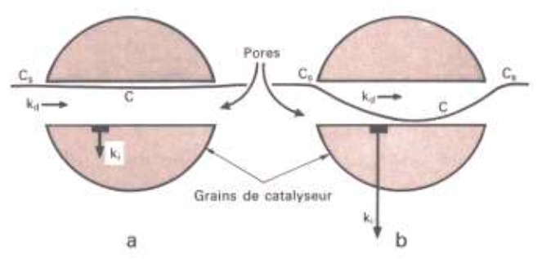
Diffusional limitation
k_{d} = diffusion constant; k_{i} = reaction rate constant per m² of catalysts; S = specific surface area
k_{d} = k_{i}∙S; Surface is supplied with reactants; no diffusional limitation
k_{d} << k_{i}∙S; Internal surface of the catalyst is not supplied with reactants; Diffusional limitation

Slide 41
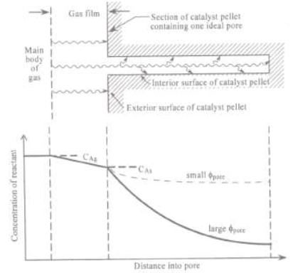
Diffusional limitation
Gradient of reactant concentration in
  Fluid film of particle (External diffusion)
  Inside the pore (Internal diffusion)

Slide 42
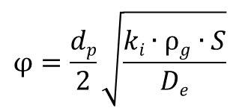
Diffusional limitation
We want to use as many active sites as possible (even deep in the internal pore system)
We want to avoid diffusional limitation
Effectivenes factor η (observed reaction rate / maximal theoretical reaction rate) depends on Thiele modulus
Thiele modulus φ describes the „quality“ of catalyst grain in terms of internal diffusion:
$$φ=\frac{dp}{2}\sqrt{\frac{ki∙ρg∙S}{De}}$$
d_{p} = diameter of grain; k_{i} = reaction rate constant per m² of catalysts; S = specific surface area; ρ_{g} = density of the catalyst including pores; D_{e} = diffusion coefficient of the reactant in the pores

Slide 43

Diffusional limitation
Thiele modulus φ describes the „quality“ of catalyst grain in terms of internal diffusion:
The higher the Thiele modulus, the higher probability of diffusional limitations to occur
Internal diffusional limitations occur always to some extent
$$φ=\frac{dp}{2}\sqrt{\frac{ki∙ρg∙S}{De}}$$

Slide 44
Diffusional limitation
Thiele modulus φ describes the „quality“ of catalyst grain in terms of diffusion:
Let‘s decrease d_{p} = small catalyst grains
Let‘s decrease ρ_{g} = higher pore volume
Let‘s increase D_{e} = bigger pores
$$φ=\frac{dp}{2}\sqrt{\frac{ki∙ρg∙S}{De}}$$
Catalyst synthesis,
shaping, thermal
treatment…
…in order to avoid the internal diffusional limitations as much as possible…

Slide 45
Diffusional limitation
Gradient of reactant concentration in
  Fluid film of particle (External diffusion)
    Viscosity of vector gas
    Linear velocity of vector gas
    Size of the grains
    Diffusion coeff of reactants
  Inside the pore (Internal diffusion)

Slide 46
Diffusional limitations
Note: Up to now we have discussed only diffusion of reactants
Same applies for heat diffusion
I.e. diffusional limitations can lead to important issues!
  Effectivenes factor η > 1
  Hot spots
  Sintering of catalysts
  Shift/loss of selectivity
  Explosion
Industrial point of view

Slide 47
Diffusional limitations
Internal diffusional limitations always present to some extent
  We can diminish them at the time of catalyst preparation (pore volume, pore diameter, size of catalysts grains)
External can be avoided at the time of catalytic reaction
  Linear velocity of vector gas,…
How to reveal external diffusional limitations?

Slide 48
Diffusional limitations
How to reveal external diffusional limitations?
Constant temperature and constant contact time (other parameters can vary) lead to constant conversion, selectivity, and yield

Slide 49
Diffusional limitations
How to reveal external diffusional limitations?
Contact time practically???
1 unit of linear gas velocity
1 unit of reactant feed
0.5 unit of linear gas velocity
0.5 unit of reactant feed
1 unit of catalyst mass
1 unit of catalyst volume
0.5 unit of catalyst mass
0.5 unit of catalyst volume
Conversion, yield, and selectivity are equal!
If not, then we encounter external diffusional limitations!

Slide 50
Space velocity and contact time
Contact time = 1/space velocity
Space velocity [h^{–1}]
  Based on catalyst mass (WHSV, weight hourly space velocity)
    weight of reactant per weight of catalyst per hour
  Based on catalyst volume (GHSV or LHSV – gas/liquid…)
    Volume of feed gas@STP (reactant + gas vector) per volume of catalyst bed per hour
Be careful, contact time can be based on WHSV, GHSV, or LHSV!

Slide 51
Space velocity and contact time
Calculations with volumes always much less convenient than weight…
So…Why is GHSV/LHSV important in heterogeneous catalysis??
1 unit of linear gas velocity
Feed of reactant constant
0.5 unit of linear gas velocity
Feed of reactant constant
1 unit of catalyst mass
1 unit of catalyst volume
1 unit of catalyst mass
1 unit of catalyst volume
WHSV is constant. GHSV is different.
Conversion, yield, and selectivity are different!

Slide 52
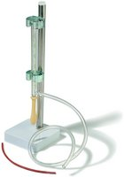
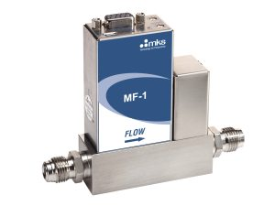
Space velocity and contact time
1 unit of linear gas velocity [m³ h^{–1}]
1 unit of reactant feed
1 unit of catalyst mass
1 unit of catalyst volume
Soap bubble flow meter
Mass flow controller

Slide 53
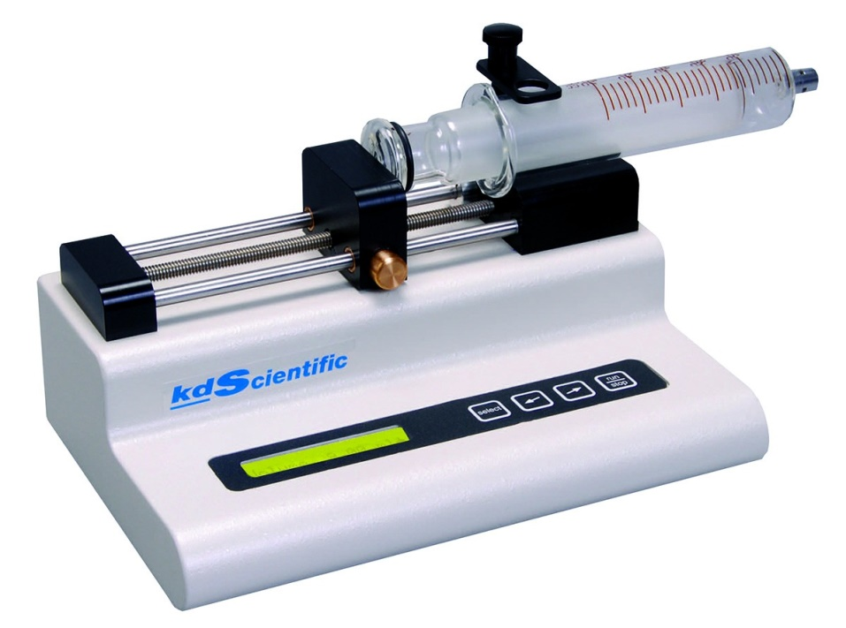
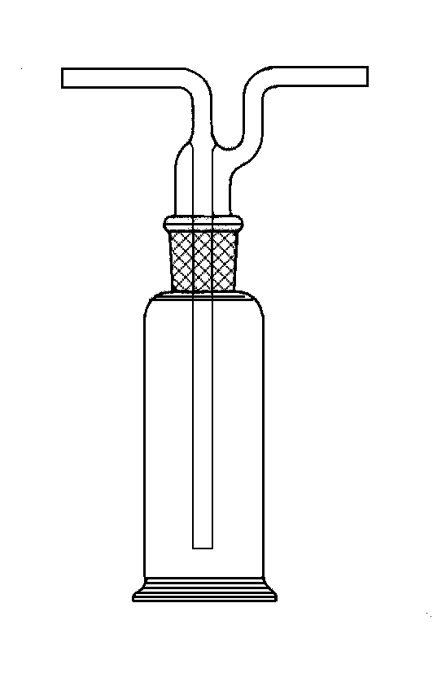
Space velocity and contact time
1 unit of linear gas velocity
1 unit of reactant feed [g or cm³ h^{–1}]
→ gas
(= mass flow control, soap…)
→ liquid
1 unit of catalyst mass
1 unit of catalyst volume
Vapor saturator (= bubbler)
Automatic syringe pump

Slide 54
Space velocity and contact time
1 unit of linear gas velocity
1 unit of reactant feed
1 unit of catalyst mass [g]
1 unit of catalyst volume [cm³]
→ dilute with inert
material to
a constant volume
Remember,
GHSV important for catalyst comparison

Slide 55
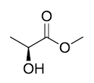
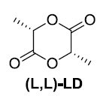
Homework 2
Gas phase transesterification
Continuous flow fixed bed reactor
TiO₂/SiO₂
2
-2 MeOH
Temperature [°C] | Conversion sample 1 (4.2 wt% Ti) [%] | Conversion sample 2 (0.9 wt% Ti) [%]
220 | 39 | 8.6
230 | 48 | 9.6
240 | 59 | 13
250 | 82 | 17
260 | 93 | 21
Create Arrhenius plots for both catalysts (plot ln k [mol_{LD} g_{cat}^{–1} h^{–1}] vs. 1000/T [K^{–1}]
Estimate apparent E_{a} and A from Arrhenius equation
What makes the difference between these two catalysts?
Selectivity = 90 % in all cases; WHSV = 15.5 h^{–1}
ACS Catal. 2018, 8, 9, 8130–8139

