Slide 1
Heterogeneous catalysis
Lecture 6
Catalysts characterization - continuation

Slide 2
Catalyst characterization
Outline
  Special MAS NMR techniques
  Hydrophilicity vs. Hydrophobicity meas
    Water sorption
    Dynamic water sorption
    Inverse gas chromatography
    Microcallorimetry
    Quartz crystal microbalance
  In situ and operando techniques

Slide 3
Special MAS NMR techniques
MQMAS
DNP

Slide 4
Hydrophilicity vs. Hydrophobicity
Why?
  Remember: Adsorption/desorption step in cata as important as cata rxn itself (@Lecture 1)
  Moreover: strong efforts nowadays put forward bio-sources instead of fossil fuels
  Compare
    Oil – long hydrocarbon chains (hydrophobic)
    Wood – cellulose, lignin = sugar based materials = a lot of oxygen, OH groups (hydrophilic)

Slide 5
Hydrophilicity vs. Hydrophobicity
Possibilities:
  Water sorption
  Dynamic vapor sorption/Quartz crystal microbalance
  Inverse gas chromatography
  Microcallorimetry

Slide 6
Hydrophilicity vs. Hydrophobicity
Problems:
  What is a measure of hydrophobicity?
    A material can have high/low affinity to both water and organic molecules (i.e. if a sample is hydrophilic, it does not necessarily mean it is hydrophobic!)
      % of pore volume filled with water at certain p/p₀
      Hydrophobic index (water/toluene competitive sorption)
      Heat of adsorption, heat of immersion
      …
  Chemisorption: Do chemisorbed molecules account for hydrophobicity/philicity?

Slide 7
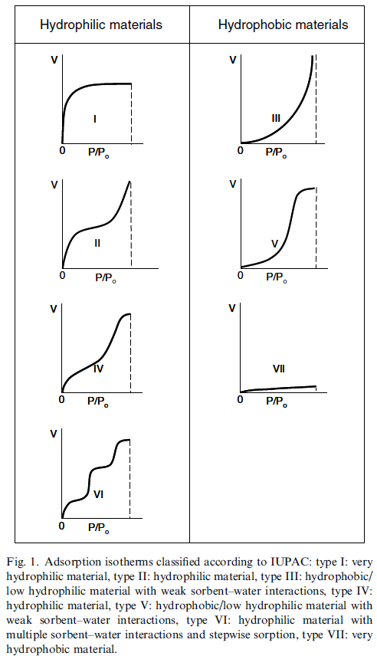
Hydrophilicity vs. Hydrophobicity
Water sorption
  Similar to N₂ physisorption
  Known volume and pressure
  in the cell, known mass
  of the sample

Slide 8
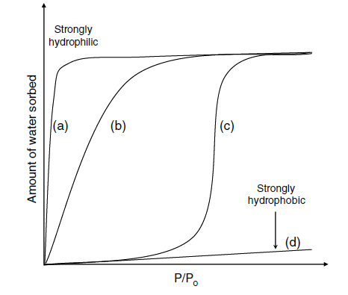
Hydrophilicity vs. Hydrophobicity
Water sorption
Water clustering = water-water interaction (liquefaction, condensation) stronger than water-adsorbent
Very strong interaction water-adsorbent
Very weak interaction water-adsorbent

Slide 9

Hydrophilicity vs. Hydrophobicity
Water sorption
  Plotting ln p against 1/T at constant adsorption uptake gives a straight line with a slope equal to H_{iso}/R
  H_{iso} = isosteric heat of adsorption
  Isotherms at multiple temperatures needed!

Slide 10
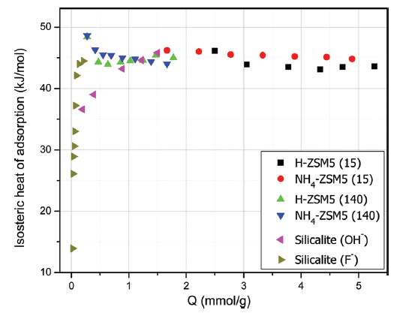
Hydrophilicity vs. Hydrophobicity
Water sorption
  H_{iso} = isosteric heat of adsorption
Hydrophilic material = very high H_{iso} = strong interaction water-adsorbent
H_{iso} more or less constant = water-water interaction (condensation)
Hydrophobic material = very low H_{iso} = negligible interaction water-adsorbent

Slide 11
Hydrophilicity vs. Hydrophobicity
Dynamic vapor sorption/Quartz crystal microbalance
  You deposit your material on an accurate microbalance
  You expose it to vapors of different gases/liquids (water, alcohols, hydrocarbons,…)
  You follow the uptake by changes of mass
  If we can control/follow pressure, then isotherms can be obtained similar to a classic physisorption

Slide 12
Hydrophilicity vs. Hydrophobicity
Inverse gas chromatography
  You pack column (≈ 50 cm) with the material you want to test (≈ 0.5 g)
  You inject series of gases/liquids (e.g. methane, ethane,…hexane, heptane; methanol, ethanol,…; benzene, toluene, xylene…)
  You follow retention time (you directly see „affinity“ of your material to selected liquids)
  Models (math) can give surface energy,…

Slide 13
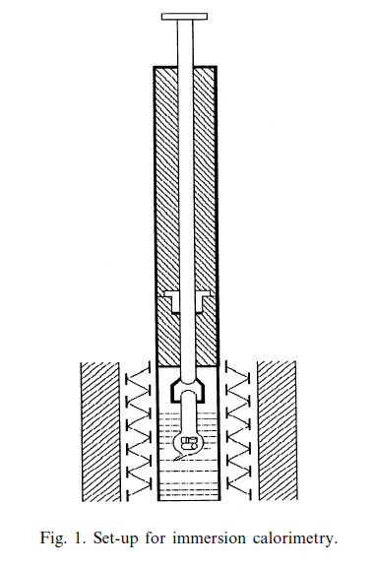
Hydrophilicity vs. Hydrophobicity
Immersion microcalorimetry
  Evacuated sample sealed
  in a bulb with brittle end
  Bulb immersed in a testing
  liquid, sealed
  Bulb broken (rod pushed down)
  Liquid gets into the bulb,
  adsorbs, heat of immersion
  released and measured

Slide 14
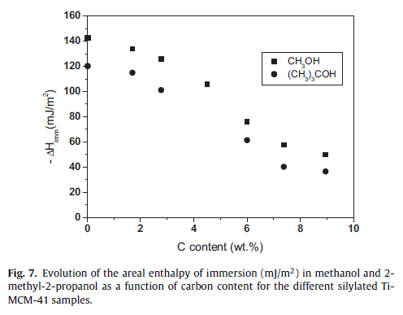
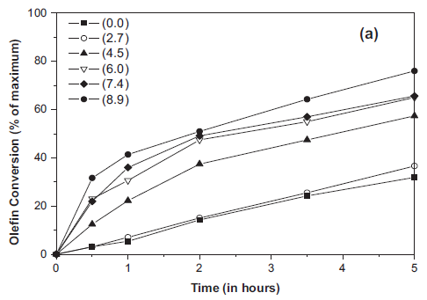

Hydrophilicity vs. Hydrophobicity
Immersion microcalorimetry
  Ti-MCM-41, pure inorganic vs. increasing degree of surface silylation (increasing carbon content)
J. Silvestre-Alberó et al. / Applied Catalysis A: General 507 (2015) 14–25

Slide 15
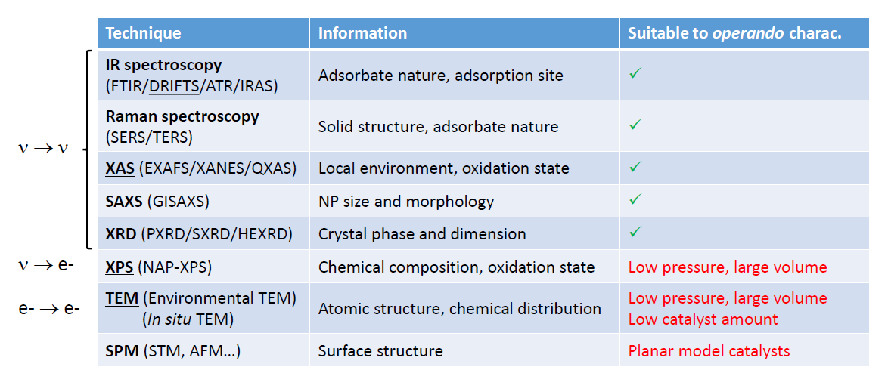
In situ and operando techniques
In situ = online analysis of a working catalyst
Operando = online analysis of a working catalyst at relevant conditions (p, T, WHSV)

Slide 16
In situ and operando techniques
We already know these techniques, let‘s look at the examples!
  Low energy electron diffraction (LEED, gives similar results to x-ray diffraction = analysis of crystal structures)
  X-ray absorption near edge structure (XANES)
  Diffusive reflectance infrared Fourier transform spectroscopy (DRIFTS)

Slide 17
In situ and operando techniques
Example: LEED – low energy electron diffraction
Ethylbenzene dehydrogenation to styrene
  600 °C, 1 atm, 10-fold excess water vapor
  Over Fe₂O₃ epitaxially grown on Pt(111)
Flow reactor located in a high pressure cell
  Heated by lasers
  GC-MS analysis of catalytic products
  LEED analysis enabled by gate valve (high pressure/ultra high vacuum) and sapphire window

Slide 18
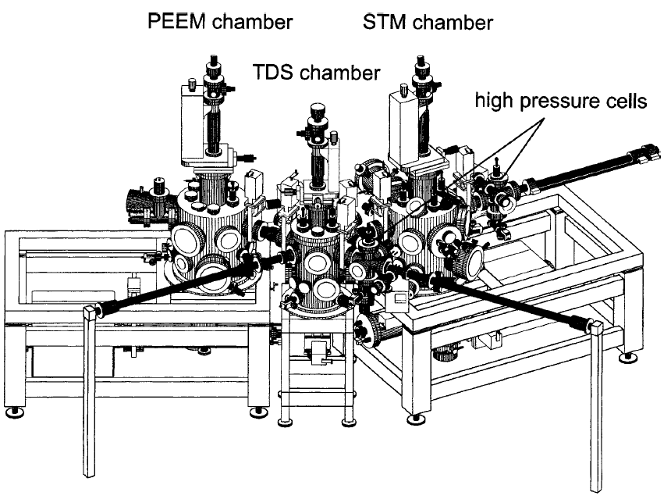
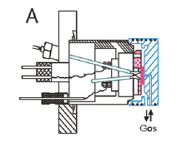
In situ and operando techniques
Example: LEED – low energy electron diffraction

Slide 19
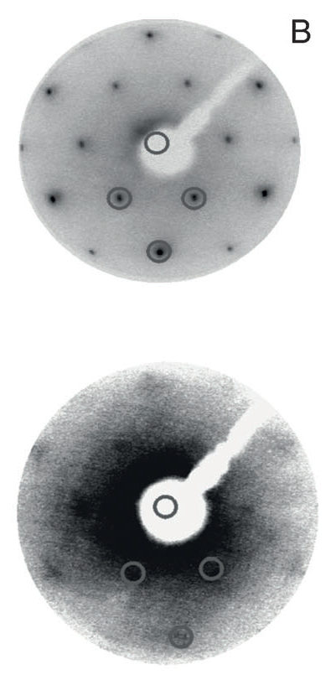
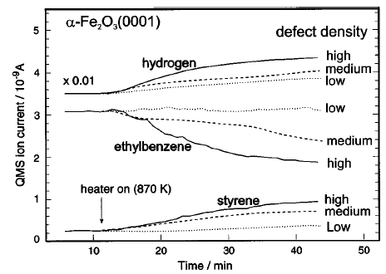
Before catalytic reaction
After catalytic reaction
Initial period, no catalytic activity
Working catalyst

Slide 20
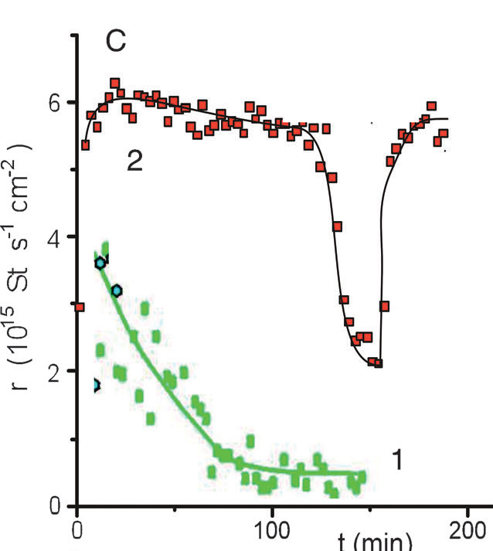
In situ and operando techniques
Example: LEED – low energy electron diffraction
0.5 eq O₂ addition
Active catalyst
Non-crystalline Fe₂O₃
Metastable (Reduction!)
Carbon deposition (Styrene!)
Loss of catalytic activity

Slide 21
In situ and operando techniques
Example: XANES – x-ray absorption near edge structure
Methanol oxidation to formaldehyde over Cu
  25–450 °C, 1 mbar
  Cu in the form of polycrystalline foil
  2 CH₃OH + O₂ → 2 CH₂O + 2 H₂O

Slide 22
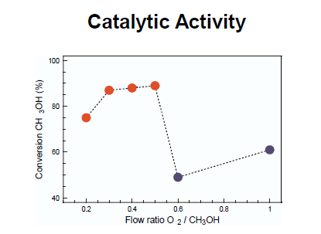
In situ and operando techniques
Example: XANES – x-ray absorption near edge structure
  2 CH₃OH + O₂ → 2 CH₂O + 2 H₂O

Slide 23
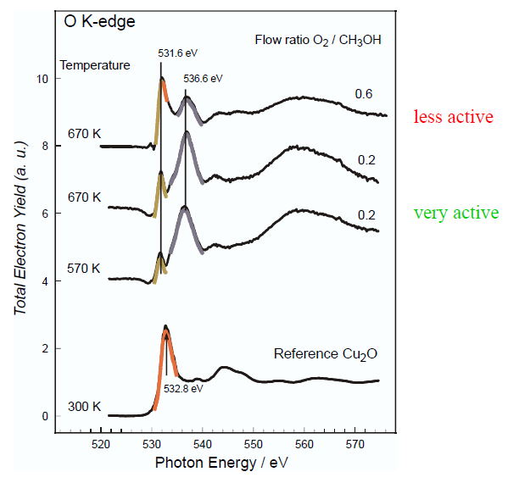
In situ and operando techniques
Example: XANES – x-ray absorption near edge structure
2 oxide and 1 suboxide species

Slide 24
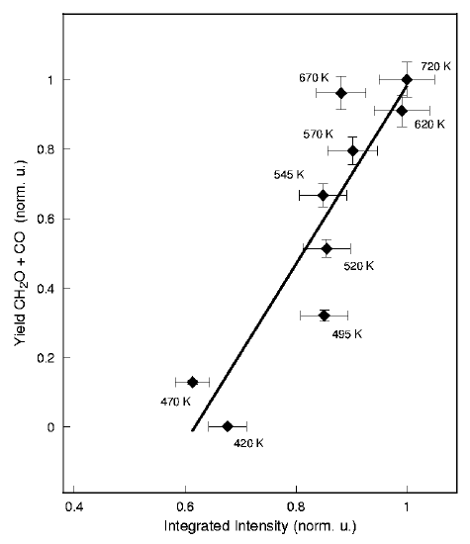
In situ and operando techniques
Example: XANES – x-ray absorption near edge structure
Positive correlation between catalytic activity and Cu suboxide species
Explanation/idea/description of active species: Subsurface oxygen cover by a strained layer of copper atoms
Results confirmed by near ambient pressure XPS (NAP XPS)

Slide 25

In situ and operando techniques
Example: DRIFTS – diffuse reflectance infrared Fourier transform spectroscopy
Coupling of ethanol and acetaldehyde to 1,3- butadiene over Ta doped zeolite
  300 °C, 1 atm
  Well dispersed (virtually isolated) Ta sites
  2 C₂H₅OH + CH₃CHO → C₄H₆ + 2 H₂O

Slide 26
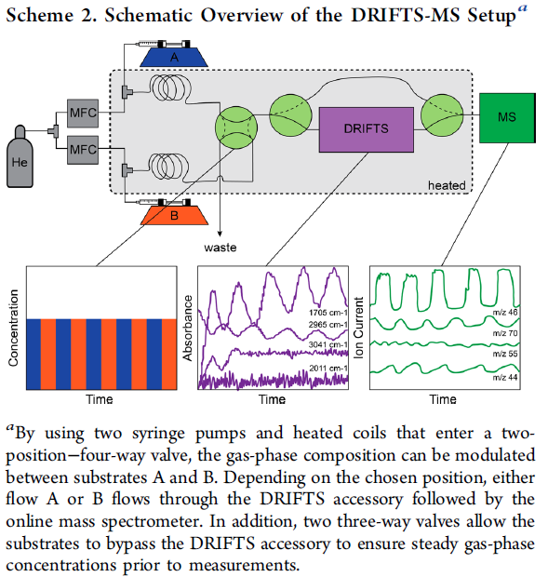
In situ and operando techniques
Example: DRIFTS – diffuse reflectance infrared Fourier transform spectroscopy

Slide 28
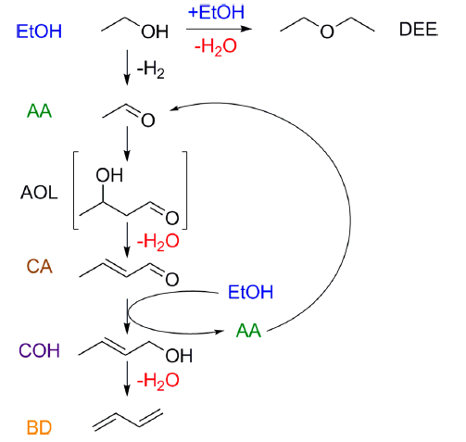
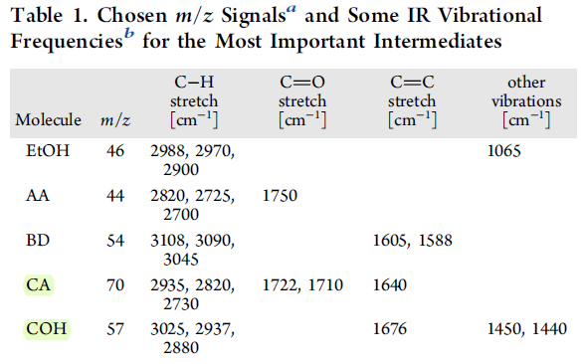
In situ and operando techniques
Example: DRIFTS

Slide 29
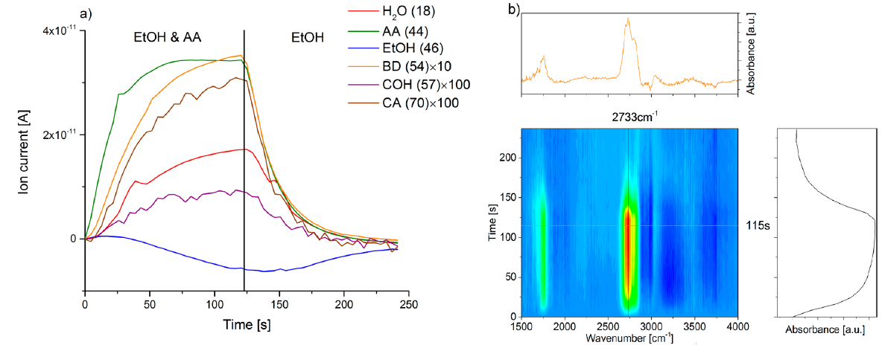
In situ and operando techniques
Example: DRIFTS – diffuse reflectance infrared Fourier transform spectroscopy

