Slide 1
Heterogeneous catalysis
Lecture 8
Haber-Bosch synthesis of ammonia

Slide 2
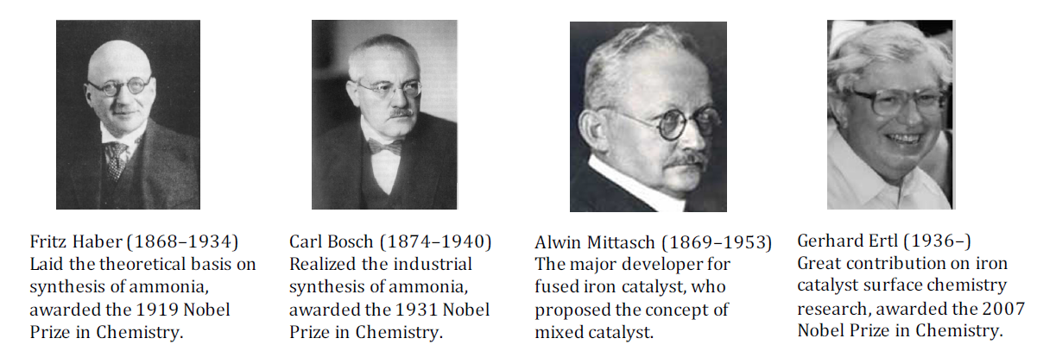
Haber-Bosch synthesis of ammonia
The nitrogen problem – atmospheric N₂ fixation (breaking N≡N bonds)
Fertilizers – modern agriculture feeding billions of people on Earth
176 millions tons ammonia produced in 2016 worldwide
1–2 % of the world‘s entire energy supply; 2–5 % of total natural gas production

Slide 3
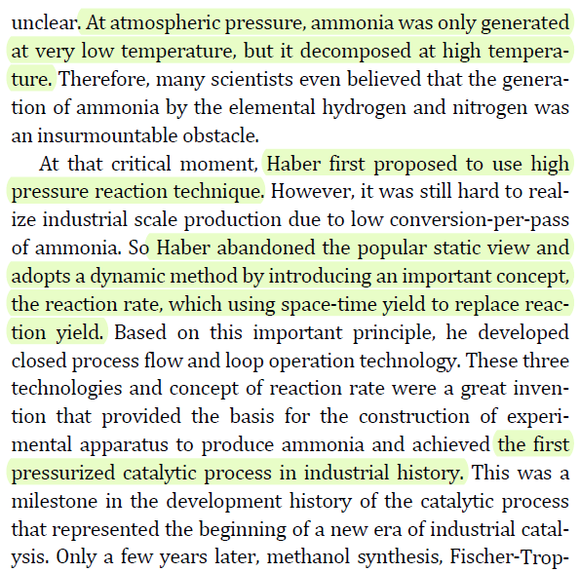

Slide 4
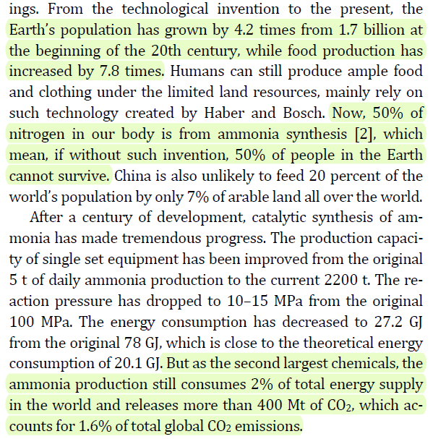

Slide 5
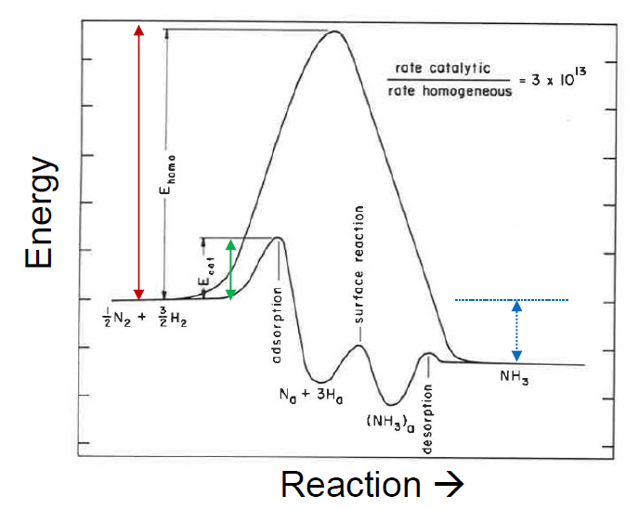
0.5 N₂ + 1.5 H₂ → NH₃ (ΔH₂₉₈ = –46.22 kJ mol^{–1})

Slide 6
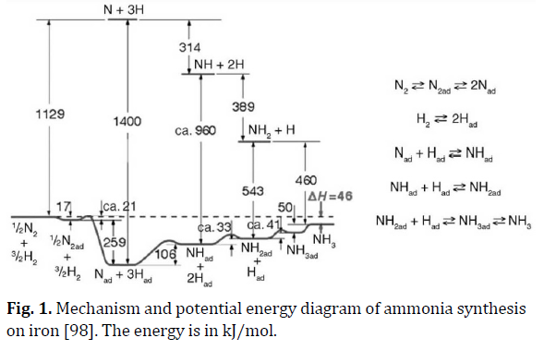
0.5 N₂ + 1.5 H₂ → NH₃ (ΔH₂₉₈ = –46.22 kJ mol^{–1})
Reactions at surfaces: From atoms to complexity; Noble prize lecture 2007; Gerhardt Ertl

Slide 7
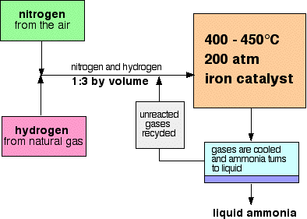
Haber-Bosch synthesis of ammonia
Temperature: a compromise between thermodynamics (exothermic rxn) and kinetics (low rxn rates at low temperatures)
Pressure: a compromise between thermodynamics (Le Chatelier‘s principle) and costs (high pressure reactors)

Slide 8
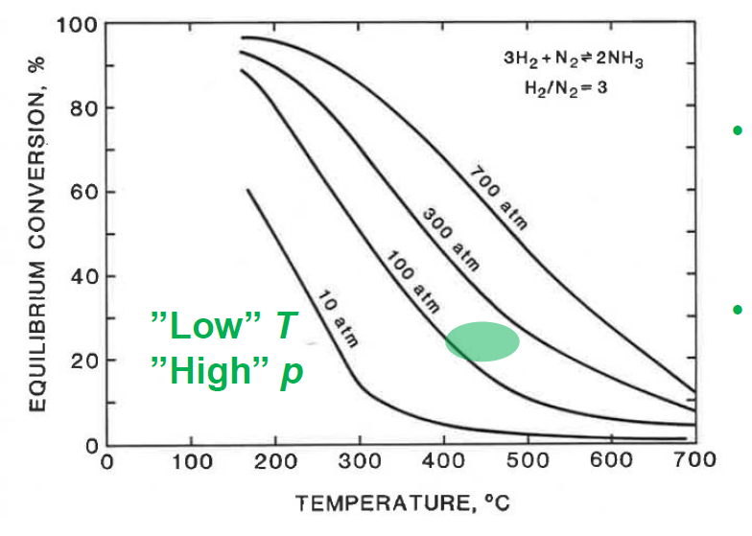
Haber-Bosch synthesis of ammonia
„Low“ temperature – exothermic rxn
High pressure – no. of molecules in gas phase decreases

Slide 9
Haber-Bosch synthesis of ammonia
Catalyst?
  Early 1800s: ammonia decomposition over Fe and other metals is known
  1908, Haber: reaction of hydrogen with nitrogen over catalyts based on Os and U (500 °C, 150–200 atm)
  1908–1922, Bosch and Mittasch (BASF): 2500 different catalyst formulations (almost all elements of PT tried), 6500 runs (already in 1911), finished in 1922 after a total of 22 000 tests (trial-and-error)
  Serendipity: Gallivare magnetite from Sweden (naturally containing K, Ca, and Al as impurities) used as catalyst with excellent results
  1913, BASF: first ammonia production plant, catalyst = „promoted“ Fe

Slide 10
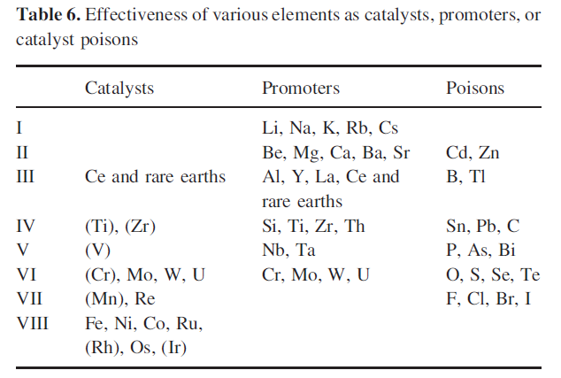
Haber-Bosch synthesis of ammonia
Catalyst?

Slide 11
Haber-Bosch synthesis of ammonia
Catalyst?
  „promoted“ Fe
  Why?
  A third compromise: better results with Ru, Os, but price has to be considered in large-scale industrial processes →Fe
  Moreover Ru suffers from to strong H₂ chemisorption (i.e. H₂ effectively works as catalyst poison, no spot for N₂ chemisorption at high pressures)
  →Fe
  Fe-based catalysts stable up to 15 years time-on-stream
  →Fe

Slide 12
Haber-Bosch synthesis of ammonia
Catalyst?
  1913: Promoted Fe by Mittasch?
  Nowadays: Promoted Fe by Mittasch (only slight changes!)
  Promoted Fe?
  Fe-K₂O-Al₂O₃ (also low amounts of Ca, Mg, Si may occur)
  Commercially available „ammonia catalyst“ is an oxidized form of this formulation based on magnetite (Fe₃O₄-K₂O-Al₂O₃), reduction necessary!
  „structural promoter“ – „porosity stabilizer“
  Activity promoter
  Active component, α-Fe

Slide 13
Haber-Bosch synthesis of ammonia
Fe-K₂O-Al₂O₃, example of composition
BASF S6-10 ammonia catalyst | Fe [at%] | K [at%] | Al [at%] | Ca [at%] | O [at%]
Bulk – unreduced | 40.5 | 0.35 | 2.0 | 1.7 | 53.2
Surface – unreduced (XPS) | 8.6 | 36.2 | 10.7 | 4.7 | 40.0
Surface – reduced (XPS) | 11.0 | 27.0 | 17.0 | 4.0 | 41.0
Surface – cat. active spot (AES)* | 30.1 | 29.0 | 6.7 | 1.0 | 33.2
*Auger electron spectroscopy, similar to EDAX in SEM, comparable results
Ullman‘s Encyclopedia of Industrial Processes; Max Appl; Ammonia, 2. Production processes

Slide 14
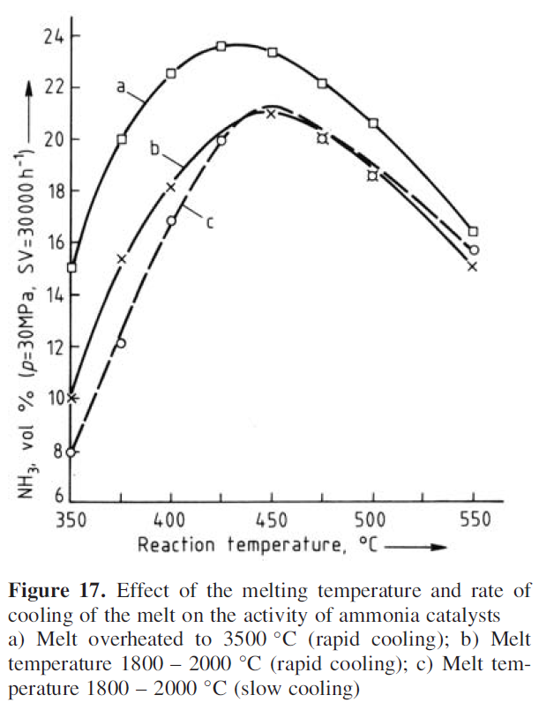
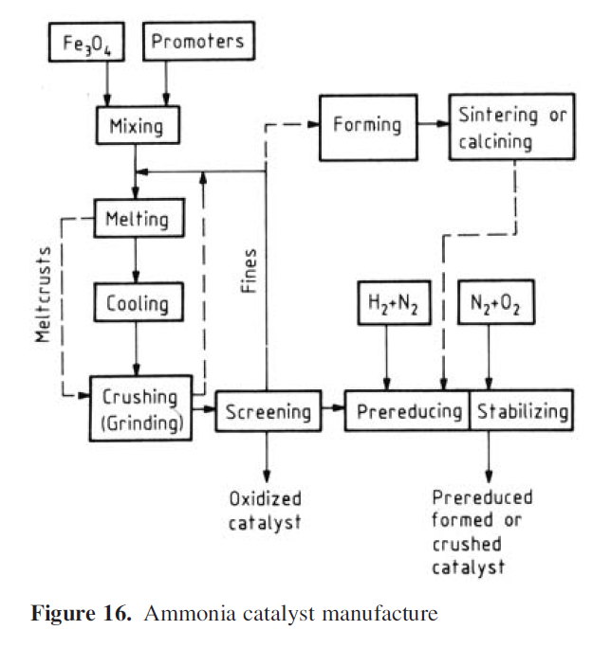
Haber-Bosch synthesis of ammonia
Fe-K₂O-Al₂O₃: Industrial production

Slide 15
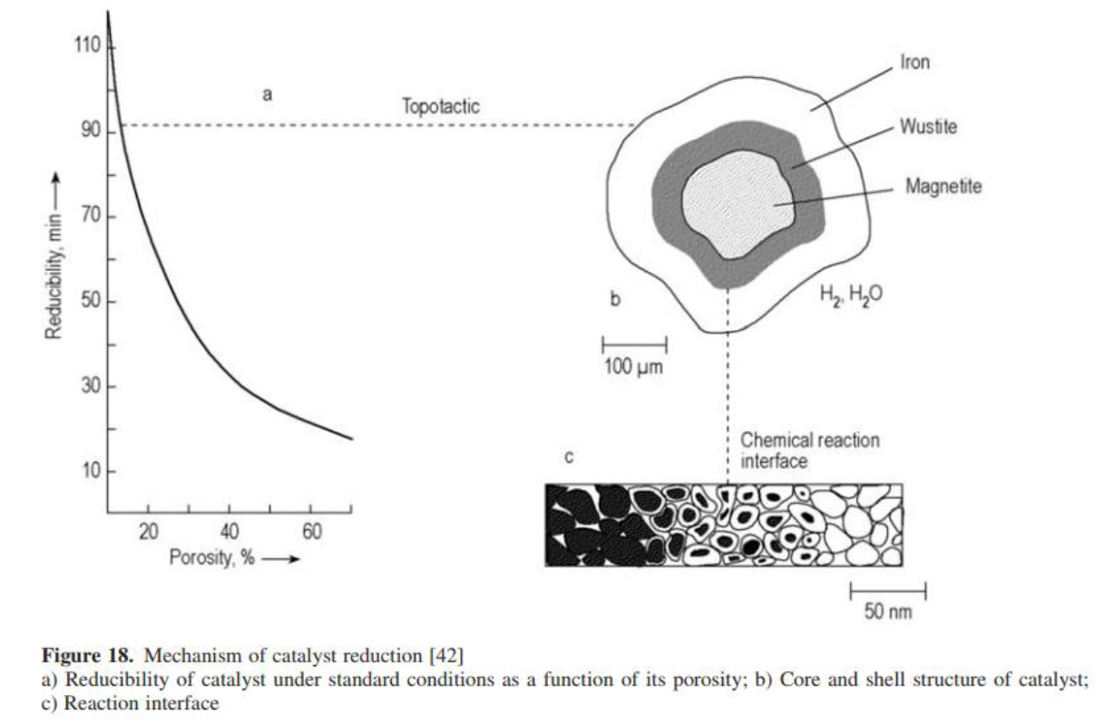
Haber-Bosch synthesis of ammonia
Fe-K₂O-Al₂O₃, reduction before use

Slide 16
Haber-Bosch synthesis of ammonia
Fe-K₂O-Al₂O₃
  30 nm primary crystallites, grain/particle size 6–10 nm
  Pore volume 0.09–0.1 cm³ g^{–1}, bimodal pore size distribution 10 nm and 25–50 nm, surface area ca. 15 m g^{–1}, pores represent 44–46 % of total volume
  Porosity originates in the reduction of originally nonporous Fe₃O₄ and is stabilized by Al₂O₃ (stability against sintering of particles)
Ullman‘s Encyclopedia of Industrial Processes; Max Appl; Ammonia, 2. Production processes

Slide 17
Haber-Bosch synthesis of ammonia
  Fe-K₂O-Al₂O₃
  Why Fe (and Ru and Os) are active???
  Why K improves activity???
  „structural promoter“ – „porosity stabilizer“
  Activity promoter
  Active component, α-Fe

Slide 18
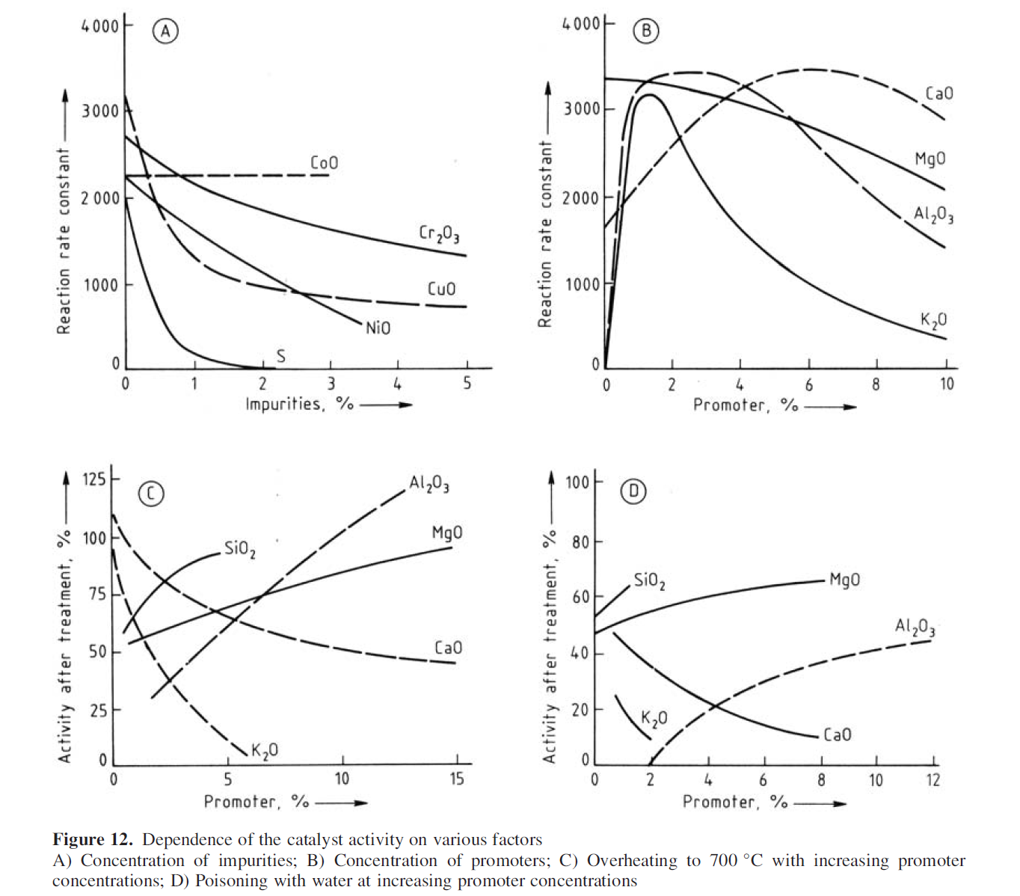

Slide 19
Haber-Bosch synthesis of ammonia
  Fe-K₂O-Al₂O₃
  Why Fe (and Ru and Os) are active???
  Why K improves activity???
  „structural promoter“ – „porosity stabilizer“
  Activity promoter
  Active component, α-Fe

Slide 20
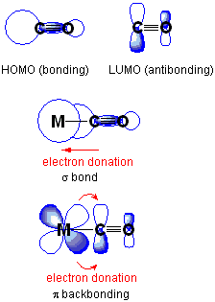
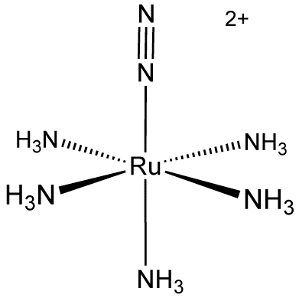
Haber-Bosch synthesis of ammonia
Why Fe, Ru, Os? N₂ as a ligand in complexes!

Slide 21
Haber-Bosch synthesis of ammonia
Why K?
Electropositivity = ability to donate electrons
Basicity (e.g. KOH)
No 1. mechanism: We need to push electrons back to N₂ = weakening of N≡N triple bond
No 2. mechanism: We need to desorb NH₃ from catalyst surface. Basic NH₃ desorbs well from basic surface.

Slide 22
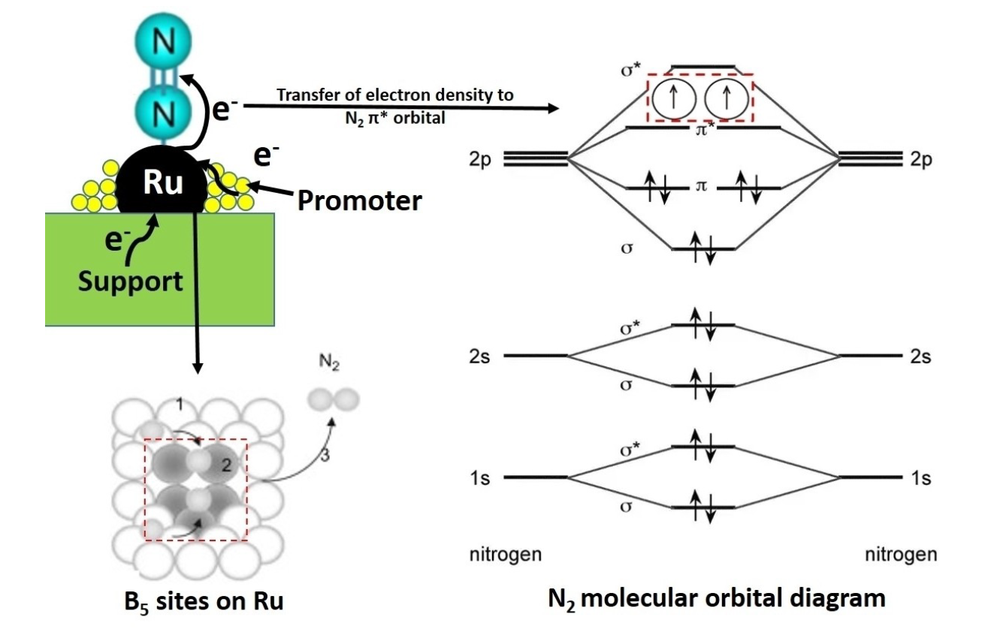
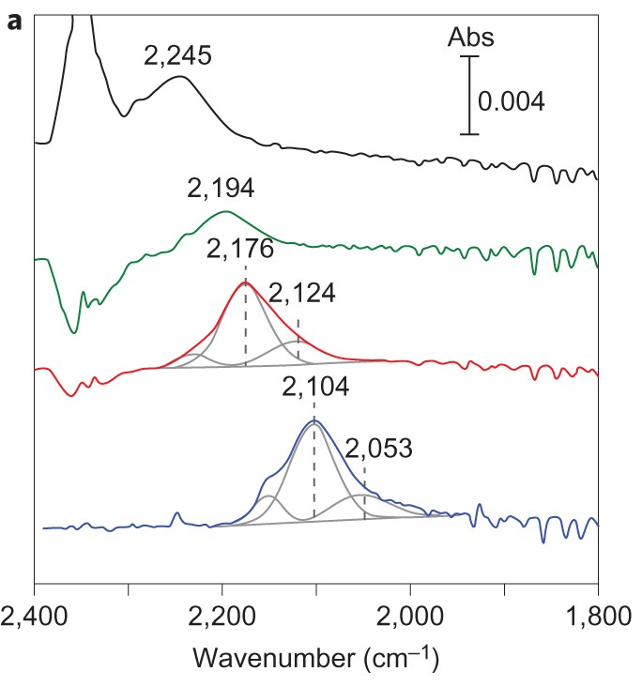
Haber-Bosch synthesis of ammonia
A method to follow the extent of π back e⁻ donation?
doi.org/10.1002/cctc.202001141

Slide 23
Haber-Bosch synthesis of ammonia
Ways of improvement, thorough studies
  Influence of Fe crystal planes
  Back to Ruthenium
  Alloys of metals with strong and weak interaction with N₂
  Electron-donating supports („Electrides“, hydrides, oxides, carbon)
  Metal nitrides as catalyst supports (MvK)
  Electrocatalytic NH₃ synthesis

Slide 24
Haber-Bosch synthesis of ammonia
Fe-K₂O-Al₂O₃: Industrial production

Slide 25
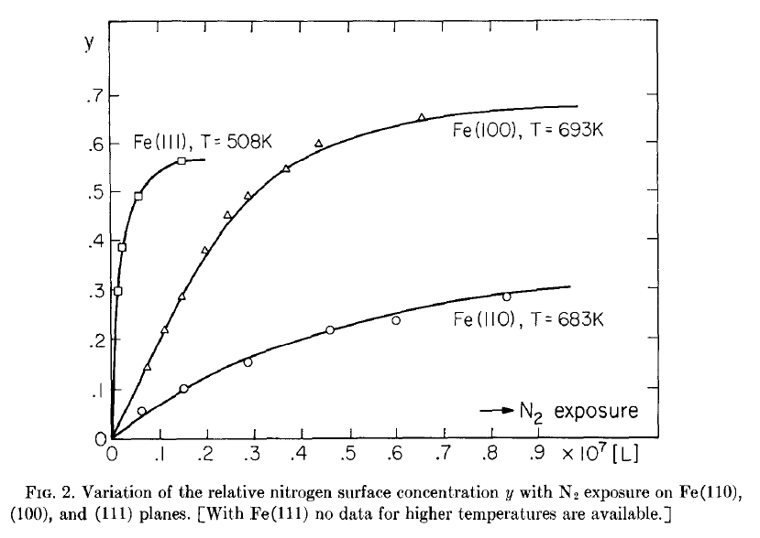
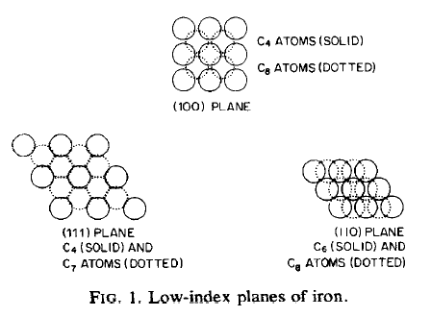

Haber-Bosch synthesis of ammonia
Comparison of catalytic activity on different Fe crystal planes (111 vs. 100 vs. 110)

Slide 26
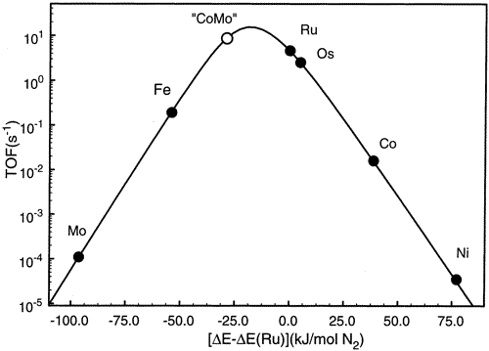

Haber-Bosch synthesis of ammonia
Alloying of metals with strong and weak interaction with N₂
Figure 1 Calculated turnover frequencies for ammonia synthesis as a function of the adsorption energy of nitrogen. The synthesis conditions are 400 °C, 50 bar, gas composition H₂:N₂ = 3:1 containing 5% NH₃.

Slide 27
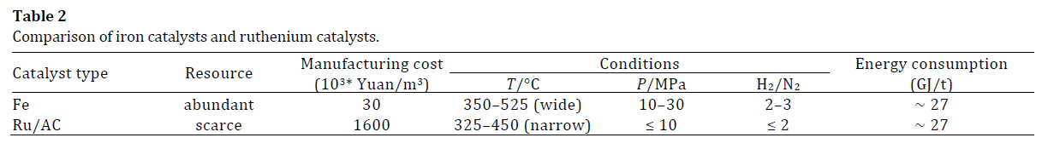
Haber-Bosch synthesis of ammonia
Back to Ruthenium
  Let‘s forget about price (stable and active catalyst will pay back)
  Ru suffers from to strong H₂ chemisorption (i.e. H₂ effectively works as catalyst poison, no spot for N₂ chemisorption at high pressures)
  In 1992 new catalyst patented: Ru-Ba-K/C (British Petroleum); minor but industrial use
  New activity benchmark for catalytic studies

Slide 28
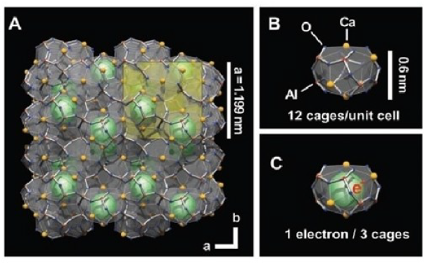
Haber-Bosch synthesis of ammonia
Electron donating catalyst supports („Electrides“)
  E.g. Mayenite: 12CaO.7Al₂O₃
  2x12CaO.7Al₂O₃ + 4 H₂ → [Ca₂₄Al₂₈O₆₄]⁴⁺.4(H⁻) + 2 H₂O
  2x12CaO.7Al₂O₃ + 2 Ca → [Ca₂₄Al₂₈O₆₄]⁴⁺.4(e⁻) + 2 CaO
Science 301 (5633), 626-629.

Slide 29
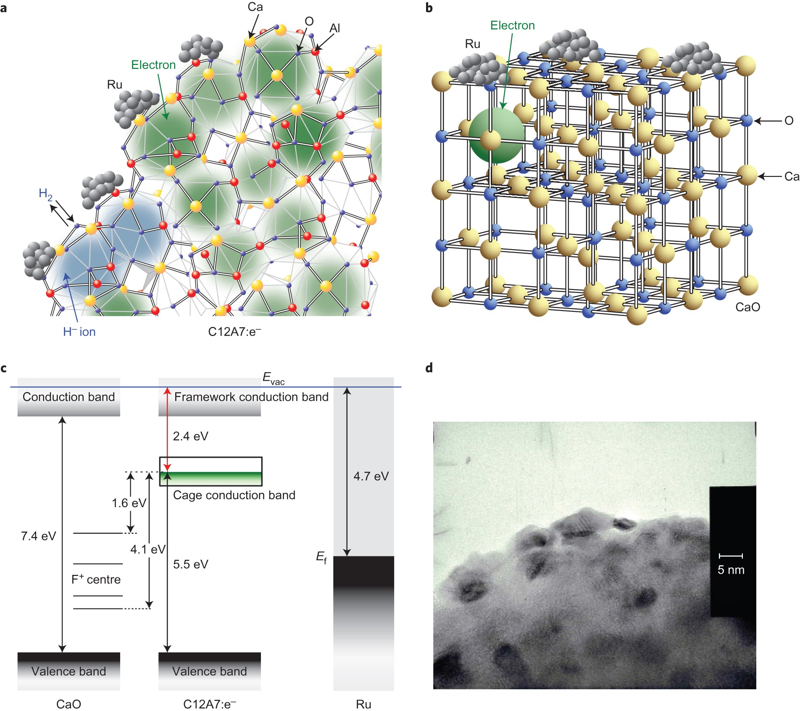
Haber-Bosch synthesis of ammonia
Electron donating catalyst supports („Electrides“)
  E.g. Mayenite: 12CaO.7Al₂O₃
  2x12CaO.7Al₂O₃ + 4 H₂ → [Ca₂₄Al₂₈O₆₄]⁴⁺.4(H⁻) + 2 H₂O
  2x12CaO.7Al₂O₃ + 2 Ca → [Ca₂₄Al₂₈O₆₄]⁴⁺.4(e⁻) + 2 CaO

Slide 30
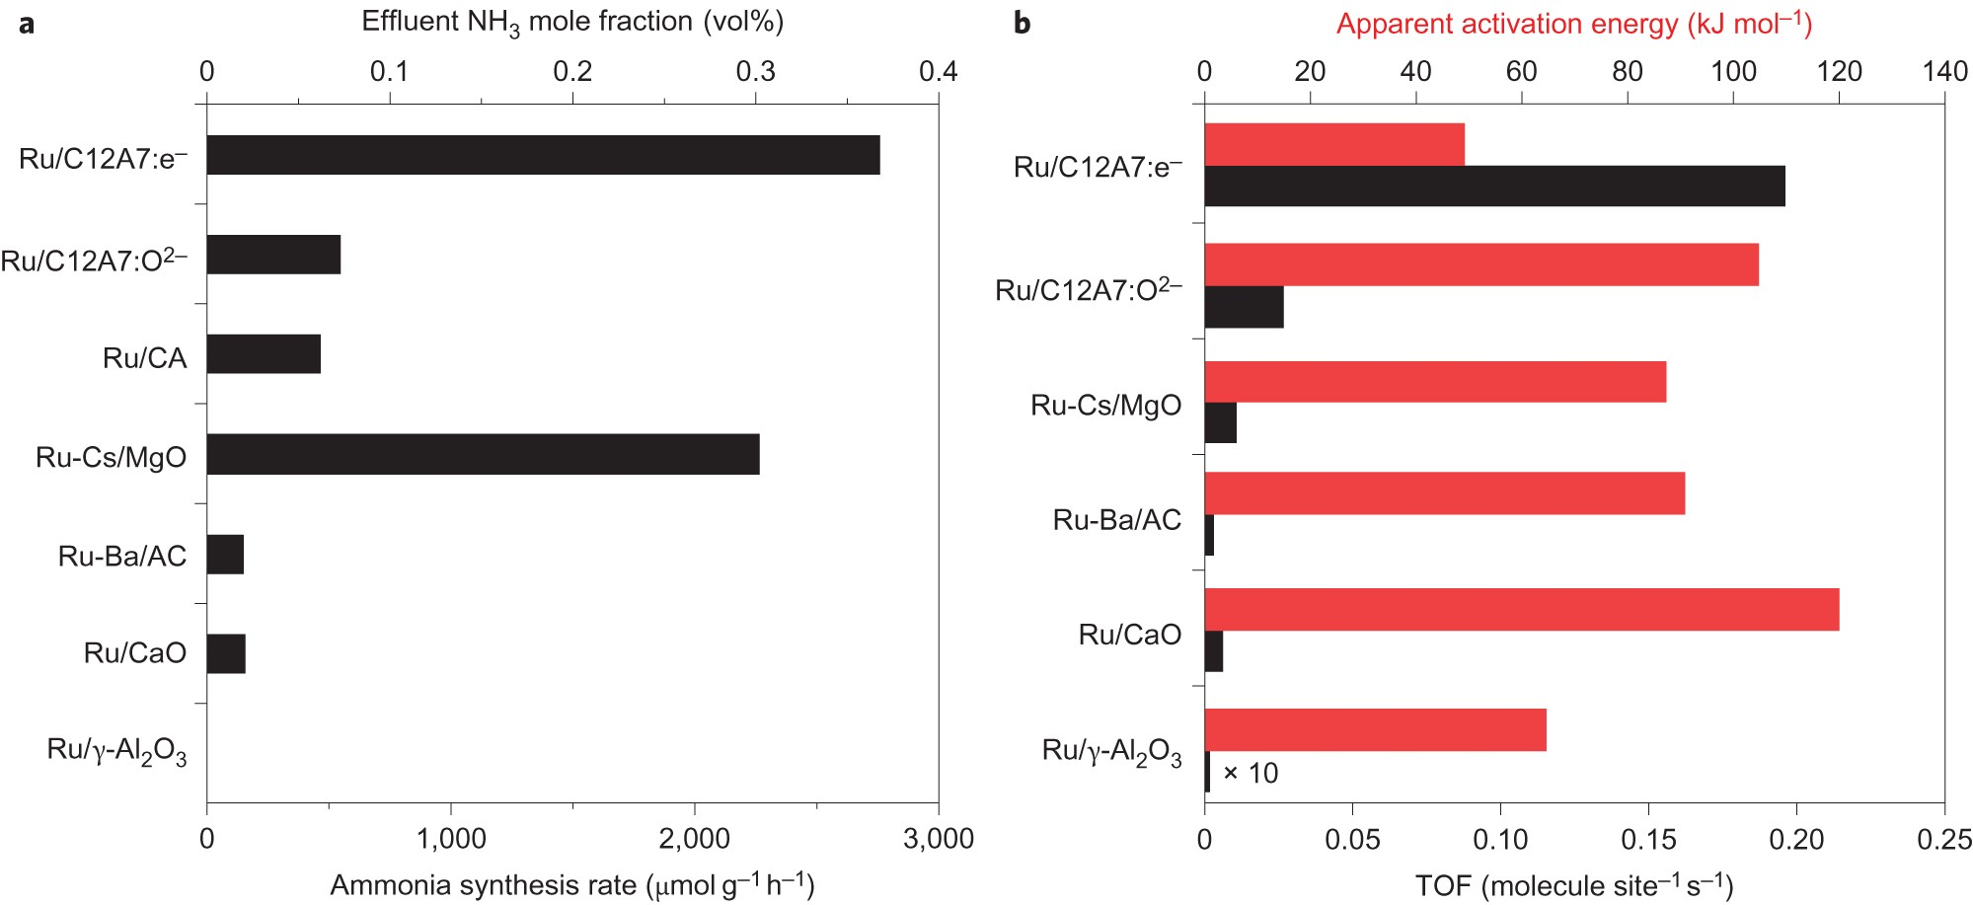
Haber-Bosch synthesis of ammonia
Electron donating catalyst supports („Electrides“)
  Ru/[Ca₂₄Al₂₈O₆₄]⁴⁺.4(e⁻): N≡N triple bond dissociation is not a rate determining step anymore!
  N−H bond formation becomes RDS
Nature 2012
DOI: 10.1038/NCHEM.1476

Slide 31
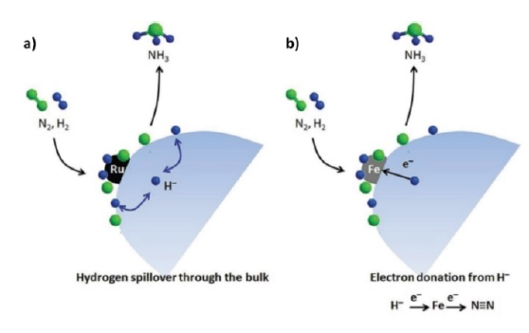
Haber-Bosch synthesis of ammonia
Electron donating catalyst supports (Hydrides)
  LiH, CaH₂, TiH₂, CaFH, Ca₂NH, BaCeO_{3-x}N_{y}H_{z}
  H⁻ are strongly electron donating species
  Moreover, they can release some H⁻ ion from the lattice and refill it with hydrogen from H₂ in the reaction mixture
  Deactivation: Highly reactive hydrides (e.g. LiH) form surface layer of imides and nitrides = deactivation. Some extra hydrogen needed to prevent it.
doi.org/10.1002/cctc.202001141

Slide 32
Haber-Bosch synthesis of ammonia
Electron donating catalyst supports (others)
  Oxides based mostly reduced CeO₂
  Carbon

Slide 33
Haber-Bosch synthesis of ammonia
Metal nitrides
  Nitrogen can be released from their lattice and later on refilled from N₂ in the reaction mixture (MvK)
  Fe, Mo: Strong N₂ chemisorption. Formation of Fe, Mo nitrides in situ?

Slide 34
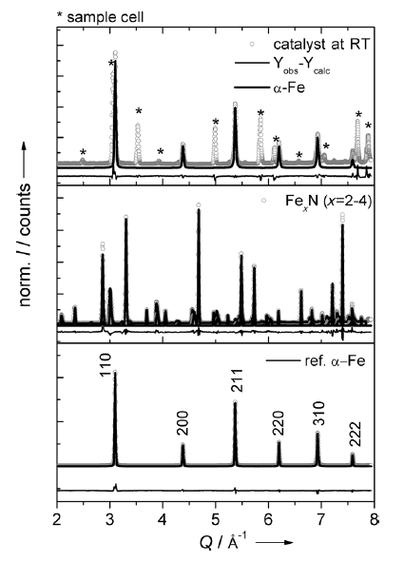
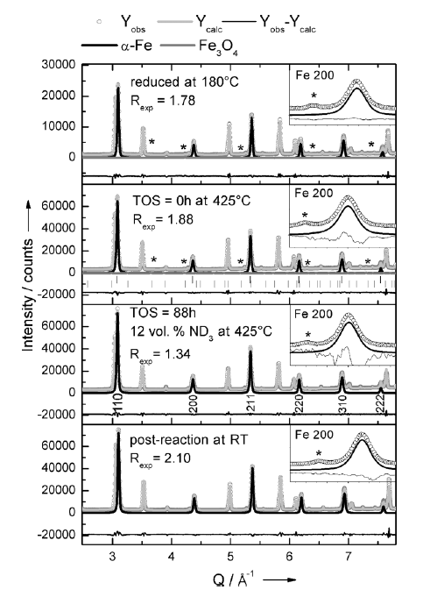
Haber-Bosch synthesis of ammonia
Metal nitrides
  promoted Fe, the industrial catalyst: Big question!
  Nitridation of Fe by NH₃ known from steel industry (steel hardening)
  Thermodynamic data suggest Fe nitrides stable at H-B rxn conditions
Iron nitrides
NOT
observed in bulk!
Surface?
Post catalytic run neutron diffraction
In situ run neutron diffraction

Slide 35
Haber-Bosch synthesis of ammonia
Metal nitrides
  Mo? Its interaction with N₂ even stronger than in Fe!
  Mo nitrides formation observed!
  CoMo alloy? Co₃Mo₃N!

Slide 36
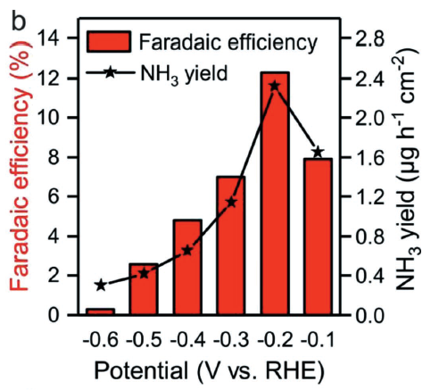
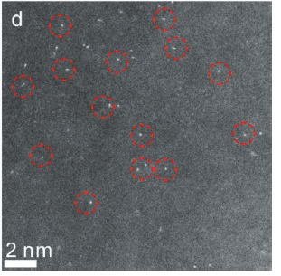

Electrocatalytic NH₃ synthesis
Single Au atoms deposited on N-doped graphene layers

Slide 37
Enzymatic N₂ fixation and its transformation to NH₃
Nature
  Nitrogenase
  RT
  Ambient pressure
  It works! And much better than all our „tailored“ catalysts.

