Slide 1
Heterogeneous catalysis
Lecture 9
Zeolites in oil refinement

Slide 2
Zeolites - synthesis
Reaction mixture: …, …, …, …
  pH adjustment, (gelation)
  Hydrothermal treatment in an autoclave
  …
  …
Result: H-zeolite (Brønsted acidic with H⁺ ions)

Slide 3
Zeolites - synthesis
Reaction mixture: Na₂SiO₃, Al₂O₃, quarternary ammonium salt (=structure directing agent), water
  pH adjustment, (gelation)
  Hydrothermal treatment in an autoclave
  Ion exchange (Na⁺ for NH₄⁺)
  Calcination (= NH₃ removal)
Result: Crystalline H-zeolite (Brønsted acidic with H⁺ ions)

Slide 4
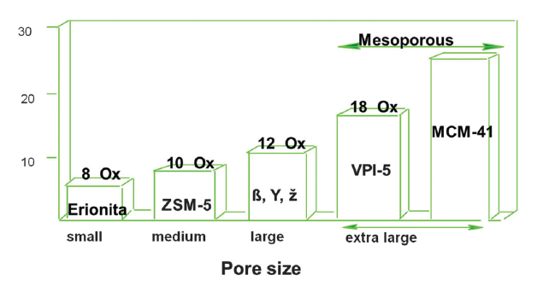
Zeolites - synthesis
Pore size
Si/Al ratio ≥ 1
DOI: 10.1039/c3cs60394f

Slide 5
Zeolites - acidity
Brønsted: …
  Structure:
Lewis: …
  Structure:

Slide 6
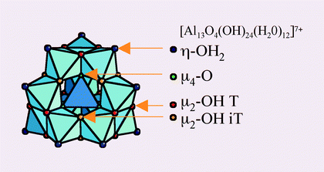
Zeolites - acidity
Brønsted: negative charge of the aluminosilicate net balanced by strongly acidic protons
  Structure:
Lewis: Al atoms that are not embedded in the aluminosilicate net (e.g. surface species, amorphous stuff, alumina particles) = extraframework aluminum species (EFAL)
  Structure:
    H⁺

Slide 7
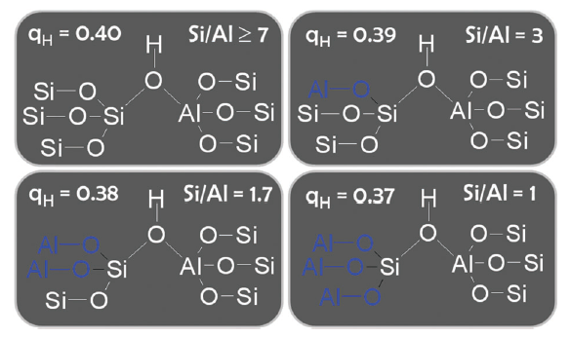
Zeolites - acidity
Brønsted: depends on the second coordination sphere (i.e. Si/Al ratio)
Lewis: Extraframework aluminum species (EFAL) depends on
  Si/Al ratio
  Aging (time on stream, steaming)
  Can be washed out (depending on pH – acid washing)

Slide 8
Zeolites - acidity
High Si/Al ratio
  Strong Brønsted acid sites
  Weak Brønsted acid sites
  Strong Lewis acid sites
  Weak Lewis acid sites
Low Si/Al ratio
  Strong Brønsted acid sites
  Weak Brønsted acid sites
  Strong Lewis acid sites
  Weak Lewis acid sites

Slide 9
Zeolites - acidity
High Si/Al ratio
  Strong Brønsted acid sites
  Weak Brønsted acid sites
  Strong Lewis acid sites
  Weak Lewis acid sites
Low Si/Al ratio
  Strong Brønsted acid sites
  Weak Brønsted acid sites
  Strong Lewis acid sites
  Weak Lewis acid sites

Slide 10
Zeolites - acidity
Confinement effect
Superacidity
  Various probes at RT – acid site strength similar to 70 % H₂SO₄ (=NO!)
  Ability to protonate hydrocarbons at working conditions (=YES!)
  ?

Slide 11
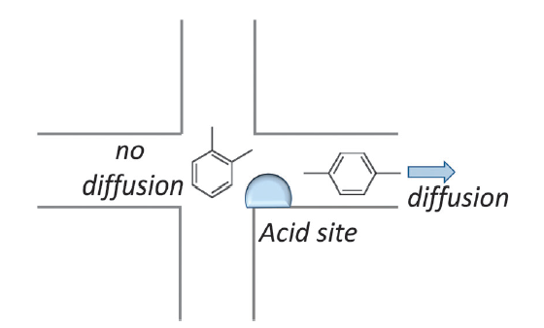
Zeolites – diffusion/shape selectivity
Diffusion
  Big difference between zeolites with 8 membered vs. 12 membered ring pore openings
  Big difference between zeolites with 1D, 2D, and 3D-connected pore structure
Shape selectivity
DOI: 10.1039/c3cs60394f

Slide 12
Zeolites in oil refinement
Fluid catalytic cracking
Isobutane-butene alkylation
Reforming (+ steam reforming)
Hydrocracking
Linear paraffin isomerization
DOI: 10.1039/c3cs60394f

Slide 13
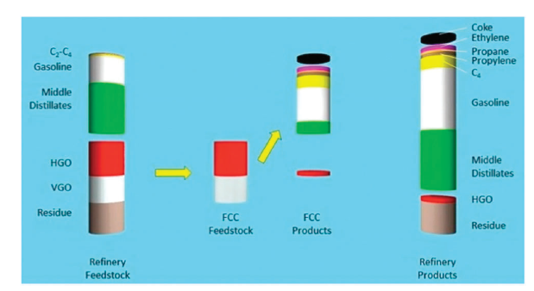
Zeolites in oil refinement
Fluid catalytic cracking

Slide 14
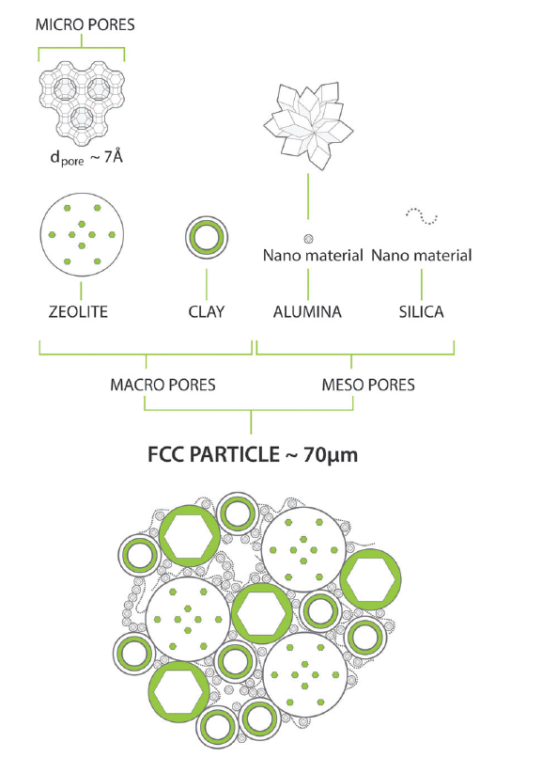
Zeolites in oil refinement
Fluid catalytic cracking
  Zeolite Y 10-50 wt%
  Binders 50-90 wt%
  At the beginning – AlCl₃
  Addition of HZSM-5

Slide 15
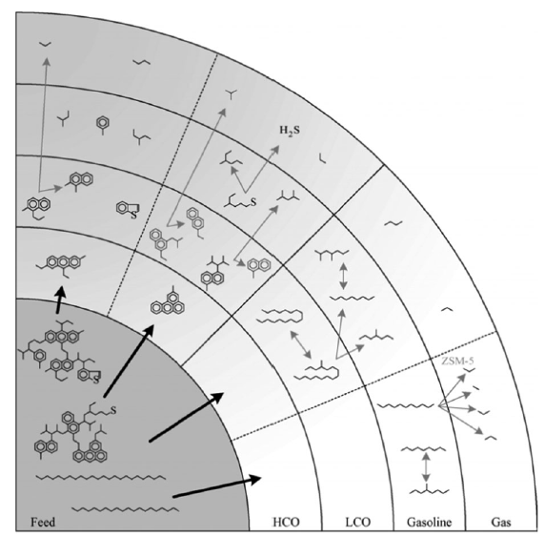
Zeolites in oil refinement
Fluid catalytic cracking
  Shortening of long linear hydrocarbons
  Isomerization to branched hydrocarbons
  „Aromatization“
  HZSM-5 for higher propylene production

Slide 16
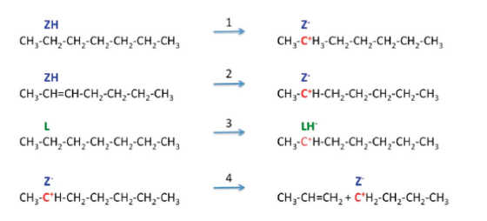
Zeolites in oil refinement
Fluid catalytic cracking
  Protonation + protolytic cracking
  H⁻ abstraction + β scission

Slide 17
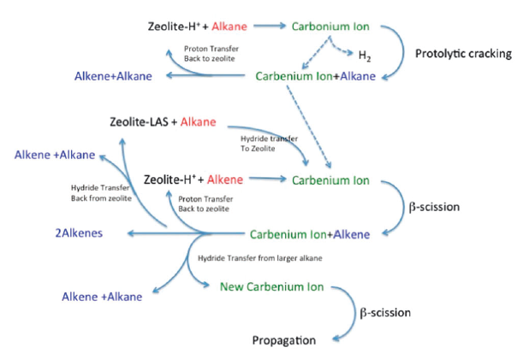
Zeolites in oil refinement
Fluid catalytic cracking
  Protonation + protolytic cracking
  H⁻ abstraction + β scission

Slide 18
Zeolites in oil refinement
Fluid catalytic cracking
  Protonation + protolytic cracking
    We need strong Brøsted acid sites (zeolite Y)
  H⁻ abstraction + β scission
    We need strong Lewis acid sites (steamed/(acid washed) zeolite Y)
  Long linear hydrocarbons diffusion
    Precracking on alumina and silica-alumina (non-innocent binders)
    Hierarchical porosity in zeolites (steamed/(acid washed) zeolite Y)

Slide 19
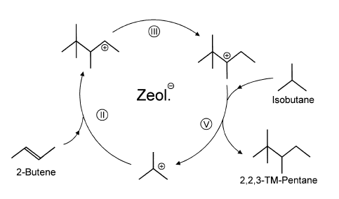

Zeolites in oil refinement
Isobutane-butene alkylation
  We want highly branched C8 hydrocarbons (high octane number)
  HF and H₂SO₄ catalyzed alkylation still running in industry
  Large pore zeolites as a substitution

Slide 20
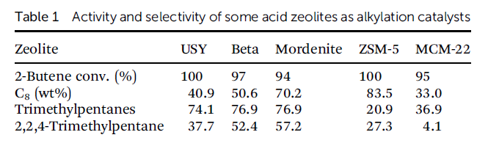
Zeolites in oil refinement
Isobutane-butene alkylation
  Large pore zeolites as a substitution
  BUT! 2-butene dimerization…oligomerization…coking…deactivation

Slide 21
Zeolites in oil refinement
Linear paraffin isomerization
  Linear C8 (C7) → branched C8 (C7)
  Requires strong Brønsted acidity and hydrogenation/dehydrogenation activity (Pt(Ni) on mordenite)
  Mordenite – large pore, monodirectional pores
  Mordenite – dealuminated (strong H⁺), acid washed (low EFAL)
  Protonation = carbocations
  Stability of carbocations? Branched hydrocarbons?

Slide 22
Zeolites in oil refinement
Linear paraffin isomerization
  Pt(Ni) on mordenite
  How do we deposit Pt on a zeolite? (Lecture 3)

Slide 23
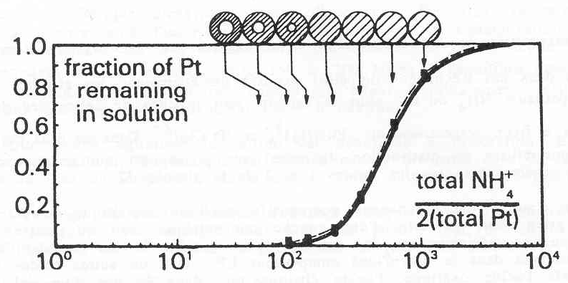
Zeolites in oil refinement
Linear paraffin isomerization
  Pt, Pd, Ni on mordenite
  Electrostatic interaction = Ion exchange
    Competitive ion exchange
    [NH₄⁺]

Slide 24
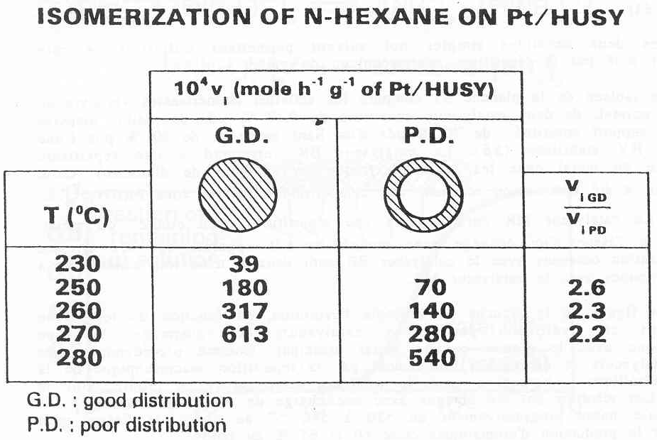
Zeolites in oil refinement
Linear paraffin isomerization
  Pt, Pd, Ni on mordenite
  Electrostatic interaction = Ion exchange
    Competitive ion exchange

Slide 25
Zeolites in oil refinement
Hydrocracking (i.e. cracking in the presence of H₂)
  Shortening of long hydrocarbons
  From linear to branched (alkylation, carbocations,…)
  Hydrogenation/dehydrogenation
  Pt, Pd on mordenite (also zeolite Y and β)

Slide 26
Zeolites in oil refinement
Reforming and steam reforming
  Cyclization, isomerization of cyclic compounds to cyclohexene, cyclohexene and its derivatives dehydrogenation to benzene, toluene, xylene (BTX), and other aromatics
  H₂ as a useful „by-product“
  Pt on high surface area support, non-acidic
  Reforming in the presence of H₂O = H₂ production

