Slide 1
Exprimované geny a přírodní selekce
Produkty funkčních genů a jejich význam v ekologických studiích

Slide 2
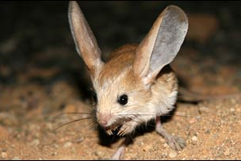
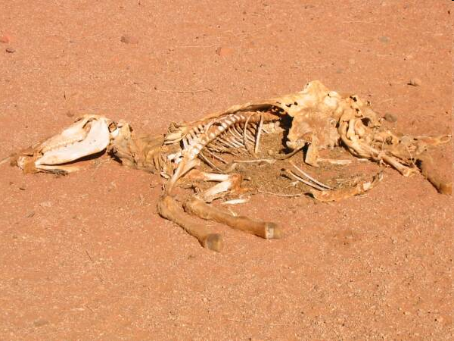
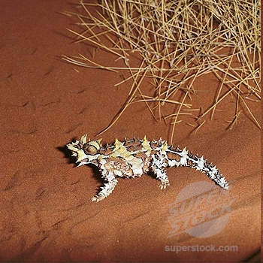
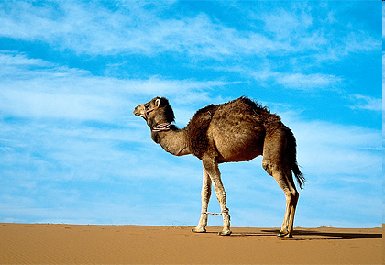
Geny a adaptace
studium selekčních tlaků daných prostředím a evoluční odpovědi na ně → vznik adaptací, tj. geneticky podmíněné přizpůsobení se prostředí (vs. fenotypová plasticita)
např. interakce s abiotickým prostředím

Slide 3
Proč geny v molekulární ekologii?
Geny mají funkční význam – geneticky determinovaný polymorfismus
-> studium proximátních mechanismů
Př.: Proč je samec hýla rudého červeně zbarven?
ultimátní vysvětlení – aby se líbil samicím a zplodil s nimi více potomků
proximátní vysvětlení – protože karotenoidy získané z potravy ukládá více do peří a méně je používá v imunitní odpovědi (protože má dobré geny)

Slide 4
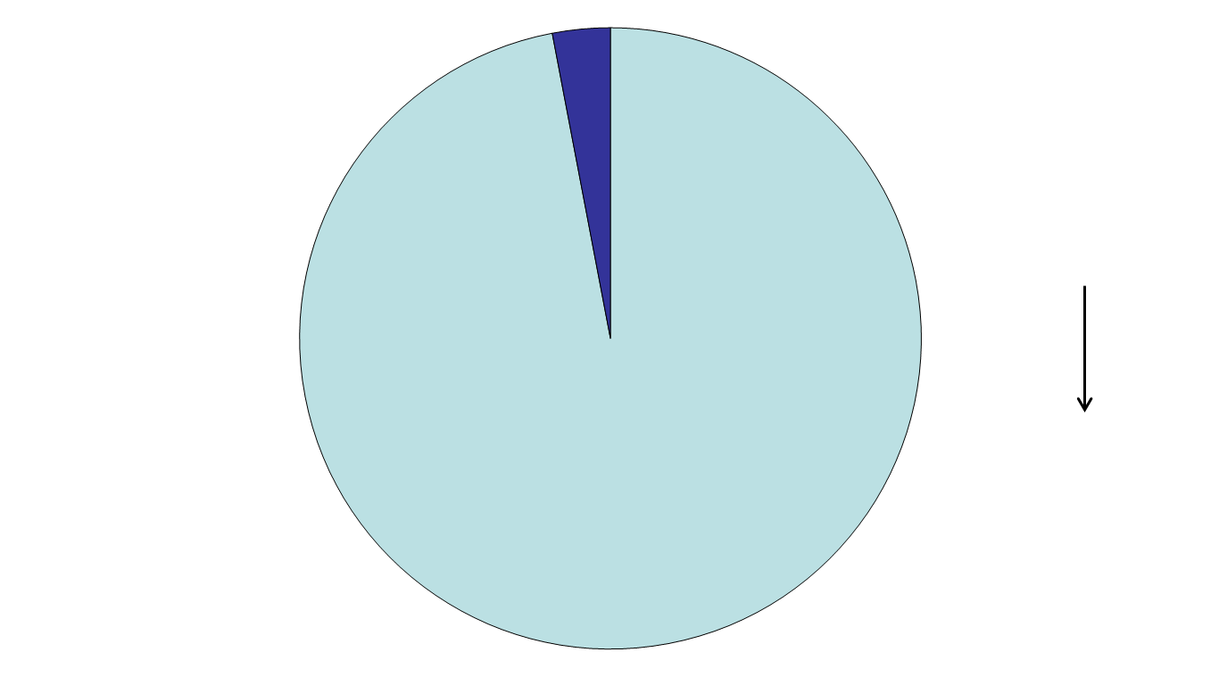
Funkční vs. neutrální genetická variabilita
kódující DNA = funkční geny
fenotyp
přírodní výběr
nekódující DNA (repetice, pseudogeny, introny atd.)
adaptace ke specifickému prostředí
97% lidské DNA nic nekóduje!!!

Slide 5
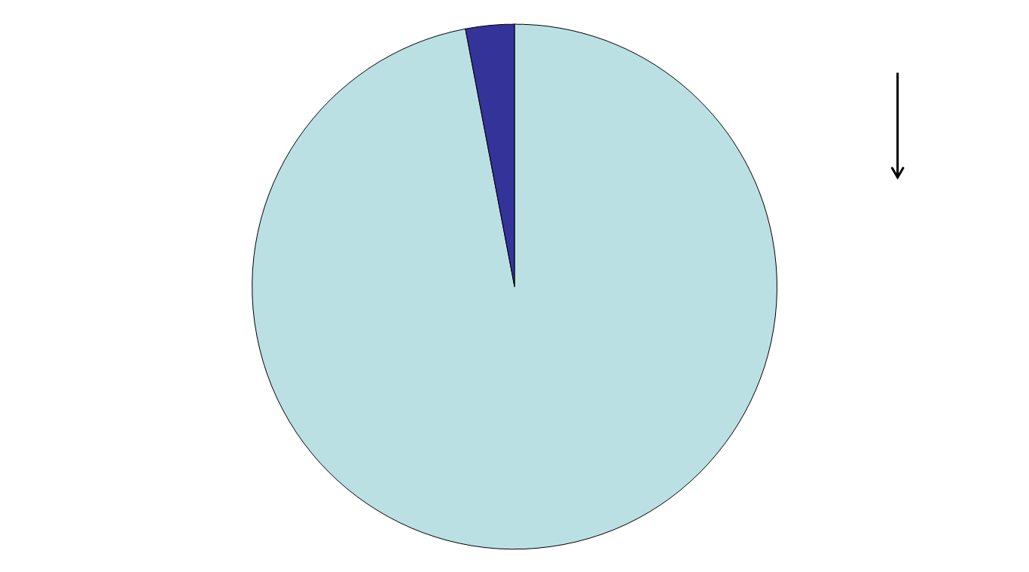
Jak relevantní je informace získaná z genetických dat
Příklad: 10 microsatelitů = „neutrální znaky“
populačně-genetická struktura
inbreeding
bottleneck
adaptace
proximátní evoluční mechanismy
a priori neutrální k působení přírodního výběru

Slide 6
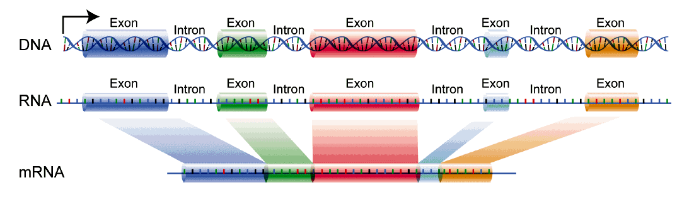
Struktura genů
Exons → protein coding, under selection
Introns → non-coding, neutral
Intergenic regions → non-coding, neutral
Notes:
The first two are as said the motors generating variation. The remaining ones are what happens in populations. Shapes variation and reshuffels variation. Their relative importance determines what happens to new variants in populations.
The study of allele frequency changes induced my them is the domain of population genetics. But of course all of them are reflected also in DNA sequence, and all of them can be studies using phylogenetic methods.
he sequence data we look at is influenced by all of them, and depending on the application we have to consider some of them that we are not even interested in, in order to not falsely interpret results.
In the following I’ll go into applications. And will refer to which assumptions we make in which case, and how we have to take these factors into account.

Slide 7
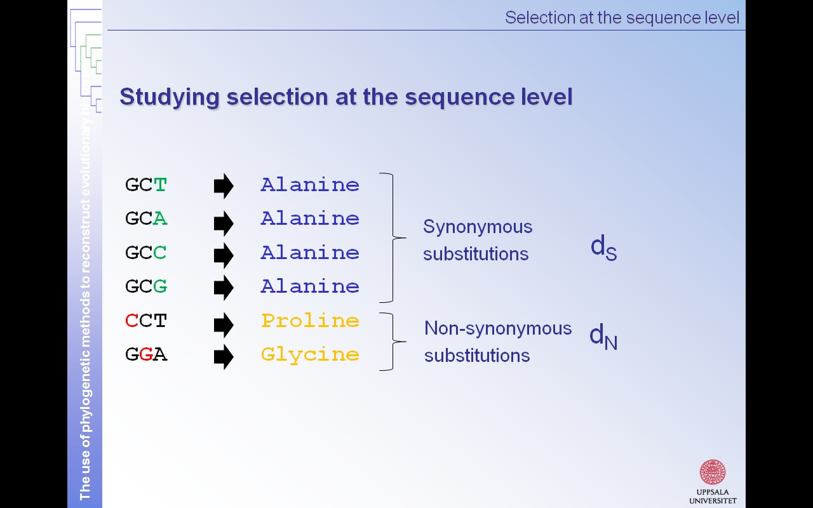
Degenerovaný genetický kód
3rd position evolves neutrally
→ 1st and 2nd position under selection
Notes:
The first two are as said the motors generating variation. The remaining ones are what happens in populations. Shapes variation and reshuffels variation. Their relative importance determines what happens to new variants in populations.
The study of allele frequency changes induced my them is the domain of population genetics. But of course all of them are reflected also in DNA sequence, and all of them can be studies using phylogenetic methods.
he sequence data we look at is influenced by all of them, and depending on the application we have to consider some of them that we are not even interested in, in order to not falsely interpret results.
In the following I’ll go into applications. And will refer to which assumptions we make in which case, and how we have to take these factors into account.

Slide 8
Jak poznat, že na daný gen působí selekce?
Fylogenetická analýza (detekce na úrovni sekvencí)
Populačně-genetická analýza (detekce na úrovni frekvence alel)
Notes:
First polymorphisms are segregating within species. After speciation the gene-flow is usually interrupted. Thus the evolution is uncoupled, and mutation, drift and selection happen independently in both taxa. Over time, the polymorphisms (can) get species specific. It is the accumulation of

Slide 9
Jak poznat, že na daný gen působí selekce?
Gene-tree versus species tree
Gene tree
Species tree
population split
speciation complete
A
B
Studium selekce – fylogenetická analýza
Notes:
First polymorphisms are segregating within species. After speciation the gene-flow is usually interrupted. Thus the evolution is uncoupled, and mutation, drift and selection happen independently in both taxa. Over time, the polymorphisms (can) get species specific. It is the accumulation of

Slide 10
Studium selekce – fylogenetická analýza
Gene-tree versus species tree
Gene 1
Gene 2
A
B
C
A
B
C
A
B
C
Notes:
The two genes show incongruencies. Still, if you imagine many species and many gene-trees, they will have common signals corresponding to species. There is a growing number of methods to estimate species trees from gene-trees. It is here that certain population processes come into play!

Slide 11
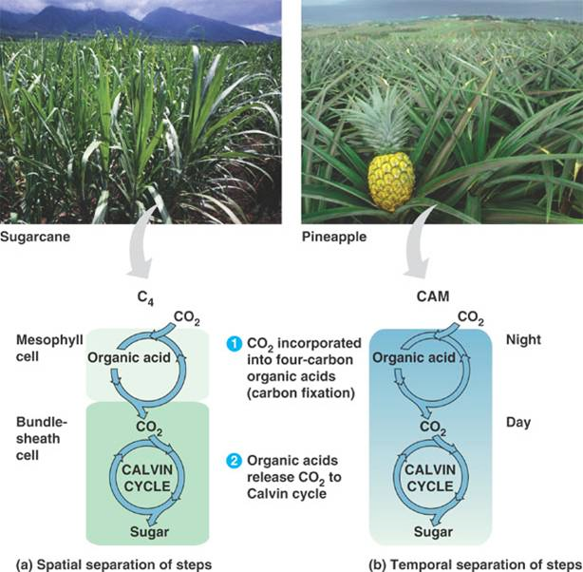
Studium selekce – fylogenetická analýza
Gene-trees & Selection: The case of C4 photosynthesis
Christin et al. 2007, Curr Biol
PEPC gene
→C4 photosynthesis
Notes:
The first two are as said the motors generating variation. The remaining ones are what happens in populations. Shapes variation and reshuffels variation. Their relative importance determines what happens to new variants in populations.
The study of allele frequency changes induced my them is the domain of population genetics. But of course all of them are reflected also in DNA sequence, and all of them can be studies using phylogenetic methods.
he sequence data we look at is influenced by all of them, and depending on the application we have to consider some of them that we are not even interested in, in order to not falsely interpret results.
In the following I’ll go into applications. And will refer to which assumptions we make in which case, and how we have to take these factors into account.

Slide 12
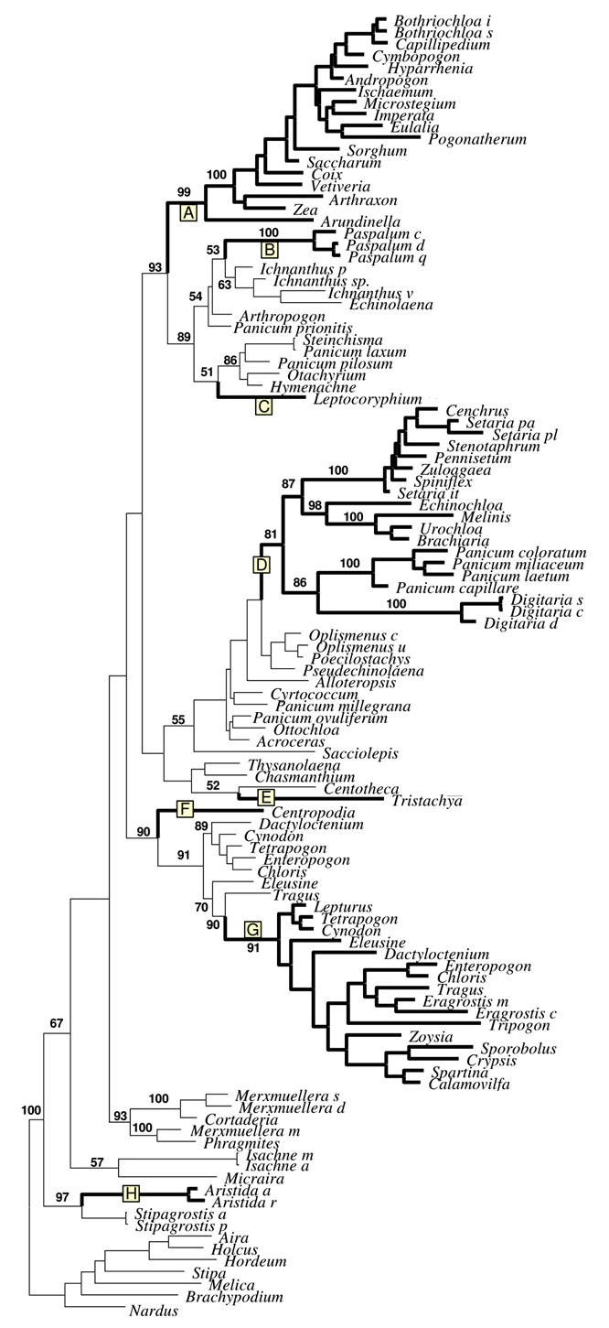
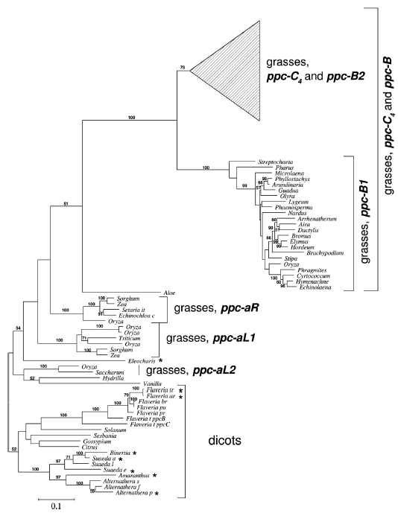
species-tree
◄intronic sequences
gene-tree
coding sequences►
Y
x
Christin et al. 2007, Curr Biol
Notes:
The first two are as said the motors generating variation. The remaining ones are what happens in populations. Shapes variation and reshuffels variation. Their relative importance determines what happens to new variants in populations.
The study of allele frequency changes induced my them is the domain of population genetics. But of course all of them are reflected also in DNA sequence, and all of them can be studies using phylogenetic methods.
he sequence data we look at is influenced by all of them, and depending on the application we have to consider some of them that we are not even interested in, in order to not falsely interpret results.
In the following I’ll go into applications. And will refer to which assumptions we make in which case, and how we have to take these factors into account.

Slide 13
Selekce na úrovni sekvencí
Notes:
The first two are as said the motors generating variation. The remaining ones are what happens in populations. Shapes variation and reshuffels variation. Their relative importance determines what happens to new variants in populations.
The study of allele frequency changes induced my them is the domain of population genetics. But of course all of them are reflected also in DNA sequence, and all of them can be studies using phylogenetic methods.
he sequence data we look at is influenced by all of them, and depending on the application we have to consider some of them that we are not even interested in, in order to not falsely interpret results.
In the following I’ll go into applications. And will refer to which assumptions we make in which case, and how we have to take these factors into account.

Slide 14
Selekce na úrovni sekvencí
Testing for selection: d_{N}/d_{S}
d_{N}/d_{S} = 1 as many syn as non-syn substitutions → neutral evolution
d_{N}/d_{S} < 1 less non-syn than syn substitutions → purifying selection
d_{N}/d_{S} > 1 more non-syn than syn substitutions → positive selection
d_{S}
Rate of synonsymous substitutions, ‘neutral’ evolutionary rate
d_{N}
Rate of non-synonsymous substitutions
Notes:
The first two are as said the motors generating variation. The remaining ones are what happens in populations. Shapes variation and reshuffels variation. Their relative importance determines what happens to new variants in populations.
The study of allele frequency changes induced my them is the domain of population genetics. But of course all of them are reflected also in DNA sequence, and all of them can be studies using phylogenetic methods.
he sequence data we look at is influenced by all of them, and depending on the application we have to consider some of them that we are not even interested in, in order to not falsely interpret results.
In the following I’ll go into applications. And will refer to which assumptions we make in which case, and how we have to take these factors into account.

Slide 15
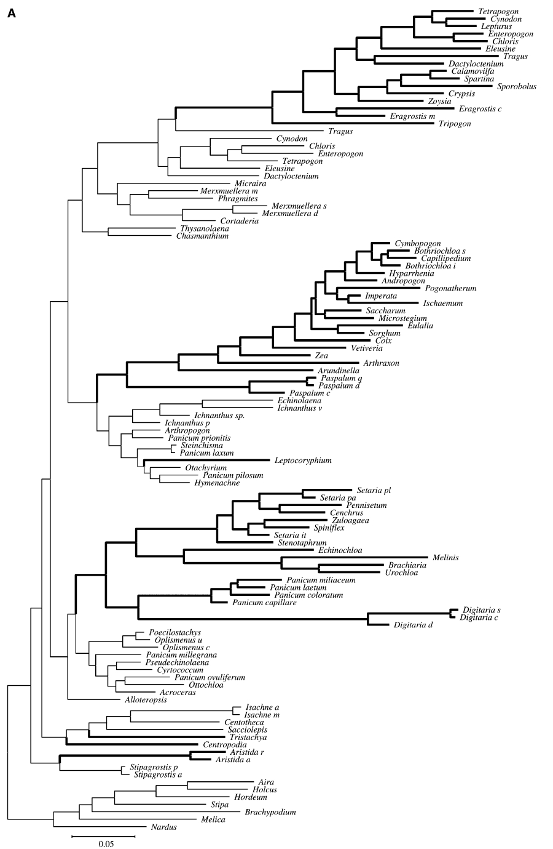
◄intronic sequences
coding sequences►
without positively
selected sites
Christin et al. 2007, Curr Biol
Notes:
The first two are as said the motors generating variation. The remaining ones are what happens in populations. Shapes variation and reshuffels variation. Their relative importance determines what happens to new variants in populations.
The study of allele frequency changes induced my them is the domain of population genetics. But of course all of them are reflected also in DNA sequence, and all of them can be studies using phylogenetic methods.
he sequence data we look at is influenced by all of them, and depending on the application we have to consider some of them that we are not even interested in, in order to not falsely interpret results.
In the following I’ll go into applications. And will refer to which assumptions we make in which case, and how we have to take these factors into account.

Slide 16
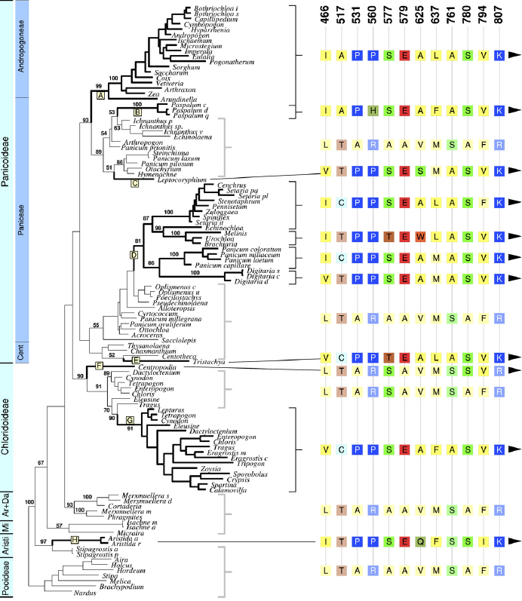
Y
x
PEPC gene
12 codons with d_{N}/d_{S} > 1
Sequences of unrelated but ecologically similar species more similar at these positions than they are in related species.
→ convergent evolution!
Christin et al. 2007, Curr Biol
Notes:
The first two are as said the motors generating variation. The remaining ones are what happens in populations. Shapes variation and reshuffels variation. Their relative importance determines what happens to new variants in populations.
The study of allele frequency changes induced my them is the domain of population genetics. But of course all of them are reflected also in DNA sequence, and all of them can be studies using phylogenetic methods.
he sequence data we look at is influenced by all of them, and depending on the application we have to consider some of them that we are not even interested in, in order to not falsely interpret results.
In the following I’ll go into applications. And will refer to which assumptions we make in which case, and how we have to take these factors into account.

Slide 17
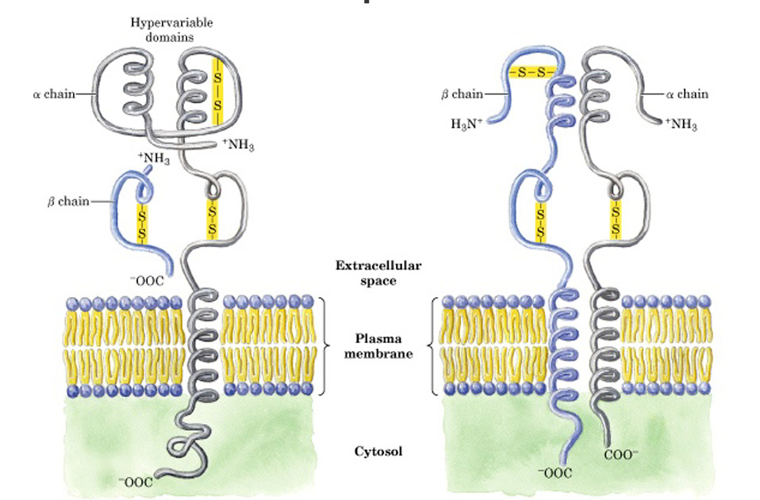
Major histocompatibility complex (MHC)
Buňka nabízející antigen spustí imunitní odpověď
Oblast rozeznávající antigen
Class I
Class II

Slide 18
Studium selekce – populačně-genetická analýza
Srovnání populačně-genetické struktury na MHC genech a neutrálních znacích (mikrosatelity)
migrace
náhodný drift
migrace
náhodný drift
neutrální znaky
MHC – pokud nepůsobí selekce
migrace
náhodný drift
migrace
náhodný drift
selekce
migrace
náhodný drift
selekce
MHC
MHC
neutrální znaky
diverzifikující selekce
balancující selekce
Je možno kvantifikovat např. pomocí F_{ST}

Slide 19
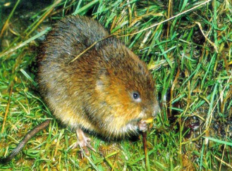

Studované lokality – 7 populací ve stejné fázi populačního cyklu
Důkaz přírodního výběru v současnosti: analýza populačně-genetické struktury
- Srovnání neutrálních znaků a MHC
01
02
03
Canton Nozeroy (pohoří Jura, région Franche-Comté)
04
05
06
07
Bryja et al. 2007, Molecular Ecology

Slide 20
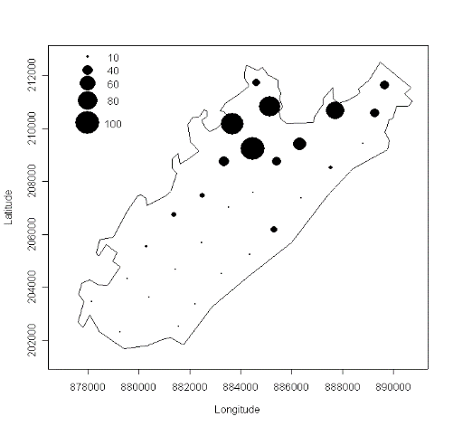
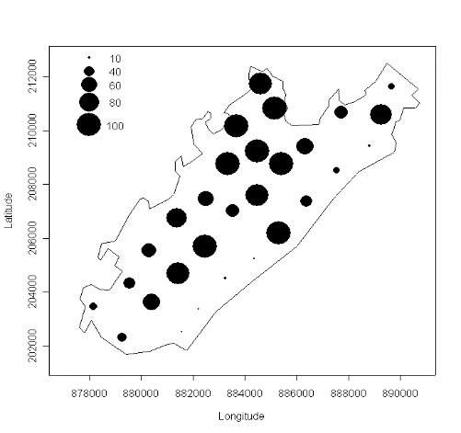
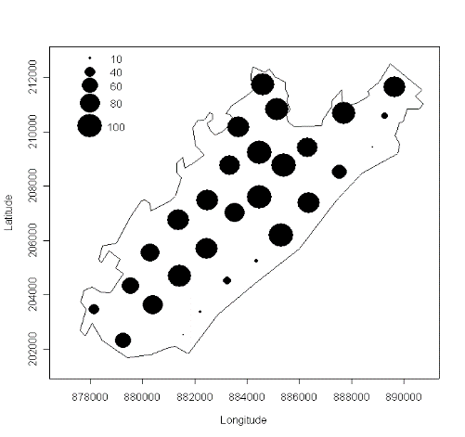
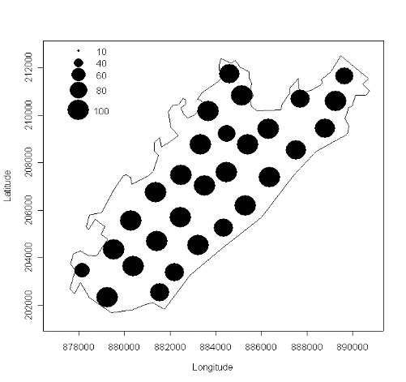
→ 2001-2003: fáze růstu populační hustoty
April 2002
October 2002
April 2003
October 2003

Slide 21
Diferenciace populací v průběhu růstu denzity
*
*
* Signifikantní rozdíl DQA1 vs. mikrosatelity
Pokles diferenciace s nárůstem denzity (nárůst disperze, tj. toku genů)
MHC (zejména DQA1) – signifikantně odlišné od mikrosatelitů
Bryja et al. 2007, Molecular Ecology

Slide 22
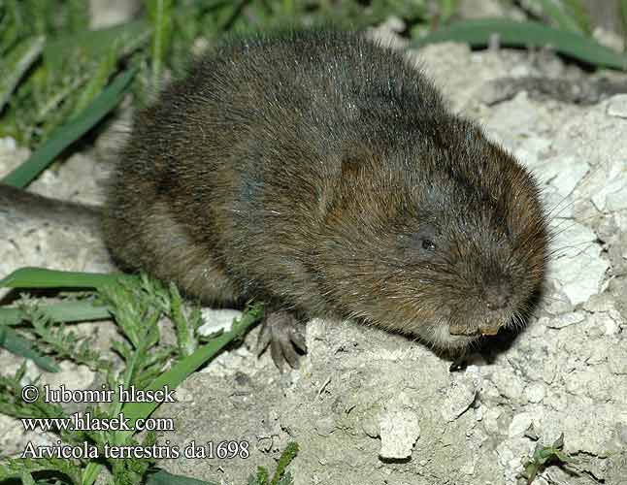
Závěr: Typ selekce na MHC závisí na početnosti populace
Nízká denzita
Lokální rozdíly ve společenstvech patogenů
Lokální diverzifikující selekce
Vysoká denzita
Nárůst diverzity parazitů v důsledku disperze
Balancující selekce
Bryja et al. 2007, Molecular Ecology

Slide 23
Metody studia funkční variability
Sledování kandidátních genů
Genomické přístupy (mnoho genů najednou)

Slide 24
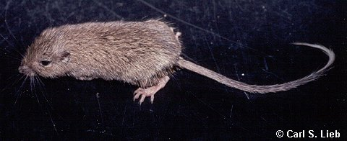

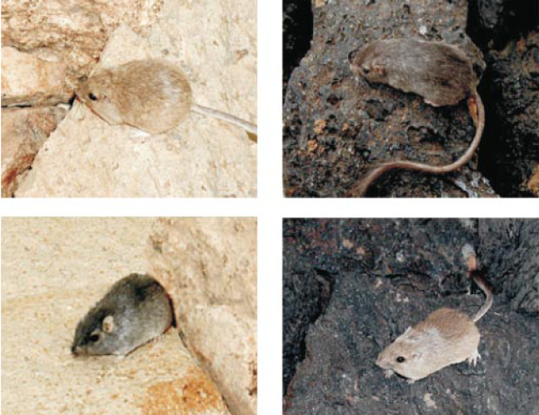
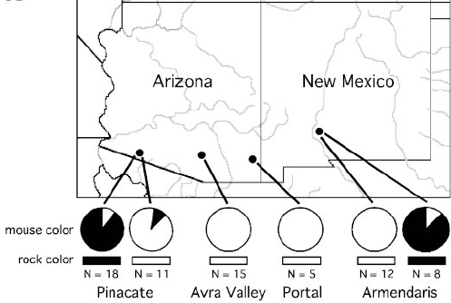
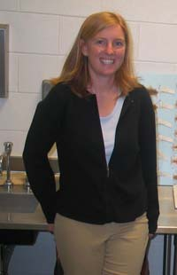
pytlouš
Chaetodipus intermedius
Hoekstra, Nachman et al.
Tmavé a světlé zbarvení
Odpovídá barvě prostředí (tmavé zbarvení na lávě)

Slide 25
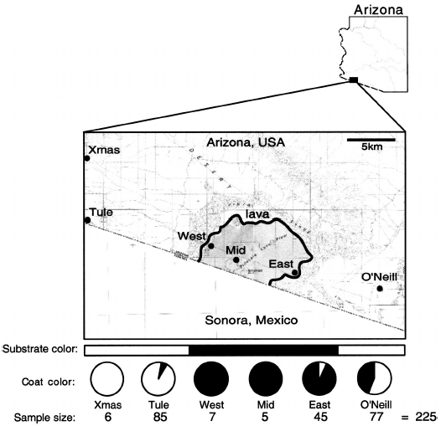
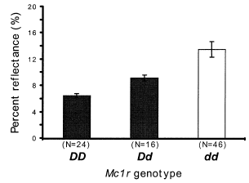
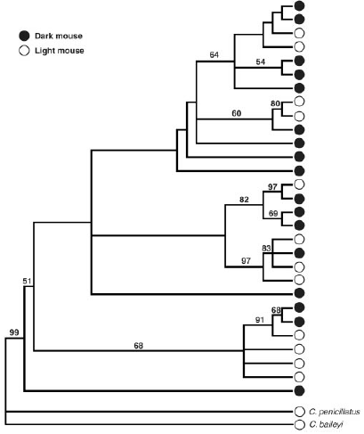
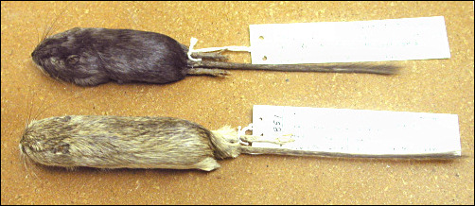
Arizona
Korelace zbarvení
s prostředím i na malé škále
mtDNA nekoreluje se zbarvením
Sekvenování kandidátních genů
(známých z inbredních myší)
melanocortin-1 receptor MC1R
Záměna 4 aminokyselin
Jednoduchá dědičnost alel a zbarvení

Slide 26
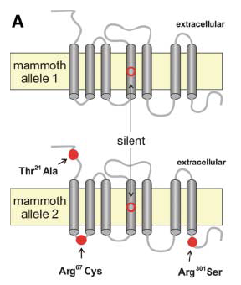
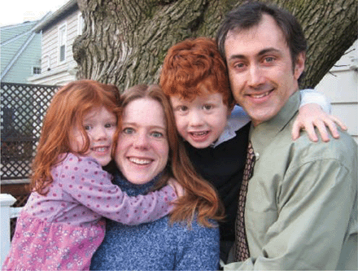
MC1R u člověka, mamuta a dalších
U člověka zrzavé vlasy a neschopnost se opálit
Zbarvení krav, koňů a psů
Výskyt dvou odlišných variant u mamutů

Slide 27
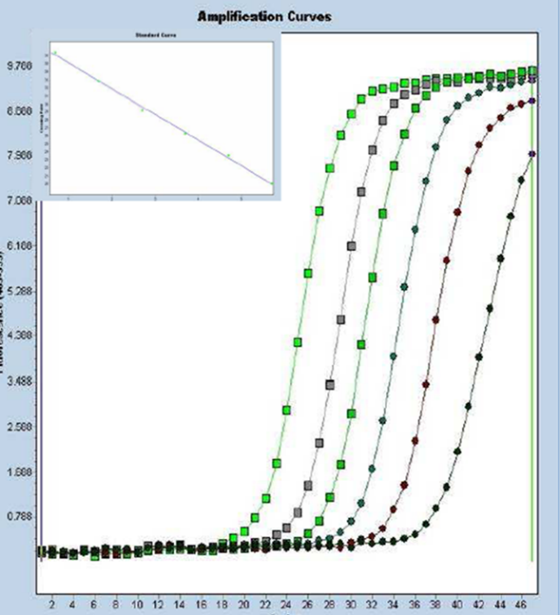
Measuring of expression - qPCR
Relative comparison of quantity of particular DNA, e.g. level of specific gene expression (i.e. particular RNA = cDNA) (e.g. comparison of different tissue types, elevations, treatement vs. non-treatement etc.)
housekeeping genes – use as standard for quantification
same number of copies in all cells (e.g. genes encoding proteins of cytoskeleton)
constitutive genes - expressed in all cells, independent on experimental treatment
validation of housekeeping genes should be performed before their use in gene expression experiments
Notes:
A gene which is to be used as a loading control (or internal standard) should have various features - see slide.

Slide 28
Sledování mnoha genů najednou

Slide 29
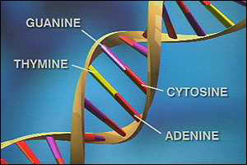
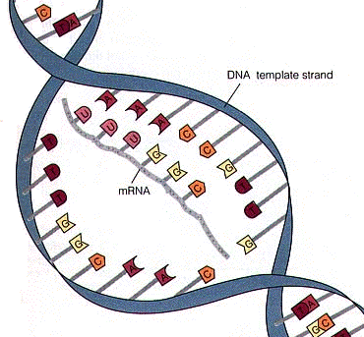
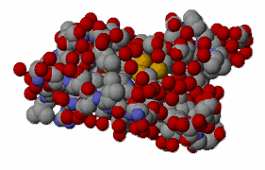
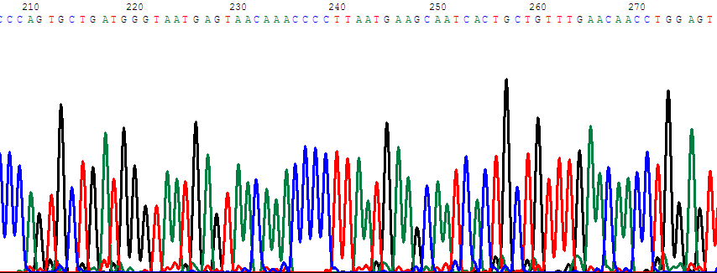
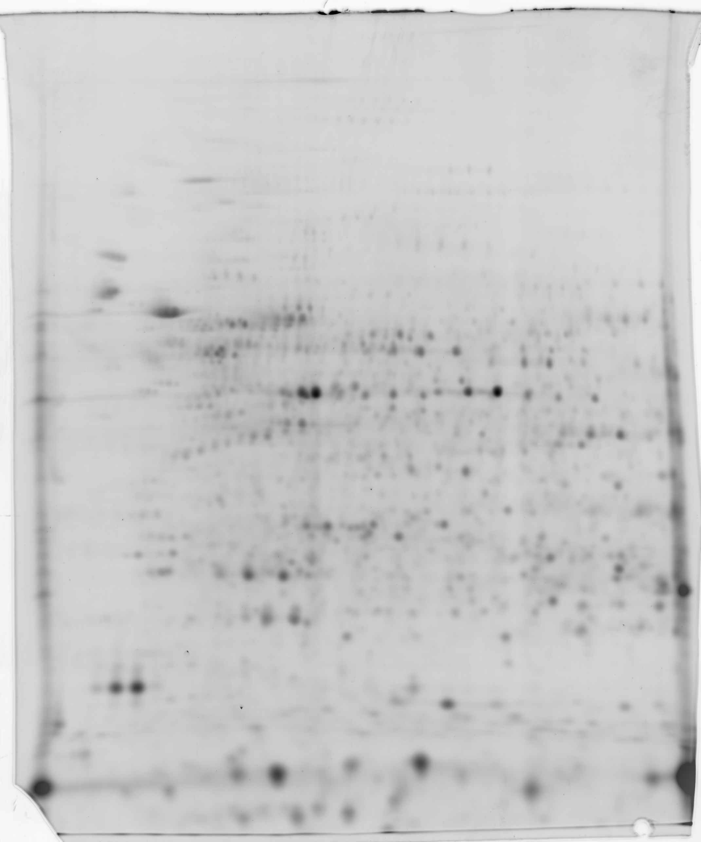

DNA
mRNA
Proteins
Transcription
Translation
Exome
Genome
Transcriptome
Proteome
3 billion bases
20-30,000
genes
~100,000
proteins
Functional Genomics
Genomics Transcriptomics Proteomics

Slide 30
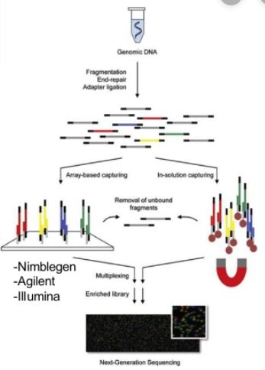
Exome-Seq
Targeted exome capture
targets ca. 20,000 coding sequences
high depth of coverage for more accurate variant calling

Slide 31
Transcriptomics – analysis of mRNAs
1. microarrays
2. RNA seq (NGS)

Slide 32
1. Analysis of gene expression by microarrays
Ranz JM, Machado CA: Uncovering evoutionary patterns of gene expression using microarrays. TREE, 21(1): 29-37

Slide 33
Microarray analysis of transcriptome
(~ specific DNA hybridization)
ACTGGTCCATAA
Probe (i.e. synthesized oligonucleotides complementary to particular genes)
Target (i.e. mix of transcripts in a form of cDNA = mRNA přepsaná do DNA reverzní transkriptázou, tj. neobsahuje introny)

Slide 34
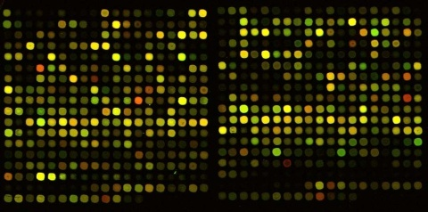
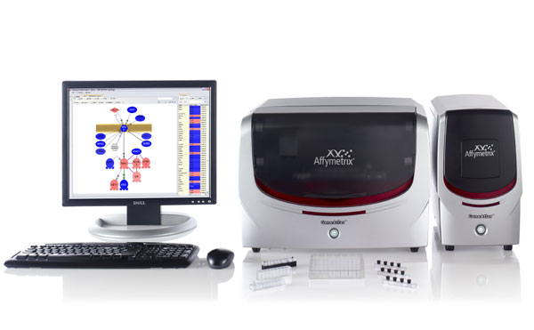
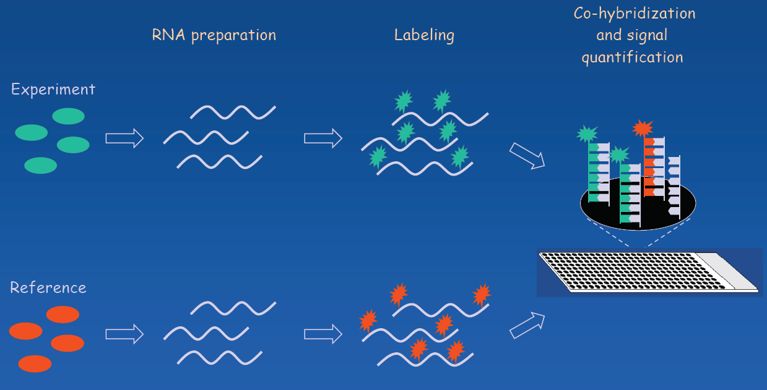
Sledování exprese genů microarrays
Sledování exprese mnoha (tisíce) genů najednou
Založeno na hybridizaci
Sleduje se rozdíl vůči kontrole ("heterologous hybridization") = dvoukanálový experiment
Affymetrix
Agilent Technologies

Slide 35
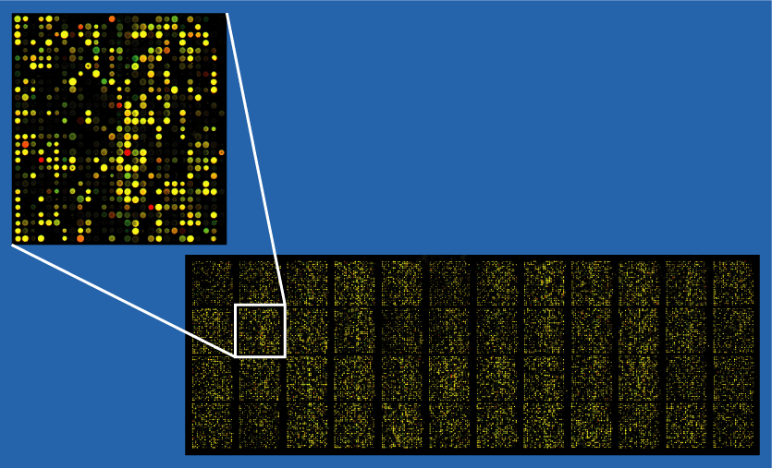
Vyhodnocení chipu – analýza obrazu
(srovnání úrovně exprese mezi kontrolou a experimentem)
desítky tisíc transkriptů
- komerčně dostupné pro kompletní transkriptom cca 25 druhů (Affymetrix)
(další jsou rychle vyvíjeny, i na zakázku)
- celkově ale microarrays ustupují před RNAseq

Slide 36
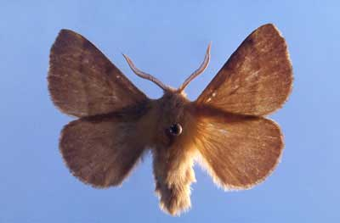
Populus trichocarpa x deltoides a Malacosoma disstria bourovec
Ralph et al. 2006
cDNA microarray
15496 genů > ¾ genomu
Po 24 hodinách
1191 genů up-regulated
537 down-regulated
Obrana: endochitinázy, inhibitory proteáz
Signální funkce
Transport, metabolismus, regulace transkripce

Slide 37
2. RNAseq
(„high-throughput sequencing of cDNAs“)

Slide 38
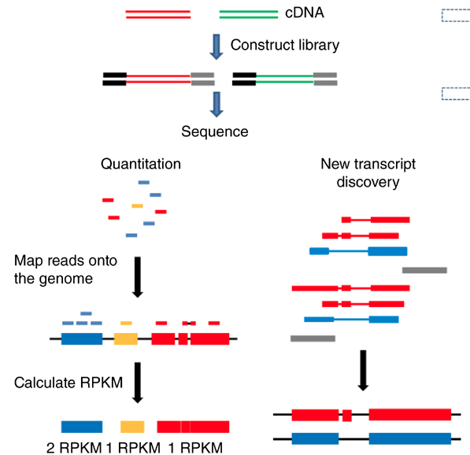
RNA-Seq workflow for gene expression analysis
Fragmented mRNA
List of differentially expressed genes
Adapted from Zeng and Mortazavi, Nature Immunology 13 (2012)

Slide 39
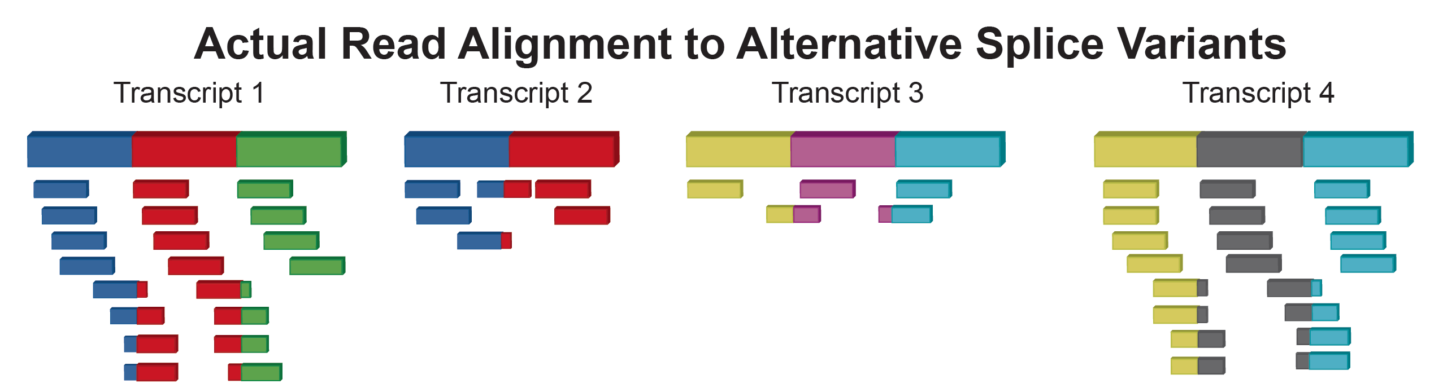
RNA-Seq quantification
(RPKM = reads per kilobase per million reads)
The reference transcriptome is required

Slide 40
Gene ontology (http://geneontology.org/)
= functional annotation analysis
založena na databázích dostupných anotovaných genů u modelových organismů
Cellular Component - the parts of a cell or its extracellular environment
Molecular Function - the elemental activities of a gene product at the molecular level, such as binding or catalysis
Biological Process - operations or sets of molecular events with a defined beginning and end, pertinent to the functioning of integrated living units: cells, tissues, organs, and organisms.

Slide 41

Example of GO annotation: cytochrome c
molecular function: oxidoreductase activity
biological proces: oxidative phosphorylation
cellular component: mitochondrial matrix

Slide 42
Examples

Slide 43
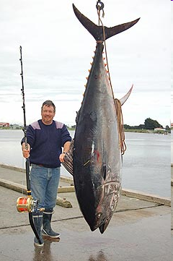
Jaká je úroveň exprese v různých tkáních?
quantitative real-time PCR
- srdeční, červená a bílá svalovina
- rozdíly v expresi 113, 81 a 196 genů
- rozdíly jsou způsobeny tkáňově specifickým stupněm endotermie
vliv aklimatizace k chladu (20° vs 15°C)

Slide 44
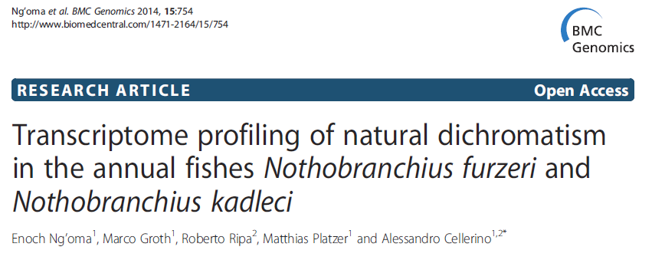
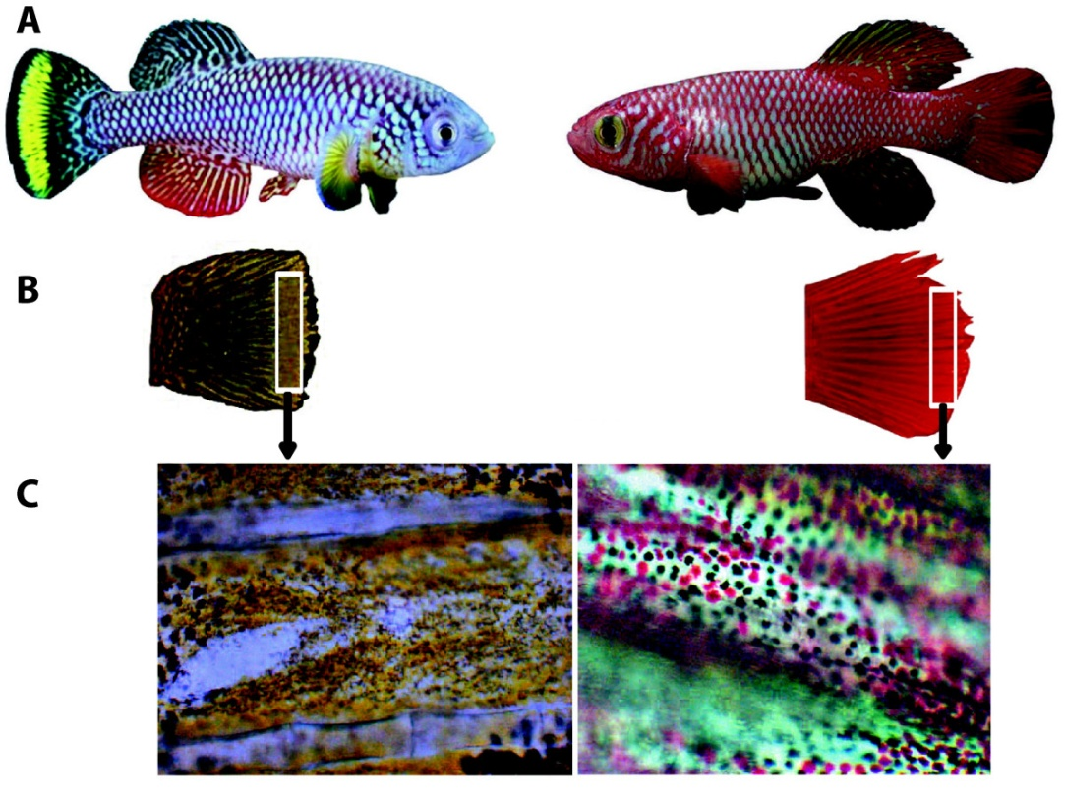
cca 334 miliónů sekvencí („reads“); 42 mil./sample
210 DEGs („differentially expressed genes“) – 119 up-regulated, 91 down-regulated u žlutých jedinců
xanthophory
melanophory
erythrophory

Slide 45

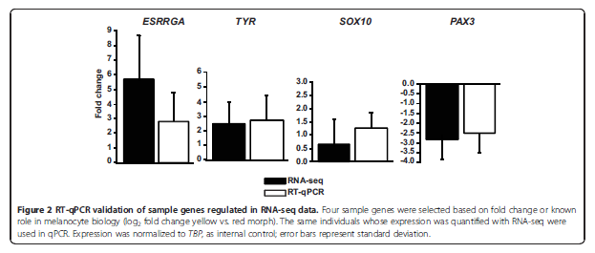
Konzistence výsledků
změny v expresi jdou stejným směrem u RNA-seq i RT-qPCR vybraných genů
hierarchical clustering of expression level
„žlutí“ a „červení“ jsou si navzájem podobní

Slide 46
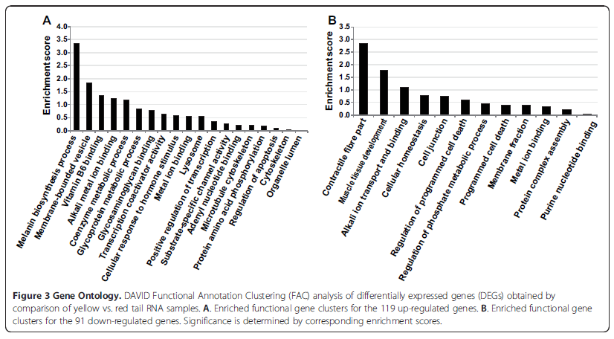
Functional annotation clustering
(= gene ontology)
up-regulated in yellow
down-regulated in yellow
xanthophory u žlutých jedinců jsou asociovány s melanogenezí
v dalším kroku je možné studovat roli jednotlivých kandidátních genů

Slide 47
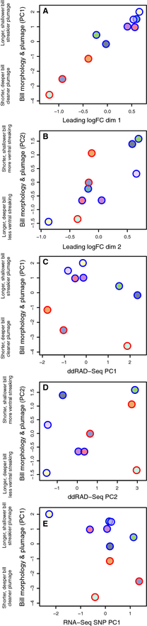


Mason and Taylor 2015
Only differentially expressed genes are responsible for morphological changes (zobák, zbarvení)
20721 SNPs (ddRAD)
215825 SNPs (RNAseq)
20721 SNPs (ddRAD) – no genetic difference at neutral loci

Slide 48



Sequencing of 73 genomes of all three „species“
expression data
~55-Mb inversion of chromosome 1 („supergene“)
multiple candidate genes related to melanogenesis, carotenoid coloration, and bill shape
latitudinal gradient in ecotype distribution – balanced polymorphism of supergene haplotypes

Slide 49
Závěr
Molekulární ekologie se rychle vyvíjí
Metody se zásadně vylepšují a mění
Co platilo dnes, nemusí platit zítra – těšme se tedy na zítřek

