Slide 1

Lecture 3b : Structural variants
Modern Genomic Technologies (LF:DSMGT01 )
Vojta Bystry
vojtech.bystry@ceitec.muni.cz

Slide 2

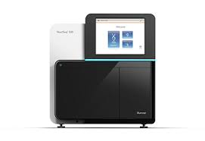
NGS data analysis
de-multiplexing
Raw data
.fastq
Experiment design
QC
Not known
reference
Not ”classic” reference
Genome/Transcriptome Reference Mapping
.bam
Metagenomics
Reference assembly
Immunogenetic
VDJ-genes
CRISPR
sgRNA
QC
Methylation
Bisulfide-seq
Interaction
analysis
CHIP-seq
Expression analysis
RNAseq
Variant analysis
WES
…
2

Slide 3
Structural variants calling

Slide 4
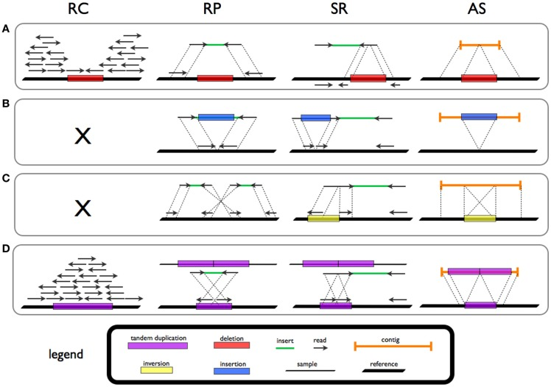
Structural variants calling
RC = Read count
  Copy number variants (CNV)
RP = Read pair
  Pair-end sequencing
SR = Split reads
AS = Assembled read

Slide 5
Structural variants calling
RC = Read count
  Copy number variants (CNV)
RP = Read pair
  Pair-end sequencing
SR = Split reads
AS = Assembled read
A = DELETION
B = INSERTION
C = INVERSION
D = DUPLICATION

Slide 6
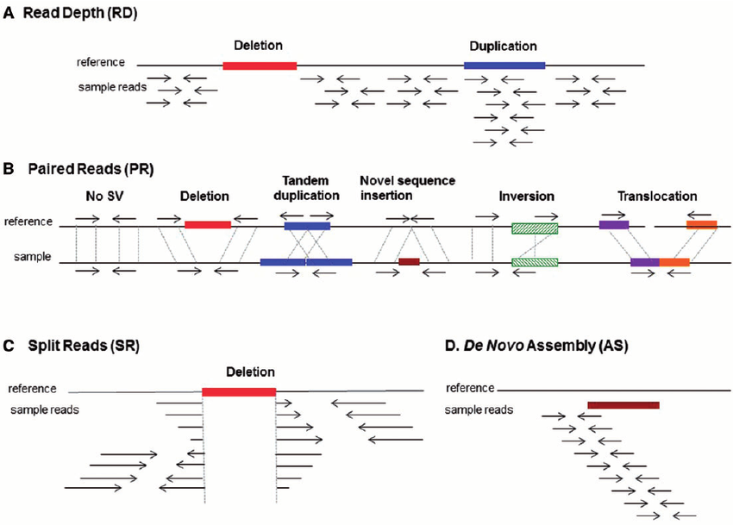
Structural variants calling

Slide 7
Structural variants calling
Copy number variants (CNV)
  Copy number analysis (CNA)
Structural variants (SV)
  Discordant reads analysis
Fusion genes analysis
  SV in coding sequence
  From RNA-seq
  Medical application

Slide 8
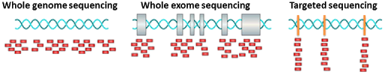
Copy number variants
Not-PCR amplified (WGS)
PCR amplified (WES,targeted)

Slide 9
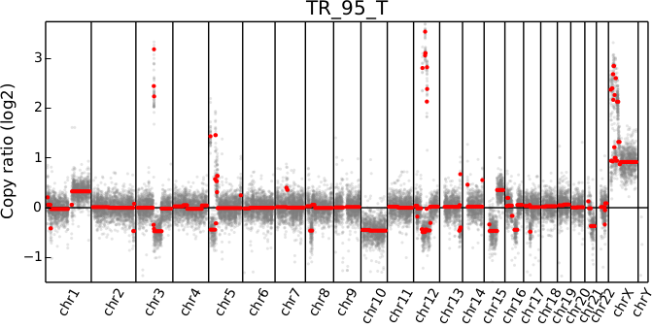
WGS copy number variants
Running window
Normalization to the absolute coverage

Slide 10
PCR amplified CNV
Individual analysis problematic
Somatic tumor-normal pairs
Panel of (normal) samples

Slide 11
Structural variants calling

Slide 12
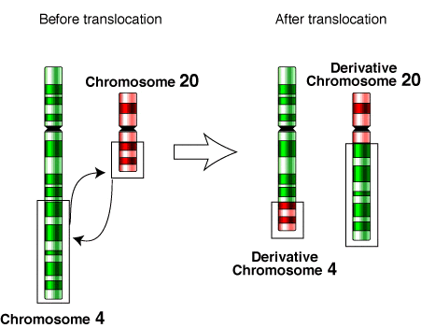
Fusion genes

Slide 13
CEITEC
@CEITEC_Brno
Thank you for your attention!
Vojta Bystry
vojtech.bystry@ceitec.muni.cz
www.ceitec.eu

