Slide 1
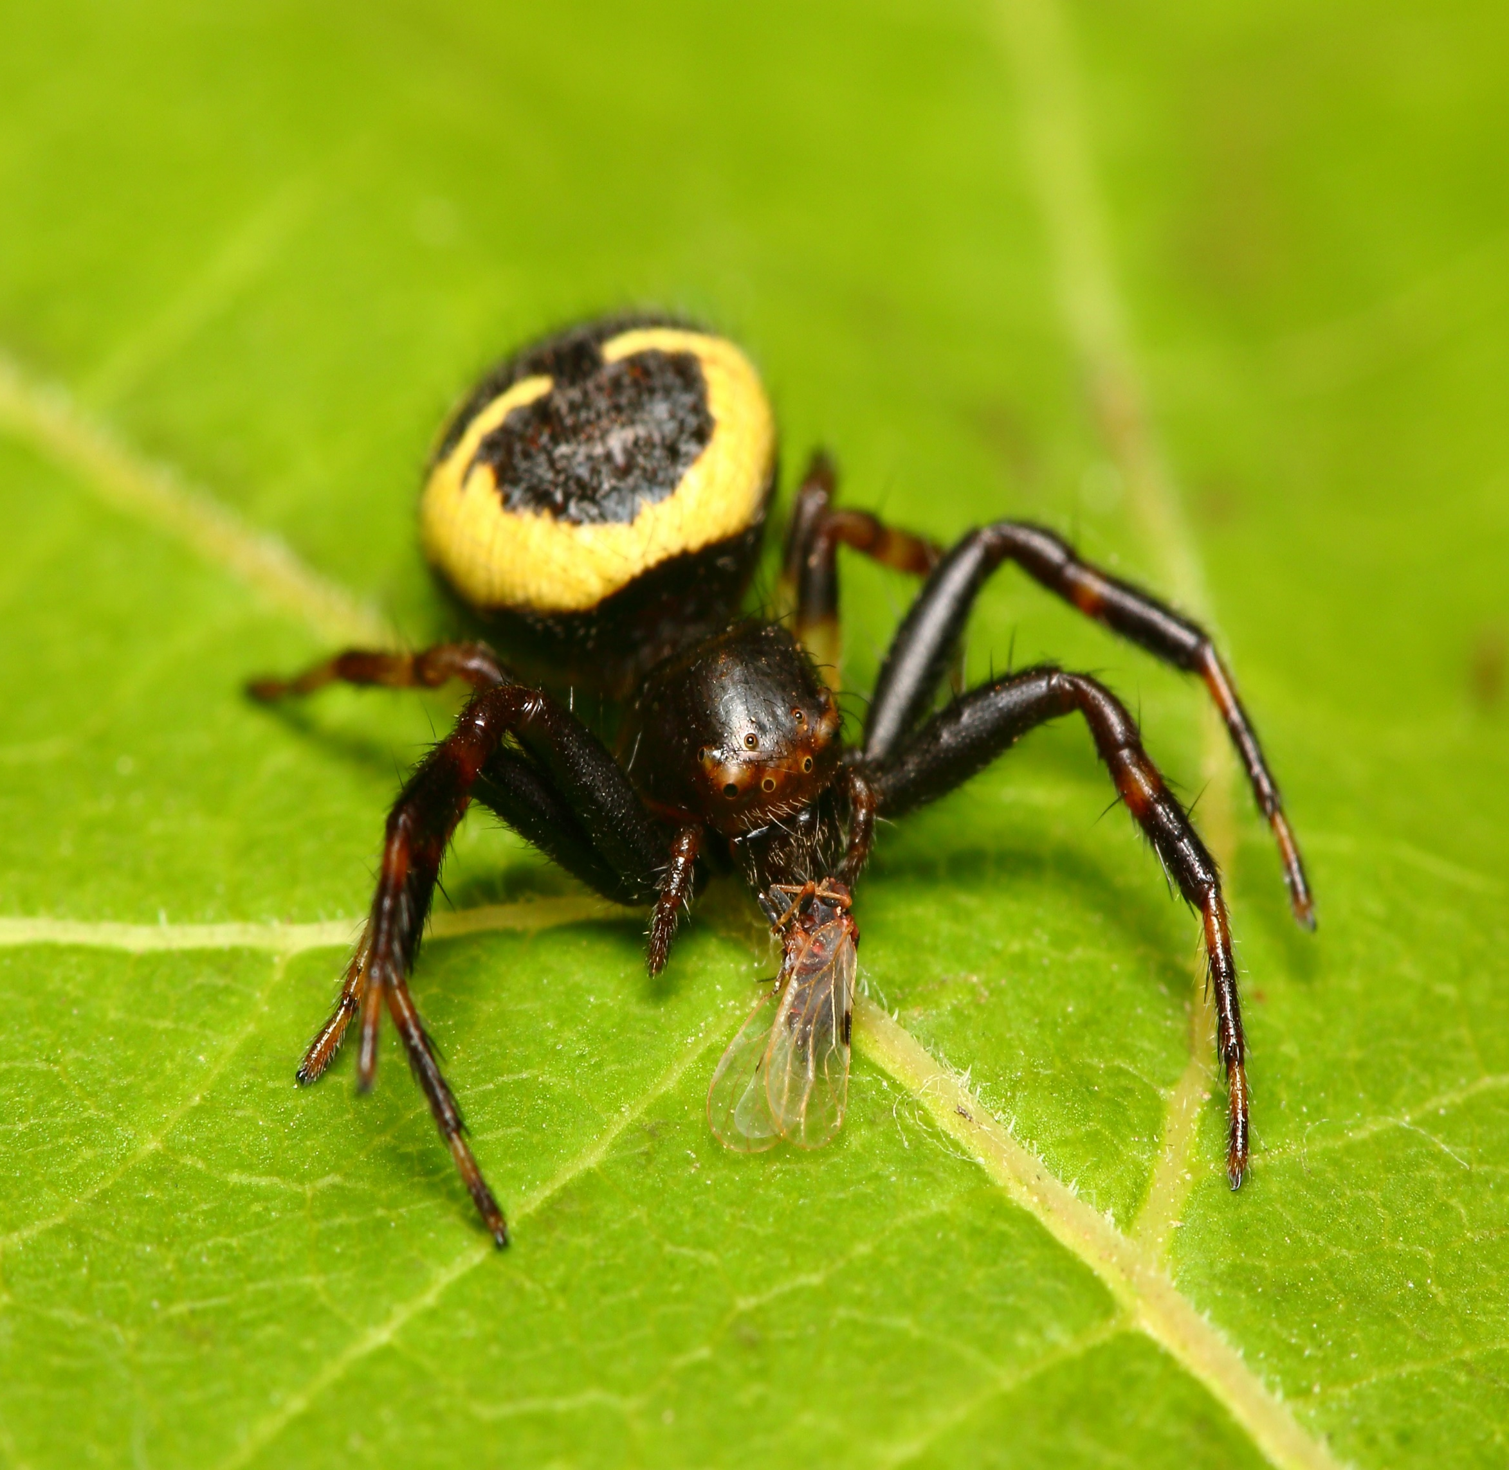
Effect of integrated pest management (IPM) on abundance and trophic interactions of arthropod predators inside pear orchards during winter and spring
Domagoj Gajski

Slide 2
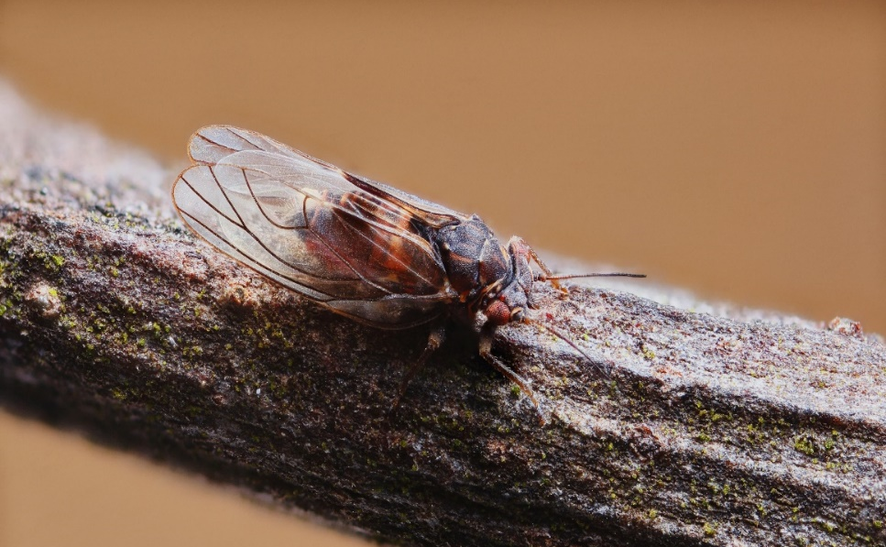
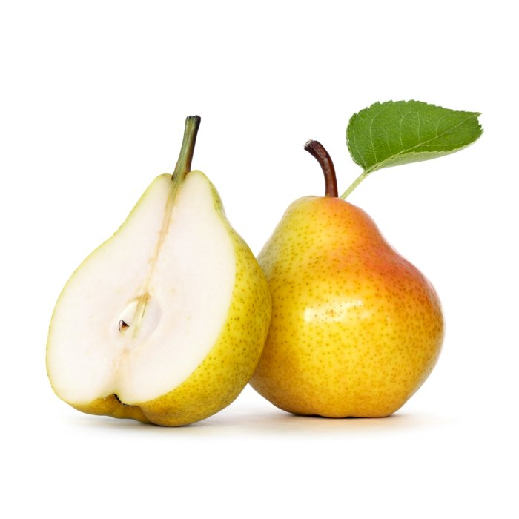
Psyllids - Cacopsylla spp.
Main pest in pear orchards:
Extract nutrients from pear trees
Induce development of sooty moulds
Transmit harmful phytoplasmas that cause pear decline
Active already in early spring ➔ high abundance in early summer
Resistant to pesticides due to their polyvoltine nature

Slide 3
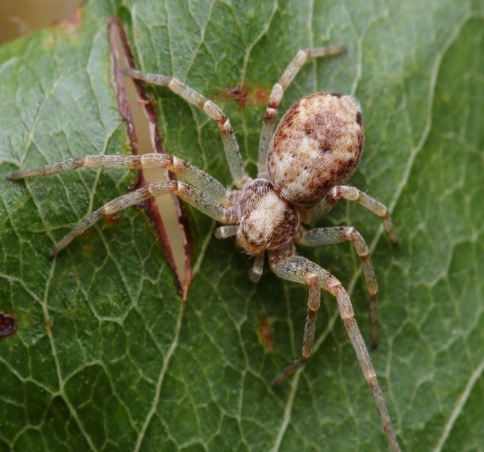
Naturaly occuring predators
Coccinellids
Spiders
Specialists – Anthocoris spp.
Generalist predators

Slide 4
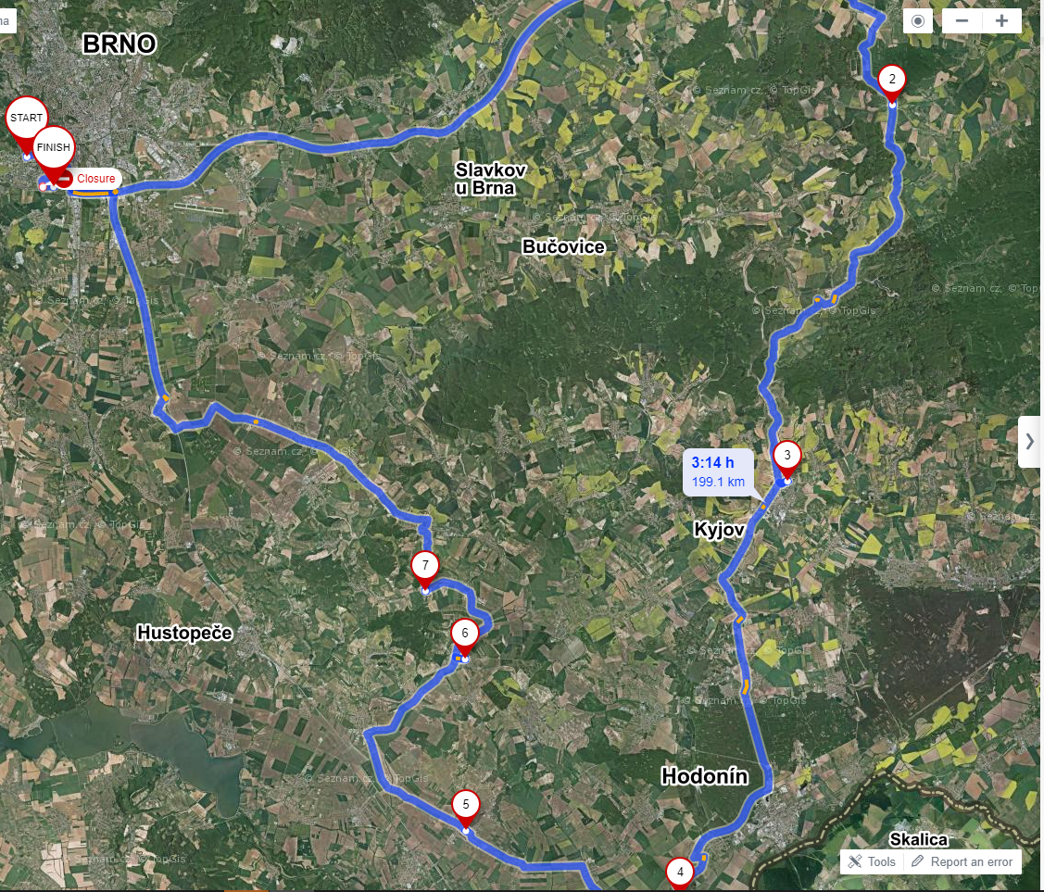
Experimental design
PEAR ORCHARDS:
Netčice
Litenčice
Velke Bilovice 1
Morkuvky
Visited in December, February and April!
Stary Liskovec
Velke Bilovice 2
Kobyli
Mikulčice
Ecological management
- control
Integrated pest management

Slide 5
Experimental design
MARGIN
CENTER

Slide 6
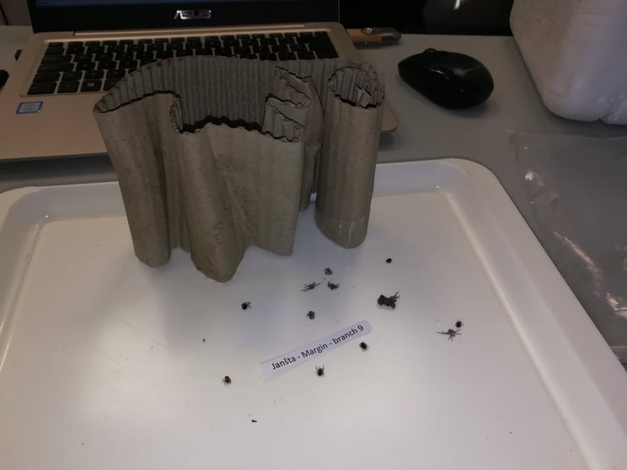
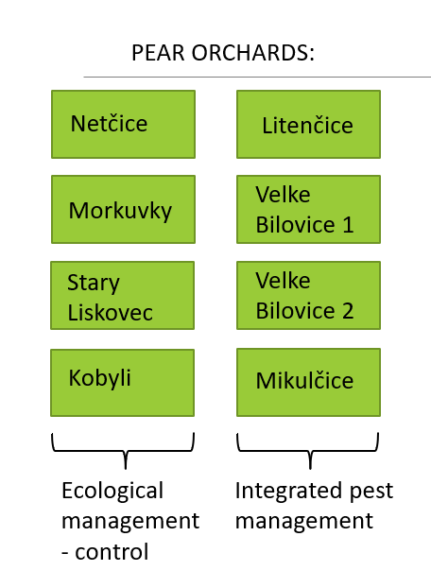
Experimental design
Installing cardboard traps around trunks and branches
Sorting samples and identification
December ➔ February ➔ April

Slide 7
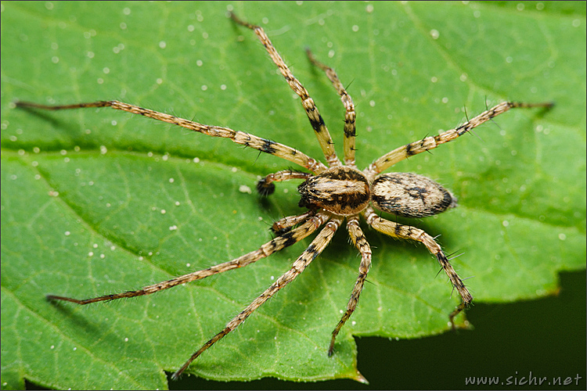
Over 10 000 arthropod samples, out of which 4139 were predators.
Out of the predators, more than 80 % were spiders.

Slide 8
Effect of pest management type on presence of some spider groups

Slide 9
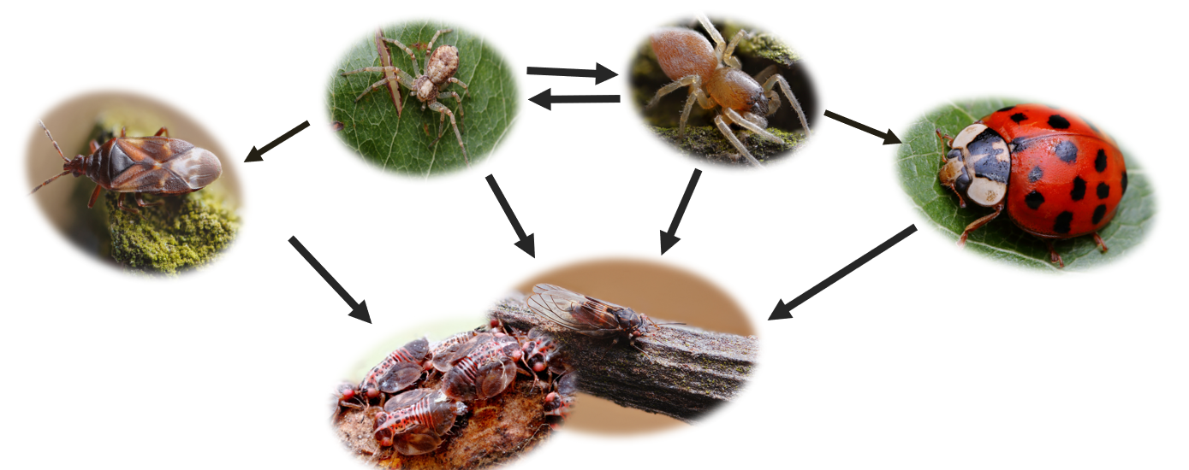
Aims during this course:
Compare abundancies of arthropod clades or predatory guilds between:
differently treated orchards (IPM vs EKO)
samples taken at the margin and the center of the same orchard
Compare species richness, diversity and size differences of all arthropods between:
differently treated orchards (IPM vs EKO)
samples taken at the margin and the center of the same orchard
Assess if there is a relationship between presence of some specific arthropod groups on the same tree (e.g. if some predator inhabits a tree due to the presence of some specific prey).

Slide 10
Aims during this course:
Have data about seasonal abundance changes of predators and psyllids during spring
Would assess their relationship through regression charts and calculating the significance of their relationship, taking into account the seasonal change and abundance change
Learn how to make such beautiful charts :)

Slide 11
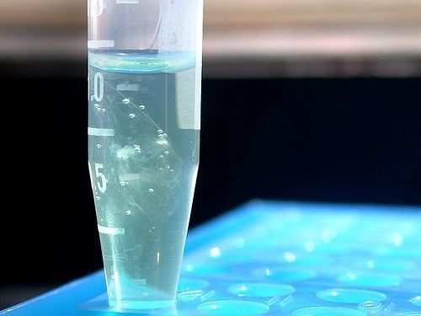
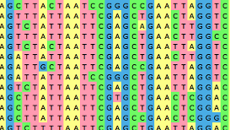
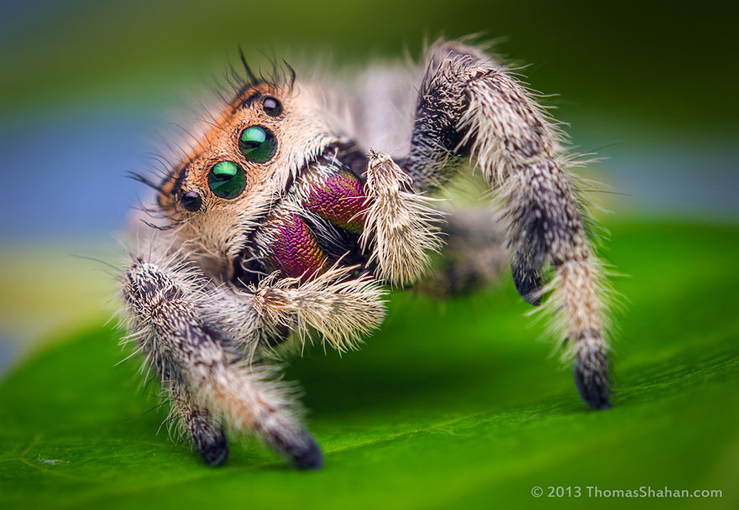
How to study the diet of bugs – molecular methods
You will never guess what I had for lunch!
DNA extraction, PCR
Sequencing
Bioinformatics and Identification of sequences
Ok, ok! You got me! I had a juicy fly!

Slide 12
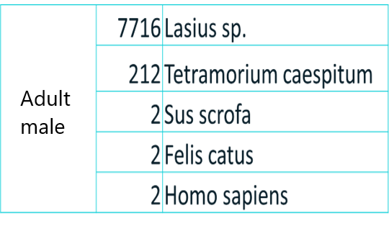
Transformation of information
Each prey will be turned into 1 (present) or 0 (not present)

Slide 13
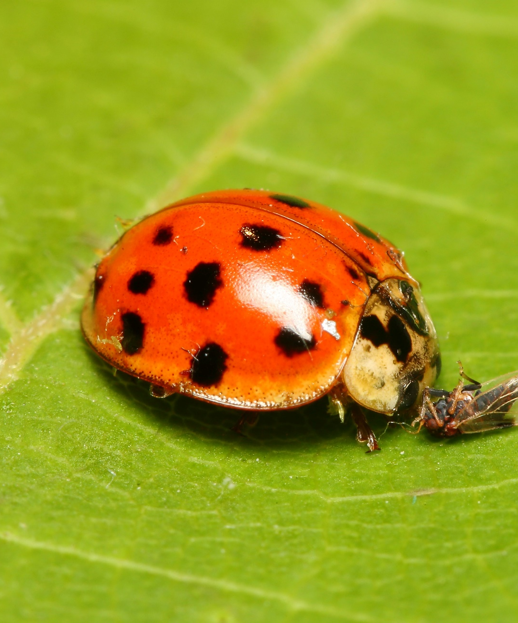
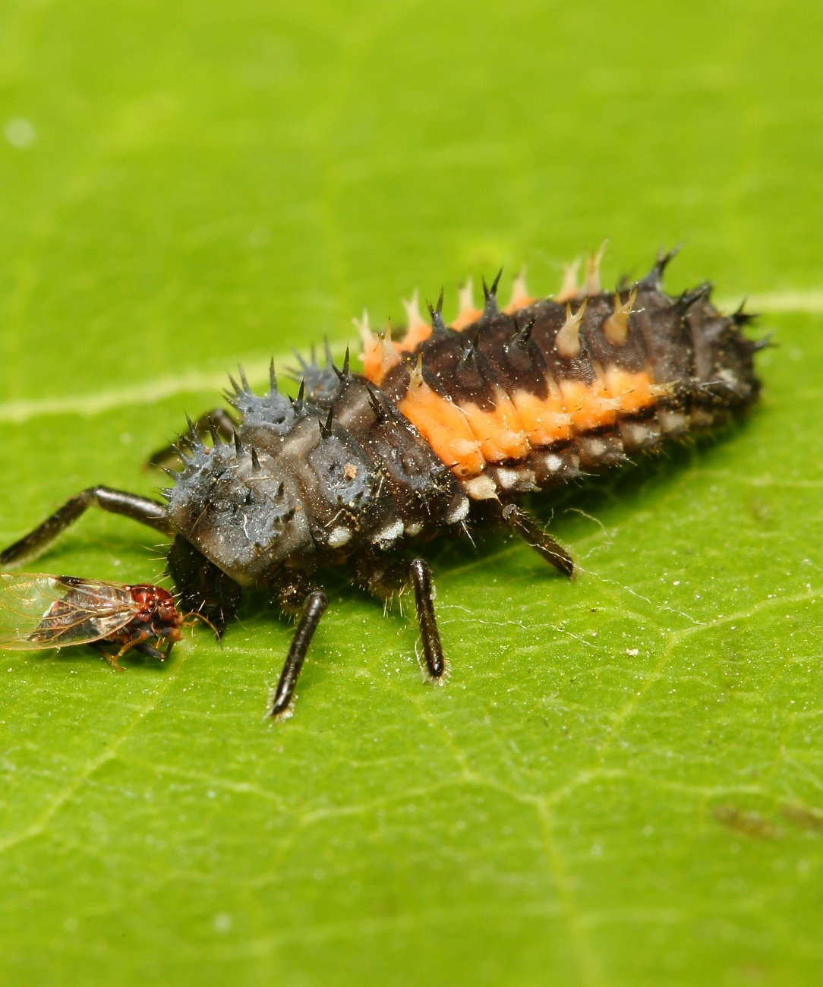
Thank you for your attention!

