Slide 1
Photoacoustic
Vítězslav Otruba

Slide 2
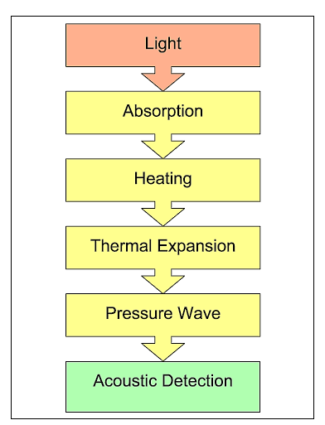
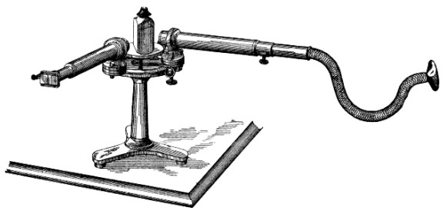
The spectrophone
In 1881 A.G. Bell proposed a spectrophone “for the purpose of examination of the absorption spectra of bodies in those portions of the spectrum that are invisible”.

Slide 3
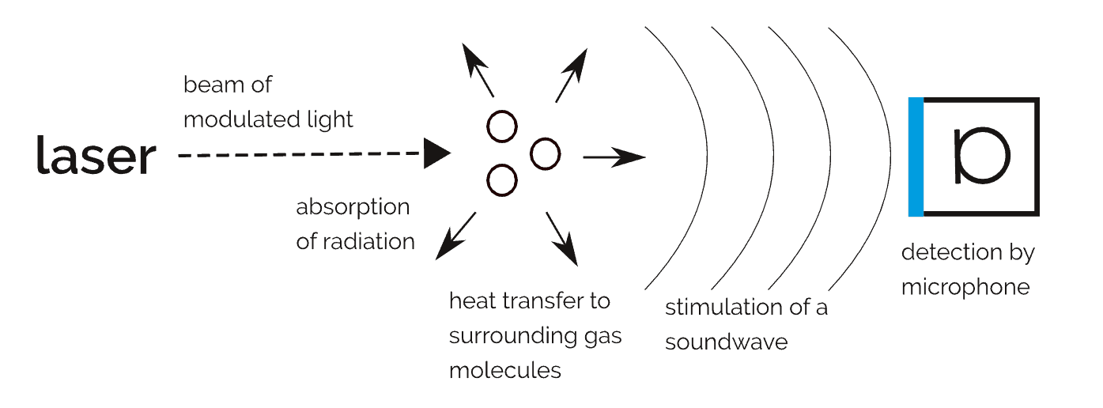
Photoacoustic effect
The photoacoustic effect is referred to as the occurrence of acoustic effects in the sample under investigation as a result of its localized periodic heating induced by incident amplitude modulated light radiation.
The modulation frequency can take values over a very wide range of 10 to 10⁸ Hz, depending on the type of substance to be studied and the type of acoustic detector. Modern microphones in combination with quality electronics can detect acoustic effects corresponding to temperature changes of the order of 10⁻⁶ to 10⁻⁷ ° C.
The phenomenon occurs in gaseous, liquid and solid substances and according to the way in which heat is distributed from the source, two functional modes are distinguished - thermoacoustic and thermoelastic.

Slide 4
(Photoacoustic Spectroscopy - PAS)
The level of acoustic effects depends on the amount of radiation absorbed - by measuring the photoacoustic effect at different wavelengths of light to determine the absorption spectrum of the test substance. PAS has some advantages over conventional optical spectroscopy:
transmitted, reflected or elastically scattered light is not detected and does not interfere with the measurement itself
allows to measure highly optically permeable materials (gases) containing a small amount of absorbing component (10⁻¹⁵ methane in nitrogen)
Optical absorption can be measured even with high scattering materials (powders, amorphous substances, gels, colloidal suspensions etc.) or even with optically impermeable substances
analysis of subsurface layers without sample destruction
offers the possibility of measuring over a wide range of frequencies with the same detector

Slide 5
Instrumentation requirements
Source of intense radiation
  Laser is optimal
  Classic power supplies are also possible (eg. Xe lamp)
Sensitive detection
  Microphones
  Hydrophones
  Piezo detectors
  Strain gauges
  Fiber detectors
    Strain gauge
    Piezoelectric
Analysis of output signal of detectors
  FT
  Transition signal analysis
  Correlation functions

Slide 6
Process flow diagram in OA (gas phase)
Photochemical reactions
Absorption of radiation
Luminiscence
Absorption by cuvette window
Modulated gas heating
Generation of acoustic oscillations
Boundary conditions
Acoustic wave propagation
Detection
processing

Slide 7
Application 1
Measurement of low absorbance
A_{min} ≈ 10⁻¹⁰ cm⁻¹ (pro l = 10 cm), typically cca 10⁻³ cm⁻¹ (pro l = 1 cm)
  Low concentrations
  Transitions with low probability
  Vibration and rotational spectra of high n
Trace content detection
In gas up to ≈ 10⁻¹³
Small size with semiconductor lasers
  Detectors in gas chromatography
  Field inspection devices
  Sensors for process control
Examples:
  NH₃, SO₂ ≈ 10⁻¹⁰
  NO₂ ≈ 10⁻¹¹
  CH₄ ≈ 10⁻¹²
  CO ≈ 10⁻⁸

Slide 8
Application 2
Absorption from excited states
Chemical reactions in the gas phase
  Intermediate concentration measurement
  Spectra IR, UV, Raman of intermediates
  Reaction schemes, e.g.:
  CH₃I → CH₃* + I
  ²P_{1/2} ↔ ²P_{3/2} ?
  Doppler-free spectrometry
  Spectrometry of condensed phases

Slide 9
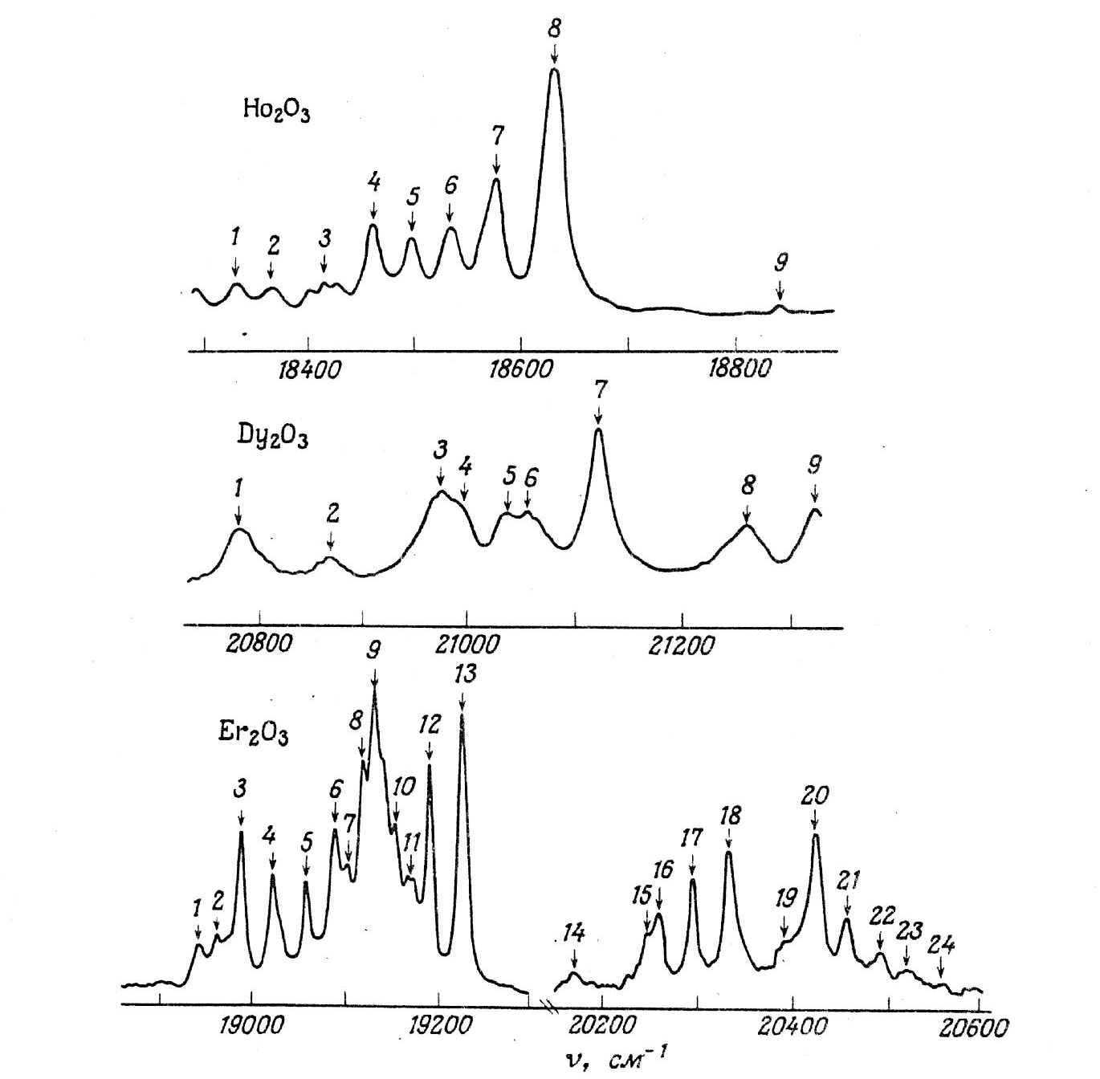
Rare Earth Powder Oxide Spectrum

Slide 10
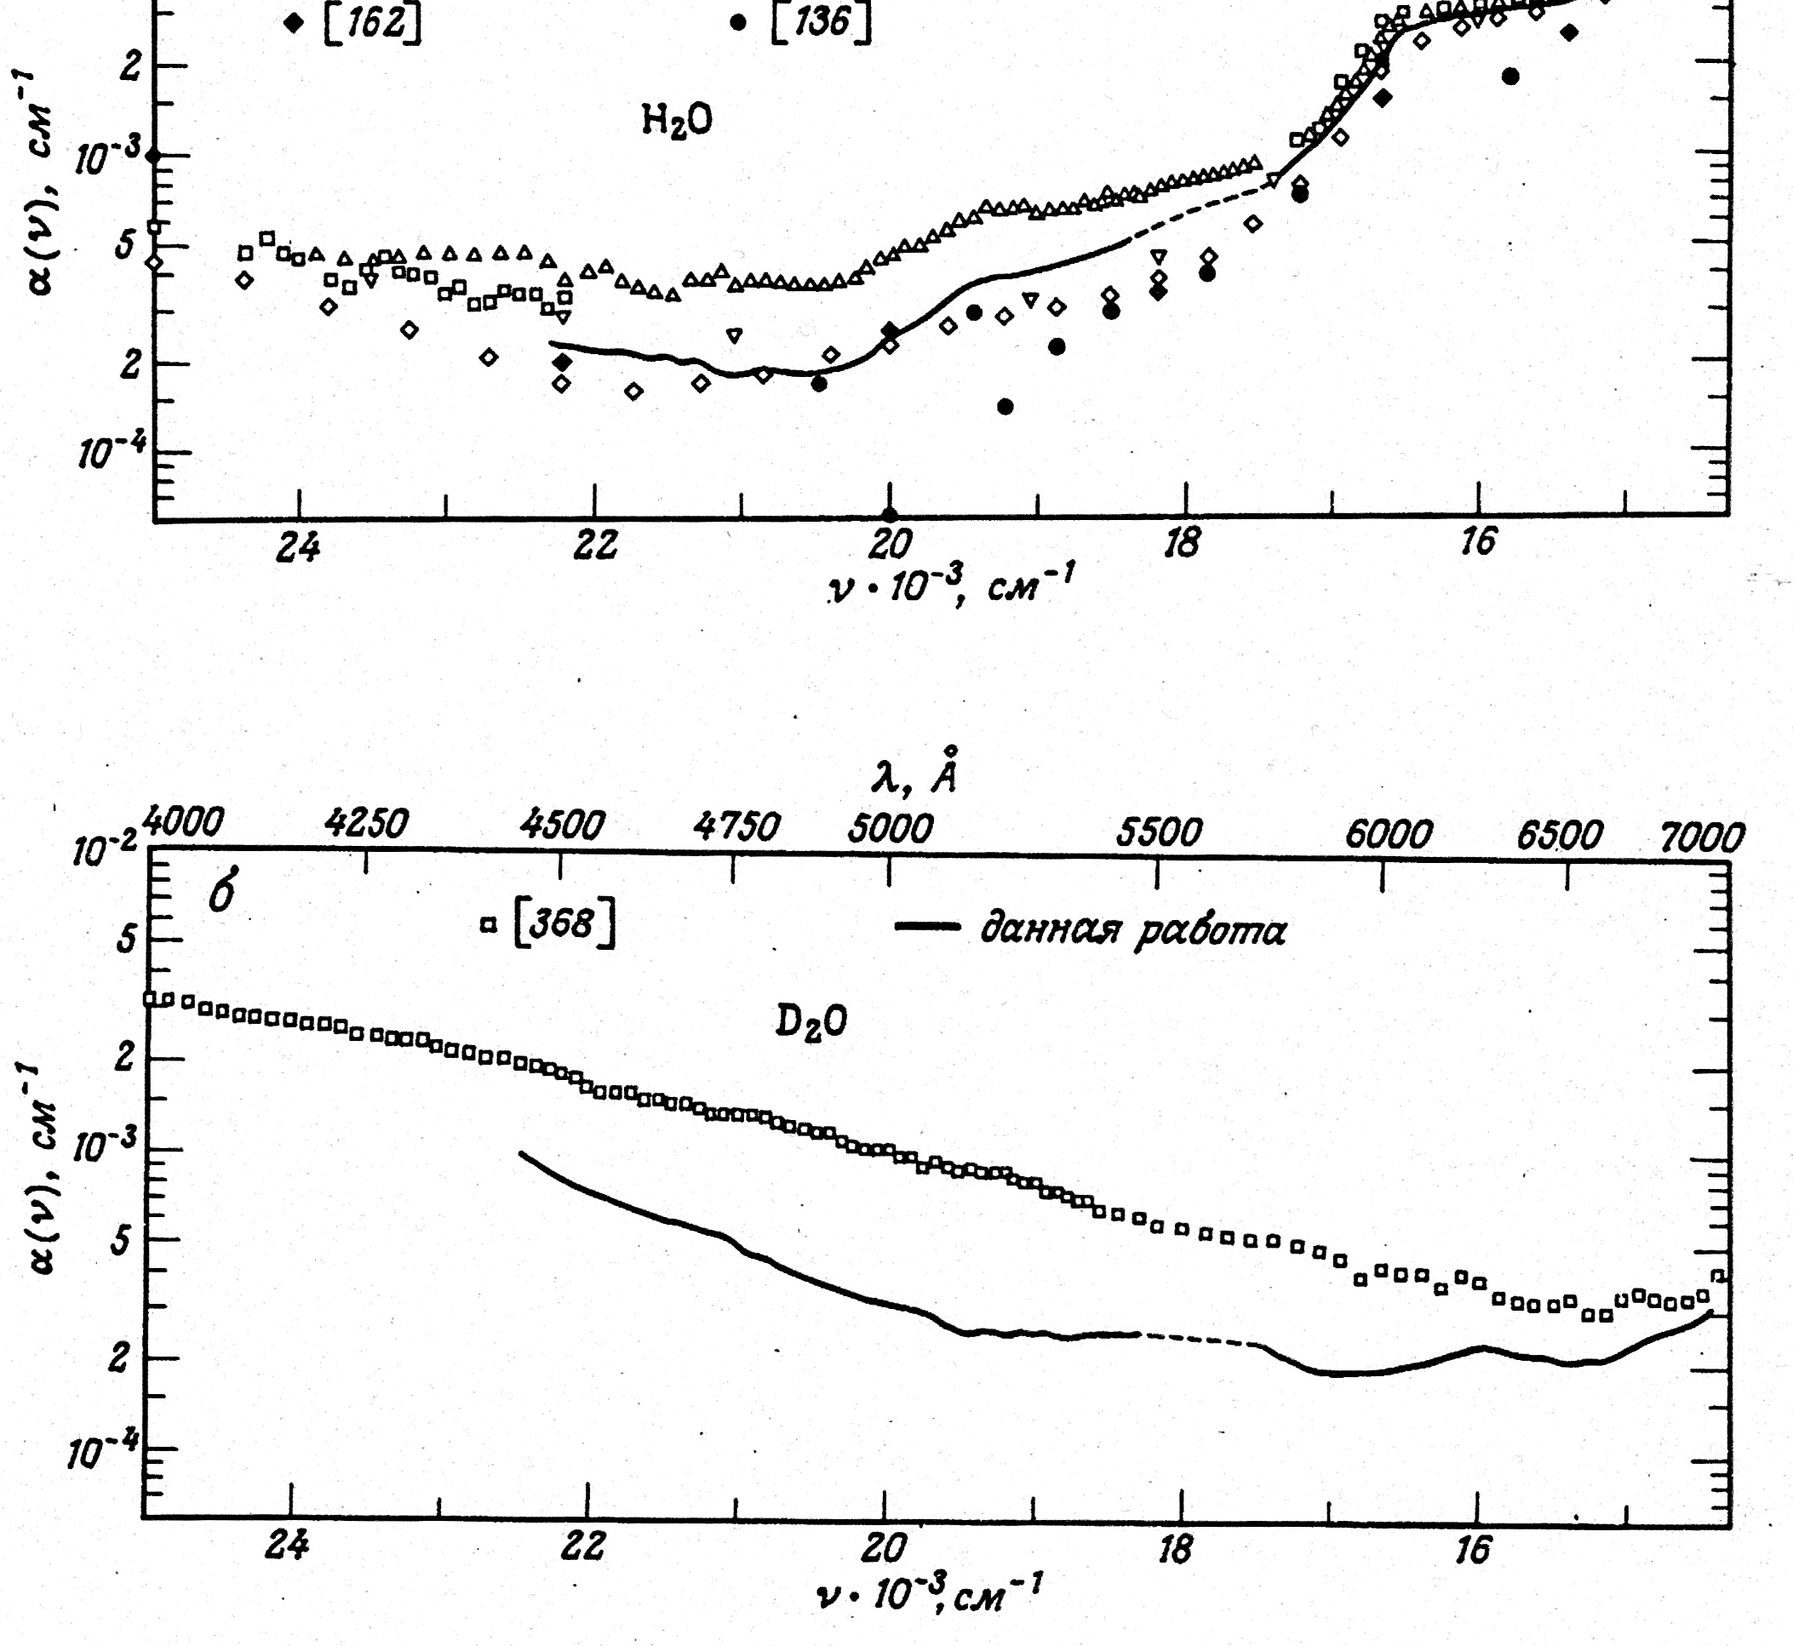
Absorption spectra of water
Absorption optoacoustic spectra of water and heavy water measured by dye lasers (solid line) in comparison with works of other authors.

Slide 11
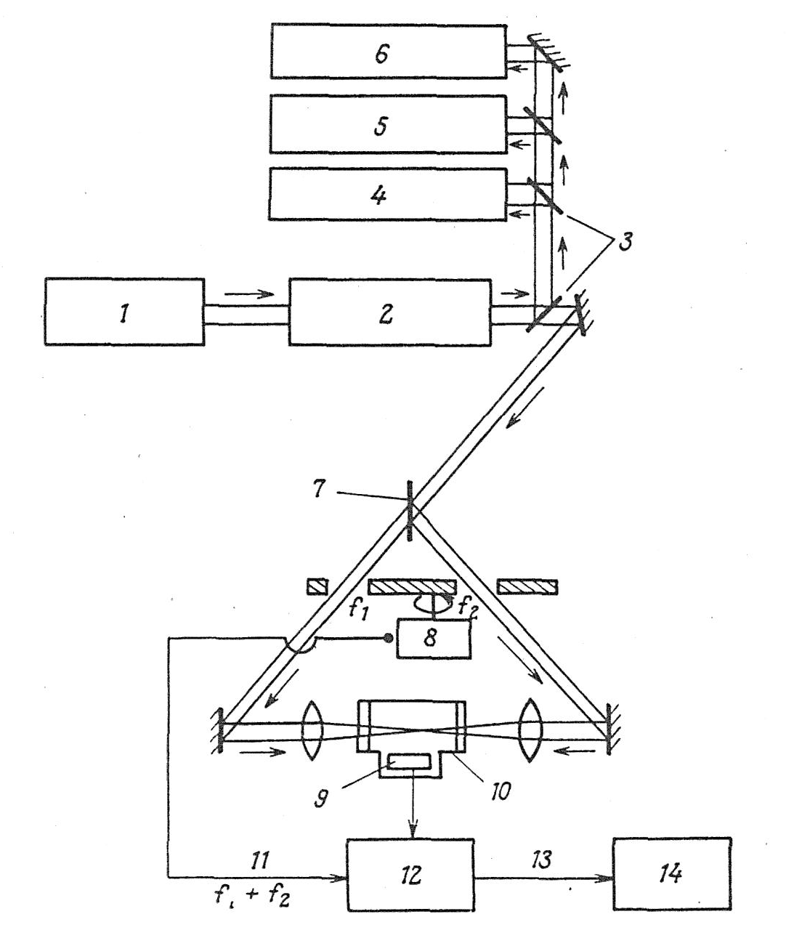
Doppler-free photoacoustic spectrometry
Description :
1 – Ar⁺ laser
2 – single-mode dye laser
3 – beam splitter
4 – spectrum analyzer
5 – reference absorption cell
6 – spectrometer
7 – 50% beam splitter
8 – electric motor
9 – microphone
10 – acoustic cuvette
11 – base frequency
f₁ (751 Hz) + f₂ (454 Hz)
12 – lock-in amplifier
13 – output
14 – data evaluation
The frequency equal to the sum f1 + f2 will be generated only if both opposite beams saturate the same particles, ie particles at zero velocity with respect to the beams.

Slide 12
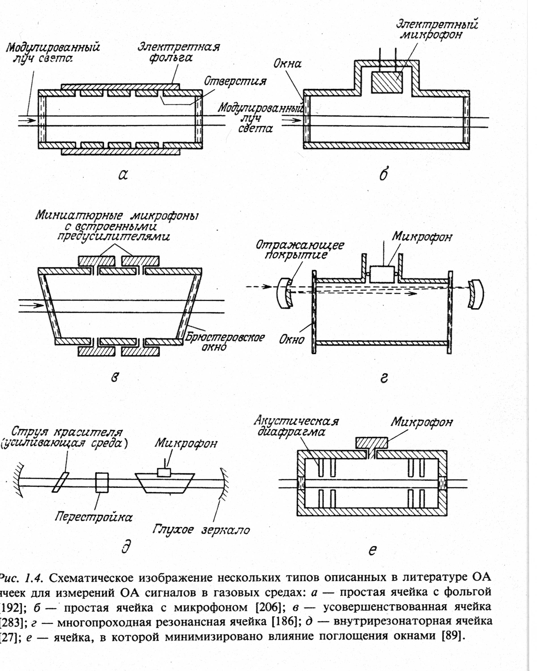

Slide 13
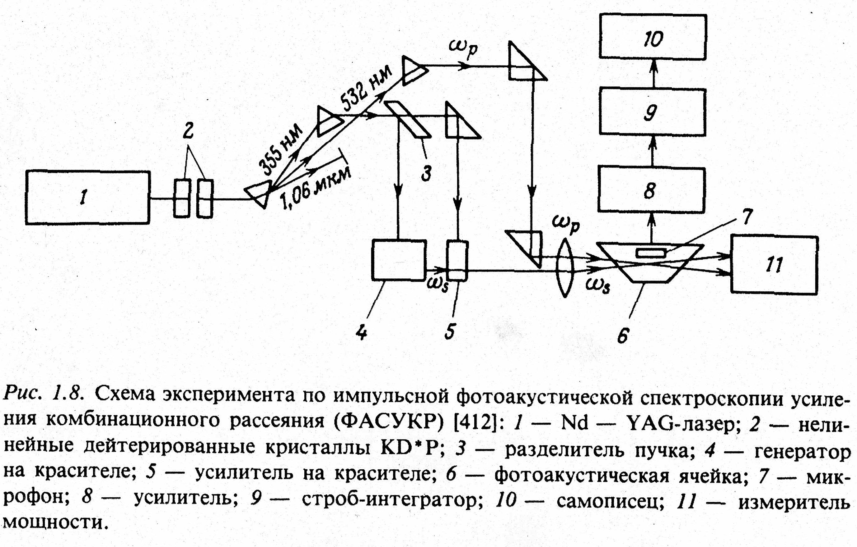

Slide 14
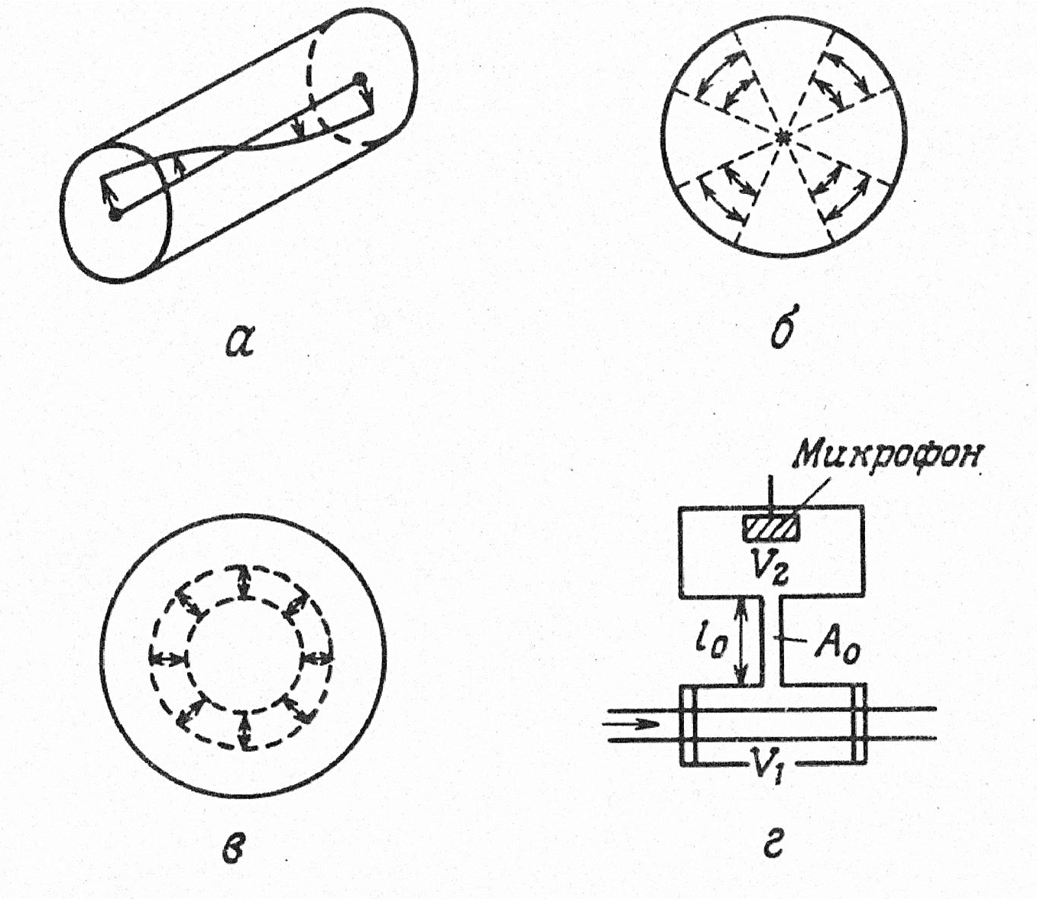
Resonant optoacoustic cuvettes
A – longitudinal resonance
B – azimuthal resonance
C – radial resonance
D – Helmoltz resonator
(A₀ perpendicular cross-sectional area of the tube, l₀ – tube length)
A
B
C
D

Slide 15
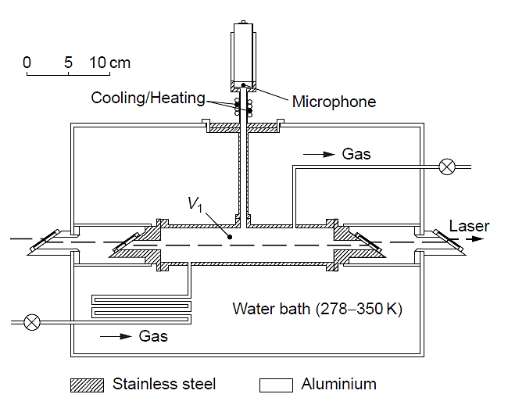
Photoacoustic cell applied for temperature-dependent investigations on fatty acids. The temperature of the water bath was varied between 278 and 350K with a cold finger and two immersion heaters, while the temperature of the microphone
was kept constant with a cooling/heating device.

Slide 16
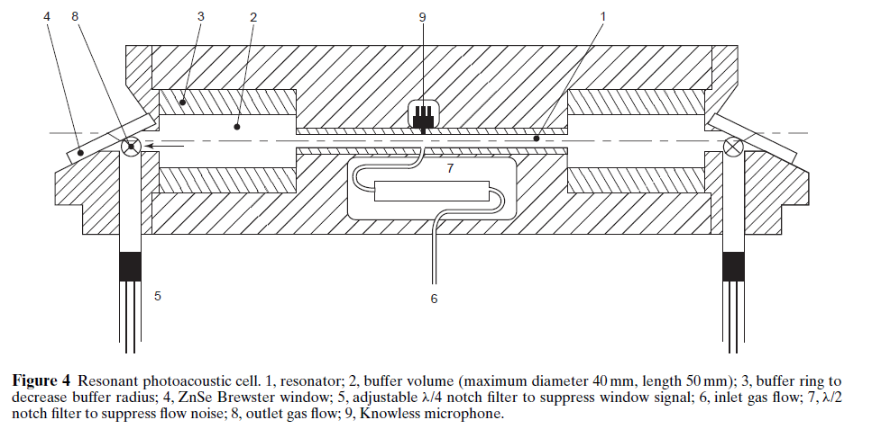
Resonant photoacoustic

Slide 17
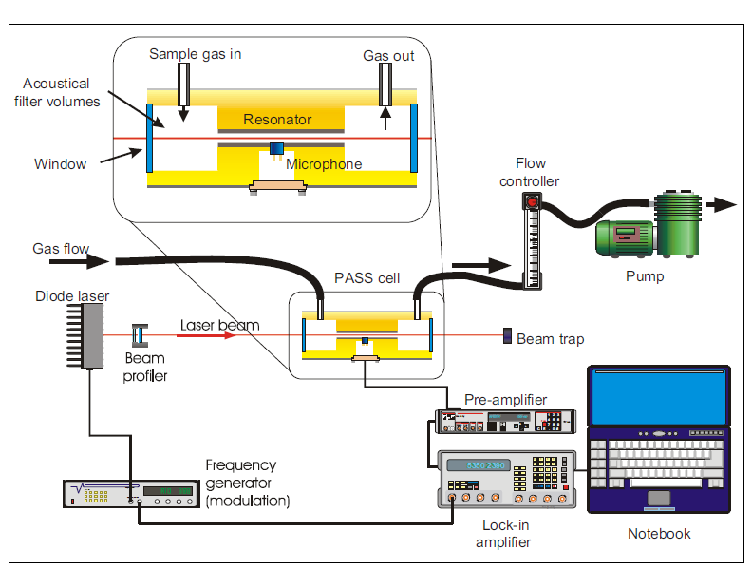
Photoacoustic soot sensor

Slide 18
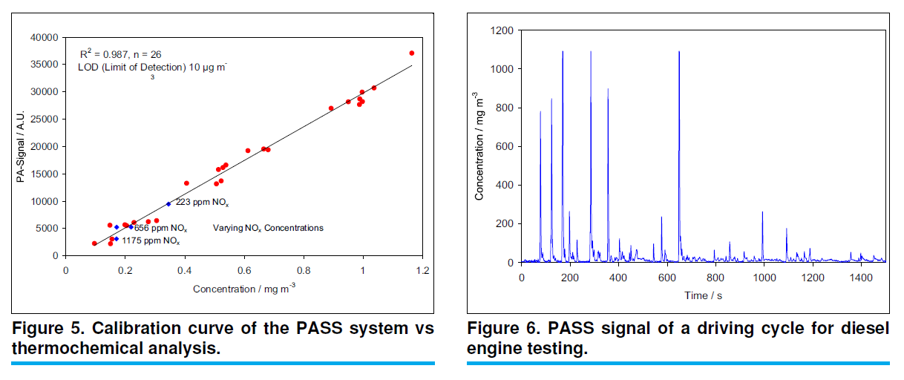

Slide 19
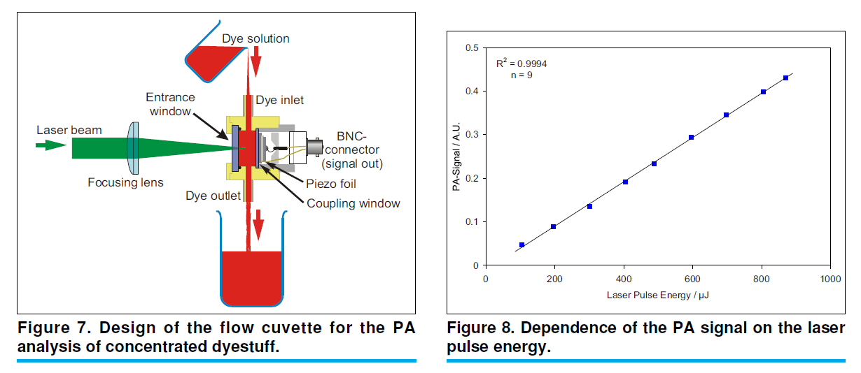

Slide 20
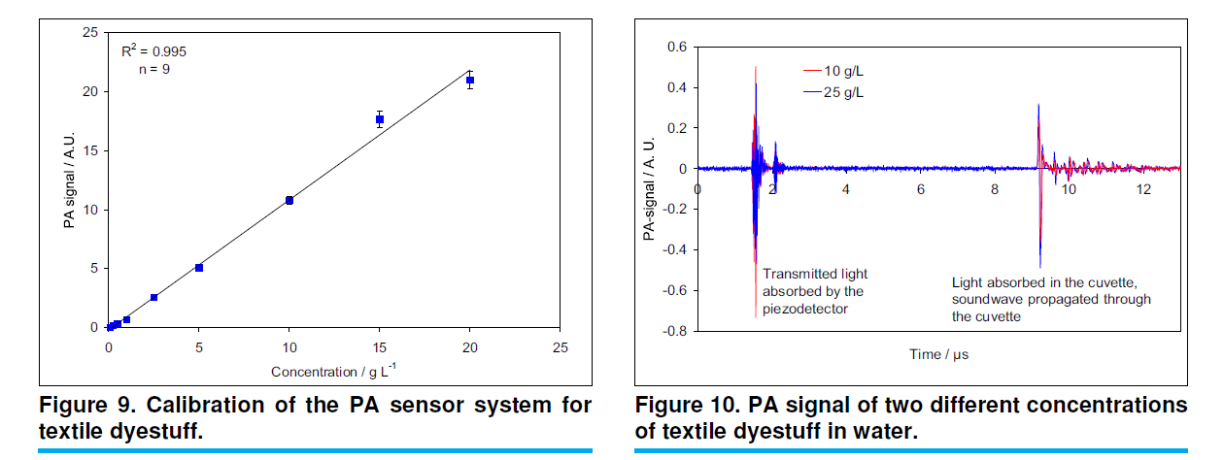

Slide 21
Photoacoustic Microscopy - PAM
Because light radiation is very easy to focus on an area of the order of 10⁻⁶ m, it is possible to perform a photoacoustic phenomenon in microscale and to obtain information about the two-dimensional distribution of the photoacoustic signal by sample scanning.
By computer processing of this information, an image can also be created on the screen where different blackening areas correspond to different intensity of the photoacoustic signal. However, it is a complex function not only of light absorption in the sample but also of its local structure, its elastic and thermal properties, and also the morphology and perfection of the sample surface.
It always depends on factors influencing not only absorption but also light scattering.

Slide 22
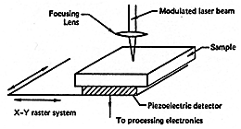
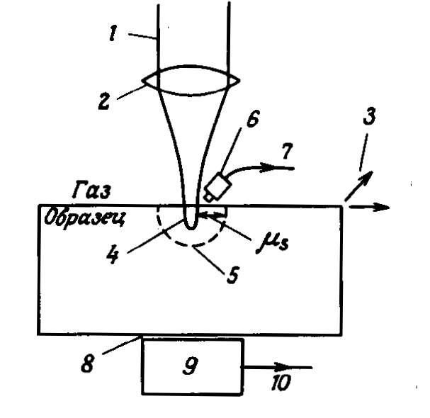
Principles of PAM
The amplitude-modulated laser light radiation is focused on a spot of about 1µm in diameter on the surface of the sample and the sample is scanned in two dimensions. The resulting photoacoustic signal is detected by a transducer in direct contact with the sample (9) or microphone (6). The electrical signal is further processed and used to create an image on the monitor screen.
As a transducer, piezoelectric grinding is usually used, which can work with high modulation frequencies, allows faster scanning and has less sensitivity to ambient noise.
Electret miniature microphones with high sensitivity and frequency range up to MHz are used as microphone.

Slide 23
PAM applications
The method provides visual information in a microscale similar to conventional optical microscopy and further allows e.g.:
to determine the local optical absorption spectrum or its differences in different places of the surface
obtain information about local thermal and elastic properties (detection of layered structures on and under the surface)
detect photovoltaic processes in semiconductor devices (the presence of short circuits or losses can be detected in a timely and non-destructive manner)
investigate photochemical processes
measure thin film thickness (by analyzing amplitude and phase of photoacoustic signal)
determine the depth profile of the examined material (by changing the wavelength of the incident light or by changing the modulation frequency, the depth of the optical penetration and the depth at which the photoacoustic signal is produced can be changed)
detect the presence of fluorescent dopants (since fluorescence reduces the PAM signal) and possibly their absorption band if it is possible to change the wavelength of the modulated excitation light.

