Slide 1



Functional Genomics and Proteomics
National Centre for Biomolecular Research
Faculty of Science Masaryk University
Protein characterization by mass spectrometry
C7250
Part IV
Zbyněk Zdráhal
RG Proteomics, CEITEC-MU
Proteomics CF, CEITEC-MU
NCBR FS MU
zdrahal@sci.muni.cz

Slide 2
C7250
Appropriate sample preparation – key stone of success
GIGO
conservation of original protein status conservation of modification status (e.g. phosphatase inhibitors)
removal of contaminants interferring MS analysis
...

Slide 3

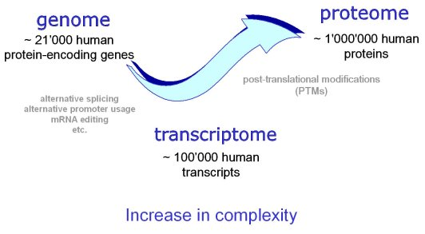
C7250
Demandingness of proteome analysis
protein number exceeds substantially number of genes
human genome contains ~21 000 genů, but human proteome might contain
~ 1 000 000 proteins and their forms
(isoforms, PTMs)
(http://www.expasy.org/sprot/hpi/hpi_desc.html)
~ 10 000 proteins in cell
wide range of protein concentrations (~ 10 orders)
necessity of efficient separation of high abundant components from low abundant ones,
no PCR-like amplification method
wide range of physico-chemical properties
protein complexes
necessity of protein complex analysis for deeper understanding mechanisms of cellular
processes
about 80% of proteins perform their funcions only as a part of a complex
proteoforms

Slide 4
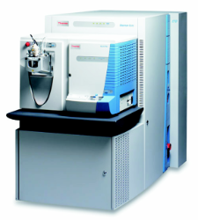
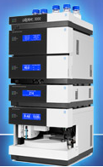
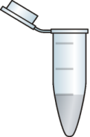

Fractionation/separation
C7250
to obtain maximum information
Direct LC-MS/MS analysis of the whole sample
~ 100 peptides
~ 10⁵ peptides
1000 peptides/peak
~ 900 peptides
scan rate
time limitation
not measured

Slide 5
Fractionation/separation
C7250
the aim: to simplify extremely complex mixture
to separate specific group of proteins/peptides (e.g. phosphopeptides)
necessity of combination of separation principles – multidimensional separation
selection of appropriate combination for given experiment
(separation dimension might be also selected method of MS analysis)
electrophoretic techniques:
isoelectric focusing (in-gel, in-liquid)
SDS PAGE
2D gel electrophoresis (DIGE)
capillary electrophoresis
chromatographic techniques:
liquid chromatography
- reverse phase
- ionex
- molecular sieve
- affinity (IMAC, MOAC, antibody)
- HILIC (hydrophilic interaction chromatography)
immunoprecipitation
off-line
on-line

Slide 6


Slide 7
C7250
Standard 1-D approaches
„SIMPLE“ MIXTURES
1-D GE
separation
protein level
protein
digestion
MALDI-MS/MS
LC-MS/MS
1-D LC-MS/MS
shotgun proteomics
protein
digestion
separation
peptide level
MS/MS
separation
protein level
MS
MS/MS
top-down
high resolution !!

Slide 8
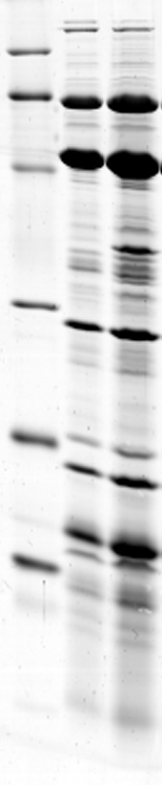

C7250
Protein isolate of bacteriophage – 1-D separation
kDa
GE
cca 50 bands
97.4
66.2
LC-MS/MS
45.0
Iden. – 5 major
proteins
31.0
21.5
concentration range
reduced possibility of minor component detection
it infuenced by
instrumentation
LC separation conditions
14.4

Slide 9
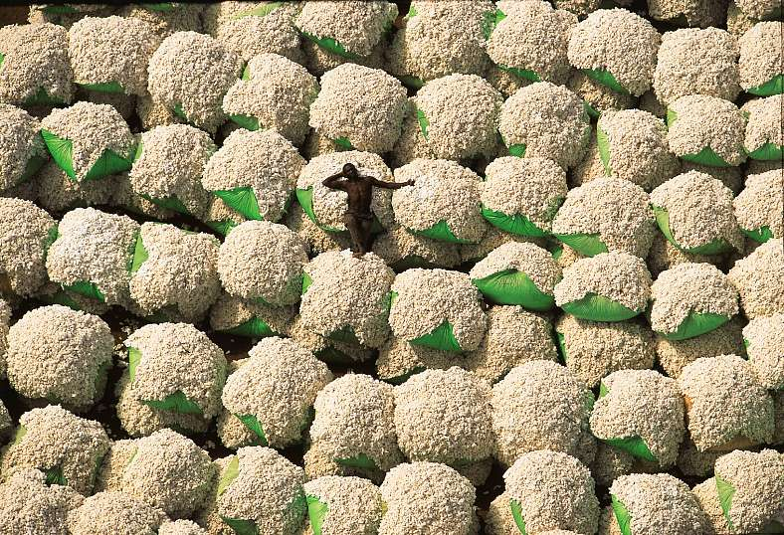

Slide 10
C7250
Classical 2-D approaches
2-D
2-D GE
MALDI-MS
MALDI-MS/MS
separation
protein level
protein
digestion
LC-MS/MS
2-D LC-MS/MS
protein
digestion
separation
peptide level
MS/MS
on-line/off-line
LC-MALDI

Slide 11
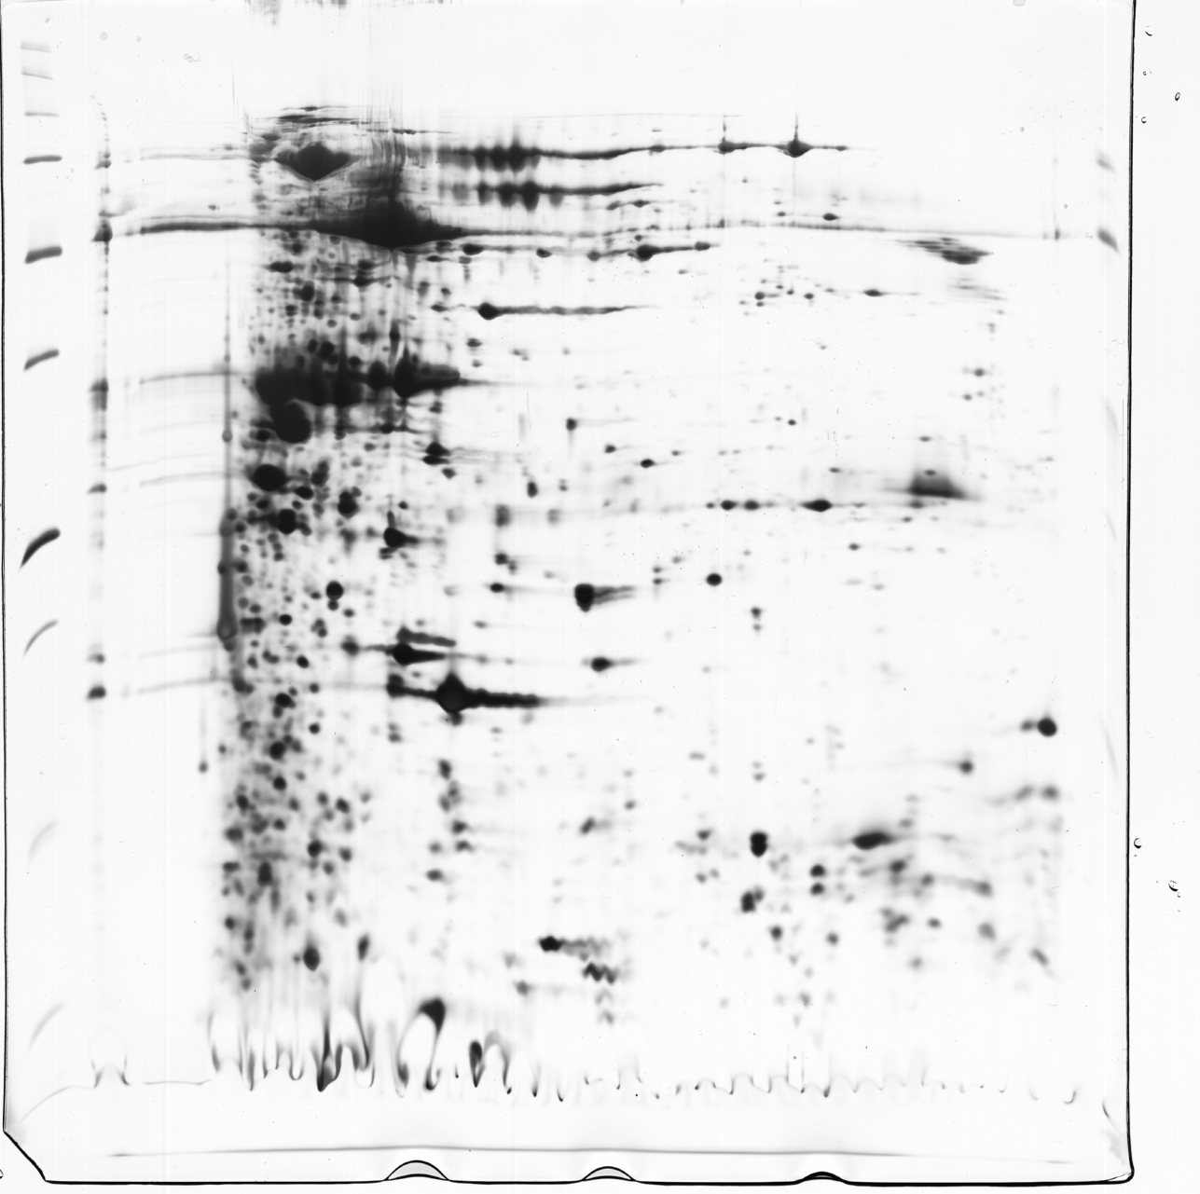
C7250
Protein isolate of bacteriophage – 2-D separation
2-D GE/MALDI-MS
≈ 700 spots
≈ 20 proteins

Slide 12

C7250
Protein mix
2-D LC
peptides
On-line (“MudPIT”)
digestion
MS/MS
1D - SCX
2D - RP
fractionation
step by step
Peptide
fraction
Peptide
fraction
Peptide
fraction
Off-line
Peptide
fraction
Peptide
fraction
1D - SCX
UV
Peptide
fraction
Peptide
fraction
LC
MS/MS
Peptide
fraction
2D - RP
MudPIT (multidimensional protein identification technology)

Slide 13
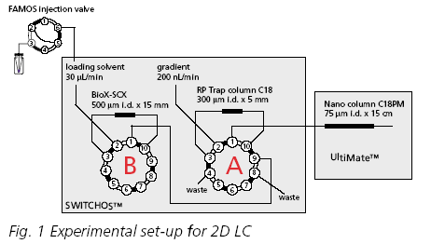
C7250
2-D LC
peptides
On-line

Slide 14
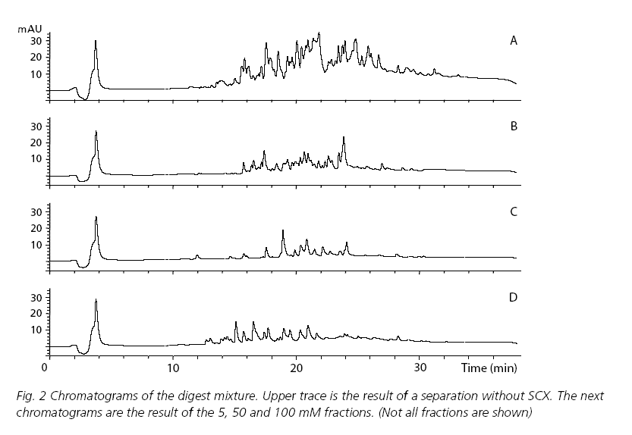
C7250
2-D LC (peptides)
On-line
1D-RP
2D-RP, fraction 5 mM
2D-RP, fraction 50 mM
2D-RP, fraction 100 mM
Dionex application note

Slide 15
2-D LC (peptides)
RP-RP
the same stationary phase – jiné pH
C7250
Orthogonality of Separation
www.ace-hplc.com

Slide 16



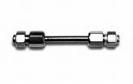

C7250
Characterization of proteome and phosphoproteome of HEK293 cells
cooperation with Assoc. Prof. Bryja group, FS MU
HEK293
Data processing
lysis
analysis of phosphofractions
LC-MS/MS (pH 3)
(Orbitrap Elite)
SDT buffer [SDS+DTT+Tris]
TiO₂
enrichment
FASP
1D LC separation
pH 10
reversed phase
TMT labeling
analysis of fractions
LC-MS/MS (pH 3)
(Orbitrap Elite)
direct analysis
w/o and with SPL
LC-MS/MS (pH 3)
(Orbitrap Elite)
Data processing
Data processing
SPL – „scheduled precursor list“ analysis enables repeated analysis of sample with exclusion of already identified peptides in previous analysis

Slide 17
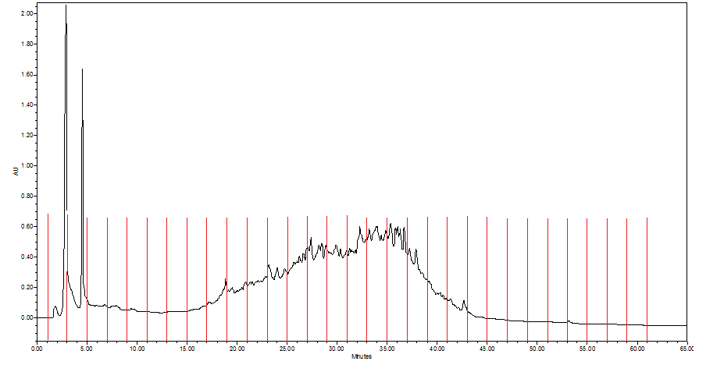
C7250
LC-separation of the digested sample in 1D (high pH)
1D LC separation
pH 10
reversed phase
1 2 3 4 5 6 7 8 9 10 11 12 13 14 15 16 17 18 19 20 21 22 23 24 25 26 27 28 29 30

Slide 18
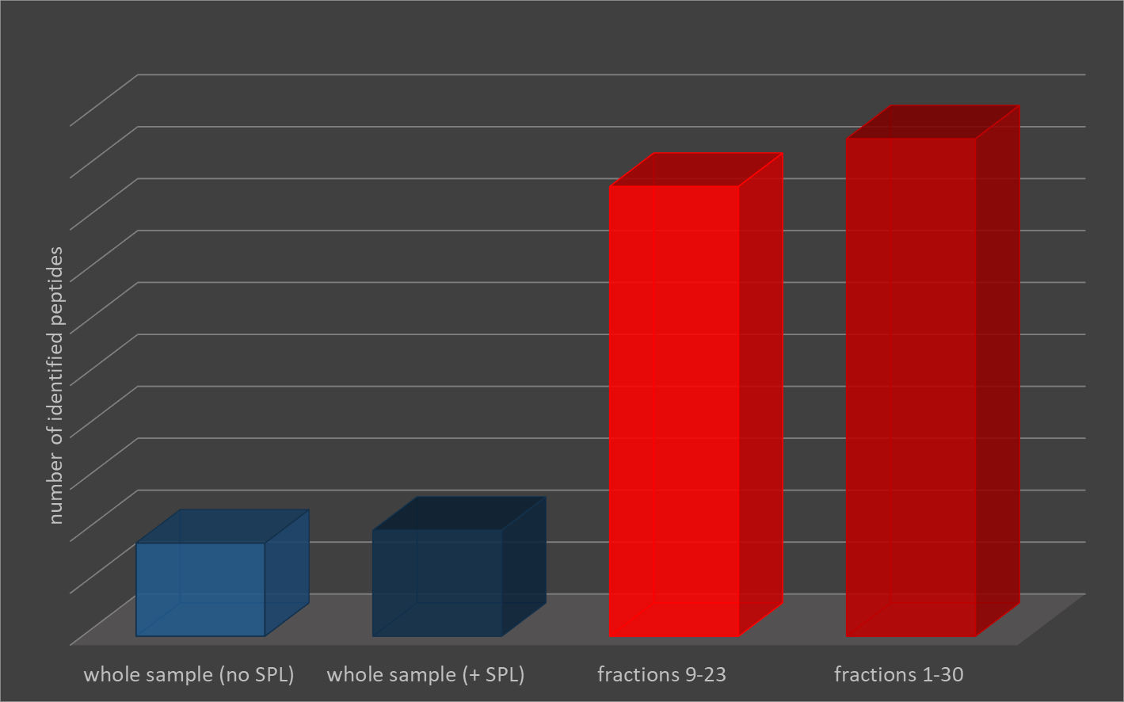
C7250
direct analysis
w/o and with SPL
LC-MS/MS (pH 3)
(Orbitrap Elite)
analysis of fractions
LC-MS/MS (pH 3)
(Orbitrap Elite)
Number of identified peptides
Data processing
Data processing
95781
86212
17931
20395

Slide 19
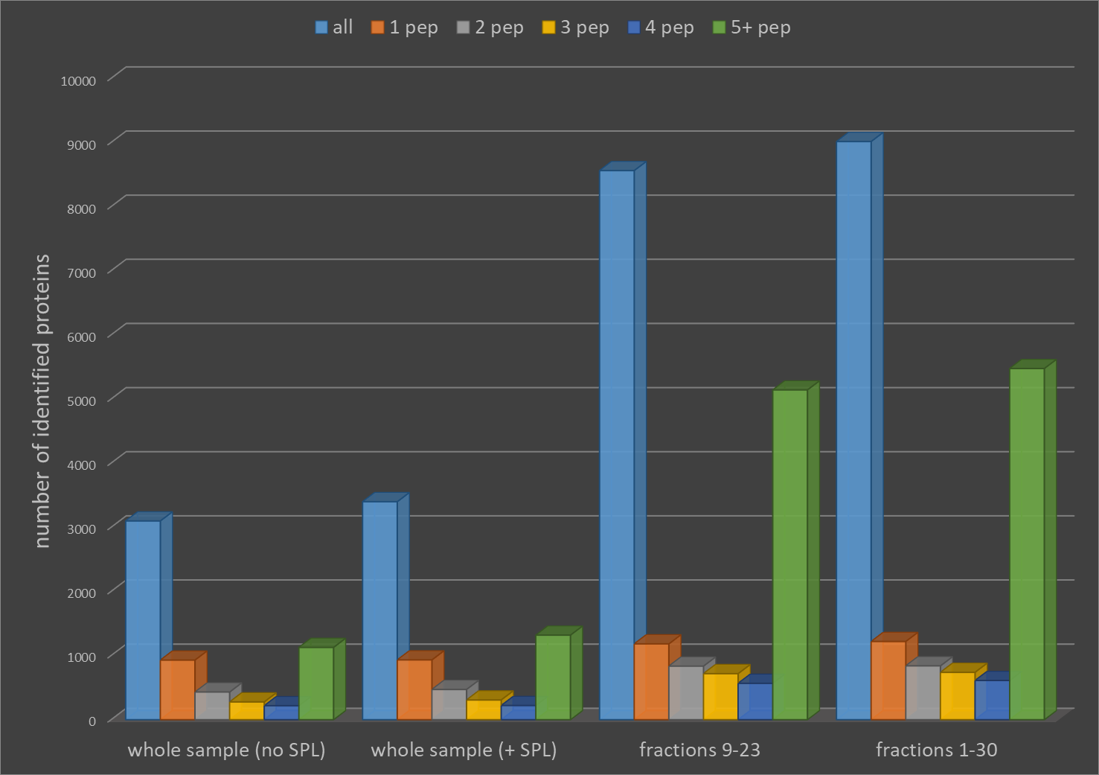
C7250
Number of identified proteins
Fractionation
three fold increase in number of identified proteins
Higher sequence coverage for most proteins
9013
8560
5474
5140
3098
3398
1126
1317

Slide 20
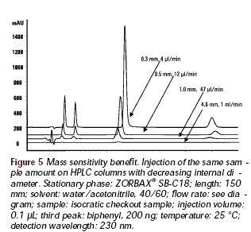
C7250
Diameter of HPLC column vs sensitivity
„Sensitivity increases with a decrease in column diameter because the same sample mass (amount) is eluted in a smaller volume. Therefore the concentration of the eluting peak is higher and the detection signal is stronger.“
Amer. Lab., 2001, 33 (10), 26-38.

Slide 21
C7250
Capillary and nano columns
Increase in sensitivity
reduction of injected sample amounts
reduced consumption of solvents
www.ace-hplc.com

Slide 22
C7250
2-D LC
peptides
sorbents
1-D: ionex
reverse phase
HILIC
IMAC (phospho)
affinity (e.g. lectin – glyco)
2-D: reverse phase
On-line vs Off-line
automation flexibility
optimalization
continuous collection of fractions

Slide 23
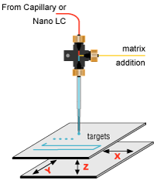
C7250
LC –MALDI
(peptides)
nano LC (RP)
Peptide
fraction
ESI-MS/MS
on-line
Deposition on MALDI target
off-line
MALDI
TOF/TOF MS
Sample storage

Slide 24


Slide 25
C7250
LC separation of complex protein mixtures
Various types of detection (e.g. UV)
Protein mix
Fractionation I.
Protein
1D fraction
Ionex, SEC, ….
exp.
Protein
1D fraction
Fractionation II.
Protein
2D fraction
RP
exp.
Protein
2D fraction
digestion
ESI-MS/MS
1D (2D) HPLC

Slide 26
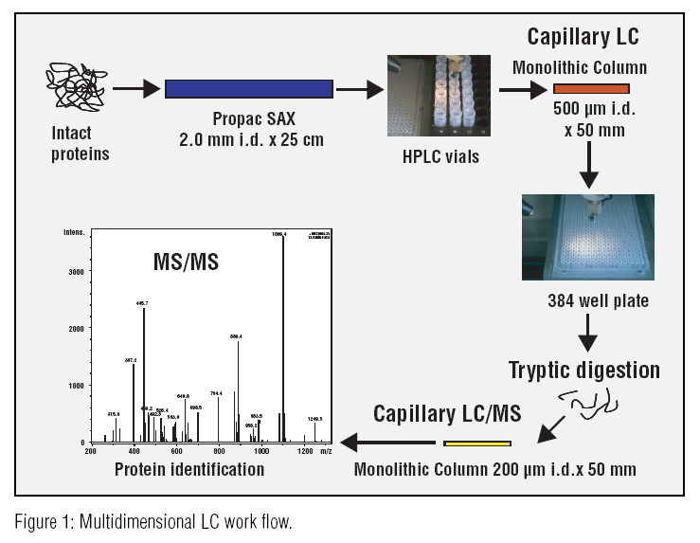
C7250
LC separation of complex protein mixtures
proteins
peptides

Slide 27

C7250
Combination of GE a LC separation
1-D GE
proteins
peptides
slices
nano 1-D LC
digestion
ESI-MSMS
protein fractionation
or
IPG strip

Slide 28
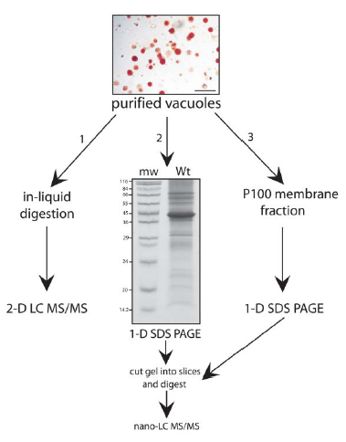
C7250
2D-Off-line (3D ?)
2D-On-line
from Carter et. al. The Plant Cell, 2004, 16, 3285–3303.

Slide 29
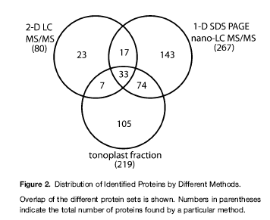
C7250
from Carter et. al. The Plant Cell, 2004, 16, 3285–3303.

Slide 30
C7250
Example of multidimensional proteome analysis (screening)
Depleted blood plasma
(3500 – 9000 proteins ??)
0. dimension
IEF (liq)
1. dimension
20 fractions
LC (RP)
2. dimension
1600 fractions
GE (1D/2D)
3/4. dimension
“ ∞ “ fractions
from H. Wang, Molecular & Cellular Proteomics, 2005, 4, 618–625.

Slide 31
C7250
A draft map of the human proteome
Min-Sik Kim et al., Nature 509, 575-581 doi:10.1038/nature13302
293 000 non redundant peptides
corresponding to proteins encoded by 17294 genes

Slide 32
C7250
Targeted separation - immunoaffinity fractionation (Y(phos))
from A.D. Zoumaro-Djayoon et al. / Methods 56 (2012) 268–274

Slide 33
C7250
Targeted MS analysis of selected proteins
Q1 „fix“
Q3 „fix“
Parent mass
CID
Fragment mass
Q1
Q2
Q3
quadrupole Q1 and Q3 are fixed to selected values of m/z ( Q1-precursor and
Q3- selected fragment), only precursors displaying production of selected
fragment during fragmentation in collisional cell are recorded
enables to follow tens of reactions (transitions) during analytical run (MRM)
from K. Bluemlein et al. / Nature protocols 6 (2011) 859 –869

Slide 34


Slide 35
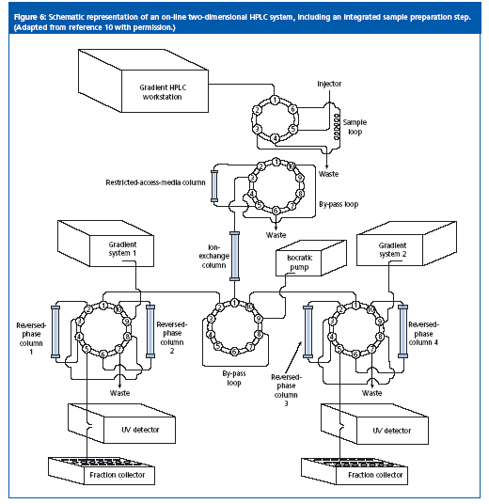
High throughput
C7250

Slide 36
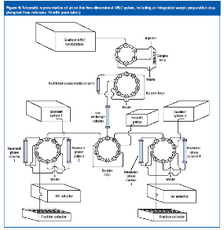
C7250
+ Miniaturization - chip technology

Slide 37


Slide 38
Functional Genomics and Proteomics
National Centre for Biomolecular Research
Faculty of Science Masaryk University
Protein quantification by MS

Slide 39
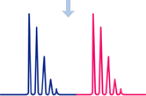
C7250
Protein quantification by MS
Approaches:
using isotopically different tags
  Absolute quantification
  determination of protein concentration (amount) by addition of
  corresponding standard with known amount (AQUA, PSAQ)
  Relative quantification
  evaluation of relative changes of the protein content in compared
  samples
  label free
  metods of absolute and relative quantification based on statistical processing of MS, or MS/MS data
  advantage of this approach is possibility of comparison of unlimited number of samples and absence of derivatization reaction or isotopically labeled standards

Slide 40
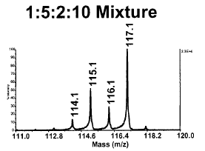
Relative quantification approaches
C7250
Protein sample A
Protein sample B
SILAC, in-vivo
100%
ICAT, ICPL, iTRAQ
Separated digestion of samples
Digestion of pooled samples
MS/MS
iTRAQ, ¹⁶O/ ¹⁸O
LC-MS
LC-MS/MS (iTRAQ)
Identical peptides in MS mode
are not distinguished
Identical peptides from different samples
are distinguished

Slide 41
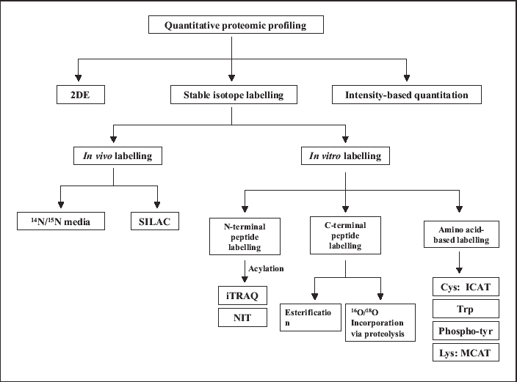
C7250
Overview of relative quantification methods
W. Yan, S.S. Chen, Briefings in functional genomics and proteomics 4 (1), 1–12, (2005)

Slide 42
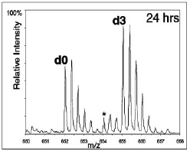
C7250
Stable Isotope Labelling with Amino acids in Cell culture (SILAC)
A
B
in vivo
proteins are labeled by growing cells
in media containing isotopically labeled
amino acids
(e.g. ²H-Leu, ¹³C-Lys, ¹³C-Tyr,¹³C-Arg,
¹³C/¹⁵N-Arg)
AA normal
AA labeled
cell growing
combining
purification
digestion
MS quantification
picture from Ong et al.: MCP 1(2002), 376

Slide 43
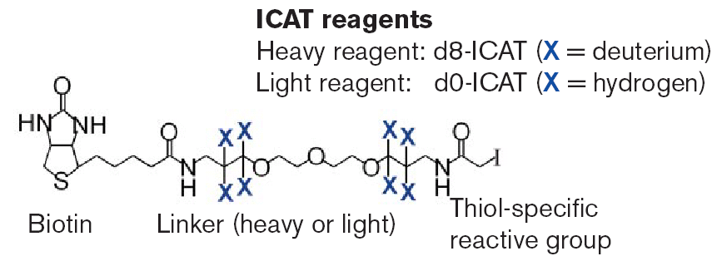
C7250
ICAT ... Isotope-Coded Affinity Tags
technology for protein expression analysis
improved quantitation of a wider range of proteins
overcomes limitations of 2-D gel method (e.g. membrane, low abundant proteins)
tags specific for cysteine-containing peptides (reduction of sample complexity)
easy automation of a procedure

Slide 44
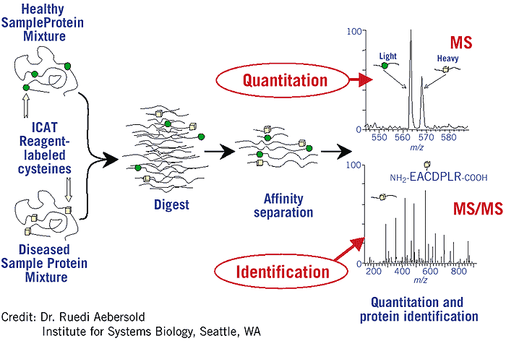
C7250
ICAT analysis
peak ratios = relative abundance

Slide 45
C7250
Comparison of in vivo and in vitro quantification methods (SILAC vs ICAT)
Cell cultures
from Ong et al.: MCP 1 (2002), 376

Slide 46
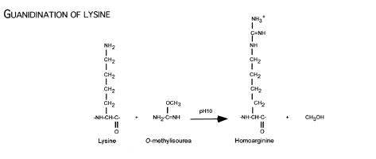
C7250
Mass Coded Abundance Tagging (MCAT)
tryptic digestion
modification of digest of selected sample (K)
mixing nemodif/modif in ratio 1:1
Δ = 42 Da
Cagney G., Emili A.: Nature Biotechnol 20 (2002), 163-170

Slide 47
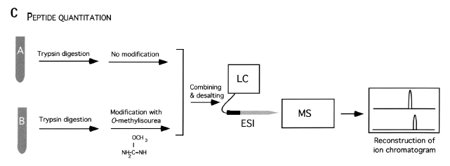
C7250
MCAT
1:1
Cagney G., Emili A.: Nature Biotechnol 20 (2002), 163-170

Slide 48
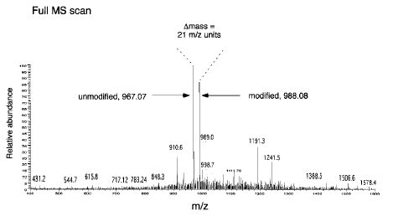
C7250
MCAT
peak ratios = relative abundance
Cagney G., Emili A.: Nature Biotechnol 20 (2002), 163-170

Slide 49
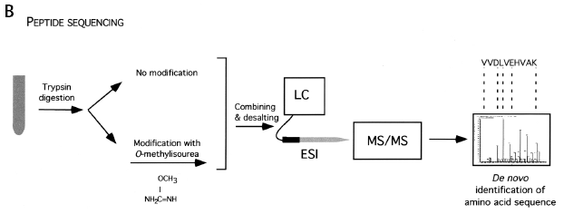
C7250
MCAT
possibility of utilization of derivatization for de novo sequencing
b ions unchanged , y ions in doublets (42 Da)

Slide 50
C7250
Reductive alkylation - dimethylation
- lysine and N-term of peptide
- isotopically labeled formaldehyde (D, ¹³C)
Hsu et al., Anal.Chem. 2003

Slide 51
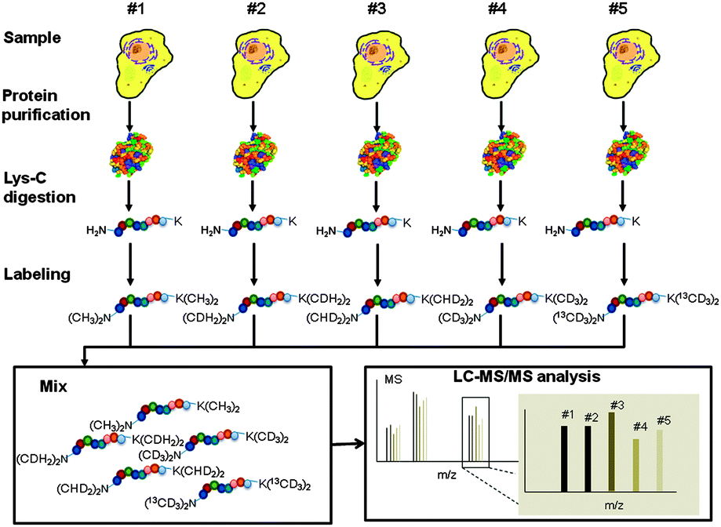
C7250
Reductive alkylation - dimethylation
Wu et al., Chem. Commun. 2014

Slide 52
C7250
Reductive alkylation - dimethylation
Wu et al., Chem. Commun. 2014

Slide 53


Slide 54
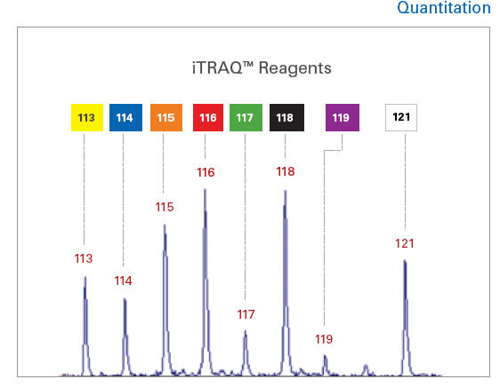
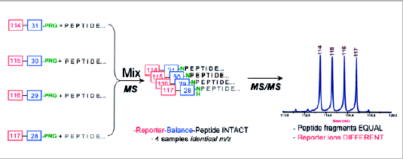
C7250
iTRAQ
isobaric tags (4, 8), preferentially on Lys
labeled samples have the same behavior during LC separation and MS analysis
quantification based on intensity ratios of reporter ions after MS/MS
1:1:1:1
Applied Biosystems
similarly TMT tags (Thermo Fisher Scientific) – 6/10 tags (see later)

Slide 55
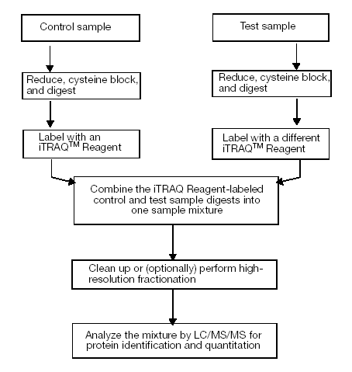
C7250
iTRAQ
Applied Biosystems

Slide 56
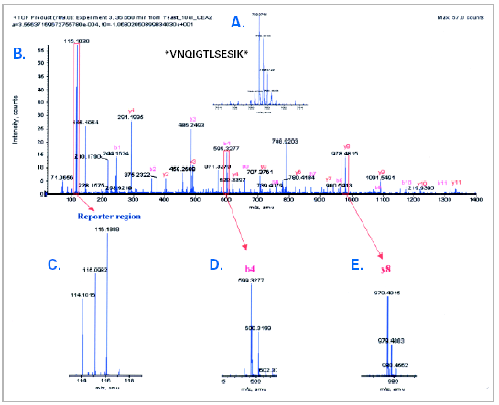
C7250
iTRAQ
Applied Biosystems

Slide 57
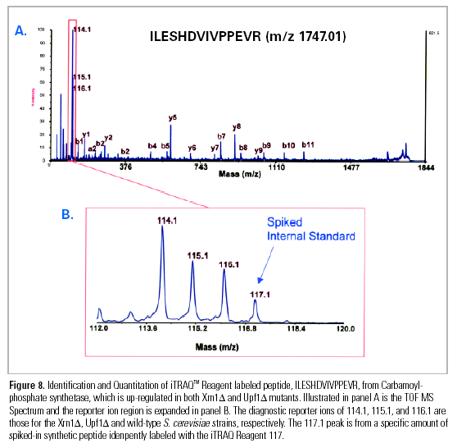
C7250
iTRAQ
Applied Biosystems

Slide 58
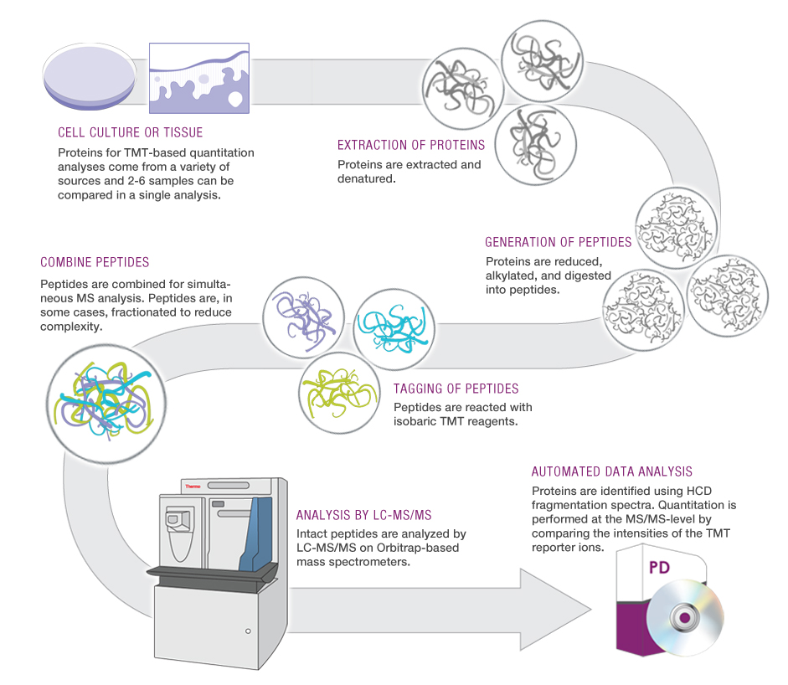
C7250
TMT labels
Tandem Mass Tags
TMT značky
from http://planetorbitrap.com

Slide 59
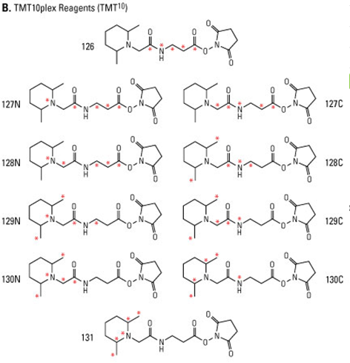
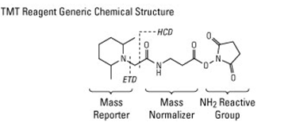
TMT
C7250
isobaric labels (up to 16-plex)
MS/MS
lysine labeling
Cysteine-reactive mass tags (6-plex)
quantitation of the relative abundance of cysteine modifications, such as S- nitrosylation, oxidation and disulfide bonds
Carbonyl-reactive mass tags (6-plex)
glycan, steroids, or oxidized proteins quantification
Thermo Fischer Scientific

Slide 60
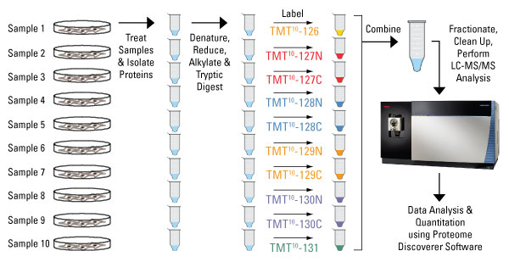
C7250
TMT
Thermo Fischer Scientific

Slide 61
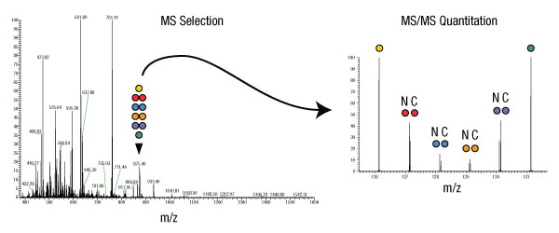
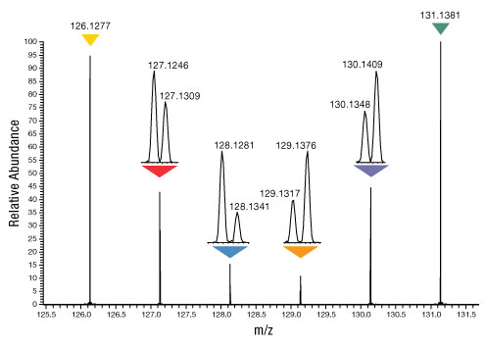
C7250
TMT
Reagents contain different numbers and combinations of 13C and 15N isotopes in the mass reporter. The different isotopes result in a 10-plex set of tags that have mass differences in the reporter that can be detected using high resolution Orbitrap MS instruments.
Thermo Fischer Scientific

Slide 62
EASI-tag
Easily Abstractable Sulfoxide-based Isobaric tag
C7250
(a) Molecular structures of the triplex version of EASI-tag. The isobaric labeling reagents are composed in a
modular way of four functional groups and feature a central sulfoxide moiety, which introduces an asymmetric,
low-energy cleavage site (zig-zag lines indicate fragmentation site). The stable-isotope labeled positions of the
neutral loss and equalizer group for multiplexing are indicated by asterisks. Standard labeling protocols can be
applied to couple peptides via the amine-reactive moiety.
(b) Mass spectra of an EASI-tag-labeled yeast peptide mixed in a ratio of 1:3:10. HCD fragmentation of the doubly charged precursor ion abstracts the neutral loss group and yields the peptide-coupled reporter ion cluster.
bioRxiv preprint first posted online Nov. 27, 2017; doi: http://dx.doi.org/10.1101/225649

Slide 63
EASI-tag
Easily Abstractable Sulfoxide-based Isobaric tag
C7250
(c) Co-isolation of the natural isotope cluster in a standard isolation window centered on the precursor ion (upper panel) convolutes the relative abundance of peptide coupled reporter ions. An asymmetric isolation window (lower panel) that suppresses the signal from adjacent isotope peaks and enables direct quantification of reporter ions.
(d) The precursor mass information is retained in the peptide-coupled reporter ions for EASI-tag labeled peptides. Colored peaks indicate the peptide-coupled reporter ions from an identified yeast peptide in a two proteome experiment (mixing ratios: 1:3:10 for yeast & 1:1:1 for human). Grey peaks are peptide-coupled reporter ions from a co-isolated peptide.
(e) EASI-tag- and TMT-labeled HeLa peptides were fragmented with normalized collision energies between 10 and 34. (N = 17,565 precursors for EASI-tag & 20,610 for TMT)
bioRxiv preprint first posted online Nov. 27, 2017; doi: http://dx.doi.org/10.1101/225649

Slide 64


Slide 65

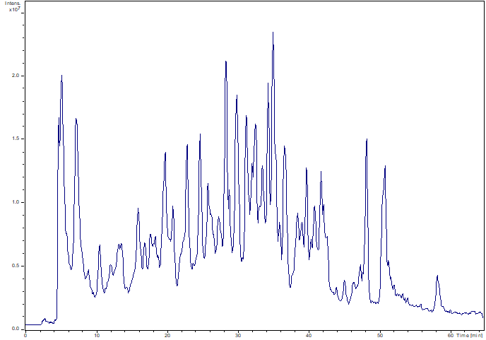
C7250
Label – free approach
No labels
Samples measured individually
Comparison of „unlimited“ number of samples
Identification based on MS/MS data, connection of identity to individual signals (intensity, area)
normalization
imputation of missing values
calculation of fold changes for individual proteins among samples
LC-MS/MS
noise removal
peak detection
intensity/area calculation for individual peaks
Statistics evaluation
significant changes in proteome
induced by stimuli under study
Critical steps:
  data normalization
  imputation of missing values (DIA – reduction of number of missing values)

Slide 66
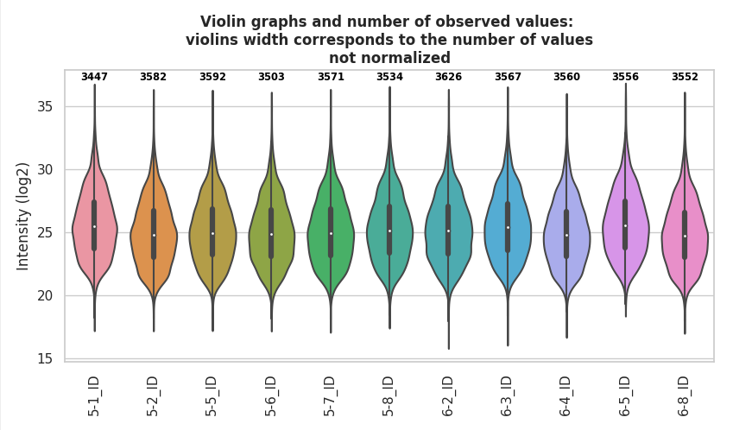
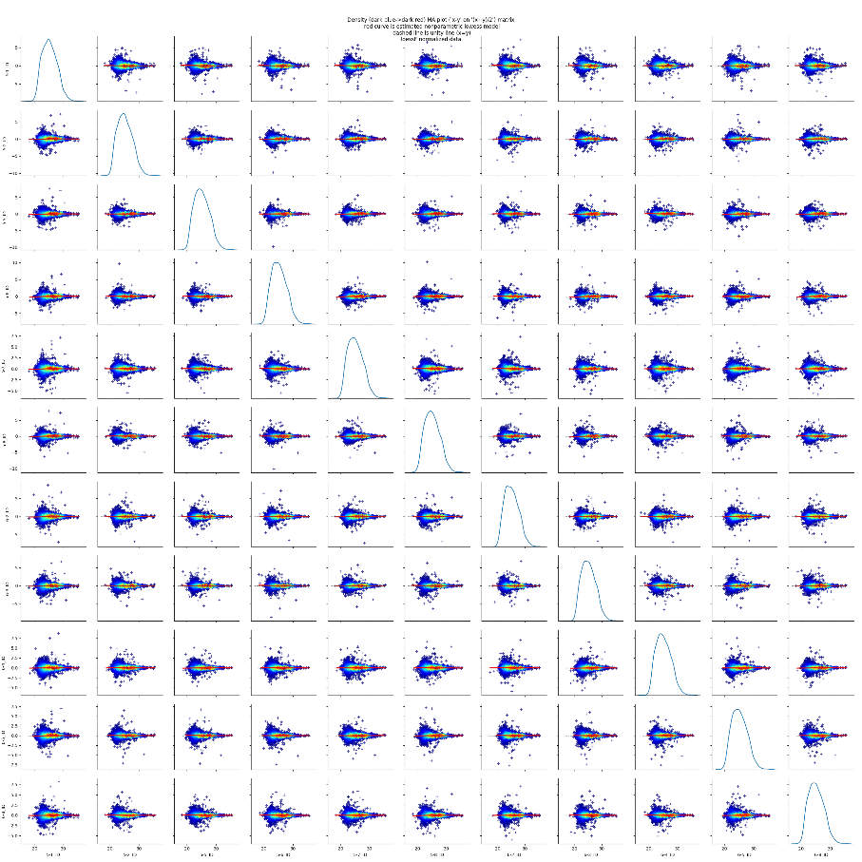
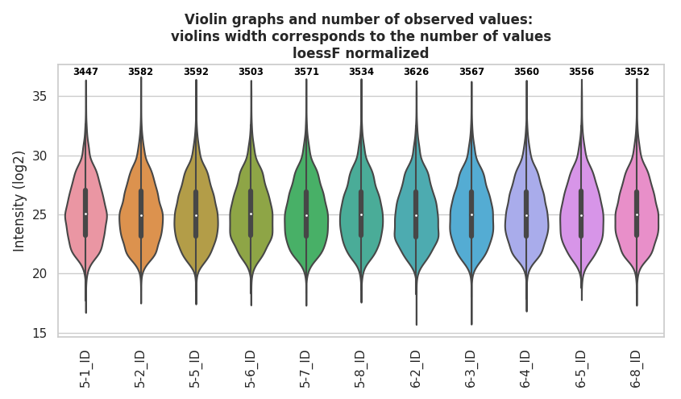
C7250
Label – free approach
MA plots - dependence of (x-y) on (x+y)/2

Slide 67
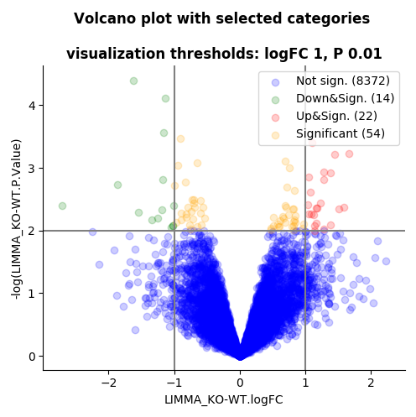
C7250
Label – free approach

Slide 68


Slide 69




C7250
Absolute quantification using AQUA peptides
AQUA Peptide Selection
Order selected peptide isotopically labeled (¹⁵N, ¹³C)
Adding labeled peptide to protein mix
Digest
Analyze by LC-MS/MS to quantitate protein of interest
Select an optimal tryptic peptide and stable isotope amino acid from the sequence of your protein of interest
Optimize LC-MS/MS separation protocol for quantitation
Price !!!
Only for selected protein

Slide 70
C7250
Absolute quantification
AQUA peptides
QconCAT
PSAQ
construction of artificial gene for expression of proteotypic peptides originated from up to 20 proteins
synthesis of
isotopically labeled proteotypic peptides
expression of the whole
izotopically labeled protein (plus tag for purification)
expression in E.coli using labeled medium
purification of artificial protein
protein purification
addition of known amount into sample
addition of known amount into sample
addition of known amount into sample
digestion
digestion
digestion
MS analysis
MS analysis
MS analysis
Rivers at al., MCP 6, 1416 (2007)
Brun et al., MCP 6, 2139 (2007)

Slide 71
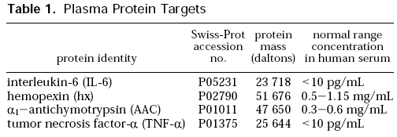
C7250
Absolute quantification
Stable Isotope Standards and Capture by Anti-Peptide Antibodies
(SISCAPA)
MRM
PRM
S. Pan, J. Proteome Res., 8, 787 (2009)
N.L. Anderson, J. Proteome Res., 3, 235 (2004)

Slide 72


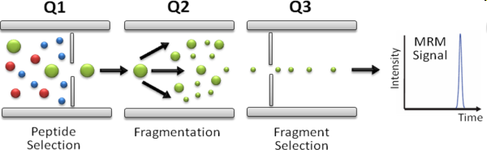
C7250
Targeted MS/MS analysis of selected proteins
relative /absolute quantification
multiple reaction monitoring (MRM)
screening – selection of candidate protein
method establishment (selection of MRM transitions – peptide + selected fragment)
final analysis and data processing
In-solution
digestion
LC-MS/MS – MRM mode
Protein mixture
Peptides
Similarly PRM
http://www.srmatlas.org

Slide 73
C7250
Multiplex Immuno-Liquid Chromatography−Mass Spectrometry−
Parallel Reaction Monitoring (LC−MS−PRM)
Quantitation of immune markers CD8A, CD4, LAG3, PD1, PD-L1, and PD-L2
in Frozen Human Tissues
Zhang et al., J. Proteome Res. 2018, 17, 3932−3940

Slide 74
C7250
Accurate MS-based Rab10 Phosphorylation Stoichiometry
Karayel et al., Mol Cell Proteomics (2020) 19(9) 1546–1560
assay to measure increased phospho Rab levels using synthetic stable isotope-labeled analogues for both phosphorylated and non-phosphorylated tryptic peptides surrounding Rab10-Thr73
Limit of detection (LOD) of SIL Rab10-pThr73 tryptic peptide (FHpTITTSYYR) with various acquisition methods; full MS, SIM, mxSIM and PRM.

Slide 75
Absolute Quantification of over 1800
Yeast Proteins
C7250
Lawless C., MCP,15, 1309–1322, 2016.

Slide 76

The end

