Slide 1



Functional Genomics and Proteomics
National Centre for Biomolecular Research
Faculty of Science · Masaryk University
Protein characterization by mass spectrometry
C7250
Part I
Zbyněk Zdráhal
RG Proteomics, CEITEC-MU
Proteomics CF, CEITEC-MU
NCBR FS MU
zdrahal@sci.muni.cz

Slide 2
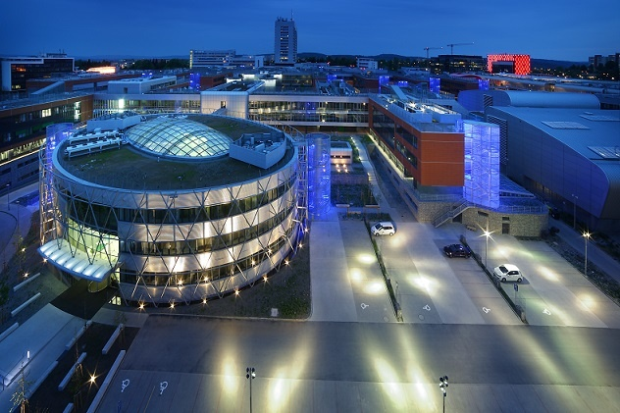


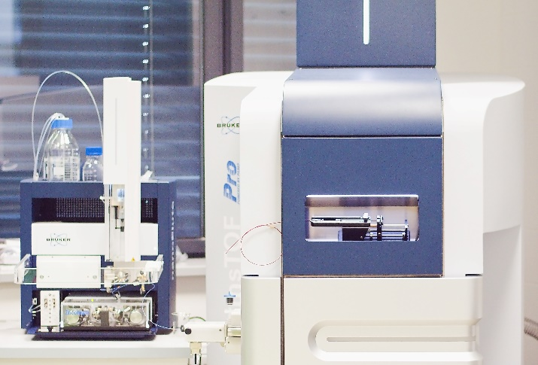
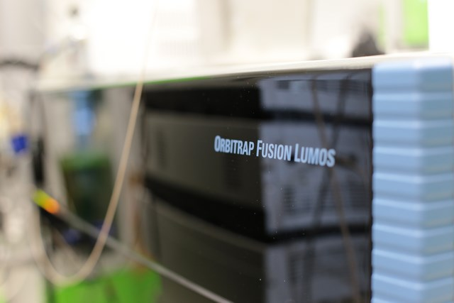

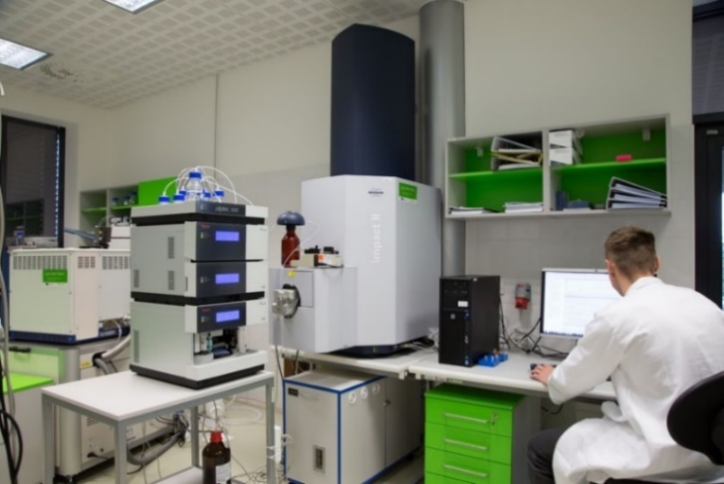
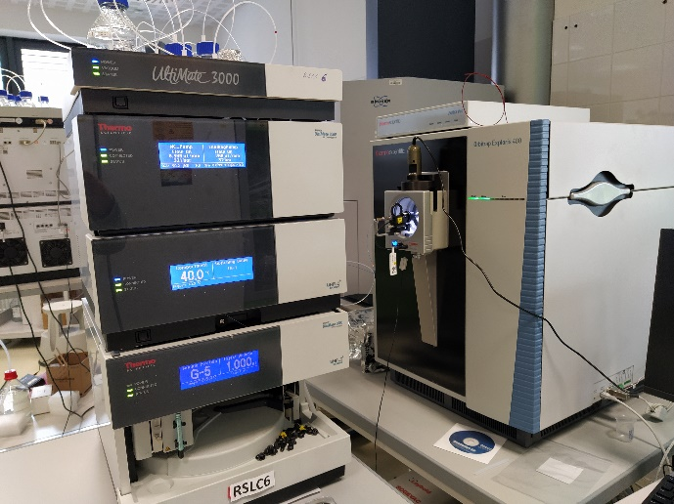
Zbyněk Zdráhal
Phone: +420 777 926 602
E-mail: zbynek.zdrahal@ceitec.muni.cz
CF: www.ceitec.eu/proteomics-core-facility/cf95
RG: www.ceitec.cz/proteomika-zbynek-zdrahal/rg49

Slide 3
C7250
Aims of course:
    applications/potential of mass spectrometry in proteomics
    basic approaches of MS analysis
    „interpretation/validity“ of MS results
MS
Core Lab

Slide 4
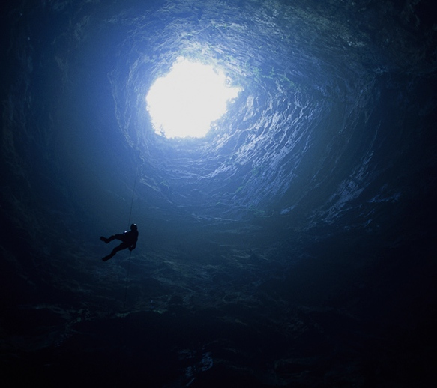

Slide 5
C7250
Proteins are responsible for both the structure and the functions of all living organisms.
Genes are simply the instructions for making proteins.
IT IS PROTEINS THAT MAKE LIFE.
http://www.biology-pages.info/P/Proteomics.html

Slide 6
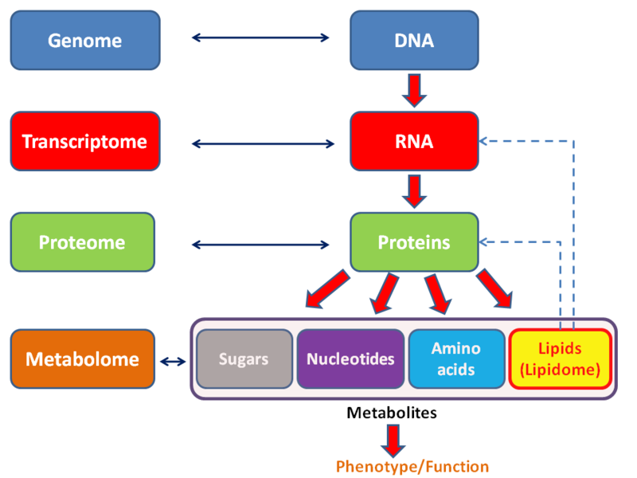
C7250
http://en.wikipedia.org/wiki/File:Metabolomics_schema.png

Slide 7
C7250
Proteomics – discipline dealing with proteome analysis
what might happen
what is really happening
Transcriptomics
Proteomics
Genomics
mRNA
protein
functional
protein
DNA
transcription
posttranscriptional modifications
(alternative splicing etc.)
translation
posttranslational mods
Protein complexes

Slide 8
C7250
Proteomics - Why?
several proteins/proteoforms might form from each gene, not possible to
indicate them by DNA/RNA analysis
there no direct correlation between mRNA content and final content of
proteins
functionality of protein depends frequently on its interaction with other
proteins or DNA/RNA
only at protein level epigenetics factors of gene expression regulation are
detectable

Slide 9
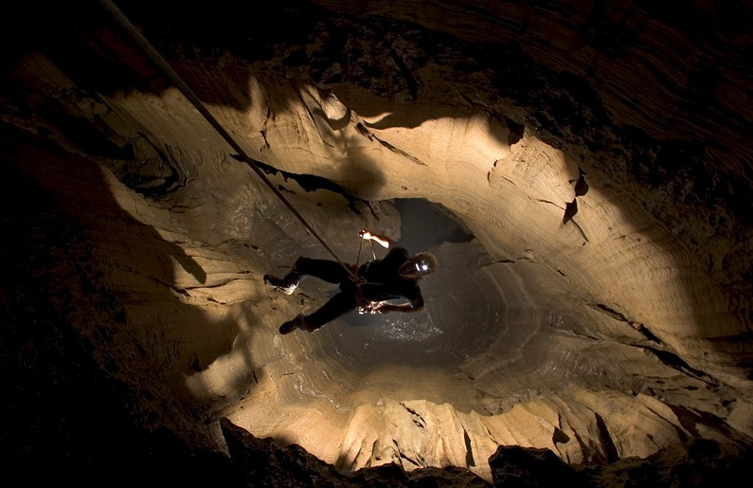

Slide 10

C7250
Proteome
The Desperate Man, Gustave Courbet
the word “proteome” is derived from PROTEins expressed by a genOME, and it refers to all the proteins produced by an organism
Marc Wilkins in 1994
the complement of proteins expressed in a cell, tissue, or organism by a genome
the entire complement of proteins found in an organism over its entire life cycle, or in a particular cell type at a particular time under defined environmental conditions.
The entire set of proteins expressed by a genome, cell, tissue or organism at a certain time. More specifically, it is the set of expressed proteins in a given type of cell or organism, at a given time, under defined conditions.
proteotype

Slide 11


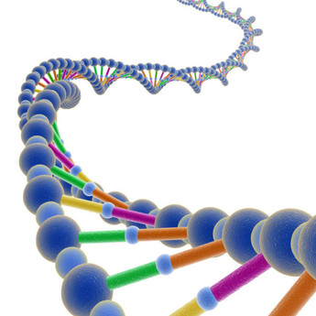




C7250
Genome vs Proteome
static
the same genome
different proteome
dynamic

Slide 12
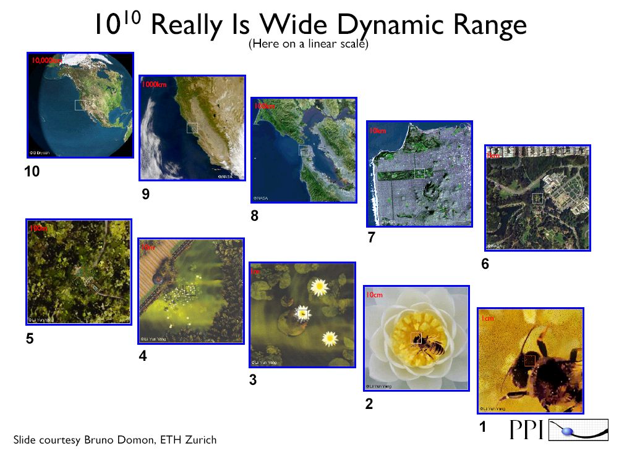
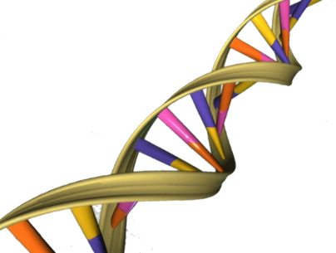
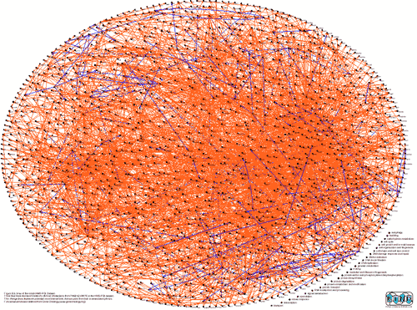
C7250
Genome versus Proteome
relatively stable all proteins including
DNA sequence all their forms in cell (tissue, organisms) at given time under given conditions
4 basic building units 20 (22) basic building units
range of concentrations over 10 orders
efficient analytical techniques necessity of development of developed (PCR, NGS) sensitive and reliable techniques for identification and quantitation

Slide 13
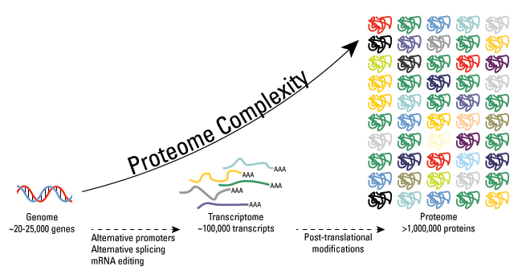
C7250
Genome vs Traskriptome vs Proteome
Estimates for human
http://www.piercenet.com/method/overview-post-translational-modification

Slide 14
C7250
Proteome complexity
Aebersold R. et al, Nat. Chem. Biol., 14, 206–214 (2018)
74 unique histone H4 proteoforms out of 3 000 000 theoretically possible (based on known PTMs) were detected in differentiating human embryonic stem cells.
The nature behaves rationally or technologies are still not developed enough
Phanstiel D. et al, PNAS, 105, 4093–4098 (2008)

Slide 15
C7250
Proteomics
Proteomics is the large-scale study of proteins, particularly their structures and functions.
The first is the more classical definition, restricting the large-scale analysis of gene products to studies involving only proteins.
The second and more inclusive definition combines protein studies with analyses that have a genetic readout such as mRNA analysis, genomics, and the yeast two-hybrid analysis (Pandey A, Mann M Nature. 2000 Jun 15; 405(6788):837-46)
proteom
Proteomics has been enabled by the accumulation of :
DNA and protein sequence databases
improvements in mass spectrometry
computer algorithms for database searching.
YY-protein
protein
protein
protein
protein
protein
protein
protein
protein
protein
protein
protein
protein
protein
protein-X
protein
protein
protein
protein
protein
protein
protein
protein
protein
protein
W-protein-Z
protein
protein
protein
protein
protein
protein

Slide 16
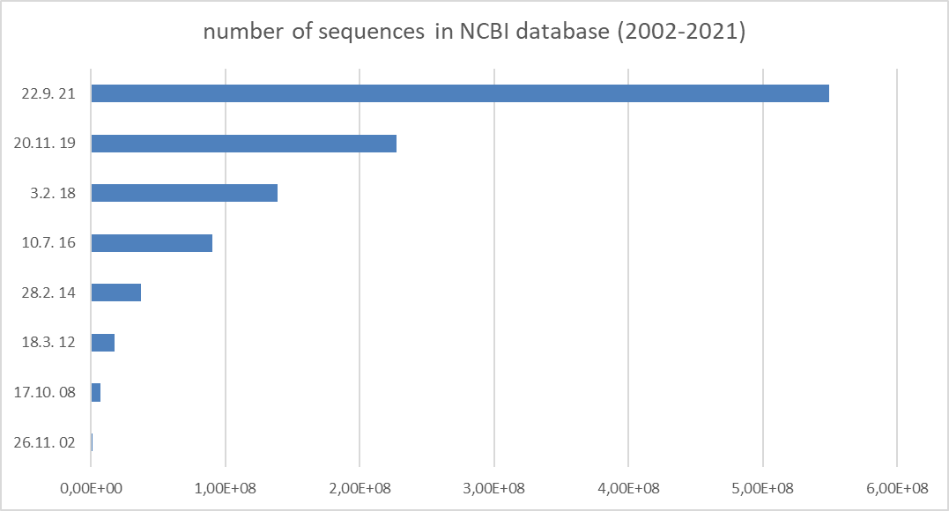
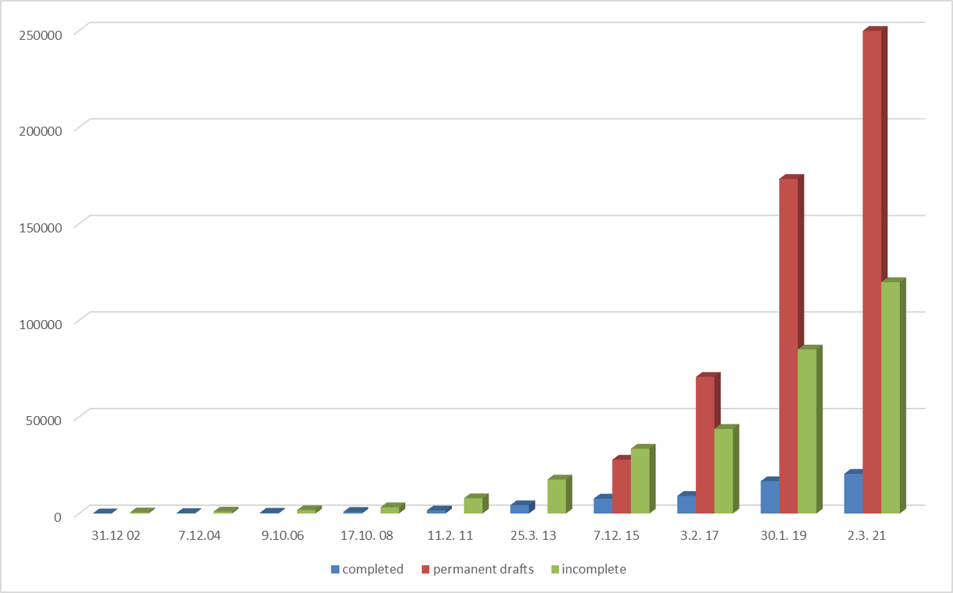
C7250
Increase in knowledge of genomes
protein characterization by MS is in principle based on knowledge of primary sequence
UniProtKB ~220 mil. sequences
https://gold.jgi.doe.gov/

Slide 17
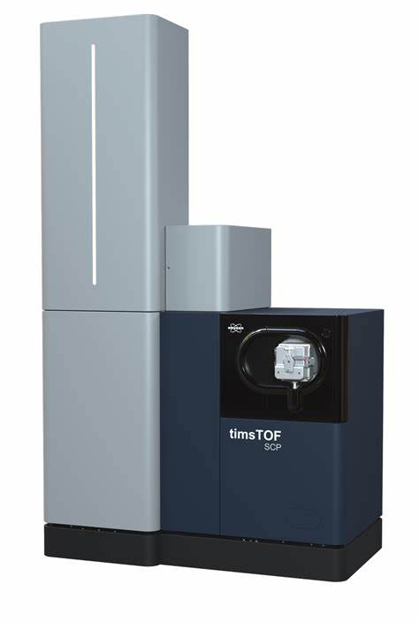
C7250
Single cell proteomics
Mass spectrometry technology progress
HeLa cells, FACS, LC-MS/MS (TimsTOF Pro)
0,8 ng of digest ~ 3 HeLa cells
Brunner A.-D. et al. bioRxiv (2021), https://doi.org/10.1101/2020.12.22.423933

Slide 18

C7250
mass spectrometry
enables simultaneous qualitative and quantitative characterization of thousands of proteins
Analysis of „proteome“
MS

Slide 19
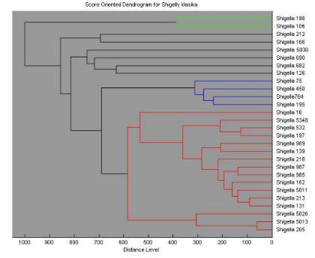
C7250
Mass spectrometry in proteomics
Intact mass analysis
(MW, MALDI-MS profiling)
Protein identification
(incl. protein complexes, de novo sequencing)
S_{phos}
Characterization of protein modifications
Δ m/z = 167
m/z
Protein quantification
(relative and absolute quantification)
MALDI-MS imaging,
3D structure

Slide 20
C7250
Proteomic approaches
Differential (expression) proteomics
Functional proteomics
Structural proteomics

Slide 21
C7250
Differential (expression) proteomics
Qualitative and quantitative comparison of proteomes
aim – determination of changes at protein (and their forms
(e.g. PTMs)) levels
which were induced by internal or extermal stimuli.
control
stress
Rhodotorula glutinis
Cooperation with prof. Márová, FCH BUT Brno

Slide 22
C7250
Differential proteomics
Targeted approach
Monitoring of quantitative changes of selected proteins (e.g. biomarkers) in sample sets.
Determination of enterotoxin (S. aureus)
MS
MS/MS
is
internal std
real
real
LC-MS/MS (MRM, PRM)

Slide 23
C7250
Functional proteomics
Study of interactions of proteins and their functional context
- protein-protein interactions
- architecture of protein complexes
- protein interactions with other types of molecules (RNA, DNA
metabolites ...)
L. Kozakova et al.,
Cell Cycle, 14 (6), 920-930 (2015)
K.G. Guruharsha et al., Cell, 147, 690–703 (2011)

Slide 24
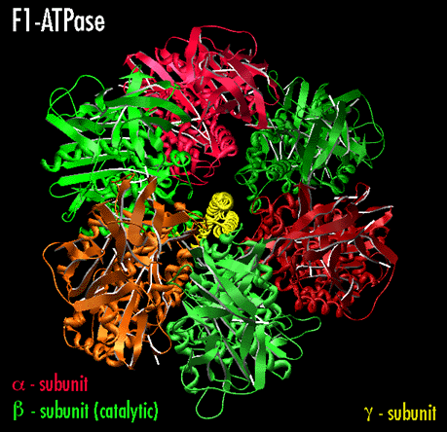
C7250
Structural proteomics
Study of higher levels of protein structure (tertiary, quaternary) and relation of a structure to protein function.
X-ray crystalography
NMR
cryoEM
MS (in minority)
Structure is formed by different types of bonds – ion interactions, hydrogen bridges, van der Waals forces or disulfidic bridges.

Slide 25
Functional Genomics and Proteomics
National Centre for Biomolecular Research
Faculty of Science Masaryk University
MS instrumentation
and
proteins

Slide 26
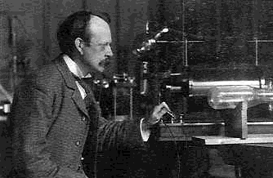
C7250
History of mass spectrometry
Thomson J.J. (1856 – 1940)
On the Masses of the Ions in Gases at Low Pressures
Philosophical Magazine, 1899, 48:295, p.547-567
1906 – Nobel prize for physics
for theoretical and experimental investigations on the conduction of electricity by gases
Eight of his students and his son also became Nobel Prize winners
J.J. Thomson working with his cathode ray tube
Thomson's investigations into the action of electrostatic and magnetic fields on the nature of so called "anode rays" or "canal rays" would eventually result in the invention of the mass spectrometer (then called a parabola spectrograph) by Francis Aston (Nobel Prize for Chemistry 1922), a tool which allows the determination of the mass-to-charge ratio of ions and which has since become an ubiquitous research tool in Chemistry.
„ ... By this means there is attained what is known as a mass spectrogram, that is to say a series of lines in which each line corresponds to a certain atomic weight.“
Dr. H.G. Soderhaum - 1922

Slide 27
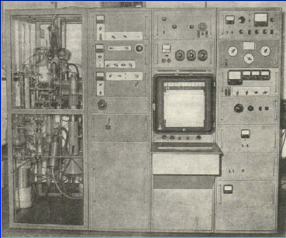
C7250
History of mass spectrometry
The first Czech mass spectrometer - 1953
V. Čermák, V. Hanuš, Č. Jech, J. Cabicar
by courtesy of dr. M. Polášek

Slide 28
C7250
Mass spectrometry- today
Benchtop LC-MS/MS system
ion trap LTQ Velos (Thermo)
High resolution hybrid mass spectrometer Orbitrap Fusion™ Lumos™ Tribrid™ (Thermo)

Slide 29
C7250
Mass spectrometry
principle:
measurement of ratio of relative molecule mass and charge number (m/z) of ions of analyzed compounds
m – ion mass
z – number of charges
vacuum
vacuum
ion
source
mass
analyzer
Detector
basic steps:
    ionization of molecules of analyzed compounds
    ion separation according to their m/z
    ion detection
result:
  mass spectrum – dependence of ion intensity vs its m/z
  thus determination of ion mass
  in case of a molecular ion
  molecular mass
a.i.
Da
2955
m/z

Slide 30

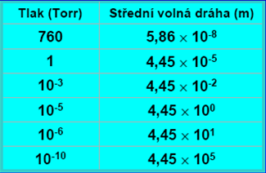
C7250
Why vacuum in MS
to prevent ions from unwanted collisions during their way from ion source to detector
The mean free path of a molecule
the average distance the molecule travels between two consecutive collisions with other moving particles
example: N₂ molecules
pressure (Torr)
free mean path (m)
adopted from presentation of dr. M. Polášek

Slide 31


Slide 32
Functional Genomics and Proteomics
National Centre for Biomolecular Research
Faculty of Science Masaryk University
Ionization techniques

Slide 33
C7250
New „soft“ ionization techniques - ESI and MALDI
basic prerequisite for wide use of MS in biomolecule analysis
(Nobel prize 2002)
MALDI
matrix-assisted laser desorption/ionization
most often in combination with time-of-flight mass analyzer - TOF
(MALDI-MS, MS/MS)
ESI
electrospray ionization
usually in combination with ion trap and hybrid mass spectrometers
(IT, QQQ, QTOF, IT-Orbitrap, IT-ICR etc.)
-
-
-
-
-

Slide 34
C7250
MALDI
Desorption-ionization process
matrix is low mass compound capable to absorb laser radiation
e.g. Dihydroxybenzoic acid (for UV laser)
Soft ionization without fragmentation
Simple spectra
Sample storage on sample target
pictures by courtesy of Dr. Sauerland (Bruker)

Slide 35
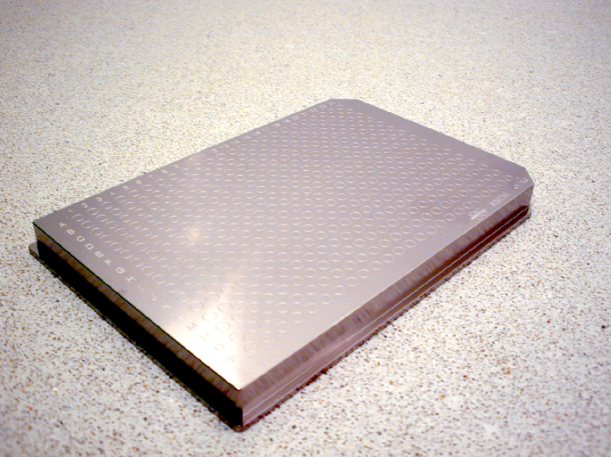
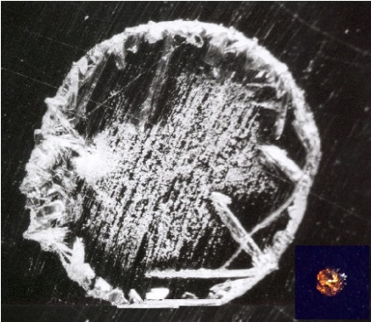
C7250
Sample target for MALDI-MS Ultraflextreme (Bruker)
386 positions
Sample spot with DHB matrix

Slide 36
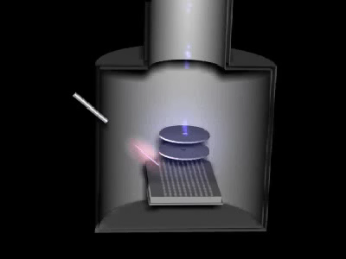
C7250
MALDI – ionization
First part, cca 30s

Slide 37
C7250
MALDI-TOF spectrum of myoglobin (16 951 Da)
[M+H]⁺
1+

Slide 38
Salt content influence on MALDI ionization
C7250
a.i.
a.i.
a.i.
DH (E. coli, 3 mg/ml, desalted on Sephadex)
DH (E. coli, 0.6 mg/ml, desalted on Sephadex)
500
600
DH (E. coli, 3 mg/ml, glycine buffer 100 mM)
450
120
400
MALDI - MS
500
100
350
80
400
300
250
60
300
200
40
150
200
100
20
100
50
0
20000
30000
40000
50000
60000
70000
m/z
20000
30000
40000
50000
60000
70000
m/z
20000
30000
40000
50000
60000
70000
m/z

Slide 39
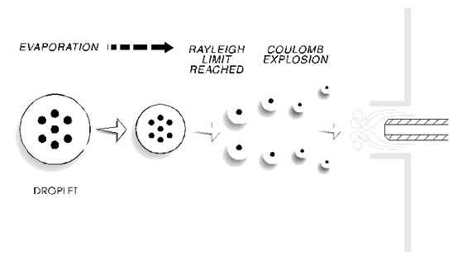
C7250
Electrospray Ionization
Soft ionization under atmospheric pressure
Simple connection to separation techniques
(HPLC, CE)
Multiply-charged ions
M. Wilm, Principles of Electrospray Ionization, MCP, 2011; 10 (7)

Slide 40
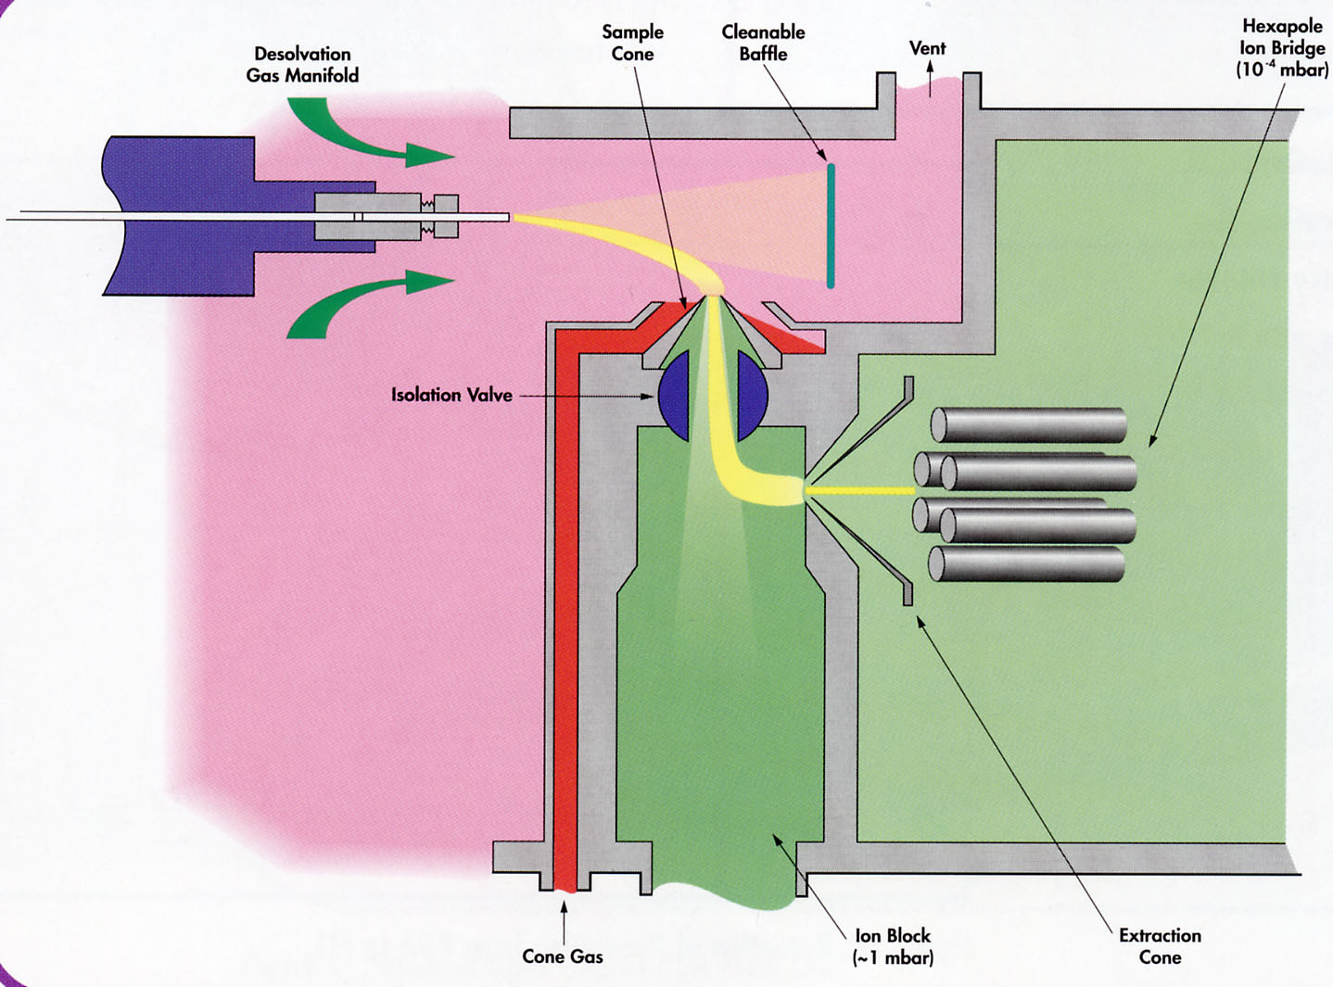
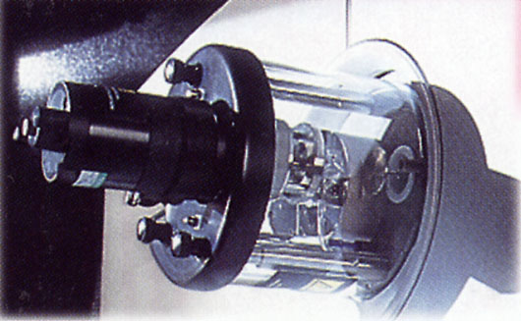
C7250
ESI – z spray

Slide 41
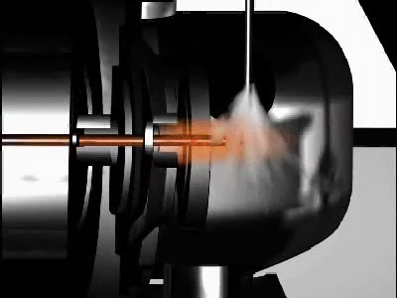
C7250
ESI – ionization
(orthogonal geometry)

Slide 42
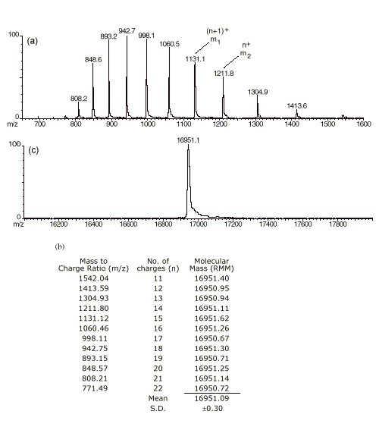
C7250
ESI spectrum of myoglobin (16 951 Da)
+ 21
+ 12
transformed spectrum

Slide 43
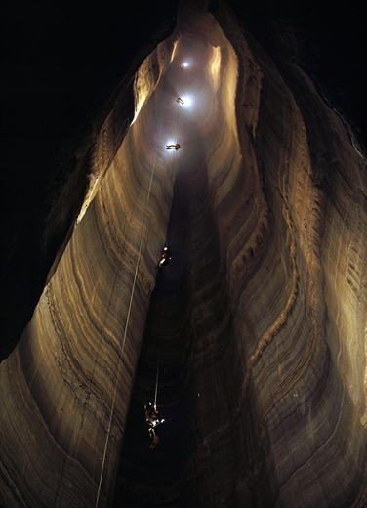

Slide 44
Functional Genomics and Proteomics
National Centre for Biomolecular Research
Faculty of Science Masaryk University
Mass analyzers

Slide 45
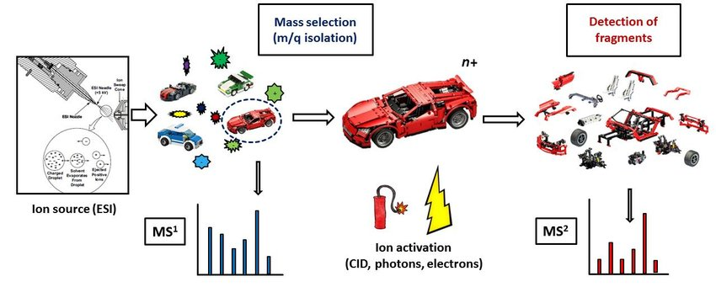
MS and MS/MS
MS
MS/MS
tandem mass spectrometry
MS²
z
m/z of the whole ion
m/z of the fragments derived from the ion

Slide 46
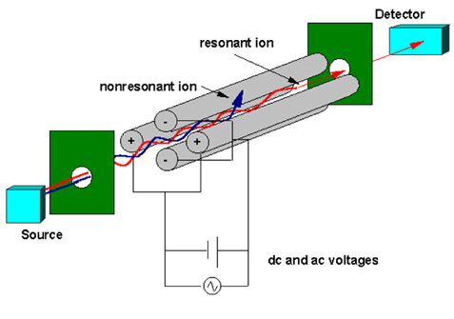
C7250
Quadrupole analyzer (Q)
mass filter
limited mass range (m/z < 4 000)
low resolution
discrimination of high mass ions
MS/MS not possible

Slide 47
C7250
Full Scan
Q scan
Selected ion monitoring
Q fix

Slide 48
C7250
Ion trap (IT)
limited mass range (m/z < 6 000, 20 000)
low resolution
enables MS/MS (MS^{n} up to 10)
Main RF
Auxiliary RF
Lenses
(1/3 Frequency
of Main RF)
Octopoles
Conversion
Dynode
Electron
Multiplier
Endcap
Optimized Asymptote Angle
Ring Electrode
pictures by courtesy of Dr. Sauerland (Bruker)

Slide 49
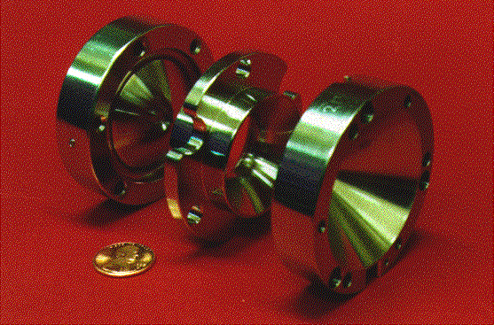
C7250

Slide 50
C7250
Ion trap
MS scan
ion capture
sequential ion ejecting out from the trap according to m/z
ion detection
IT-MS
MS/MS scan
ion capture
isolation of ions with selected m/z (precursors)
excitation and fragmentation of isolated ions
fragment detection (product ions)

Slide 51
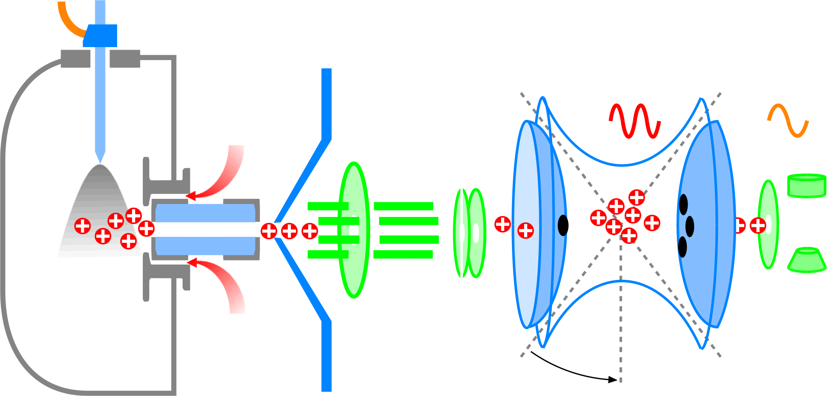
C7250
ETD in the HCT_{ultra}
Fluoranthene
anion
Gate Lens (nCI) = block
Electrospray
ion accumulation
Precursor
ion isolation
Reactant anion
accumulation
(nCI source)
ETD fragmentation
Scan
Gate Lens (nCI) = pass
Skimmer = block
by courtesy of Dr. Arnd Ingendoh (Bruker)

Slide 52
C7250
by courtesy of Dr. Arnd Ingendoh (Bruker)

Slide 53
C7250
by courtesy of Dr. Arnd Ingendoh (Bruker)

Slide 54
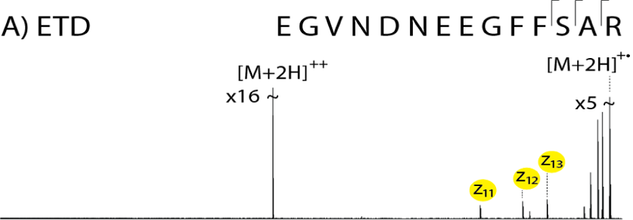
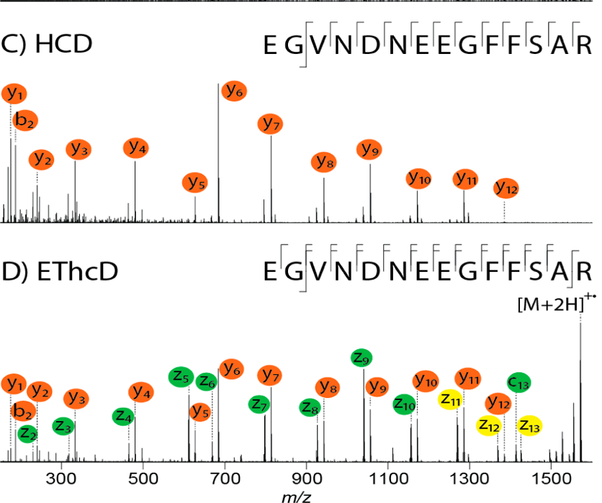
C7250
Combining Electron-Transfer and Higher-Energy Collision
EThcD
Frese et al., Anal. Chem. 2012, 84, 9668−9673

Slide 55
Linear ion trap
Quadrupole
Ion trap

Slide 56
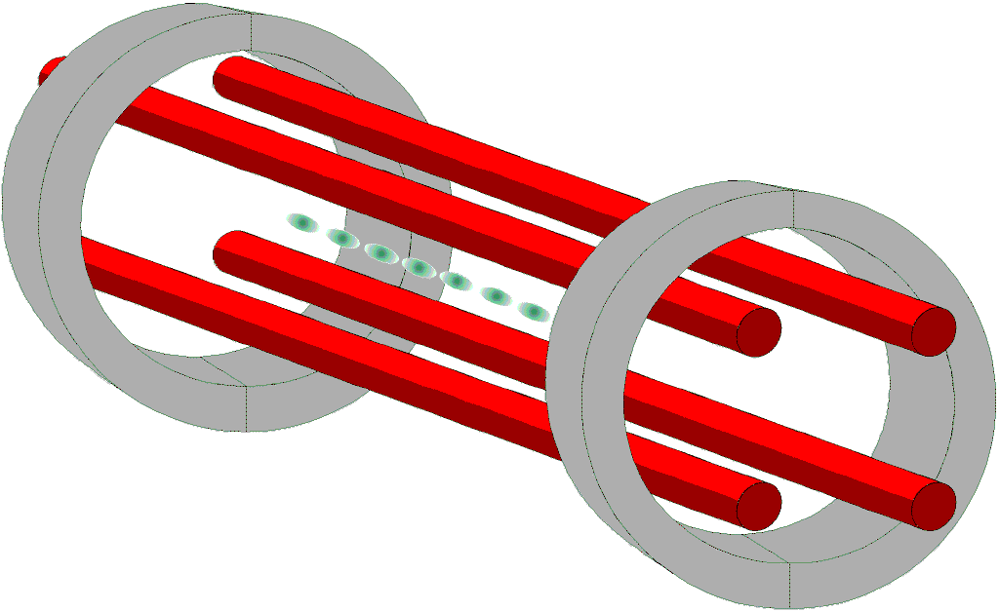

C7250
Linear ion trap
displays advantages of quadrupole and ion trap
limited mass range (m/z < 6 000)
increased ion capacity by order sensitivity increase
enables MS/MS (MS^{n})

Slide 57
Trapping Forces in a Linear Ion Trap
C7250
…simultaneously Ramp EXB
Main RF
Ramped…
Radial RF Trapping Voltage
Axial DC
Trapping
Voltage
Axial DC
Trapping
Voltage
Radial RF Trapping Voltage
Exit Lens
with Grid
Auxiliary RF
Ramped….

Slide 58
C7250
Dual pressure ion trap
LTQ Velos (Thermo)
HP chamber – increase of efficiency of ion traping and their fragmentation
LP chamber – improves resolution and scan speed

Slide 59
C7250
Time-of-Flight analyzer (TOF)
E = 1/2mv²
„unlimited“ mass range (m/z < 1 000 000)
fast scanning
high resolution (R až 60 000)
enables MS/MS by PSD (post source decay) – not used today
MALDI
Detector 1
(reflectron Off)
Detector 2 (reflectron On)
Ion Source
Reflectron

Slide 60
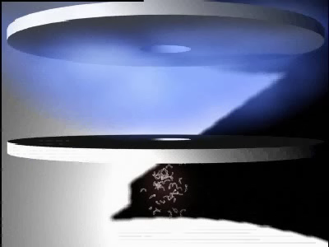
C7250
TOF – ion separation
Second part

Slide 61
C7250
Protein (BSA, 66.4 kDa, ≈15 pmol on spot)
[Abs. Int.]
[M+H]⁺
66465
650
600
550
500
450
400
350
300
250
200
[M+2H]²⁺
150
33219
[2M+H]⁺
100
132721
50
0
20000
40000
60000
80000
m/z
100000
120000
140000

Slide 62
C7250
Peptide (≈ 50 fmol on spot)
resolution cca 18 000
[M+H]⁺
1+
[M+Na]⁺

Slide 63
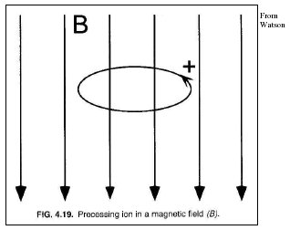
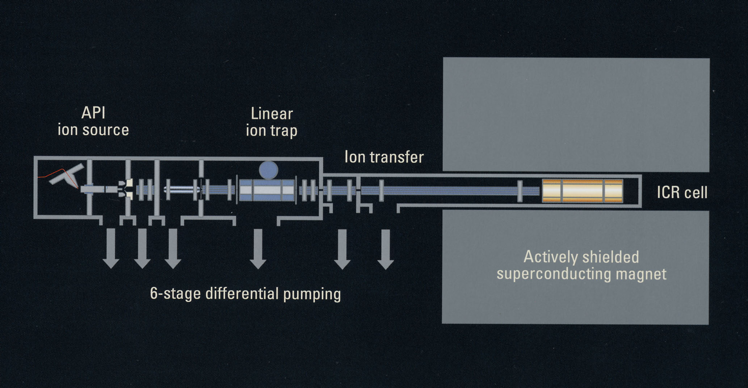

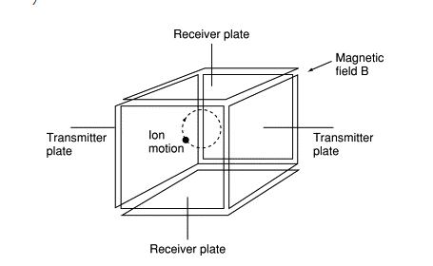
C7250
Ion cyclotron resonance with Fourier transformation
FT- ICR MS
ultimate resolution (R >10 000 000)
determination of elemental composition
enables MS^{n}, top-down approaches
disadvantage (magnet up to 15T, liquid He), high operational costs

Slide 64
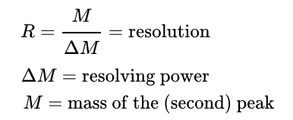
C7250
Significance of high resolution
In an simplified way,
resolution value indicates lowest distinguishable mass difference
Mass of elements is not whole numbers
H 1,0079
C 12,0107
N 14,0067
O 15,9994
C₂H₃O 43,0184
C₃H₇ 43,0547
ΔM
R DM at mass 43
100 0,43
1000 0,043
10000 0,0043
Sufficient resolution results in possibility to deduce elemental composition
In case of compounds above we need resolution of 1185

Slide 65
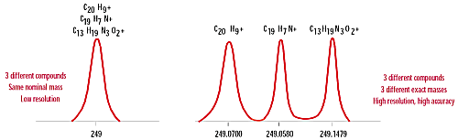
C7250
Significance of high resolution

Slide 66
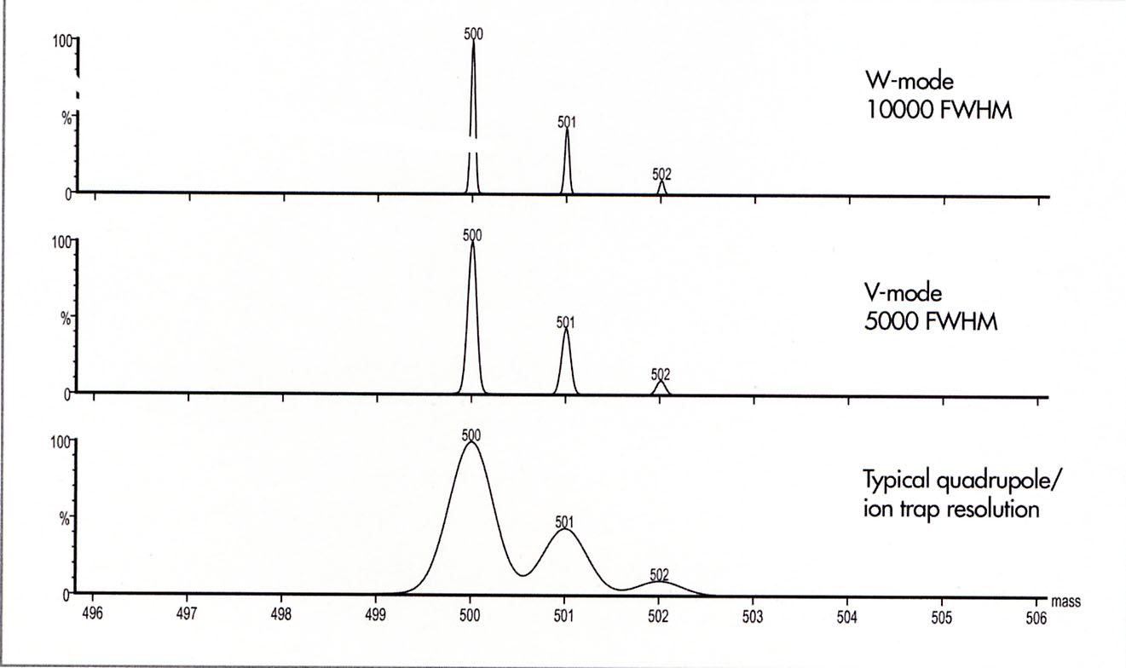
C7250
Significance of high resolution

Slide 67
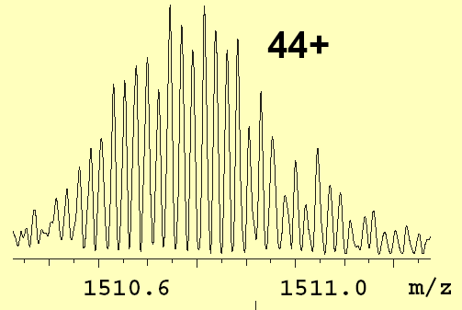
C7250
0,023 Da
BSA, ESI ionization, FT-ICR MS

Slide 68

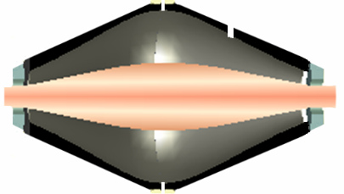


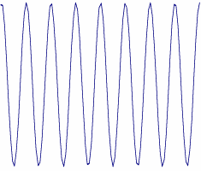
C7250
Orbitrap
high resolution in MS and MS/MS
(up to 1 000 000, but w/o magnet)
limited mass range m/z < 4 000
ESI
API Ion Source
Linear Ion Trap
C-Trap
The oscillating ions induce an image current into the two outer halves of the orbitrap, which can be detected using a differential amplifier
Orbitrap
Ions generate a sinusoidal wave signal
with permission Ing. Petr Verner (Thermo)

Slide 69
C7250
Full Scan – High Resolution, Zoom-in
0.1 ppm
RP 60,000 @ m/z 400
NL:
100
516.76672
9.93E6
Brady_Angio_02#9 RT: 0.23
80
AV: 1 T: FTMS + p ESI Full
ms [ 140.00-1500.00]
60
40
-0.8 ppm
20
516.78448
0
516.76671
516.78490
Simulation
100
80
Val5-Angiotensin II
60
Lys-des_Arg-Bradykinin
40
20
0
516.75
516.76
516.77
516.78
516.79
516.80
516.81
516.82
m/z
with permission Ing. Petr Verner (Thermo)

Slide 70
C7250
Simulations at different resolution settings
R=7,500
R=15,000
R=30,000
R=60,000
R=>100,000
516.4
516.6
516.8
517.0
517.2
517.4
517.6
517.8
518.0
518.2
518.4
518.6
518.8
519.0
m/z
with permission Ing. Petr Verner (Thermo)

Slide 71
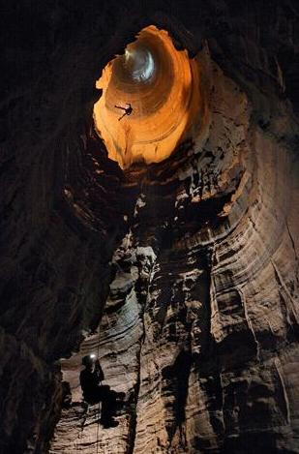

Slide 72
Functional Genomics and Proteomics
National Centre for Biomolecular Research
Faculty of Science Masaryk University
Basic approaches of data acquisition in MS

Slide 73
DDA – Data Dependent Acquisition
One precursor selected for MS/MS at a time
DIA – Data Independent Acquisition
Set of precursors is fragmented simultaneously

Slide 74
C7250
Acquisition modes
DDA
DIA
Liu et al, Expert Rev. Mol. Diagn., 13(8), 811 (2013)

Slide 75
SWATH MS
Q-TOF, MS/MS < 10 ppm
C7250
m/z
Retention time
full MS/MS spectrum
Gillet et al, MCP, 11, 1-17 (2012)

Slide 76
C7250
Liu et al, Expert Rev. Mol. Diagn., 13(8), 811 (2013)

Slide 77
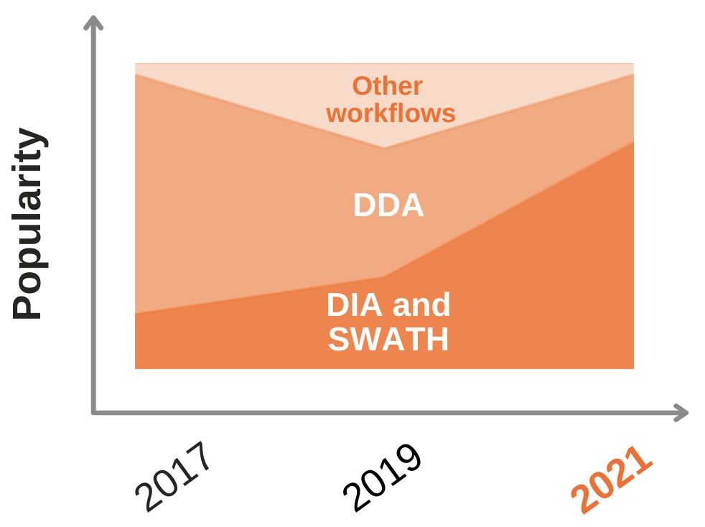
C7250
Unleash the power DIA combined with short gradients (evosep.com)

Slide 78
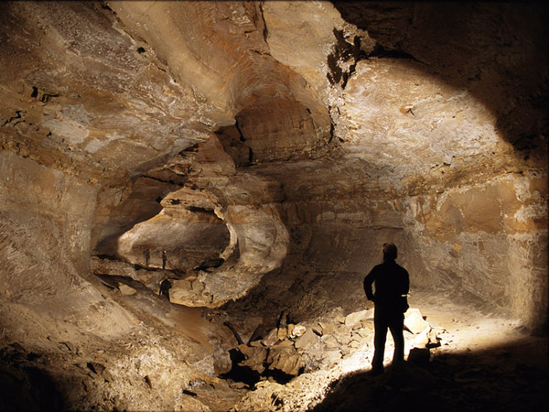

Slide 79
Functional Genomics and Proteomics
National Centre for Biomolecular Research
Faculty of Science Masaryk University
Hybrid systems

Slide 80

C7250
Triple quadrupole, 3-Q
(original design, not hybrid)
robust
quantification
limited mass range (m/z < 4 000)
enables MS/MS (MS²)
variety of scan modes
low resolution
ESI
N₂ Inlet
RF
Ion Guide
Q1
Q2
Collision Cell
Q3
Detector

Slide 81
C7250
Product Ion Scan
Q 1
Q2
Q 3
Q1 fix
Q3 scan
Collision cell
quadrupole Q1 transmits into collisional cell only ions with selected m/z
quadrupole Q3 analyzes all fragments formed in collisional cell by CID
(originated from selected ions (precursors) transmitted by Q1)
ABI documents

Slide 82
C7250
Selected reaction monitoring, SRM
Multiple reaction monitoring, MRM
Parent mass
CID
Fragment mass
Q1 „fix“
Q3 „fix“
Q1
Q2
Q3
quadrupole Q1 and Q3 are fixed to selected values of m/z ( Q1-precursor and
Q3- selected fragment), only precursors displaying production of selected
fragment during fragmentation in collisional cell are recorded
enables to follow tens of reactions (transitions) during analytical run (MRM)
improved sensitivity
detection of low abundant components (e.g. biomarkers in complex samples)
ABI documents
Notes:
Multiple Reaction Monitoring – This is the scan with the highest duty cycle and is used for detecting a specific molecule at high senstivity. Here, Q1 is set on the parent mass, the collision energy is optimized to produce a diagnostic fragment of that parent ion, and Q3 is set to the mass of that fragment. Only ions with this exact transition will be detected.

Slide 83

Parallel reaction monitoring (PRM)
C7250
Q-Orbitrap MS
similar to SRM/MRM
all fragments of selected precursor are deected
with high resolution/accuracy for determination of m/z
Simplier method adjustment
improved precursor identification and quantification securing high sensitivity
https://www.creative-proteomics.com/services/parallel-reaction-monitoring-prm.htm

Slide 84


C7250
3-Q
(LIT instead of Q3)
increased sensitivity (enhanced scans)
enables MS/MS (MS^{n})
low resolution
ESI
Linear ion trap
Q0
Q1
Q2
Q3
Collisional cell
accumulation of ions during LIT scan (reduced loss of ions)

Slide 85


C7250
Q-TOF
(TOF instead of Q3)
Turbo pump
Turbo pump
IonCooler™ Guide
Q1
Q2
Collisional cell
TOF
high resolution (až 60 000)
enables MS/MS (MS²)
ESI, MALDI

Slide 86


C7250
Q-TOF
Bruker

Slide 87

C7250
Q-TOF
(TOF - W design)

Slide 88

C7250
Q-Orbitrap
(Orbitrap instead of Q3)
high resolution up to 480 000
m/z range < 6000
HCD, ETD
Exploris 480
Thermo

Slide 89
C7250
Q-Orbitrap
BoxCar acquisition method (extended dynamic range)
limitation – C-trap capacity (1 000 000 charges)
capacity is often saturated by high abundant ions
BoxCar collects ions in C-trap in narrow m/z segments allowing to accumulate low abundant ions increasing number of identified peptides and extending dynamic range
MS/MS scans are restricted
creation of peptide library is required for identification (mostly done at MS level)
Meier F. et al., Nature Methods, 15, 440-448 (2018)

Slide 90
C7250
Q-Orbitrap
BoxCar acquisition method
Meier F. et al., Nature Methods, 15, 440-448 (2018)

Slide 91
Q-Orbitrap
BoxCar acquisition method
C7250
MaxQuant assembles the full scan (black traces) and BoxCar scans (red traces) of an acquisition cycle to a single high-dynamic-range scan. First, all spectra are transformed to a common high-resolution m/z grid, and the signals from each scan (here one full scan and two BoxCar scans) are integrated over the entire LC elution time (step 1). From the integrated signals, the shape of the quadrupole transmission function for each BoxCar scan is globally determined by a pointwise comparison to the full scan (step 2). The resulting relative transmission factors for each m/z bin in each BoxCar scan are used as weights for calculating the average signal intensity from the full scan and the BoxCar scans. These hybrid spectra are taken as a replacement for standard full scans in all subsequent processing steps without further adjustments (step 3).
Meier F. et al., Nature Methods, 15, 440-448 (2018)

Slide 92
Q-Orbitrap
BoxCar acquisition method
C7250
generation of a peptide library
analysis of individual samples
- Hela cell line
- 45 min LC run
Meier F. et al., Nature Methods, 15, 440-448 (2018)

Slide 93

C7250
Orbitrap Fusion™ Lumos Tribrid
Precursor fragmentation techniques:
CID – ion trap
ETD – ion trap
HCD – ion-routing multipole
EThcD – ion trap/ion-routing multi pole
Ion separation/detection:
Ion trap – low resolution
Orbitrap – high resolution
ETD HD – high dynamic range ETD providing significantly increased
fragment ion coverage
Resolution Orbitrap
15 000–1 000 000 (FWHM) at m/z 200

Slide 94


C7250
TOF-TOF
Bruker
relatively high resolution (< 30 000)
enables MS/MS (MS²)
MALDI
enables off-line connection with LC
(LC-MALDI approach)
AB Sciex

Slide 95
ion mobility + mass spectrometry

Slide 96
C7250
Trapped Ion Mobility Spectrometry
timsTOFTM
coupling ion mobility separation with mass spectrometry
ion mobility brings additional separation dimension
ion mobility allows separation of structural isomers
(in general, compounds with the same or close m/z differing in ccs)
The TIMS analyzer is a segmented rf ion guide wherein ions are mobility-analyzed using an electric field that holds ions stationary against a moving gas, unlike conventional drift tube ion mobility spectrometry where the gas is stationary. Ions are initially trapped, and subsequently eluted from the TIMS analyzer over time according to their mobility (K).
TIMS theory – Michelmann K. et al.: J. Am. Soc. Mass Spectrom. 26,14-24 (2015)

Slide 97

C7250
Trapped Ion Mobility Spectrometry
timsTOFTM
Ion mobility separates compounds based on their collisional cross section (CCS), which is primarily a function of three-dimensional shape.
Unique to TIMS: higher m/z (CCS) elute first.
with courtesy of M. Boháč (Bruker)

Slide 98



C7250
Trapped Ion Mobility Spectrometry
timsTOFTM
1. Accumulate & Trap step
~10 x higher sensitivity
2. Elute or scan out step
with courtesy of M. Boháč (Bruker)

Slide 99

C7250
Trapped Ion Mobility Spectrometry
timsTOFTM
resolution of coeluting compounds with overlapping isotopic patterns

Slide 100
C7250
Trapped Ion Mobility Spectrometry
timsTOFTM
analysis of HeLa digest (200 ng)
120 min LC run
Average number of protein group identifications in a single run (N=4) with different TIMS settings
Number of proteins quantified in N out of four replicates.
BioRxiv, https://doi.org/10.1101/336743

Slide 101


C7250
Field Asymmetric Ion Mobility Spectrometry
FAIMS
If a mixture of ions of different sizes and types is introduced between two metal plates, the application of high voltage in an appropriate waveform to the plates will create a condition where some types of ions drift and hit the metal plates while other types of ions remain between the plates.
basic principle:
http://www.faims.com/howpart1.htm
Analysis of tryptic digest of HeLa cell lysate
FAIMS – Thermo Fisher

Slide 102
The end

