Slide 1



Functional Genomics and Proteomics
National Centre for Biomolecular Research
Faculty of Science Masaryk University
Protein characterization by mass spectrometry
C7250
Part V
Zbyněk Zdráhal
RG Proteomics, CEITEC-MU
Proteomics CF, CEITEC-MU
NCBR FS MU
zdrahal@sci.muni.cz
Notes:
nfsnf

Slide 2
Proteomic MS applications

Slide 3
C7250
Assessment of products of synthesis
MALDI-MS

Slide 4
Assessment of reaction course
C7250
Modified BSA vs. std. BSA (≈ 5 pmol)
a.i.
MALDI - MS
1400
mass diff. cca 3 kDa
1200
1000
MW(adukt) = 250
Number of binded molecules
N = 12
MW(adukt) = 250
Počet navázaných aduktů
N = 12
800
600
400
200
0
20000
40000
60000
80000
100000
120000
140000
m/z
/D=/Data/Zbynek/020205/BSA/2Lin/pdata/1 Administrator Fri Feb 22 13:59:04 2002

Slide 5
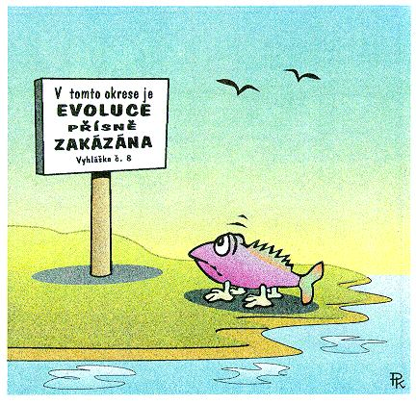
„Evolution is strictly prohibited in this district“

Slide 6
C7250
MALDI-MS profiling
Identification of microorganisms by MALDI-MS
cultivation
peptide/protein
extraction
MALDI MS
(3 – 20 kDa)
microorganism identification
taxonomy
PCA analysis
database of MALDI-MS profiles

Slide 7
MALDI-MS spectra (profiles) of selected bacteria
C7250
a.i.
a.i.
Sphingomonas paucimobilis
2500
2500
2000
2000
Aeromonas hydrophila
1500
1500
Pseudomonas aeruginosa
1000
1000
500
Alcaligenes faecalis
500
0
0
5000
5000
7000
7000
9000
9000
11000
11000
m/z
m/z

Slide 8
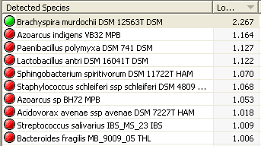
C7250
Graphical expression of MALDI-MS bacteria profile similarity
Staphylococcus saprophyticus CCM 3317 CCM
Staphylococcus epidermidis CCM 7221 CCM
Staphylococcus epidermidis CCM 2446 CCM
identification based on comparison of measured profile with database profile
Staphylococcus epidermidis CCM 2124 CCM
Peptostreptococcus anaerobius CCM 3790 CCM
Serratia rubidaea CCM 3412 CCM
Streptococcus mitis CCM 7411 CCM
Finegoldia magna CCM 3785 CCM
Corynebacterium urealyticum CCM 4186 CCM
Corynebacterium urealyticum CCM 3976 CCM
Corynebacterium urealyticum CCM 3975 CCM
Corynebacterium pilosum CCM 6140 CCM
Campylobacter jejuni ssp jejuni CCM 7212 CCM
Campylobacter jejuni CCM 6214 CCM
validated method in clinical practise
Campylobacter jejuni ssp jejuni CCM 6191 CCM
Campylobacter jejuni ssp jejuni CCM 6189 CCM
Campylobacter coli CCM 6211 CCM
Campylobacter fetus subsp fetus CCM 5682 CCM
Campylobacter fetus subsp fetus CCM 6210 CCM
Campylobacter fetus subsp fetus CCM 5683 CCM
1000
900
800
700
600
500
400
300
200
100
0
Distance Level
L. Tvrzová, A. Teshim, I. Sedláček, M. Lexa, A. Voráč, O. Šedo,, A. Kostrzewa, T. Meier

Slide 9
C7250
4
x10
MALDI-MS profiling of beer
2.5
2564
Intens. [a.u.]
3281
2.0
2812
3623
1.5
5589
6225
1.0
7239
10014
10305
9851
10144
9690
0.5
2000
3000
4000
5000
6000
7000
8000
9000
10000
Brewery 3 bottle 5
MALDI-TOF MS fingerprint containing proteins
Brewery 3 bottle 4
Brewery 3 bottle 3
Brewery 3 bottle 2
Brewery 3 bottle 1
Brewery 2 bottle 2
cooperation with FCH BUT Brno
prof. Márová
Brewery 2 bottle 1
Brewery 2 bottle 5
Brewery 2 bottle 4
Brewery 2 bottle 3
Brewery 1 bottle 2
Brewery 1 bottle 1
Brewery 1 bottle 5
Brewery 1 bottle 4
Brewery 1 bottle 3
1000
900
800
700
600
500
400
300
200
100
Distance Level

Slide 10
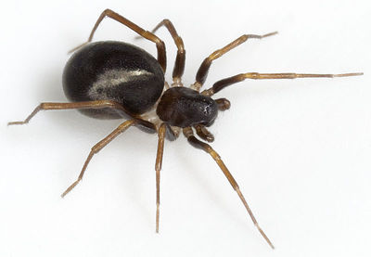



MALDI-MS profiling of spider venoms
C7250
evolution of food specialisation in spiders
species adaptations
ant-eating spiders
Z. merlijni
cooperation with prof. Pekar, FS MU
Pekár S. et al., J. Anim. Ecol., 81 (4), 838-848 (2012)
Bočánek O. et al., Toxicon, 133, 18-25 (2017)
Pekár S. et al. Mol. Ecol., 27 (4), 1053-1064 (2018)

Slide 11
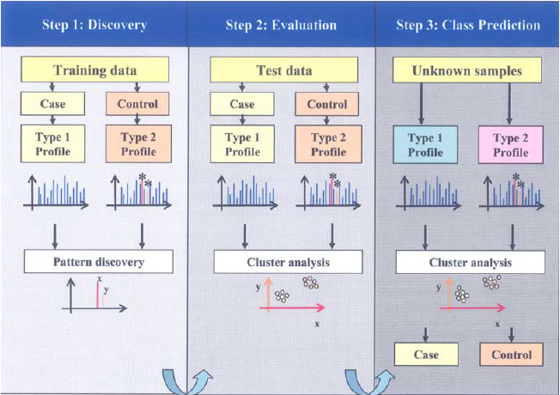
MALDI-MS profiling–early detection of diseases
(peptide profiling, pattern profiling)
C7250
Patient
no or minimal sample prep
(ionex, IMAC, affinity sorbents)
MALDI MS, SELDI MS
(3 – 20 kDa)
profile analysis
high number of factors influencing protein composition
not related with diagnosed disease
high profile variability
no strict limits for clear positive/negative disease detection
!

Slide 12
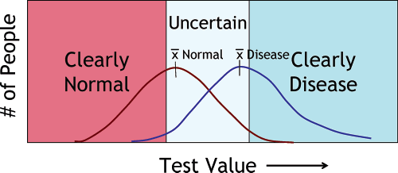
C7250
J. LaBaer et al., J. Proteome Res., 4 (4) 1053-1059 (2005).
M. Ehmann et al., Pancreas, 34 (2) 205-214 (2007).

Slide 13
C7250
MS-based approaches for biomarker searching
direct MS analysis
(MALDI MS, SELDI MS)
biomarker identification
Separation
GE. LC
Pattern profiling
comparison of peptide (protein) profile of sample „healthy“ vs. patient
(bez identifikace, statistická analýza)
comparison of protein (peptide) content of sample „healthy“ vs patient
MS
MS/MS
identification of differentialy regulated proteins
early disease detection
biomarker specifity!!!
specific antibody
Immunodetection
SRM, SWATH/Protein arrays

Slide 14

N-Glycan profiling of lung adenocarcinoma in patients
at different stages of disease
C7250
Detail of MALDI-MS spectra (m/z range of 2650-4150):
a) P1 (stage IB/grade1)
b) P7 (stage IIA/grade4)
c) P13 (stage IIIA/grade2)
MALDI-TOF-MS spectra of N-glycans after desialylation
Man;
Gal;
GlcNAc;
Fuc
Lattová E. et al., Modern Pathology (2020) 33:1146–1156

Slide 15


Slide 16
C7250
Relative quantification by MS
isotopically labeled tag approaches
(comparison of limited number of samples, up to 10)
protein quantification
replica 1
100%
replica 2
replica 3
label-free approaches
(comparison of unlimited number of samples, lower accuracy)
Targeted quantification of selected proteins by MS
MRM (SRM), PRM

Slide 17
C7250
Characterization of proteome changes
differential (expression) proteomics
image analysis of 2-D gels
LC-MS/MS of selected spots with different intensity
B
identification (MS) separated from quantification (spot intensity on gel)
mixed spots
Acidithiobacilus ferrooxidans grown on ferrous iron (A) and elemental sulfur (B)
cooperation with Department of Biochemistry, FS MU
P. Bouchal et al., Proteomics 2006, 6, 4278–4285.

Slide 18

C7250
Search for marker proteins for chicken salmonella infection
relative quantification
control
infected
gut wall sample
protein isolates
tryptic digestion
reductive alkylation
LC-MS/MS
data processing

Slide 19
C7250
identification more than 2300 protein
quantification for more than 1900
infected/
control
Accession | Description
363741657 | PREDICTED: syntenin-2-like [Gallus gallus] |  | 41.032
118095649 | PREDICTED: beta-1,3-galactosyl-O-glycosyl-glycoprotein beta-1,6-N-acetylglucosaminyltransferase 3 [Gallus gallus] |  | 34.036
4927286 | alpha enolase [Bos taurus] |  | 33.575
112491068 | Chain A, Crystal Structure Of A M-Loop Deletion Variant Of Ment In The Cleaved Conformation |  | 30.221
56118294 | ribonuclease homolog precursor [Gallus gallus] |  | 25.497
363741459 | PREDICTED: protein-glutamine gamma-glutamyltransferase E [Gallus gallus] |  | 24.786
clarifying of mechanisms of molecular processes
search for marker proteins for early detection
confirmation by real-time PCR
cooperation with VRI Brno
Matulova M. et al., Vet. Res., 44:37 (2013)

Slide 20

Characterization of the extent and dynamics of translational regulation
during tobacco male gametophyte development and the subsequent functional progamic phase
the three types of mRNA-containing ribonucleoprotein particles:
POL - translating polysomes
RNP - free ribonuclear particles
EPP - long-term storage EDTA/puromycin-resistant particles
six developmental stages
9317 protein groups identified across all samples and replicates
2,089 for quantitative analyses (only proteins identified by five or more peptides in all biological and technical replicates of the particular sample were considered as reliably present).
Hafidh S. et al., Plant Physiol., 178 (1), 258-282 (2018)
37

Slide 21
Characterization of the extent and dynamics of translational regulation
during tobacco male gametophyte development and the subsequent functional progamic phase
Dynamics of seven protein groups associated with PABPs
Overall abundance of PABP transcripts
affect mRNA cellular fate, metabolism, translation, and storage
Hafidh S. et al., Plant Physiol., 178 (1), 258-282 (2018)

Slide 22
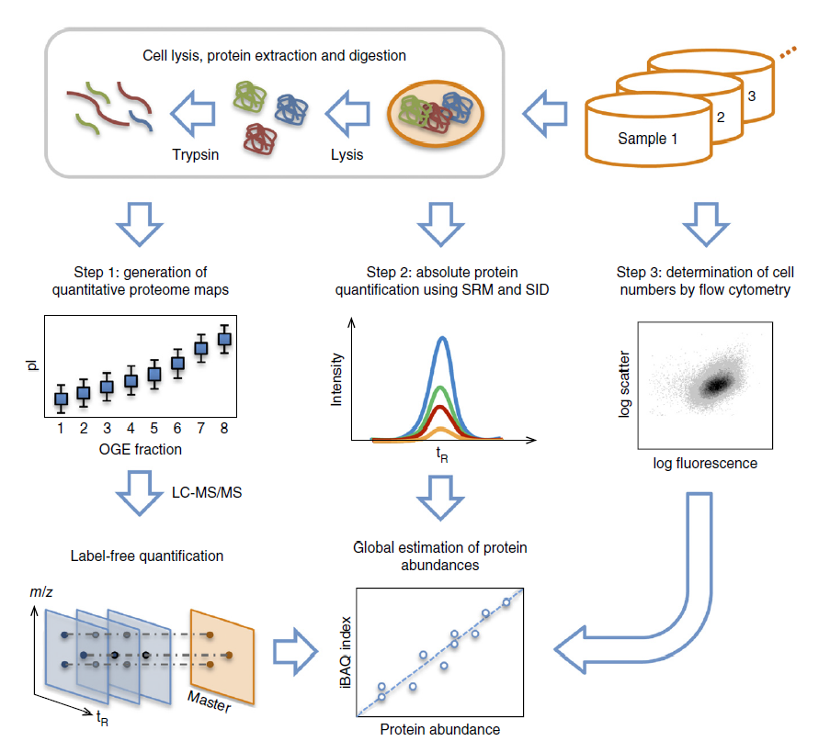
The quantitative and condition-dependent Escherichia coli proteome
22 different growth conditions in biological triplicates.
growth on minimal media with an excess of different carbon and energy sources
growth in glucose-limited chemostat cultures with varying growth rates,
growth on glucose excess with different stress conditions,
growth on complex medium, and
1 and 3 d into stationary phase.
cellular protein concentrations for 55% of predicted E. coli genes (>2,300 proteins)
41 proteins related to glycolytic pathway, tricarboxylic acid cycle enzymes and others was selected to absolute quantification
The concentration range of the 41 proteins covered more than four orders of magnitudes ranging from around
92,000 to only 2 copies per cell.
Schmidt A., Nature Biotechnol., 34 (2016), 104 – 110

Slide 23
C7250
Comparison of human cancer cell line proteome and transcriptome
10 mg proteins
126 frakcí
72 frakcí
Protein fractionation
Peptide fractionation
N. Nagaraj et al., Mol. Syst. Biol., 7, 548 (2011).

Slide 24


Slide 25
Targeted analysis of selected protein/PTM
C7250
Schematic workflow of a constrained SRM assay
Step1: 1. Biological samples include body fluids (such as blood or saliva), cell lysate, and tissue. 2. PTM proteins and protein isoforms are extracted from cell lysate and tissue. 3. Protein enrichment methods are applied for less abundant proteins. 4. PTMs and protein isoforms are digested by enzymes, including trypsin, Lys-C, etc. 5. After digestion, modified, unmodified peptides, and peptides representing the whole protein are selected.
Step2: 1. Isotope-labeled peptides are synthesized to serve as internal standards for the post-translationally modified peptides, unmodified peptides, and peptides representing the whole protein. 2. Mass spectrometer parameters are optimized by using the synthetic peptides. 3. Isotopic labeled peptides are internal standards and spiked in the samples. PTMs and isoforms are quantified by SRM or MS3 assay.
Liu X., et al., Methods 61 (2013) 304–312

Slide 26
C7250
Targeted analysis of selected protein/PTM
SRM
IADPEHDHTGFLTEYVATR
IADPEHDHTGFLTEYVATR – 2x Phospho
Quantitative assays for ppErk1. (A) Erk1 phosphorylation was measured by a constrained SRM assay in trypsin-digested extracts from EGF-stimulated vascular smooth muscle cells. Extracted ion chromatograms are presented with the area under the curve (1000) displayed in the top right corner. Heavy isotope-labeled internal standards were utilized for peak identification and normalization.
SRM and western blot assays show a similar time-course of Erk1 phosphorylation in response to EGF.
Liu X., et al., Methods 61 (2013) 304–312

Slide 27


Slide 28
C7250
Phosphoproteome analysis – four fractionation approaches
ERLIC - Electrostatic Repulsion-Hydrophilic Interaction Chromatography
Chen et al., J. Chromatogr. B, 879, 25 (2011)

Slide 29
Phosphoproteome analysis – four fractionation approaches
C7250
Each method – over 4000 phoshopeptides
In total – 9069 phosphopeptides – 9463 sites / 3260 proteins
Chen et al., J. Chromatogr. B, 879, 25 (2011)

Slide 30
Phosphoproteome analysis– quality and quantity
C7250
Porcine muscle
Postmortem changes
160 phosphoproteins with 784 sites identified
184 phosphorylation sites on 93 proteins had their phosphorylation levels significantly changed.
Huang et al., J. Proteomics, 106, 125 (2014)

Slide 31
C7250
Phosphoproteome analysis– quality
Comparison of identified peptides in replicas
Huang et al., J. Proteomics, 106, 125 (2014)

Slide 32
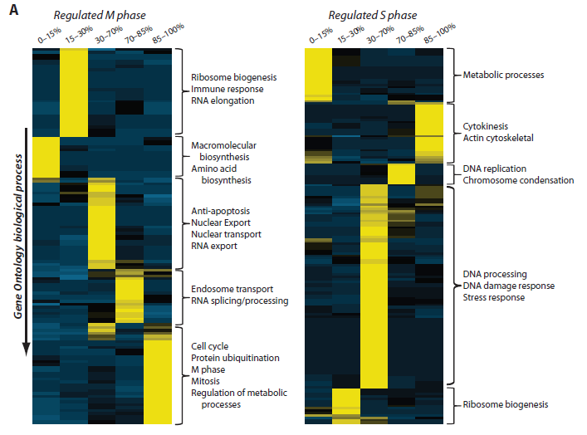
CG010
Phosphoproteome analysis
Olsen J.V. et al., Sci. Signal., 3 (104) ra3 (2010)
quantified 6027 proteins
quantified 20,443 unique phosphorylation sites
- HELA cells
- SILAC labeling
- TiO₂ enrichment
- LC-MS/MS (Orbitrap)
The panels show the phenotypic phosphoproteome comparison organized by GO biological process for mitotic (left) and S phase (right) cells. Proteins involved in metabolic processes have high-occupancy phosphorylation sites during mitosis, but low-occupancy sites during S phase (color scale: yellow, high overrepresentation; dark blue, high underrepresentation).

Slide 33


Slide 34
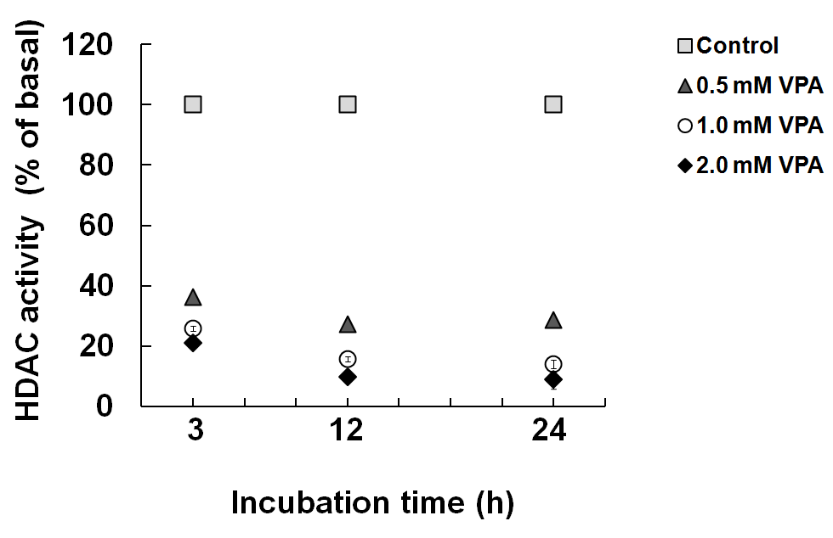
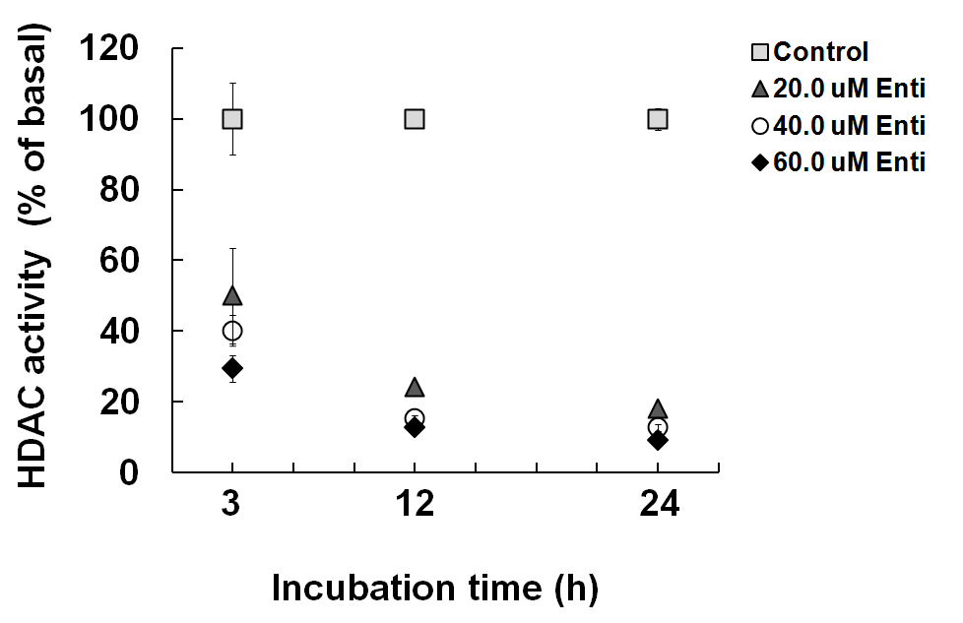
C7250
Characterization of effect of histone deacetylase inhibitors
to establish a set of methods
- HDAC Fluorimetric Cellular Activity Assay Kit
- MALDI-MS of N-terminal part of histones (after Glu-C digestion)
- AUT-AU 2-D GE combined with LC-MS/MS analysis
Total HDAC inhibiton effect
Valproic acid
Entinostat
B-CLL MEC-1 cells
Činčárová et al, Mol. Biosyst. (2012)

Slide 35
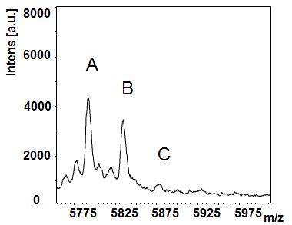
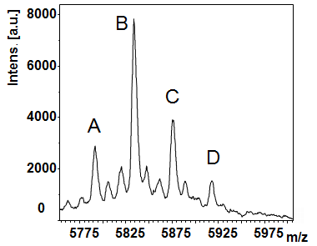
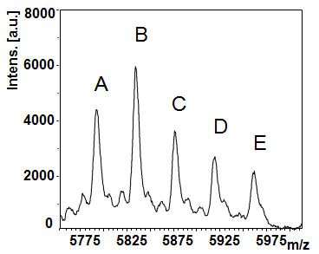
C7250
Characterization of effect of histone deacetylase inhibitors
MALDI-MS of Histone H4 acetylated forms
N-terminal fragment (1-53 AA)
control
Valproic acid
Entinostat
A E 0 4 acetylations

Slide 36
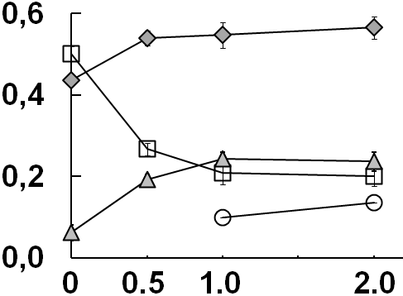
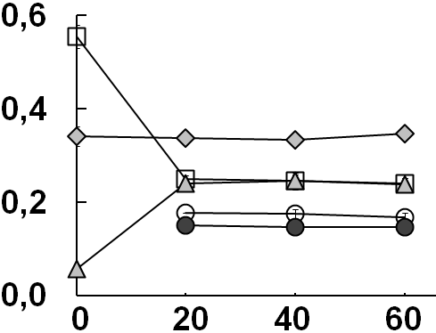
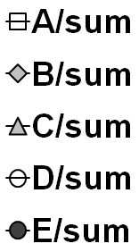
C7250
Characterization of effect of histone deacetylase inhibitors
Changes of particular H4 acetylated forms vs inhibitor concentration
(24h treatment)
Valproic acid
Entinostat
Ratio
VPA [μM]
Enti [μM]
A E 0 4 acetylations

Slide 37

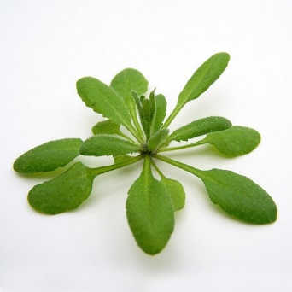


Characterization of Post-Translational Modifications of Histones
LC-MS/MS
histone extraction
TCA precipitation
derivatization
at protein level
tryptic digestion
derivatization
at peptide level
e.g. in Sidoli S. et al., J. Vis. Exp. 111:e54112 (2016).

Slide 38


C7250
Filter-Aided Sample Preparation Procedure for Mass Spectrometric
Analysis of Plant Histones
human histone extract after TCA precipitation re-dissolved in MilliQ water
human recombinant histone standards
A. thaliana histone extract after TCA precipitation re-dissolved in SDS
A. thaliana histone extract after TCA precipitation re-dissolved in MilliQ water
A. thaliana histone extract in sulfuric acid diluted in MilliQ water
Ledvinova D.. et al, Front. Plant Sci., 9, article 1373 (2018)

Slide 39
C7250
Filter-Aided Sample Preparation Procedure for Mass Spectrometric
Analysis of Plant Histones
Ledvinova D.. et al, Front. Plant Sci., 9, article 1373 (2018)

Slide 40

Inter-individual variations of Histone Modification Patterns
C7250
cooperation with Prof. Fajkus group, CEITEC-MU
two Arabidopsis thaliana ecotypes Columbia 0 (Col-0) and Wassilewskija (Ws)
grown from seeds collected from a single parent plant (Single) and a set of parent plants (Mixed).
mixed
single
Brabencova S. et al, Front. Plant Sci., 8, article 2084 (2017)

Slide 41
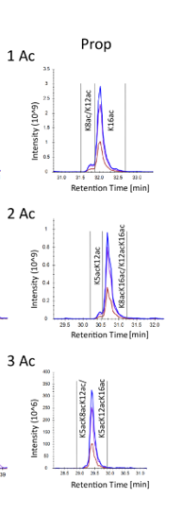
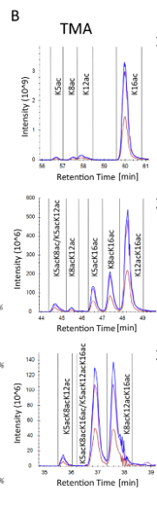
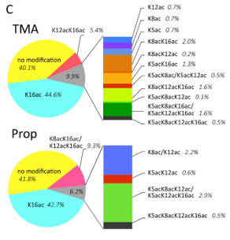
C7250
Improvement of separation of histone peptide modified forms
novel derivatization agent
Histone H4 4-17 GKGGKGLGKGGAK
~ 2x more forms
Histone extracts from MEC1 cell line.
Kucharikova et al, Mol. Cell. Proteomics, 20, 100114 (2021)

Slide 42
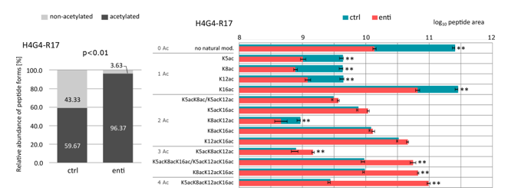
C7250
Assessment of effect of histone deacetylase inhibitors
Kucharikova et al, Mol. Cell. Proteomics, 20, 100114 (2021)
HDAC inhibitors – potential for cancer treatment

Slide 43
C7250
Multi-level proteomics reveals host-perturbation strategies of
SARS-CoV-2 and SARS-CoV
GG enrichment
TiO₂ enrichment
(a)Time-resolved profiling of SARSCoV-2 infection by multiple -omics methods. The plot shows normalized MS intensities of three SARS-CoV-2 viral proteins over time and overview of identified and regulated distinct transcripts, proteins, ubiquitination and phosphorylation sites, using data independent (DIA) or dependent (DDA) acquisition methods
Stukalov A. et al., bioRxiv: https://doi.org/10.1101/2020.06.17.156455

Slide 44


Slide 45
C7250
Charakterization of protein complexes
functional proteomics
> 80% proteins is functional only as a part of complex
~ 10000 types of interactions
Aloy P., Russell R. B.: Nat. Biotechnol. 22 (10), 1317-1321 (2004)
sample
(cells)
search for new intraction partners
study of „whole“ complex
complex
purification
MS/MS
analysis
confirmation of
true interaction
partners
separation
digestion

Slide 46
C7250
Purification of protein complexes
in vivo expression of bait protein with a tag
high degree of complex purity
loss of weakly binded interaction partners
T. Köcher, G. Superti-Furga: Nat. Methods, 4(10), 807-815 (2007).

Slide 47
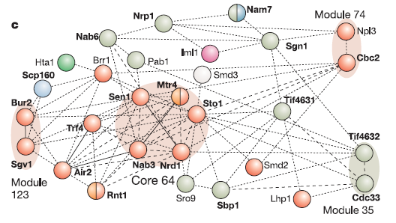
C7250
MS capabilities in protein complex analysis
identification of individual complex members including their PTMs
confirmation of interaction partners (exclusion of nonspecific interactors)
determination of complex stoichiometry
determination of 3D structure of complex (cross-linking)
Gavin A.-C. et al.: Nature, 440 (30), 631-636.

Slide 48

C7250
Identification of individual interaction partners
ctrl
complex
ctrl
complex
sample prep
digestion in gel
LC-MSMS
digestion in solution
LC-MSMS
possibility to label samples by tags for relative quantification and to pool the samples for further processing

Slide 49
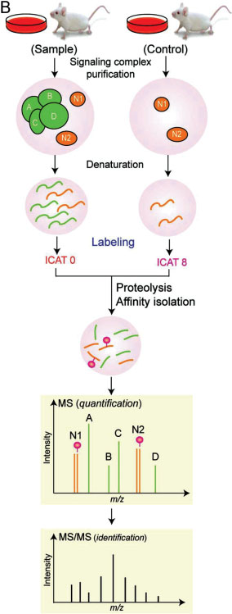
Confirmation of true interaction partners
C7250
At present, label – free approach
non-specific interaction 1:1
W. Yang et al., Proteomics 2008, 8, 832–851

Slide 50
Enzyme-catalyzed proximity labeling
BioID
unique method to screen for physiologically relevant protein interactions that occur in living cells.
Enzyme - BirA - the biotin protein ligase - of Escherichia coli biotinylates only a single cellular protein.
a mutant BirA attaches biotin to a large number of cellular proteins in vivo
Choi-Rhee E, Schulman H, Cronan JE. Protein Sci. 2004;13(11):3043–50

Slide 51
Enzyme-catalyzed proximity labeling
BioID
The ligase is fused to a protein of interest and expressed in cells, where it biotinylates proximal endogenous proteins.
Biotinylation is a rare protein modification in nature, it enables selective isolation and identification with standard biotin‐affinity capture.
Proteins identified by BioID are candidate interactors for the protein of interest.
BioID can be applied to insoluble proteins, can identify weak and/or transient interactions, and is amenable to temporal regulation.
Initially applied to mammalian cells, BioID has potential application in a variety of cell types from diverse species.
Roux KJ, Kim DI, Burke B. Curr Protoc Protein Sci. 2013;74:Unit 19 23.

Slide 52
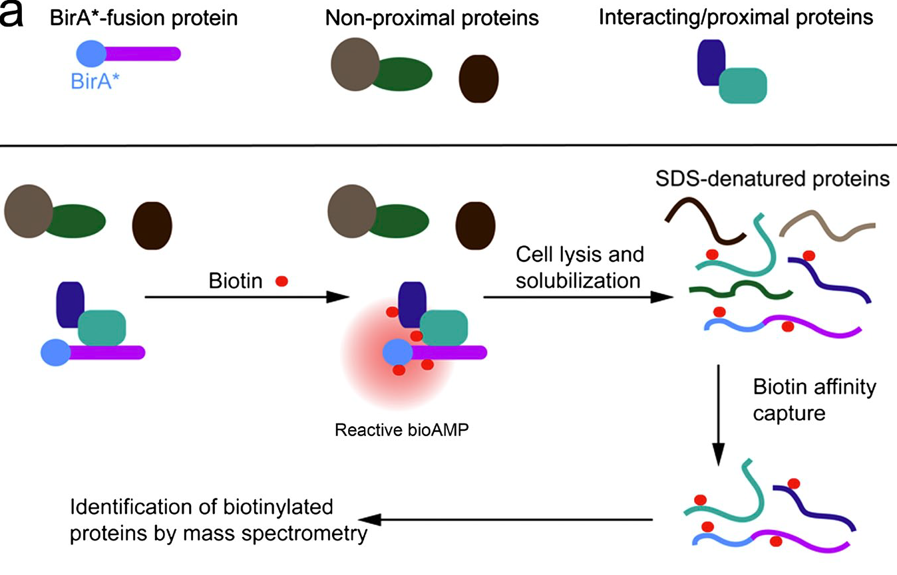
Enzyme-catalyzed proximity labeling
BioID
Roux KJ, Kim DI, Raida M, Burke B. J Cell Biol. 2012;196(6):801–10

Slide 53
Enzyme-catalyzed proximity labeling
TurboID/miniTurbo
multiply mutated BirA
higher efficiency of labeling than BioID or BioID2
faster kinetics
Branon T., C. et al., Nat Biotechnol. 2018 October ; 36(9): 880–887

Slide 54


Slide 55

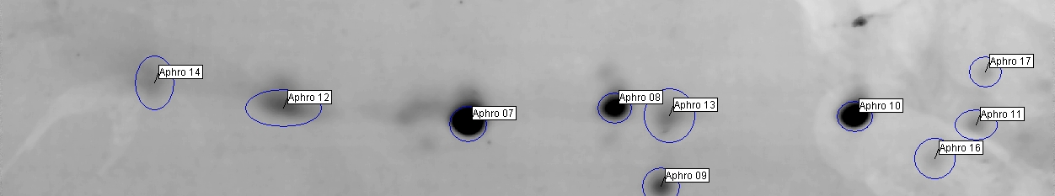
C7250
Sequence confirmation and determination of OBP protein isoforms
de novo sequencing
saliva
2D gel electrophoresis
MS/MS of selected spots
Myodes glareolus
unknown genome
no antibodies
Obp3A
Obp3B
Obp2
cooperation with prof. Stopka FS CU, Prague
Stopková R., Zdráhal Z., Ryba Š. et al, BMC Genomics 2010, 11:45

Slide 56
C7250
Sequence confirmation and determination of OBP protein isoforms
RNA analysis
(FS CU Prague)
proteomic analysis
(FS CU/Proteomics CF)
RNA isolation
cDNA synthesis
PCR with Aphrodisin primers
(hamster)
purification
cloning
sequencing
initial
aminoacid sequence
protein isolation
2D GE
in-gel digestion
MALDI-MS/MS
de novo
corrected AA sequence
(Blast, new proteins)
database of OBP protein sequences
identification of protein isoforms

Slide 57
C7250
Sequence confirmation and determination of OBP protein isoforms
MALDI-MS/MS a LC-MS/MS
manual spectra interpretation
original sequence - QAELEGKWVTTAIAADNIDTIEEEGPMR (OBP3)
DAELEGTWYTTAIAADNVDTIEEEGPLR
HAELEGTWYTTAIAADNVDTIEEEGPLR
m/z 3079.4
DAELEGTWYTTAIAADNVDTIEEEGPLR
MALDI-MS/MS

Slide 58


Slide 59
C7250
MS Imaging

Slide 60
C7250
MALDI-MS imaging
samples:
fresh frozen tissue sections
individual cells or clusters of cells isolated by laser-capture microdissection or contact blotting of a tissue on a membrane target.
MS analysis
scanning of sample area point by point
image corresponds to planar distribution of individual m/z
distribution of peptides (proteins, lipids,...)

Slide 61
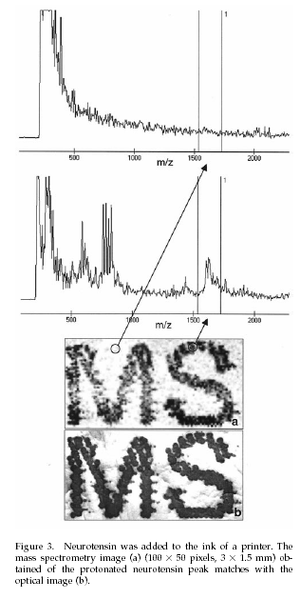
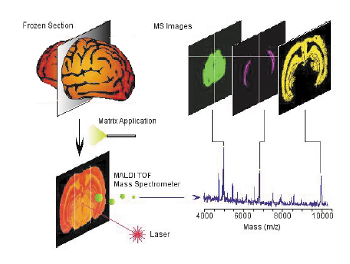
C7250
MALDI-MS imaging
M. Stoeckli, T.B. Farmer, R.M. Caprioli: J Am Soc Mass Spectrom, 10, 67–71 (1999)

Slide 62
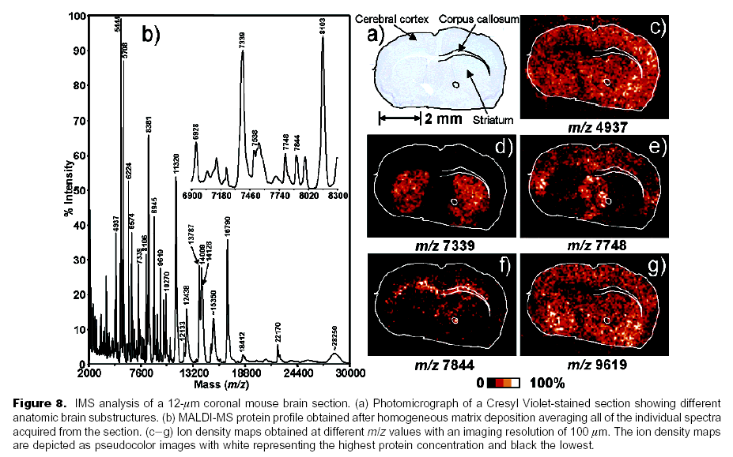
C7250
MALDI-MS imaging
Chaurand et al:Anal. Chem.2004, 76,1145-1155

Slide 63
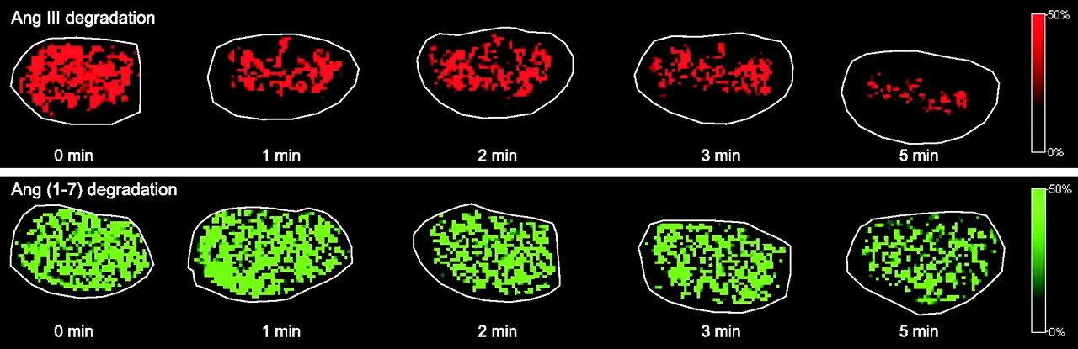
C7250
Degradation of Ang III and Ang-(1–7) in mouse kidney sections.
Grobe N. et al, Am. J. Physiol. Endocrinol. Metab., 302 (8), E1016 (2012)

Slide 64
bruker.com

Slide 65
C7250
Liu et al, Expert Rev. Mol. Diagn., 13(8), 811 (2013)

Slide 66


Slide 67
C7250
Nanopore peptide sequencing
A DNA-peptide conjugate was pulled through the biological nanopore MspA by the DNA helicase Hel308. Reading the ion current signal through the nanopore enabled discrimination of single–amino acid substitutions in single reads.
Fig. 1. Reading peptides with a nanopore.
A) The DNA-peptide conjugate consists of a peptide (pink) attached via a click linker (green) to an ssDNA strand (black). This DNA-peptide conjugate is extended with a typical nanopore adaptor comprised of an extender that acts as a site for helicase loading (blue) and a complementary oligo with a 3′ cholesterol modification (gold).
B) The cholesterol associates with the bilayer as shown in (a), increasing the concentration of analyte near the pore. The complementary oligo blocks the helicase, until it is pulled into the pore (b), causing the complementary strand to be sheared off (c), whereupon the helicase starts to step along DNA.
H. Brinkerhoff et al., Science 10.1126/science.abl4381 (2021)

Slide 68
Nanopore peptide sequencing
C7250
(C) As the helicase walks along the DNA, it pulls it up through the pore, resulting in (a) a read of the DNA portion followed by (b) a read of the attached peptide.
(D) Typical nanopore read of a DNA-peptide conjugate (black), displaying step-like ion currents (identified in red). The asterisks * indicate a spurious level
not observed in most reads and therefore omitted from further analysis. The dagger † indicates a helicase backstep. (E) Consensus sequence of ion current steps (red), which for the DNA section is closely matched by the predicted DNA sequence (blue). The linker and peptide sections are identified by counting half-nucleotide steps over the known structural length of the linker. Error bars in the measured ion current levels are errors in the mean value, often too small to see.
H. Brinkerhoff et al., Science 10.1126/science.abl4381 (2021)

Slide 69
The end

