Slide 1
Heterogeneous catalysis (C9981)
0. Technical information
Basic principles, thermodynamics, and a little bit of kinetics
Active sites and catalyst evaluation

Slide 2
Technical information
Syllabus
Theory behind the heterogeneous catalysis: thermodynamics, kinetics, diffusion.
Synthesis of heterogeneous and single-site catalysts
Characterization
Your presentations
Examples of industrial catalytic processes: Haber-Bosch synthesis of ammonia; three-way catalysts; zeolites in oil refinement.
Homeworks
Not mandatory
But useful for the exam
We will go through the homeworks in the lectures only if there are some homeworks to go through

Slide 3
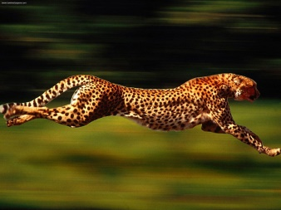
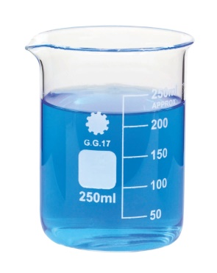
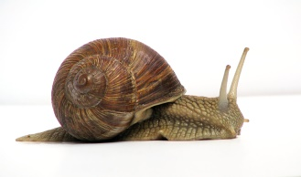
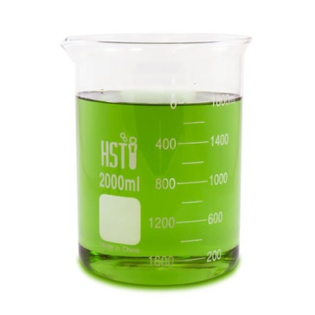
Definition
Catalyst is…
  A substance that speeds up a chemical reaction
  Without being consumed or changed
+ CATA
+ CATA
We get our products
  In shorter time; at lower rxn temperature; at lower pressure
  cheaper; economical; ecological

Slide 4
Types of catalyst (based on phase)
Homogeneous
Heterogeneous
Enzymatic
+ CATA

Slide 5
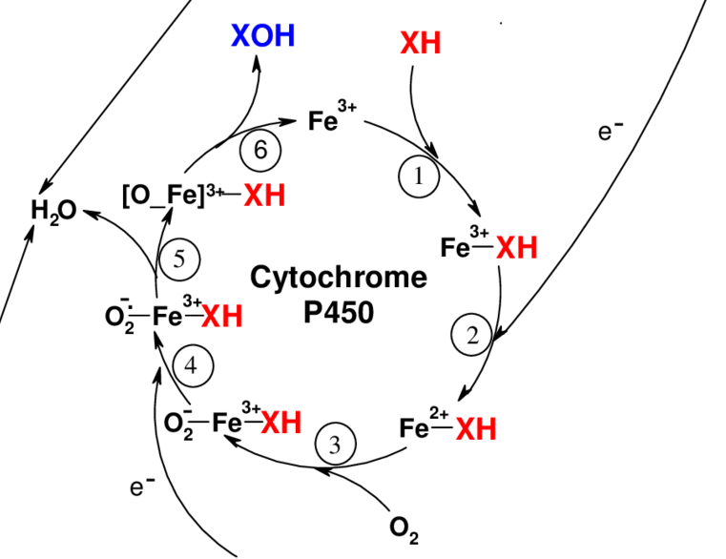
Enzymatic catalysis
Cytochrome P450
Catalytic cycle

Slide 6
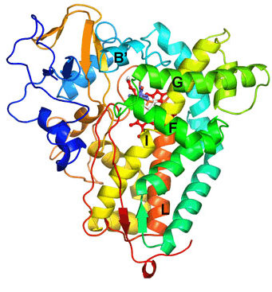
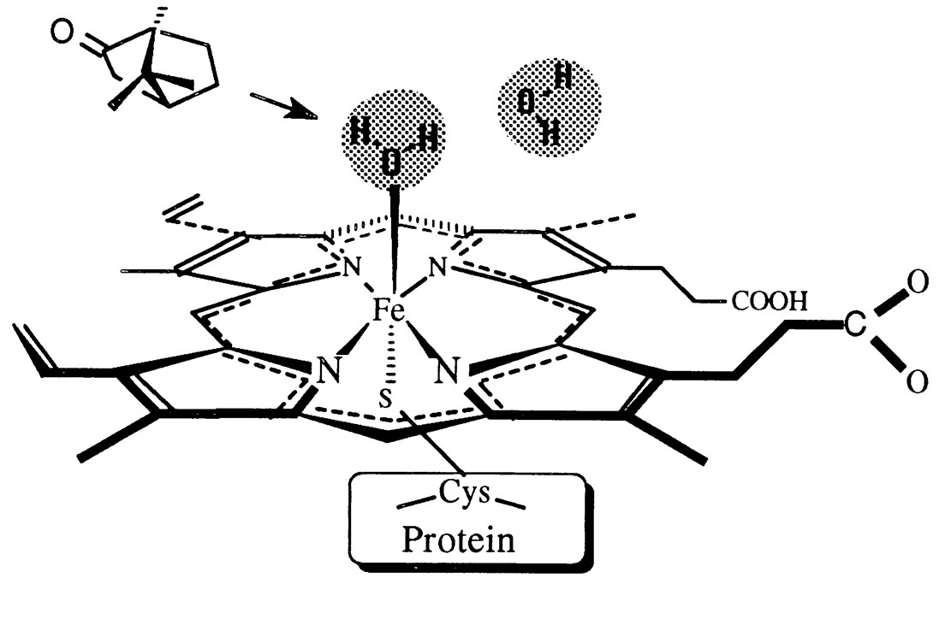
Enzymatic catalysis
Cytochrome P450
Active site

Slide 7
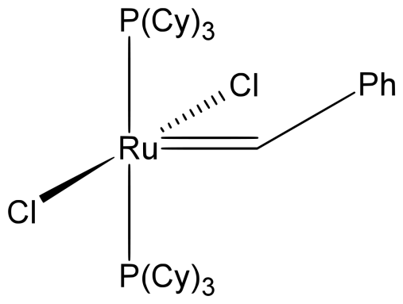
Homogeneous catalysis
A catalyst and rxn mixture in one unique phase
Gas phase
Liquid phase
1/
Cl + O₃ → ClO₃
ClO₃ → ClO + O₂
ClO + O → Cl + O₂
Total:
O₃ + O → 2 O₂
2/
Isomerization of hydrocarbons with HF
(both in gaseous phase)
1/
Esterification of acids with alcohols catalyzed by H⁺
(e.g. H₂SO₄, H₃PW₁₂O₄₀)
2/
Olefin metathesis
over Grubbs catalyst (organometallics dissolved in liquid solvent along with precursors

Slide 8
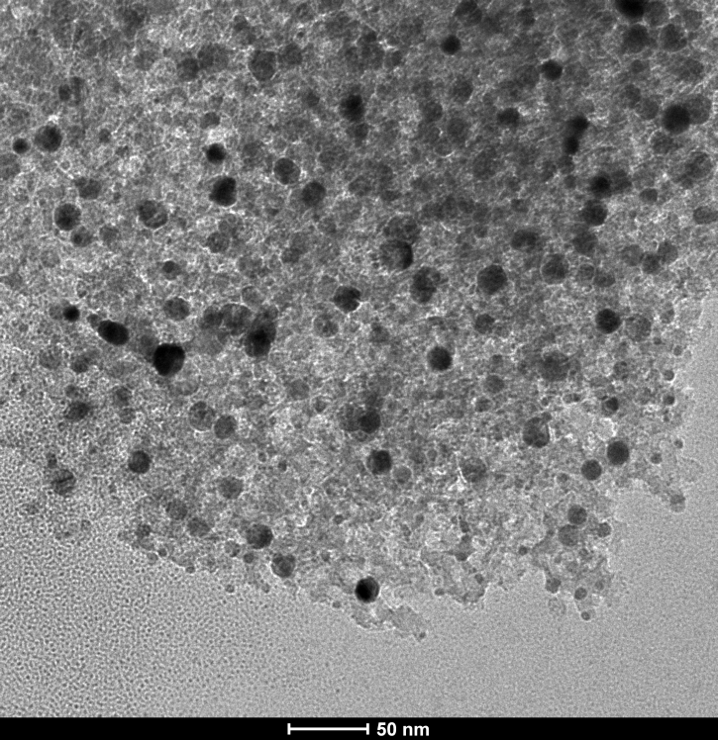
Heterogeneous catalysis
A catalyst is present in a different, distinct phase in contrary to the rxn mixture
Gas phase rxn mixture over solid catalyst
  Olefin metathesis
Ethene
+
Butene
Propene
material???

Slide 9
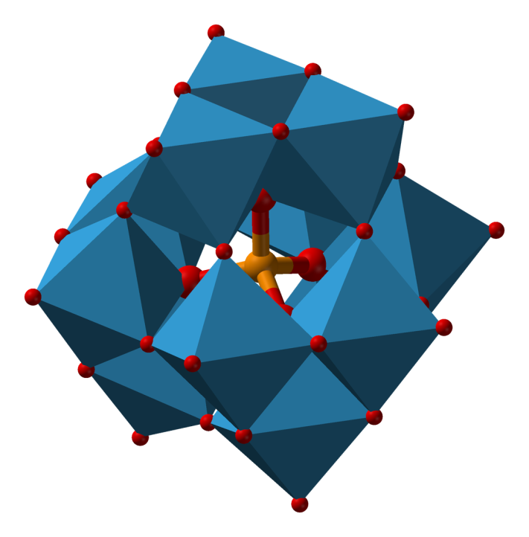
Heterogeneous catalysis
A catalyst is present in a different, distinct phase in contrary to the rxn mixture
Gas phase rxn mixture over solid catalyst
  Alcohol dehydration
Methanol
Dimethylether
H₃PW₁₂O₄₀; a molecular compound, not a material!

Slide 10
Heterogeneous catalysis
A catalyst is present in a different, distinct phase in contrary to the rxn mixture
Liquid phase rxn mixture over solid catalyst
  Alcohol dehydration
Dibutylether
+
Butenes
Butanol
H₃PW₁₂O₄₀; insoluble molecular compound

Slide 11
Heterogeneous catalysis
A catalyst is present in a different, distinct phase in contrary to the rxn mixture
Liquid phase rxn mixture over solid catalyst
  Olefin metathesis
Longer olefins
Longer olefins

Slide 12
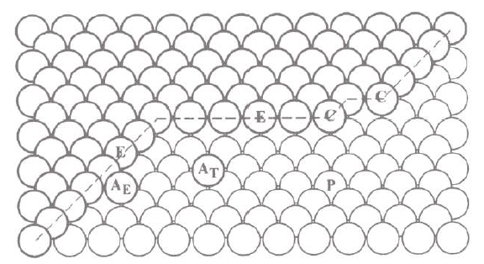

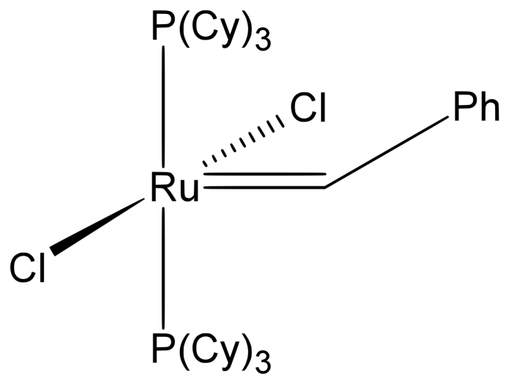
Heterogeneous vs. Homogeneous catalysis
Well defined
= easier to characterize the active site, describe reactivity, and evaluate catalytic performance
Ill defined
= active site???
= more than one type of active sites???
= number of active sites???

Slide 13
Heterogeneous vs. Homogeneous catalysis
One phase with reactants
= higher probability that all necessary species meet and react☺
Distinct phase
= diffusion???
= adsorption???
= desorption???

Slide 14
Heterogeneous vs. Homogeneous catalysis
Separation???
Reusability/Price???
Toxicity???
Batch rxns only???
Distinct phase
= easy to separate
= reusable/recyclable
= clean products
= continuous processes

Slide 15
Heterogeneous vs. Homogeneous catalysis
Homogeneous and Heterogeneous catalysis are complementary to each other
We choose either hetero or homo based on the rxn we want to catalyze (pros and cons)

Slide 16
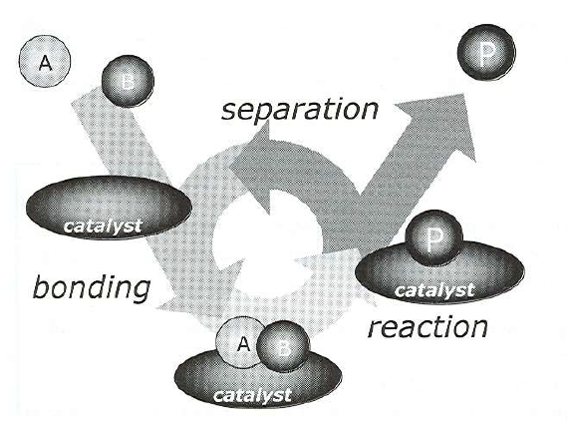
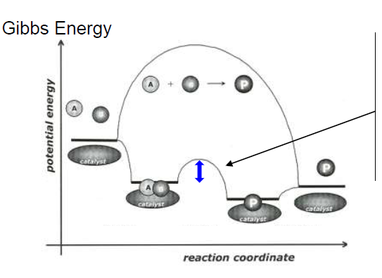
Catalytic cycle
A + B → P
E_{a} >> E_{a}(cata); k = A∙e^{–Ea/RT}
ΔG = ΔG(cata); ΔG = –RT∙lnK

Slide 17
Thermodynamics vs. kinetics
Addition of catalyst into the rxn mixture
  does change „k“
  does not change „K“
A → P, speeded up by addition of a catalyst
K = 1; ΔG = 0 kJ mol^{–1}; final rxn mixture: 1A + 1P
The catalyst is then equally efficient in catalysing the opposite process
P → A; final rxn mixture: 1A + 1P

Slide 18
Thermodynamics vs. kinetics
If a catalyst is efficient in dehydration
  then it can be possibly used in hydration
If a catalyst is efficient in hydrogenation
  then it can be possibly used in dehydrogenation
I.e.: It depends on ΔG of studied reaction, whether the catalyst hydrogenates or dehydrogenates.
We know how to shift equilibrium of chemical reaction☺ (#GenChem). This is not a job of the catalyst.

Slide 19
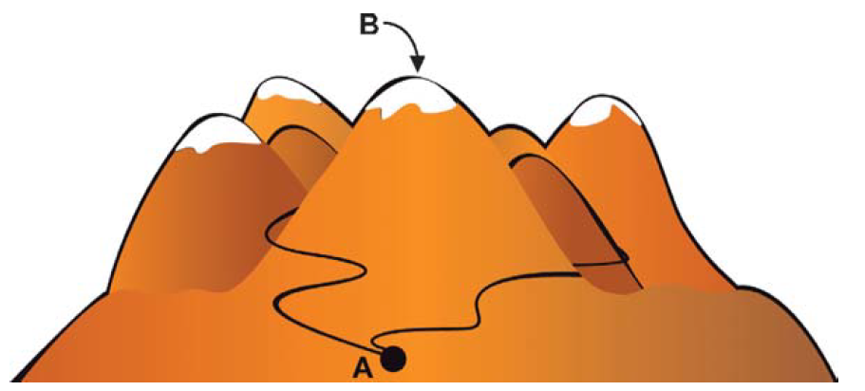
Thermodynamics vs. kinetics
Reaction coordinate: A multidimensional problem

Slide 20
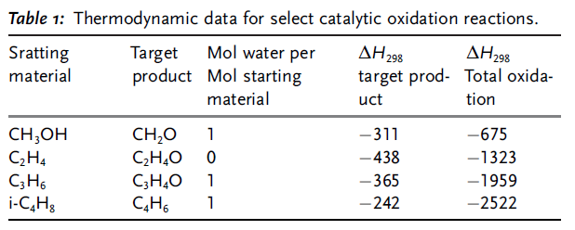

Thermodynamics vs. kinetics
Reaction coordinate: A multidimensional problem
  e.g. selective oxidation reactions (Table 1)
    We are not shooting for the most stable product (thermodynamically); Difficult!
Mountain
cottage
Spa
resort

Slide 21
Thermodynamics vs. kinetics
Reaction coordinate: A multidimensional problem
  How is it possible that we sometimes end up in a mountain cottage and not in the spa resort???
  We need a catalyst!
  The catalyst will lower the activation energy of our way to the mountain cottage (beautiful views, crazy friends,…)
  The catalyst will increase the activation energy of our way to the spa resort
  E.g. The catalyst has to increase the rate of hiking (selective oxidation) and decrease the rate of hiking (total oxidation). What a difficult job!

Slide 22
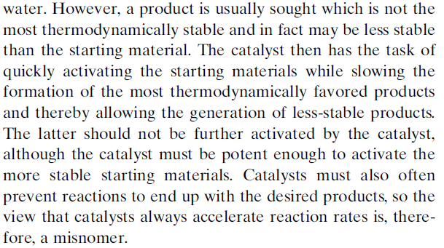
Thermodynamics vs. kinetics
Reaction coordinate: A multidimensional problem

Slide 23
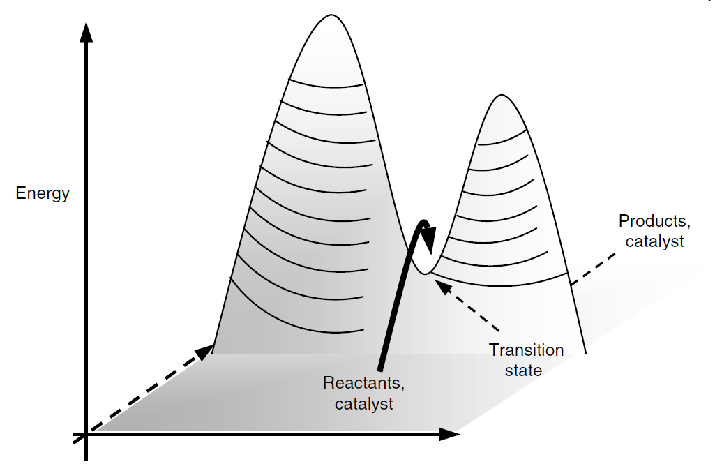
Thermodynamics vs. kinetics
Reaction coordinate: From multidimensional to two-dimensional problem

Slide 24
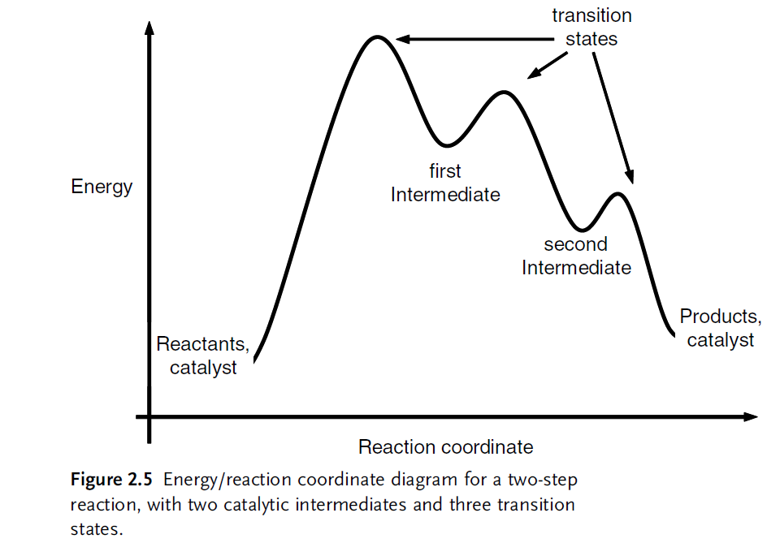
Thermodynamics vs. kinetics
Transitions state vs. Intermediate

Slide 25
Thermodynamics – heterogeneous catalysis
A + B → P
1: Adsorption of reactants on catalyst surface (hetero) / Formation of reaction intermediate ABC (enzymes and homo)
1
2
1
3
In heterogeneous catalysis always thermodynamically favorable
(coordinatively unsaturated surface + adsorbate)
Let‘s imagine weak interaction of A, B, and catalyst surface…???
Let‘s imagine very strong interaction of catalyst surface, A, and/or B…??

Slide 26
Thermodynamics
A + B → P
3: Desorption of products from catalyst surface (hetero) / Rupture of product intermediate PC (enzymes and homo)
1
2
3
Let‘s imagine very strong interaction of P with catalyst surface…???

Slide 27
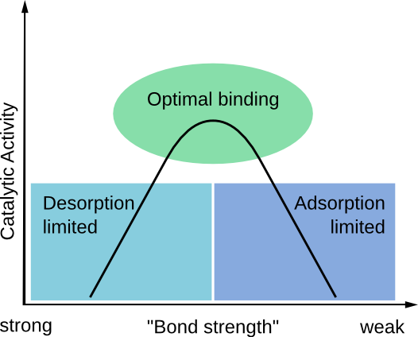
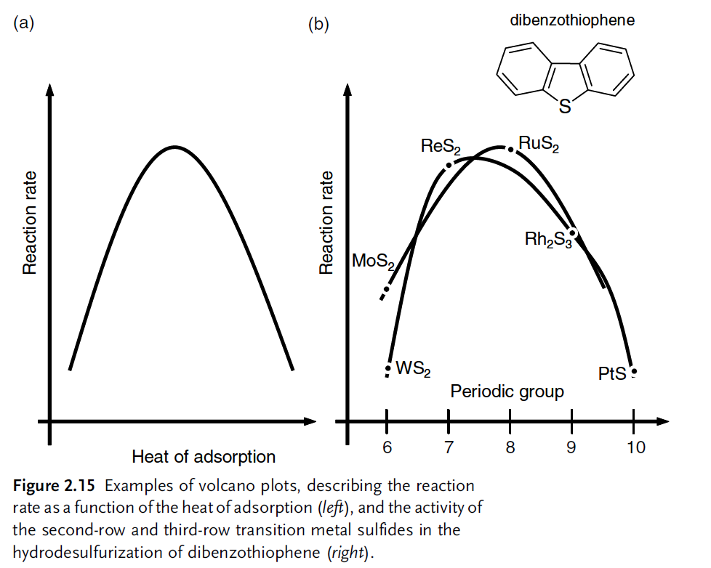

Thermodynamics
Interactions of A,B, and P with catalyst not too weak, not too strong
(= physi/chemisorption on catalyst surface)
Sabatier‘s principle; Volcano plot

Slide 28
Thermodynamics vs. kinetics
A + B → P
Before going any further…
Steps 1 and 3 are equally important to step 2 in catalysis .
Adsorption and desorption of A, B, and P might have a significant effect on E_{a}.
1
2
3
In kinetic studies in heterogeneous catalysis we estimate only apparent activation energy (E_{app}), where all these contributions are included.

Slide 29
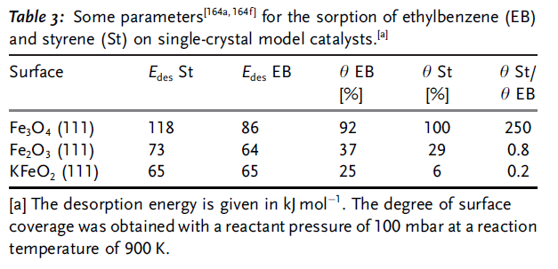
Thermodynamics vs. kinetics
Importance of reactant adsorption and product desorption
  Example: Ethylbenzene dehydrogenation to styrene
The best
catalyst

Slide 30
Thermodynamics vs. kinetics
A + B → P
What is preceding the step 1 and following the step 3 ?
Diffusion!
Diffusion of A, B, and P might have a significant effect on E_{a} as well.
1
2
3
In kinetic studies in heterogeneous catalysis we estimate only apparent activation energy (E_{app}), where all these contributions are included.

Slide 31
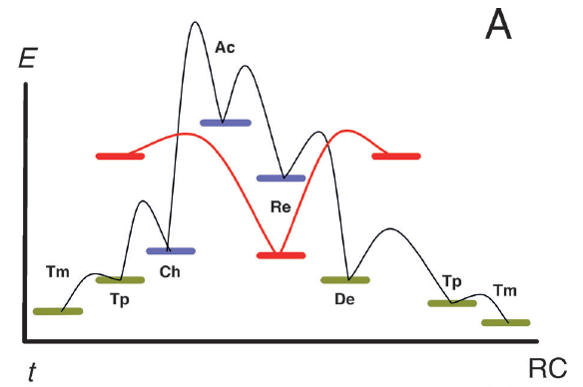
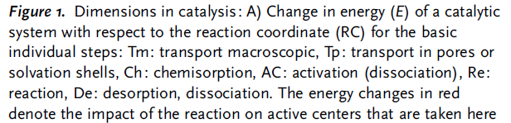
Thermodynamics vs. kinetics
Another representation of the complexity of heterogeneous catalytic reaction
Adsorption, desorption, and diffusion of A, B, and P might have a significant effect on E_{a}.

Slide 32
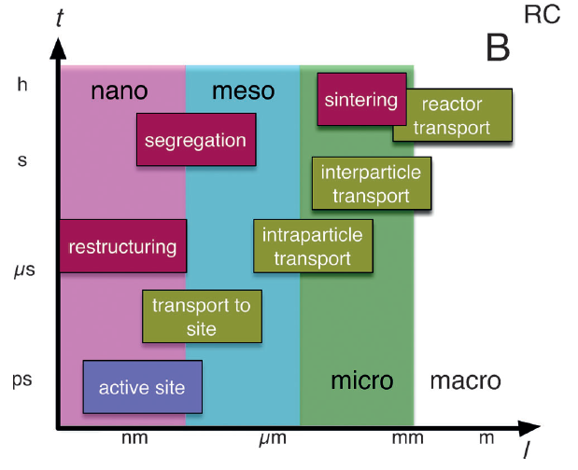
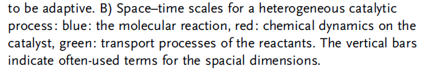
Thermodynamics vs. kinetics
Another representation of the complexity of heterogeneous catalytic reaction
Adsorption, desorption, and diffusion of A, B, and P might have a significant effect on E_{a}.

Slide 33
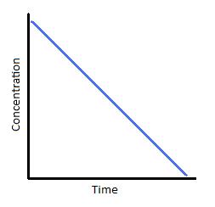
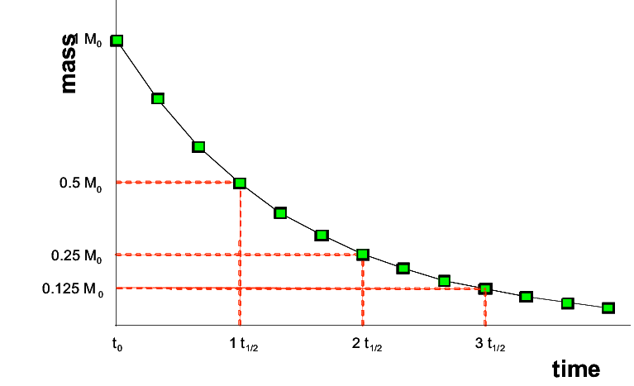
Kinetics
We know kinetics☺ (#ChemKin)
Rxns of zero order, first order, and second order
But in catalysis also 0.39 order, –0.5 order… (many elementary rxns, fight for active site between reactants and products,…!)

Slide 34
Thermodynamics vs. kinetics
A + B → P
2: In order to decrease E_{a} for step 2 we need to design an active site of the catalyst as good as possible
1
2
What is the active site???
How do we measure the „goodness“ of the active site???
3

Slide 35
Active sites

Slide 36
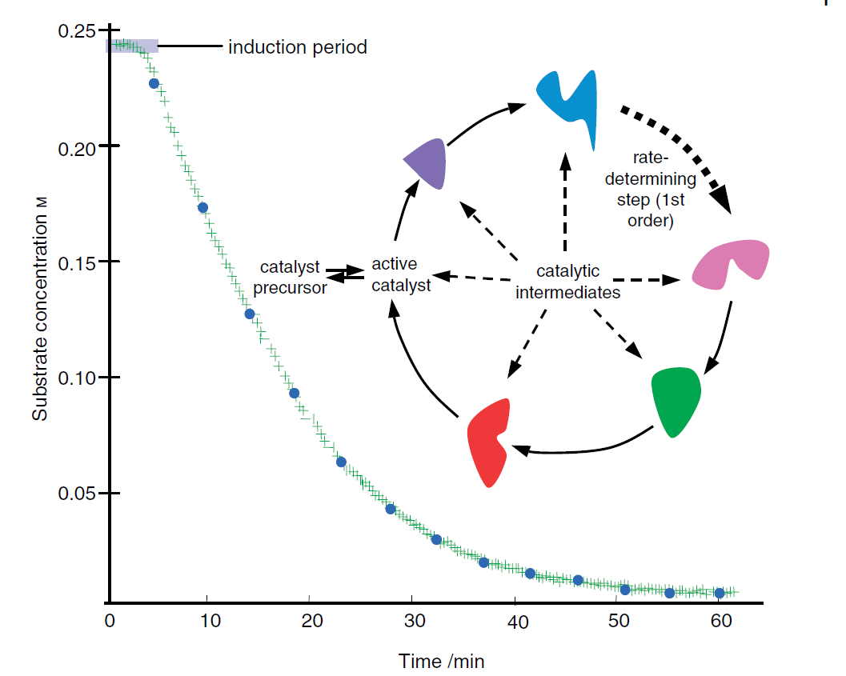
Active sites
Active sites are often dynamic: They has to be created first!

Slide 37
Active site/catalyst evaluation
Turn-over frequency (TOF; [s^{–1}])
= number of catalytic cycles performed by 1 active site per time unit
Precise numbers for homogeneous and enzymatic catalysis
Numbers for heterogeneous catalysis???
TOF [s^{–1}]
Hetero: ~1–100 s^{–1}
Homo: ~10–1000 s^{–1}
Enzymes: ~10000–1000000 s^{–1}

Slide 38
Active site/catalyst evaluation
Turn-over number (TON; [-])
= number of catalytic cycles performed by 1 active site before deactivation (~lifetime)
Precise numbers for homogeneous and enzymatic catalysis
Numbers for heterogeneous catalysis???

Slide 39
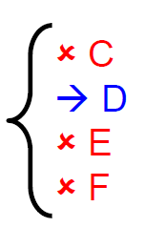
Active site/catalyst evaluation
Selectivity is ability of catalyst to form one product from a pool of products (possibly many)
Selectivity (S; [%])
= number of D molecules produced / R molecules converted
reactant R

Slide 40
Active site/catalyst evaluation
Enantiomeric enrichment is ability of catalyst to form selectively one enantiomer
Enantiomeric enrichment (ee; [%])
= S(P_{R}) – S(P_{S})
(e.g. Final mixture consists of 90 % P_{R} and 10 % P_{S}
ee = 80 %)
S [%] ee [%]
Hetero: 1–100 1–100
Homo: > 90 > 70
Enzymes: > 99.99 > 99.99

Slide 41
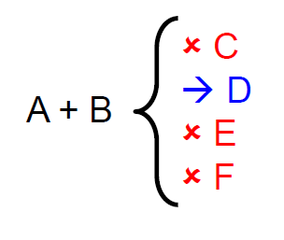
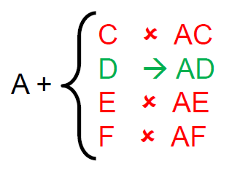
Active site/catalyst evaluation
Selectivity is ability of catalyst to form one product from a pool of products (possibly many)
Specificity is ability of catalyst to react with one reactant among many (similar) reactants

Slide 42
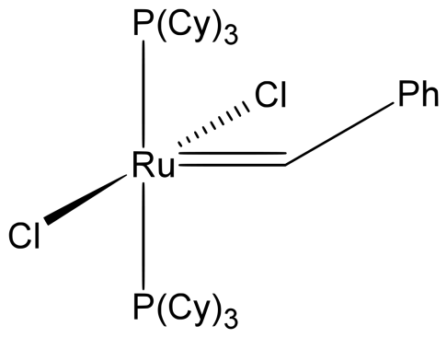

Active sites
Electronic and steric properties do play an important role! (TOF, TON, Selectivity, ee, specificity).

Slide 43

Catalyst evaluation
R → P + P‘
Conversion (C; [%])
= number of R molecules converted / number of R molecules introduced
Yield (Y; [%])
= number of P molecules produced / number of R molecules introduced
Selectivity (S; [%])
= number of P molecules converted / number of R molecules converted
$$S=\frac{Y}{C}$$

Slide 44
Catalyst evaluation
R → P + P‘
Productivity (Site Time Yield, STY; [g g^{–1} s^{–1}])
= amount of product P produced per unit of time and unit of catalyst mass
= high conversion, high selectivity, low catalyst mass, high flow
= industrial viewpoint

Slide 45
Catalyst evaluation
Ecological point of view
Atom efficiency [%]
= mass of desired product / total mass of all products
E factor [-]
= mass of all wastes (solvents, gases, unreacted precursors, byproducts) / mass of desired products
EQ factor [-]
= E factor, mass of each waste multiplied by Q (environmental unfriendliness), e.g. Q = ~0 for water, ~ 1 for NaCl, and ~1000 for toluene…

Slide 46
Catalyst evaluation
Ecological point of view
Atom efficiency [%], E factor [-], EQ factor [-]
Gas phase, flow mode
Liquid phase, toluene as solvent, batch mode

Slide 47
HW1. Aminolysis of styrene oxide over Zr catalyst, in toluene, batch, 40 °C
Rxn mixture, time 0
1 Zr : 250 styrene oxide : 3000 toluene; aniline in excess
Rxn mixture, time = 10 min, ¹H NMR analysis – ratio of integrated areas, protons in red/blue circle
1 Product III : 0.01 Product IV : 19.4 styrene oxide : 777 toluene (CH₃ group integration)
Calculate conversion, TOF [h⁻¹], selectivity to product IV.
What is the fraction of the products we did not analyze?

