Slide 1
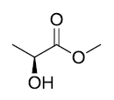
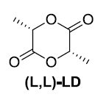
Homework 4
Gas phase transesterification
Continuous flow fixed bed reactor
TiO₂/SiO₂
2
-2 MeOH
Temperature [°C] | Conversion sample 1 (4.2 wt% Ti) [%] | Conversion sample 2 (0.9 wt% Ti) [%]
220 | 39 | 8.6
230 | 48 | 9.6
240 | 59 | 13
250 | 82 | 17
260 | 93 | 21
Create Arrhenius plots for both catalysts (plot ln k [mol_{LD} g_{cat}^{–1} h^{–1}] vs. 1000/T [K^{–1}]
Estimate apparent E_{a} and A from Arrhenius equation
What makes the difference between these two catalysts?
Selectivity = 90 % in all cases; WHSV = 15.5 h^{–1}
ACS Catal. 2018, 8, 9, 8130–8139

Slide 2
Heterogeneous catalysis
Lecture 3
Catalysts preparation

Slide 3
Types of catalysts
Bulk catalysts
Supported catalysts
Agglomerated catalysts

Slide 4
Types of catalysts
Bulk catalysts
Supported catalysts
Agglomerated catalysts
  Intermediate category
  Catalysts obtained by mixing active species with support (powders+precursors)
  Ill defined catalysts – broad application in industry

Slide 5
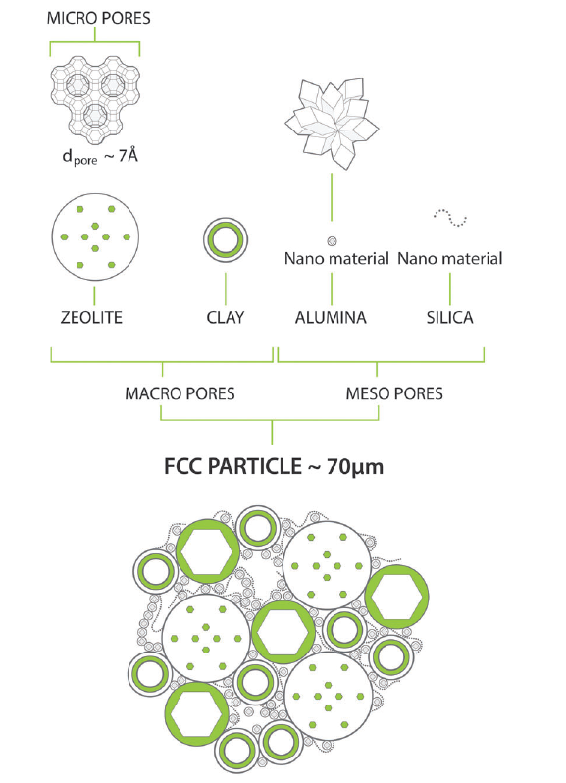

Slide 6
Types of catalysts
Bulk catalysts
Supported catalysts
Malaxed-agglomerated catalysts

Slide 7
Preparation of bulk catalysts
The whole body of the catalyst is made of one active substance
= It must be cheap, thermally, mechanically, and chemically stable, porous,…!
  Silica-alumina (cracking)
  Raney nickel, Co molybdate (hydrogenation)
  Catalyst supports: silica, alumina, silica-alumina, zeolites, TiO₂, MgO, carbon

Slide 8
Preparation of bulk catalysts
Ceramic route (heat and beat)
  e.g. Molybdates Bi₂O₃ + MoO₃ → Bi₂MoO₆
  Used as selective oxidation catalysts (propylene to acrolein)
  Homogeneity, time, temperature
(Co-)Precipitation
  E.g. NH₄VO₃ + Al(NO₃)₃ → V-Al oxynitride (used in propene ammoxidation to acrylonitrile)
  change of pH leads to precipitation
Sol-gel method
Combustion synthesis
Solvothermal method
  e.g. zeolites

Slide 9
Preparation of bulk catalysts
Ceramic route, (co-)precipitation, sol-gel method, combustion synthesis, and solvothermal method:
#InorgMatChem
Heat and beat quickly and effectively?
Sol-gel continuously???
Ball milling!
Aerosol assisted
sol-gel process!
Flame spray
pyrolysis!

Slide 10
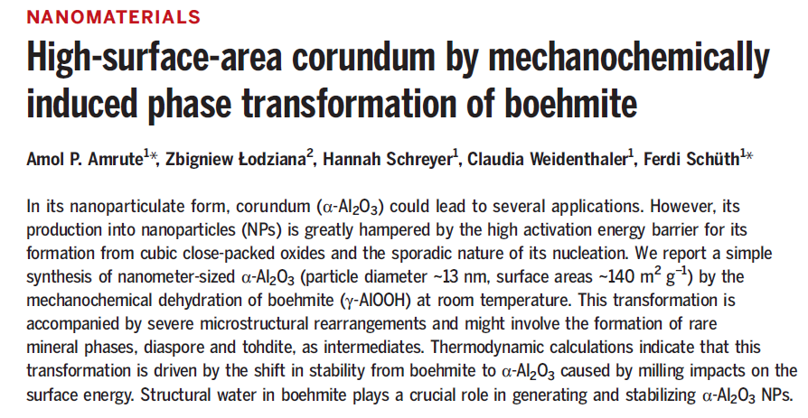
Preparation of bulk catalysts

Slide 11
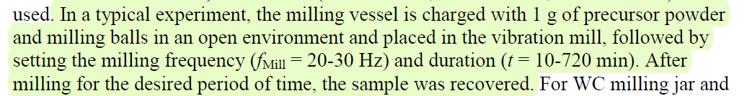
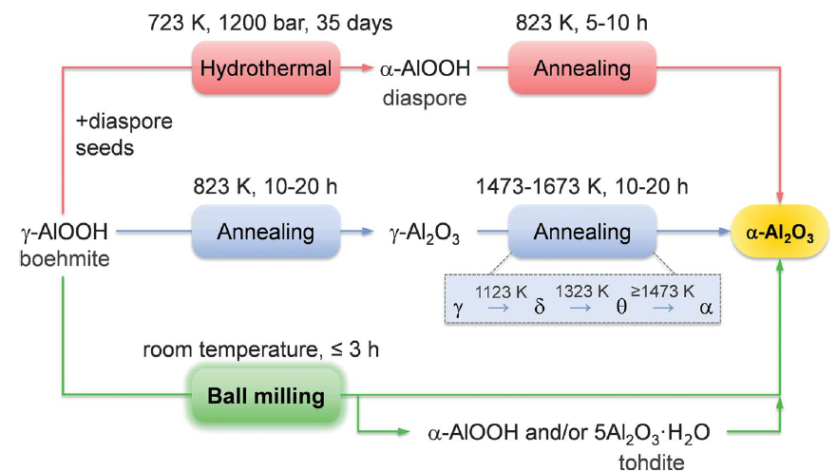
Preparation of bulk catalysts

Slide 12
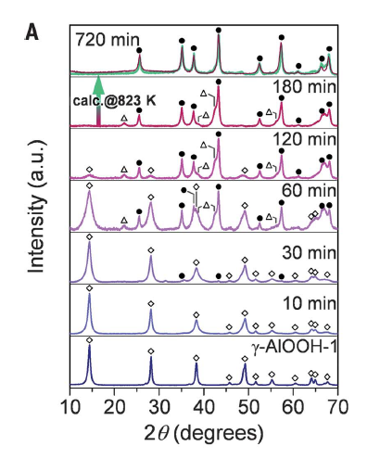
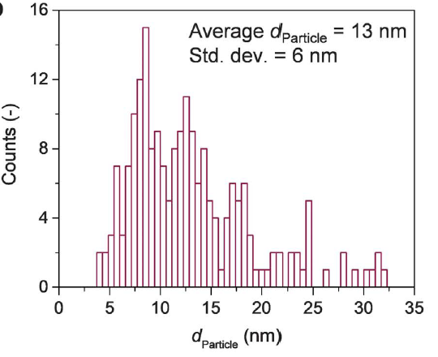
Preparation of bulk catalysts
◊ γ-AlOOH
● α-Al₂O₃
Δ α-AlOOH

Slide 13
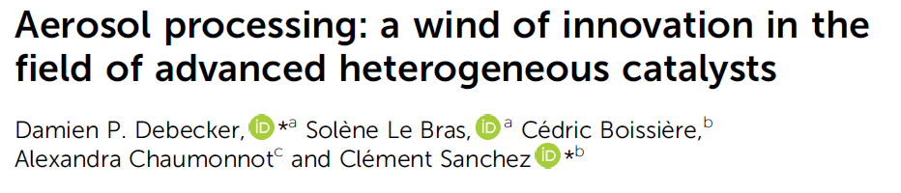
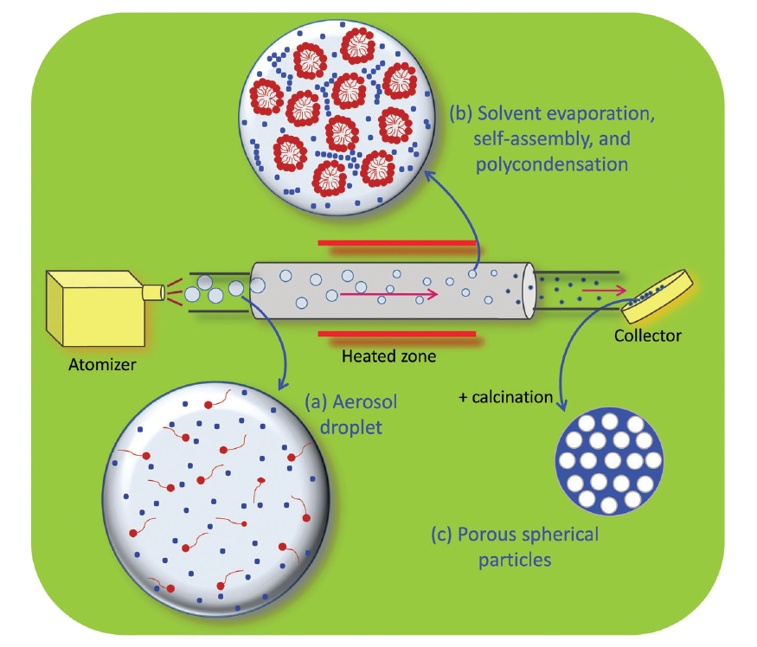
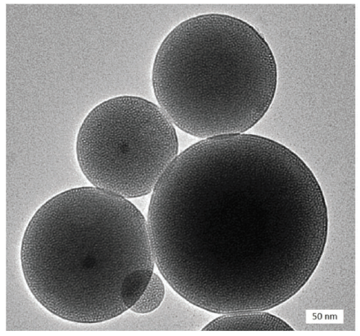
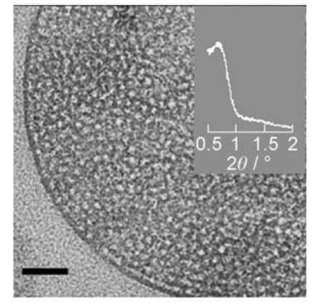
Preparation of bulk catalysts

Slide 14
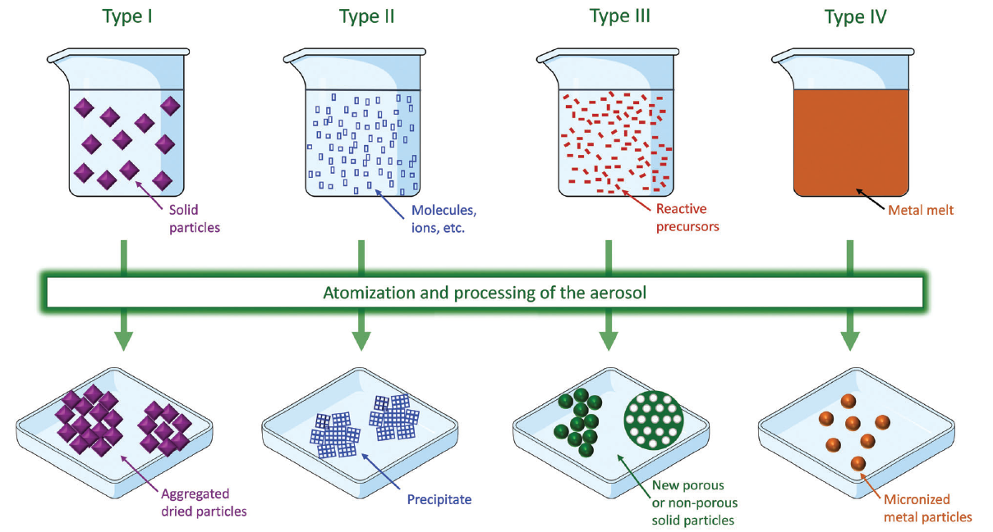
Preparation of bulk catalysts

Slide 15
Preparation of bulk catalysts
Flame spray pyrolysis

Slide 17
Preparation of bulk catalysts
Flame spray pyrolysis

Slide 18
Types of catalysts
Bulk catalysts
Supported catalysts
Malaxed-agglomerated catalysts

Slide 19
Preparation of supported catalysts
Properties of catalyst supports
  Cheap
  Porous
  Thermally, mechanically, and chemically stable
  …
Role of catalyst supports (non-innocent)
  Porosity/hydrophobicity vs. Activity/selectivity
  O, H, N,…bank (MvK mechanism)
  Electron donor/acceptor (Haber-Bosch)
  …

Slide 20
Preparation of supported catalysts
Three types of interaction between support and active phase
  Weak
  Electrostatic
  Covalent

Slide 21
Preparation of supported catalysts
Weak interaction = Impregnation methods
  Wet impregnation
    Suspension of support (e.g. SiO₂ in water)
    Solution of metal salt (e.g. Cu(NO₃)₂ in water)
    Mixed together (suspension)
    Cu²⁺ cations diffuse into the pores of SiO₂ support (=we need to wait for enough long time, Fick laws)
    Drying, calcination (= formation of Cu₂O NPs on SiO₂), (reduction of Cu₂O to Cu NPs)
    Disadvantages: Time, homogeneity.

Slide 22
Preparation of supported catalysts
Weak interaction = Impregnation methods
  Dry impregnation (Incipient wetness impregnation)
    Dry support, pores full of gas (e.g. SiO₂ in ambient air)
    Solution of metal salt, V = pore volume (e.g. Cu(NO₃)₂ in water)
    Mixed together (paste)
    Capillary elevation (fast) brings Cu²⁺ solution directly into the pores (concentration gradients might occur – pore size!)
    Drying, calcination (= formation of Cu₂O NPs on SiO₂), (reduction of Cu₂O to Cu NPs)
    Solubility limits!

Slide 23
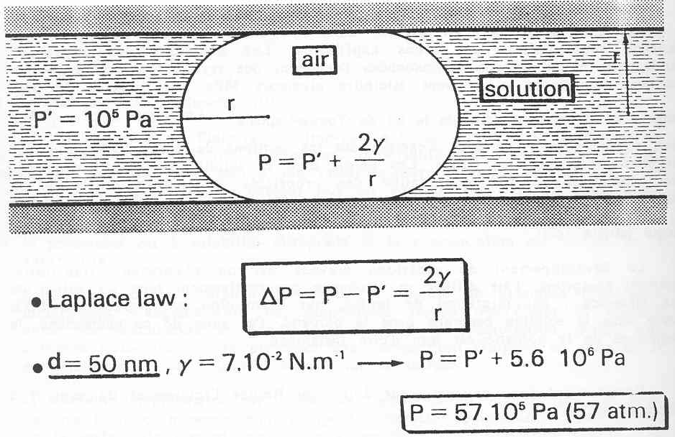
Preparation of supported catalysts
Weak interaction = Impregnation methods
  Dry impregnation (Incipient wetness impregnation)
    Big issue: Gas trapped inside the pores
    Pore collapse
    Mechanical degradation
    Attrition
    …

Slide 24
Preparation of supported catalysts
Weak interaction = Impregnation methods
  Dry impregnation (Incipient wetness impregnation)
    Big issue: Gas trapped inside the pores
    Possible solutions:
    No gas (impregnation under vacuum)
    Lower surface tension (addition of a surfactant)
    Wait until gas dissappears and impregnation is completed (either gas dissolves in solution or bubbles move out from the pores)

Slide 25
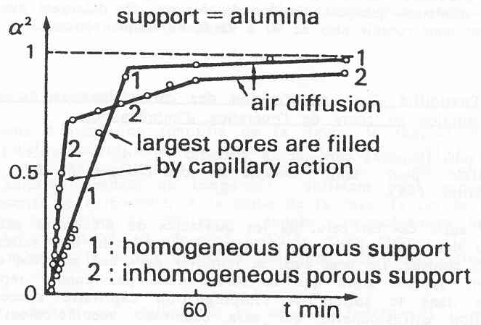
Preparation of supported catalysts
Weak interaction = Impregnation methods
  Dry impregnation (Incipient wetness impregnation)
    Big issue: Gas trapped inside the pores

Slide 26
Preparation of supported catalysts
Three types of interaction between support and active phase
  Weak
  Electrostatic
  Covalent

Slide 27
Preparation of supported catalysts
Electrostatic interaction = Ion exchange
  Classic ion exchangers: clays, layered hydroxides, zeolites
  Oxides with the help of pH

Slide 28
Preparation of supported catalysts
Electrostatic interaction = Ion exchange
  Zeolites, how does it work?
  Cation compensating the negative charge?
  Na⁺ from the synthetic step

Slide 29
Preparation of supported catalysts
Electrostatic interaction = Ion exchange
  Zeolites, how does it work?
  Na⁺ → H⁺ directly?
  Na⁺ → ??? → H⁺

Slide 30
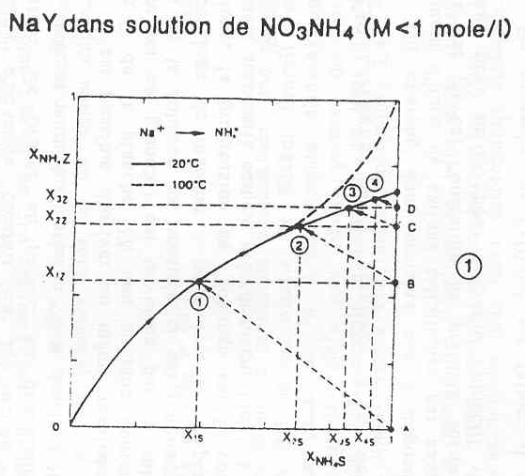
Preparation of supported catalysts
Electrostatic interaction = Ion exchange
  Zeolites, how does it work?
  Na⁺ → NH₄⁺ → H⁺
  Zeolite NaY
  Up to 73 % of Na⁺ can
  be exchanged at R.T.
  4 consecutive steps
  or
  continuous ion exch.
  ^{ΔT}

Slide 31
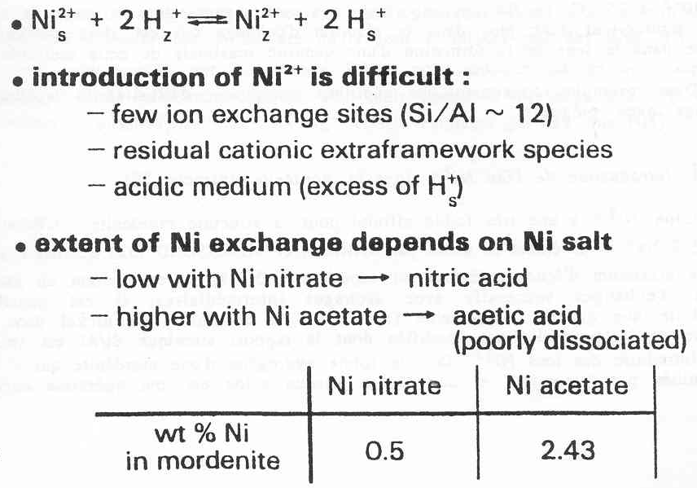
Preparation of supported catalysts
Electrostatic interaction = Ion exchange
  Enhancement…trap for leaving ion (shifting equilibrium)!
  e.g. Exchange of Ni²⁺ for H⁺ in zeolite mordenite
  Ni(NO₃)₂ vs. Ni(OAc)₂

Slide 32
Preparation of supported catalysts
Electrostatic interaction = Ion exchange
  Trap
    OAc⁻ + H⁺ → AcOH (rarely dissociated)
    OH⁻ + H⁺ → H₂O (rarely dissociated)
    SCN⁻ + Ag⁺ → AgSCN (rarely dissociated)
Salt - trap
Support

Slide 33
Preparation of supported catalysts
Electrostatic interaction = Ion exchange
  Classic ion exchangers: clays, layered hydroxides, zeolites
  Oxides with the help of pH

Slide 34
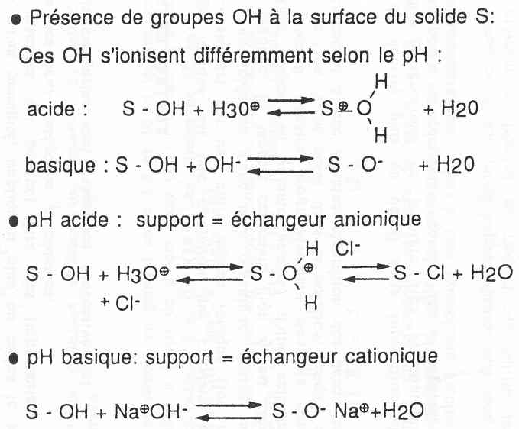
Preparation of supported catalysts
Electrostatic interaction = Ion exchange
  Oxides with the help of pH

Slide 35
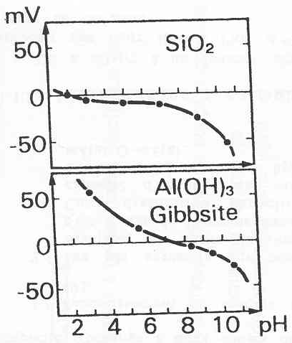
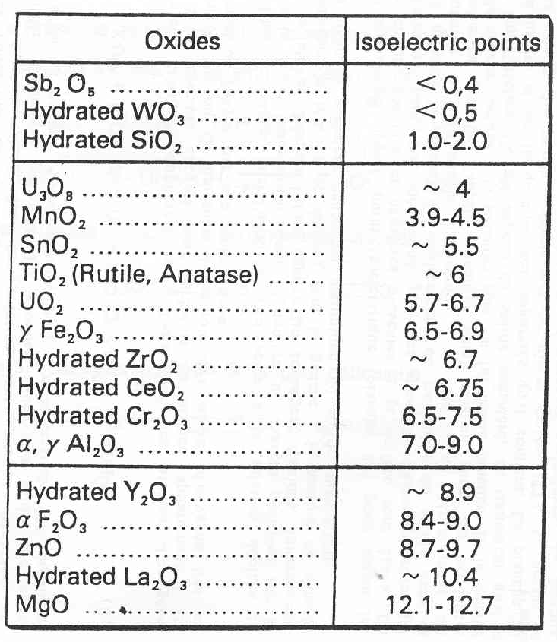
Preparation of supported catalysts
Electrostatic interaction = Ion exchange
  Oxides with the help of pH
    Isoelectric point

Slide 36
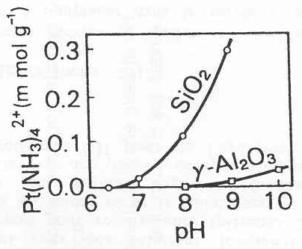
Preparation of supported catalysts
Electrostatic interaction = Ion exchange
  Oxides with the help of pH
    Exchange capacity: the farther you are from isoelectric point, the higher the exchange capacity.

Slide 37
Preparation of supported catalysts
Electrostatic interaction = Ion exchange
  Oxides with the help of pH
    Stability of support at different pH!
    Precursor stability at different pH!
Hydrolysis, condensation,
precipitation…!

Slide 38
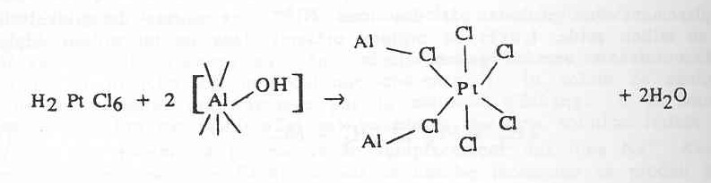
Preparation of supported catalysts
Electrostatic interaction = Ion exchange
  Oxides with the help of pH
    Competitive ion exchange
    Example: very high affinity between Al₂O₃ and Pt
    Result: heterogeneous distribution of Pt (only outer surface)

Slide 39
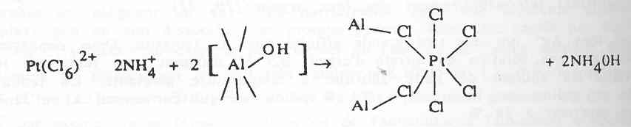
Preparation of supported catalysts
Electrostatic interaction = Ion exchange
  Oxides with the help of pH
    Competitive ion exchange
    NH₄OH dissociates readily, NH₄⁺ competes with Pt for sites (= inverse to trap)
    Result: homogeneous distribution of Pt through the support
2–

Slide 40
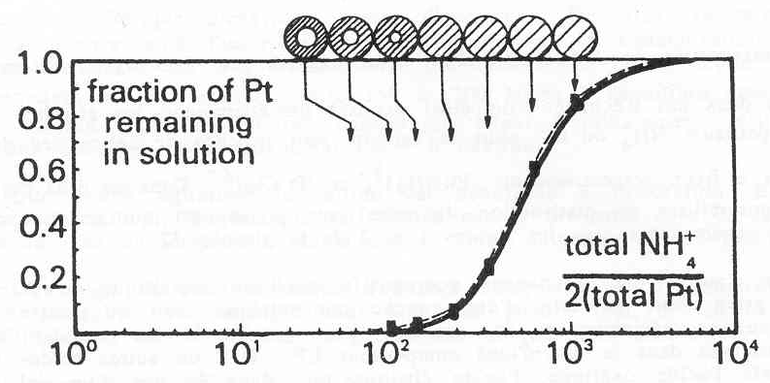
Preparation of supported catalysts
Electrostatic interaction = Ion exchange
  Oxides with the help of pH
    Competitive ion exchange
    [NH₄⁺]

Slide 41
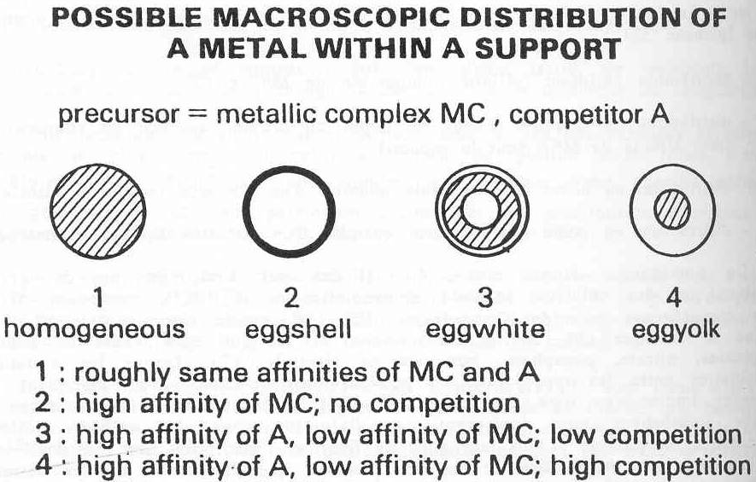
Preparation of supported catalysts
Electrostatic interaction = Ion exchange
  Oxides with the help of pH
    Competitive ion exchange

Slide 42
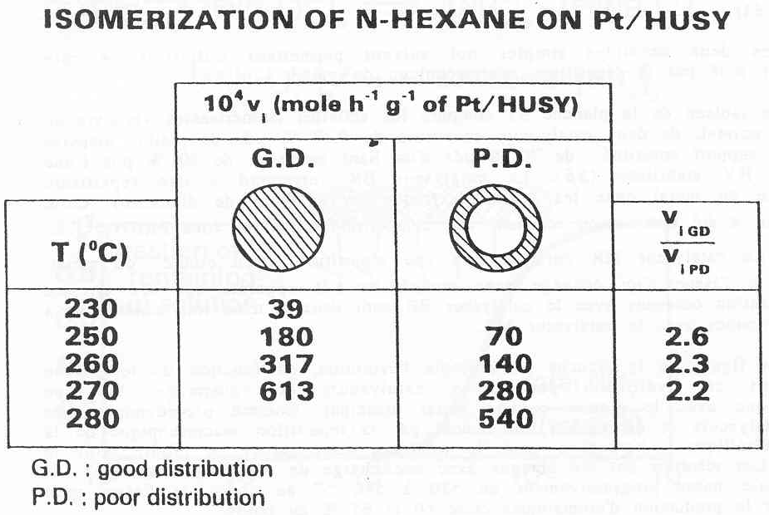
Preparation of supported catalysts
Electrostatic interaction = Ion exchange
  Oxides with the help of pH
    Competitive ion exchange

Slide 43
Preparation of supported catalysts
Electrostatic interaction = Ion exchange
  Oxides with the help of pH
    Competitive ion exchange: Note
    We say homogeneous Pt distribution…
    But how homogeneous???
    Latest research from de Jong group (University Utrecht, HR-TEM, perfect control of Pt deposition on atomic scale) shows that uniform Pt homogeneity is not ideal for hexane isomerization!

Slide 44
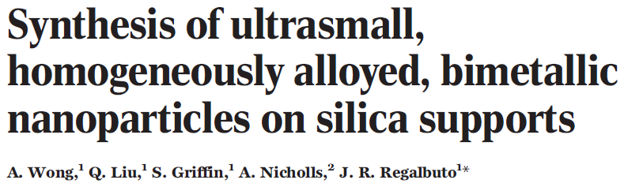
Preparation of supported catalysts
Electrostatic interaction = Ion exchange
  Oxides with the help of pH
    Detailed knowledge of isoelectric point, precursor behavior, control over pH:

Slide 45
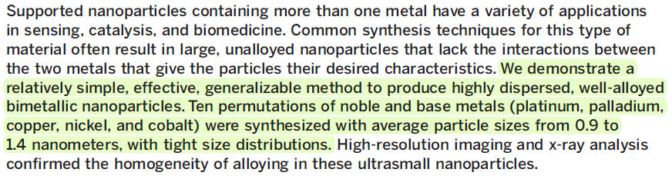
Preparation of supported catalysts
Electrostatic interaction = Ion exchange
  Oxides with the help of pH
    Detailed knowledge of isoelectric point, precursor behavior, control over pH:

Slide 46
Preparation of supported catalysts
  NPs by wet (dry) impregnation vs. impregnation with electrostatic interaction
Electrostatic
interaction
+
+
+
+
+
−
−
−
−
−
calcination
Uniform NPs

Slide 47
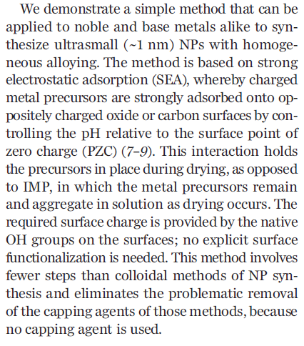
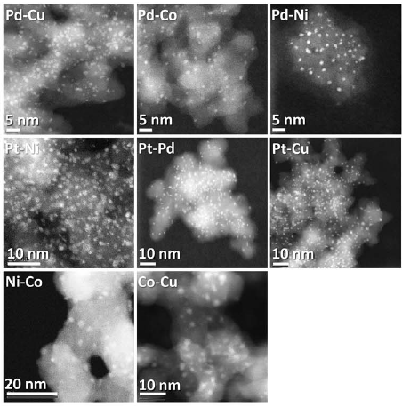
Preparation of supported catalysts
Electrostatic interaction = Ion exchange
  Oxides with the help of pH

Slide 48
Preparation of supported catalysts
Three types of interaction between support and active phase
  Weak
  Electrostatic
  Covalent

Slide 49
Preparation of supported catalysts
Covalent bonds = grafting
  Formation of metal oxide on top of catalyst support
  Is calcination necessary? More in lecture on single site catalysts…

Slide 50
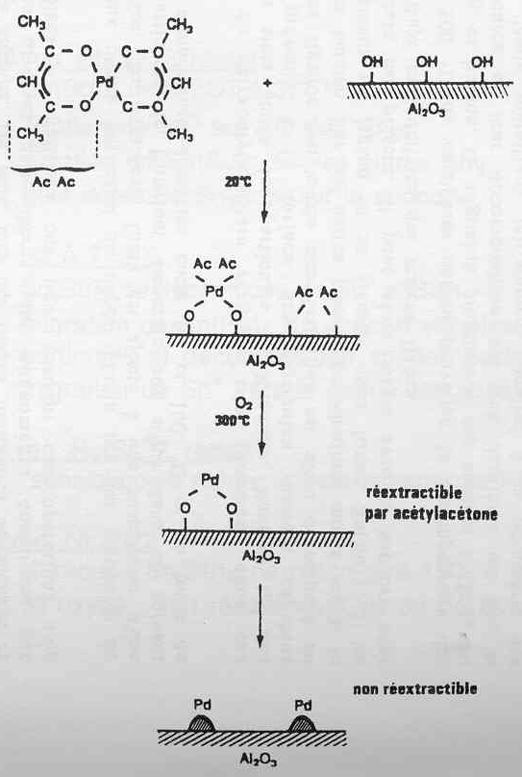
Preparation of supported catalysts
Covalent bonds = grafting
  Formation of metal NPs on top of catalyst support

Slide 51
Preparation of supported catalysts
Covalent bonds = grafting
  NPs by impregnation vs. grafting
Covalent bonds
calcination
Uniform NPs

Slide 52
Preparation of supported catalysts
Covalent bonds = grafting
  Formation of metal NPs on top of graphene oxide
Content of COOH groups
increased by oxidation
(HNO₃, H₂O₂,O₃,…)

Slide 53
Preparation of supported catalysts
Covalent bonds = grafting
  Formation of metal NPs on top of graphene oxide
  Last step: Pd reduction

Slide 54
Preparation of supported catalysts
Covalent bonds = Deposition/precipitation
  Starts as a dry impregnation
  Metal salt is then selectively precipitated at the catalyst surface
  Precipitation mainly by pH change – hydrolysis/condensation

