Slide 1
Heterogeneous catalysis
Lecture 4
Catalyst synthesis – continuation
Shaping
Single site catalysts

Slide 2
Shaping
Why is shaping important?
  Accessibility
  (micro+meso+macro porosity)
  Mechanical resistance
  (application of binders)
  Reducing pressure drop
  (p₁ > p₂)
  Hydrothermal stability, coking, poisoning,…
p₁
p₂
→ Industrial point of view

Slide 3
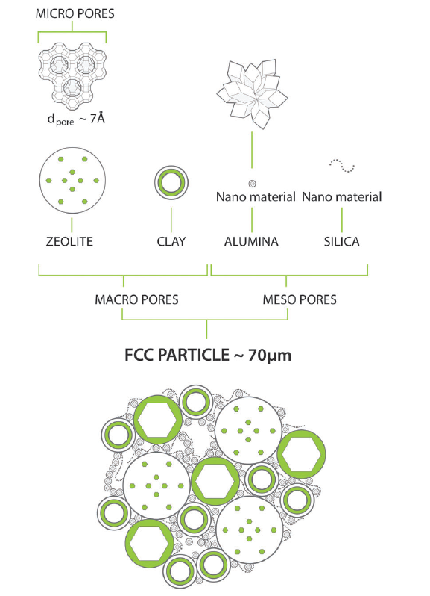
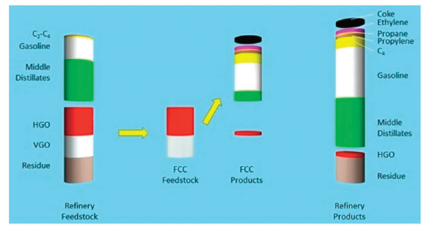
Shaping
Industrial example:
Fluid catalytic cracking

Slide 4
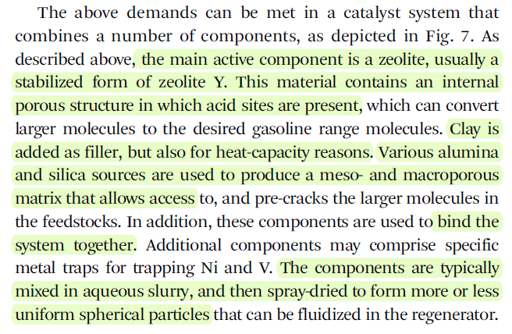
Shaping
Fluid catalytic cracking
„agglomerated catalyst“

Slide 5
Shaping
Industrial example:
Fluid catalytic cracking
Elementary particles
micrograin

Slide 6
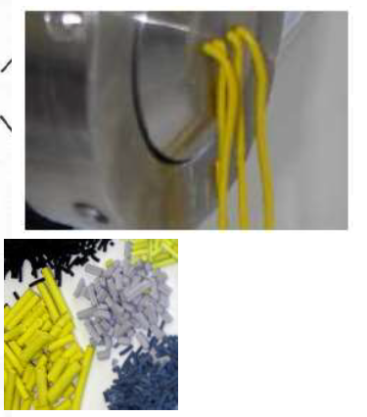
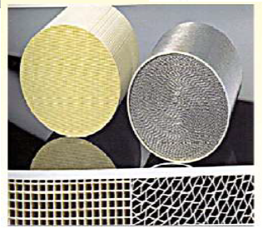
Shaping
Macroscopic shaping
  Extrusion
  Pelletization
  Molding/casting
grain

Slide 7
Shaping
Shaping as a „mechanochemical synthesis“?

Slide 8
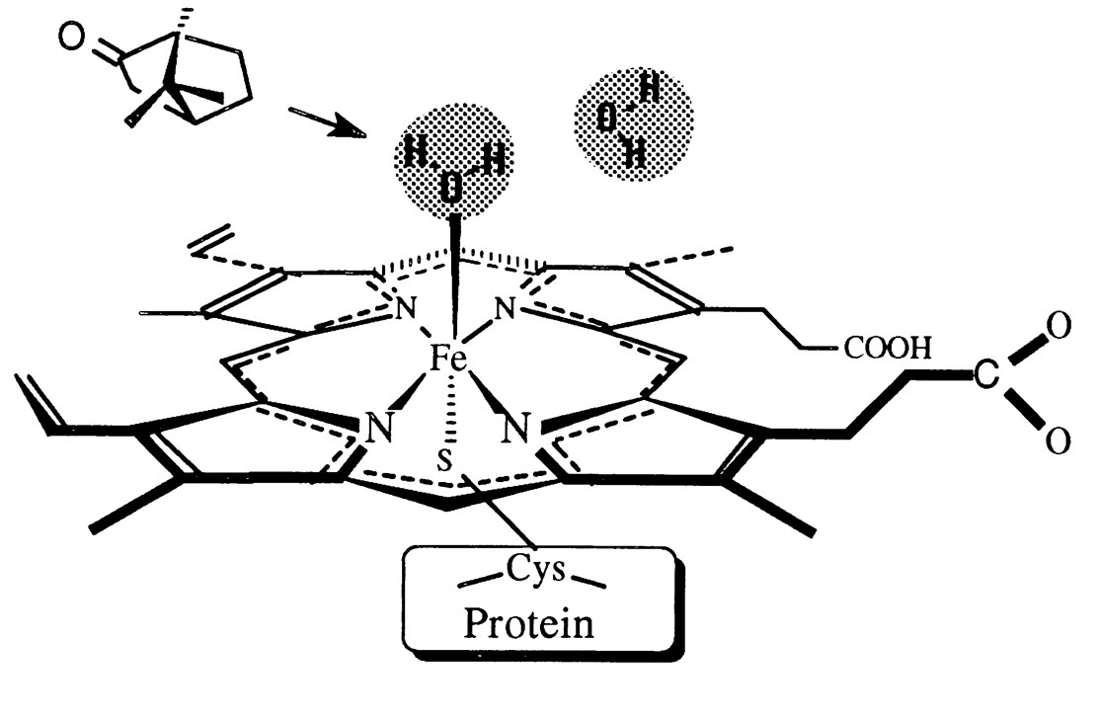
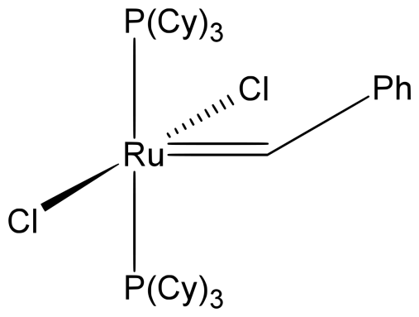
Single site catalysts
What is it?
Grubbs catalyst
Homogeneous catalysis
Active site in cytochrome P450
Enzymatic catalysis

Slide 9
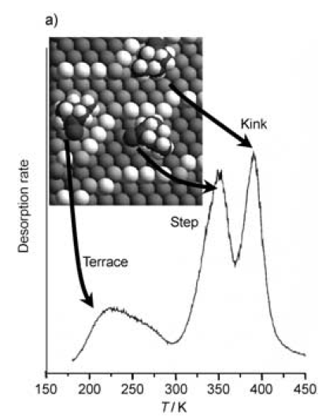
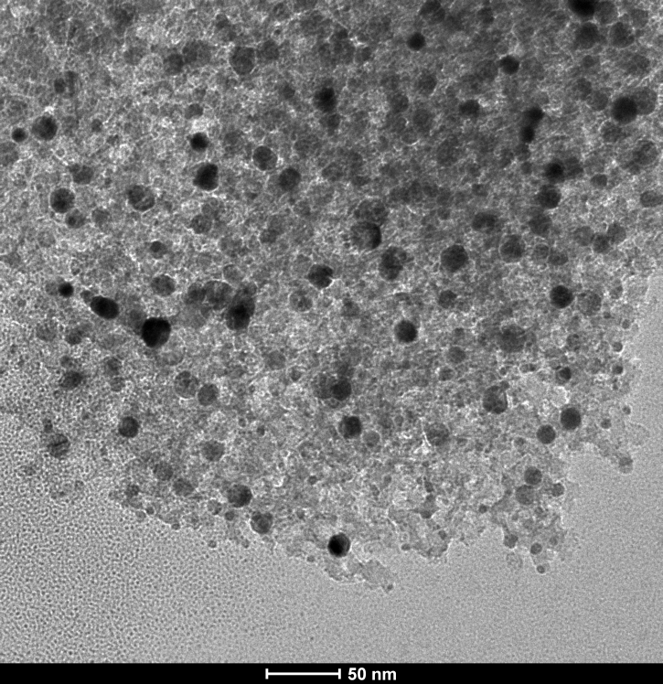
Single site catalysts
What is it?

Slide 10
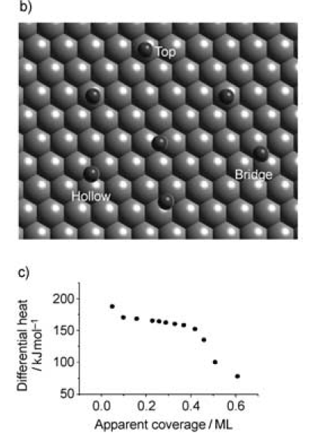
Single site catalysts
What is it?

Slide 11
Single site catalysts
Any continuous material (metal, oxide), where catalysis relies mainly on structure deffects
Instead
  One (or more) atoms
  Spatially isolated
  Same energy of interaction with reactant
  Structurally well characterized (similar to homo)

Slide 12
Single site catalysts
What is it?
  Individual isolated ion/atom/molecular complex/cluster
    Grafted on porous support
    Created within the material by building block approach
  „Ship in bottle“ structures– e.g. molecular complex/enzyme trapped within a zeolitic cage
  Crystalline, open-structure, microporous solids (e.g. zeolites) with active sites uniformly distributed throughout the bulk

Slide 13
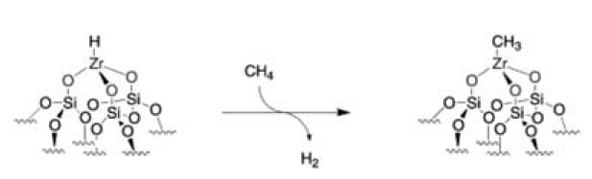
Single site catalysts
Why?

Slide 14
Single site catalysts
Why?
  Number of active sites
  Turn-over frequency, TOF
  Characterization of active site
  Quantum-chemical calculations
  ↓
  Understanding mechanism
  Understanding kinetics
  ↓
  Bridging gap between homo-and heterogeneous cata

Slide 15
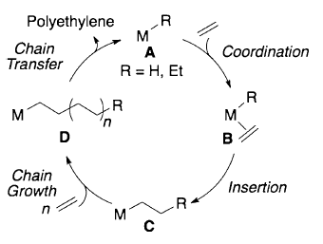
Single site catalysts
Bridging gap between homogeneous and heterogeneous catalysis – example:
  Phillips catalyst = „CrO₃“ dispersed on silica
  Ethylene polymerization (50 % of global production of linear HDPE)
  No co-catalyst (compare with Ziegler-Natta + MAO)
  What is the actual active site???

Slide 16
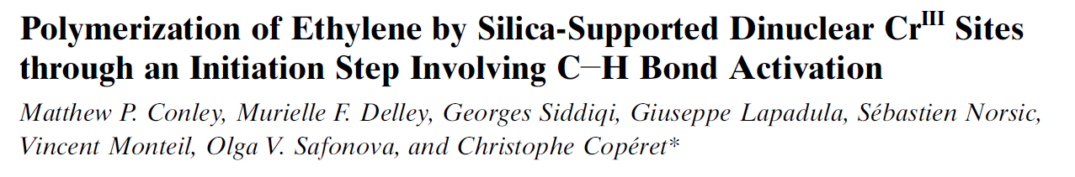
Single site catalysts
CrO₃ dispersed on silica
Ethylene exposure induces „mild reduction“
Only 10 % of Cr sites are active
Cr^{II} or Cr^{III}??? Big discussion…

Slide 17
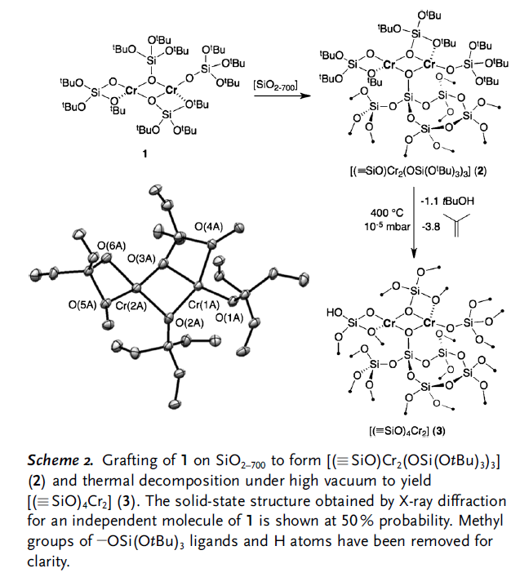
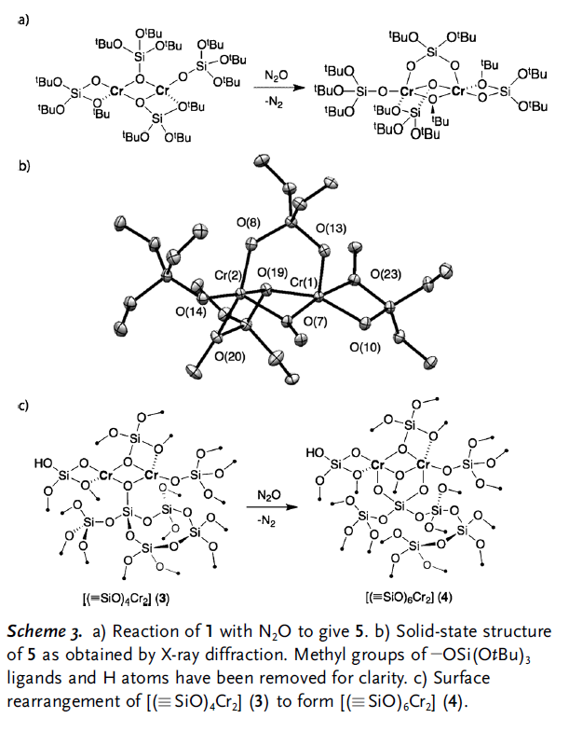
Single site catalysts
Cr^{II}
Cr^{III}

Slide 18
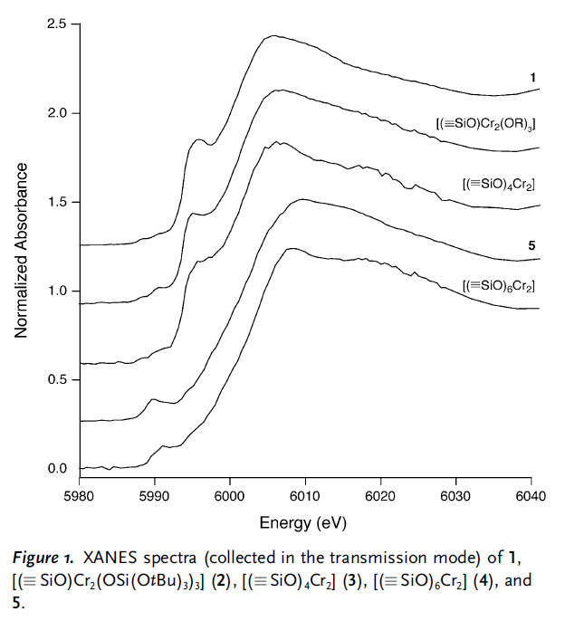
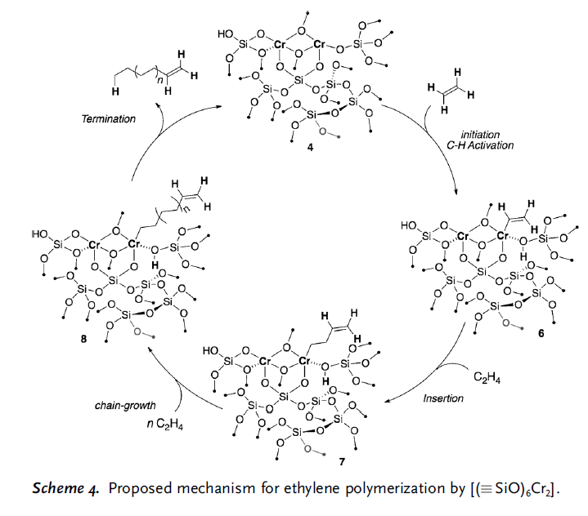
Single site catalysts
Cr^{III} is active!

Slide 19
Single site catalysts
What is it?
  Individual isolated ion/atom/molecular complex/cluster
    Grafted on porous support
    Created within the material by building block approach
  „Ship in bottle“ structures– e.g. molecular complex/enzyme trapped within a zeolitic cage
  Crystalline, open-structure, microporous solids (e.g. zeolites) with active sites uniformly distributed throughout the bulk

Slide 20


Single site catalyts
Grafting on silica
  Detailed knowledge of surface (number of OH groups per nm²)
  Rigorous water- and oxygen-free environment

Slide 21
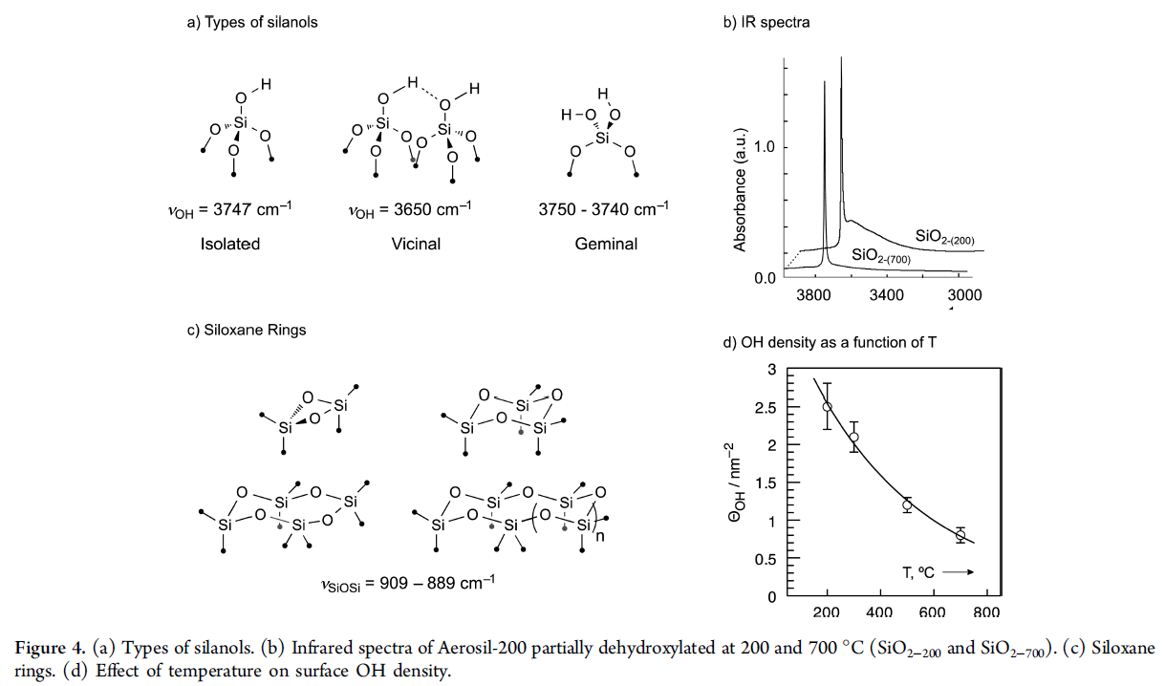
Single site catalysts

Slide 22
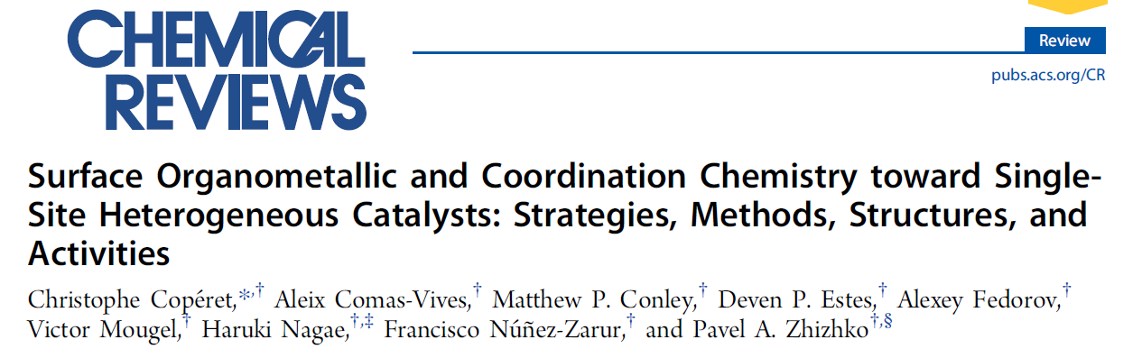
Single site catalysts
Metal precursors (almost all d + f elements)
  Organometallic compounds
  Metal amides and silylamides
  Metal alkoxides and siloxides
  Metal halogenides

Slide 23
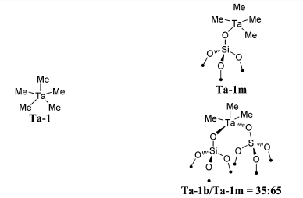
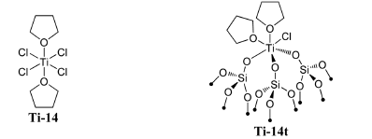
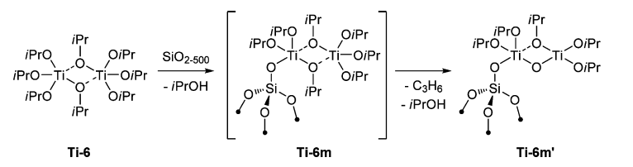
Single site catalysts

Slide 24
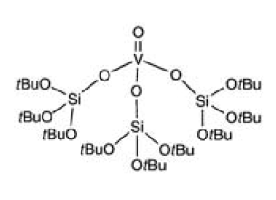
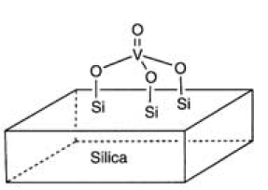
Single site catalysts
In many cases silica needed all around the active site (no unreacted chlorines etc.)
1.
+ SiO₂
− butanol
2. ΔT
− butene

Slide 25
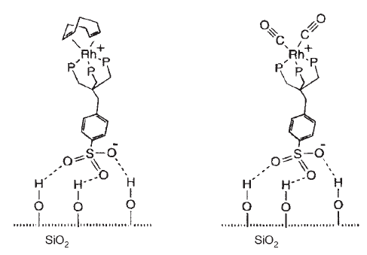
Single site catalysts
Grafting on silica – other types of bonding

Slide 26
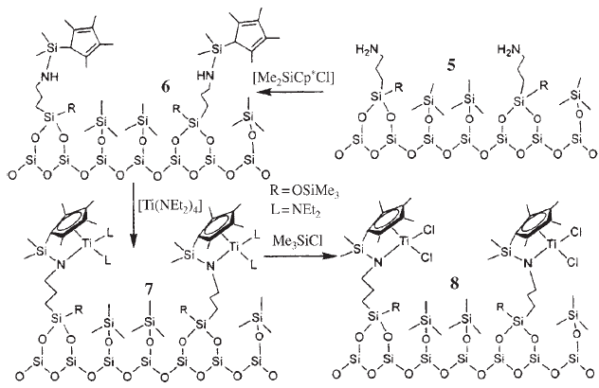
Single site catalysts
Grafting on silica – other types of bonding

Slide 27
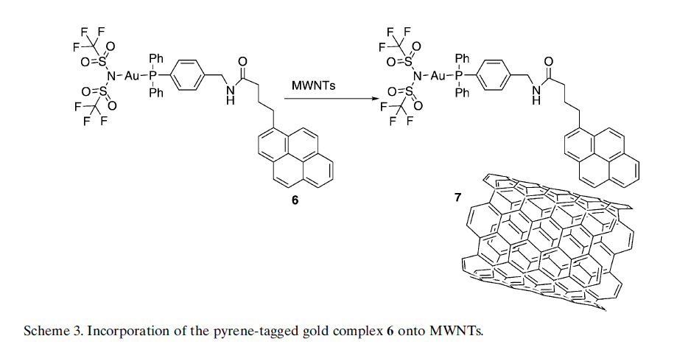
Single site catalysts
Grafting on carbon – π-π stacking

Slide 28
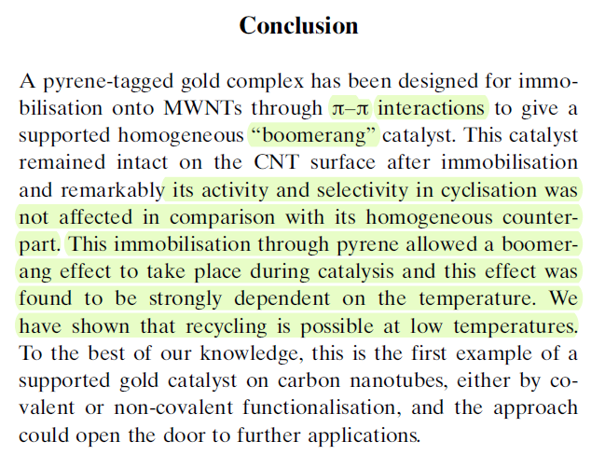
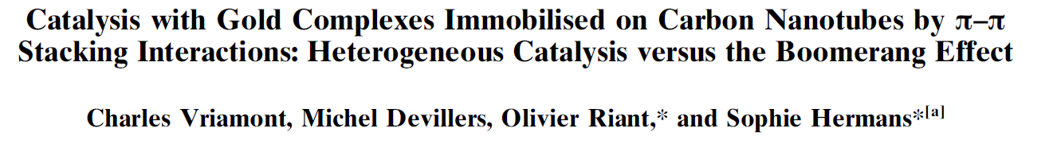
Single site catalysts
Grafting on carbon – π-π stacking
  Boomerang effect

Slide 29
Single site catalysts
What is it?
  Individual isolated ion/atom/molecular complex/cluster
    Grafted on porous support
    Created within the material by building block approach
  „Ship in bottle“ structures– e.g. molecular complex/enzyme trapped within a zeolitic cage
  Crystalline, open-structure, microporous solids (e.g. zeolites) with active sites uniformly distributed throughout the bulk

Slide 30
Single site catalysts
M
M
O
O
+ n MCl_{x}
-ClSnMe₃
M
O
O
M
M
Si₈O₂₀(SnMe₃)₈
=
SnMe₃
MCl_{x} = PCl₃, SiCl₄, BBr₃, AlCl₃, GaCl₃, TiCl₄, ZrCl₄, VCl₄, VOCl₃, SnCl₄, WCl₆, MoO₂Cl₂
1. N.N. Ghosh, J.C. Clark, G.T. Eldridge, C.E. Barnes, Chem. Comm., (2004) 856-857.
2. M.-Y. Lee, J. Jiao, R. Mayes, E. Hagaman, C.E. Barnes, Catalysis Today, 160 (2011) 153-164.

Slide 31
Single site catalysts
Si₈O₁₂(OSnMe₃)₈
R
R
R
O
R
Cl
S
i
C
O
l
O
Si
4
Al
Al
Cl
Al
O
O
RO
Cl
O
O
R
Me₃SnCl
O
Me₃SnCl
limiting
amount
Si
Si

Slide 32
Single site catalysts
Targeting connectivity
L
O
X⁺
O
O
Al
Al
O
O
O
O
3C-Al←L
L = py (1), THF (2)
[X][4C-Al]
X = NBu₄⁺ (3)

Slide 33
Single site catalysts
Targeting geometry
  Tetrahedral
  Square planar
O
O
Ti
O
O
4C-Ti

Slide 34
Single site catalysts
What is it?
  Individual isolated ion/atom/molecular complex/cluster
    Grafted on porous support
    Created within the material by building block approach
  „Ship in bottle“ structures– e.g. molecular complex/enzyme trapped within a zeolitic cage
  Crystalline, open-structure, microporous solids (e.g. zeolites) with active sites uniformly distributed throughout the bulk
CHARACTERIZATION?

Slide 35
Single site catalysts
What is it?
  Individual isolated ion/atom/molecular complex/cluster
    Grafted on porous support
    Created within the material by building block approach
  „Ship in bottle“ structures– e.g. molecular complex/enzyme trapped within a zeolitic cage
  Crystalline, open-structure, microporous solids (e.g. zeolites) with active sites uniformly distributed throughout the bulk

Slide 36
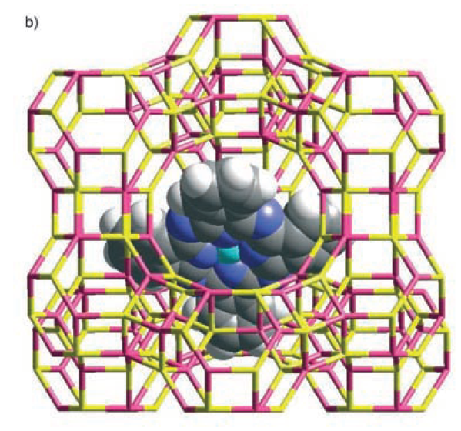
Single site catalysts
Cobalt phthalocyanine within zeolite Y

Slide 37
Single site catalysts
Single site very well preserved (no dimerization,…)
Diffusion of molecules small enough in the micropore system of zeolite – both reactants and products – enhancing specificity and selectivity

Slide 38
Single site catalysts
Synthesis?
  Cation exchange (2Na⁺ for Co²⁺)
  Complexation with ligands within the zeolite pores
„Co²⁺-exchanged zeolite-Y was heated with excess amount of 1,2-dicyanobenzene (DCB) under vacuum. Excessive DCB was then extracted (Soxhlet).
The dicyanobenzene molecule is small enough (∼6.5 Å) to diffuse through the 7.4 Å windows of the supercage of the zeolite and condense around the metal ion to form cobalt phthalocyanine.“

Slide 39
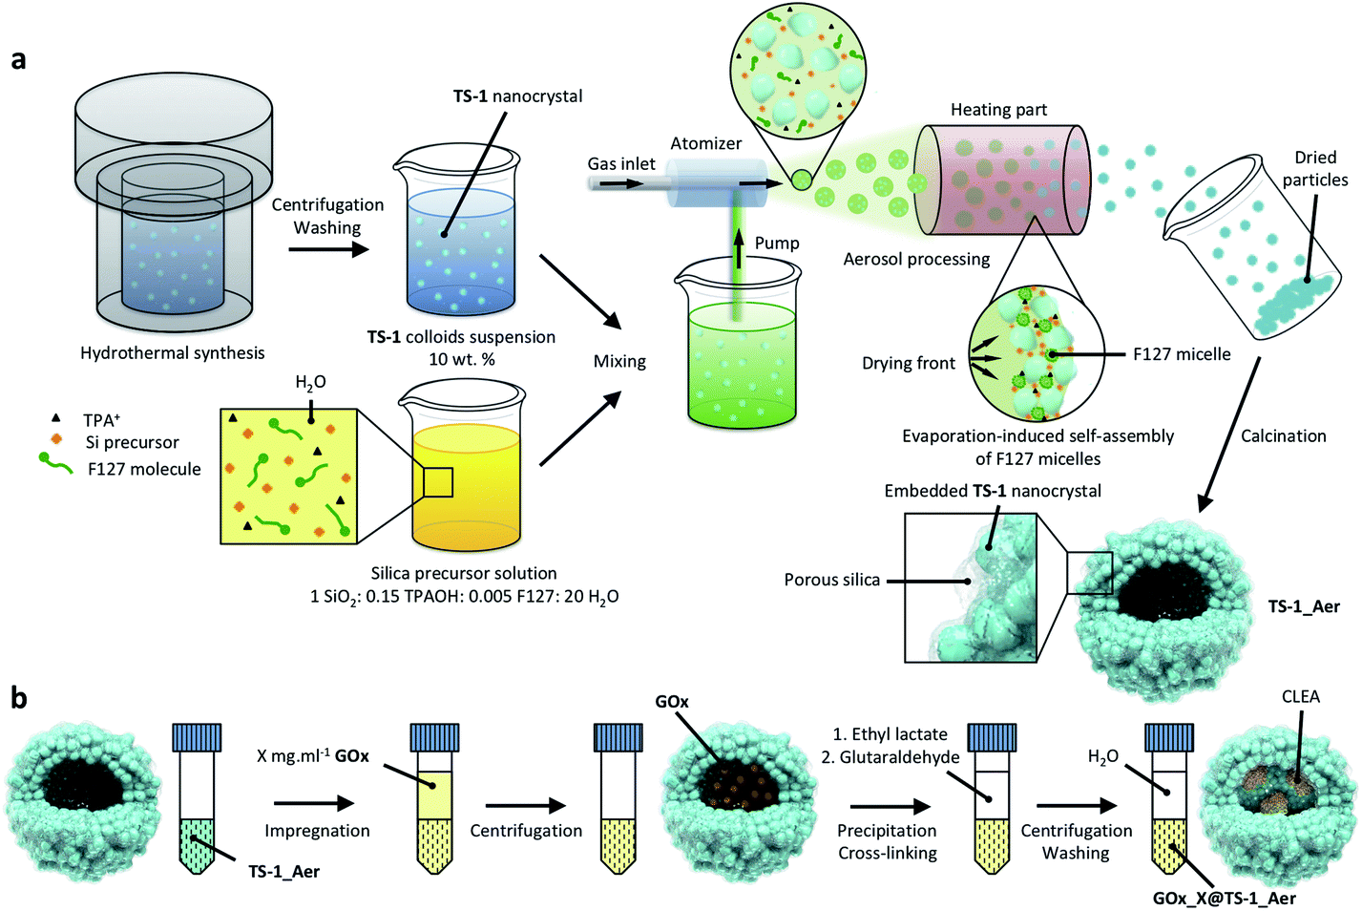
Single site catalysts
Enzyme agglomerates inside a hollow silica sphere
Chem. Sci., 2020,11, 954-961

Slide 40
Single site catalysts
What is it?
  Individual isolated ion/atom/molecular complex/cluster
    Grafted on porous support
    Created within the material by building block approach
  „Ship in bottle“ structures– e.g. molecular complex/enzyme trapped within a zeolitic cage
  Crystalline, open-structure, microporous solids (e.g. zeolites) with active sites uniformly distributed throughout the bulk

Slide 41
Single site catalysts
Zeolites
  ≡Si−O(H)−Al≡
MAlPOs
  ≡M^{II}−O(H)−P≡
  M = Mg, Co, Zn, Mn…

Slide 42
Single site catalysts
Zeolites and MAlPOs
  Microporous
  Crystalline
  Ideal to study by many analytical techniques

Slide 43
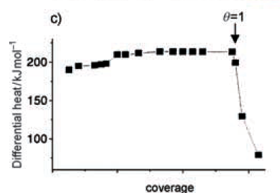
Single site catalysts
Zeolites and MAlPOs
  Isolated sites???
    Si/Al ratio ≥ 200; perfect crystallinity
  Equivalent sites???
  Amorphous grains/surface species

Slide 44
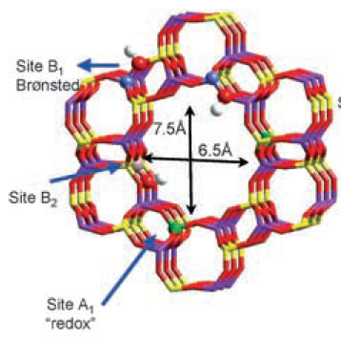
Single site catalysts
Zeolites and MAlPOs
  Isolated sites???
  Equivalent sites???
    Different positions in cage
  Amorphous grains/surface
  species

Slide 45
Single site catalysts
Zeolites and MAlPOs
  Isolated sites???
  Equivalent sites???
  Amorphous grains/surface species
    e.g. extraframework aluminum species
      From not fully embedded (connectivity = 3) surface Al atoms to amorphous alumina (nano)particles
      Tetra, penta, hexacoordinated
      Easy to overlook (99 % of the material is crystalline), but important to notice
      Their role in catalysis???

Slide 46
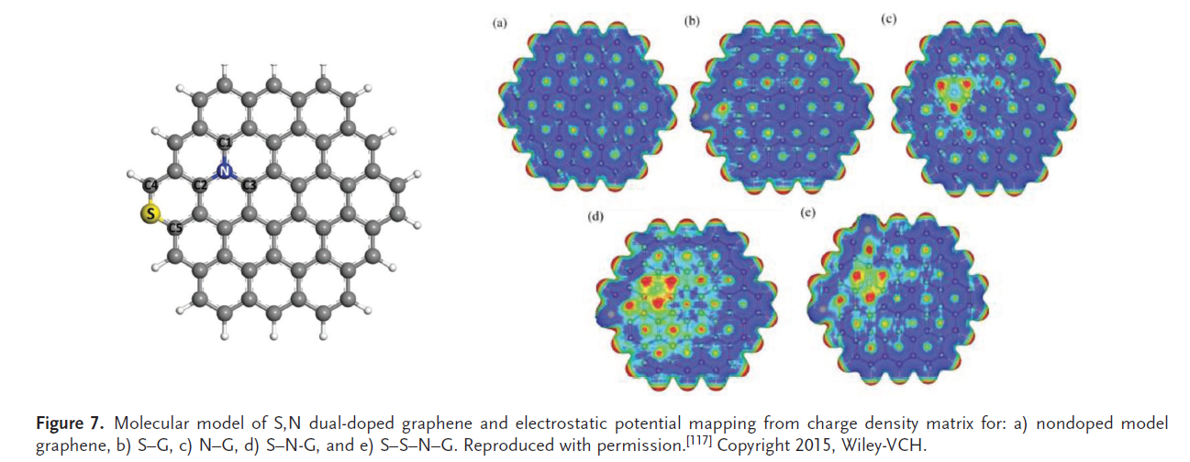
Single site catalysts
Similar but different (Markus Antoinetti et al.)
Doped graphene sheets
Isolated sites located by HR-TEM

Slide 47
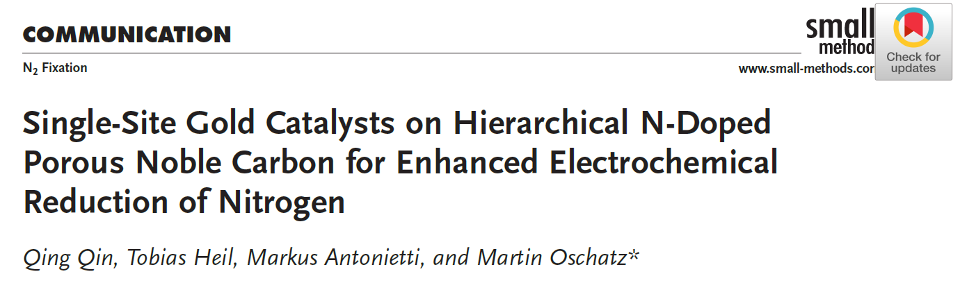
Single site catalysts
Doped graphene sheets
  Single metal atoms within carbon layer
    Single atom = „complex like“
    Conductive carbon layer, electrons shared = „metal like“
    Unique
    Single-site Au highly active in Haber-Bosch ammonia synthesis, mild conditions

Slide 48
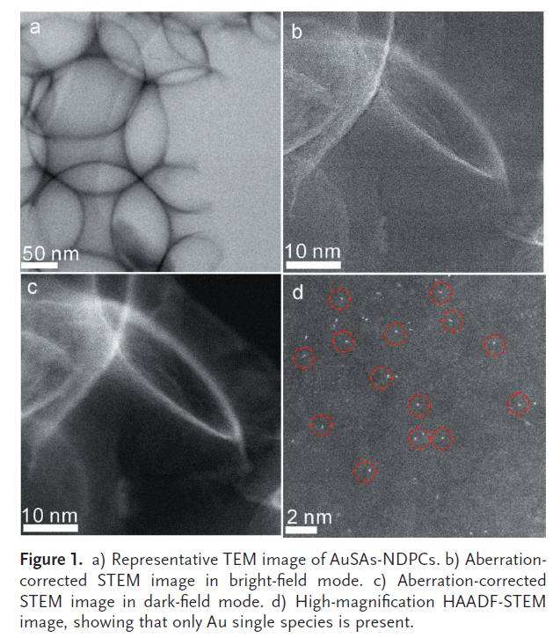
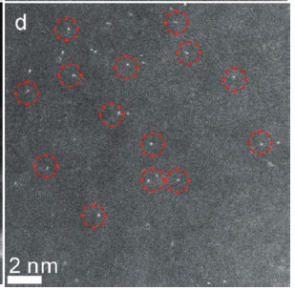
Single site catalysts
Doped graphene sheets
  Single Au atoms within N-doped graphene

Slide 49
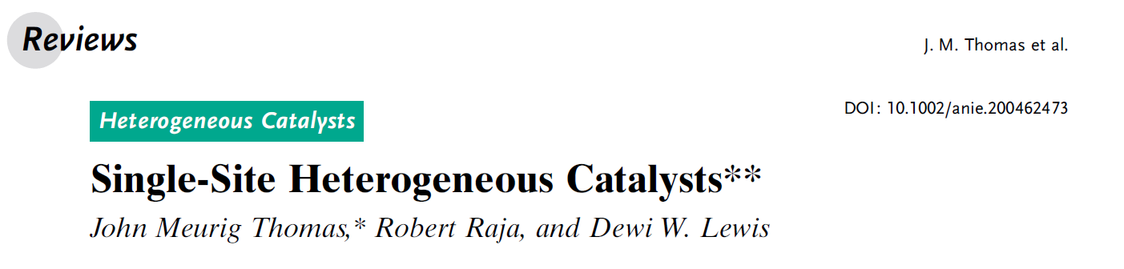
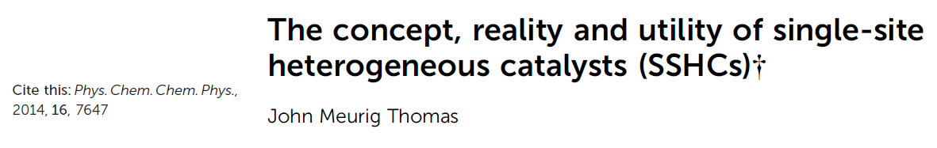
References

