Slide 1
Heterogeneous catalysis
Lecture 5
Catalysts characterization

Slide 2
Catalyst characterization
Outline
  DRUV
  XPS
  XANES & EXAFS
  Chemisorption
  ToF-SIMS

Slide 3
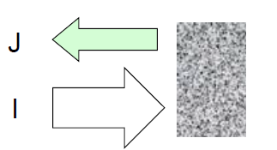
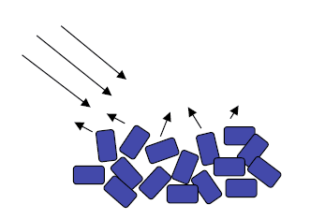
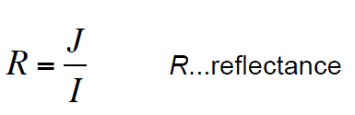
Diffuse reflectance UV-Vis spectroscopy (DRUV)
I
J
Is there any link between reflectance and absorbance?
Yes, there is!
Kubelka-Munk model allows to obtain quantitatively the absorption spectrum of a solid from diffuse reflectance measurement (theory behind in textbooks)

Slide 4
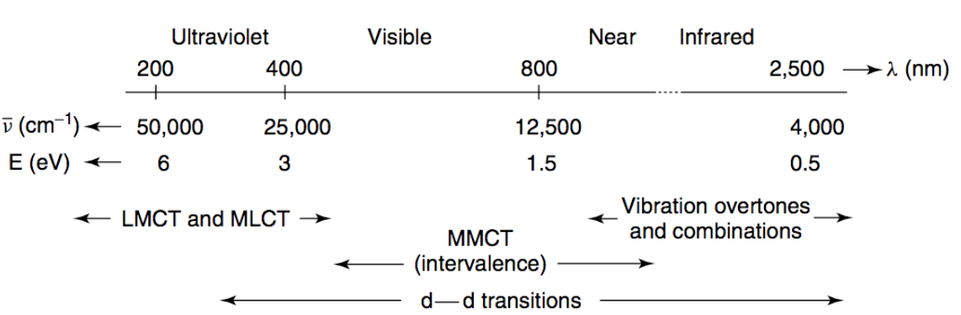
Diffuse reflectance UV-Vis spectroscopy (DRUV)
LMCT = ligand-to-metal charge transfer
MLCT = metal-to-ligand charge transfer
MMCT = metal-to-metal charge transfer

Slide 5
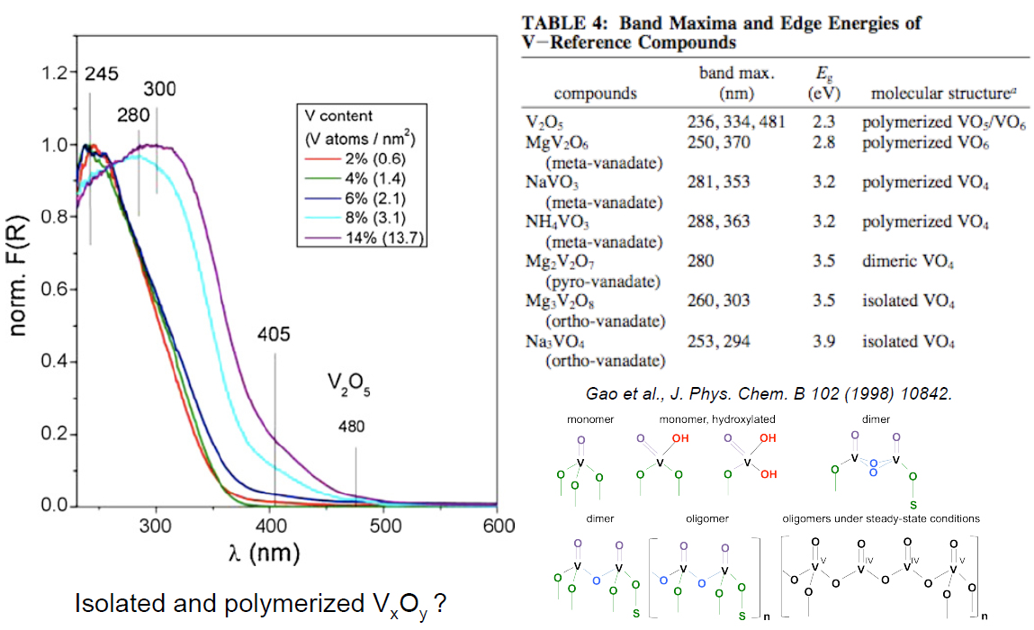
Diffuse reflectance UV-Vis spectroscopy (DRUV)

Slide 6
Ionization Spectroscopies
ionization
continuum
Photoelectron spectroscopy:
  UV: valence shell ionizations
  X-ray: core electron ionizations (XPS, XANES, EXAFS):
KE
0
virtual
levels
valence
levels
E_{photon} = hν =
BE + kinetic energy (KE)
BE
Photoelectron Spectroscopy analyzes the energies of the ionized electrons (XPS).
X-ray Absorption Spectroscopy analyzes the absorption curve of the X-ray spectrum associated with ionization of a core electron (XANES and EXAFS)
core
levels

Slide 7
X-ray photoelectron spectroscopy (XPS)
We measure the number and the energy of photoelectrons emitted from the surface layer
E_{photon} = hν =
BE + kinetic energy (KE)
Number of photoelectrons gives access to quantity
Energy of photoelectrons gives access to quality
Depth? 5–20 nm.

Slide 8
X-ray photoelectron spectroscopy (XPS)
Auger

Slide 9
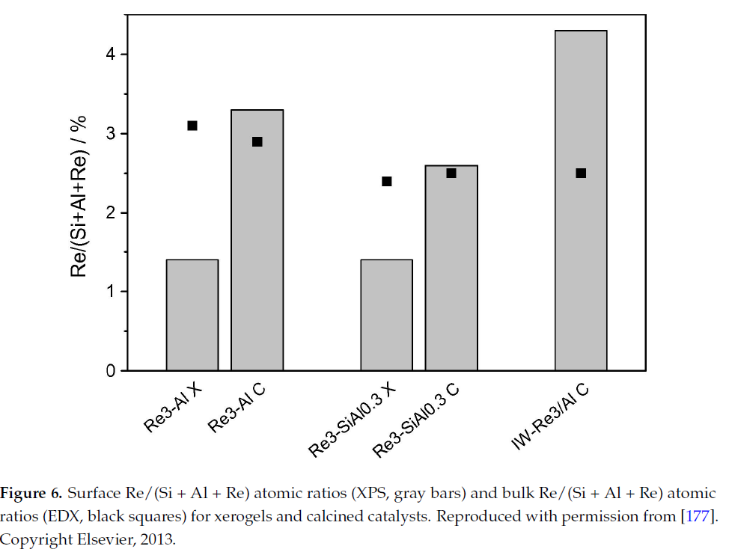
X-ray photoelectron spectroscopy (XPS)
Surface vs. bulk composition
Surface
Bulk
Calcination
K. Bouchmella et al. /Journal of Catalysis 301 (2013) 233–241

Slide 10
X-ray photoelectron spectroscopy (XPS)
Oxidation state
C⁰
C^{I}
?
C^{II}
C^{III}
C^{IV}
1000
0
Binding energy [eV]
Who will hold its electrons more powerfully? C⁰ or C^{IV}?

Slide 11
X-ray photoelectron spectroscopy (XPS)
Oxidation state
C⁰
C^{I}
C^{II}
C^{III}
C^{IV}
1000
0
Binding energy [eV]
Why do we talk about carbon?
Surface of each sample contains some carbon impurities = Adventitious carbon = calibration of BE

Slide 12
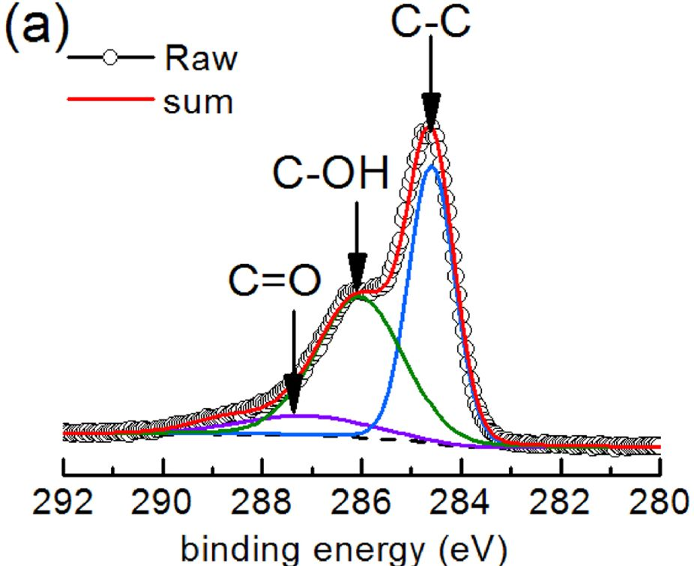
X-ray photoelectron spectroscopy (XPS)
Oxidation state

Slide 13
X-ray photoelectron spectroscopy (XPS)
Similar consideration:
SiO₄ vs. CSiO₃
Ta(OSi)_{x}(OTa)_{6-x} vs. Ta(OTa)₆
Electronegativity (O) =
Electronegativity (C) =
Electronegativity (Si) =
Electronegativity (Ta) =

Slide 14
X-ray photoelectron spectroscopy (XPS)
Spin-orbital interaction and other electron interactions lead to additional features in XP spectra characteristic for
  Oxidation states
  Groups
  …
Characteristic for Mn²⁺

Slide 15
X-ray photoelectron spectroscopy (XPS)
Spin-orbital interaction and other electron interactions lead to additional features in XP spectra characteristic for
  Oxidation states
  Groups
  …
Characteristic for
aromatic carbon

Slide 16
Ionization Spectroscopies
ionization
continuum
Photoelectron spectroscopy:
  UV: valence shell ionizations
  X-ray: core electron ionizations (XPS, XANES, EXAFS):
KE
0
virtual
levels
valence
levels
E_{photon} = hν =
BE + kinetic energy (KE)
BE
Photoelectron Spectroscopy analyzes the energies of the ionized electrons (XPS).
X-ray Absorption Spectroscopy analyzes the absorption curve of the X-ray spectrum associated with ionization of a core electron (XANES and EXAFS)
core
levels

Slide 17
XANES and EXAFS
In XANES and EXAFS we measure number and energy of transmitted photons, which caused ionization of a core electron
(i.e. absorbance vs. energy)
Monochromator
Synchrotron
    Energy needed is so much greater
    than that available from a
    typical X-ray tube found in most labs
Sample
X-ray storage ring
I_{o}
I_{t}
I_{ref}
Metal
Reference
Foil
I_{fluor}

Slide 18
XANES and EXAFS
XAS: X-ray absorption spectroscopy; alternatively
XAFS: X-ray absorption fine structure
  XANES: X-ray absorption near edge structure (pre-edge); alternatively NEXAFS (near edge x-ray absorption fine structure)
  EXAFS: Extended x-ray absorption fine structure (= behind edge)
What is an edge?

Slide 19
XANES and EXAFS
KE
Edge = 0
virtual
levels
valence
levels
BE
EXAFS
core
levels
XANES

Slide 20
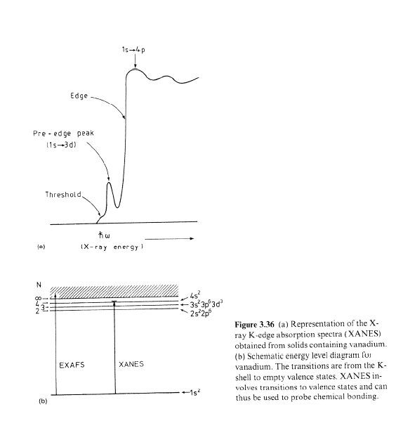
XANES and EXAFS
EXAFS
XANES

Slide 21
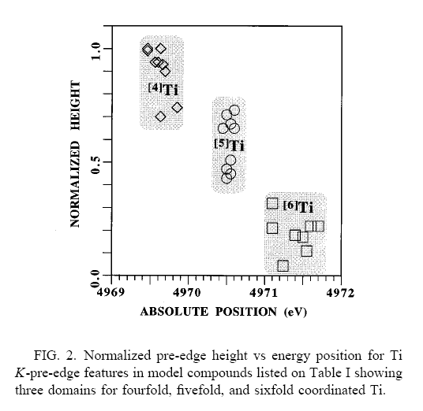
XANES
Qualitative information on coordination environment
(dipole selection rules apply)
  Is there a pre-edge feature?
    Yes – no inversion center
    No – there is an inversion center
Quantitative info also possible
Figure from Farges, et. al. Physical Review B: Condens. Matter 1997, 56(4), 1809-1819.

Slide 22
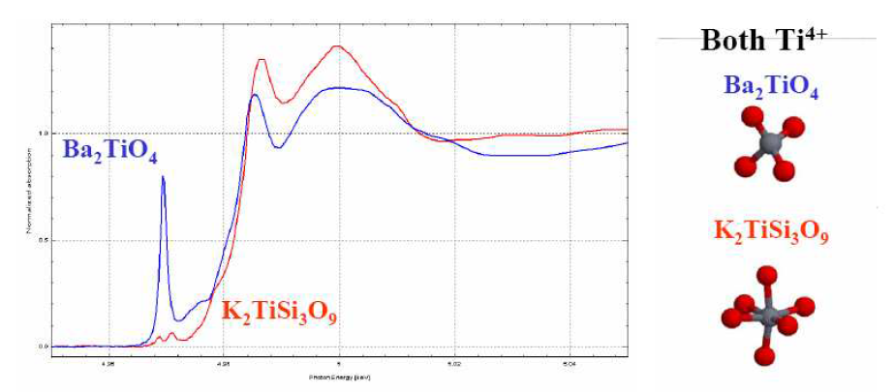
XANES
Coordination environment

Slide 23
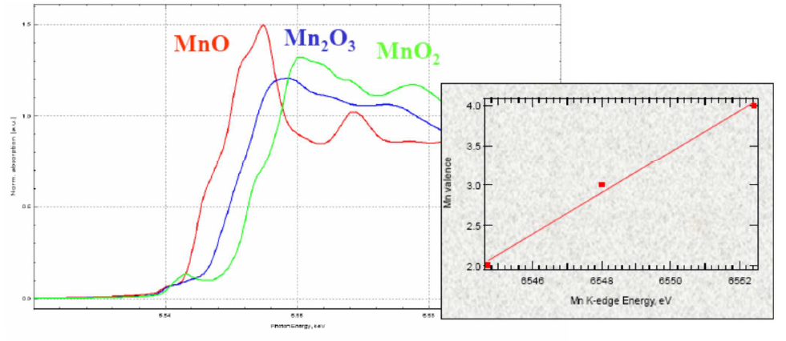
XANES
Position of the edge…binding energy…oxidation state

Slide 24
EXAFS
XANES
EXAFS
Relative absorbance [a.u.]
What type of information
is hidden there???
Absorbance
Energy
E_{o}

Slide 25
EXAFS
The scattering phenomena
Scattering from Ti
Back-scattering
from “neighbors”

Slide 26
EXAFS
Step 2: Extract χ(k)
Step 1: The data
10
EXAFS
5
k³ χ(k) (Å⁻³)
Arbitrary Units
0
Math
-5
-10
χ(k)
E_{o}
0
5
k (Å⁻¹)
10
15
Fourier Transform
Step 3: The FT
Step 4:
Develop structural model that fits that data
d(M-X), CN(X),
AtNum(X)

Slide 27
EXAFS
Ti–O
Ti–O
Ti–Cl
Ti∙ ∙ ∙ Si
Ti∙ ∙ ∙ Si
15
— Ti(Si₈O₂₀)₄
— FEFF 8 fit
10
10
Cl
O
Ti
|χ(R)| (Ǻ⁻⁴)
|χ(R)| (Ǻ⁻⁴)
O
Cl
Ti
O
5
O
O
O
5
0
0
1
2
3
4
5
6
0
1
2
3
4
5
6
0
R (Ǻ)
Structure elucidation of an amorphous material!
If more Ti sites, than average; analysis more difficult!

Slide 28
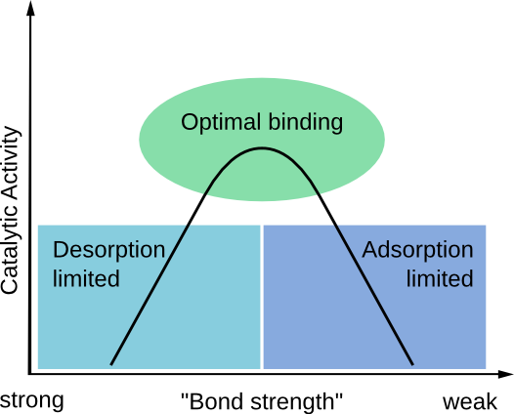
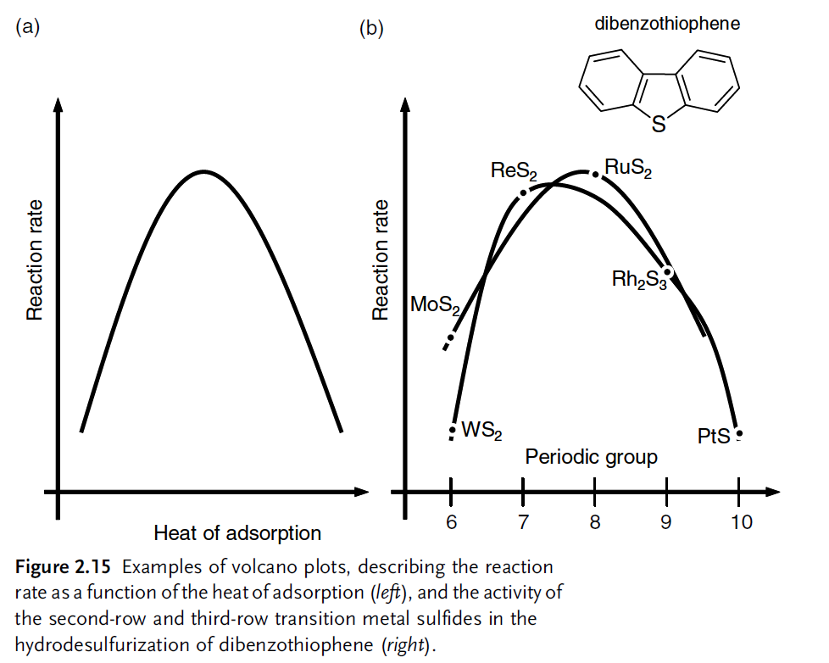
Chemisorption
Interactions of A,B, and P with catalyst not too weak, not too strong
(= physi/chemisorption on catalyst surface)
Sabatier‘s principle;
Volcano plot@Lecture 1

Slide 29
Chemisorption
Different sites = different probes
  Acid sites
    NH₃, alkylamines, pyridine, 2,6-dimethylpyridine, CO
  Basic sites
    CO₂
  Redox
    H₂, O₂, N₂O
  Reactants can be used as probes
    e.g. ethanol dehydration = I can study chemisorption of ethanol

Slide 30
Chemisorption
Different ways how to do it
  Volumetric
  Thermally programmed desorption/oxidation/reduction
  Pulse titration
  Chemisorption of IR (NMR) active molecules and their analysis by IR (NMR)

Slide 31
Chemisorption
Volumetric
  Similar to N₂ physisorption (glass tube of known volume, addition of known volume of gas, pressure measurement)
  NH₃ adsorption isotherms measured twice, sample evacuated between the two measurements
  (physisorption vs. chemisorption)
  High temperatures in contrary to N₂ physisorption (e.g. 50 °C)

Slide 32
Chemisorption
Temperature?
Volumetric
1st isotherm
Uptake
=
physisorption + chemisorption
evacuation
Uptake
=
physisorption only
(chemisorbed NH₃ already there)
2nd isotherm
Difference
1st – 2nd
=
chemisorbed NH₃

Slide 33
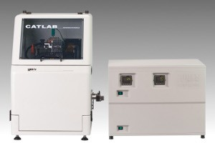
Chemisorption
Thermally programmed desorption/oxidation/reduction
Detector
(MS, TCD)
Furnace

Slide 34
Chemisorption
Thermally programmed desorption/oxidation/reduction
Ar
NH₃
Ar
700
Dehydration
Pretreatment
500
Chemisorption
Desorption
Analysis
Temperature [°C]
150
Temperature?
Time

Slide 35
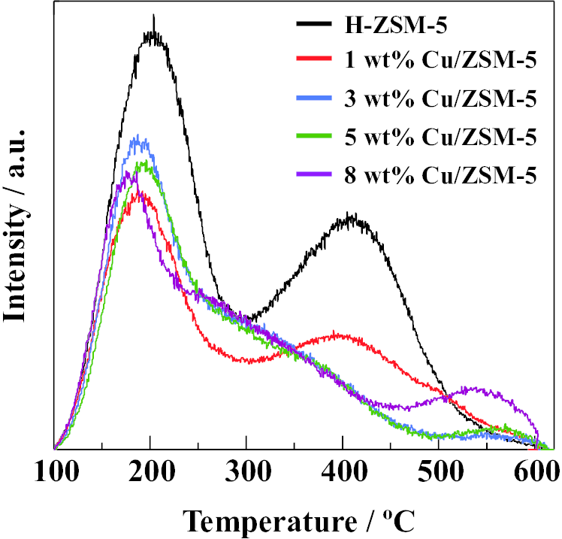
Chemisorption
Thermally programmed …
NH₃ TPD

Slide 36
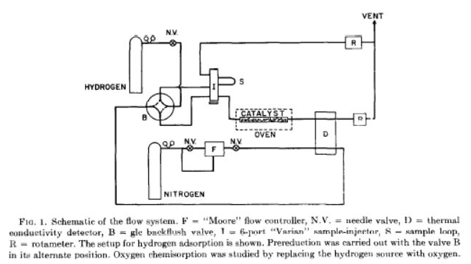
Chemisorption
Pulse titration

Slide 37
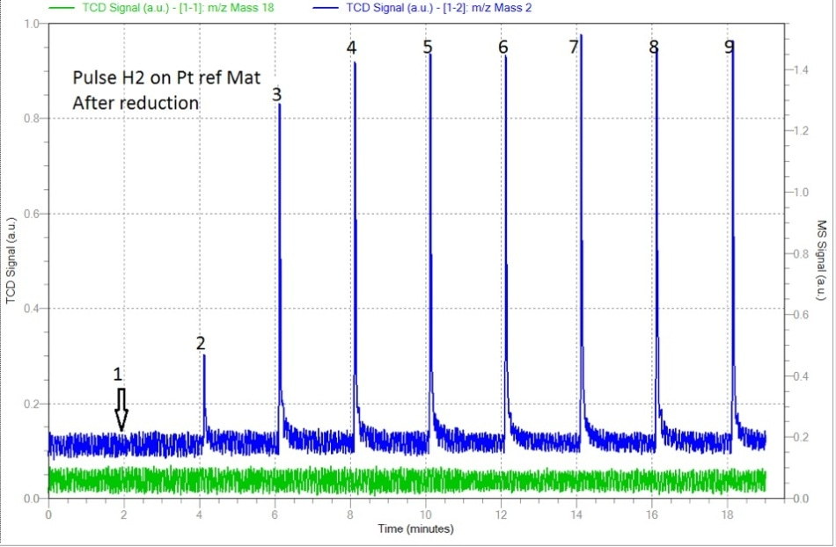
Chemisorption
Pulse titration

Slide 38
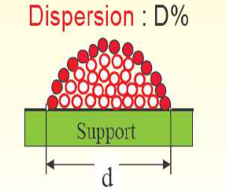
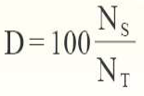
Chemisorption
Pulse titration
  Correct choice of gas (H₂, CO, O₂, N₂O)
  Correct choice of temperature
    = Monolayer
    = Dispersion, particle size, „active metal surface area“
Number of surface
atoms
Total number of
atoms

Slide 39
Chemisorption
Pulse titration
  Very good correlation can be observed between active surface area by H₂ chemisorption and activity in hydrogenation of … for classical hydrogenation catalyts (Pt, Pd)
  H₂ chemisorption is dissociative!
  H–H bond breaks at the time of chemisorption, this is the key to high reactivity (adsorbed molecular hydrogen)
  This is Langmuir‘s chemistry
H H H
Pt Pt Pt

Slide 40
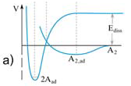
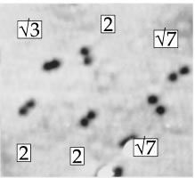
Chemisorption
X₂ dissociative chemisorption (detour)
H H H
Pt Pt Pt
E_{diss}, noncatalyzed
A₂
„Hot“ O atoms
Lifetime 10^{–13} s
E_{a}
A₂, ad
2A, ad
O₂ adsorption on Pt(111) surface @165 K
O–O in O₂ = 1.2Å, here much longer

Slide 41
Chemisorption
Pulse titration
  Very good correlation can be observed between active surface area by H₂ chemisorption and activity in hydrogenation of … for classical hydrogenation catalyts (Pt, Pd)
  BUT
Example: methanol synthesis over Cu NPs
  CO₂ + 2 H₂ → CH₃OH
H H H
Pt Pt Pt
Science 18 May 2012:
Vol. 336, Issue 6083, pp. 893-897

Slide 42
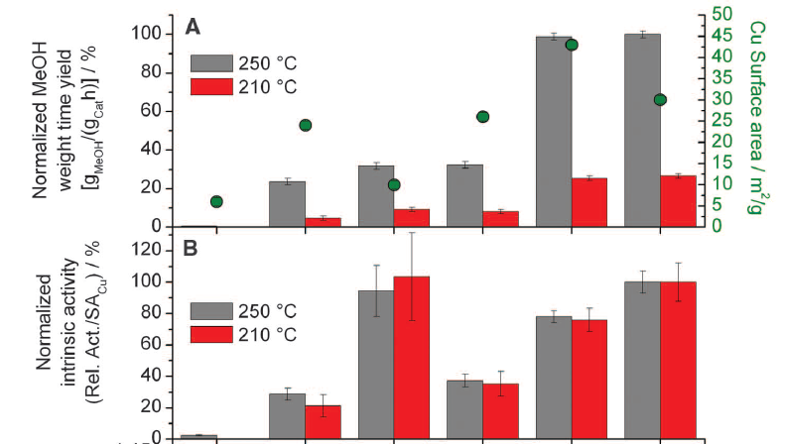
Chemisorption
Example: methanol synthesis over Cu NPs

Slide 43
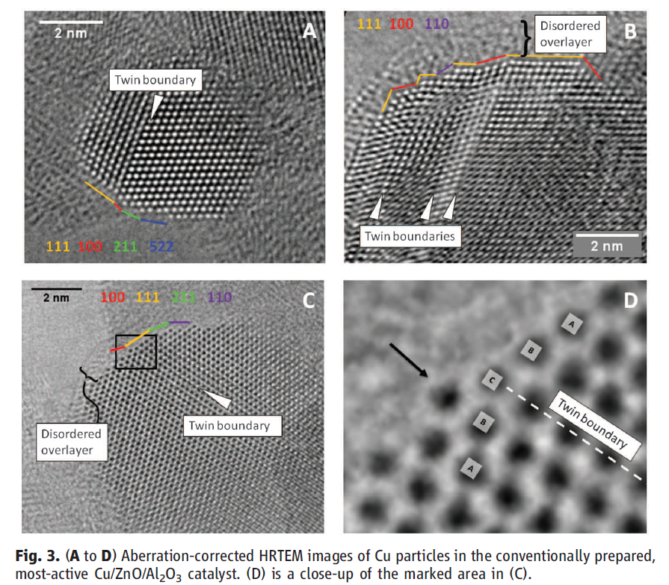
Chemisorption
Example: methanol synthesis over Cu NPs

Slide 44
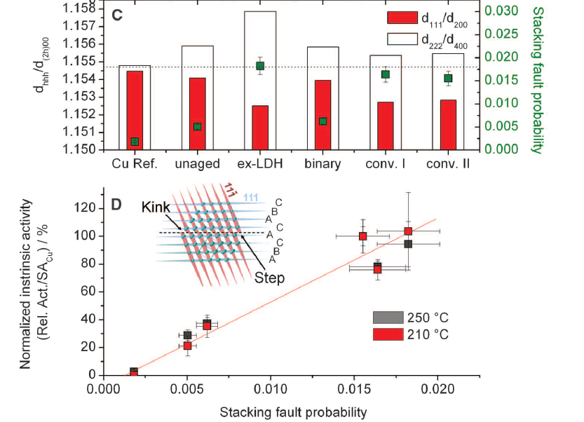
Chemisorption
Example: methanol synthesis over Cu NPs

Slide 45
Chemisorption
Pulse titration
  Homework
  Silver (2.2 wt% on silica)
  Surface reaction:
  2Ag_{surf} + O₂ → 2 AgO_{surf}
  @T = 170 °C (no bulk oxidation!)
  m_{sample} = 0.5021 g
  V_{pulse} = 0.00925 cm³ O₂@RT@1atm
  Max TCD signal = 0.022
  D = ?
Pulse | TCD signal
#1 | 0
#2 | 0
#3 | 0
#4 | 0
#5 | 0
… | …
#28 | 0
#29 | 0
#30 | 0.002
#31 | 0.005
#32 | 0.011
#33 | 0.016
#34 | 0.019
#35 | 0.021
#36 | 0.022

Slide 46
Chemisorption
Adsorption of IR (NMR) active molecules
  Pyridine and its derivatives
  CO
  Trialkylphosphine oxides
  …

Slide 47
Chemisorption
Adsorption of IR (NMR) active molecules
  Number of sites
    Lambert-Beer law
  Strength of sites
    Desorption under vacuum at different temperatures
  Nature of sites
    Different vibration modes

Slide 48
Chemisorption
Adsorption of IR (NMR) active molecules
Example: pyridine adsorption on an acid catalyst

Slide 49

Chemisorption
Adsorption of IR (NMR) active molecules
Example: CO adsorption on MgO, a catalyst that activates methane for oxidation, ideal products are ethane and ethylene
  2 CH₄ + 0.5 0₂ → C₂H₆ + H₂O
  2 CH₄ + 0₂ → C₂H₆ + 2 H₂O
H^{δ-}∙∙∙C ^{δ+}H₃
Mg O Mg O Mg O

Slide 50
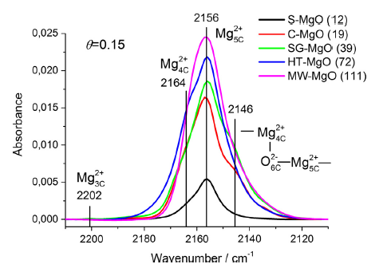
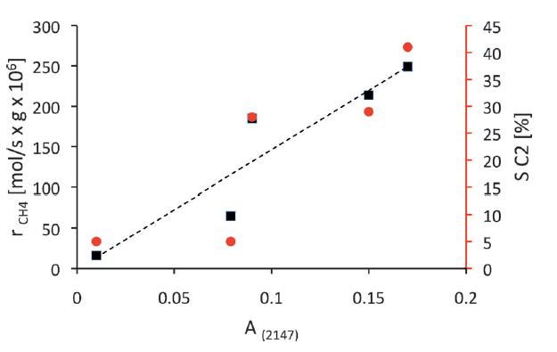
Chemisorption
Example: CO adsorption on MgO

Slide 51
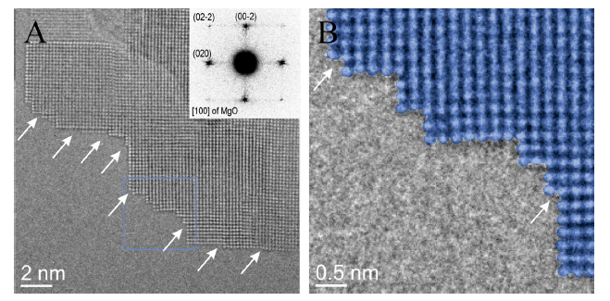
Chemisorption
Example: CO adsorption on MgO

Slide 52
Chemisorption
Example: CO adsorption on MgO
Single step edge is the active site
  Good correlation between integral of absorption band at 2147 cm^{–1} and catalytic activity
  Band at 2147 cm^{–1} represents single step edge
  Au atoms selectively deposits on single step edges (observed by HR-TEM) = catalyst poisoning, active site „titration“

Slide 53
ToF-SIMS
Time of flight secondary ion mass spectrometry
Catalyst surface bombarded by „primary“ ions
(e.g. Bi₅⁺)
Surface atoms (top ≈1 nm) expelled by this bombardment forming charged clusters = secondary ions created
Analysis of secondary ions gives us information about catalyst surface

Slide 54
ToF-SIMS
Surface composition
  AlO₂– is a function of Al concentration in top 1 nm
  AlSiO₃– is a mixed Al-Si cluster (good Al dispersion)
  Al₂O₄– signifies badly dispersed Al species

Slide 55
Catalyst characterization
Outline
  DRUV
  XPS
  XANES & EXAFS
  Chemisorption
  ToF-SIMS

