Slide 1
Heterogeneous catalysis
Lecture 6
Catalysts characterization - continuation

Slide 2
Catalyst characterization
Outline
Solid state NMR techniques
Hydrophilicity vs. Hydrophobicity meas
Water sorption
Dynamic water sorption
Inverse gas chromatography
Microcallorimetry
Quartz crystal microbalance
In situ and operando techniques

Slide 3
Solid state NMR techniques
Magic angle spinning (MAS)
Multiple quantum experiments (MQ)
Dynamic nuclear polarization (DNP)

Slide 4
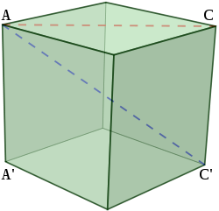
Solid state NMR techniques
Magic angle spinning (MAS)
54.74 °
Spinning averages dipolar interaction, chemical shift anisotropy, and quadrupolar interaction
“Residues” of these interactions are observed as spinning sidebands
Static and double rotation NMR possible

Slide 5
Solid state NMR techniques

Slide 6
Solid state NMR techniques
CPMAS

Slide 7
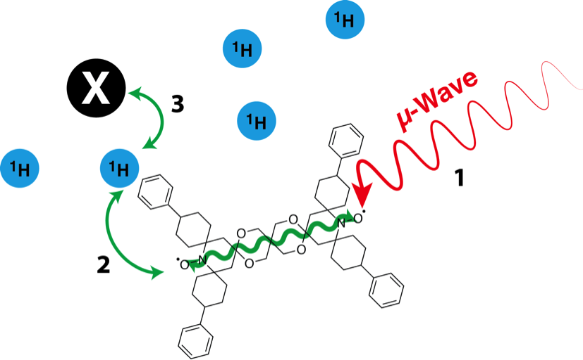
Solid state NMR techniques
Dynamic nuclear polarization (DNP)

Slide 8
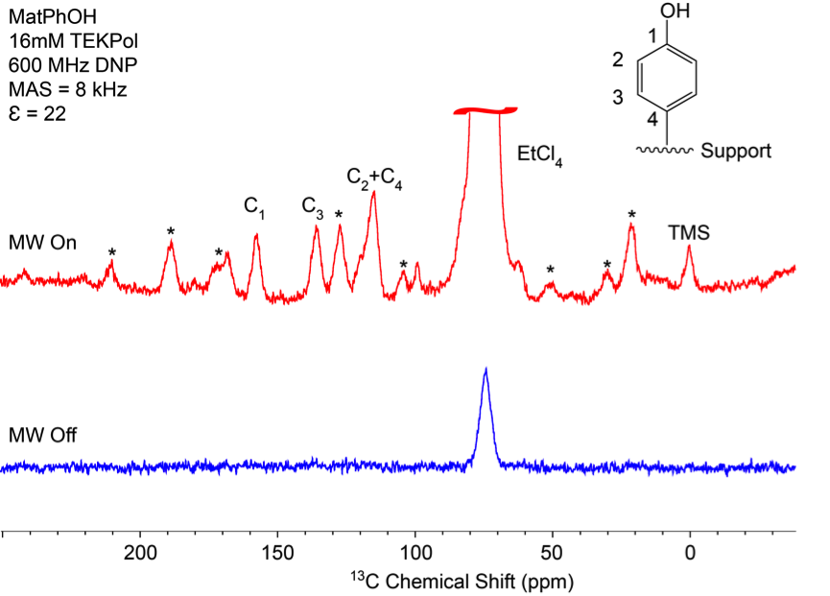
Solid state NMR techniques
Dynamic nuclear polarization (DNP)
¹³C

Slide 9
Solid state NMR techniques
²⁹Si

Slide 10
Solid state NMR techniques
²⁷Al

Slide 11
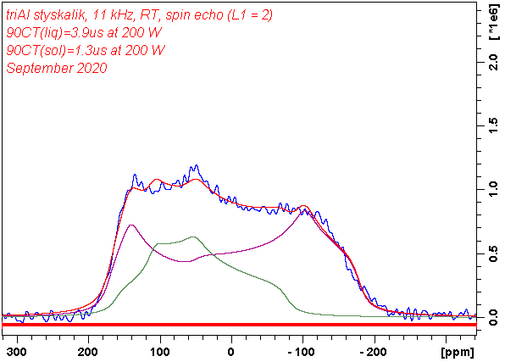
Solid state NMR techniques
Static NMR (=no spinning)
²⁷Al

Slide 12
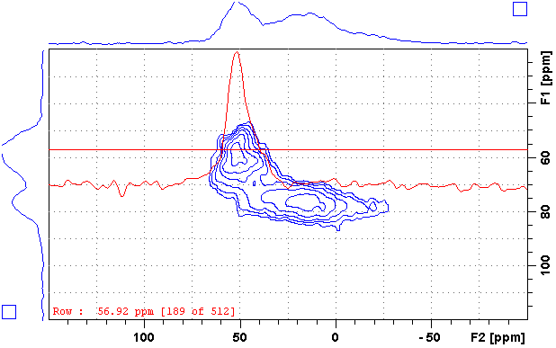
Solid state NMR techniques
Multiple quantum MAS (MQMAS)
2D ²⁷Al TQMAS

Slide 13
Hydrophilicity vs. Hydrophobicity
Why?
Remember: Adsorption/desorption step in cata as important as cata rxn itself (@Lecture 1)
Moreover: strong efforts nowadays put forward bio-sources instead of fossil fuels
Compare
Oil – long hydrocarbon chains (hydrophobic)
Wood – cellulose, lignin = sugar based materials = a lot of oxygen, OH groups (hydrophilic)

Slide 14
Hydrophilicity vs. Hydrophobicity
Possibilities:
Water sorption
Dynamic vapor sorption/Quartz crystal microbalance
Inverse gas chromatography
Microcallorimetry

Slide 15
Hydrophilicity vs. Hydrophobicity
Problems:
What is a measure of hydrophobicity?
A material can have high/low affinity to both water and organic molecules (i.e. if a sample is hydrophilic, it does not necessarily mean it is hydrophobic!)
% of pore volume filled with water at certain p/p₀
Hydrophobic index (water/toluene competitive sorption)
Heat of adsorption, heat of immersion
…
Chemisorption: Do chemisorbed molecules account for hydrophobicity/philicity?

Slide 16
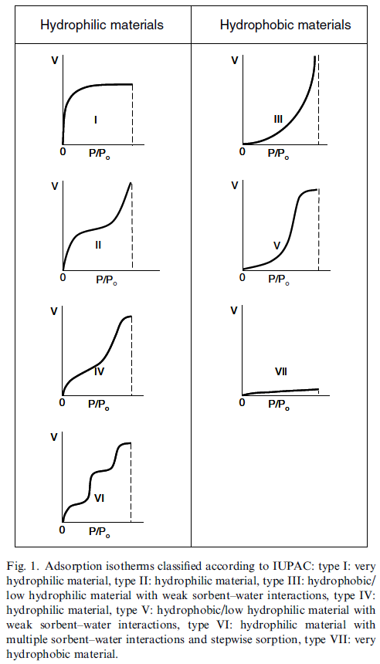
Hydrophilicity vs. Hydrophobicity
Water sorption
Similar to N₂ physisorption
Known volume and pressure in the cell, known mass of the sample

Slide 17
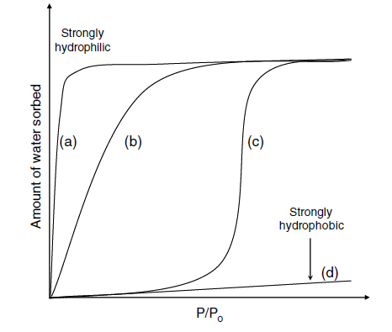
Hydrophilicity vs. Hydrophobicity
Water sorption
Water clustering = water-water interaction (liquefaction, condensation) stronger than water-adsorbent
Very strong interaction water-adsorbent
Very weak interaction water-adsorbent

Slide 18
Hydrophilicity vs. Hydrophobicity
Water sorption
Plotting ln p against 1/T at constant adsorption uptake gives a straight line with a slope equal to H_{iso}/R
H_{iso} = isosteric heat of adsorption
Isotherms at multiple temperatures needed!

Slide 19
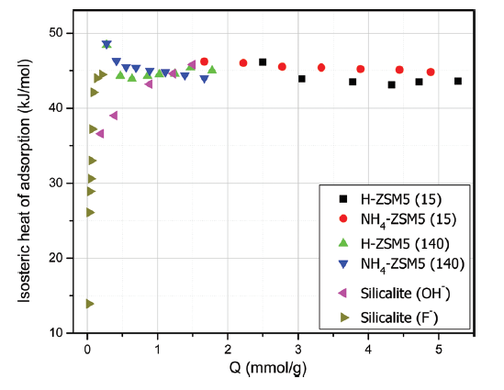
Hydrophilicity vs. Hydrophobicity
Water sorption
H_{iso} = isosteric heat of adsorption
Hydrophilic material = very high H_{iso} = strong interaction water-adsorbent
H_{iso} more or less constant = water-water interaction (condensation)
Hydrophobic material = very low H_{iso} = negligible interaction water-adsorbent

Slide 20
Hydrophilicity vs. Hydrophobicity
Dynamic vapor sorption/Quartz crystal microbalance
You deposit your material on an accurate microbalance
You expose it to vapors of different gases/liquids (water, alcohols, hydrocarbons,…)
You follow the uptake by changes of mass
If we can control/follow pressure, then isotherms can be obtained similar to a classic physisorption

Slide 21
Hydrophilicity vs. Hydrophobicity
Inverse gas chromatography
You pack column (≈ 50 cm) with the material you want to test (≈ 0.5 g)
You inject series of gases/liquids (e.g. methane, ethane,…hexane, heptane; methanol, ethanol,…; benzene, toluene, xylene…)
You follow retention time (you directly see „affinity“ of your material to selected liquids)
Models (math) can give surface energy,…

Slide 22
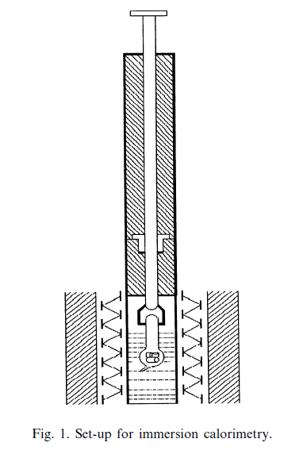
Hydrophilicity vs. Hydrophobicity
Immersion microcalorimetry
Evacuated sample sealed in a bulb with brittle end
Bulb immersed in a testing liquid, sealed
Bulb broken (rod pushed down)
Liquid gets into the bulb, adsorbs, heat of immersion released and measured

Slide 23
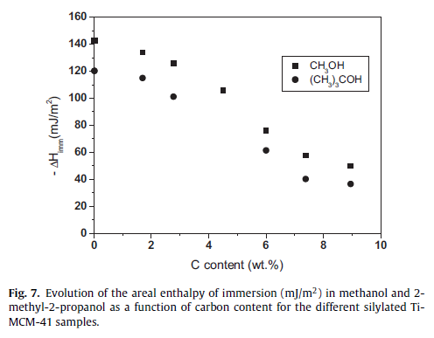
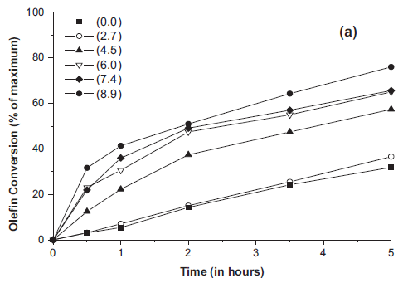
Hydrophilicity vs. Hydrophobicity
Immersion microcalorimetry
Ti-MCM-41, pure inorganic vs. increasing degree of surface silylation (increasing carbon content)
J. Silvestre-Alberó et al. / Applied Catalysis A: General 507 (2015) 14–25

Slide 24
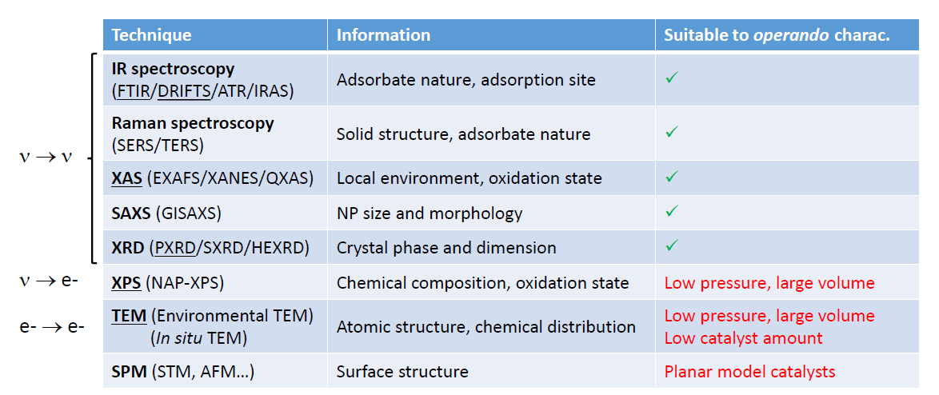
In situ and operando techniques
In situ = online analysis of a working catalyst
Operando = online analysis of a working catalyst at relevant conditions (p, T, WHSV)

Slide 25
In situ and operando techniques
We already know these techniques, let‘s look at the examples!
Low energy electron diffraction (LEED, gives similar results to x-ray diffraction = analysis of crystal structures)
X-ray absorption near edge structure (XANES)
Diffusive reflectance infrared Fourier transform spectroscopy (DRIFTS)

Slide 26
In situ and operando techniques
Example: LEED – low energy electron diffraction
Ethylbenzene dehydrogenation to styrene
600 °C, 1 atm, 10-fold excess water vapor
Over Fe₂O₃ epitaxially grown on Pt(111)
Flow reactor located in a high pressure cell
Heated by lasers
GC-MS analysis of catalytic products
LEED analysis enabled by gate valve (high pressure/ultra high vacuum) and sapphire window

Slide 27
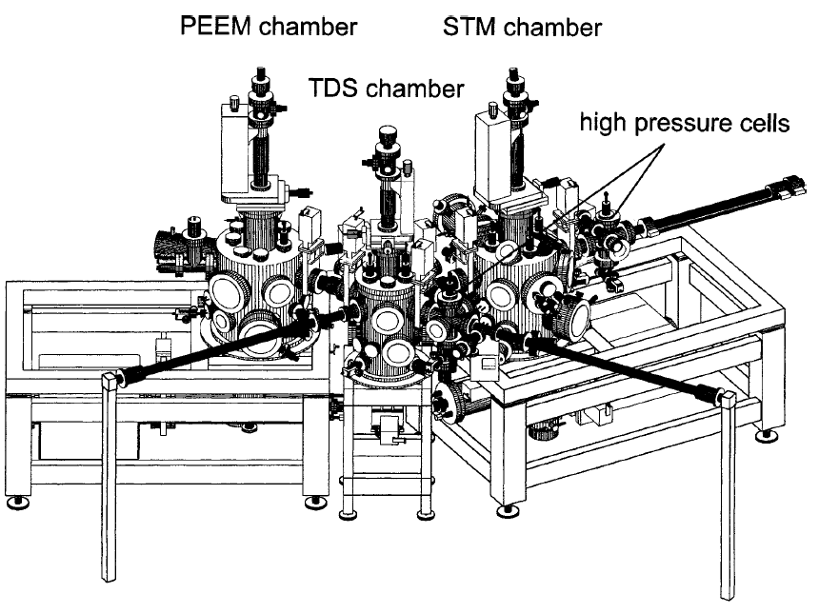
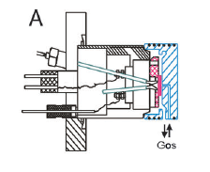
In situ and operando techniques
Example: LEED – low energy electron diffraction

Slide 28
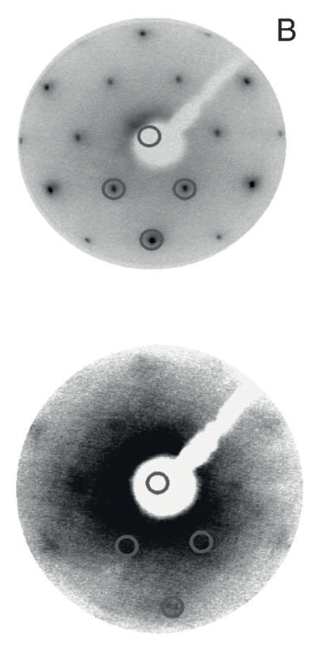
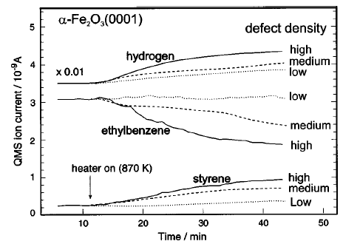
Before catalytic reaction
After catalytic reaction
Initial period, no catalytic activity
Working catalyst

Slide 29
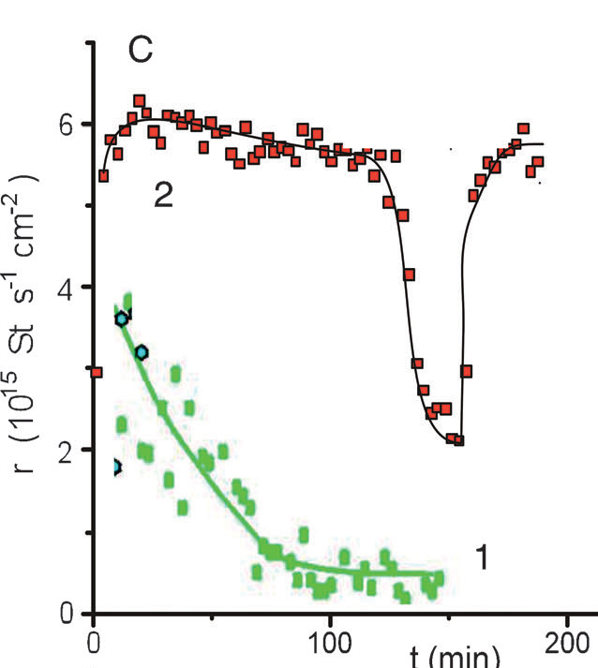
In situ and operando techniques
Example: LEED – low energy electron diffraction
0.5 eq O₂ addition
Active catalyst
Non-crystalline Fe₂O₃
Metastable (Reduction!)
Carbon deposition (Styrene!)
Loss of catalytic activity

Slide 30
In situ and operando techniques
Example: XANES – x-ray absorption near edge structure
Methanol oxidation to formaldehyde over Cu
25–450 °C, 1 mbar
Cu in the form of polycrystalline foil
2 CH₃OH + O₂ → 2 CH₂O + 2 H₂O

Slide 31
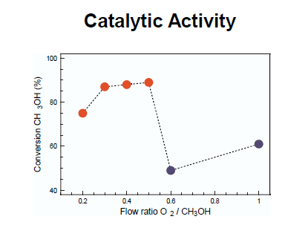
In situ and operando techniques
Example: XANES – x-ray absorption near edge structure
2 CH₃OH + O₂ → 2 CH₂O + 2 H₂O

Slide 32
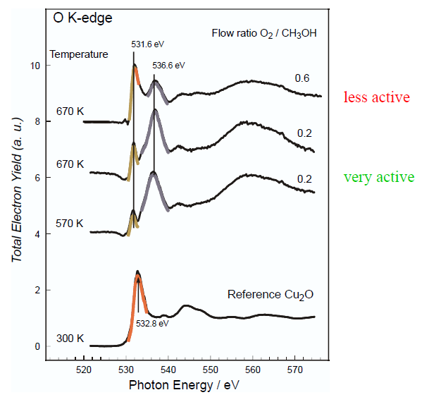
In situ and operando techniques
Example: XANES – x-ray absorption near edge structure
2 oxide and 1 suboxide species

Slide 33
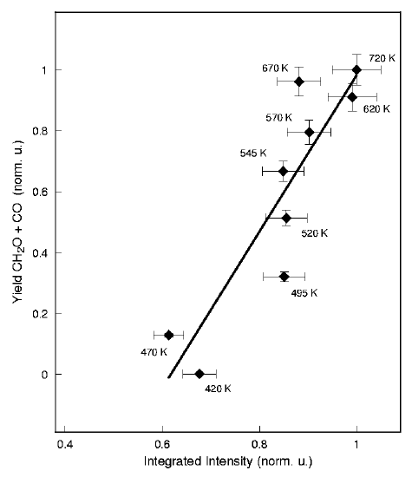
In situ and operando techniques
Example: XANES – x-ray absorption near edge structure
Positive correlation between catalytic activity and Cu suboxide species
Explanation/idea/description of active species: Subsurface oxygen cover by a strained layer of copper atoms
Results confirmed by near ambient pressure XPS (NAP XPS)

Slide 34
In situ and operando techniques
Example: DRIFTS – diffuse reflectance infrared Fourier transform spectroscopy
Coupling of ethanol and acetaldehyde to 1,3- butadiene over Ta doped zeolite
300 °C, 1 atm
Well dispersed (virtually isolated) Ta sites
2 C₂H₅OH + CH₃CHO → C₄H₆ + 2 H₂O

Slide 35
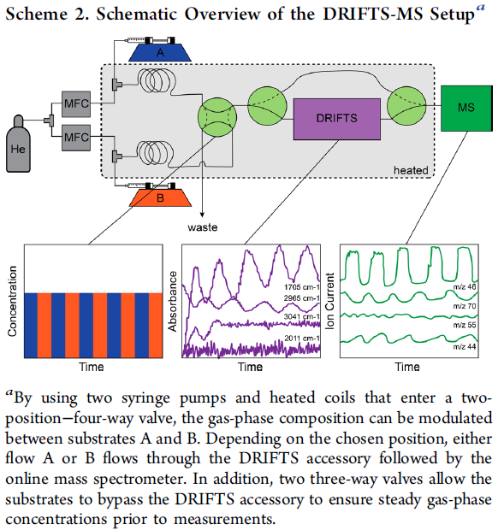
In situ and operando techniques
Example: DRIFTS – diffuse reflectance infrared Fourier transform spectroscopy

Slide 37
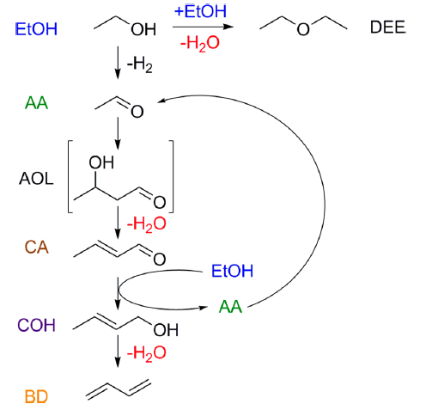
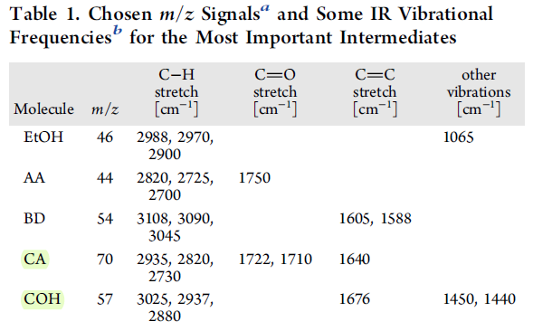
In situ and operando techniques
Example: DRIFTS

Slide 38
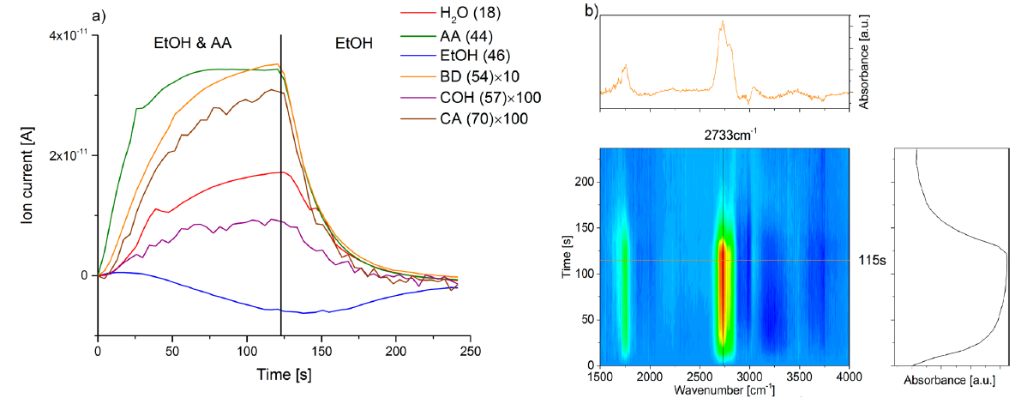
In situ and operando techniques
Example: DRIFTS – diffuse reflectance infrared Fourier transform spectroscopy

