Slide 1
Heterogeneous catalysis
Lecture 9
Zeolites in oil refinement

Slide 2
Zeolites - synthesis
Reaction mixture: …, …, …, …
  pH adjustment, (gelation)
  Hydrothermal treatment in an autoclave
  …
  …
Result: H-zeolite (Brønsted acidic with H⁺ ions)

Slide 3
Zeolites - synthesis
Reaction mixture: Na₂SiO₃, Al₂O₃, quarternary ammonium salt (=structure directing agent), water
  pH adjustment, (gelation)
  Hydrothermal treatment in an autoclave
  Ion exchange (Na⁺ for NH₄⁺)
  Calcination (= NH₃ removal)
Result: Crystalline H-zeolite (Brønsted acidic with H⁺ ions)

Slide 4
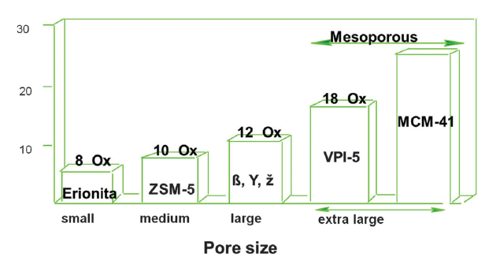
Zeolites - synthesis
Pore size
Si/Al ratio ≥ 1
DOI: 10.1039/c3cs60394f

Slide 5
Zeolites - acidity
Brønsted: …
  Structure:
Lewis: …
  Structure:

Slide 6
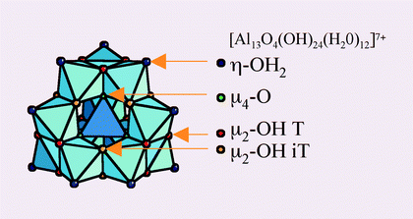
Zeolites - acidity
Brønsted: negative charge of the aluminosilicate net balanced by strongly acidic protons
  Structure:
Lewis: Al atoms that are not embedded in the aluminosilicate net (e.g. surface species, amorphous stuff, alumina particles) = extraframework aluminum species (EFAL)
  Structure:
    H⁺

Slide 7
Zeolites - acidity
Brønsted: negative charge of the aluminosilicate net balanced by strongly acidic protons
  Structure:
    H⁺
Changes in local Al structure revealed by EXAFS
DOI: 10.1039/C8CS00887F

Slide 8
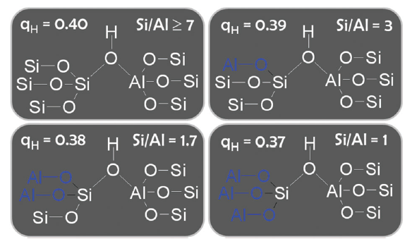
Zeolites - acidity
Brønsted: depends on the second coordination sphere (i.e. Si/Al ratio)
Lewis: Extraframework aluminum species (EFAL) depends on
  Si/Al ratio
  Aging (time on stream, steaming)
  Can be washed out (depending on pH – acid washing)

Slide 9
Zeolites - acidity
High Si/Al ratio
  Strong Brønsted acid sites
  Weak Brønsted acid sites
  Strong Lewis acid sites
  Weak Lewis acid sites
Low Si/Al ratio
  Strong Brønsted acid sites
  Weak Brønsted acid sites
  Strong Lewis acid sites
  Weak Lewis acid sites

Slide 10
Zeolites - acidity
High Si/Al ratio
  Strong Brønsted acid sites
  Weak Brønsted acid sites
  Strong Lewis acid sites
  Weak Lewis acid sites
Low Si/Al ratio
  Strong Brønsted acid sites
  Weak Brønsted acid sites
  Strong Lewis acid sites
  Weak Lewis acid sites

Slide 11
Zeolites - acidity
Confinement effect
Superacidity
  Various probes at RT – acid site strength similar to 70 % H₂SO₄ (=NO!)
  Ability to protonate hydrocarbons at working conditions (=YES!)
  ?

Slide 12
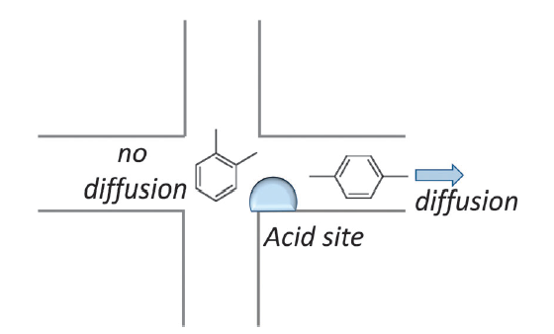
Zeolites – diffusion/shape selectivity
Diffusion
  Big difference between zeolites with 8 membered vs. 12 membered ring pore openings
  Big difference between zeolites with 1D, 2D, and 3D-connected pore structure
Shape selectivity
DOI: 10.1039/c3cs60394f

Slide 13
Other microporous frameworks
Non-Al zeolites
  Be²⁺, Zn²⁺, B³⁺, Ga³⁺, Fe³⁺, Ge⁴⁺, Ti⁴⁺, Sn⁴⁺
  15 % variation in radius (vs. Si⁴⁺)
  ±0.4 a.u. Pauling electronegativity
Aluminophosphates (AlPOs)
  SiO₂ and AlPO₄ and isoelectronic structures
  No catalytic activity
M(II) Aluminophosphates
  Mild Brønsted acids and(or) redox catalysts
Silicoaluminophosphates (SAPOs)
  Mild Brønsted acids

Slide 14
Other microporous frameworks
Non-Al zeolites
  Be²⁺, Zn²⁺, B³⁺, Ga³⁺, Fe³⁺, Ge⁴⁺, Ti⁴⁺, Sn⁴⁺
  15 % variation in radius (vs. Si⁴⁺)
  ±0.4 a.u. Pauling electronegativity
Lewis acidity in non-Al zeolites
Open vs. Closed acid sites in non-Al zeolites

Slide 15
Other microporous frameworks
Aluminophosphates (AlPOs)
  M(II) Aluminophosphates
  Silicoaluminophosphates (SAPOs) = milder acidity
DOI: 10.1016/j.cattod.2011.02.027

Slide 16
Zeolites in oil refinement
Fluid catalytic cracking
Isobutane-butene alkylation
Reforming (+ steam reforming)
Hydrocracking
Linear paraffin isomerization
DOI: 10.1039/c3cs60394f

Slide 17
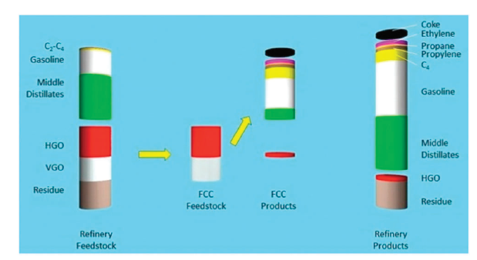
Zeolites in oil refinement
Fluid catalytic cracking

Slide 18
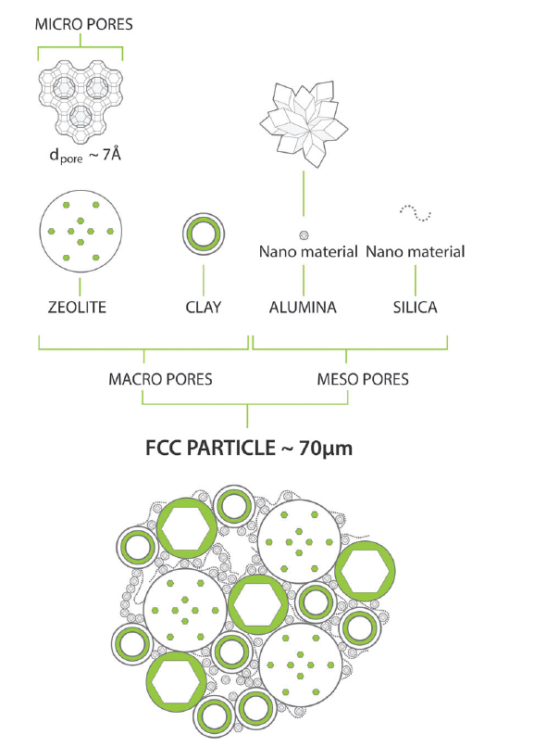
Zeolites in oil refinement
Fluid catalytic cracking
  Zeolite Y 10-50 wt%
  Binders 50-90 wt%
  At the beginning – AlCl₃
  Addition of HZSM-5

Slide 19
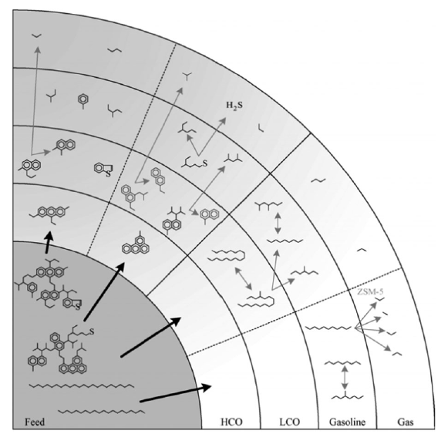
Zeolites in oil refinement
Fluid catalytic cracking
  Shortening of long linear hydrocarbons
  Isomerization to branched hydrocarbons
  „Aromatization“
  HZSM-5 for higher propylene production

Slide 20
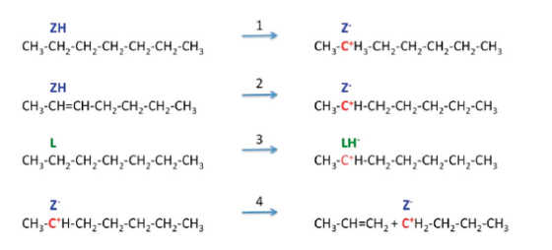
Zeolites in oil refinement
Fluid catalytic cracking
  Protonation + protolytic cracking
  H⁻ abstraction + β scission

Slide 21
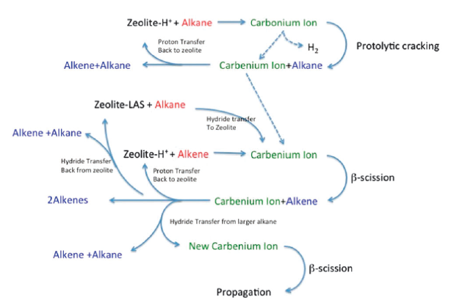
Zeolites in oil refinement
Fluid catalytic cracking
  Protonation + protolytic cracking
  H⁻ abstraction + β scission

Slide 22
Zeolites in oil refinement
Fluid catalytic cracking
  Protonation + protolytic cracking
    We need strong Brøsted acid sites (zeolite Y)
  H⁻ abstraction + β scission
    We need strong Lewis acid sites (steamed/(acid washed) zeolite Y)
  Long linear hydrocarbons diffusion
    Precracking on alumina and silica-alumina (non-innocent binders)
    Hierarchical porosity in zeolites (steamed/(acid washed) zeolite Y)

Slide 23
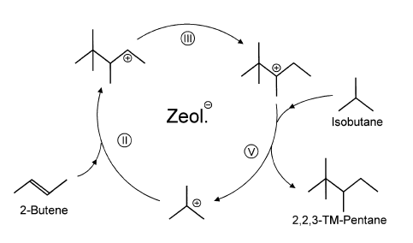

Zeolites in oil refinement
Isobutane-butene alkylation
  We want highly branched C8 hydrocarbons (high octane number)
  HF and H₂SO₄ catalyzed alkylation still running in industry
  Large pore zeolites as a substitution

Slide 24
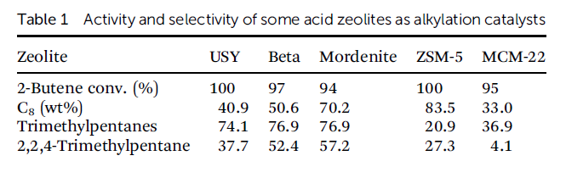
Zeolites in oil refinement
Isobutane-butene alkylation
  Large pore zeolites as a substitution
  BUT! 2-butene dimerization…oligomerization…coking…deactivation

Slide 25
Zeolites in oil refinement
Linear paraffin hydroisomerization
  Linear C8 (C7) → branched C8 (C7)
  Requires strong Brønsted acidity and hydrogenation/dehydrogenation activity (Pt(Ni) on mordenite)
  Mordenite – large pore, monodirectional pores
  Mordenite – dealuminated (strong H⁺), acid washed (low EFAL)
  Protonation = carbocations
  Stability of carbocations? Branched hydrocarbons?

Slide 26
Zeolites in oil refinement
Linear paraffin hydroisomerization
  Linear C8 (C7) → branched C8 (C7)
  Requires strong Brønsted acidity and hydrogenation/dehydrogenation activity (Pt(Ni) on mordenite)
  Mechanism???
    Dehydrogenation of n-alkane to n-alkene on Pt
    Diffusion???
    Protonation of n-alkene to secondary carbenium ion on H⁺ zeolite
    Secondary carbenium ion rearranges to tertiary (more stable) carbenium ion
    Desorption from acid site produces iso-alkene, H⁺ is restored
    Diffusion???
    Hydrogenation of iso-alkene to iso-alkane on Pt

Slide 27
Zeolites in oil refinement
Linear paraffin hydroisomerization
  Researchers interested in the effect of “intimacy” (Pt-acid site)
  Affects mainly selectivity, activity to some extent
  An optimum between “too close” and “too far”

Slide 28
Zeolites in oil refinement
Linear paraffin hydroisomerization
  Researchers interested in the effect of “intimacy” (Pt-acid site)
  Affects mainly selectivity, activity to some extent
  An optimum between “too close” and “too far”
DOI: 10.1021/acscatal.8b01461

Slide 29
Zeolites in oil refinement
Linear paraffin hydroisomerization
  Pt(Ni) on mordenite
  How do we deposit Pt on a zeolite? (Lecture 3)

Slide 30
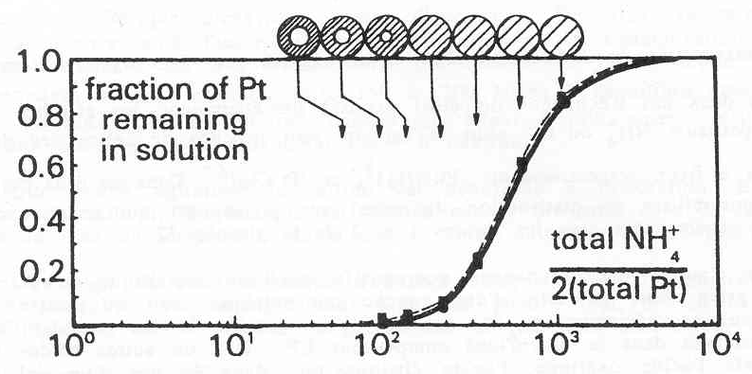
Zeolites in oil refinement
Linear paraffin hydroisomerization
  Pt, Pd, Ni on mordenite
  Electrostatic interaction = Ion exchange
    Competitive ion exchange
    [NH₄⁺]

Slide 31
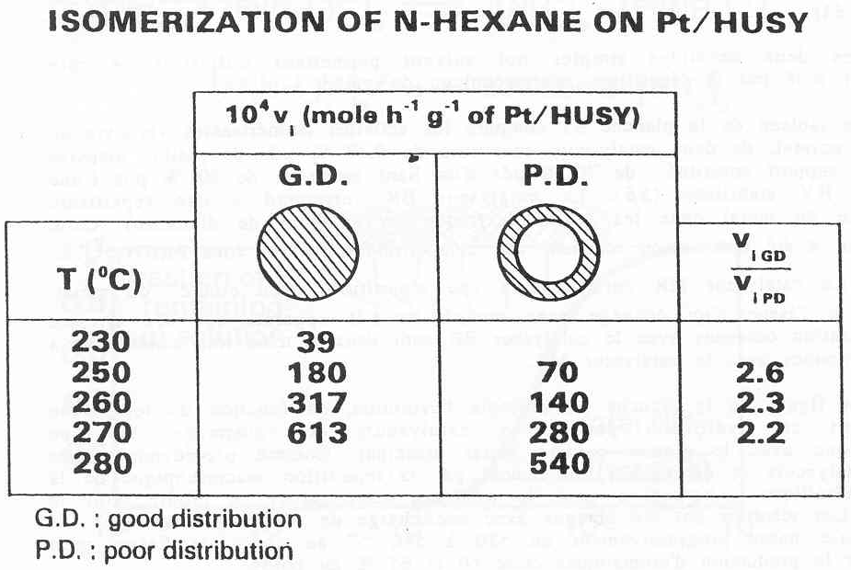
Zeolites in oil refinement
Linear paraffin hydroisomerization
  Pt, Pd, Ni on mordenite
  Electrostatic interaction = Ion exchange
    Competitive ion exchange

Slide 32
Zeolites in oil refinement
Hydrocracking (i.e. cracking in the presence of H₂)
  Shortening of long hydrocarbons
  From linear to branched (alkylation, carbocations,…)
  Hydrogenation/dehydrogenation
  Pt, Pd on mordenite (also zeolite Y and β)

Slide 33
Zeolites in oil refinement
Reforming and steam reforming
  Cyclization, isomerization of cyclic compounds to cyclohexene, cyclohexene and its derivatives dehydrogenation to benzene, toluene, xylene (BTX), and other aromatics
  H₂ as a useful „by-product“
  Pt on high surface area support, non-acidic
  Reforming in the presence of H₂O = H₂ production

Slide 34
Microporosity of zeolites
+
Regular structure
High stability
Shape selectivity
Confinement effect
−
Diffusion limitations
Coking
Fast deactivation
Solution?
Extra-large pore zeolites
Nanocrystalline zeolites
Hierarchical zeolites
Two-dimensional zeolites
MCM-41, SBA-15 and other mesoporous silica???

Slide 35
Microporosity of zeolites
+
Regular structure
High stability
Shape selectivity
Confinement effect
−
Diffusion limitations
Coking
Fast deactivation
Solution?
Extra-large pore zeolites
Nanocrystalline zeolites
Hierarchical zeolites
Two-dimensional zeolites
MCM-41, SBA-15 and other mesoporous silica???

Slide 36
Microporosity of zeolites
Extra-large pore zeolites
  Germanosilicates
  New organic structure-directing agents
  Ge for Al substitution
  Assembly-disassembly-organization-reassembly (prof. Čejka, Prague)
DOI: 10.1039/C8CS00887F

Slide 37
Microporosity of zeolites
Nanocrystalline zeolites
  Classic hydrothermal synthesis
  But! Part of Si source = MeSi(OEt)₃
DOI: 10.1016/j.cattod.2009.04.016

Slide 38
Microporosity of zeolites
Nanocrystalline zeolites
  Classic hydrothermal synthesis
  But! Part of Si source = MeSi(OEt)₃
Nano-HZSM-5
Micro-HZSM-5
Ethanol dehydration to ethylene
DOI: 10.1016/j.cattod.2009.04.016

Slide 39
Microporosity of zeolites
Hierarchical zeolites
  Add something into the rxn mixture in order to create large pores
    Hard templates (carbon,…)
    Soft templates (alkoxysilanes with a long aliphatic chain)
  Dealumination, desilication
    HNO₃, NaOH
DOI: 10.1039/B805502E

Slide 40
Microporosity of zeolites
Hierarchical zeolites
  Add something into the rxn mixture in order to create large pores
  Dealumination, desilication: alkaline–acid, acid–alkaline, and fluorination–alkaline post-synthesis treatments of H-MOR (below)
DOI: 10.1039/B805502E

Slide 41
Microporosity of zeolites
Two-dimensional zeolites
  Pillaring
    CTMA⁺, sonication, surfactant removal = stacked layers
  Delamination
    CTMA⁺, sonication, TEOS hydrolysis, calcination = layered zeolites with permanently expanded interlayer spaces

