Slide 1
Mendelian randomisation

Slide 2
The RCT concept
Everything except the intervention is (hoped to be) the same in the two groups
Defined study sample
Randomisation to two groups
Intervention group
Control group
Measure outcome
Measure outcome

Slide 3
Randomisation
… is allocation of the units of analysis to the different experimental groups or conditions according to chance, such that each unit has an equal probability of selection into each group
Most powerful way of ensuring characteristics not systematically allocated to a particular group
Can randomise in groups (clusters)

Slide 4
The aim of randomisation is to…
create groups that are comparable with respect to known or unknown confounding factors
There are two steps in the process
Generating an unpredictable allocation sequence e.g. tossing a coin, using a computer random number generator
Concealing the allocation sequence from the investigators

Slide 5
Mendelian randomisation studies

Slide 6
Mendelian randomisation studies
Observational design with (almost) RCT strengths
Based on Mendel’s second law: alleles of different genes assort independently of one another during gamete formation
Inheritance of one trait should be independent of inheritance of other traits
Genetic variant used as proxy for exposure is unrelated to conventional vascular risk factors and other disease marker

Slide 7
Glynn RJ,
Clinical Chemistry 56:3
388–390 (2010)

Slide 8
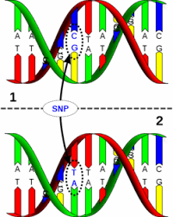
MR studies of biological or behavioural risk factors
Identify genetic marker (often a SNP)
  Associated with the risk factor
  Not associated with the disease via other pathways (i.e. not associated with other risk factors)
Estimate association between:
  Genetic markers and RF
  Observational RF and disease
  Genetic marker and diseases
Compare observational and MR associations
Observational associations can be biased, confounded, MR should be unbiased

Slide 9
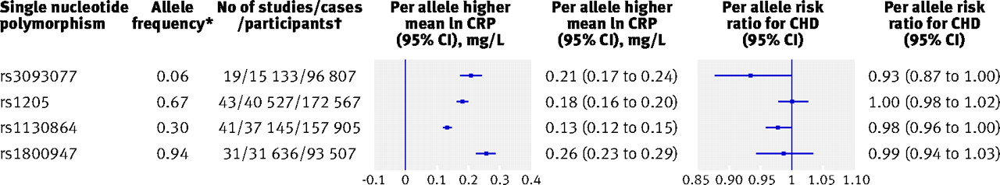
Estimates of association of each single nucleotide polymorphism with ln concentrations of C reactive protein
C Reactive Protein Coronary Heart Disease Genetics Collaboration (CCGC) BMJ 2011;342:bmj.d548
Notes:
Fig 2 Estimates of association of each single nucleotide polymorphism with ln concentrations of C reactive protein and risk of coronary heart disease (CHD). *Frequency of allele for increased concentrations of circulating ln C reactive protein (that is, risk allele). Associations presented per additional copy of risk allele. †For associations between single nucleotide polymorphism and coronary heart disease, studies with <10 cases or <50 participants were excluded from analyses. Study specific estimates stratified, where appropriate, by sex, ethnicity, and trial arm and combined with random effects models. Maximum available data on genetic variants, circulating C reactive protein, and coronary heart disease used for analyses; sensitivity analyses restricted to participants with data on C reactive protein single nucleotide polymorphisms, circulating C reactive protein, and coronary heart disease did not differ from current analyses. Fig C in appendix 3 on bmj.com shows study specific associations between single nucleotide polymorphism and C reactive protein and coronary heart disease for each single nucleotide polymorphism

Slide 10
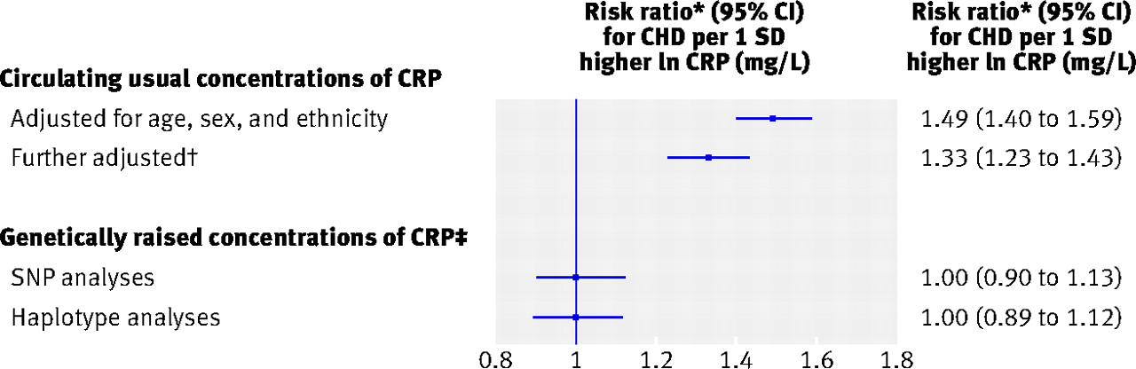
Association of (1) circulating concentrations and (2) genetically raised concentrations of C reactive protein (CRP) with risk of coronary heart disease (CHD)
*Corrected for regression dilution in C reactive protein and potential confounding factors
C Reactive Protein Coronary Heart Disease Genetics Collaboration (CCGC) BMJ 2011;342:bmj.d548
Notes:
Fig 4 Estimates of association of circulating concentrations and genetically raised concentrations of C reactive protein (CRP) with risk of coronary heart disease (CHD). *Corrected for regression dilution in C reactive protein and potential confounding factors.

Slide 11
Association of (1) circulating concentrations and (2) genetically raised concentrations of C reactive protein (CRP) with risk of coronary heart disease (CHD)
*Corrected for regression dilution in C reactive protein and potential confounding factors
C Reactive Protein Coronary Heart Disease Genetics Collaboration (CCGC) BMJ 2011;342:bmj.d548
Notes:
Fig 4 Estimates of association of circulating concentrations and genetically raised concentrations of C reactive protein (CRP) with risk of coronary heart disease (CHD). *Corrected for regression dilution in C reactive protein and potential confounding factors.

Slide 12
Assumptions / limitations
A gene influences disease solely through B. This is unverifiable, as a single gene can influence disease risk through multiple pathways other than B (pleiotropy);
Other alleles, G’, may be correlated with G (linkage disequilibrium) and influence D through other pathways, thereby inducing confounding;
Other characteristics of individuals at birth, C’, that independently predict the development of D can be correlated with G (population stratification) or influence the expression of G (epigenetics),
Both other alleles and patient characteristics can modify the effect of G on B, the effect of G on D, or both.

Slide 13
Types of comparisons in different types of studies
Study design | Type of comparison
Ecological studies | Comparing disease frequency between populations
Cross-sectional studies | Comparing disease frequency between persons with and without characteristic of interest
Cohort studies | Comparing disease incidence between exposed and unexposed persons
Case-control studies | Comparing frequency of (past) exposure between cases and healthy controls
Interventional studies | Comparing incidence of events in persons exposed to the intervention of interest and in control group
Mendelian randomisation | Comparing frequency of events in persons with and without genotype associated with exposure

Slide 14
hierarchy of major study designs
systematic review of RCTs
interventional
RCT
Mendelian
randomisation studies
observational
cohort
case control
ecological
validity

