Slide 1
Moderation
E0420
Week 12

Slide 2
Interactions
Multiple variables in regression = additive effect
Interaction is different from the additive effect
When relation between X and Y depends on levels of Z
Moderation is an interaction
Polynomial terms are interactions (e.g. x²)

Slide 3
Types of interactions
By number of variables
2-way interactions
3-way interactions
By type of variables
categorical * categorical
categorical * continuous
continuous * continuous

Slide 4
Additive effects
First-order effects
For two variables:
Sleep_hrs = B0 + B1_{Age} + B2_{hrs_inet}
Sleep_hrs = 9.449 - 0.131_{Age} – 0.117_{hrs_inet}
Values:
Age: 10.5 – 21.29
Hours on internet: 0 – 7

Slide 7
Interaction
Higher-order effects
In interaction, the first order effects are conditional (depending on the value of the other IV)
The conditional association is symmetrical:
X on Z = Z on x
Interaction term is entered into regression along with the X and Z variables
In hierarchical regression, it is better to use the interaction term as a separate step

Slide 8
.2 association between depression and social skills when anxiety = 0
.6 association between anxiety and social skills and when depression = 0
.4 association between depression and anxiety increases by .4 for every unit increase in the cross-product
From Peggy Keller’s Moderation presentation from Spring 2012, University of Kentucky

Slide 9
From Peggy Keller’s Moderation presentation from Spring 2012, University of Kentucky

Slide 10
Interactions in ANOVA
ANOVA interactions are equal to interactions from regression
ANOVA can only do interactions with categorical variables
People used to categorize continuous variables = bad idea
Lower power
Potentially spurious findings

Slide 11
Mediation vs moderation
Mediation = explains association
Moderation = conditions the association
Mediation = a third variable explains the association between the two variables
Z mediates = Z carries (a part of) an effect between X and Y
Moderation = a third variables influences the strength of the association between the two variables
Z moderates – Z makes the association between X and Y become stronger/weaker

Slide 12
X
Y
Mediation
M
X
Y
Moderation
M

Slide 13
Centering
As mentioned in the previous lecture, centering is necessary for interaction terms
Interpretability (if there is no meaningful 0)
Then, the first order coefficient X represents its value when Z = average (and not 0)
To deal with multicollinearity
X | Z | XZ | X_c | Z_c | XZ
0 | 0 | 0 | -5 | -5 | 25
2 | 2 | 4 | -3 | -3 | 9
4 | 4 | 16 | -1 | -1 | 1
6 | 6 | 36 | 1 | 1 | 1
8 | 8 | 64 | 3 | 3 | 9
10 | 10 | 100 | 5 | 5 | 25
r = 0.96
X (M) = 5
X (Z) = 5
r = 0.00 X (M) = 0
X (Z) = 0

Slide 14
Note on centering
Not needed to center when a meaningful zero or when dichotomous
No need to center additional IVs in the model that are not part of the interaction term

Slide 15
Plotting the interaction
Plotting is essential for understanding moderation
We usually select 2-3 values for the moderator to be plotted
Those are the lines you see
For categorical moderator, it would be the categories
For continuous moderator, most often it is +/- 1SD of moderator (+mean)

Slide 16
From Peggy Keller’s Moderation presentation from Spring 2012, University of Kentucky

Slide 17
Simple slopes
The slopes that we plot (conditional) can be tested for significance
The computation of SE is not that straightforward
Software can be used to test the simple slopes
PROCESS macro
Quantpsy.org
Can obtain CIs and region of significance
Johnson-Neyman

Slide 18
Different types of interactions
Positive synergistic
Negative synergistic
From Peggy Keller’s Moderation presentation from Spring 2012, University of Kentucky

Slide 19
Different types of interactions
Antagonistic
From Peggy Keller’s Moderation presentation from Spring 2012, University of Kentucky

Slide 20
Different types of interactions
Curvilinear by linear interaction
From Peggy Keller’s Moderation presentation from Spring 2012, University of Kentucky

Slide 21
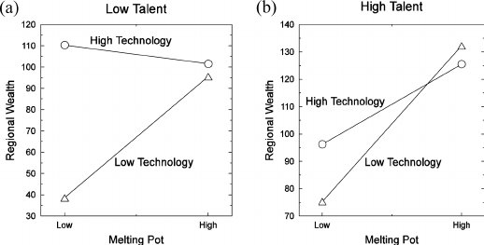
3-way interaction
X*Z*W
Rutten, R., & Gelissen, J. (2008). Technology, talent, diversity and the wealth of European regions. European Planning Studies, 16(7), 985-1006.

