Slide 1
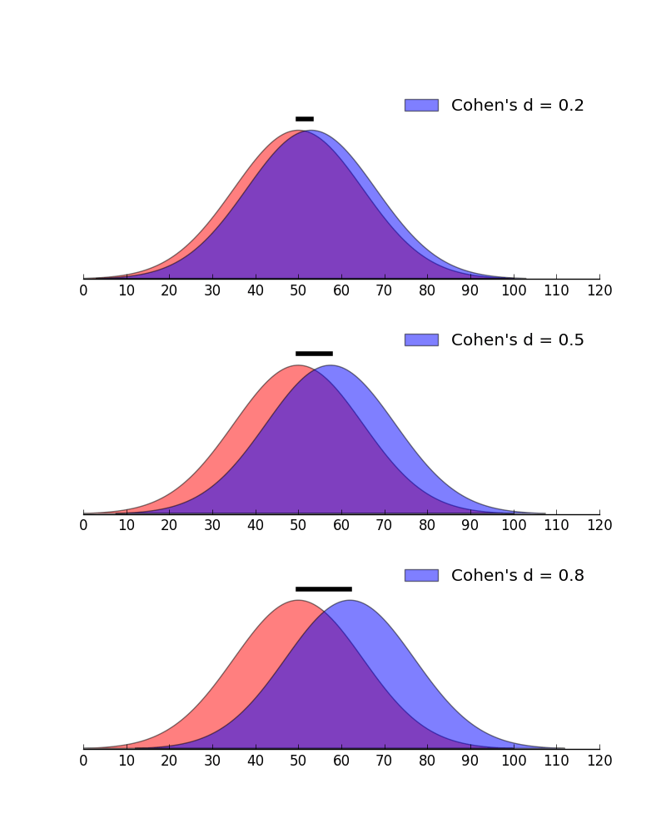
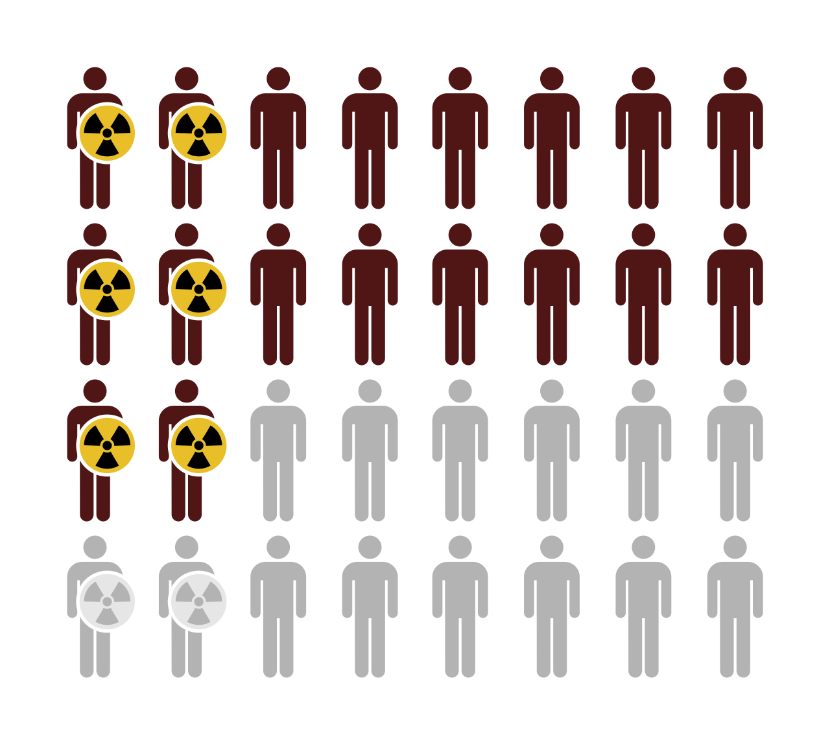
Effect Sizes
E0420
Week 13

Slide 2
Why do we report effect sizes?
Statistical significance ≠ practical significance
We need to know how large the obtained effect is
Effect size = objective (and standardized) measure of the magnitude of the observed effect
Standardized = comparable across studies
  Meta-analyses
Population impact measures
  Measures used to describe the impact of health risks and benefits in a population (to inform health policy)
    Odds Ratio (OR), Relative Risk (RR)
    Number needed to treat (NNT), Population attributable fraction (PAF)

Slide 3
Effect sizes for common statistical tests
Test | Effect Size
Chi-square – 2x2 table | Phi (φ), Odds Ratio (OR), Relative Risk (RR)
Chi-square – bigger table | Cramer’s V
T-test | Cohen's d
ANOVA | η2, Cohen’s f
Correlation | R
Regression – linear | β, R²
Regression – logistic | OR, RR
Mediation | R², proportion mediated, standardized indirect effect
Moderation | R², f²

Slide 4

Cohen's d
Standardized mean difference
d = Cohen's d effect size; X1 and X2 = means of the two groups; s1 and s2 = standard deviations of the two groups
https://rpsychologist.com/cohend/
Notes:
Sources: Larner, A. J. (2014). Effect size (Cohen's d) of cognitive screening instruments examined in pragmatic diagnostic accuracy studies. Dementia and geriatric cognitive disorders extra, 4(2), 236-241.

Slide 5
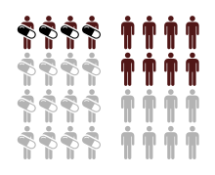
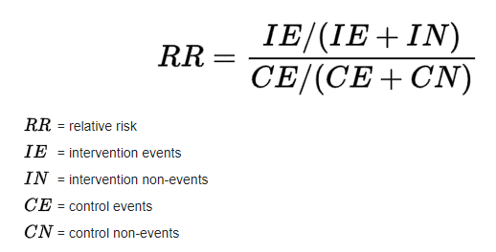
Relative risk
The relative risk (=risk ratio [RR]) is the ratio of risk of an event in one group (e.g., exposed group) versus the risk of the event in the other group (e.g., nonexposed group).
The group exposed to treatment (left) has half the risk (RR = 4/8 = 0.5) of an adverse outcome (black) compared to the unexposed group (right)
Equivalent information to Odds Ratio (OR)
Notes:
Sources: https://en.wikipedia.org/wiki/Relative_risk

Slide 6
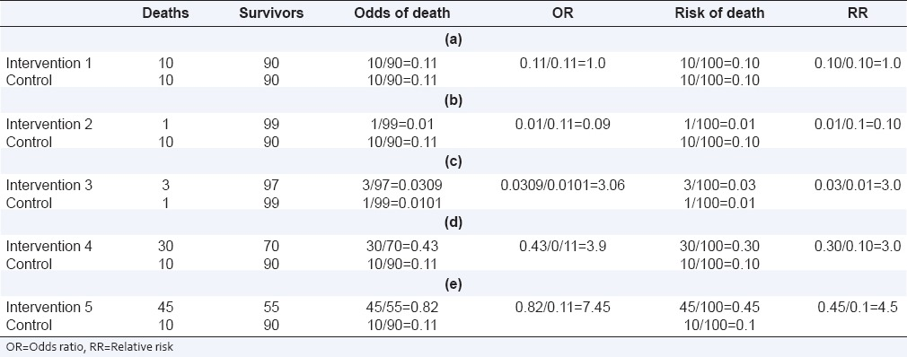
Relative Risk vs Odds Ratio
Notes:
Sources: Ranganathan, P., Aggarwal, R., & Pramesh, C. S. (2015). Common pitfalls in statistical analysis: Odds versus risk. Perspectives in clinical research, 6(4), 222–224. https://doi.org/10.4103/2229-3485.167092

Slide 7
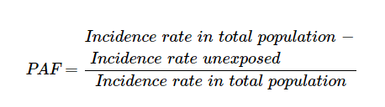
Population attributable fraction (PAF)
PAF is the proportion of incidents in the population that are attributable to the risk factor
A quarter of the population is exposed to a risk factor (i.e., radiation) and has a higher risk of an adverse outcome (black). In the whole population, one ninth of the adverse outcomes can be attributed to the exposure (PAF = 1/9)
Notes:
Sources: https://en.wikipedia.org/wiki/Attributable_fraction_for_the_population

Slide 8
Real-life Example
The population attributable fractions to compare the contributions of different sources of alcohol supply are shown in Table 4. They suggest that due to high prevalence in this sample (~ 18%) as well as consistently increased risk for later alcohol use, parental supply of alcohol emerged as the major contributor to frequent use at age 15, with PAF 0.17 and 0.12 for less frequent use (adolescent and pediatrician report) and 0.23/0.23 for frequent use. Supply of alcohol from other family member was also considerable, with PAF between 0.10 and 0.13 for the adolescent report and between 0.05 and 0.11 for the pediatrician report.

Slide 9
Final Assignment (80 points)
Topic and data selection (10 points)
  Please, fill this spreadsheet on 16/12 at the latest: https://ucnmuni.sharepoint.com/:w:/t/ERAGroup-internal/ESaph_FXvC1IvKZLlSPsjyEBnzdRc10xt8yV-RHBNzQK7g?e=5IMYRY
Data analysis and write-up (70 points)
  Submit SPSS syntax, output, and a word document to is.muni Homework Vaults (“Odevzdávárna”) on 11/2 at the latest.
Papers must be double-spaced, typed, and follow a specific reference/formatting style (e.g., APA, Chicago, CSE)
Example is in is.muni -- Study Materials -- Course-related instructions

