Slide 1
Data preparation
E0420
Week 2

Slide 2
Let me analyze already!
Different types of variables
Basic diagnostics of variables in dataset are necessary
Without it, findings can be meaningless/spurious/null!

Slide 3
Distribution
How are values distributed within a sample
The shape of the distribution determines how we can analyze the data
Fortunately, majority of values in a sample conform to a well-known distribution

Slide 4
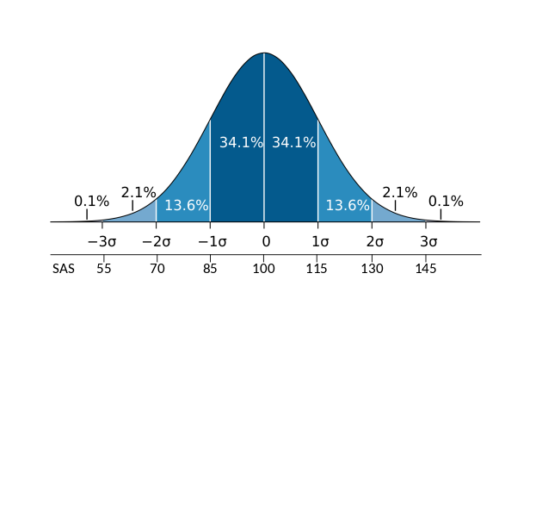
Normal/Gaussian distribution
Also called bell curve
https://commons.wikimedia.org/wiki/File:Wechsler.svg

Slide 5
Galton board and the laws of nature
Notes:
https://www.edumedia-sciences.com/en/media/905-galton-board

Slide 6
Central limit theorem
The distribution of sums of random variables will resemble normal distribution
Notes:
https://seeing-theory.brown.edu/probability-distributions/index.html#section3

Slide 7
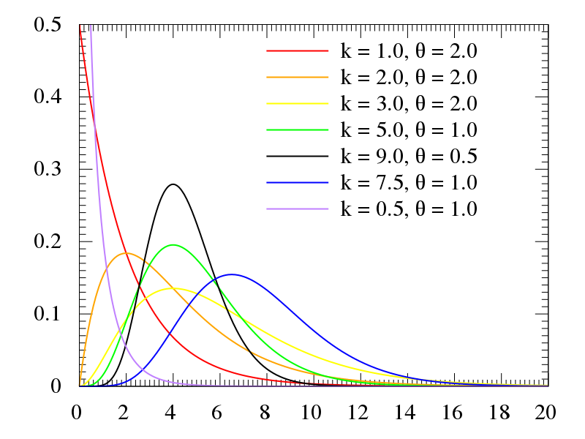
Specific types of distributions
Binomial
Beta distribution
Gamma distribution
and other…
https://commons.wikimedia.org/wiki/File:Gamma_distribution_pdf.svg

Slide 8
Basic descriptive terms
Sum – adding values together
Mean (M) – sum of values divided by their count
Mode – most frequently occurring value
Median – value at the 50% (“in the middle”)
Standard deviation (SD) – distance of a value from a sample mean
Variance – squared SD
Quantile – cut point dividing the range of the distribution into intervals with equal probabilities
Minimum – the smallest value
Maximum – the largest value
Notes:
Please review information from your previous stats course.

Slide 9
Plotting data
One variable
Histogram – bars represent meaningful groups of data
Box plot – box-and-whisker-plot
Represents minimum, maximum, median, and interquartile range (IQR)
Box is IQR (25%-75%), whiskers are min/max or 1.5 IQR
Two variables
Scatterplot
Represents data points as related to two variables

Slide 10
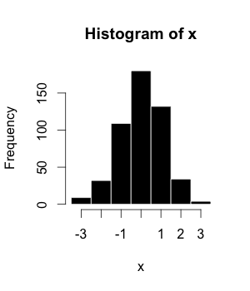
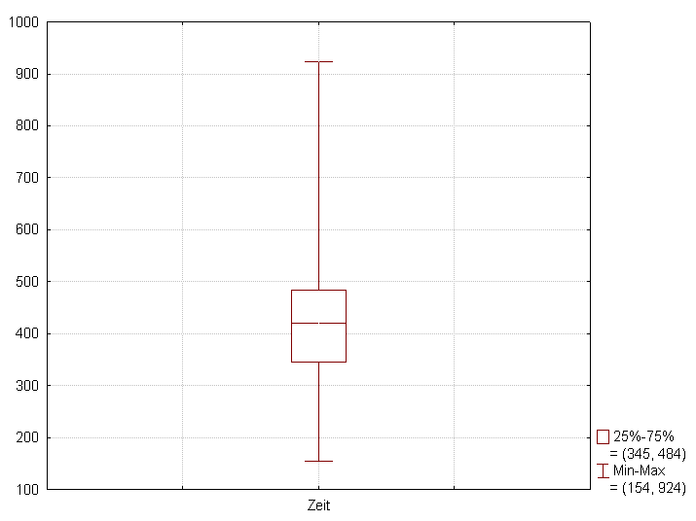
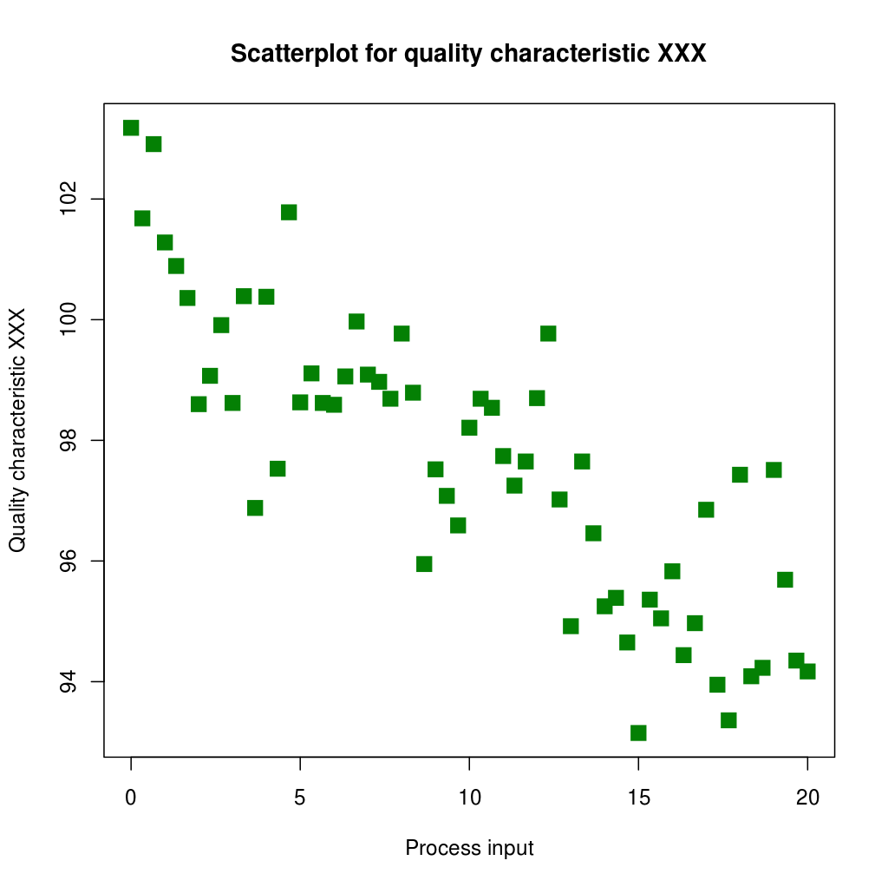
Box plot
Scatterplot
https://commons.wikimedia.org/wiki/File:Example_histogram.png
https://commons.wikimedia.org/wiki/File:Box-Plot_mit_Min-Max_Abstand.png
https://commons.wikimedia.org/wiki/File:Scatter_diagram_for_quality_characteristic_XXX.svg

Slide 11
Scatterplot
Graphical representation of association between two variables (correlation)
can add a trendline (a line of best fit) – linear regression

Slide 13
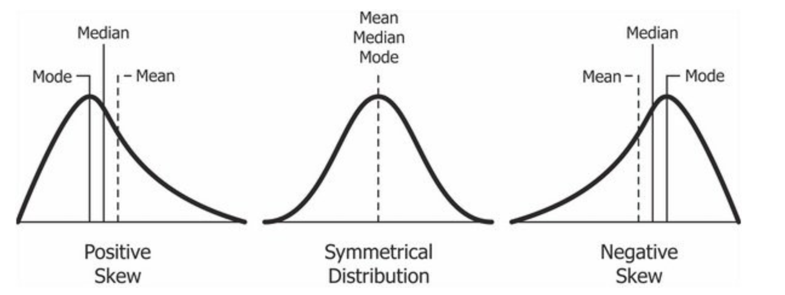
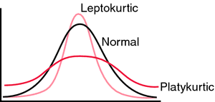
Non-normal distributions
Skewness
Kurtosis
https://commons.wikimedia.org/wiki/File:Relationship_between_mean_and_median_under_different_skewness.png
https://medical-dictionary.thefreedictionary.com/kurtosis

Slide 14
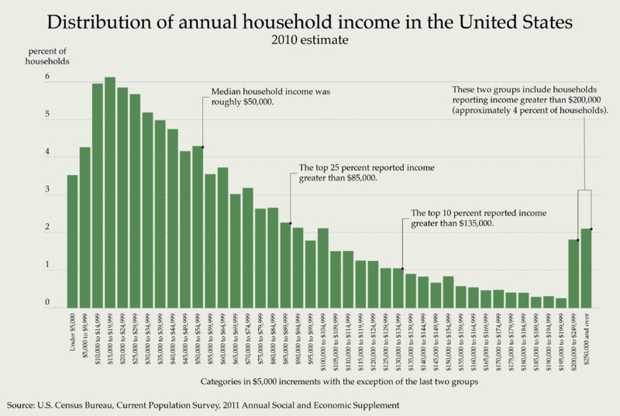
https://commons.wikimedia.org/wiki/File:Distribution_of_Annual_Household_Income_in_the_United_States_2010.png

Slide 15
Outliers
Atypical data points (with regards to the sample values)
Could be due to:
Contamination (for bio samples)
Error in data entry
Just a really atypical case

Slide 16
Outliers – why do we care?
Outliers can have a huge impact on the characteristics of the sample
Example
Erasmus students in class – 10 students
With outlier:
M = 25.8
SD = 15.9
Median = 21
Without outlier:
M = 20.8
SD = 0.83
Median = 21
# | age
1 | 20
2 | 21
3 | 20
4 | 22
5 | 21
6 | 20
7 | 22
8 | 20
9 | 71
10 | 21

Slide 17
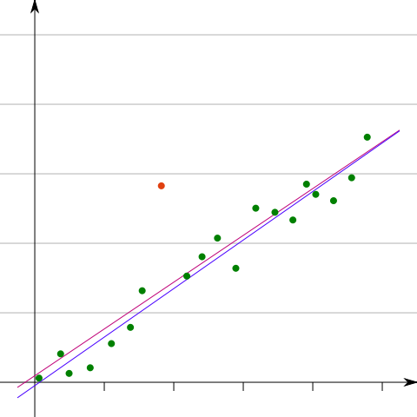
Identifying outliers
“Eyeballing it” - scatterplot
Using box plot or histogram
Using some cut-off
+- 2 SDs or 1.5*IQR -Q1
4. Using indices for multivariate outliers
https://commons.wikimedia.org/wiki/File:Outlier_statistics.svg

Slide 18
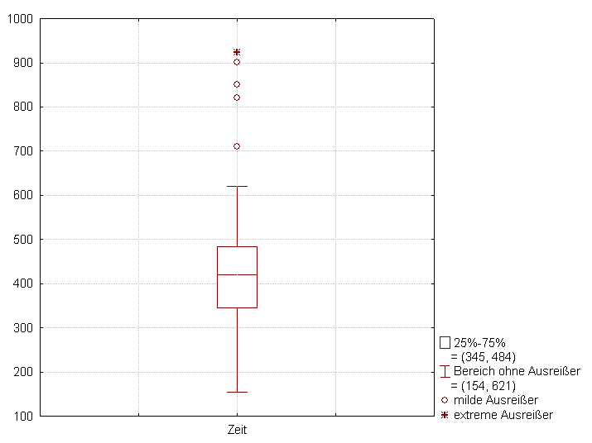
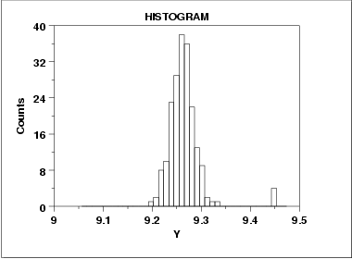
Identifying outliers – graphs
Box plot with 1.5 IQR = everything beyond that is outlier
https://en.wikipedia.org/wiki/Box_plot#/media/File:Box-Plot_mit_Interquartilsabstand.png
https://www.itl.nist.gov/div898/handbook/eda/section3/eda33e8.htm

Slide 19
Mahalanobis distance
Identifying multivariate outliers – outliers that are distant from a combination of scores
A point can be a multivariate outlier even if it is not a univariate outlier
https://commons.wikimedia.org/wiki/File:Outlier_statistics.svg

Slide 20
Outliers – what should we do?
Errors in data entry – need to fix
Extreme values
Remove?
Keep in?
Substitute?
Depends on the type of data

Slide 21
Outliers?
Remove only unlikely values
Variables can be transformed
Other analytic techniques can be used (Poisson regression)
Yang, S., Puggioni, G., Harlow, L. L., & Redding, C. A. (2017). A Comparison of Different Methods of Zero-Inflated Data Analysis and an Application in Health Surveys. JMASM Editors, 16(1), 518-543.

