Slide 1
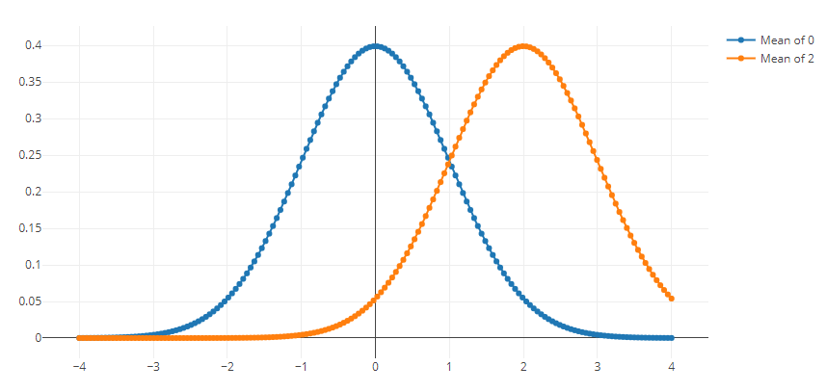
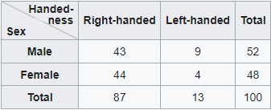
Comparing groups
Chi-square test
T-test
E0420
Week 3

Slide 2
Let's analyze!
https://stats.idre.ucla.edu/other/mult-pkg/whatstat/
Testing associations between:
1 categorical independent variable (IV, predictor, exposure variable)
  T-test can handle only 2 categories (if more, use ANOVA)
  Chi-square is not limited by the number of categories
1 dependent variable (DV, outcome)
  Categorical – Chi-square test
  Continuous – T-test
Notes:
Association
Value of one variable tells us something about the value of the other variable
Distribution of one variable vary according to the other variable

Slide 3
Let's analyze!
Categorical IV:
  Gender (males vs females), type of exposure (eating fish vs not eating fish), work or school group/class (scientists vs administrators), or experimental/treatment group
DV
  Continuous – BMI, depression score, hrs slept per night
  Categorical – presence of a diagnosis (diabetes, pregnancy, depression), success or failiure
Comparing means (T-test) or proportions (Chi-square) of a DV across 2 groups/levels of an IV
A word about categorization of continuous IVs
  Mean/median/tercile split
  Change in the original information, smaller effect size, potentially spurious effects

Slide 4
How does Chi-square work?
1. Constructing contingency table (2x2 table, cross tabulation)
= number of cases in each category
2. Comparing observed numbers in each category to expected numbers in each category if there is no association (= null hypothesis)
= obtaining the χ2 statistic
3. Using χ2 distribution for specific degrees of freedom to determine how likely is the obtained χ2 if null hypothesis is true
= determining statistical significance (p-value)
If the probability is 5% (α = .05) or less, the χ2 is stat. sig.
In general, large χ2 suggests rejection of null hypothesis
Notes:
Comparing association between 2 categorical variables
The Chi-Square Test in Structural Equation Modeling: This tests the null hypothesis that the predicted model and observed data are equal. Because you want your predictions to match the actual data as closely as possible, you do not want to reject this null hypothesis. In other words, a nonsignificant result for this test indicates good model fit.

Slide 5
1. Contingency table
 | Feeling depressed
 | Yes | No | Total
Male | 96 (40%) | 144 (60%) | 240
Female | 72 (24%) | 228 (76%) | 300
Total | 168 (31%) | 372 (69%) | 540
Observed numbers
Notes:
Large contingency tables valid if less than 20% of expected numbers are under 5 and none is less than 1

Slide 6
2. Obtaining the χ2 statistic
Observed numbers
 | Feeling depressed
 | Yes | No | Total
Male | 96 (40%) | 144 (60%) | 240
Female | 72 (24%) | 228 (76%) | 300
Total | 168 (31%) | 372 (69%) | 540
Expected numbers
 | Feeling depressed
 | Yes | No | Total
Male | 75 | 165 | 240
Female | 93 | 207 | 300
Total | 168 (31%) | 372 (69%) | 540
Notes:
Assumptions:
The levels (or categories) of the variables are mutually exclusive
Independence of the groups

Slide 7
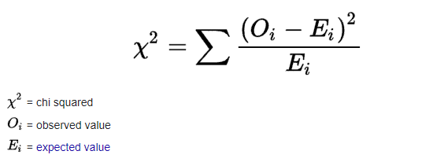
2. Obtaining the χ2 statistic
In our case, χ2 = 15.97

Slide 8
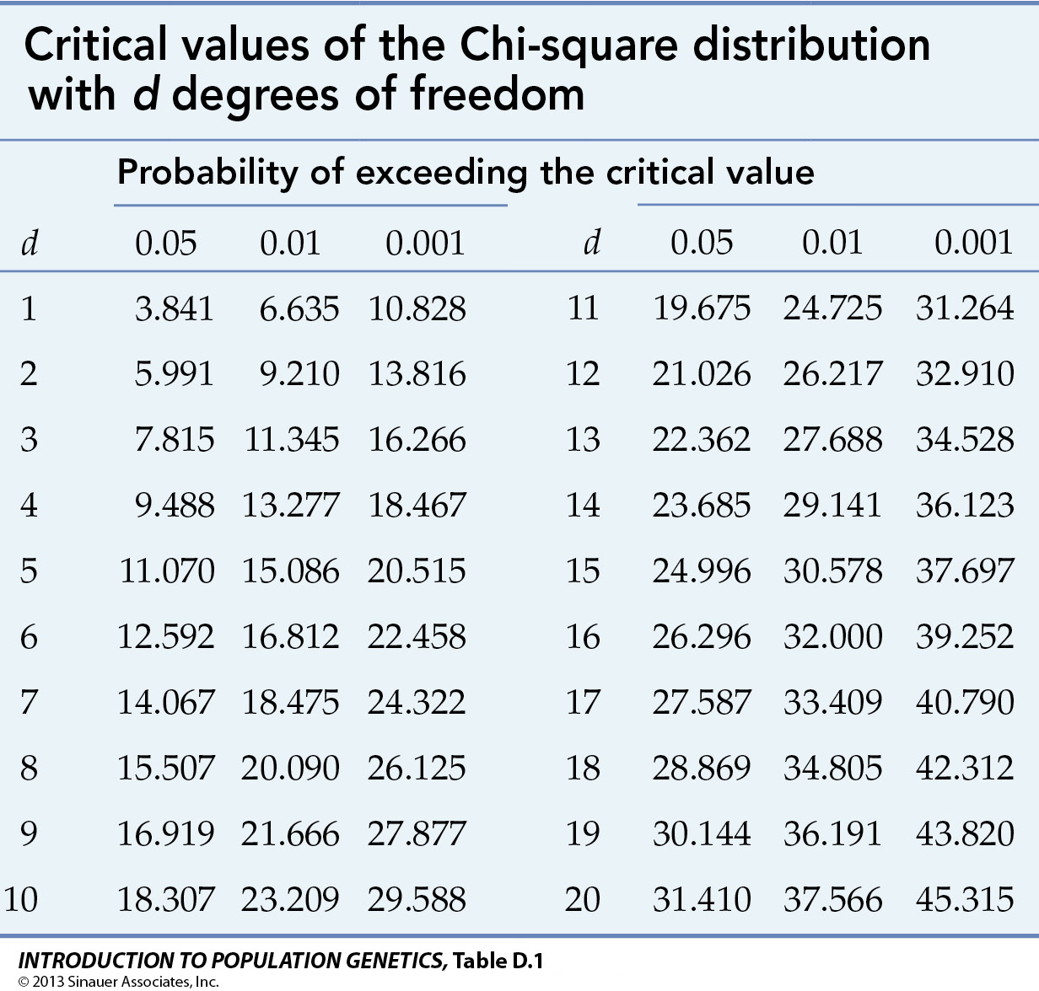
3. Determining statistical significance
degrees of freedom (df) = (r-1)(c-1) where r is the number of rows and c is the number of columns
Critical value is based on the selected alpha level and df
In our case, χ2 = 15.97
https://www.mun.ca/biology/scarr/4250_Chi-square_critical_values.html
Notes:
The number of degrees of freedom is the number of values in the final calculation of a statistic that are free to vary = the number of independent pieces of information that go into the estimate of a parameter
In general, the degrees of freedom of an estimate of a parameter are equal to the number of independent scores that go into the estimate minus the number of parameters used as intermediate steps in the estimation of the parameter itself (most of the time the sample variance has N − 1 degrees of freedom, since it is computed from N random scores minus the only 1 parameter estimated as intermediate step, which is the sample mean)

Slide 9
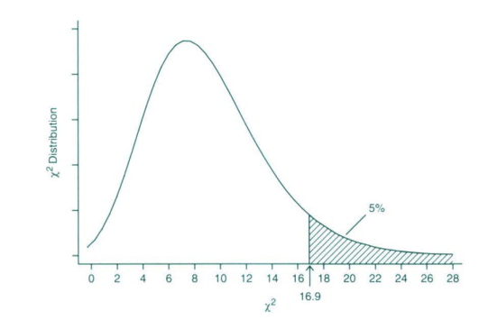
Chi-square distribution

Slide 10
Chi-square write-up
A chi-square test was performed to examine the association between gender and feeling depressed. The association between these variables was significant, χ2 (1, N = 540) = 15.97, p < .001. Women were more likely than men to feel depressed.

Slide 11
T-test use
Purpose:
  Comparing means of a continuous DV across 2 groups (binary IV)
  Useful when we have „natural“ IV groups (e.g., experimental condition)
Types:
  Independent T-test
  Paired-samples T-test

Slide 12
T-test assumptions
Assumption of independence
  Applies for independent t-test
Assumption of normality
  DV should be approximately normally distributed
Assumption of homogeneity of variance
  The two independent samples are assumed to be drawn from populations with identical population variances
  The variances of DV should be equal in both IV groups

Slide 13
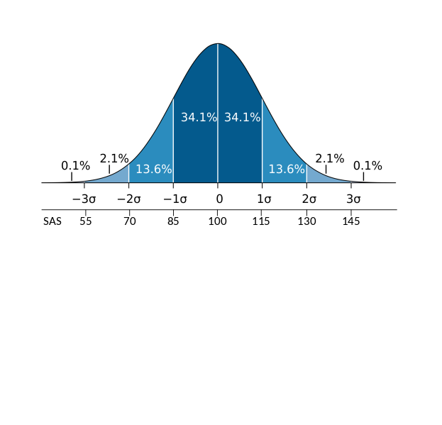
Normal/Gaussian distribution
Also called bell curve
https://commons.wikimedia.org/wiki/File:Wechsler.svg

Slide 14
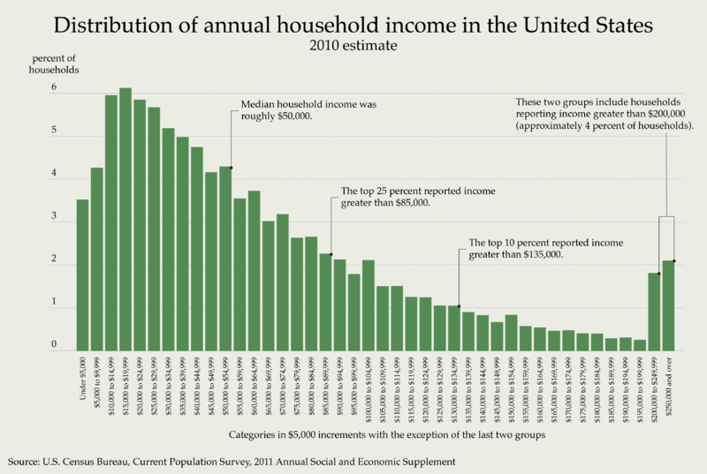
https://commons.wikimedia.org/wiki/File:Distribution_of_Annual_Household_Income_in_the_United_States_2010.png

Slide 15
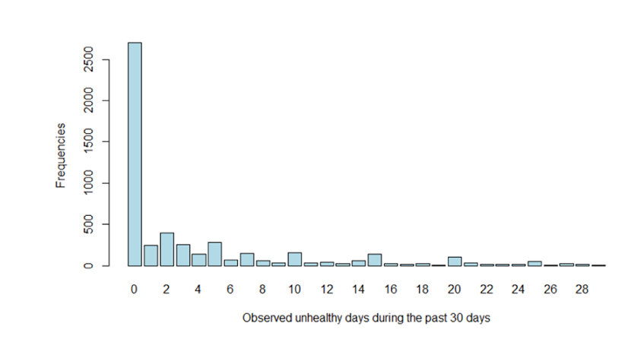

Slide 16
How does T-test work?
1. Obtaining mean and SD of the DV in each IV group
2. Comparing the observed differences in the group means to expected differences (= null hypothesis)
= obtaining the t statistic
3. Using t distribution for specific degrees of freedom to determine how likely is the obtained t if null hypothesis is true
= determining statistical significance (p-value)
If the probability is 5% (α = .05) or less, the t is stat. sig.
In general, large t suggests rejection of null hypothesis
Notes:
- In t-test, expected differences are usually 0

Slide 17
1. Obtaining means and SDs
Testing differences in depression scores on Beck Depression Inventory (BDI) between males and females
Females
  Mean = 9
  SD = 2
  N = 50
Males
  Mean = 6
  SD = 3
  N = 40

Slide 18
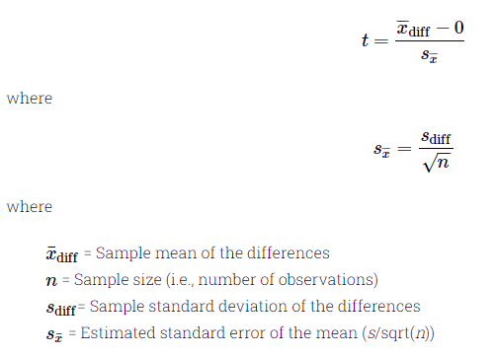
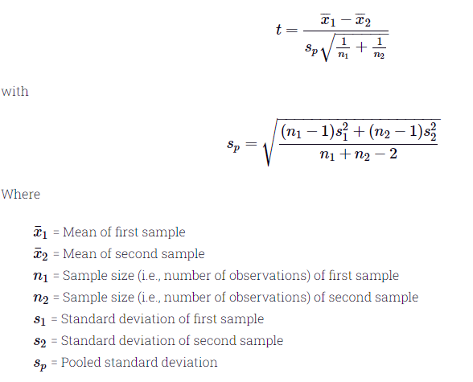
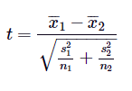
2. Obtaining the t statistic
  Paired-samples T-test
  Independent T-test
  Equal variance assumed
  Equal variance not assumed
Notes:
When calculating the magnitude of the effect (i.e., the difference between the samples), we need to take into account the measurement error in the samples
If the observations in our sample fluctuate a lot around the mean, the differences might be due to this fluctuation (measurement error) rather than due to genuine effect

Slide 19
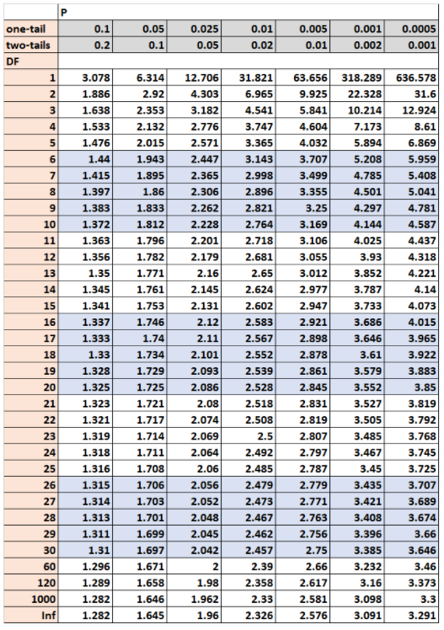
3. Determining statistical significance
df = n - 1 for paired-samples
df = (n₁ - 1) + (n₂ - 1) for independent samples
Critical value is based on the selected alpha level, df, and whether we are testing one-tailed or two-tailed hypothesis
In our case, t = 5.67

Slide 20
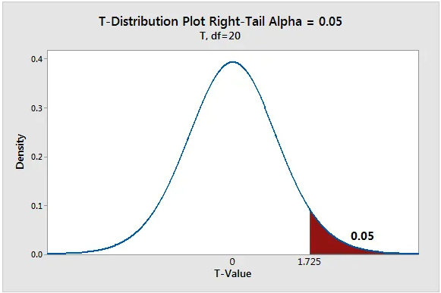
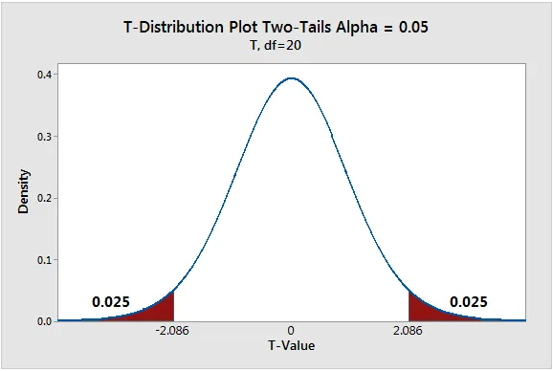
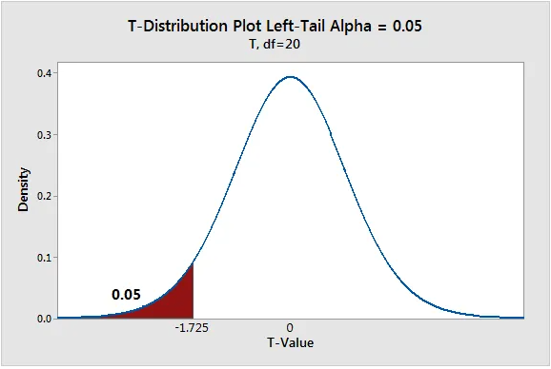
One-tailed or two-tailed hypothesis

Slide 21
T-test write-up
The 25 participants who received the drug intervention (M = 480, SD = 34.5) compared to the 28 participants in the control group (M = 425, SD = 31) demonstrated significantly better peak flow scores, t(51) = 2.1, p = .04.
There was a significant increase in the volume of alcohol consumed in the week after the end of semester (M = 8.7, SD = 3.1) compared to the week before the end of semester (M = 3.2, SD = 1.5), t(52) = 4.8, p < .001.

