Slide 1
Analysis of variance
ANOVA
E0420
Week 5

Slide 2
What for?
To compare more than two independent means = more than two groups
ANOVA = regression
More precisely, both are linear models
  More about that later on in the course

Slide 3
Logic
To see whether there is a “signal” in the noise
To see whether the variance due to group membership is systematic
To compare whether group means differ from grand mean
Notes:
Group means

Slide 4
ANOVA model
Categorical independent variable
Continuous dependent variable
All of the assumptions we know from t tests apply here
  Normality of distribution of DV within each group
  Homogeneity of variance
  Independence of observations

Slide 5
ANOVA types
One-way ANOVA
Two-way ANOVA
Repeated measures ANOVA
ANCOVA
MANOVA
MANCOVA

Slide 6
One-way ANOVA
Comparing whether means of groups differ from the baseline
H0: the group means are not significantly different from the grand mean (i.e. the sample average)
Terms:
  Sums of squares (SS)
  degrees of freedom (df)
  Mean square (MS)
  F-test

Slide 7

Sums of squares (SS)
SS/(n-1) = variance
SS between = variance between groups = IV
SS within = variance within groups = error
SS Total = SS between + SS within
Mean square: SS/df

Slide 8
Degrees of freedom
  The number of independent values that can vary in an analysis
  df = n – # parameters
  for 2 groups = 1df, for 3 groups = 2df…
  Ex: average is 10 out of 3 numbers. What are the 3 numbers?
    X1, X2, X3
    Once we know X1 and X2, X3 has only one solution = 2 degrees of freedom

Slide 9
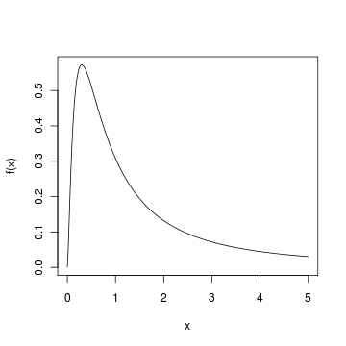
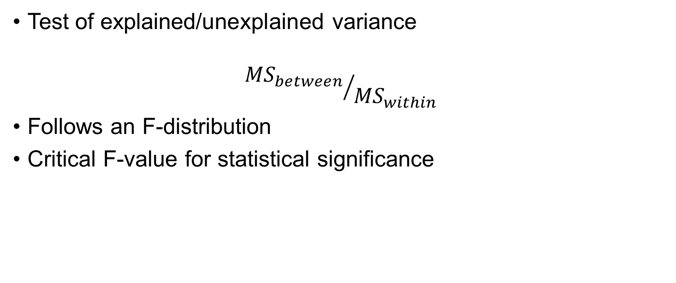
F-test
Test of explained/unexplained variance
$${{MS}_{between}}/{{MS}_{within}}$$
Follows an F-distribution
Critical F-value for statistical significance
http://www.r-tutor.com/elementary-statistics/probability-distributions/f-distribution

Slide 10
Post-hoc tests
F-test is an omnibus test
  Tells you whether the variance explained is significantly greater than random variance
  Does not tell you which group means are different from grand mean
Need to run post-hoc tests – pairwise comparisons
Running multiple t tests inflates Type I error rate
n of groups | comparisons | Type I error rate
2 | 1 | 5%
3 | 3 | 14%
4 | 6 | 26%
5 | 10 | 40%
6 | 15 | 54%
7 | 21 | 66%
8 | 28 | 76%
9 | 36 | 84%
10 | 45 | 90%

Slide 11
Different types
Bonferroni
  Easy to compute
  Conservative – decreases statistical power
Tukey – for all pairwise comparisons
Dunnett – for comparing group means to control, not to each other
LSD
HSD
Scheffé

Slide 12
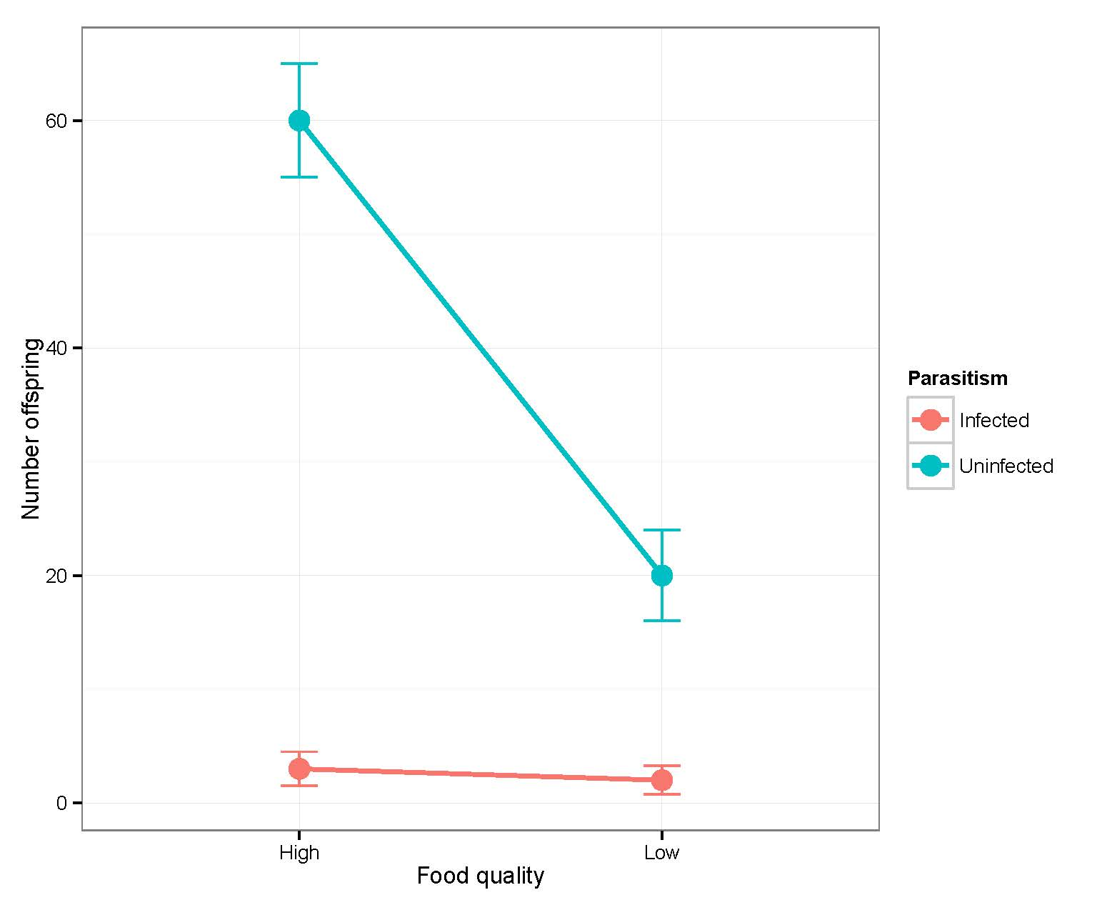
Two-way ANOVA
Two categorical variables
Can estimate interactions (IV1 conditional on levels of IV2 and vice versa)
https://dynamicecology.wordpress.com/2014/10/02/interpreting-anova-interactions-and-model-selection/

Slide 13
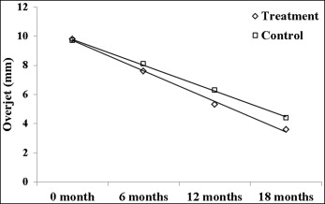
Repeated measures ANOVA
For asessing the effect of categorical IV with more timepoints of the DV
E.g., pretest-posttest

Slide 14
ANCOVA
ANalysis Of COVAriance
ANOVA + controlling for other variables

Slide 15
MANOVA
Multiple Analysis Of VAriance
Estimates effects on multiple DVs
  Using a combination of DVs
multivariate F value (Wilks‘ λ)

Slide 16
Statistical write-up
There was a statistically significant difference between groups as determined by one-way ANOVA, F(2,27) = 4.467, p = .021.
A post hoc Tukey test showed that the Group A and Group B differed significantly at p < .05; the Group C was not significantly different from the other two groups.

