Slide 1
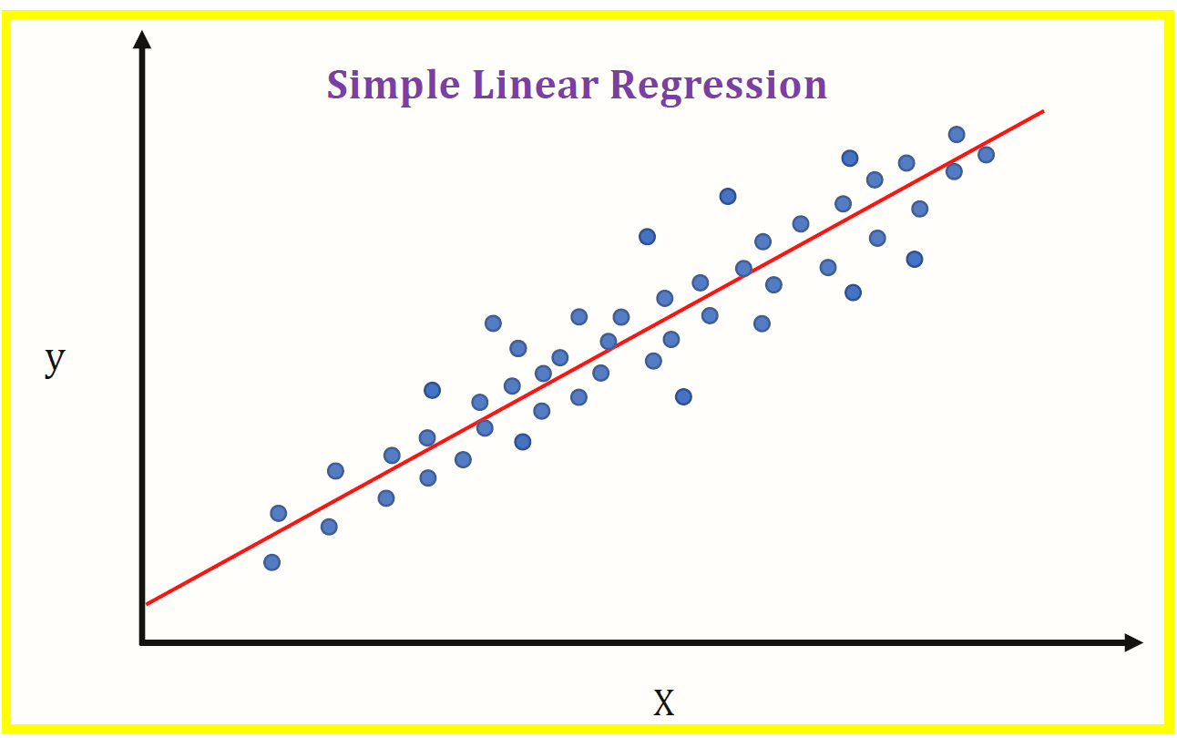
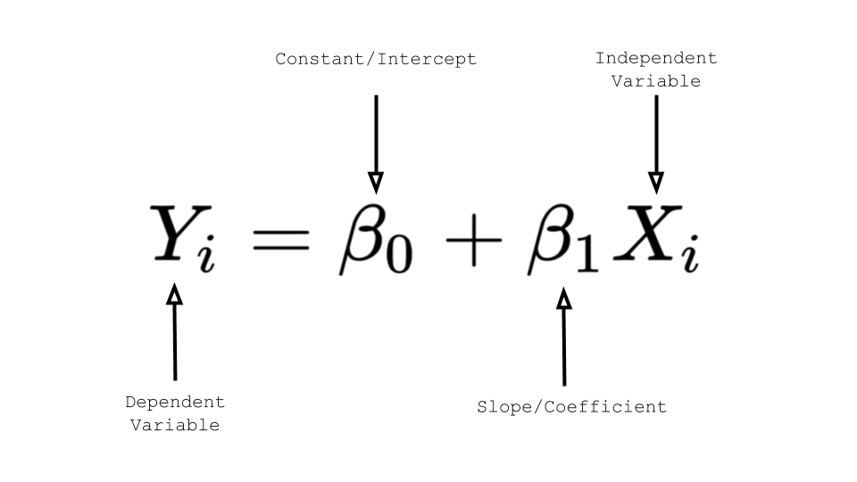
Simple linear regression
E0420
Week 6

Slide 2
What is it good for?
Testing associations between:
1 or more independent variables (IVs)
  Categorical/binary
  Ordinal
  Continuous
1 dependent variable (DV, outcome)
Possibility to add covariates

Slide 3
Goal of regression
Prediction
  Use known IV(s) to predict DV
  Correlation ≠ causation still applies!
Explanation
  Explain the DV’s variability by partitioning a “chunk” that is explained by the IV, and a “chunk” that is left unexplained

Slide 4
How regression works
Finding a matematical function, or model that best describes the association between the variables
Simple linear regression - a straight line, or linear equation
The regression line is obtained that provides the best possible description of the relationship between X (IV) and Y (DV)
If the association is not linear, we can model also quadratic function

Slide 5
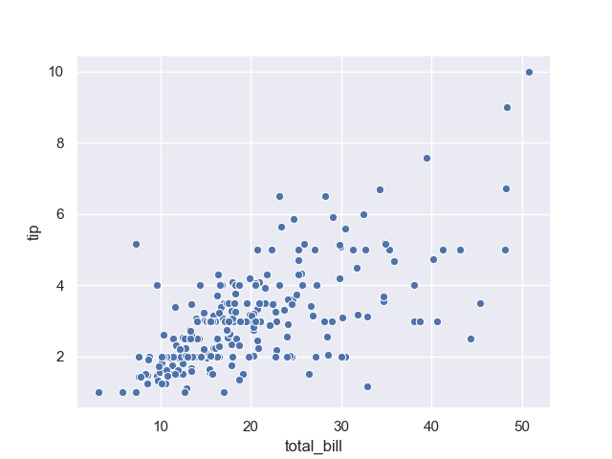
Which line is the best fitting?
Notes:
https://pythonbasics.org/seaborn-scatterplot/

Slide 6
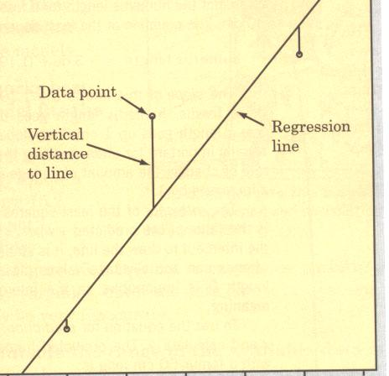
Which line?
The regression line selected is the one that minimizes the sum of the squared vertical distances to the data points

Slide 7
The regression line
The slope of the line is given by a constant value used for everyone in the sample, β₁
  How much of a change in Y (DV) is expected for every one-unit increase in X (IV)
  Unstandardized (B) or standardized (β)
The point at which the line crosses the Y axis is also a constant, β₀
  Intercept
  This is also the value of Y (DV) when X equals zero (IV)
X_{i} and Y_{i} are variable scores for each observation

Slide 8
FCAT example
The following data show 2001 FCAT math scores and the percentage of free/reduced lunch students for 10 elementary schools
What is the IV? And DV?
% Free Lunch | 2001 FCAT Math
9.4 | 366
57.2 | 302
54.6 | 327
15.7 | 330
19.5 | 330
38.5 | 335
61.3 | 308
66.3 | 318
16.4 | 335
14.9 | 340

Slide 9
FCAT example
The values of B₁ and B₀ are:
  B₁ = -.618
  B₀ = 350.969
The regression equation is
  Y_{i} = 350.969 -.618(X_{i})
Interpreting the unstandardized regression coefficient:
  For every 1% increase in the free/reduced lunch rate, a .618 decrease is predicted in FCAT scores

Slide 10
Predicting scores (DV from IV)
  Consider the school with a F/R lunch rate of 38.5
  Y’_{i} = 350.969 -.618(38.5) = 327.176
In regression terms, Y’ is the predicted score, or predicted value of Y
Y’ would be the same for every school with F/R % (i.e, X) = 38.5
However, the predictions come with an error!

Slide 11
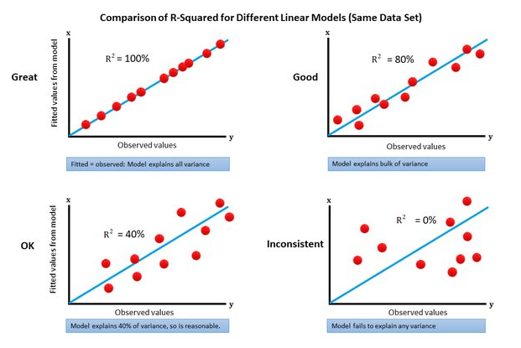
How much of an error?
How well does our line fit the data?
How much variability in DV is explained by IV?
Notes:
https://www.datasciencecentral.com/r-squared-in-one-picture/

Slide 12
Explaining variability
Consider the school with a free/reduced lunch rate (X₁) of 9.4 and an FCAT mean (Y₁) of 366
This school was 36.9 FCAT points above the grand mean of Y (329.10)
This distance of 36.9 points represents school 1’s contribution to the Y variability
It is the goal of the regression procedure to explain this total variation (SS_{TOTAL})

Slide 13
Graphic of SS_{TOTAL}
This model does not include the IV = each school’s mean is a function of the grand mean and a unique error
(Y_{i} – Ybar)²
Mean of Y

Slide 14
The effect of IV
Quantification of the shift in scores from the overall mean that can be attributed to the IV
This shift can be computed for each value of X (the IV)
This is found using the predicted Y scores from the regression equation (line)
The variability attributed to the IV for the entire sample is computed by
  Squaring each expected distance from the mean (the positive and negative distances would cancel out otherwise)
  Summing these values across the entire sample (SS_{REG})

Slide 15
Graphic of SS_{REG}
(Y_{i}’ – Ybar)²
Mean of Y

Slide 16
Residual (error) variability
The IV does not completely explain the variation in Y scores
The portion of the variation around the mean that is not captured by the IV is called residual variability
This is defined as the difference between the observed Y values and those predicted by the regression line
e_{i} = Y_{i} – Y’_{I}
The residual variability for the entire sample is computed by
  Squaring each person’s residual (the positive and negative errors would cancel out otherwise)
  Summing these values across the entire sample (SS_{RES})

Slide 17
Graphic of SS_{RES}
(Y_{i} – Y_{i}’)²
Mean of Y
Residual

Slide 18
FCAT example
The residual for the school with a 9.4% F/R lunch rate would be:
  e₁ = Y₁ – Y’₁ = 366 – 345.16 = 20.84
Thus, the school's actual performance was 20.84 FCAT points higher than what would be predicted using %F/R
20.84 is the portion of that school’s FCAT variation that is not explained by the IV

Slide 19
Summary of FCAT example
The 1st school’s total distance, or variation from the mean of Y was 36.9
Of this variation, 16.06 can be attributed to the IV, while 20.84 is unexplained
Thus, the total variation for this school has been partitioned into two components that sum to the total variation for that school
36.9 = 16.06 + 20.84

Slide 20
Partitioning total variability
For the entire sample, the total variation in Y can be partitioned into two components:
  Variability attributed to the IV (SS_{REG})
  Variability not accounted for by the IV (SS_{RES})

Slide 21
Graphic of variance partitioning
Residual = (Y_{i} – Y_{i}’)²
IV Effect = (Y_{i}’ – Ybar)²
Mean of Y

Slide 22
FCAT example
The following quantities are obtained from the ANOVA summary table
  SS_{TOT} = 2858.9
  SS_{REG} = 1748.826
  SS_{RES} = 1110.074

Slide 23
Coefficient of determination (R²)
The total proportion (or %) of the DV variability that is explained by knowing X is called the coefficient of determination
FCAT example:
Squaring Pearson’s r yields .782² = .612

Slide 24
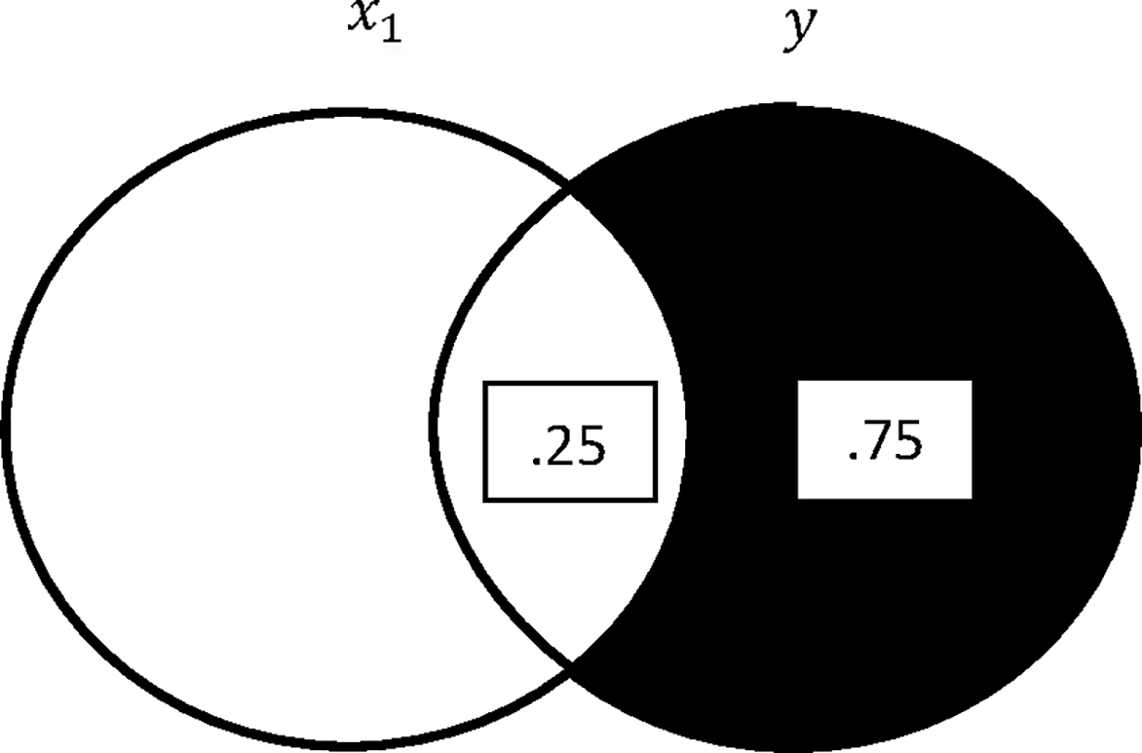
R²
Notes:
https://www.datasciencecentral.com/r-squared-in-one-picture/
O’Brien, R. M. (2018). A consistent and general modified Venn diagram approach that provides insights into regression analysis. Plos one, 13(5), e0196740.

Slide 25
Significance testing of R²
RQ: Does the IV (IVs) account for variability in DV?
H₀: R² is no larger than 0
Test this assumption via F statistic, reject H0 if F statistic is ≥ critical F (p ≤ .05)
F represents a comparison of the variance explained by the IV and the residual variance
F test tells you if a group of variables are jointly significant
df_{REG} = k
df_{RES} = N - k - 1

Slide 26
Significance testing of regression (b) coefficients
Upon finding a significant R² value, determine which IV is contributing most to the significant R²
Unstandardized regression coefficients are tested using a t statistic
  T-test tells you if a single variable is statistically significant
This tests whether or not the slope is different from 0
  H₀: β = 0, H₁: β ≠ 0

Slide 27
Simple linear regression assumptions
Linearity: The relationship between X and the mean of Y is linear
Independent errors: Residuals of observations should be uncorrelated
Homoscedasticity: The variance of residual is the same for any value of X
Normally distributed errors: Residuals in the model should be random, normaly distributed values with a mean of 0

Slide 28
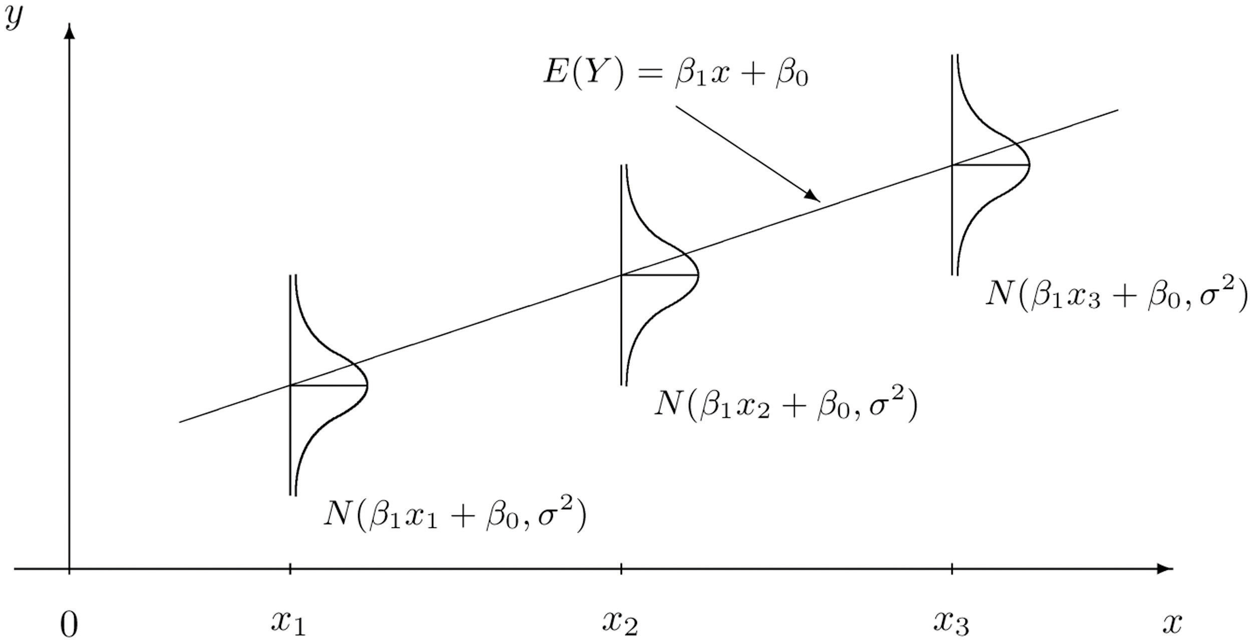
Normality of residuals

Slide 29
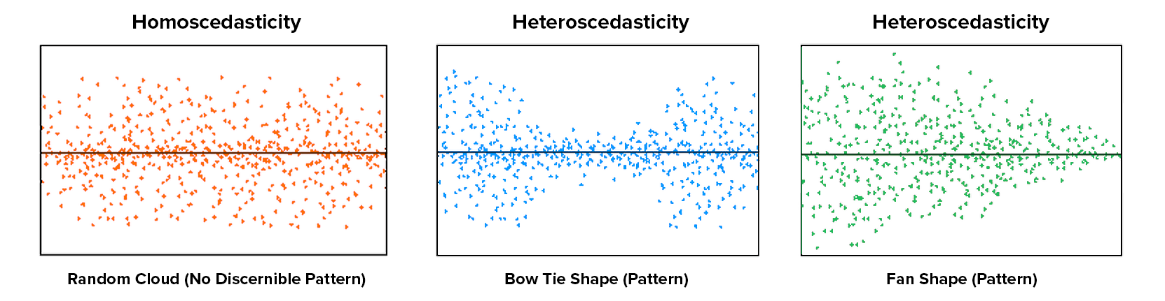
Homoscedascity

Slide 30
Regression write-up
The results of regression analysis showed that extraversion explained 35.8% of the variance (R² =.38, F(2,55)=5.56, p<.01) in aggressive tendencies (β = .56, p<.001).

Slide 31
Regression analysis steps
Run the analysis in SPSS
Check the assumptions
Determine the magnitude and significance of R²
If R² significant, determine the magnitude and significance of regression coefficients (B, β)
Interpret R², B, β
Write-up the results

