Slide 1
Patofyziologie poruch endokrinního systému II

Slide 2
Mezibuněčná komunikace
Neurokrinní - neuroendokrinní
Endokrinní (hormony)
Parakrinní (cytokiny)
Autokrinní (různé)

Slide 3
Hormones
Proteins / peptides
  Preprohormone (ER, GA, secretion granules)
Steroids
  Cholesterol
Amines
  Tyrosine

Slide 4
Endocrine regulation
Negative feedback
Positive feedback
Production (endocrine gland)
Transport (binding proteins in plasma)
Target tissue (receptors on cells)

Slide 5
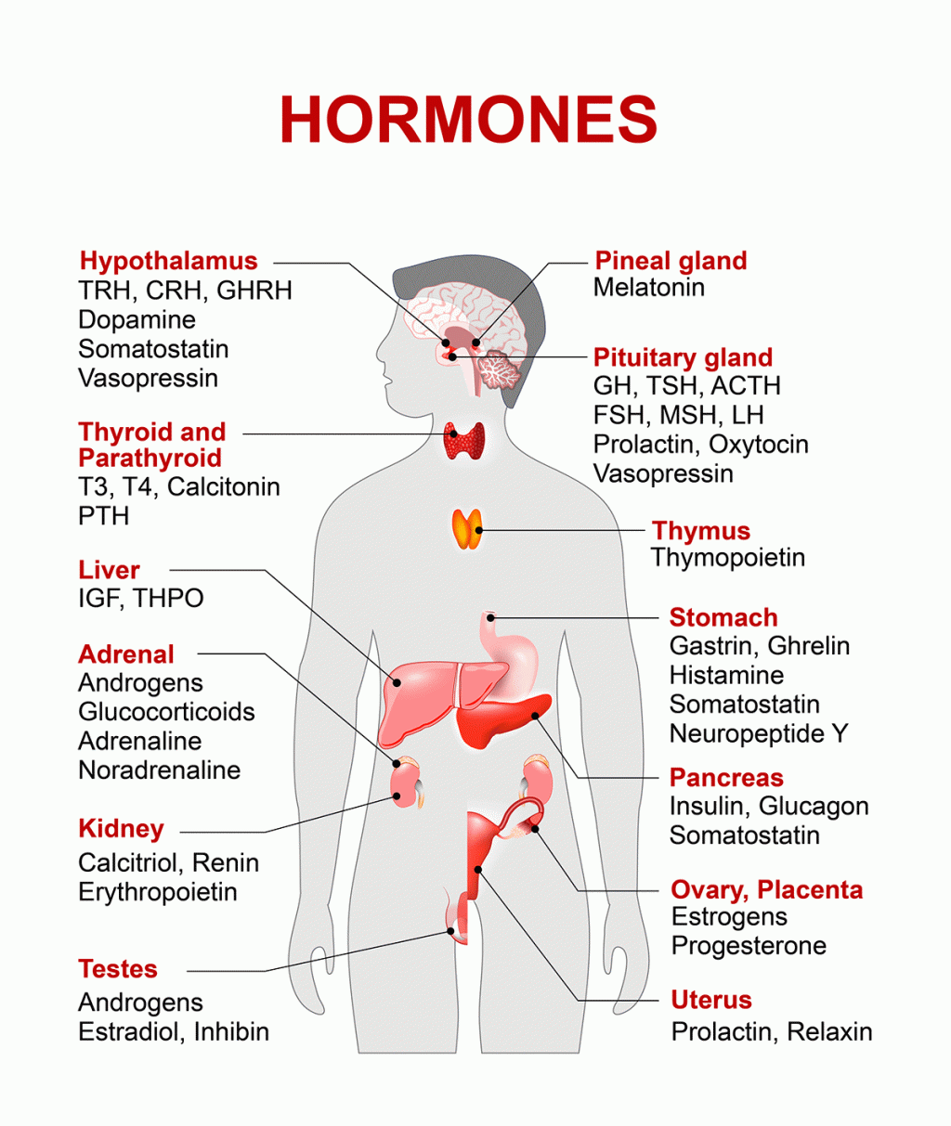
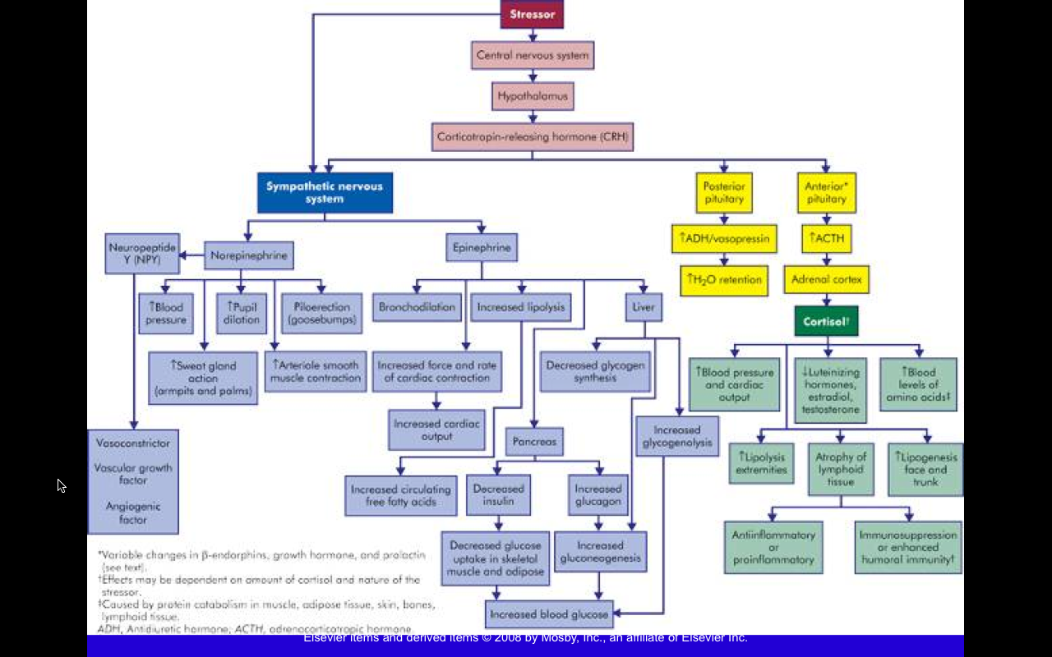
Endokrinní systém

Slide 6
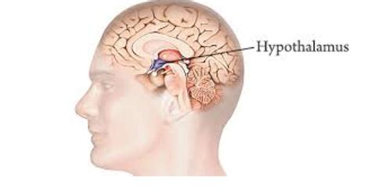
Hypothalamus
Neural regulation of the autonomic nervous system - adrenal medulla
Production of ADH and oxytocin
Regulation of the pituitary

Slide 7
Hypothalamus
Liberins
  CRH (ACTH), TRH (TSH), GHRH (GH), GnRH (LH, FSH), Salsolinol (PRL)
Statins
  Somatostatin (GH), Dopamine (PRL)

Slide 8
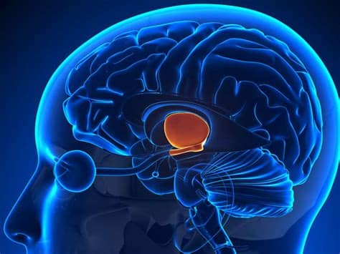
Endokrinní hypotalamus
Uvolňovací faktory pro
Hormony
Růstový hormon (GHRH)
Štítnou žlázu (TRH) Kortikotropin (CRH) Pohlavní hormony (FSH RH, LH RH)
Vasopresin (ADH) Oxytocin
Blokující faktory pro
Prolaktin (PIF)
Růstový hormon
Pro přední lalok hypofýzy
Pro zadní lalok hypofýzy
11

Slide 9
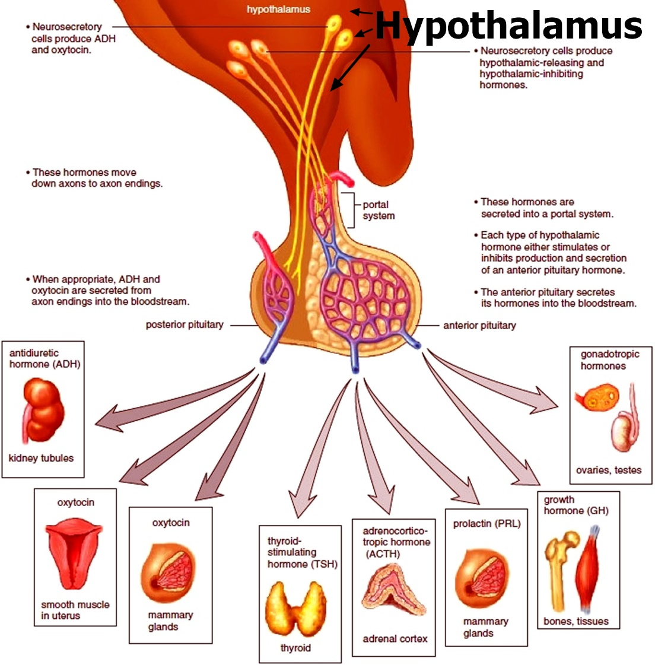
Hypothalamus - poruchy
Příčiny: ↑ tu, ↓ trauma, kongenitální změny, poruchy prokrvení, autoimunita
Hypersekrece: jednotlivé hormony – typické příznaky
Hyposekrece:
hypotalamický panhypopituitarismus = snížení sekrece všech hormonů hypofýzy kromě prolaktinu
porucha sexuálního vyzrávání, spermatogeneze a menstruačního cyklu (FSH, LH)
snížená odpověď na zátěž (stres) (CRH)
hypotyreóza (TRH)
poruchy růstu (GHRH)
12

Slide 10
Hypothalamus
Hypothalamic - pituitary axis
Control of the production and release of pituitary hormones
Pulsatile secretion
Specific membrane receptors
Second messenger
Autoregulation

Slide 11
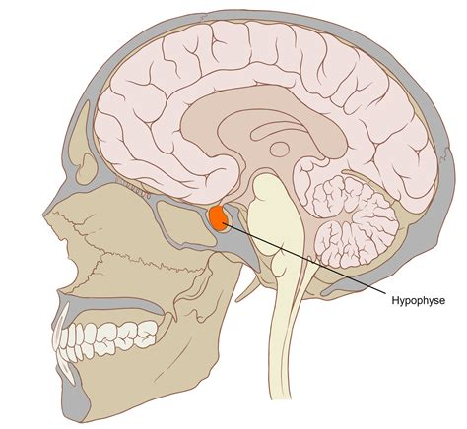
Pituitary
Anterior pituitary
  Adenohypophysis
  ACTH, TSH, FSH, LH, PRL, GH, MSH
  Endocrine regulation
Posterior pituitary
  Neurohypophysis
  ADH, Oxytocin
  Neural regulation of hormone release

Slide 12
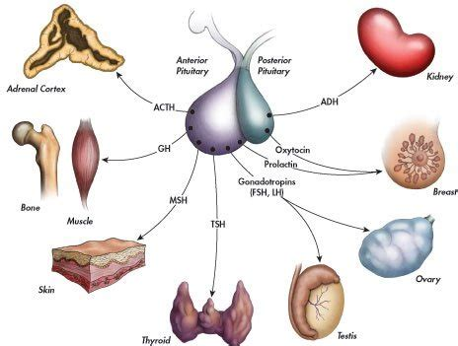
Hypofýza

Slide 13
Hypopituitarism
General
Selective
Infections, infarctions, cysts, tumors, injuries, iatrogenic, Sheehan syndrome
Fertility, Growth ...
Therapy - supplementation

Slide 14
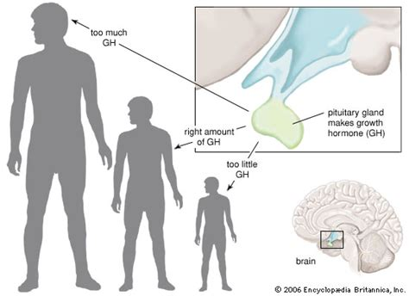
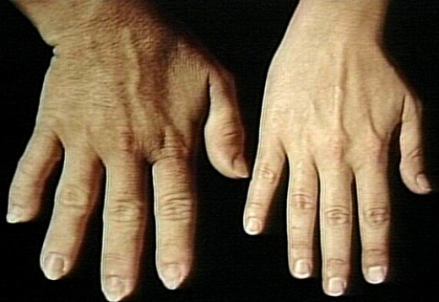
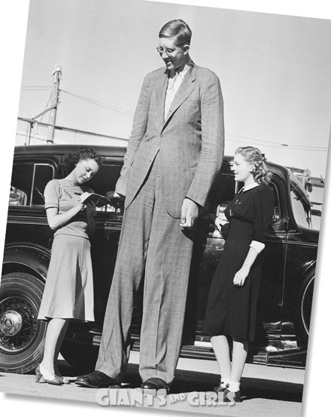
Poruchy růstového hormonu
GH overproduction
  Gigantism
    Before puberty
  Acromegaly
    After puberty

Slide 15
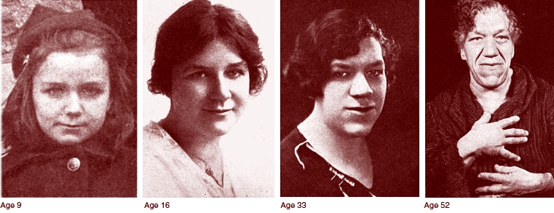
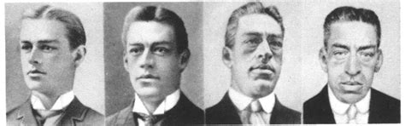
Poruchy růstového hormonu - akromegalie

Slide 16
Poruchy sekrece ADH
ADH insufficiency
  Diabetes insipidus
    Polydipsia, polyuria
Overproduction ADH
  Syndrome of IADH
    Hypoosmolarity of plasma, hyponatriemia, oliguria

Slide 17
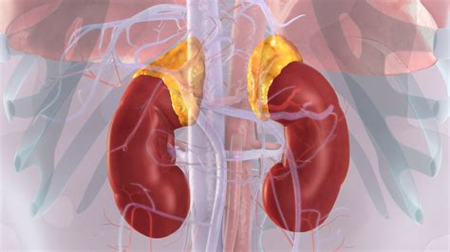
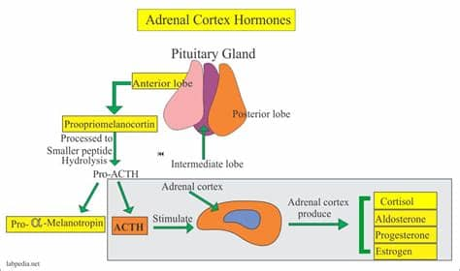
Adrenal glands
Cortex
  Zona glomerulosa (mineralocorticoids)
  Zona fasciculata (glucocorticoids)
  Zona reticularis (androgens)
Medulla
  catecholamines

Slide 18
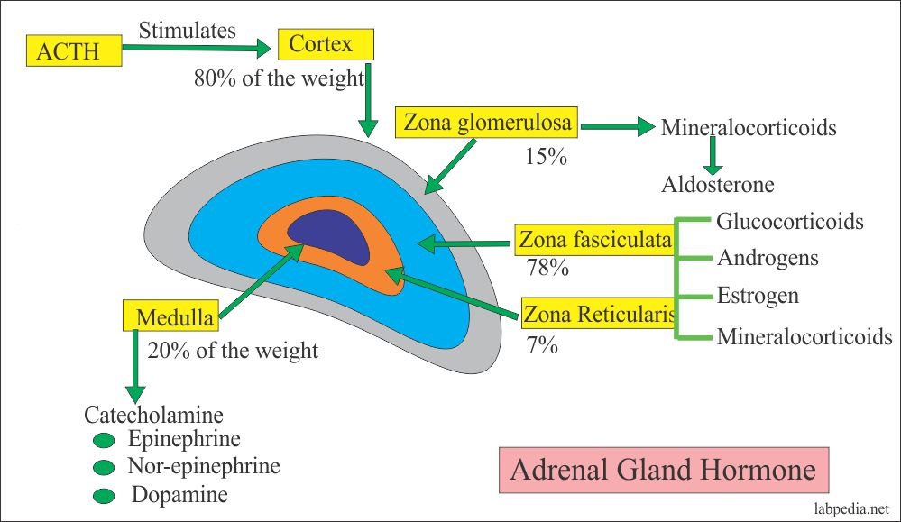

Slide 19
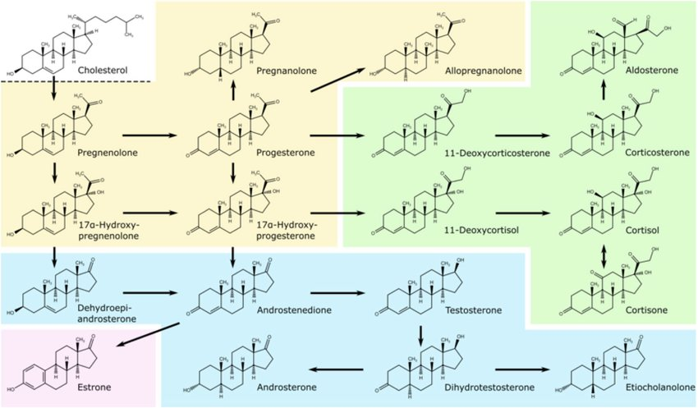

Slide 20
Disorders of the adrenal glands
Insufficiency
  Primary – Addison's disease
    Autoimmune, tuberculosis, hemorrhage (Waterhouse- Friderichsen syndrome in meningococcal infections)
  Secondary – pituitary disorders, discontinuation of glucocorticoid therapy

Slide 21
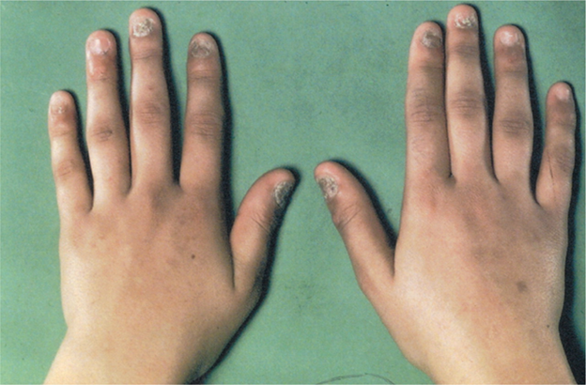
Addison's disease
Aldosterone insufficiency
  Hypotension, hyponatremia, hyperkalemia
Skin pigmentation
  Pro-Opio-Melanoma-Cortico-Tropin
ACTH increased (dif-dg secondary adrenal insufficiency)

Slide 22
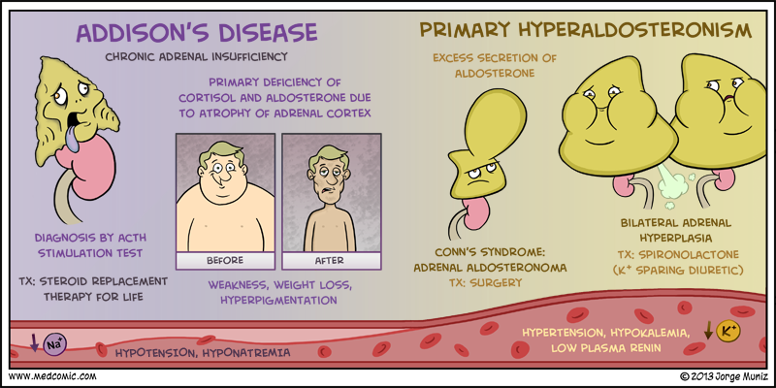
Conn's disease
Primary hyperaldosteronism
  Mostly unilateral endocrine active tumor
  Hypertension
  Hypernatremia
  Hypokalemia

Slide 23
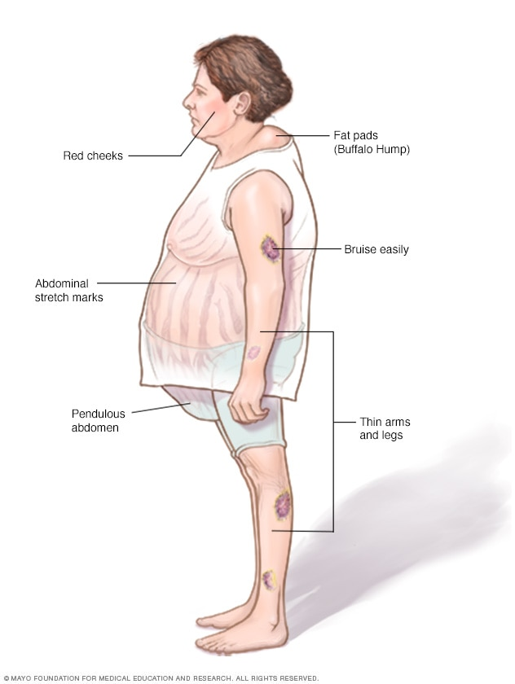
Cushing's syndrome
Hypercortisolism
  Primary
    Adrenal adenoma
  Secondary
    Cushing's disease - overproduction of ACTH
    Ectopic production - lung ca
    Iatrogenic

Slide 24
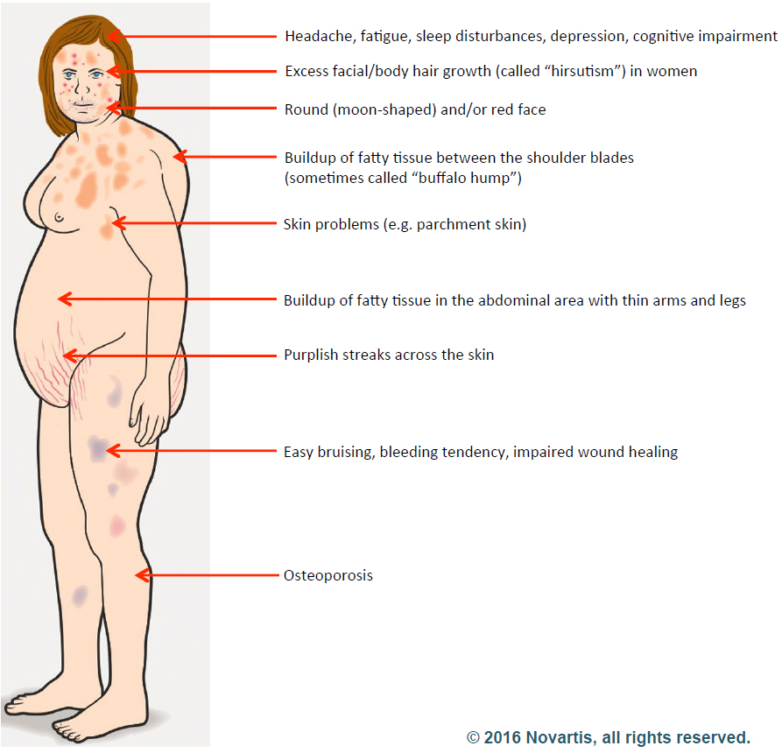
Cushing's syndrome
Central obesity
Hypertension
Osteoporosis
Reduced growth
Mental changes
Hirsutism, acne, oligomenorrhea

Slide 25
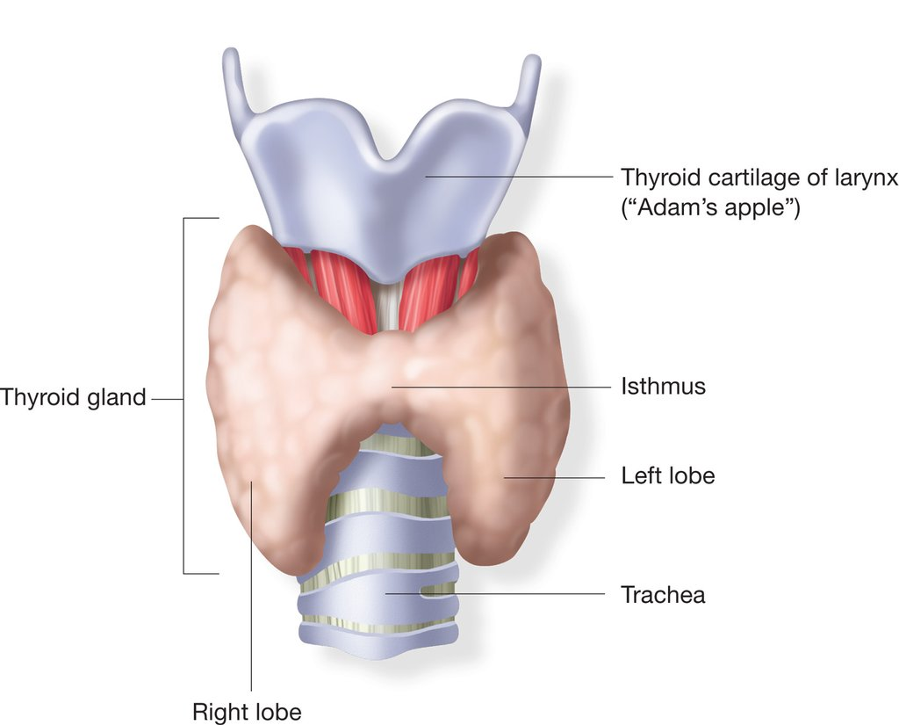
Thyroid gland – physiology
Actions of the thyroid
  Controls body temperature
  How body burns calories
  Controls how fast food moves through
  digestive tract
  Muscle strength
Thyroid hormones
  T4-thyroxine
  T3-triiodothyronine
  Calcitonin

Slide 26
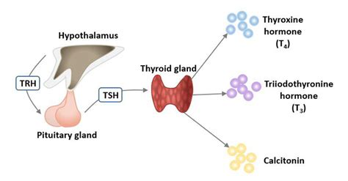
Thyroid
Iodine is rare
Ubiquitary receptors
Highly potent action
Very common disorders
– 5% women
– 0,5% men

Slide 27
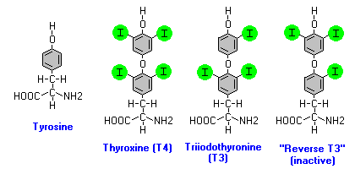
Thyroid hormones

Slide 28
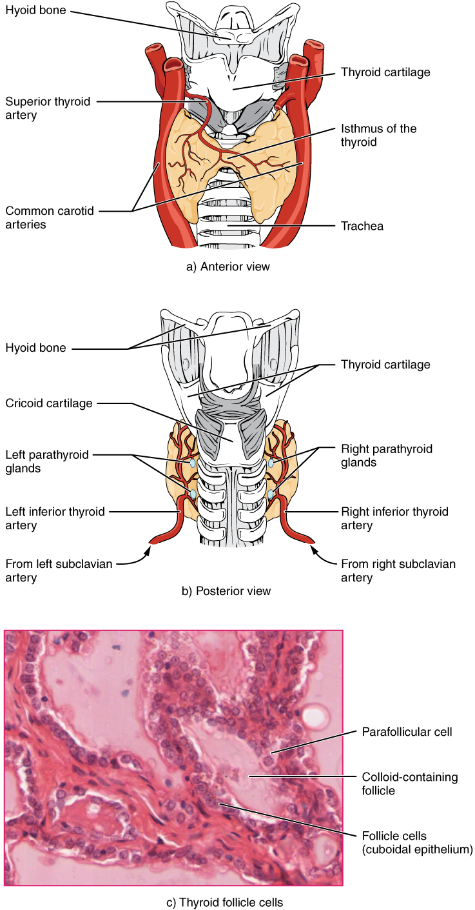
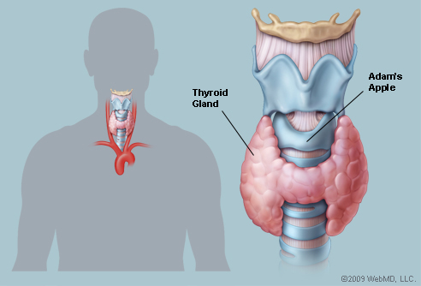
Thyroid gland

Slide 29
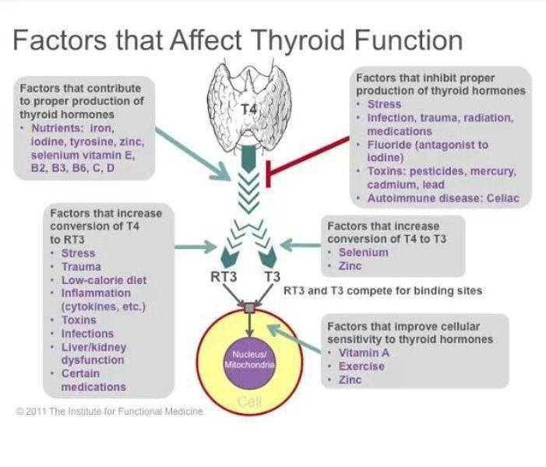

Slide 30
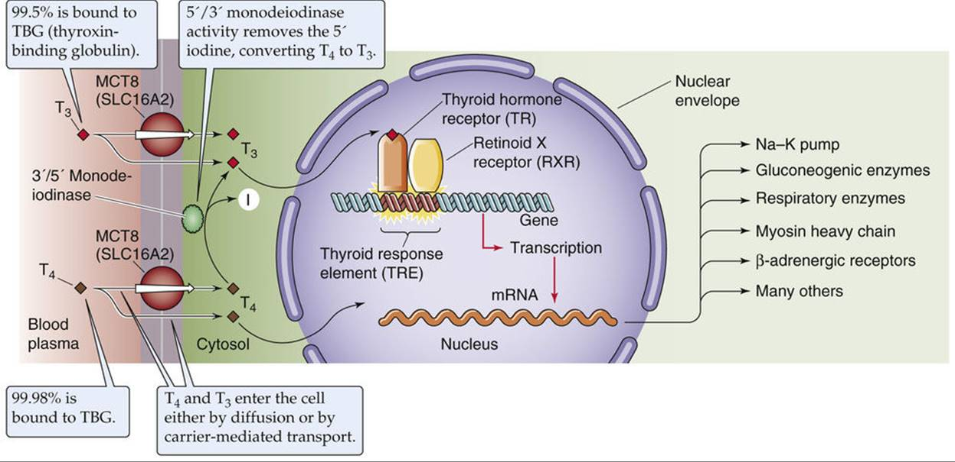

Slide 31
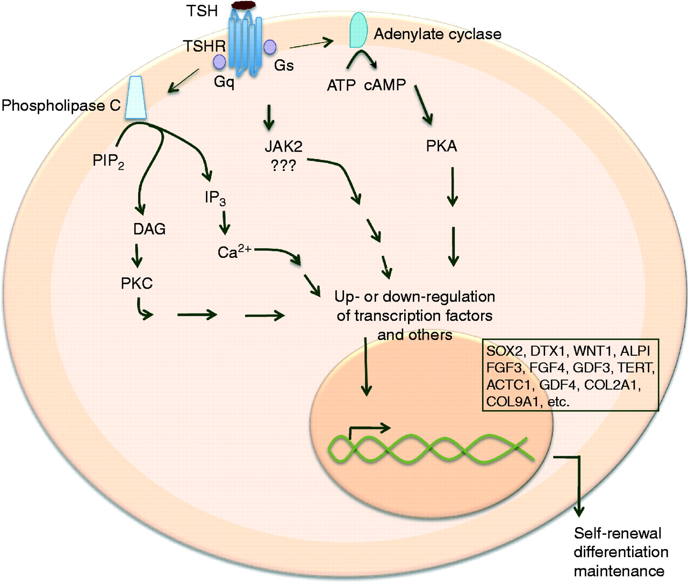

Slide 32
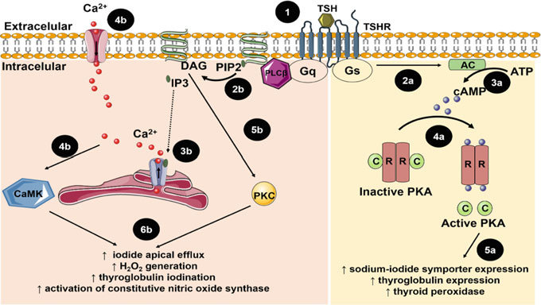

Slide 33
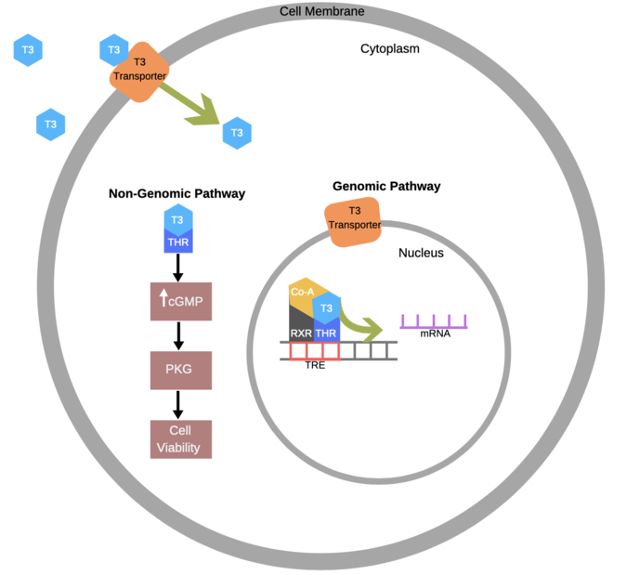
Repression of TR
Depression
Loss of vision
Heart problems
Weight gain
Fatigue
Hearing loss
Sensitivity to cold
Weakness
Issues with digestion
Cognitive impairment

Slide 34
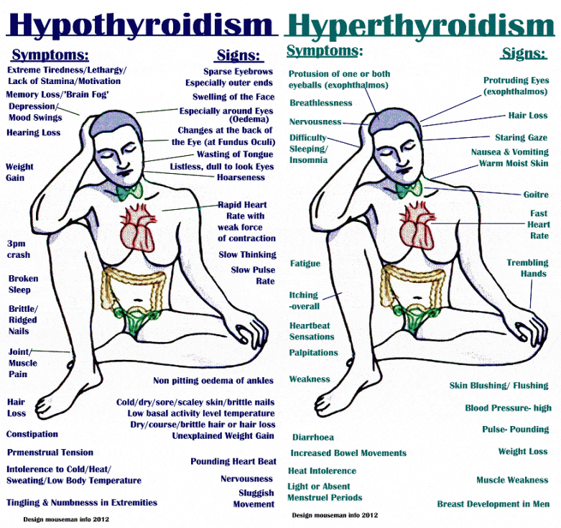
Hyperthyroidism vs hypothyroidism

Slide 35
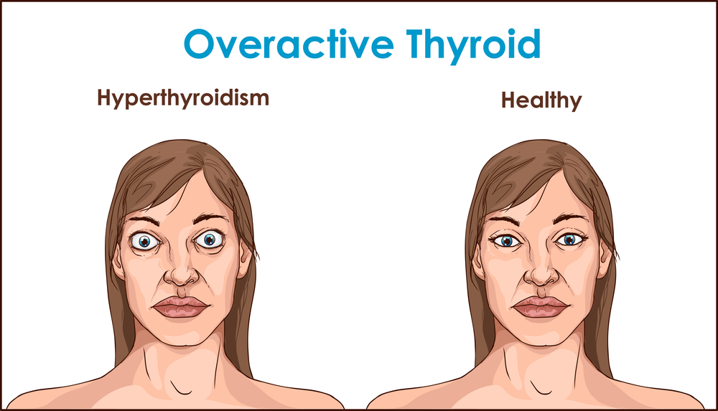
Hyperthyroidism
Emotional symptoms
  Nervousness
  Restlessness
  Anxiety
  Irritability
  Sleeplessness or insomnia
  Exhaustion

Slide 36
Causes of hyperthyroidism
Grave’s disease
A benign nodule on the thyroid
Thyroiditis
Taking too much of the synthetic thyroid hormone

Slide 37
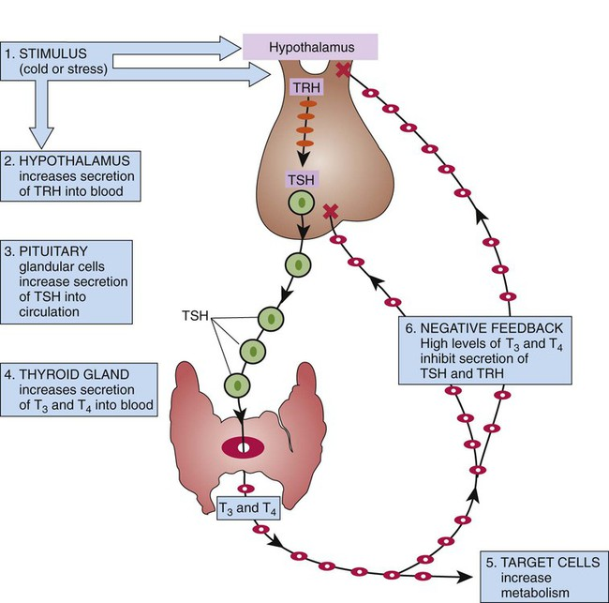

Slide 38
Hyperthyroidism DiffDg
Graves’ Disease
Toxic Multinodular Goiter
Toxic Adenoma
Thyroiditis
  silent (Hashimoto’s) – painless, often post partum
  subacute (de Quervain’s) – painful, post viral
  drug-induced – amiodarone, lithium, interferon
Thyrotoxicosis factitia
  ingestion

Slide 39
Thyroid storm (crisis)
Sudden onset
Fever
Profuse diaphoresis
Flushed warm skin
Tachycardia
Weakness, lethargy and confusion
Coma
Nausea, vomiting, diarrhea

Slide 40
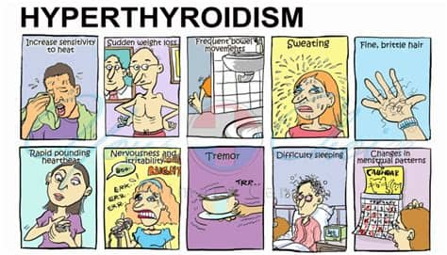
Treatment of hyperthyroidism
Causative
Radioactive iodine
  Supplementation
High-dose iodine – Wolff-Chaikoff effect
Beta-blockers
Antithyroid treatment
  Propylthiouracil (PTU)
Thyroidectomy

Slide 41
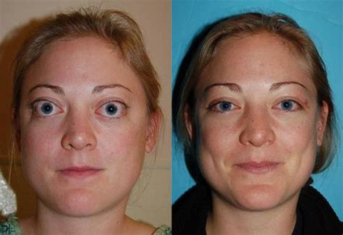
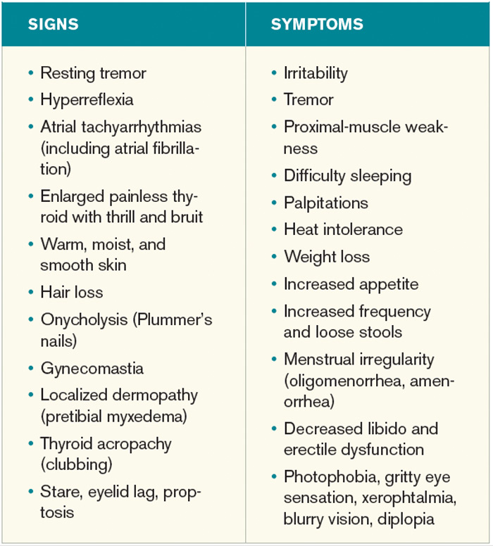
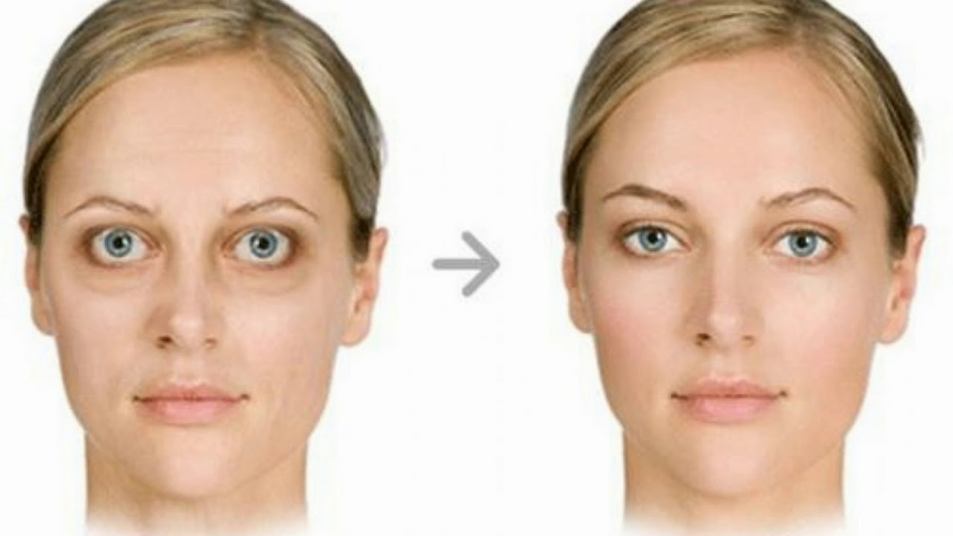
Grave’s disease

Slide 42
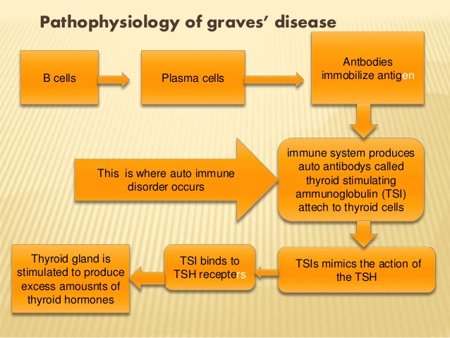
Pathophysiology of Graves diseases

Slide 43
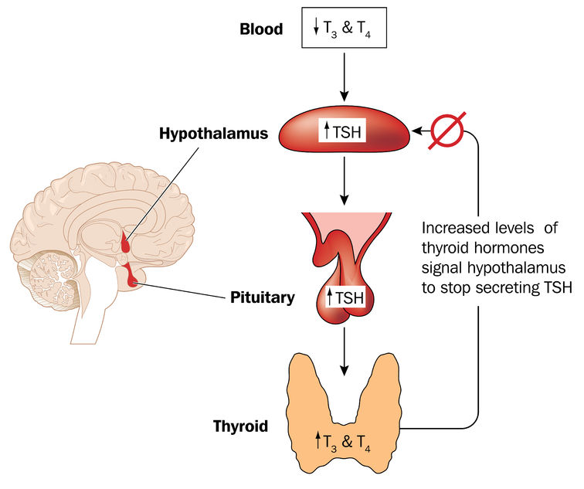
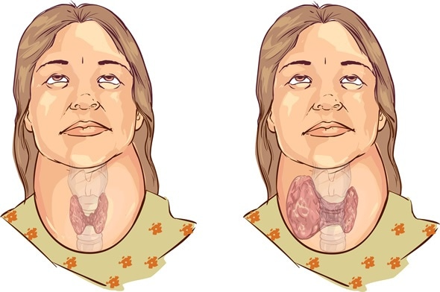
Goiter

Slide 44
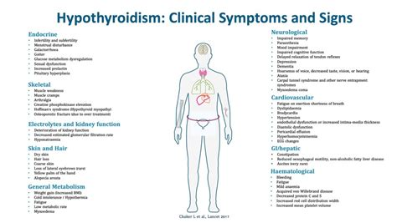
Hypothyroidism

Slide 45
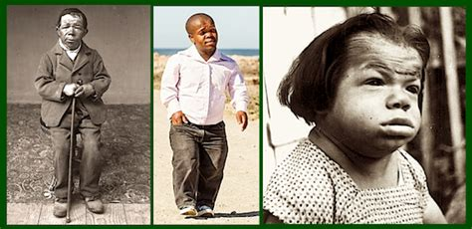
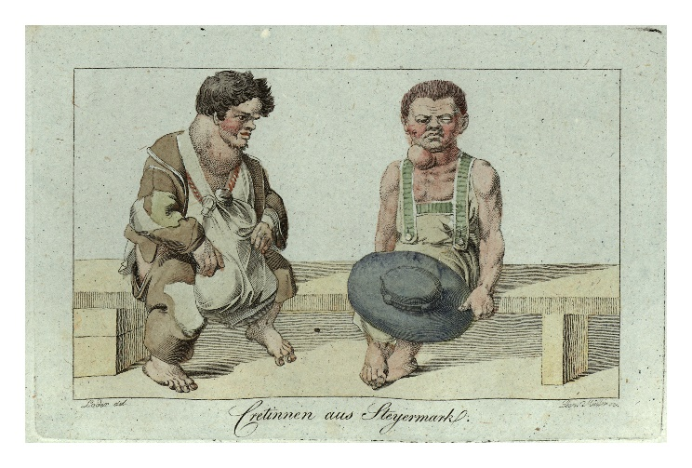
Hyposekrece T3, T4 v dětství
Kretenismus
nedostatek T3 a T4 již intrauterinně, porucha vývoje žlázy nebo endemický nedostatek jodu
poruchy růstu, kratší končetiny
poruchy intelektu, spavost
únava, svalová slabost
zácpa, velké bříško

Slide 46
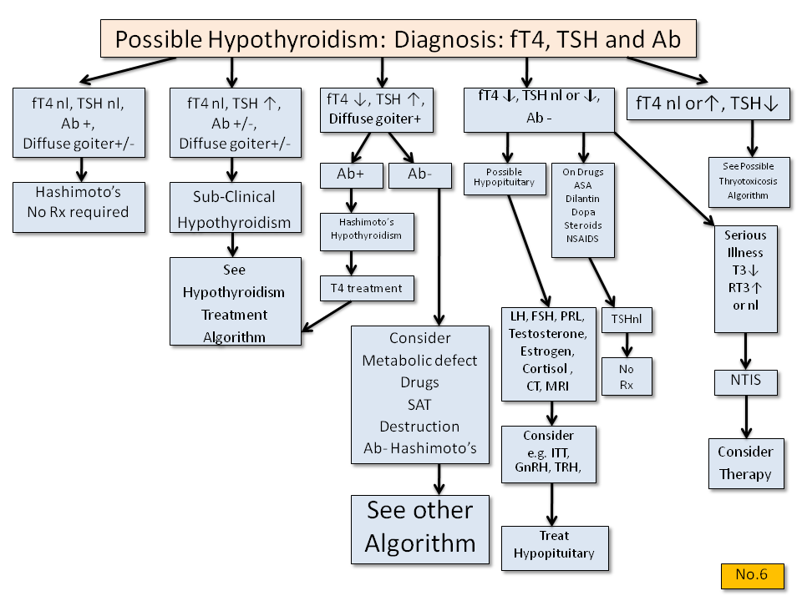
Hypothyroidism

Slide 47
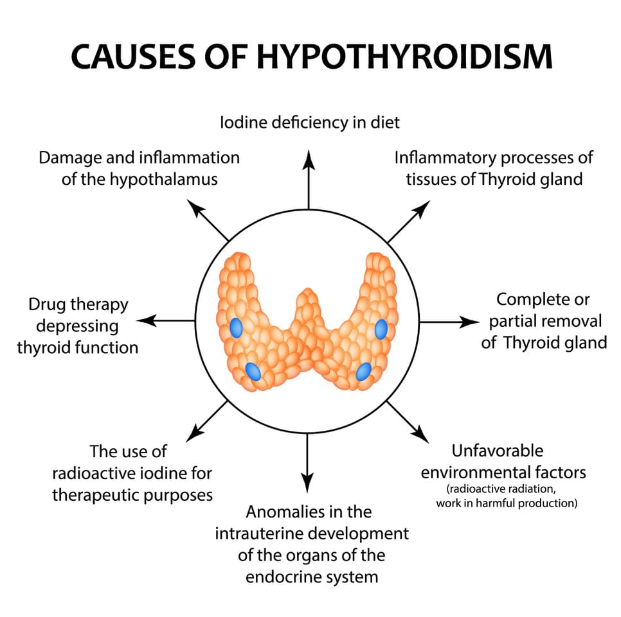
Hypothyroidism
Primary
  Thyroid gland
  Hashimoto’s disease
    Autoimmune thyroid destruction
  Creteinism
    Neonatal screening
Secondary
  Pituitary gland

Slide 48
Hypothyroidism
Treatment of hypothyroidism
  Causative
  Thyroid hormone replacement
  Iodine
    Jod-Basedow effect

Slide 49
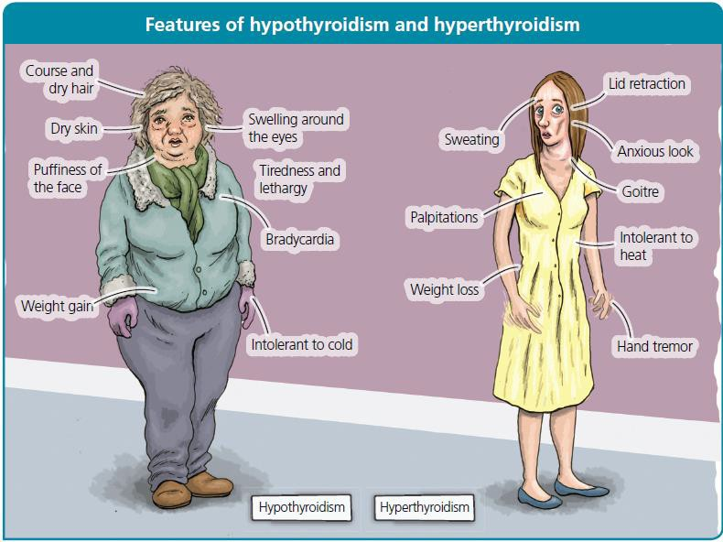

Slide 50
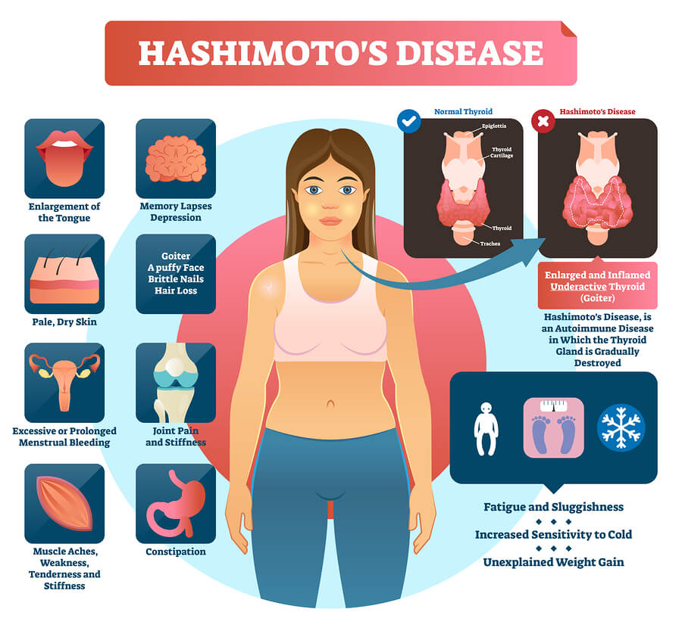
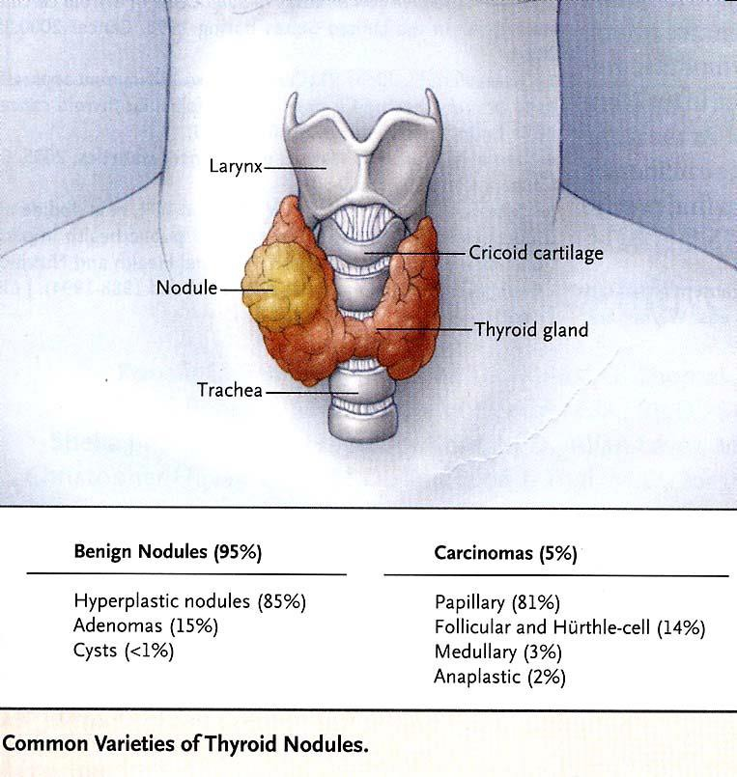

Slide 51
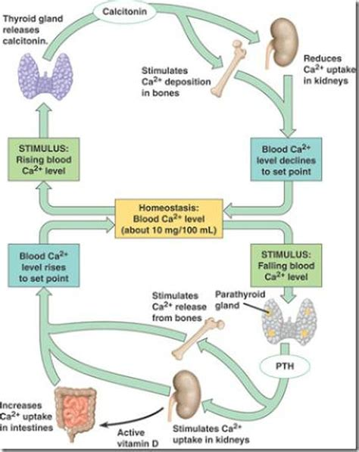
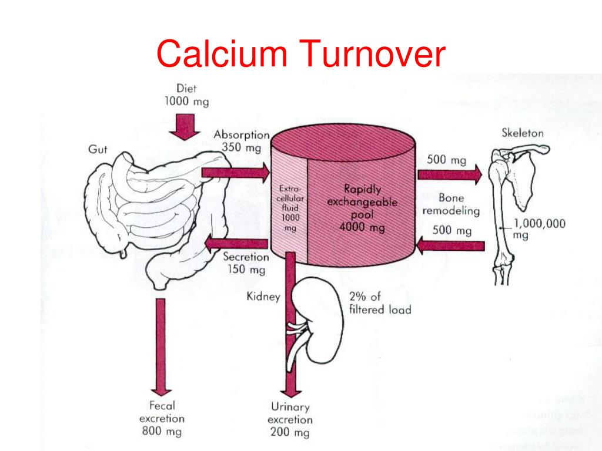

Slide 52

Parathyroid glands

Slide 53
Hypercalcemia
Symptoms
  Renal (stones, polydipsia, polyuria)
  Bones (pain)
  Gut (constipation)
  Brain (depression, fatique, anorexia)
Signs
  Hypertension, cognitive impairment, joint swelling, bone deformities

Slide 54

Hypercalcemia
Causes
  Primary (tertiary) hyperparathyroidism
  Malignancies (parathyroid hormone-related protein)
  Hypervitaminosis D
  Renal failure
Therapy
  Diuretics
  Bisphosphonates
  Calcitonin

Slide 55

Hypocalcemia

Slide 56


Slide 57


Hypoparathyroidism

Slide 58
Děkuji za pozornost

