Slide 1
DNA supercoiling

Slide 2
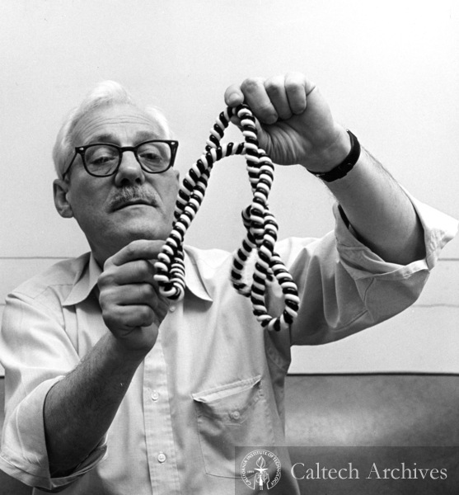
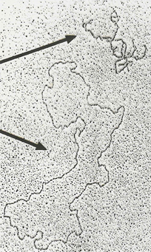
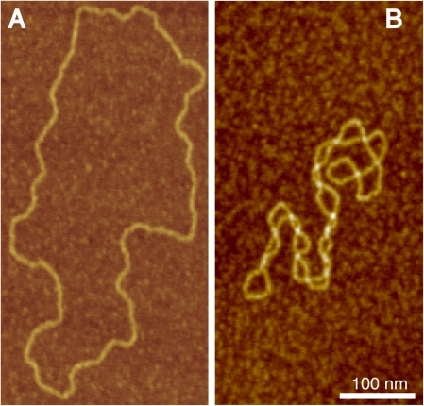
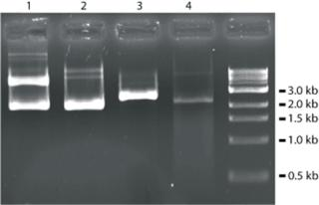
Jerome Vinograd, 1965
sedimentation equilibrium experiments with viral DNA
circular DNAs can exist in two distinct forms differing in buoyant density
supercoiled (compact ) and relaxed (loose)
electron microscopy
AFM
agarose gel elfo

Slide 3
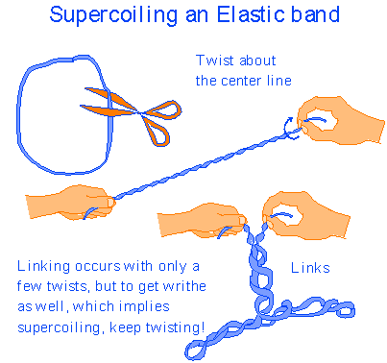
Double helical DNA behaves like a rubber rod
some torsional and bending elasticity
„shape memory“
tendency to keep B-conformation
tendency to keep the axis straight
Interplay between twisting and bending deformations

Slide 4
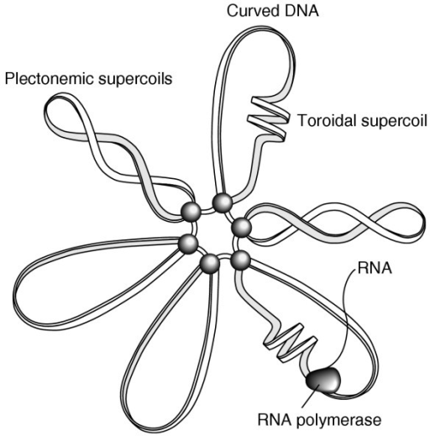
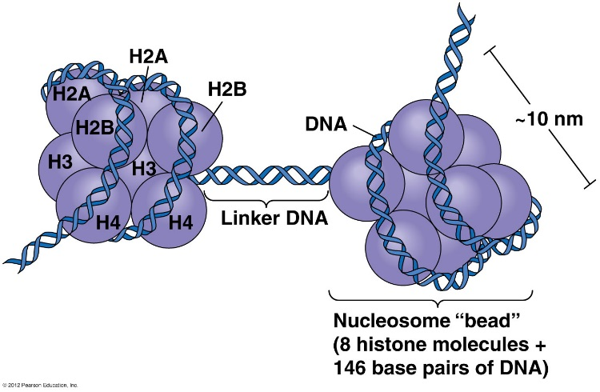
Superhelicity is a property of DNA without free ends
circular duplex DNA (plasmids)
linear molecules with constrained (anchored) ends (chromatin loops)
linear and circular nicked DNAs are inherently relaxed
plectonemic and toroidal supercoils
superhelicity absorbed in nucleosomes and other protein-DNA complexes

Slide 5
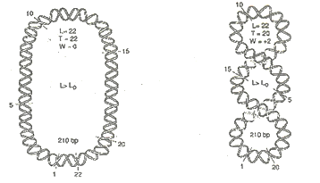
relaxed DNA: Lk = N/10.5 = Lk₀, where N=number of base pairs
equation Lk= Tw+Wr is valid even for relaxed DNA;
when relaxed DNA lies on a plane, Wr=0, Lk₀=Tw= N/10.5
(definition of relaxed DNA; Wr may be ≠0)
supercoiled DNA: Lk ≠ Lk₀
(definition of supercoiled DNA)
negatively scDNA: Lk < Lk₀ (linking deficit)
positively scDNA: Lk > Lk₀ (linking extent)
Lk - Lk₀ = ΔLk (superhelicity level)
ΔLk/Lk₀ = σ (superhelix density: superhelicity level normalized on DNA molecule size)
ΔLk= ΔTw+ΔWr
Lk cannot be changed without interrupting at least one DNA strand
Linking number
Twist
Writhe
Lk= Tw+Wr
How many times a strand is crossing a strand
Number of superturns
Number of crossing points in duplex DNA (=number of double helix turns)

Slide 6
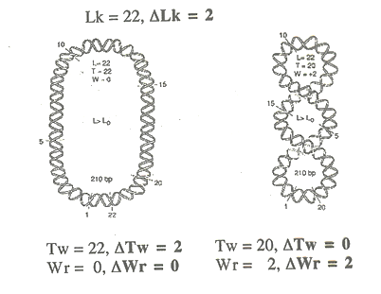
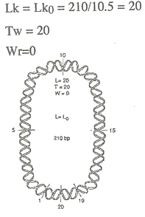
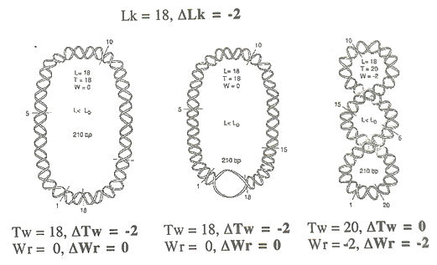
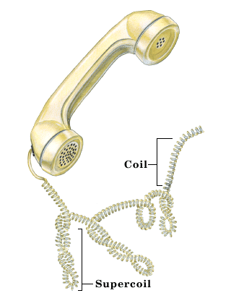
relaxed
positively supercoiled
(with linking excess)
positive superhelical stress forces the right-handed double helix
to close
negatively supercoiled
(with linking deficit)
negative superhelical stress forces the right-handed double helix
to open
In real situation, superhelicity distributed between
ΔTw (locally or globally)
and ΔWr
duplex
globally untwisted
duplex
locally untwisted
duplex
twisted normally, supercoils formed

Slide 7
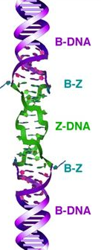
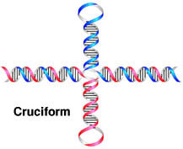
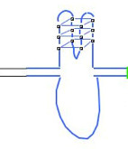
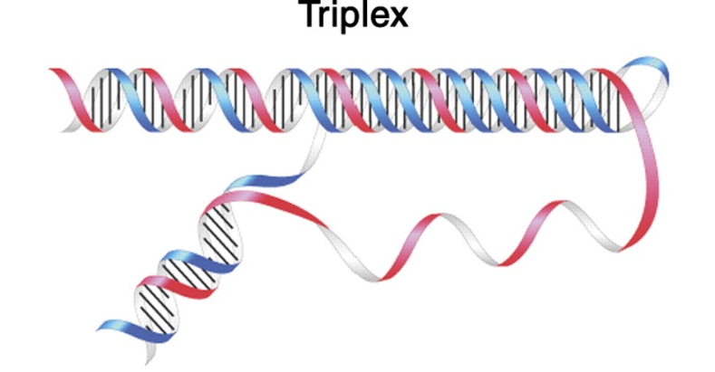
Open local structures
formed in appropriate sequence motifs
characterized by locally reduced twist, compared to B-DNA
paranemic: possible to form/abolish without mutual rotation of opposite strands
Quadruplexes
Left-handed (Z-form) duplex

Slide 8
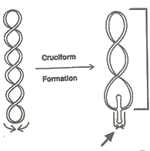
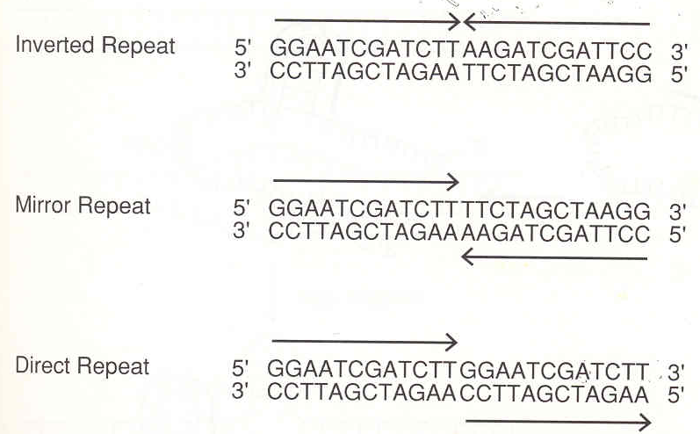
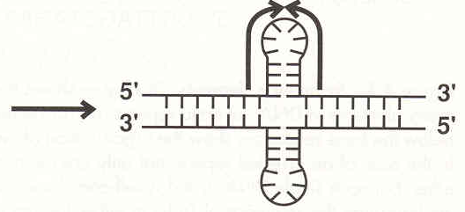
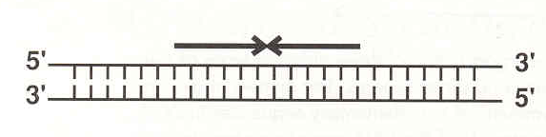
Open local structures in negatively supercoiled DNA
cruciform DNA
inverted repeat (sequences with dyad symmetry)
partial relaxation of negative superturns
(cca 1 superturn per 10 bp of cruciform struture)
unpaired bases
local reduction of twist

Slide 9
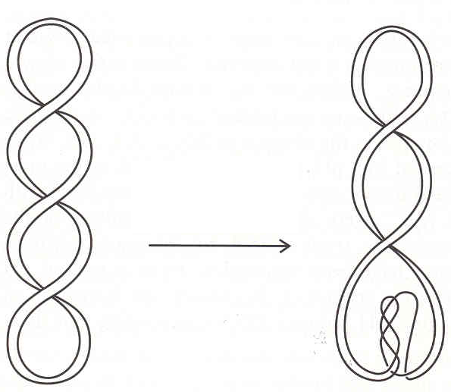
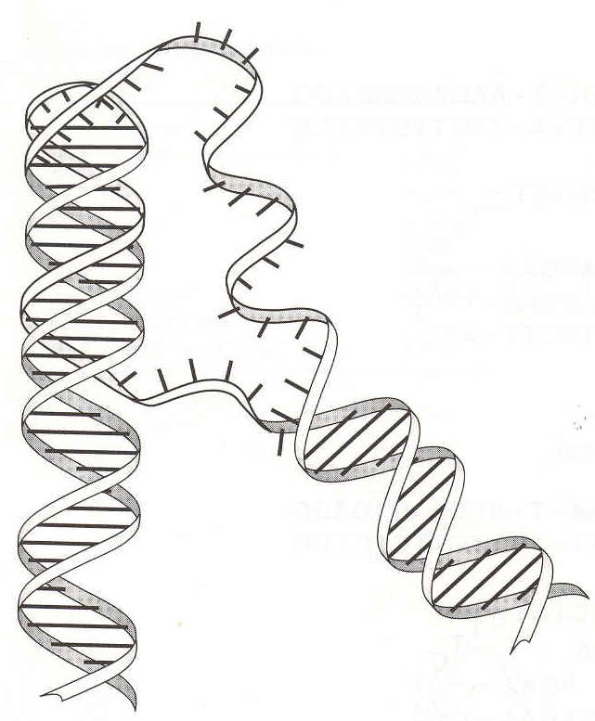
Open local structures in negatively supercoiled DNA
Intramolecular triplex
homoPu•homoPy segment with mirror symmetry
TAT (H*-DNA) – stabilized by Mg²⁺; C⁺GC (H-DNA) – stabilized in weakly acidic media)
T
T
A
T
A
A
partial relaxation of negative superturns
(cca 1 superturn per 10 bp of cruciform struture)
A
A
A
A
T
T
T
local reduction of twist

Slide 10


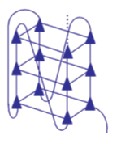
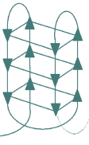
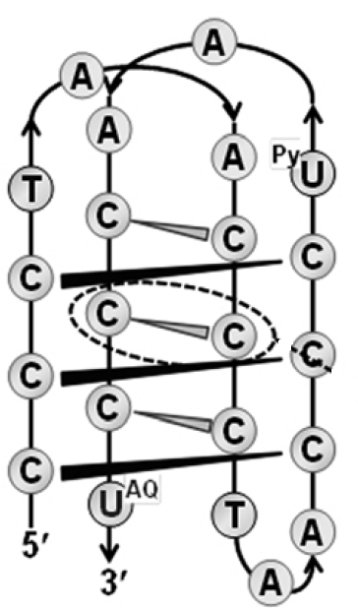
Open local structures in negatively supercoiled DNA
Intramolecular quadruplexes
G:C-rich motifs
G-quadruplexes C-quadruplexes (i-motifs)
(K⁺-stabilized) (weakly acidic pH)

Slide 11
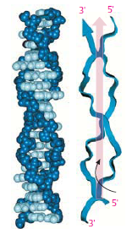
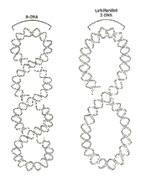
Open local structures in negatively supercoiled DNA
Lef-handed Z-DNA
(Pu-Py)_{n} segment within negatively supercoiled DNA)
local reduction of twist
(to negative values)
partial relaxation of negative superturns
(cca 2 superturns per 14 bp of Z-DNA structure)

Slide 12
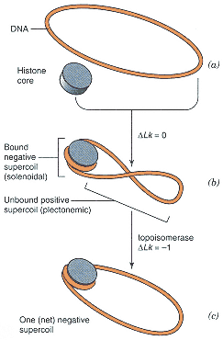
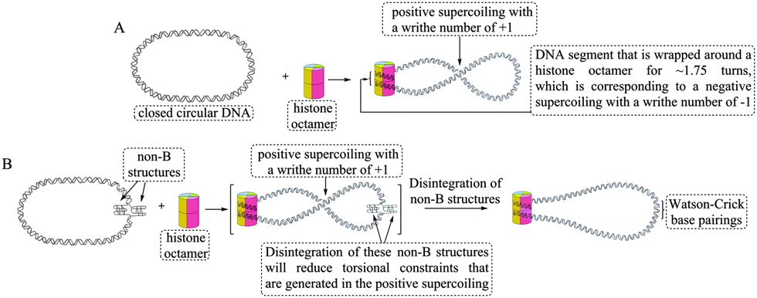
DNA supercoiling and nucleosome formation

Slide 13
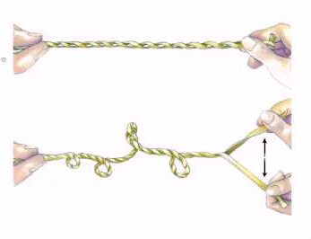
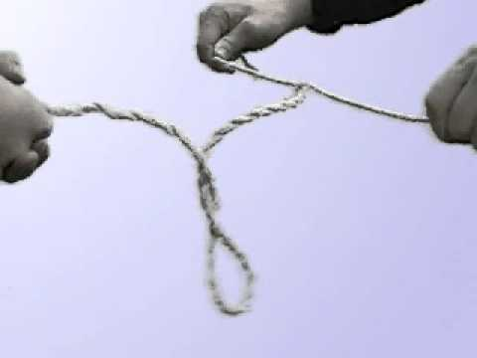
DNA supercoiling and replication/transcription
local untwisting of duplex in replication fork/transcription complex induces formation of superturns
(link to video)

Slide 14
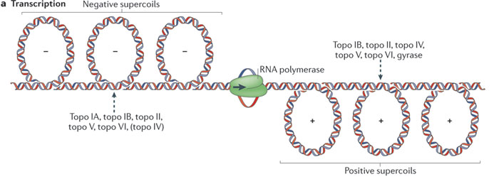
DNA supercoiling and replication/transcription
local untwisting of duplex in replication fork/transcription complex induces formation of supercoils

Slide 15
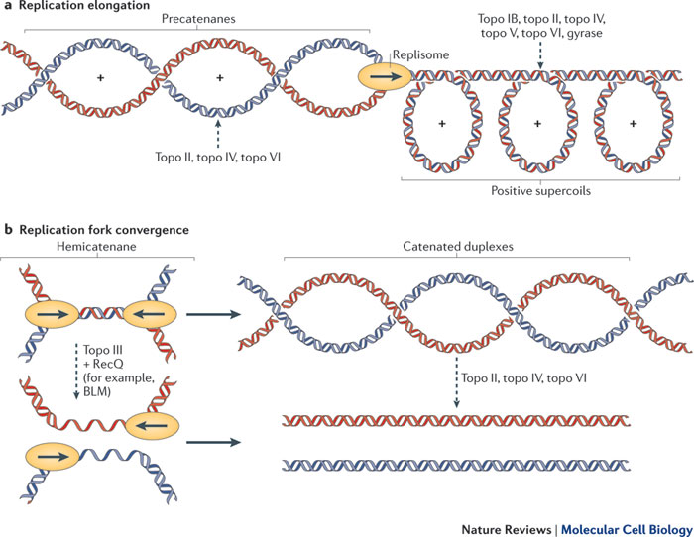
DNA supercoiling and replication/transcription
local untwisting of duplex in replication fork/transcription complex induces formation of supercoils

Slide 16
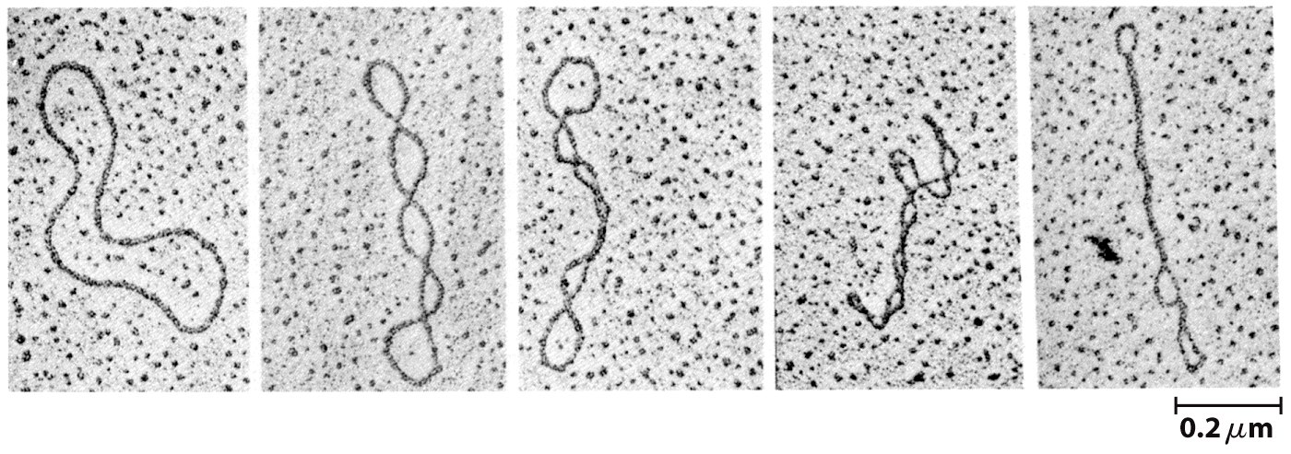
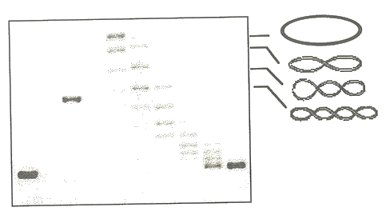
Topoisomers
molecules of circular duplex DNA differing in Lk value
separation of palsmid molecules differing in |Wr| in agarose gel
0
±1
±2
±3
electron microscopy
etc.
bundle of unresolved topoisomers of high |Wr|

Slide 17
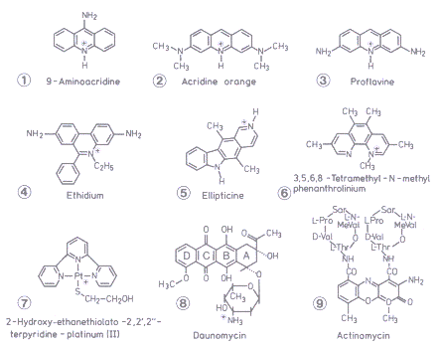
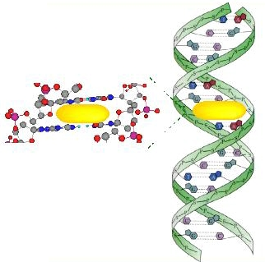
Superhelicity and intercalation
intercalators: planar ligands intercalating between base pairs in duplex DNA
stacking interaction

Slide 18
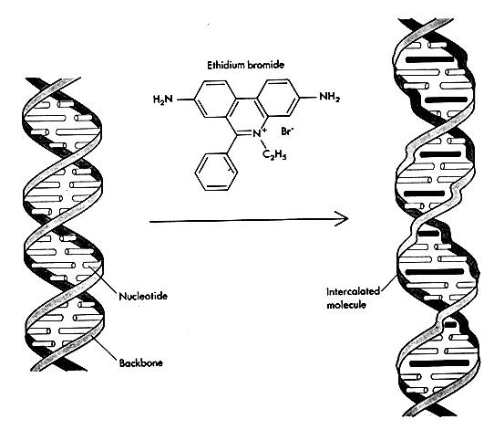
Superhelicity and intercalation
characteristic changes in DNA conformation:
extension in length
untwisting

Slide 19
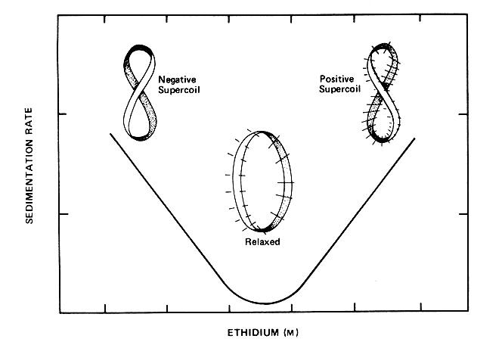
Superhelicity and intercalation
increasing concentration of an intercalator:
gradual relaxation of negative superturns
formation of positive superturns
intercalation reduces Lk₀ value!
(even in unconstrained relaxed DNA, number of double helix turns is reduced)
Lk₀ decreases, Lk constant!
Lk < Lk₀
Lk > Lk₀
Lk = Lk₀

Slide 20
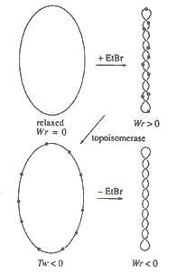
Superhelicity and intercalation
preparation of topoisomers:
an intercalator is used to modulate superhelicity level
topoisomerase removes superturns existing at the given intercalator concentration
negative superturns which were absorbed by intercalation are restored after the intercalator removal

Slide 21
2D electrophoresis of topoisomers and detection of structural transitions
open local structures are formed in scDNA with sufficiently negative superhelix density
they absorb a part of the superhelical stress, which is reflected in reduction of Wr (number of superturns)
decrease of the negative superhelicity causes the open structures to disintegrate and B-DNA duplex to reform
negative superhelicity reduction can be attained by intercalation

Slide 22
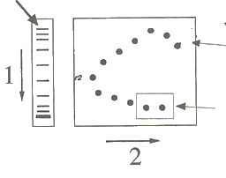
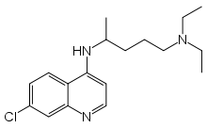
2D electrophoresis of topoisomers and detection of structural transitions
slowest in absence of CQ (Wr=0)
4 positive superturns in CQ
topoisomers are prepared and separated in first dimension
then the gel is soaked with chloroquine (CQ) to remove certain number of superturns (e.g., 4) and second dimension is run
resolution of
± topoisomers unresolved without CQ
Wr>0
slowest in the presence of CQ (-Wr reduced by 4 to 0)
Wr<0
resolution of
negative topoisomers unresolved without CQ
without structural transition: C-shaped pattern

Slide 23
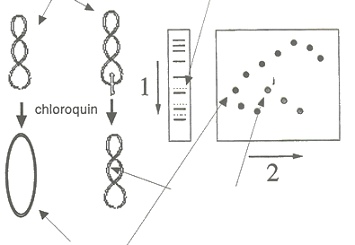
2D electrophoresis of topoisomers and detection of structural transitions
these two molecules are not resolved
(Wr=-2 or Wr=-2 + another two superturns absorbed by cruciform)
topoisomers are prepared and separated in first dimension
then the gel is soaked with chloroquine (CQ) to remove certain number of superturns (e.g., 4) and second dimension is run
resolution of topoisomers with and without the transition
cruciform removed, 2 superturns maintained
superturns removed
with structural transition: G-shaped pattern

Slide 24
Chemical probing of non-B structures (to recall)
the open local structures contain unpaired bases, unstacked base pairs or otherwise distorted sites
loops, junctions...
increased chemical reactivity of the nucleobases
Quadruplexes
Left-handed (Z-form) duplex

Slide 25
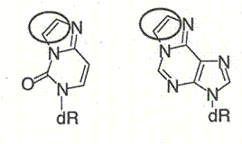
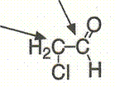
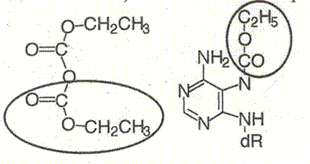
Chemicals selectively reacting with unpaired bases:
osmium tetroxide complexes
(Os,L)
(T, more slowly C)
chloroacetaldehyde
(CAA)
(A, C)
diethyl pyrocarbonate
(DEPC)
(A, G)

Slide 26
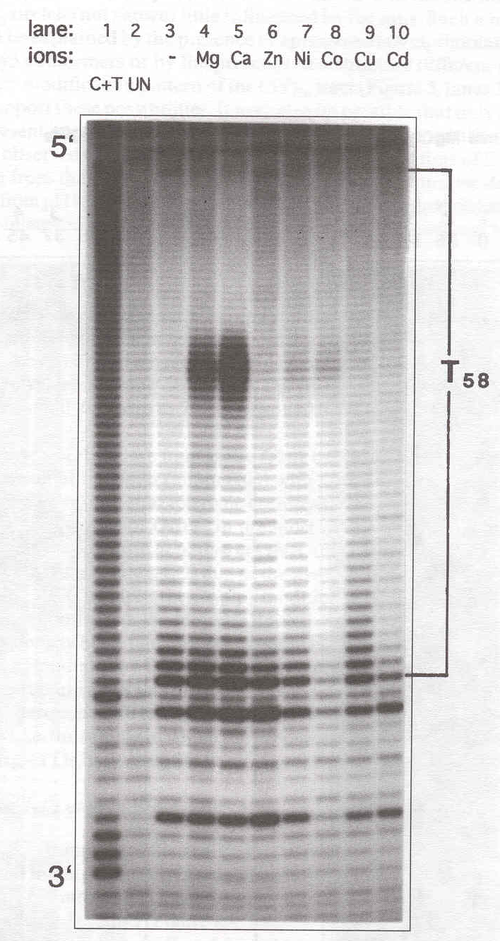
Using the Maxam-Gilbert technique, it is possible to determine with a high preciseness which nucleotides are forming the local structure
modification of supercoiled DNA
restriction cleavage, radiactive labeling
hot piperidine
sequencing PAGE
the structure can be deduced from the modification pattern
TTTTTTTTTTTTTTTTTTTTTTTTTTTTTTTTTTTTTTTT
AAAAAAAAAAAAAAAAAAAAAAAAAAAAAAAAAAAAAAAA

Slide 27
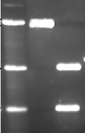
Single-strand selective enzymes
only detection of a open structure, not identification at the sequence level
often sufficient: evidence of formation of a expected structure
nucleases S1, P1, mung bean... cleave ss DNA (or RNA)
scDNA cleaved by S1, then restriction cleavage to map S1 celavage site
restrictase
S1
restrictase
agarose elfo
restriction site
S1
distinct bands indicate site-specific cleavage by S1

Slide 28
Combination of chemical probes with S1 nuclease
chemical probes work within wider range of conditions than enzymes
modification of scDNA
then restrictase cleavage
chemical modification of bases in structure that existed in scDNA prevent formation of B-DNA
then S1 cleavage in the modified site
S1
restrictase
S1
agarose elfo
restriction site
chemical modification
distinct bands indicate site-specific modification

Slide 29
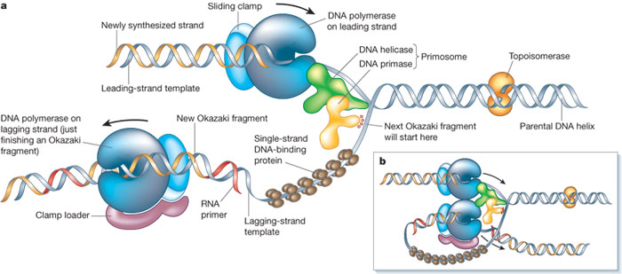
Topoisomerases
enzymes relaxing (or introducing) superhelical stress in DNA: changing Lk
solving the „knotty problem“ in replication, transcription
(video)

Slide 30
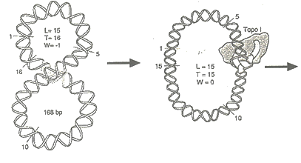


Topoisomerase I
creating and sealing a single-strand break
only relaxation
no ATP needed: transesterification, covalent binding of the enzyme to DNA (phosphoester of a Tyr residue)
relax either only negative superturns (E. coli topo I), or both positive and negative (topo I from wheat germ)
Lk changed by 1 (one strand threaded through a ssb)

Slide 31



Topoisomerase II
creating and sealing a double-strand break
relaxing or introducing superhelicity (DNA gyrase)
ATP consumption (conformational changes of the protein)
Lk changed by 2 (double helix threaded through a dsb)

Slide 32



Other processes catalyezd by topoisomerases
Topoisomerase I:
circular duplex formation of two complementary ss circles (=relaxation of negatively scDNA!)
knotting/unknotting of ss circles
catenation/decatenation of nicked circles
Topoisomerase II:
knotting/unknotting of duplex circles
catenation/decatenation of duplex circles

Slide 33
Importance of decatenation activity in replication

