Slide 1
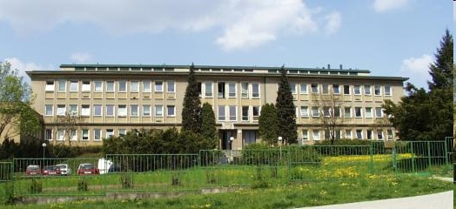



CD Spectroscopy and its Role in the History of our Knowledge of DNA Conformation
Michaela Vorlíčková mifi@ibp.cz
Institute of Biophysics
Czech Academy of Sciences Brno
Czech Republic
Laboratory of Biophysics of Nucleic Acids
Notes:
tralala

Slide 2
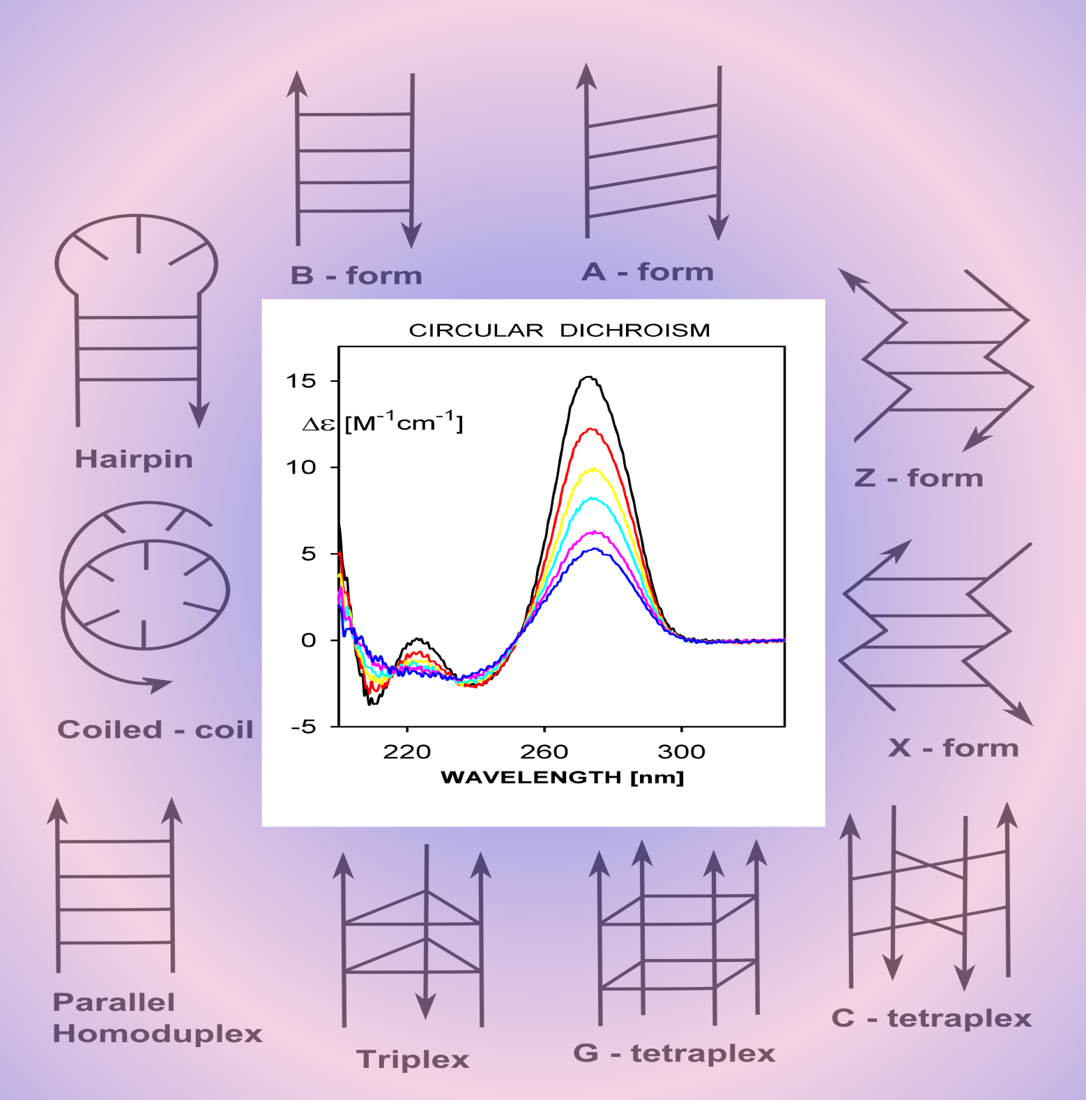

Slide 3
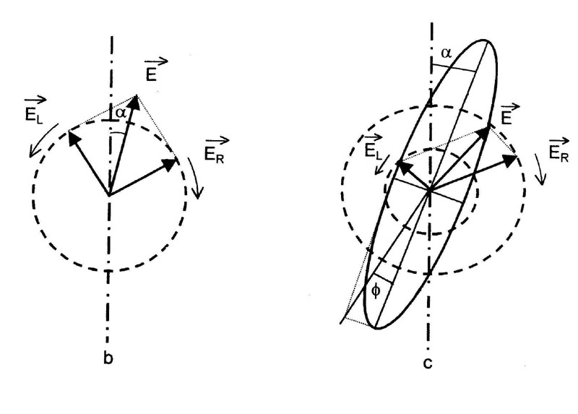
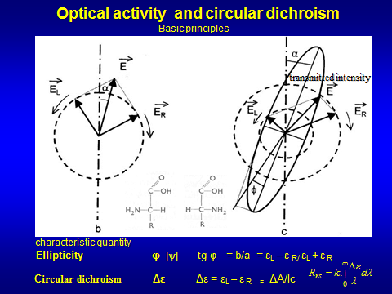
Circular dichroism and optical activity of biopolymers
) CD – principle, quantities - ellipticity, ΔA, Δε, relation between ORD and CD
Optical activity property of a chiral molecule
Chiral molecules (aminoacids, sugars) are those lacking mirror symmetry
Optical rotation of the plane of polarization (difference in refraction indexes –difference in propagation velocity) may be either to the right (dextrorotatory -D)
or to the left (levorotatory –L) depending on the stereoisomer (enantiomer) present
Specific rotation – characteristic quantity
[α]^{T}_{λ} = α/cl
Optical rotatory dispersion - ORD
is the dependednce of specific rotation on the wavelength

Slide 4
Circular dichroism and optical activity of biopolymers
CD phenomenon – different absorption of the left-handed and right-haned circularly polarized light.
quantity- ellipticity Φ [θ] tg θ = b/a = ε_{L} – ε _{R/} ε_{L} + ε _{R} = difference/sum
Circular dichroism Δε Δε = ε_{L} – ε _{R =} ΔA/cl, θ=3300. Δε

Slide 5
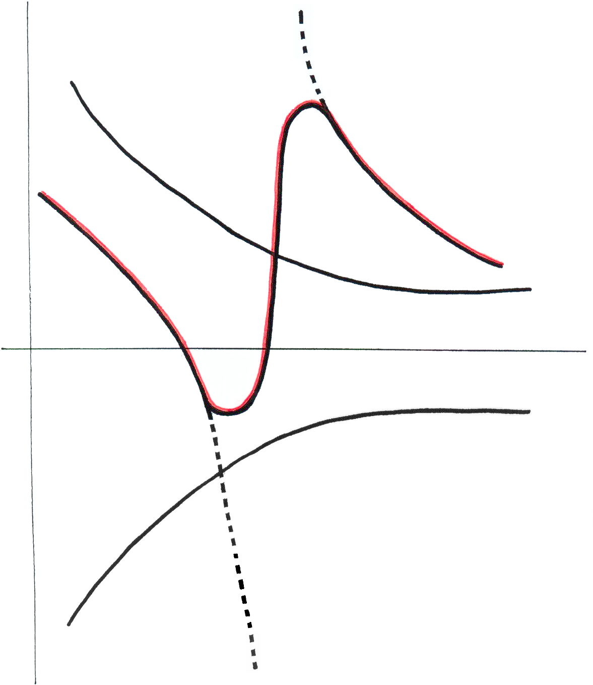
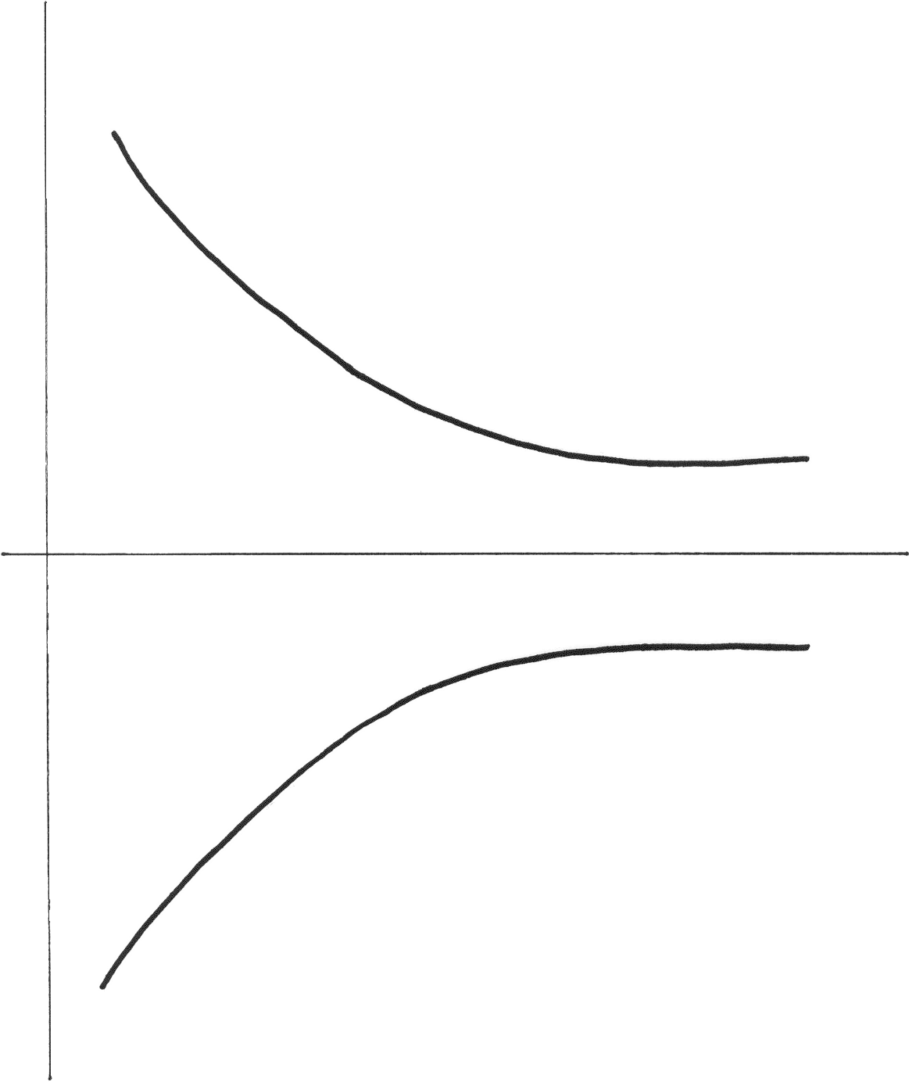
Optical rotatory dispersion (ORD) is the dependednce of specific rotation on the wavelength
Cotton effect
[α]
dextrorotatory
λ[nm]
levorotatory
The Cotton effect is the characteristic change in optical rotatory dispersion (and/or circular dichroism) in the vicinity of an absorption band of a substance.

Slide 6
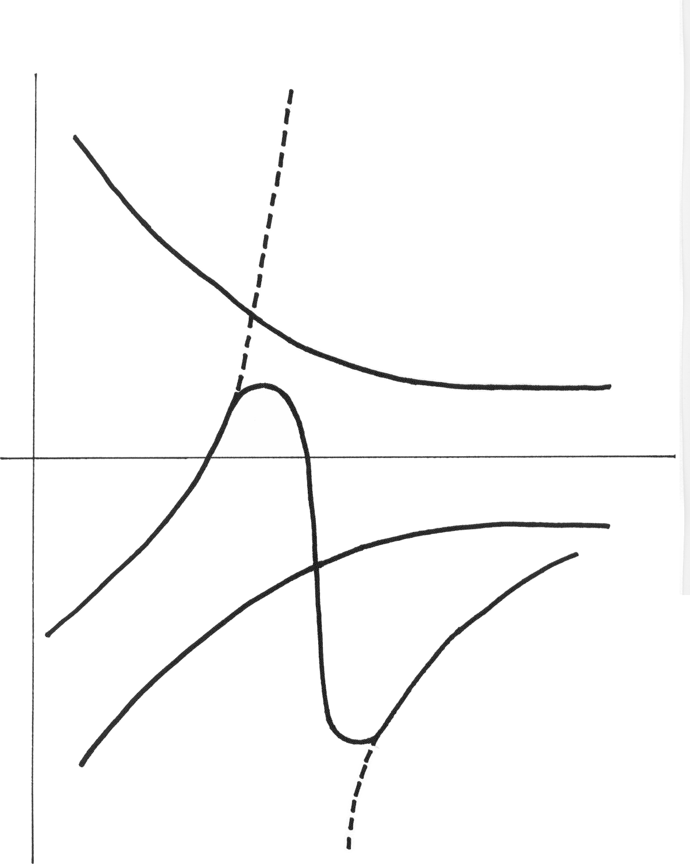
Optical rotatory dispersion
Cotton effect
λ[nm]

Slide 7
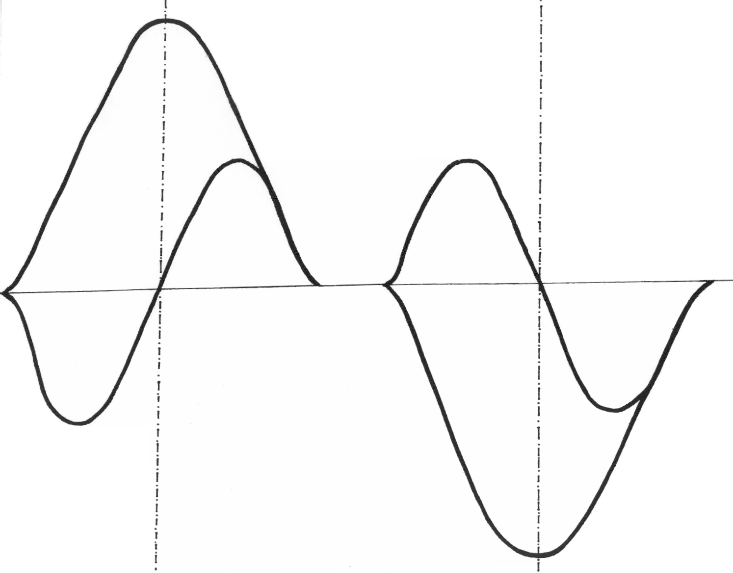
CD
ORD
+
λ
ORD
-
CD

Slide 8
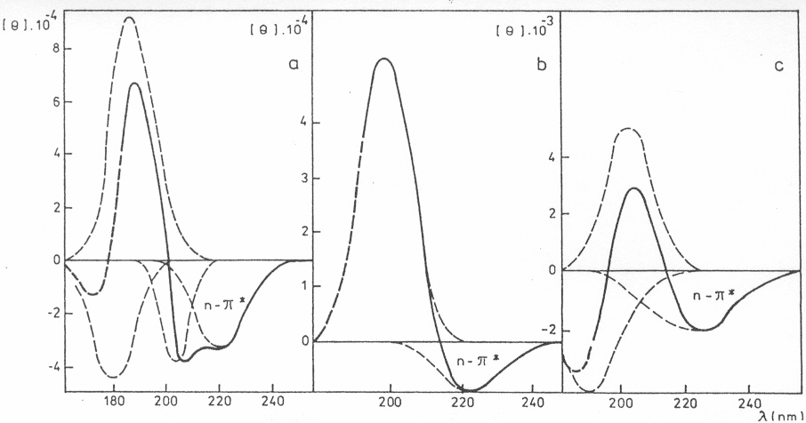
CD of proteins
α-helix
β-sheet
β-turn

Slide 9
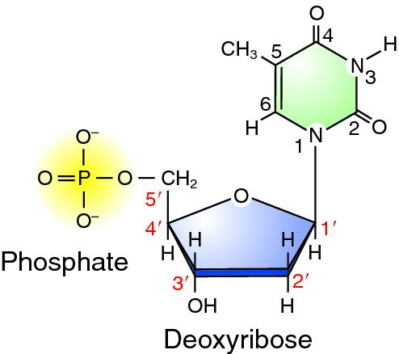
Preconditions for an appearance of CD of DNA
ABSORBANCE
BASE
+
CD
CHIRALITY
* SUGAR

Slide 10
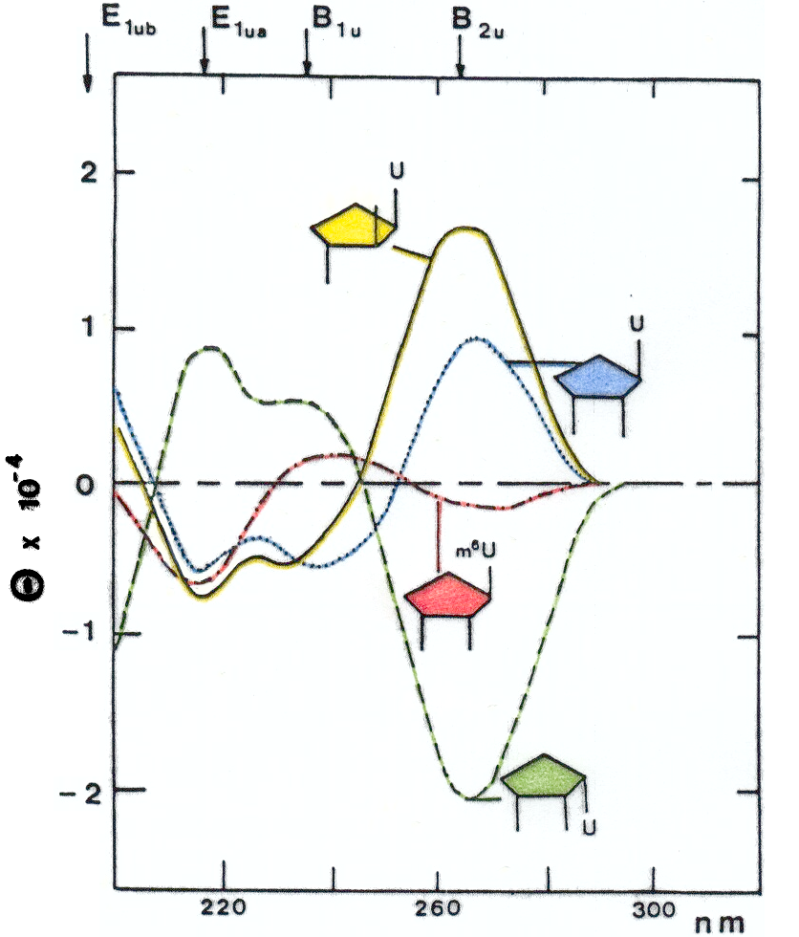

Slide 11
Conditions of the origin of CD
BASE
BASE
BASE
BASE
BASE
BASE
BASE
* SUGAR
BASE
* SUGAR
* SUGAR
BASEE
BASE
ABSORPTION
* SUGAR
* SUGAR
* SUGAR
+
CD
* SUGAR
* SUGAR
* SUGAR
CHIRALITY
* SUGAR

Slide 12
Tetraplexes
Kypr, J., Kejnovska, I., Renciuk, D., Vorlickova, M.:
Circular dichroism and conformational polymorphism of DNA. Nucleic Acids Res. 37 (2009) 1713-1725.

Slide 13
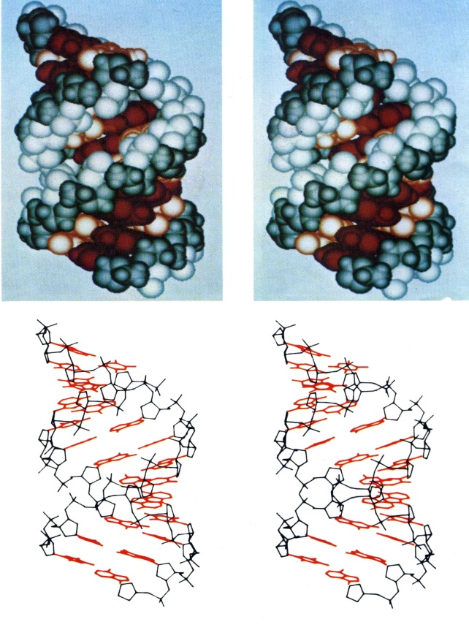
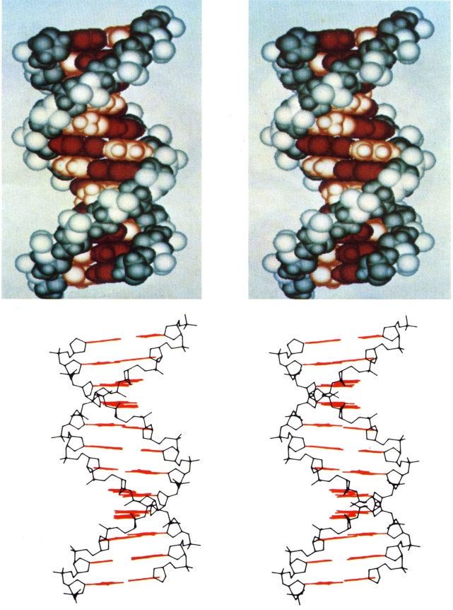
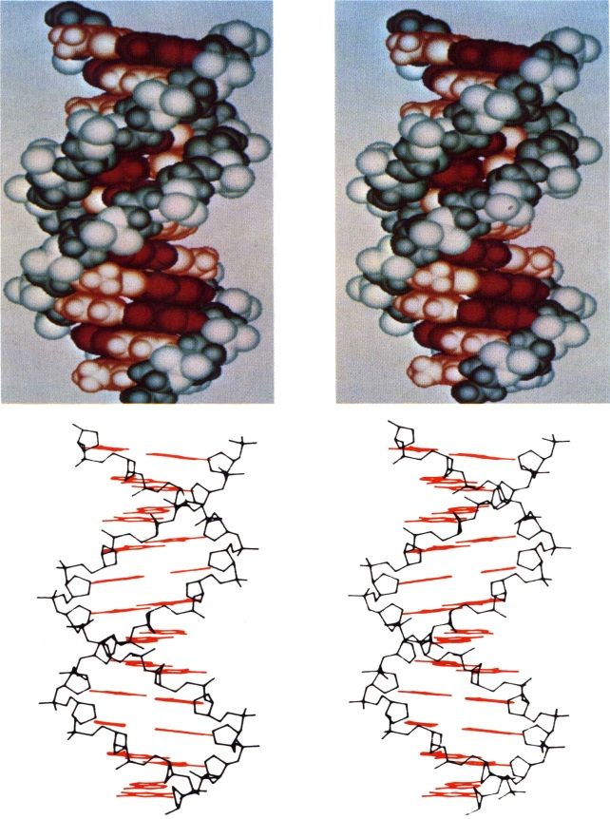
A
B
C,D,T…
Long DNA molecules can be oriented by mechanical stroking. X ray diffraction pattern obtained on these semicrystaline matter enables to determine some periodicities of the DNA arrangement
M. Wilkins, R. Franklin, W+C

Slide 14
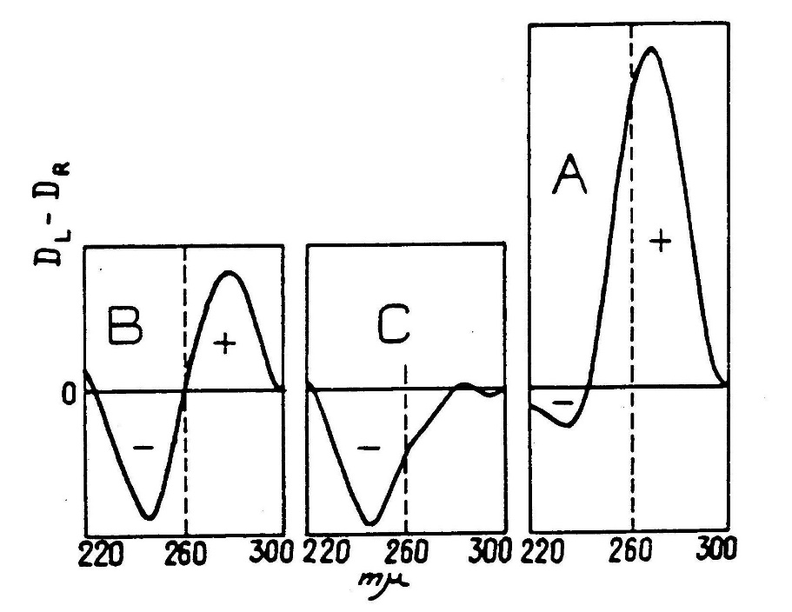
Tunis-Schneider, M.J.B., Maestre, M.F.:
Circular dichroism spectra of oriented and unoriented deoxyribonucleic acid films - a preliminary study. J. Mol. Biol. 52 (1970) 521-541.

Slide 15
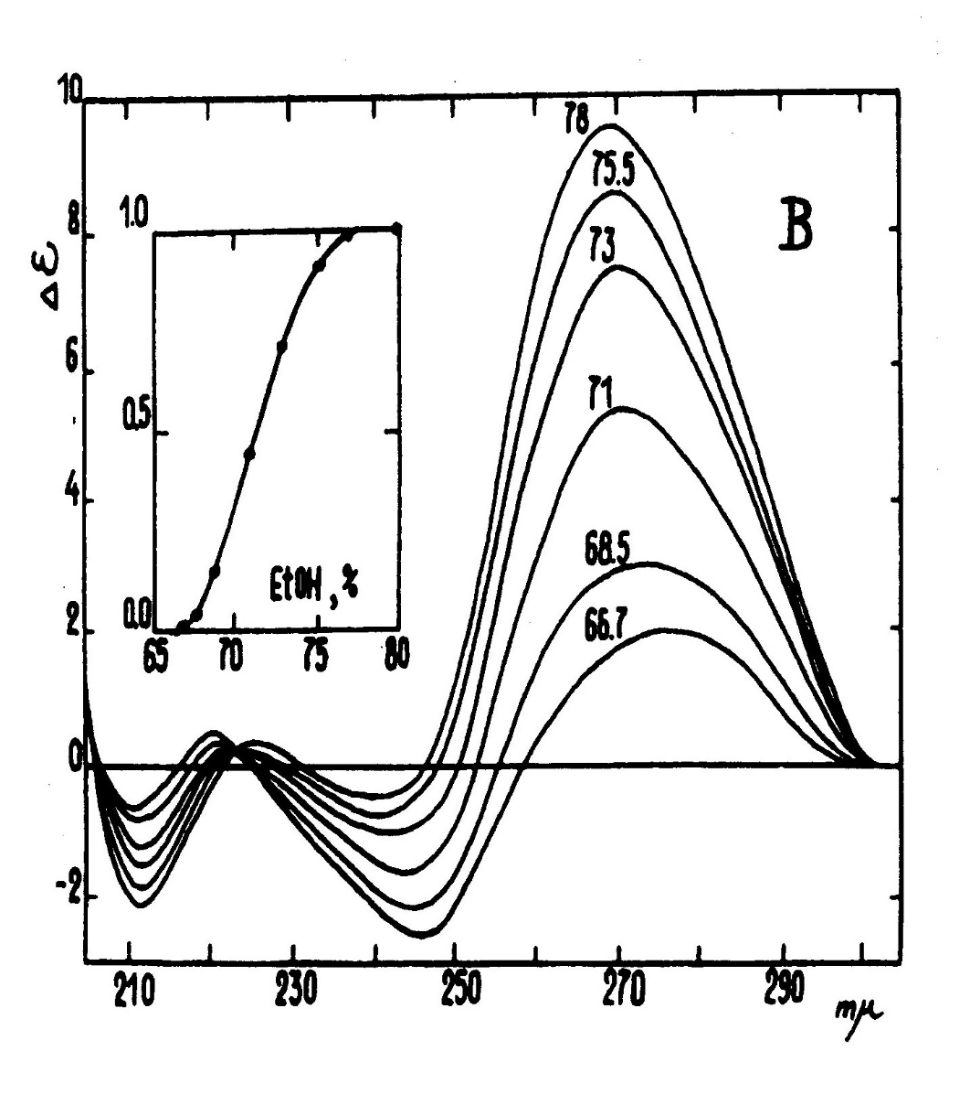

Non-cooperative changes
within the same global structure
A
B
C,D
B
Cooperative changes between discrete structures
Ivanov, V. I., Minchenkova, L. E., Minyat, E. E, Frank-Kamenetskii, M. D.,
Schyolkina, A. K.:. The B to A transition of DNA in solution. J. Mol. Biol. 87 (1974) 817-833.

Slide 16
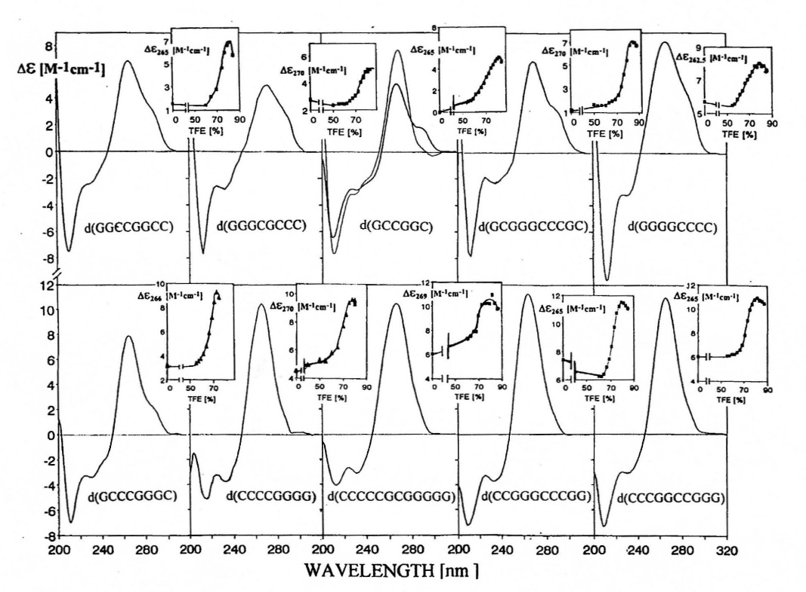
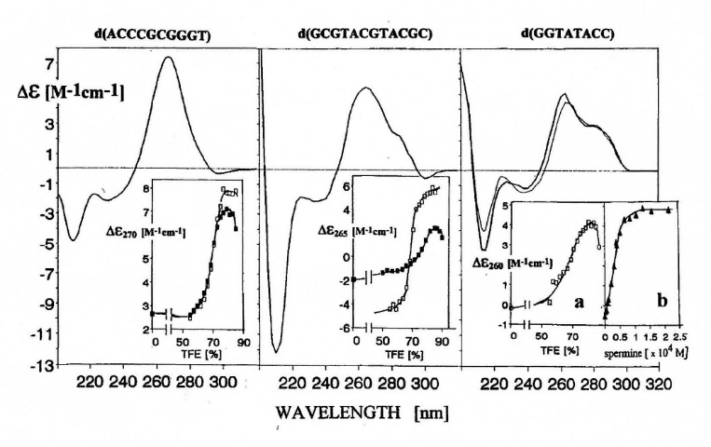
Kypr, J., Chladkova, J., Zimulova, M. Vorlickova, M.:
Aqueous trifluoroethanol solutions simulate the environment of DNA in the crystaline state.
Nucleic Acids Res. 27 (1999) 3466-3473.

Slide 17
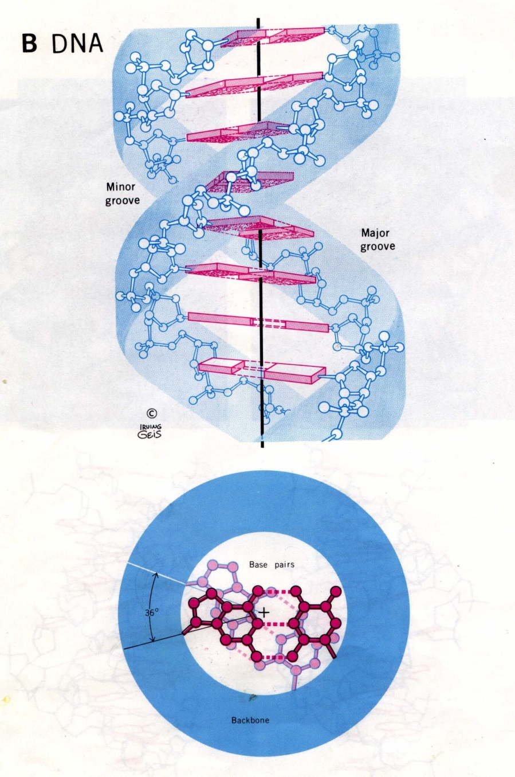
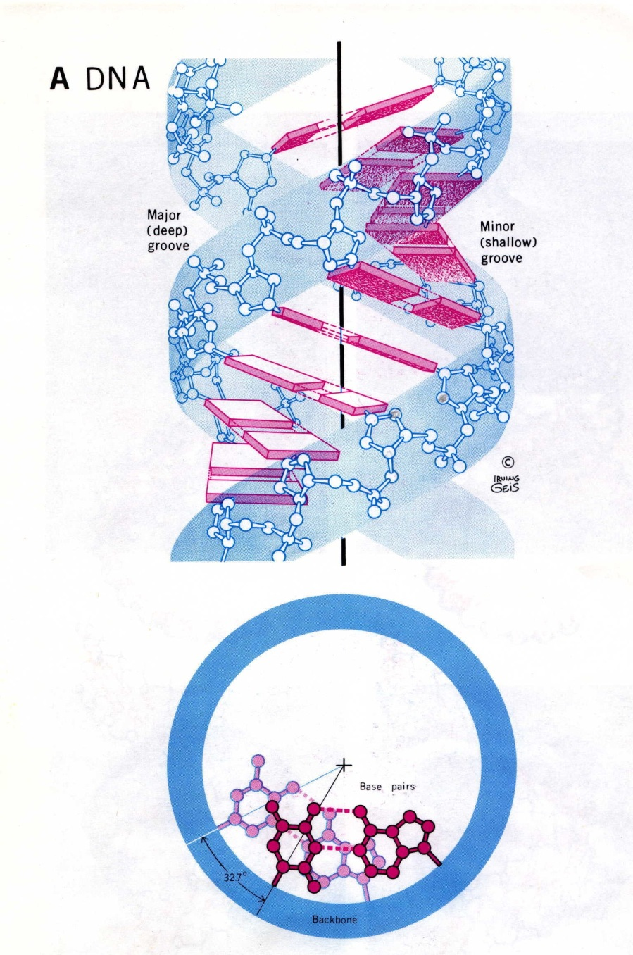

Slide 18
GCGCGCGCGCGCGCGCGCGCGCGCGCGCGCGCGCGCGCGCGC
Δε
R
L
λ
220
300
Pohl, F.M., Jovin T.M.: Salt-induced co-operative conformational change of a synthetic DNA: Equilibrium and kinetic studies with poly(dG-dC) J.Mol. Biol. 67 (1972) 375-396

Slide 19
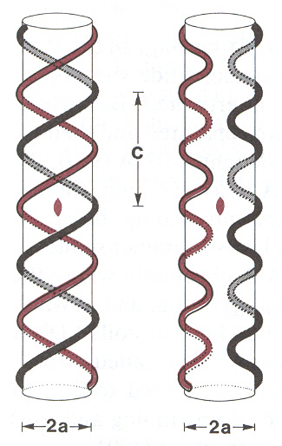
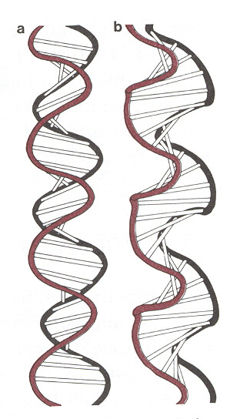
Rodley et al., 1976; Sasisekharan and Pattabiraman, 1976, 1978; Bates et al., 1977, 1980a; Albiser and Premilat, 1980, 1982; Millane and Rodley, 1981;

Slide 20
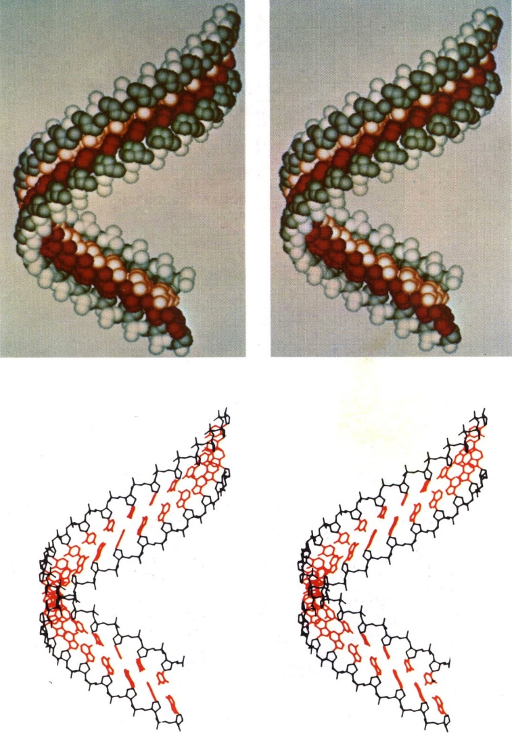
Vilma Olson:
Spatial configuration of ordered polynucleotide chains: A novel double helix.
Proc. Natl. Acad. Sci. USA 74 (1977) 1775-1779.

Slide 21
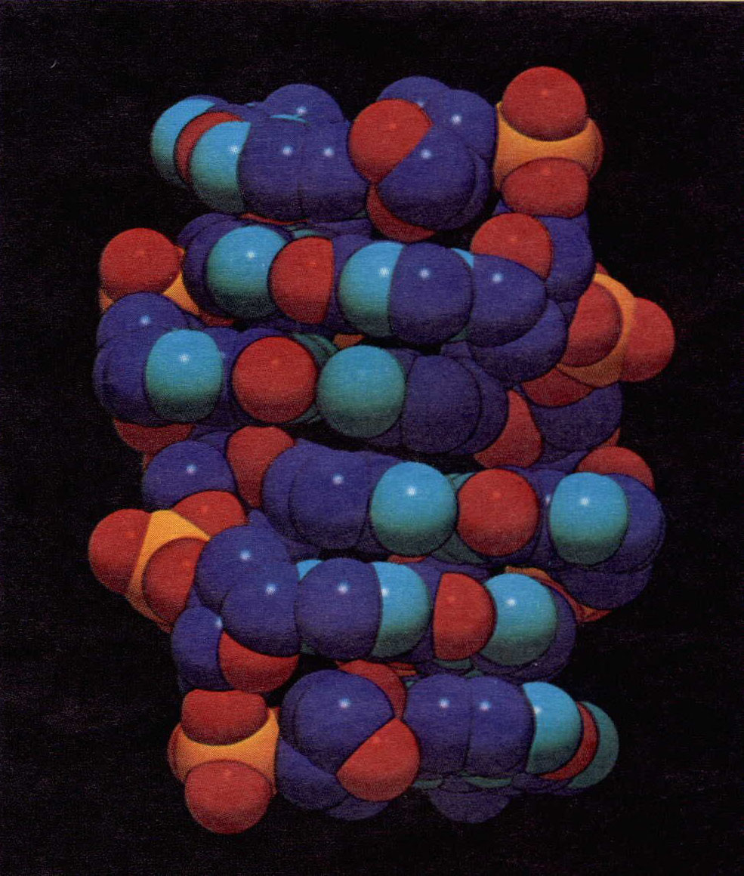
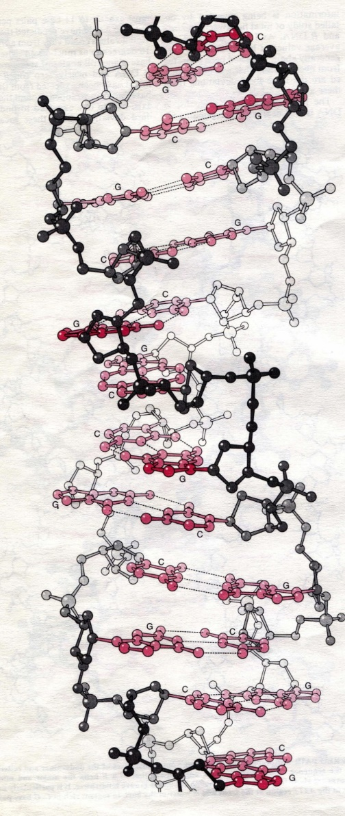
Z
Wang, A. H.; Quigley, G. J.; Kolpak, F. J.; Crawford, J. L.; van Boom, J. H.; van der Marel, G.; Rich, A. Molecular structure of a left-handed double helical DNA fragment at atomic resolution. Nature. 282 (1979) 680–686.

Slide 22
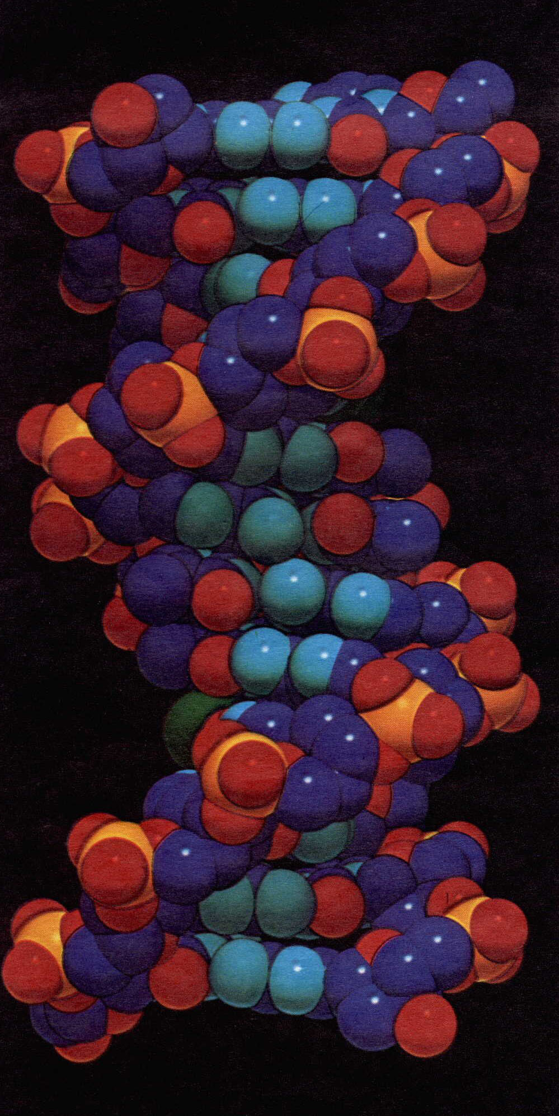
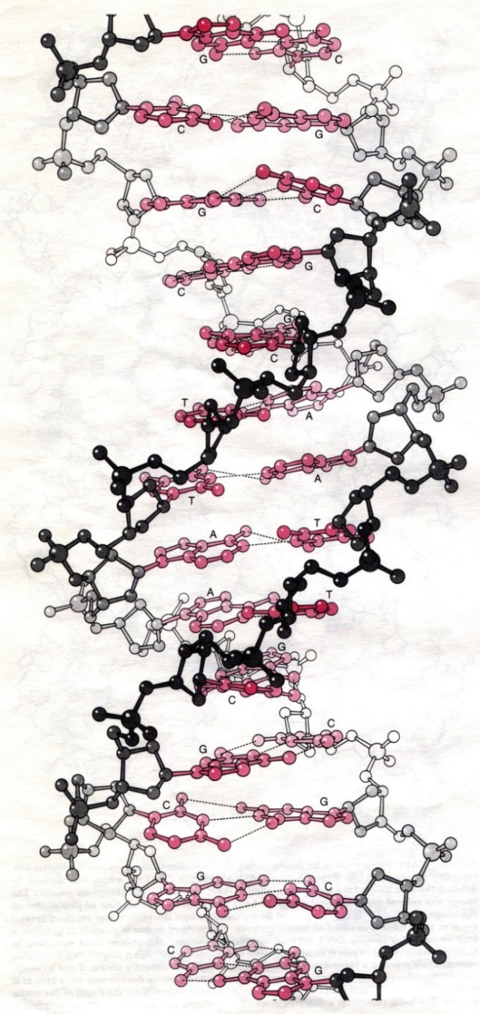
B
Wing, R., Drew, H., Takano, T., Broka, Ch., Tanaka, S., Itakura, K., Dickerson, R.E.:
Crystal structure analysis of a complete turn of B-DNA Nature 287 (1980) 755–758.

Slide 23
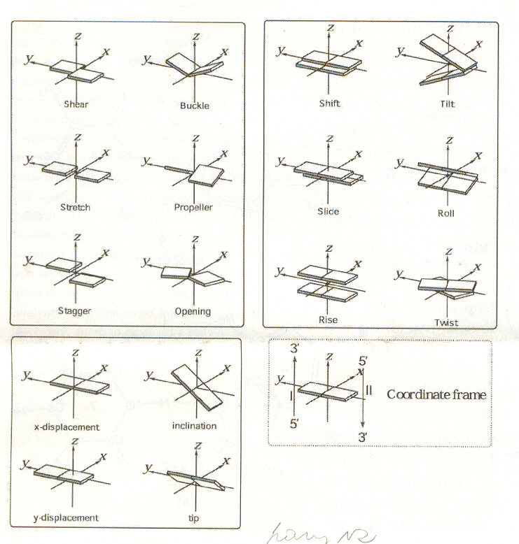

Slide 24
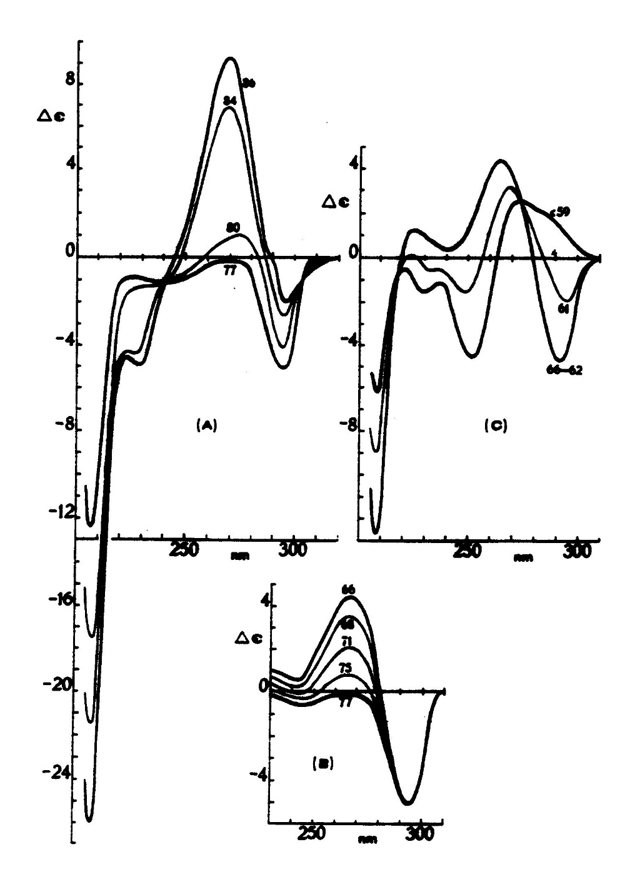
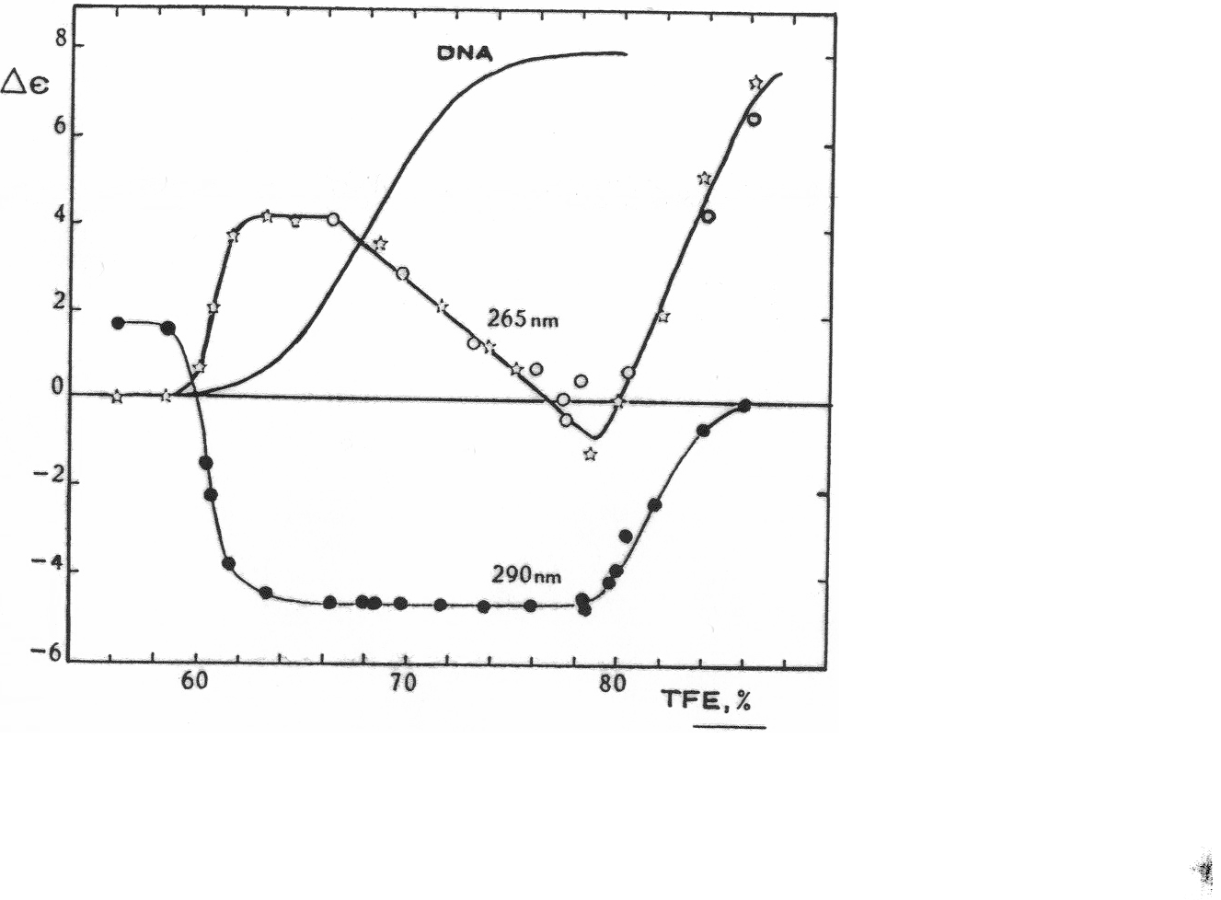
Valery I. Ivanov, Elvira E. Minyat
The transitions between left- and right-handed forms of poly(dG-dC)
Nucleic Acids Res. 9 (1981) 4783-4798

Slide 25
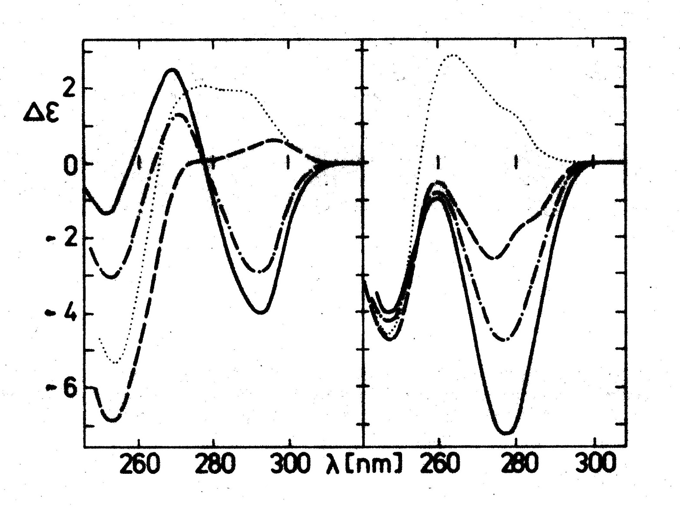
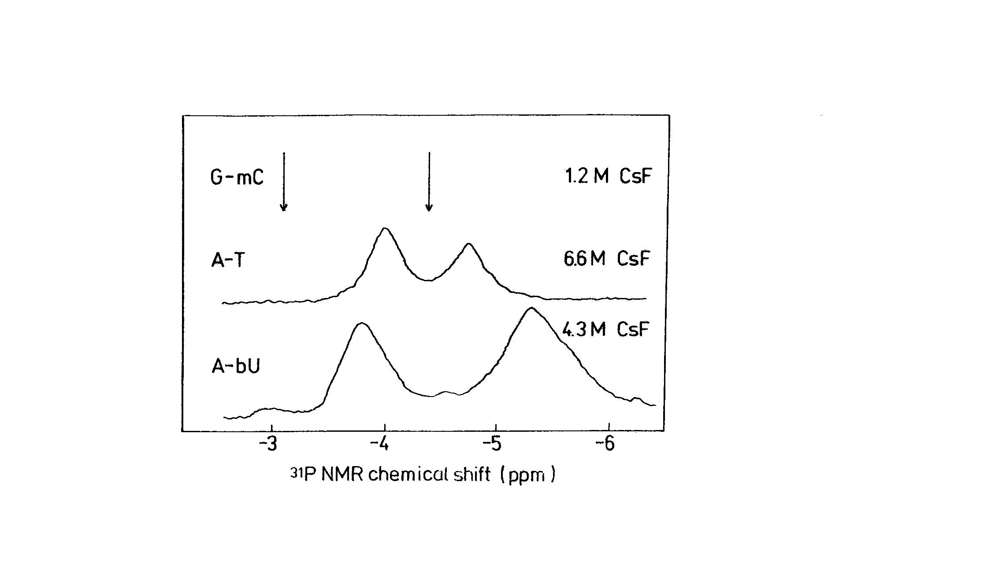
ATATATATATATATATATATATATATATATATATATA
Z
mC-G
³¹P NMR
X
TpA
ApT
Vorlíčková, M., Sklenář, V., Kypr, J.: Salt-induced Conformational Transition of Poly[d(A-T)] J. Mol. Biol. 166 (1983) 85-92

Slide 26
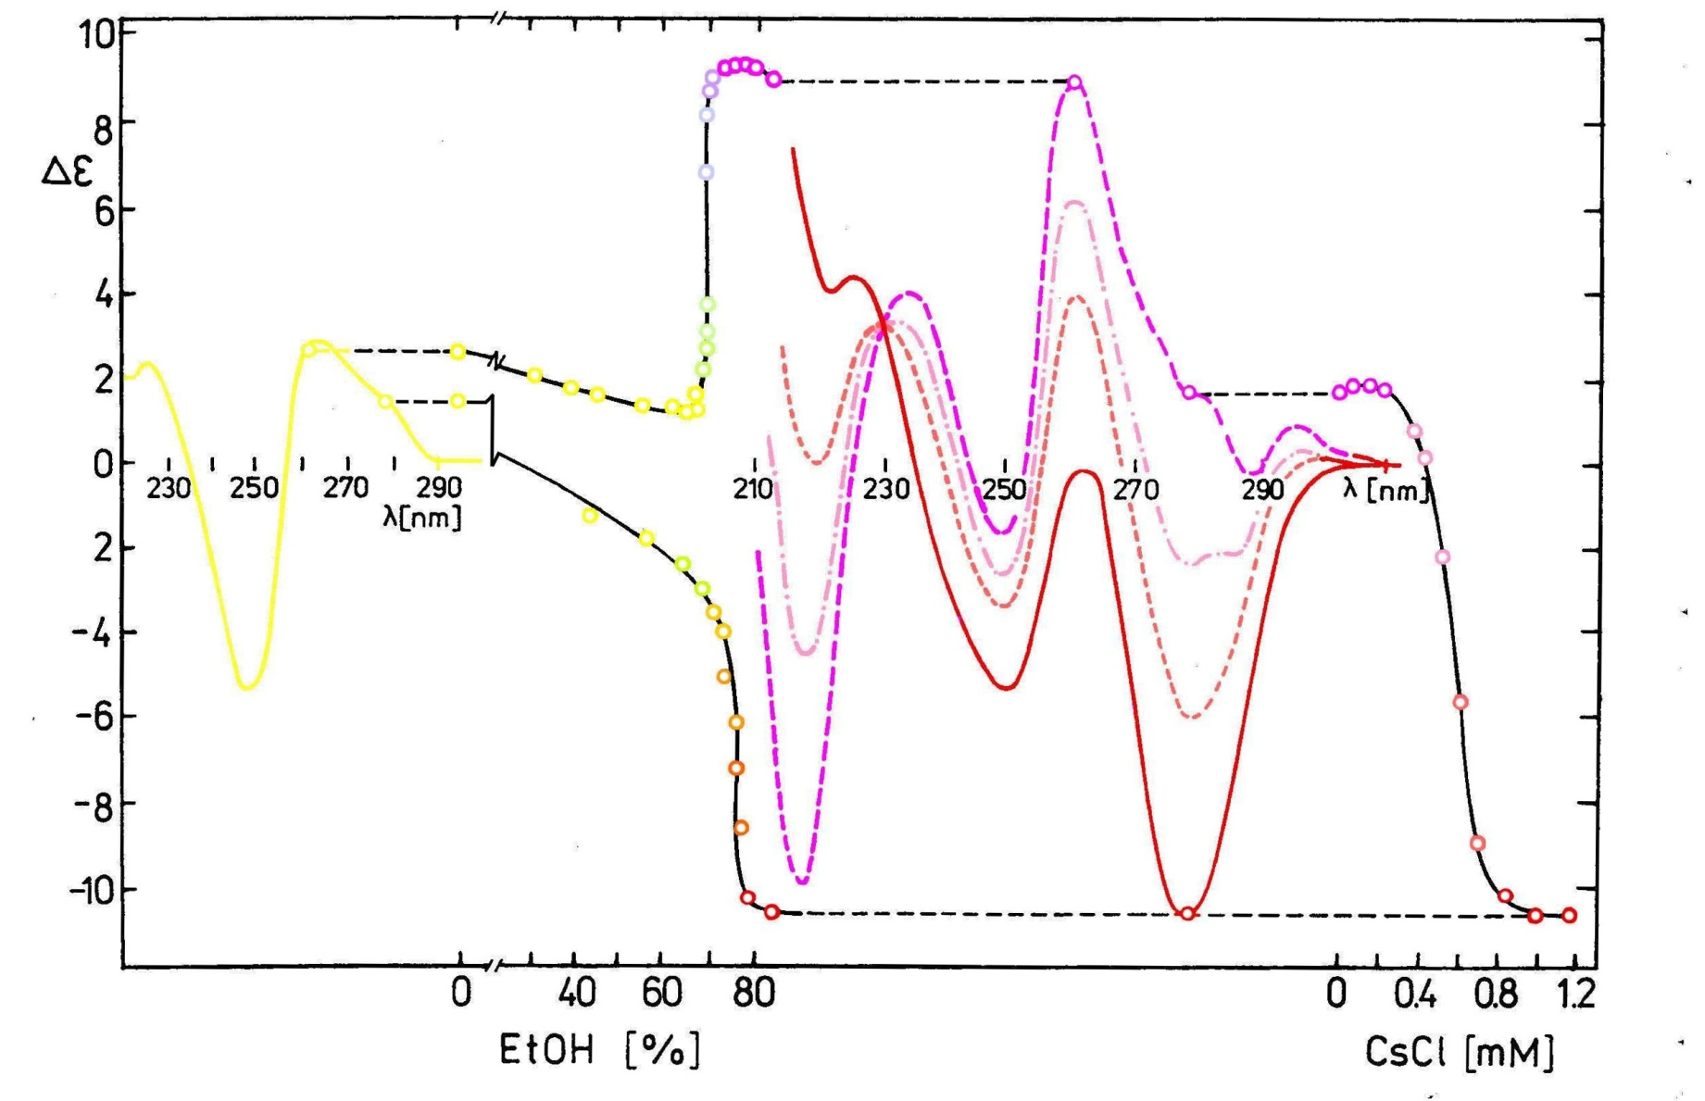
ATATATATATATATATATATATATATATATATATATA
A
B
B-A
A-X
B-X
X

Slide 27
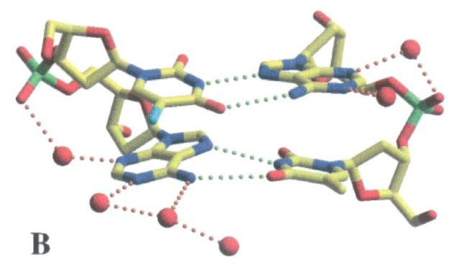
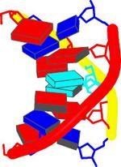
Antiparallel duplex of alternating A-T fragment with Hoogsteen base pairing.
Abrescia, N.G.A., Thompson, A., Huynh-Dinh, T., Subirana, J.A.: Alternating A-T fragment with Hoogsteen base pairing. Proc.Nat.Acad.Sci.USA , 99 (2002) 2806 – 2811.

Slide 28
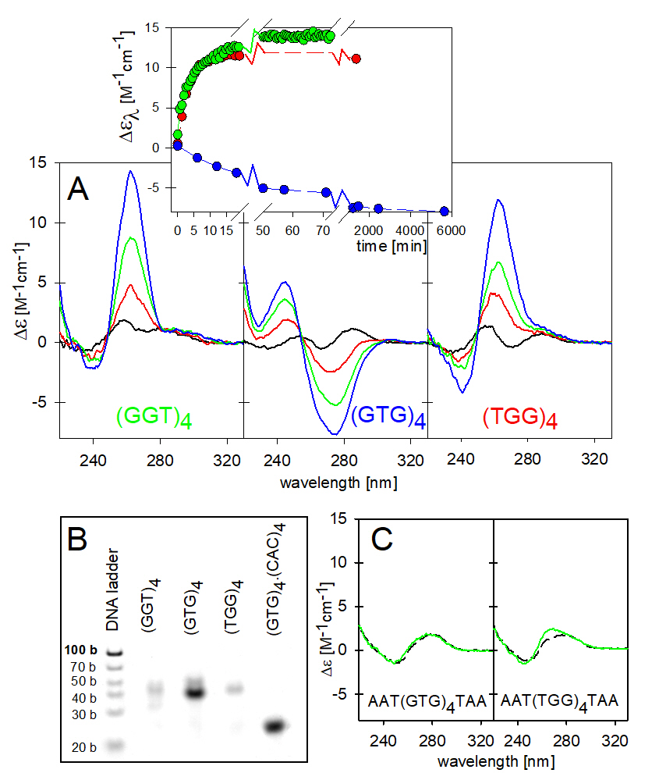
(TA)n
Z forms

Slide 29
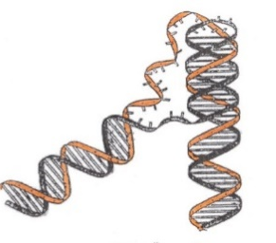
Alternating (Pu-Py)_{n}
(Pu)_{n} . (Py)_{n} complexes
(dG)n. (dC)n
…
G
C
G
C
G
C
…
…
G
G
G
G
G
G
…
B
A
Z
C
G
C
G
C
G
C
C
C
C
C
C
…
A
T
A
T
A
T
…
…
A
A
A
A
A
A
…
B
A
X
Z
T
A
T
A
T
A
(dA)n.(dT)n
T
T
T
T
T
T
A
…
A
C
A
C
A
C
…
…
A
G
A
G
A
G
…
B
Z
X
T
G
T
G
T
G
T
C
T
C
T
C
(dA-dG)n.(dC-dT)n

Slide 30

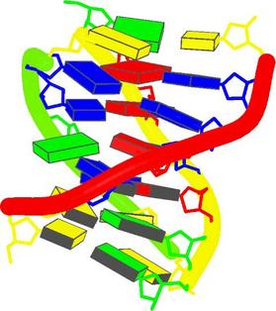
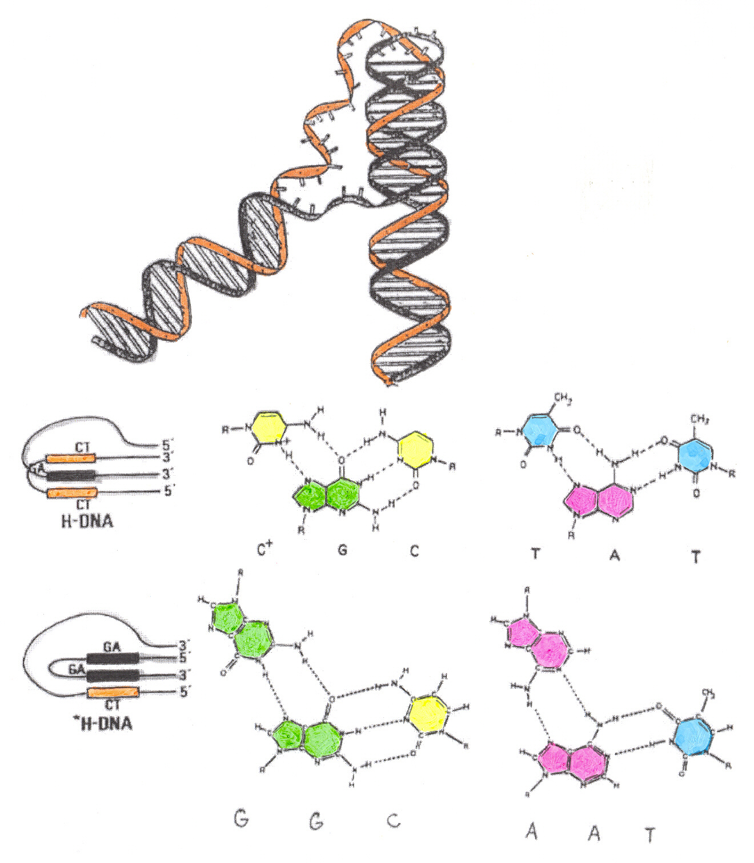
DNA Triplex
Pyrimidine. Purine. Pyrimidine
Radhakrishnan, I., Patel, D.J. (1994)

Slide 31
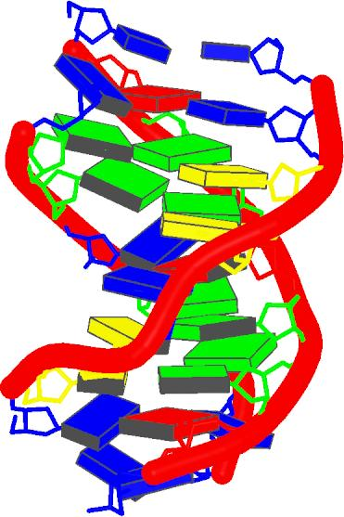
DNA TRIPLEX
T C C T C C T T T T T T A G G A G G A T T T T T T G G T G G T
Radhakrishnan, I., Patel, D.J. (1993)
Pyrimidine. Purine. Purine

Slide 32
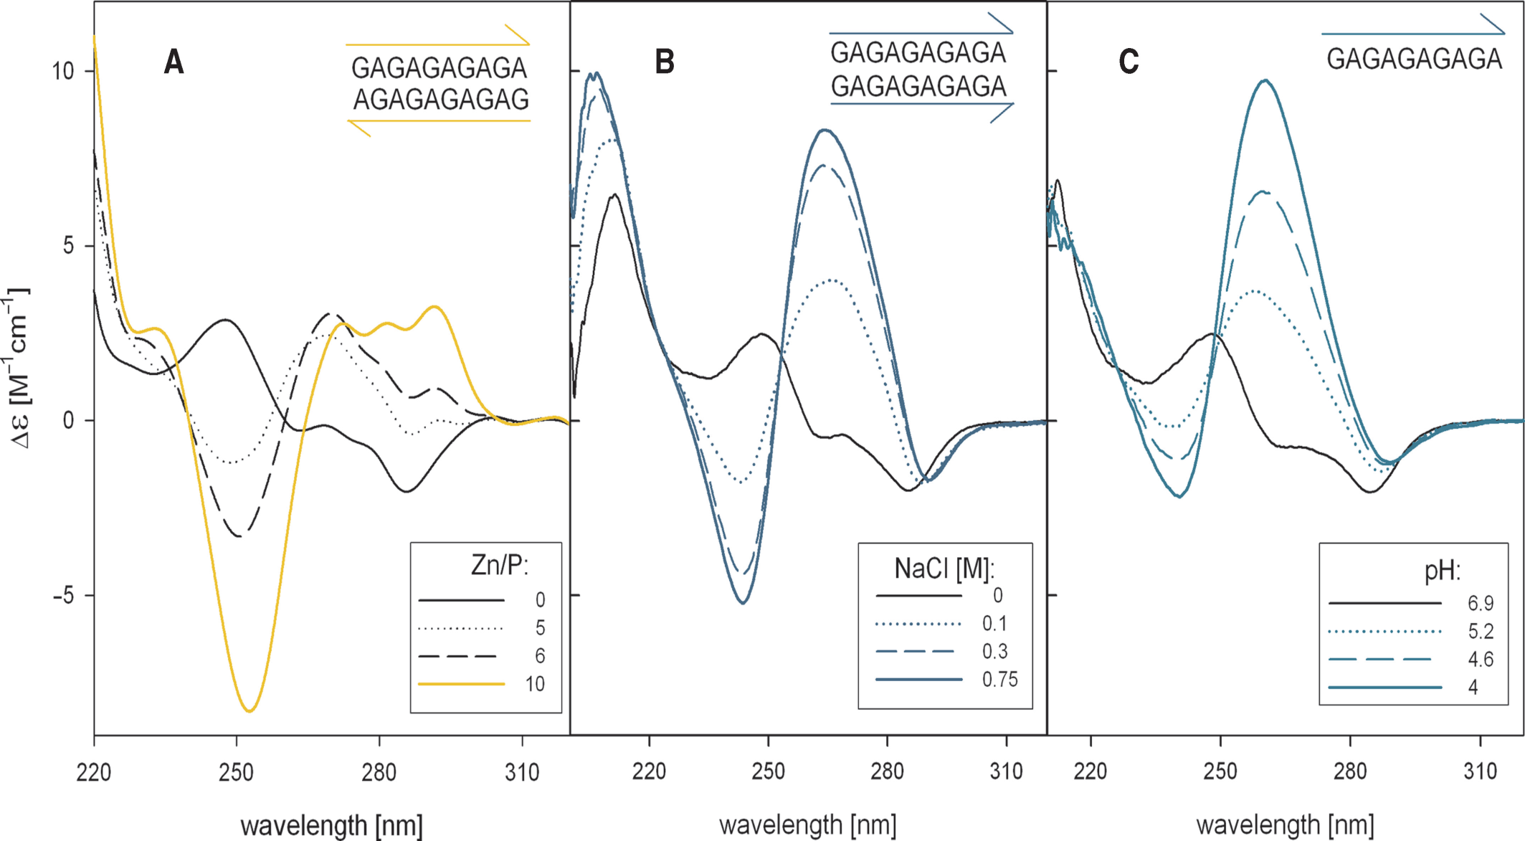
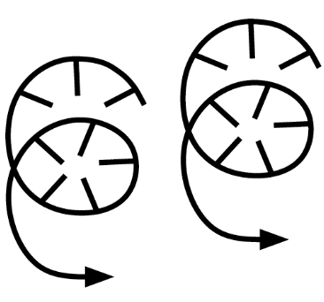
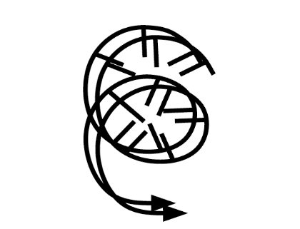
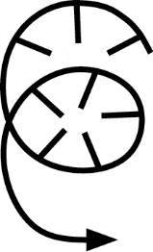
.
.
A Casasnovas, J.M., et al. Azorin, F.:. Structural polymorphism of d(GA.TC)_{n} DNA sequences. Intramolecular and intermolecular associations of the individual strands. J. Mol. Biol. 233 (1993) 671-6811.
B Rippe, K., Fritch, V., Westhof, E., Jovin, T.M.: Alternating d(G-A) sequences form a parallel-stranded DNA homoduplex. EMBO J. 11 (1992) 3777-3786.
C Dolinnaya, N. G., Fresco, J. R: Single-stranded nucleic acid helical secondary structure stabilized by ionic bonds: d(A+-G)10. Proc. Natl. Acad. Sci. USA 89 (1992) 9242-9246.
C Vorlícková, M., Kejnovská, I., Kovanda, J., Kypr, J.: Dimerization of the guanine-adenine repeat strands of DNA. Nucleic Acids Research, 1999, Vol. 27, No. 2 581–586.

Slide 33
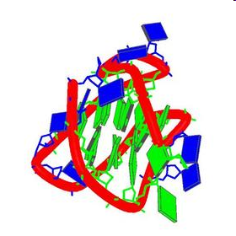
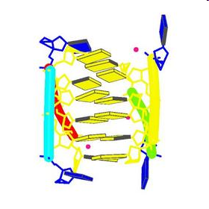
Quadruplexes
frequently occur in promoters of genes and were shown to control their expression.
Kang, C.H. et al.(1994)

Slide 34
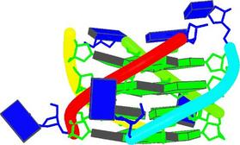
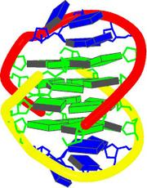
CD spectra reflecting formation of a parallel and antiparallel
guanine quadruplex
K
DNA
DNA
Penazova, H., Vorlickova, M.
Guanine tetraplex formation by short DNA fragments containing runs of guanine and cytosine.
Biophys. J. 73 (1997) 2054-2063
RNA

Slide 35
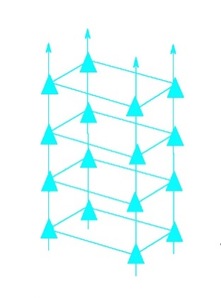
Fragment of Pu-27 promoter c-myc: (1998)
TGGGGAGGGTGGGGAGGGTGGGGAAGG
K⁺
WAVELENGTH [nm]

Slide 36
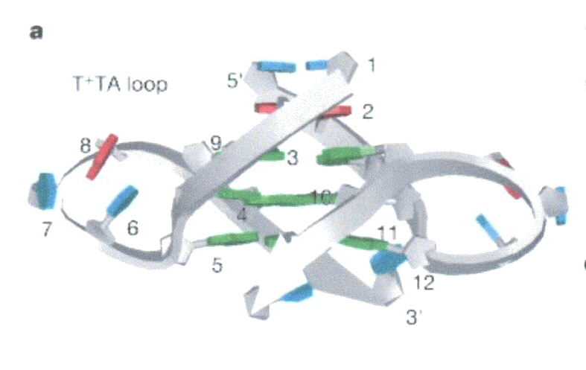



d(TAGGGTTAGGGT) 12
d[AGGG(TTAGGG)3]
Phan, A.T. et al.:
J.Am.Chem.Soc.126(2004)8710
Parkinson, G.N., Lee, M.P.H, Neidle, S.
Nature 417 (2002) 876-880.

Slide 37


Human telomeric DNA forms quadruplex
Xu, Y.: Chem. Soc. Rev. (2011)
Telomeric DNA is associated with aging
Telomerase – does not get older – ageless, immortal
Quadruplex does not allow telomerase to get on the sequence
The telomere quadruplex became a target for developing anticancer drugs

Slide 38



Vorlíčková, M., Chládková, J., Kejnovská, I., Fialová, M., Kypr, J.:
Guanine quadruplex topology of human telomere DNA is governed by the number of (TTAGGG) repeats.
Nucleic Acids Res. 33 (2005) 5851-5860.
G3(TTAG3)_{n} in 150 mM K⁺
1mM Na phosphate
3+1
wavelength [nm]
Number of
G3 blocks
3 4 5 6 7 8 9 10 12 14 16
2

Slide 39




3 + 1
3 + 1
K⁺
syn
AG₃(TTAG₃)₃ TAG₃(TTAG₃)₃ AAAG₃(TTAG₃)₃AA
anti
TAG₃(TTAG₃)₃TT
Luu, K.N., Phan, A.T., Kuryavyi, V., Lacroix, L., Patel, D.J. (2006) J.Am.Chem.Soc., 128, 9963-9970.
Ambrus, A., Chen, D., Dai, J., Bialis, T., Jones, R.A., Yang, D. (2006) Nucleic Acids Res. 34, 2723–2735.
Phan, A. T., Luu, K.N., Patel, D.J. (2006) Nucleic Acids Res., 34, 5715-5719.

Slide 40
Vorlíčková, M., Chládková, J., Kejnovská, I., Fialová, M., Kypr, J.:
Guanine quadruplex topology of human telomere DNA is governed by the number of (TTAGGG) repeats.
Nucleic Acids Res. 33 (2005) 5851-5860.
G3(TTAG3)_{n} in 150 mM K⁺
1mM Na phosphate
How does the structure of the long telomere DNA look like?
3+1
wavelength [nm]
Number of
G3 blocks
3 4 5 6 7 8 9 10 12 14 16
2

Slide 41






Vorlíčková, M., Chládková, J., Kejnovská, I., Fialová, M., Kypr, J.:
Guanine quadruplex topology of human telomere DNA is governed by the number of (TTAGGG) repeats.
Nucleic Acids Res. 33 (2005) 5851-5860.
Long telomere molecules have a beads on a string- like arrangement
Xu, Yet al.
Angev. Chemie (2009)
enthalpy
What is the structure of the bead?

Slide 42








BASKET
CHAIR
PARALLEL
G₃(TTAG₃)₃
AG₃(TTAG₃)₃ TTAG₃(TTAG₃)₃
AG₃(TTAG₃) ₃
AG₃(TTAG₃)₃
Parkinson, Lee, Neidle:
Nature 417 (2002) 876-880.
He et al.:Nucleic Acids Res. 32 (2004) 5359-5367.
Matsugami, et al.:. Nucleic acids symp. Series 50 (2006) 45-46.
Xu et al.: Bioorg.& Medicinal Chem.
14 (2006)5584 – 5591.
3 + 1
2 + 2
Balagurumoorthy, Brahmachari: J. Biol. Chem. 269 (1994) 21858-21869.
Redon et al.: Nucleic Acids Res. 31 (2003) 1605-1613.
3 +1
TAG₃(TTAG₃)₃TT
TTAG₃(TTAG₃)₃TTA
Phan, at al.: Nucleic Acids Res. 34 (2006) 5715-5719.
Lim et al.: Nucleic Acids Res. 41 (2013) 10556-10562.
AG₃(TTAG₃)₃ TAG₃(TTAG₃)₃
AAAG₃(TTAG₃)₃AA
BASKET
two tetrads
acidic form
Luu, et al.: J.Am.Chem.Soc., 128 (2006) 9963-9970.
Ambrus, et al.: Nucleic Acids Res. 34 (2006) 2723–2735.
anti
G₃(TTAG₃) ₃T
TAG₃(TTAG₃)₃
syn
Lim, et al.: J.Am.Chem.Soc. 131 (2009) 4301–4309.
Galer et all.: Angewandte Chem. 55 (2016) 1993-1997.

Slide 43






Different quadruplex structures observed for the same sequence at the same solvent conditions
nucleoside conc:
200 mM
120 mM
55 mM
16 mM
0.8 mM
( 0.1 mM)
K⁺
The arrangement of the human telomere quadruplex is polymorphic
AG₃(TTAG₃)₁₆
Renciuk, D., Kejnovska, I., Skolakova, P., Bednarova, K., Vorlickova, M.:
Arrangements of human telomere DNA quadruplex
in physiologically relevant K+ solutions
Nucleic Acids Research 37 (2009) 6625-6634

Slide 44



i - motif
Gehring, K., Leroy, J.L., Gueron, M.:
A tetrameric DNA structure with protonated cytosine.cytosine base pairs. Nature 363 (1993) 561-565.
Two parallel duplexes bound by C.C⁺ pairs
are intercalated in the antiparallel fashion

Slide 45


Simonsson, T., Přibylová, M., Vorlíčková, M.: Biochem. Biophys. Res.Commun.278 (2000) 158–166
Fragmenty promotoru c-myc
Human c-myc Promoter Fragment
TCCCCACCTTCCCCACCCTCCCCACCCTCCCCA

Slide 46
) Školáková, P., Renčiuk, D., Palacký, J., Krafčík, D., Dvořáková, Z., Kejnovská. I., Bednářová, K., Vorlíčková, M.: Systematic investigation of sequence requirements for DNA i-motif formation. Nucleic Acids Research 47 (2019) 2177–2189.
) Dvořáková, Z., Renčiuk, D., Kejnovská, I., Školáková, P., Bednářová, K., Sagi, J. Vorlíčková, M.: i-Motif of cytosine-rich human telomere DNA fragments containing natural base lesions. Nucleic Acids Research Nucleic Acids Research 46 (2018) 1624-1634.
(C3Tx)3Cn
Three nucleotides in the loop are optimal for intramolecular iM formationare
Single nucleotides in the loop result in bimolecular iM
One C is spent for loop in the case of two non-C nucleotides in the loop
Strictly alternating C.C+ pairing
Is required for iM stability

Slide 47
) Školáková, P., Renčiuk, D., Palacký, J., Krafčík, D., Dvořáková, Z., Kejnovská. I., Bednářová, K., Vorlíčková, M.: Systematic investigation of sequence requirements for DNA i-motif formation. Nucleic Acids Research 47 (2019) 2177–2189.
) Dvořáková, Z., Renčiuk, D., Kejnovská, I., Školáková, P., Bednářová, K., Sagi, J. Vorlíčková, M.: i-Motif of cytosine-rich human telomere DNA fragments containing natural base lesions. Nucleic Acids Research Nucleic Acids Research 46 (2018) 1624-1634.
(CnT3)3Cn

Slide 48
) Školáková, P., Renčiuk, D., Palacký, J., Krafčík, D., Dvořáková, Z., Kejnovská. I., Bednářová, K., Vorlíčková, M.: Systematic investigation of sequence requirements for DNA i-motif formation. Nucleic Acids Research 47 (2019) 2177–2189.
) Dvořáková, Z., Renčiuk, D., Kejnovská, I., Školáková, P., Bednářová, K., Sagi, J. Vorlíčková, M.: i-Motif of cytosine-rich human telomere DNA fragments containing natural base lesions. Nucleic Acids Research Nucleic Acids Research 46 (2018) 1624-1634.
(CnT3)3Cn

Slide 49


Iva Kejnovská
Jan Palacký
Petra Školáková
Klára Bednářová
Zuzana Dvořáková
Daniel Renčiuk
Jaroslav Kypr
Jean-Louis Mergny
Jiří Šponer
Lukáš Trantírek
Jiří Fajkus
Miroslav Fojta
mifi@ibp.cz

Slide 50
CHIROPTICKÉ METODY
Optical Rotatory Dispersion - ORD
Závislost úhlu stočení roviny polarizace lineárně polarizovaného světla průchodem opticky aktivní látkou na vlnové délce procházejícího záření. (180-800 nm)
Circular Dichroism-CD
Závislost rozdílu absorpce pro vlevo a vpravo kruhově polarizované světlo na vlnové délce absorbovaného záření v oblasti energií elektronových přechodů. (180-1000 nm)
Infrared Circular Dichroism-IRCD (VCD)
Závislost rozdílu absorpce pro vlevo a vpravo kruhově polarizované světlo na vlnové délce absorbovaného záření v oblasti energií vibračních přechodů. (1-5 um)
Fluorescence Detected circular Dichroism -FDCD
Závislost rozdílu intenzity fluorescence, excitované vlevo a vpravo kruhově polarizovaným světlem na vlnové délce excitačního záření. (~ 200 nm až vlnová délka emise)
Circulary Polarized Luminiscence (emission) - CPL (CPE)
Spektrální průběh rozdílu intenzit (spontánní) emise vlevo a vpravo cirkulárně polarizovaného světla. (Interval vlnových délek emise chromoforu)
Circular Diferential Raman Dispersion - Raman CID
Spektrální průběh rozdílů intenzit Ramanova rozptylu vlevo a vpravo kruhově polarizovaného dopadajícího záření. (Interval vlnových délek Ramanova jevu)

