Slide 1
S5015
Light microscopy methods in biology
Lecture 1: History and principles of light microscopy
Milan Ešner
Cellular Imaging Core Facility, Ceitec MU
milan.esner@ceitec.muni.cz

Slide 2
S5015 : Light microscopy methods in biology
Lecture 1: September 30, 2021 at 9:00
History of microscopy, fundamentals of light microscopy. Contrasting techniques in transmitted light microscopy – brightfield, darkfield, phase contrast, DIC.
Widefield fluorescence microscopy - deconvolution, point spread function, point spread function measurements, description.
Detectors in widefield microscopy, filters, light sources.
Lecture 2: October 14, 2021 at 9:00
Confocal microscopy - principles, types of confocal microscopes – scanning, spinning disc, channel vs spectral imaging, linear unmixing.
Lasers, detectors, beam splitters, optical sections. Lightsheet microscopy.
Lecture 3: October 25, 2021 at 9:00
Imaging below diffraction limits – SIM, SMLM, STED
Lecture 4: November 4, 2021 at 9:00
Basics of Image analysis – image types, pixels, voxels, basic filters, image processing, metadata, deconvolution, 3D visualization,
objects detection, quantification.
Practical 1: December 14, 2021 at 9:00
Transmitted light microscopy, widefield fluorescence, confocal, Apotome, SIM
Practical 2: December 15, 2021 at 9:00
Sample preparation, single molecule localization microscopy acquisition and analysis, deconvolution.

Slide 3
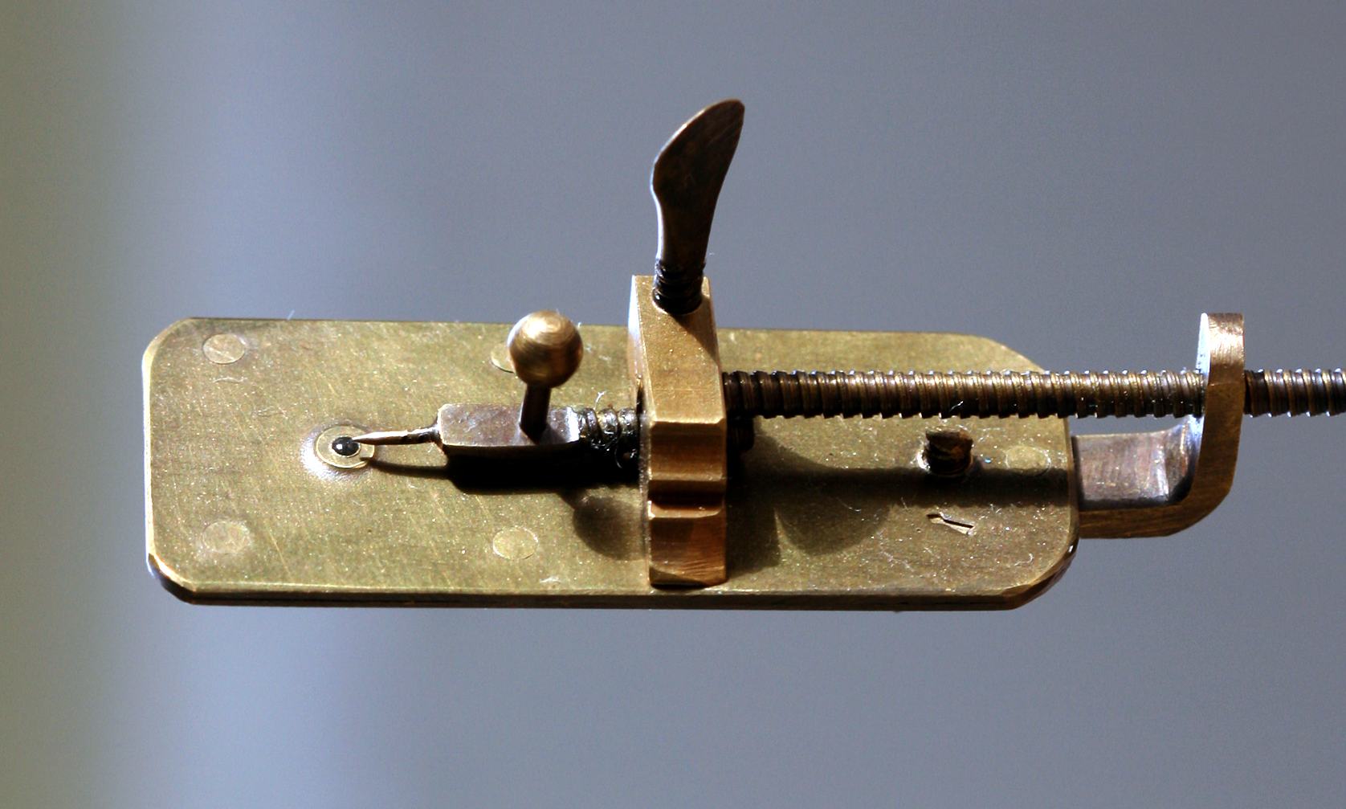
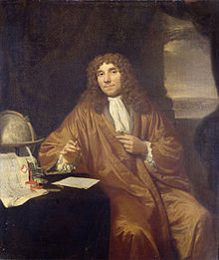
Antonie van Leeuwenhoek (1632 – 1723)
Dutch businessman and scientist. Best known for his pioneering work in microscopy. Used single lens microscope
of his own design.

Slide 4
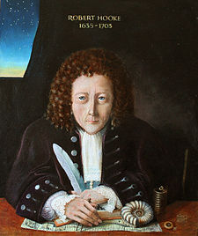
Robert Hooke (1635 – 1703)
English scientist, philosopher, architect and polymath. Improved design of compound microscope and use it
for scientific exploration – book Micrographia. Use term <cell> in biological context.

Slide 5
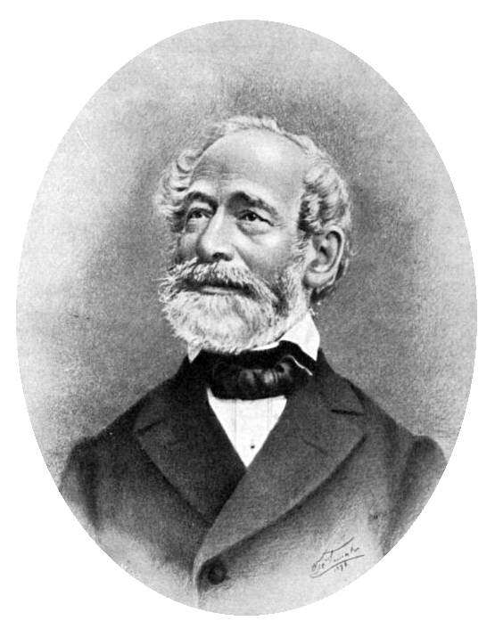
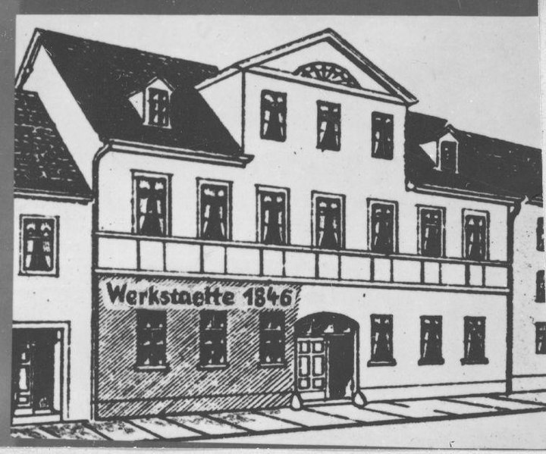
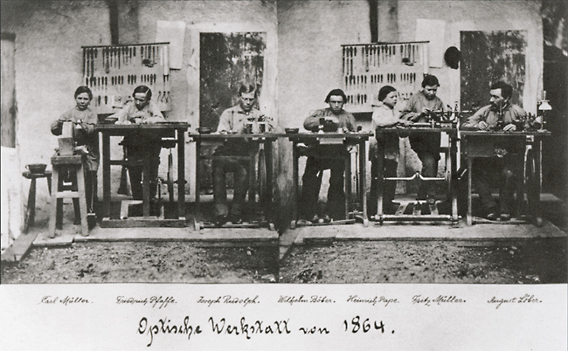
Carl Zeiss (1816 – 1888)
German scientific instrument maker, optician and businessman. Founder of Carl Zeiss workshop in 1864
together with Ernst Abbe and Otto Schott in Jena, Germany.

Slide 6
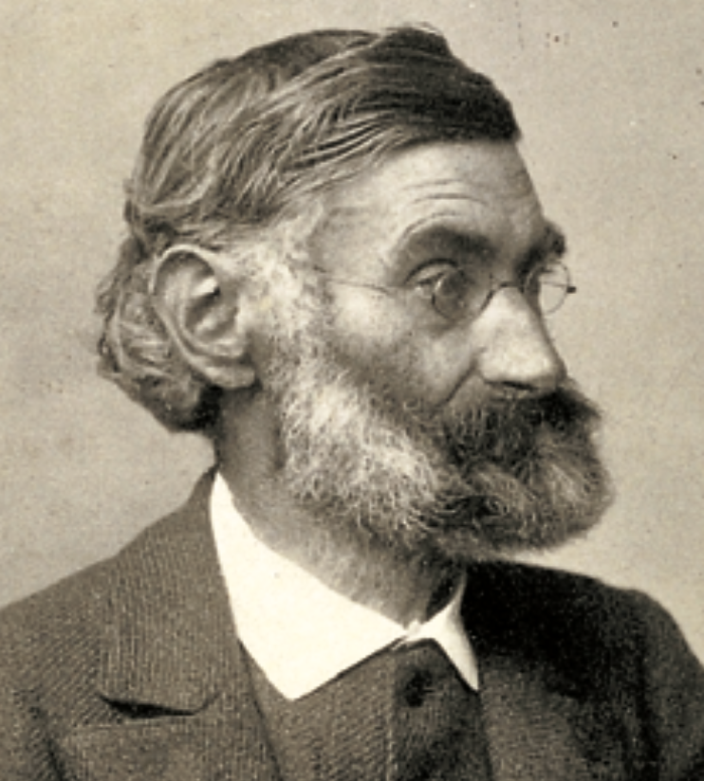
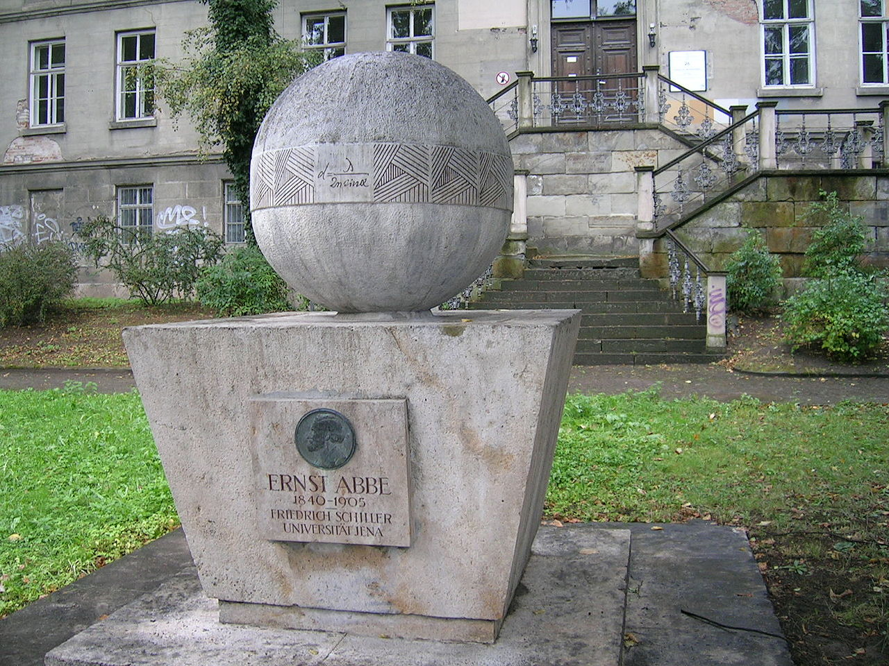
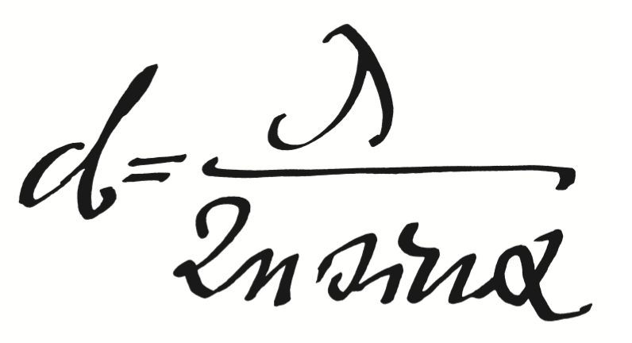
Ernst Abbe (1840 – 1905)
German physicist, optical scientist, entrepreneur and social reformer. With Zeiss and
Schott he developed numerous optical instruments. Among his inventions are apochromatic lens,
Abbe condenser, refractometer.
He defined numerical aperture -> mathematically describing optical resolution of light microscopes.
He was also strongly implicated in unions and workers rights. In Zeiss he introduced 8-hour workday.

Slide 7
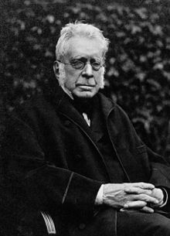
George Biddell Airy (1801 – 1892)
English mathematician and astronomer. He established Greenwich as the location
of the prime meridian. His main contribution to microscopy was explaining of
formation of concentric diffraction pattern around the bright spot of light,
named after him – Airy disc.

Slide 8
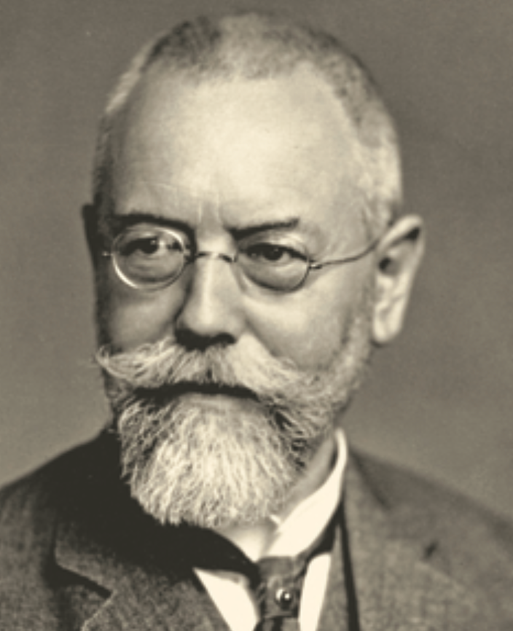
August Koehler (1866 – 1948)
German optical scientist. He developed and improved light illumination of sample, Koehler illumination.

Slide 9
Siedentopf and Zsigmondy
First concept of light sheet microscope – illumination objective orthogonally to detection objective. Zsigmondy received Nobel prize for chemistry in 1925 for his research on colloid solutions.

Slide 10
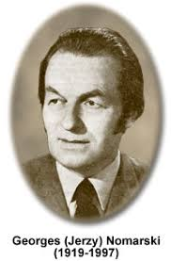
Frits Zernike (1888 – 1966)
Georges Nomarski
(1919-1997)
Dutch physicist. Invented phase contrast microscopy. Producing high contrast images of
transparent samples, hardly visible in standard bright field transmitted light imaging.
Widely used technique of contrast enhancing. Received Nobel prize in 1953.
Polish physicist. Developed differential interference contrast (DIC) –
contrast enhancing technique based on polarized light.

Slide 11
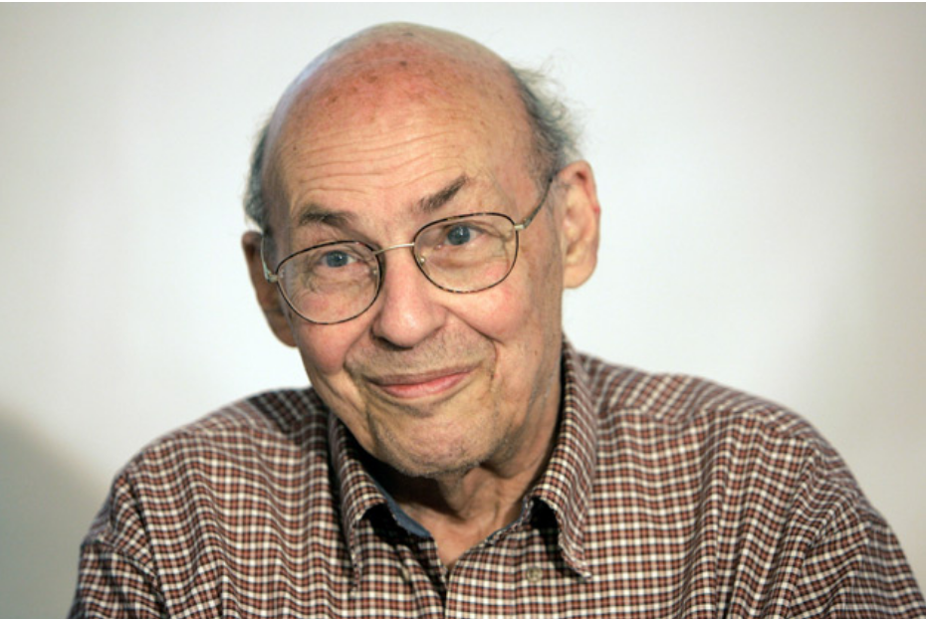
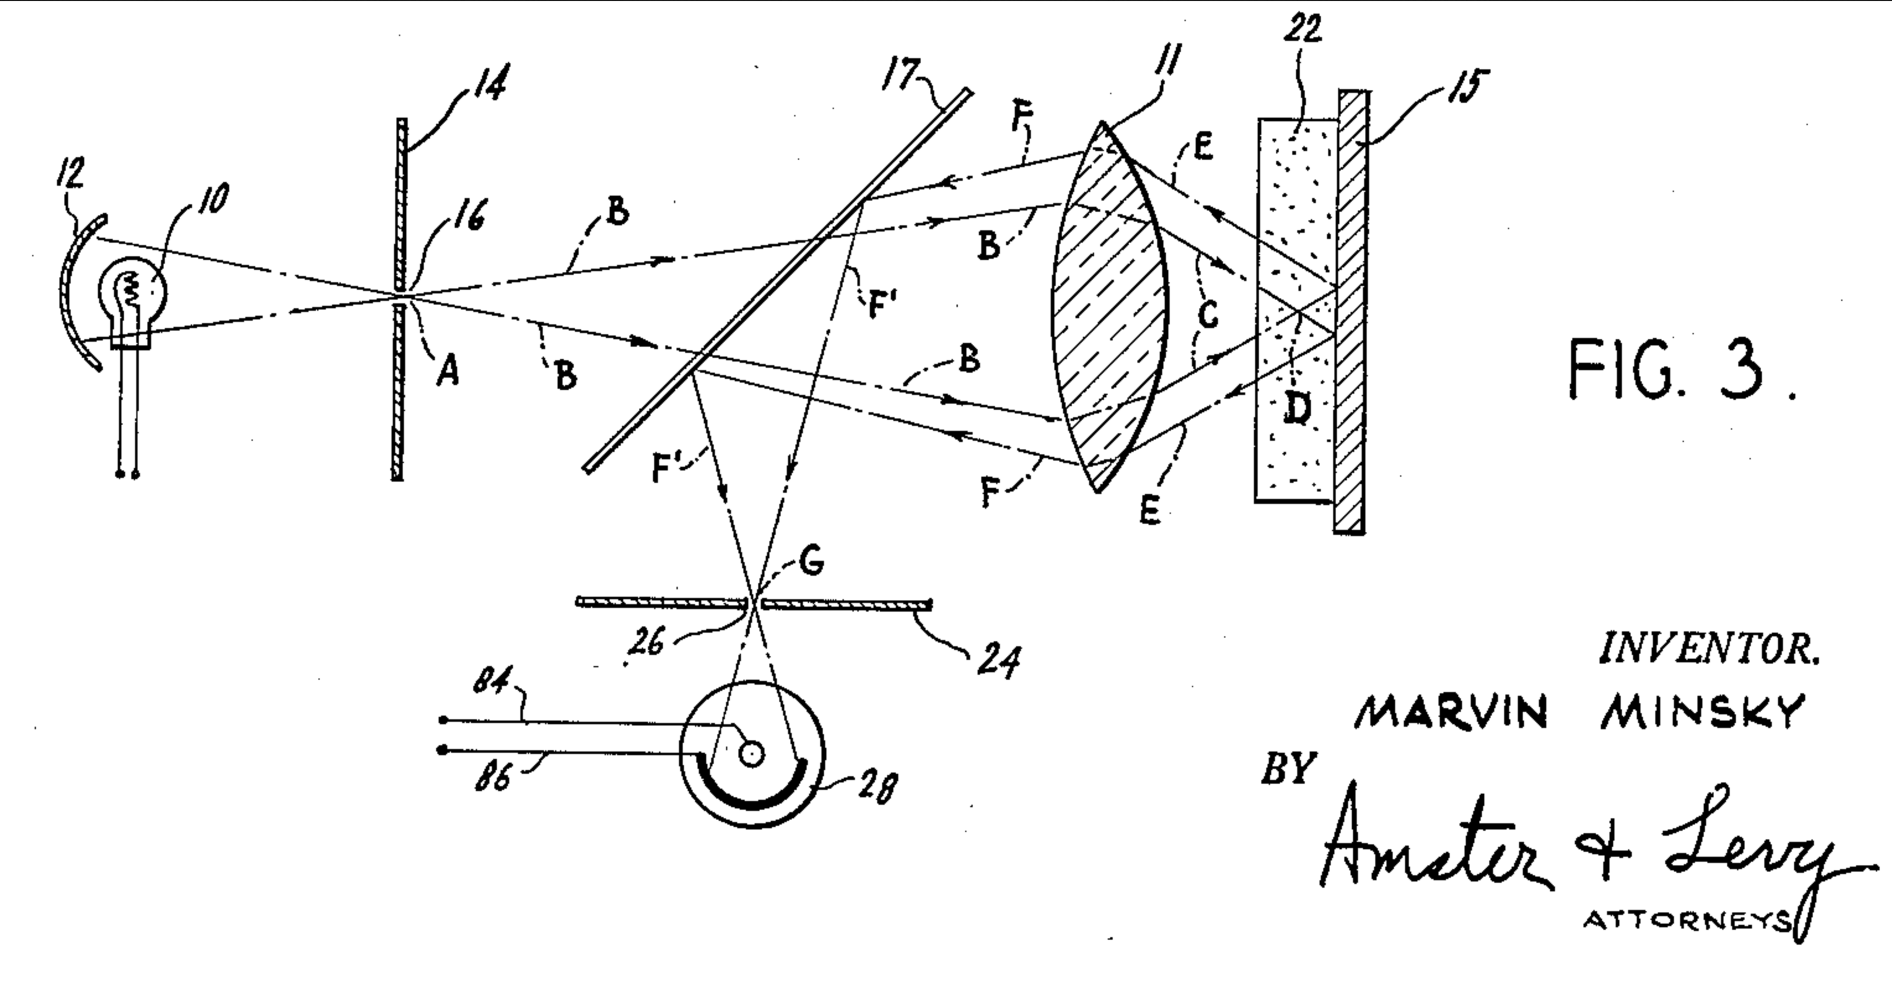
Marvin Minsky (1927-2016)
American scientist, doing mainly research of artificial intelligence. He is
Co-founder of Massachusetts Institute of Technology (MIT).
He developed first scanning confocal microscope in 1957.

Slide 12
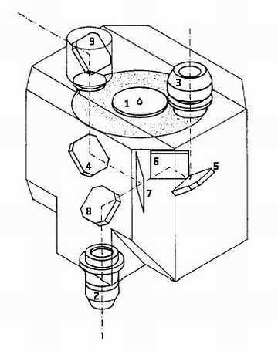
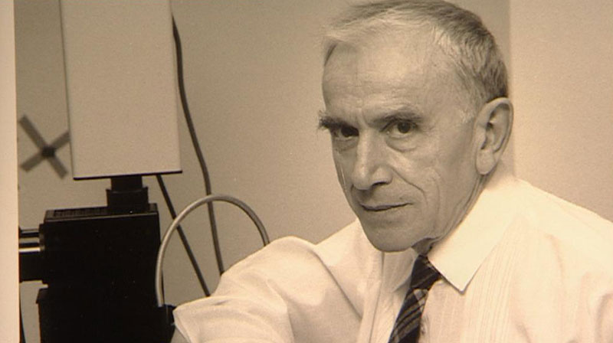
Mojmír Petráň (*1923)
Czechoslovak scientist. Studied medicine at Charles university, Prague.
With Milan Hadravsky he developed spinning disc confocal microscope in 1964, using Nipkow disc from TV.

Slide 13
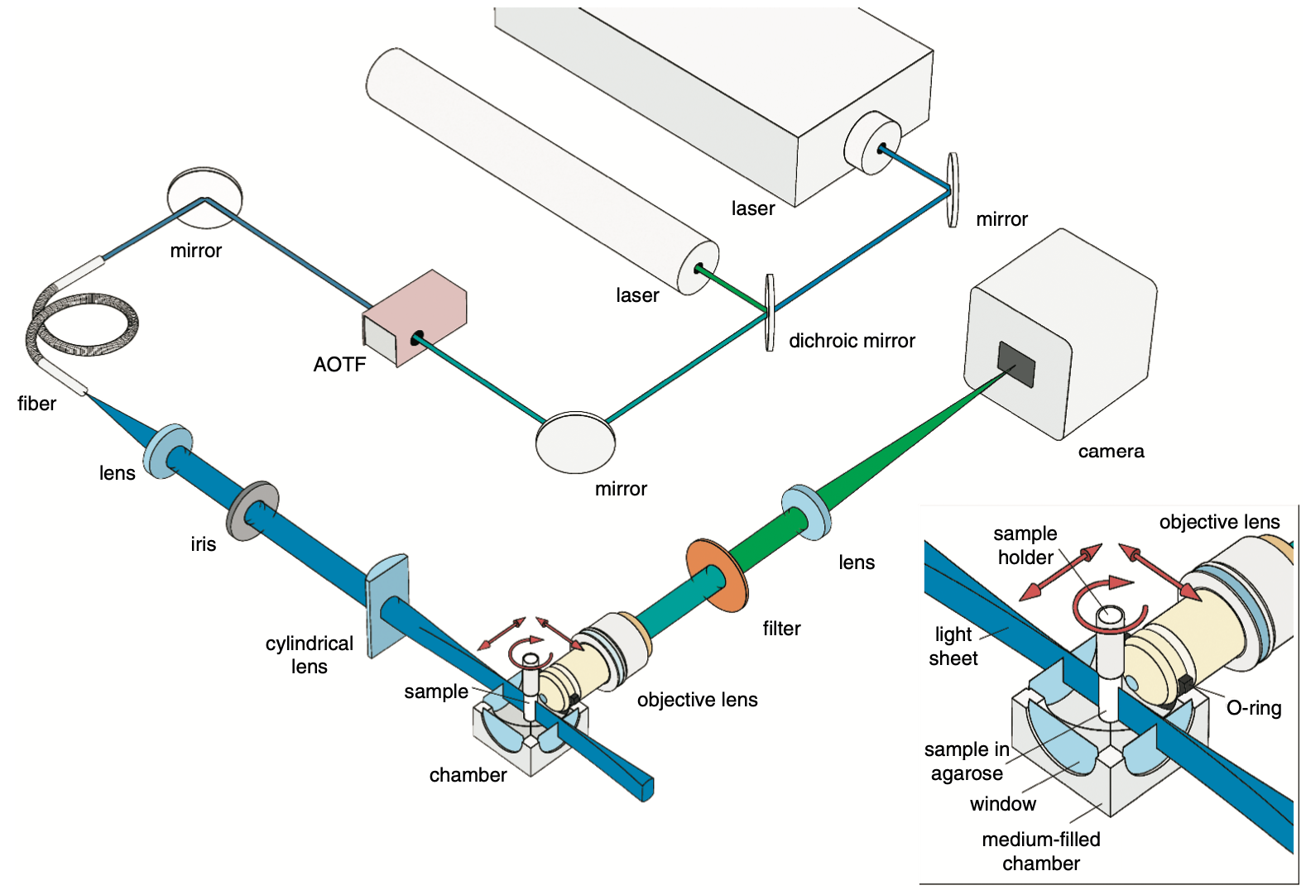
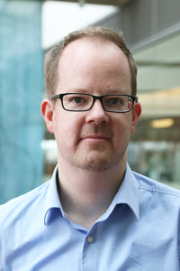
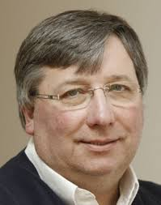
Jan Huisken, Eric Stelzer
Developed fluorescence light sheet microscope (selective plane illumination microscope) in 2004.
Almost 100 years after Siedentopf and Zsigmony microscope they built first fluorescence microscope,
using different optical paths for illumination and detection. Today exists many variants of lightsheet
microscopes and several commercial systems are available.

Slide 14
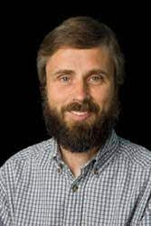
Mats Gustafsson (1960-2011)
Developped method of structured illumination microscopy SIM. SIM surpass diffraction limit of optical microscopes
and is able to achieve resolution below 100 nm.

Slide 15
Eric Betzig (*1960)
Inventor of single molecule localization technique STORM/PALM together with William Moerner and
lattice light sheet technology. Received Nobel prize in 2014 together with Eric Betzig and Stephen Hell

Slide 16
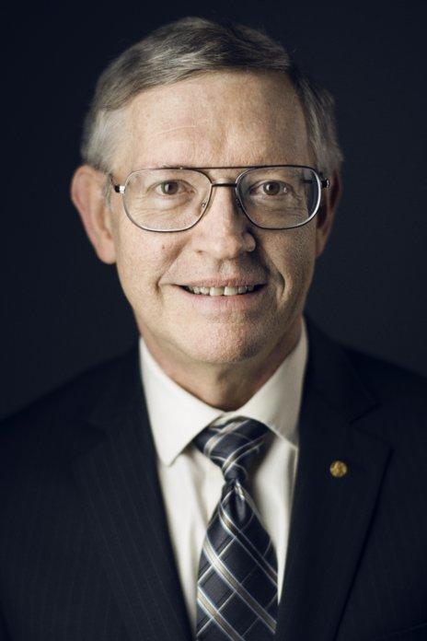
William Moerner
Contributed to development of sinlge molecule localization microscopy. Received Nobel prize in 2014 together
with Eric Betzig and Stephen Hell

Slide 17
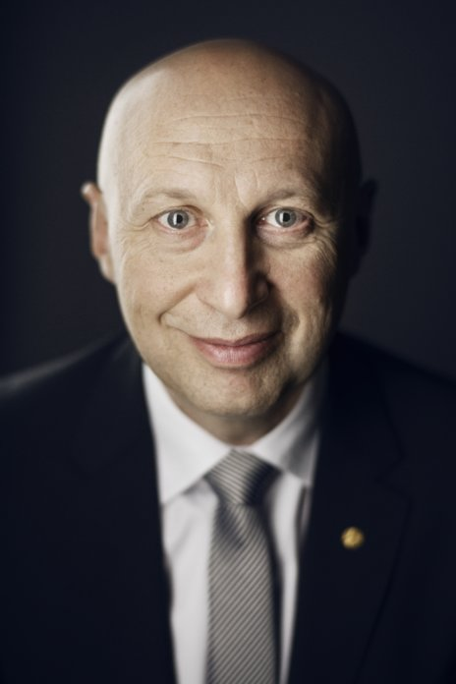
Steffen Hell
Invented stimulated emission depletion (STED) microscopy. Received Nobel prize in 2014 together
with Eric Betzig and Stephen Hell

Slide 18
Principles of light microscopy

Slide 19
Image formation
Magnification
Resolution
Contrast
In microscopy you don’t observe an OBJECT, you observe an IMAGE of the object
Three steps in image formation
1) Light diffraction by the specimen
2) collection of diffracted/non-diffracted rays by objective
3) interference of diffracted and non-diffracted rays in the image plane.

Slide 20
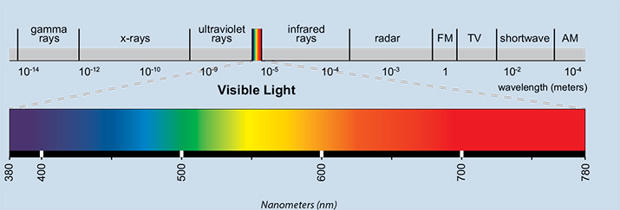
Light
Visible electromagnetic radiation with electric and magnetic fields whose amplitudes
oscillate as a sine function over dimensions of space and time.
Dual character: waves – amplitude and phase
particles – photons.
Monochromatic - single wavelength (color).
Polychromatic
Coherent – waves of the same wavelength that maintain the same phase relation.
Noncoherent
Polarized – waves with E-vectors in parallel.
Nonpolarized
Collimated – waves with the same coaxial paths of propagation (same direction).
Divergent
shorter wavelength = higher energy

Slide 21
Light diffraction
When light passes at the edge of object (opening, aperture, specimen),
light is bended on edges and passes to the area of geometrical shadow.
Due to the diffraction, Image of a point is not a point

Slide 22
Light diffraction and interference
Constructive interference

Slide 23
Light diffraction and interference
Destructive interference

Slide 24
Light diffraction and interference
3nd
2nd
1st
0
1st
2nd
3nd

Slide 25
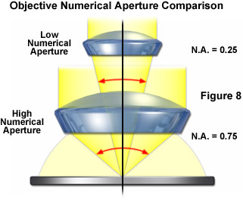
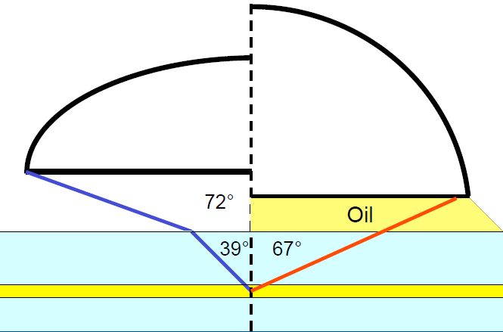
Numerical aperture
$$NA=n∗sin ⍺$$
Air objective
Oil immersion
objective
From P. Evennett
$$NA=1∗sin 72$$
$=1 ∗0.95$
$=$ 0.95
$$NA=1.515∗sin 67$$
$=$ 1.515 * 0.92
$=$ 1.4
www.zeiss-campus.magnet.fsu.edu
Immersion objectives have higher NA and therefore higher resolution.
Adjust refractive index of immersion to your medium!!!
Mowiol, prolong, vectashield –> oil immersion
Glycerol -> glycerol immersion
PBS, medium –> water immersion
Mismatch = high spherical aberrations

Slide 26
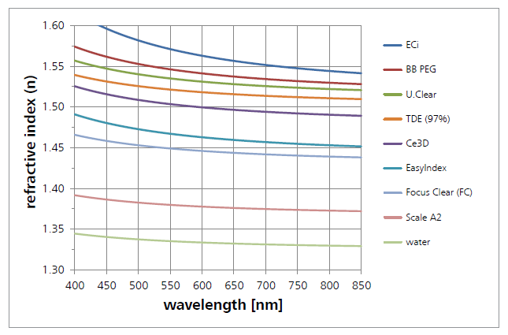
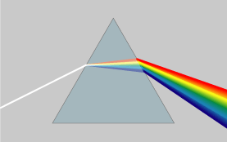
Refractive index
Refraction
Light entering to different medium changes the speed
$$n=\frac{speed of light in vacuum}{speed of light in the medium}$$
- Determines how much light is bent (refracted), when entering the material
Snell’s law:
n1 * sin(α1) = n2 * sin(α2)
α1
air
n1
$$\frac{\sin{α1}}{\sin{α2}}=\frac{n2}{n1}$$
Medium | R. Index (n)
Air | 1
Water | 1.333
Glycerol | 1.46
Immersion Oil | 1.515
Cover glass | 1.515
water
n2
α2
RI is different for every wavelength – light dispersion on prism.

Slide 27
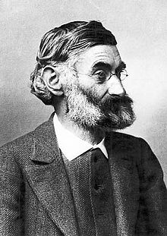
Ernst Karl Abbe
Resolution
(1840 – 1905)
Microscope
d = $\frac{λ}{2∗NA}$
Numerical aperture

Slide 28
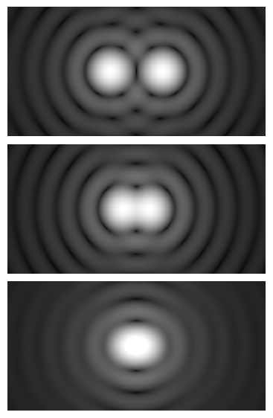
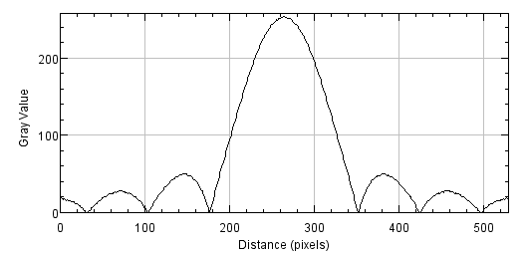
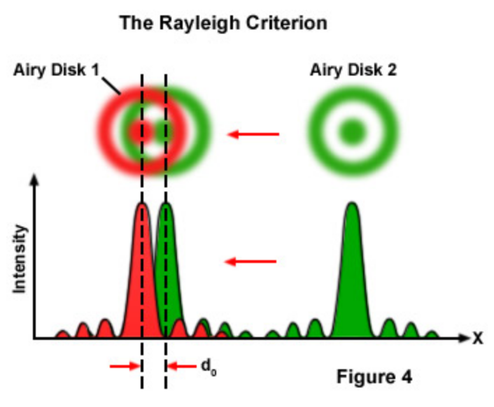
Resolution
Rayleigh criterion
Two point sources are regarded as just resolved when the principal diffraction maximum of one image coincides with the first minimum of the other.
$$−1.22 ∗ \frac{λ}{D}$$
$$1.22 ∗ \frac{λ}{D}$$
By Spencer Bliven - Own work, Public Domain, https://commons.wikimedia.org/w/index.php?curid=31456019
R: resolution/distance
R $=0.61 ∗ \frac{λ}{NA}$
λ: wavelength of light
NA: numerical aperture

Slide 29
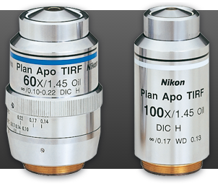
Lateral resolution
Conventional microscope
Confocal microscope
1 AU pinhole
Confocal microscope
0.25 AU pinhole
$$d=0.61∗\frac{λ_{emm}}{NA}$$
$$d=0.61∗\frac{λ_{exc}}{NA}$$
$$d=0.37∗\frac{λ_{exc}}{NA}$$
For green light (550 nm and 1.4 NA objective) d ≅ 240 nm
Limiting resolution of light microscopes (diffraction limited).
Objective | Resolved distance d (nm)
5x/0.15 | 2200
10x/0.3 | 1100
20x/0.5 | 700
40x/0.75 | 450
40x/1.3 | 260
63x/1.4 | 240
100x/1.3 | 260
Magnification does not play a role in resolution!
Only NA and λ are taken into account!

Slide 30
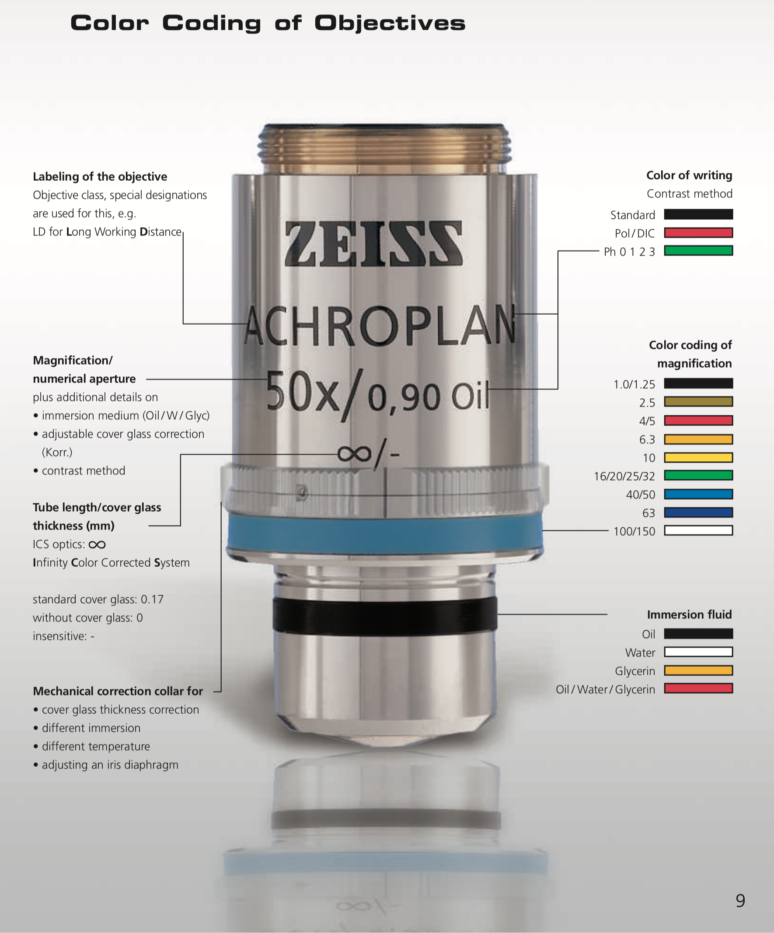
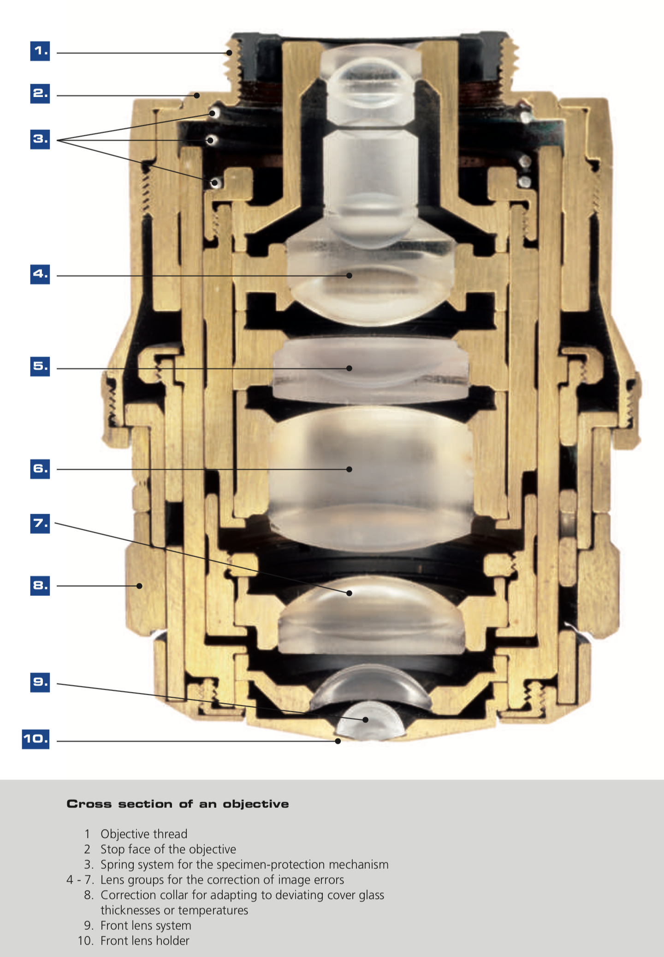
Objective coding
⍺

Slide 31
Most frequent lens abberations
Chromatic aberrations
Apochromatic objectives
F
F
Spherical aberrations
Use correct coverslip
Refraction media match
F
F

Slide 32
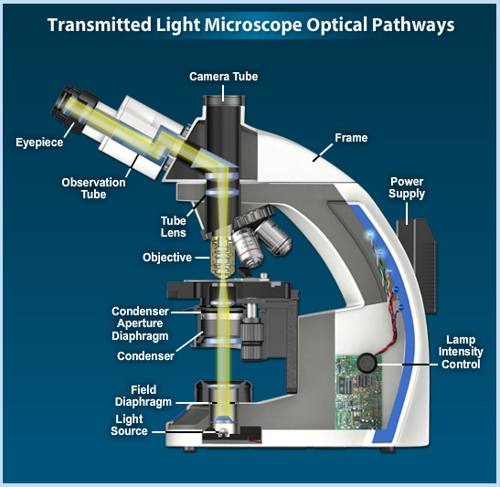
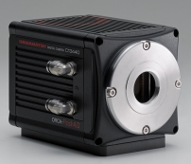
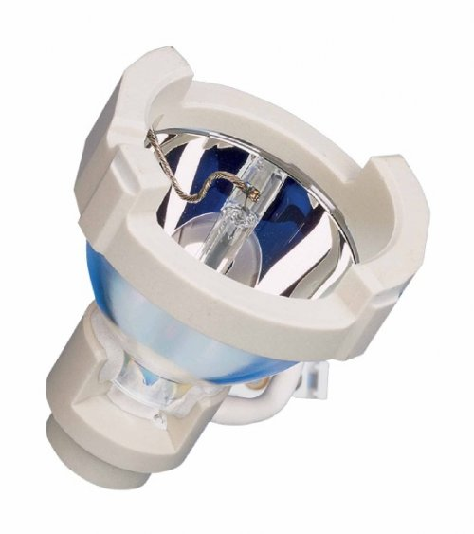
Transmitted light microscopy

Slide 33
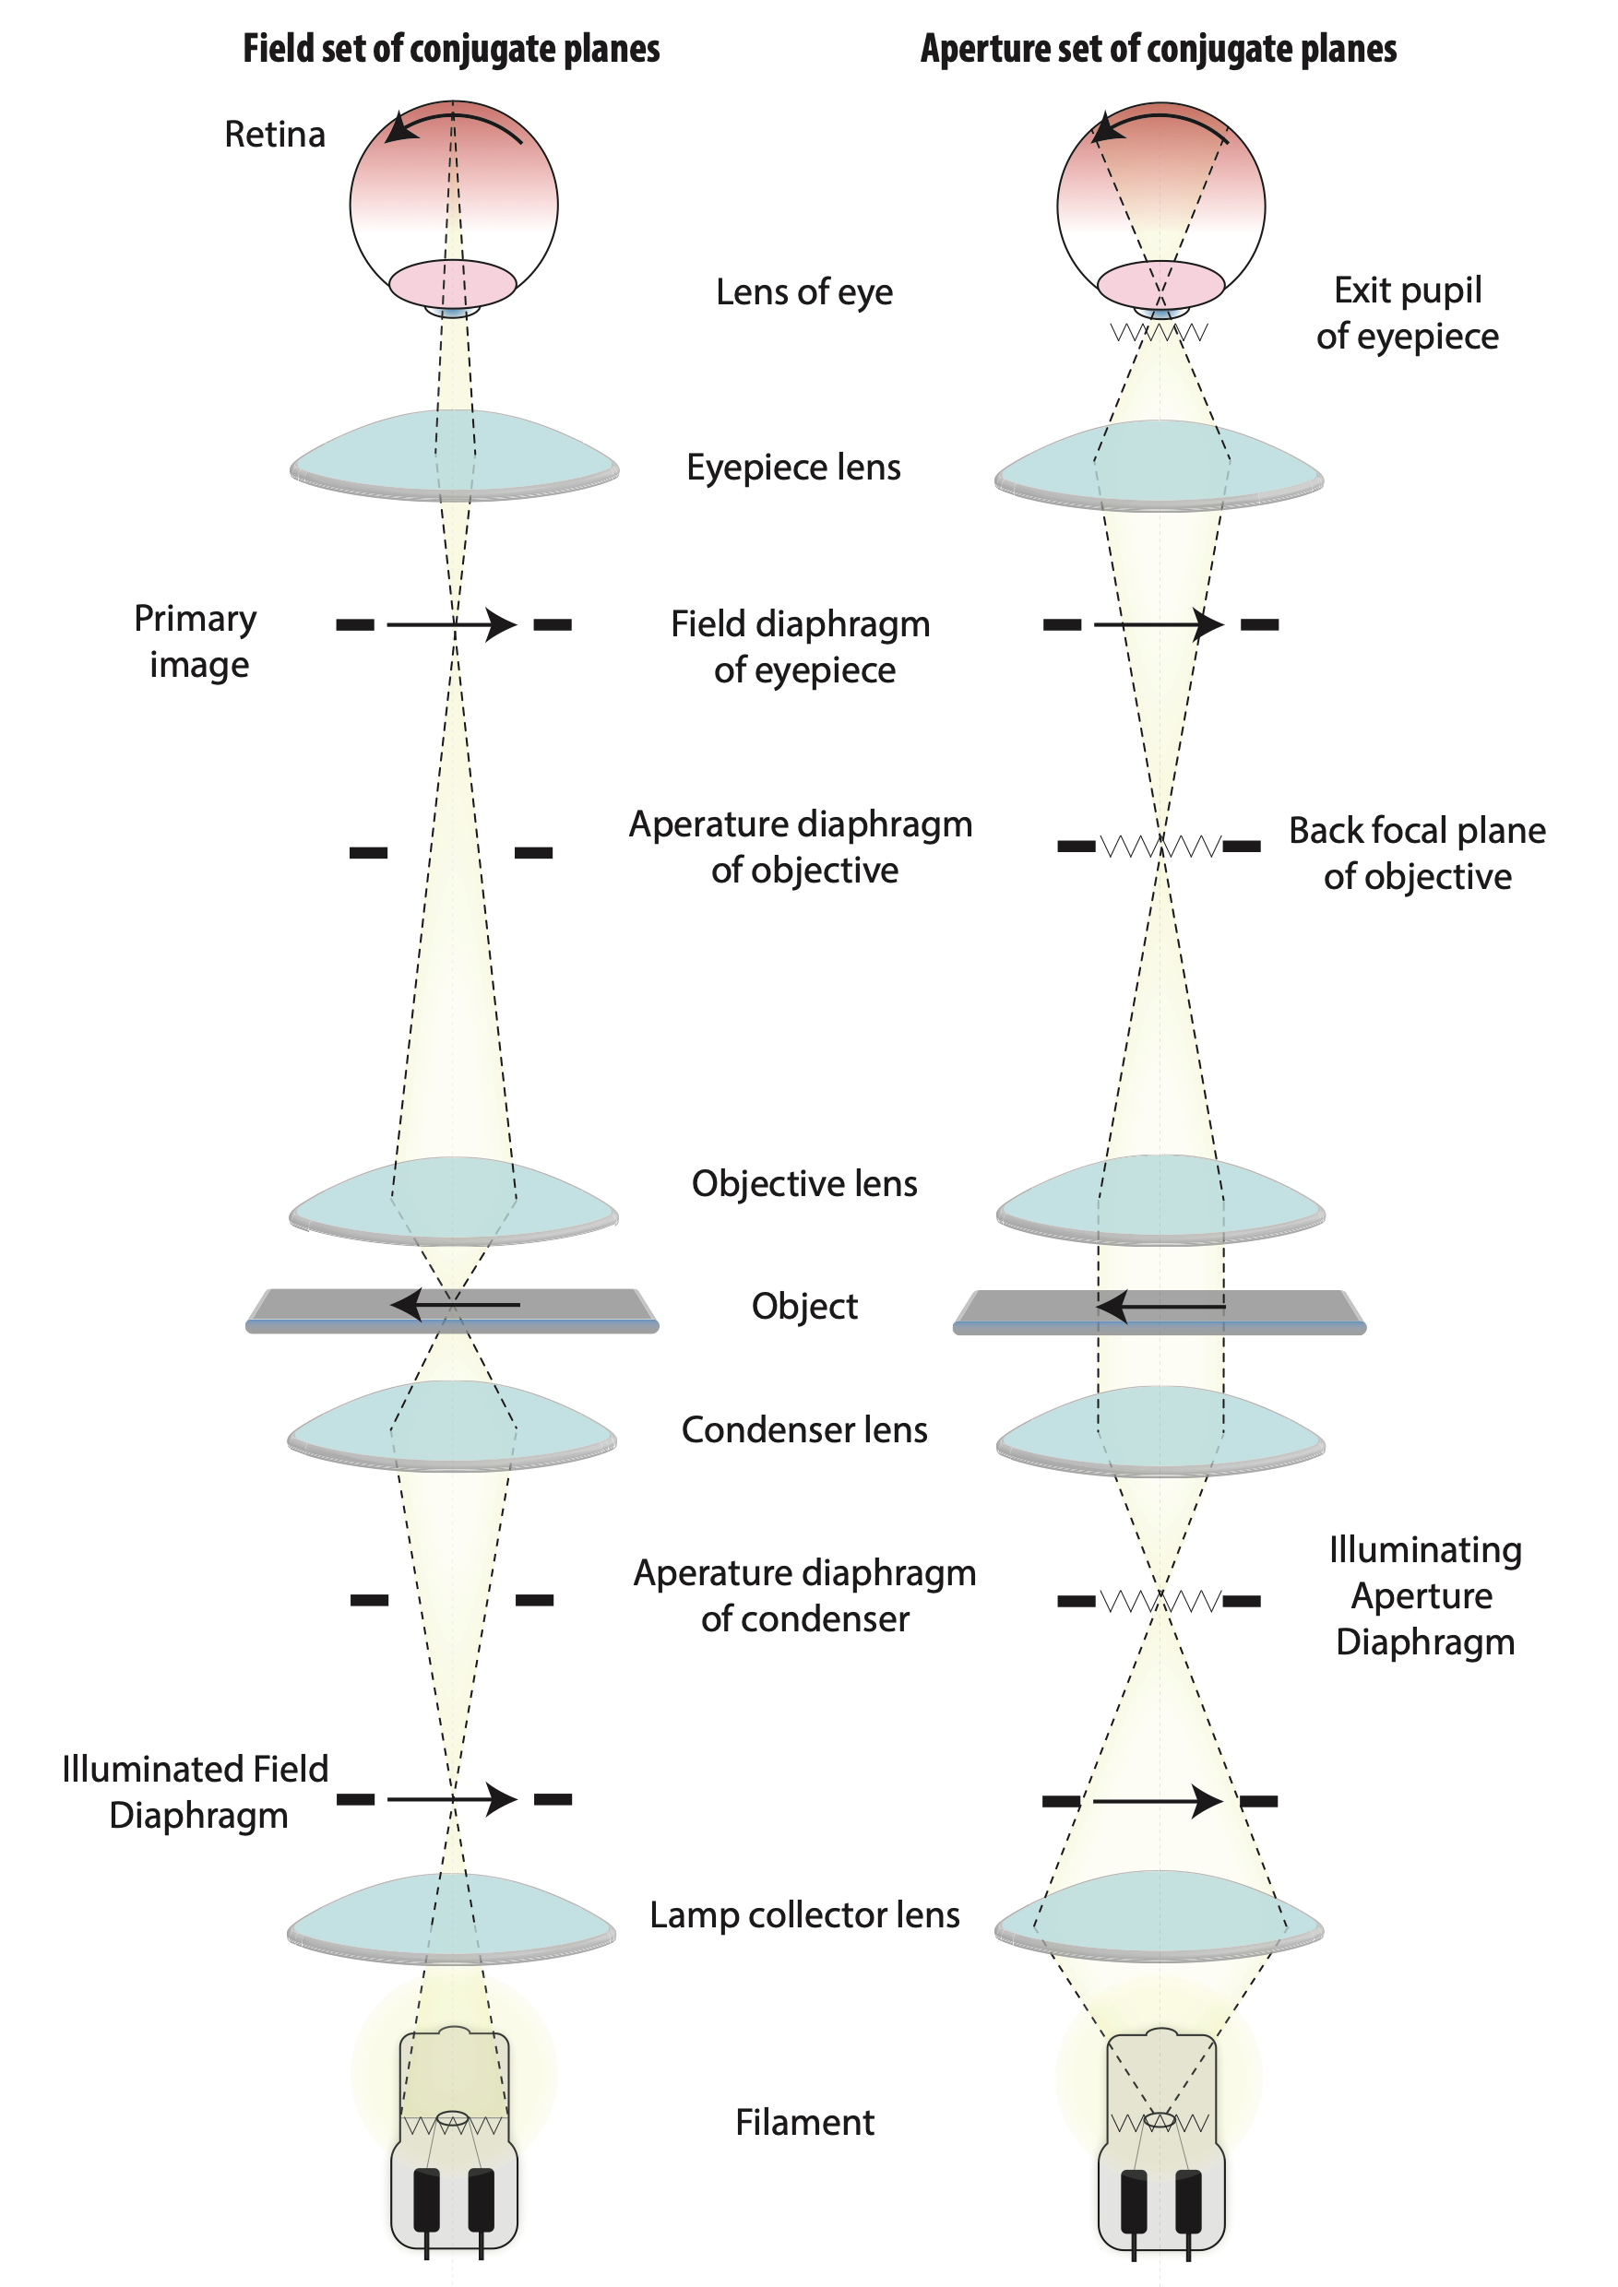
Conjugated planes
Field set
Aperture set

Slide 34
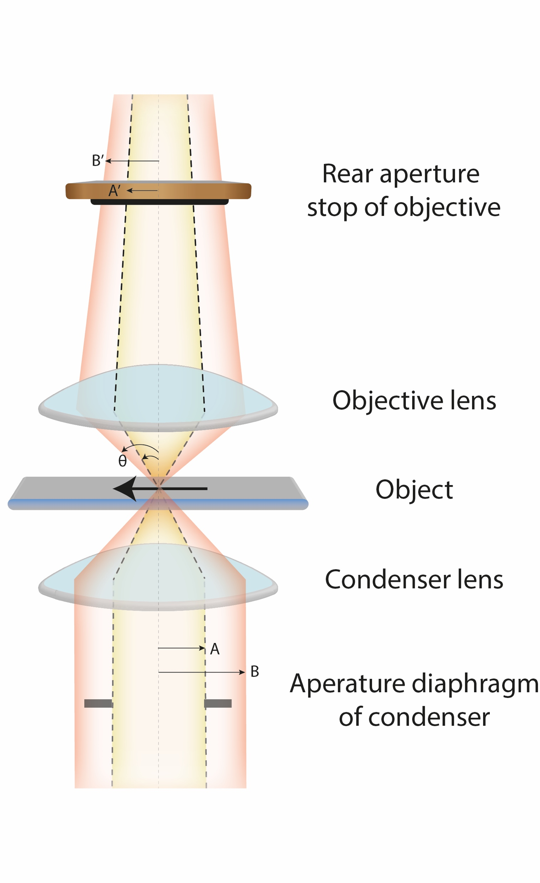
Bright field
Light passing directly through specimen to eys ot other detector
BF – bright field, some microscopes H on condensor
+ Easy to setup, no special requirements
- Low contrast
Closed illuminating aperture

Slide 35
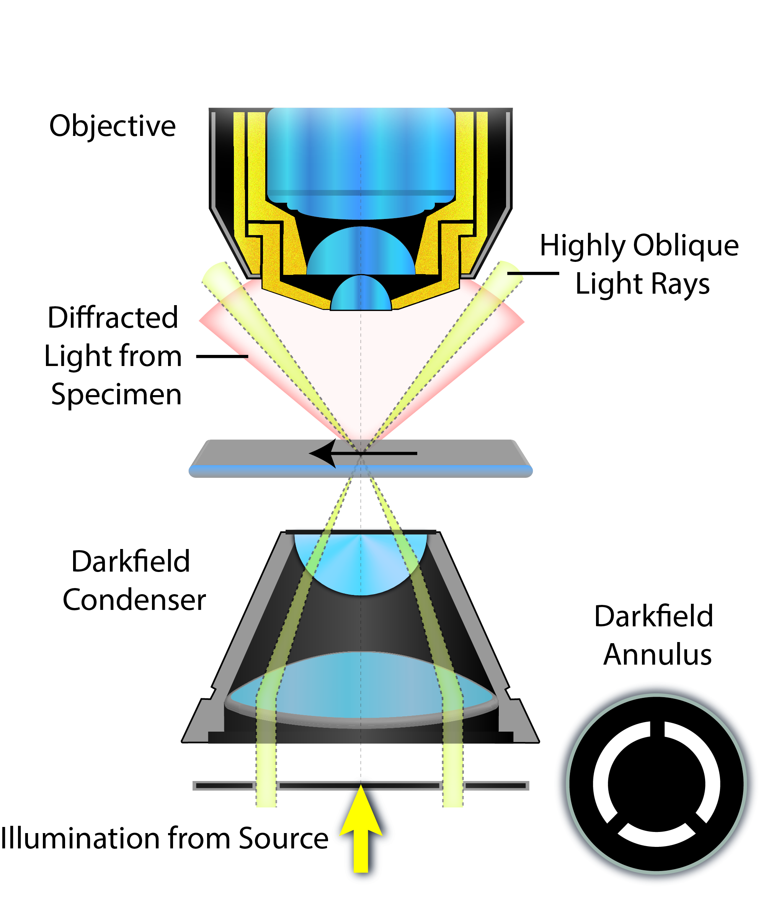
Dark field
Only diffracted light from specimen passing to objective
DF – bright field
+ Easy to setup, no special requirements, for high NA
Special condenser required
Dark field

Slide 36
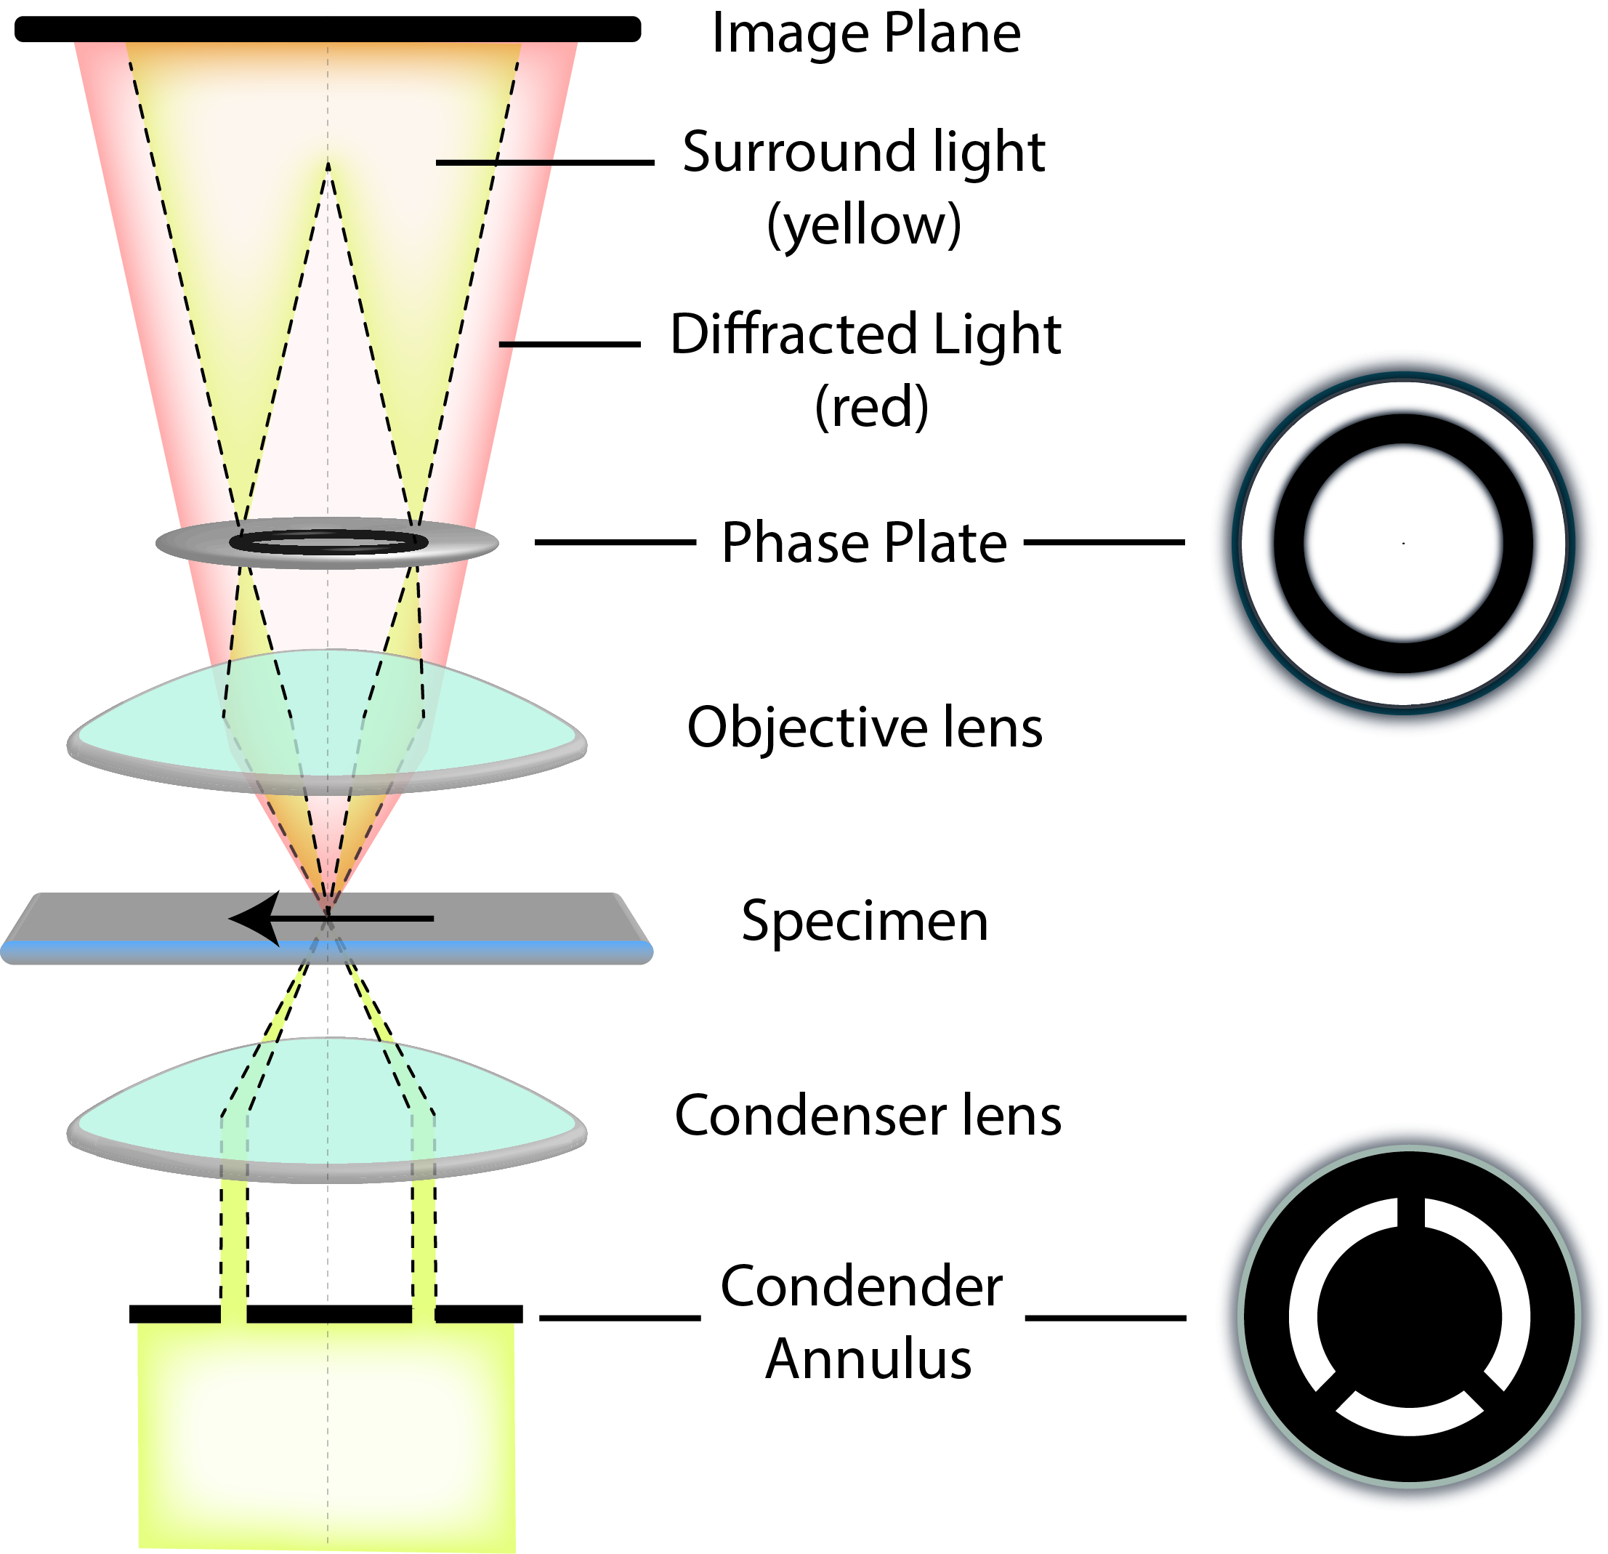
Phase contrast
Transparent objects not visible in the transmitted light mode still
diffract light path and cause phase shift
Phase contrast imaging transform phase differences into
amplitude differences.
Ph1, Ph2, Ph3 – phase contrast
+ Easy to setup, nice contrast, working on plastic dish
- Special objectives required, halo effect around objects

Slide 37
Differential interference contrast (DIC)
Based on polarised light. Transform local gradient in optical path
length (refractive index and thickness) in an object into regions of
contrast in the object image. Amplitude differences in the image
due to refractive index and/or thickness of the specimen.
+ nice contrast, 3D perspectives, no halos around objects
- Works on glass only, not trivial to setup
https://www.olympus-lifescience.com

Slide 38
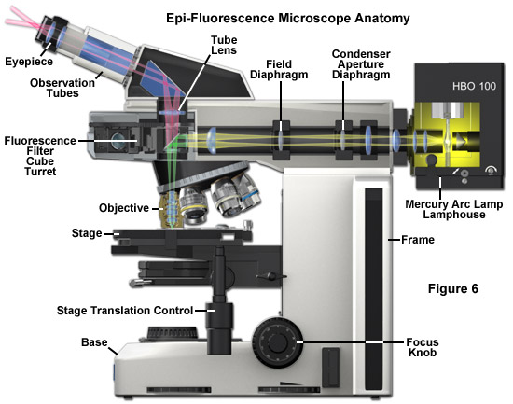
Fluorescence microscopy
Reflected light
light
Emisní
filtr
Excitation
filter

Slide 39
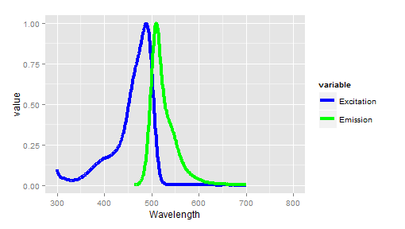
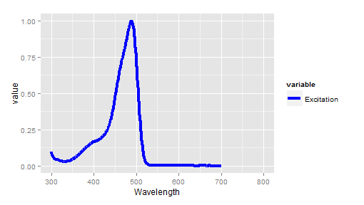
Fluorescence
Fluorescein

Slide 40
Types of fluorescent microscopes
Diffraction limited resolution
widefield (epifluorescence)
confocal microscopes
point scanning microscopes
spinning disc microscopes
lightsheet microscopes
Resolution below diffraction limit - nanoscopes
Structured illumination (SIM)
Stimulated emission depletion (STED)
Stochastic optical reconstruction (STORM)

Slide 41
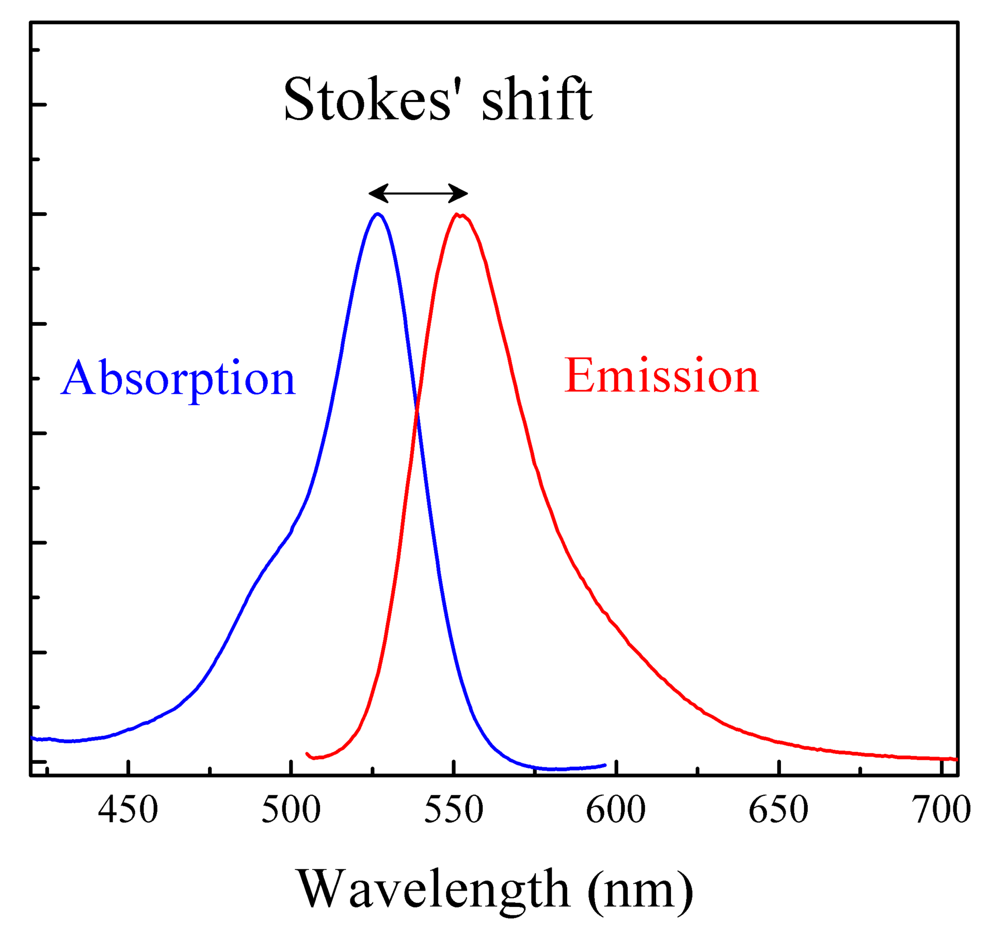
Fluorescence
Stokes shift
Difference between positions of the band maxima of the absorption and emission spectra
Fluorescein
https://en.wikipedia.org/wiki

Slide 42
Fluorescence
Jablonski diagram
S₂
excited state
S₁
Fluorescein
energy
Radiation - fluorescence
S₀
ground state

Slide 43
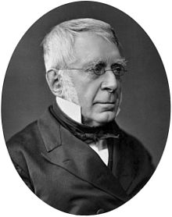
Airy disc
George Biddell Airy (1801-1892)
Best focused point source of light won’t appear as a point, but as a spot
surrounded by series of concentric bright rings – Airy pattern.
Size of Airy disc depend on the light wavelength and the size of aperture.
Imaging
Device
(circular aperture)
Airy disc (d)
- Airy disc contain ~84% of the light from the point source

Slide 44
Point spread function
Three dimensional diffraction pattern of light emitted from an infinitely small point source
in the specimen and transmitted to image plane
object
convolution
Image
Point Spread Function (PSF)

Slide 45
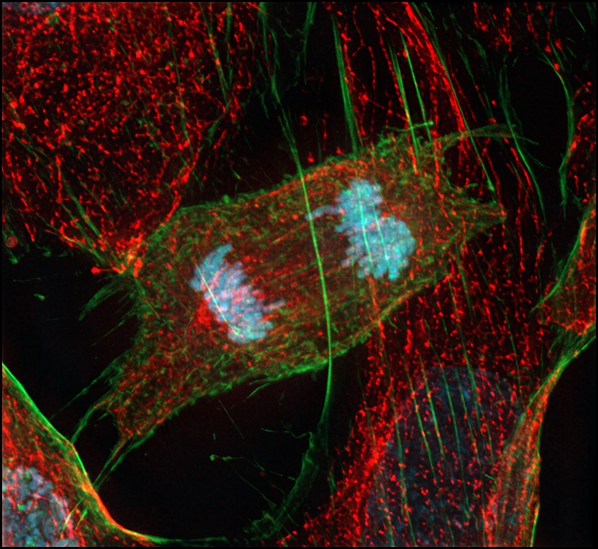
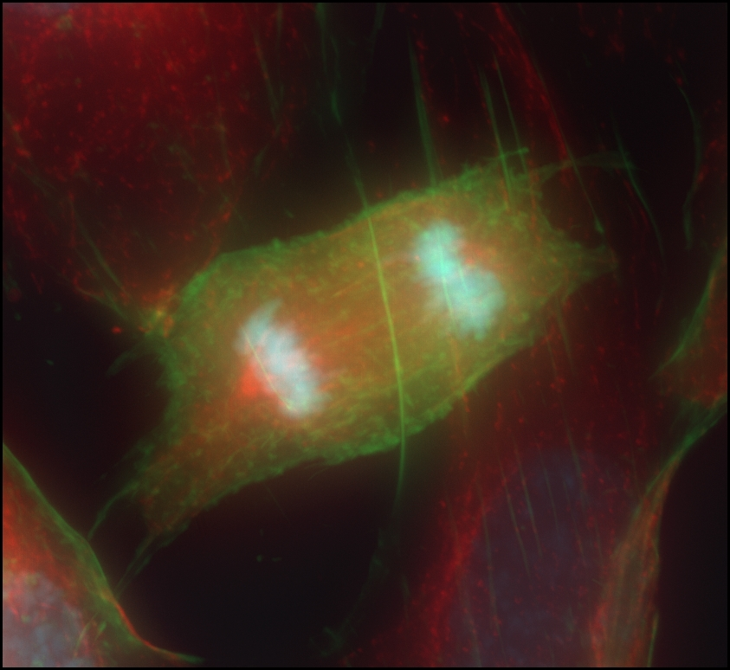
Deconvolution
Three dimensional diffraction pattern of light emitted from an infinitely small point source
in the specimen and transmitted to image plane
object
Image
convolution
Point Spread Function (PSF)
deconvolution

Slide 46
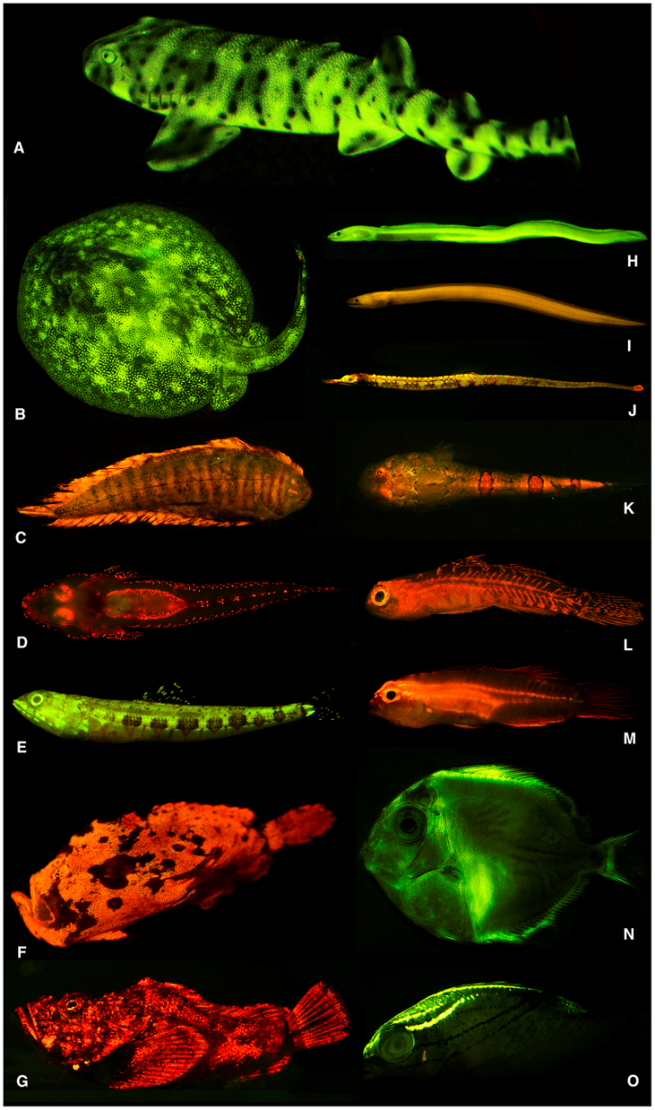
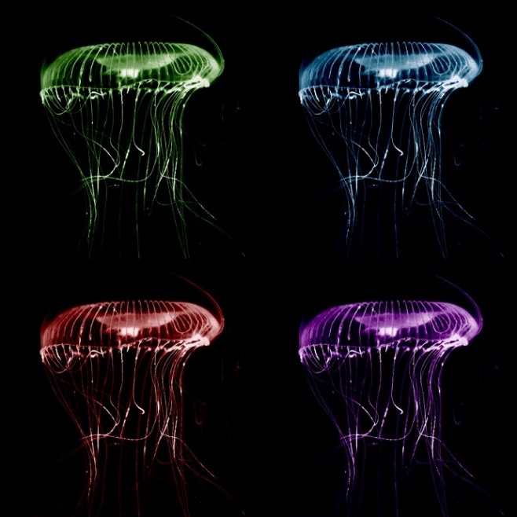
Fluorescence
Fluorescent proteins in living organisms
Osamu
Shinomura
Martin
Chalfie
Roger
Tsien
Nobel prize in chemistry 2008
Discovery and development
of the green fluorescent protein
GFP
Aequorea victoria
https://en.wikipedia.org/wiki/Fluorescence

Slide 47
Components of fluorescent microscope
Detector
Emission spectrum
Emission
filter
Excitation light
Excitation
filter
Dichromatic
mirror
Sample

Slide 48
Filters and beam splitters
Single bandpass (limitations min and max)
Longpass filter
Shortpass filter
Multi bandpass filter

Slide 49
Filters and beam splitters
Crosstalk/bleed through

Slide 50
Light sources
Mercury short arc lamp:
Obsolete, short life time – 200 hours, toxic wapors
Manual alignmnent

Slide 51
Light sources
Metal halide lamp:
Longer life time – 2000 hours
No alignment, contains also mercury

Slide 52
Light sources
Xenon lamp

Slide 53
Light sources
LED – light emmiting diodes
Single wavelength, or combination of several LED‘s
Instantly switching ON/OFF

Slide 54
Detectors
Widefield microscopes – CCD or sCMOS sensors
Pixel number, pixel size, bit depth, quantum efficiency, spectral response
- Smallest unit of sensor with defined size (x,y dimensions)
- Sensor consists of many pixels
Isolated interline device
(charge transfer)
Photoactive part
(photodiode)
photodiode
photons
electrons

Slide 55
Detectors
Pixels
Binning and resolution
Several neighborhoods pixels are accumulated together and readed as one unit
Increasing sensitivity, decreasing resolution, decreasing size of image
Binning 1 – full resolution
Resolution = 12 x 12 pixels
Pixel size = 6 x 6 μm
Binning 2
Resolution = 6 x 6 pixels
Pixel size = 12 x 12 μm
Binning 4
Resolution = 3 x 3 pixels
Pixel size = 24 x 24 μm

Slide 56
Detectors
Spectral response and quantum efficiency

Slide 57
Detectors
Bit depth
Analog to digital converter (ADC) – convert analog signal (current in Voltage) to discrete
digital values - number of grey values.
Number of bits | 1 | 2 | 4 | 8 | 12 | 14 | 16
Number of grey values | 2 | 4 | 16 | 256 | 4,096 | 16,384 | 65,536
$$Grey values=2^{number of bits}$$

Slide 58
Exposure
Correct exposure – read histogram

Slide 59
Exposure
Correct exposure – read histogram
Saturation - blooming
1 sec
2 sec
4 sec
8 sec

Slide 60
Digital sampling
Important to know resolution of the system, avoid oversampling and undersampling
Pixel size should be 2-3 x smaller than the actual resolution of the system
Objectiv: Zeiss Plan-Apochromat 100x/1.4
Optovar:1.6x
C-mount: 1x
Camera: Hamamatsu Flash 4.0
Resolution (GFP) = 0.51 * 550/1.4 = 200 nm
Magnification = 100 x 1.6 x 1 = 160
Camera pixel size = 6.5 x 6.5 μm
Nyquist requirement = 2.3 times the resolution = 85 nm
Image pixel size $= \frac{camera pixel size x binning}{total magnification}=\frac{6.5 x 1}{160}$ = 0.0406 μm = 40.6 nm
Oversampled: Max. resolution = 200 nm, image pixel = 40 nm

Slide 61
Coverslips
Important! Acts as external part of the objective
Standard thickness is 0.17 mm (170 μm) == grade 1.5, best 1.5H (high precision 170 μm ± 0.05 μm)
Variability should not exceed ±0.1 for objective with high NA
Some objectives have correction collar to adjust for different thickness of cover slip
Grade Number | Thickness (μm)
0 | 83-130
1 | 130-160
1.5 | 160-190
2 | 190-250
Mounting media
Refraction index should be close to refraction index of glass == 1.5168
Home made – Mowiol solution
Commercial solutions – VectaShield, Prolong glass

Slide 62
Thank you for your attention
Lecture 2: October 14, 2021 at 9:00
Confocal microscopy - principles, types of confocal microscopes – scanning, spinning disc, channel vs spectral imaging, linear unmixing.
Lasers, detectors, beam splitters, optical sections. Lightsheet microscopy.

