Slide 1


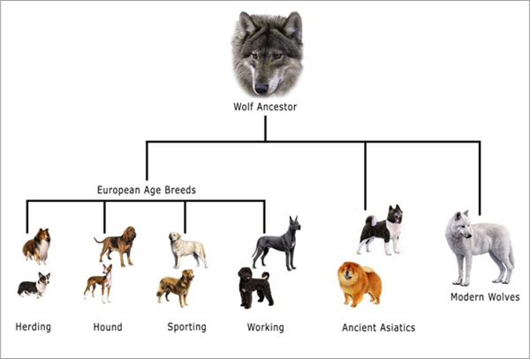
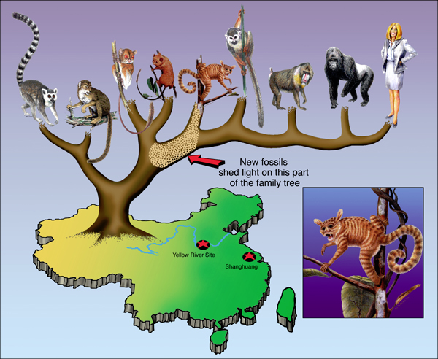
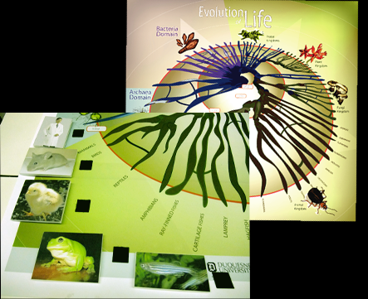
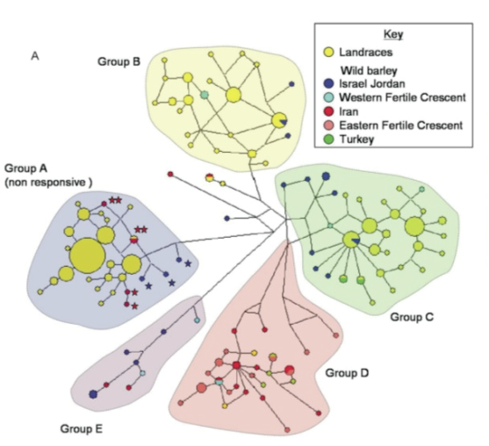
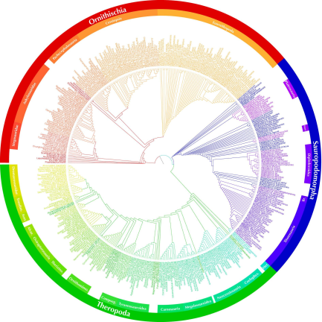

MODULARIZACE VÝUKY EVOLUČNÍ A EKOLOGICKÉ BIOLOGIE
CZ.1.07/2.2.00/15.0204
>gi|5835135|ref|NC_001644.1| Pan paniscus mitochondrion, complete genome GTTTATGTAGCTTACCCCCTTAAAGCAATACACTGAAAATGTTTCGACGGGTTTATATCACCCCATAAAC AAACAGGTTTGGTCCTAGCCTTTCTATTAGCTCTTAGTAAGATTACACATGCAAGCATCCGTCCCGTGAG TCACCCTCTAAATCACCATGATCAAAAGGAACAAGTATCAAGCACACAGCAATGCAGCTCAAGACGCTTA GCCTAGCCACACCCCCACGGGAGACAGCAGTGATAAACCTTTAGCAATAAACGAAAGTTTAACTAAGCCA TACTAACCTCAGGGTTGGTCAATTTCGTGCTAGCCACCGCGGTCACACGATTAACCCAAGTCAATAGAAA CCGGCGTAAAGAGTGTTTTAGATCACCCCCCCCCCAATAAAGCTAAAATTCACCTGAGTTGTAAAAAACT CCAGCTGATACAAAATAAACTACGAAAGTGGCTTTAACACATCTGAACACACAATAGCTAAGACCCAAAC TGGGATTAGATACCCCACTATGCTTAGCCCTAAACTTCAACAGTTAAATTAACAAAACTGCTCGCCAGAA CACTACGAGCCACAGCTTAAAACTCAAAGGACCTGGCGGTGCTTCATATCCCTCTAGAGGAGCCTGTTCT GTAATCGATAAACCCCGATCAACCTCACCGCCTCTTGCTCAGCCTATATACCGCCATCTTCAGCAAACCC TGATGAAGGTTACAAAGTAAGCGCAAGTACCCACGTAAAGACGTTAGGTCAAGGTGTAGCCTATGAGGCG GCAAGAAATGGGCTACATTTTCTACCCCAGAAAATTACGATAACCCTTATGAAACCTAAGGGTCGAAGGT GGATTTAGCAGTAAACTAAGAGTAGAGTGCTTAGTTGAACAGGGCCCTGAAGCGCGTACACACCGCCCGT CACCCTCCTCAAGTATACTTCAAAGGATATTTAACTTAAACCCCTACGCATTTATATAGAGGAGATAAGT CGTAACATGGTAAGTGTACTGGAAAGTGCACTTGGACGAACCAGAGTGTAGCTTAACATAAAGCACCCAA CTTACACTTAGGAGATTTCAACTCAACTTGACCACTCTGAGCCAAACCTAGCCCCAAACCCCCTCCACCC TACTACCAAACAACCTTAACCAAACCATTTACCCAAATAAAGTATAGGCGATAGAAATTGTAAATCGGCG CAATAGATATAGTACCGCAAGGGAAAGATGAAAAATTACACCCAAGCATAATACAGCAAGGACTAACCCC TGTACCTTTTGCATAATGAATTAACTAGAAATAACTTTGCAAAGAGAACTAAAGCCAAGATCCCCGAAAC CAGACGAGCTACCTAAGAACAGCTAAAAGAGCACACCCGTCTATGTAGCAAAATAGTGGGAAGATTTATA GGTAGAGGCGACAAACCTACCGAGCCTGGTGATAGCTGGTTGTCCAAGATAGAATCTTAGTTCAACTTTA AATTTACCTACAGAACCCTCTAAATCCCCCTGTAAATTTAACTGTTAGTCCAAAGAGGAACAGCTCTTTA GACACTAGGAAAAAACCTTATGAAGAGAGTAAAAAATTTAATGCCCATAGTAGGCCTAAAAGCAGCCACC AATTAAGAAAGCGTTCAAGCTCAACACCCACAACCTCAAAAAATCCCAAGCATACAAGCGAACTCCTTAC GCTCAATTGGACCAATCTATTACCCCATAGAAGAGCTAATGTTAGTATAAGTAACATGAAAACATTCTCC TCCGCATAAGCCTACTACAGACCAAAATATTAAACTGACAATTAACAGCCCAATATCTACAATCAACCAA
PHYLOGENETIC ANALYSIS I.

Slide 2
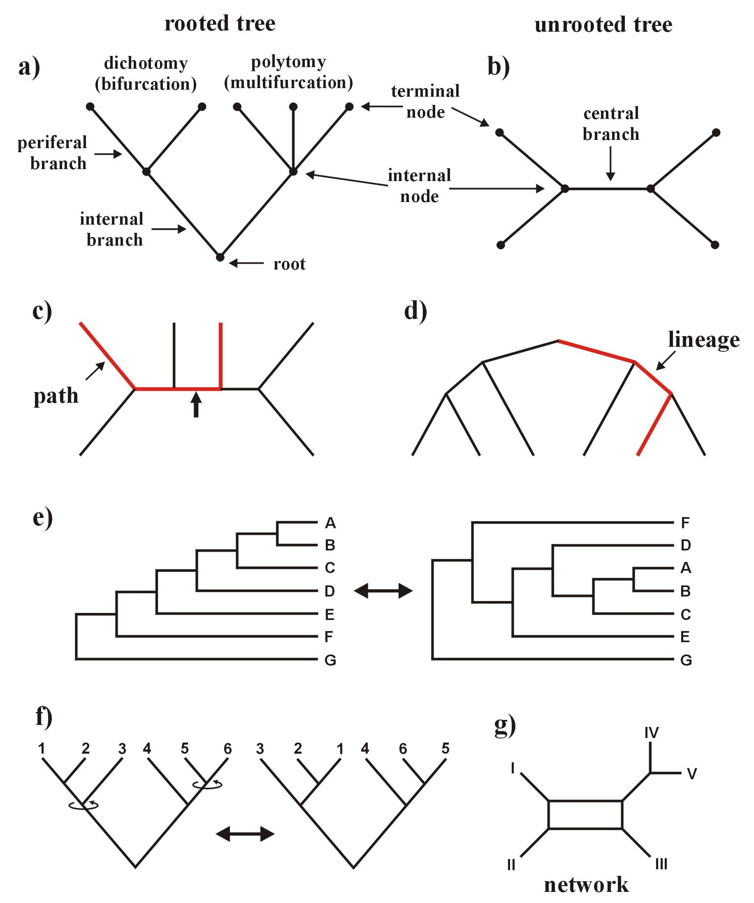
Definition of basic concepts:
phylogenetic tree = phylogeny (fylogenie): rooted, unrooted
branches = edges (větve): peripheral, internal, central
nodes = vertices (uzly): internal, terminal
dichotomy = bifurcation, polytomy = multifurcation
OTU, HTU
tree topology

Slide 3
Definition of basic concepts:
connects terminal node with root
connects two terminal nodes
path (dráha)
lineage (linie)

Slide 4
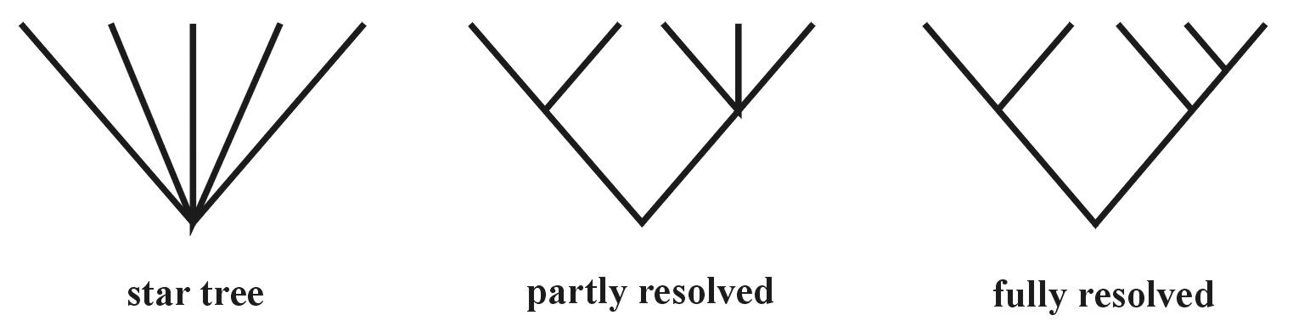
Definition of basic concepts:

Slide 5
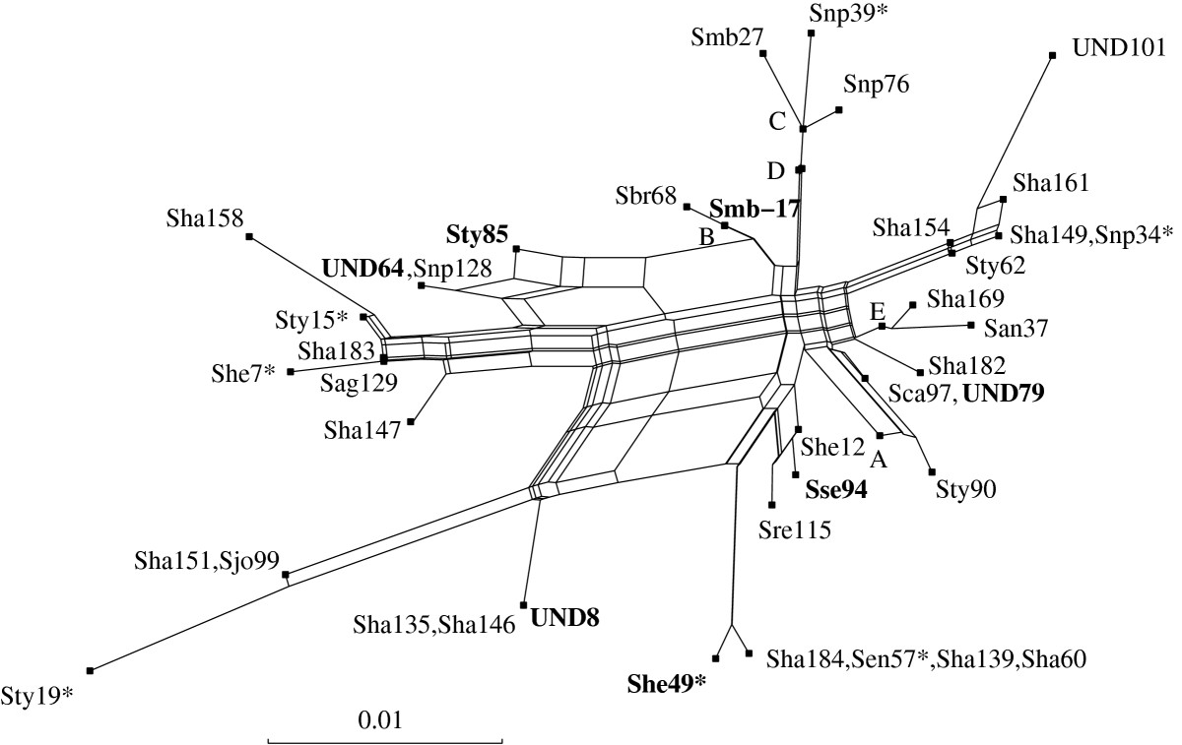
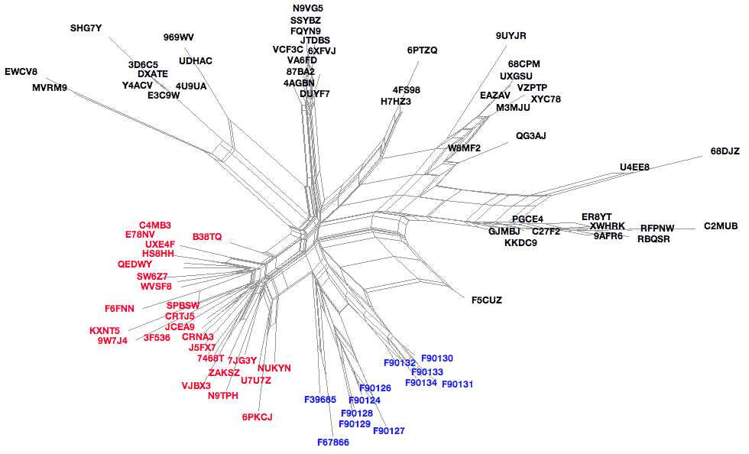

Slide 6
How many trees?

Slide 7
> Avogadro
constant*)
number of electrons in visible universe
(Eddington number)
*) 6,022 141 79×10²³ mol⁻¹

Slide 8
What type of data can we use?
DATA
Distances
Discrete
characters
Immunology
DNA-DNA hybridization
Binary
Multistate
11010010011
ABCDEF
unordered
ACGTTAGCT
ordered
A→B→C

Slide 9
Types of data
Nucleotide and protein sequences:
H_sapiens MTPMRKINPLMKLINHSFIDLPTPSNISAWWNFGS
P_troglod ATGACCCCGACACGCAAAATTAACCCACTAATAAA
base = character state
site = character

Slide 10
Types of data
retroelements: SINE (Alu, B1, B2), LINE
microsatellites, SNP

Slide 11
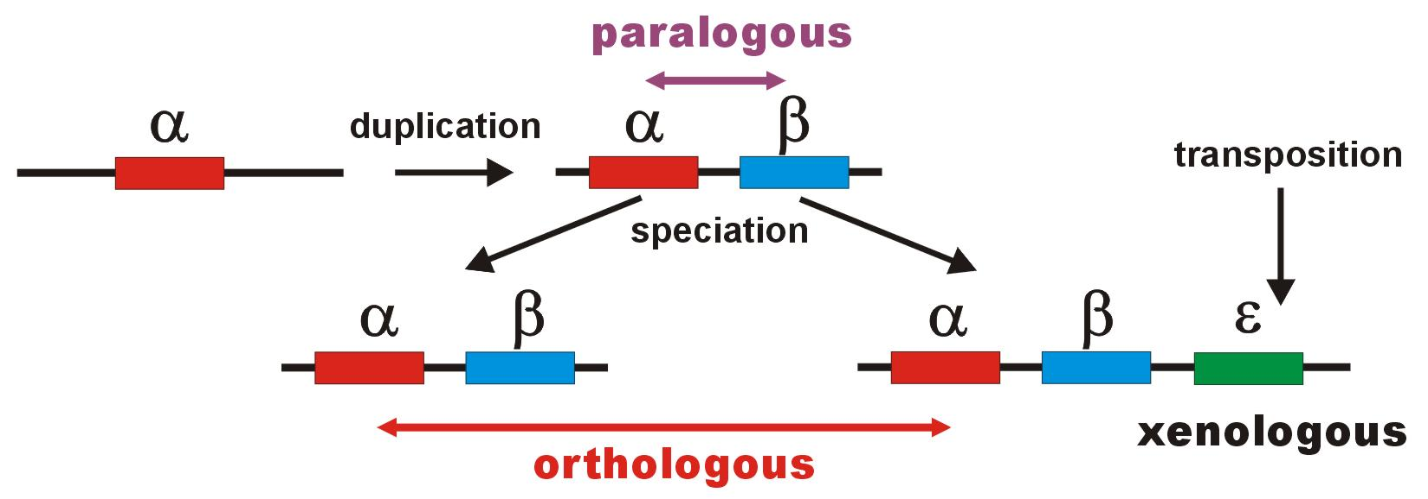
Problem with homology of sequences

Slide 12
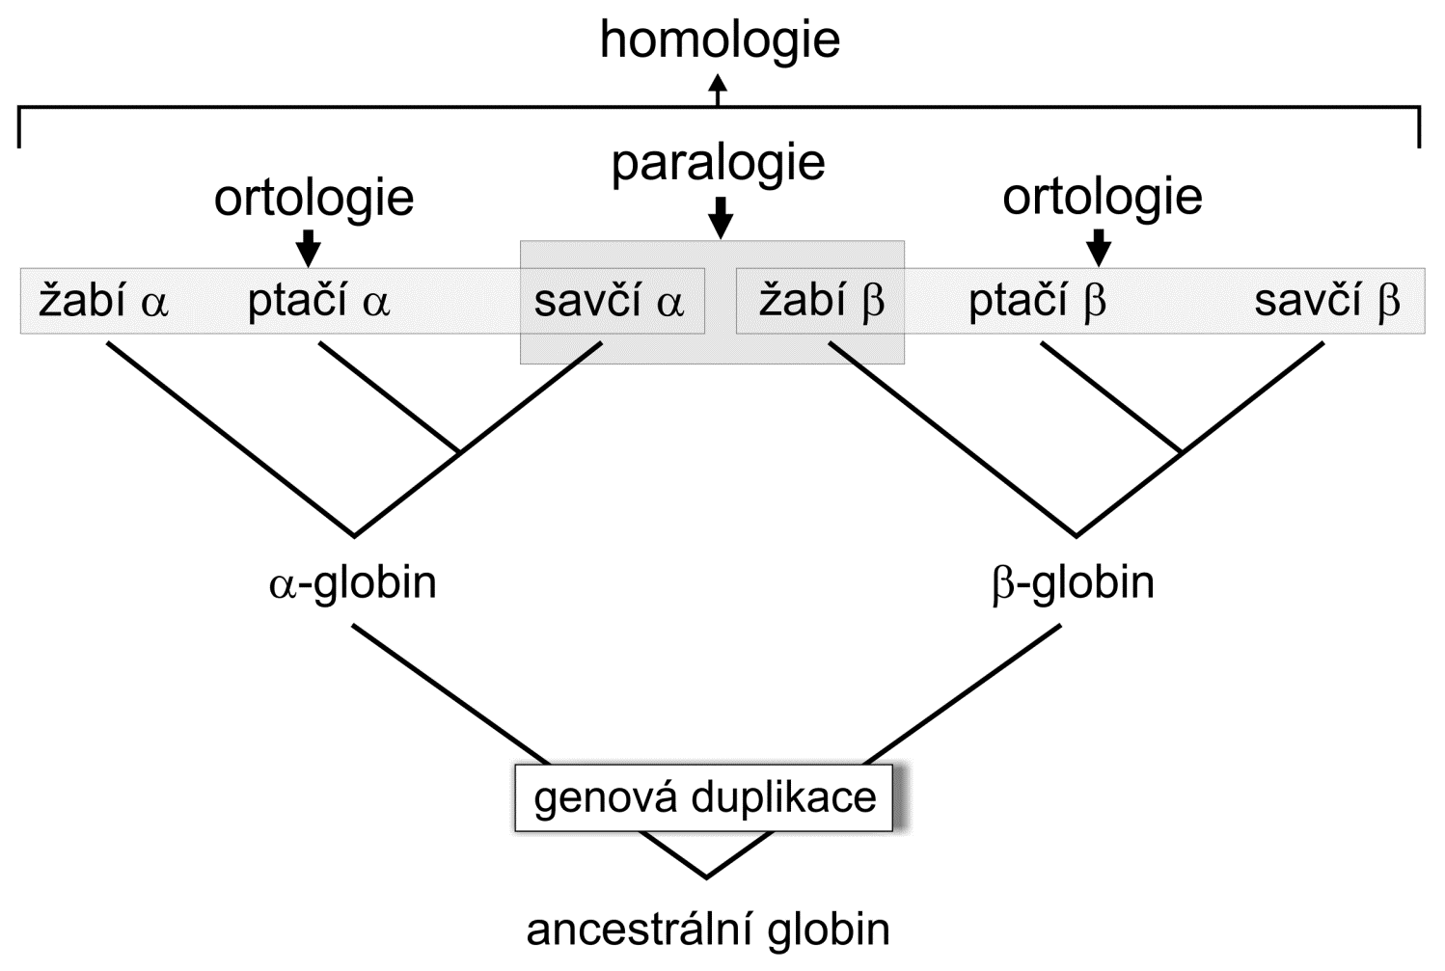
Problem with homology of sequences
Individual sites in DNA sequences may not be fully independent!

Slide 13
Sequences
DNA databases:
EMBL (European Molecular Biology Laboratory) – European Bioinformatics Institute,
Hinxton, UK: http://www.ebi.ac.uk/embl/
GenBank – NCBI (National Center for Biotechnology Information), Bethesda,
Maryland, USA: http://www.ncbi.nlm.nih.gov/Genbank/
DDBJ (DNA Data Bank of Japan) – National Institute of Genetics, Mishima, Japan:
http://www.ddbj.nig.ac.jp/
Database managment: usually packages Sybase or ORACLE
outputs: ASCII (American Standard Code for Information Interchange)

Slide 14
Sequences
Protein databases:
SWISS-PROT – University of Geneve & Swis Institute of Bioinformatics:
http://www.expasy.ch/sprot/ a http://www.ebi.ac.uk/swissprot/
PIR (Protein Information Resource) – NBRF (National Biomedical Research Foundation,
Washington, D.C., USA) & Tokyo University & JIPID (Japanese International Protein
Information Database, Tokyo) & MIPS (Martinsried Institute for Protein Sequences,
Martinsried, Germany): http://www-nbrf.georgetown.edu/
PRF/SEQDB (Protein Resource Foundation) – Ósaka, Japan:
http://www.prf.or.jp/en/os.htm
PDB (Protein Data Bank) – University of New Jersey, San Diego & Super-computer
Center, University of California & National Institute of Standards and Technology:
http://www.rcsb.org/pdb/

Slide 15
File formats:
FASTA:
>H_sapiens
ATGACCCCAATACGCAAAATTAACCCCCTAATAAAATTAATTAACCACTCATTCATCGACCTCCCCACCC
CATCCAACATCTCCGCATGATGAAACTTCGGCTCACTCCTTGGCGCCTGCCTGATCCTCCAAATCACCAC
AGGACTATTCCTAGCCATACACTACTCACCAGACGCCTCAACCGCCTTTTCATCAATCGCCCACATCACT
CGAGACGTAAATTATGGCTGAATCATCCGCTACCTTCACGCCAATGGCGCCTCAATATTCTTTATCTGCC
TCTTCCTACACATCGGGCGAGGCCTATATTACGGATCATTTCTCTACTCAGAAACCTGAAACATCGGCAT
...
>P_troglod
ATGACCCCGACACGCAAAATTAACCCACTAATAAAATTAATTAATCACTCATTTATCGACCTCCCCACCC
CATCCAACATTTCCGCATGATGGAACTTCGGCTCACTTCTCGGCGCCTGCCTAATCCTTCAAATTACCAC
AGGATTATTCCTAGCTATACACTACTCACCAGACGCCTCAACCGCCTTCTCGTCGATCGCCCACATCACC
CGAGACGTAAACTATGGTTGGATCATCCGCTACCTCCACGCTAACGGCGCCTCAATATTTTTTATCTGCC
TCTTCCTACACATCGGCCGAGGTCTATATTACGGCTCATTTCTCTACCTAGAAACCTGAAACATTGGCAT
...
>P_paniscus
ATGACCCCAACACGCAAAATCAACCCACTAATAAAATTAATTAATCACTCATTTATCGACCTCCCCACCC
CATCCAATATTTCCACATGATGAAACTTCGGCTCACTTCTCGGCGCCTGCCTAATCCTTCAAATCACCAC
AGGACTATTCCTAGCTATACACTACTCACCAGACGCCTCAACCGCCTTCTCATCGATCGCCCACATTACC
CGAGACGTAAACTATGGTTGAATCATCCGCTACCTTCACGCTAACGGCGCCTCAATACTTTTCATCTGCC
TCTTCCTACACGTCGGTCGAGGCCTATATTACGGCTCATTTCTCTACCTAGAAACCTGAAACATTGGCAT
...

Slide 16
File formats:
GenBank:
ORIGIN
1 tgaaatgaag atattctctt ctcaagacat caagaagaag gaactactcc ccaccaccag
61 cacccaaagc tggcattcta attaaactac ttcttgtgta cataaattta catagtacaa
121 tagtacattt atgtatatcg tacattaaac tattttcccc aagcatataa gcaagtacat
181 ttaatcaatg atataggcca taaaacaatt atcaacataa actgatacaa accatgaata
241 ttatactaat acatcaaatt aatgctttaa agacatatct gtgttatctg acatacacca
301 tacagtcata aactcttctc ttccatatga ctatcccctt ccccatttgg tctattaatc
361 taccatcctc cgtgaaacca acaacccgcc caccaatgcc cctcttctcg ctccgggccc
421 attaaacttg ggggtagcta aactgaaact ttatcagaca tctggttctt acttcagggc
481 catcaaatgc gttatcgccc atacgttccc cttaaataag acatctcgat ggtatcgggt
541 ctaatcagcc catgaccaac ataactgtgg tgtcatgcat ttggtatttt tttattttgg
601 cctactttca tcaacatagc cgtcaaggca tgaaaggaca gcacacagtc tagacgcacc
661 tacggtgaag aatcattagt ccgcaaaacc caatcaccta aggctaatta ttcatgcttg
721 ttagacataa atgctactca ataccaaatt ttaactctcc aaacccccca accccctcct
781 cttaatgcca aaccccaaaa acactaagaa cttgaaagac atatattatt aactatcaaa
841 ccctatgtcc tgatcgattc tagtagttcc caaaatatga ctcatatttt agtacttgta
901 aaaattttac aaaatcatgc tccgtgaacc aaaactctaa tcacactcta ttacgcaata
961 aatattaaca agttaatgta gcttaataac aaagcaaagc actgaaaatg cttagatgga
1021 taattttatc cca
//

Slide 17
File formats:
PHYLIP (“interleaved” format):
6 1120
H_sapiens ATGACCCCAA TACGCAAAAT TAACCCCCTA ATAAAATTAA TTAACCACTC
P_troglod ATGACCCCGA CACGCAAAAT TAACCCACTA ATAAAATTAA TTAATCACTC
P_paniscus ATGACCCCAA CACGCAAAAT CAACCCACTA ATAAAATTAA TTAATCACTC
G_gorilla ATGACCCCTA TACGCAAAAC TAACCCACTA GCAAAACTAA TTAACCACTC
P_pygmaeus ATGACCCCAA TACGCAAAAC CAACCCACTA ATAAAATTAA TTAACCACTC
H_lar ATGACCCCCC TGCGCAAAAC TAACCCACTA ATAAAACTAA TCAACCACTC
ATTCATCGAC CTCCCCACCC CATCCAACAT CTCCGCATGA TGAAACTTCG
ATTTATCGAC CTCCCCACCC CATCCAACAT TTCCGCATGA TGGAACTTCG
ATTTATCGAC CTCCCCACCC CATCCAATAT TTCCACATGA TGAAACTTCG
ATTCATTGAC CTCCCTACCC CGTCCAACAT CTCCACATGA TGAAACTTCG
ACTCATCGAC CTCCCCACCC CATCAAACAT CTCTGCATGA TGGAACTTCG
ACTTATCGAC CTTCCAGCCC CATCCAACAT TTCTATATGA TGAAACTTTG

Slide 18
File formats:
NEXUS (PAUP*, “interleaved”):
#NEXUS
begin data;
dimensions ntax=6 nchar=1120;
format datatype=DNA interleave datatype=DNA missing=? gap=-;
matrix
P_troglod ATGACCCCGACACGCAAAATTAACCCACTAATAAAATTAATTAATCACTC
P_paniscus ATGACCCCAACACGCAAAATCAACCCACTAATAAAATTAATTAATCACTC
H_sapiens ATGACCCCAATACGCAAAATTAACCCCCTAATAAAATTAATTAACCACTC
G_gorilla ATGACCCCTATACGCAAAACTAACCCACTAGCAAAACTAATTAACCACTC
P_pygmaeus ATGACCCCAATACGCAAAACCAACCCACTAATAAAATTAATTAACCACTC
H_lar ATGACCCCCCTGCGCAAAACTAACCCACTAATAAAACTAATCAACCACTC
P_troglod ATTTATCGACCTCCCCACCCCATCCAACATTTCCGCATGATGGAACTTCG
P_paniscus ATTTATCGACCTCCCCACCCCATCCAATATTTCCACATGATGAAACTTCG
H_sapiens ATTCATCGACCTCCCCACCCCATCCAACATCTCCGCATGATGAAACTTCG
G_gorilla ATTCATTGACCTCCCTACCCCGTCCAACATCTCCACATGATGAAACTTCG
P_pygmaeus ACTCATCGACCTCCCCACCCCATCAAACATCTCTGCATGATGGAACTTCG
H_lar ACTTATCGACCTTCCAGCCCCATCCAACATTTCTATATGATGAAACTTTG
end;

Slide 19
File formats:
Clustal X:
P_troglod ATGACCCCGACACGCAAAATTAACCCACTAATAAAATTAATTAATCACTCATTTATCGAC
P_paniscus ATGACCCCAACACGCAAAATCAACCCACTAATAAAATTAATTAATCACTCATTTATCGAC
H_sapiens ATGACCCCAATACGCAAAATTAACCCCCTAATAAAATTAATTAACCACTCATTCATCGAC
G_gorilla ATGACCCCTATACGCAAAACTAACCCACTAGCAAAACTAATTAACCACTCATTCATTGAC
P_pygmaeus ATGACCCCAATACGCAAAACCAACCCACTAATAAAATTAATTAACCACTCACTCATCGAC
H_lar ATGACCCCCCTGCGCAAAACTAACCCACTAATAAAACTAATCAACCACTCACTTATCGAC
******** ******* ***** *** **** **** ** ****** * ** ***
P_troglod CTCCCCACCCCATCCAACATTTCCGCATGATGGAACTTCGGCTCACTTCTCGGCGCCTGC
P_paniscus CTCCCCACCCCATCCAATATTTCCACATGATGAAACTTCGGCTCACTTCTCGGCGCCTGC
H_sapiens CTCCCCACCCCATCCAACATCTCCGCATGATGAAACTTCGGCTCACTCCTTGGCGCCTGC
G_gorilla CTCCCTACCCCGTCCAACATCTCCACATGATGAAACTTCGGCTCACTCCTTGGTGCCTGC
P_pygmaeus CTCCCCACCCCATCAAACATCTCTGCATGATGGAACTTCGGCTCACTTCTAGGCGCCTGC
H_lar CTTCCAGCCCCATCCAACATTTCTATATGATGAAACTTTGGTTCACTCCTAGGCGCCTGC
** ** **** ** ** ** ** ****** ***** ** ***** ** ** ******

Slide 20
File formats:
FASTQ:
Line 1 begins with a '@' character and is followed by a sequence identifier and an optional description (like a FASTA title line).
Line 2 is the raw sequence letters.
Line 3 begins with a '+' character and is optionally followed by the same sequence identifier (and any description) again.
Line 4 encodes the quality values for the sequence in Line 2, and must contain the same number of symbols as letters in the sequence.

Slide 21
Illumina sequence identifiers:
@HWUSI-EAS100R:6:73:941:1973#0/1
HWUSI-EAS100R | the unique instrument name
6 | flowcell lane
73 | tile number within the flowcell lane
941 | 'x'-coordinate of the cluster within the tile
1973 | 'y'-coordinate of the cluster within the tile
#0 | index number for a multiplexed sample (0 for no indexing)
/1 | the member of a pair, /1 or /2 (paired-end or mate-pair reads only)

Slide 22
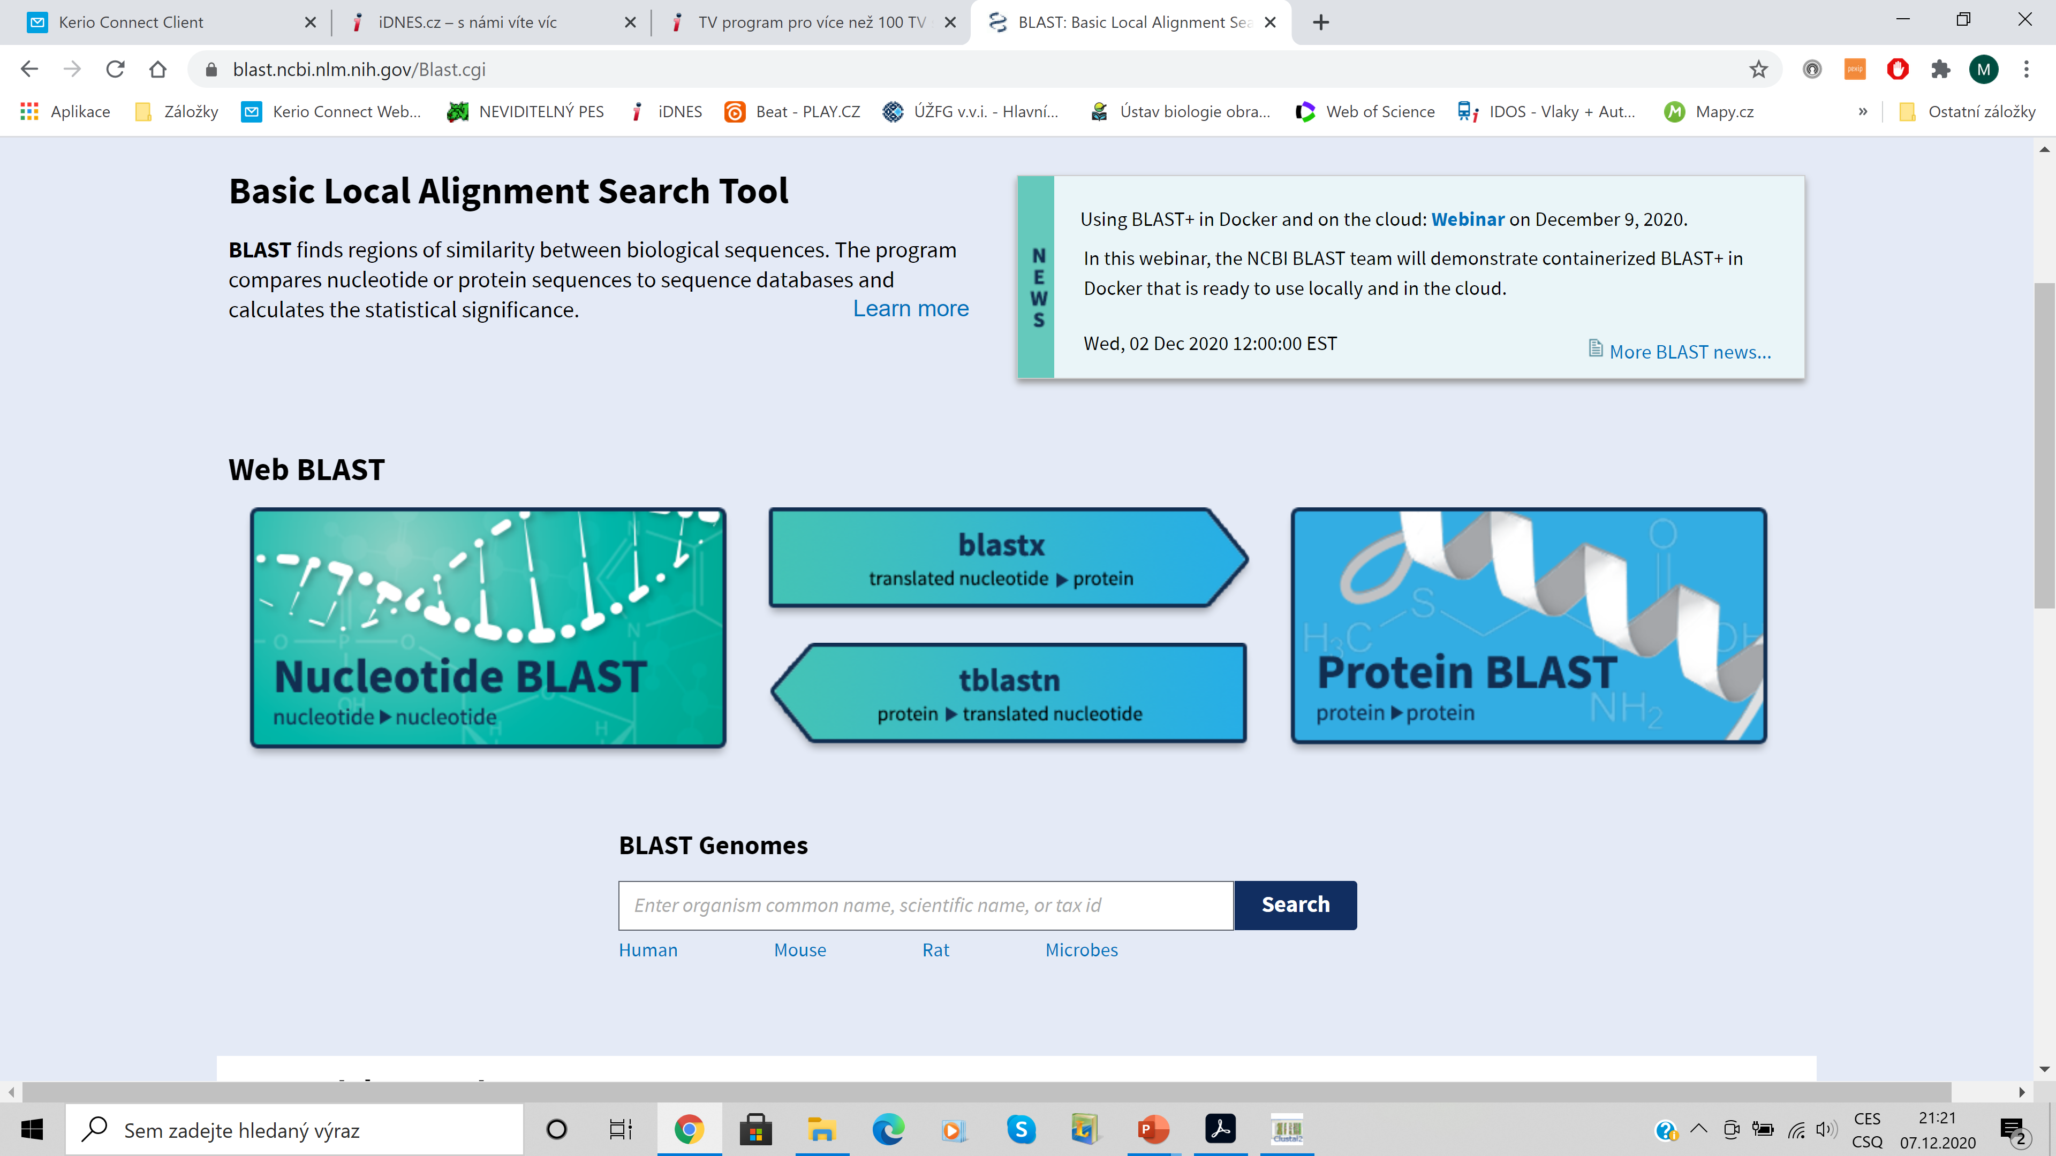
BLAST

Slide 23
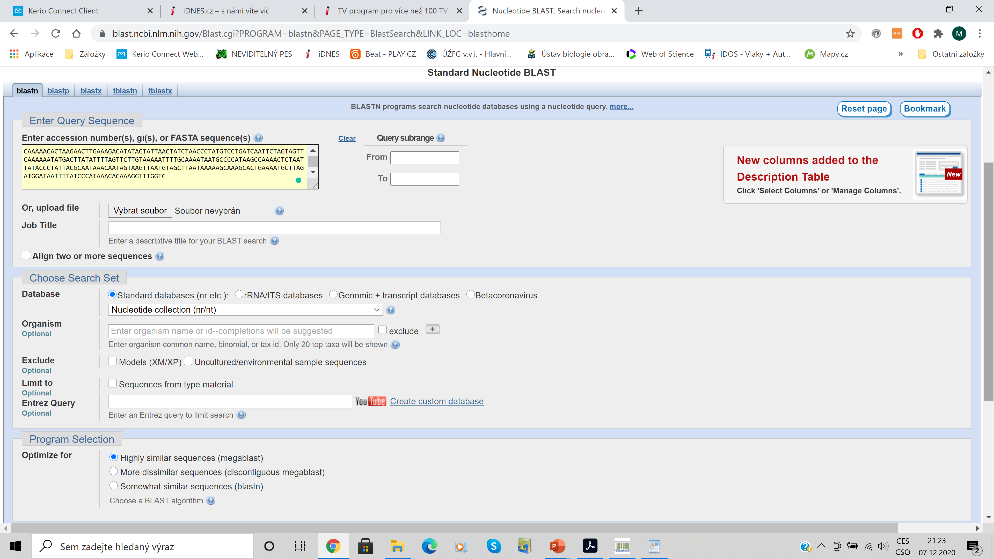
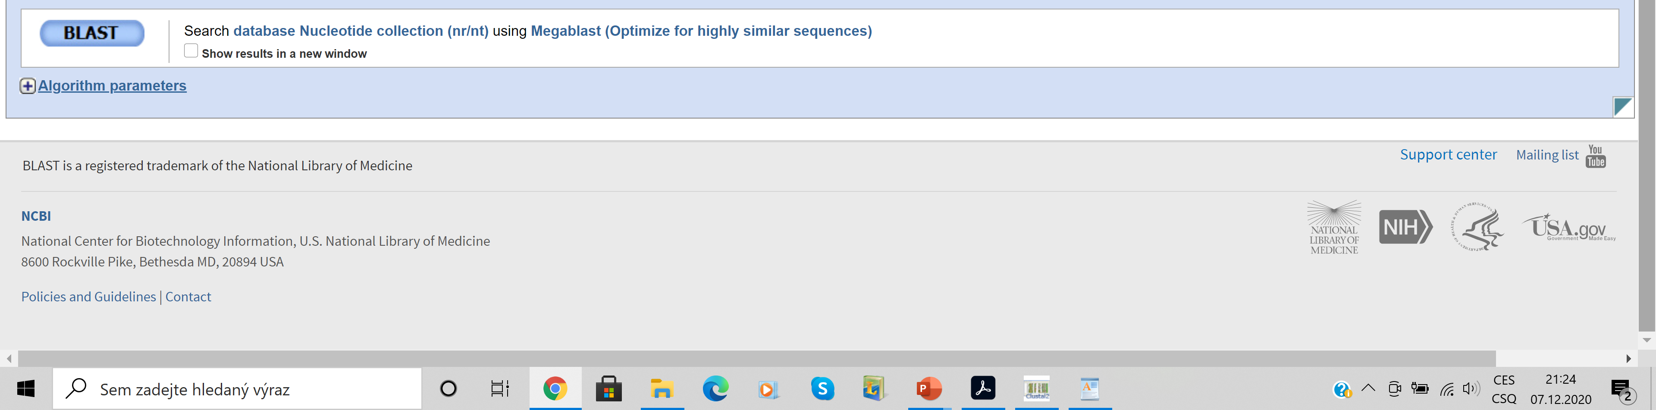

Slide 24
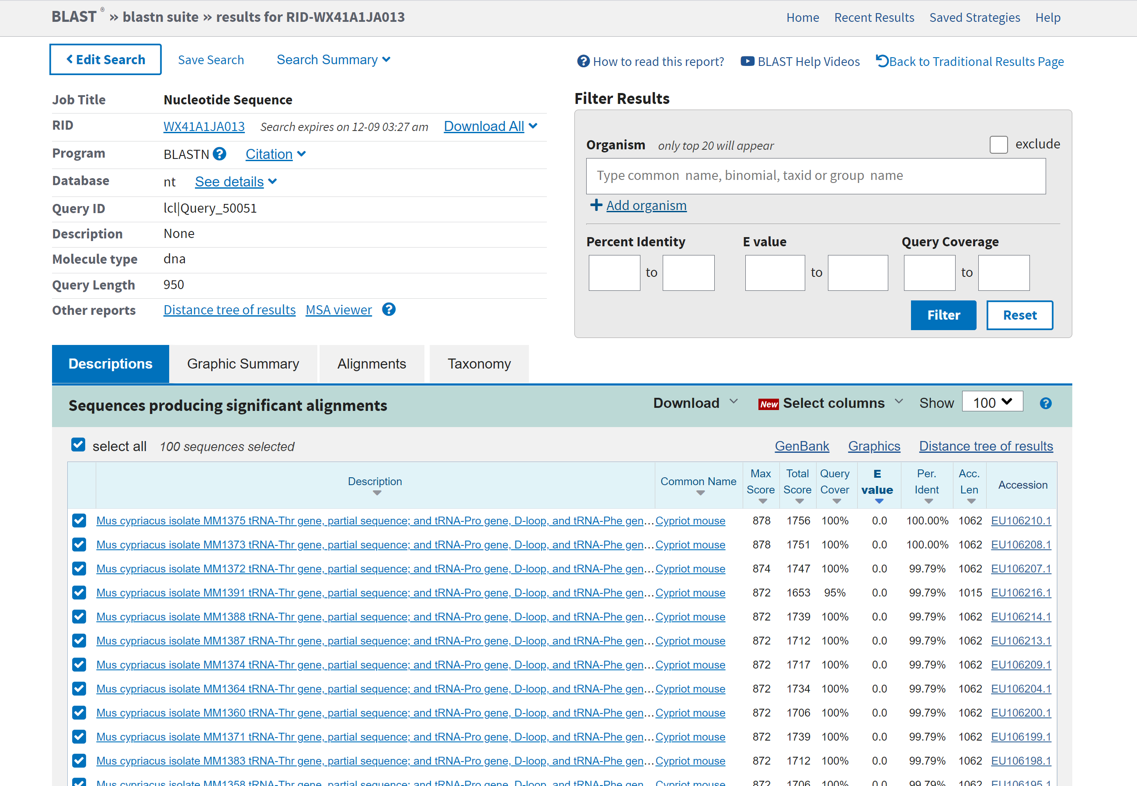

Slide 25
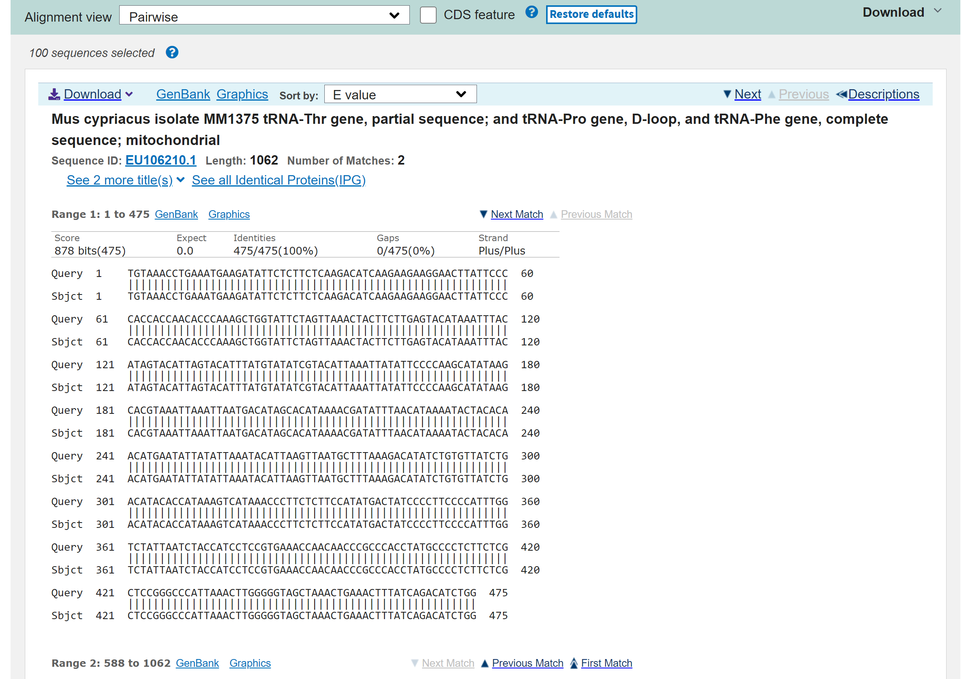

Slide 26
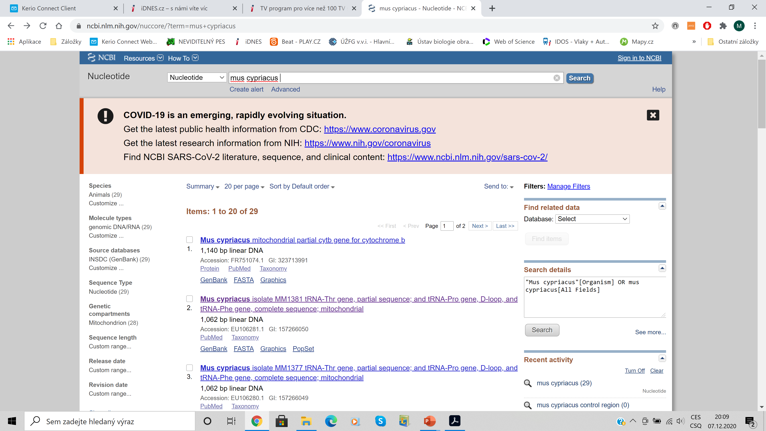
GenBank

Slide 27
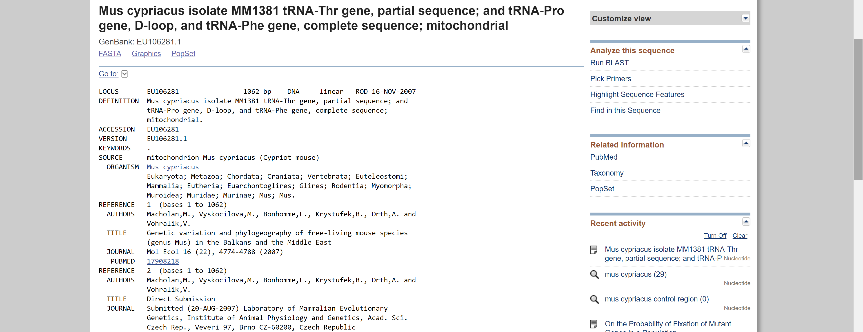
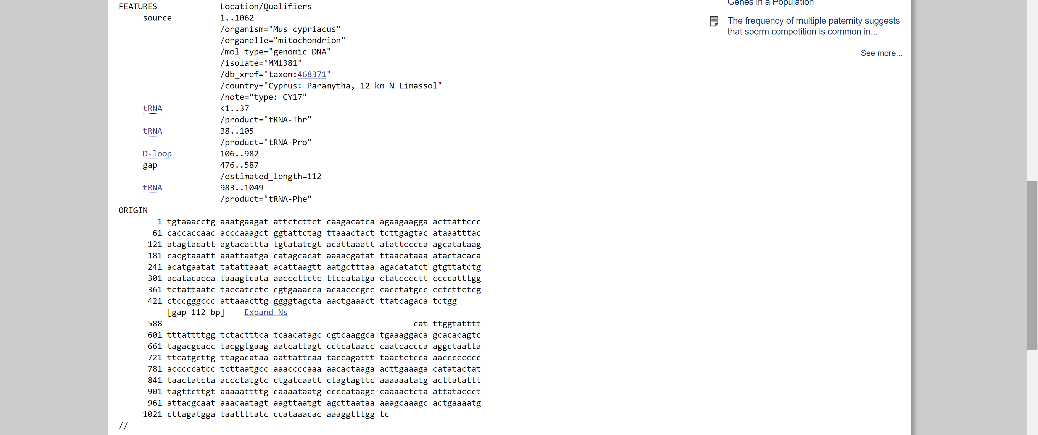

Slide 28
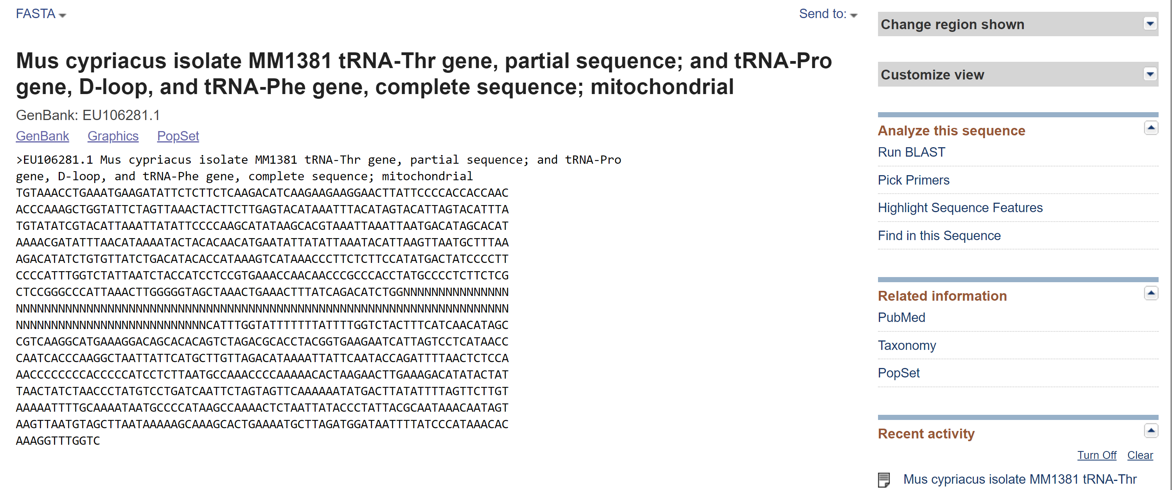
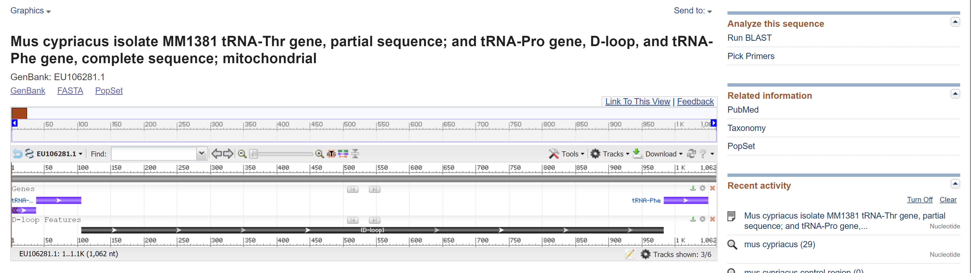

Slide 29
Sequence alignment:
dot plot
Sequence 1 TTGTACGACGG
Sequence 2 TTGTACGACG
TTGTACGACGG TTGT---ACGACGG
⏐⏐⏐⏐⏐⏐⏐⏐⏐⏐ ⏐⏐⏐⏐ ⏐⏐⏐
TTGTACGACG TTGTACGACG
Sequence 1 ACTTGTGCTTC
Sequence 2 ACGTGCTGCTC
ACTTG-TGCTTC
Path 1 ⏐⏐ ⏐⏐ ⏐⏐⏐⏐
ACGTGCTGCTC
ACTTGTGCTTC
Path 2 ⏐⏐ ⏐⏐⏐⏐⏐ ⏐
AC--GTGCTGCTC

Slide 30
Sequence alignment:
GP = g + hl
g - gap penalty
h – gap extension
penalty
l – gap length
Gap penalty:
g = penalizace za výskyt mezery (1×)
h = extenze za každou „pomlčku“
l = délka mezery (= počet „pomlček“)
Př.: GC‒ ‒ ‒ ‒ ‒TTAA
l = 5, g = x, h = 5x

Slide 31
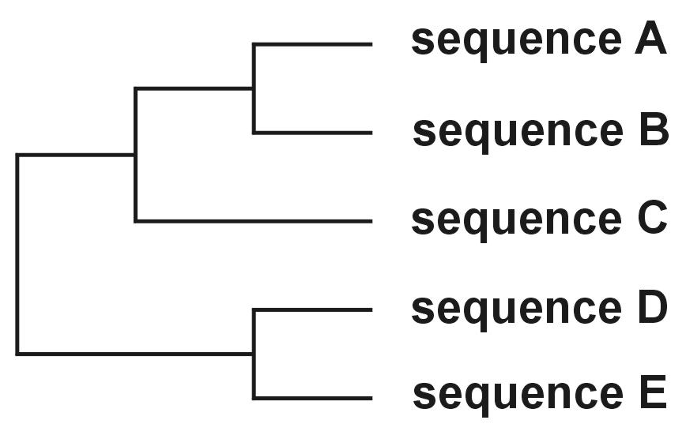
Progressive alignment - ClustalX
3 phases:
Alignment of sequence pairs → pairwise distances
Construction of guide tree (eg. Neighbor-Joining)
Alignment of all sequences according to guide tree
I.
II.
III.
I.

Slide 32
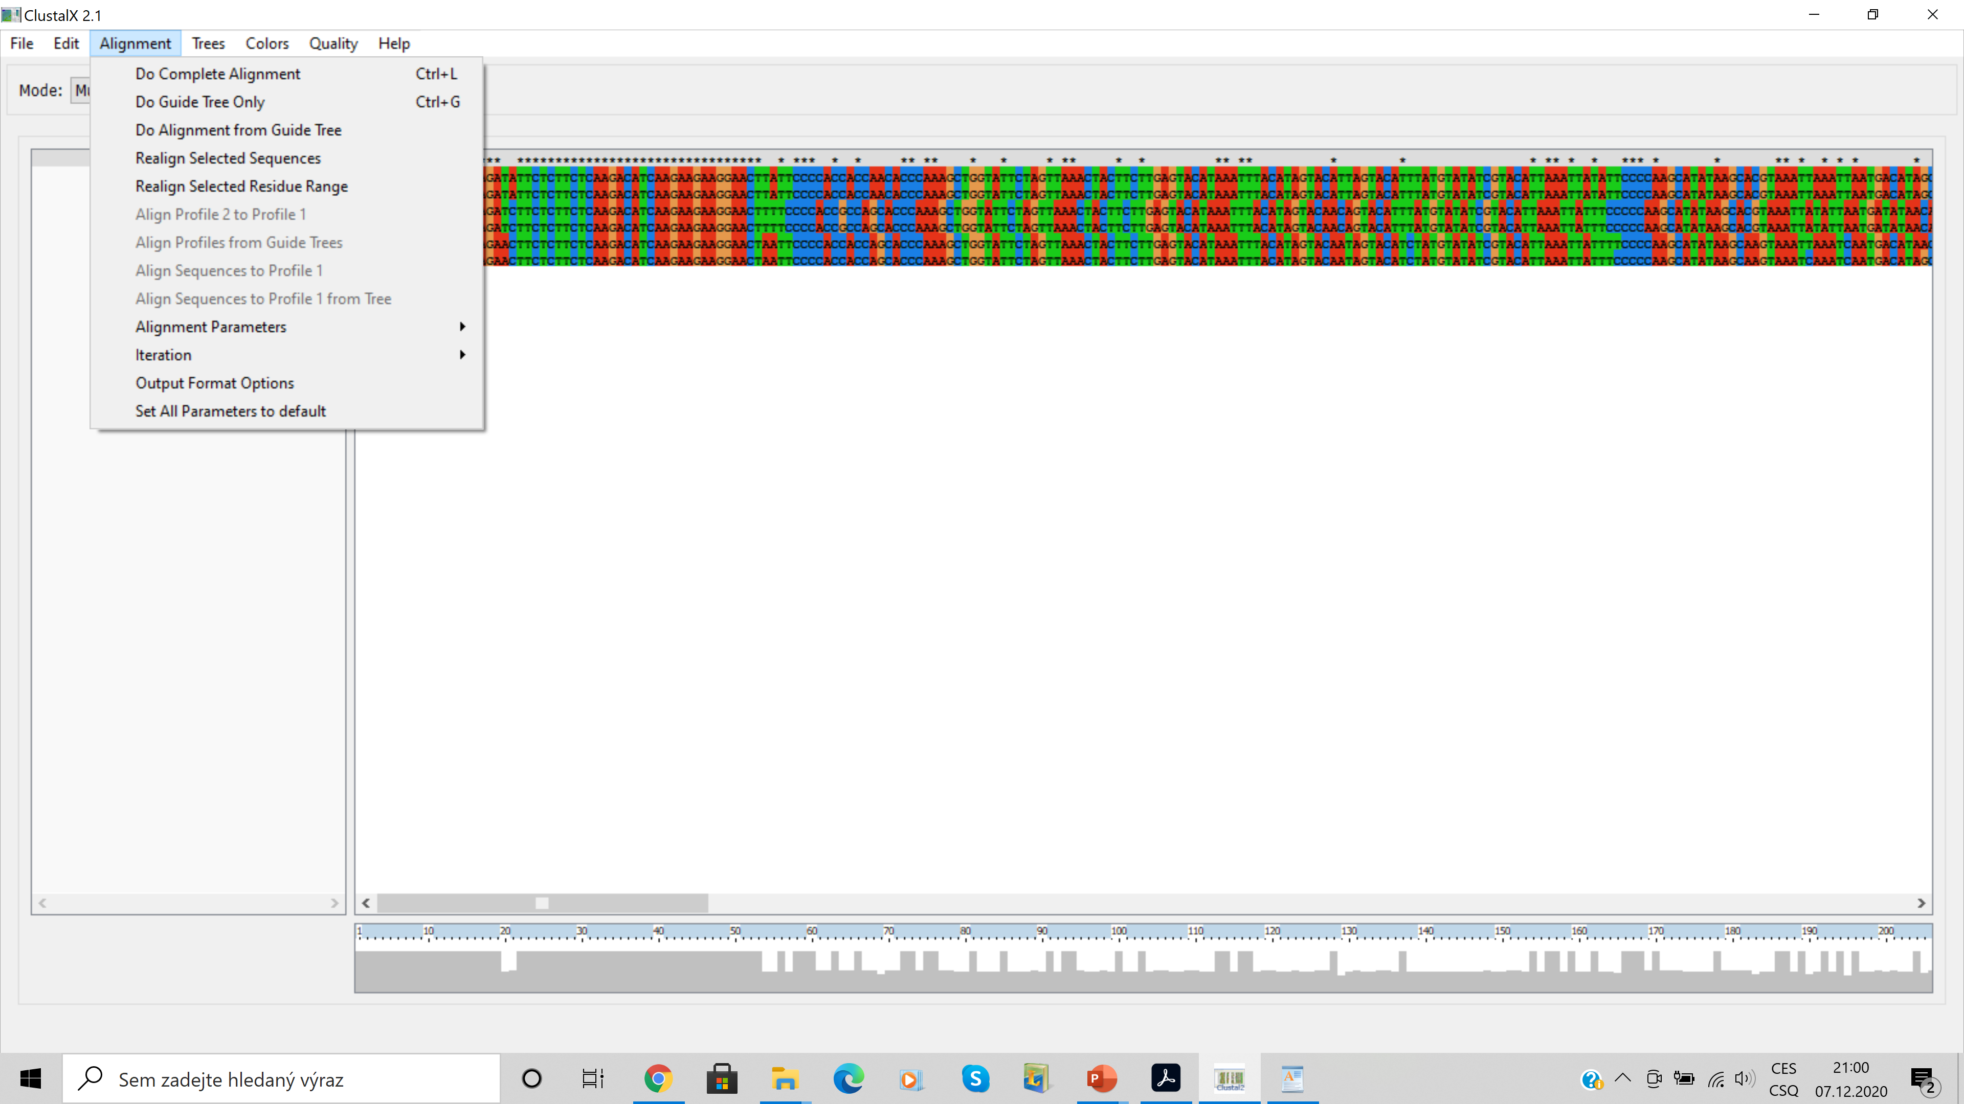

Slide 33
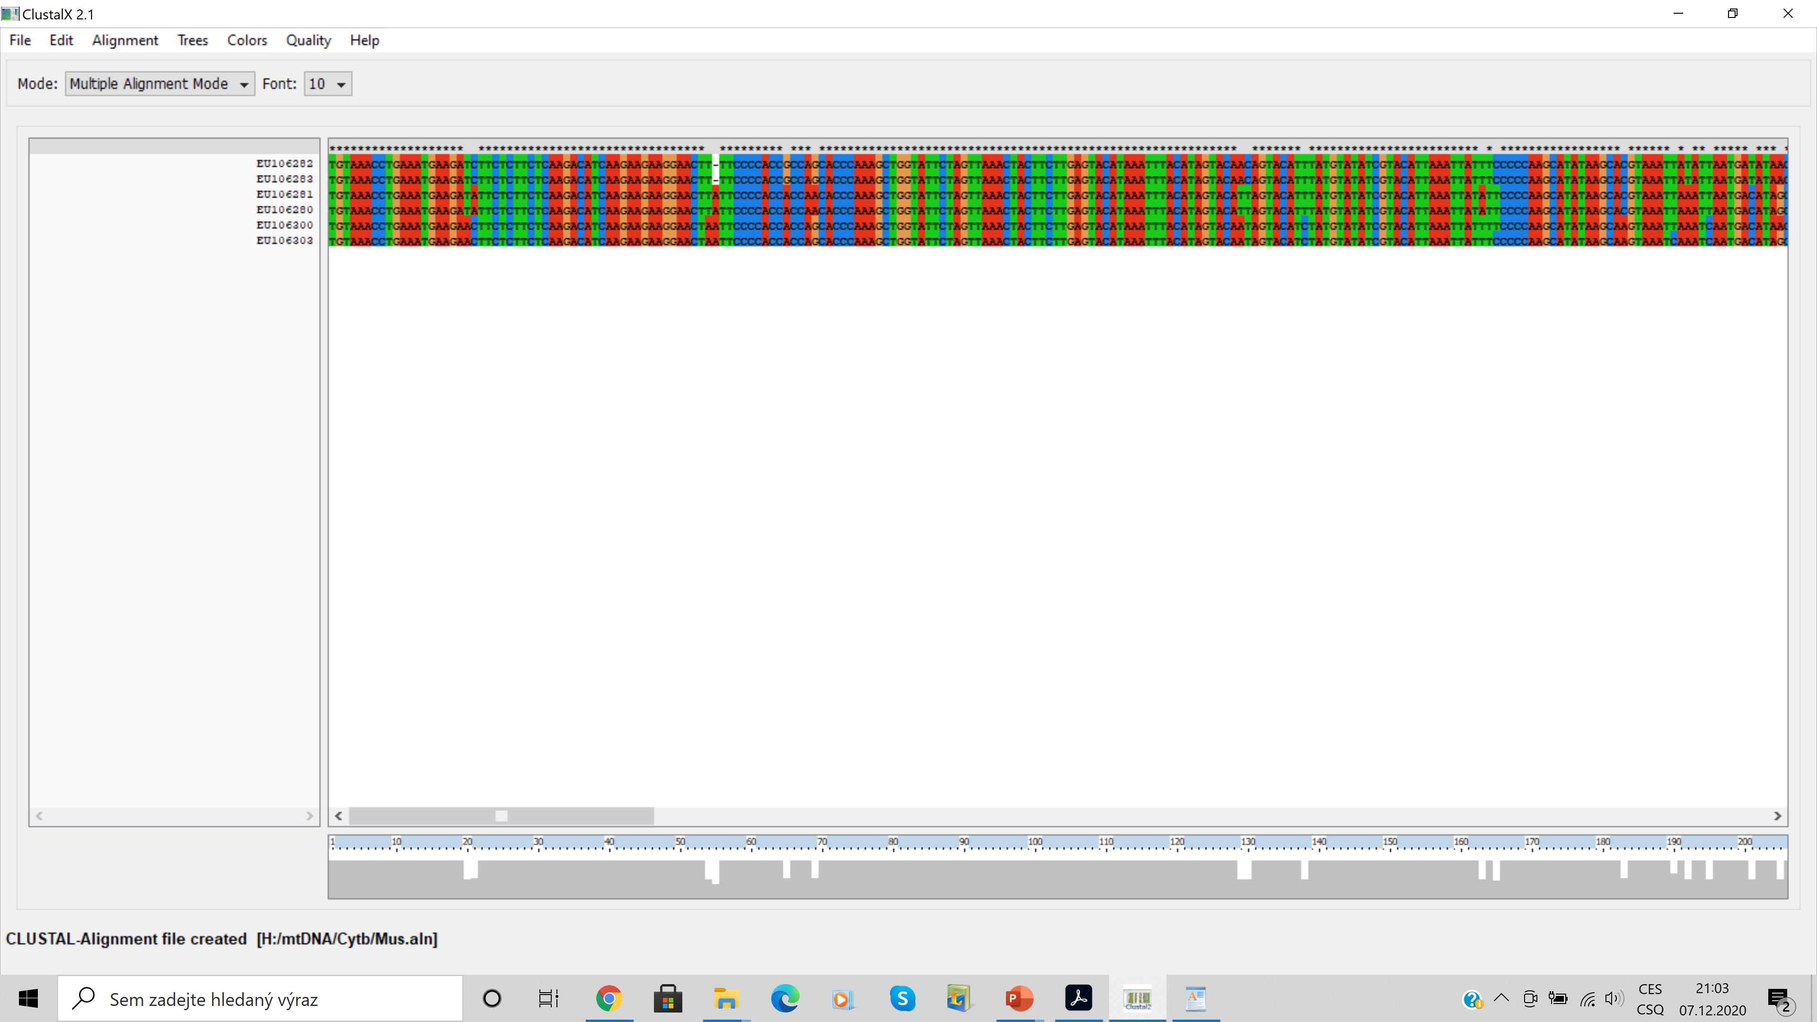

Slide 34
Problem with progressive alignment
6 species:
gorilla AGGTT
horse AG-TT
panda AG-TT
penguin A-GTT
chicken A-GTT
ostrich AGGTT
AGGTT
AG-TT
AG-TT
AG-TT
AG-TT
AGGTT
gorilla AGGTT
horse AG-TT
panda AG-TT
penguin A-GTT
chicken A-GTT
ostrich AGGTT
AGGTT
A-GTT
A-GTT
A-GTT
A-GTT
AGGTT

Slide 35
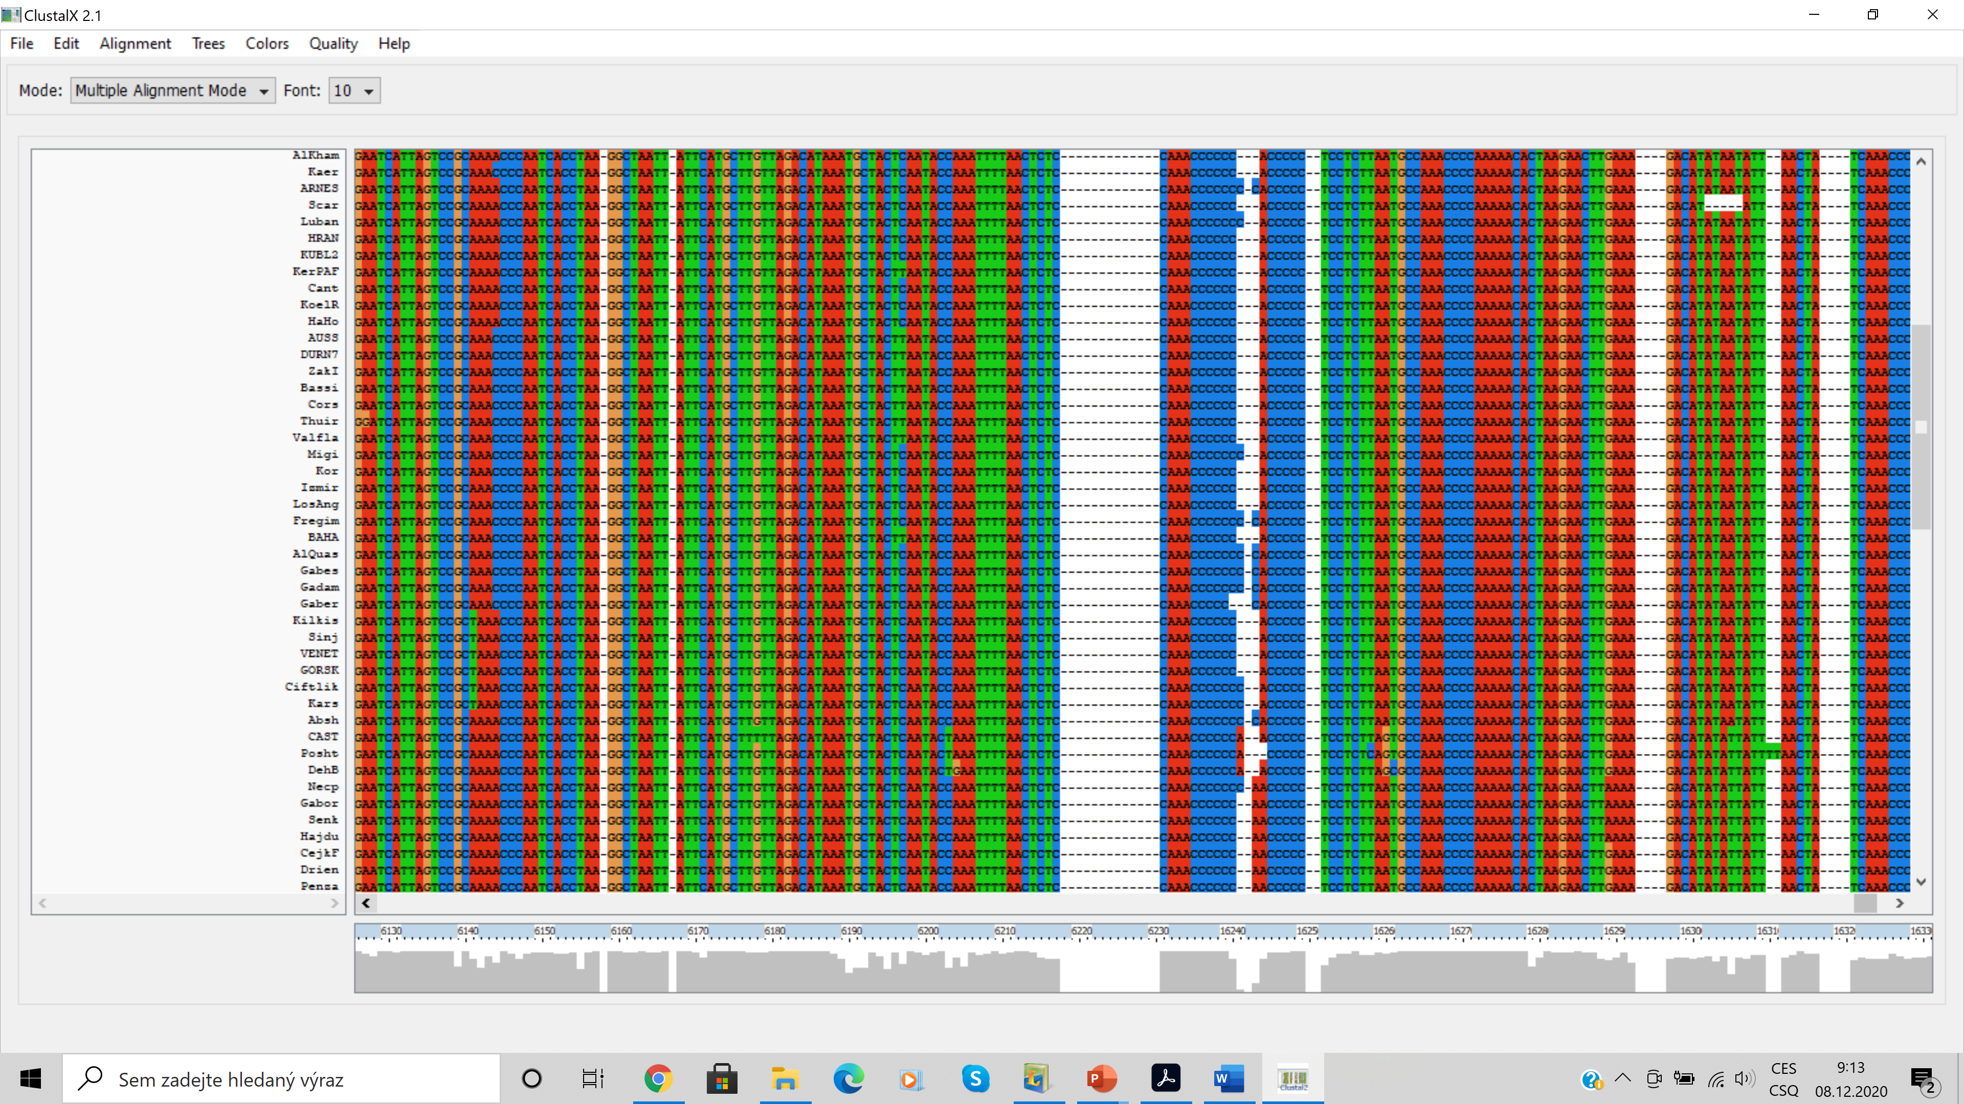
Many other alignment programs: e.g. MAFFT, MUSCLE, Geneious...

Slide 36
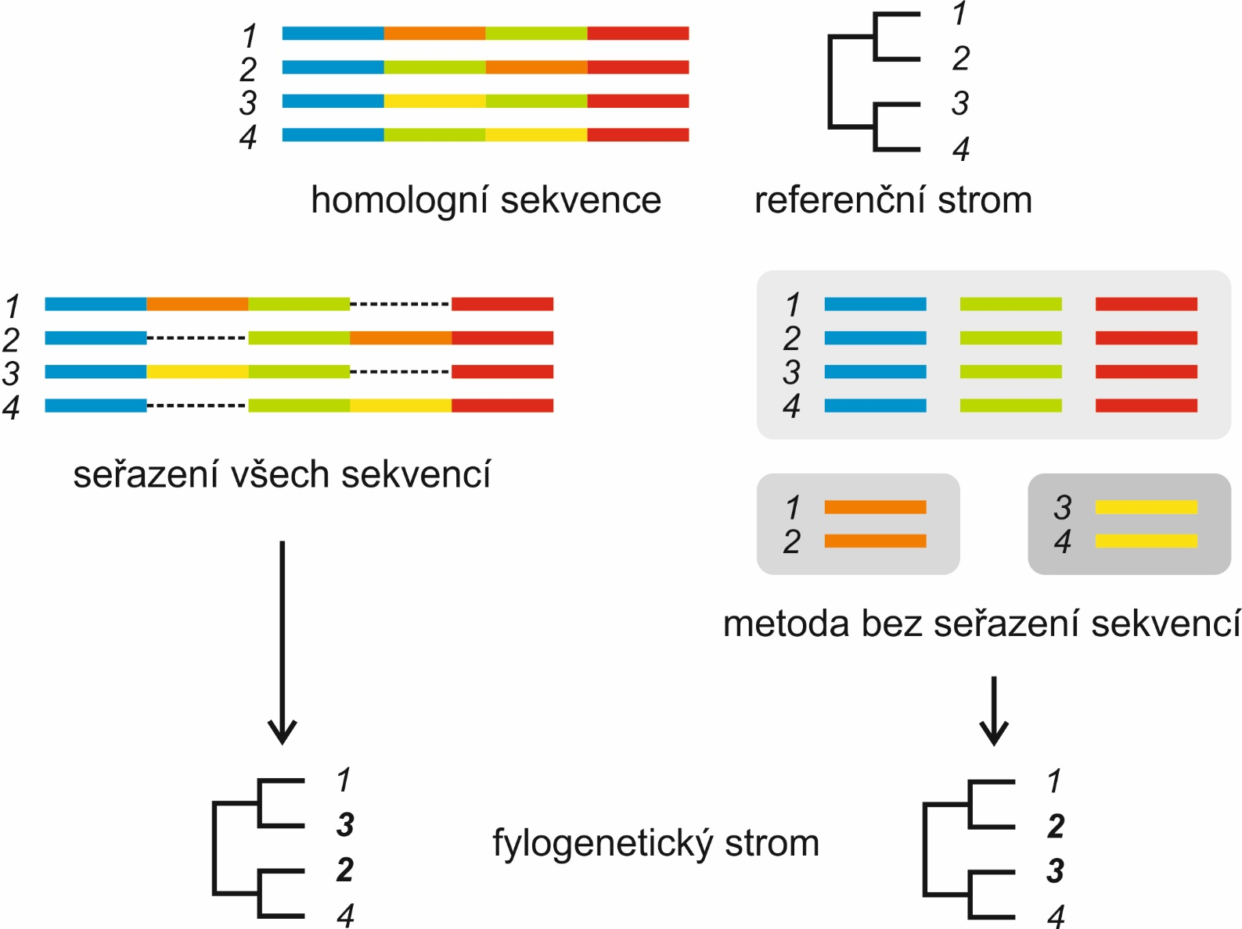
There are also methods without alignment:

Slide 37
Methods
Data types
distances
characters
UPGMA
neighbor-
joining
algorithms
Methods of tree construction
Fitch-
Margoliash
minimum
evolution
maximum
parsimony
maximum
likelihood
Bayesian a.
optimality criteria

Slide 38
How to assess the methods?
Efficiency: how fast is the method?
Power: how many characters we need?
Consistency: does increasing characters result in true tree?
Robustness: how does it work when assumptions are
violated?
Falsifiability: does it allow testing assumptions?

Slide 39
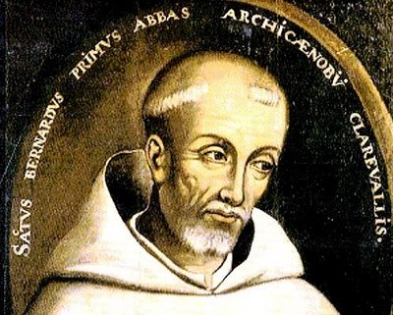
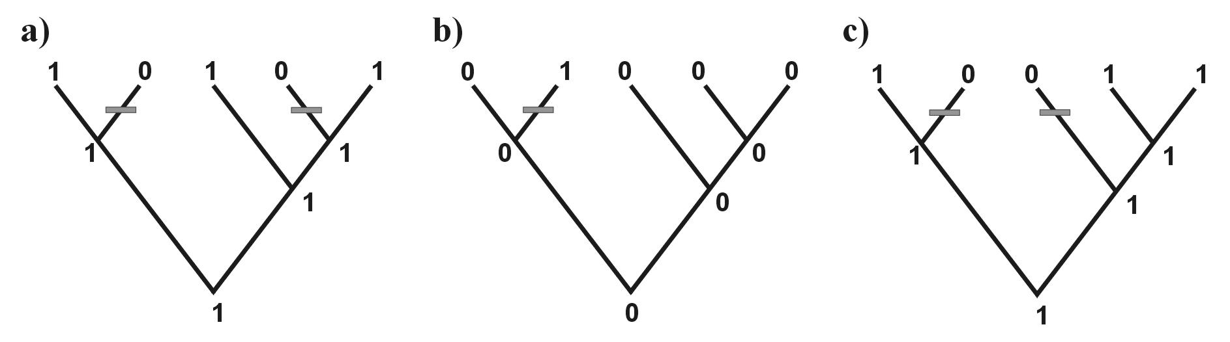
Maximum parsimony, MP
(maximální úspornost)
William of Ockham (c. 1287 – 1347)
Occam’s razor
 | I | II | III
A | 1 | 0 | 1
B | 0 | 0 | 1
C | 1 | 0 | 0
D | 0 | 1 | 0
E | 1 | 0 | 1
minimal number of steps = 3
real number of steps = 5
⇒ 2 extra steps → homoplasy
2 steps
1 step
2 steps

Slide 40
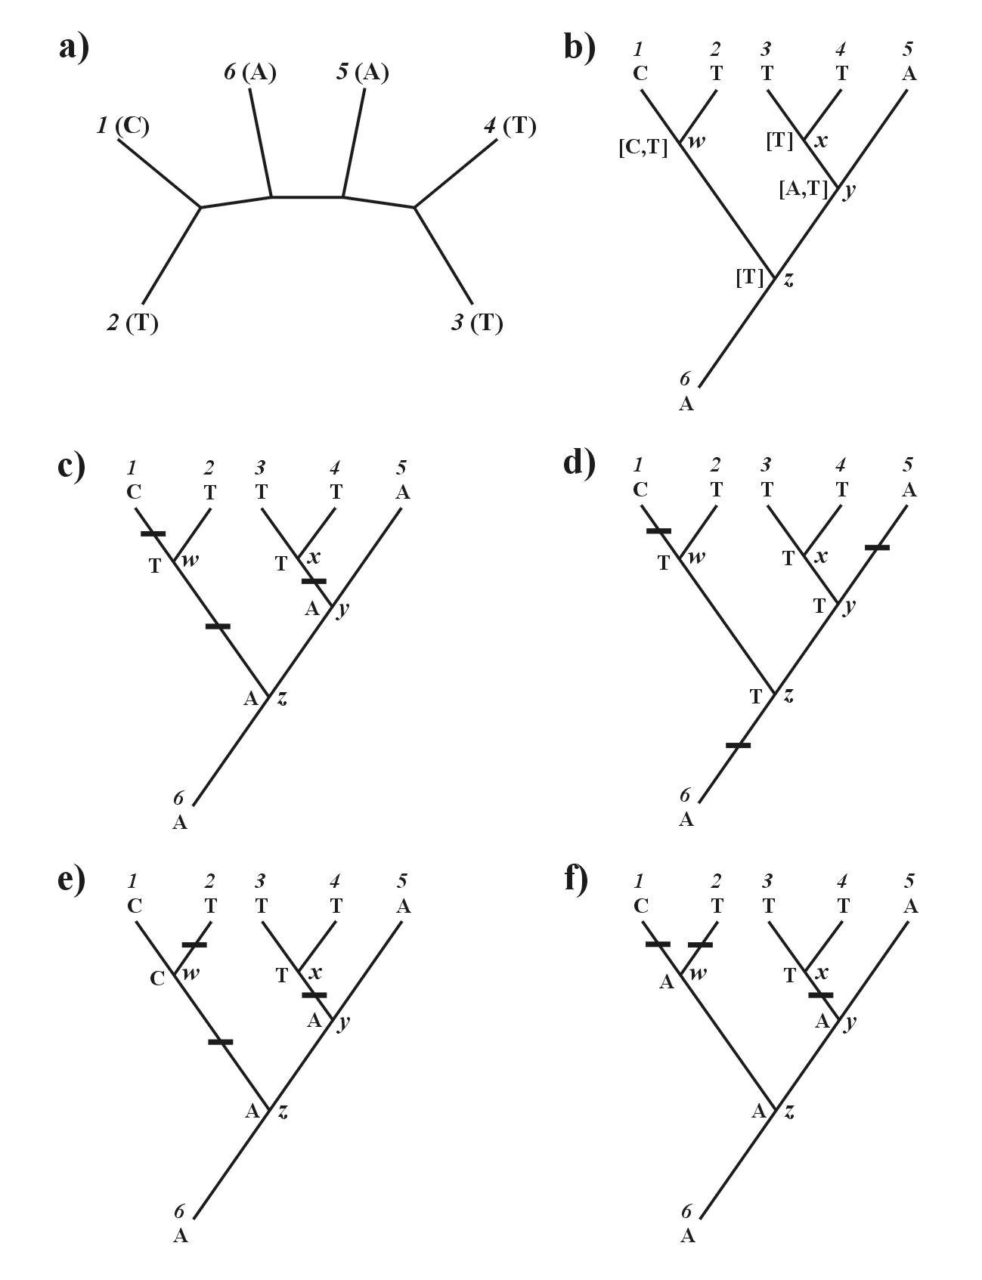
Estimation of number of steps: Fitch algorithm
1. arbitrary root

Slide 41
Estimation of number of steps: Fitch algorithm
1. arbitrary root
2. Downward:
w = C or T
x = T
y = A or T
z = T

Slide 42
Estimation of number of steps: Fitch algorithm
1. arbitrary root
2. Downward:
w = C or T
x = T
y = A or T
z = T
3. Upward:
z = T, nebo A
total length = 3
DELTRAN
(DELayed TRANsformation)
ACCTRAN
(ACCelerated TRANsformation)

Slide 43
Problem of homoplasy:
parsimony-informative and non-informative characters (sites)
- invariant sites (symplesiomorphies)
- singletons (autapomorphies)
index of consistency, CI
retention index, RI
rescaled consistency index, RC
homoplasy index, HI)
RC = CI × RI
HI = 1 - CI
m = min. no. of possible steps
s = min. no. needed for explaining the tree
g = max. no. of steps for any tree

Slide 44
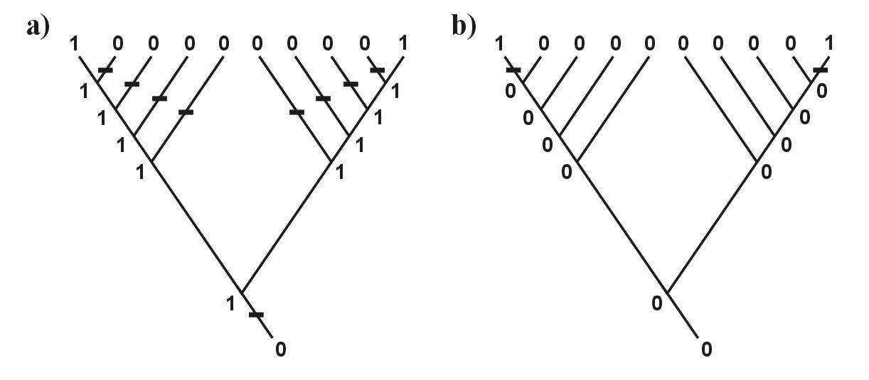
Metods of parsimony:
Fitch: X → Y a Y → X
neseřazené znaky (A → T nebo A → G etc.)
Wagner: X → Y a Y → X
seřazené znaky (1 → 2 → 3)
Dollo: X → Y a Y → X, potom nelze X → Y
… restriction-site and
restriction-fragment data
Camin-Sokal: X → Y,
not Y → X
… SINE, LINE
“relaxed Dollo criterion”
weighted = transversion p.
generalized p.: cost matrix = step matrix

Slide 45
Wagner
Fitch
*)
Dollo
transversion
*) M is an arbitrarily large number, guaranteeing that only one transformation to each derived
state will be permitted.

Slide 46
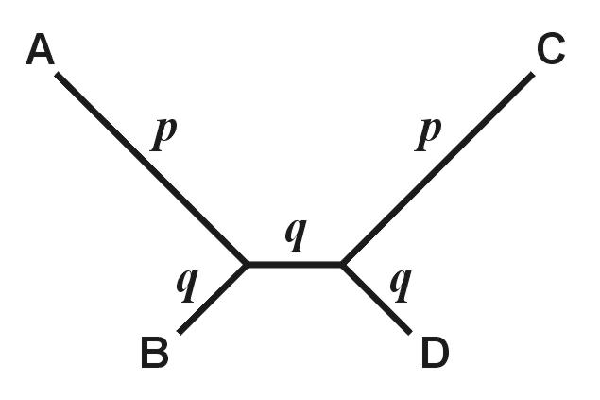
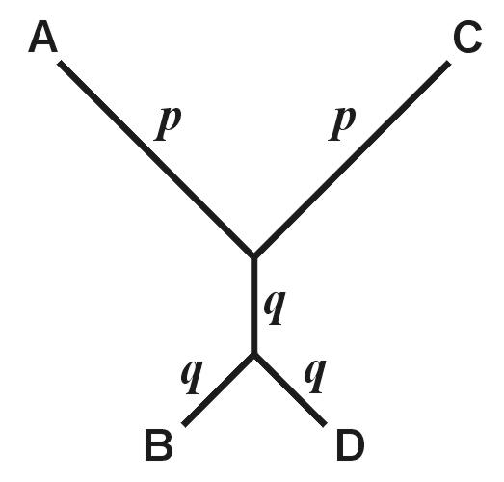
Parsimony and consistency
“true”
“wrong”
p>>q
((A,B),(C,D))
((A,C),(B,D))

Slide 47
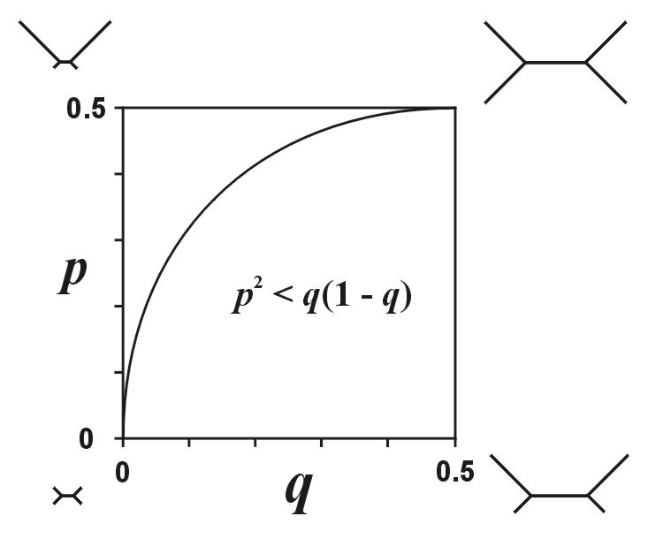
Parsimony and consistency
„Felsenstein
zone“
In the Felsenstein zone, parsimony is inconsistent

Slide 48
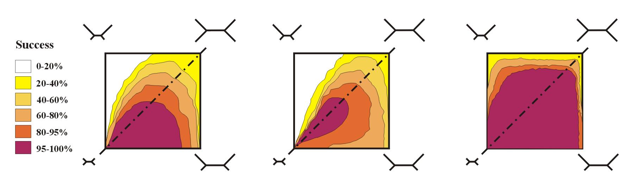
Parsimony and consistency

Slide 49
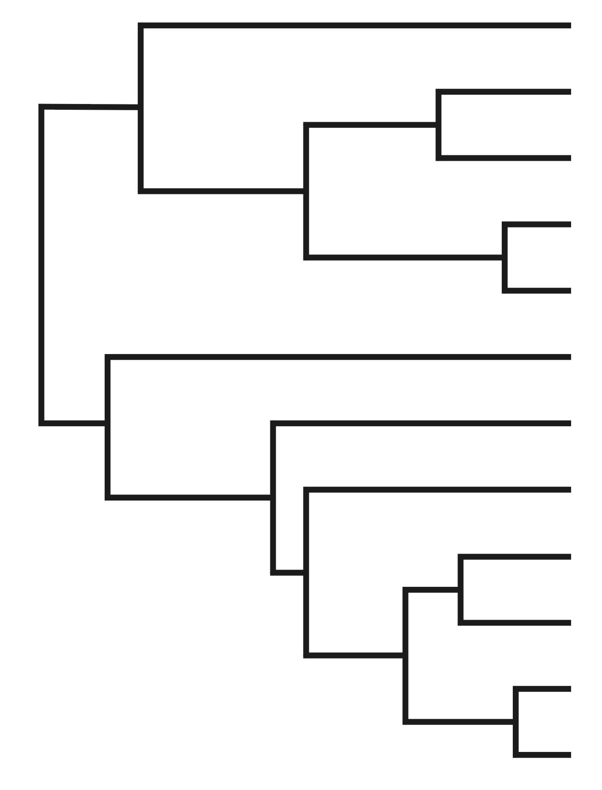
Parsimony and consistency
long branches
long-branch attraction (LBA)

Slide 50
Search for optimal tree
Exact methods:
a) exhaustive search
b) branch-and-bound

Slide 51
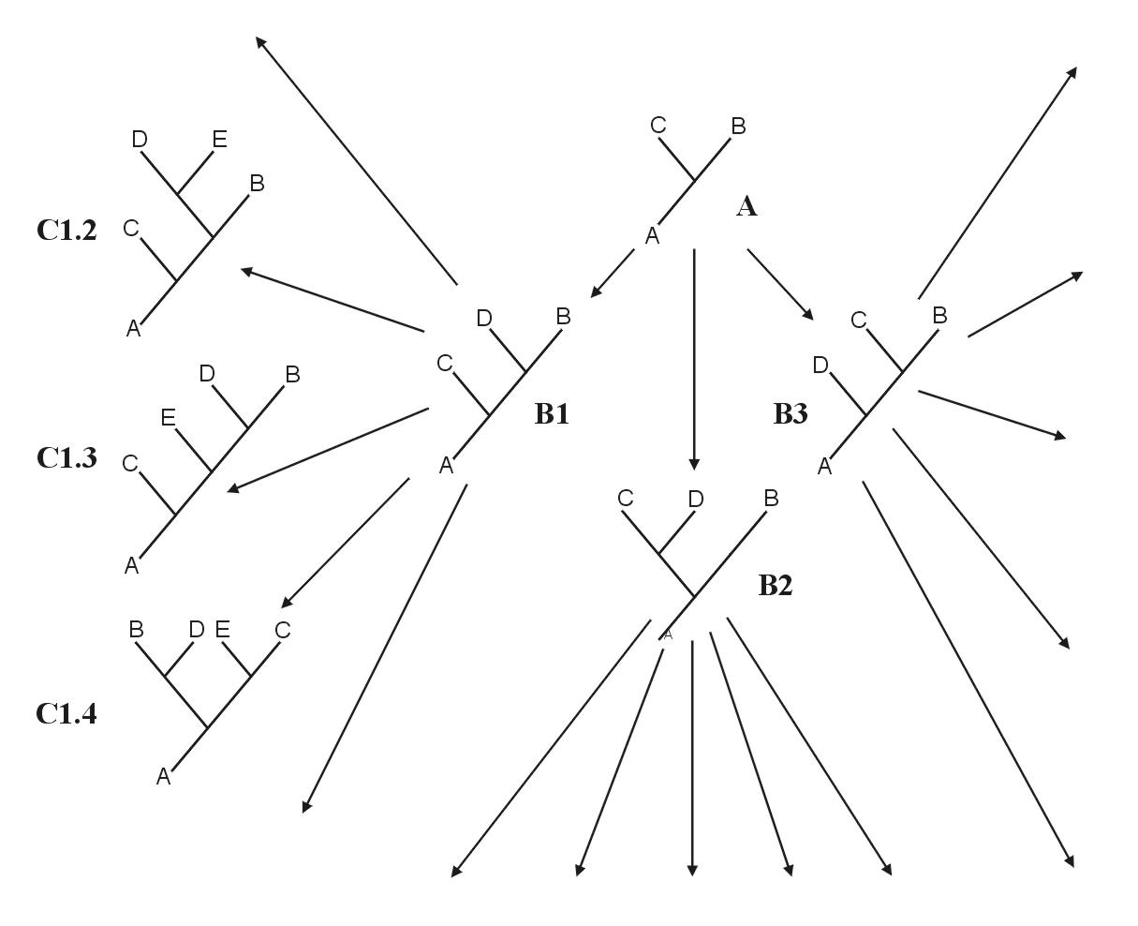
branch-and-bound
starts with 3 taxa, sequential addition
if the tree is longer than
a randomly chosen tree, the process is terminated

Slide 52
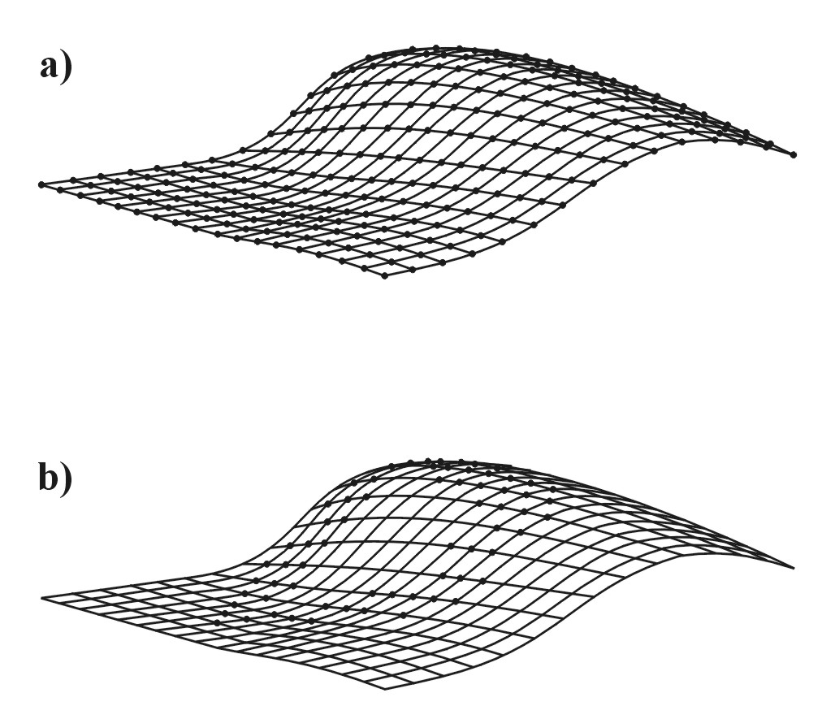
2. Heuristic search
all possible trees

Slide 53
stepwise addition
star decomposition
branch swapping
heuristic search

Slide 54
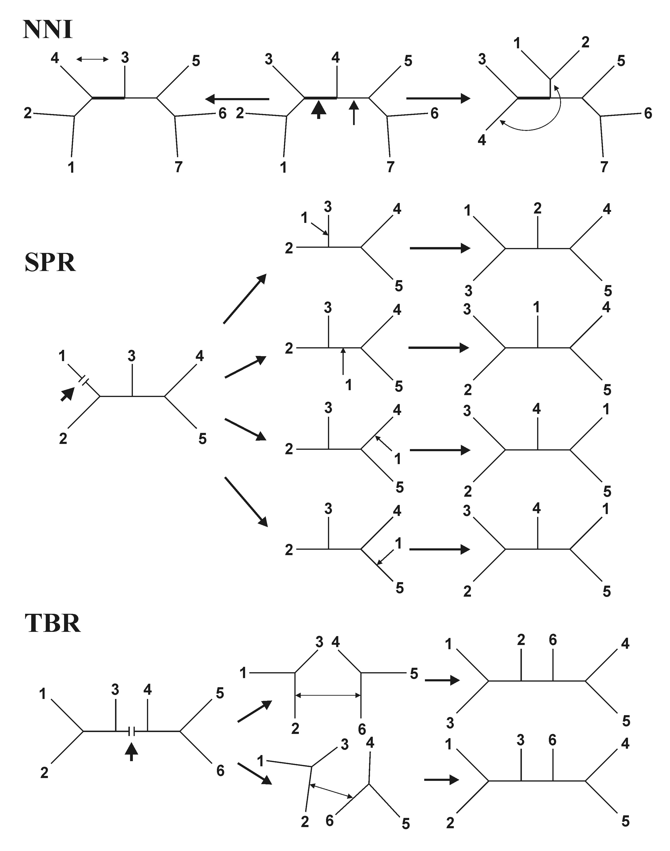
nearest-neighbor
interchanges (NNI)
subtree prunning
and regrafting (SPR)
tree bisection and
reconnection (TBR)

Slide 55
Evolutionary models and distance methods
Base after substitution
A C G T
A -¾ ¼ ¼ ¼
Original base C ¼ -¾ ¼ ¼
G ¼ ¼ -¾ ¼
T ¼ ¼ ¼ -¾
− α α α
α − α α
α α − α
α α α −
Q =
Jukes-Cantor (JC): equal base frequencies
equal substitution rates

Slide 56
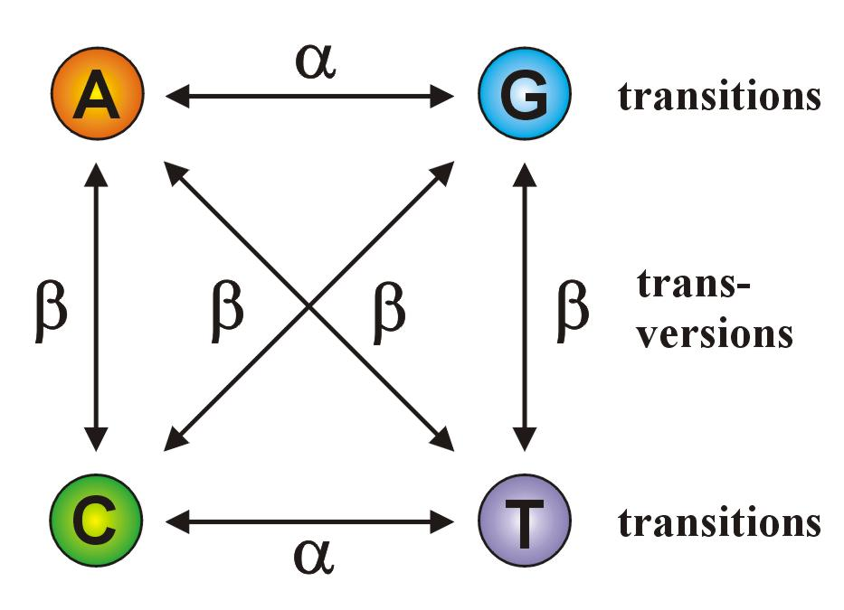
Kimura 2-parameter (K2P): transitions ≠ transversions
− β α β
β − β α
α β − β
β α β −
Q =
If α = β, K2P = JC

Slide 57
Felsenstein (F81): different base frequencies
− π_{C} π_{G} π_{T}
π_{A} − π_{G} π_{T}
π_{A} π_{C} − π_{T}
π_{A} π_{C} π_{G} −
Q =
Jestliže πA = πC = πG = πT, F81 = JC
Hasegawa-Kishino-Yano (HKY): different base frequencies
transitions ≠ transversions
− π_{C}β π_{G}α π_{T}β
π_{A}β − π_{G}β π_{T}α
π_{A}α π_{C}β − π_{T}β
π_{A}β π_{C}α π_{G}β −
Q =
General time-reversible (GTR, REV): different base frequencies
different substitution rates

Slide 58
Jukes-Cantor (JC)
π_{A}=π_{C}=π_{G}=π_{T}
α=β
unequal base frequencies
more than 1 type of substitution
Felsenstein (F81)
π_{A}≠π_{C}≠π_{G}≠π_{T}
α=β
Kimura‘s two-parameter (K2P)
π_{A}=π_{C}=π_{G}=π_{T}
α≠β
Felsenstein (F84)
π_{A}≠π_{C}≠π_{G}≠π_{T}
a=c=d=f=1, b=(1+K/π_{R}), e=(1+K/π_{Y}), kde π_{R}=π_{A}+π_{G} π_{Y}=π_{C}+π_{T}
Hasegawa-Kishino-Yano (HKY)
π_{A}≠π_{C}≠π_{G}≠π_{T}
α≠β
Tamura-Nei (TrN)
π_{A}≠π_{C}≠π_{G}≠π_{T}
α≠β
Kimura’s three-substitution-type (K3ST)
π_{A}=π_{C}=π_{G}=π_{T}
α≠β
2 transition types
General-time reversible (GTR)
π_{A}≠π_{C}≠π_{G}≠π_{T}
a, b, c, d, e, f

Slide 59
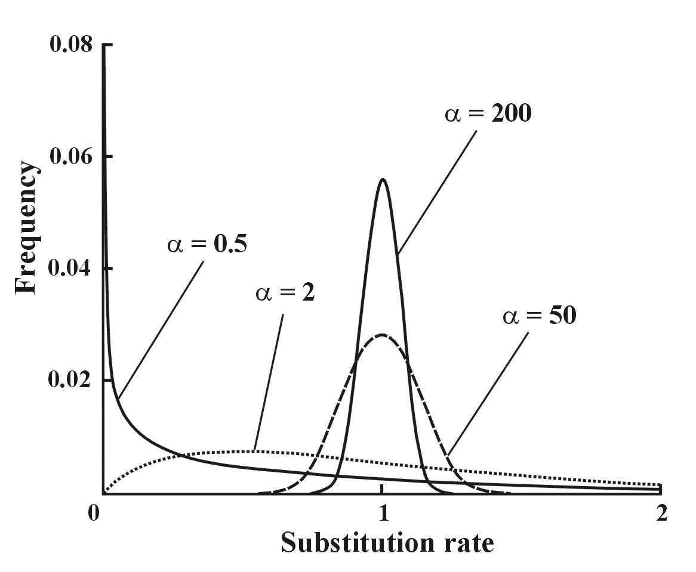
Heterogenity of substitution rates
in different parts of sequences
the higher α, the more homogeneous are substitutions
Gamma (Γ) distribution:
shape parameter α
discrete gamma model
invariant sites
→ GTR+ Γ+I

Slide 60
Model comparison:
Likelihood ratio test (LRT):
nested models
LR = 2(lnL2 – lnL1)
χ² distribution, p2 – p1 degrees of freedom
Akaike information criterion (AIC):
nonnested models
AIC = -2lnL + 2p, kde p = number of free parametres
better model → lower AIC
Bayesian information criterion (BIC):
nonested models
BIC = -2lnL + plnN, where N = sample size

Slide 61
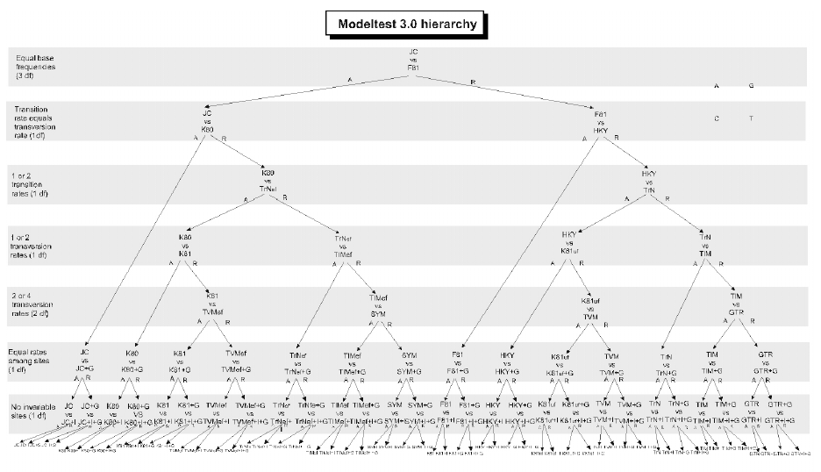
Model comparison:
hierarchical LRT – ModelTest (Crandall and Posada), jModelTest

Slide 62
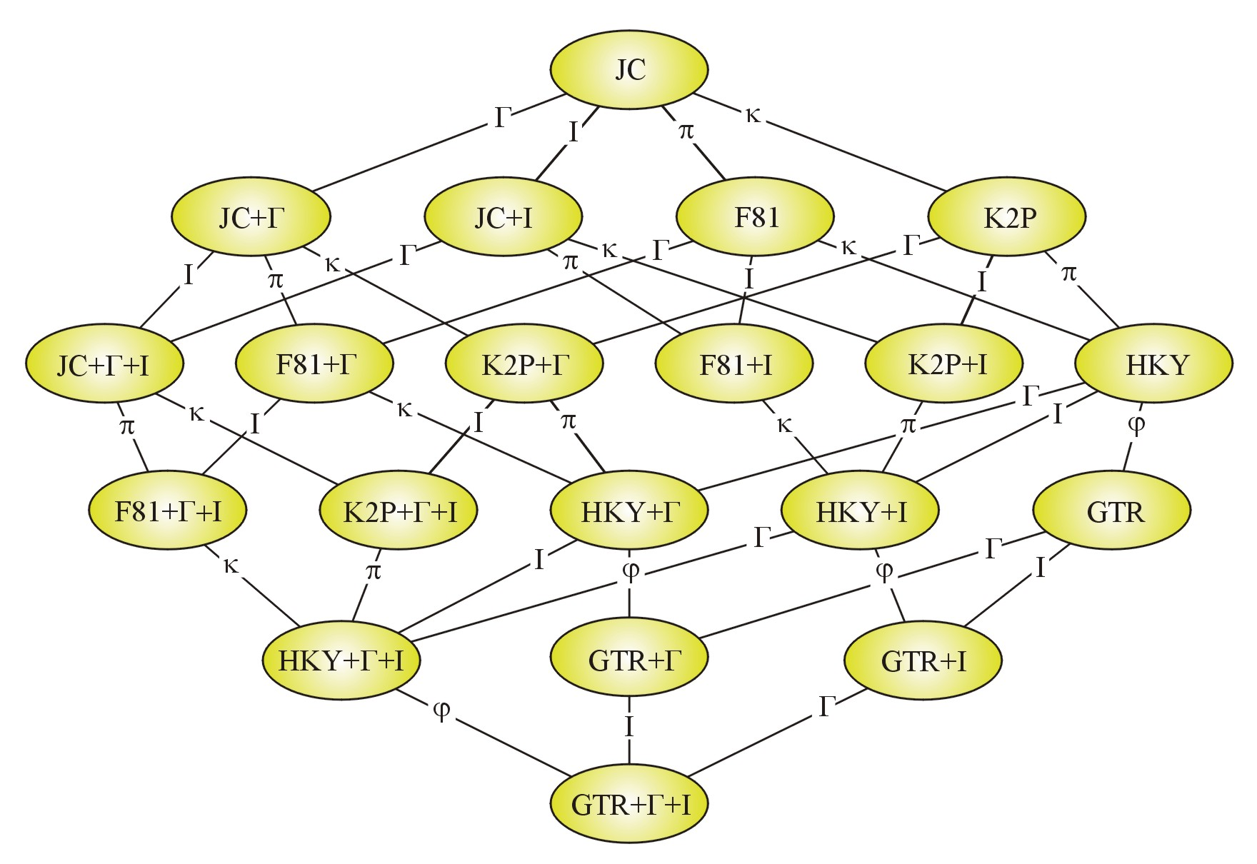
Model comparison:
dynamic LRT:

Slide 63
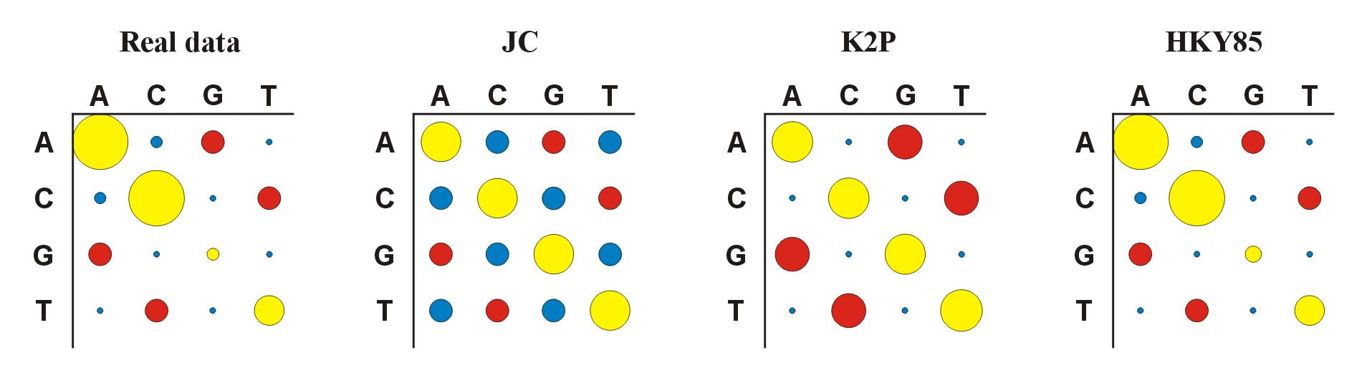
Model comparison:
error!
More parametres ⇒ more realism, but …
… also less confidence (estimates based on the same amount of data!)

Slide 64
Distances
computed for each pair of taxa, from distance (or similarity) matrix
– tree inference
distance methods base on assumption that if we know true distances,
we can very easily infer the true phylogeny
advantage: very fast and simple (also with a calculator)

Slide 65
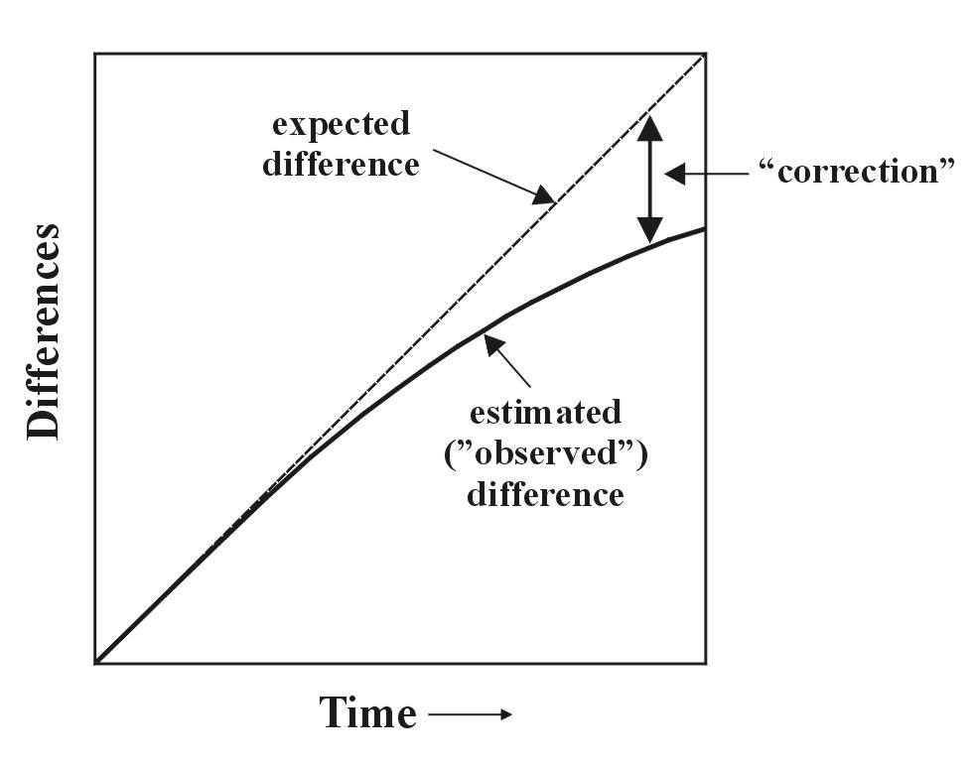
1 10 20 30
sequence 1: ACCCGTTAAGCTTAACGTACTTGGATCGAT
sequence 2: ACCCGTTAGGCTTAATGTACGTGGATCGAT
p-distance: p = k/n = 3/30 = 0,10
problem of
saturation:

Slide 66
Distances for some models:

Slide 67
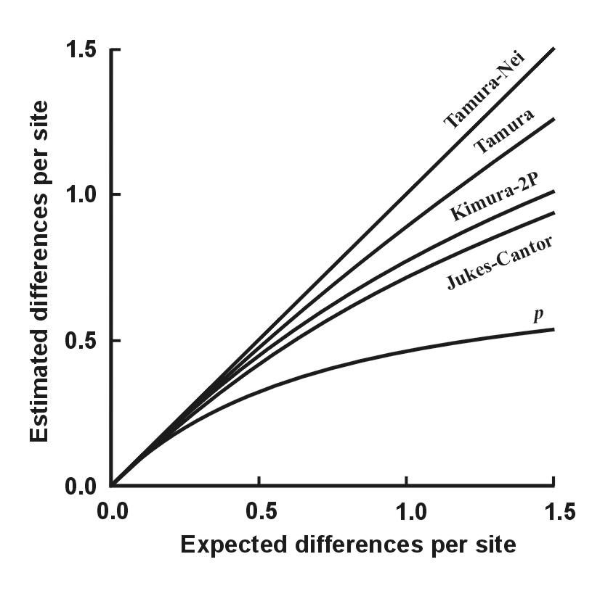

Slide 68
Cluster analysis - UPGMA
chimp bonobo gorilla human orang.
chimp (Š) --
bonobo (B) 0,0118 --
gorilla (G) 0,0427 0,0416 --
human (Č) 0,0382 0,0327 0,0371 --
orangutan (O) 0,0953 0,0916 0,0965 0,0928 --
Find min d(ij)
Calculate new matrix (ŠB-k) = [d(B-k)+d(Š-k)]/2
Repeat 1 a 2.

Slide 69
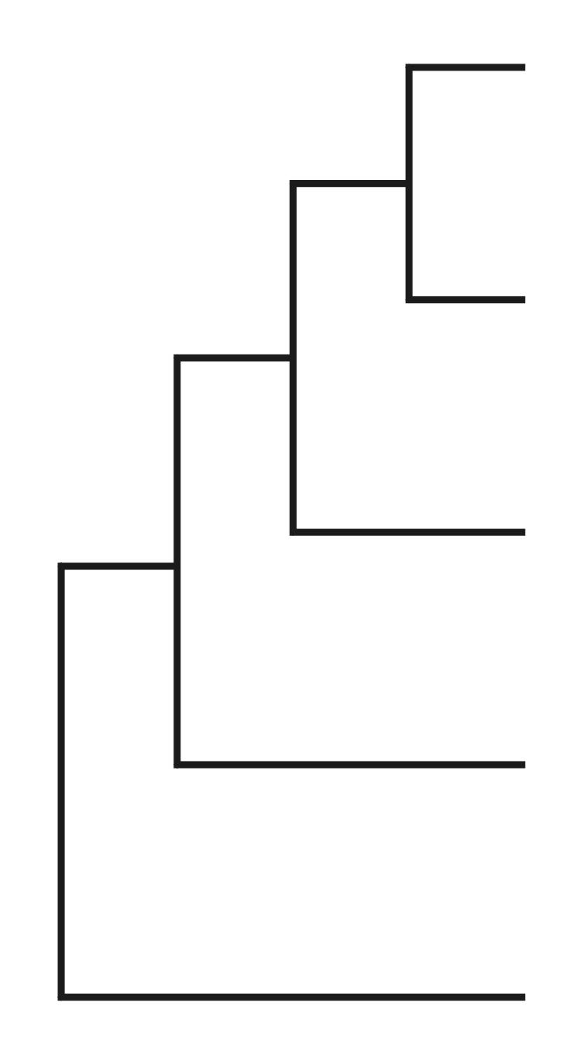

ŠB gorilla human orang.
ŠB --
gorilla (G) 0,0422 --
human (Č) 0,0355 0,0371 --
orangutan (O) 0,0935 0,0965 0,0928 --
UPGMA (unweighted pair-group method using arithmetic means):
d[(BŠČ)G] = {d(BG)+d(ŠG)+d(ČG)}/3
WPGMA: d[(BŠČ)G] = {d[(BŠ)G] + d(ČG)}/2
single-linkage (metoda nejbližšího souseda)
complete-linkage (m. nejvzdálenějšího souseda)
Š
B
Č
G
O

Slide 70
UPGMA and consistency
additive distances: d_{AB} + d_{CD} ≤ max (d_{AC} + d_{BD}, d_{AD} + d_{BC})
tj. distance between 2 taxa equals sum of branches
connecting them
ultrametric distances: d_{AC} ≤ max (d_{AB}, d_{BC})
A
B
D
C
A
C
B
additive tree ultrametric tree

Slide 71
UPGMA and consistency

Slide 72
Neighbor-Joining, NJ
Algorithmic method
Principle of minimal evolution → minimizes sum of branch lenghts S
Each pair of nodes adjusted according to its divergence from others
Single additive tree

Slide 73
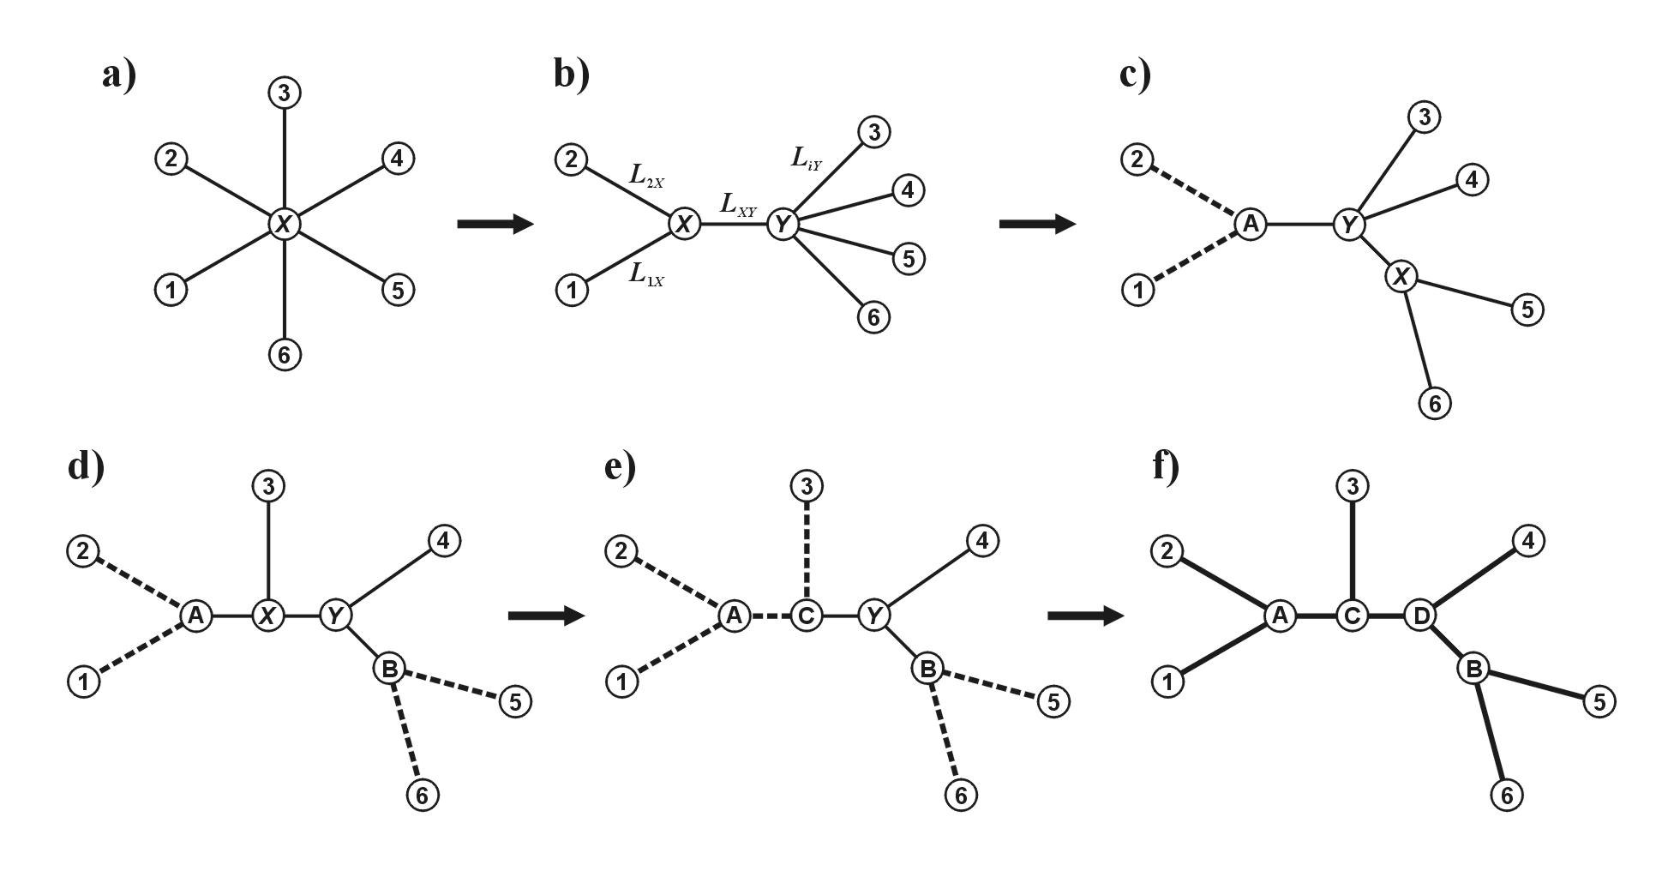
star tree

Slide 74
finding nearest neighbors
star tree

Slide 75
finding nearest neighbors
star tree
distance recalculation

Slide 76
finding nearest neighbors
star tree
distance recalculation
S = 32,4
S = 29,5
S = 28,0
repeating...

Slide 77
Drawbacks of distance data:
loss of information during transformation
after transformation to distances, we cannot infer original data
(different sequences may result in the same distance)
we cannot study the evolution in different parts of sequence
difficult biological interpretation of branch lengths
we cannot combine more distance matrices

