Slide 1
3. Reprodukční bariéry
Bi6570 Mikroevoluce a speciace rostlin (podzim 2022)
František Zedek

Slide 2
3. Reprodukční bariéry
Bi6570 Mikroevoluce, speciace a taxonomie rostlin (podzim 2020)
František Zedek

Slide 3
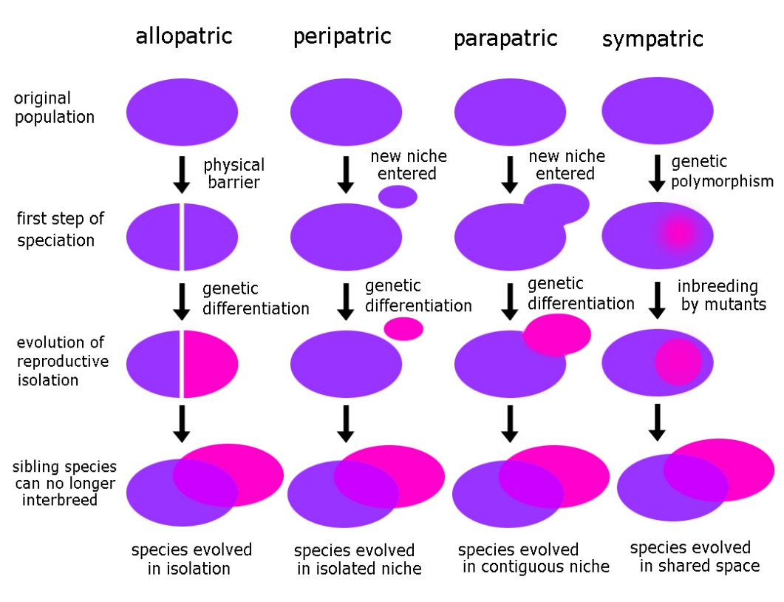
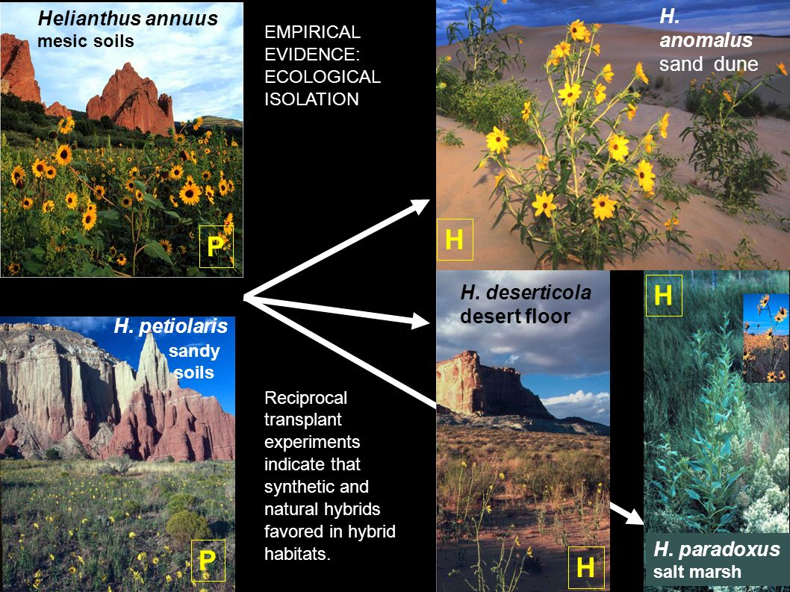
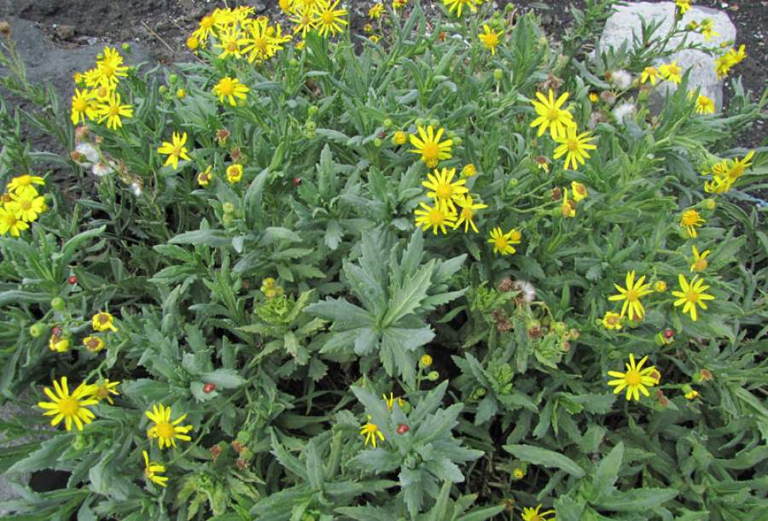
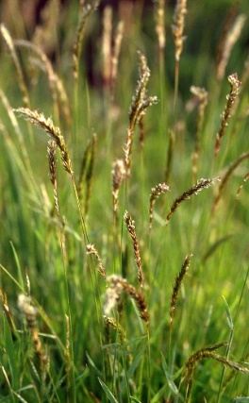
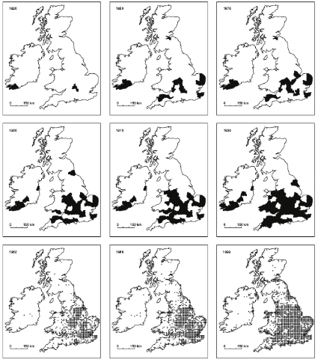
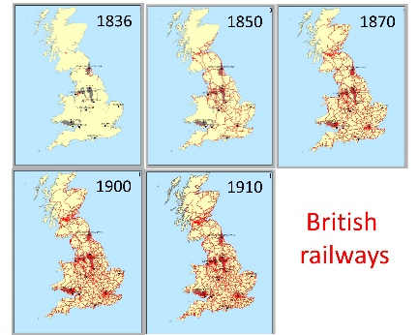
Plant speciation, reproductive barriers
s
Senecio squalidus
1820
1850
1870
1900
1910
1930
1962
1988
1999
Anthoxanthum odoratum
Trelogan lead and zinc mine in Wales
abandoned in 1911.
Baack et al. (2015) The origins of reproductive isolation in plants. New Phytologist 207: 968–984.
Lowry et al. (2008) Ecological reproductive isolation of coast and inland races of Mimulus guttatus. Evolution 62: 2196-2214.
Rothfels et al. (2015) Natural hybridization between genera that diverged from each other approximately 60 million years ago. Am. Naturalist 185:433-442..

Slide 4
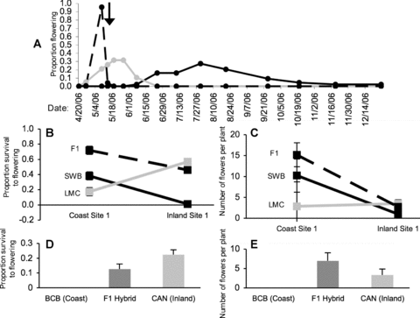
Prezygotic barriers
Local adaptation causing a prezygotic barrier between coastal and inland populations of Mimulus guttatus (Phrymaceae)
Lowry et al. (2008) Ecological reproductive isolation of coast and inland races of Mimulus guttatus. Evolution 62: 2196-2214.

Slide 5
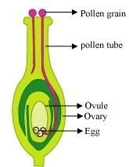
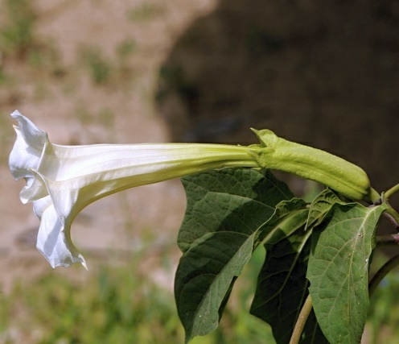
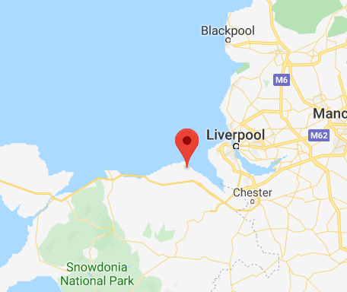
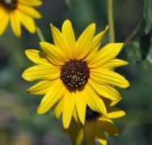

Prezygotic barriers
Baack et al. (2015) The origins of reproductive isolation in plants. New Phytologist 207: 968–984.
Bucholz et al. (1935) Pollen-Tube Growth of Ten Species of Datura in Interspecific Pollinations. PNAS 21: 651-656.
Riesberg et al. (1995) Interspecific Pollen Competition as a Reproductive Barrier Between Sympatric Species of Helianthus (Asteraceae). Am J Bot 82: 515-519.
Antonovics (2006) Evolution in closely adjacent plant populations X: long-term persistence of prereproductive isolation at a mine boundary. Heredity 97: 33-37.

