Slide 1
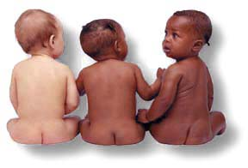
Mendel´s principles in human genetics

Slide 2
Peculiarities of genetic studies in humans
Ethical standards forbids experiments and selection in human beings
Humans have usually small number of offsprings
Phenotype is influenced by external conditions - polygenic traits
Generation period is too long – max 4 generations for 1 scientists
Complexity of human genome
Historically, the mating was limited to individuals in certain population (nation, religion..) x huge number of means of transport = migration nowadays

Slide 3
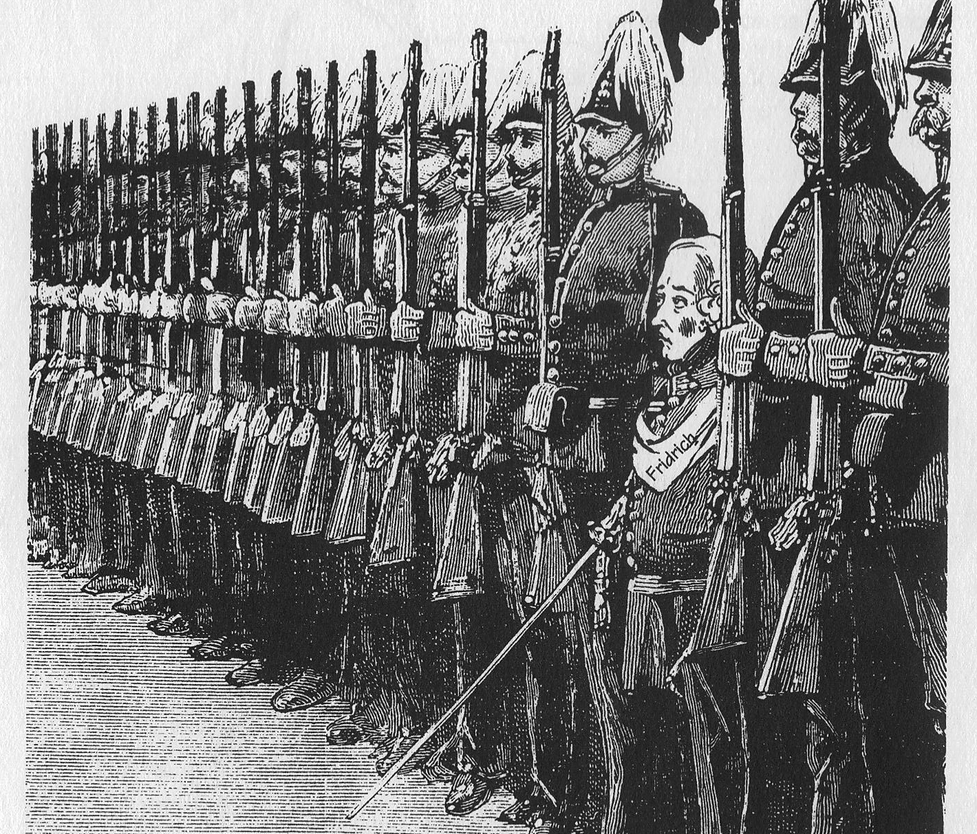
Directed mating in humans?
Fridrich I Prussian had searched tall women for mating with tall men in order to produce royal guard soldiers

Slide 4
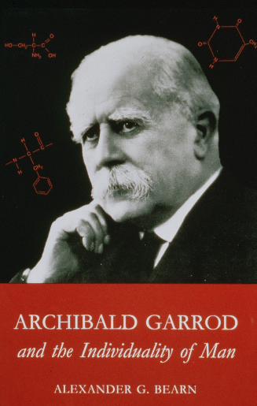
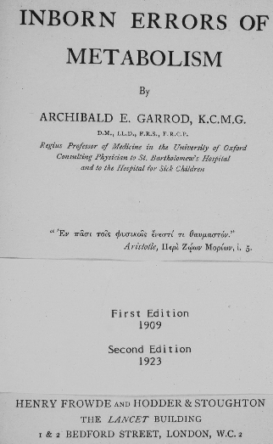
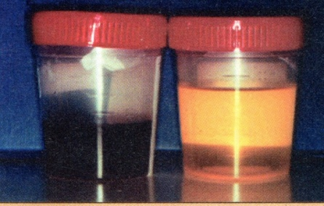
Archibald Garrod – physician, verified Mendel´s principles by connecting the incicndece of metabolic abnromalilites and mutant recessive alleles (1910) – dysfnuction of enzymes!
aa
Alkaptonuria – frequent in offsprings with parent blood relative parents! Trait has inheritance according to Mendel´s rules for recessive traits
Enzymopaties
Alkaptonuria
Albinism
Cystinuria
Pentosuria
Genes have influence on chemical basis of individuals… Recessive allele = enzyme non-functional!
Homogentisic acid in urine alkaptonuritic patient

Slide 5

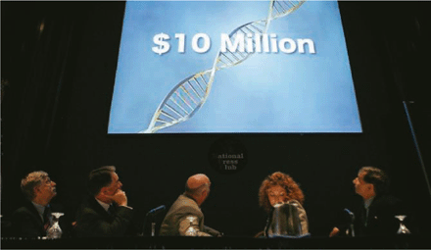

Human Genome Project
In 2003 was HGP finished. Human genome consists of 3 billion base pairs m

Slide 6
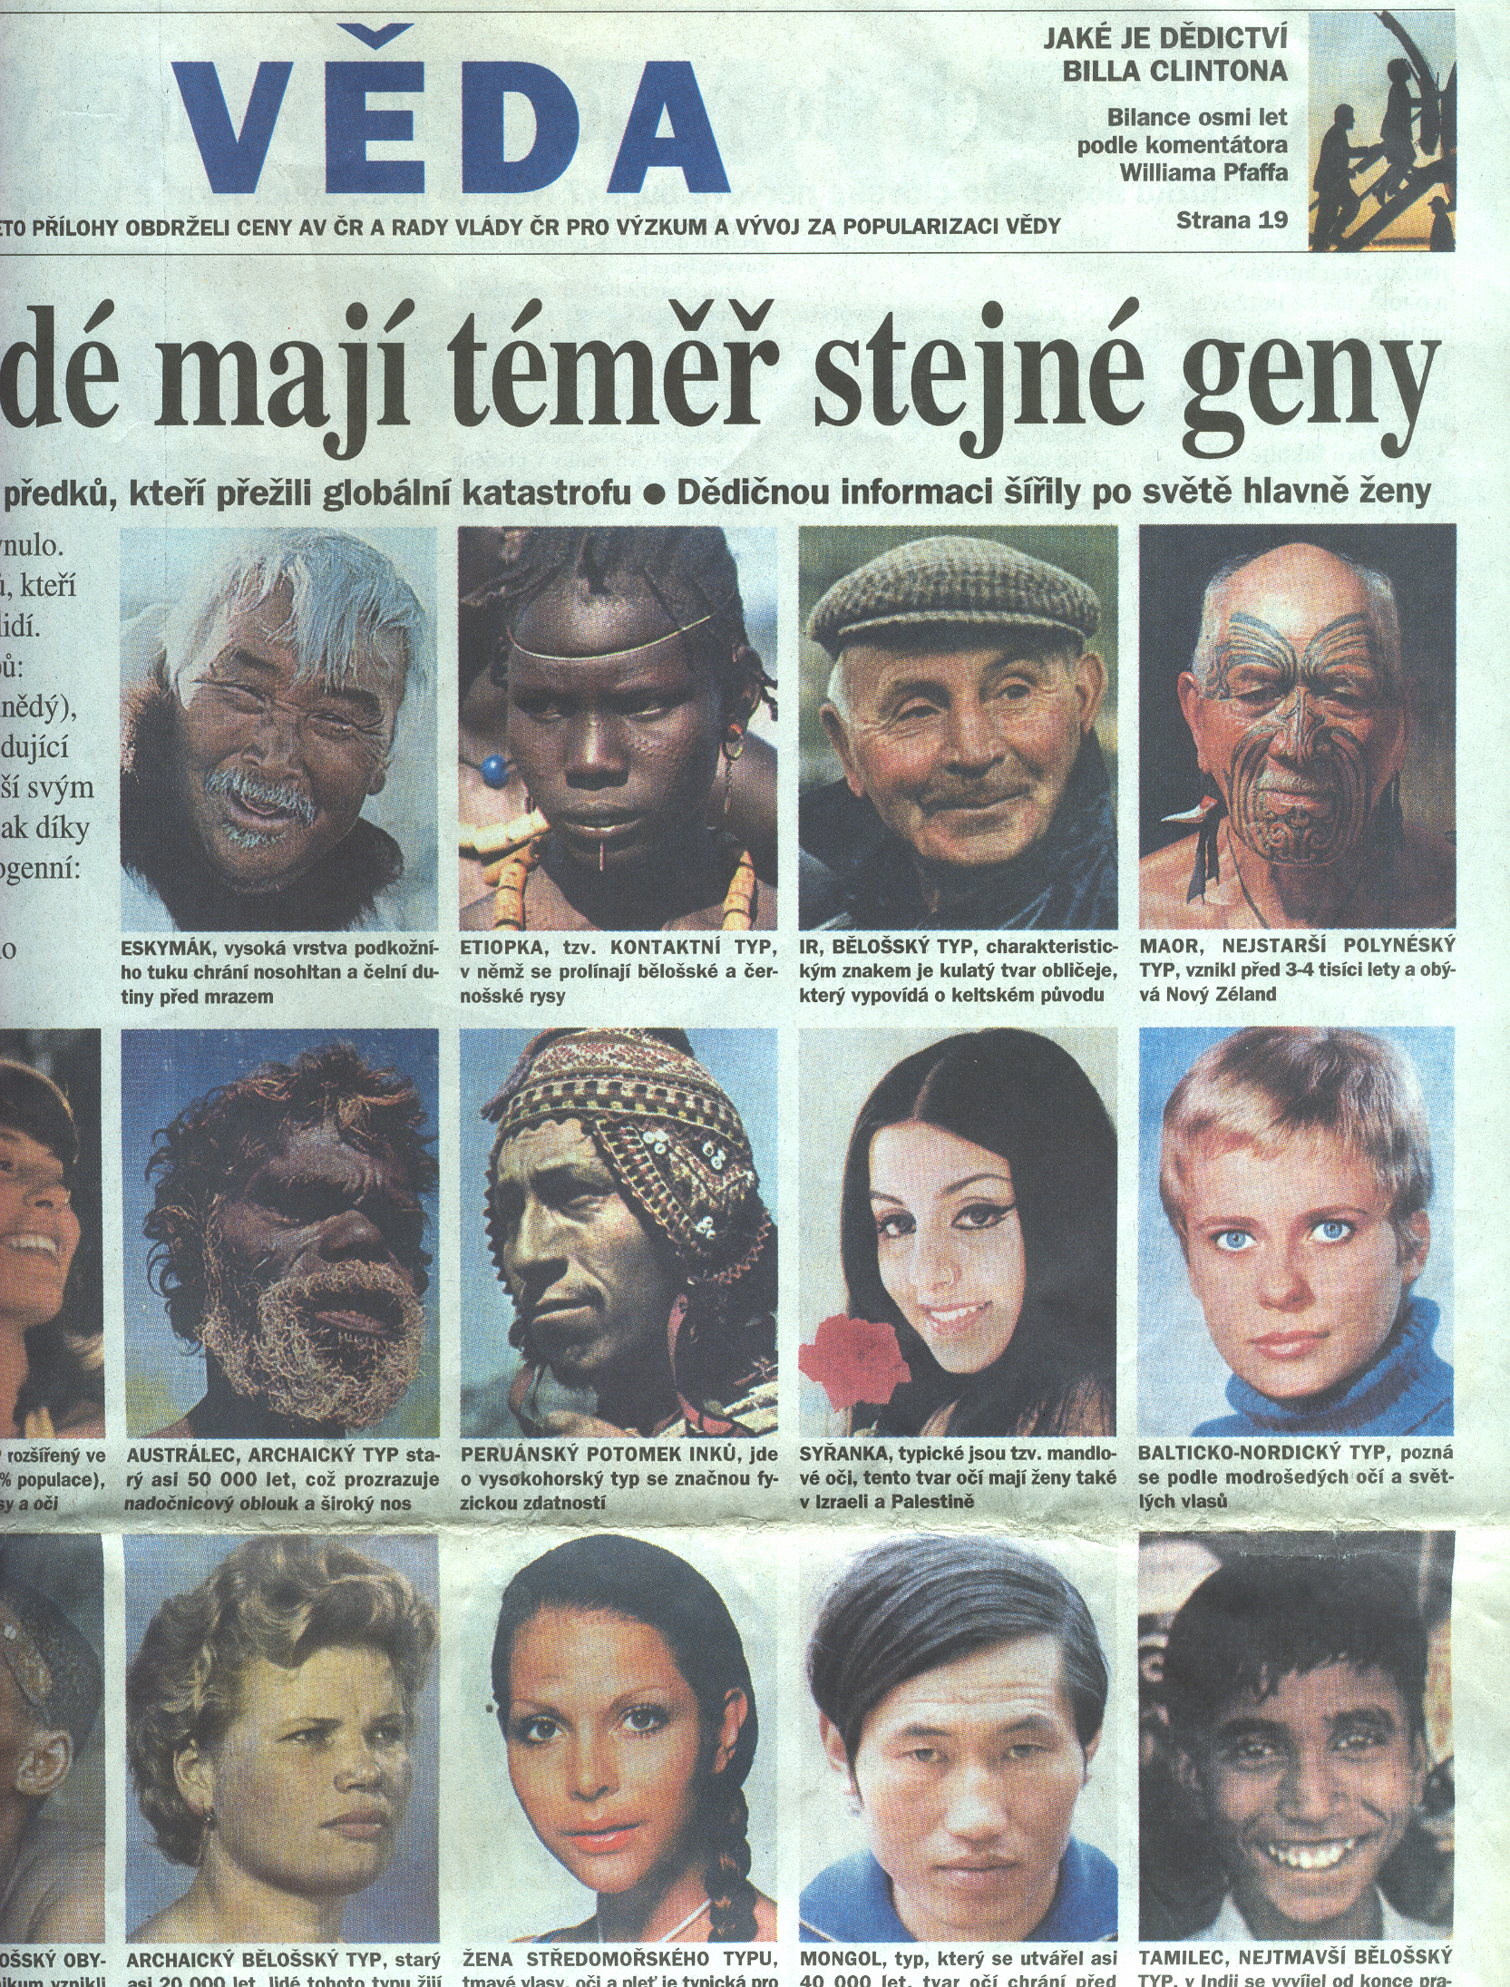
Genome of the individuals of the given kind is the same
Genotypes of individuals of same kind can be different diversity of the genome

Slide 7
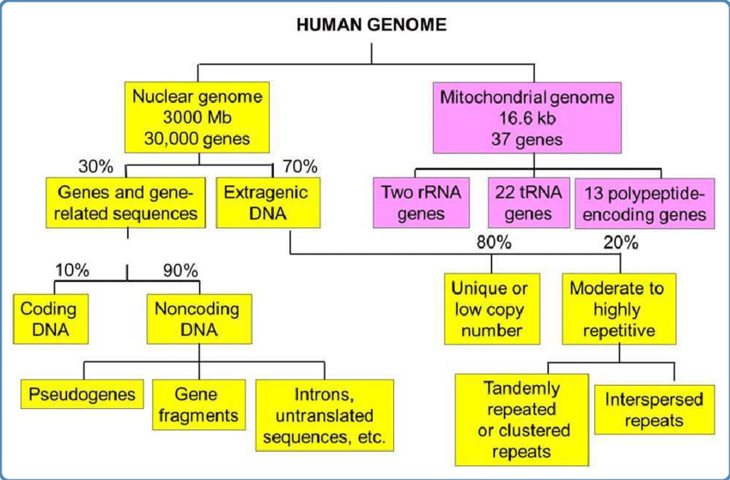
98% of human genome is non protein-coding!
> 50% of genome is consisted of repetitive sequences

Slide 8
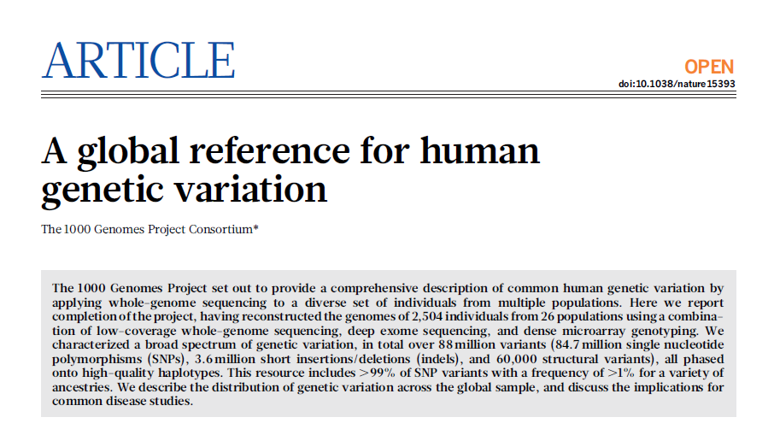
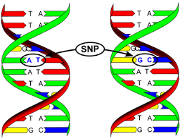
Variability of human genome on DNA level
1000 Genomes Project Consortium
2504 genomes sequenced from individuals from various areas of Earth (26 populations)
88 million of genetic variants
84,7 million SNP – single nucleotide polymorphisms
3,6 million indels
60 000 SV – structural variants
Nature 256, October 2015
typical genome differs from the reference human genome at 4.1 million to 5.0 million sites
99.9% of variants consist of SNPs and short indels,
structural variants affect more bases: the typical genome contains
an estimated 2,100 to 2,500 structural variants: affecting cca 20 million bases of sequence !
Single change on DNA level can cause genetic disease!

Slide 9
Genetically determined pathologies in humans
various disorders of mental and physical development are found in about 5% of newborns
Approx. 0,6 - 0,7 % population has congenital chromosomal aberration
approx. 0,36 % newborns is born with monogenic diseases, which will manifested in 90% of cases in pubertal age
Primary cause of genetically-based diseases is change of DNA in form of mutation or pathological variant

Slide 10
Types of genetic diseases
Monogenic diseases (AD, AR, sex-linked)
Chromosomal aberrations
Complex diseases with multifactorial type of inheritance (diabetes, allergies)
Genetic aberrations in somatic cells (tumors)
Mitochondrial genetic diseases
Non-mendelian inheritance diseases (uniparental disomy, unstable trinucleotide expansions

Slide 11
Genetics, medical genetics and medicine
Medical genetics is widespread, multidisciplinary field of preventive medicine
Medical genetics is any application of genetic principles to medical practice. This includes studies of inheritance, mapping disease genes, diagnosis and treatment, and genetic counseling.
1969 – Medical genetics recognized as standalone medical field in Czechoslovakia
The most of the diseases has any genetic background
Nowadays, in CR are departments of medical genetic parts of most of the big hospitals in – Praha, Brno, Olomouc, Ostrava, Plzeň, Hradec Králové, České Budějovice
Also private companies in a form of private genetic laboratories

Slide 12
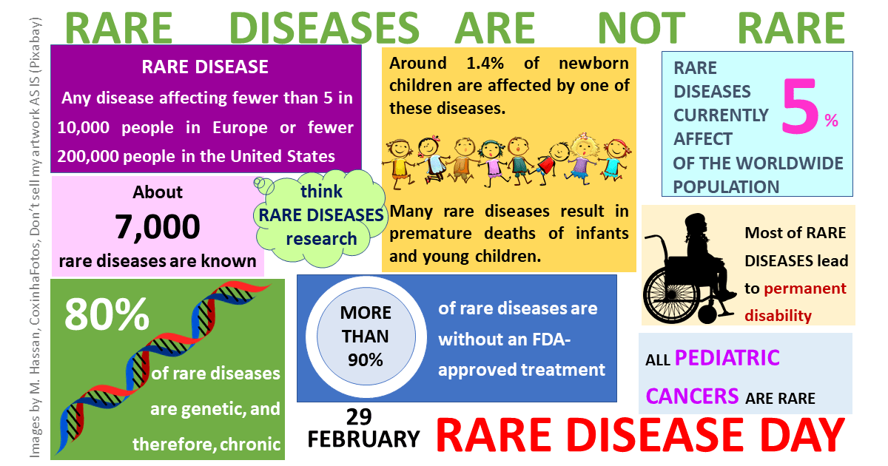
https://www.mdpi.com/files/multidisciplinary_topic_graphical_abstract/429/Graphical%20Abstract_def.png
In EU, disease is called „rare“ when incidence is less than 5 / 10 000 individuals
Encompass a wide range of conditions, such as movement disorders, metabolic diseases, neurological diseases or retinal dystrophy
Most of them lack an effective treatment = traumatization of parents, whole families

Slide 13
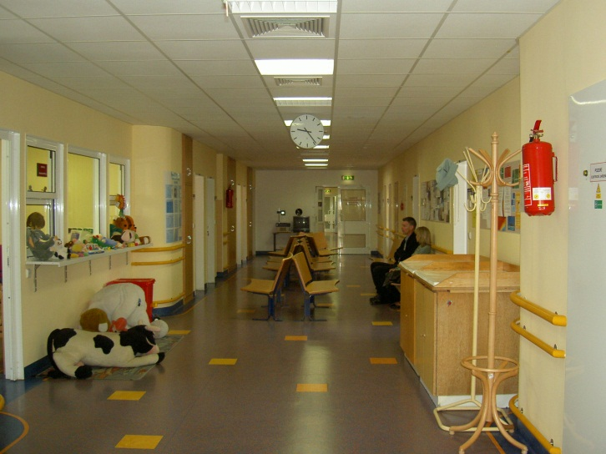
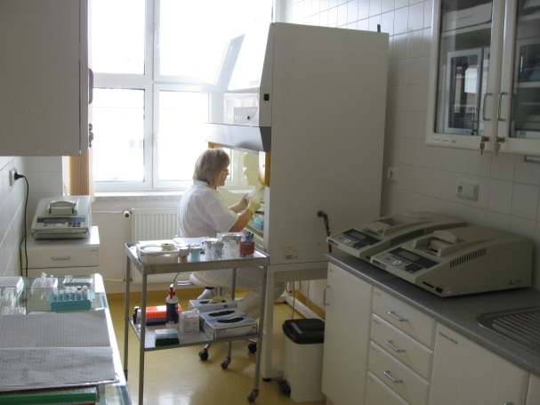
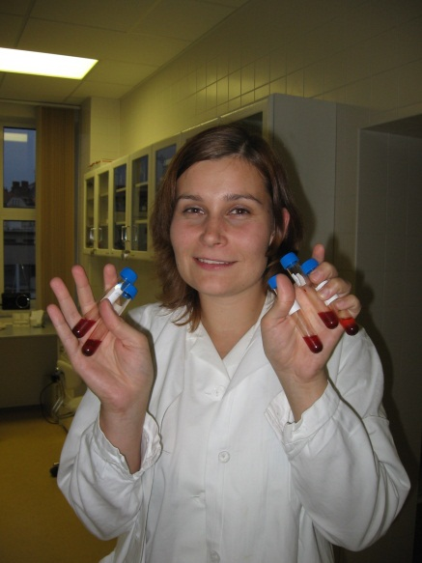
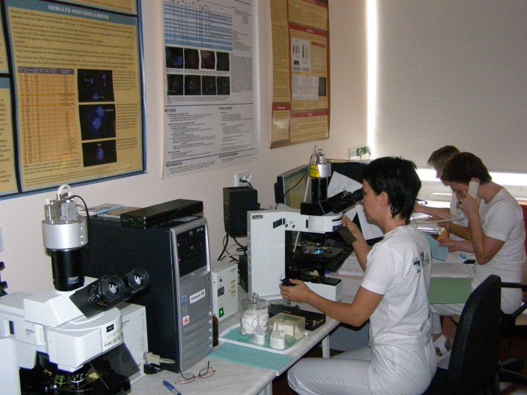
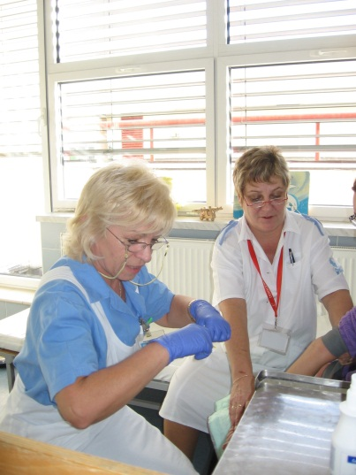
Dpt. Of Medical Genetics, Univeristy Hospital Brno www.fnbrno.cz/olg

Slide 14
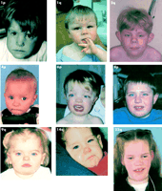
Patients of DMG - children
Children with inherited neurodevelopmental disorders and their families
Children with suspicious or verified inherited diseases and their families (cystic fibrosis)
Children with suspicious or verified inherited aberration of metabolism with and their families
Children with suspected incidences of inherited chromosomal aberration including stigmatization, development delays, early births,

Slide 15

Patients of DMG - adults
Blood relative pairs
Individuals with long-term persons exposed for long periods to environmental pollutants
Pairs treated with infertility or repeated spontaneous aborts
Sperm and egg donors

Slide 16
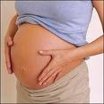
Patients of DMG – pregnant women
Positive familial anamnesis (in/dysferility, aborts, NDDs..)
Unfavorable anamnesis during pregnancy (long disease or acute diseases, medical treatments, vaccinations, addictive substances)
Pathological finding in biochemical or ultrasound screening
Older than 35 years
Birth of dead fetus or exitus of newborn
Parents are carriers of balanced translocation

Slide 17

Genetic counselling
performed by a physician - geneticist
a medical profession dedicated to the care of patients with genetic diseases and their families.
clinical geneticists provide the necessary laboratory diagnostics, identify patients who are at increased risk of developing or transmitting a genetic disease.
combines the determination of the risk of disability of the developing individual with psychological and educational activities - informing the patient and family members
The main goal of genetic counselling is to answer the question "What is the risk of our child being affected by a hereditary disease?"

Slide 18
Genetic counselling in clinical praxis
The basic role of genetic counselling is to provide patients with genetic diseases or their relatives with sufficient information about the nature of the condition, its future course, treatment options and, above all, the risk of recurrence in other members of the family.
to determine the genetic prognosis !!!
genetic risk (%) - above 10 % unfavorable

Slide 19
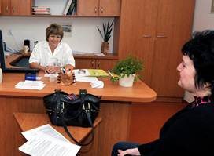
Genetic counselling – gathering of information
Personal and family anamnesis
Genealogical examination, compilation of at least a three-generation family tree
Ethnic information
Consanguinity
Nonpaternity

Slide 20
Genetic counsellor is dedicated to answer during session following questions:
is the disease occurring in the family hereditary?
what is the type of inheritance of the disease in the family?
what is the risk of recurrence of the disease in the family?
what is the risk of any hereditary disease in offspring?
is it possible to prevent the onset and development of hereditary disease?
is it possible to detect an inherited disease in the fetus during pregnancy?
is it possible to detect hereditary disease before pregnancy?
can the disease be treated?

Slide 21
Take care !
inherited
congenital (de novo?)
familial (genetic and enviromental origin)

Slide 22
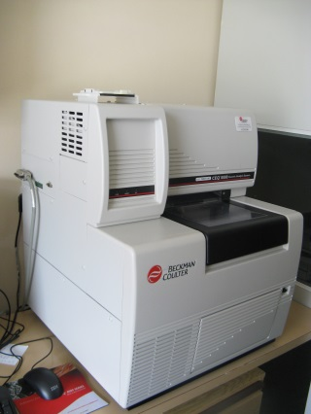
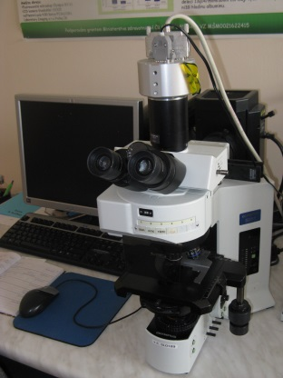
Diagnostic approaches
Methods of clinical genetics
Pedigree analyses
Laboratory techniques
Cytogenetics - karyotypes, FISH….
DNA or RNA diagnostics

Slide 23
Clinical-genetic examination
Somatic abnormalities - stigma
Congenital developmental defects e.g. malformations (e.g. cleft palate), dysplasia - abnormalities of certain tissues
Psychomotor development
Mental retardation
Dermatoglyphics

Slide 24
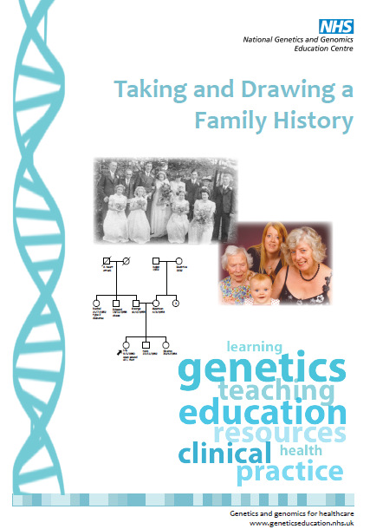
Pedigree analysis
Analysis of pedigrees it is possible to find out:
incidence of hereditary diseases in the
family
type of heredity
diagnosis
probability of disability in descendants or relatives - genetic prognosis
influence on treatment (preventive examinations...)

Slide 25
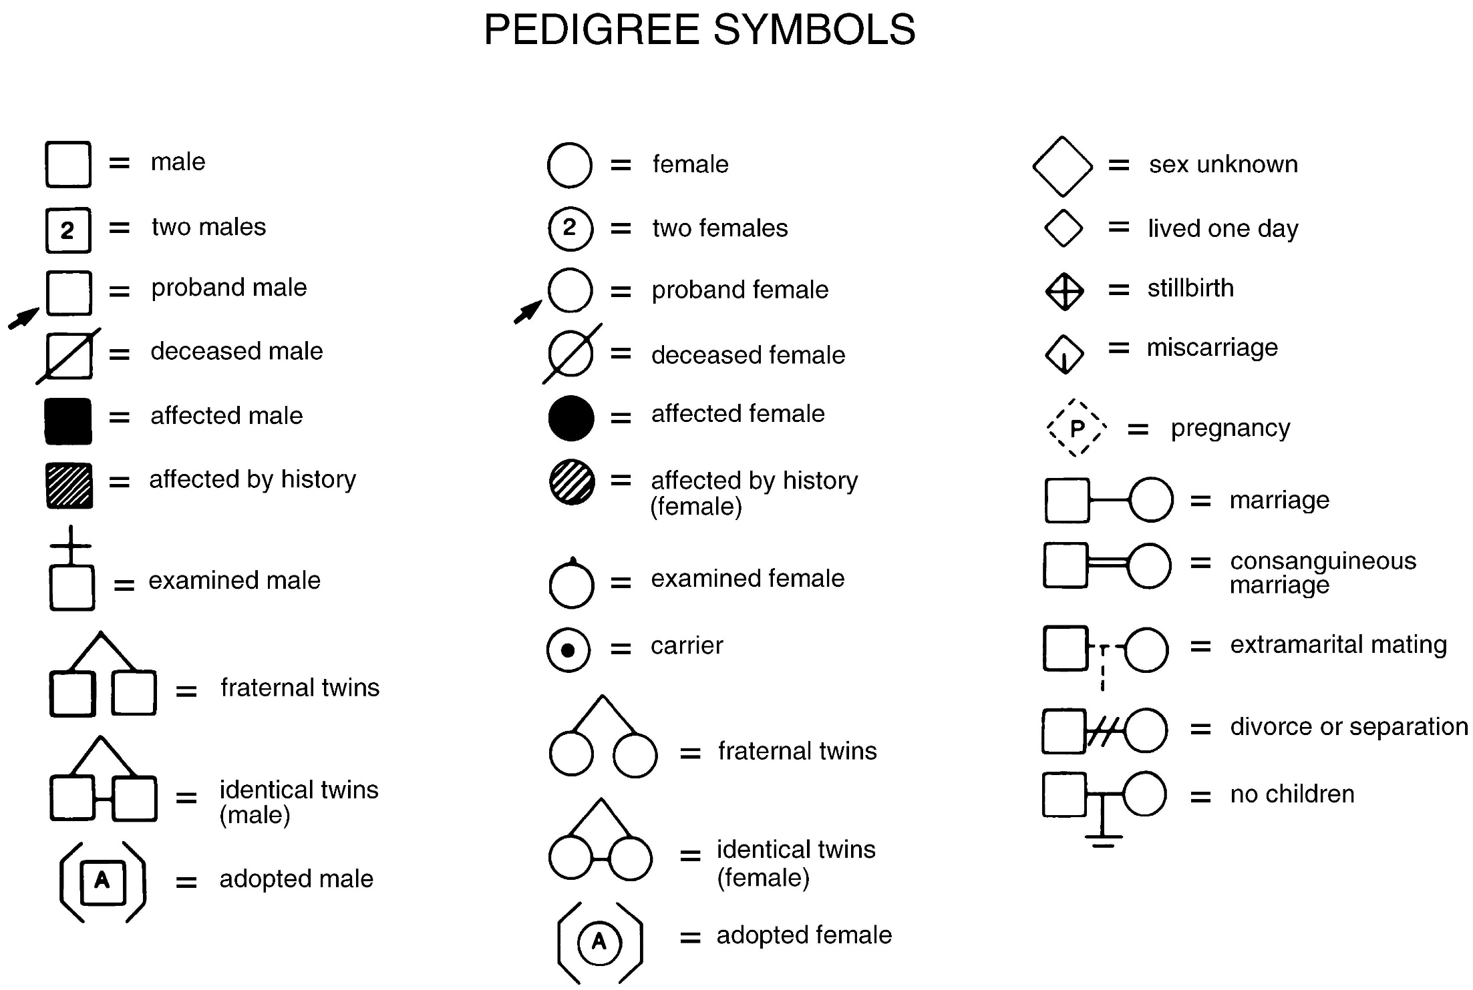

Slide 26
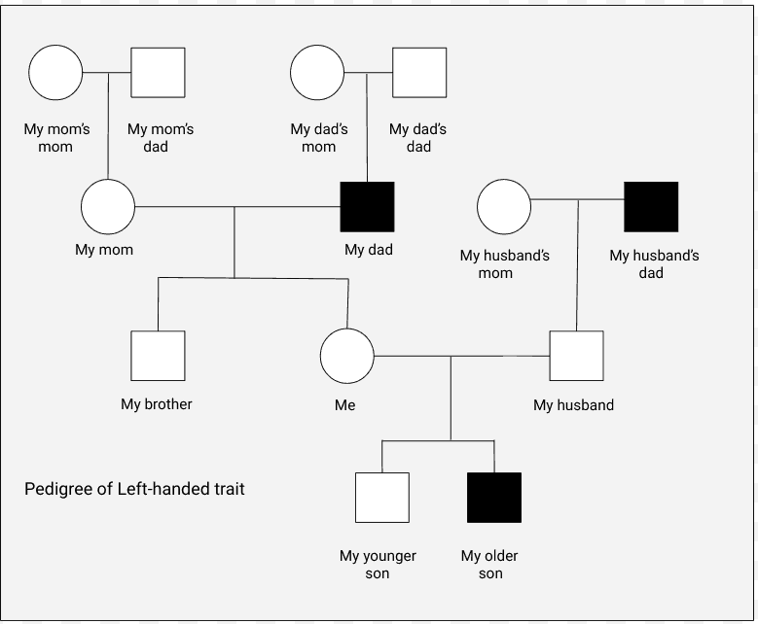
Example of pedigree
https://kristinmoonscience.com/wp-content/uploads/2019/11/Incomplete-pedigree-of-left-handed-trait.png

Slide 27
Monogenic diseases(DNA mutation at the level of one gene - change of gene product !
Most monogenic inherited diseases manifest themselves before birth, early after birth or in childhood
Mendelian inheritance is characteristic !
Types of inheritance
- Autosomal dominant - AD
- Autosomal recessive - AR
- X-linked recessive - XR
- X-linked dominant - XD

Slide 28
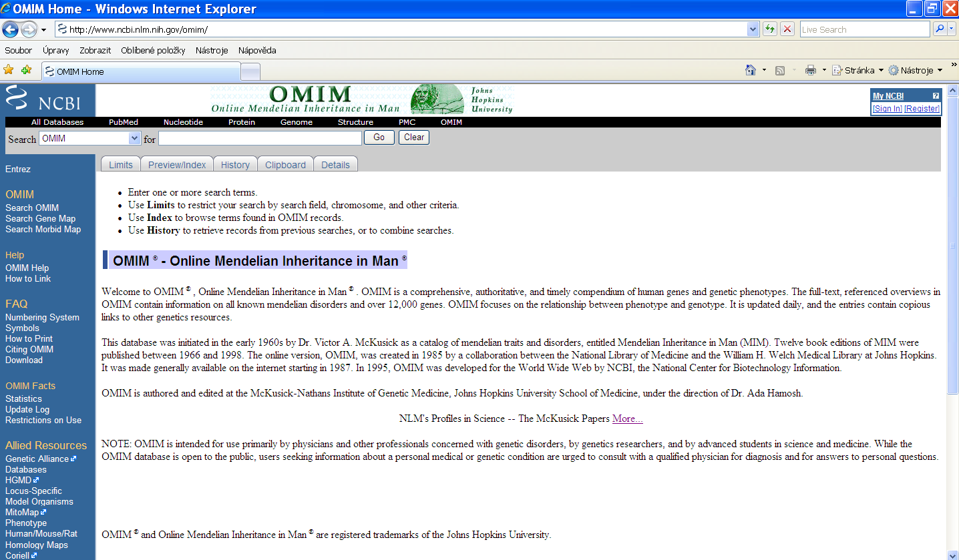
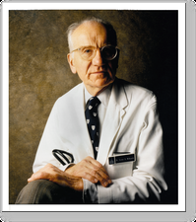
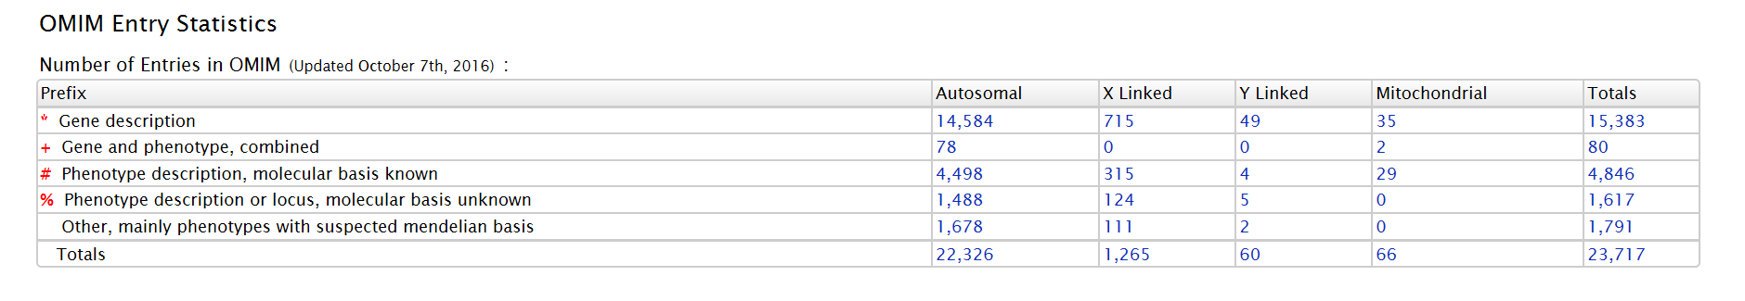

Slide 29
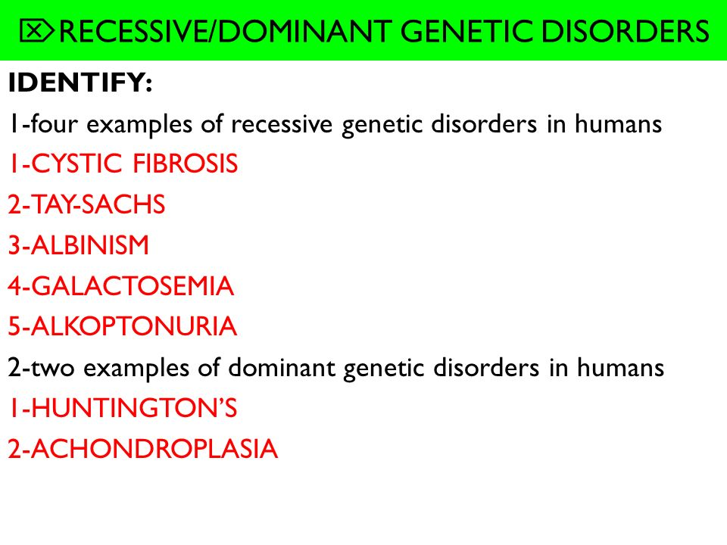
příklady
https://slideplayer.com/slide/6199975/18/images/16/%EF%83%96RECESSIVE%2FDOMINANT+GENETIC+DISORDERS.jpg

Slide 30
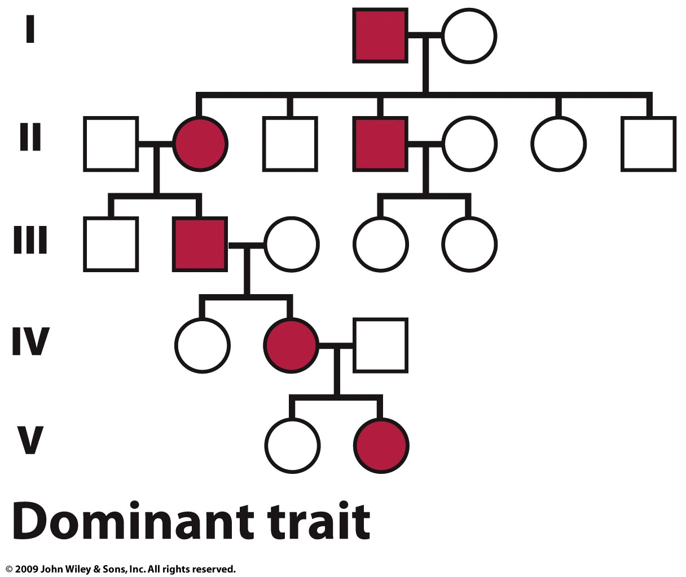
Pedigree - example of autosomal dominant inheritance
Affected gene product:
mostly proteins of morphological and structural character
biological carriers, cell receptors

Slide 31
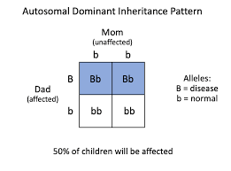
Autosomal dominant inheritance
(AA, Aa – affected, aa- healthy)
The MOST COMMON TYPE of disease inheritance in humans
vertical type of inheritance
dominant allele lies on the autosome - males and females equally affected
sex ratio 1:1
heterozygotes are also affected - clinical manifestation = 1 copy of the gene
the affected person has one parent equally affected
50% risk of recurrence for offspring and siblings of the affected person
- healthy family members usually have healthy children
The most common case
Aa x aa
AA x aa
Aa X Aa

Slide 32
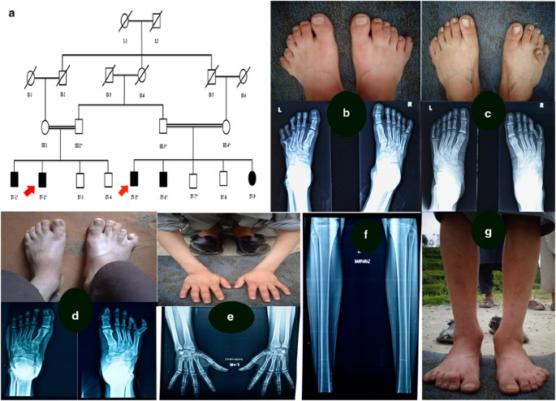
Polydactyly – AD inhertiance
https://media.springernature.com/m685/springer-static/image/art%3A10.1038%2Fejhg.2017.83/MediaObjects/41431_2017_Article_BFejhg201783_Fig1_HTML.jpg

Slide 33
Achondroplasia – AD ihneriatnce
Achondroplasia is a genetic bone disease that accounts for a person's short stature
translated from Greek, it means insufficient cartilage formation
the gene responsible for this disease was discovered in 1994 : mutation in the fibroblast growth factor receptor 3 (FGFR3) gene
it is a congenital skeletal disorder
arms and legs are shorter than the trunk and the head circumference increases unusually rapidly in the first few months of life.
Other symptoms include lower muscle tension, higher joint extensibility, and susceptibility to upper respiratory tract infections and otitis media
Because of their short limbs, people of small stature have to exert themselves a lot when walking, so many of them develop various degrees of bowing of the legs at school age.

Slide 36
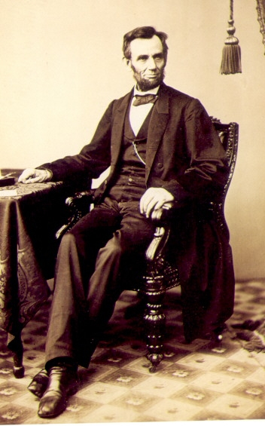
Marfan syndrome – AD inheritance
Incidence 1:5-10000
mutation of FBN1 – protein fibrilin 1 – a component of connective tissue)
genetic disorder of connective tissue - ligament
skeletal abnormalities
tall stature, long thin limbs
long thin fingers (arachnodactyly)
anomalies of the heart and blood vessels
?

Slide 37
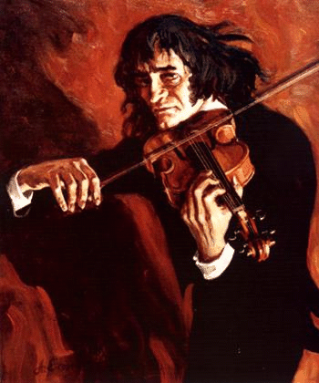


Marfan syndrome – N. Paganini?

Slide 38
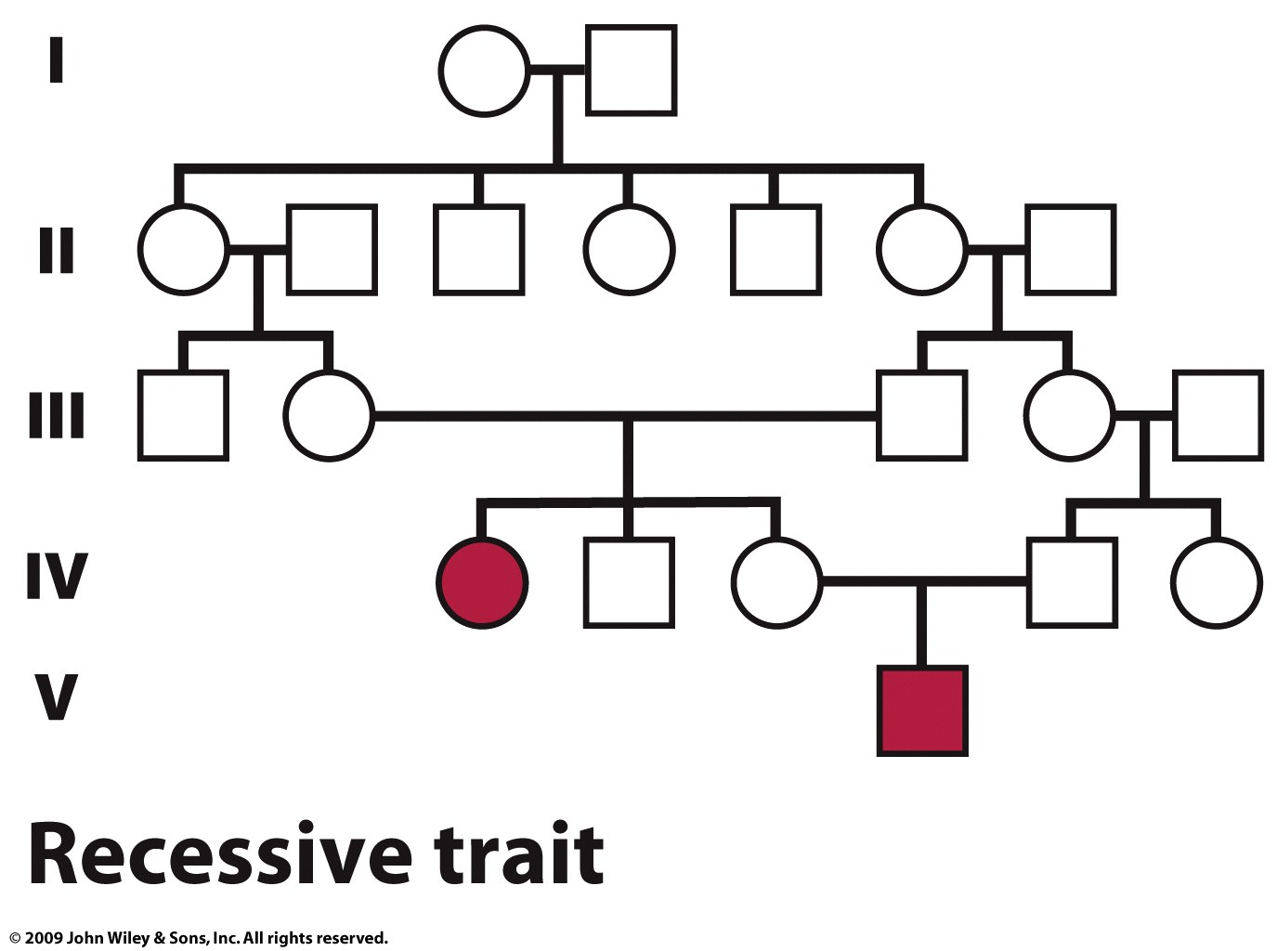
Pedigree - example of autosomal recessive inheritance
Aa

Slide 39
Autozomal recessive inheriatnce (aa – affected) !
Aa - health - the standard heterozygote allele is able to compensate for the mutant allele
mutant recessive allele on the autosome
1:1 sex ratio
horizontal type of inheritance
sibling risk 25% (Aa x Aa)
disability only occurs in homozygotes
more common in consanguineous marriages
Genotypes
The most common type of parent....carriers !
The risk of a carrier having a disabled child depends on the likelihood that his partner is also a carrier
Aa x Aa...1/4 affected
Aa x aa...1/2 affected
aa x aa...all affected

Slide 40
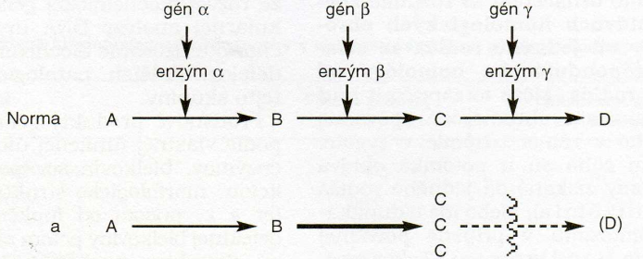
AR inheritance - example
Metabolic dysfunctions
Enzymopathies – enzyme disorder: almost always AR,
heterozygotes with 50% residual allele activity are clinically normal (Aa)
Metabolic blockades - all pathophysiological consequences of enzymopathies can be attributed to substrate accumulation or product deficiency
Substrate product
Disorders of metabolism of
amino acids, sugars, lipids,
purines, pyrimidines, etc.)
(phenylketonuria, alkaptonuria, albinism, galactosemia)
enzyme

Slide 41
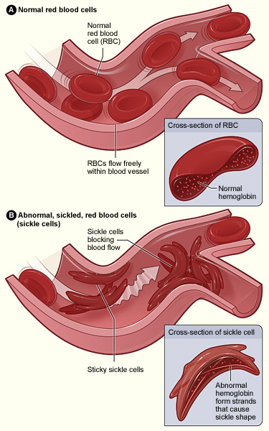
AR inheritance – sickle cell anemia
Mechanism
HbA
HbS
mutation
Mutation T – A causes change in AA sequnece: GLU - VAL
Normal adult haemoglobin (HbA) consists of 4 subunits, two alpha (α) and two beta (ß - 146 AA). each subunit is composed of a protein part, globin, and a prosthetic (non-protein) part, HEME group

Slide 42
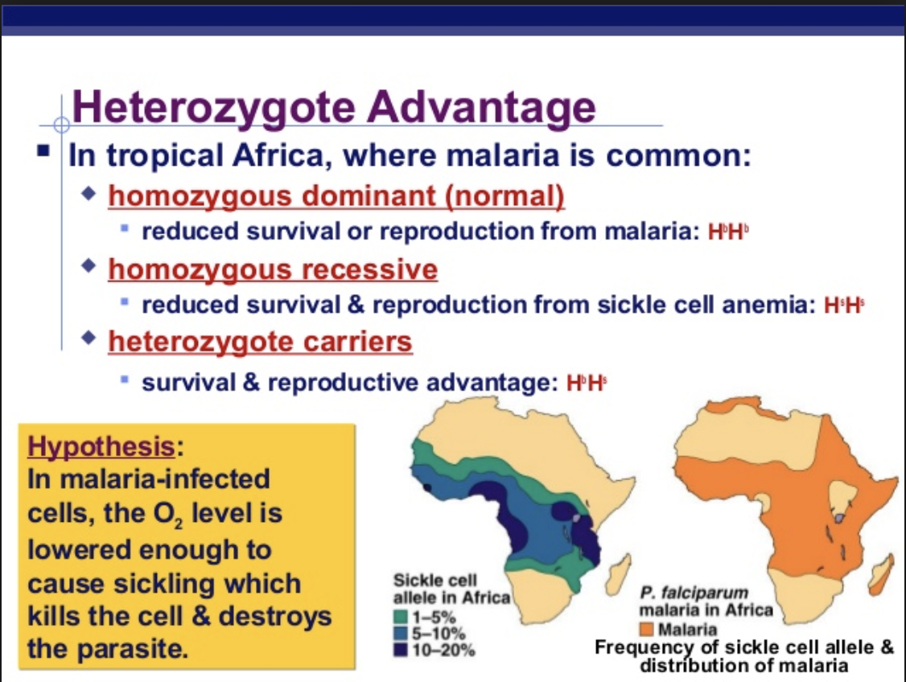
Substitution of CTT for CAT in sickle cell anemia in the beta chain of hemoglobin leads to substitution of one amino acid joining the polymeric fibers the sickle-shaped form blood cells
HbA/HbA
homozygotes - normal
HbA/HbS
heterozygotes
HbS/HbS - sickle cell anaemia
(microcirculation disorders, capillary blockage, bone marrow infarction, tissue damage)
1 : 600 Afican Americans
HbA/HbA : HbA/HbS
1, 46 : 1
The mutant allele still persists in the population...?
Rozšíření srpkovité anémie

Slide 43
Cystic fibrosis – AR inheritance
one of the most common in Caucasians (predominant disease in Northern Europeans !!!)
basis - mutation in the CFTR gene, range about 250 kb, coding region with 27 exons
gene discovered in 1989 (7q31)
incidence in the Czech Republic about 1/2000 - 1/3000
frequency of carriers in the Czech Republic about 1/25-1/29
mean age at diagnosis 6-8 months, 66% of patients under 1 year
severity is limited mainly by lung involvement....
median survival in 1976 - 18 years, in 1995 - 30 years, very little improvement since 1990, now new drugs?

Slide 44
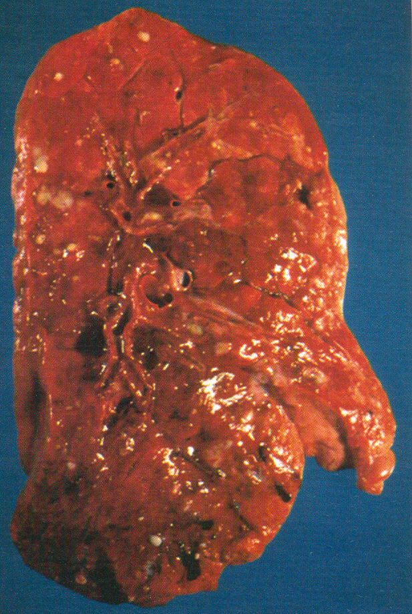
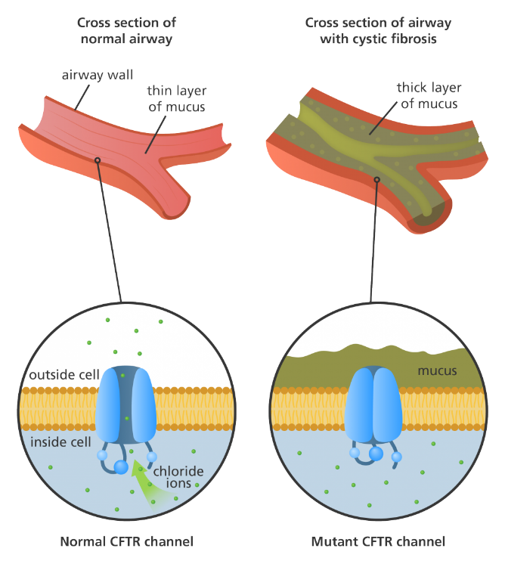
CF - pathophysiological defect - impaired ION TRANSPORT in epithelial cells
Photograph of the middle transverse section of the lung in a patient with CF (mucus plugs in the lungs)
CFTR protein - chloride channel - regulates the flow of salts and water
CF - mutation - the channel is missing or non-functional !

Slide 45
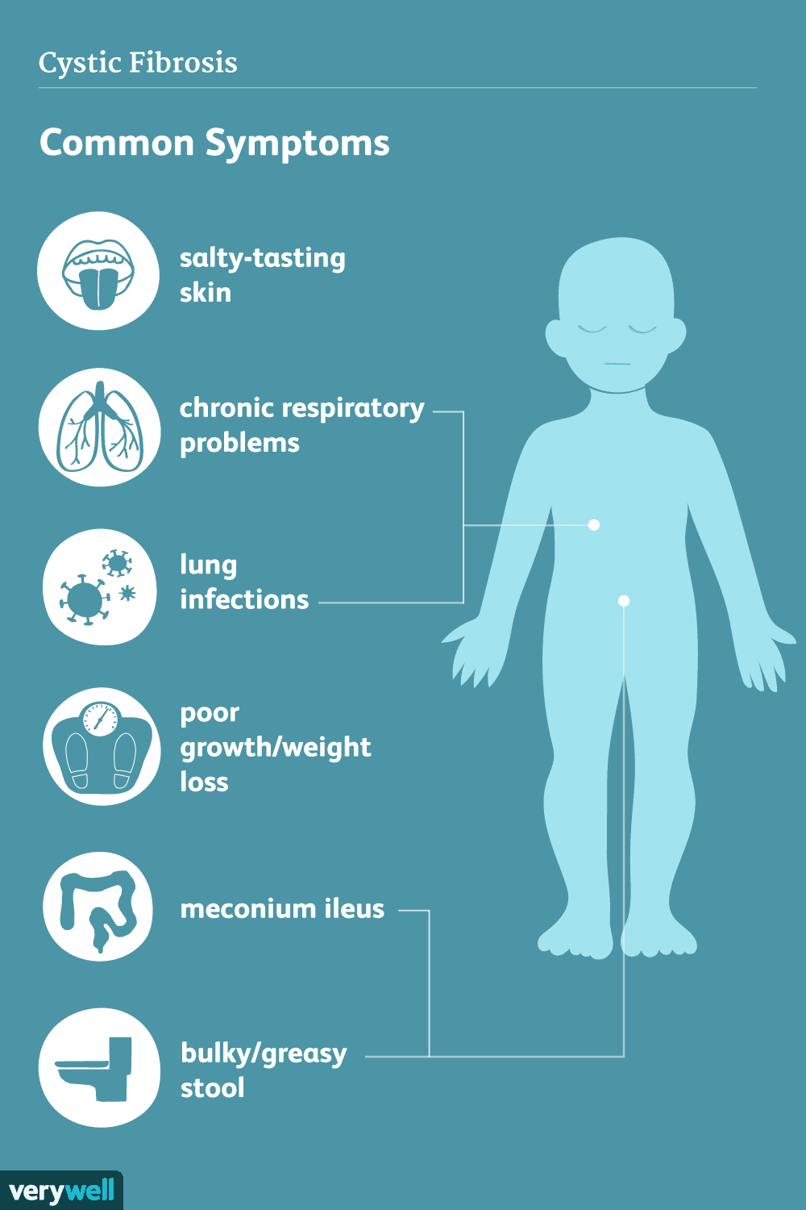
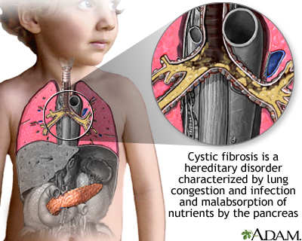
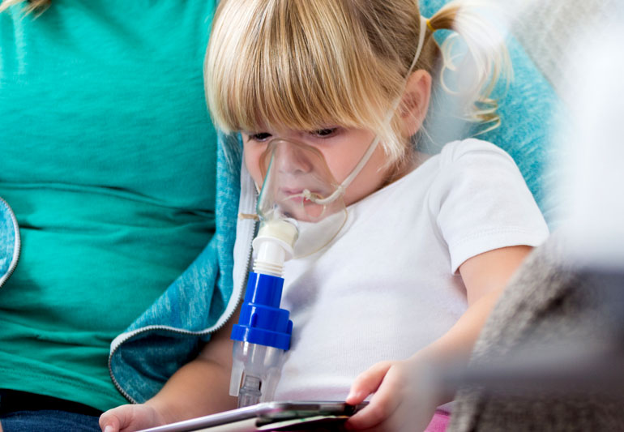

Slide 46
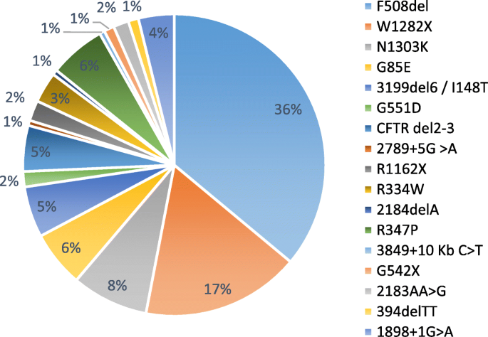
CF – mutation types in Europe
https://media.springernature.com/lw685/springer-static/image/art%3A10.1186%2Fs43042-021-00178-5/MediaObjects/43042_2021_178_Fig2_HTML.png

Slide 47
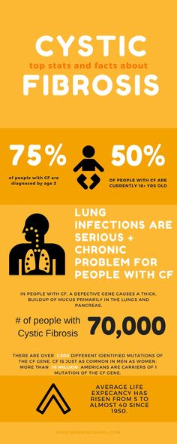
Higher concerntartion of NaCL in sweat…. „Salty children“
about 2000 mutations have been detected in the CFTR gene...!!!!
there are 5 classes of mutations...different severity of disability
only 7 mutations above 1% of CF patients
Patients:
50% homozygous for dF508/dF508
40% compound heterozygous - dF508 and other mutant allele
A standard.... a1 a2 a3 ... mutations a1a2 a1a3 ... patients
Allelic heterogeneity !

Slide 48
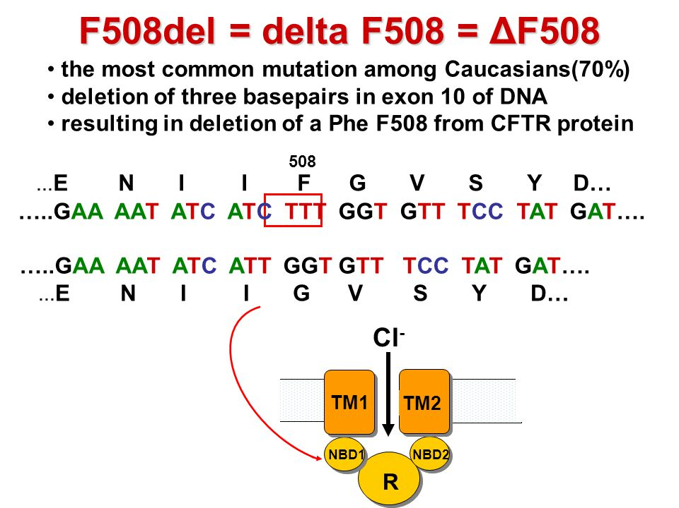
https://images.slideplayer.com/19/5867314/slides/slide_5.jpg

Slide 49
The most common CFTR gene mutations in the Czech population - allelic heterogeneity - multiple mutations at the same locus = composition of heterozygotes
MUTATION FREQUENCY IN CF PAC. EXON (26)
1. dF508 68,8% 10
2. CFTRdele 2,3 (21kb) 4,64% 2, 3
3. G551D 4,03% 11
4. N1303K 3,02% 21
5. G542X 2,22% 11
6. 1898+1 G-A 2,04% intron
7. 2143delT 1,11% 12
8. R347P 0,74% 7
9. W1282X 0,55% 20
10. E92X 0,37% 4
11. R1162X 0,37% 19

Slide 50
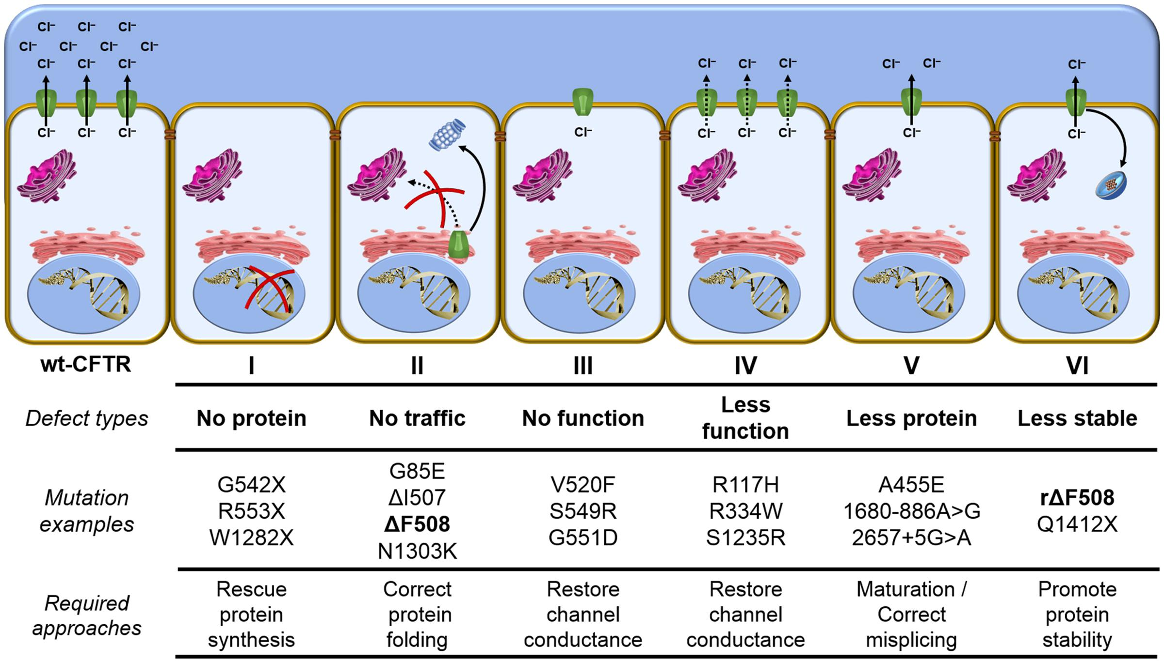
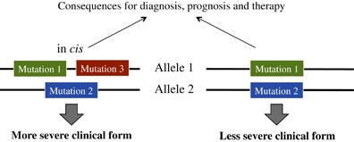

Slide 51
CF newbron screening
Definition of NS
The active, nationwide search for a disease in the population of all newborns in its preclinical stage so that these diseases are diagnosed and treated before they have time to manifest and cause irreversible damage to the newborn's health
As of October 2009, 13 diseases are being screened for as part of newborn screening in the Czech Republic
(CF, phenylketonuria, hyperphenylalaninemia, …)
Searching by laboratory method - the principle of analysis of a so-called dry drop of blood on filter paper taken in a standard way

Slide 52
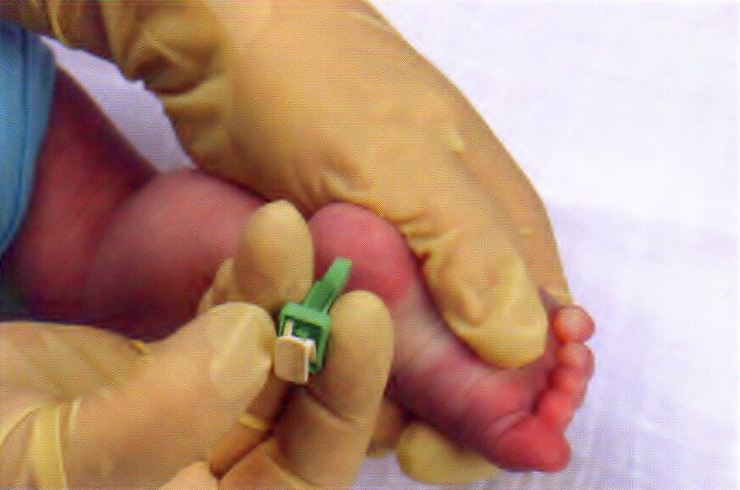
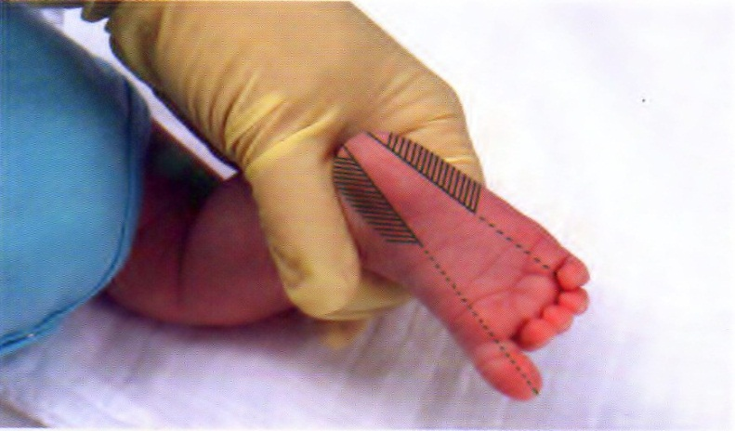
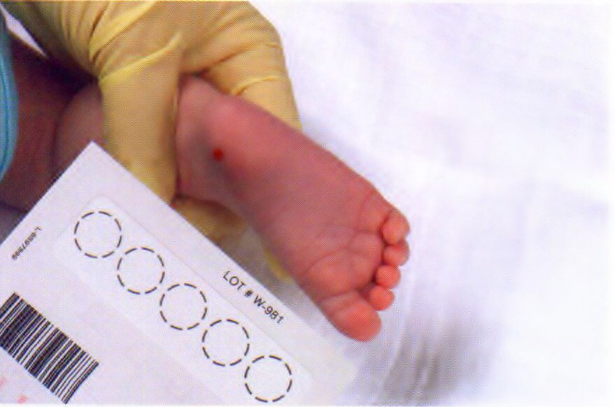

Blood aspiration for newborn screening

Slide 53



Causal treatment of CF – new drugs?
Molecular therapy of CF
Ivacaftor
Lumacaftor
Symdeko

Slide 54
X-linked recessive inheritance
A a
a
Sex chromosomes: women XX, men XY
the affected person is usually a man, his sons are healthy and his daughters are carriers of the disease
female carriers have 1/2 sons who are sick and 1/2 daughters who are carriers
rare occurrence in women - daughter of affected man and female carriers, women with karyotype 46,XaXa 45,Xa, ...
example - haemophilia
Hemizygoteous state

Slide 55
Pedigree of X-linked recessive disease

Slide 56


Slide 57


Haemophilia rare congenital bleeding disorder that occurs in people with a limited amount of either clotting factor VIII/ 8 (haemophilia A) or clotting factor IX/ 9 (haemophilia B)
Severity of haemophilia | Percentage of normal factor activity in blood | Number of international units (IU) per millilitre (ml) of whole blood
normal range | 50%-150% | 0.50–1.5 IU
mild haemophilia | 5%-40% | 0.05–0.40 IU
moderate haemophilia | 1%-5% | 0.01­–0.05 IU
severe haemophilia | less than 1% | less than 0.01 IU

Slide 58

Haemophillia – clinical features

Slide 59

A Royal Disease
Queen Victoria of England, who ruled from 1837-1901, is believed to have been the carrier of hemophilia B, or factor IX deficiency. She passed the trait on to three of her nine children.

Slide 60

Kinship crossing - consanguinity

Slide 61
Inbreeding
inbreeding occurs when parents have common ancestors and are therefore related to each other.
Inbreeding between relatives is referred to as consanguinity from the Latin term "of the same blood„
example - crosses between siblings, half-siblings and first cousins - the offspring are inbreed
inbreeding increases the frequency of homozygotes and decreases the frequency of heterozygotes and is quantified by the inbreeding coefficient F
F value range from 0 to 1 1 = all alleles have same origin
F = probability that an individual has two copies of the gene
identical in origin (autozygous) because they come from a common ancestor
(if they are identical, the individual is homozygous)

Slide 62


Part of Ptolemy peidgree
Common ancestor

Slide 63


Incidence of albinism in Amish community

Slide 64


Habsburgs - frequent hereditary mental and psychological illnesses due to consanguineous marriages
Joanna of Castile (Mad)
Married with Habsburg 1496
Philip I (Handsome) Archduke of Austria

Slide 65
What destroys House of Habsburgs? Inbreeding
In the Habsburg dynasty, uncles and nieces, aunts and nephews, as well as cousins often married each other. The so-called inbreeding coefficient, which is a measure of how closely related individuals are.
While the first Spanish king of the Habsburgs, Philip I the Magnificent, had an inbreeding coefficient of 0.025 - meaning that 2.5% of his genes were identical to those of his relatives. Seven generations and 200 years later - in the case of Charles II - the inbreeding coefficient was already tenfold, i.e. 0.25 (25%!!!)

