Slide 1
Genetic analyses in tumor diseases

Slide 2
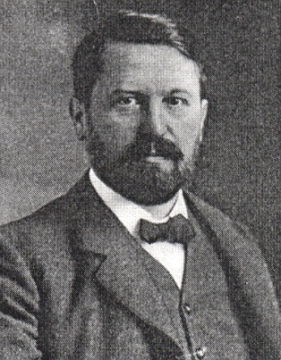
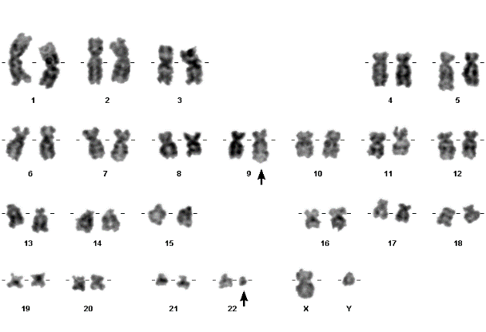
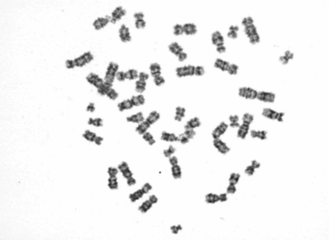
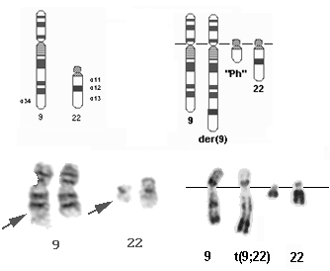
Developopmnet of tumor genetics (cytogenetics)
David Hanseman (1890) Theodor Boveri (1914)
Nowell a Hungerford (1960)
The first theories on the relationship between mitotic disorders and tumorigenesis
Discovery of Ph chromozomu
Tjio and Levan (1956)
Rowley (1973)

Slide 3
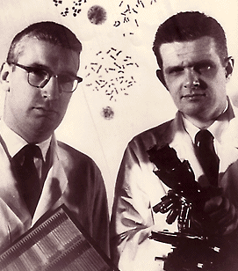
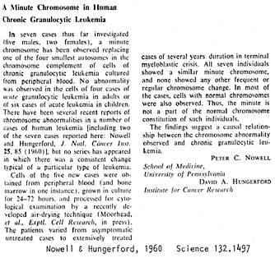
1960
A minute chromosome in human granulocytic leukemia. Science 132, 1960, 1497.
…the findings suggest a causal relationship between the chromosome abnormality observed and chronic granulocytic leukemia…
PC Nowell, DA Hungerford, University of Pennsylvania in Philadelphia

Slide 4
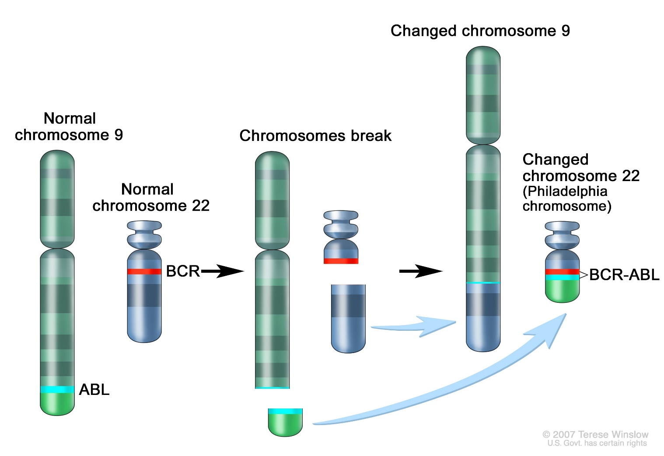
The origin of the Philadelphia chromosome (Ph) and the BCR - ABL fusion gene after translocation
resistance to apoptosis
influence on the cell cycle
Chronic myeloid leukaemia (CML) - 25% of all adult leukaemias with an incidence of 1-2 cases per 100,000 population
Ph chromozome - 95 % patients with CML

Slide 5
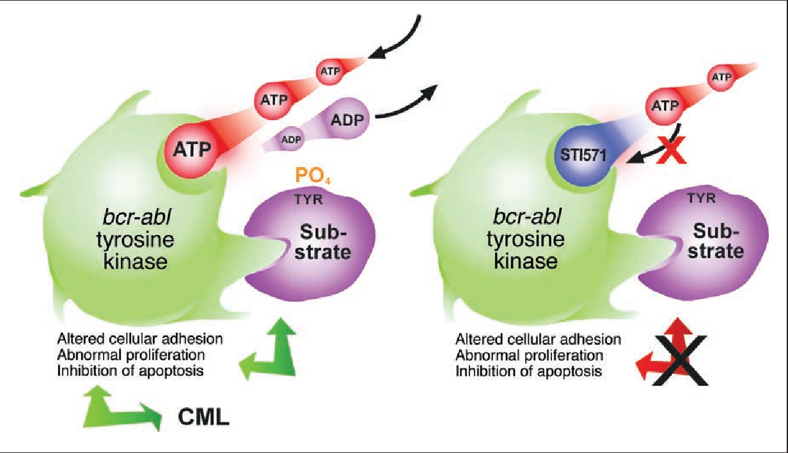
t(9;22) negative effects can be trated! 1998 - Clinical trilas of STI 571 agens(Glivec – Novartis) - inhibitor of TKs
Tyrosine kinase inhibitors - imatinib, dasatinib and nilotinib - a model for modern non-cytostatic treatment of malignant diseases !!Personalized medicine !!

Slide 6
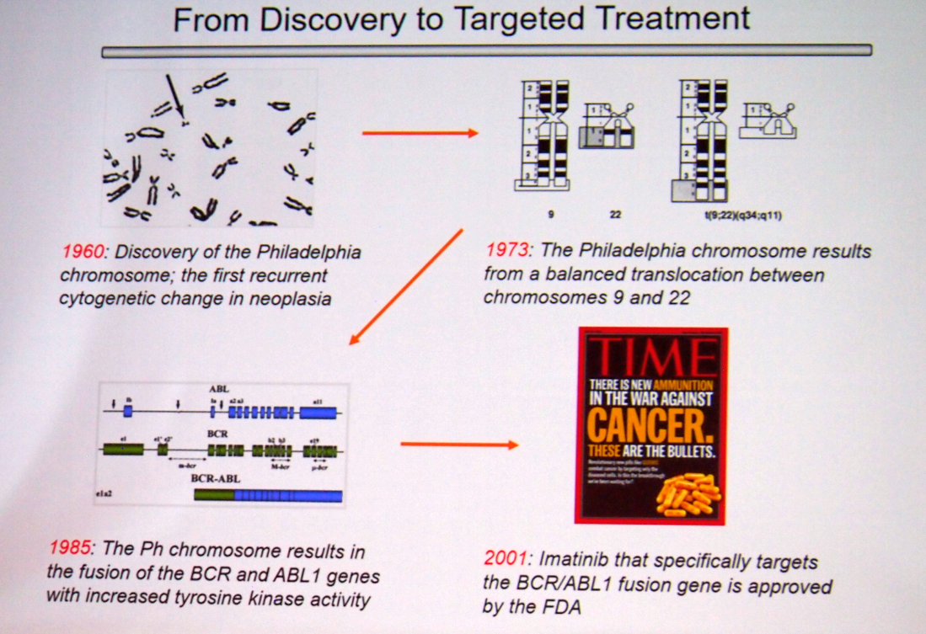

Slide 7

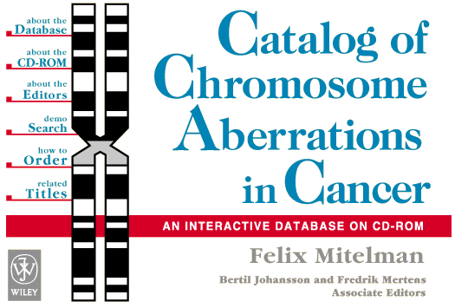
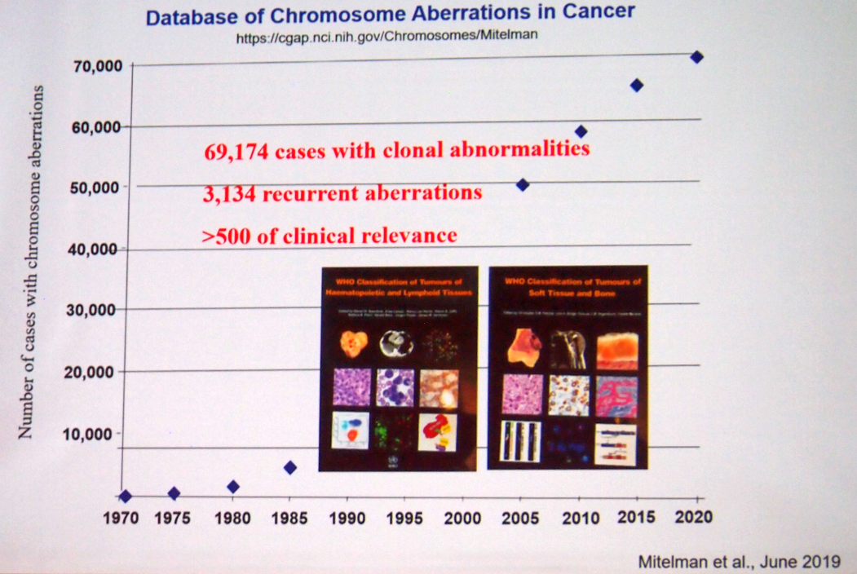
Database of chromosomal aberrations in cancer
Prof. Felix Mitelman

Slide 8
The role of cytogenetic testing in oncology
an integral part of oncohaematological examinations (initial examinations) as well as examinations of some solid tumours
cytogenetic and molecular genetic methods used in oncology are part of the diagnosis and treatment of many malignancies in the sense of:
  clarifying the diagnosis, determining the prognosis
  stratification of patients, determination of treatment strategy
  differential diagnosis
  treatment monitoring (prediction of sensitivity to treatment)
  monitoring residual disease after transplantation
  prediction of the likely course of the disease
  localization of proto-oncogenes and tumor suppressor genes
the importance of cytogenetic and molecular genetic testing in hematological malignancies is also emphasized in the classification of myeloid certain cancers, where separate entities with specific genetic changes are distinguished

Slide 9
Techniques used for detection of CHAs in tumor diseases
Standard G- banding
Fluorescence in situ hybridization (FISH) - especially I-FISH - specific probes for tumor investigation - deletion, translocation, inversion....!!!
- always set a cut off for a given probe !
Additional methods
Multicolor FISH (M-FISH, SKY)
Multicolor banding (M-BAND - complex rearrangements
Microchip technology (array-CGH)

Slide 10
G-banding in tumor diseases
basic examination method - tumor karyotype
we use cells cultured in vitro, mainly from bone marrow, less from peripheral blood or other types of tissues
cultured in culture medium at 37°C without stimulation
success rate of cytogenetic examination of BM around 80%
150 - 200 bands (G-banding)
but...worse chromosome morphology, few mitoses
Examination of karyotype in tumors is still of great importance- we evaluate individual mitoses, we can also detect small clones....

Slide 11
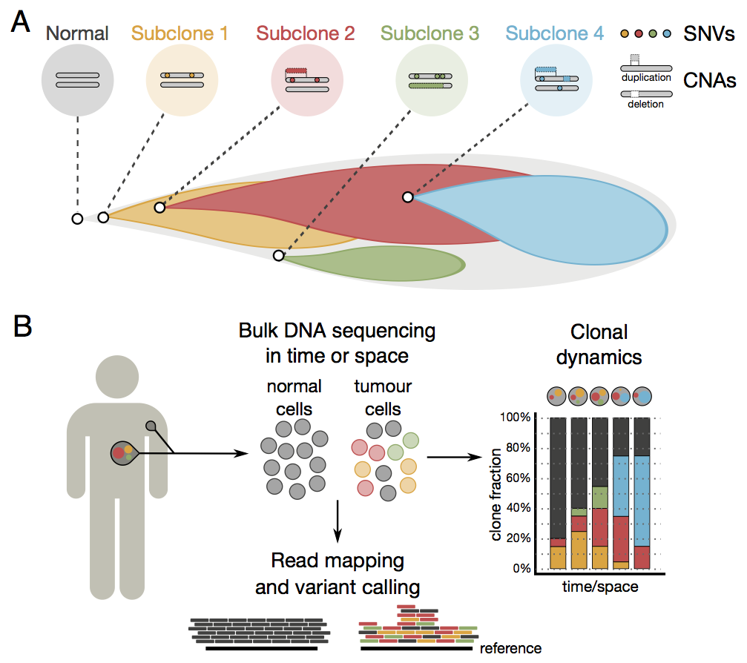
Clonal CHAs in tumors
Tumor cell populations are composed of heterogeneous cells....important !!!!
Most changes are clonal, but we often find cells with normal karyotypes
The karyotype of a tumor evolves gradually ....we find several clones - selection advantage !!!
CLONE
= the same chromosome is missing in 3 mitoses
= 2 mitoses have the same supernumerary chromosome or the same structural aberration
https://www.sanger.ac.uk/wp-content/uploads/140529-clonal_0.png

Slide 12
Genome destabilization and the multistep process of tumor formation
Tumor formation is the result of mutations affecting genes:
1) cell aging (telomerase)
2) cellular proto-oncogenes –
e.g. MYC, ERBB, MYB, INT1, RAS, NEU, ABL (activation by insertional mutagenesis, point mutation, translocation, gene amplification) behave in a dominant manner
3) tumour suppressor genes TP53, Rb1
mutation, loss of gene or whole chromosome, loss of heterozygosty (LOH), recessive character
1% of tumours - gametic mutations
99% of tumours - somatic mutations

Slide 13
Chromosomal aberrations in tumours - basic classification
Primary basis for tumorigenesis, a single change, triggers a multistep process of carcinogenesis - e.g. t(9;22)
Secondary secondary occur during the course of the disease, image of the stage of the disease, expression of tumour progression, sometimes a prognostic factor for disease progression
Specific regularly in a certain type of tumour, the same chromosomes represent a specific tumour marker, genes involved in the tumour process have been identified at the breakpoints - influence on prognosis !!!
Random they occur randomly, affecting different chromosomes

Slide 14
Chromosomal changes in tumours - classification according to mechanism
    loss of genetic material
    (deletion, monosomy)
    multiplication of genetic material
    duplication, amplification, trisomy, polyploidy)
    translocation without loss of material
    (translocation, inversion, insertion)

Slide 15
Numerical CHAs in tumor diseases
aneuploidy x polyploidy - common in tumours !
hyperdiploidy (more than 46 chromosomes) - often better prognosis (ALL, multiple myeloma) ...more active tumor suppressor genes?
hypodiploidy - less than 46 chromosomes - worse prognosis
Methods of investigation - classical cytogenetics, I-FISH, flow cytometry, array-CGH (not ploidy)

Slide 16
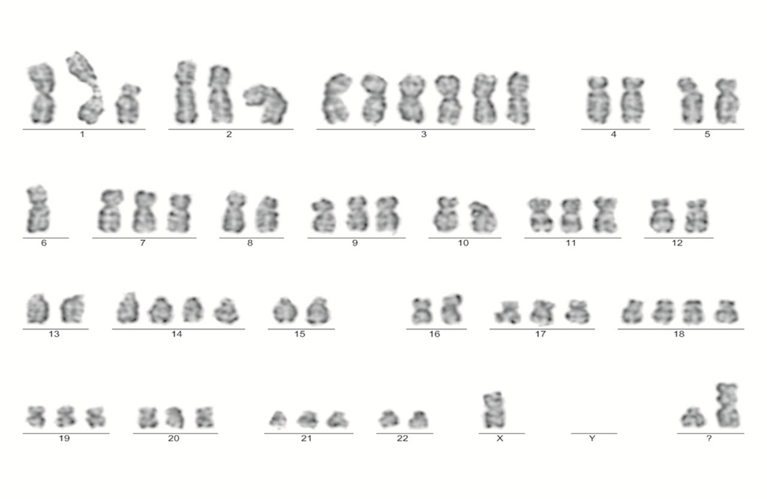
Demonstration of hyperdiploid karyotype in a patient with myeloma - 63 chromosomes
Multiple myeloma: hyperdiploid subgroup
non hyperdiploid subgroup
Hypotriploid karyotype from patient with extramedular myeloma relapse at the time of diagnosis detected by G-banding. ISCN: 63,X,-X,-X,der(1),+3,+3,+3,-4,-5,-6,-6,-8,-10,-12,-13,+14,-15,-16,+18,-22,+mar,+mar

Slide 17
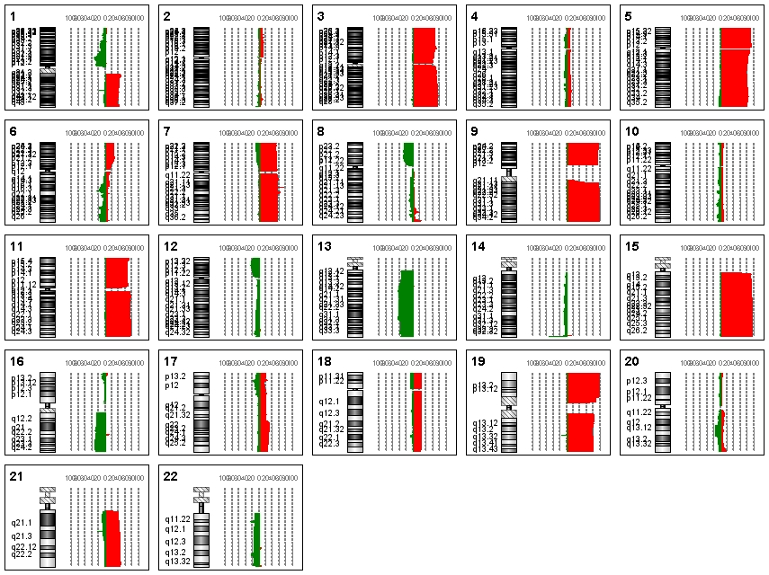
Summary of whole genome profiles in 51 patients with multiple myeloma - hyperdiploid subtypes - "odd chromosome" trisomy array-CGH
Trisomy of chromosomes 3, 5, 7, 9, 11, 15, 17, 19 often occurs in MM - better prognosis !

Slide 18
Consequences of individual chromosomal aberrations in the process of carcinogenesis
Translocations
genes directly involved in the tumour process identified at the breakpoints
There are two principal consequences of translocations and inversions:
  a break site within genes on each chromosome, rearranging them to create a fusion gene encoding a chimeric protein involved in the malignant process
  deregulation of gene expression by translocation to a strong promoter region (gene for T-cell receptor or immunoglobulin protein near proto-oncogene) ...often transcription factors

Slide 19
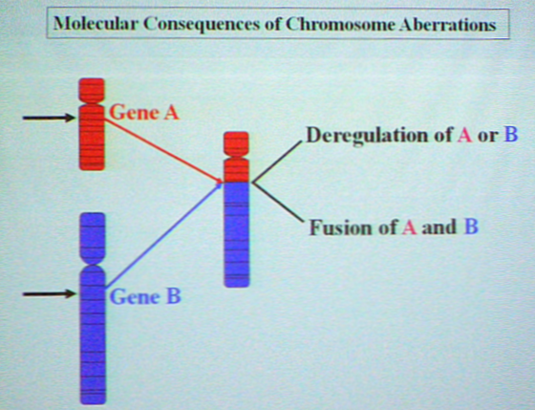
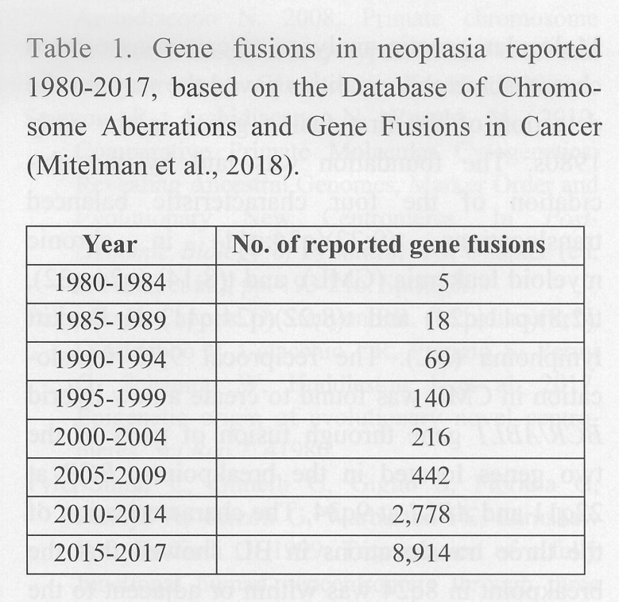
Translocations and tumors
Discovered fusion genes - counts
Hemat. l malignancies - 1231
Solid tumours - 9641

Slide 20
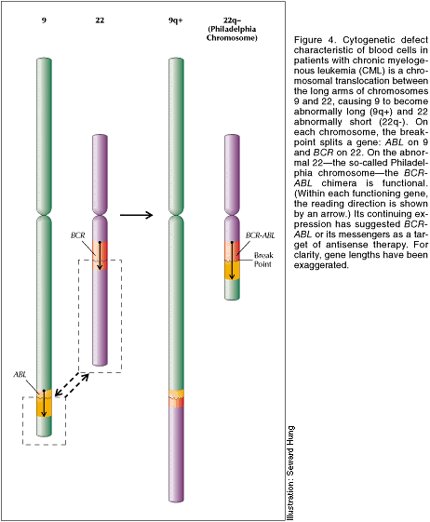
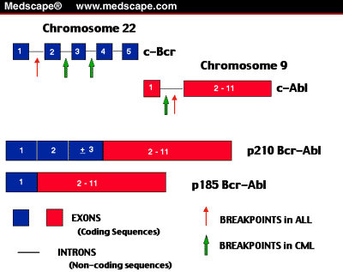
Consequences of individual chromosomal aberrations in the process of carcinogenesis
Translations associated with creation of chimeric proteins
t(9;22) – chronic myeloid leukemia (CML)
„PH“ chromosome
the cellular proto-oncogene ABL is localized on chromosome 9q34, the BCR gene on chromosome 22q11
during translocation, mutual exchange of parts of both chromosomes cration of a BCR/ABL fusion gene is created which encodes the hybrid protein p210, which initiates the malignant process...several breakpoints
t(15;17) – acute myeloid leukemia (AML)
PML/RARA fusion protein is likely the target protein in trans retinoic acid therapy
direct relationship between treatment of genetic defect and malignancy

Slide 21
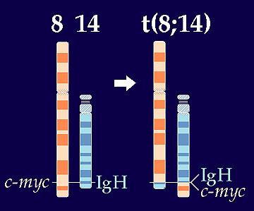
Consequences of individual chromosomal aberrations in the process of carcinogenesis
Translocations associted with protooncogen activation
t(8;14) - Acute Lymphoblastic Leukemia
c-MYC oncogene from 8q24 moved to the immunoglobulin heavy chain gene region on 14q32
the relocation results in deregulation of c-MYC proto-oncogene expression
deregulation triggers the process of carcinogenesis
t(2;8), t(8;22)
variant translocation with a breakpoint in the c-MYC gene ...regions of the kappa (2p11) and lambda (22q11) light chain genes

Slide 22
Examples of translocations in B cell lymphomas – involvement of IgH locus 14q32!
MALT lymphomas (mucosa-associated lymphoid tissue)
  recurrent translocations associated with include t(11;18)(q21;q21); t(1;14)(p22;q23); t(14;18)(q32;q21) and t(3;14)(p14.1;q32)
Follicular lymphoma (FL)
  the recurrent translocation associated with FL is characterised by t(14;18)(q32;q21)
Mantle cell lymphoma (MCL)
the recurrent translocation associated with is t(11;14)(q13;q32)
Burkitt lymphoma (BL)
characterised typically by t(8;14)(q24;q32)

Slide 23

Consequences of individual chromosomal aberrations in the process of carcinogenesis
Deletions - examples
loss of part of a chromosome, often affecting tumour-suppressor genes (RB1, p53) or genes for stimulatory and growth factors
LOH- loss of heterozygosity due to gene deletion
specific changes in haematological malignancies
del 5q - acute myeloid lekuemia, myelodysplatic syndrome
in AML and MDS, the deletion is interstitial, the extent is highly variable,
5q31-critical region is always affected, multiple genes controlling normal hematopoiesis are mapped in the region
del 11q23
in AML and ALL, MLL gene is mapped in the 11q23 region, moreover MLL involved in numerous translocations (6q27, 9p21, 10p15, 17q11, 19p13) besides deletions
Monosomy
loss of whole chromosomes, changes are rather secondary, frequent monosomy 5, 7 in MDS

Slide 24
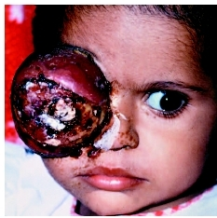
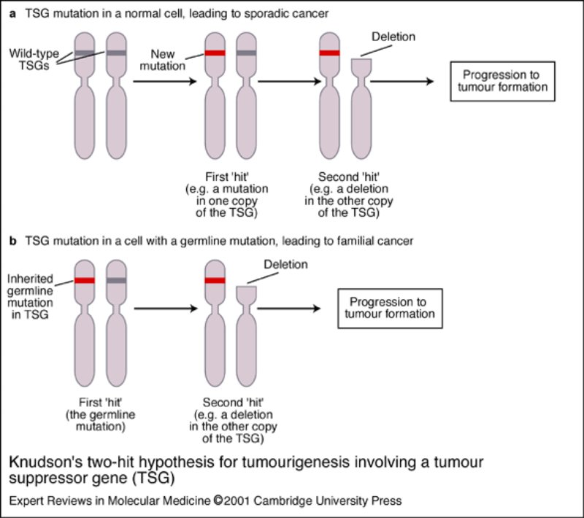
RB1 gene deletion - loss of constitutive heterozygosity in retinoblastoma - LOH
Knuston hypothesis – (the double hit theory)
„The most tumor suppressor genes require both alleles to be inactivated, either through mutations or through epigenetic silencing, to cause a phenotypic change“
Alfred G. Knudson, 1971
Notes:
24

Slide 25
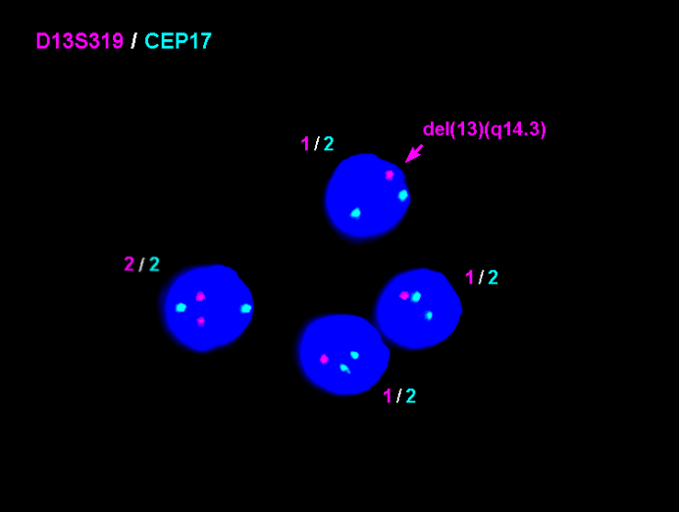
Examples of significant deletions in tumor diseases
Retinoblastoma - malignant eye tumor of children del(13)(q14) - RB1 gene - blocks progression to S phase
Wilms tumour - kidney tumour
del(11)(p) 11p13 - 11p15
del(16)(q) WT1 gene
Neuroblastoma - del(1)(p36)
TP53 gene deletion (17p13) - many tumors !!!

Slide 26
Consequences of individual chromosomal aberrations in the process of carcinogenesis
Aberrations with gain of genetic material
Duplication, trisomy
multiplication of whole or parts of chromosomes
frequent secondary changes in tumor cells
multiplication of gene dosage
cancer progression
in leukemias common +8, in CLL specific +12, other Ph copies
Amplification
frequent in solid tumors but also in leukemias
mostly amplification of proto-oncogenes (N-myc,
c-myc, Her 2)
double minutes, homogeneously staining areas (DMs, HSRs) are seen in mitosis !!!
Detection: I-FISH, array-CGH
examination for the presence of amplification is of diagnostic and prognostic importance !!!
Amplifikace

Slide 27
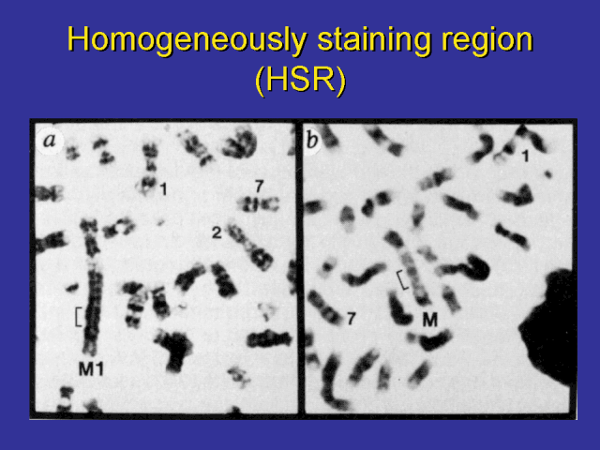
regions of amplified genes in the karyotype (absence of banding)

Slide 28
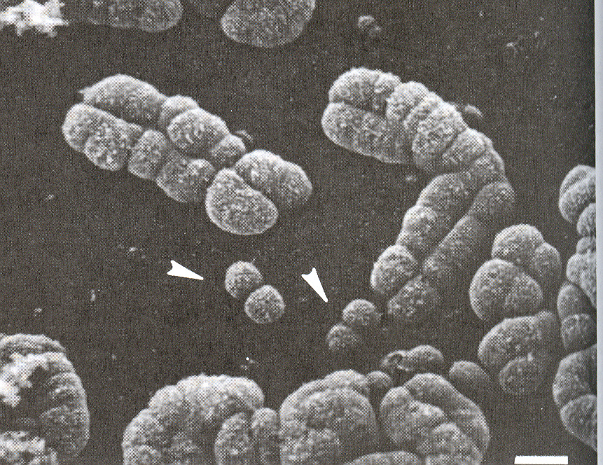
Double minutes DMs during mitosis
DMs are formed by HSR decay - they contain several thousand copies of a certain gene !!!

Slide 29
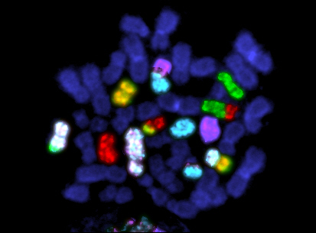
Complex karyotypes in tumor diseases
Complex karyotype - we detect numerical or numerical changes involving three or more chromosomes or structural changes involving three or more breaks
Poor prognosis!!!

Slide 30
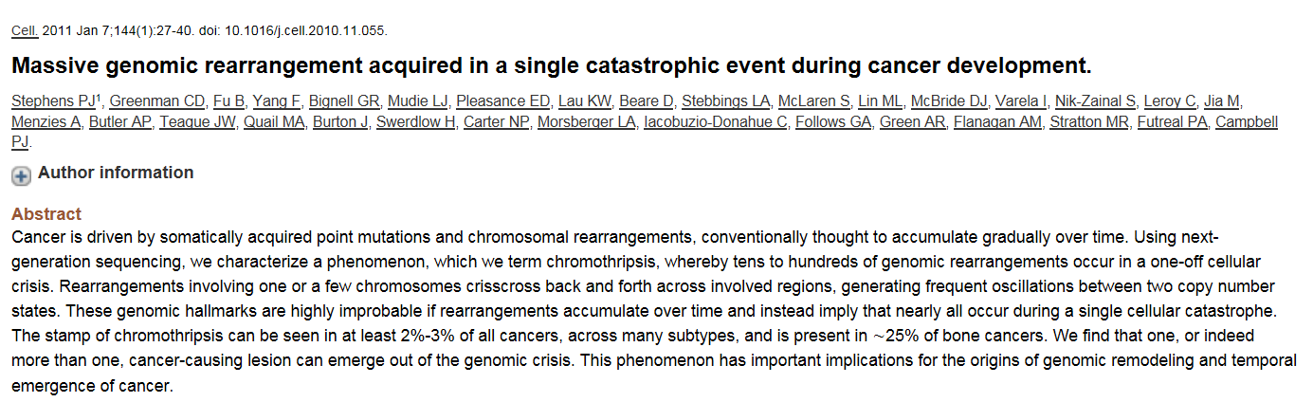
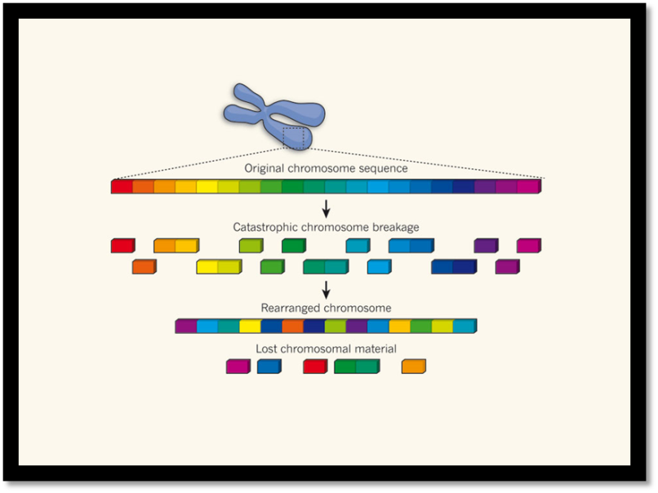
Chromothripsis - new view of tumour formation (new mechanism of complex changes - discovered in 2011)
Pacient WITH CLL
NGS - 42 genomových
přestaveb !

Slide 31
Chromothripsis
chromothripsis (from Greek chromos - chromosome and thripsis - division into pieces)
these are tens or hundreds of rearrangements on one or more chromosomes, occurring suddenly during a single catastrophic event
a chromosome or a part of it is broken into small pieces (multiple double-strand breaks....) and these are then randomly put back together by reparative mechanisms
however, this assembly is not completely accurate, some parts may be assembled in a different order, missing or duplicated
chromothripsis has been demonstrated in various types of tumours (2-3%), but also in congenital genetic diseases

Slide 32
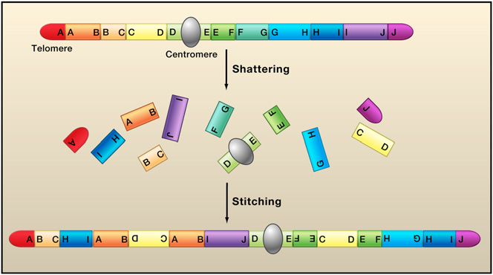
Chromothripsis
Cytogenetic consequences - complex rearrangements, deletions, duplications, insertions, inversions...
Chromothripsis is proposed to involve the shattering of a single chromosome, a small group of chromosomes, or a single chromosome arm. The fragments, or a subset of the fragments, are then stitched together by nonhomologous end-joining.
Meyerson and Pellman 2011

Slide 33
Chromothripsis and tumor diseases
incidence of 2 - 3% of all cancers
chromothripsis has been demonstrated in leukemia, multiple myeloma, colon cancer, medulloblastoma, neuroblastoma, etc.
frequent occurrence in bone tumors (up to 25%) - osteosarcoma, Ewing's sarcoma, chondrosarcoma
chromothripsis - worse prognosis !!! - extensive rearrangements - deletions, duplications, inversions, insertions - deregulation of a large number of genes....

Slide 34
Alghortim of cytogenetic/genomic analyses in cancer diseases:
G-banding, I-FISH, M_FISH, M-BAND array-CGH
Comprehensive analysis of cytogenetic changes in tumors
individualization of medical therapy, biological therapy"

Slide 35
Prognostic changes of chromosomal aberrations associated with negative prognosis in hematoncologic and solid cancer diseases

Slide 36
Chronic myeloid leukemia (CML) 1:100 000
Ph is usually present in 95% of patients at the time of diagnosis, (where it is not, we usually find a masked Ph chromosome as insertion)
there are 3 breakpoint regions in the BCR gene
the best prognosis is for patients who have a
Ph chromosome as the only change at the time of diagnosis !!!
at the time of diagnosis, presence of other chromosomal changes besides Ph, is an unfavourable prognostic feature
at the time of blastic reversal, up to 70% of patients have additional chromosomal changes, most often +8, Ph duplication, +19, i(17q)
FISH detects BCR/ABL rearrangement, specific probe allows to investigate also interphase nuclei

Slide 37
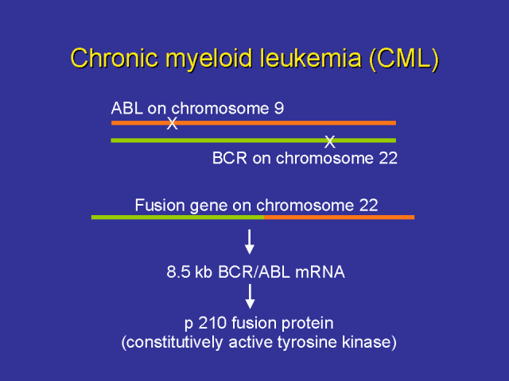
I – FISH translocation DNA probes

Slide 38
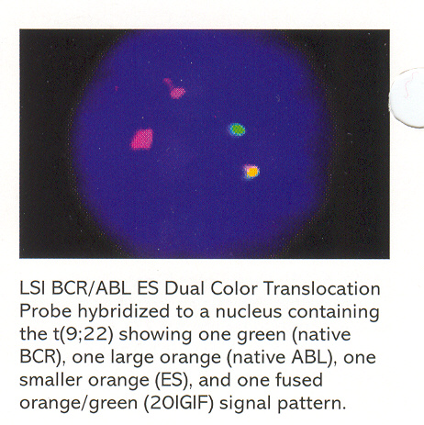
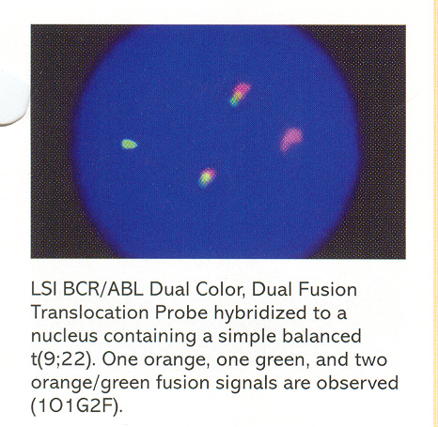
Translocation t(9;22) - bcr/abl – interphase
Translocation positive cells can be
or
DUAL fusion s – double fusion signal
With additional signal

Slide 39
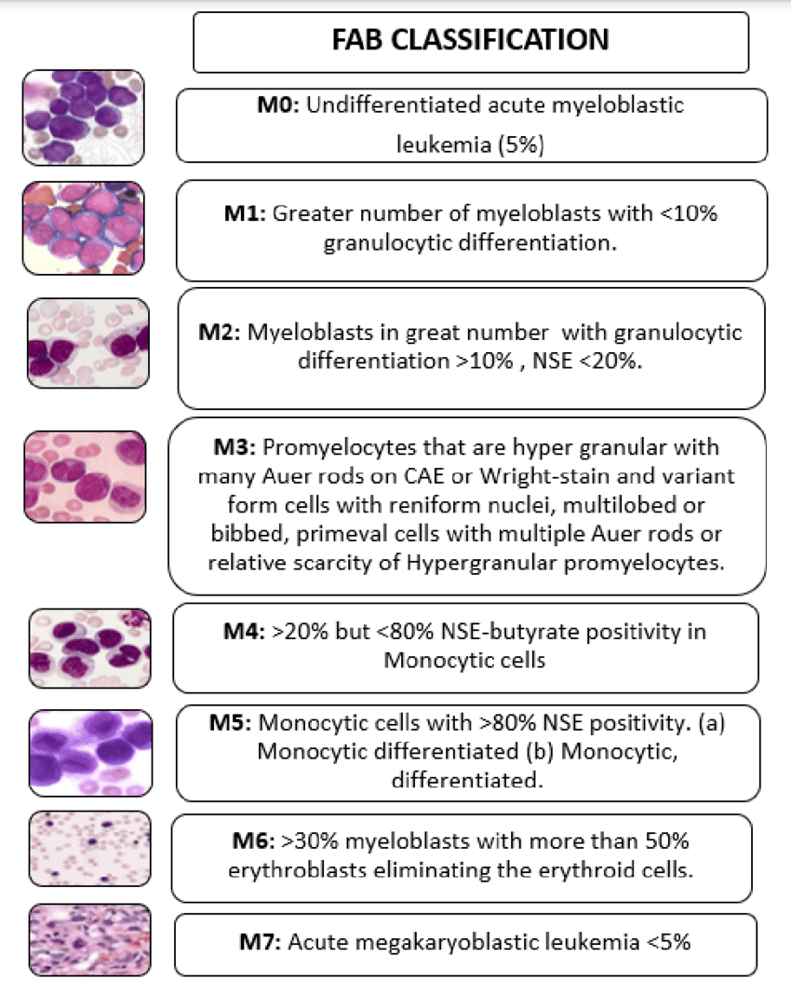
Acute myeloid leukemia (AML)
3/100 000
60-70% of patients have a clonal chromosomal aberration
the aberrant clone is often accompanied by a normal clone
Chromosomal changes present at the time of diagnosis disappear after achieving remission, reappear in relapse, often with other secondary changes
some changes specific to FAB subtypes of AML, diagnostic and prognostic significance, disease monitoring !
The French-American-British (FAB) classification of AML:
M1 - M7, M0 according to aberrations

Slide 40
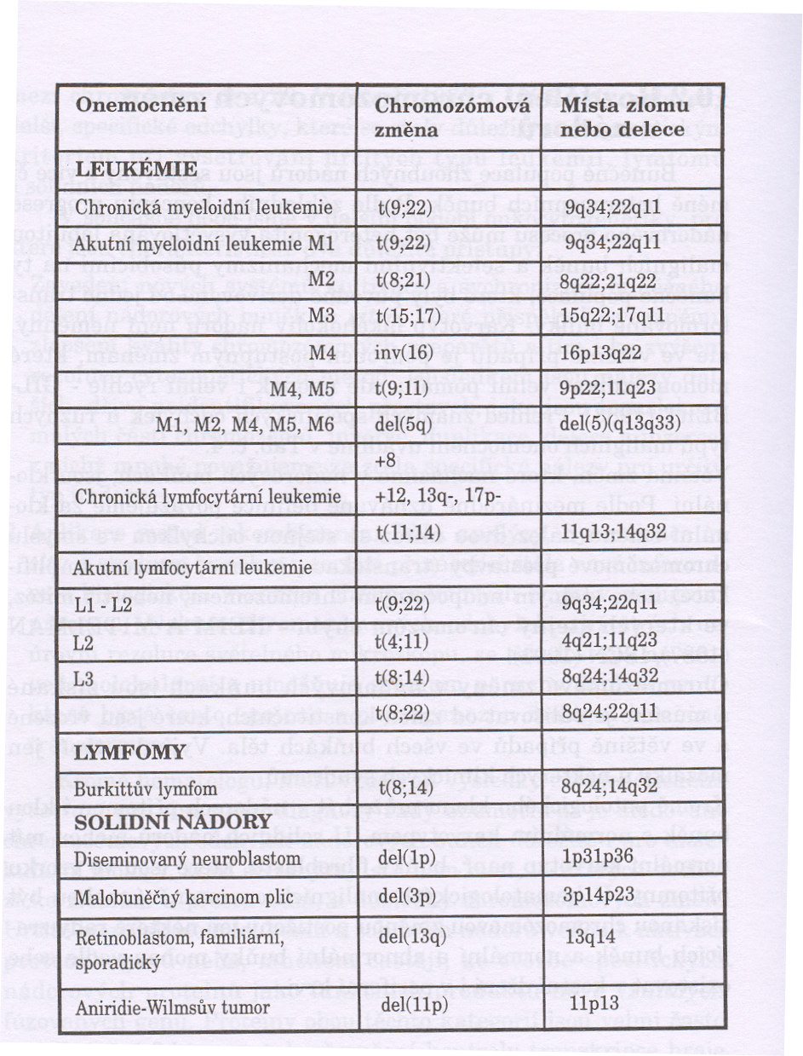
AML subgroups

Slide 41

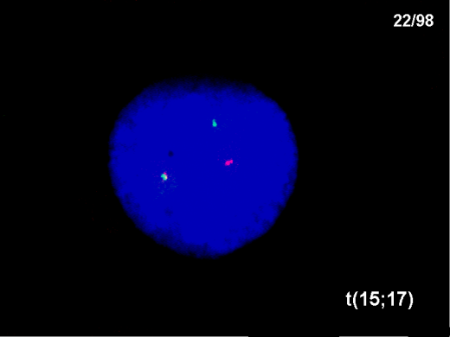

AML aberrations
AML-M2 - t(8;21)
mapped genes ETO, AML1
mainly in younger patients, often in children
secondary changes -Y, -X, 9q-, 7q-, +8
good prognosis
AML-M3: t(15;17)
PML/RARA genes mapped
Less frequently variant translocations
most common additive change +8
good prognosis

Slide 42

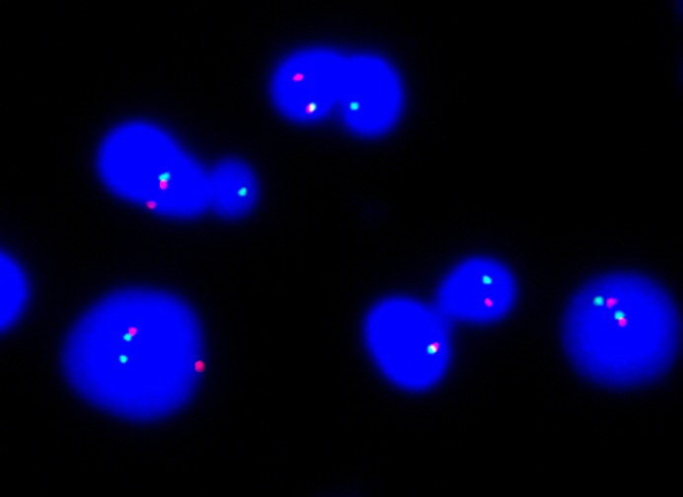
AML aberrations
AML-M5 disruption 11q23 DNA probe
11q23 aberrations involving
deletions or translocation in
the break region of the MLL gene
up to 50% of patients have these changes
most common t(1;11), t(6;11), t(9;11),
t(10;11), t(11;19) and others (40
translocations)
often also in paediatric AML
generally unfavourable prognosis
Disruption in MLL genu

Slide 43

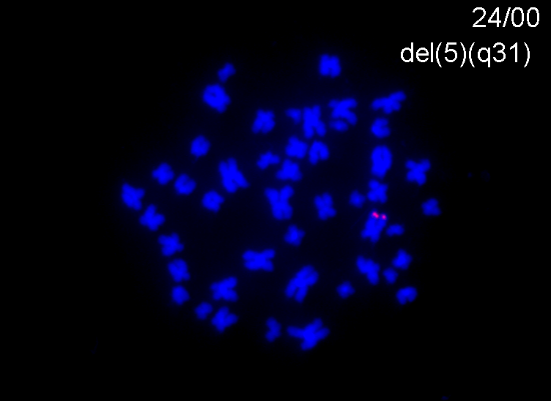
Myelodysplastic syndrome (MDS) 15/100 000
rare disease, occurs in the elderly, pancytonemia in the blood, often transitioning to acute leukemia
rare disease, occurs in the elderly, pancytonemia in the blood, often transitioning to acute leukemia
chromosomal changes in about 60% of patients
del(5q) - 5q-syndrome
interstitial deletion, extent of deletion varies, missing 5q31 band
other changes: -5, del(7q), -7, +8, del(11q), 12p-,
frequent complex changes
best prognosis in patients with normal karyotype, single 5q- favourable prognosis,
combination with other changes unfavourable,
-7 very unfavourable, patients with complex changes have the shortest survival !!!

Slide 44
Acute lymphocytic leukemia (ALL)
ALL is the most common childhood malignancy; 3 : 100 000
70-90% of patients have an acquired chromosomal aberration
t(12;21) - TEL/AML1 - better prognosis !
Numerical chromosome changes
a) hyperdiploidy
  most common, more than 46 chromosomes, moderate prognosis
  more than 50 chromosomes, good prognosis
  supernumerary chromosomes 4, 6, 10, 14, 17, 18, 20 and 21
b) hypodiploidy
  number less than 46, unfavourable prognosis
  the importance of I-FISH in detecting hyperdiploid and hypodiploid clones, the algorithm uses a panel of the 10 most frequently included chromosomes

Slide 45

Chronic Lymphocytic Leukemia
little cell proliferation activity in vitro, often normal karyotype found
CHAs found in more than 40% of CLL patients with FISH
Trisomy 12
  most common, in B-CLL, more than 20% of patients
  often combined with del(13q), del(6q), del(17p), or complex rearrangements
  median survival 3-4 years, better response to chemotherapy
del(13q)
  RB1 gene, the most common alteration after trisomy 12
del(17p)
  TP53 gene, prognostic significance, survival 1.5-2 years

Slide 46
Multiple myeloma
A clonal disease that results from a malignant mutation in the development of the B-lymphocytes
It accounts for about 10% of all oncohematological diseases
Affects mainly the elderly, rare before the age of 40
Currently incurable, with variable survival and patient response to treatment
Wide spectrum of clinical manifestations: bone destruction, pancytopenia, anaemia, impaired antibody immunity, myeloma nephropathy ...
Optimization of treatment requires determination of prognostic factors

Slide 47
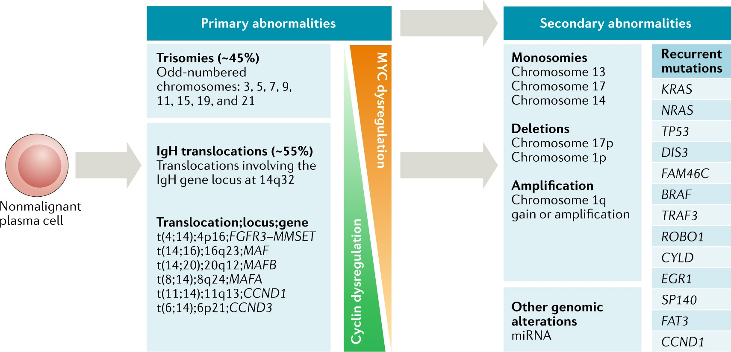
Mnohočetný myelom a cytogenetika
https://www.nature.com/articles/s41571-018-0018-y

Slide 48
Multiple myeloma and CHAs
Cytogenetic changes - an important prognostic factor in MM !!!
Hypodiploidy: most often monosomy of chromosome 8, 13, 14, X unfavourable prognosis
Hyperdiploidy: most often trisomy of chromosome 3, 5, 7, 9, 11, 15,19, 21 favorable prognosis
Translocation involving the IgH gene (14q32):
t(11;14) (q13;q32) favourable prognosis
t(4;14)(p16;q32), t(14;16) (q32;q23) unfavourable prognosis
RB1 gene deletion (13q14) - intermediate prognosis
Deletion of p53 gene (17p) poor prognosis
gain 1q21 - poor prognosis

Slide 49
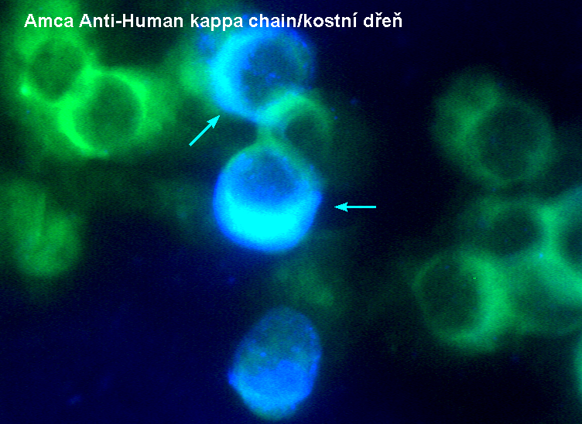
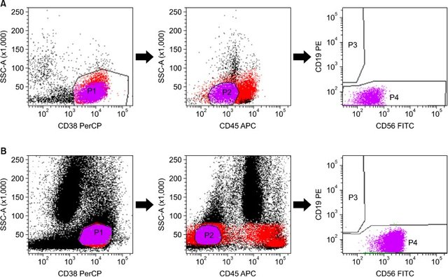
Cell sorting in MM pacients fluorescence immunophenotyping and interphase in situ hybridization
FICTION technique in MM
fluorescence immunophenotyping and interphase in situ hybridization
Simplified flow cytometric immunophenotyping panel for multiple myeloma, CD56/CD19/CD138(CD38)/CD45

Slide 50
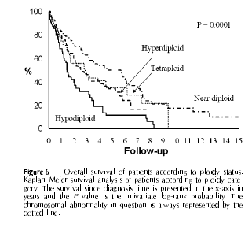
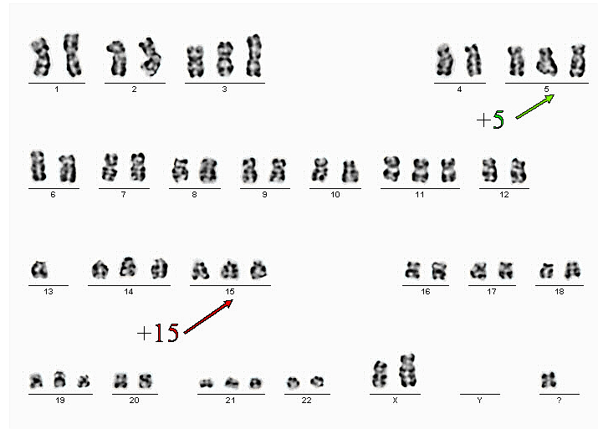
Prognosis of disease in MM patients
Effect of presence of aneuploidies
Status | 5 Year Survival (%)
Pseudodiploid | 49.9
Near-tetraploid | 34.6
Hyperdiploid | 33.5
Hypodiploid | 10
Převzato z Debes –Marun et al., 2003, Blood

Slide 51
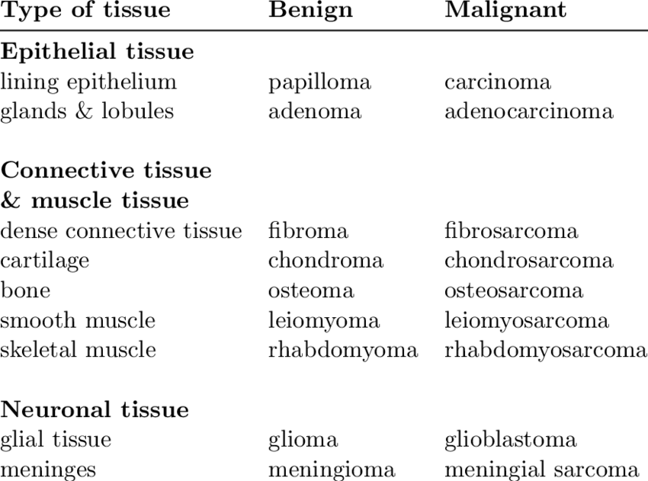
Solid tumors
https://www.researchgate.net/profile/Annette-Gylling-lindroos/publication/47931966/figure/tbl1/AS:669431457918989@1536616305664/Classification-of-solid-tumors-according-to-tissue-of-origin-modified-from.png

Slide 52
Cytogenetics of solid tumors
Biological material:
effusion (ascitic tumors) - epithelial and tumor cells
culture of tumor cells
tumor imprints (FISH) ....confirmation by pathologist !
paraffin sections (FISH)
cytospins

Slide 53
Cytogenetics of solid tumors
Problems:
Difficulty of long-term cultivation ( will it outgrow non-tumor material ?)
lack of mitoses, quality of slides
complexity of karyotype (unbalanced changes)
heterogeneity of tumors
individualization of patient treatment - cytogenetic and genetic testing is essential !

Slide 54
Cytogenetické změny u některých solidních nádorů dětí
Retinoblastoma - malignant eye tumour in children del(13)(q14) - RB1 gene
Wilms tumor - kidney tumor
del(11)(p) 11p13 - 11p15 - WT1 gene
del(16q)
Ewing's sarcoma - t(11;22)(q24;q12)
EWS-FLI1 fusion gene
Neuroblastoma - amplification of N-myc gene, del(1)(p36), del 11q, gain(17)(q)
Medulloblastoma - c-myc gene amplification

Slide 55
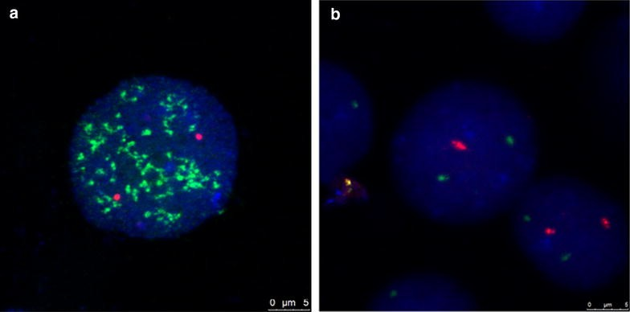
Neurobalstoma – FISH probes
N-myc amplification
del1p36

Slide 56
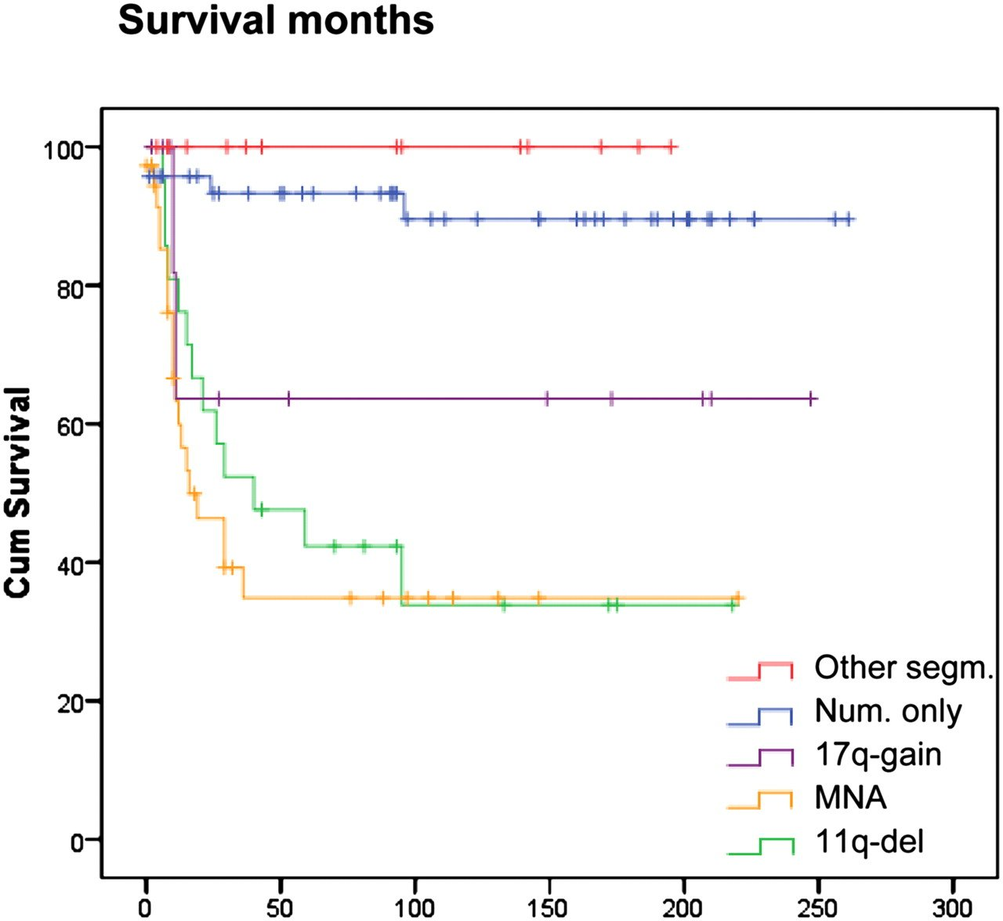
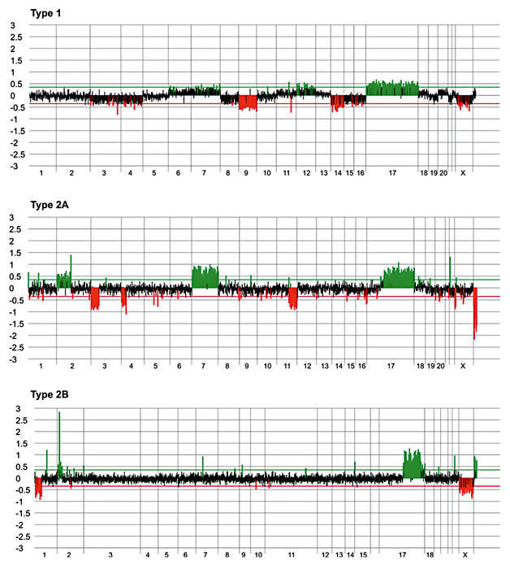
Prognosis and therapy of neuroblastoma based on genomic profiles of tumor cells!
https://www.researchgate.net/profile/Bjorn-Menten/publication/6674618/figure/fig2/AS:267916767658004@1440887743724/ArrayCGH-visualisation-of-representative-neuroblastoma-tumors-each-belonging-to-a_W640.jpg
https://www.pnas.org/cms/10.1073/pnas.0910684107/asset/8abb56dc-6792-42d3-b860-42a65347b35e/assets/graphic/pnas.0910684107fig04.jpeg

Slide 57
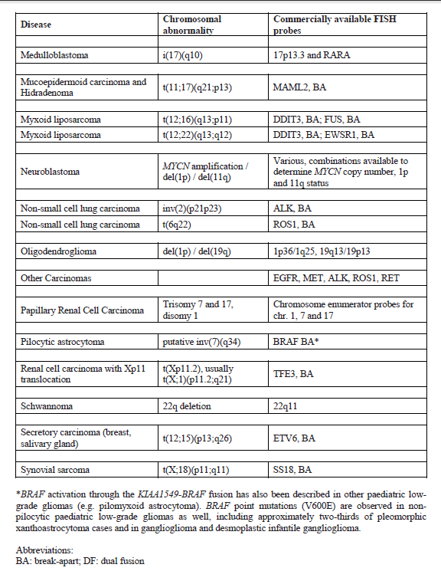
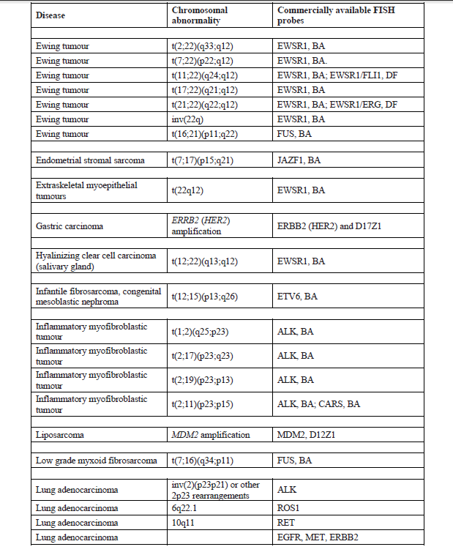
Examples of FISH analyses usedin solid tumors

Slide 58
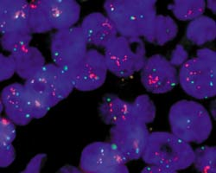
Personalized medicine and HER -2 gene amplification in breast cancer
Breast CA...6000 women per year in the Czech Republic
Her 2 - an important prognostic and therapeutic marker
Occurs in 25-30% of breast cancers
Gene amplification is associated with an unfavorable prognosis (rapid proliferation, shortened survival time)
treatment with Herceptin ...transtuzumab - blocking Her 2 receptor !
Prediction of the course of the disease

Slide 59
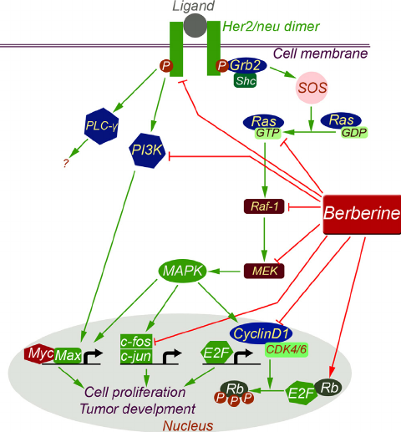
HER-2/neu Overview
Human Epidermal Growth Factor Receptor-2
Also known as:
  c-erbB2
  neu (rat homolog)
Codes for a 185 Kd transmembrane cell surface receptor
Member of the tyrosine kinase family
https://www.researchgate.net/profile/Parham-Jabbarzadeh-Kaboli-2/publication/264976148/figure/fig2/AS:295978197372932@1447578109798/Her2-neu-signaling-pathway-The-her2-neu-heterodimer-is-a-growth-factor-receptor-that.png

Slide 60
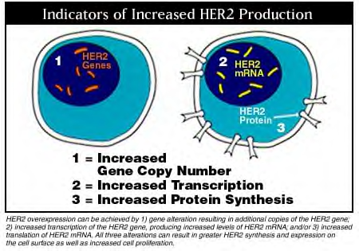
Indicators of Increased HER-2 production
Image from Genetech

Slide 61

HER-2/neu DNA Probes
HER-2/neu & chr. 17
17p11.1-q11.1 17 alpha
17q11.2-q12 HER-2/neu
17q11.2 -q12
HER-2/neu gene
Centromere
Telomere
~ 400 kb

Slide 62
HER-2/neu DNA Probes and Gene Amplification
Aneuploidy:
multiple copies
of chr. 17
Chr 17
True gene amplification: HSRs
Her-2/neu
probe
True gene amplification: dmin’s

Slide 63

ALK gene (2p23) disruption in Non-small cell lung pcancer (NSCLC)
Lung cancer diagnosed annually in 1.6 million people worldwide ...
NSCLC - 80% of cases; 5-year survival - about 15%
KRAS, EGFR, ALK mutations
Patients with ALK gene and disruption and EML/ALK fusion gene (5-7% of cases) benefit from targeted treatment with anaplastic lymphoma kinase inhibitor - crizotinib (Xalkori)
for EGFR gene mutations - gefitinib and erlotinib...

Slide 64

Disruption of
ALK

