Slide 1
Phagocytosis in photos

Slide 2
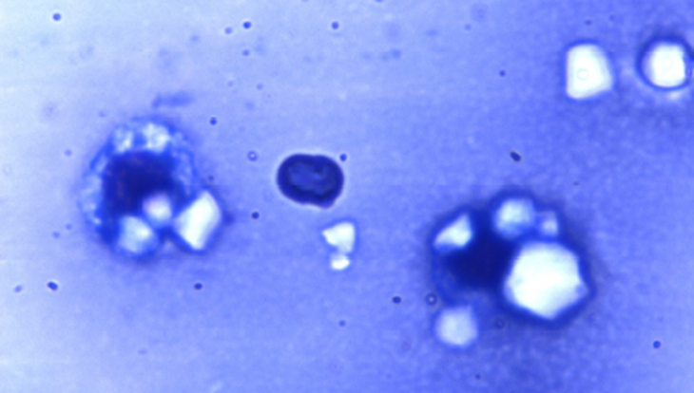

Slide 3
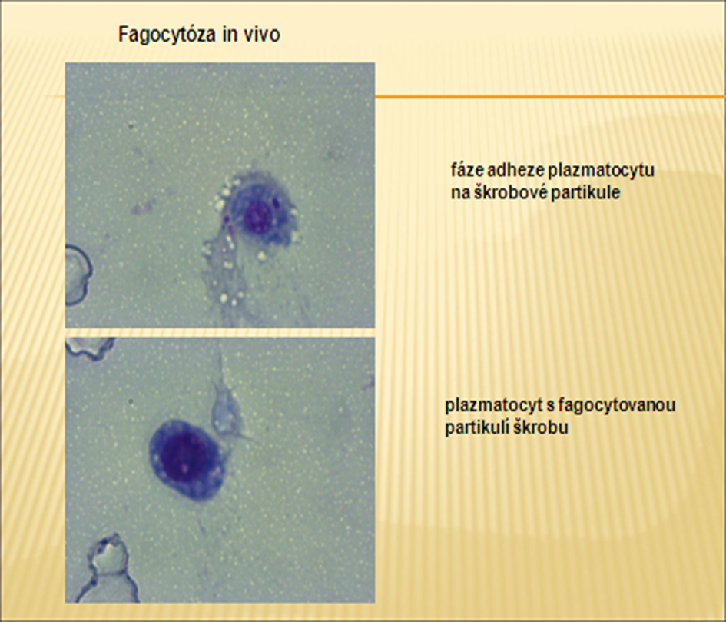
Plasmatocyte adhesis with starch parts

Slide 4
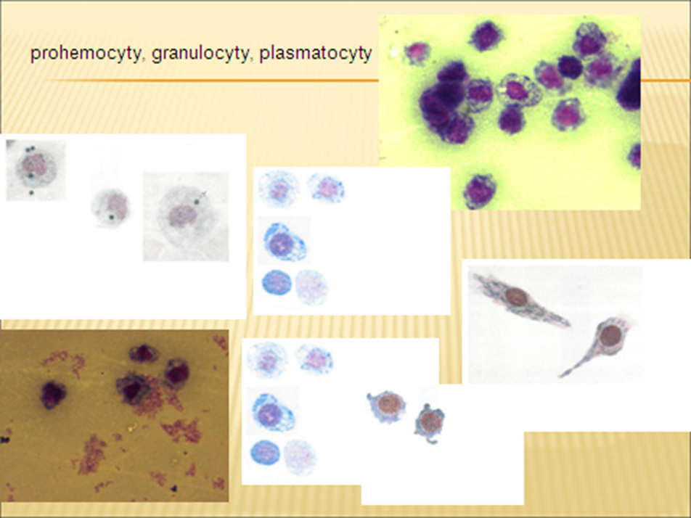
Prohaemtocytes,
Granulocytes,
Plasmatocytes

Slide 5
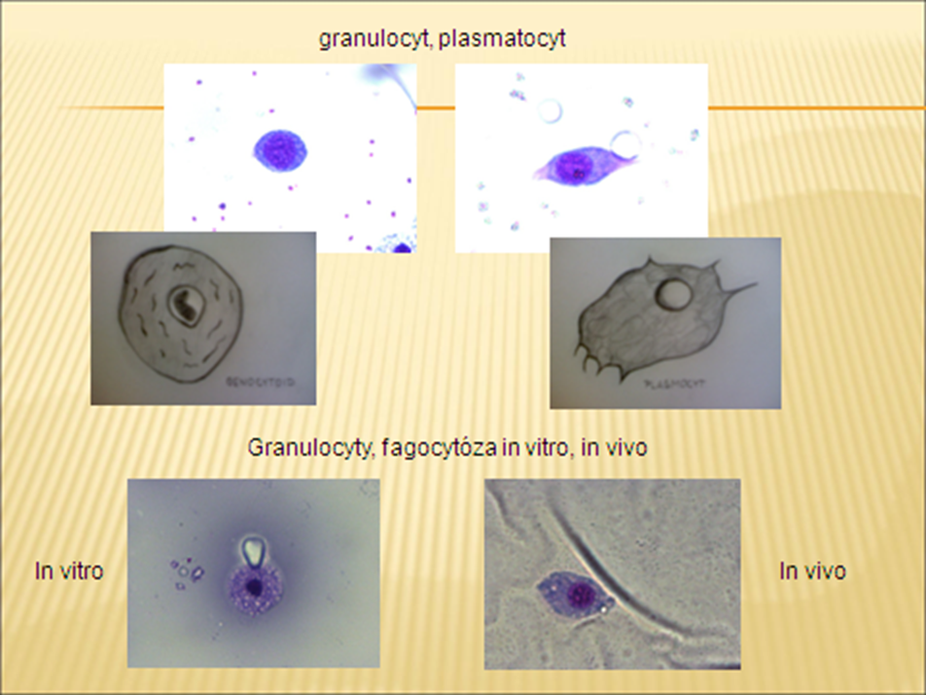
Granulocytes,
Plasmatocytes
Phagocytosis in vitro, in vivo

