Slide 1
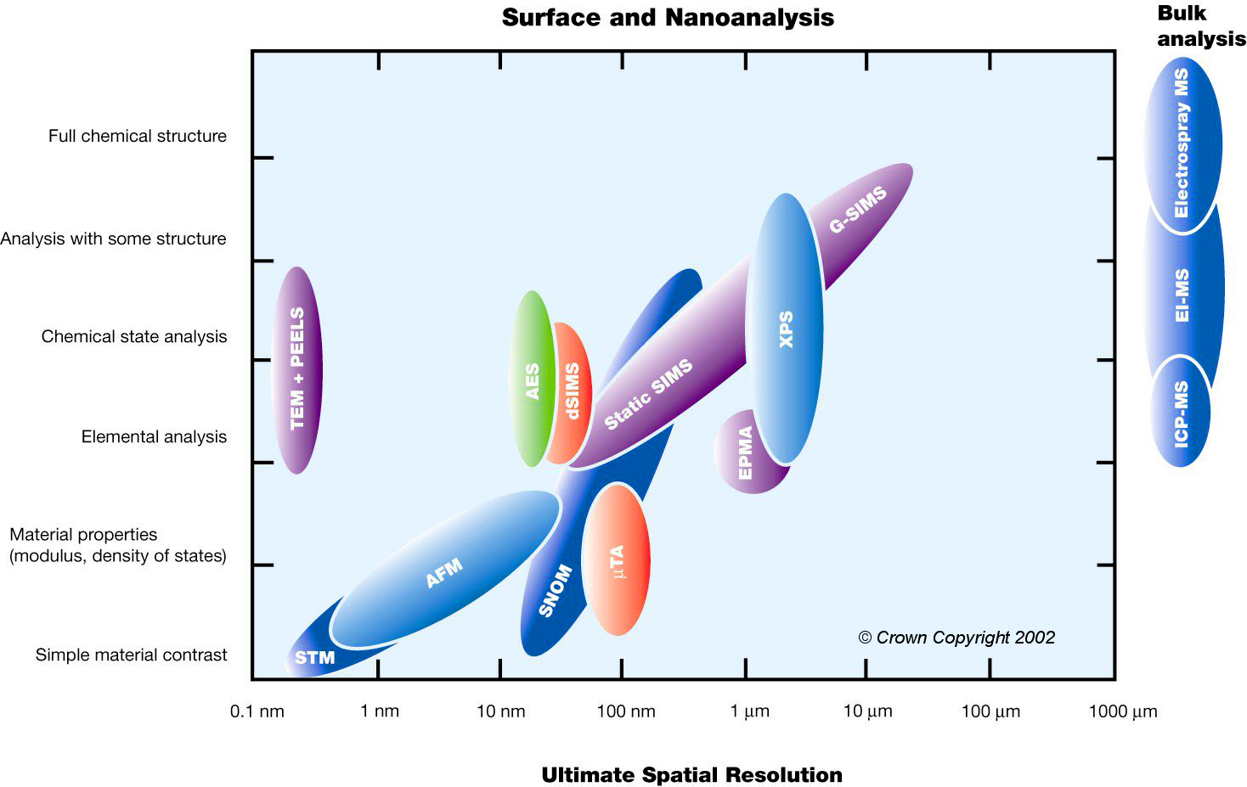
Surface Analysis

Slide 2
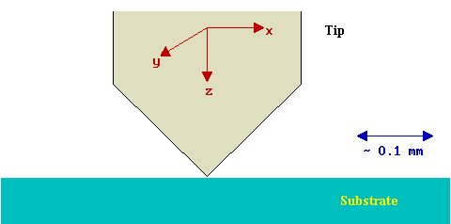
Scanning Probe Microscopy ( STM / AFM )
All of the techniques are based upon scanning a probe (typically called the tip in STM , since it literally is a sharp metallic tip) just above a surface whilst monitoring some interaction between the probe and the surface.
STM - is the tunnelling current between a metallic tip and a conducting substrate which are in very close proximity but not actually in physical contact.
AFM - is the van der Waals force between the tip and the surface; this may be either the short range repulsive force (in contact-mode) or the longer range attractive force (in non-contact mode).

Slide 3
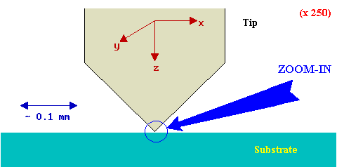
Let us look at the region where the tip approaches the surface in greater detail ....
The position of the tip with respect to the surface must be very accurately controlled (to within about 0.1 Å) by moving either the surface or the tip.
The tip must be very sharp - ideally terminating in just a single atom at its closest point of approach to the surface.

Slide 4
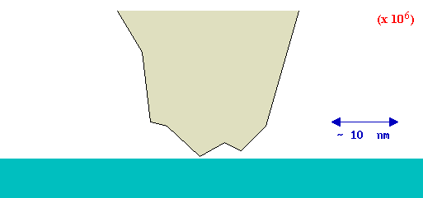
Zoom x10⁶
... the end of the tip will almost invariably show a certain amount of structure, with a variety of crystal facets exposed ...

Slide 5
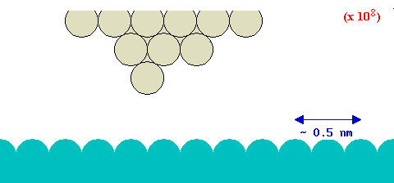
Zoom x10⁸
… and if we now go down to the atomic scale ....
... there is a reasonable probability of ending up with
a truly atomic tip.

Slide 6
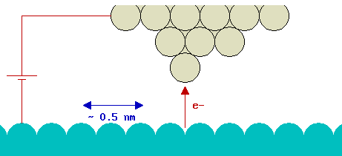
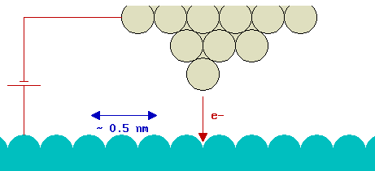
Bias
If the tip is biased with respect to the surface by the application of a voltage between them then electrons can tunnel between the two, provided the separation of the tip and surface is sufficiently small - this gives rise to a tunnelling current.
The direction of current flow is determined by the polarity of the bias.
If the sample is biased -ve with respect to the tip, then electrons will flow from the surface to the tip as shown on the left, whilst if the sample is biased +ve with respect to the tip, then electrons will flow from the tip to the surface as shown on the right.

Slide 7
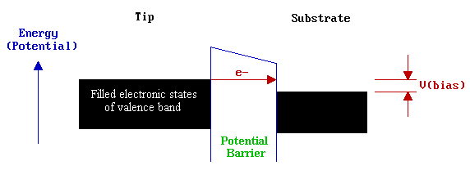
Model of the tunnelling
In this model, the probability of tunnelling is exponentially-dependent upon the distance of separation between the tip and surface : the tunnelling current is therefore a very sensitive probe of this separation.
In this model, the probability of tunnelling is exponentially-dependent upon the distance of separation between the tip and surface : the tunnelling current is therefore a very sensitive probe of this separation.

Slide 8
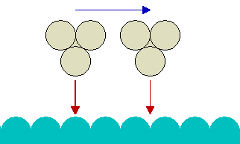
Imaging of the surface
In constant height mode (in which the tunnelling current is monitored as the tip is scanned parallel to the surface)
In constant current mode (in which the tunnelling current is maintained constant as the tip is scanned across the surface)
If the tip is scanned at what is nominally a constant height above the surface, then there is actually a periodic variation in the separation distance between the tip and surface atoms. At one point the tip will be directly above a surface atom and the tunnelling current will be large whilst at other points the tip will be above hollow sites on the surface and the tunnelling current will be much smaller.

Slide 9
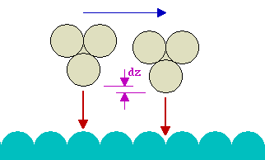
Imaging of the surface
In practice, however, the normal way of imaging the surface is to maintain the tunnelling current constant whilst the tip is scanned across the surface. This is achieved by adjusting the tip's height above the surface so that the tunnelling current does not vary with the lateral tip position. In this mode the tip will move slightly upwards as it passes over a surface atom, and conversely, slightly in towards the surface as it passes over a hollow.
The image is then formed by plotting the tip height (strictly, the voltage applied to the z-piezo) v's the lateral tip position.

Slide 10
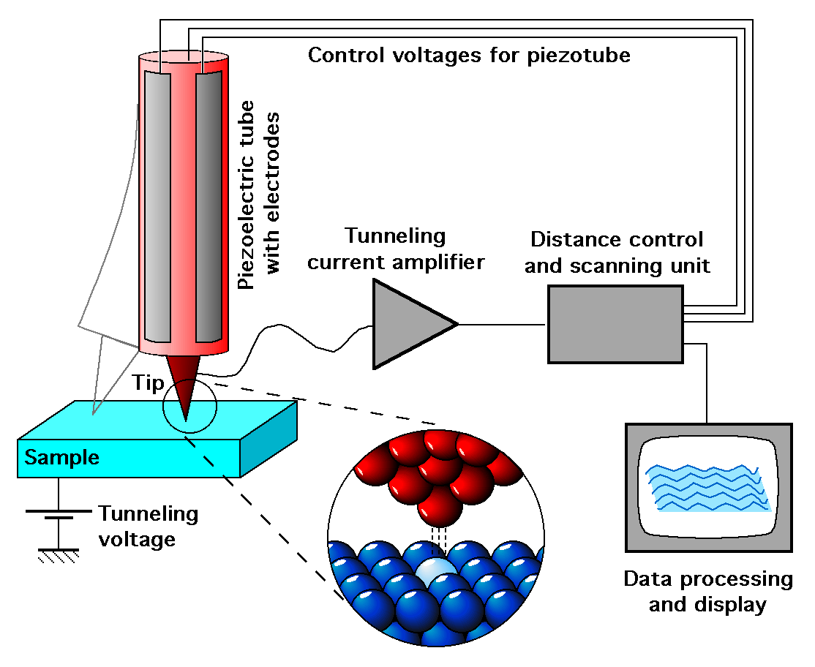
Scanning Tunnelling Microscopy

Slide 11
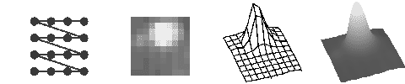
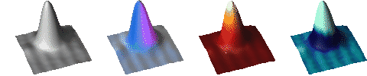
A tip is scanned over a surface at a distance of a few atomic diameters in a point-by-point and line-by-line fashion. At each point the tunneling current between the tip and the surface is measured. The tunneling current decreases exponentially with increasing distance and thus, through the use of a feedback loop, the vertical position of the tip can be adjusted to a constant distance from the surface.
The amount of these adjustments is recorded and defines a grid of values which can be displayed as a grayscale image.
Instead of assigning the values to a color we can also use them to deform the grid in the direction perpendicular to the surface.
Now we can bring back the grayscale and paint each square according to an average of the four defining grid points.
Now we paint the whole surface uniformly gray and switch on the lights.
We can use several lights at different positions and with different colors.
Instead of painting the surface just gray we can use a color palette and paint it according to height.
Or we choose the color according to another surface property, let's say curvature.

Slide 12
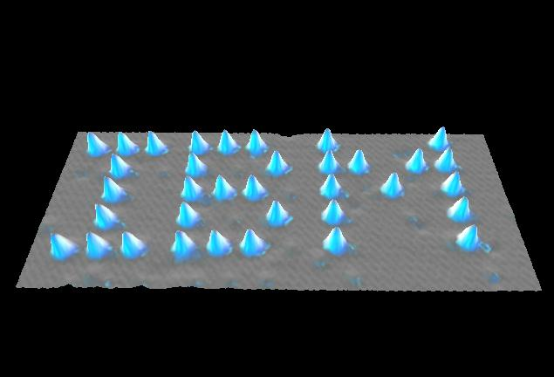
Title : The Beginning
Media : Xenon on Nickel (110)

Slide 13
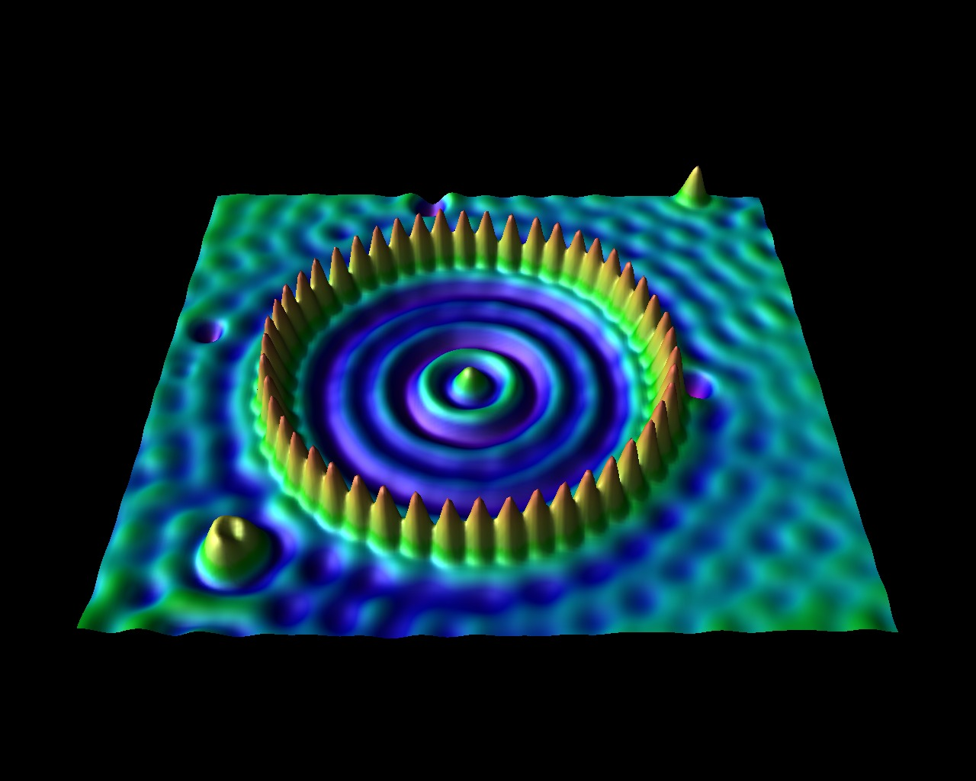
Surface state electrons on Cu(111) were confined to closed structures (corrals) defined by barriers built from Fe adatoms. The barriers were assembled by individually positioning Fe adatoms using the tip of a low temperature scanning tunneling microscope (STM). A circular corral of radius 71.3 Angstrom was constructed in this way out of 48 Fe atoms.

Slide 14
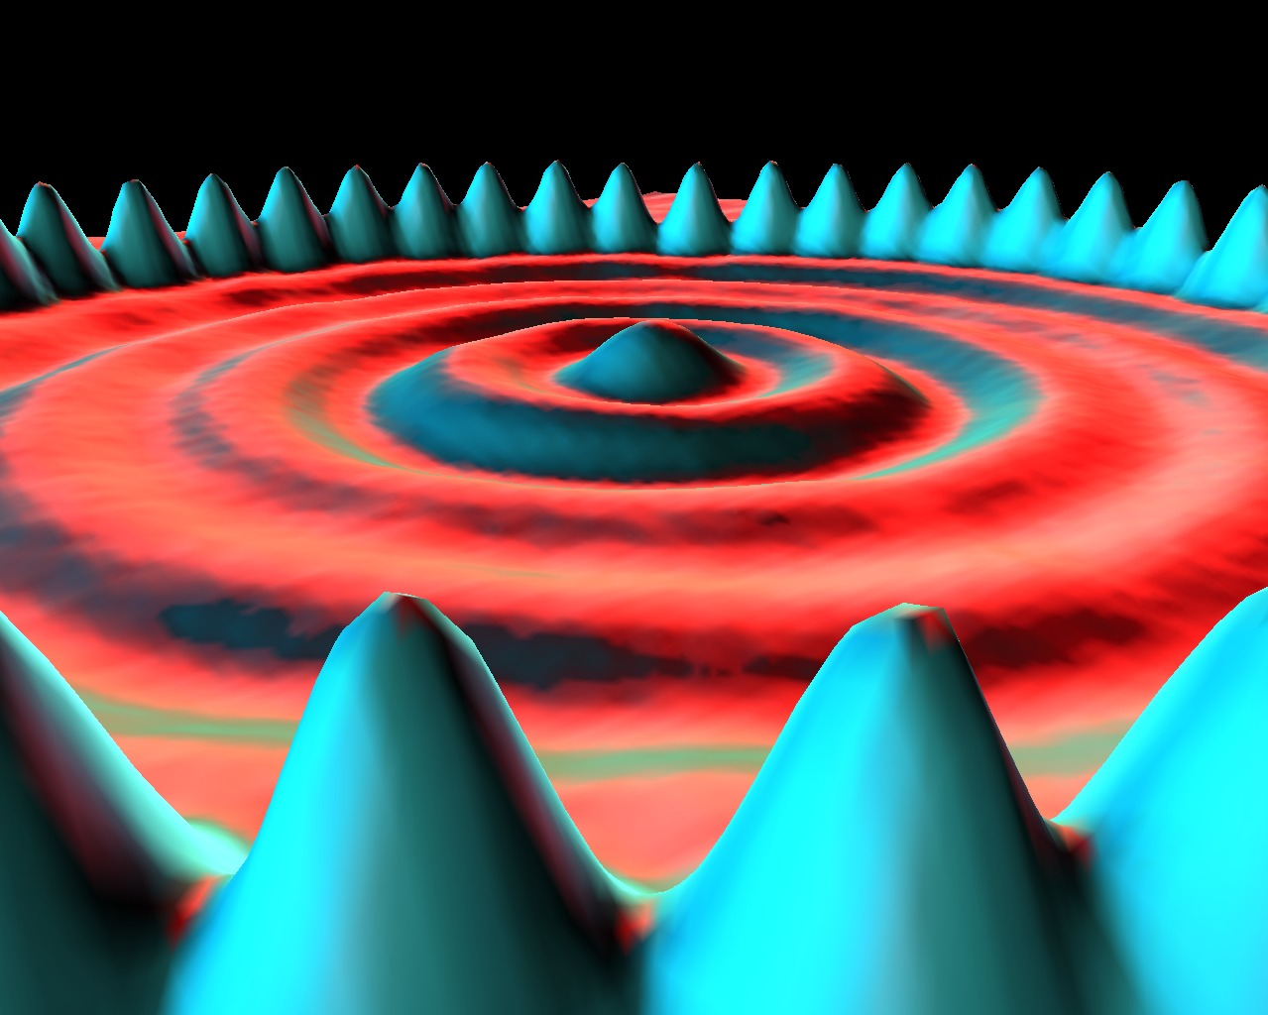
Title : Quantum Corral
Media : Iron on Copper (111)

Slide 15
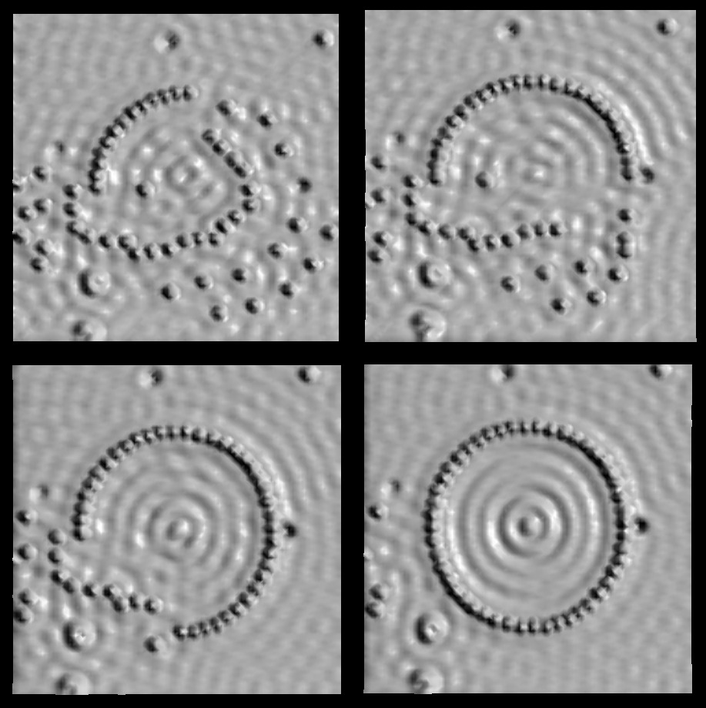
Title : The Making of the Circular Corral
Media : Iron on Copper (111)

Slide 16
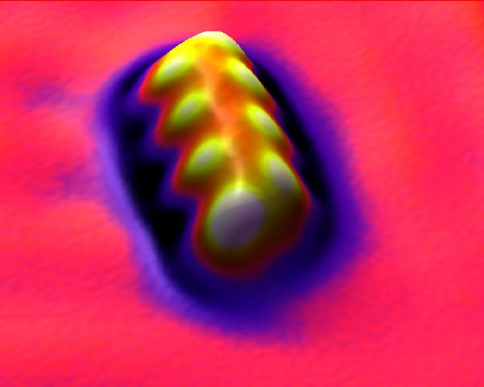
Title : Untitled
Media : Cesium & Iodine on Copper (111)
Here we see the artists' first use of color mapping. Color is assigned to the surface not only by lights but by local curvature of the surface. This helps to delineate the shape of the object (which, for the curious, is a molecule that they assembled from 8 cesium and 8 iodine atoms).
[Hopkinson, Lutz & Eigler]

Slide 17
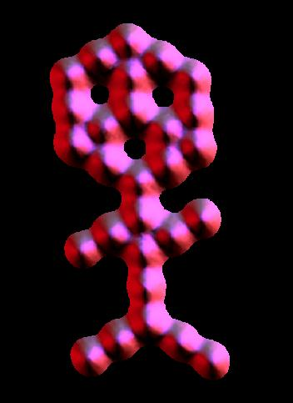
Title : Carbon Monoxide Man
Media : Carbon Monoxide on Platinum (111)

Slide 18
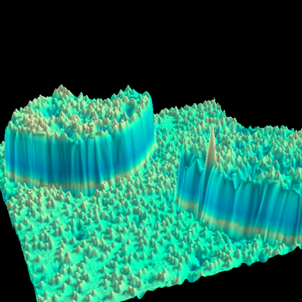
STM Image, 35 nm x 35 nm, of single substitutional Cr impurities (small bumps) in the Fe(001) surface.

Slide 19
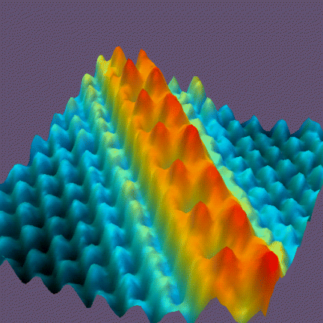
STM image 7 nm x 7 nm of a single zig-zag chain of Cs atoms (red) on the GaAs(110) surface (blue)

