Slide 1
Lasers - instrumentation
Vítězslav Otruba

Slide 2
Less common prefixes
prefix | symbol | exponent
atto | a | 10⁻¹⁸
femto | f | 10⁻¹⁵
piko | p | 10⁻¹²
nano | n | 10⁻⁹
giga | G | 10⁹
tera | T | 10¹²
peta | P | 10¹⁵
exa | E | 10¹⁸

Slide 3
Solid-state laser
Resonator
Active medium
Output radiation
Mirror
100 %
Mirror
8 - 90 %
Pumping
Cooling
Control unit
Power supply

Slide 4
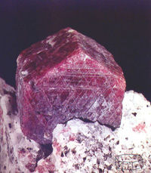
Ruby laser (Cr³⁺:Al₂O₃)
The first laser designed by T. Maiman in 1960.
Used in pulse mode, power in free running mode to 10J (1ms),
in Q-switched mode to 5J (1 – 10 ns)
three-level system

Slide 5
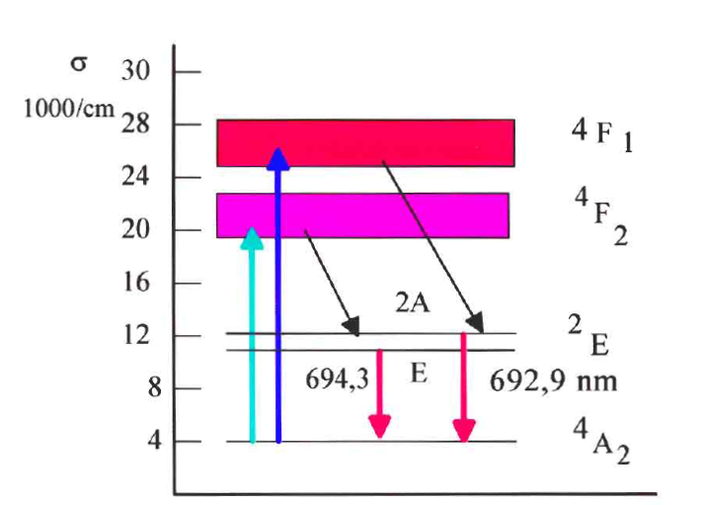
diagram of chromium energy levels in ruby laser

Slide 6
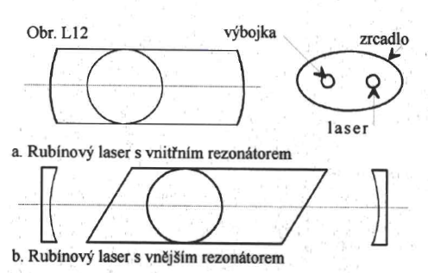
ruby laser
arrangement of ruby laser
discharge lamp
elliptical mirror
Ruby laser with internal resonator
Ruby laser with external resonator

Slide 7
Resonators
Fabry-Perot etalon
plan parallel
confocal
hemispherical
circular
roof

Slide 8
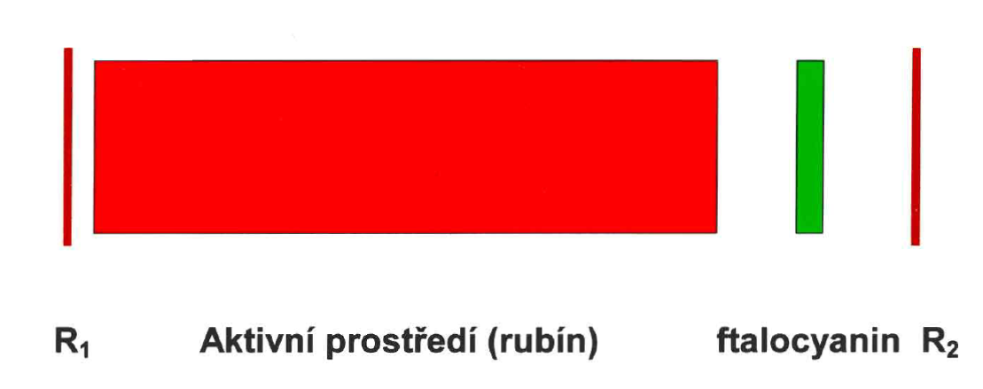
Passive Q-modulation
Example of use of saturation absorber for generation of short (nanosecond) power pulses (GW) in ruby laser
Active medium (ruby)

Slide 9
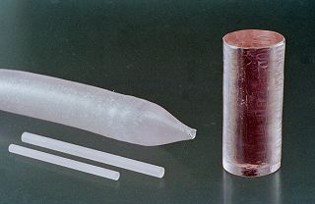
Neodymium laser
It is the most widespread solid state laser(cca 1% Nd v Y₃Al₅O₁₂) . It operates at 1,064 nm, in continuous mode power to 1 kW,
pulse to 10 J, repetition rate up to kHz. In Q-switched pulse mode 1 – 10 ns,
at synchronizing modes to 10 ps.

Slide 10
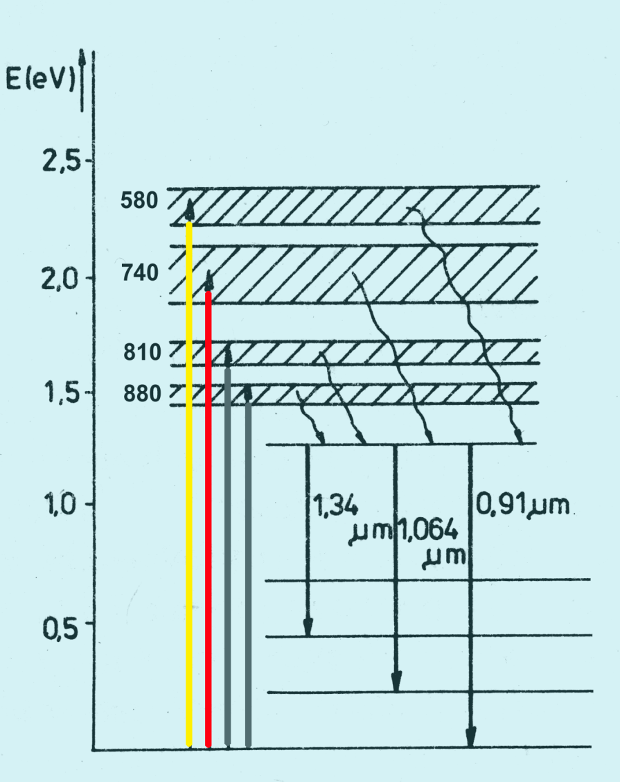
Neodymium energy level diagram of Nd in: YAG laser
Nd³⁺ in yttrium-aluminum garnet (Y₃Al₅O₁₂) replaces ions Y³⁺. Monocrystals are mechanically strong, thermally stable with minimal optical defects unlike neodymium glasses. Xenon lamps or laser or LED diodes are used for pumping.

Slide 11
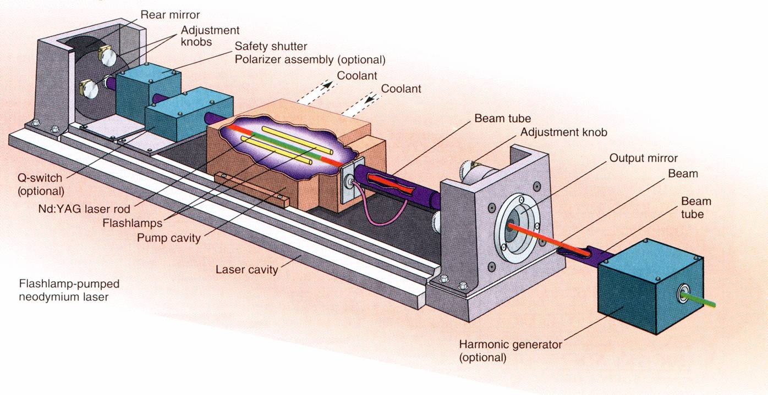
Neodymium laser

Slide 12
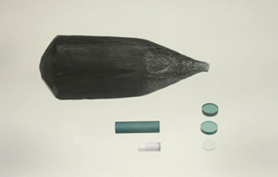
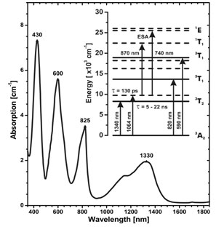
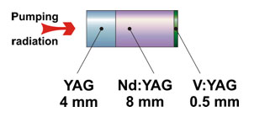
Passive Q-modulation V³+:YAG

Slide 13
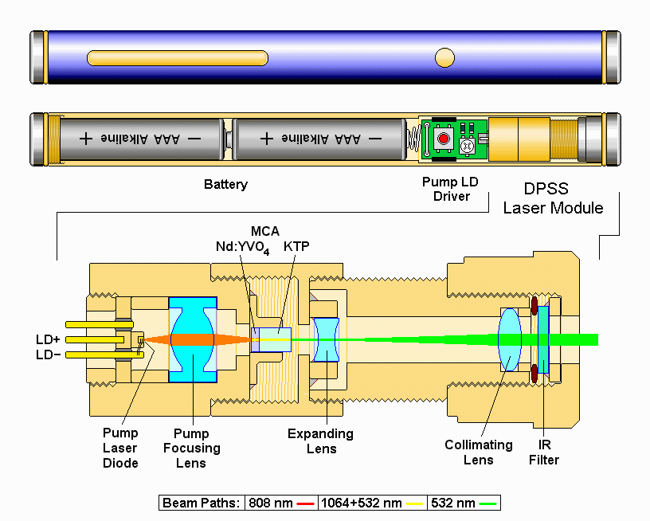
Green laser pointer

Slide 14
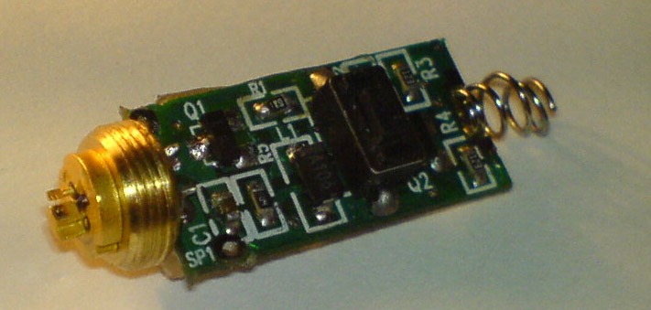
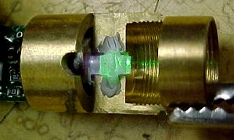
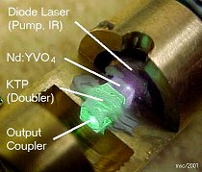
Green laser pointer

Slide 15
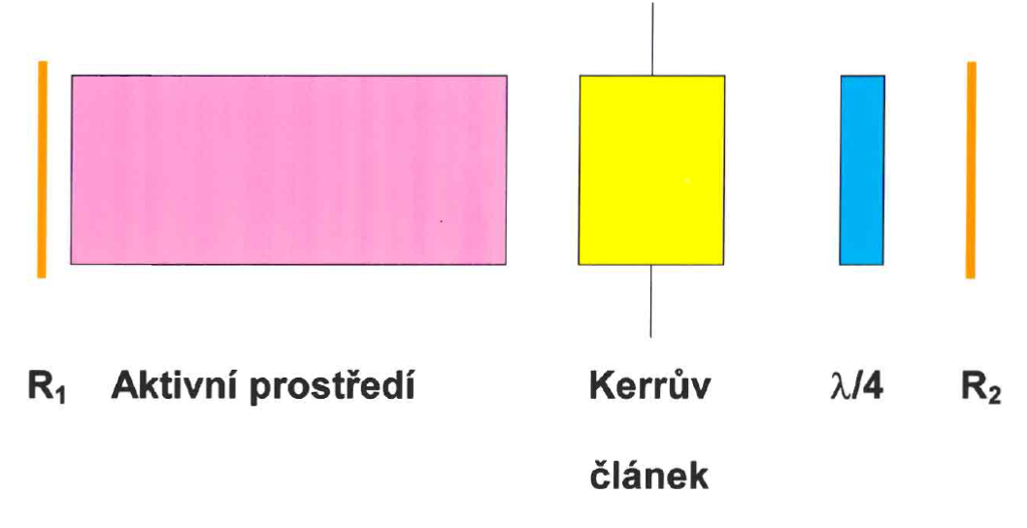
Active Q-modulation
In this case, the Q of resonator is modulated by optical shutters, such as a Kerr effect electro-optical modulator or an acoustooptical module.
Active medium
Pockels cell

Slide 16
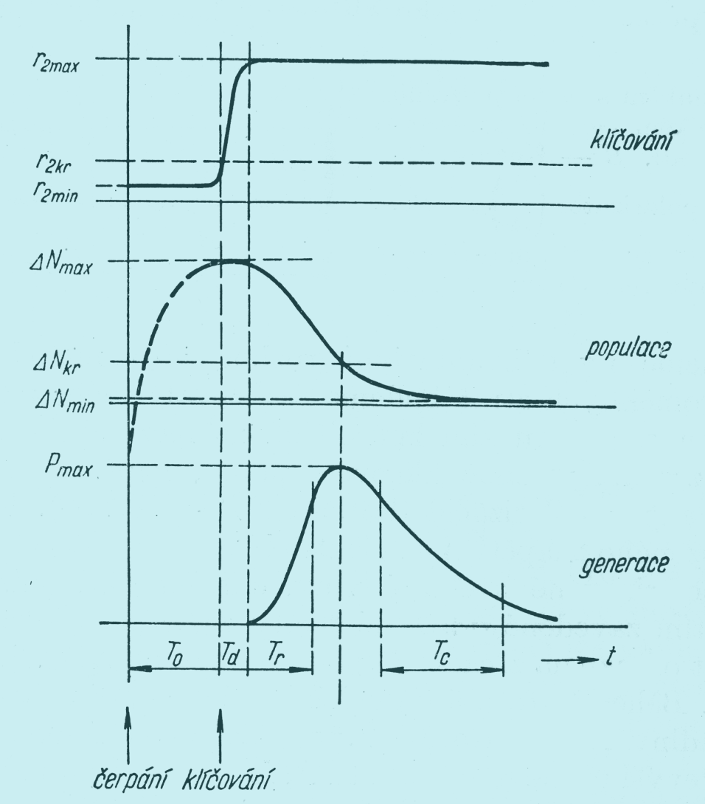
Timing of active Q-modulation
Typical timing for Nd:YAG laser:
Inverse population increase (T₀) 150µs
Trigger pulse (T_{D}) 1 ns
Generation of radiation 10ns

Slide 17
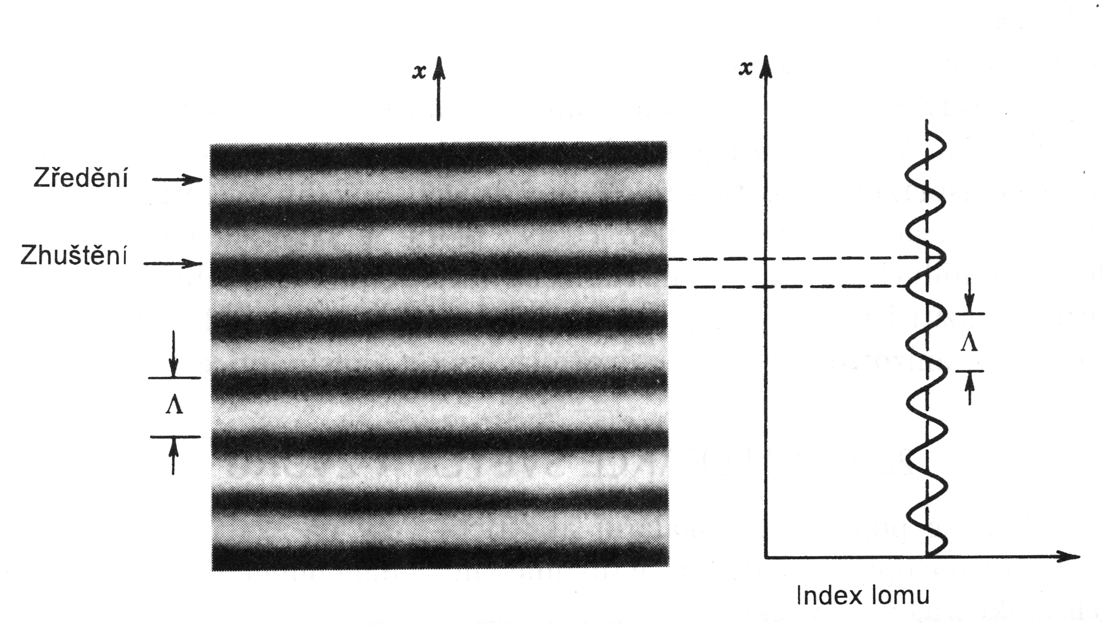
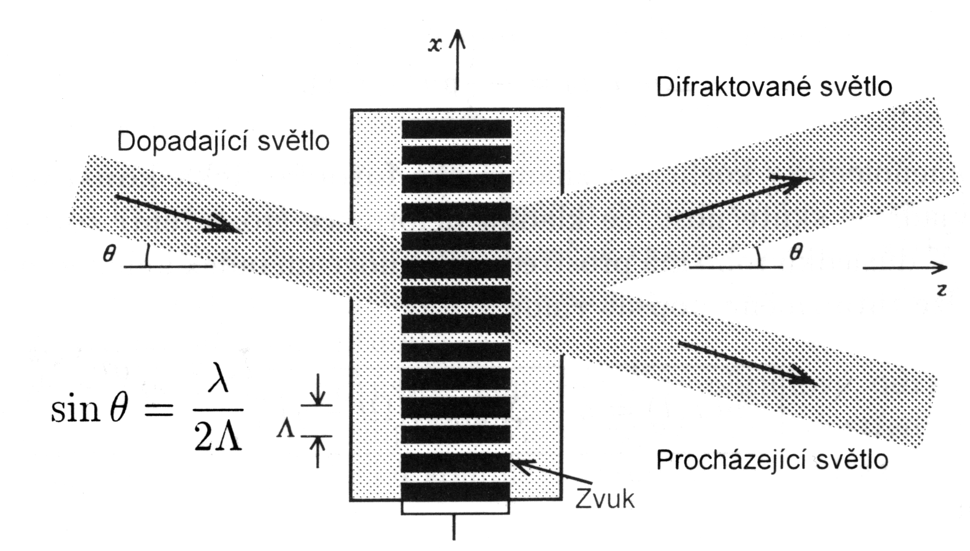
Optoacoustic modulator
If the sound propagates through the optical environment, the density and thus the refractive index change.
The simplest is the Bragg diffraction: the acoustic plane wave causes a partial reflection of the radiation if the angle Θ satisfies the Bragg condition (Bragg cell)

Slide 18
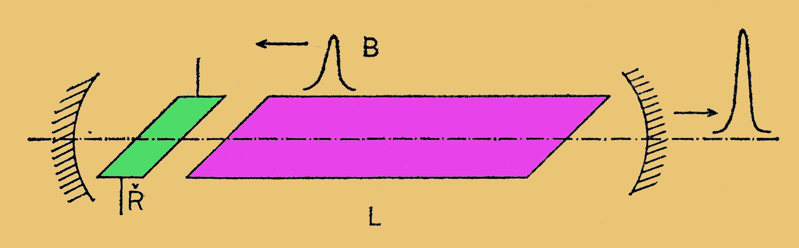
Mode-locking
Passive or active modulation of the resonator with frequencies f = c / 2L gives a sequence of very short pulses, the length of which is determined by the Fourier transform of the spectral line and the repetition rate by the time the photon cloud travels back and forth.

Slide 19
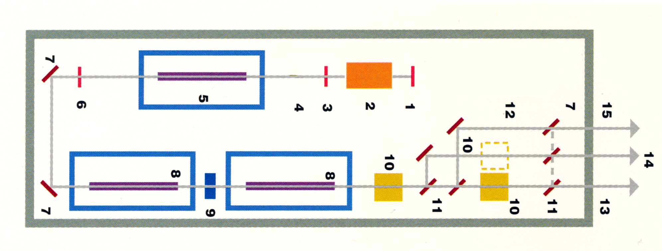
Nd:YAG laser
Laser with Q-modulation (1-6), two-stage amplifier (8), birefringence compensator (9) and harmonic frequency generators (10), output 1064 nm (13), 532/355 nm (14), 266/1064 nm residual ( 15)

Slide 20

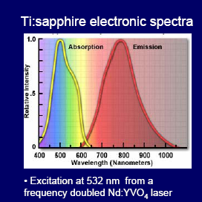
Titanium Doped Sapphire Al₂O₃:Ti³⁺

Slide 21
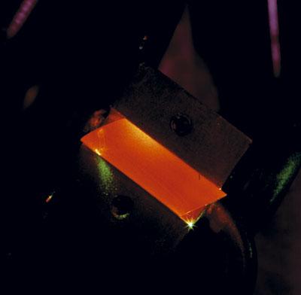
Titanium Doped Sapphire Al₂O₃:Ti³⁺
Ti₂O₃ concentration 0.06-0.5 wt%
Hardness 9 Mohs
Thermal conductivity 0.11 cal/(°C x sec x cm)
Optical Properties
Laser action 4-Level Vibronic
Fluorescence lifetime 3.2 µsec (T = 300 K)
Tuning range 660-1050 nm
Absorption range 400-600 nm
Emission peak 795 nm
Absorption peak 488 nm
Refractive index 1.76 @ 800 nm

Slide 22
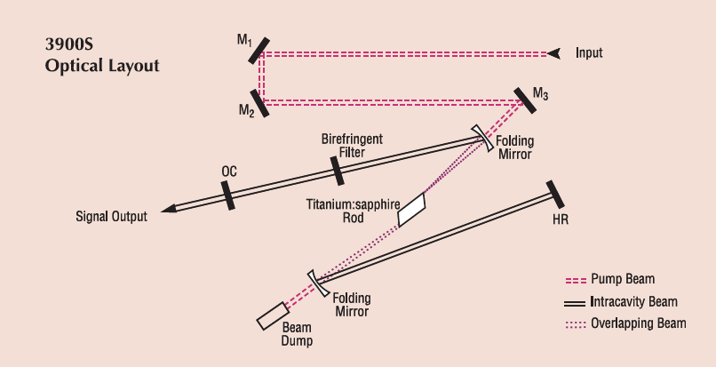
Titanium Sapphire Laser

Slide 23
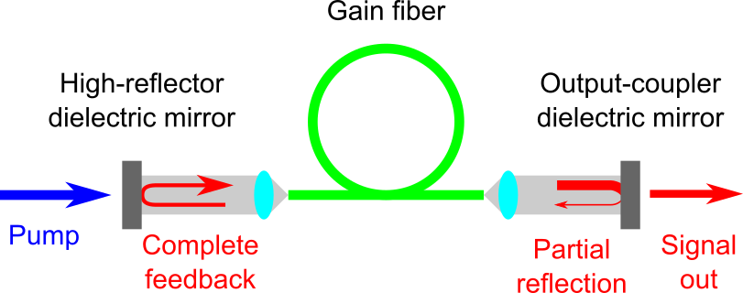
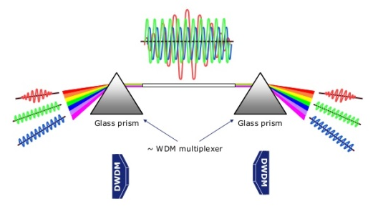
Fiber lasers
Arrangement with Linear Fabry Perot Resonator
WDM (Wavelength Division Multiplex)

Slide 24
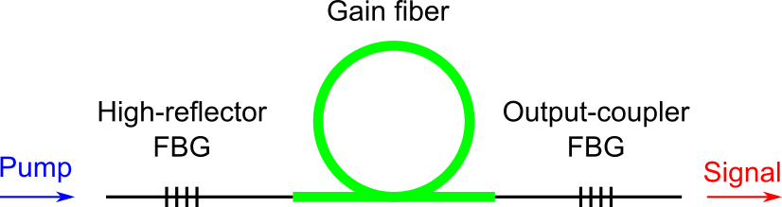
Fiber lasers
FBG – Fiber Bragg Grating

Slide 25
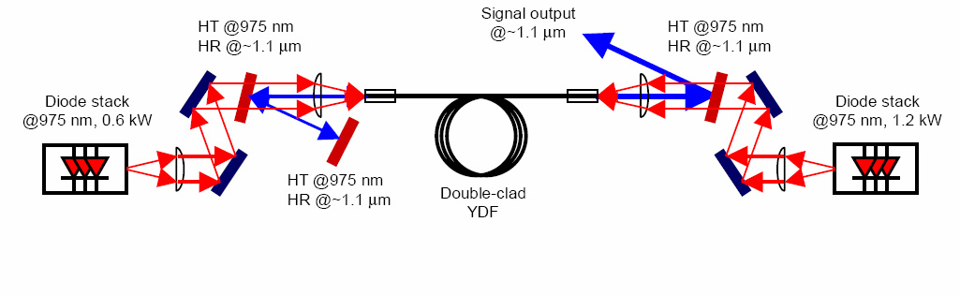
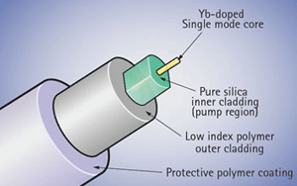
Ytterbium doped fiber laser

Slide 26
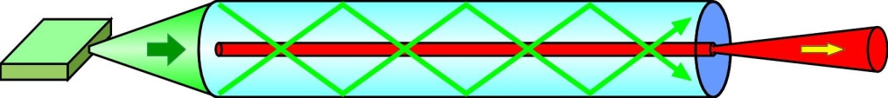
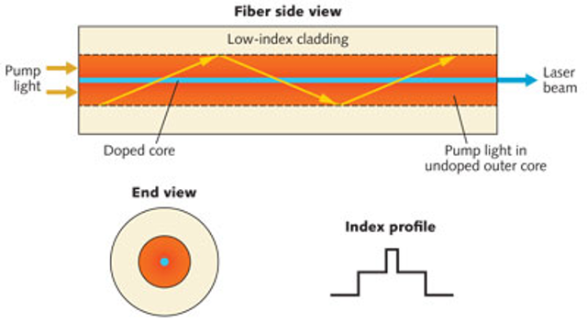
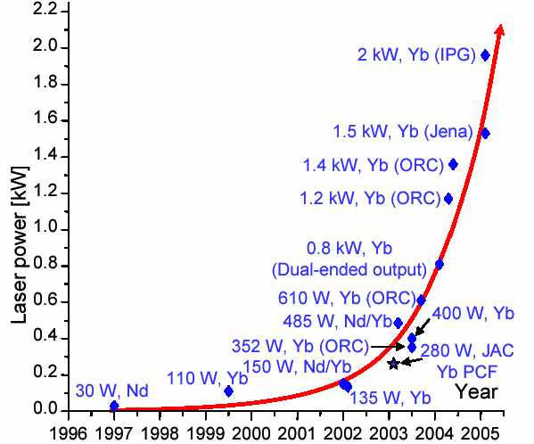
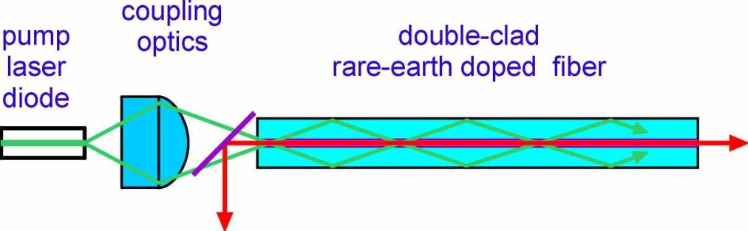
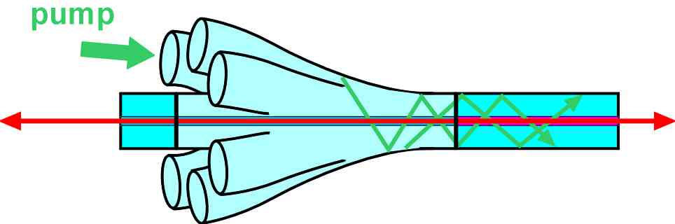
Optical excitation systems

Slide 27
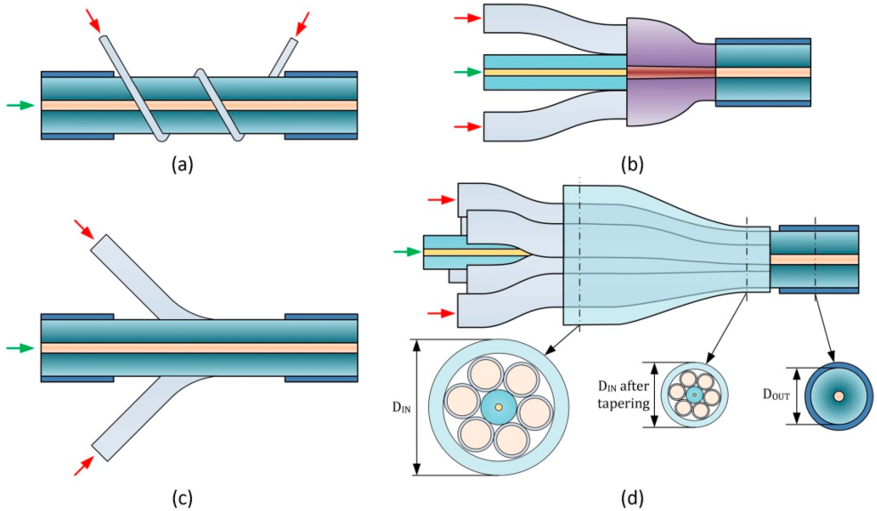
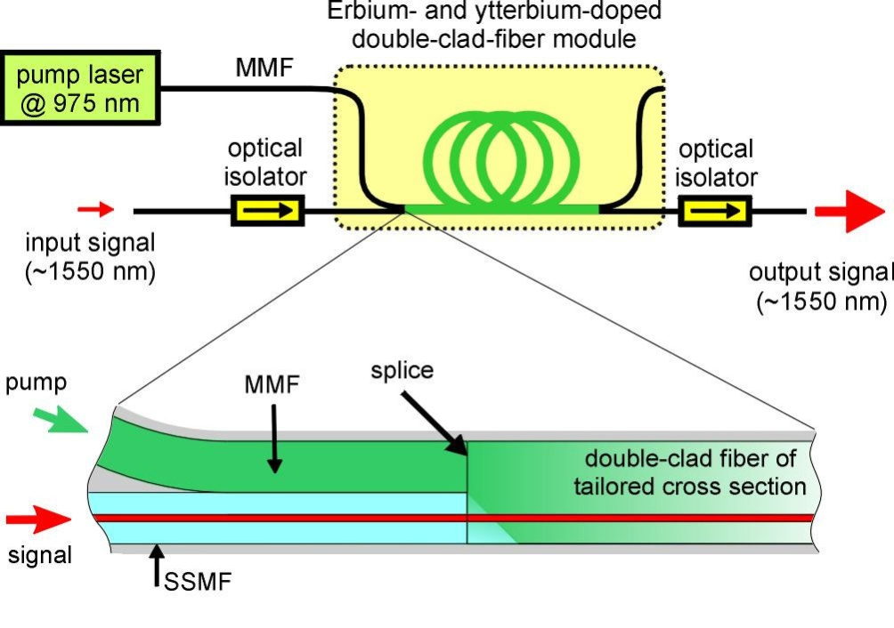
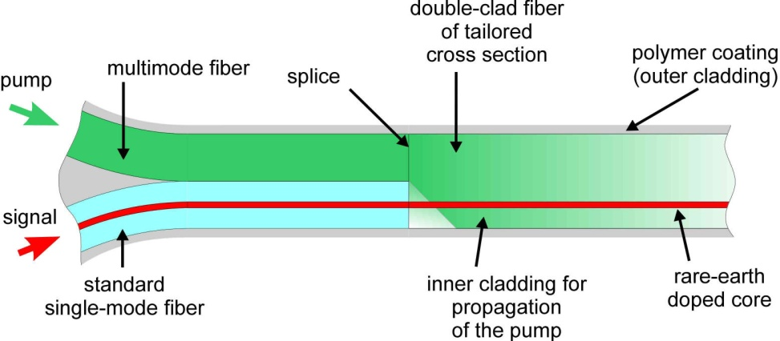
Fiber laser amplifiers

Slide 28
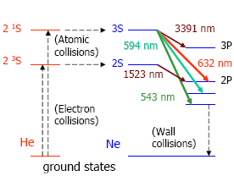
Gas laser He-Ne
Invented in 1960 as IR laser; red line used first in 1962
Electric discharge in gas excites He to 2S levels
Nearly parallel Ne levels exist
Atomic collisions transfer excitation

Slide 29
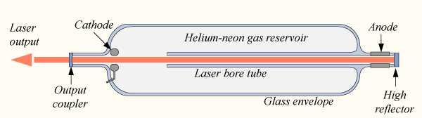
Gas laser He-Ne
Cheap and easy to manufacture – first lasers under $100
Gas tube has 85% He, 15% Ne

Slide 30
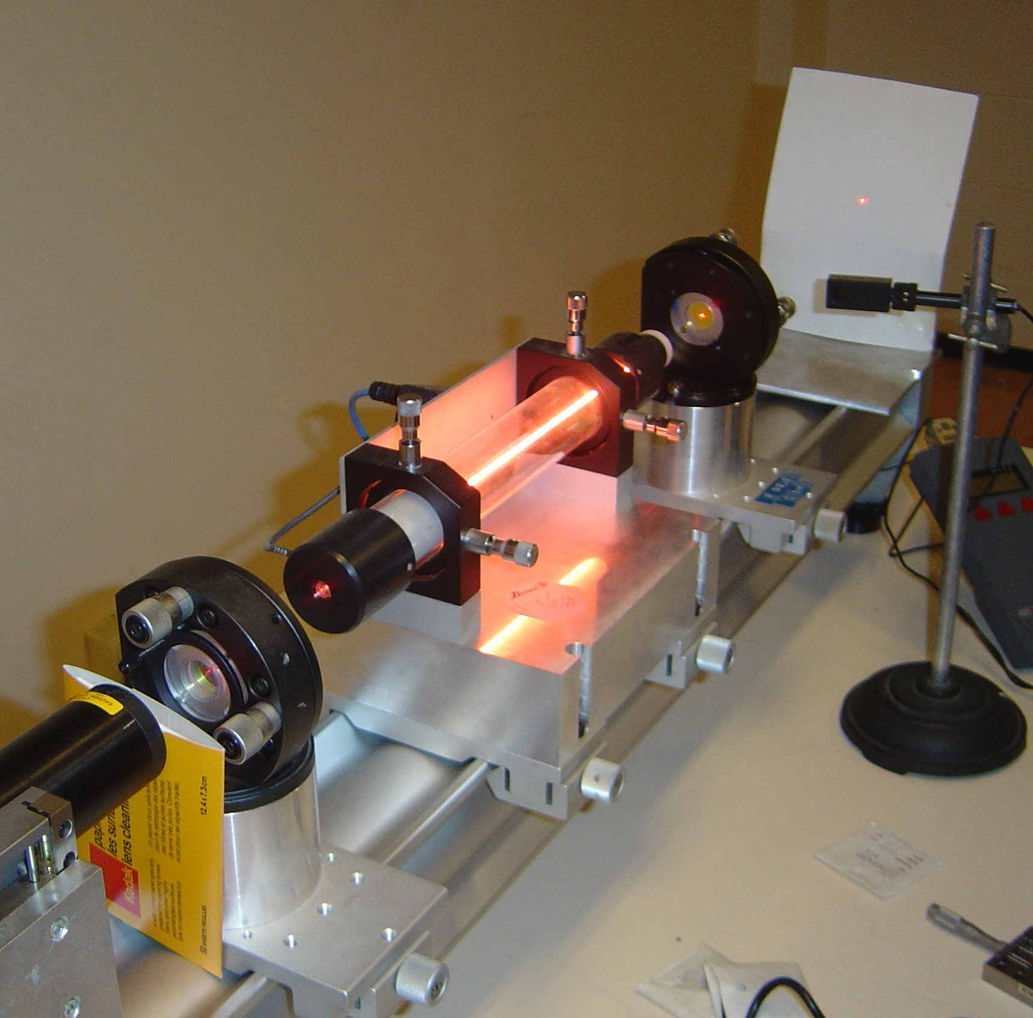
He-Ne laser

Slide 31
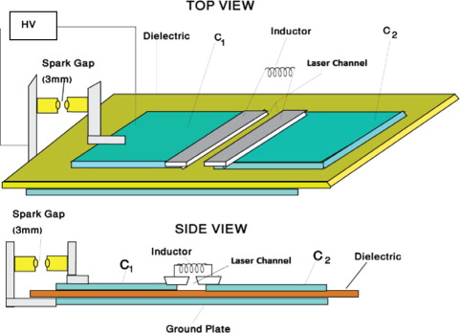
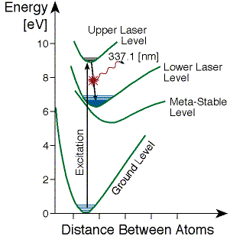
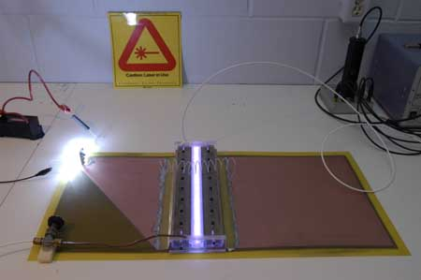
Nitrogen laser

Slide 32
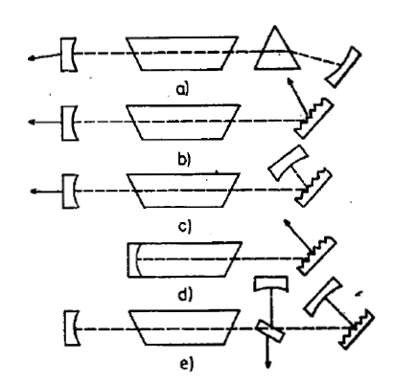
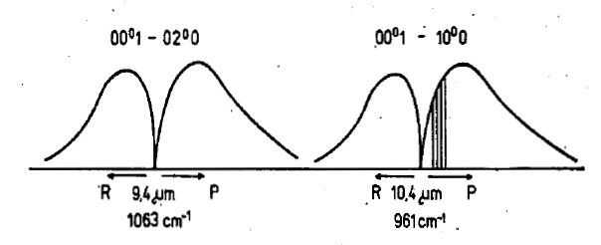
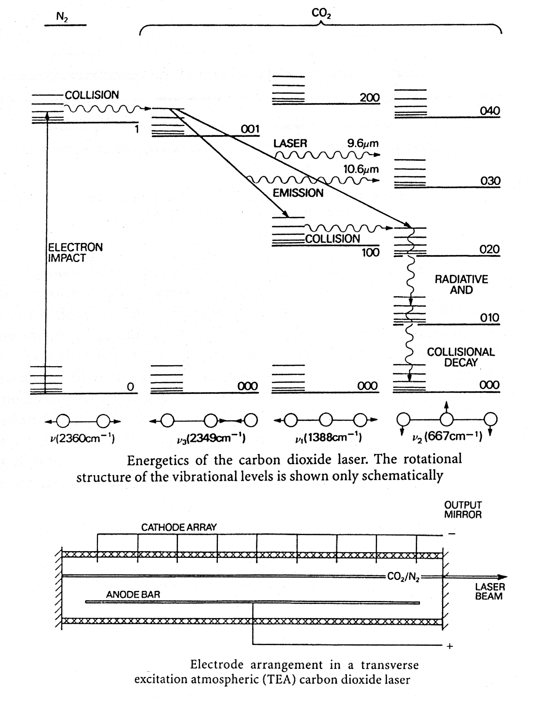
CO₂ laser
Waveform intensity of CO2 laser lines
Selection of wavelengths and beam binding

Slide 33
Energetics diagram of CO₂ laser

Slide 34
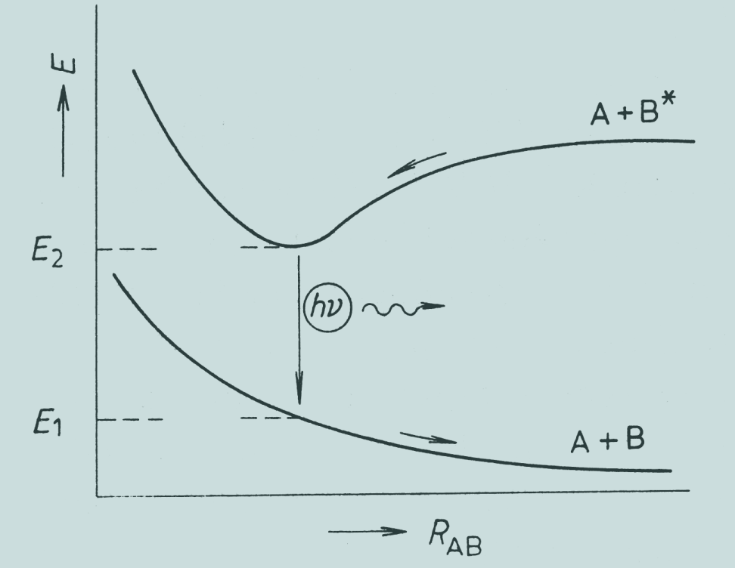
Excimer
Excimer - an unstable molecule formed for a limited time due to the action of an excited atom (molecule) with an atom (molecule) in its base ground state.
Dissociation occurs within 10⁻¹⁴s after excimer transition to base ground state (photon emission).
Dependence of the potential energy E of an excimer-forming system of atoms (molecules) A, B on their R_{AB} distance

Slide 35
KrF exciplex laser
Exciplex - excited complex
Excimer - excited dimer
Realization : 1970 Basov, Xe₂* excited electrons

Slide 36
Excimer laser
exhaust gases to the vacuum pump
power supply and switching electronics (shielded)
rear mirror and energy meter
output optics
halogen filter
cooling water
laser beam
gas tank
heat exchanger
cylindrical fan
gas control module
gas inputs
gas inlets (Kr,F,Ne)

Slide 37
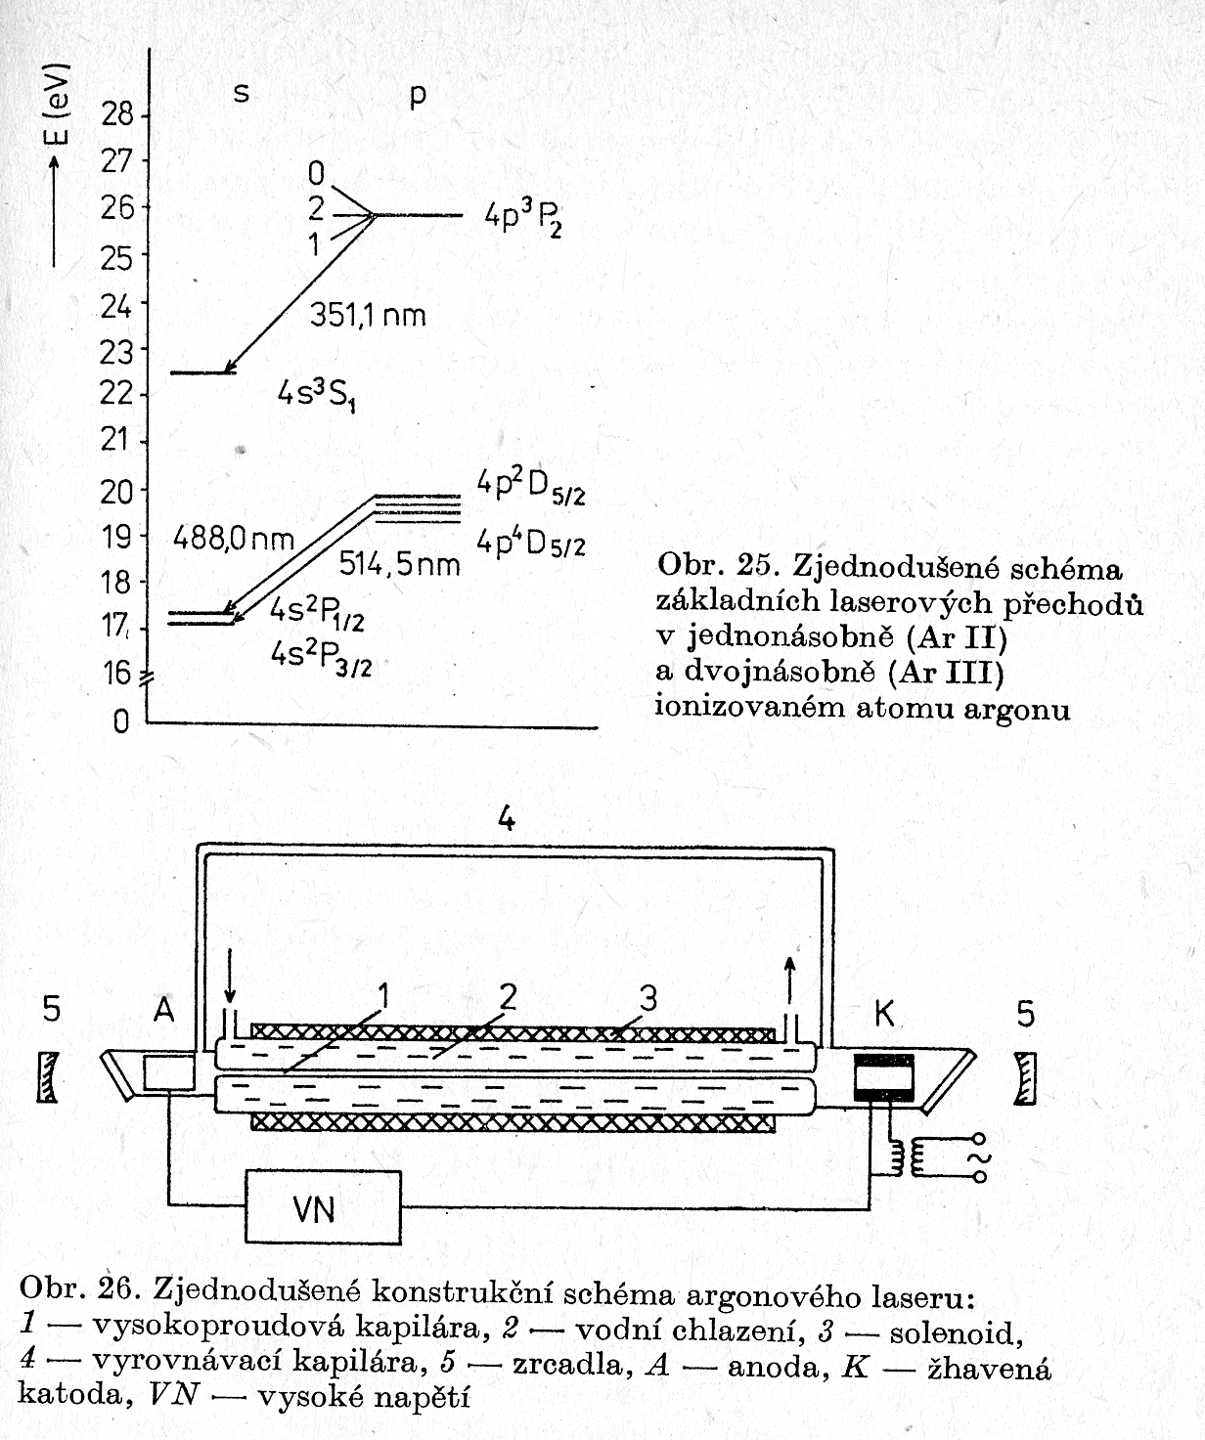
Argon ion laser
Argon laser scheme:
1-high current capillary
2-water cooling
3-solenoid
4-level capillary
5-mirrors
A-anode, K-hot cathode,
VN - high voltage
Scheme of transitions ArII and ArIII
ions

Slide 38
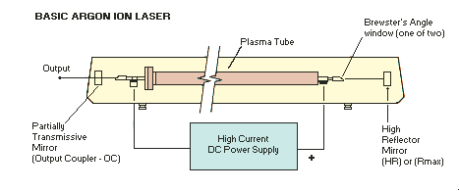
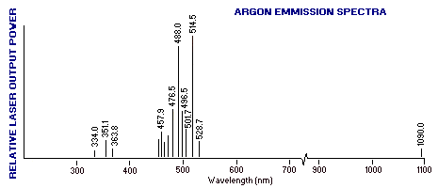
Argon ion laser

Slide 39
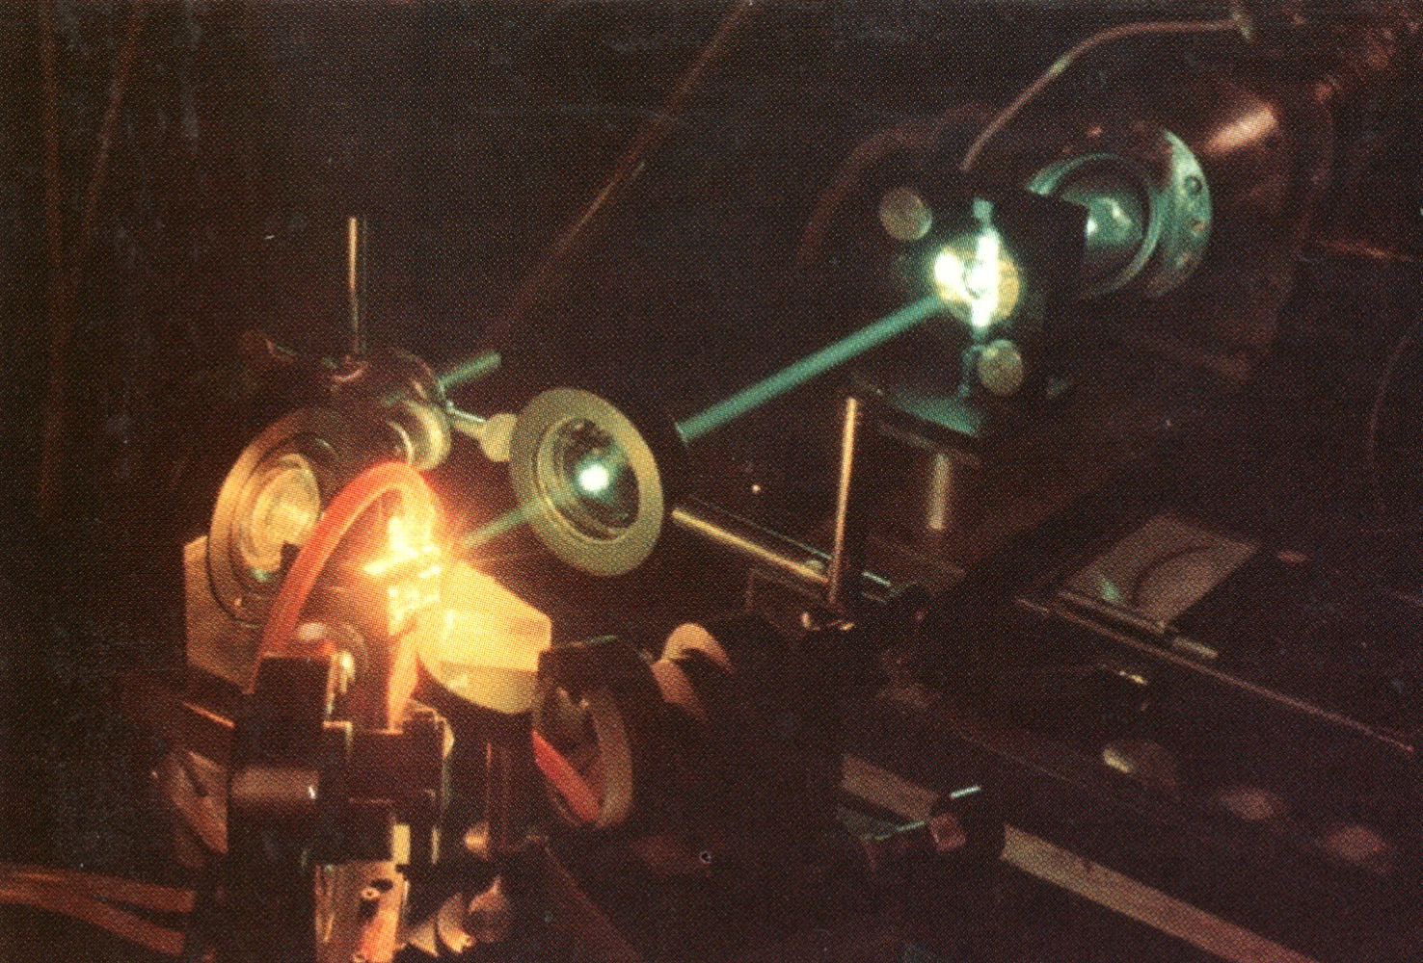
Dye lasers
Dye lasers are an ideal four-level system, and a given dye will laser over a range of ~100 nm.
Notes:
Duarte and Piper, Appl. Opt. 23, 1391 1984

Slide 40
A dye’s energy levels
The lower laser level can be almost any level in the S₀ manifold.
S₁: 1st excited
electronic state manifold
Pump Transition
Laser Transitions
S₀: Ground
electronic state manifold
Dyes are so ideal that it’s often difficult to stop them from lasing in all directions!

Slide 41
Dye lasers
They are characterized by high spectral bandwidth gain (10 -100 nm) and it follows:
Possibility of continuous change of the wavelength of the laser radiation in the range of sufficient gain bandwidth
Possibility to generate short pulses, up to 1 ps

Slide 42
Generalized Jablonski diagram of energy levels and dye transitions
singlet excited states
internal conversions
intersystem transition
triplet excited states
absorption
fluorescence
phosphorescence
singlet ground state

Slide 43

Dye energy system
Excitation by absorption of radiation by transition from ground to first singlet state
Fluorescent transition to the ground state (population inversion possible)
Non-radiative transition from S1 to metastable triplet T1 state (parasitic process)
Absorption of fluorescent radiation by T1-T2 (T3) transition - quenches the fluorescence, decreases the gain of the active medium

Slide 44
Dye laser - principle

Slide 45

Wood birefringent filters
Wood birefringent filter consists of two polarizers and a crystalline quartz plate cutted parallel with crystal axis. The thickness of the plate depends on wavelengths we want to separate. For already given example of Sodium doublet it gives the thickness of approximatelly 31.8 mm (depends also on operated temperature). These types of filters are very exact optical devices and it is necessary to hold very exact manufacture thickness tolerances.

Slide 46


Lyot birefringent filters
This filter is in fact constructed from several Wood filters serially lined up. The thickness 'd' of the first plate is such that transmits requested wavelength and provides requested performance of the filter. Each next birefringent plate has a double width of the previous one. That provides two facts; firstly, the requested wavelength is transmitted and secondly, the unwanted transmitted wavelengths of a previous birefringent plate are filtered out. Such a cascade of birefringent plates sandwiched between polarizers provides high performance filter with a half-width in order of 1/100 nanometers

Slide 47
Dye laser
Mirror (tuning)
Grating
Beam expander
cuvette with dye
Resonator mirror
Pumping (by laser)

Slide 48
Picosecond laser
Δλ= 570 – 1000 nm
Τ_{ip} ≈ 200 ps
τ_{id} ≈ 0,8 - 50 ps
f = 50 – 150 MHz

Slide 49
Mode-locked dye laser

Slide 50
Types of dyes for lasers
Rozsah emise(nm) | Strukturní typ
340 - 430 | stilbenes
360 - 480 | oxazoles
410 - 440 | anthracenes
440 - 520 | acridines
460 - 540 | coumarins
510 - 700 | xanthenes
540 - 1200 | cyanines
630 – 720 | oxazines
Emission range (nm)
Structural type

Slide 51

Experimental laser workplace

Slide 52

Prague Asterix Laser System
The backbone of the PALS Research Center is the giant iodine laser system. In its current configuration and at a base wavelength of 1315 nm, it is capable of providing pulses of up to 1 kJ in the main laser beam, in addition to 100 J in two smaller additional beams. The wavelength of the laser beams can be converted to a wavelength corresponding to a second (658 nm, red) or a third (438 nm, blue) harmonic base frequency. Due to the very short laser pulse length (approx. 350 ps), the peak laser pulse power is enormous - up to 3 TW, i.e. 3 million megawatts. The laser is able to deliver such a giant pulse about once every half hour. The PALS output beam is high quality: spatially homogeneous, and stable. Its energy practically does not change from shot to shot.

Slide 53


Asterix iodine laser
Asterix IV is a gas laser in which iodine atoms are used to generate near-infrared radiation at a wavelength of 1,315 μm. The iodine atom is obtained from the parent molecule of the alkyl iodide C3F7I by photodissociation. The atom is released from the chemical bond by means of pulsed UV radiation delivered by the lamps. The electron envelope of iodine emerging from the photodissociation reaction is excited, thereby automatically forming a population inversion with respect to the underlying state. This creates the conditions for the laser action.

Slide 54


The overall arrangement PALS
PALS is a single-beam laser system, consisting of an oscillator section generating an initial low light pulse and a string of five laser amplifiers that gradually amplify the pulse. Such an arrangement scheme is called "master oscillator - power amplifiers" (MOPA), or control oscillator - power amplifiers. The size of the amplifiers increases from one amplification stage to the next, so that the diameter of the amplified laser beam gradually increases, from the initial 8 mm to the final 290 mm. In this way, the power density of the laser beam is maintained at a value at which the surface of the individual optical elements cannot yet be damaged by excessive light load.

Slide 55


Optical amplifier
The Asterix IV / PALS laser chain includes a total of five power amplifiers. Their task is to amplify pulses coming from the oscillator to energy up to one kilojoule. The size of each amplifier gradually increases towards the end of the string - the final fifth amplifier is over 13 m long (see picture) and provides a laser beam with a diameter of 29 cm. In the split of second before the actual laser shot, the amplifiers are "activated" by discharging large capacitor batteries into the lamps surrounding the amplifier cells containing the gaseous working environment. The intense pulse of incoherent ultraviolet radiation produced by the lamps gives rise to a large number of excited iodine atoms in the cuvettes, which are "ready" to deliver their excess energy to the laser pulse coming from the oscillator.

Slide 56

Laser diodes
For small currents, LED radiation is spontaneous and is a linear function of the excitation current. Upon reaching the threshold current, the power of the stimulated radiation increases sharply and coherent radiation is again emitted from the resonator mirrors, again linearly dependent on the magnitude of the excitation current. At the same time, there is a qualitative change in the shape of the radiation characteristic of the laser diode, expressed by decreasing the angle of radiation in a plane perpendicular and parallel to the plane of the PN transition, as well as reducing the bandwidth of the emitted radiation.
COHERENT RADIATION
LASER
stimulated emission dominated
radiation power
NON -COHERENT RADIATION
LASER
spontaneous emission dominated

Slide 57

Spectrum of LEDs and laser diodes

Slide 58

Heterostructure lasers
In these types of laser with hetero-transitions, the delimitation of the waveguide is determined by a sharp change of the refractive index in the region of hetero-transition. Along with efficient light guidance, heterostructure provides conditions for effective concentration of minority carriers. The effect of hetero-transition concentrates radiation and injection carriers in selected areas.

Slide 59

Distributed Feed Back Lasers
In this type of laser, the resonator is realized without mirrors using spatial periodic structures (diffraction gratings). The function is based on periodic change of refractive index in the direction of propagation. The feedback is created by the continuous binding of the propagating wave in the opposite direction by Bragg scattering. The grid is formed by etching directly on the surface of the active layer.
These lasers are referred as DFB
metal contact
active layer
metal contact

Slide 60


Distributed Bragg Reflector Lasers
Optical radiation generation and feedback (again using an optical gratings) take place in separate parts of the structure. Two types of construction are used, with one or two Bragg mirrors. In common practice, the type with two Bragg mirrors at the ends of the waveguide is more often used
metal contact
active layer
metal contact
metal contact
active layer
metal contact

Slide 61


Spectrum of laser diodes
laser diode
wavelength (nm)

Slide 62

Edge-emitting lasers
This type (Edge Emiting Lasers - EEL) emits radiation from the edge transition. Manufacturing and applications of laser diodes currently prevails
Edge Emiting

Slide 63

Surface-emitting lasers
VCSEL (Vertical Cavity Surface Emiting Lasers) emit radiation from the part surface parallel to the transition plane. Radiation emitted from the surface is absorbed by the substrate and lost or, more preferably, is reflected from the metal contact

Slide 64

Frequency conversion
The first option is to use nonlinear phenomena of the second (third) order. The intensity of the second harmonic radiation is proportional to the square of the coefficient of optical non-linearity and the intensity of the incident wave, inversely proportional to the square of the wavelength.
DC component
second harmonic

Slide 65
Nonlinear optics - crystals
crystal | Δλ (μm) | MW/cm²
KDP (potassium dihydrogen phosphate) | 0,2-1,35 | 400
KDDP (deuterated KDP) | 0,2-1,8 | 500
ADP (ammonium dihydrogen phosphate) | 0,2-1,2 | 500
RDP (rubidium dihydrogen phosphate) | 0,2-1,5 | 300
CDA (cesium dihydrogenrsenate) | 0,26-1,6 | 500
LiIO₃ | 0,3-4,5 | 60
LiNbO₃ | 0,4-4,5 | 120
Ba₂NaNb₅O₁₅ | 0,38-5 | 100
HIO₃ | 0,4-1,3 | 100
BBO (β-BaB₂O₄) | 0,2-1,5 | 400

Slide 66



Frequency conversion
The blue arrow corresponds to ordinary (linear) susceptibility, the green arrow corresponds to second-harmonic generation, and the red arrow corresponds to optical rectification.

Slide 67


Optical Parametric Oscillator (OPO)
Based on a coherent decay photon of angular frequency ω₃ two photons whose angular frequencies ω₁ and ω₂ (signal wave and idler wave), whereby the following applies:
ω₃ = ω₁+ ω₂
and ratio
ω₁/ ω₂ =f(υ)
optical axis of the crystal

Slide 68

OPO Spectra Physics

Slide 69
Laser beam homogenization

Slide 70
Free electron laser FEL
The active environment is relativistic electrons passing through the periodic magnetic field. Electrons emit electromagnetic radiation as they move along curved orbits with wavelength:
(γ<< λ₀, γ is the so-called relativistic factor):
coherent radiation
free electron beam
undulator

Slide 71
Spectral brilliance
For characterization of high-intensity sources (mainly synchrotron) radiation, the term spectral brilliance is introduced, indicates the number of radiated photons per second per 1 mm² of the radiation source area, at 1 mrad² divergence and at 10% of the wavelength range (Δλ / λ = 0.1).
The narrower and more parallel the beam is and the more the photons are concentrated in the narrowest wavelength range, the higher the spectral brilliance.
This is inversely related to emittance, which is essentially the product of the dimension of the radiation source and the radiation divergence.

Slide 72



Synchrotron radiation
Sources of magnetic field
bending magnets
undulator
wigglers
Free electron lasers

Slide 73
Free Electron Laser
The fourth generation of SZ sources is based on the use of linear accelerators, which allow to reduce emittance and shorten the pulse length. If a short electron burst runs through a sufficiently long undulator, then the electromagnetic wave generated at each location of the undulator proceeds together with the electron beam and interacts with it and results free electron laser – FEL. It is characterized by high brilliance, significantly higher than that of a classic undulator, coherence and shortness of pulses reaching tens of fs. A very long linear accelerator is required to accelerate electrons to GeV values.

Slide 74


Free Electron Laser
Electron clusters move along a wavy orbit. Charged particles that change their speed (direction enough) emit. For understanding, let's imagine that electrons in a cluster move along a sinusoid along an undulator. If we look at them from the end of this axis, we do not see that they are moving towards us, but we see oscillate cloud of charged particles. The clusters thus generate a coherent X-ray beam. Behind the undullator, the electrons are diverted by a strong magnetic field and the resulting X-ray laser beam continues into the experiment hall

Slide 75


Femtoseconds
Concorde supersonic flies at approximately 2 Mach (twice the speed of sound in air), or 600 m / sec (2160 km / h). Over a period of 10 fs fly only 6 picometres (6.10⁻¹² m), it is 10 times less than the diameter of the carbon atom.
Average Earth – Moon distance is around 380,000 km. Light moving at 300,000 km per second will travel this distance in a little more than 1 second...
Within 100 fs however light passes only 30 µm, i.e. less than the thickness of the hair.

Slide 76

Chirp
Uncertainty relations make it impossible to have a short (~ fs) light pulse in the visible region of the spectrum that is monochromatic
In the case of pulses of optical radiation, a Chirp means a gradual change of frequency during the pulse (increase or decrease). This means that the frequency on the leading edge is different from the closing edge. If such a pulse propagates in a dispersion medium, the rate of propagation of the radiation in the leading edge is less (or greater) than in the closing portion, thereby shortening (or prolonging) the pulse.

Slide 77

Chirp of femtosecond pulse
In a dispersed environment, the femtosecond pulse, which has a large frequency range (large wavelength range), is extended by the different dispersion (refractive index, light velocity) of different wavelengths. It is therefore necessary to make a correction with the dispersion compensator to maintain the pulse time profile.

Slide 78

Model TISSA-20: < 20 fs
Stable Kerr-lens mode-locking operation5-mirror compact cavity design.
Model TISSA-20: Seeding source of broadband femtosecond pulses for Ti:sapphire amplifiers

Slide 79


Stretcher and compressor design
With gratings compressor
With gratings stretcher

Slide 80

Stretcher and compressor design

Slide 81

Amplification of femtosecond pulses with power PW

