Slide 1

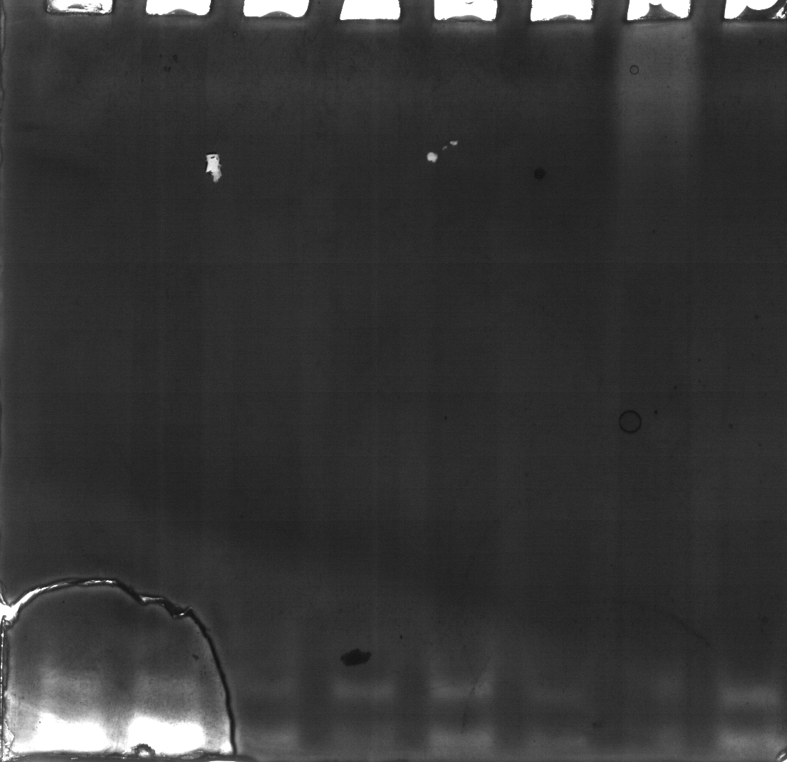
Negative
TD AAA 8 4B DSF 6F 1A 5
Isoformy APX
Positive
TD AAA 8 4B DSF 6F 1A 5
Isoformy APX

