Slide 1
C7270
Biological X-Ray Crystallography and
Cryo-Electron Microscopy
Fall 2022
Pavel Plevka, Tibor Füzik, Jiří Nováček, Holger Stark,

Slide 2
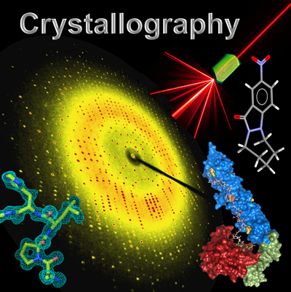
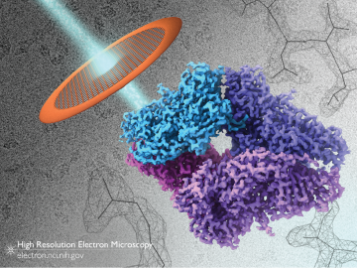
cryo-EM

Slide 3
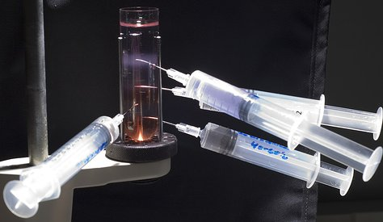
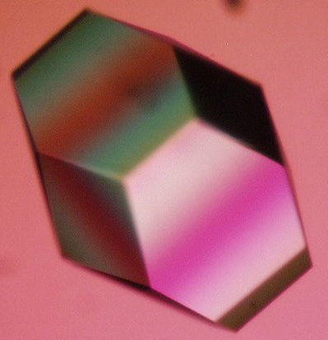
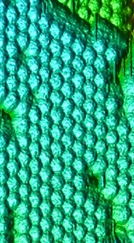
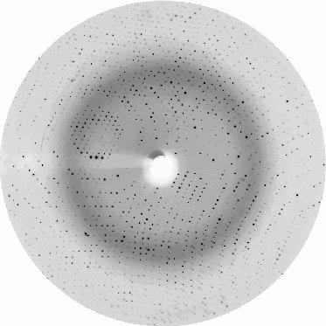
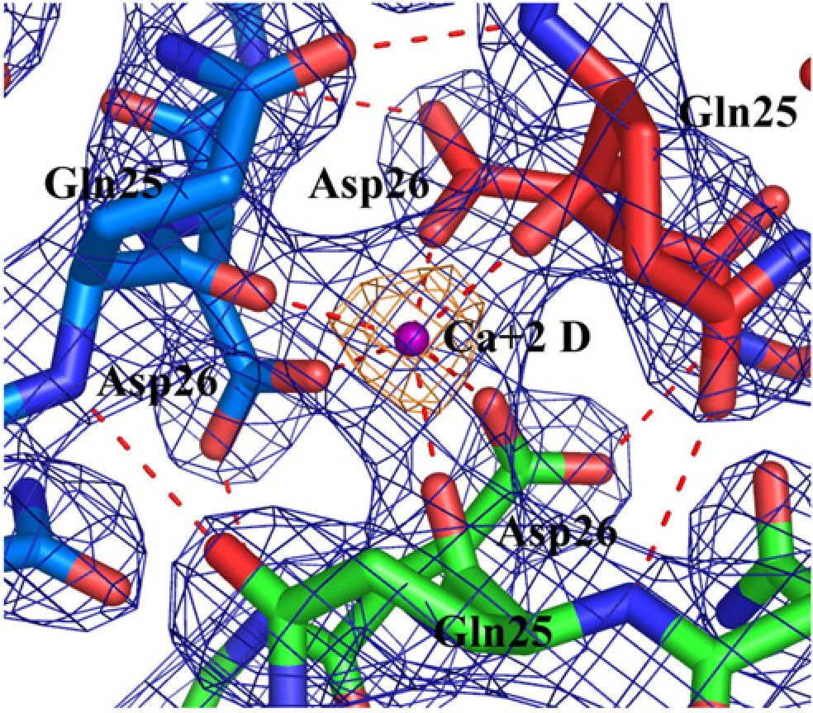
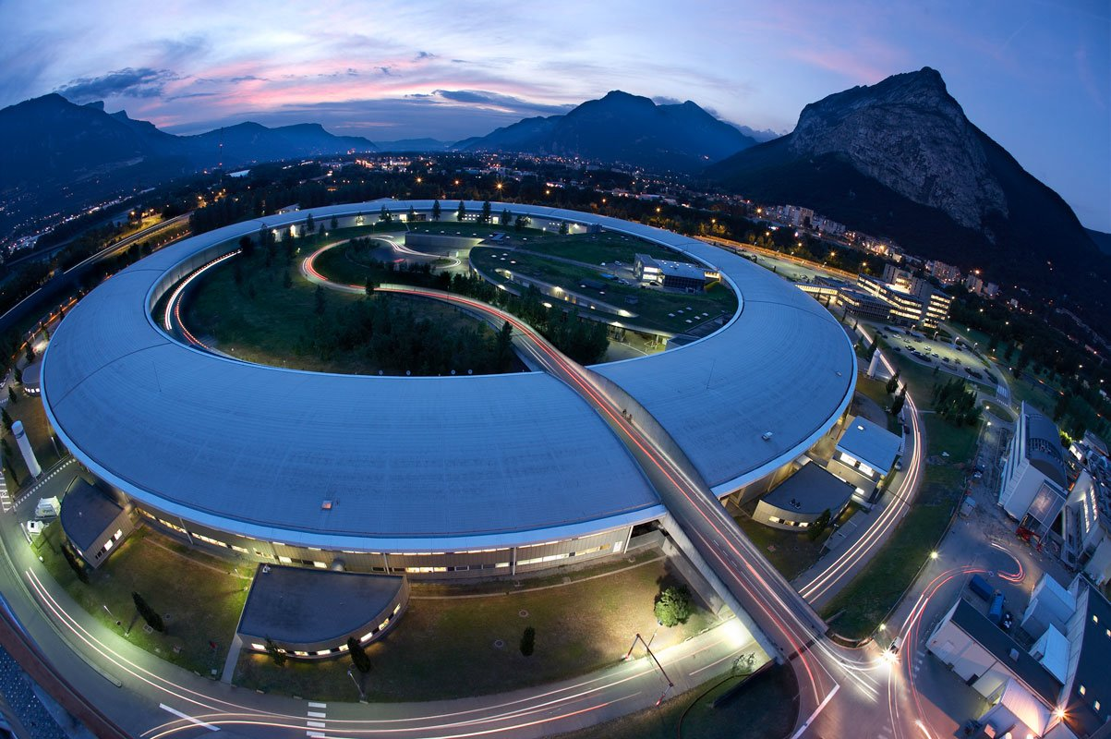
1. Expression & purification
2. Crystallization
3. Diffraction data
4. Solve structure

Slide 4
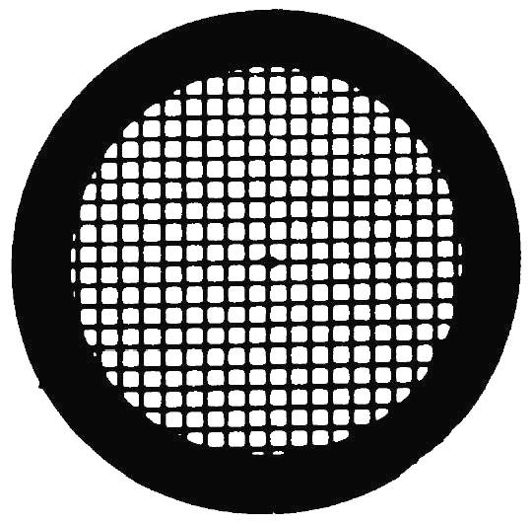
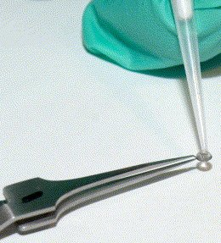
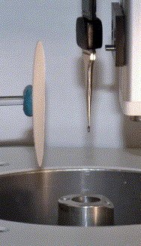
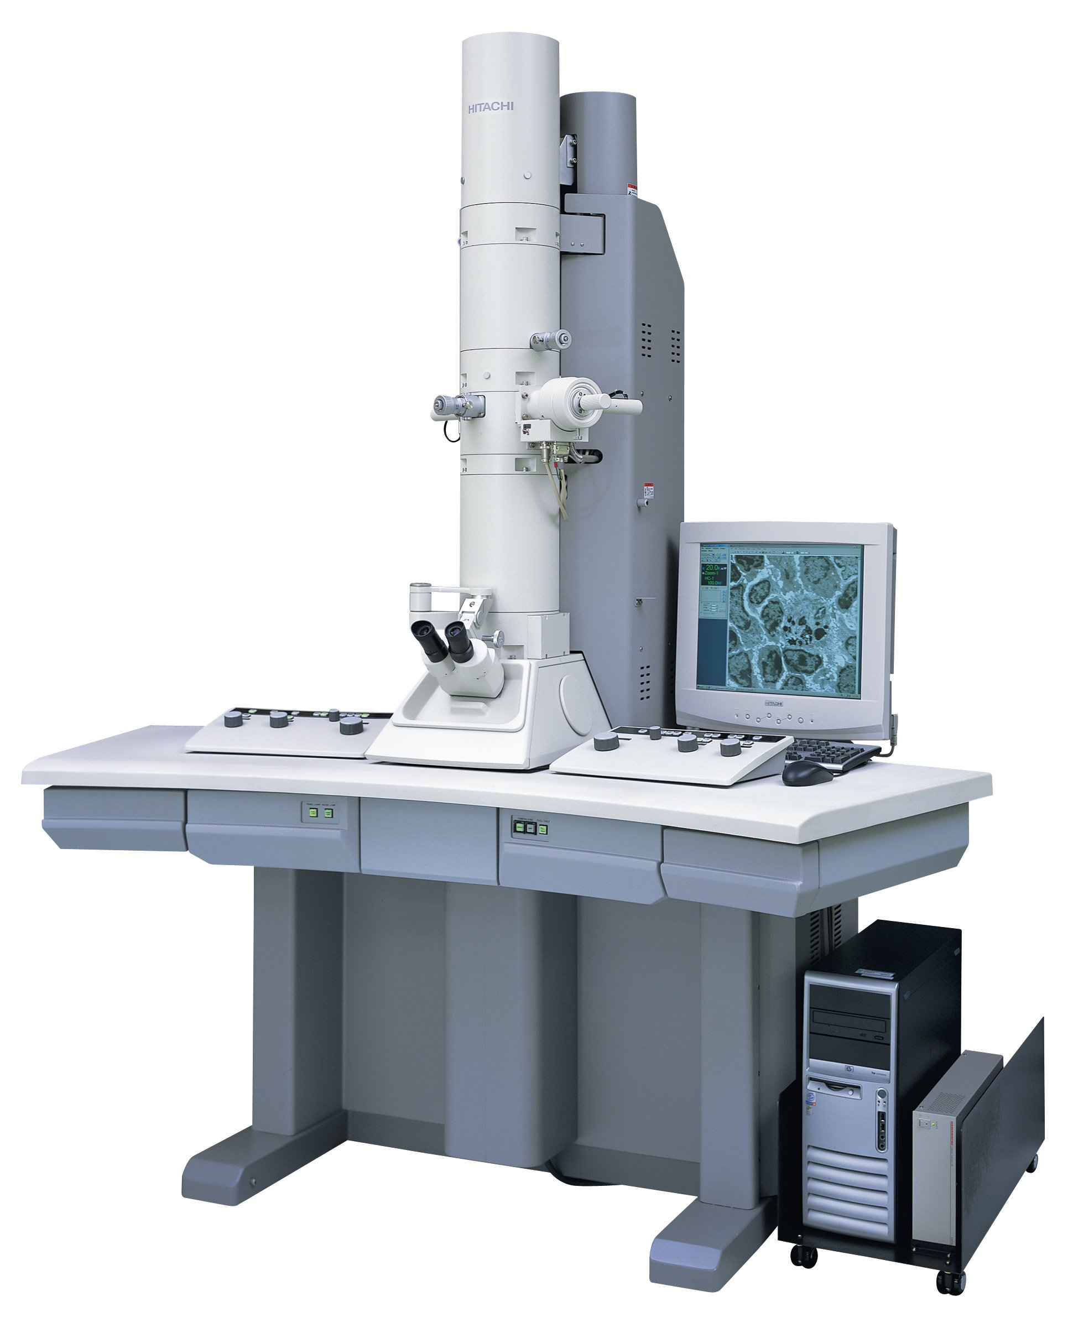
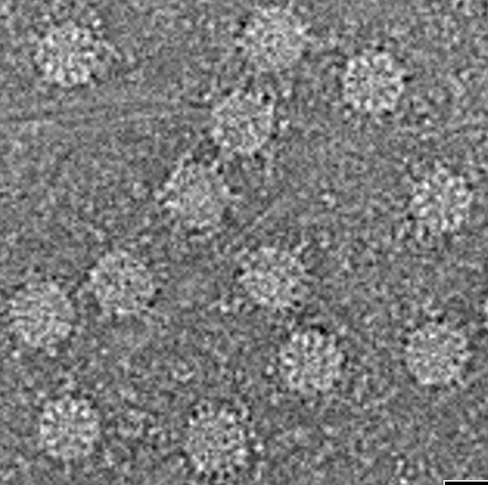
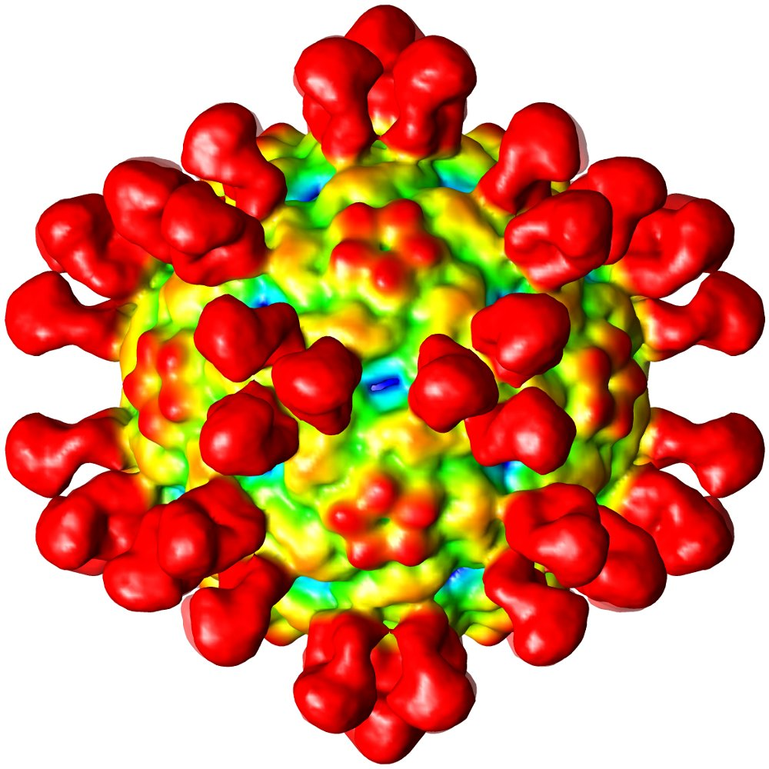
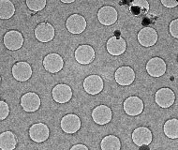
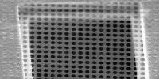
1. Expression & purification
2. Grid preparation
3. cryo-EM data
4. Reconstruction

Slide 5
Aims of the course
Diffraction of light
Approaches to resolve phase problem in crystallography
Use of electrons to display objects with high magnification and fine detail
Calculation of three-dimensional reconstruction from two-dimensional projections

Slide 6
What is asked of you:
Be present and awake
Participate in discussions
I am here to help, learning is up to you!
Ask questions - it will help to clarify the issue not only for you but for your peers as well!
In class discussions, be respectful of other students' opinions.

Slide 7
Not part of this course:
Basic math – mental overload by dealing with simple equations. (Observed before.)
Reserve time for thinking.

Slide 8
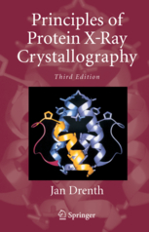
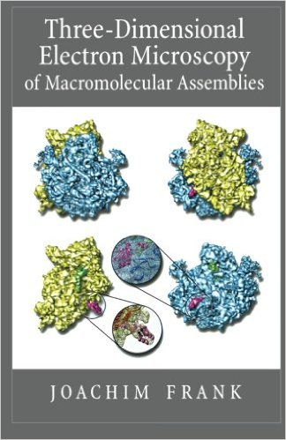
Course textbooks:

Slide 9
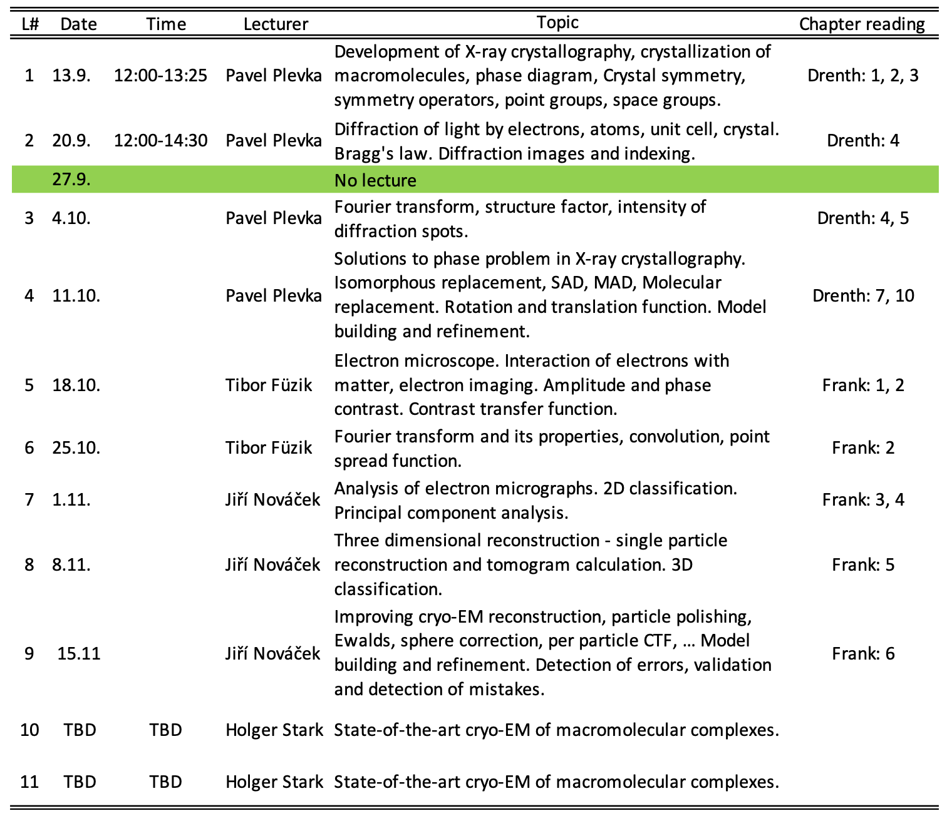
Course plan
Can we start at 14:00 or 14:30?

Slide 10
Biological X-Ray Crystallography

Slide 11
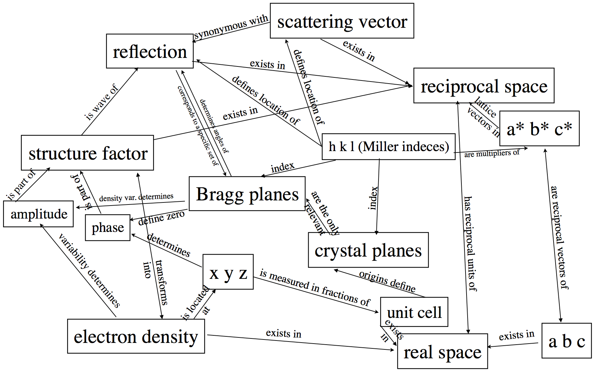

Slide 12
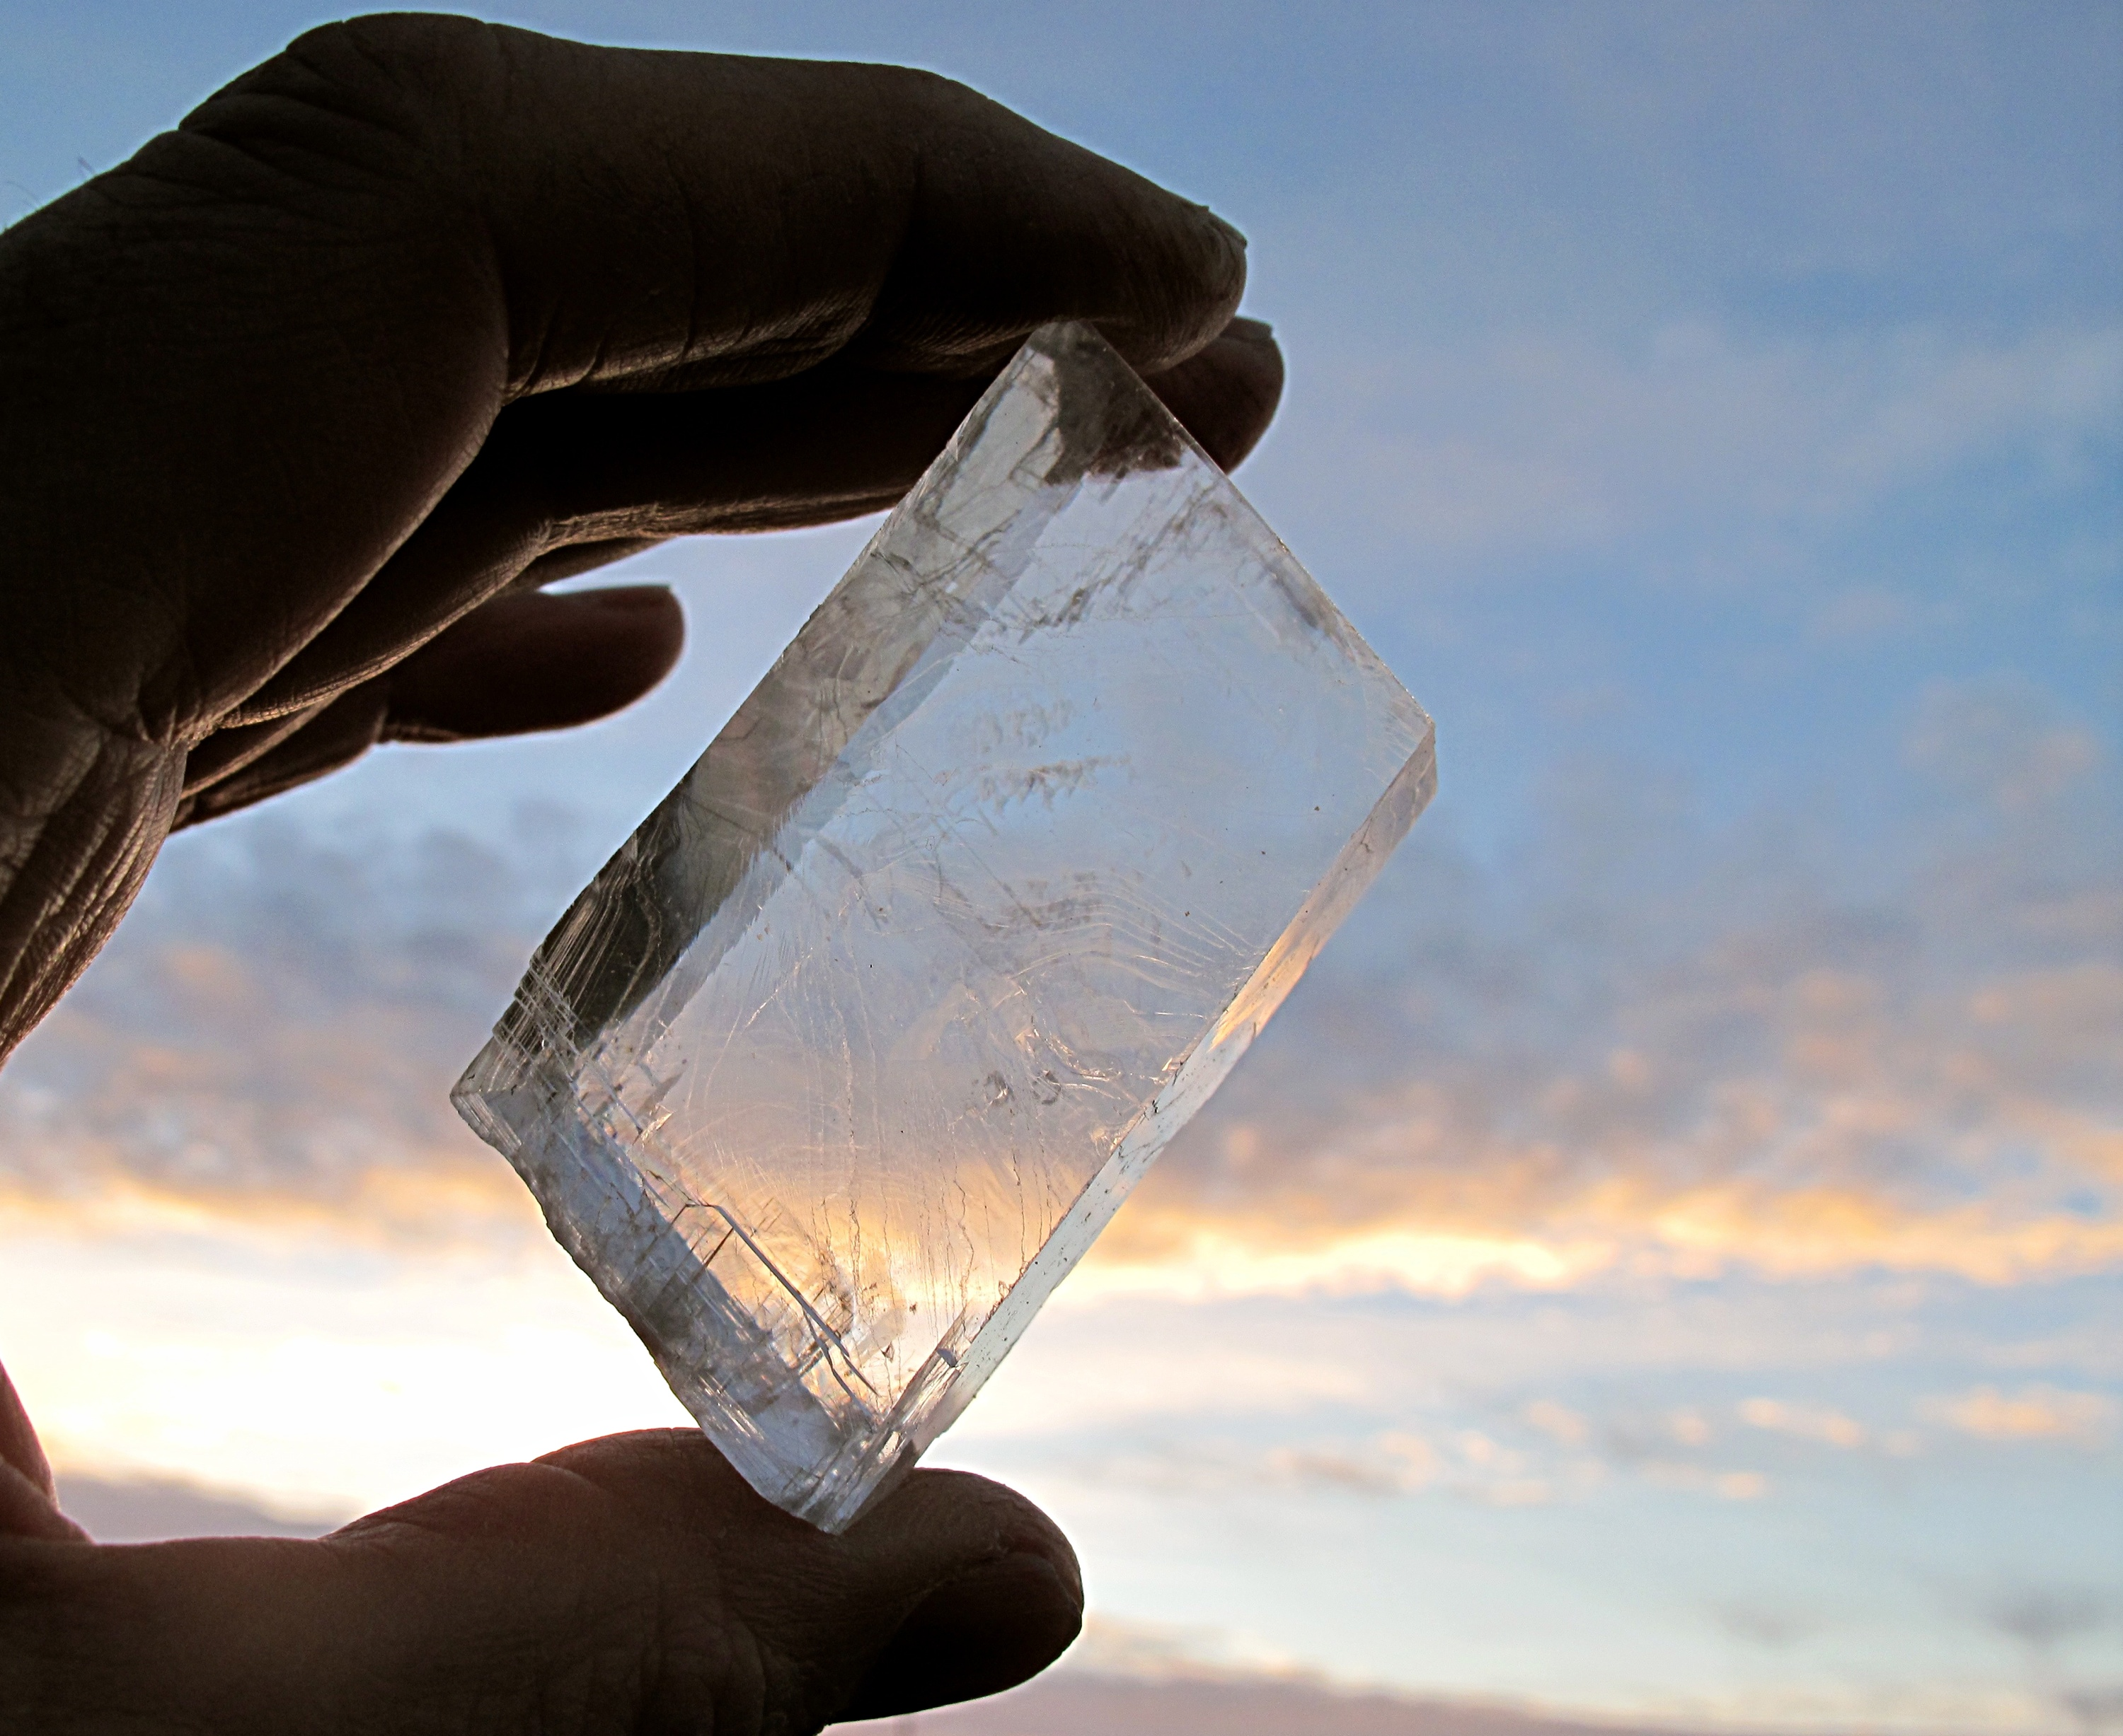
Notes:
sunstone

Slide 13
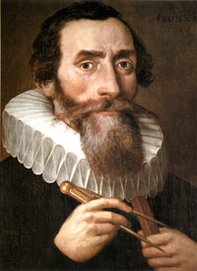
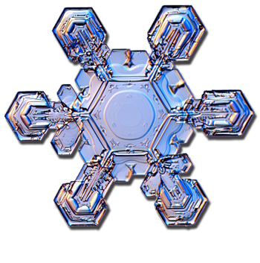
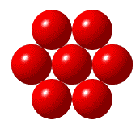
Why do single snowflakes, before they become entangled with other snowflakes, always fall with six corners? Why do snowflakes not fall with five corners or with seven?
Johannes Kepler (1571-1630)

Slide 14
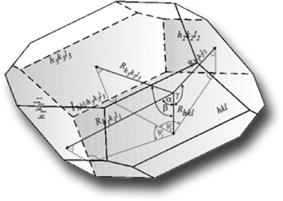
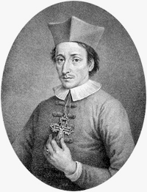
Although crystals of quartz and hematite appear in a great variety of shapes and sizes, the same interfacial angles persisted in every specimen. “Law of Constancy of Angles”
Niels Stensen (1638-1686)

Slide 15
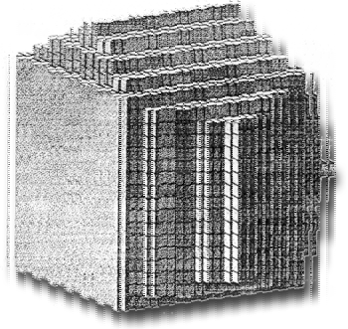
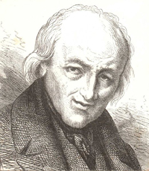
“Law of Constancy of Angles”
René Just Haüy (1743-1822)

Slide 16
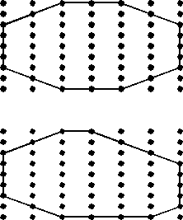
“Law of Constancy of Angles”
René Just Haüy (1743-1822)

Slide 17
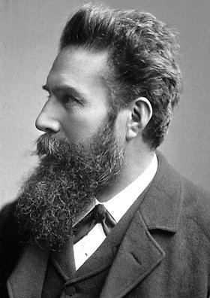
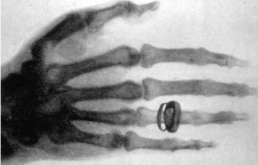
History of fundamental discoveries
WILHELM CONRAD RÖNTGEN (1845-1923)
1901 Nobel Laureate in Physics
discovery of the remarkable rays subsequently named after him

Slide 18
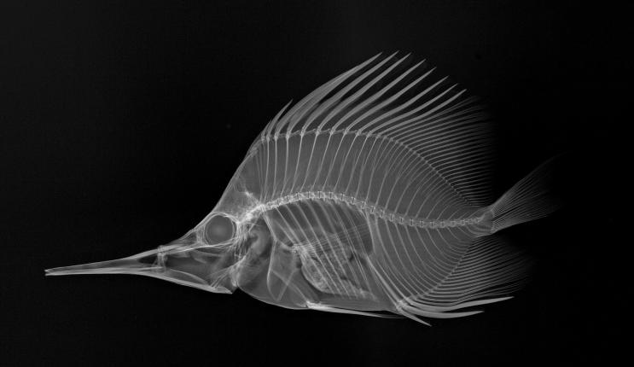

Slide 19
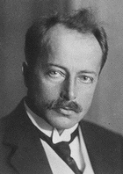
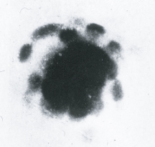
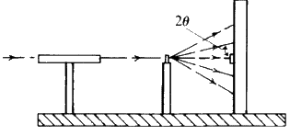
MAX VON LAUE (1879-1960)
1914 Nobel Laureate in Physics
for his discovery of the diffraction of X-rays by crystals
Friedrich and Knipping

Slide 20
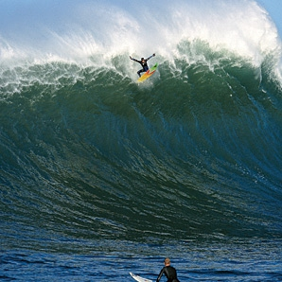
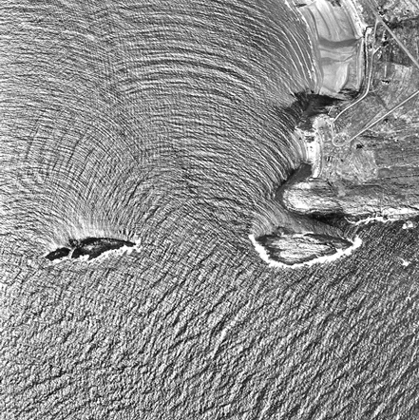
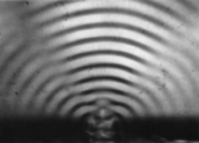
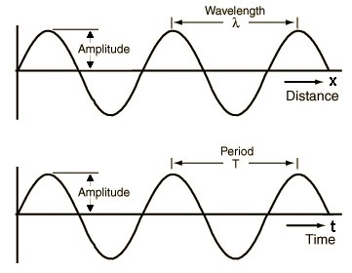
Wavelength and diffraction

Slide 21

Waves

Slide 22
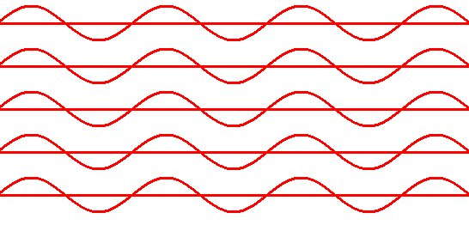
Coherent beam

Slide 23
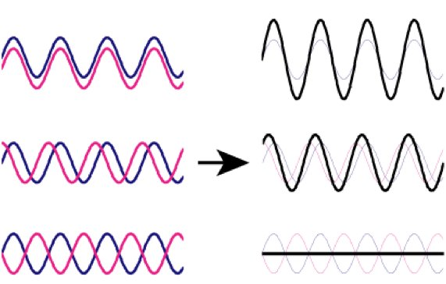
Addition of waves

Slide 24
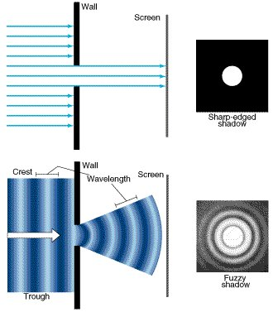
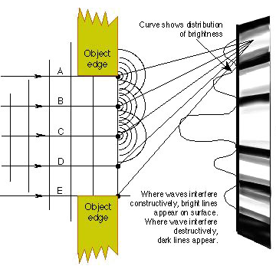
Particles & waves

Slide 25
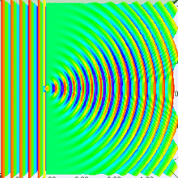
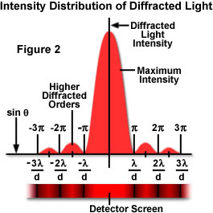
Diffraction of light

Slide 26
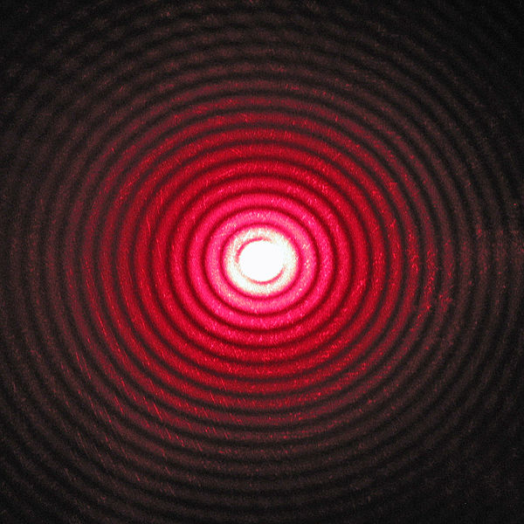
Diffraction of light

Slide 27
Wavelength and diffraction

Slide 28
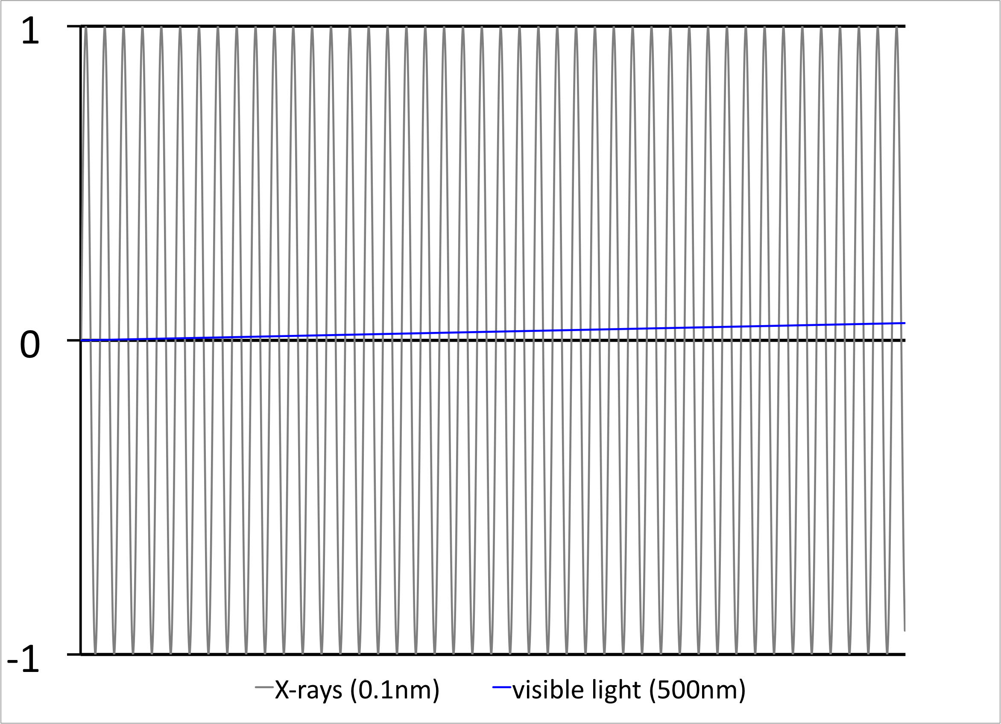
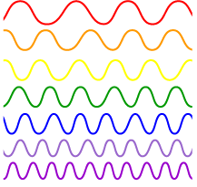
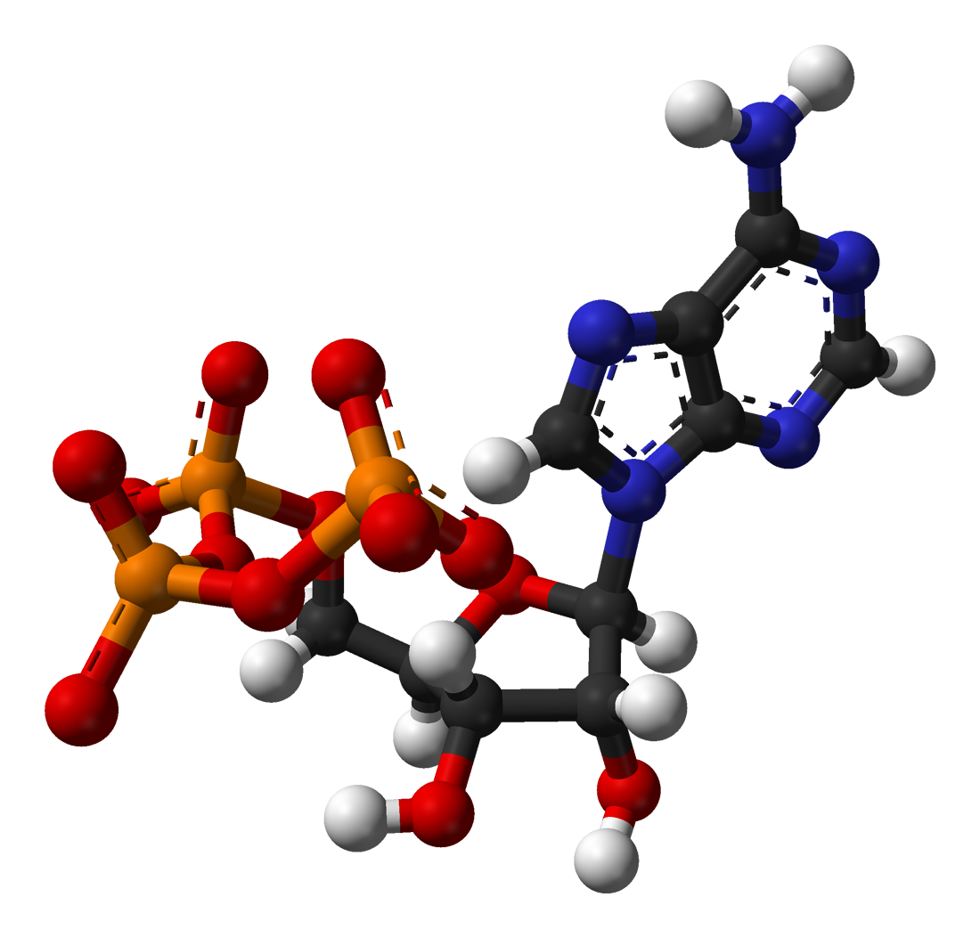
Wavelength comparison of X-rays and visible light
38λ

Slide 29
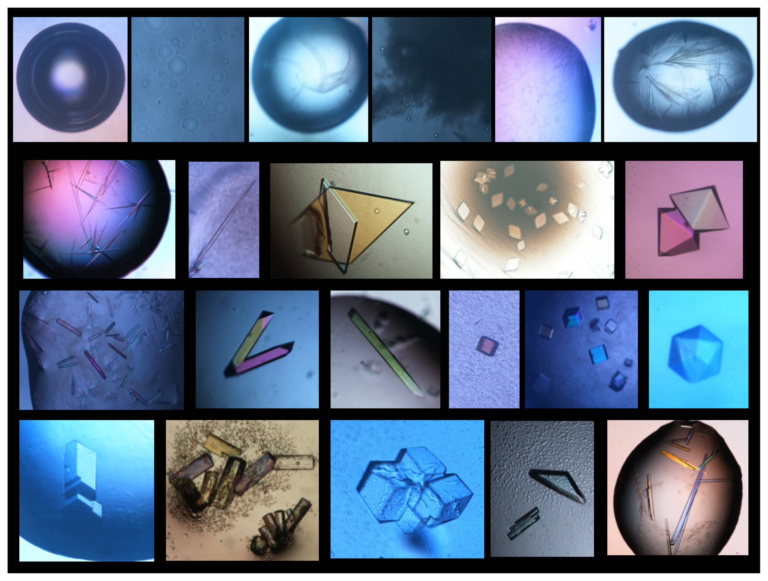
Crystallizing a Protein

Slide 30



Protein expression and purification

Slide 31

Vapor-diffusion

Slide 32

Batch and microbatch

Slide 33

Microdialysis

Slide 34

Protein crystallization phase diagram

Slide 35


Slide 36

Preparing crystals for diffraction experiment

Slide 37




Slide 38

Diffractometer with goniometer

Slide 39

Diffractometer with goniometer

Slide 40

X-ray sources
- sealed X-ray tube

Slide 41


Spectrum of copper anode

Slide 42


Synchrotron
Bending magnet
Wavelength shifter
Wiggler
Undulator

Slide 43
X-ray detectors
Single photon counter
Film
Image plates
Area detectors:
- CCDs
- Direct X-rays detectors - Pilatus

Slide 44

Crystals

Slide 45


Slide 46


Slide 47
A 2D lattice

Slide 48
Lattice
Crystal
Translationally periodic arrangement of points
Translationally periodic arrangement of motifs
Crystal = Lattice + Motif
Lattice ➢ the underlying periodicity of the crystal
Motif ➢ atom or group of atoms associated with each lattice point

Slide 49
Lattice
Motif
+


Slide 50
Crystal





















=



































Courtesy Dr. Rajesh Prasad

Slide 51


Unit cells
Instead of drawing the whole structure I can draw a representative part
and specify the repetition pattern
A cell is a finite representation of the infinite lattice
A cell is a parallelogram (2D) or a parallelopiped (3D) with lattice
points at their corners.
If the lattice points are only at the corners, the cell is primitive.
If there are lattice points in the cell other than the corners, the cell
is nonprimitive.

Slide 52


Slide 53
Arrangement of lattice points in the unit cell
No. of Lattice points / cell
 |  | Position of lattice points | Effective number of Lattice points / cell
1 | P | 8 Corners | = 8 x (1/8) = 1
2 | I | 8 Corners + 1 body centre | = 1 (for corners) + 1 (BC)
3 | F | 8 Corners + 6 face centres | = 1 (for corners) + 6 x (1/2) = 4
4 | A/ B/ C | 8 corners + 2 centres of opposite faces | = 1 (for corners) + 2x(1/2) = 2

Slide 54
SYMMETRY
If an object is brought into self-coincidence after some operation it said to possess symmetry with respect to that operation.

Slide 55
Bravais Lattice
A lattice is a set of points constructed by translating a single point in discrete steps by a set of basis vectors. In three dimensions, there are 14 unique Bravais lattices (distinct from one another in that they have different space groups) in three dimensions. All crystalline materials recognized till now fit in one of these arrangements.

Slide 56


Slide 57


Slide 58


Slide 59


Slide 60


Slide 61


Slide 62


Slide 63

Positions of twofold symmetry axes
Unit cell selection
Positions of mirror planes
Alternative unit cell selection (also correct)

Slide 64

Unit cell selection
Positions of glide planes

Slide 65
End of lecture #1 in 2022

Slide 66



SIR WILLIAM HENRY BRAGG (1862-1942)
SIR WILLIAM LAWRENCE BRAGG (1890-1971)
1915 Nobel Laureates in Physics
for the analysis of crystal structure by means of X-rays
nλ = 2d sinθ

Slide 67


There is NO PHASE DIFFERENCE if the path differences are equal to whole number multiplies of wavelength (λ)
Bragg’s law:
nλ = 2d sinθ
w
sinθ = w/d
2w = nλ

Slide 68
There is NO PHASE DIFFERENCE if the path differences are equal to prime number multiplies of wavelength (λ)
Bragg’s law:
nλ = 2d sinθ
w
sinθ = w/d
2w = nλ

Slide 69



