Slide 1
Structural Biology Methods
Fall 2022
Lecture #2

Slide 2
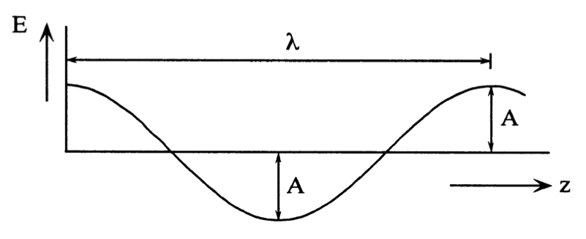
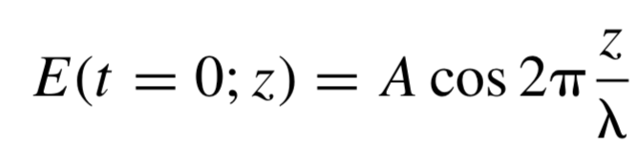
Electromagnetic wave
Electric field strength
Distance
E – electric field strength
t – time
z – position
A – amplitude
λ – wavelength
2π – to convert relative distance to angles

Slide 3
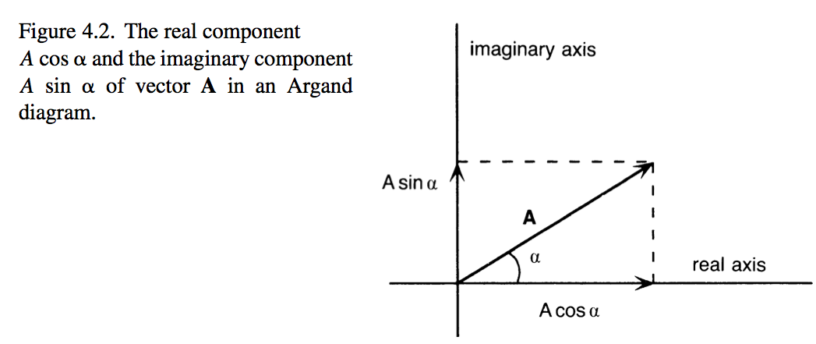
Electric field strength
Distance
E (t=0; z) = A cos (2π z/λ)
M (t=0; z) = A sin (2π z/λ)
Magnetic field strength
E (t=0; z) = A cos (2π z/λ)
F
F = A cos(2π z/λ) + i A sin(2π z/λ)
Electric field strength

Slide 4
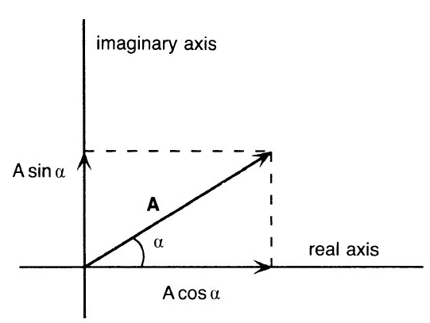
Wave as a vector
Imaginary axis
A
A
A - wave amplitude
α - wave phase angle
F
α
Real axis
F = A cosα + i A sinα
F = A exp(iα)

Slide 5
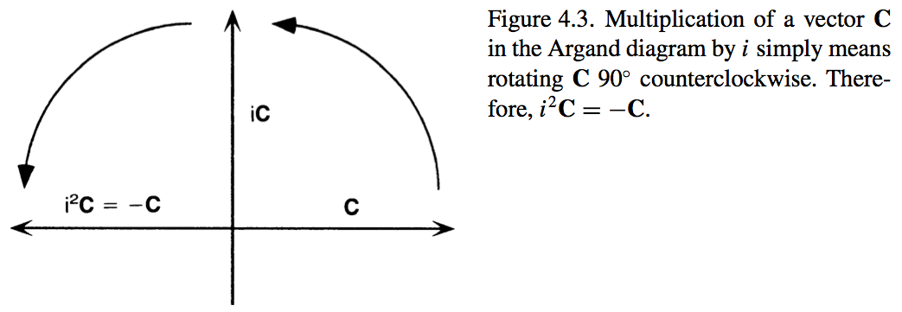


=

Slide 6
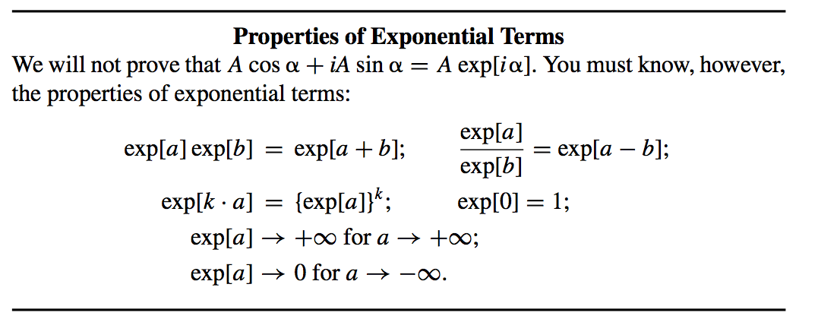
=

Slide 7
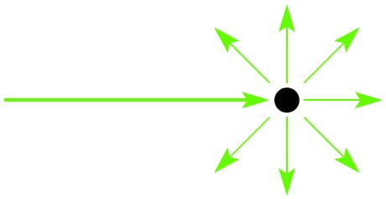
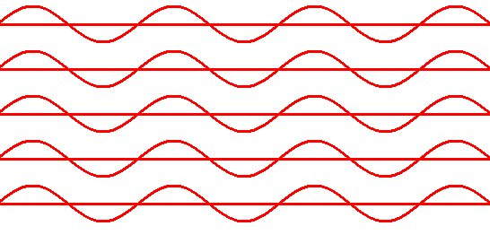
X-rays scatter from electrons in all directions
Primary beam
Secondary beams

Slide 8
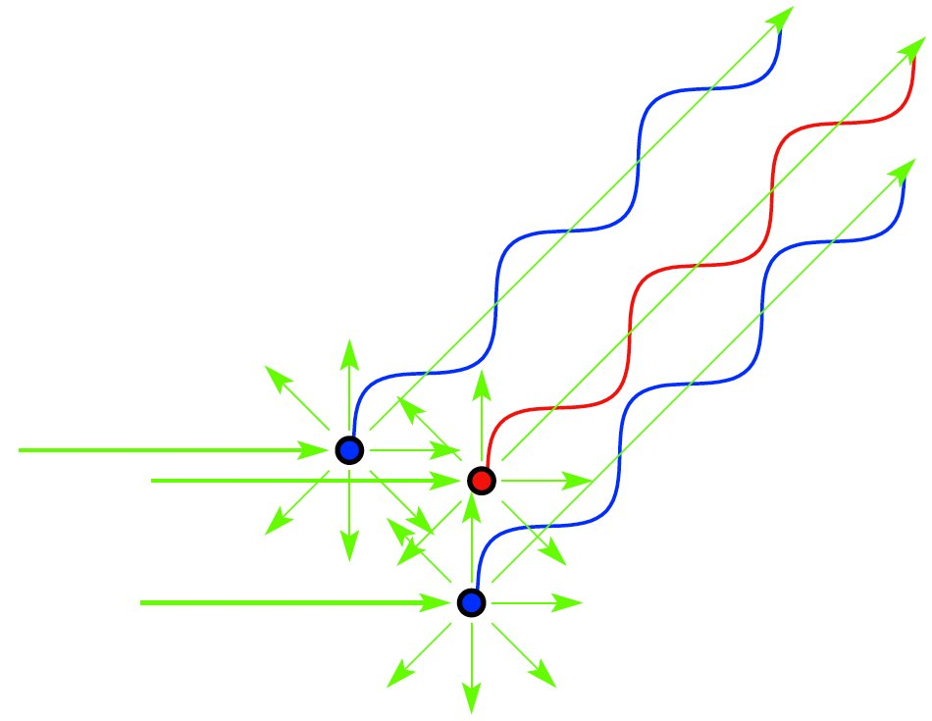
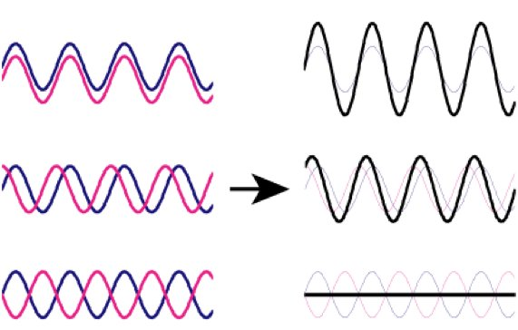
X-ray scattering from several electrons
Primary beam
When do electrons scatter “in phase” so that waves add constructively?
Notes:
Molecule is composed of many electrons
Each electron will scatter secondary radiation uppon exposure to x-rays
The scattered secondary beams will interact and cause interference
The scattering from a molecule is dependent on number of and distances between electrons
In other words, scattering from molecule is dependent on its structure
If we would know the amplitudes and phases of scattered molecule, we could calculate the structure of molecule...

Slide 9
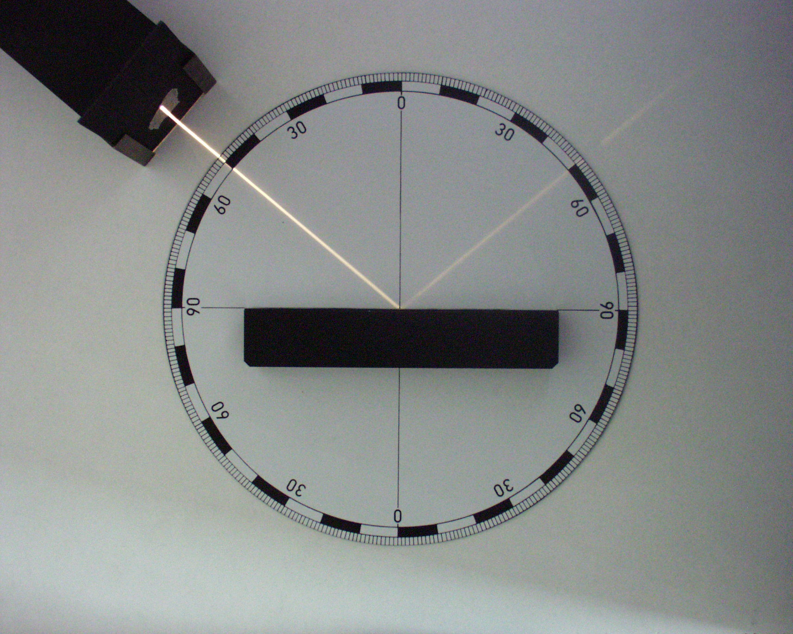
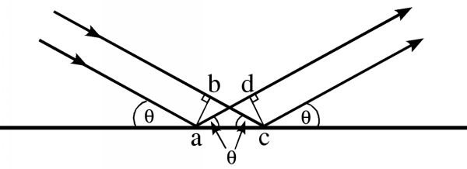
There is no path and PHASE DIFFERENCE when rays reflect from a plane

Slide 10
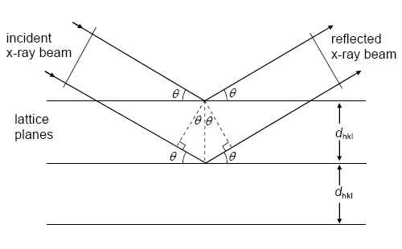
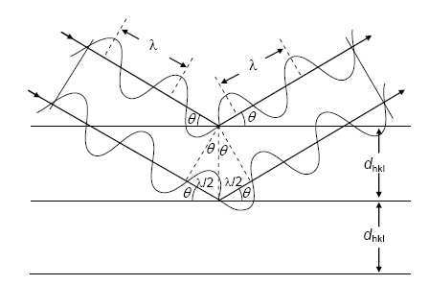
There is NO PHASE DIFFERENCE if the path differences are equal to whole number multiplies of wavelength
Bragg’s law:
nλ = 2d sinθ
w
sinθ = w/d
2w = nλ

Slide 11
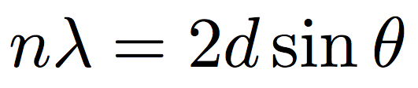
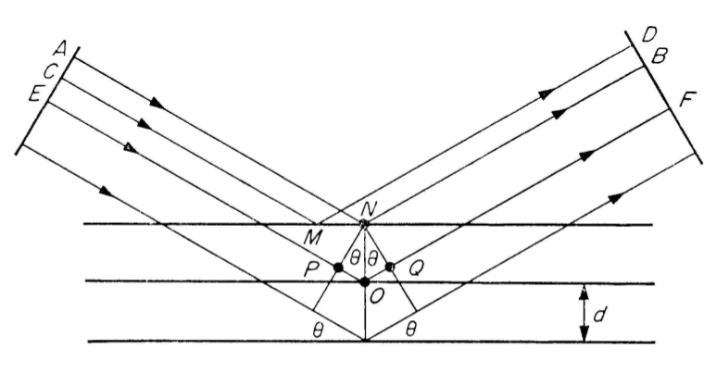

Slide 12
There is NO PHASE DIFFERENCE if the path differences are equal to prime number multiplies of wavelength (λ)
Bragg’s law:
nλ = 2d sinθ
w
sinθ = w/d
2w = nλ

Slide 13
X-rays scatter from electrons in all directions
Primary beam
Secondary beams

Slide 14
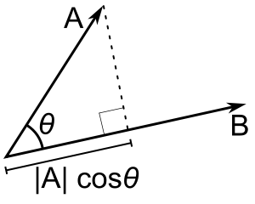
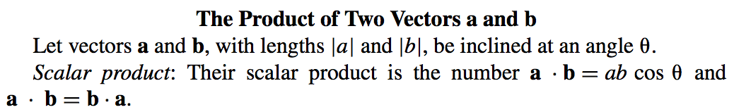
Dot product

Slide 15
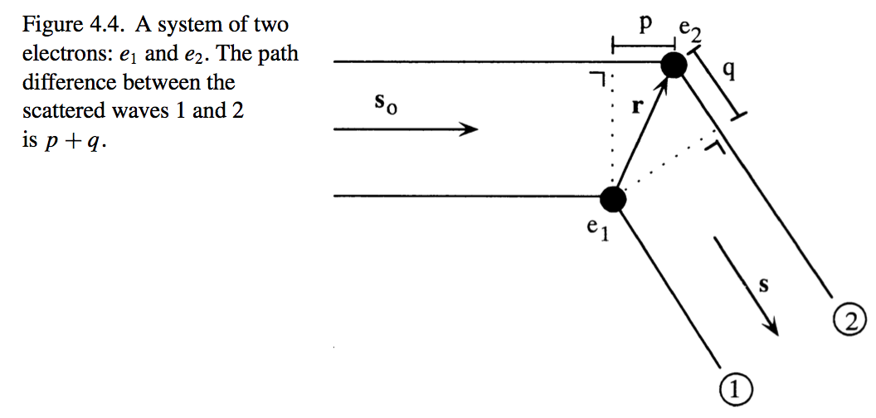





System of two electrons

Slide 16
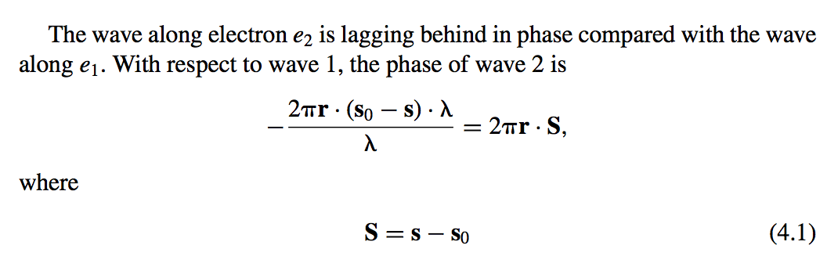

Slide 17
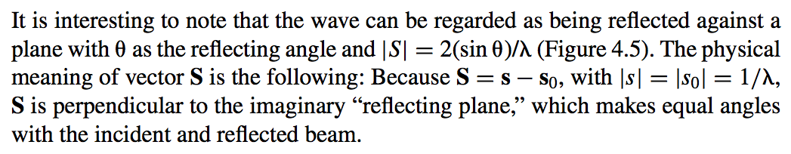
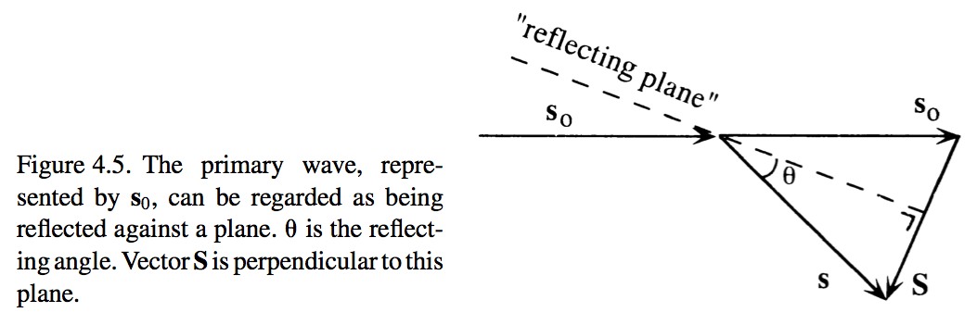
-s₀

Slide 19
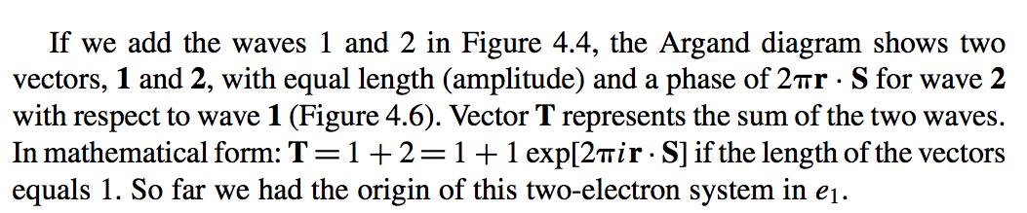
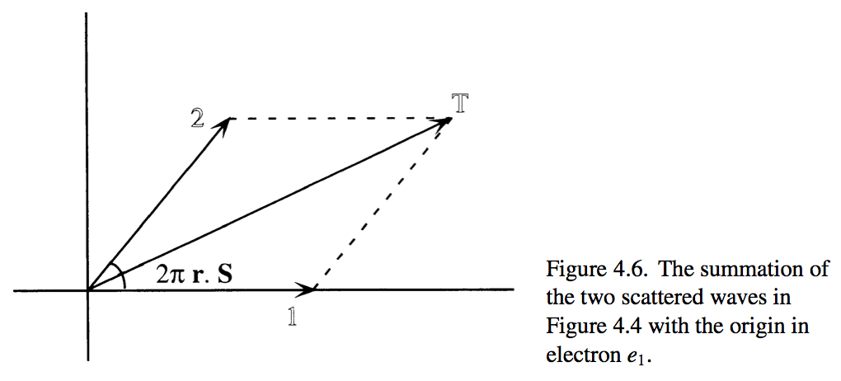

Slide 20
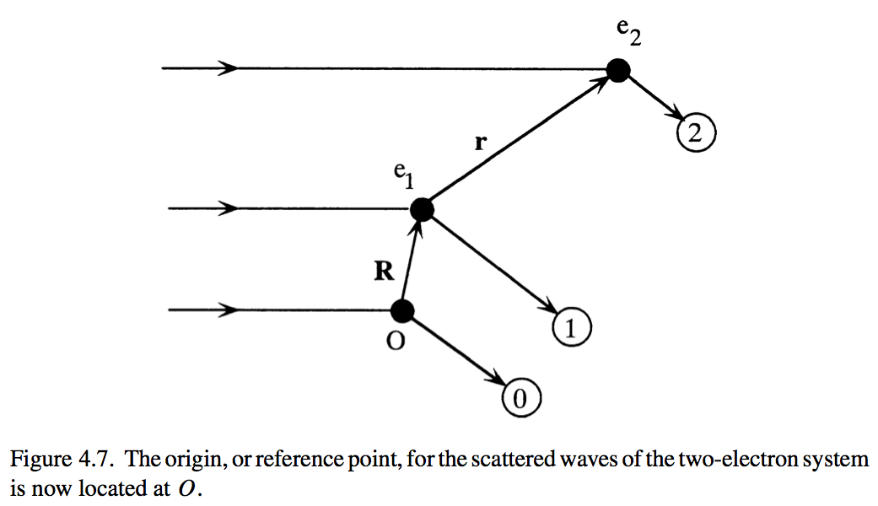
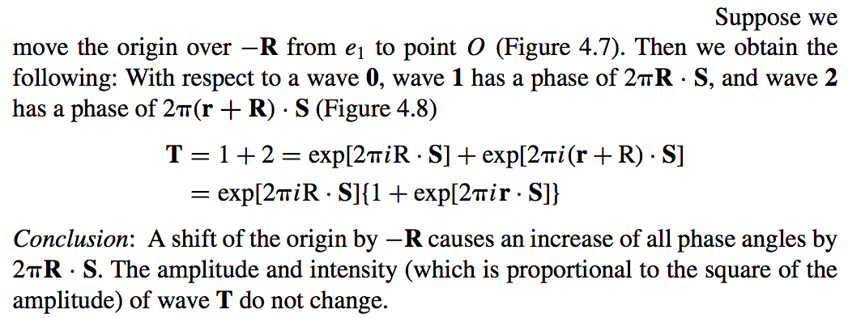

Slide 21
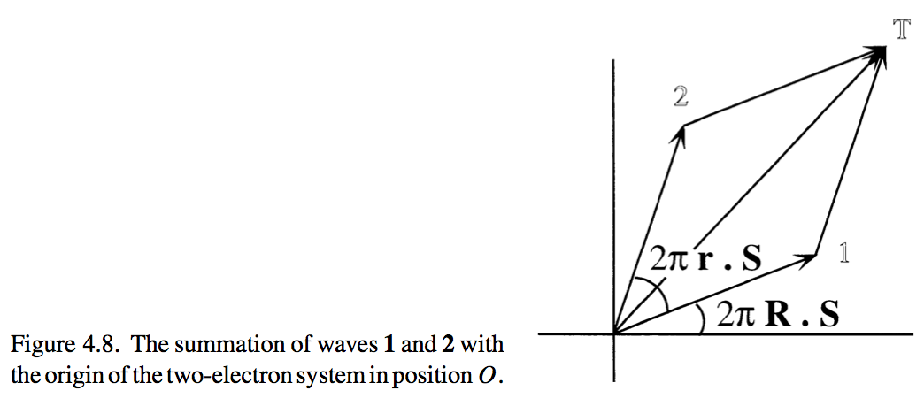

Slide 22
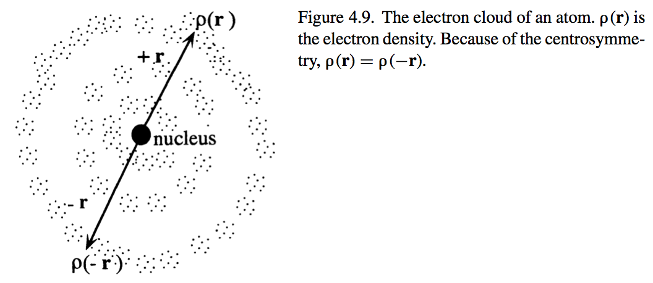
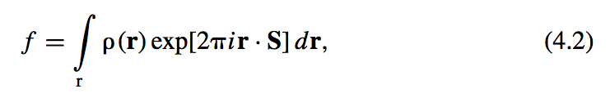
Scattering by an atom

Slide 23
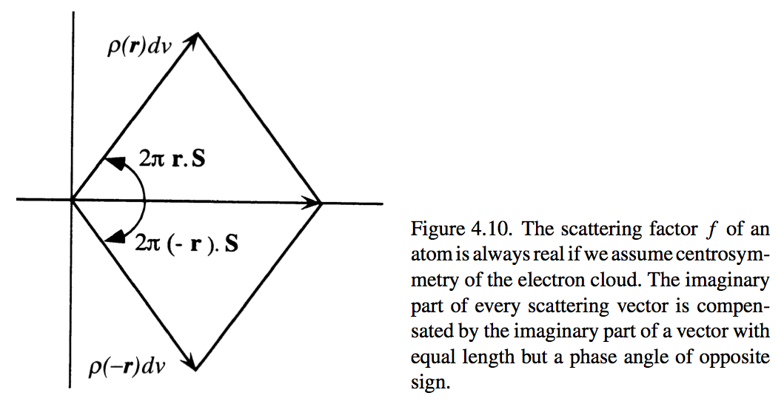
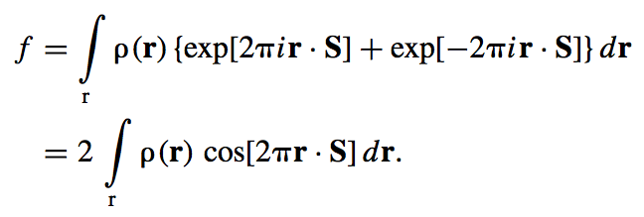

Slide 24
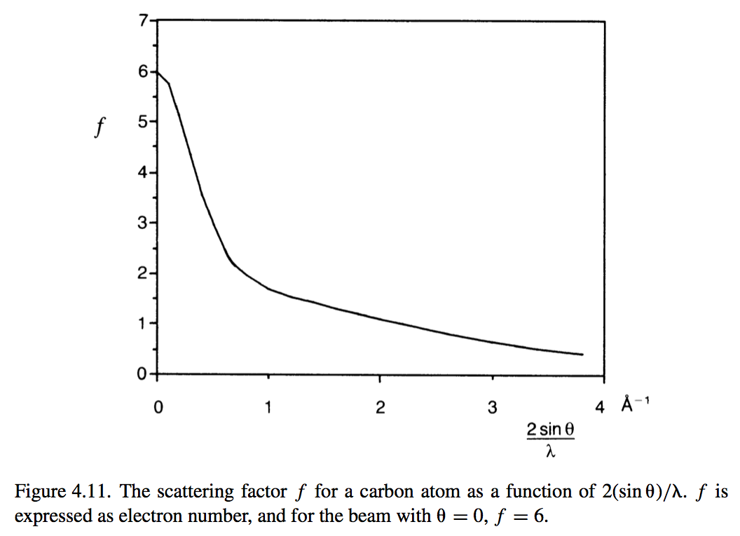
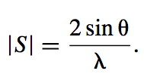
Scattering by an atom depends of the length of |S| (resolution)

Slide 25
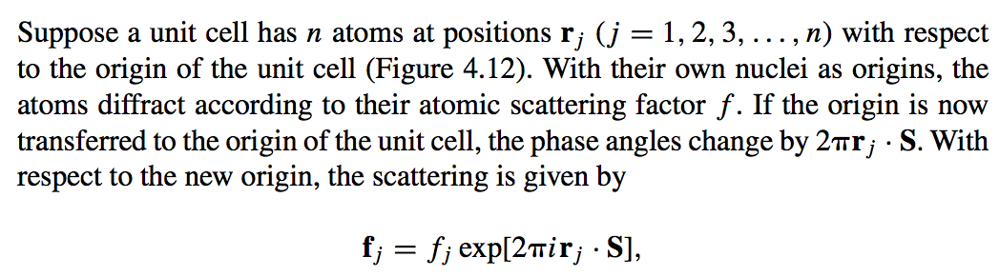
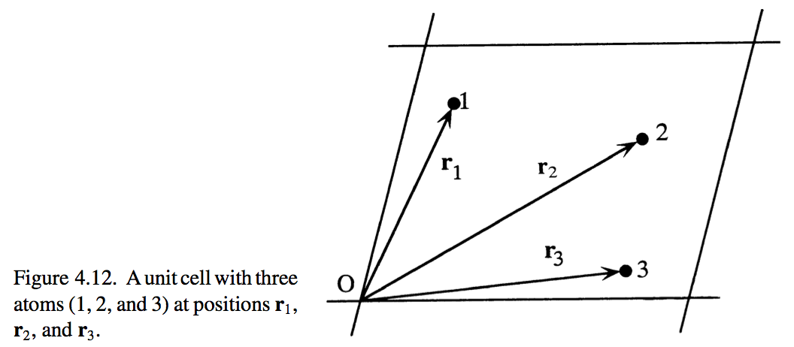
Scattering by a unit cell

Slide 26
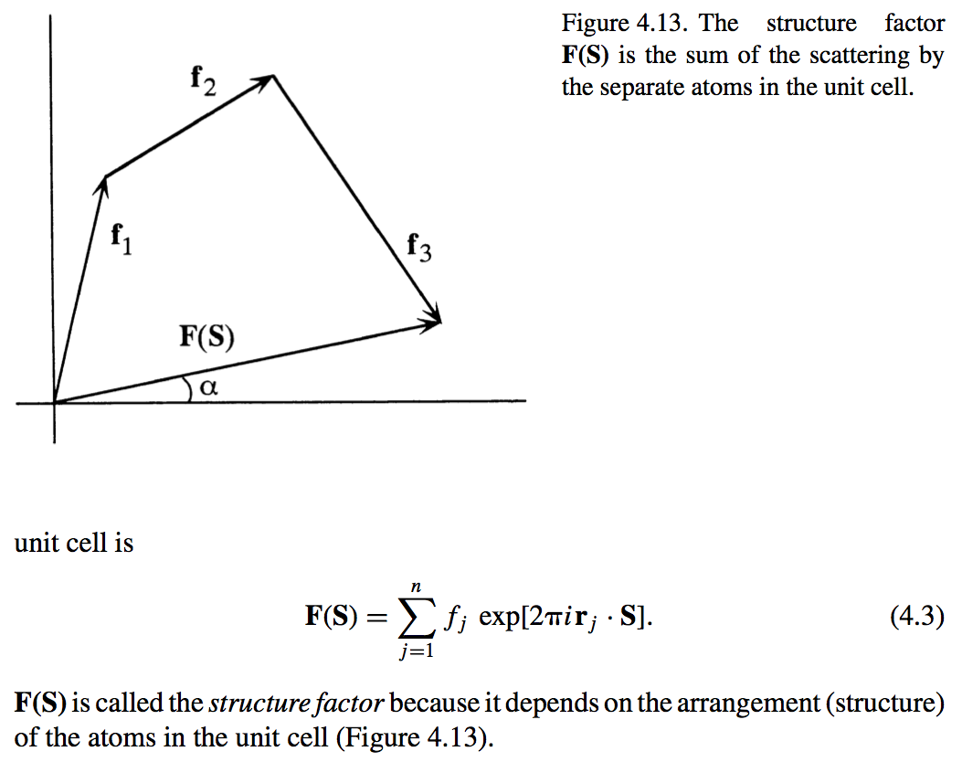

Slide 27
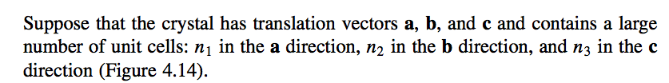
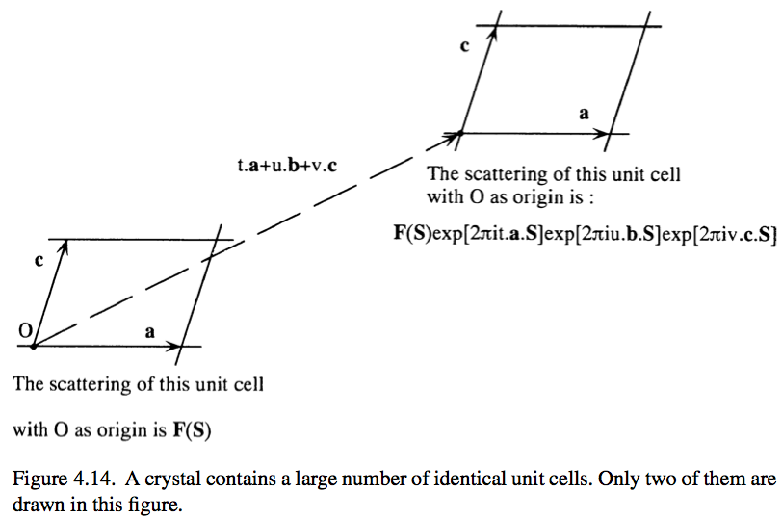
Scattering by a crystal

Slide 28
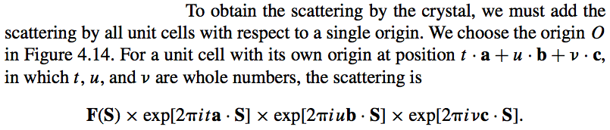
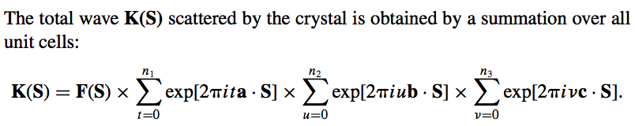

Slide 29
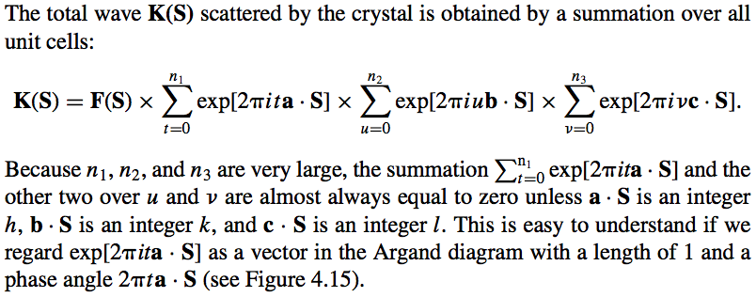
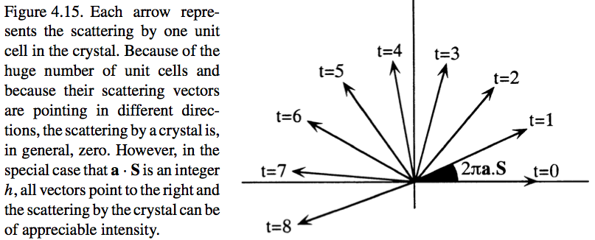

Slide 30
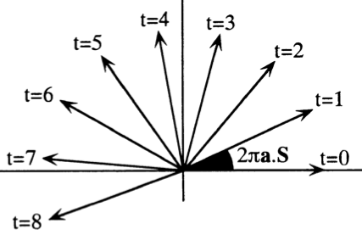
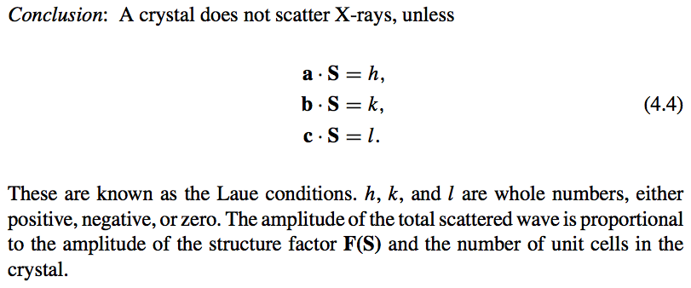

Slide 31
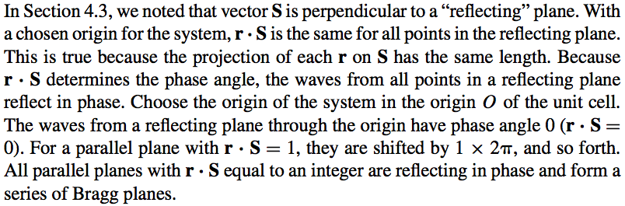
Diffraction Conditions

Slide 32
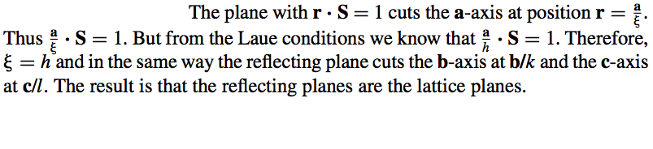
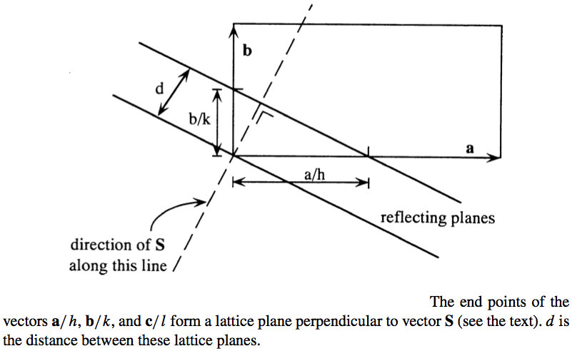
Bragg planes are identical to lattice planes

Slide 33


=>

Slide 34
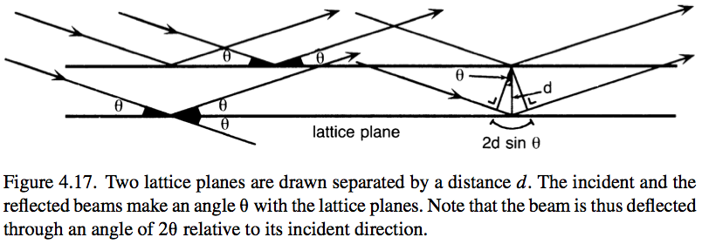
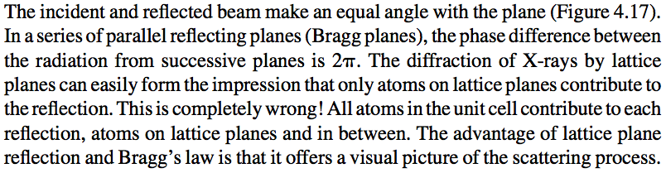

Slide 35
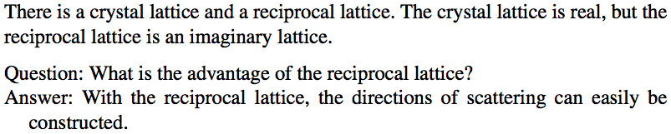
Reciprocal lattice and Ewald construction

Slide 36


Slide 37
Expected end of lecture #2

Slide 38


Slide 39



Slide 40


Slide 41


Slide 42


Slide 43


Slide 45


Slide 46




Slide 47
Wave as a vector
Imaginary axis
A
A- wave amplitude
α- wave phase
A
F
α
Real axis
F=Acosα+iAsinα
F=Aexp(iα)

Slide 48

Phase problem
α
α
α

Slide 50
Wave as a vector
Imaginary axis
A
A
A - wave amplitude
α - wave phase angle
F
α
Real axis
F = A cosα + i A sinα
F = A exp(iα)

Slide 51


Slide 52




Slide 53


Wave description
E – electric field strength
t – time
z – position
A – amplitude
λ – wavelength
2π – conversion to angles
ν – frequency
c – speed of light
ω – angular velocity
E(t=0; z) = A cos (2πz/λ)
ν = c/λ ω=2πν

